Slide 1
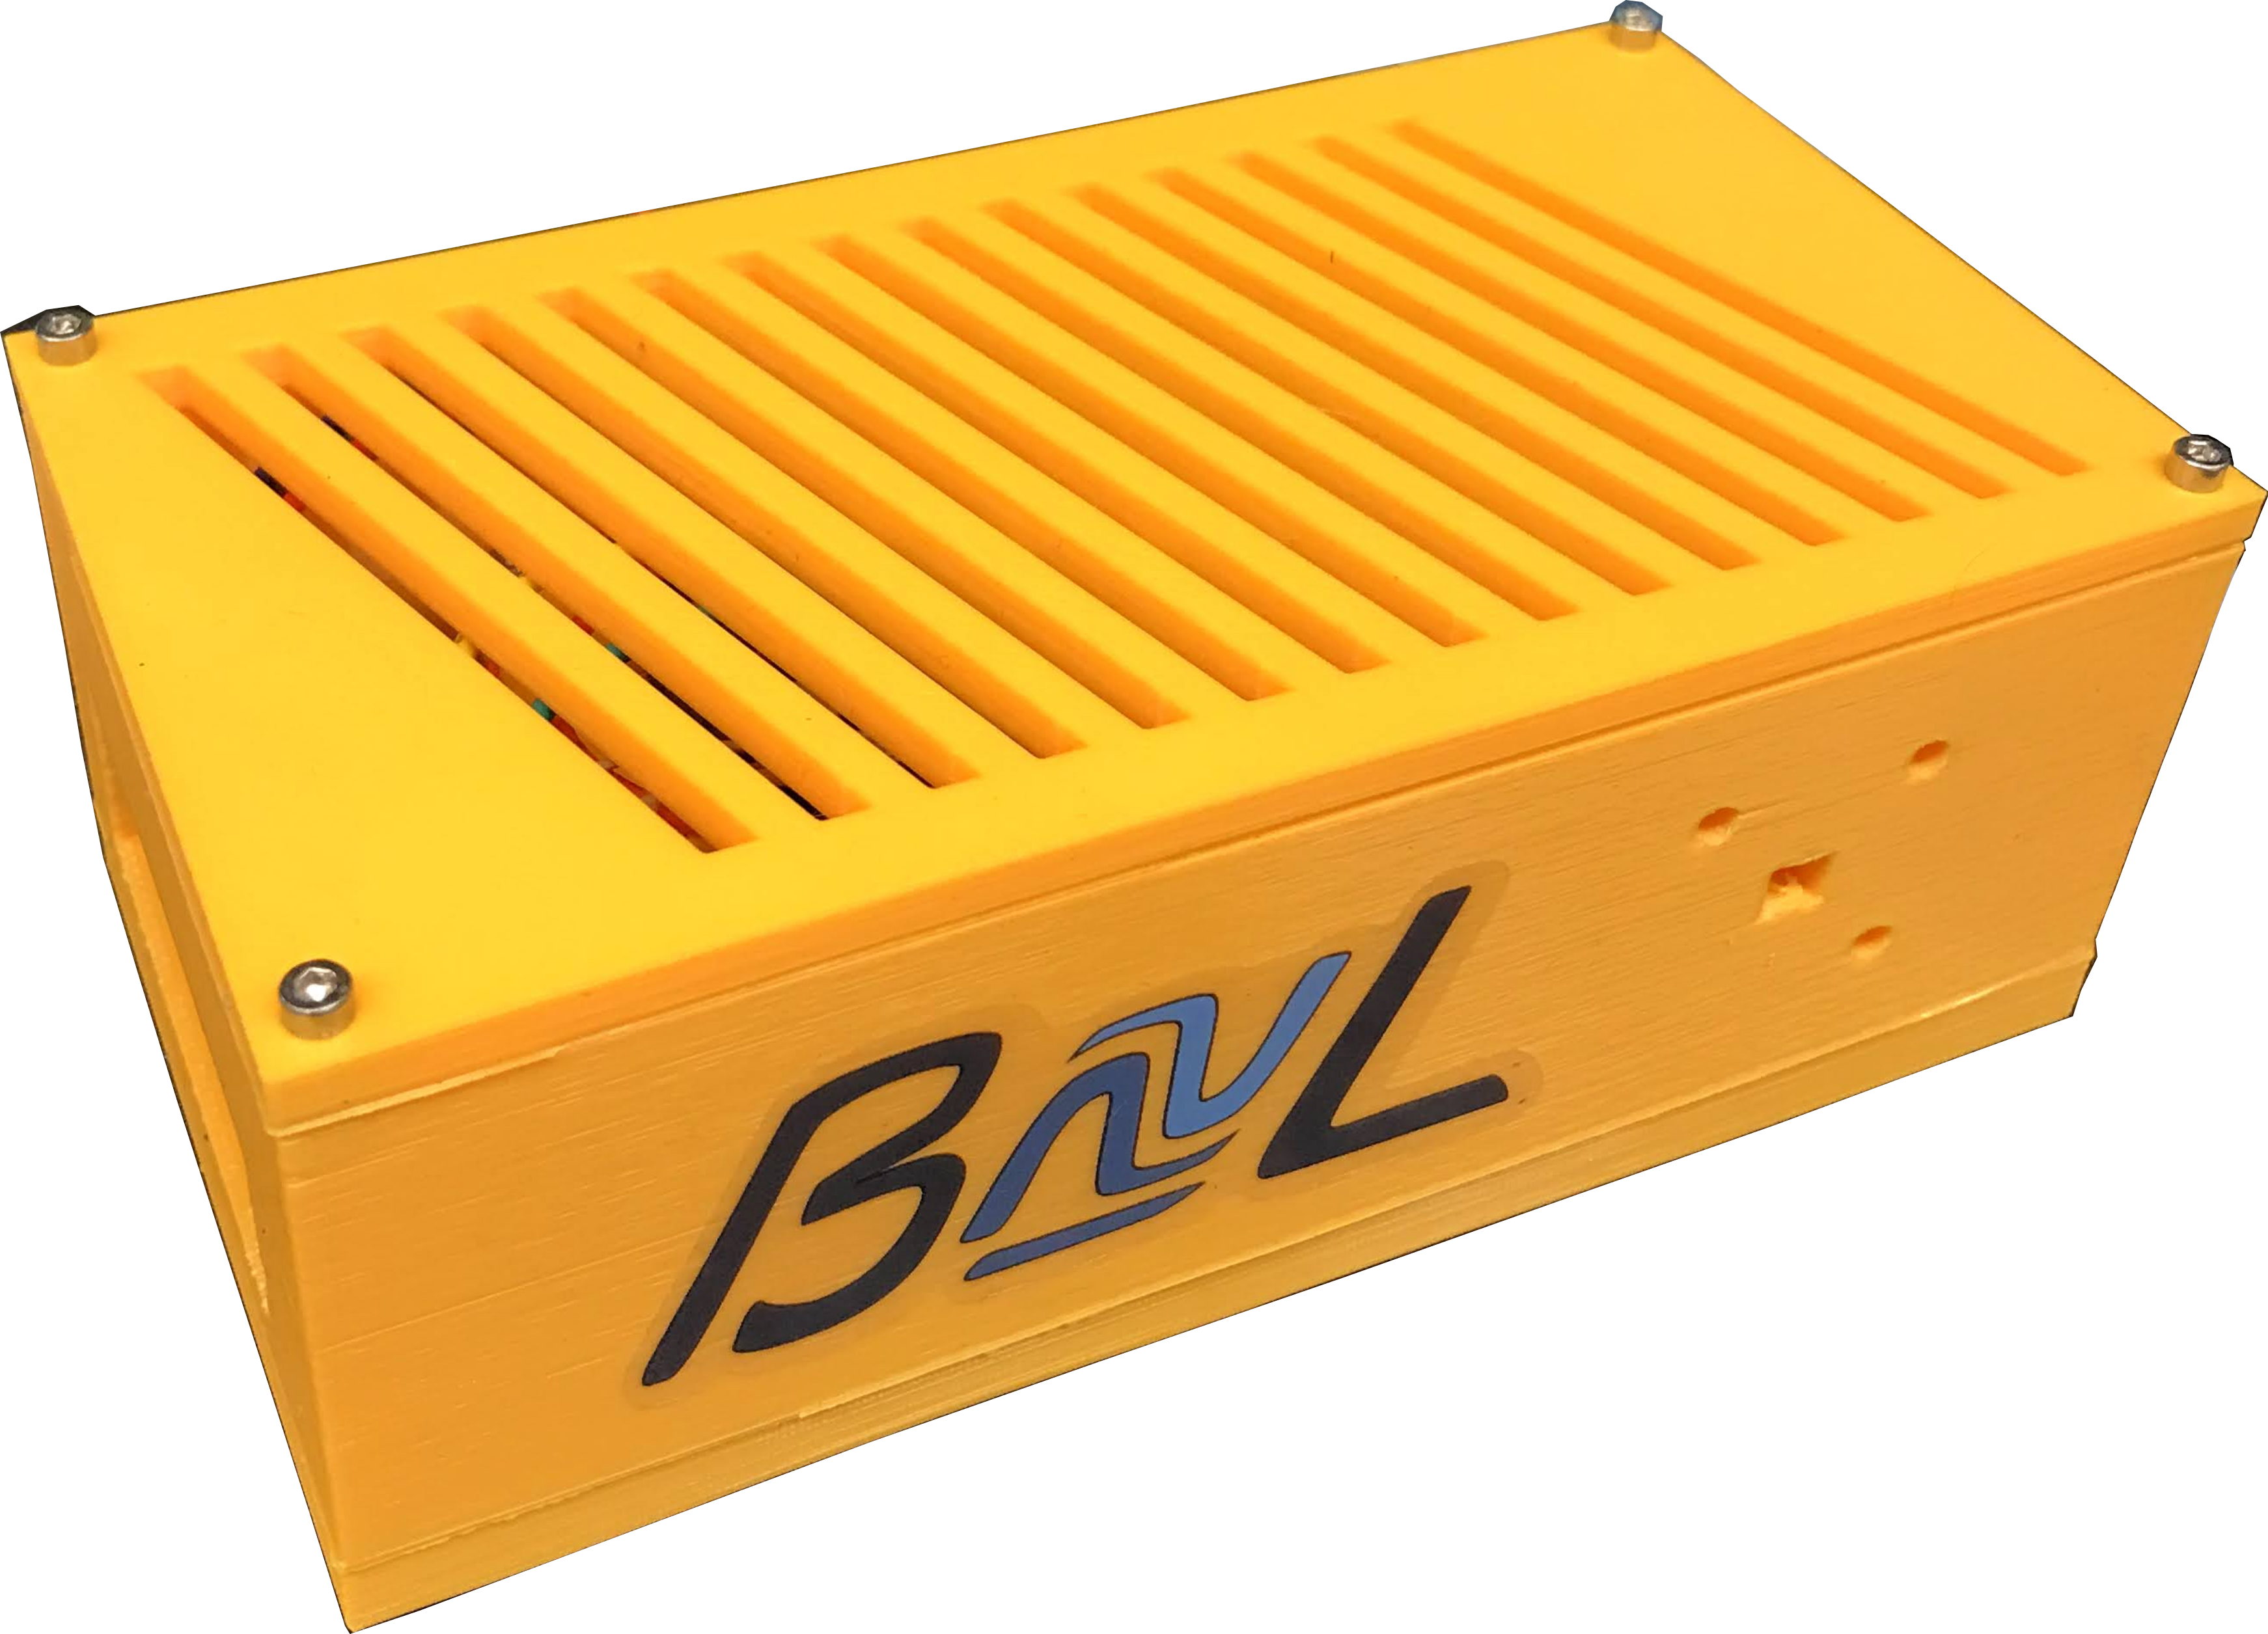



Development of a
Lab Environmental Monitor
Felix Belair
Aug 23, 2021
CASST
Supervisors: Chris Chambers,
Thomas Brunner
and Soud Al Kharusi

Slide 2
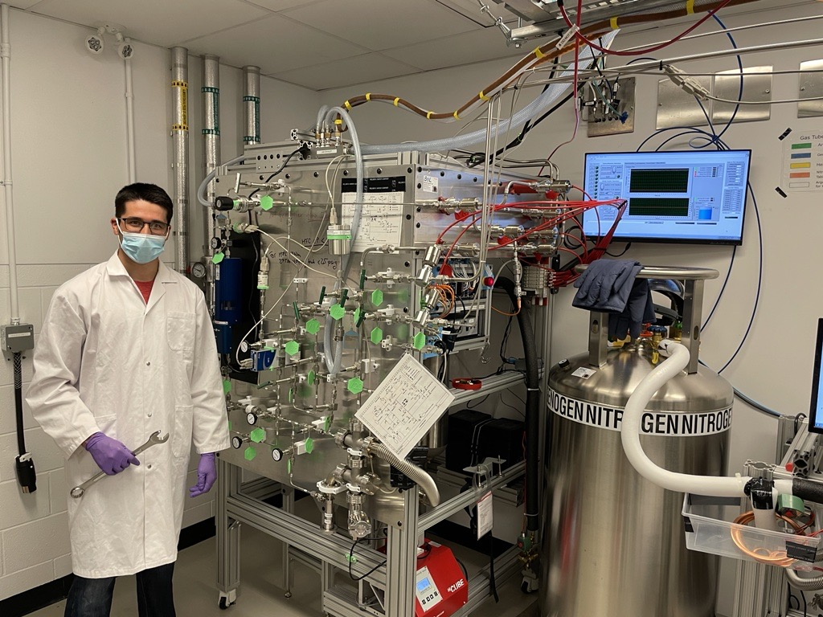
Intro About Myself
I am from Montreal
Finished CEGEP last May
Worked at the Brunner Neutrino Lab during the summer
I will start first year at McGill in physics next week!

Slide 3
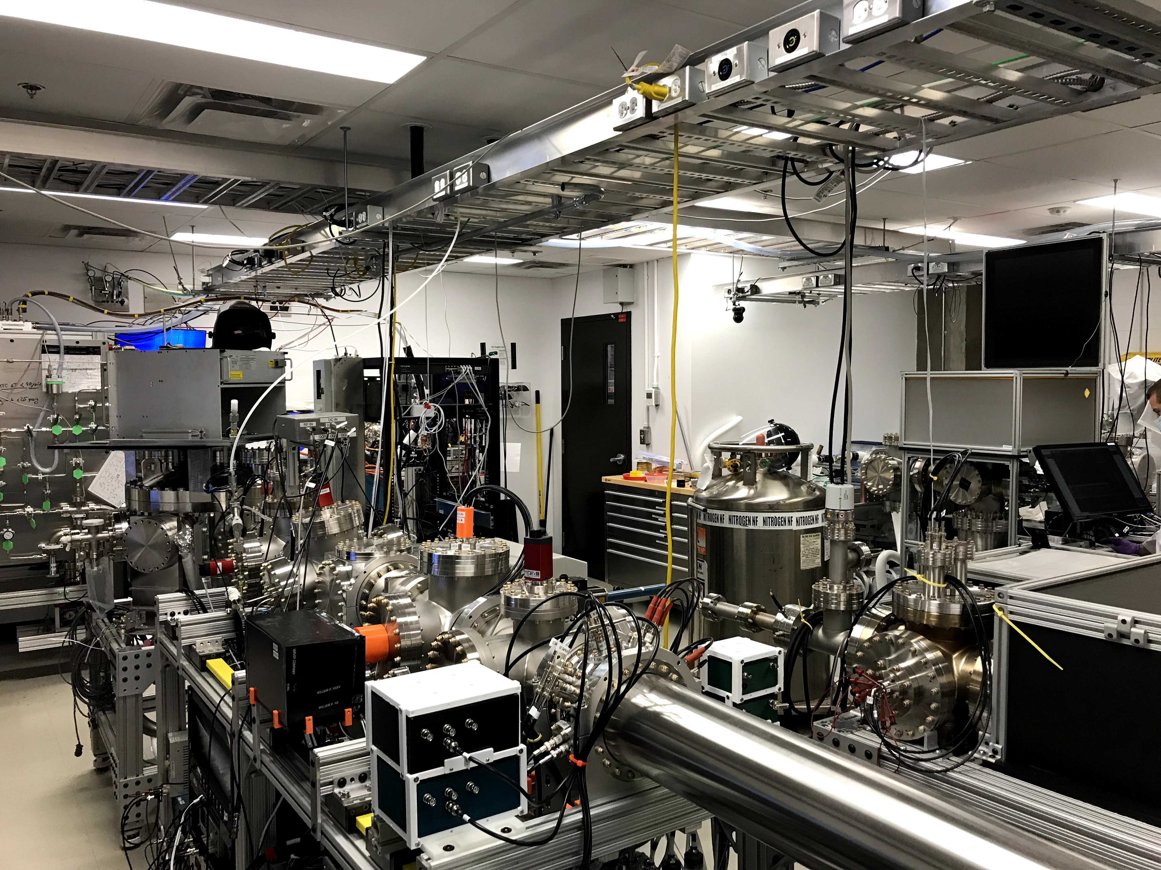
Purpose of the Lab Environmental Monitor
Goals:
Sensitive experiments require clean working space
Track temperature, pressure, humidity and dust levels
Verify if lab is positive pressure
Find out how dust enters the lab
The BνL at McGill

Slide 4
Purpose of the Lab Environmental Monitor
Goals:
Sensitive experiments require clean working space
Track temperature, pressure, humidity and dust levels
Verify if lab is positive pressure
Find out how dust enters the lab
Design Requirements:
Low maintenance/ headless
Cost efficient ≈ 150$
Modular
Open source
The BνL at McGill

Slide 5
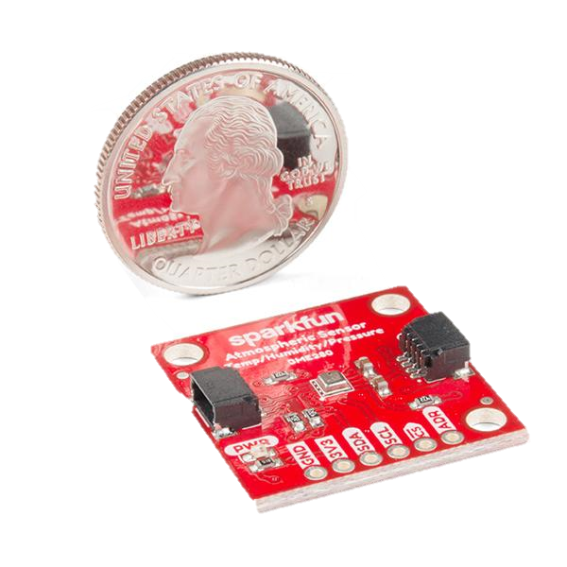
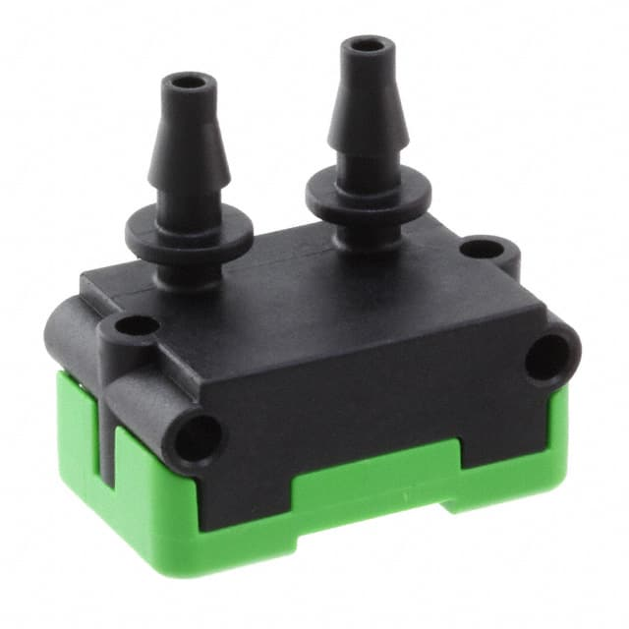
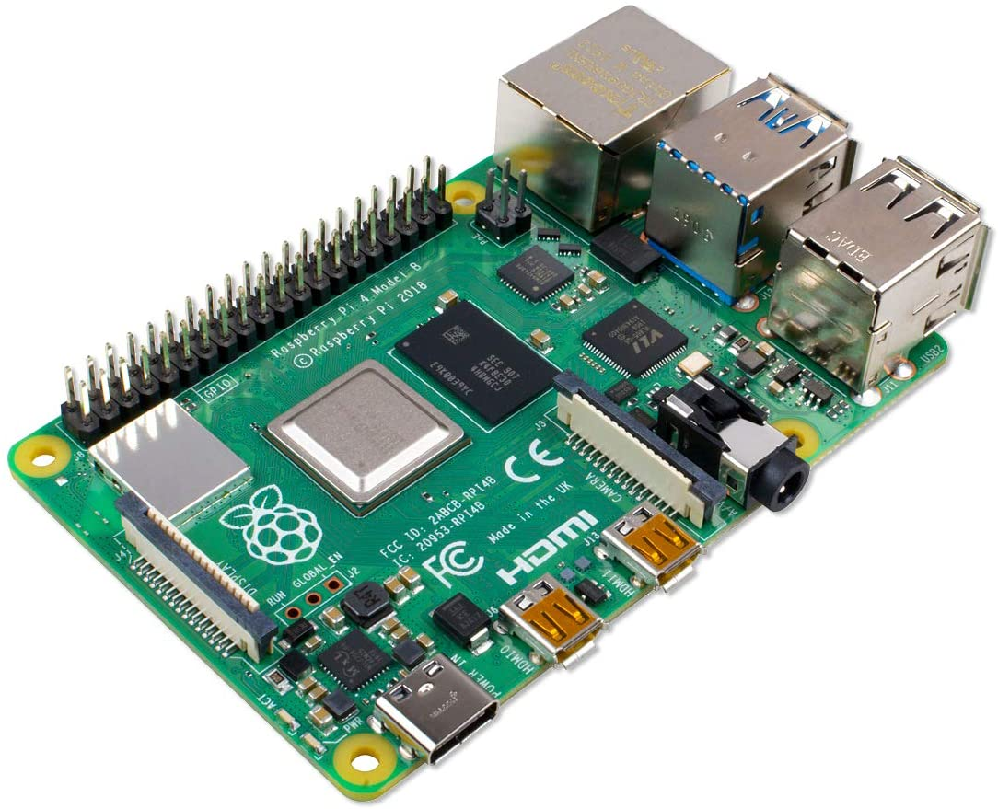
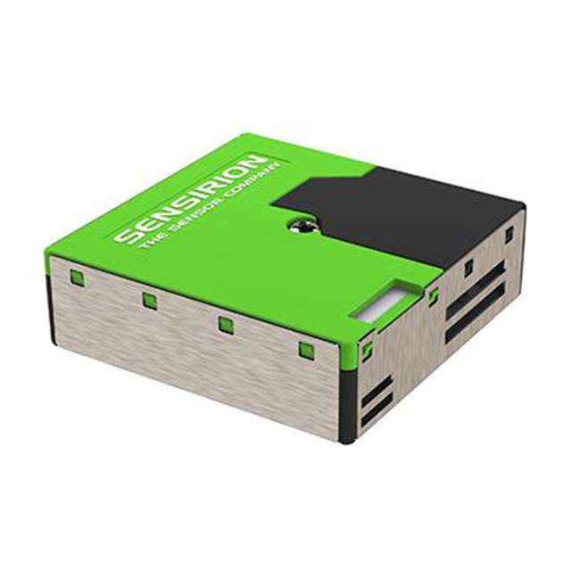

Key Components and Sensors
Atmospheric Sensor (BME280)
Differential Pressure Sensor (SDP810)
Raspberry Pi 4
Particulate Counter (SPS30)
External Power

Slide 6
Data Flow
Run Main
Program

Slide 7
Data Flow
Run Main
Program
Obtain readings
from the sensors
Readings stored
into a local .csv file

Slide 8
Data Flow
Run Main
Program
Obtain readings
from the sensors
Readings stored
into a local .csv file
File uploaded
to a database
File deleted
locally

Slide 9
Data Flow
Run Main
Program
Obtain readings
from the sensors
Readings stored
into a local .csv file
File uploaded
to a database
File deleted
locally

Slide 10
Software Framework
Config file
Determines the data
taking and uploading intervals
Sensor addresses

Slide 11
Software Framework
Config file
Sensor Functions
Responsible for obtaining
readings from sensors
Formats the readings and a header for a .csv file
Determines the data
taking and uploading intervals
Sensor addresses

Slide 12
Software Framework
Config file
Sensor Functions
MongoDB
Responsible for obtaining
readings from sensors
Formats the readings and a header for a .csv file
Determines the data
taking and uploading intervals
Sensor addresses
Uploads the file to a database
Main Program

Slide 13
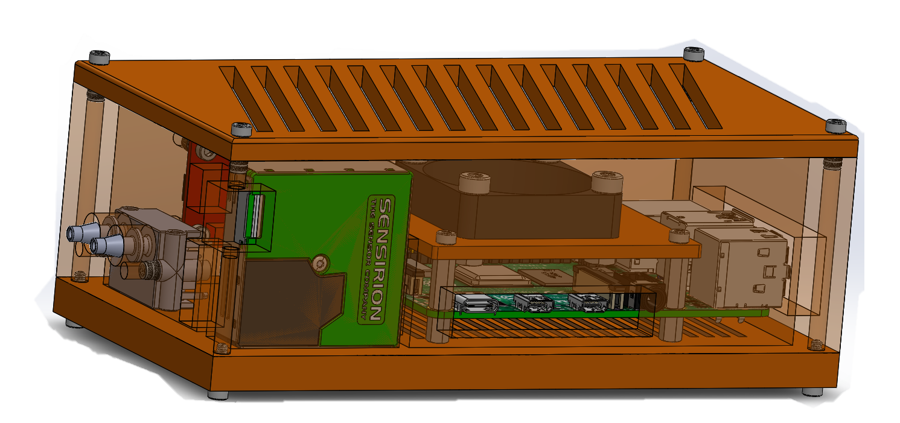
3D-Printed Case Design
BME280
Temperature,
Pressure, Humidity
Cooling
Fan
Cooling
Slits
SDP810
Differential Pressure
Port Openings
Raspberry Pi
SPS30 Particulate Sensor

Slide 14
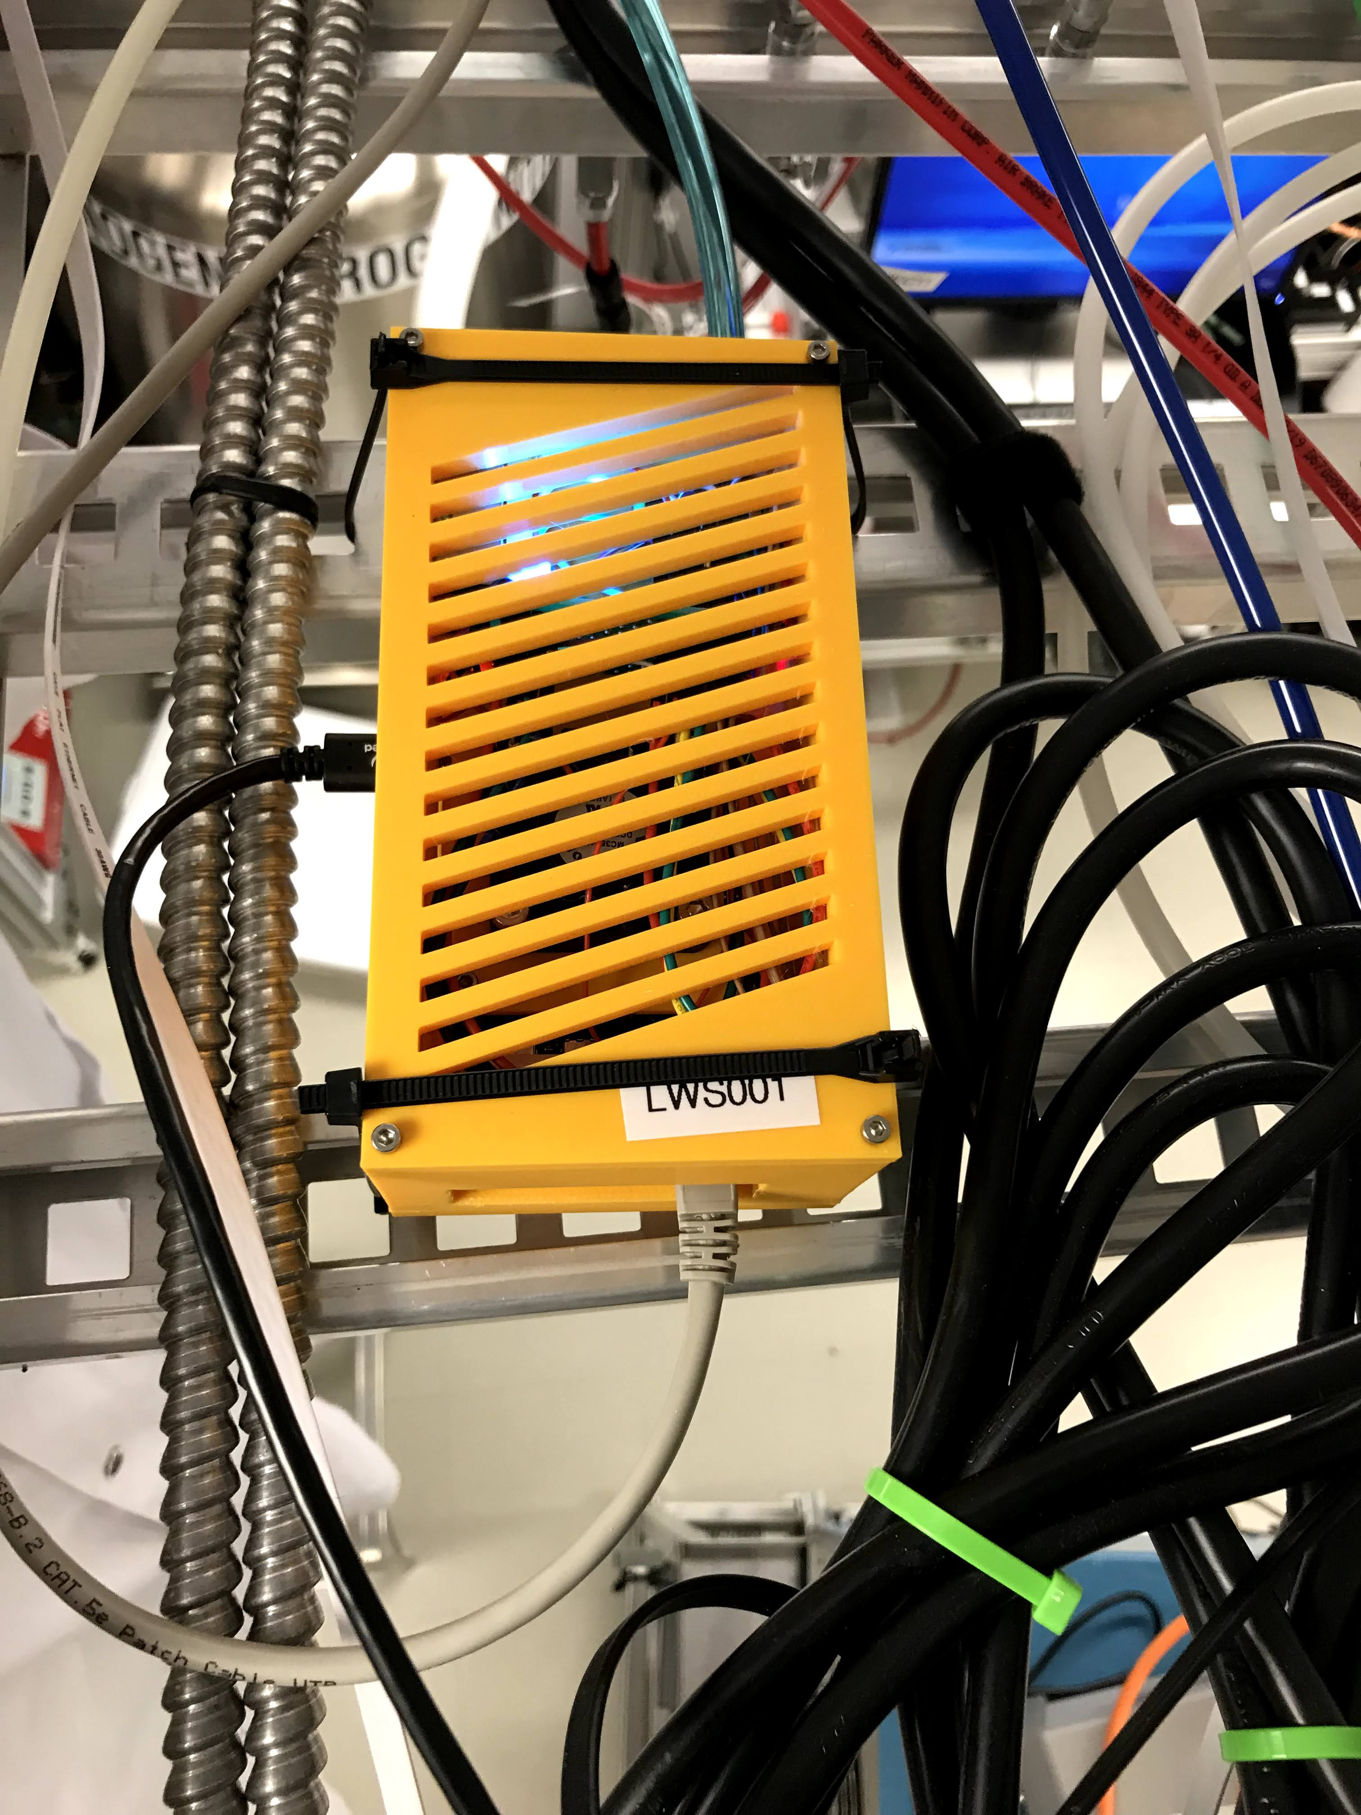
Deployment of the Environmental Monitor
Exterior
lab air
Power
Source
Current placement of the device
Ethernet

Slide 15
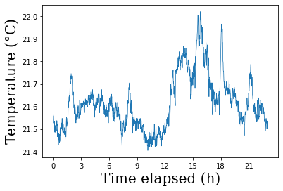
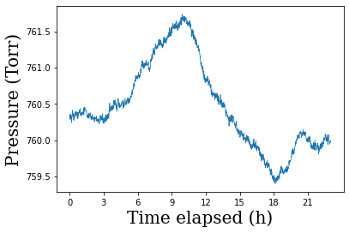
Results
Average Temperature = 21.6 °C - STD = 0.12 °C
Average Pressure = 760.4 Torr - STD = 0.6 Torr
Instrumental resolution = ± 0.01 °C
Instrumental resolution = ± 0.1 Torr
760 Torr = 1 atmosphere

Slide 16
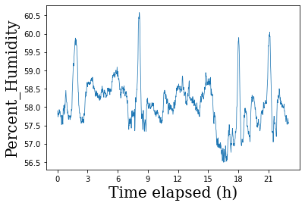
Average % Humidity= 58.08 %H - STD = 0.63%
Instrumental resolution = ± 0.008 %H

Slide 17
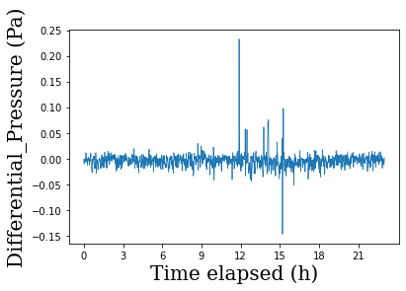
Positive Pressure lab?
Verify measurements of the sensor
Instrumental resolution = ± 0.1 Pa

Slide 18
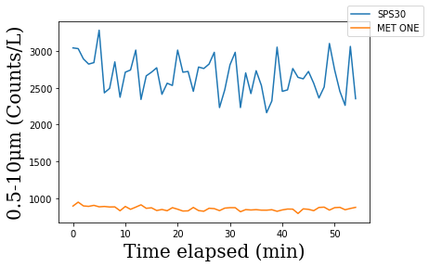
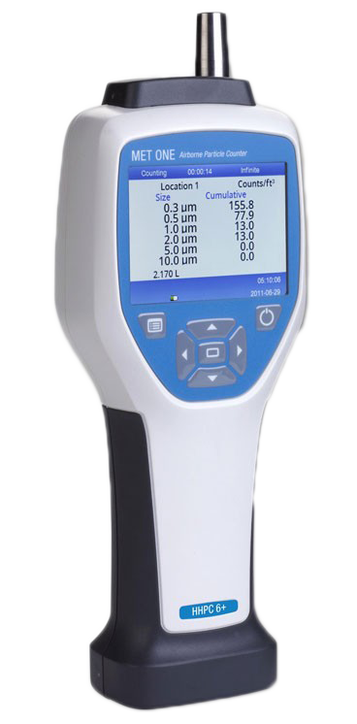
Particulate Sensor results
SPS30
MET ONE

Slide 19
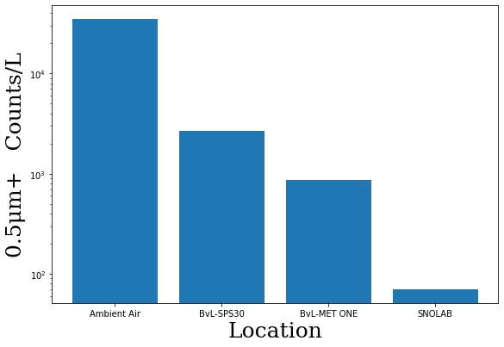
Particle Counts Comparison
Location | Approximate Counts/L Particle size > 0.5μm
Ambient Air¹ | 35000
BνL (SPS30) | 2600
BνL (MET ONE) | 860
SNO LAB² | 70
* Log scale
¹Cleanlab classification - clean-rooms.org/cleanroom-classifications/
²The deepest clean lab in the world - cerncourier.com/a/the-deepest-clean-lab-in-the-world/

Slide 20
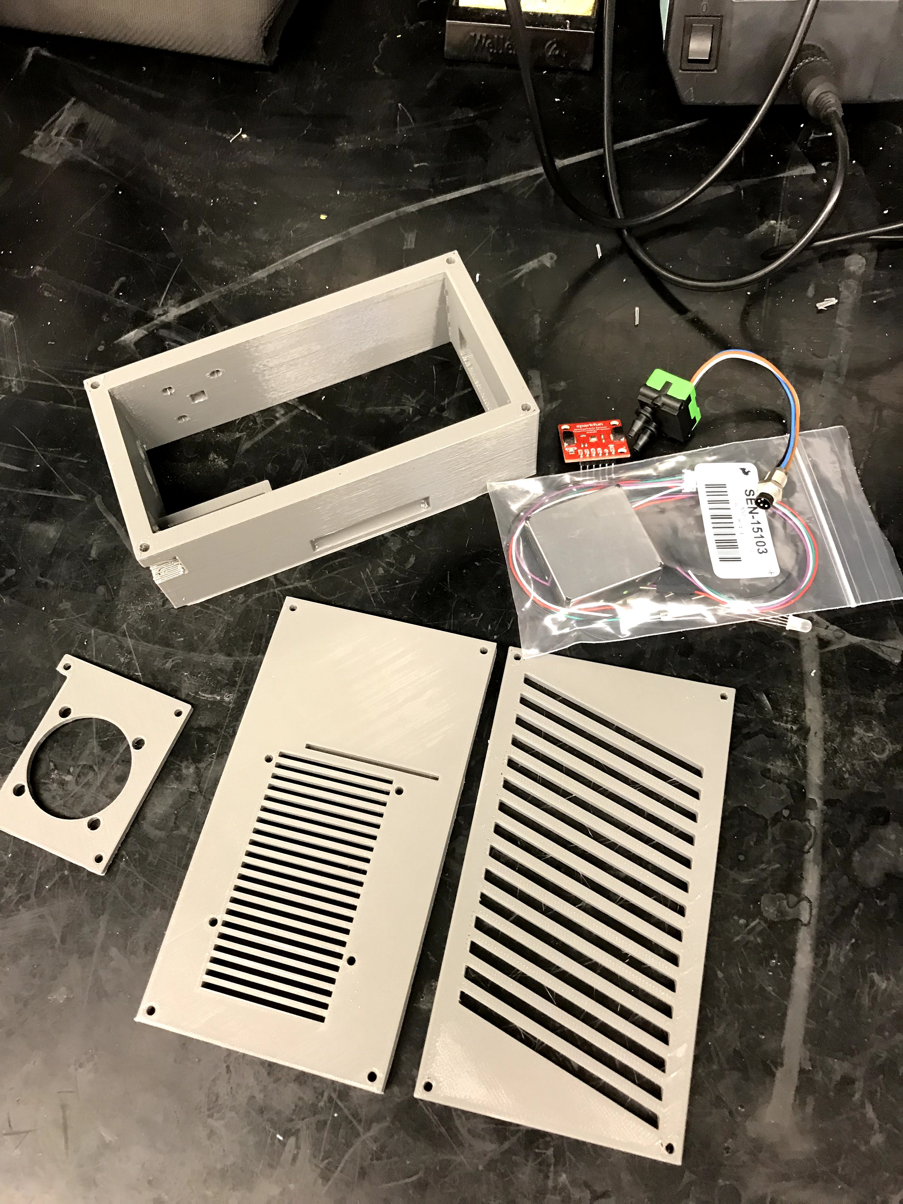

Concluding Remarks
Fully assembled and taking data
Will be uploaded later today onto https://github.com/Brunner-neutrino-lab/
Constructing a second Lab Environmental Monitor

Slide 21
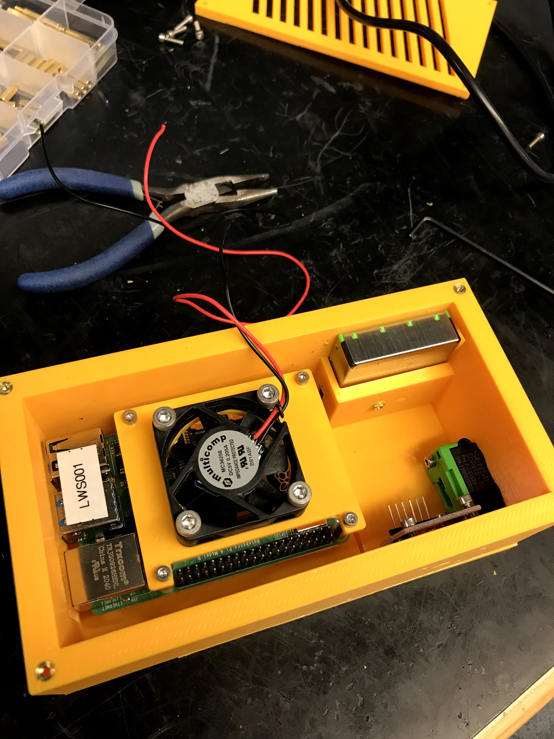
Acknowledgments
Thanks to:
Robert Turner,
Tsvetelin Totev,
Kevin Murray,
Chris Chambers,
Thomas Brunner,
Soud Al Kharusi

