Slide 1

Bubble Chambers:
The Seitz and Sounds of Dark Matter
Colin Moore
EIEIOO
May 7, 2021

Slide 2
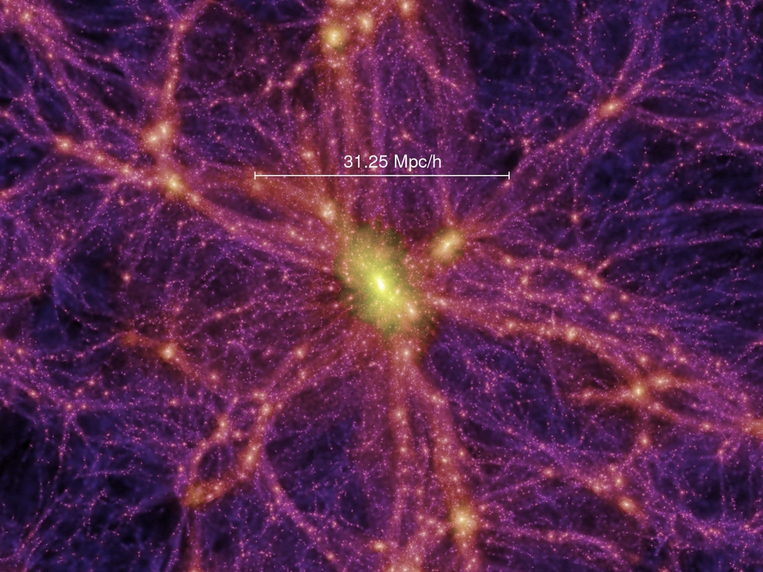
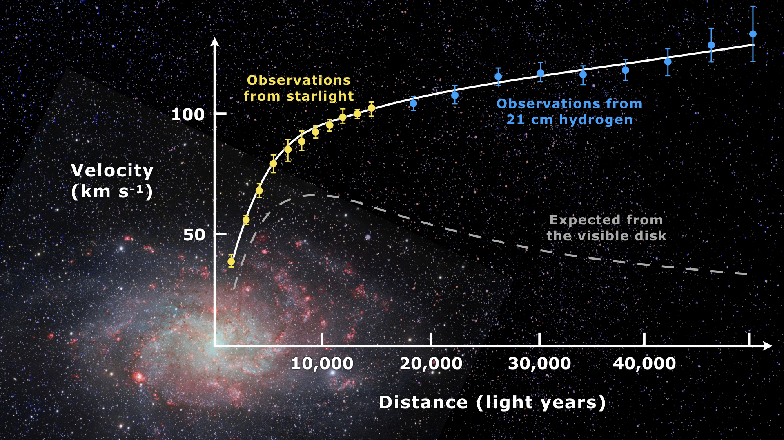
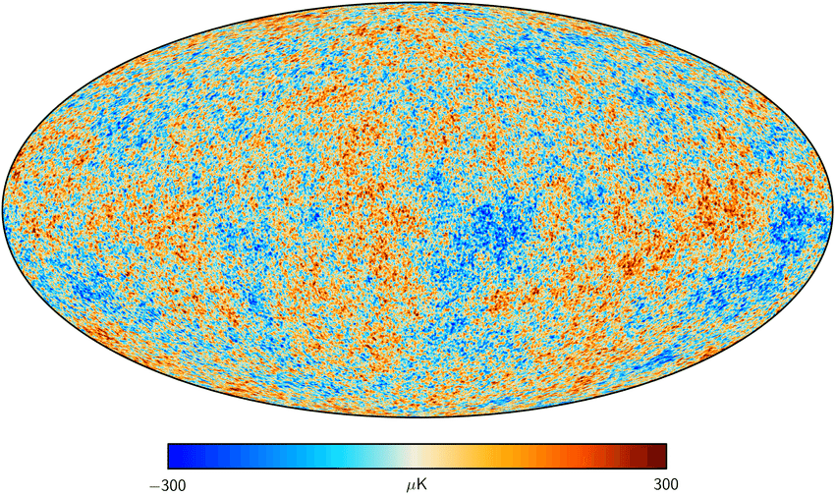
Dark Matter
Tons of evidence!

Slide 3
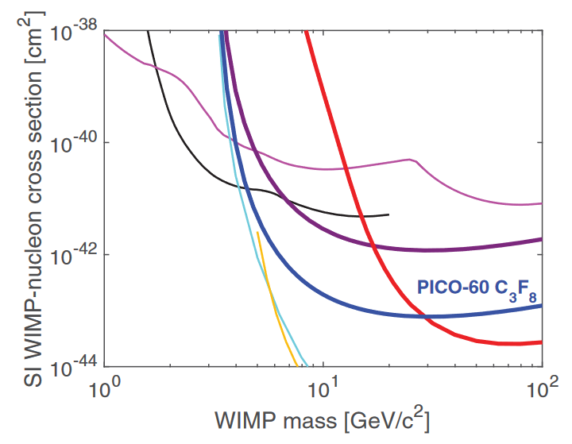
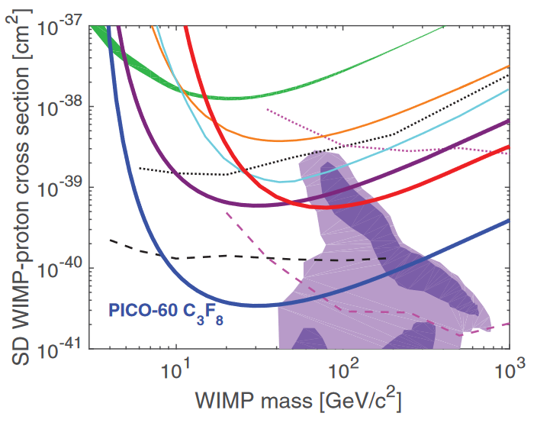
Dark Matter Interactions
Spin-Independent
Spin-Dependent
WIMP-proton and WIMP-neutron coupling equal
Interaction rate grows as square of nucleon number
  Heavier target nuclei = higher expected rate
Common targets: argon, xenon, germanium, etc.
WIMP-proton and WIMP-neutron coupling not equal
  Experiments specify WIMP-proton or -neutron
Interaction rate depends on nuclear response
  Must be calculated on a per-target basis
Common proton targets:
  fluorine (100), sodium (100), iodine (100)
Common neutron targets:
  xenon 129 (25), xenon 131 (21), germanium 73 (7.7)
Notes:
Many different theoretical interactions between WIMPs and baryonic matter
Main two of interest for most experiments is spin-independent and spin-dependent
Spin-independent
Same coupling between WIMP and proton/neutron, i.e. WIMP-nucleon coupling
Any nucleon may contribute to scattering probability, so interaction rate grows as square of number of nucleons
Spin-dependent
Different WIMP-proton and WIMP-neutron coupling
Nuclei must have non-zero spin
Only nuclei with odd number of nucleons may contribute
Spins of paired nucleons cancel
Interaction rate depends on nuclear physics
Must be calculated on a per-target basis
Common targets and their natural abundances given
Fluorine has highest WIMP-proton response
End up with these types of plots (cross-section vs mass), where lower means more parameter space excluded
Conventionally, parameter space above the line is excluded with 90% CL, i.e. if the cross section were higher you would have at least 90% chance of having seen a more significant signal

Slide 4
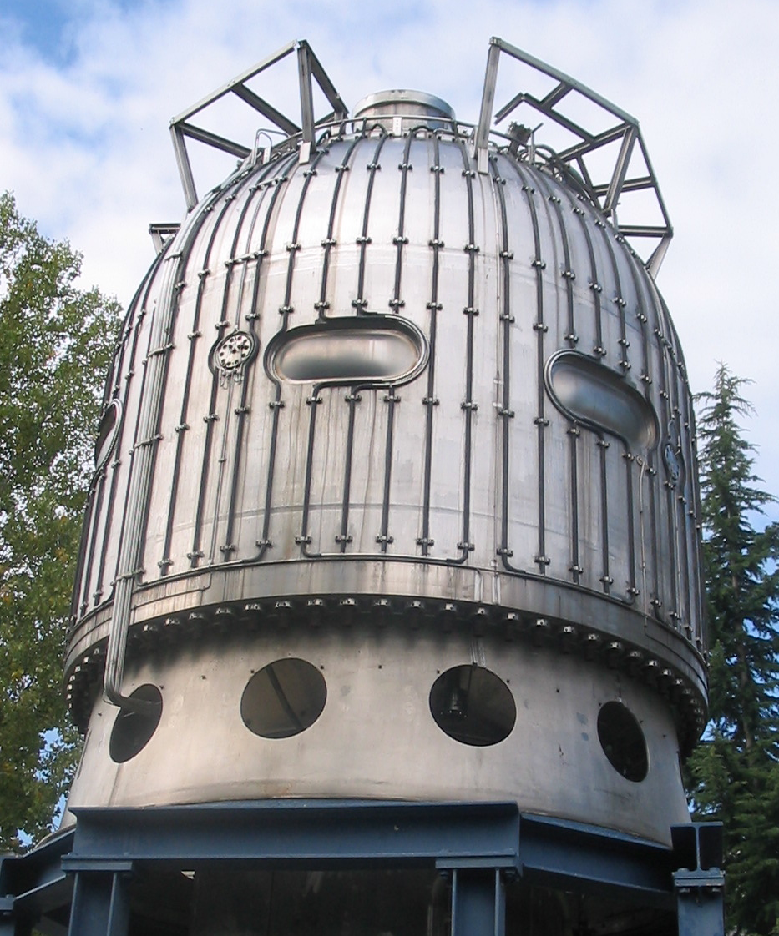
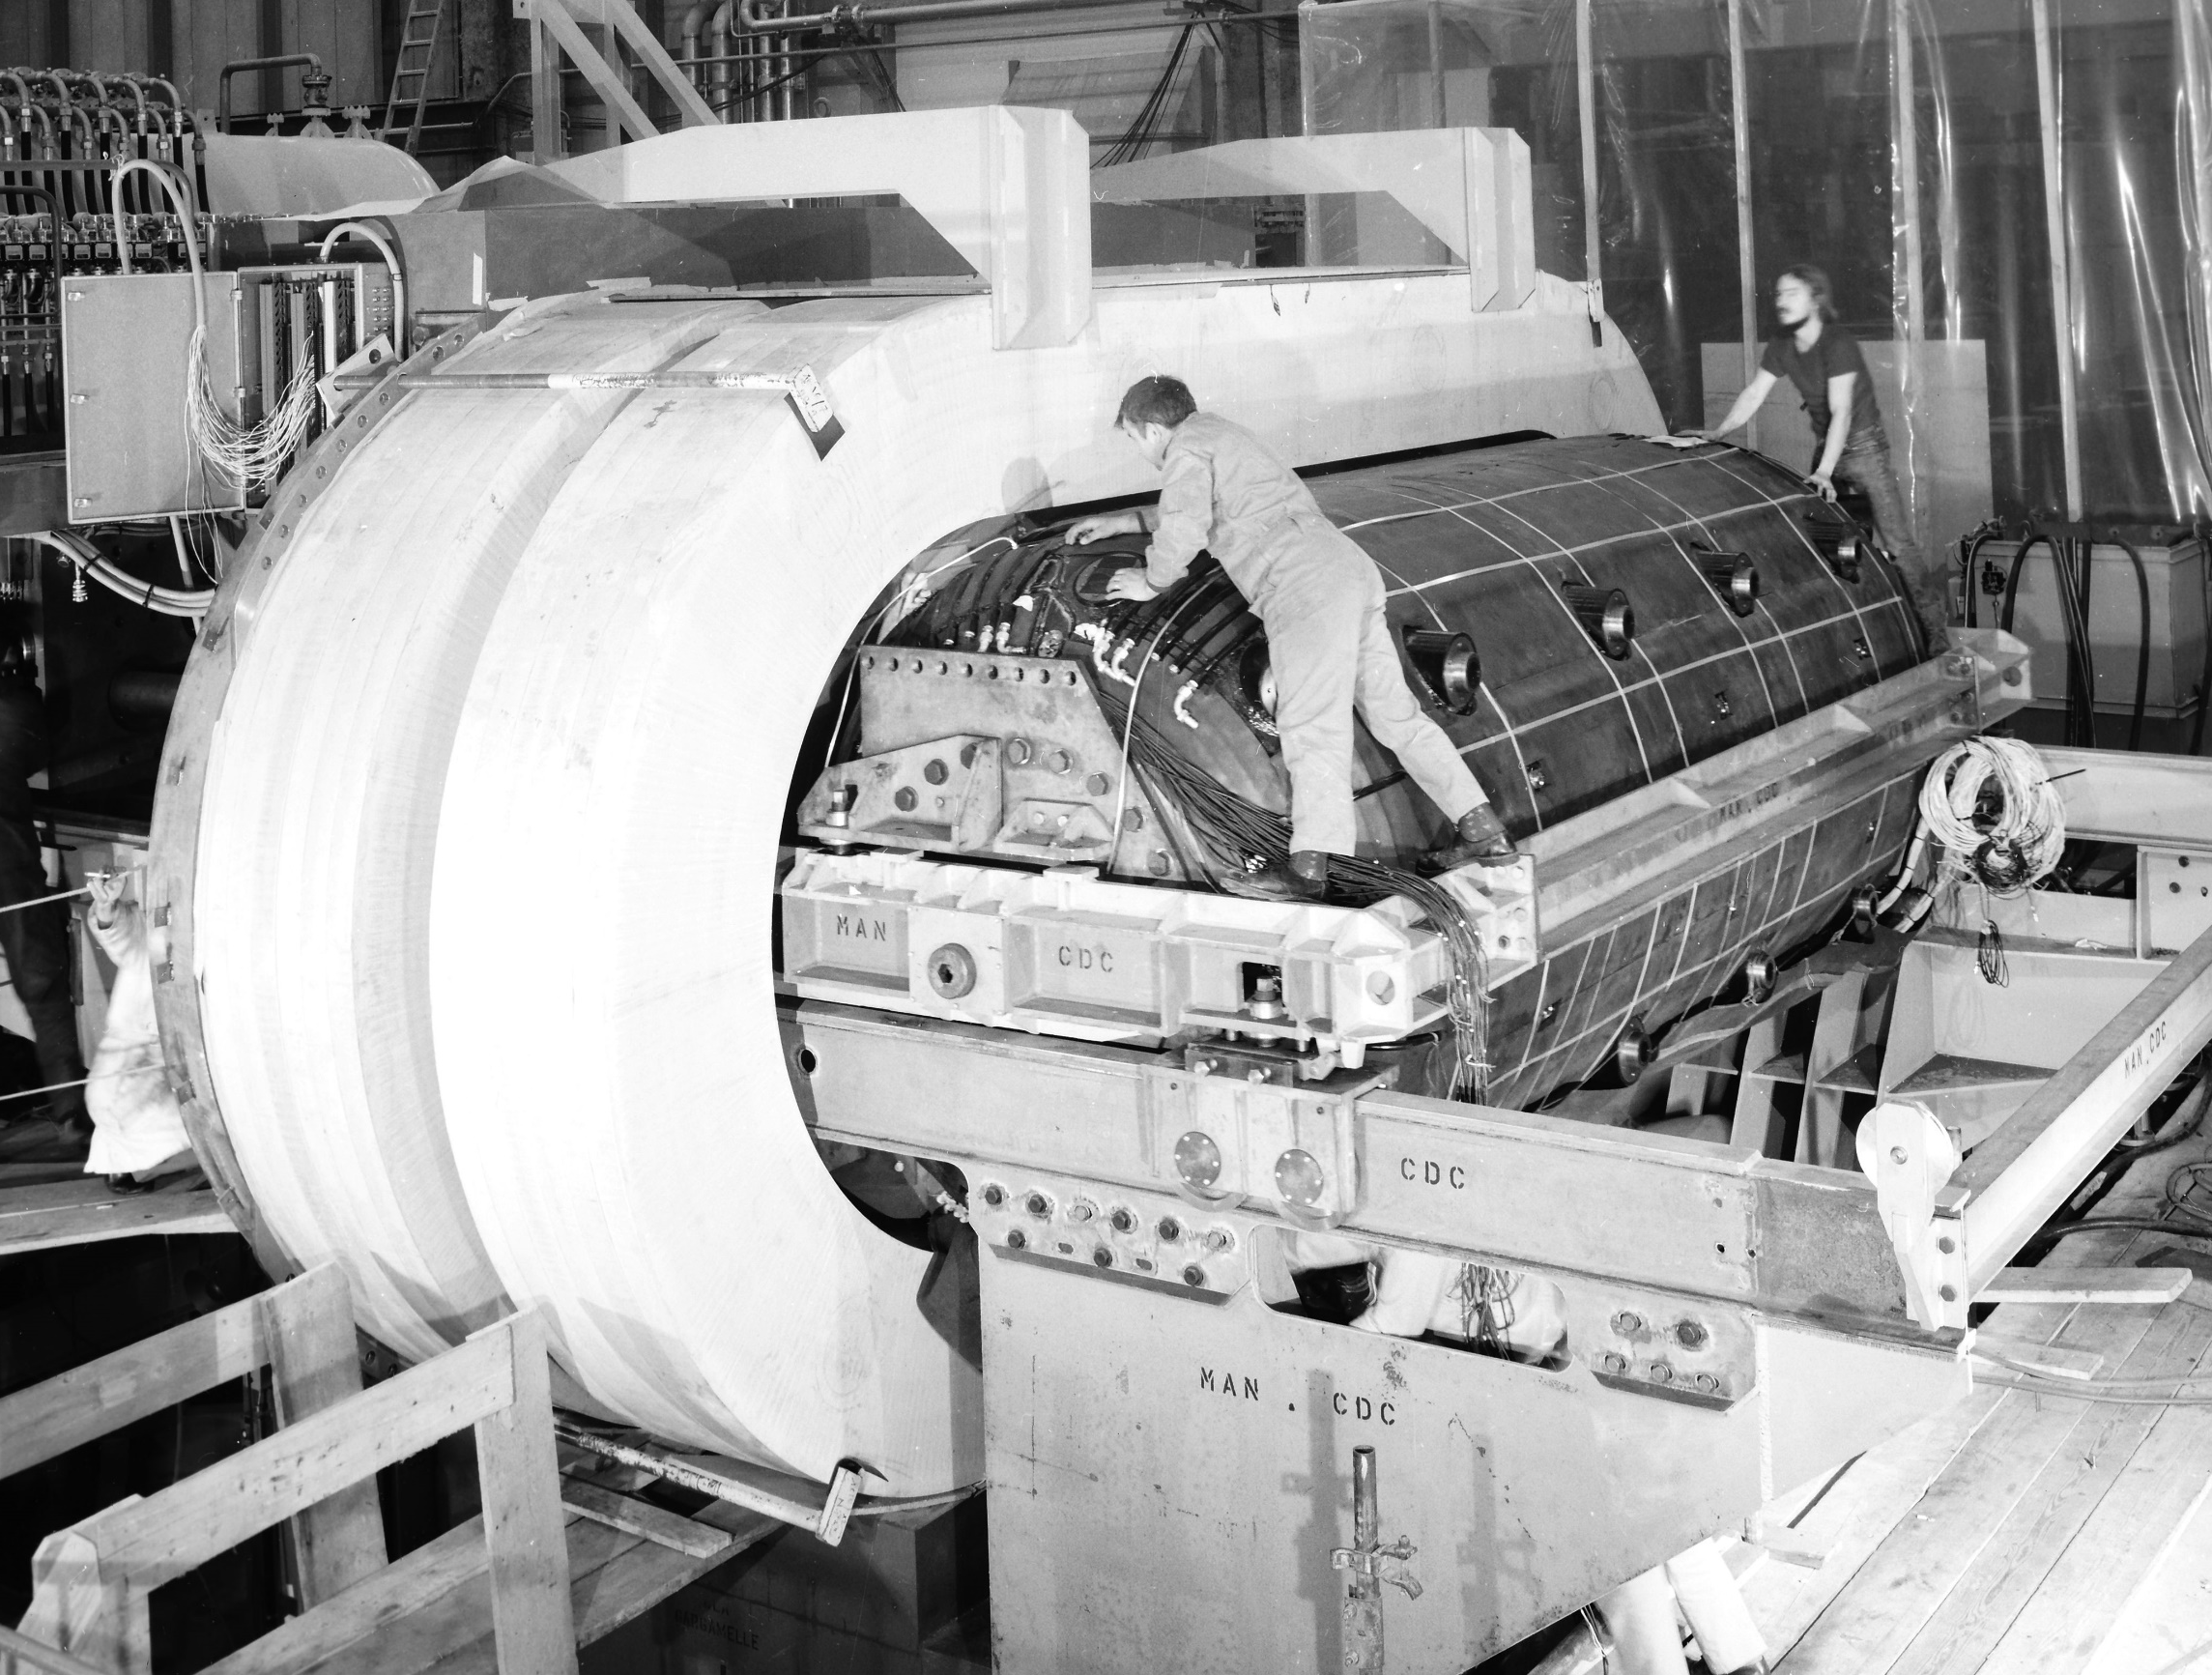
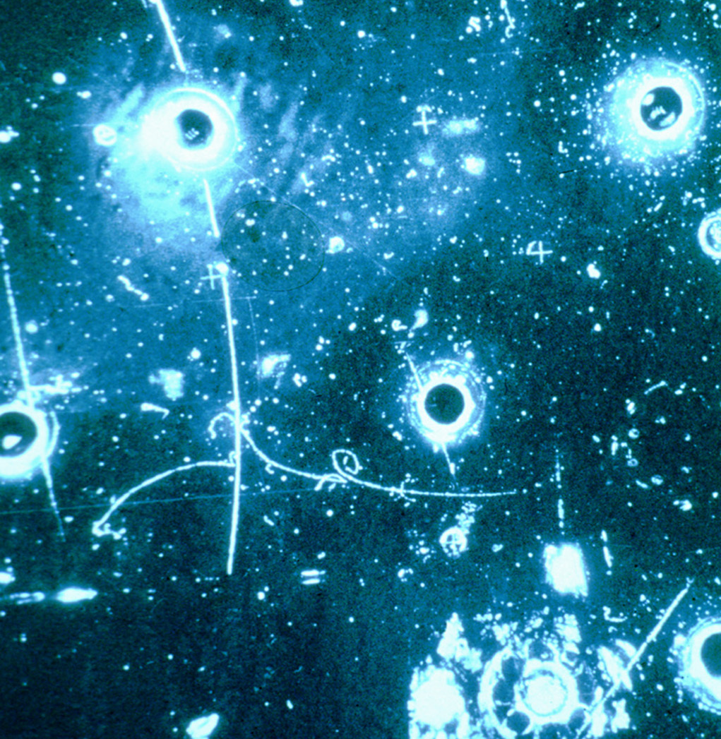
What are Bubble Chambers?
Old technology used to study particles from cosmic rays/accelerators
Pioneered in 1950s, saw use into 1980s
  D. Glaser awarded Nobel Prize in Physics in 1960 for development of bubble chambers
Used in discovery of Z⁰ boson
Superseded by newer technologies
Bubbles caused by energy deposition in superheated liquid
Images of bubbles recorded through windows in pressure vessel
Images, CW from top left:
Big European Bubble Chamber
Gargamelle
Event from Gargamelle
Notes:
Pioneered in 1950s for observing cosmic rays, saw use through 1980s at accelerator experiments
D. Glaser won Nobel Prize in Physics in 1960 for development of bubble chambers
Early chambers typically used hydrogen as the active fluid
Neutral weak boson, Z⁰, discovered at Gargamelle in 1970s
Detectors of this type are wrapped in magnetic coils
charged particles curve through magnetic fields
radius of curvature through known field gives particle charge/mass ratio (therefore identifying particle)

Slide 5
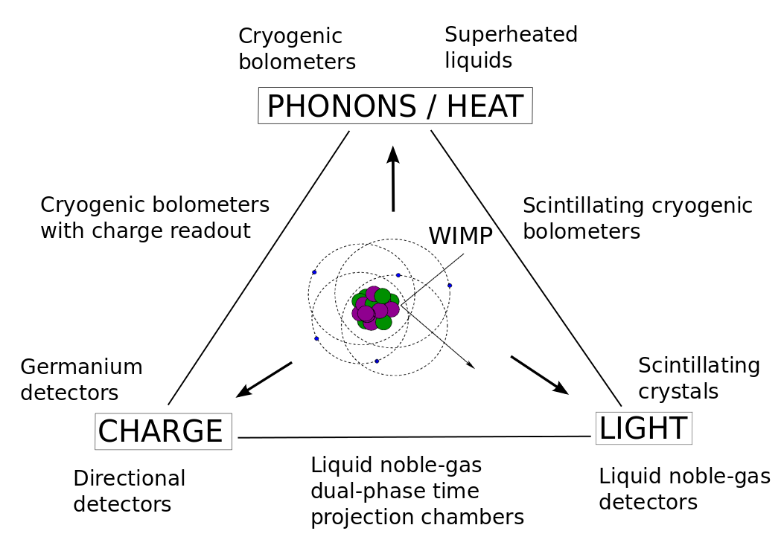
What are Bubble Chambers?
Notes:
Generally, signals from detectors are classified into three categories
Experiments detect one or more of these types of signals
Superheated detectors are in the heat category

Slide 6
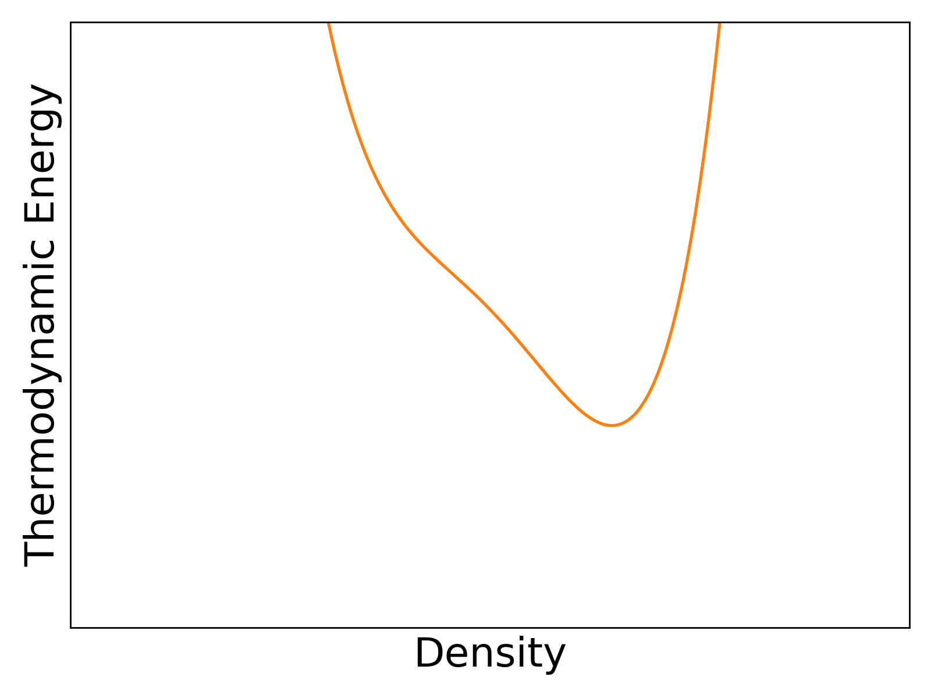
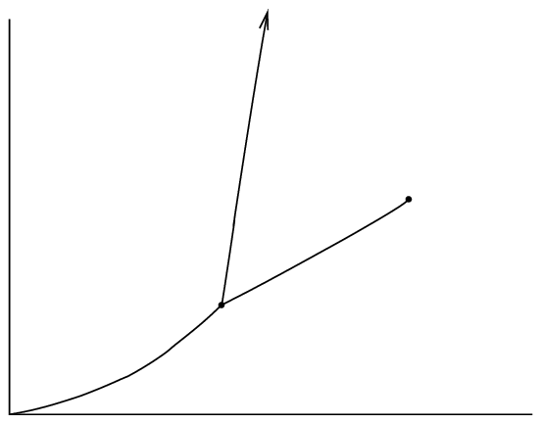
Bubble Chamber Principles
Pressure Vessel
Fixed P, T
Hydraulic Fluid
P=P₀
Freon
Liquid
Pressure
Liquid
Solid
Gas
Temperature
Notes:
Have a pressure vessel containing experiment, filled with hydraulic fluid
inner vessel which contains active fluid
Inner vessel surface must be incredibly smooth to avoid nucleation points
Nucleation points are places where a bubble tends to form (think about bubbles in a boiling pot of water)
Start out compressed; active fluid in liquid state

Slide 7
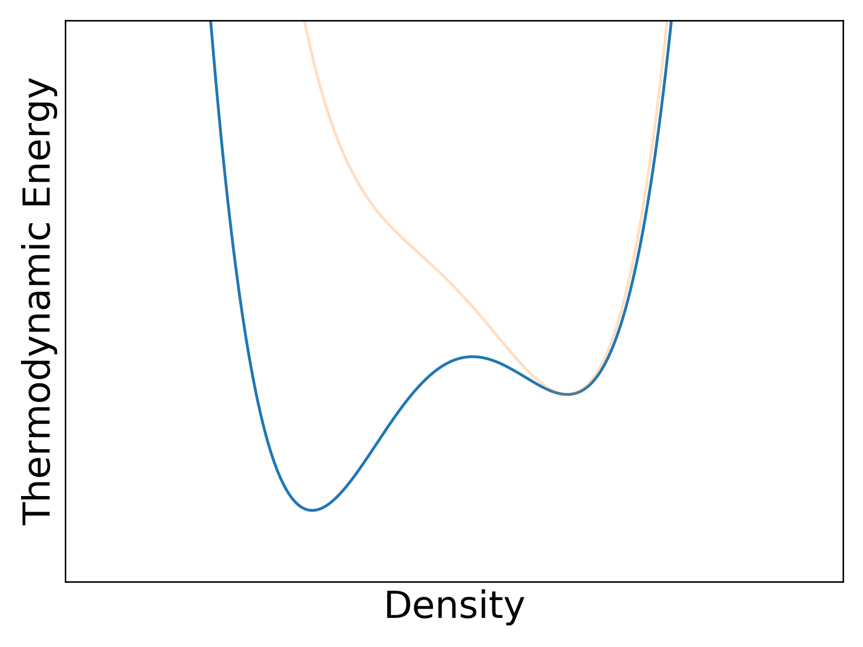
Bubble Chamber Principles
Pressure Vessel
Fixed P, T
Hydraulic Fluid
P=P₀
P<P₀
Freon
Liquid
(Superheated)
Vapour
Pressure
Liquid
Solid
Gas
Temperature
Notes:
Carefully lower pressure in detector, cross liquid-gas boundary
Pressure is below vapour pressure of active fluid at that temperature
Lowest energy state is as a vapour, but the liquid is in a metastable liquid state
“superheated”
Without nucleation sites, e.g. rough surfaces, active fluid remains a liquid

Slide 8
Bubble Chamber Principles
Pressure Vessel
Fixed P, T
Hydraulic Fluid
P=P₀
P<P₀
Freon
Liquid
(Superheated)
Vapour
Pressure
Liquid
Solid
Gas
Temperature
Notes:
Energy deposition onto a nucleus (e.g. by an incoming particle) may cause a nucleation site
Described by “hot spike” model (discussed in 2 slides)
Energy overcomes potential barrier, breaking the metastable state
Superheated liquid spontaneously erupts into gas

Slide 9
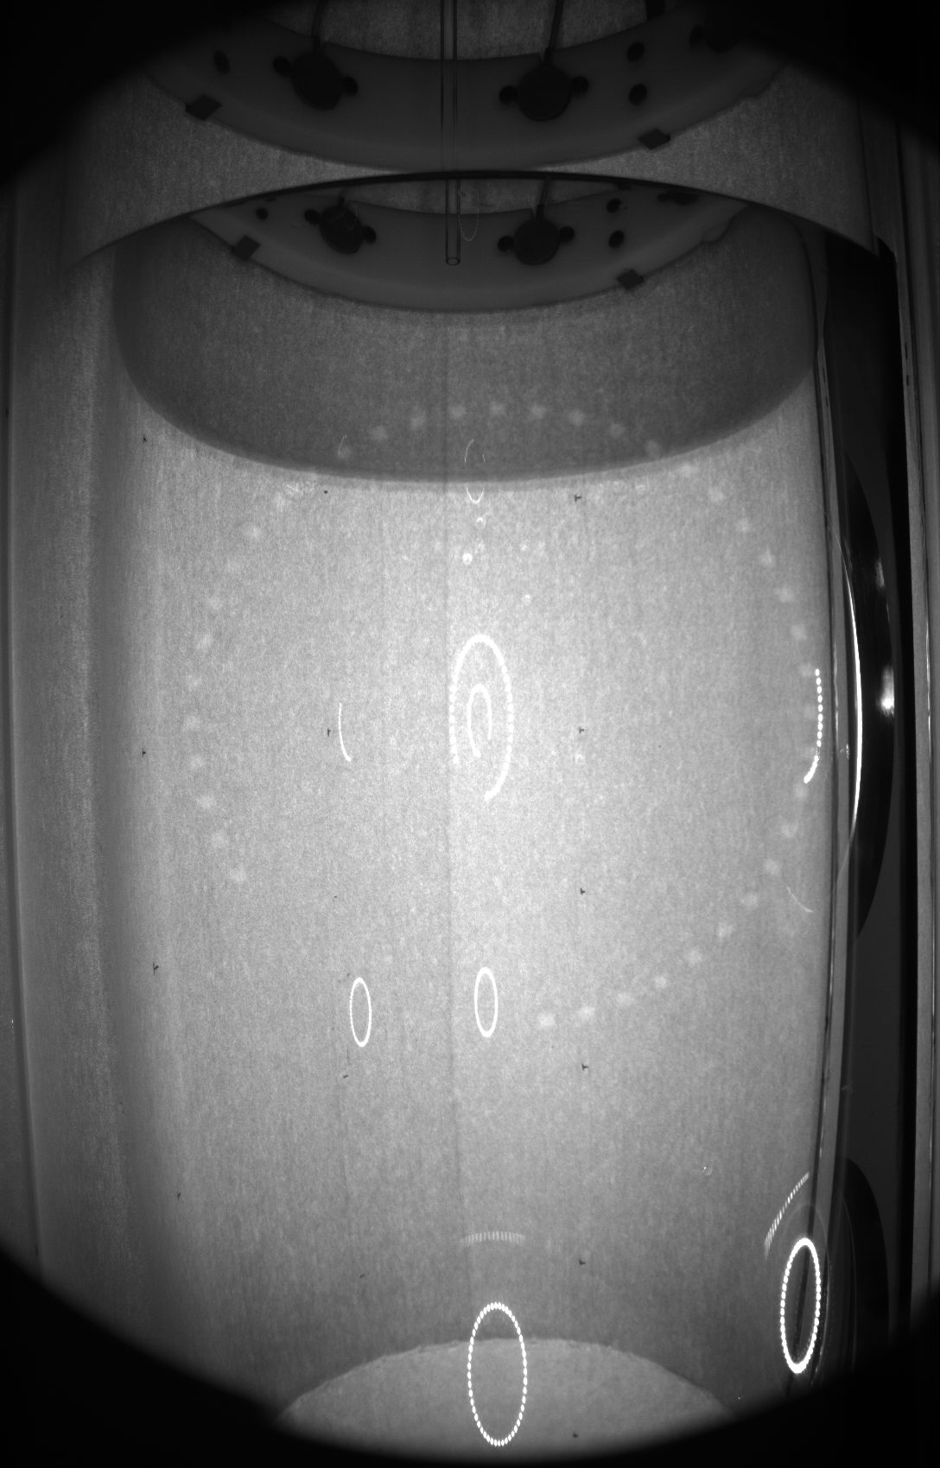
Bubble Chamber Principles
Fixed P, T
P=P₀
P<P₀
Liquid
(Superheated)
Vapour
Pressure
Liquid
Solid
Gas
Temperature
Notes:
PICO-60 event of several scatters
Three types of backgrounds:
Alpha: +2 charge, interacts quickly, deposit all energy at once (always leave a single bubble), tend to be produced near wall
Neutron: 0 charge, interacts often, but can scatter multiple times
Gamma: don’t tend to deposit energy quickly enough to form bubbles

Slide 10

How are Bubbles Formed?
Any bubble larger than the (fluid-specific) critical radius will continue to grow to macroscopic size
  PICO’s active fluid: r_{c} = 20 nm
  How does a bubble grow to the critical radius?
Energy threshold:
Surface tension
Converting liquid to gas
Expansion of vapour
Energy deposited causes region to “literally explode into bubbles of larger than critical size”
Notes:
Bubbles larger than some fluid-specific critical size will grow to macroscopic size
Sigma = surface tension, P_b = bubble pressure, P_l = liquid pressure
Growth of bubbles larger than critical size driven by vapourization of liquid
Energy required defined by Seitz model
Scary equation
Three terms, which each describe:
Energy to overcome surface tension
Energy to convert liquid to gas
Energy drawn from expansion of vapour

Slide 11
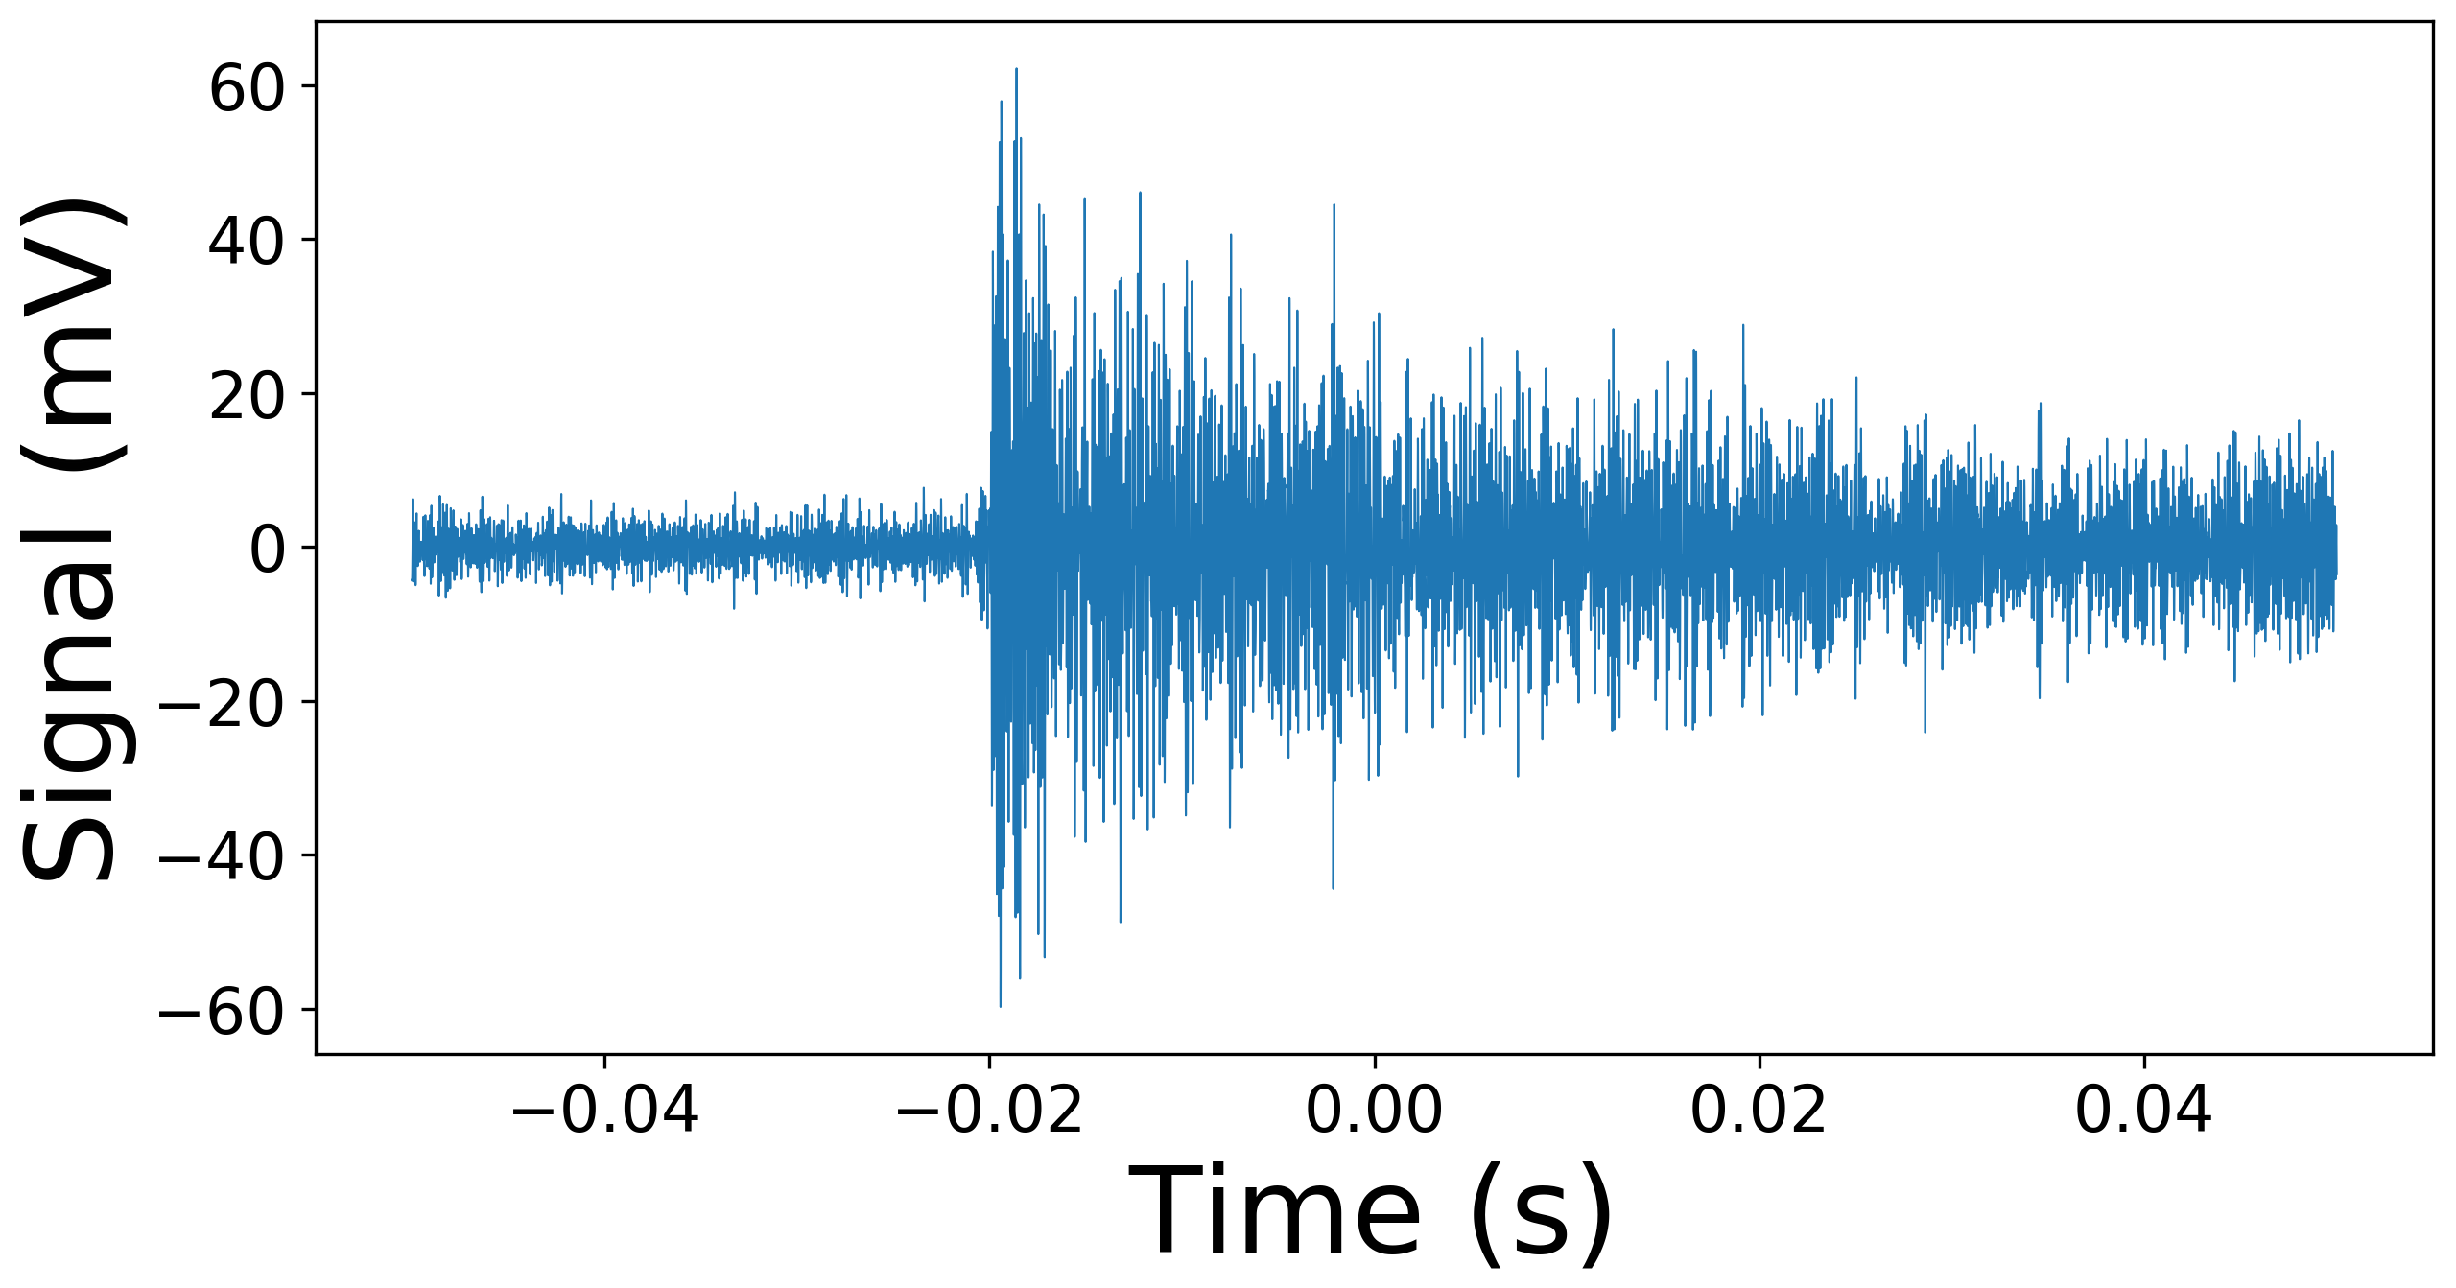
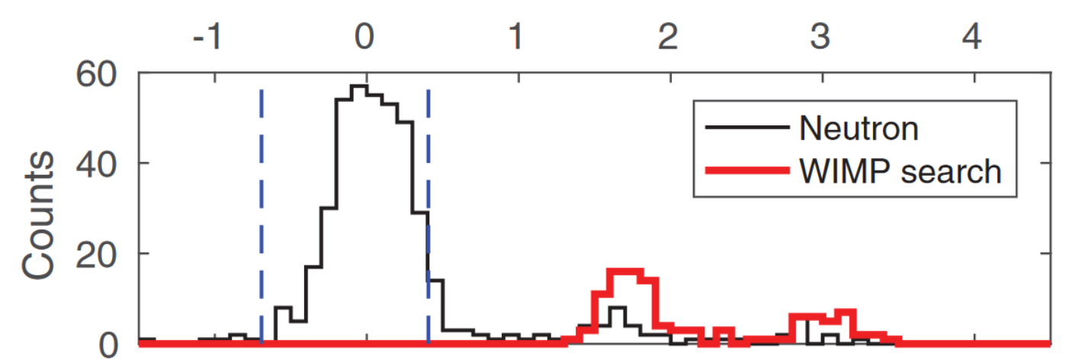

What does PICO data look like?
Optical
Acoustic
WIMP Search Region
Notes:
PICO data takes (actually three, but only covering) two main forms:
optical (i.e. pictures)
We like to know where bubbles formed, to exclude those formed near wall
Position reconstructed using stereoscopic cameras and ray tracing
Acoustic (i.e. sounds)
Piezoelectric sensors coupled to jar surface
Integral of signal in certain frequency bins gives “energy” of event
Alphas barrel through fluid, creates incredibly loud event
Neutrons scatter once off a nucleus, are much quieter’
WIMPs expected to produce same signal as neutron

Slide 12
Advantages of Bubble Chambers
Advantages
Fairly simple design/operation
Inherently insensitive to electron-recoil interactions (depending on active fluid)
Alpha rejection via acoustics
Variable threshold
Ability to change active fluid to exploit different sensitivities
  Fluorine: WIMP-proton sensitive
  Hydrogen: low-mass WIMPs
  Iodine: spin-independent
Disadvantages
No energy information
Large deadtime between events

Slide 13
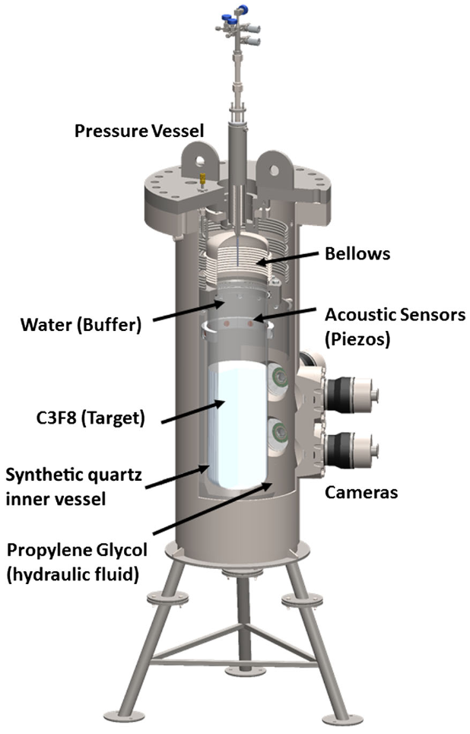
PICO-60
Previous large-scale detector
Active target: C₃F₈
  Spin-dependent sensitivity due to fluorine
Operated at SNOLAB
Used same design as all previous PICO bubble chambers
Produced world-leading WIMP-proton limit
Water buffer and bellows caused issues with spurious nucleation
  Particulate entering active region
  Water and freon mix

Slide 14
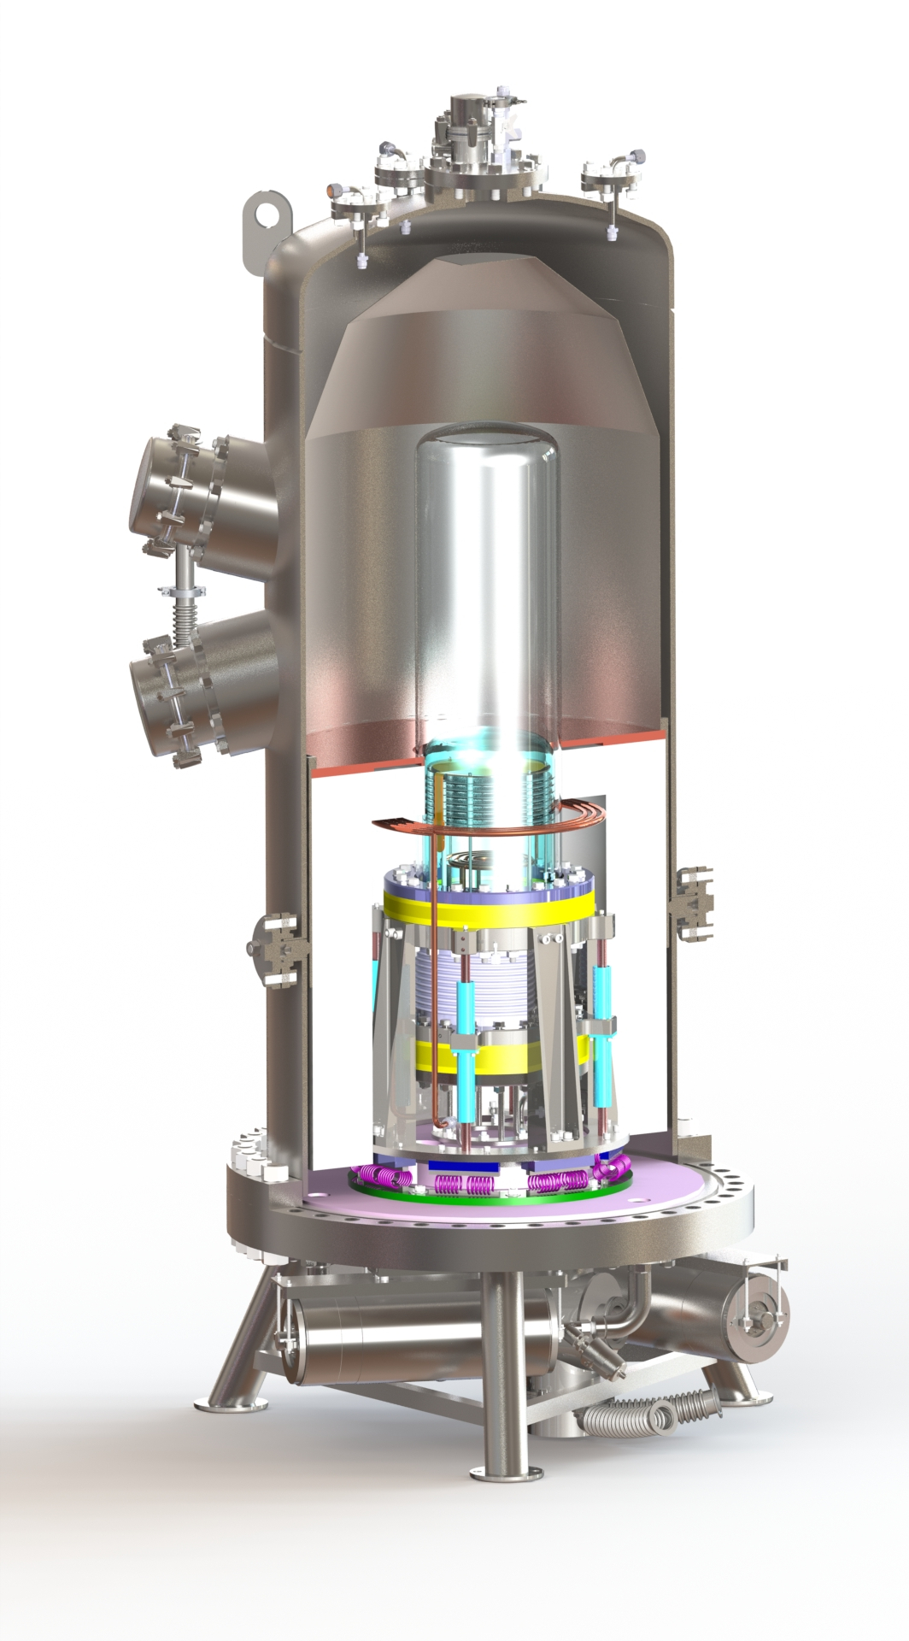
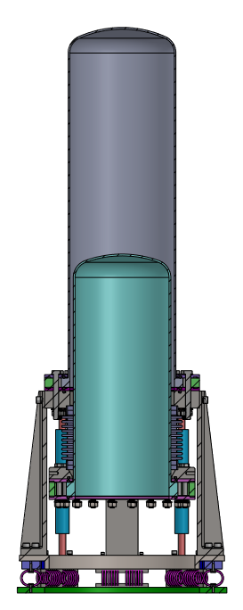
PICO-40L
Uses new “Right-Side-Up” chamber design
Water buffer replaced by second inner jar
Two thermal regions. At 30 psia:
  Warm region (15°C): C₃F₈ is superheated
  Cold Region (-25°C): C₃F₈ is liquid
First large-scale use of RSU design
Proof of concept for PICO-500
Warm
Region
Cold
Region

Slide 15
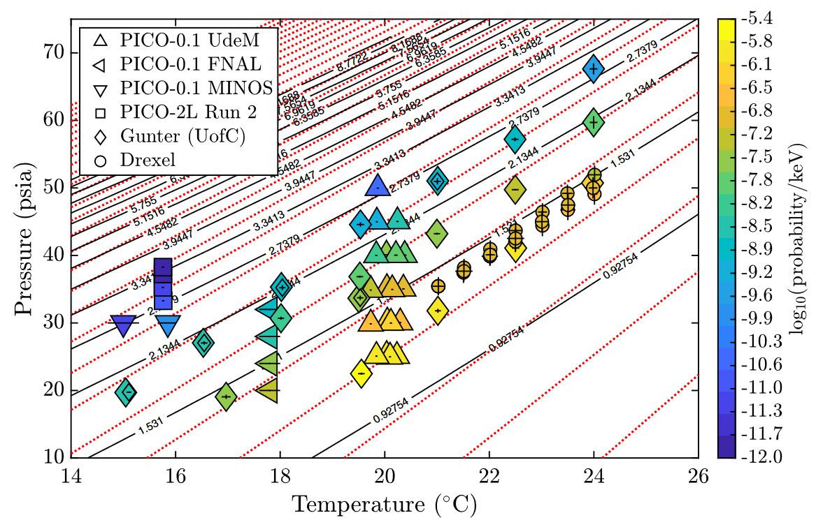
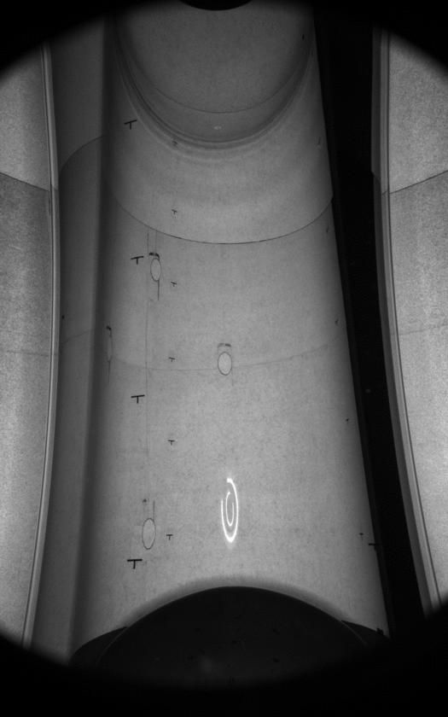
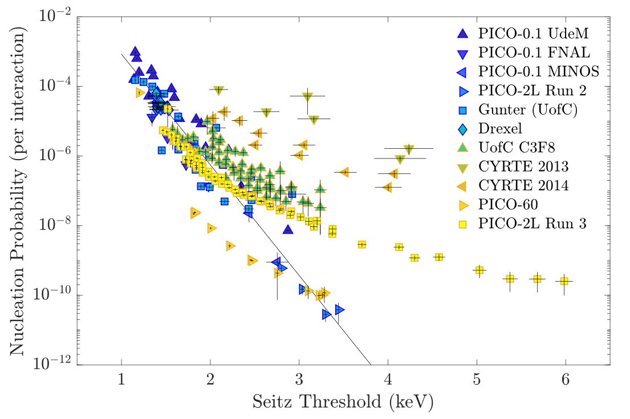
New Physics to Explore
Notes:
We’ve taken early data
Had long delays due to malfunctions
Everything is now installed/working (we think)
Black line is Seitz threshold-based expectation for electron recoils
Obviously not great at describing electron recoils
Between PICO-60 and PICO-40L, new model developed by Dan Baxter from PICO to describe electron recoil probability
X = temperature, Y = pressure, Z = nucleation probability
Black lines show constant Seitz threshold, dotted lines show new model, points show different run conditions for different bubble chambers with gamma sources
Experimental data lines up with new model
Busy plot, main takeaway is lines for constant Seitz threshold and new model aren’t parallel
Means we can optimize pressure/temperature conditions to minimize electron recoil probability while pushing to lower nuclear recoil sensitivity

Slide 16
Current Status
Issues with some subsystems prevented running for first half of 2020
June-July 2020, ~2500 events recorded (total livetime ~80 hours)
September 2020, bottom chiller sent out for repair, halting running
In March 2020, a leak formed in the pressure system from inside the pressure vessel, in an inaccessible location
  Inner vessel drained of freon
  Pressure vessel drained of oil, removed from base
  Leak identified, in process of fixing
  Taking this opportunity to upgrade some components
Plan to be running by end of summer 2021

Slide 17
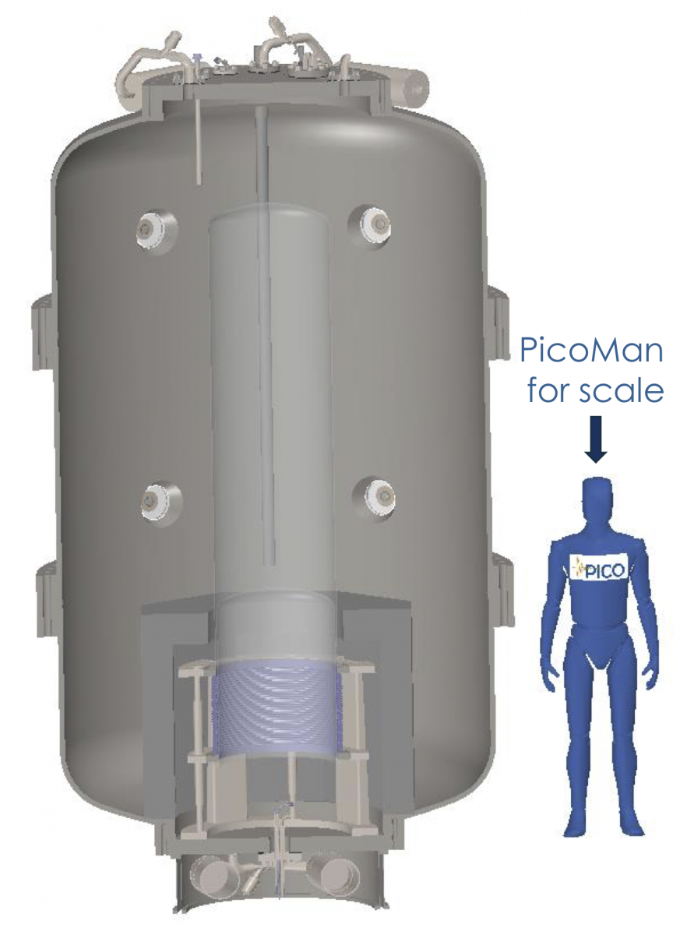
PICO-500
Next-generation, tonne-scale bubble chamber
Housed in SNOLAB cube hall (next to DEAP-3600)
Currently in design phase

Slide 18
Thanks for listening!

Slide 19
Image Sources
Slide 2:
  Rotation curve: https://commons.wikimedia.org/wiki/File:Rotation_curve_of_spiral_galaxy_Messier_33_(Triangulum).png
  CMB Anisotropies: DOI: 10.13140/RG.2.2.36598.19528
  DM Simulation: Springel, V. et al. Max Planck Institute for Astrophysics, https://wwwmpa.mpa-garching.mpg.de/galform/press/
Slide 3:
  C. Amole et al. (PICO Collaboration), Phys. Rev. Lett. 118, 251301 – Published 23 June 2017
Slide 4:
  Gargamelle: https://en.wikipedia.org/wiki/Gargamelle
  BEBC: https://en.wikipedia.org/wiki/Big_European_Bubble_Chamber
Slide 5:
  DM Triangle: https://www.arxiv-vanity.com/papers/1509.08767/
Slide 6:
  Phase diagram: DOI: 10.1119/1.1399044 (https://www.researchgate.net/figure/Phase-diagram-of-a-simple-substance-in-the-pressure-temperature-plane_fig1_1825860)
Slide 11:
  C. Amole et al. (PICO Collaboration), Phys. Rev. Lett. 118, 251301 – Published 23 June 2017
Slide 13:
  PICO-60 picture: arxiv 1902.04031

