Slide 1

Overview for
Summer Students
Mark Chen
Queen’s University
May 16, 2021

Slide 2
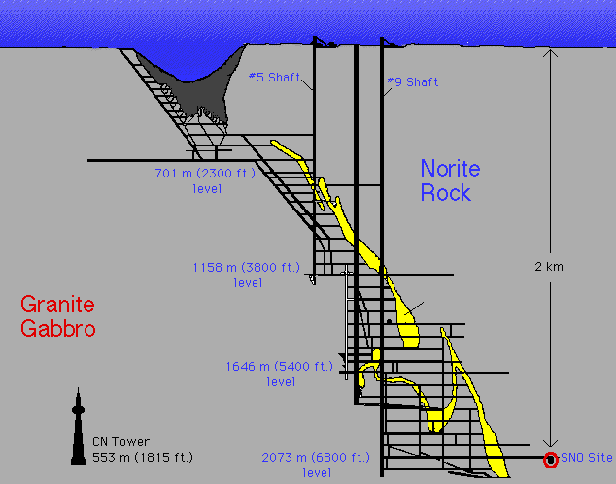


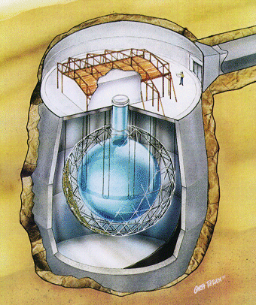
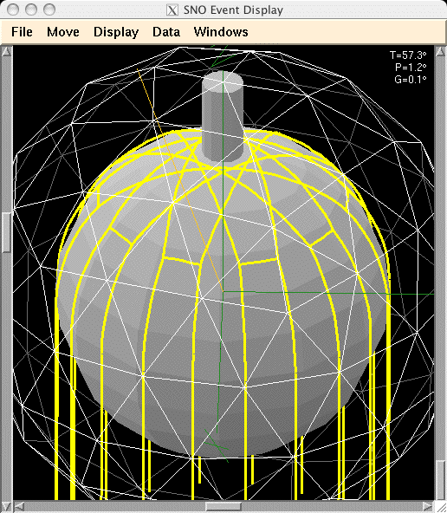
Sudbury
Neutrino Observatory
780 tonnes liquid
scintillator
1000 tonnes D₂O
12 m diameter Acrylic Vessel
18 m diameter support structure; 9500 PMTs
(~50% photocathode coverage)
1700 tonnes inner shielding H₂O
5300 tonnes outer shielding H₂O
Urylon liner radon barrier
depth: 2092 m (~6010 m.w.e.) ~70 muons/day
hold-down
rope net

Slide 3
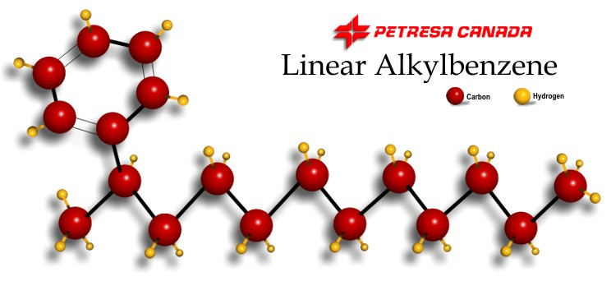
Liquid Scintillator for Neutrino Detection
>50 times light output compared to water Cherenkov
organic liquids can be made very radio-pure (e.g. Borexino)
    U, Th, K are insoluble in the scintillator
enables neutrino physics program down to <1 MeV energy
SNO+ identified linear alkylbenzene as an excellent solvent for liquid scintillator neutrino detectors
  long light attenuation length
  compatible with acrylic
  safe
  lower cost
PPO fluor 2 g/L

Slide 4
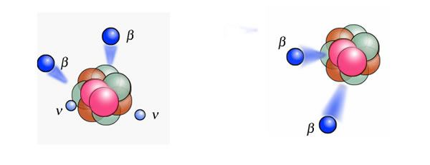
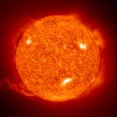

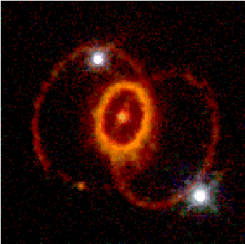
SNO+ Physics Program
search for neutrinoless double beta decay
neutrino physics
  solar neutrinos
  geo antineutrinos
  reactor antineutrinos
  supernova neutrinos
SNO+ Physics Goals

Slide 5
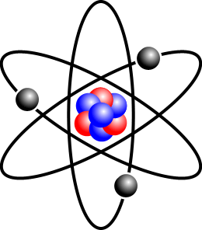
How Does SNO+ Detect Neutrinos?
neutrinos must first interact to produce a detectable charged particle
possible targets in ordinary matter:
  electrons
  atomic nuclei
    composed of nucleons (protons and neutrons)
      composed of quarks
neutrinos only undergo the weak interaction
CC:
NC:
Y has +1 charge compared to X

Slide 6

Neutrino-Electron Scattering
$$ν_{x}+e^{−}→e^{−}+ν_{x}$$
recoiling electrons make scintillation light
ν_{e,μ,τ}
ν_{e,μ,τ}
ν_{e}
e⁻
Z⁰
W⁺
e⁻
e⁻
e⁻
ν_{e}
Neutral-Current scattering Charged-Current Scattering

Slide 7


How Does SNO+ Detect Antineutrinos?
antineutrinos must first interact to produce a detectable charged particle
possible targets in ordinary matter:
  electrons
  atomic nuclei
    composed of nucleons (protons and neutrons)
      composed of quarks
antineutrinos only undergo the weak interaction
CC:
NC:
$${\overline{ν}}_{e}+X→e^{+}+Y$$
$${\overline{ν}}_{x}+e^{−}→e^{−}+{\overline{ν}}_{x}$$
Y has –1 charge compared to X

Slide 8
Inverse Beta Decay (on protons)
charged-current weak interaction of anti-electron neutrinos on protons
  this is how neutrinos were first detected by Reines and Cowan
- the positron makes a prompt scintillation signal
- the neutron takes ~0.2 ms to bounce around and then get captured (by a proton)
- releasing a 2.2 MeV gamma ray that makes a delayed signal
The inverse beta decay delayed coincidence signal is very distinctive in a liquid scintillator detector which has lots of hydrogen (protons) in the organic molecule.

Slide 9
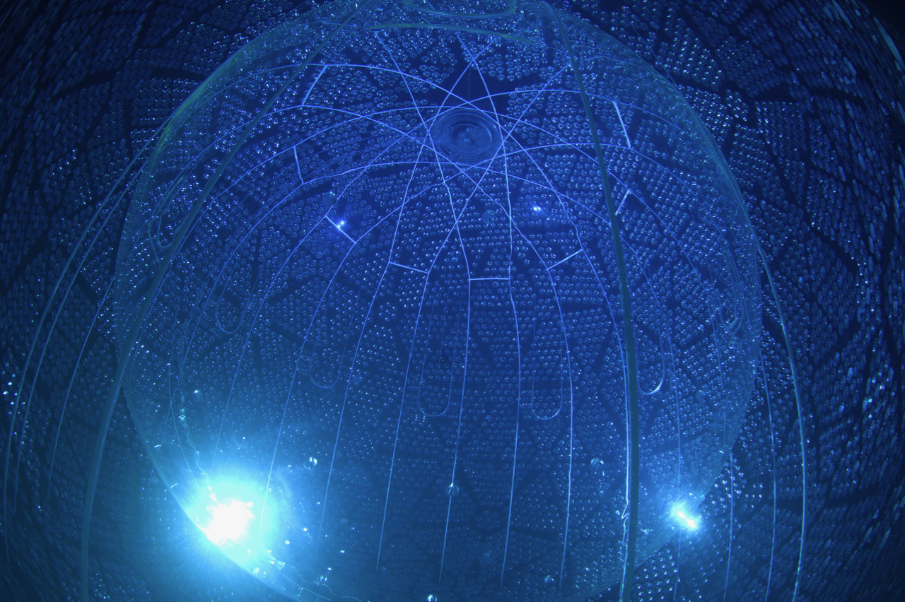
Neutrino Physics at Lower Energy
study solar neutrinos at lower energies than SNO
detect geo antineutrinos – Earth’s “neutrino glow” produced by natural radioactivity in the crust and mantle
measure antineutrino oscillations from nearby nuclear reactors (Bruce, Pickering, Darlington)
supernova neutrino watch
probe the matter-antimatter nature of neutrinos using tellurium dissolved in the liquid scintillator
➝ search for neutrinoless double beta decay

Slide 10
Double Beta Decay
some even-even nuclei cannot β decay but can undergo double beta decay, a very rare second-order weak process
e.g. ¹³⁰Te has half-life 8.2×10²⁰ years
this process occurs and has been observed two-neutrino double beta decay
mass
ββ
Z, atomic number
n
p
W⁻
e⁻
2νββ
e⁻
n
p

Slide 11

Double Beta Decay
some even-even nuclei cannot β decay but can undergo double beta decay, a very rare second-order weak process
e.g. ¹³⁰Te has half-life 8.2×10²⁰ years
can this (beyond the Standard Model) process occur? neutrinoless double beta decay
mass
ββ
Z, atomic number
n
p
W⁻
e⁻
0νββ
x
requires neutrinos to be their own antiparticle − i.e. Majorana fermions
as opposed to Dirac fermions
e⁻
n
p

Slide 12
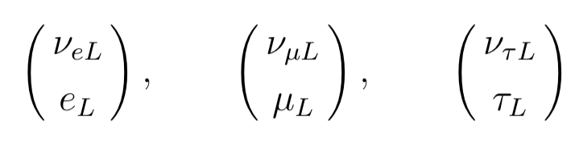
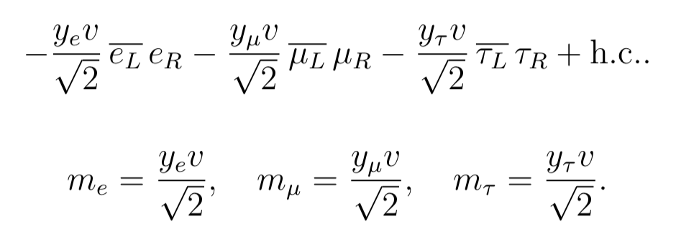

Standard Model Leptons
chiral gauge theory
$$e_{R}μ_{R}τ_{R}$$
mass is the Yukawa coupling to the Higgs
and neutrinos have zero mass

Slide 13


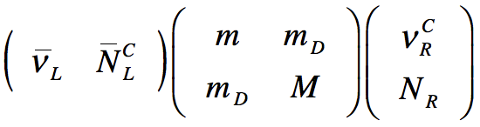
Neutrino Mass
is Physics Beyond the Standard Model
neutrinos are their
own antiparticles
Dirac Majorana
why is the Yukawa coupling so small? “talk to a different Higgs”
implies new global U(1) symmetry?! small mass could be “natural”
what’s going on with the right-handed fields?
– they would be sterile (don’t interact)
➔
+ h.c.
or both

Slide 14
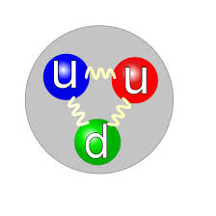
Are Neutrinos Majorana Fermions?
they carry no electromagnetic charge, no QCD colour, no moments, no other quantum number
other than lepton number…but what is that?
ν_{e}

Slide 15

Are Neutrinos Majorana Fermions?
they carry no electromagnetic charge, no QCD colour, no moments, no other quantum number
other than lepton number…but what is that?
ν_{e}
e⁺
Why does this only happen for the
“anti”-neutrino? Does the proton
know it was an anti-lepton?

Slide 16
Answer: Chirality and the Weak Interaction
the weak interaction distinguishes between left and right chirality and that’s why
does the weak interaction additionally distinguish between lepton number L = 1 and L = –1? Or is that just redundant?
if lepton number is meaningful, then particles and antiparticles are fundamentally different – neutrinos and antineutrinos carry a “global U(1) weak hypercharge associated with lepton number”
but if one discards lepton number as a meaningful quantity (lepton number is ad hoc so get rid of it) then neutrinos are Majorana fermions…FACT!
Neutrinoless double beta decay would be a lepton number violating process
ΔL = 2

Slide 17
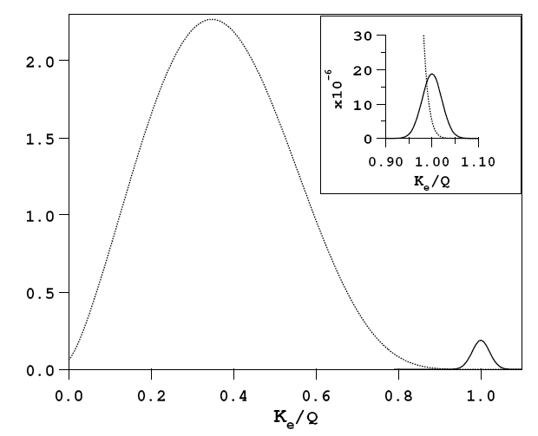
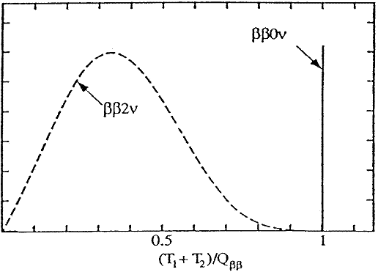
How to Search for 0νββ?
look at sum of energy of both electrons (calorimetry)
search for a peak at the double beta endpoint

Slide 18
Simulated SNO+ Neutrinoless Double Beta Decay Signal – Early ¹³⁰Te Study
VERY OLD PLOT!
SNO+ simulated signal and backgrounds
(for illustration purposes)

Slide 19
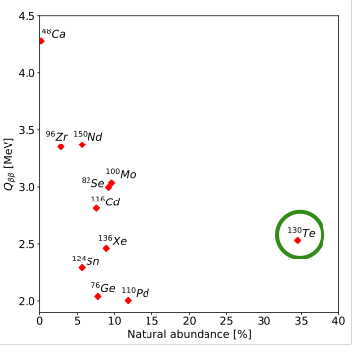
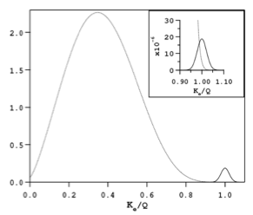
Tellurium for Double Beta Decay
Large natural isotopic abundance 34% for ¹³⁰Te
  tonne-scale for ¹³⁰Te:
  cost is $1.5 million
    compare to O($100 million) for tonne-scale of enriched isotope
  potential to increase loading from 0.5% to 3-5% ($15 million cost)
Background suppression
in the 0νββ ROI (Q=2.53 MeV), U, Th backgrounds can be tagged and rejected by suppression factors >5,000
(e.g. ²¹⁴Bi-²¹⁴Po coincidence)
  0.5% ^{nat}Te in SNO+
  1,330 kg of isotope in the detector!
¹³⁰Te and ¹³⁶Xe have the smallest 2νββ/0νββ ratio

Slide 20
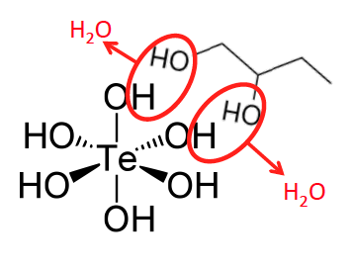
Synthesis
Current SOP synthesis
React the telluric acid with butanediol to produce an LAB soluble product
Mix aqueous telluric acid with 1,2 butanediol, heat, apply vacuum and sparge until water is removed
  Dehydration reactions are reversible, so water removal is important
  Reaction temperature 70-80°C, not less than 60°C or more than ~110°C
  BD:TeA molar ratio of 3.0
Novel approach
  “Our own” CAS number
CAS # 2173121-84-9
“Tellurium, 1,2-butanediol hydroxy oxo complexes”
Notes:
Downselect in 2016

Slide 21
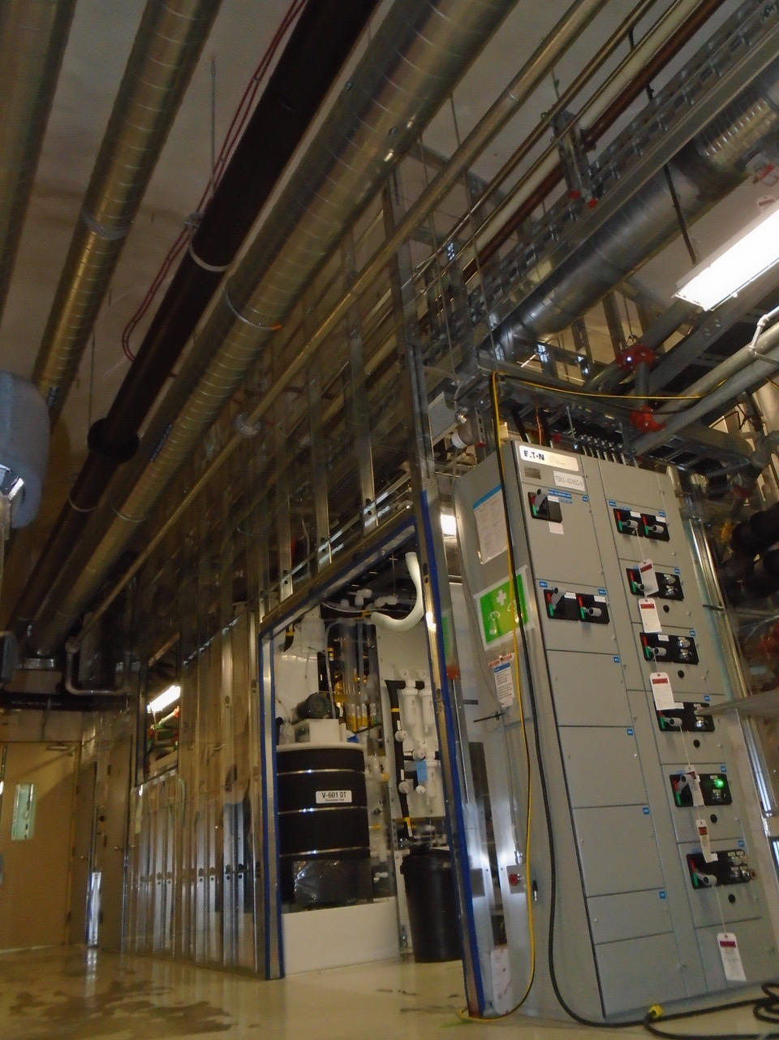
TelluriC ACID Purification Te-DIOL Synthesis

Slide 22
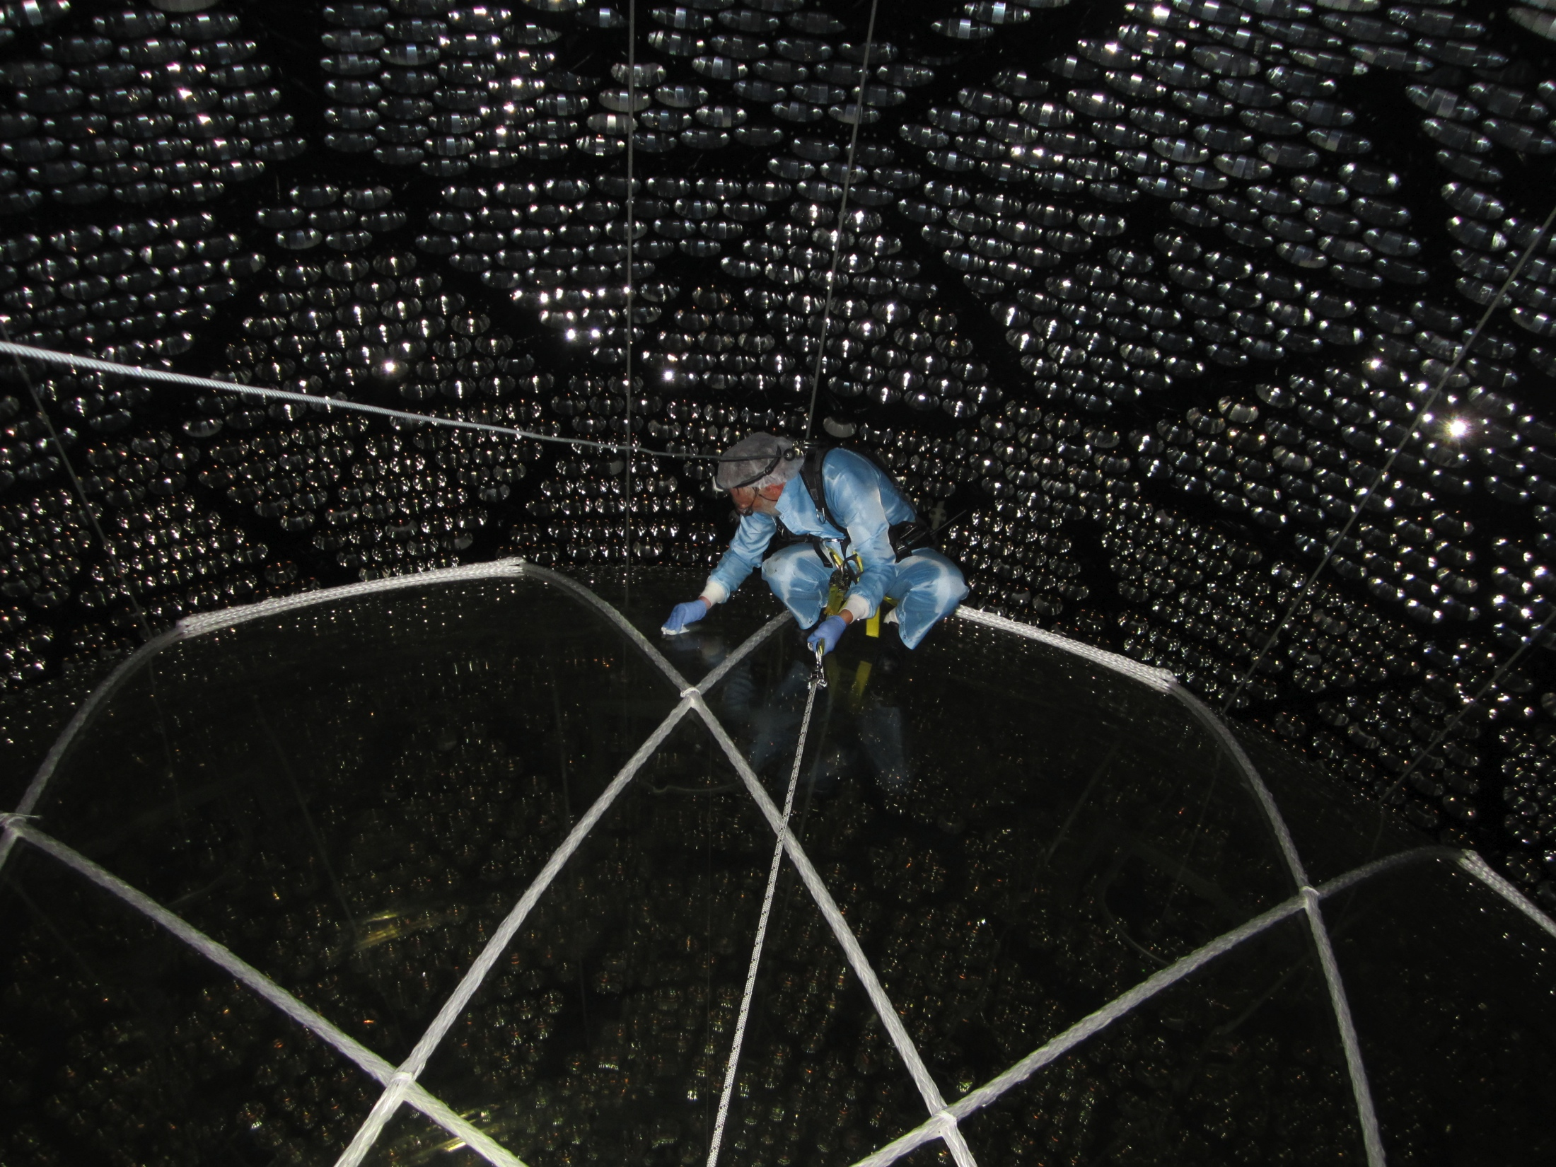
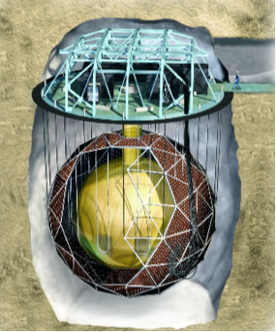

Slide 24
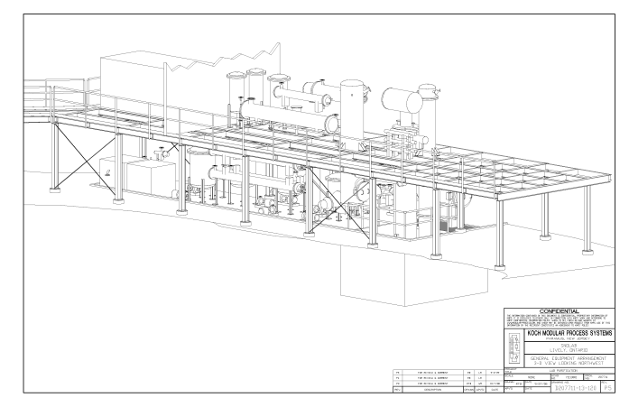
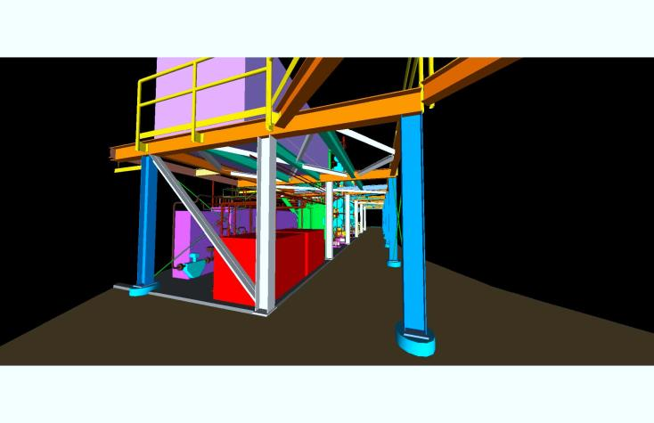
Liquid Scintillator Purification Plant
reinforce mezzanine steel
install columns, vessels, heat exchangers, tank, pumps, valves, high-grade sanitary piping (orbital-welded, electropolished stainless steel tubing)
utility plumbing (cooling water, compressed air, vent, boiloff nitrogen)
process control, wiring, instrumentation, electrical
firewalls, fire detection and suppression

Slide 25
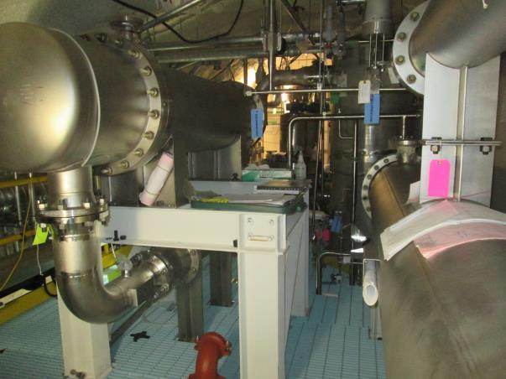
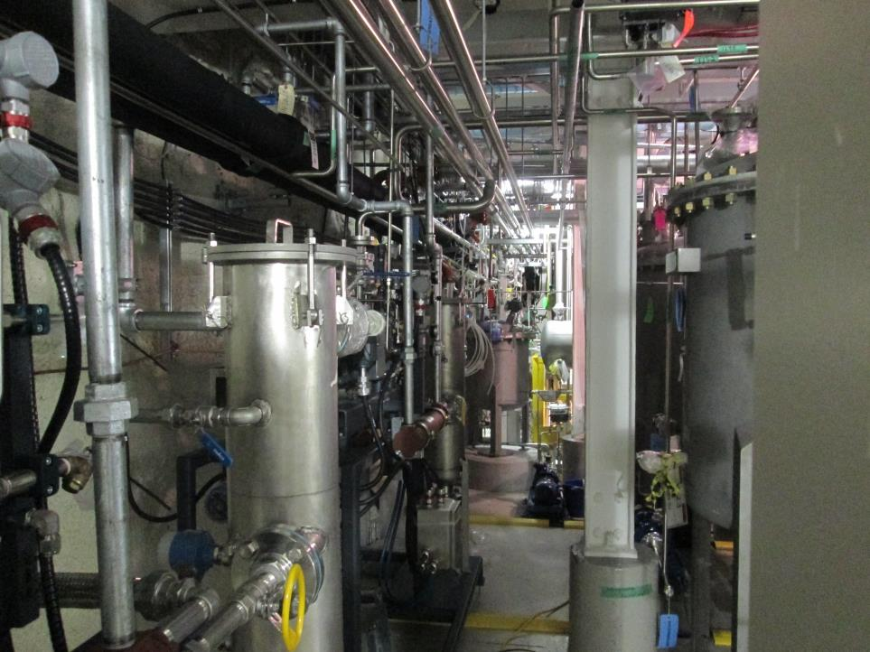

Slide 26
SNO+ Current Status
2016: Water fill of Cavity and Acrylic Vessel
May 2017: start of water “Physics” data taking
October 2018: started liquid scintillator operations
July 2019: initial fill of 20 tonnes | commissioning of scintillator purification plant
January-March 2020:
  most scintillator plant and fill problems resolved
  scintillator fill progressing well (at last!) – PAUSED by COVID-19
  partial fill (~50% filled or ~365 tonnes)
  “quiet” data – partial fill physics
October 2020-March 2021: resumption of fill
bulk AV fill completed March 27th, 2021!!
2019: Tellurium-loading plants built and installed
  commissioning the plants underway – delayed by COVID-19 – now completed
  next step: test batch and commissioning the process
  loading tellurium in the detector, then double beta decay search begins mid-end of next year

Slide 27
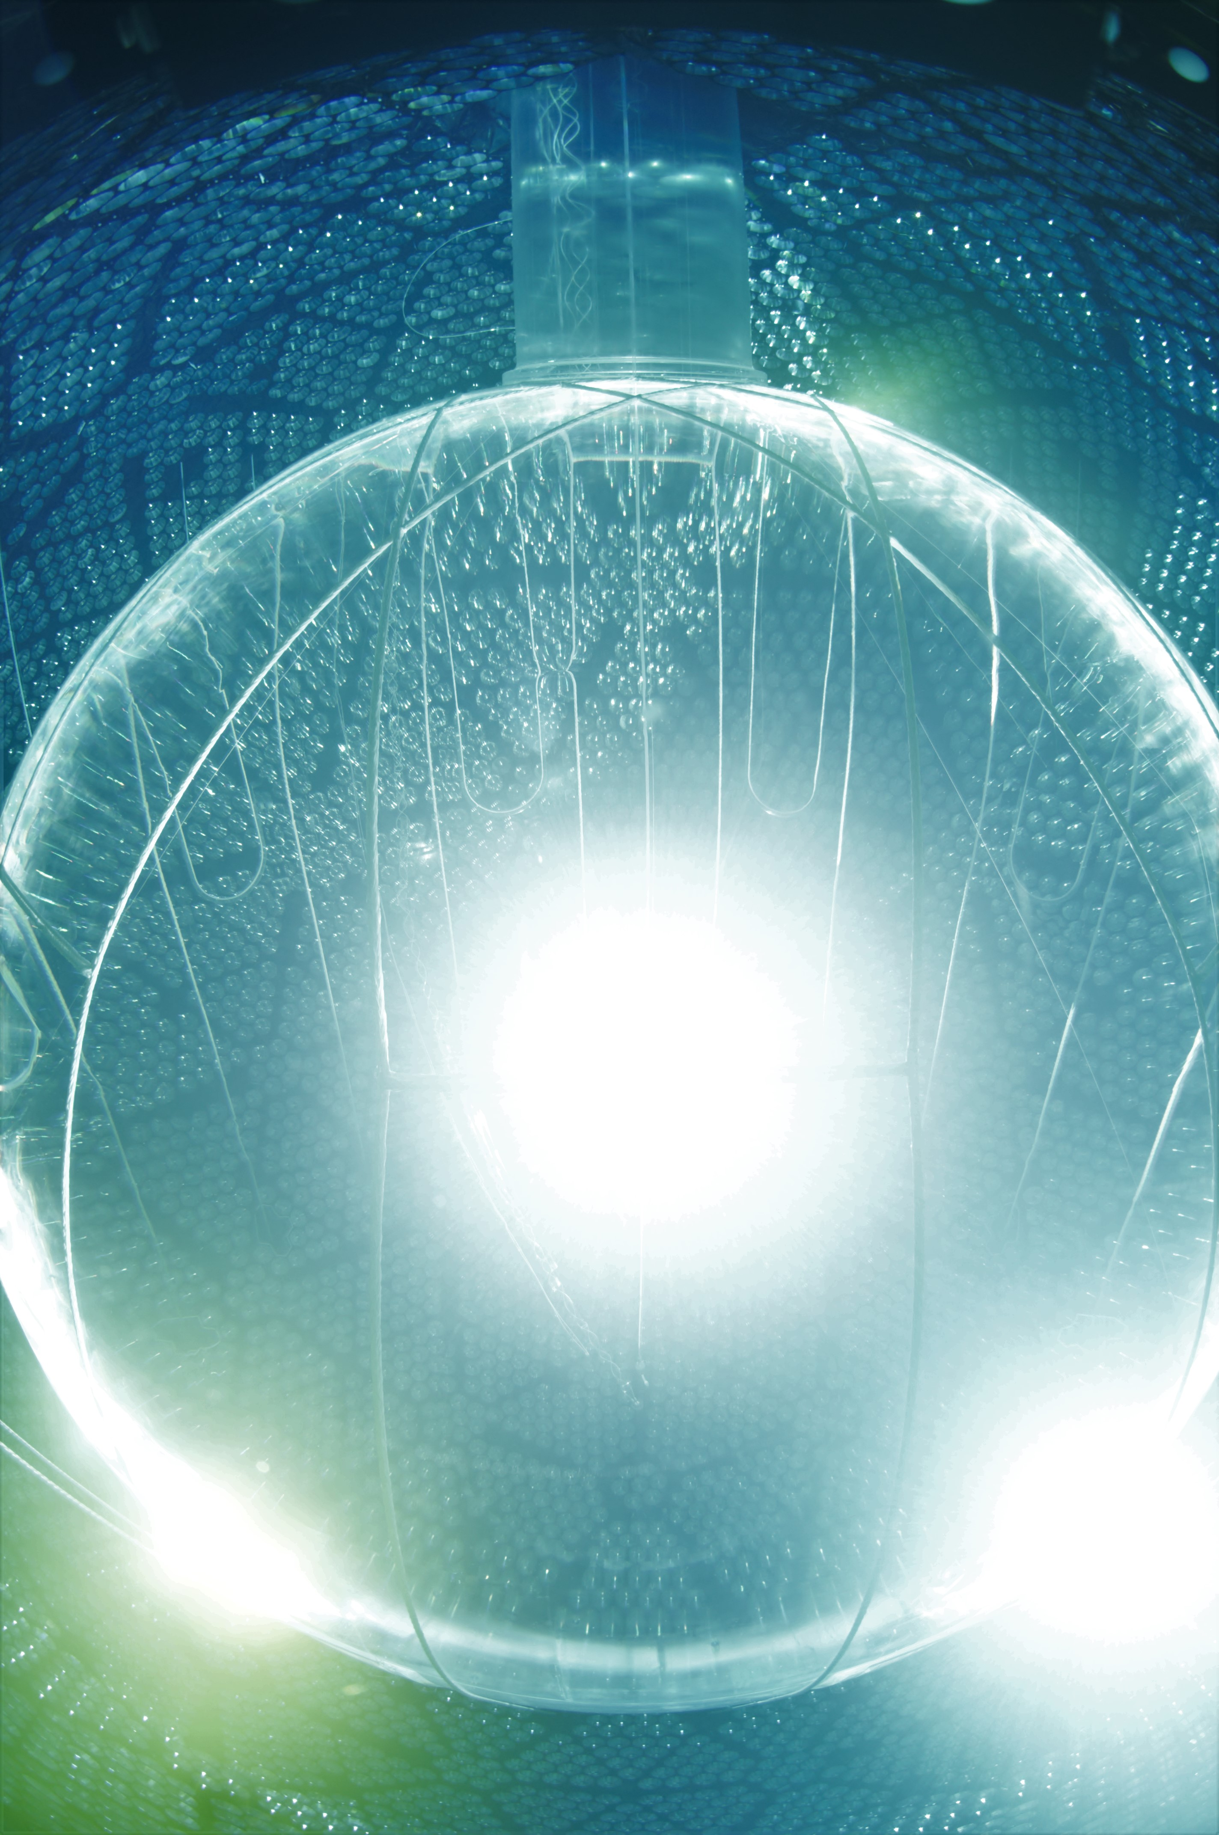

SNO+ Current Activities
analyze data from full AV fill
measure backgrounds
physics analysis – multiple topics!
plan and execute calibration procedure and campaign
ongoing scintillator plant operations (recirculation) on the AV
Te cocktail chemistry
prepare for Te process operations

Slide 28
Backup Slides

Slide 29
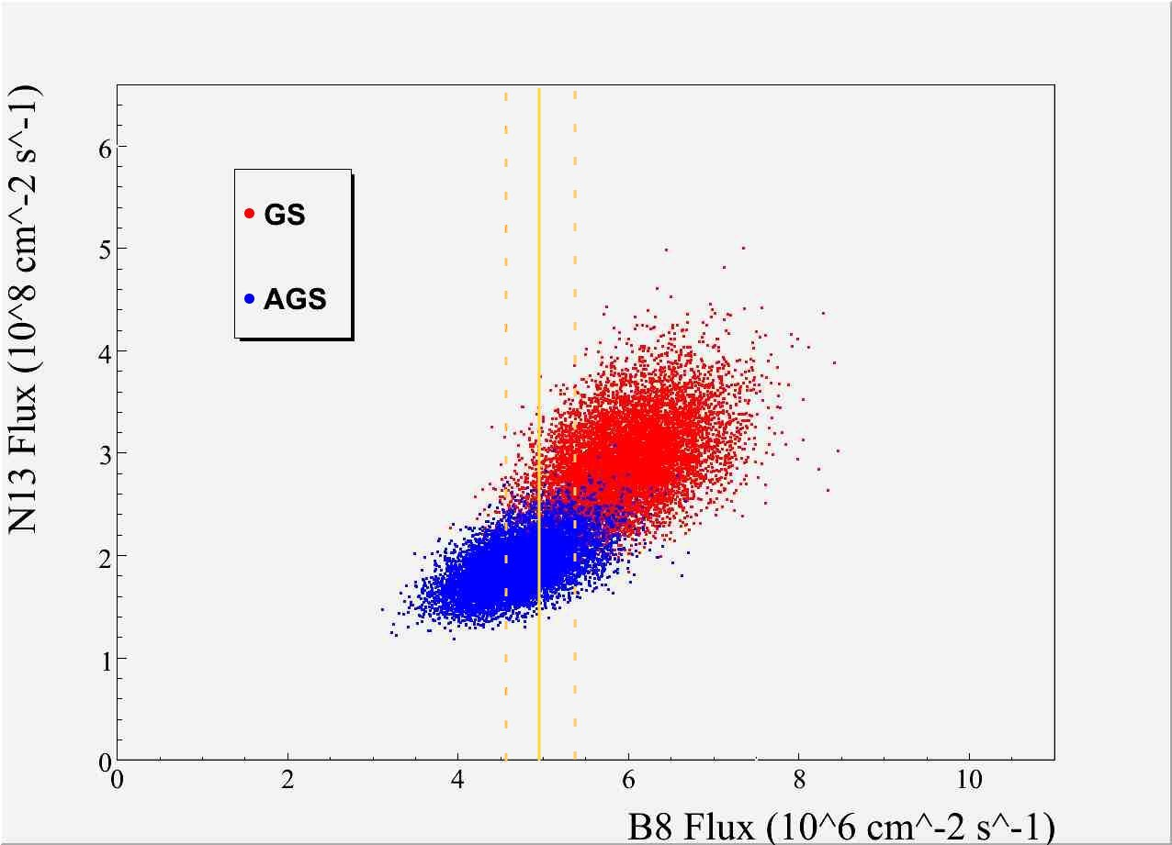
Solar Neutrinos
pep and CNO solar neutrinos
low energy ⁸B solar neutrinos
solar neutrino survival probability
solar metallicity with CNO neutrinos

Slide 30
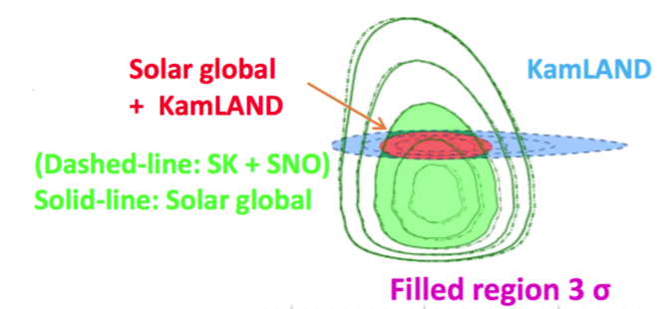
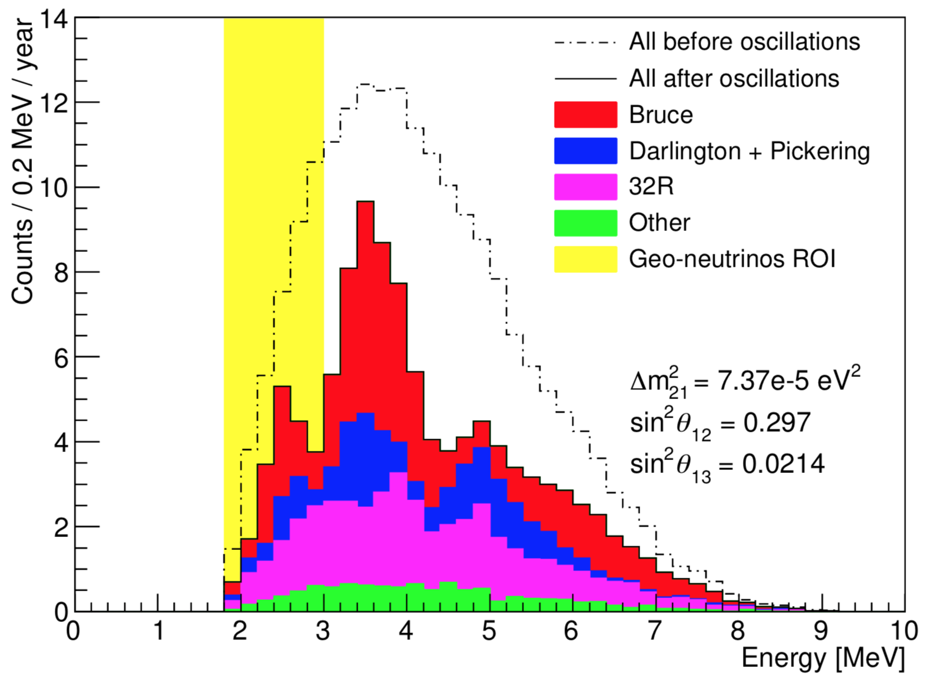
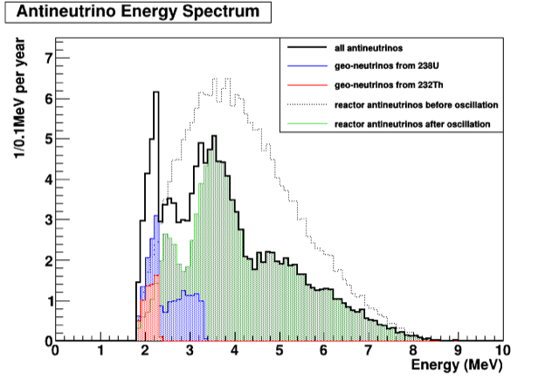
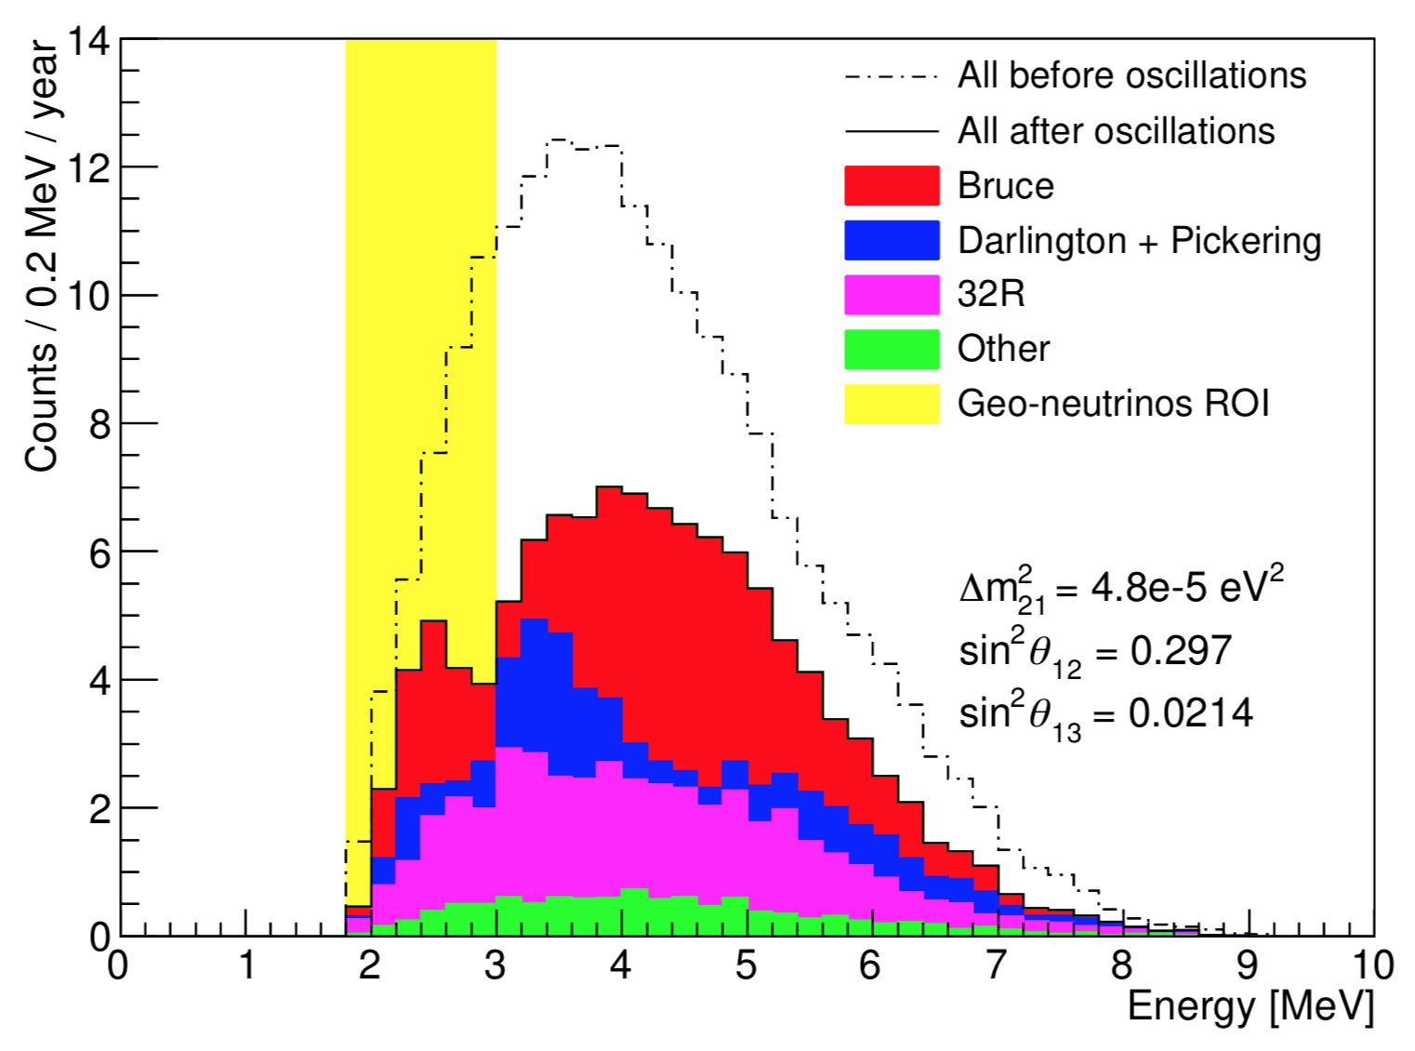
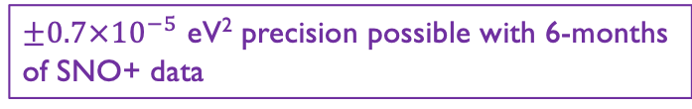
Antineutrinos – Geo and Reactor
$±0.7×{10}^{−5}$ eV² precision possible with 6-months
of SNO+ data
Geo Neutrinos in SNO+
In 6 months, a SNO+ measurement of Δm² from reactor antineutrinos achieves statistical uncertainty ±0.7e-5 eV²

