Slide 1
THE HIGH ENERGY (COSMIC) RADIATION DETECTION (HERD) ONBOARD CHINA’S SPACE STATION
V. Formato on behalf of the HERD international consortium
INFN – Sezione di Roma Tor Vergata 09/08/2022 TeVPA 2022

Slide 2
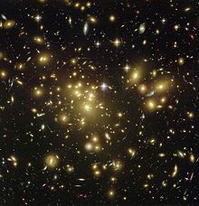
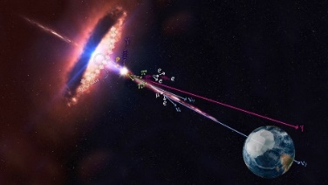
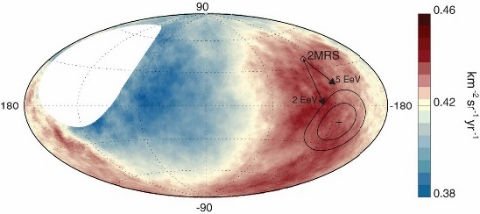
HERD: High Energy cosmic-Ray Detection: 2027?
HERD, as a space particle experiment and gamma ray observatory, is a China-led large international collaboration with key European contributions led by Italy.
One of the two flagship scientific experiments onboard China’s Space Station
Main Scientific Objectives:
  Dark matter: Indirect dark matter search with unprecedented sensitivity
  Cosmic-ray: Precise & direct cosmic ray spectrum and composition measurements up to the PeV energy
  Gamma-ray: Gamma-ray monitoring and full sky survey
PI: Shuang-Nan Zhang (IHEP); European PI: Giovanni Ambrosi (INFN)

Slide 3
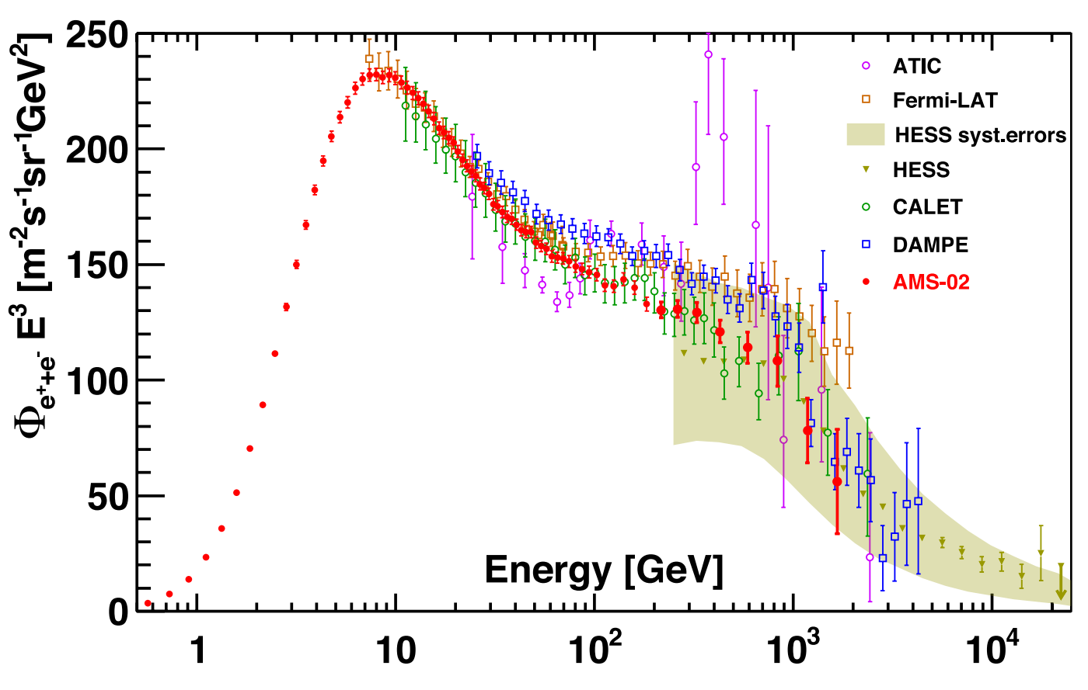
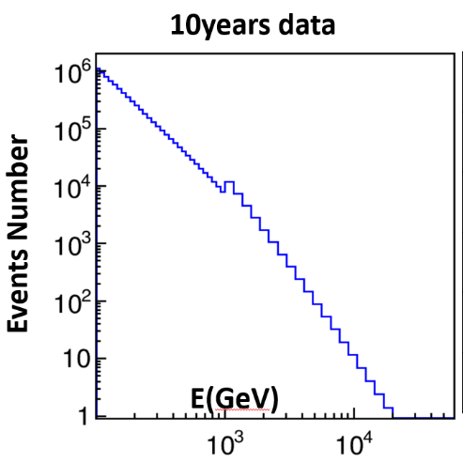
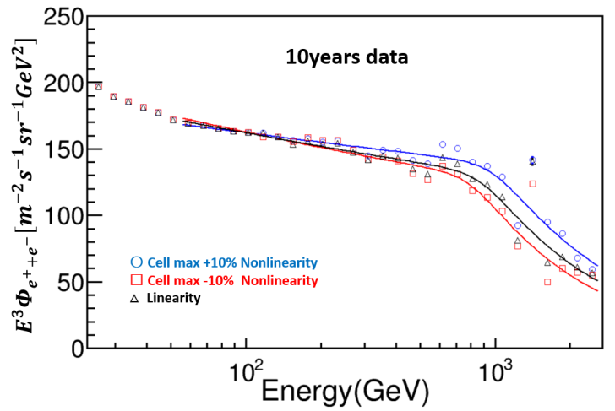
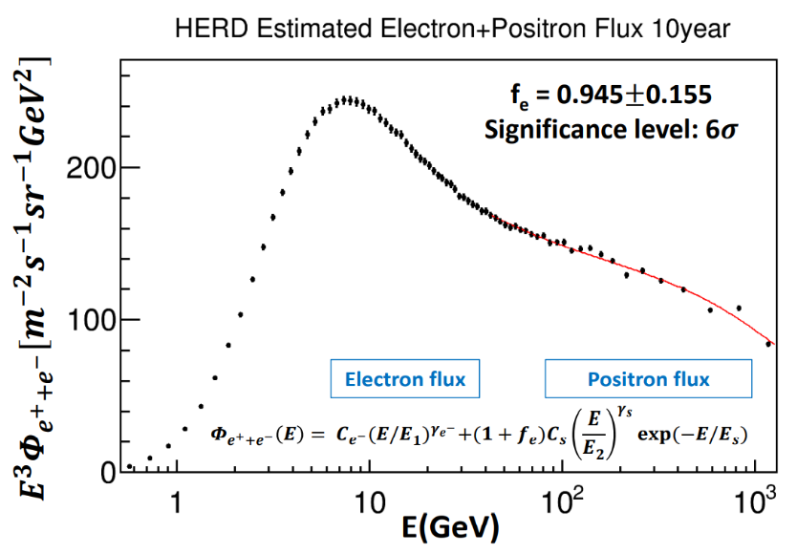
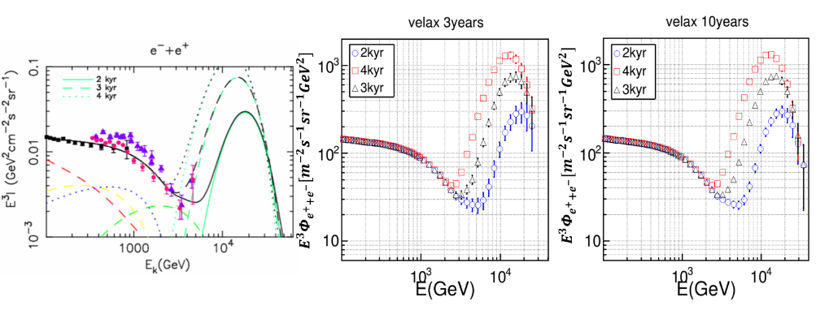
Direct measurement of cosmic electron spectrum
Check the spectrum break at TeV
Up to highest energy, ~15 TeV
Spectrum bump of HE electrons from nearby sources
Anisotropy of HE electrons from nearby sources
Examine the extra positron sources in AMS-02 spectrum

Slide 4
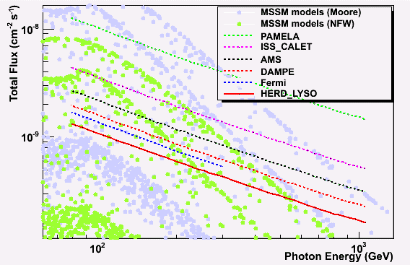
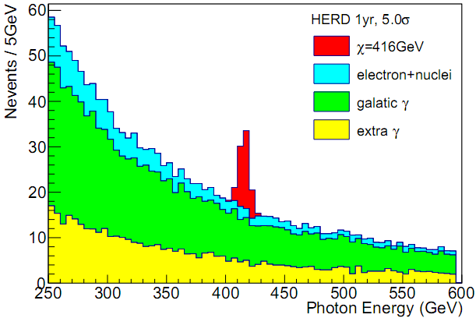
High sensitivity in dark matter search
HERD 1 yr
PAMELA: 2006-2016 CALET: 2015-2020; AMS: 2011-2024; DAMPE: 2015-2020; Fermi: 2008-2018; HERD: 2027-

Slide 5
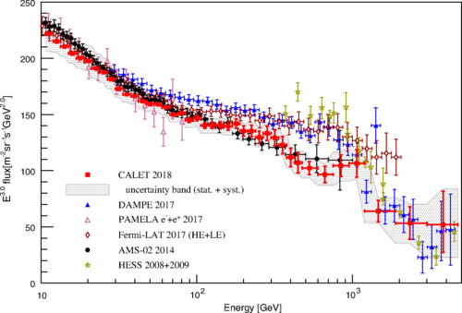
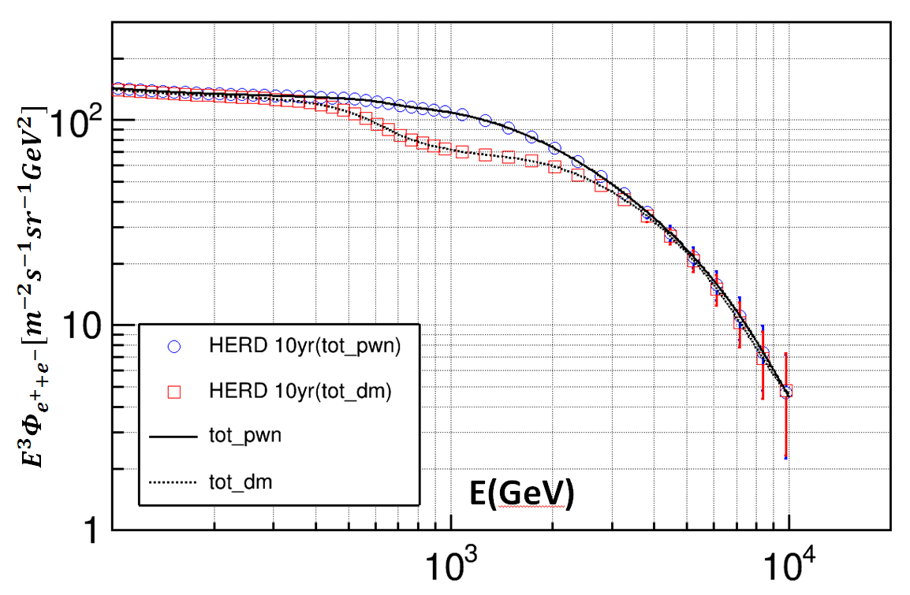
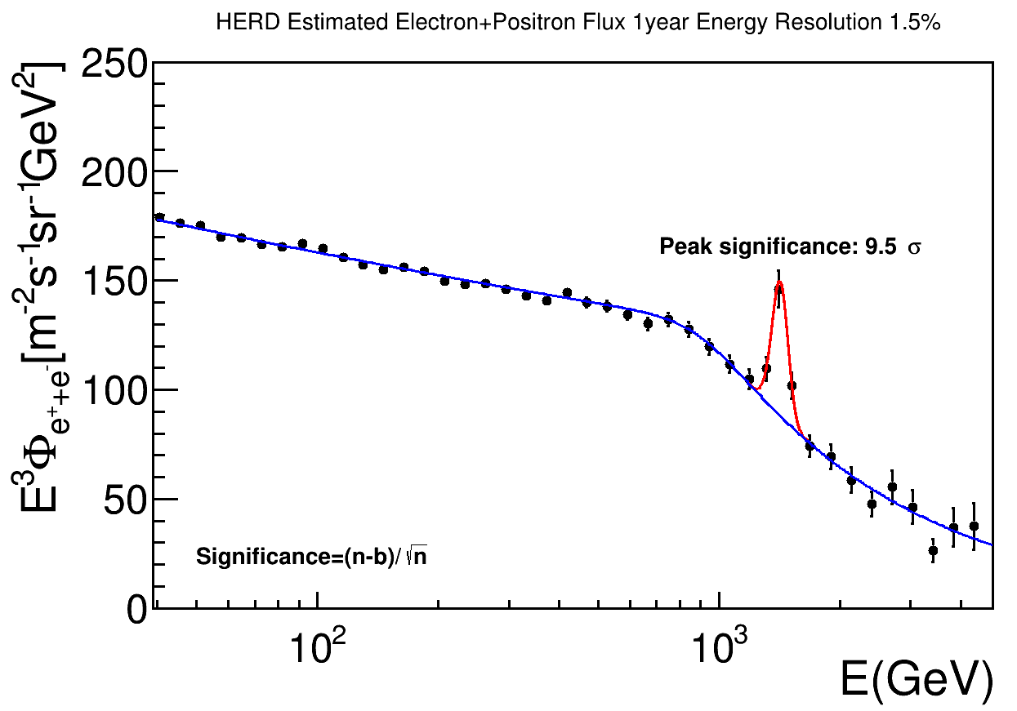
Dark matter signals?
Search the annihilation signals of dark matter particles
Peak at the DAMPE electron spectrum

Slide 6
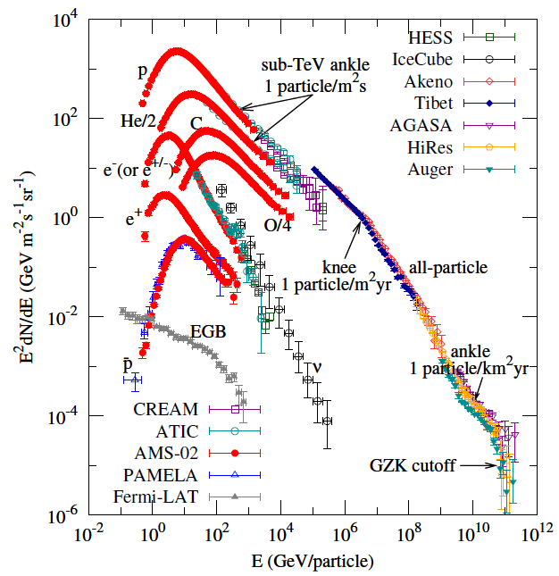
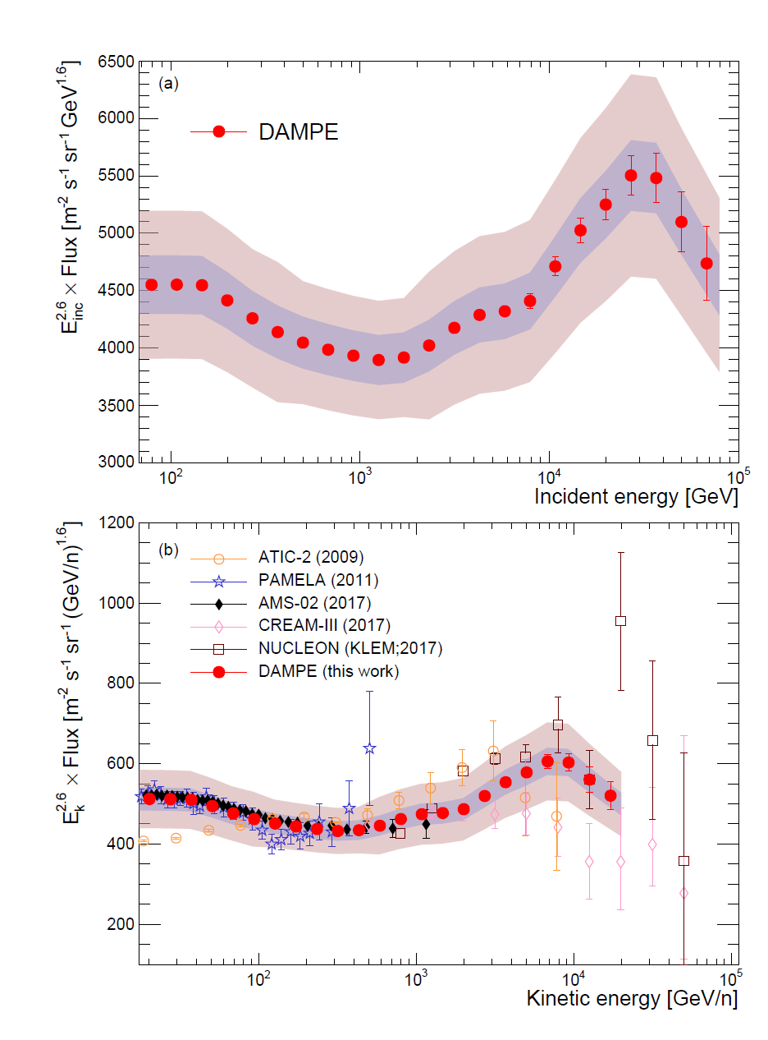
Origin of cosmic rays
PRL 126, 201102
Ground acce. limit
Ground meas.
Softening @ 34 TeV
Space meas.

Slide 7
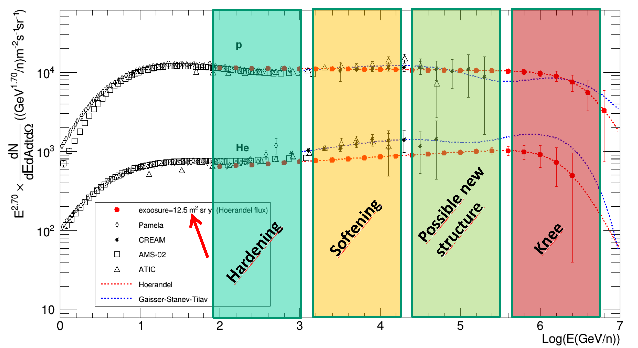
HERD Proton & He Spectra (5 year, Hoerandel fluxes)
1st single experiment to detect all key features: Hardening, Softening, Possible new structure, Knee

Slide 8
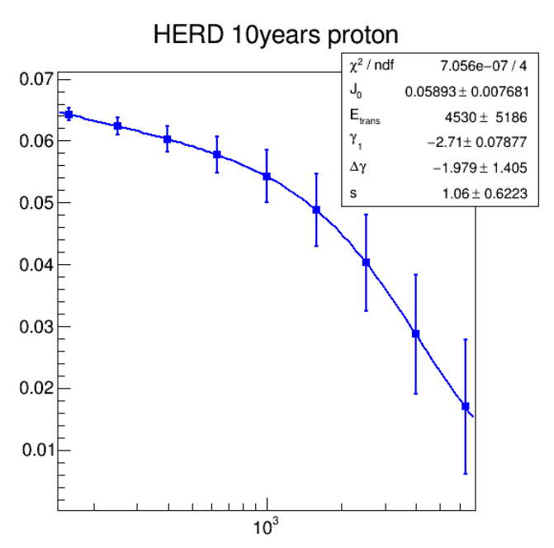
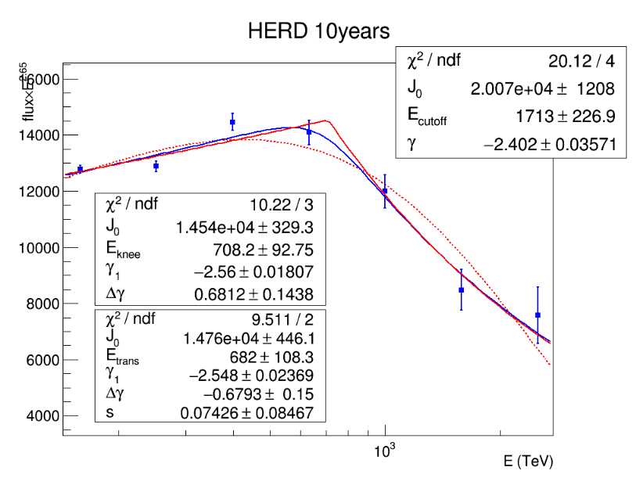
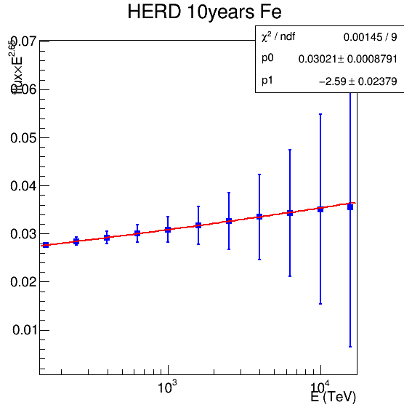
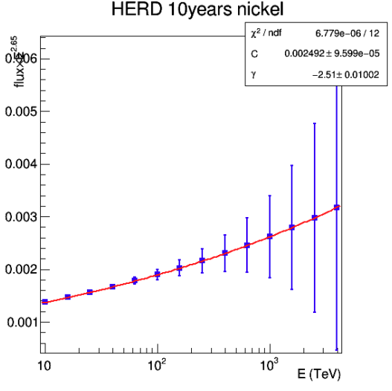
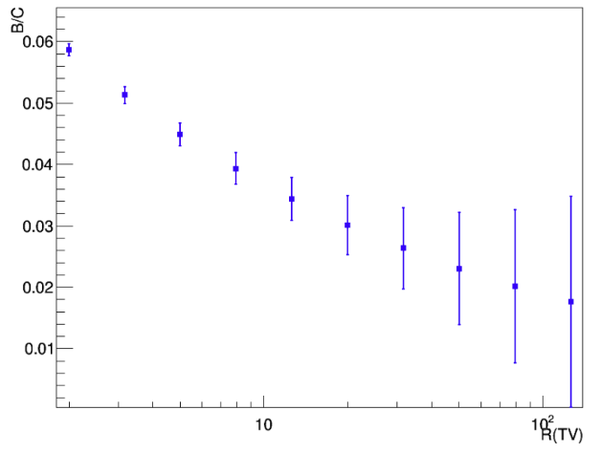
Expected CR spectral details
P+He
First direct measurement of CR “knee”
Nuclei up to Ni
Up to 8PeV
Up to 20PeV
Up to 5PeV
B/C ratio

Slide 9

Gamma ray monitoring & survey
Largest FoV for monitoring and sky survey
Multi-messenger astronomy
New multi-messenger astronomy
HERD

Slide 10
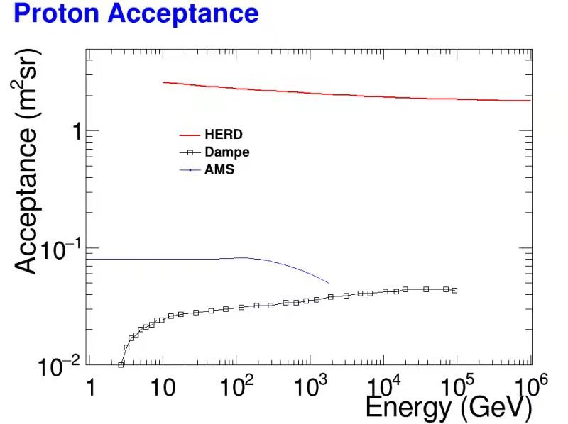
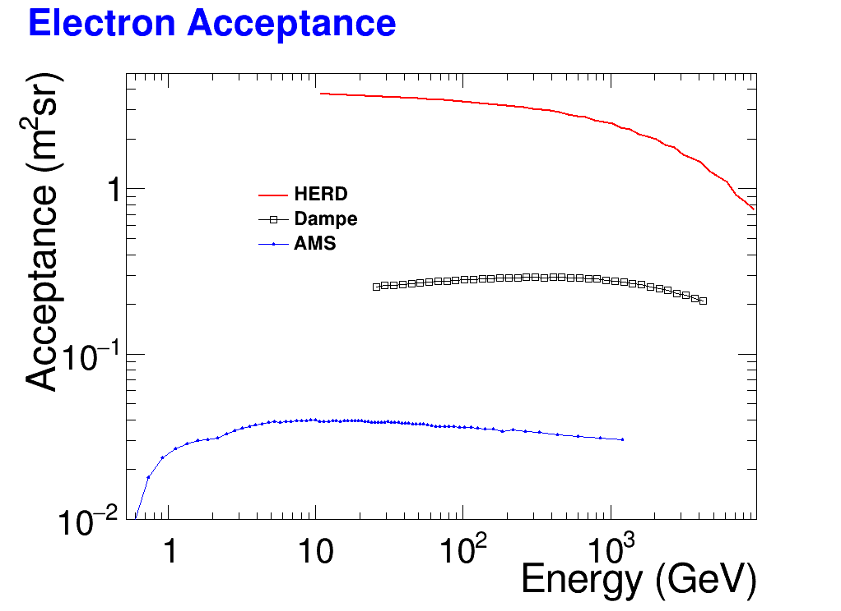
Acceptance comparison

Slide 11
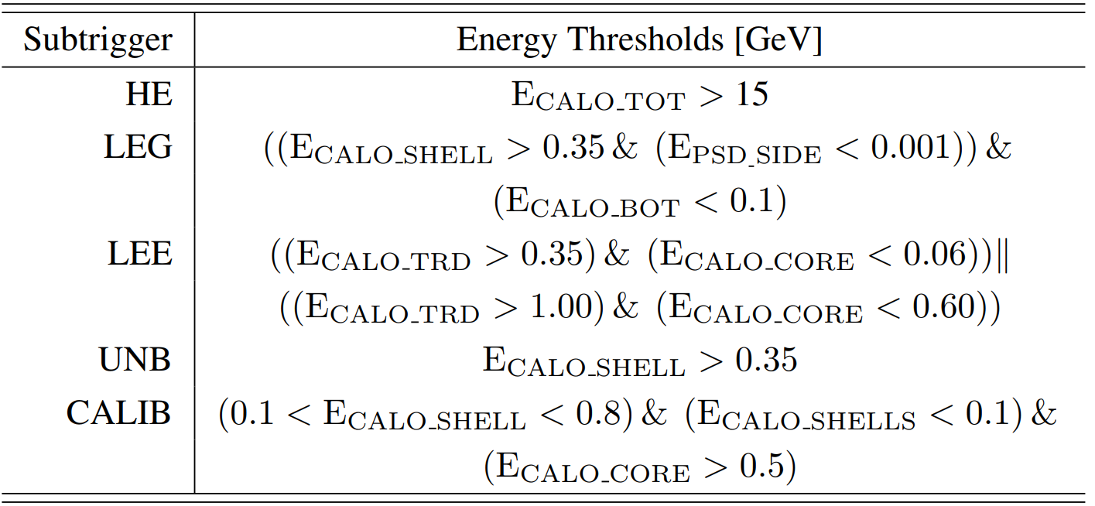
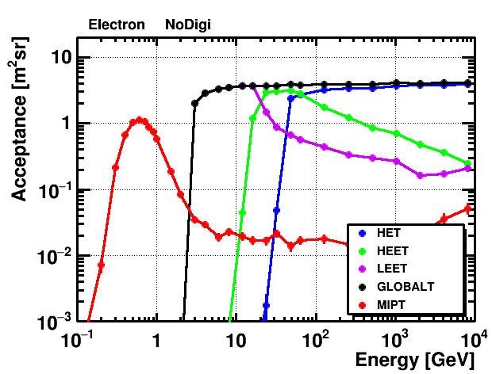
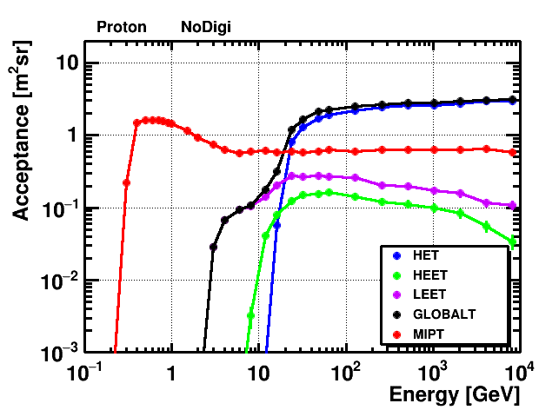
Onboard Trigger strategy
Optimization ongoing: LEG (~100MeV), LE & High Z (~GeV)
Baseline design
Advanced design

Slide 12
HERD vs. other experiments
Experiment (time) | Energy (e/γ) | Energy (p) | ∆E/E (e/γ) | ∆E/E (p) | e/p ID | e accep. m²sr | p accep. m²sr
FERMI (2008) | 1GeV-300GeV | 30GeV-10TeV | 10% | 40% | 10³ | 0.9 | <0.28
ISS-AMS02 (2011) | 1GeV-1TeV | 1GeV-1.8TeV | 2% | - | 10⁶ | 0.12 | 0.12
ISS-CALET (2015) | 1GeV-10TeV | 50GeV-10TeV | 2% | 35% | 10⁵ | 0.12 | --
DAMPE (2015) | 5GeV-10TeV | 40GeV-100TeV | ≤1.5% | 25-35% | 3*10⁴ | 0.3 | 0.04
HERD (~2027) | 10GeV-100TeV 0.5GeV-100TeV (γ) | 30GeV-PeV | 1% | 20% | 10⁶ | >3 (10X DAMPE) | >2 (50X DAMPE)
HERD is a next generation experiment, following AMS02 and DAMPE, with much better performance on direct high energy e, p, gamma-ray detection.

Slide 13
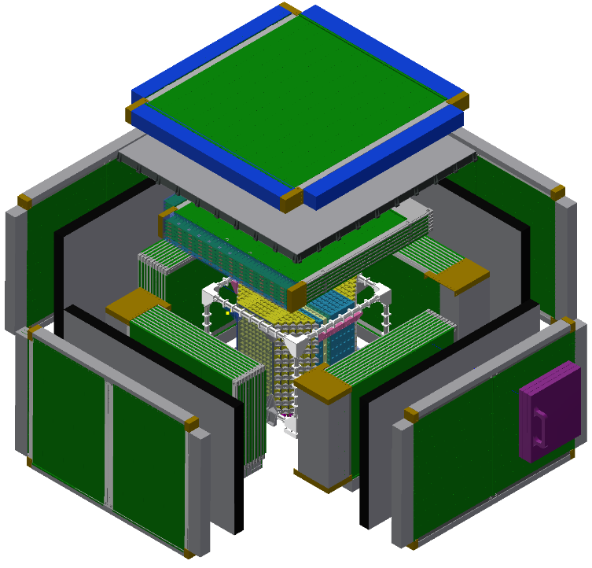
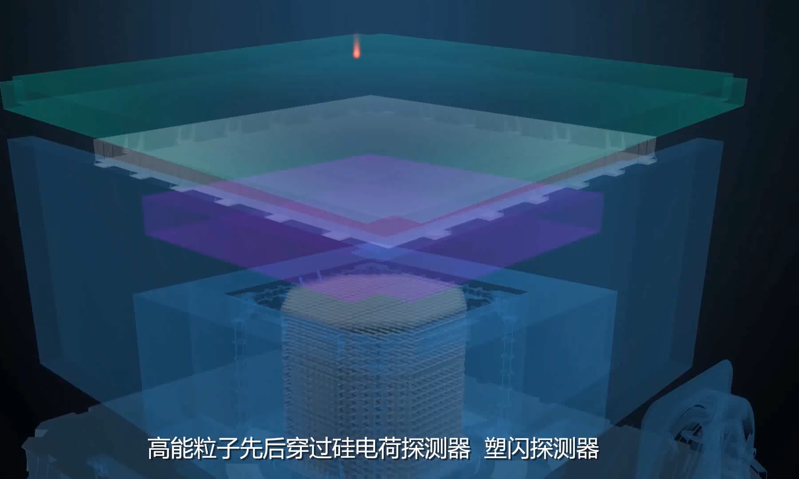




HERD payload
SCD
Z measurement
PSD
Gamma ID.
Z measurement
FIT
Tracking
Gamma conv.
Energy range (e/γ) | 10 GeV - 100 TeV (e); 0.5 GeV - 100 TeV (γ)
Energy range (CR) | 30 GeV - 3 PeV
Angular resolution | 0.1 deg.@10 GeV
Charge resolution | 0.1-0.15 c.u
Energy resolution (e) | 1%@200 GeV
Energy resolution (p) | 20%@100 GeV – PeV
e/p separation | ~10⁻⁶
G.F. (e) | >3 m²sr@200 GeV
G.F. (p) | >2 m²sr@100 TeV
TRD
TeV nuclei calibration
CALO
Energy measurement
Particle ID
Mass: ≤4000 kg
Envelope: ~3.0*2.3*1.7 m³
FoV: +/-90º
Power: ~1900 W
Telemetry: 100 Mbps
Lifetime: >10 years

Slide 14
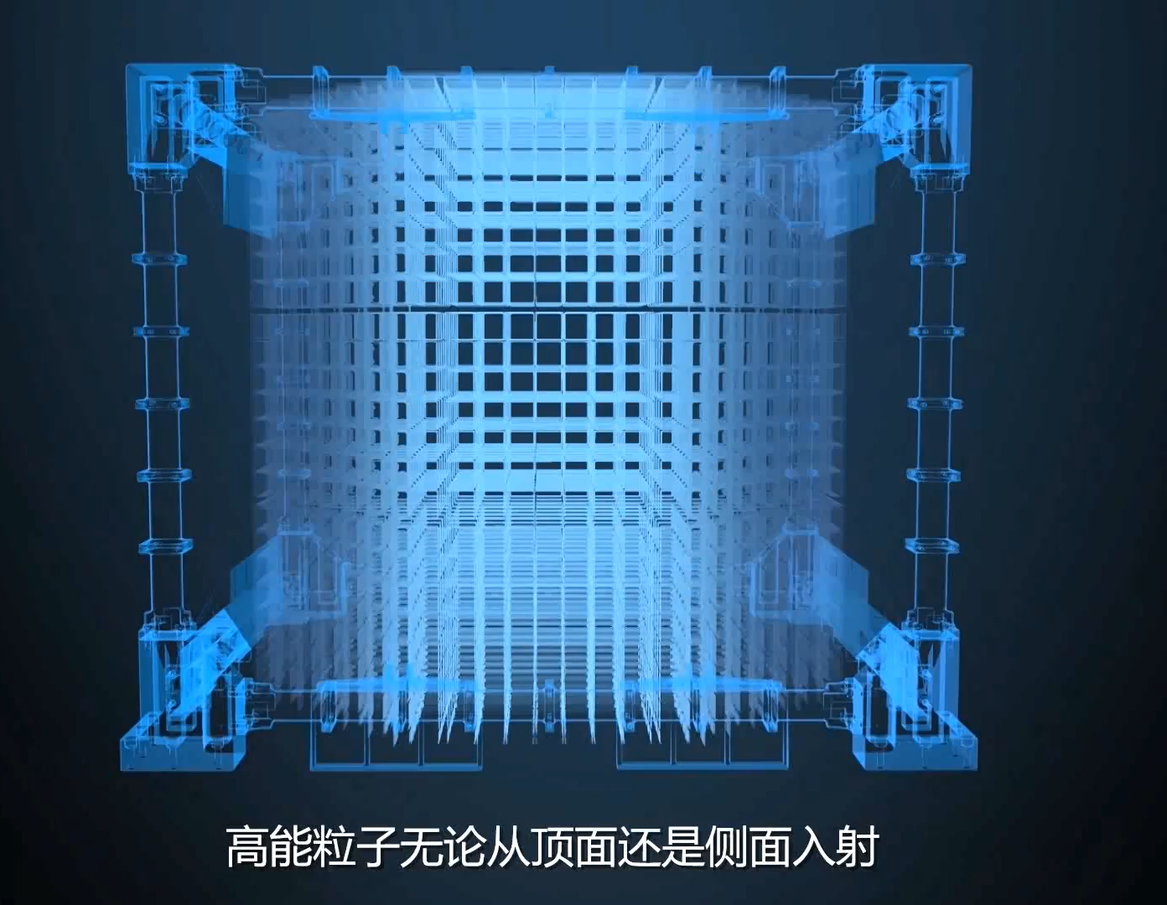
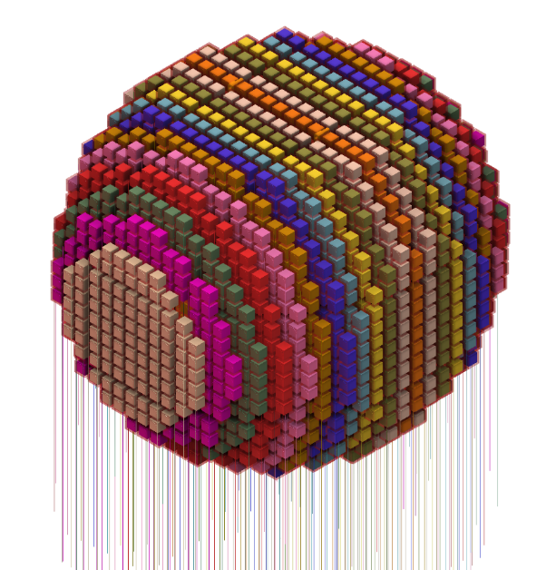
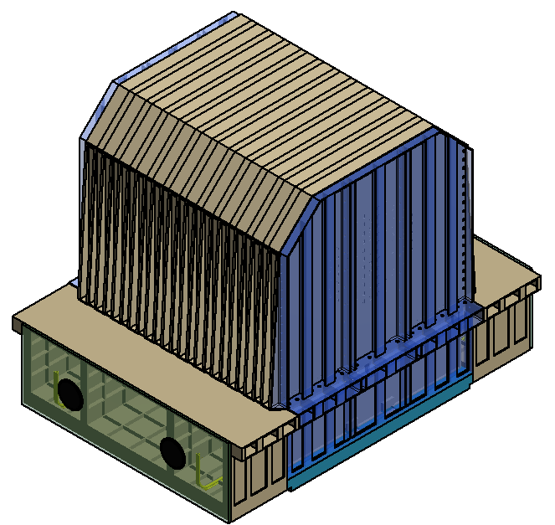
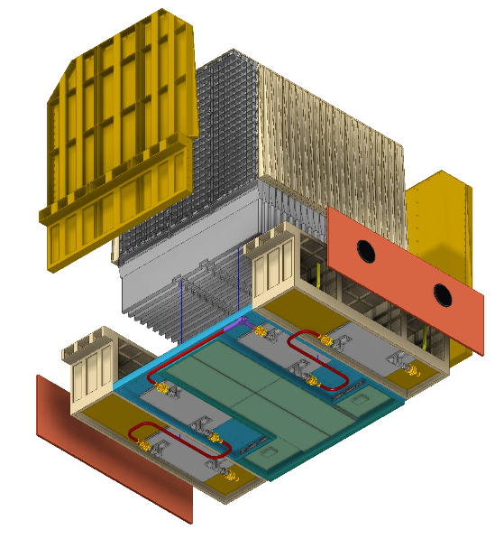
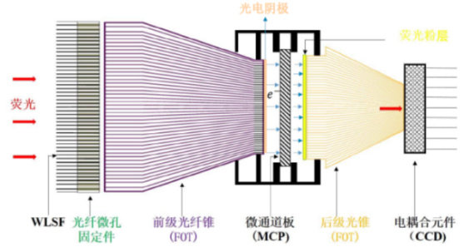
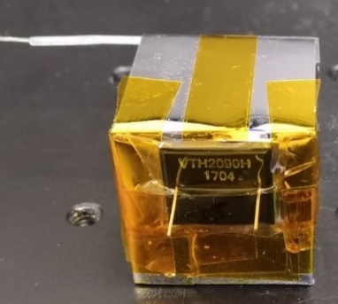
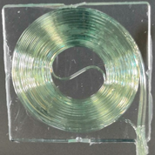
CALOrimeter
China, Italy
CALOrimeter (3 N.I.L. and 55 R.L.)
  ~7500 LYSO crystals
From octagon to sphere. +8% acceptance
Crystal array
Trigger interface
Camera interface
Trigger system
IsCMOS camera
IsCMOS camera
PD SYSTEM

Slide 15
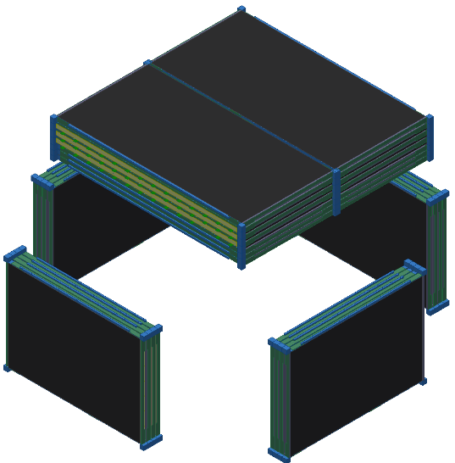
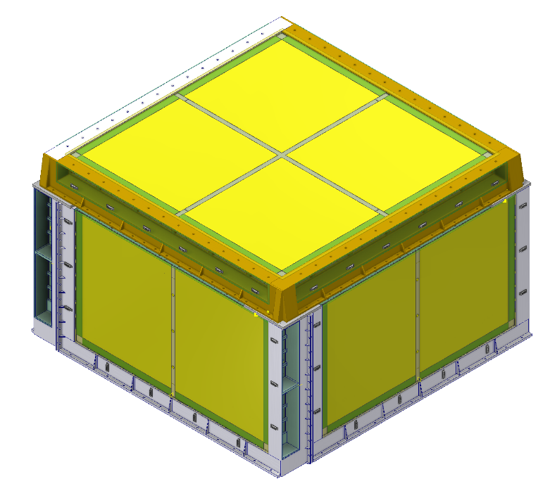
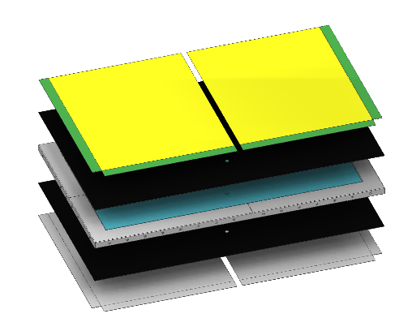
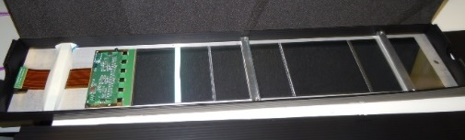
Silicon Charge Detector (SCD)
Italy, China
Charge measurement
Features of SCD
  Located at outmost to avoid ion fragmentation
  Large detection area
  Z =1 to 28
10 SSDs at most bonded in a row
Customized SSD for large dynamic range
Customized ASIC for large dynamic range
INFN Perugia, INFN Torino, IHEP, PMO, etc
Silicon ladder

Slide 16
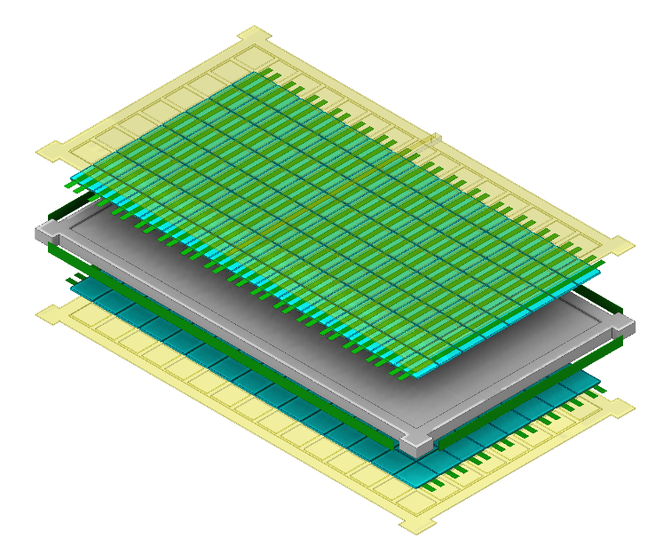
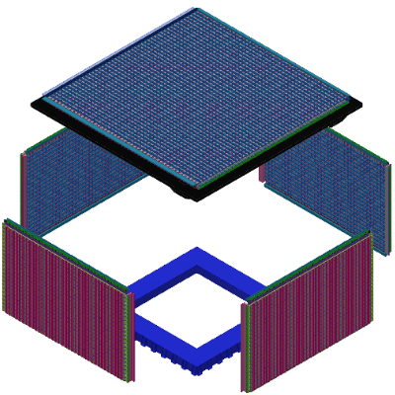
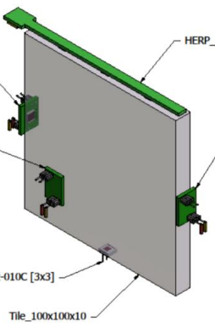
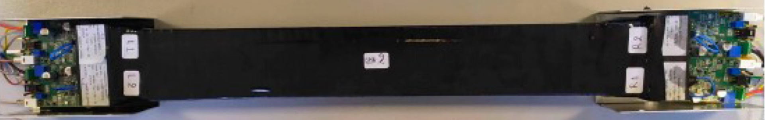
Plastic Scintillation Detector (PSD)
Italy, Spain, China
Gamma-ray ID.
Charge measurement
Basic requirements
  Full coverage of CALO for LEG trigger
  Fast veto signal within 200ns
Geometry of detection unit: Bar and/or tile
  To reduce impact of backsplash effect
PS readout by SiPMs
INFN Bari, INFN Pavia, INFN Lecce, GSSI & INFN-LNGS, ICCUB, IHEP, etc.
塑闪长条双端读出，每端4片SiPM

Slide 17
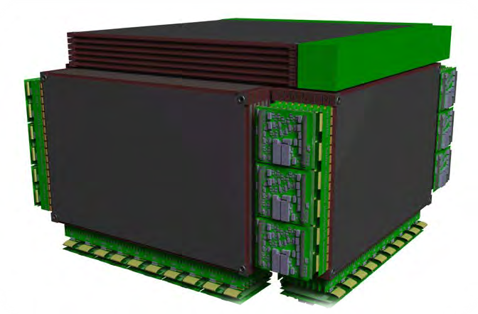
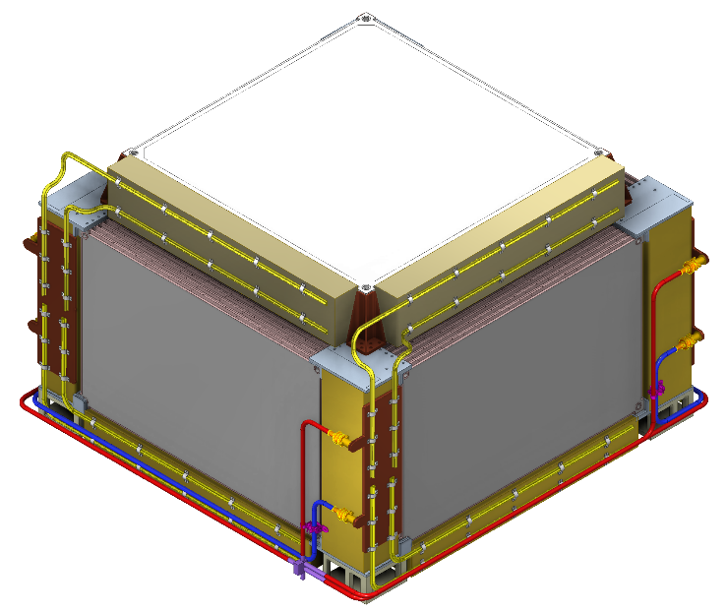
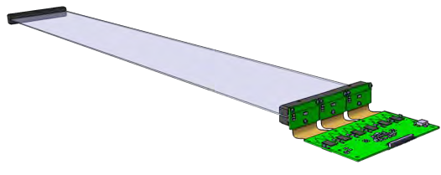
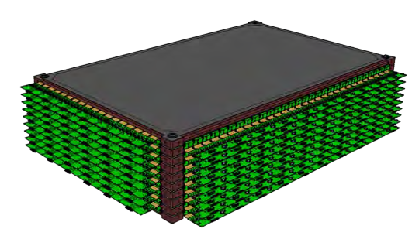
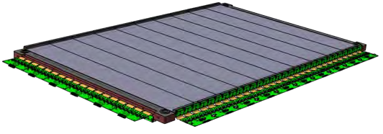
FIber Tracker (FIT)
Switzerland, Spain
Tracking
Charge measurement
Heritage of FIT
  Based on LHCb & Mu3e technology
  Robust design for high coverage ratio
Diameter of scintillator fiber:~250um
FIBER MAT is readout by SiPMs
Univ. of Geneva, EPFL, ICCUB
FIBER MAT

Slide 18
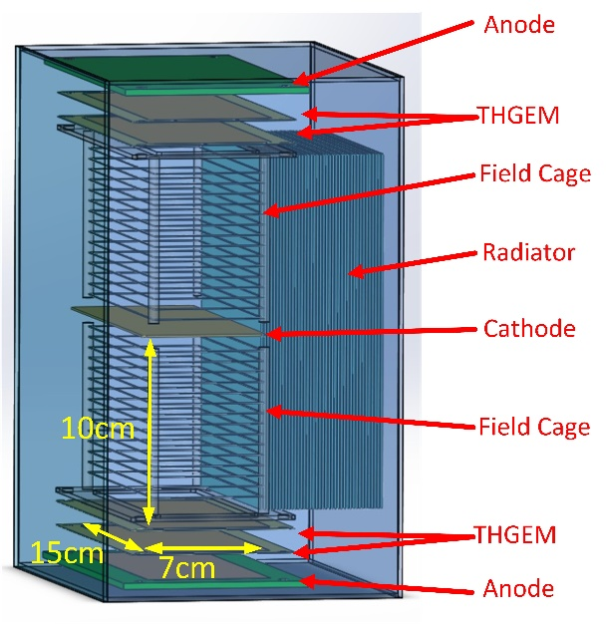
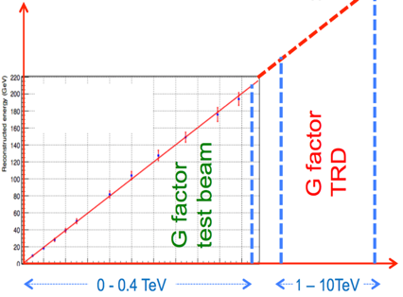



Transition Radiation Detector (TRD)
China
Energy calibration of TeV nuclei
Ground
Radiator: multi-layer thin foils
Detector:
1 atm Xe
side-on THGEM
Space
MIP
TR
Beam test result
MWPC energy response to [2.25, 2.5] TeV protons
2 months simulated observation, ~6300cm² .

Slide 19








Joint study of key fermance of HERD detectors
4 rounds of CERN beam tests were carried out.
1.3%@200GeV e-
21.0%@400GeV proton
CALO prototype (500 LYSO)
Silicon strips + new ASIC can measure Z>16
TR signals clearly seen
e/p separation 5e4@90% effi.
HERD prototypes at CERN

Slide 20


HERD consortium
The HERD consortium includes 180+ scientists from China and Europe.
  Most of the members have been collaborating on previous high energy experiments in science and hardware development.
8 HERD international workshops have been organized in China and Europe since 2012.
4 CERN beam tests on HERD prototypes have been successfully implemented by Chinese and European colleagues.
Managing structure: Institution Leaders Board; Technical Executive Board; Publication Board
Joint working group: Hardware (CALO, SCD, PSD); Software (trigger, performance, CALOSW)
 | Participating institutions
Payload Module | IHEP
CALO | IHEP, XIOPM, INFN Florence, CIEMAT
SCD | INFN Perugia, INFN Roma2, etc
FIT | Univ. of Geneva, EPFL, ICCUB
PSD | INFN Bari, INFN Pavia, INFN Lecce, GSSI & INFN-LNGS, IHEP
TRD | Guangxi Univ.
Ground calibration | IHEP, Guangxi Univ., INFN sections, Univ. of Geneva, CERN
Science center | IHEP, SDU, SSDC & INFN-CNAF (Italy), ISDC (Switzerland)
Sciences | IHEP, PMO, USTC, YNO, NAOC, SDU, GXU, TSU, PKU, NJU, YNU, SWJTU, HKU, Academia Sinica, and institutions from Italy, Switzerland, Spain, Germany, Denmark, Sweden, Russia, etc.

Slide 21



General progress
HERD will be launched and installed on CSS in 2027
Successfully reviewed and highly ranked by CMSA in 2021
A joint technical working team from CSU and IHEP is working on general design at payload level, including interfaces with and installation on CSS
  Conceptual layout design with ergonomics consideration
  Preliminary mechanical design, thermal control, electronics, data processing
  Payload AIT (preliminary)
  Study of key technologies and specifications, to be completed before 2023
Star tracker*2
TRD
Trigger
SCD&SCD Ebox *4

Slide 22









































We are looking forward to HERD in space!
China Manned Space
engineering program
Many thanks for your attention!

