Slide 1
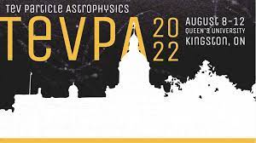

Faint light of old neutron stars from dark matter capture and detectability at the James Webb Space Telescope (JWST)
Shiuli Chatterjee
CHEP, Indian Institute of Science shiulic@iisc.ac.in
based on
  “Faint light of old neutron stars from dark matter capture and detectability at the
  James Webb Space Telescope”
  SC, Raghuveer Garani, Rajeev K. Jain, Brijesh Kanodia, M.S.N. Kumar, Sudhir K. Vempati (arXiv: 2205.05048 [astro-ph.HE])
TeV Particle Astrophysics 2022
August 11

Slide 2
Overview:
How can old Neutron Stars (NS) be probes for Dark Matter (DM)
Goodness of probe:
    Uncertainties that affect surface temperatures
    Maximal heating and detectability at the James Webb Space Telescope (JWST)
Results and Summary

Slide 3
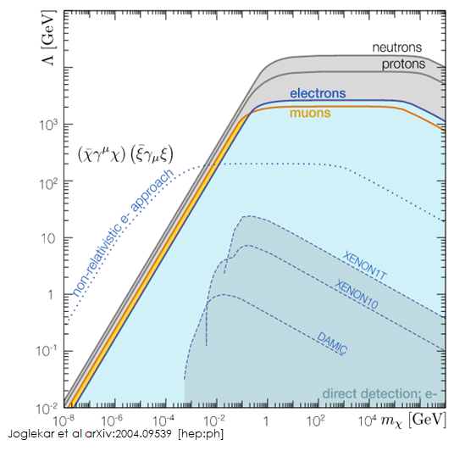
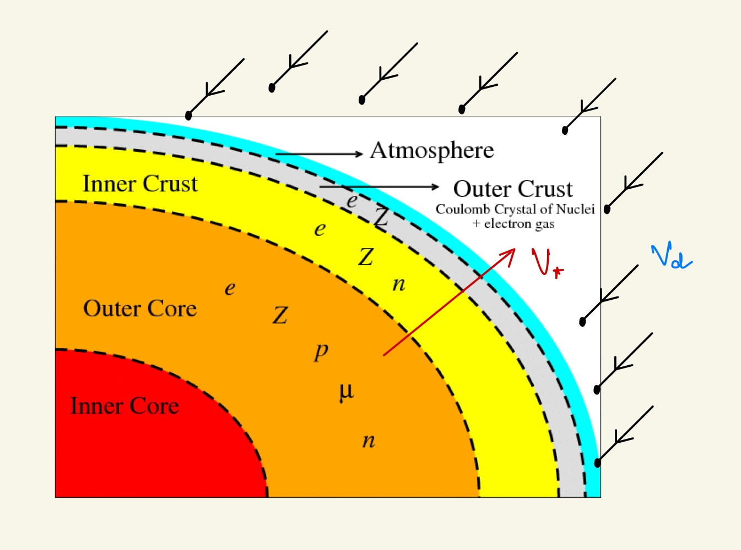
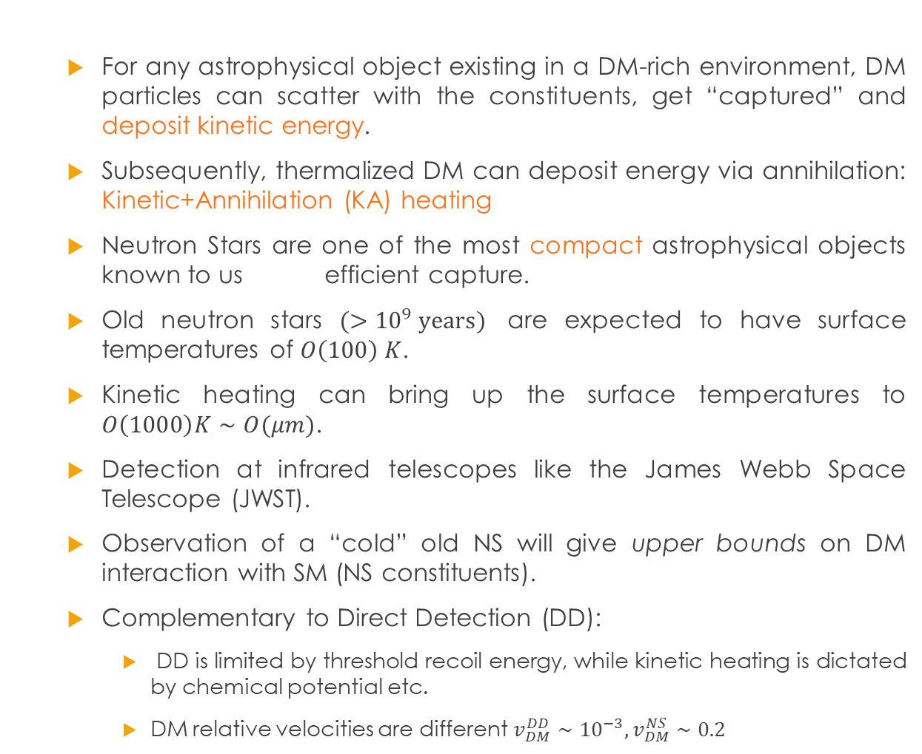
Neutron Star Heating from DM: DM Probe
  For any astrophysical object existing in a DM-rich environment, DM particles can scatter with the constituents, get “captured” and deposit kinetic energy.
  Subsequently, thermalized DM can deposit energy via annihilation: Kinetic+Annihilation (KA) heating
  Neutron Stars are one of the most compact astrophysical objects known to us efficient capture.
  Old neutron stars $(>{10}^{9} years)$ are expected to have surface temperatures of $O\left(100\right) K$.
  Kinetic heating can bring up the surface temperatures to $O\left(1000\right)K∼O(μm)$.
  Detection at infrared telescopes like the James Webb Space Telescope (JWST).
  Observation of a “cold” old NS will give upper bounds on DM interaction with SM (NS constituents).
  Complementary to Direct Detection (DD):
    DD is limited by threshold recoil energy, while kinetic heating is dictated by chemical potential etc.
    DM relative velocities are different $v_{DM}^{DD}∼{10}^{−3}, v_{DM}^{NS}∼0.2$
Baryakhtar et al arXiv:1704.01577 [hep-ph]
Garani et al arXiv: 1906.10145 [hep-ph]
Bell et al: arXiv: 1904.09803 [hep-ph]
Joglekar et al arXiv:2004.09539 [hep-ph]
Baryakhtar et al arXiv: 2203.07984v2 [hep-ph]

Slide 4
Neutron Stars as Dark Matter Probes
  The extent of heating of a NS from DM scattering and annihilation depends on:
    DM model
    Equation of State of the Neutron star: NS mass and radius and radial profile of scattering target in the NS
    Astrophysical: Ambient DM distribution (energy density and dispersion velocity) and velocity of the NS

Slide 5
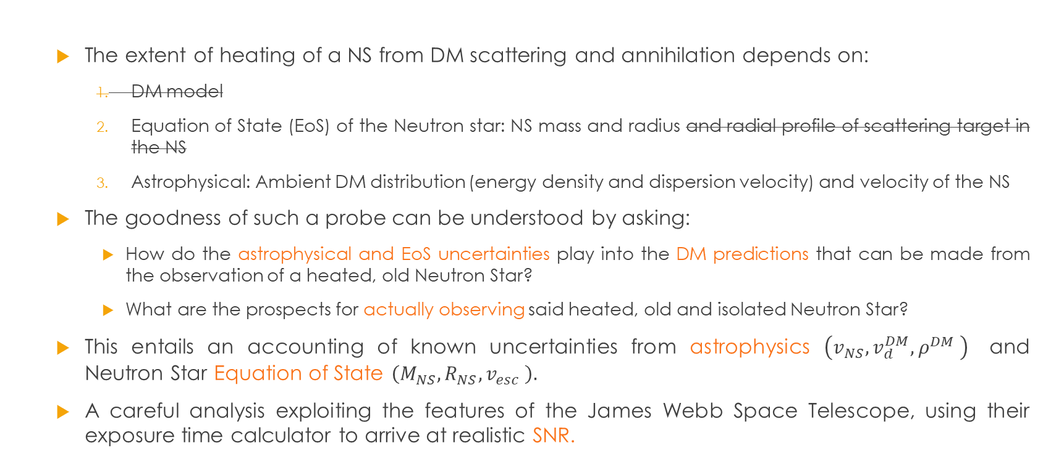
Neutron Stars as Dark Matter Probes
  The extent of heating of a NS from DM scattering and annihilation depends on:
    DM model
    Equation of State (EoS) of the Neutron star: NS mass and radius and radial profile of scattering target in the NS
    Astrophysical: Ambient DM distribution (energy density and dispersion velocity) and velocity of the NS
  The goodness of such a probe can be understood by asking:
    How do the astrophysical and EoS uncertainties play into the DM predictions that can be made from the observation of a heated, old Neutron Star?
    What are the prospects for actually observing said heated, old and isolated Neutron Star?
  This entails an accounting of known uncertainties from astrophysics $\left(v_{NS},v_{d}^{DM},ρ^{DM} \right)$ and Neutron Star Equation of State $\left(M_{NS},R_{NS},v_{esc} \right).$
  A careful analysis exploiting the features of the James Webb Space Telescope, using their exposure time calculator to arrive at realistic SNR.
While in the geometric limit in which all DM particles incident upon the NS get captured

Slide 6
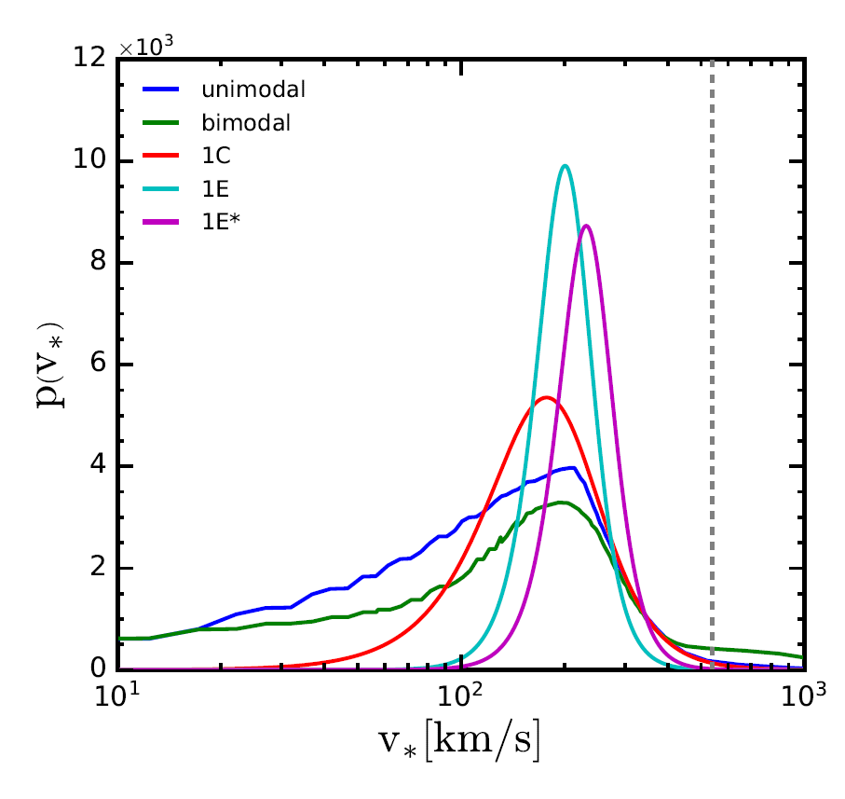
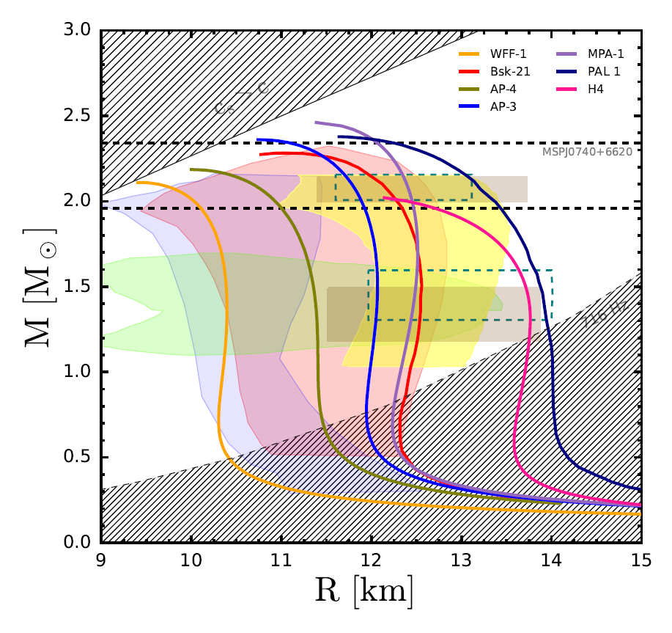
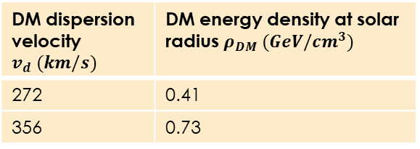
Accounting for Uncertainties:
Observed quantity: Flux from old, isolated neutron star, i.e. its surface temperature with a blackbody spectrum
$T_{surface}^{observed}∝$ astrophysics $×$ Nuclear Equation of State
Chatterjee et al 2022
DM dispersion velocity $v_{d} (km/s)$ | DM energy density at solar radius $ρ_{DM} (GeV/cm^{3})$
272 | 0.41
356 | 0.73
Ofek et al 2009
Sartore et al 2009
Bozorgnia et al 2016
Ozel and Freire, 2016
Chatterjee et al 2022

Slide 7
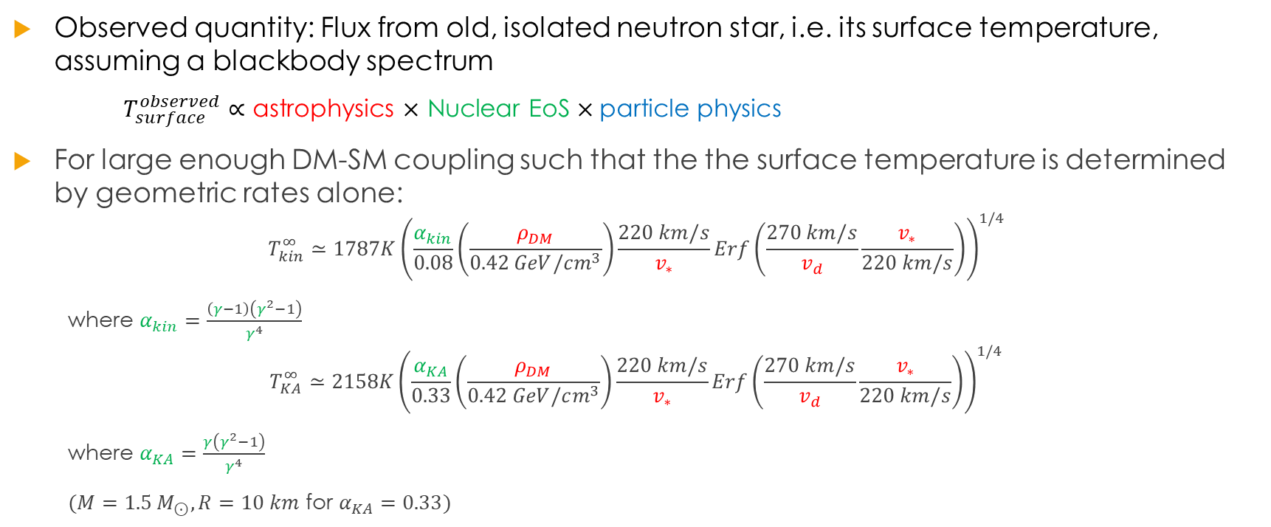
(II) Maximum temperatures and detectability:
Observed quantity: Flux from old, isolated neutron star, i.e. its surface temperature, assuming a blackbody spectrum
$T_{surface}^{observed}∝$ astrophysics $×$ Nuclear EoS $×\text{particle} \text{physics}$
For large enough DM-SM coupling such that the the surface temperature is determined by geometric rates alone:
$$T_{kin}^{∞}≃1787K{\left(\frac{α_{kin}}{0.08}\left(\frac{ρ_{DM}}{0.42 GeV/cm^{3}}\right)\frac{220 km/s}{v_{∗}}Erf\left(\frac{270 km/s}{v_{d}}\frac{v_{∗}}{220 km/s}\right)\right)}^{1/4}$$
where $α_{kin}=\frac{\left(γ−1\right)\left(γ^{2}−1\right)}{γ^{4}}$
$$T_{KA}^{∞}≃2158K{\left(\frac{α_{KA}}{0.33}\left(\frac{ρ_{DM}}{0.42 GeV/cm^{3}}\right)\frac{220 km/s}{v_{∗}}Erf\left(\frac{270 km/s}{v_{d}}\frac{v_{∗}}{220 km/s}\right)\right)}^{1/4}$$
where $α_{KA}=\frac{γ\left(γ^{2}−1\right)}{γ^{4}}$
$(M=1.5 M_{⊙}, R=10 km$ for $α_{KA}=0.33)$

Slide 8
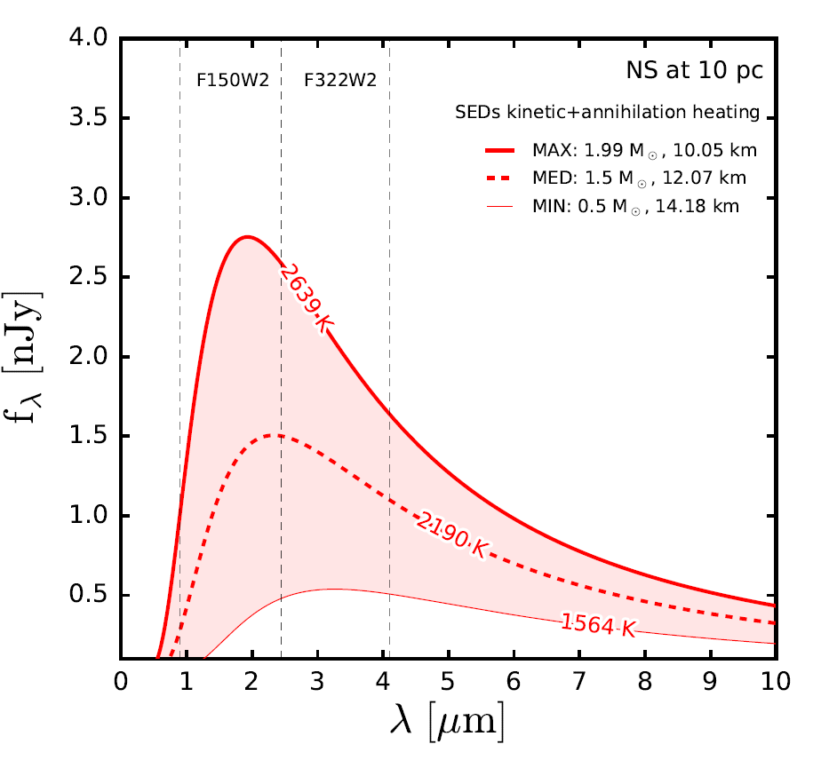
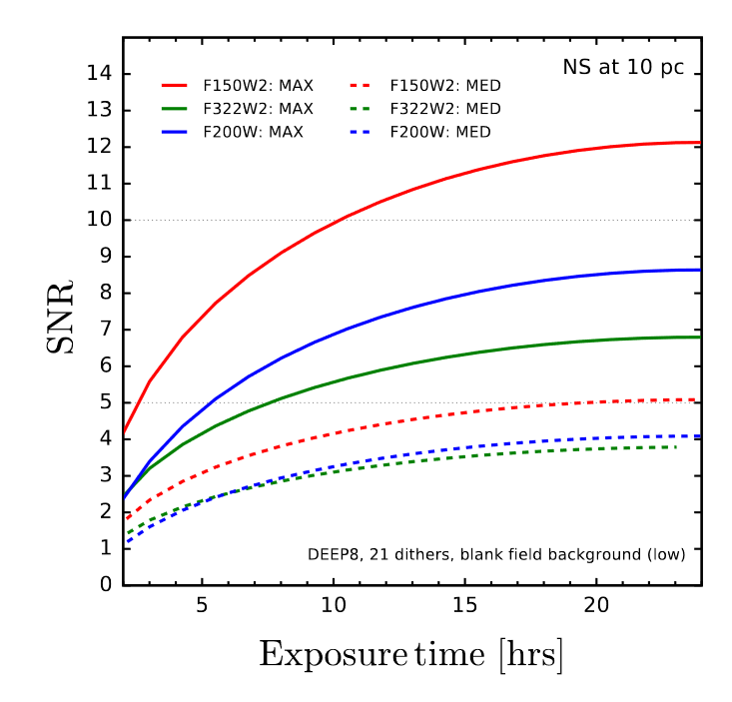
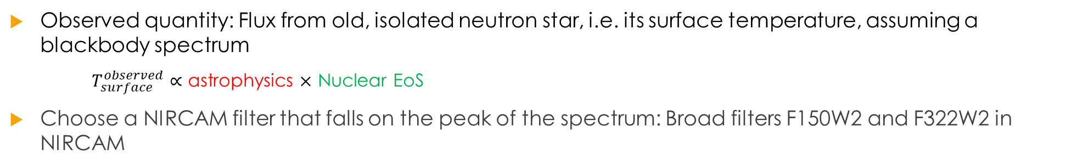
(II) Maximum temperatures and detectability:
Observed quantity: Flux from old, isolated neutron star, i.e. its surface temperature, assuming a blackbody spectrum
$T_{surface}^{observed}∝$ astrophysics $×$ Nuclear EoS
Choose a NIRCAM filter that falls on the peak of the spectrum: Broad filters F150W2 and F322W2 in NIRCAM
SC et al 2022
SC et al 2022

Slide 9
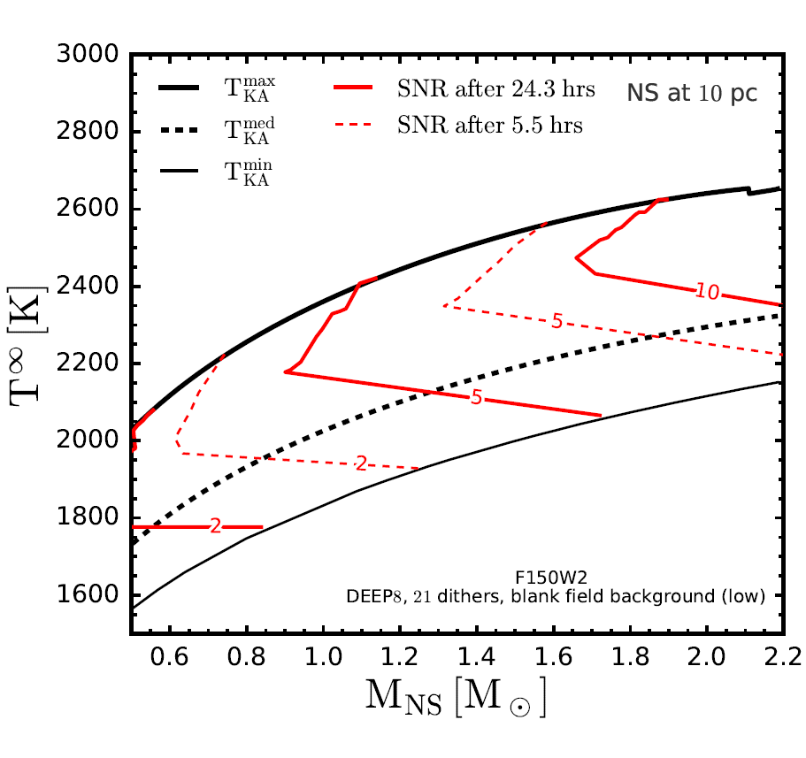
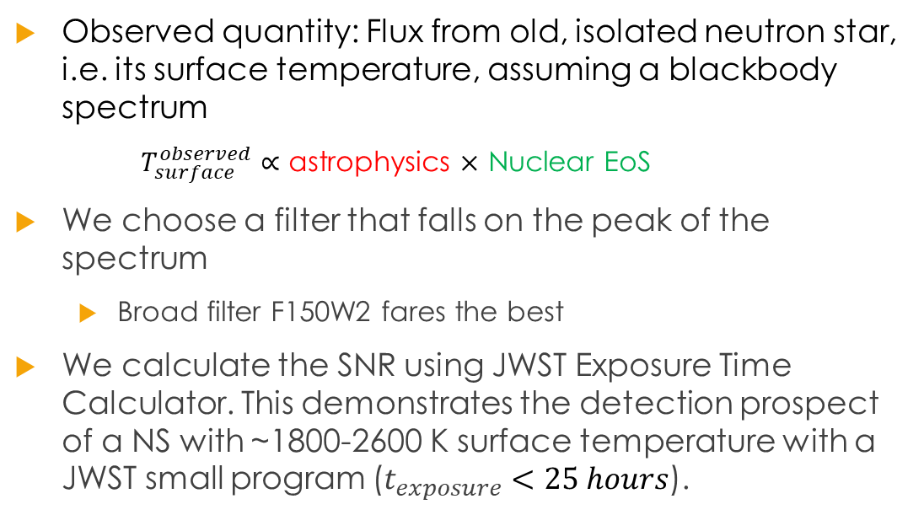
(II) Maximum temperatures and detectability:
Observed quantity: Flux from old, isolated neutron star, i.e. its surface temperature, assuming a blackbody spectrum
$T_{surface}^{observed}∝$ astrophysics $×$ Nuclear EoS
We choose a filter that falls on the peak of the spectrum
  Broad filter F150W2 fares the best
We calculate the SNR using JWST Exposure Time Calculator. This demonstrates the detection prospect of a NS with ~1800-2600 K surface temperature with a JWST small program ($t_{exposure}<25 hours$).
SC et al 2022

Slide 10
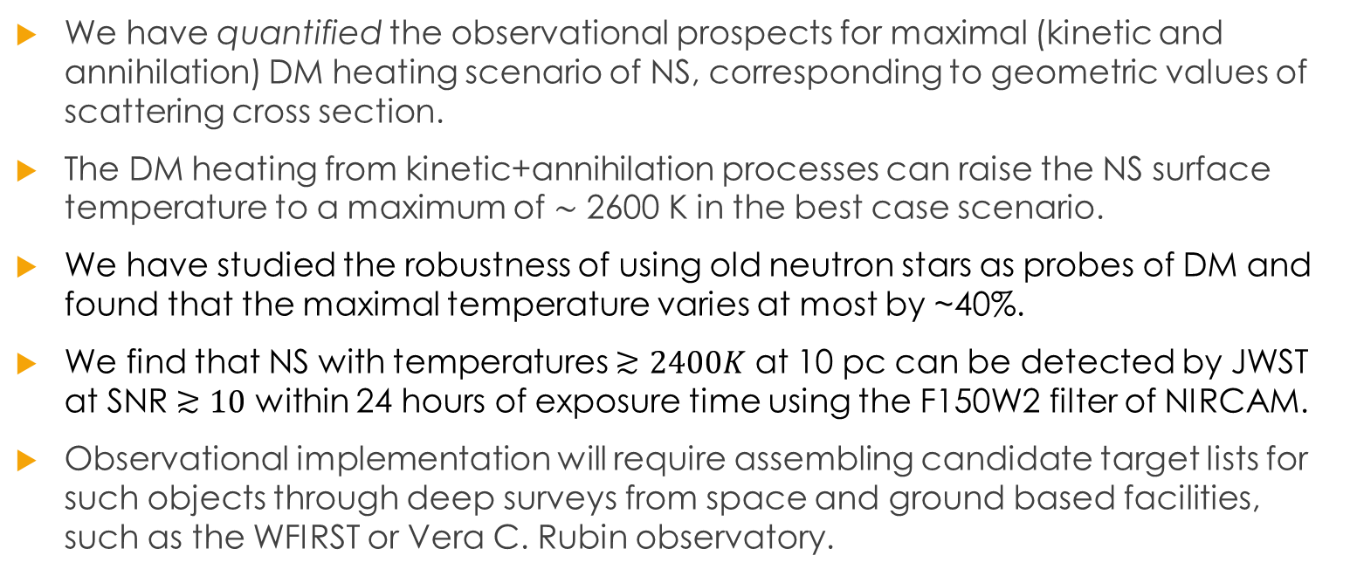
Summary
We have quantified the observational prospects for maximal (kinetic and annihilation) DM heating scenario of NS, corresponding to geometric values of scattering cross section.
The DM heating from kinetic+annihilation processes can raise the NS surface temperature to a maximum of ∼ 2600 K in the best case scenario.
We have studied the robustness of using old neutron stars as probes of DM and found that the maximal temperature varies at most by ~40%.
We find that NS with temperatures $≳2400K$ at 10 pc can be detected by JWST at SNR $≳10$ within 24 hours of exposure time using the F150W2 filter of NIRCAM.
Observational implementation will require assembling candidate target lists for such objects through deep surveys from space and ground based facilities, such as the WFIRST or Vera C. Rubin observatory.
Thank you!
shiulic@iisc.ac.in

Slide 11
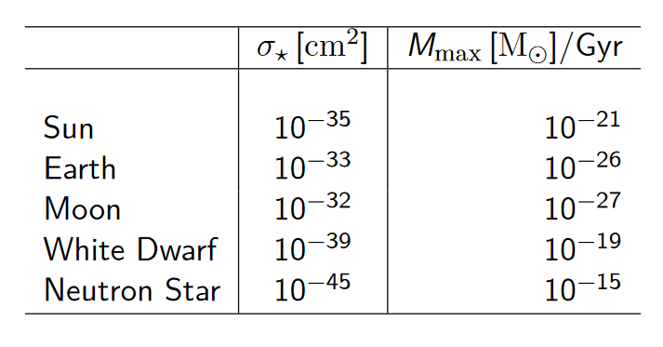
Back-up:
Garani et al arXiv: 1906.10145 [hep-ph]

Slide 12
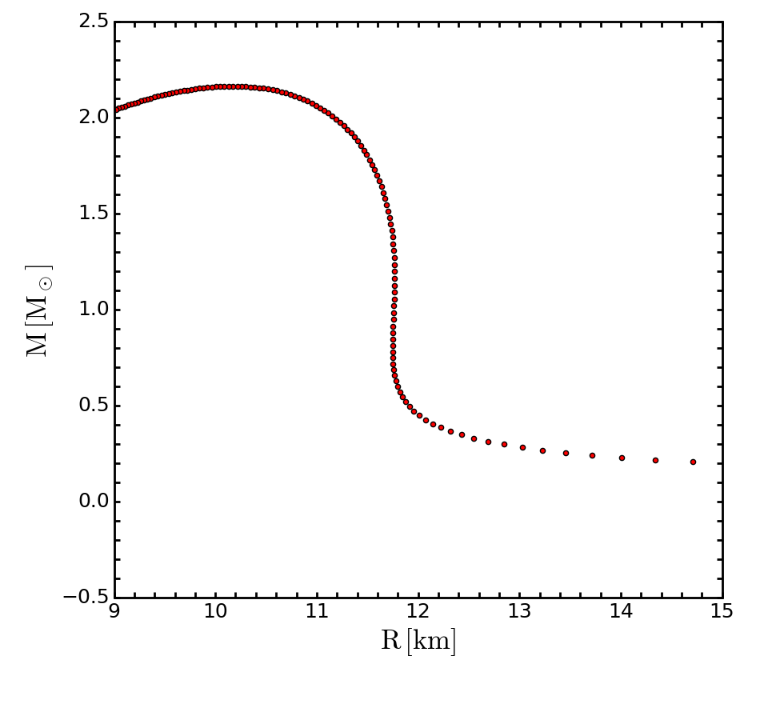
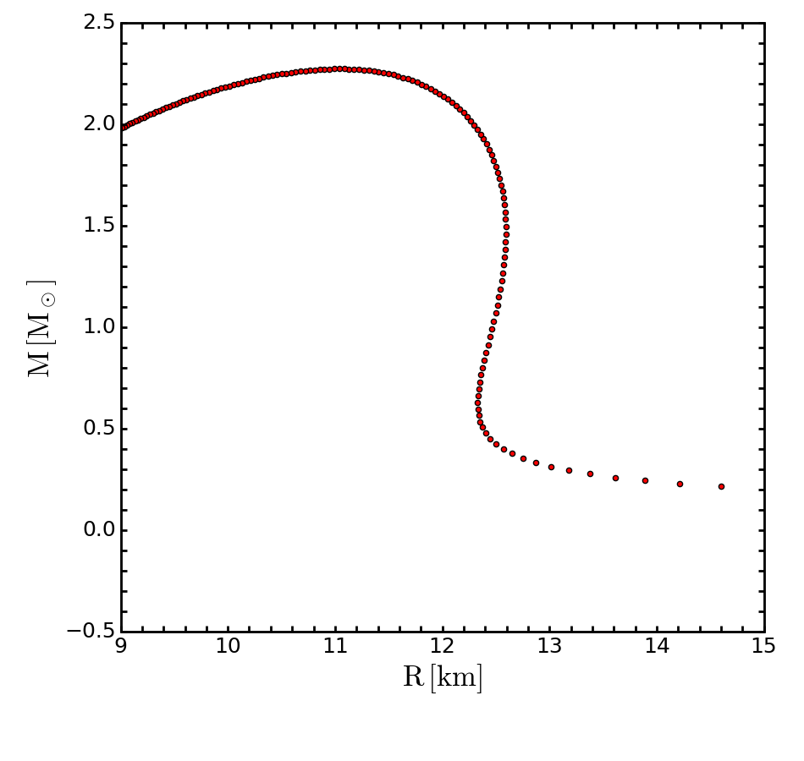
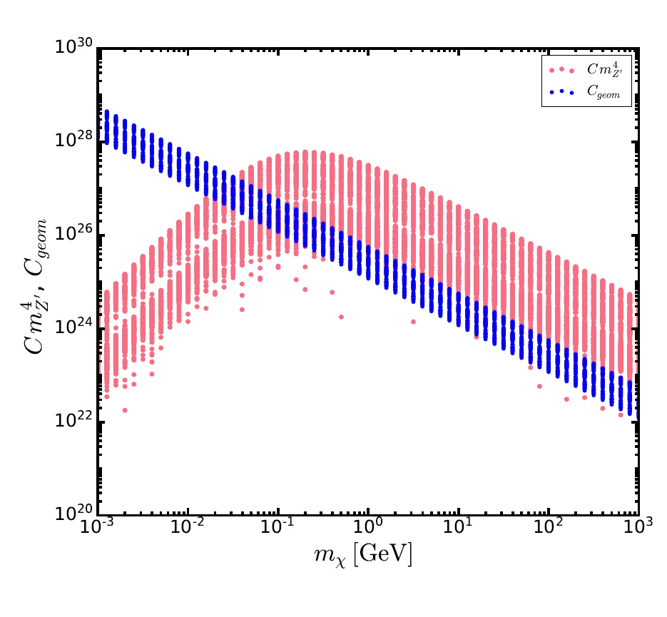
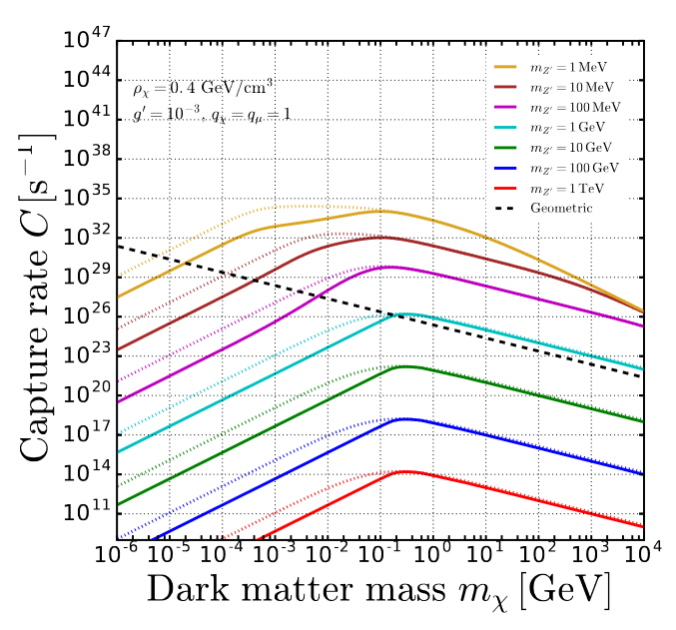
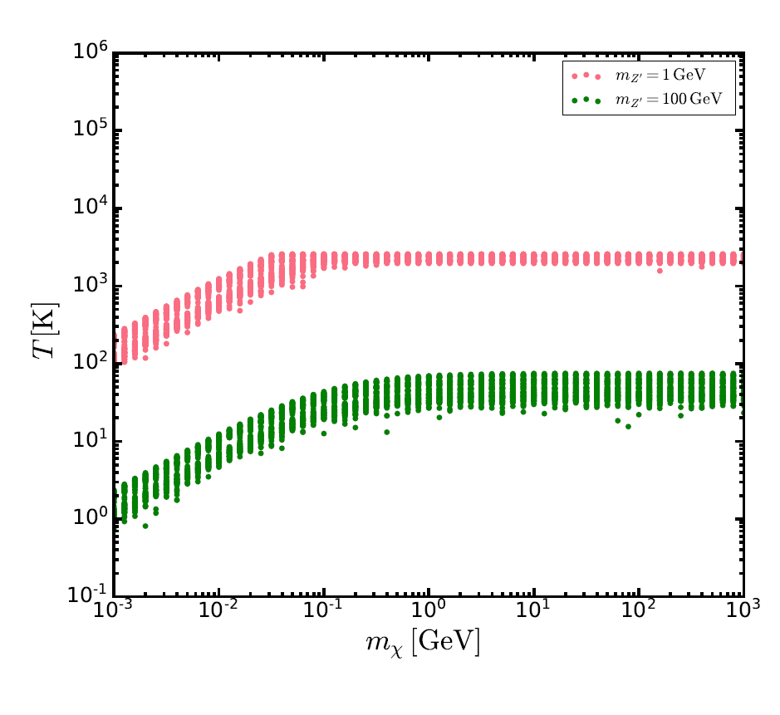
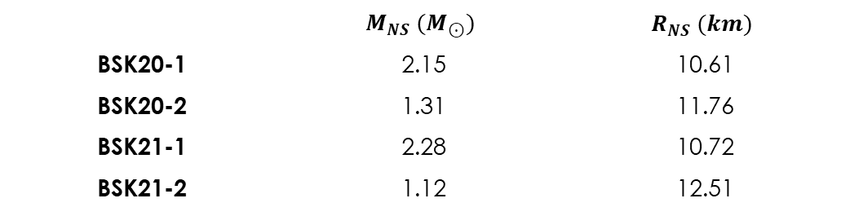
(I) Example for $U{\left(1\right)}_{L_{μ}−L_{τ}}$ model:
BSK-21:
BSK-21:
BSK-21:
BSK-20:
BSK-20:
Benchmark NS models considered:
 | $$M_{NS} (M_{⊙})$$ | $$R_{NS} (km)$$
BSK20-1 | 2.15 | 10.61
BSK20-2 | 1.31 | 11.76
BSK21-1 | 2.28 | 10.72
BSK21-2 | 1.12 | 12.51
Ongoing work: SC et al
Garani and Heeck 2019

Slide 13
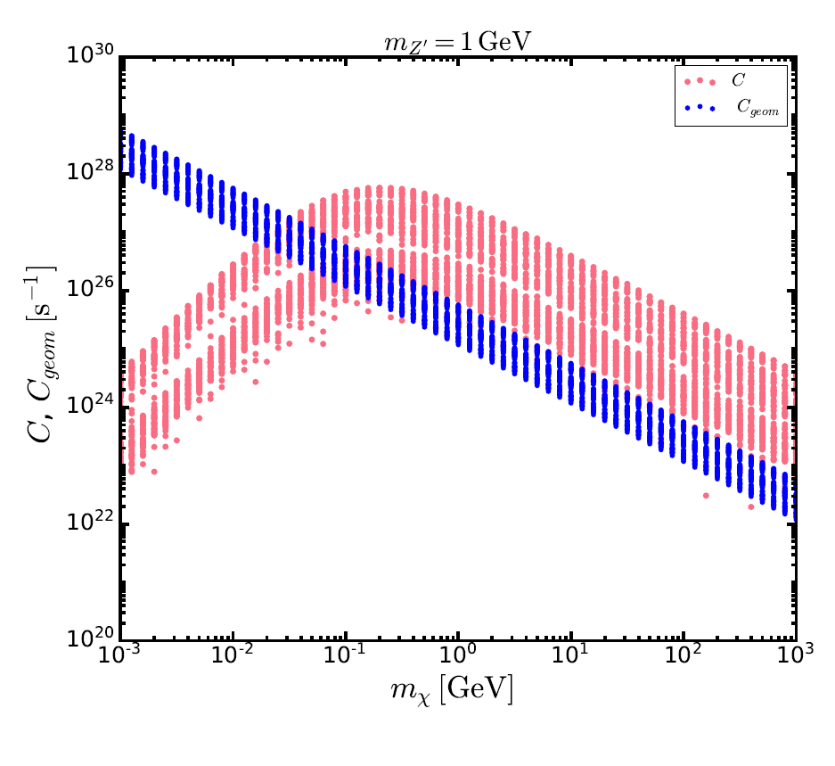
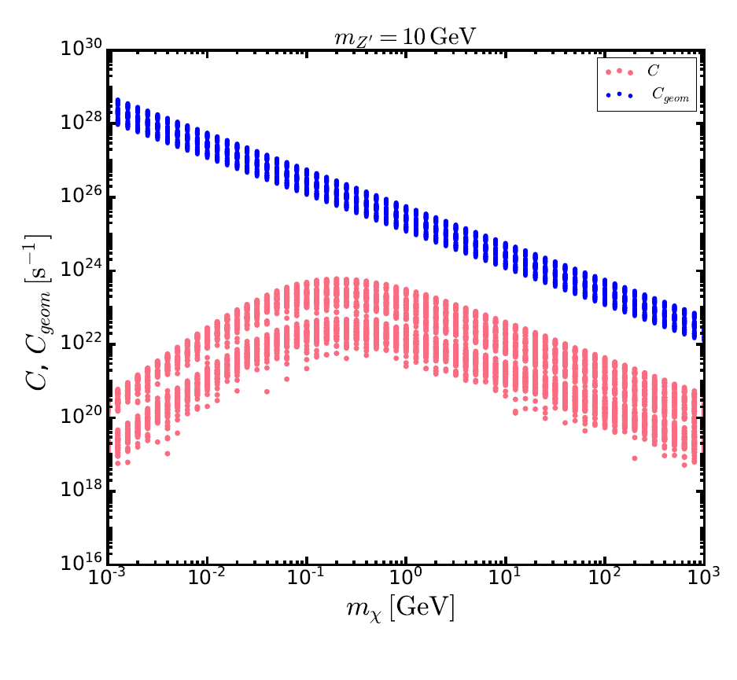
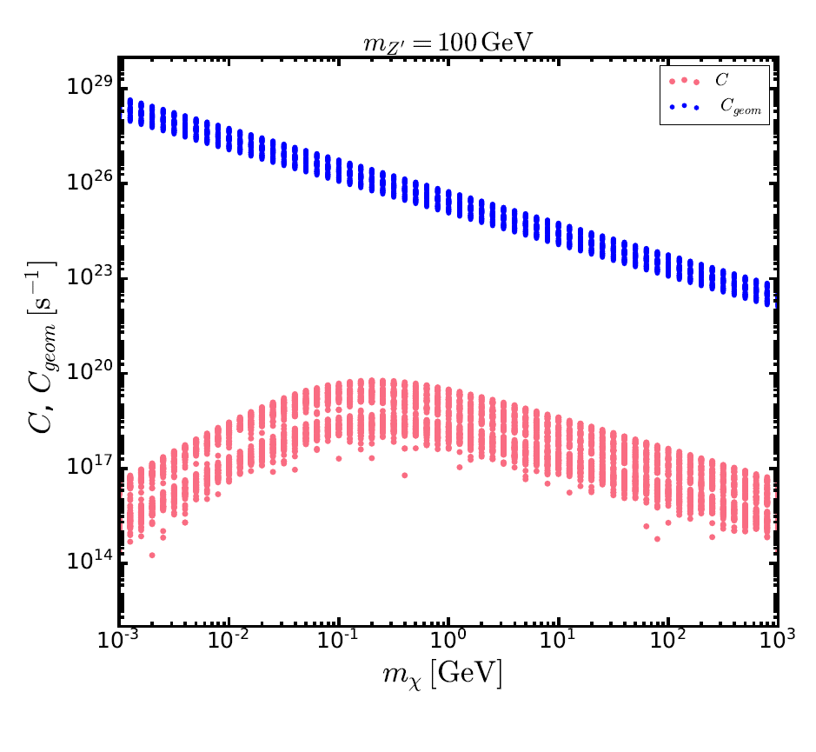
Back-up:

Slide 14
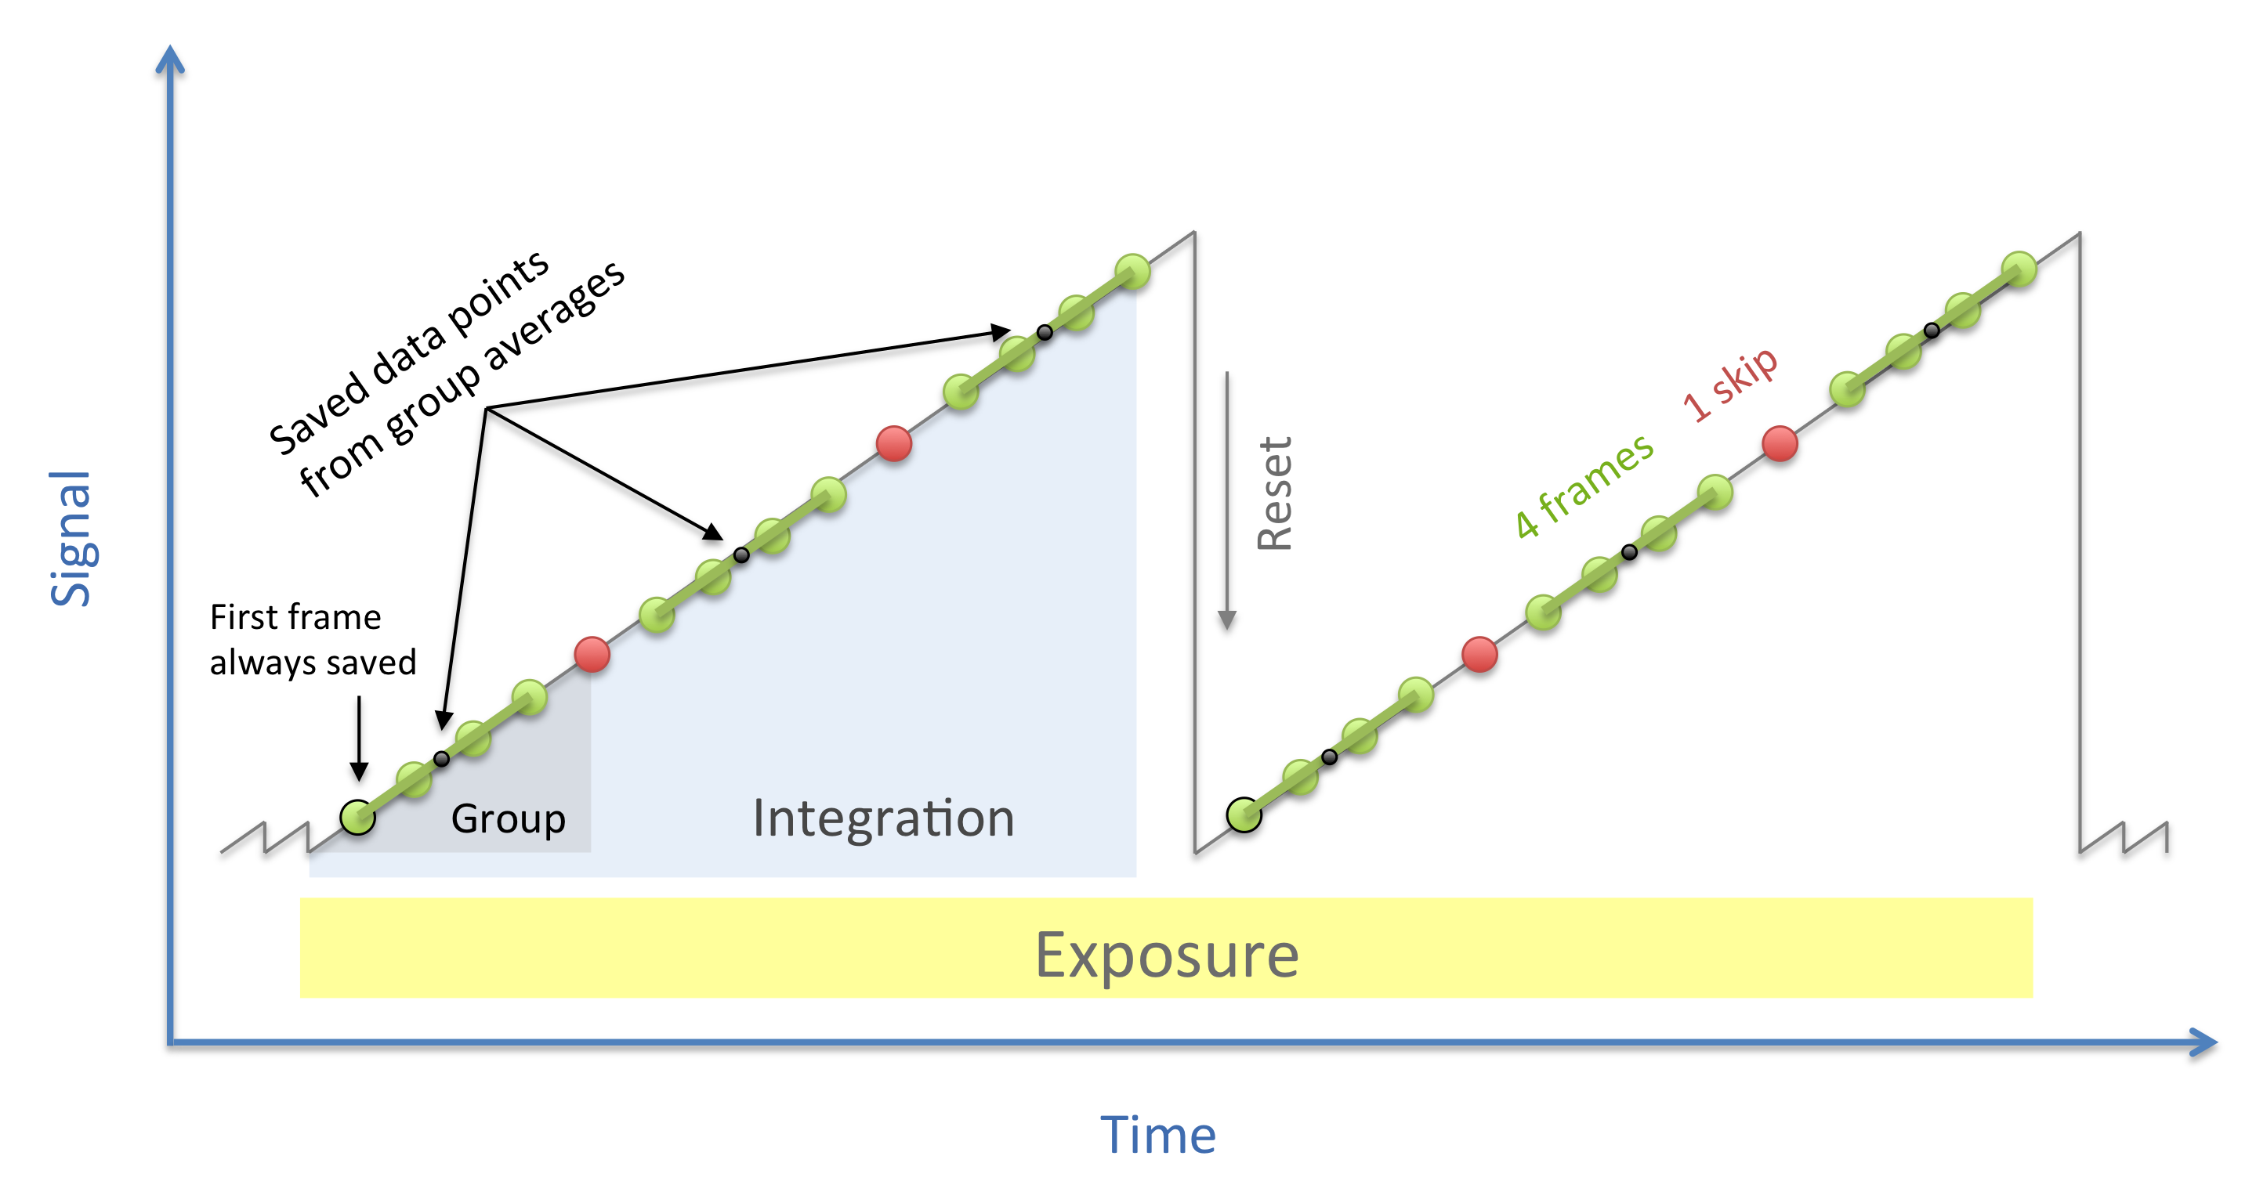
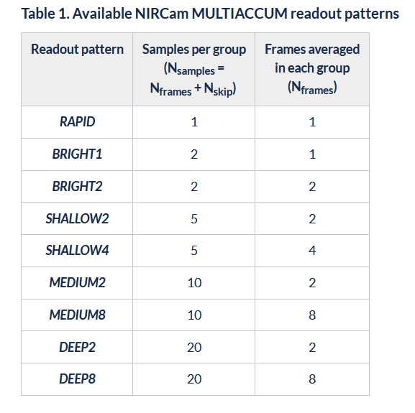
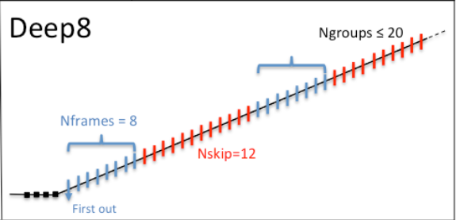
Back-up:
JWST documentation

Slide 15
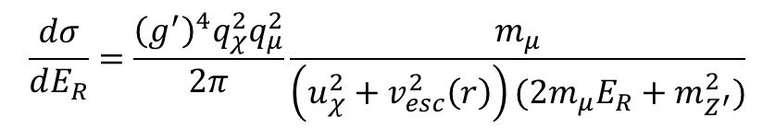
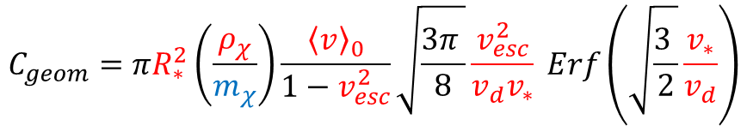

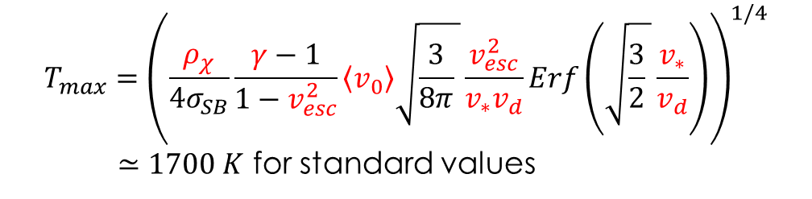
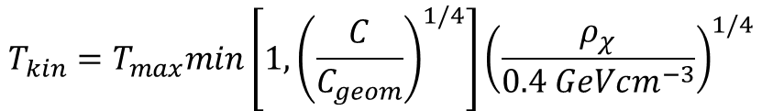
Neutron Star as Dark Matter Probes
An account of uncertainties:
$$T_{kin}=T_{max}min\left[1, {\left(\frac{C}{C_{geom}}\right)}^{1/4}\right]{\left(\frac{ρ_{χ}}{0.4 GeVcm^{−3}}\right)}^{1/4}$$
$$T_{max}={\left(\frac{ρ_{χ}}{{4σ}_{SB}}\frac{γ−1}{1−v_{esc}^{2}}\left\langle v_{0}\right\rangle \sqrt{\frac{3}{8π} }\frac{v_{esc}^{2}}{v_{∗}v_{d}}Erf\left(\sqrt{\frac{3}{2} }\frac{v_{∗}}{v_{d}}\right)\right)}^{1/4}$$
$≃1700 K$ for standard values
The magnitude of heating depends on astrophysical and particle physics parameters through:
$$C=\int_{0}^{R_{∗}}{dr 4πr^{2} n_{μ}\left(r\right)\int{du_{χ}\left(\frac{ρ_{χ}}{m_{χ}}\right)}f_{v_{∗}}\left(u_{χ}\right)\left(u_{χ}^{2}+v_{esc}^{2}\left(r\right)\right)ζ(r)\int_{E_{R}^{min}}^{E_{R}^{max}}{dE_{R}\frac{dσ}{dE_{R}}}}$$
$ζ\left(r\right)=min⁡(1,δp(r)/p_{F}(r))$ takes Pauli blocking into account where$δp\left(r\right)≃\sqrt{2}m_{red}v_{esc}(r)$ and $p_{F}\left(r\right)=\sqrt{2m_{μ}μ_{μ}(r)}$
$$\frac{dσ}{dE_{R}}=\frac{{\left(g^{′}\right)}^{4}q_{χ}^{2}q_{μ}^{2}}{2π}\frac{m_{μ}}{\left(u_{χ}^{2}+v_{esc}^{2}\left(r\right)\right)(2m_{μ}E_{R}+m_{Z^{′}}^{2})}$$
$$C_{geom}=πR_{∗}^{2}\left(\frac{ρ_{χ}}{m_{χ}}\right)\frac{{\left\langle v\right\rangle }_{0}}{1−v_{esc}^{2}}\sqrt{\frac{3π }{8}}\frac{v_{esc}^{2}}{v_{d}v_{∗}} Erf\left(\sqrt{\frac{3 }{2}}\frac{v_{∗}}{v_{d}}\right)$$
$${NS velocity: v}_{∗}$$
$$DM density and dispersion velocity: ρ_{DM},v_{d}$$
$${NS EoS dependent: n}_{μ}\left(r\right),μ_{μ}\left(r\right),v_{esc}(r)$$
Baryakhtar et al arXiv:1704.01577 [hep:ph]

Slide 16
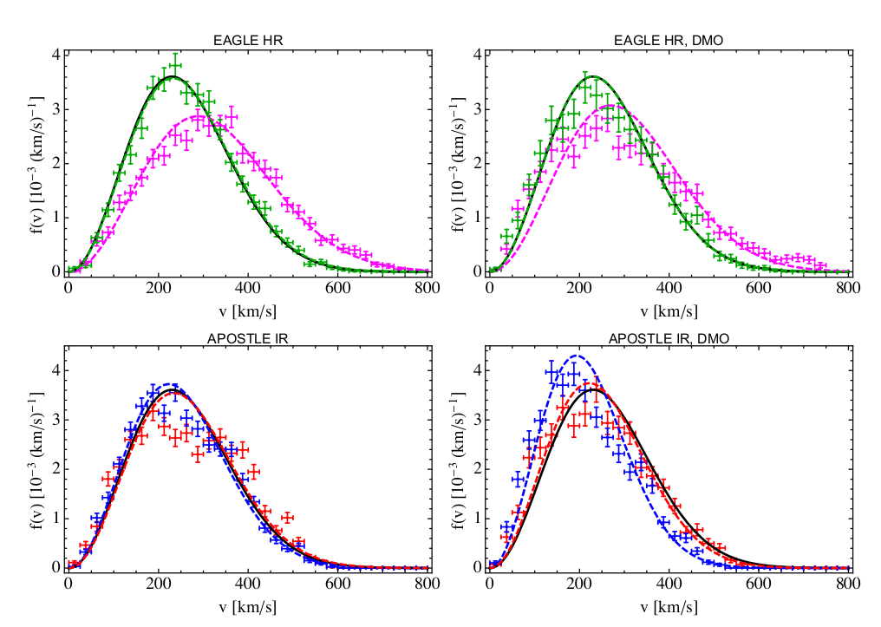

Neutron Star as Dark Matter Probes
$${NS velocity: v}_{∗}$$
$$DM density \& dispersion velocity: ρ_{DM},v_{d}$$
arXiv:1601.04707v2 [astro-ph.CO]
arXiv:0910.3684v1 [astro-ph.GA]

Slide 17
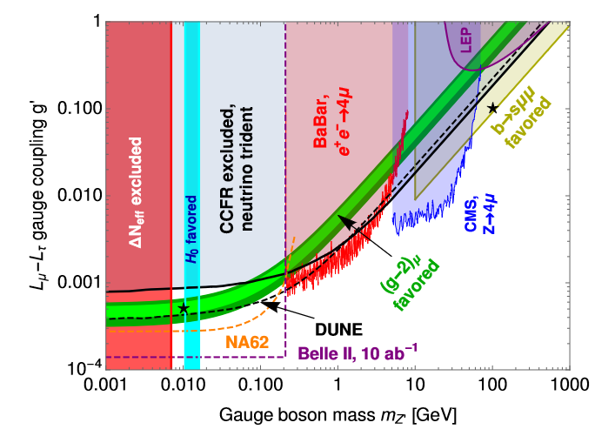
Garani et al arXiv:1906.10145

Slide 18
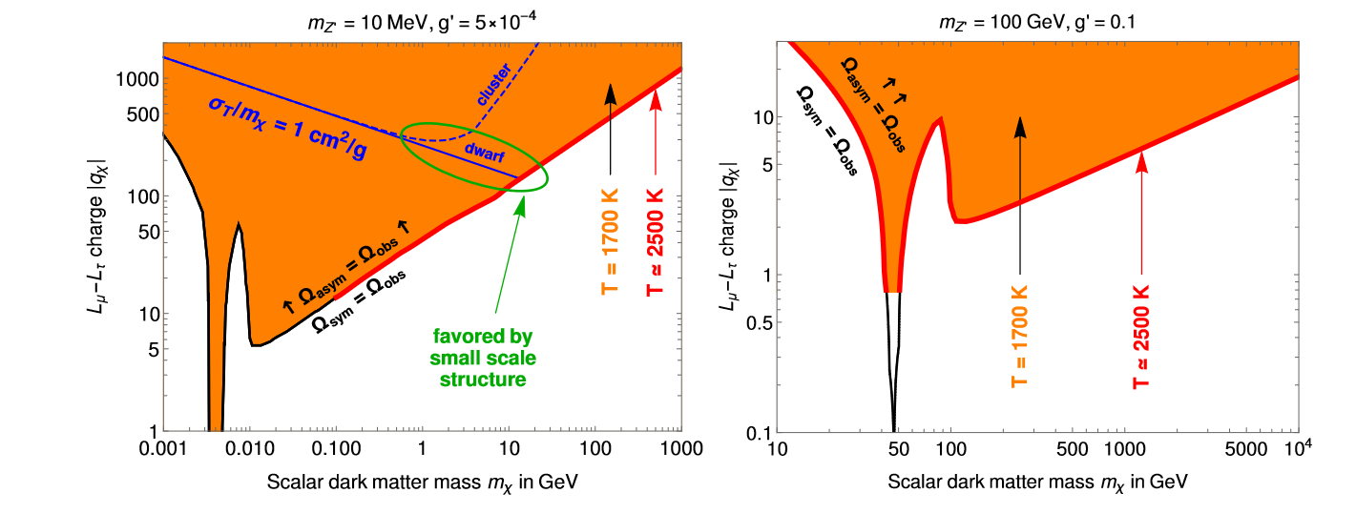
Garani et al arXiv:1906.10145

Slide 19
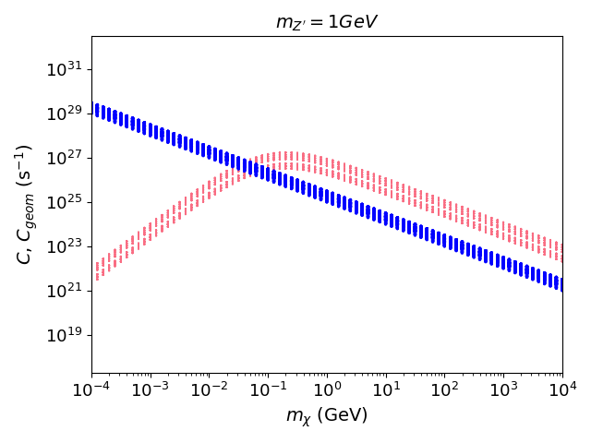
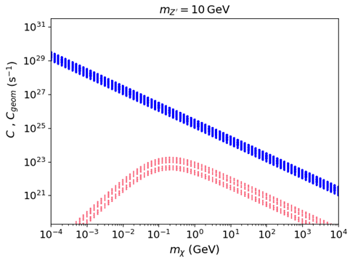
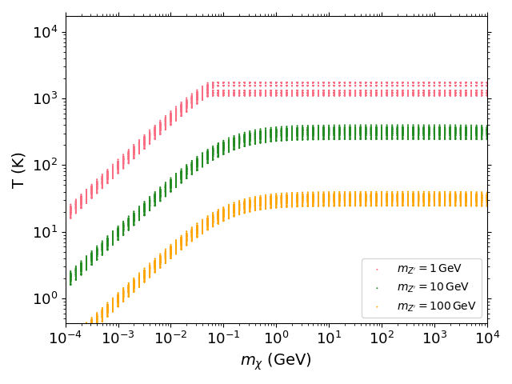
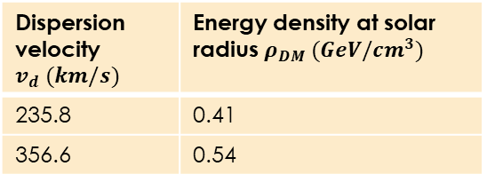
Neutron Star as Dark Matter Probes
Dispersion velocity $v_{d} (km/s)$ | Energy density at solar radius $ρ_{DM} (GeV/cm^{3})$
235.8 | 0.41
356.6 | 0.54

Slide 20
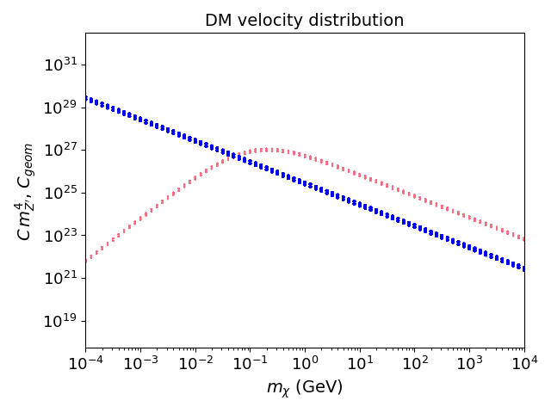
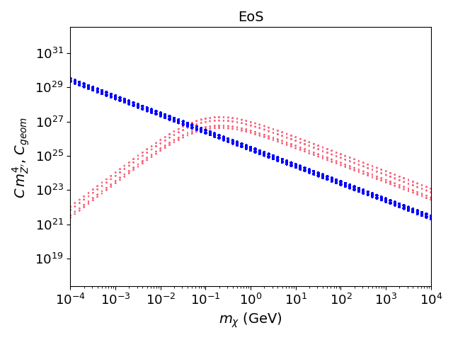
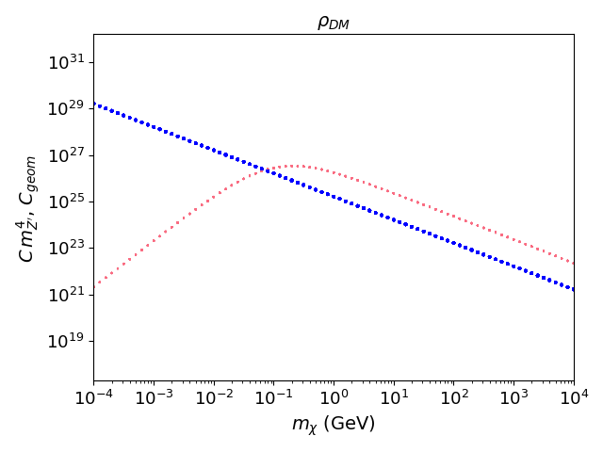
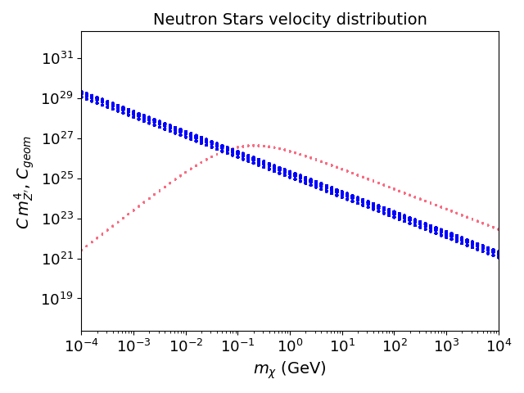

Slide 21
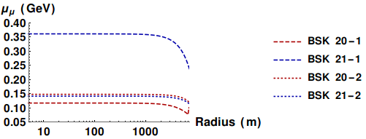
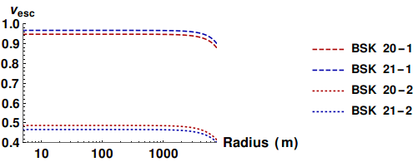
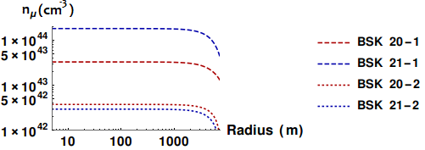
Back-up: EoS NS
$$C=\int_{0}^{R_{∗}}{dr 4πr^{2} n_{μ}\left(r\right)\int{du_{χ}\left(\frac{ρ_{χ}}{m_{χ}}\right)}f_{v_{∗}}\left(u_{χ}\right)\left(u_{χ}^{2}+v_{esc}^{2}\left(r\right)\right)ζ(r)\int_{E_{R}^{min}}^{E_{R}^{max}}{dE_{R}\frac{dσ}{dE_{R}}}}$$

Slide 22
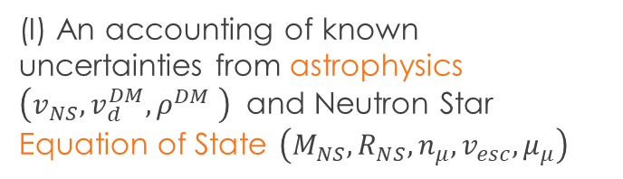
Neutron Stars as Dark Matter Probes
  Goodness of the probe would be determined by two factors:
    How do the astrophysical uncertainties play into the DM predictions that can be made from the observation of a heated, old Neutron Star.
    Variation in capture rates and temperatures from spanning over allowed range of input parameters
    What are the prospects for actually observing said heated old and isolated Neutron Star
(II) A careful analysis exploiting the features of the James Webb Space Telescope, using their exposure time calculator to arrive at realistic SNR
(I) An accounting of known uncertainties from astrophysics $\left(v_{NS},v_{d}^{DM},ρ^{DM} \right)$ and Neutron Star Equation of State $\left(M_{NS},R_{NS},n_{μ},v_{esc},μ_{μ}\right)$

