Slide 1
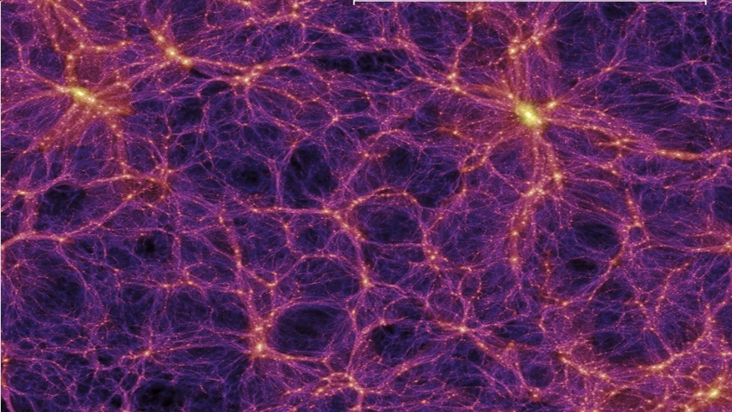
Jeans Modelling Beyond Spherical Symmetry
Adam Smith-Orlik
York University
TeVPA 2022

Slide 2
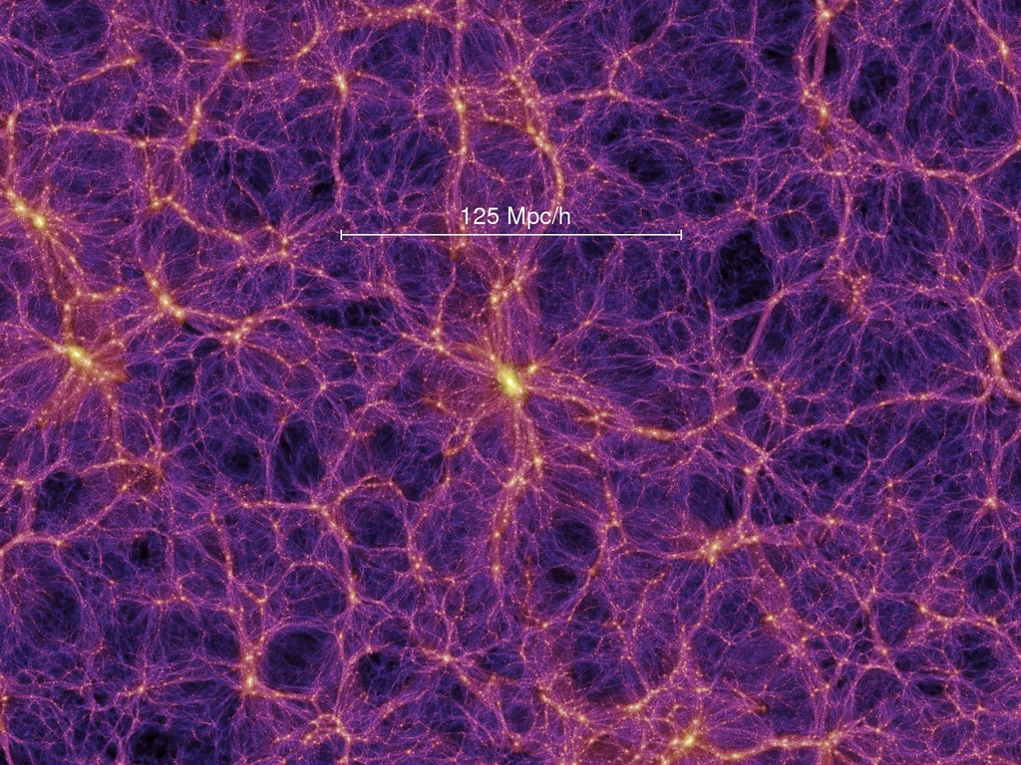


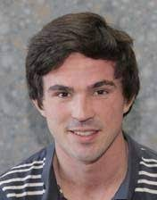

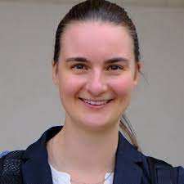
Team
Dr. Andrew Robertson
NASA JPL
Prof. Sean Tulin
York University
Prof. Laura Sagunski
Goethe University
Fabian Bautista
Perimeter Institute, York University

Slide 3

Outlook
Orientation
Motivation
Jeans Model Theory
Preliminary Results
Next Steps

Slide 4
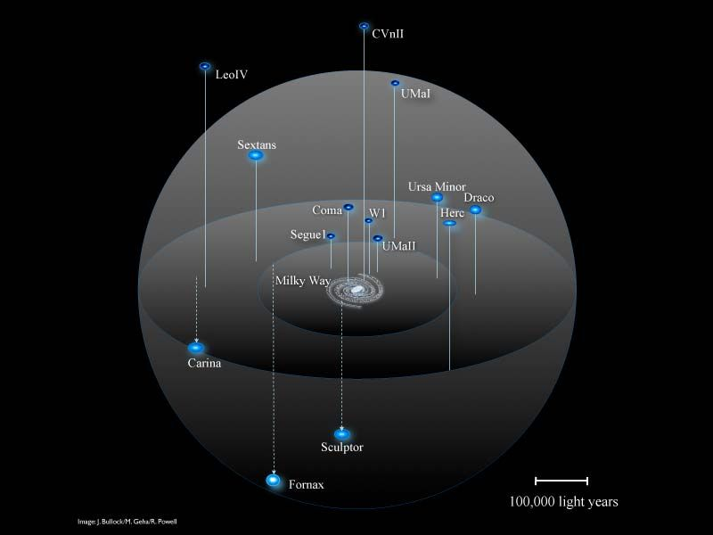
Orientation
Galaxies and galaxy clusters are enveloped in dark matter (DM) “halos”
DM halos extend far beyond the spatial extent of the baryons
J. Bullock, M. Geha, R. Powell
Notes:
Understanding the dm distribution in these halos can help understand the particle properties of dm, it can inform direct detection searches, and so on

Slide 5
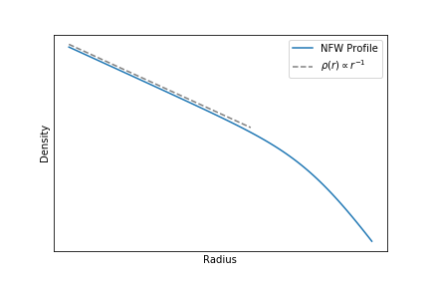

Orientation
Navarro-Frenk-White (NFW) used N-body simulations with CDM cosmologies to fit a universal DM density profile
$ρ\left(r\right)∝r^{α}$ where $α=−1$
Notes:
NFW model dm halos from galaxy to galaxy cluster scales with an essentially one-parameter model
Developed using N-body sims. On the basis of CDM cosmologies
Inner core scales as 1 over r i.e. cuspy cores and predicted to be universal of CDM halos

Slide 6

Motivation
CDM paradigm describes remarkably well the large-scale structure and evolution of the universe
Small-scales ($<1$Mpc) CDM predictions are in tension with observations
Core-cusp, diversity in rotation curves, missing satellites, too-big-to-fail, etc.

Slide 7
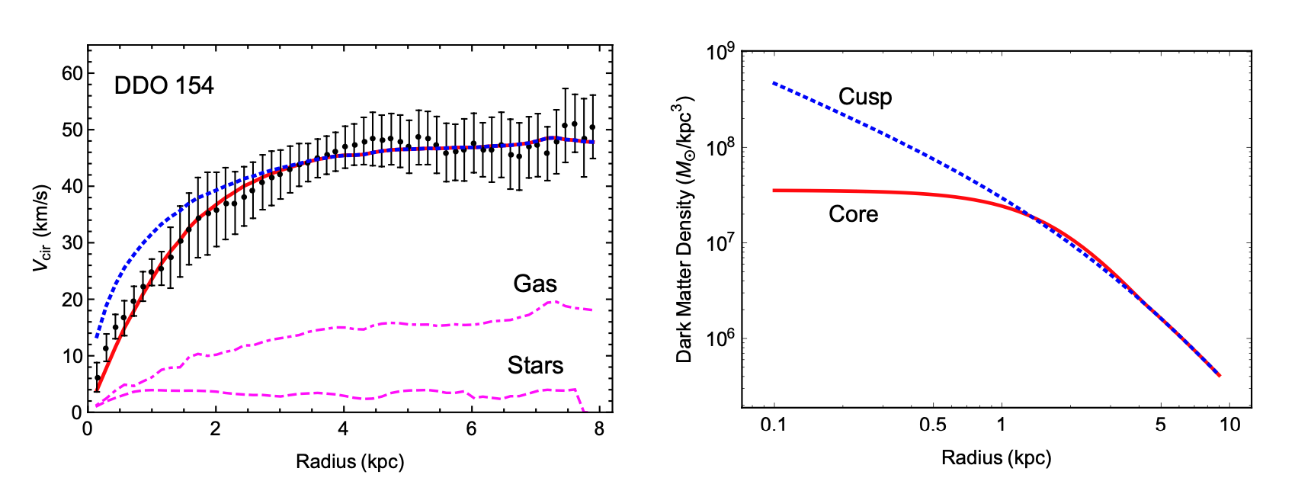
Motivation
Se-Heon Oh et al. (2015)

Slide 8
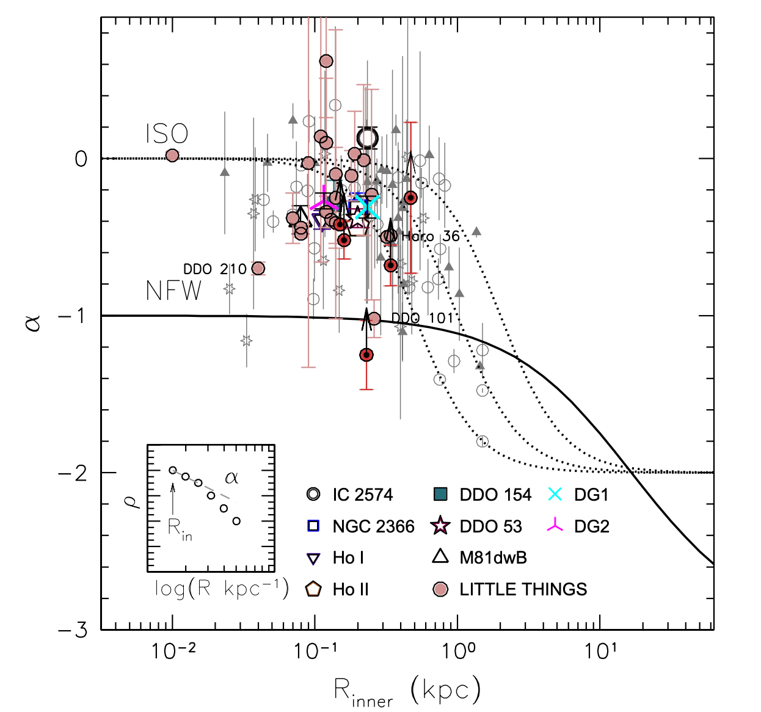
Motivation
Se-Heon Oh et al. (2015) Survey of LITTLE THINGS data

Slide 9
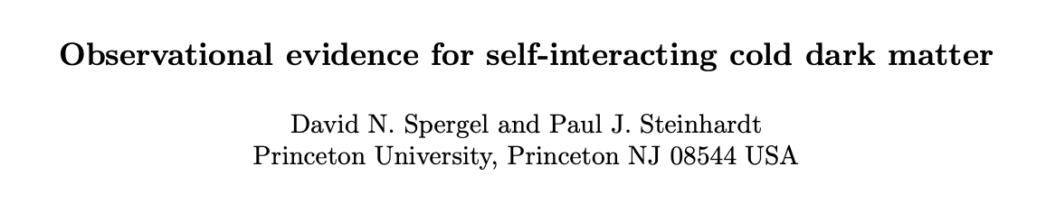
Motivation
Baryonic feedback processes -- star formation, AGNs, and supernovae
Hydrodynamical solutions do not yet fully resolve small scale issues
One economical solution as proposed by Spergel and Steinhardt (2000) is self interacting dark matter (SIDM), which has the potential to solve some small-scale issues while retaining the success of CDM on large-scales
Notes:
SIDM Preidictions:
(1) the centers of halos are spherical; (2) dark matter halos will have cores; and (3) there are few dwarf galaxies in groups but dwarfs persist in lower density environments; and, (4) the halos of dwarf galaxies and galaxy halos in clusters will have radii smaller than the gravitational tidal radius (due to collisional stripping) .

Slide 10
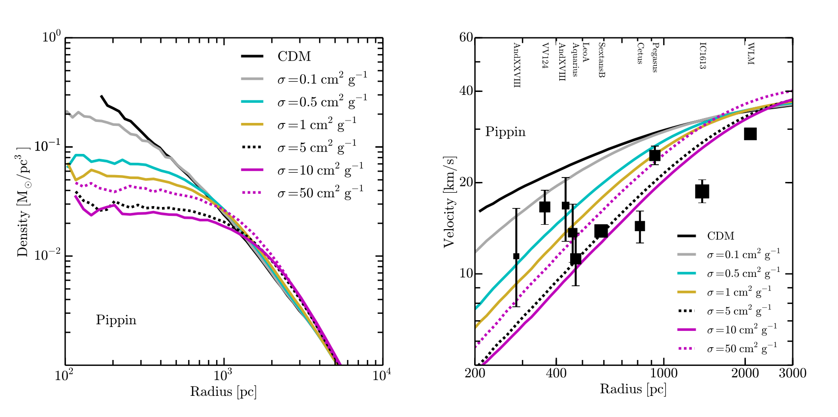
Motivation
Allowing DM to scatter leads to predictions that better match the observations
Oliver D. Elbert et al. (2014)

Slide 11
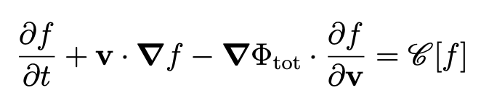

Motivation
N-body simulations have been used extensively to test the predictions of SIDM though suffer from being computationally intensive and unable to reproduce observed systems
A semi-analytical alternative to N-body simulations is the Jeans model which is derived from the collisional Boltzmann equation
Notes:
F is the dm distribution function and phi is the total gravitational potential
C is the collisional term which drives the distribution function toward kinetic equilibrium in the inner halo
Where one can take the first moment of this equation and search for quasi-equilibrium solutions

Slide 12
Motivation
N-body simulations have been used extensively to test the predictions of SIDM though suffer from being computationally intensive and unable to reproduce observed systems
A semi-analytical alternative to N-body simulations is the Jeans model which is derived from the collisional Boltzmann equation
Notes:
F is the dm distribution function and phi is the total gravitational potential
C is the collisional term which drives the distribution function toward kinetic equilibrium in the inner halo
Where one can take the first moment of this equation and search for quasi-equilibrium solutions

Slide 13
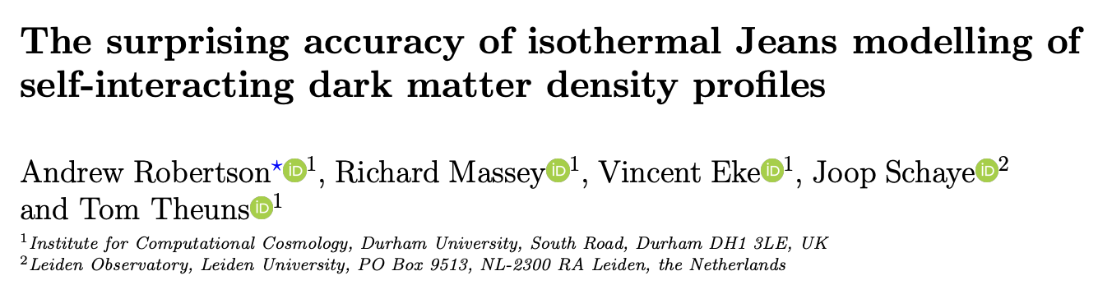
Motivation
The 1D isothermal Jeans model works well!
While computationally cheaper and able to match observables of systems, the Jeans model has only been explored in 1D assuming spherical symmetry or 2D assuming azimuthal symmetry

Slide 14
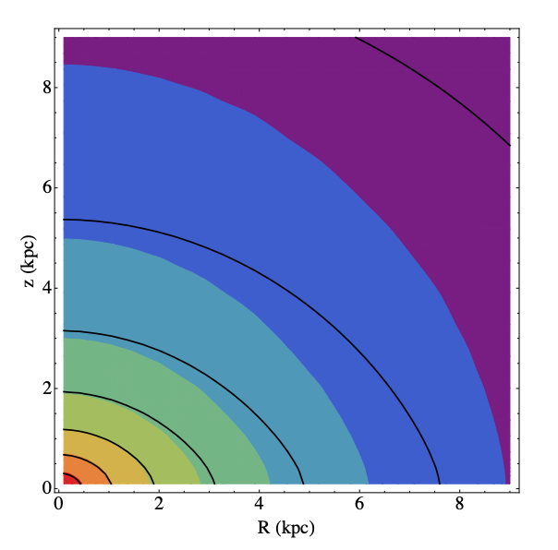
Motivation
Departures from spherical symmetry in DM halos with large baryon components (like the MW) are known to be important
To Do List:
  Extend Jeans model to higher dimensions and allow for asymmetry
  Validate model using mock data from simulations
  Confront model predictions with simulations and observations
M. Kaplinghat et al. (2014)
Notes:
Paper uses a spherical jeans model. Black contours are the SIDM isodensity contours and the color is the full numerical solutions.
SIDM distribution traces the baryons when they dominate the potential well.
Shows that there are deviations from spherical symmetry when baryons dominate.

Slide 15
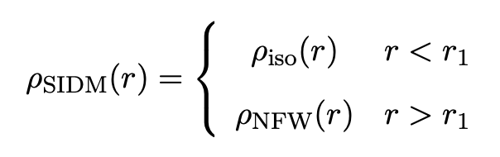
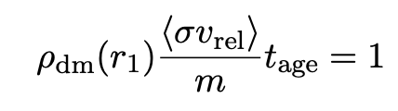

Jeans Model Theory
Following M. Kaplinghat et al. (2016) we define a characteristic radius $r_{1}$ by the rate equation
Where inside $r_{1}$ we use the Jeans model to determine the isothermal density profile and outside $r_{1}$ we fit an NFW (CDM) profile

Slide 16
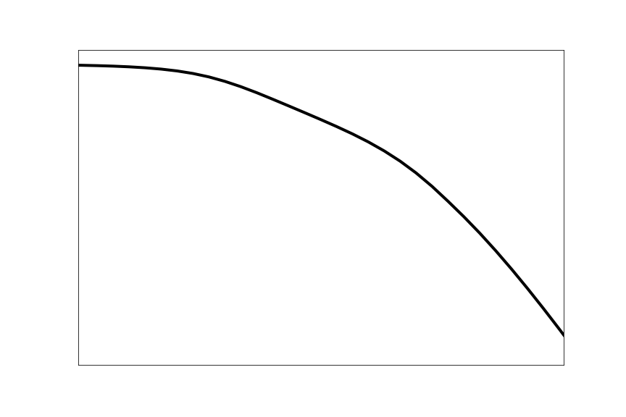





Jeans Model Theory
Following M. Kaplinghat et al. (2016) we define a characteristic radius $r_{1}$ by the rate equation
Where inside $r_{1}$ we use the Jeans model to determine the isothermal density profile and outside $r_{1}$ we fit an NFW (CDM) profile
$$ρ$$
$$r_{1}$$
$$r$$
$$ρ_{iso}(r)$$
$$ρ_{CDM}(r)$$

Slide 17



Jeans Model Theory
For the inner profile, the Jeans equation is
To which the solution is
Redefining the potentials in terms of dimensionless variables we get

Slide 18



Jeans Model Theory
To solve for $ρ_{dm}$ we need to first solve for the potential $φ_{dm}$ using Poisson’s equation
To allow for the departure from symmetry we expand $φ_{dm}$ in real-valued combination of spherical harmonics called Tesseral harmonics $Z_{lm}$ (using spherical coordinates)

Slide 19
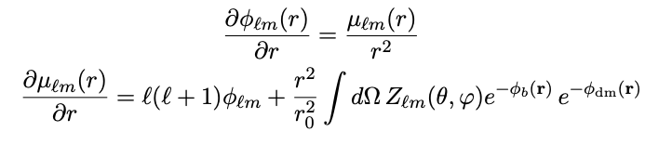
Jeans Model Theory
Substituting the expansion in we get the non-linear partial differential equation
Casting into a system of coupled first-order equations gives

Slide 20
Jeans Model Theory
Solve our system of equation using an iterative method called the relaxation method
Steps:
  Guess solution
  Calculate shift
  Linearize in the shifts and solve for new shifts
  Shift solutions by new shifts
  Repeat until convergence condition is met

Slide 21
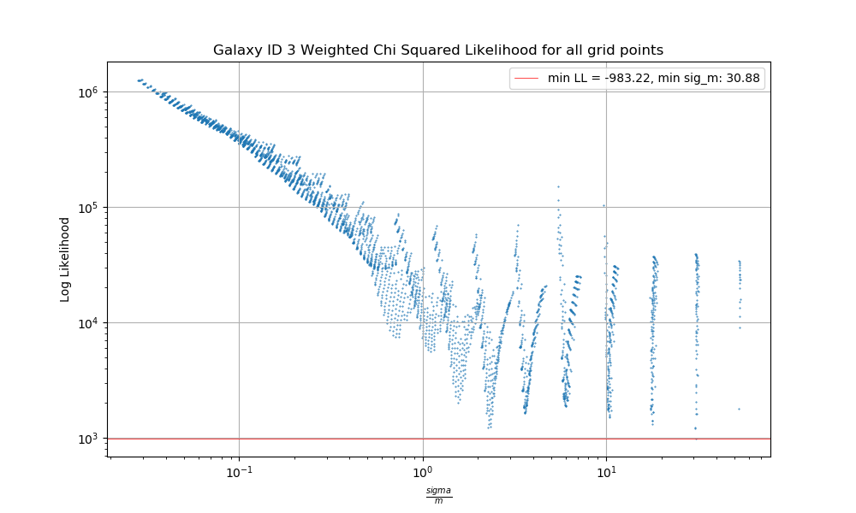


Results
To validate the Jeans model we compare results to $σ/m=1{cm}^{2}/g$ versions of the EAGLE SIDM-plus-baryons simulations
Ran a grid in $r_{1}\left(\frac{σ}{m}\right), M200, c$
Run for a subset of 250 systems shows degenerate solutions

Slide 22
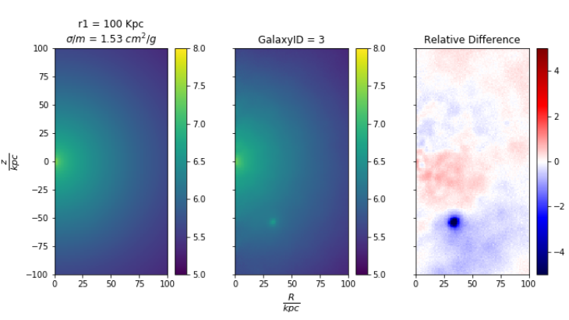
Results
2D pixel maps for the Jeans model (left) compared with the SIDM1b simulations (middle)

Slide 23
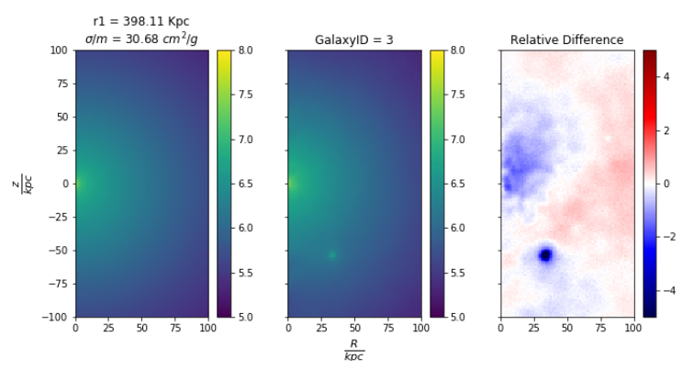
Results
2D pixel maps for the Jeans model (left) compared with the SIDM1b simulations (middle)

Slide 24
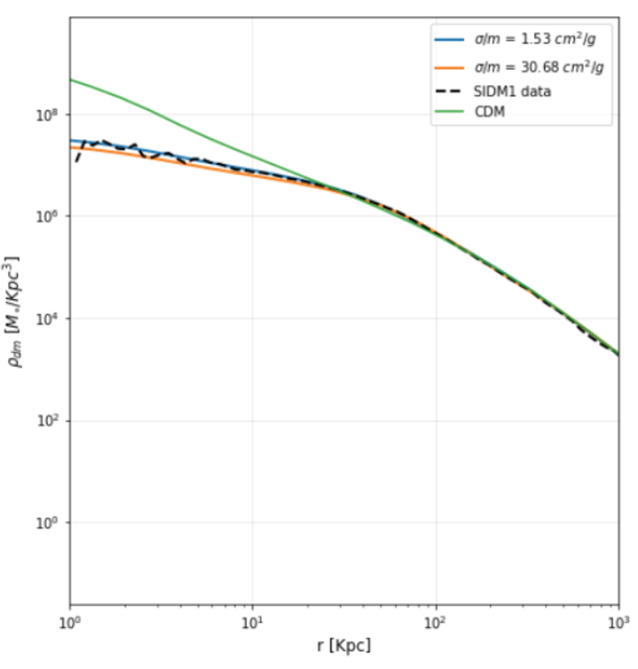
Results
Spherically averaged density plot for low and high cross section solutions

Slide 25

Results
To distinguish between high and low cross-sections we looked for a halo shape observable to compare with the simulations
We define $q_{enclosed}\left(r\right)$ by computing the ratio of the moment of inertia tensor in the R and z coordinates, i.e. $q^{2}=I_{ZZ}/I_{RR}$, in analogue to the major-to-minor axis ratio $q=c/a$

Slide 26
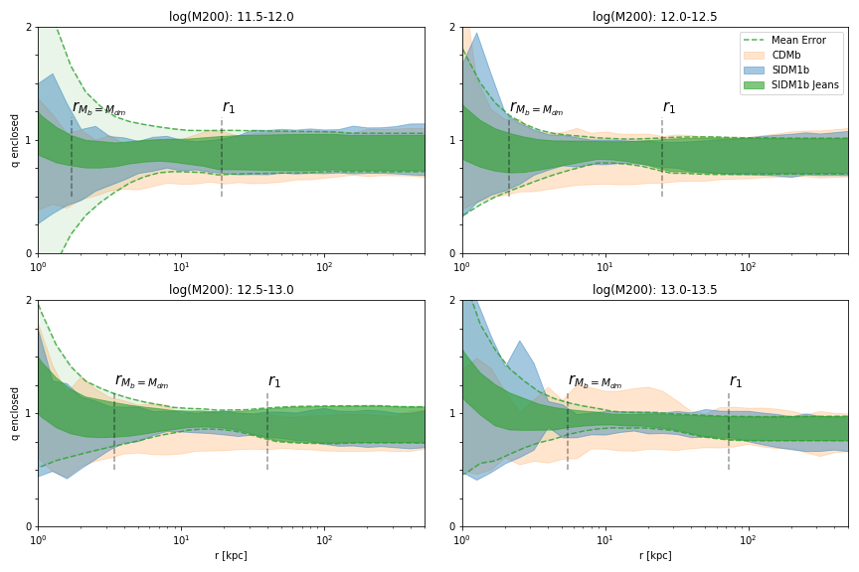
Results
PRELIMINARY
Notes:
To mention:
For all 250 systems distributed by their mass
10-90th percentiles of the q_enclosed distribution is plotted for CDM, SIDM1b, and the jeans Model
Error function from boostrapping convolved with the model to give a qualitative idea of where the model can be trusted
rMb-Mdm is gives an idea of the radius at which the baryons have an influence
Intermediate region where SIDM dominates the density and halo properties
Tightening about unity indicates that SIDM is driving the halo to be spherical

Slide 27
Results
PRELIMINARY
Intermediate regions where SIDM dominates is driven to sphericity for all mass scales

Slide 28
Next Steps
Further work to quantify the “tightening” effect and to extend our model to 3D
Compare with observational probes from gravitational lensing and x-ray surface brightness to constrain the cross section as in A.H.G. Peter et al. (2012)
Reassess constraints from x-ray emitting elliptical galaxies
Include Jeans model SIDM halos directly into a strong lensing models

Slide 29
Thank you!

Slide 30
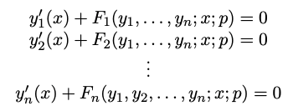

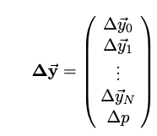

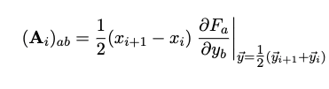
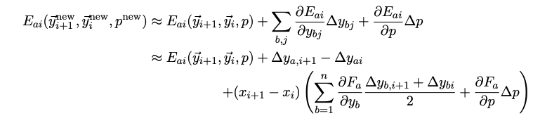

Backup
1. System of ODEs
2. Finite difference method and define a new vector
5. Define
3. Input initial guess and compute shift towards solution
4. Linearize in the shifts

Slide 31
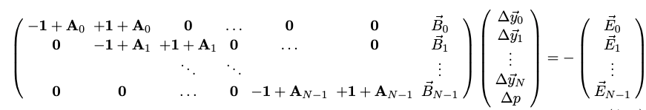

Backup
6. Define a matrix equation
7. Solve for the shifts and repeat until solution is found

