Slide 1
Global fit of Non-relativistic Effective Operator Dark Matter using Solar Neutrinos
Neal Avis Kozar
Aaron Vincent
Work with Aaron Vincent, Pat Scott, and help from the GAMBIT collaboration
AUGUST 11, 2022 TeVPA

Slide 2
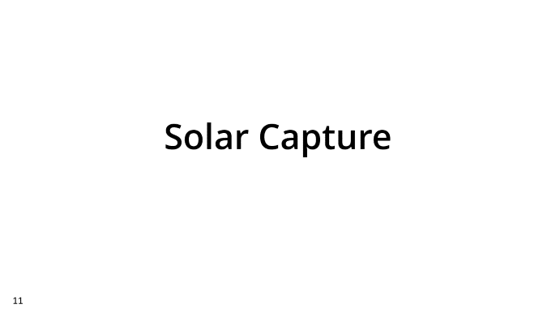
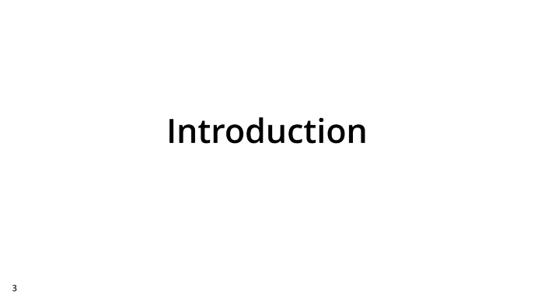
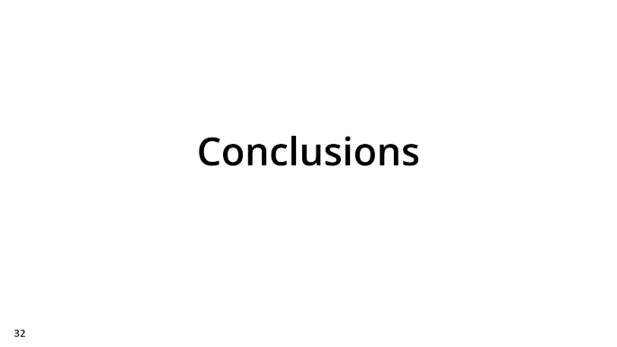
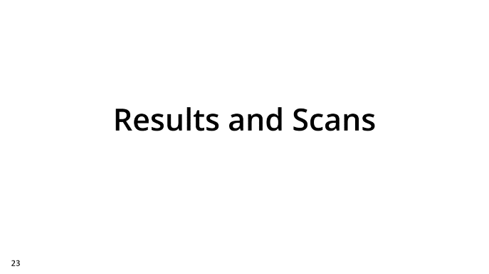
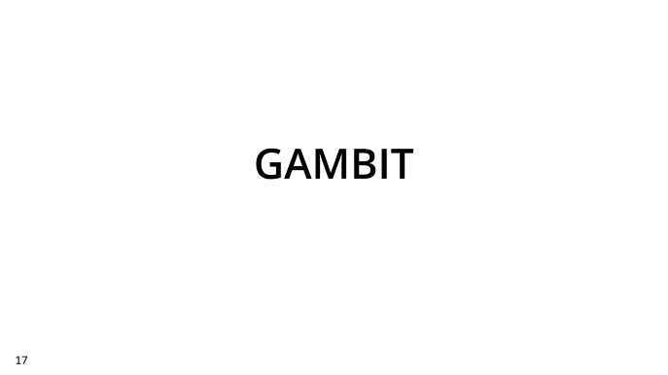
Talk Summary

Slide 3
Introduction

Slide 4
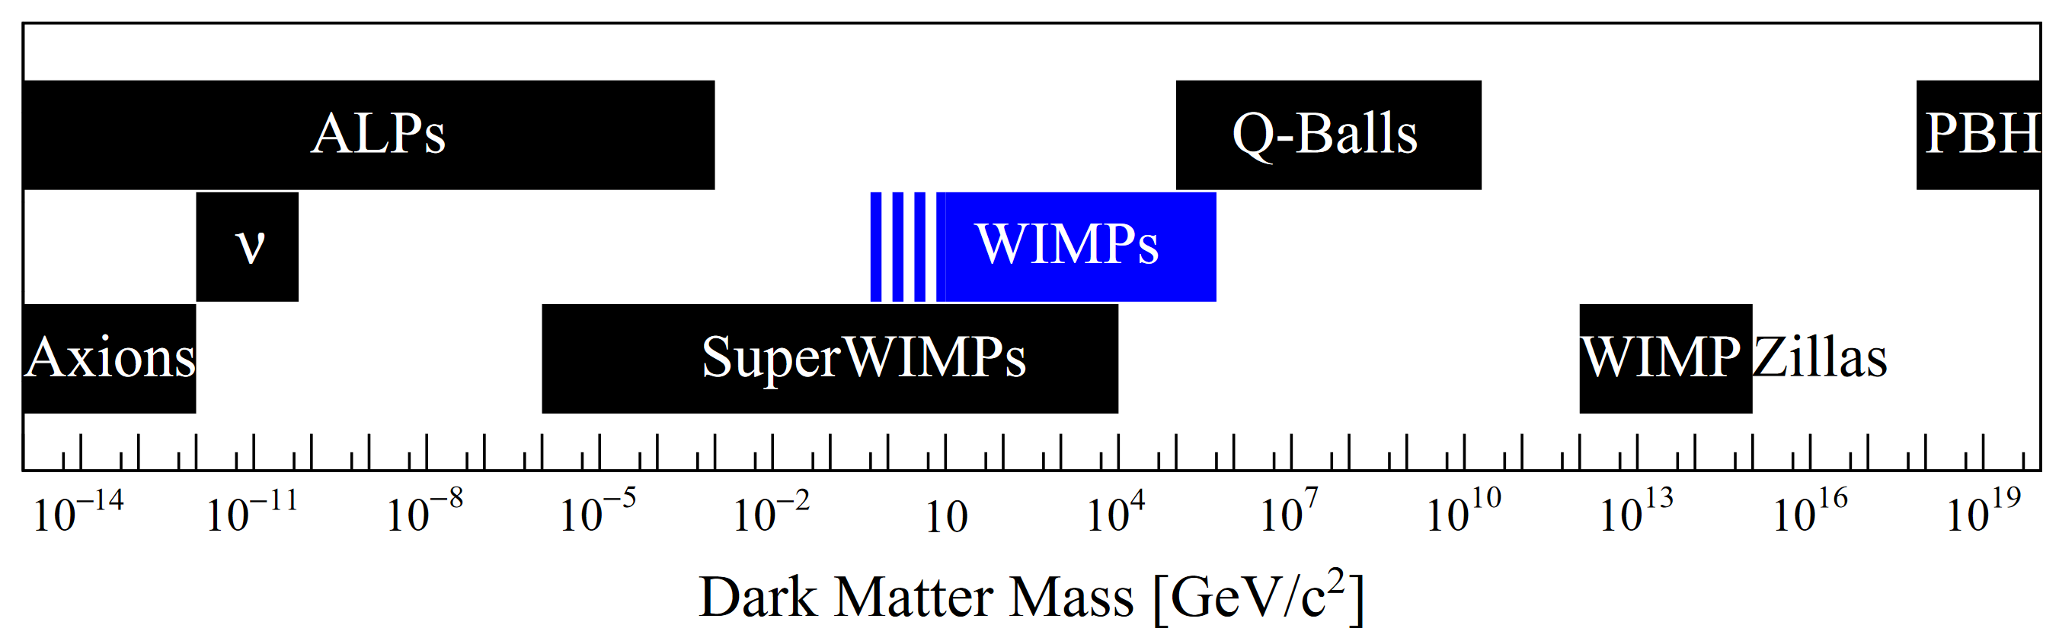
Dark Matter Candidates
Dark matter is known to interact gravitationally
Otherwise the parameter space is open to search
This work focuses on the WIMP
[1]
Notes:
The range of masses that DM could be is rather large
No alternative to gravitational interaction detected as of yet – large parameter space to search

Slide 5
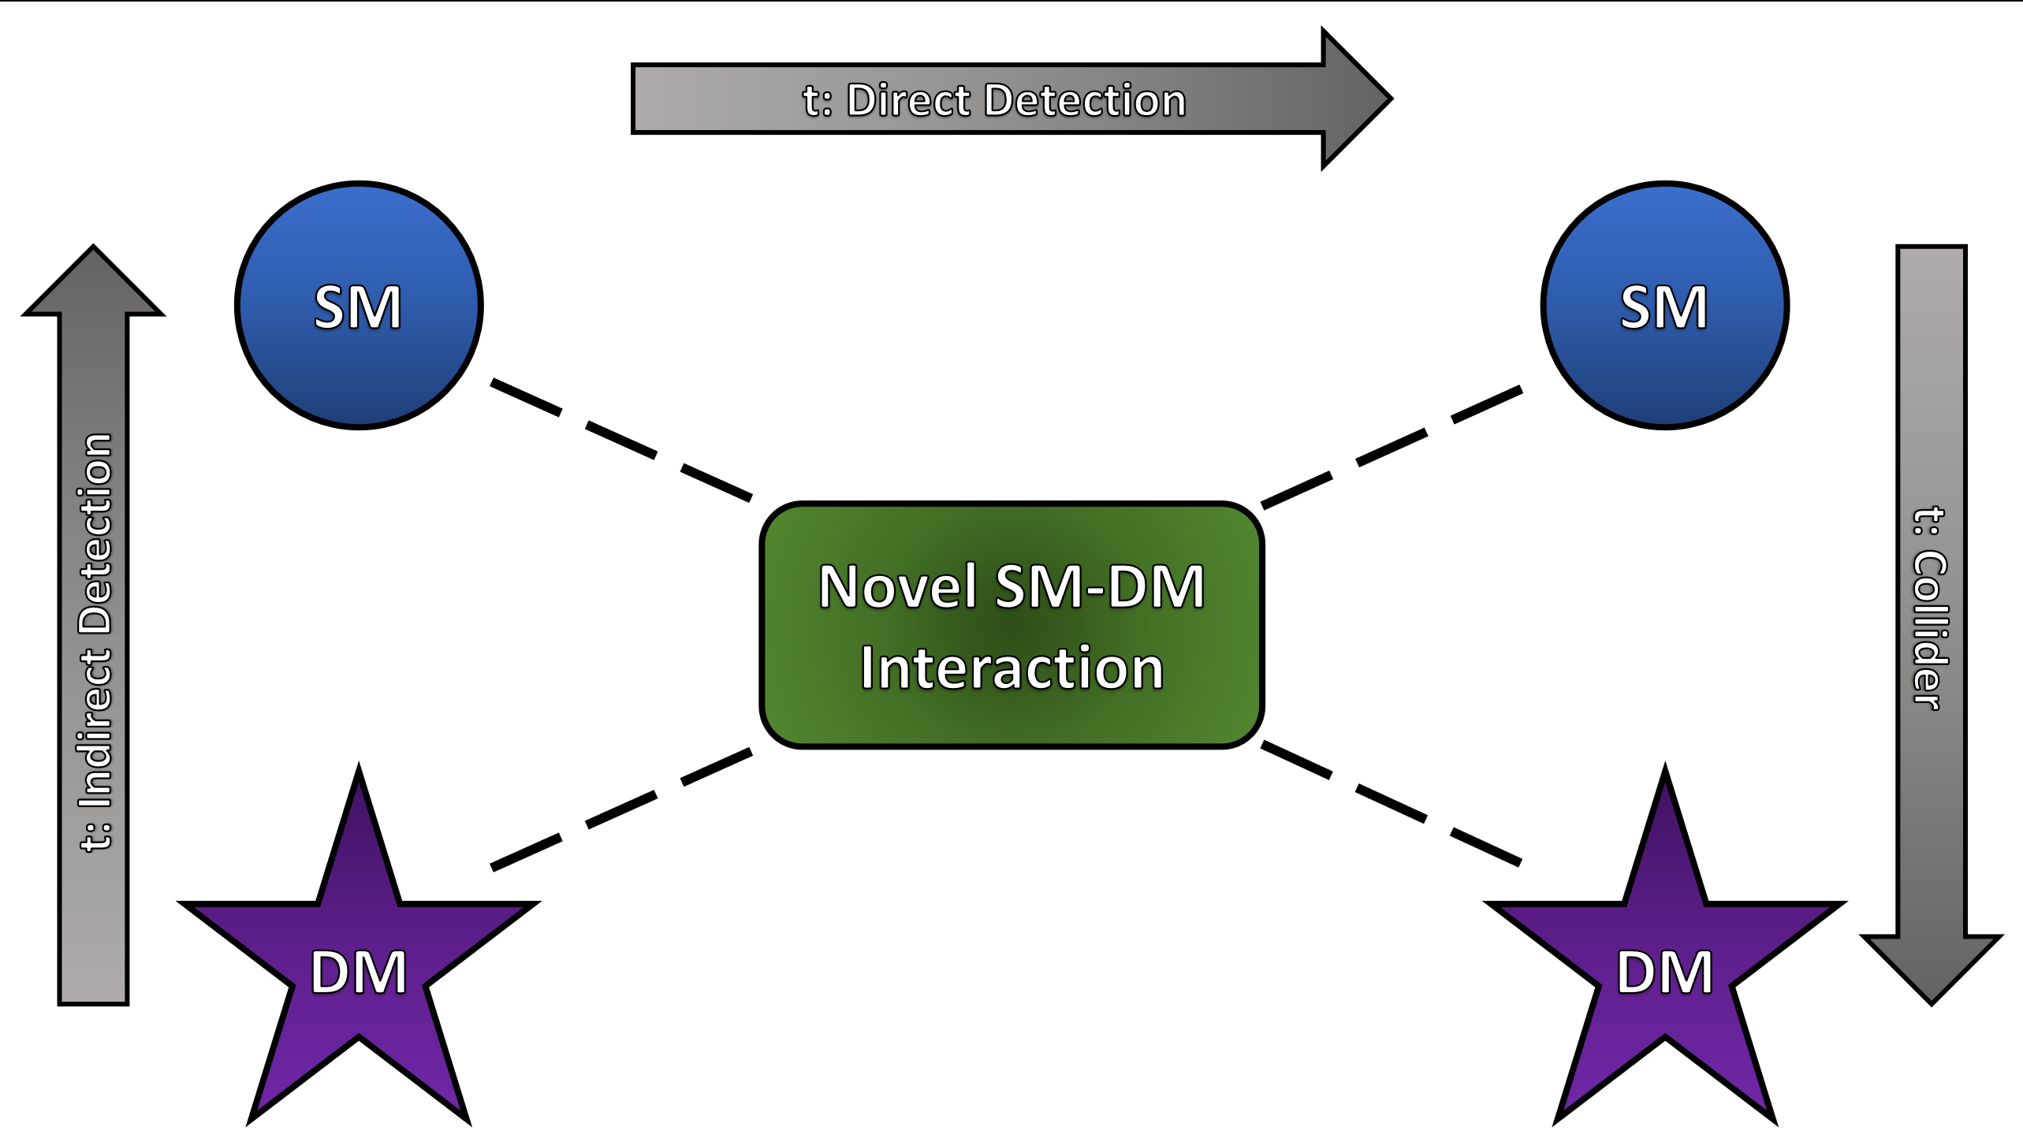
Search Types
Indirect detection, direct detection, collider searches
Each are independent detection methods
Solar neutrinos act as a compliment to direct detection
Notes:
Searches can be categorized into DD, ID, and collider

Slide 6
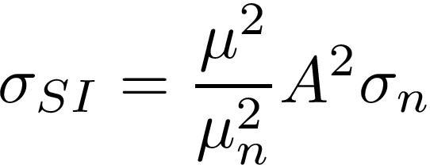
Direct Detection
The goal is to detect the recoil of nuclei from dark matter interactions
Parametrized into two cases:
  Spin-dependent, coupling to the overall spin of nuclei
  Spin-independent, which receives a coupling enhancement for higher mass nuclei
Notes:
Direct searches are described as either SD or SI
SI recieves an A^2 enchancement, making xenon a good target

Slide 7

Advantages of an Effective Field Theory
High-energy theory parametrization
Fitzpatrick et. al. [2] describe a toy model dark matter effective field theory
Dark matter substructure can be ignored at galactic halo velocities
DM
Notes:
The toy model from Fitzpatrick is used to demonstrate that an EFT helps in detection of WIMPs at galactic velocities

Slide 8
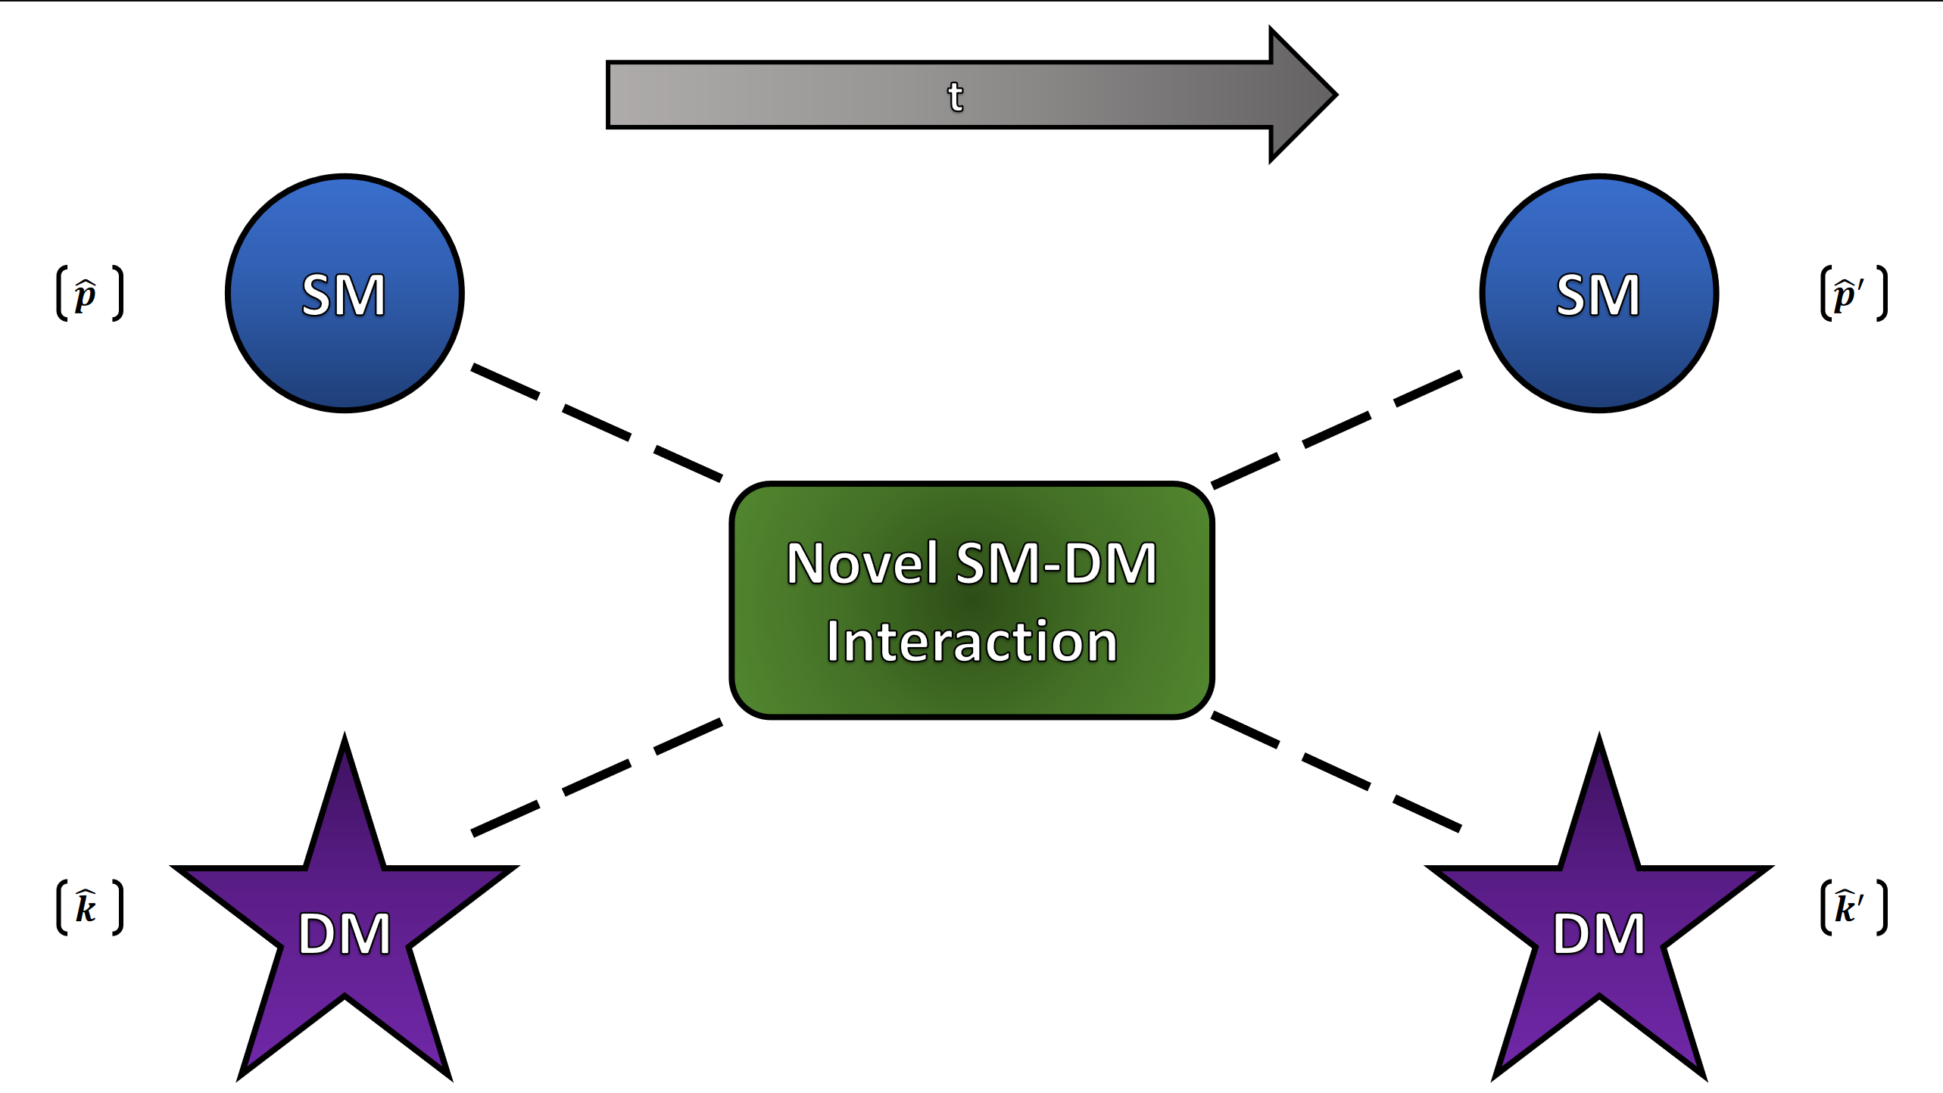
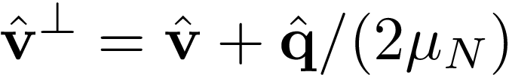
Hermitian Operators
The general case of a dark matter scattering interaction is considered
The Hermitian operators that govern the interaction are
Notes:
Hermitian operators that obey Galilean invariance
Linearly independent

Slide 9
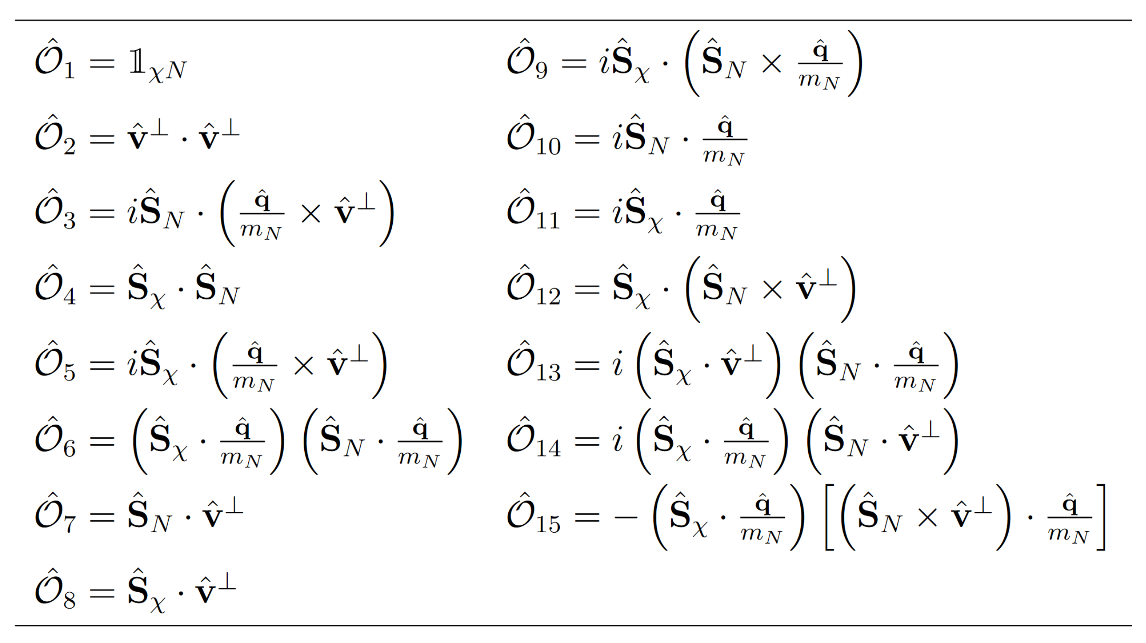
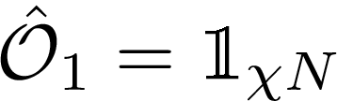
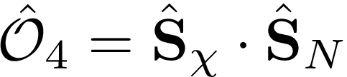
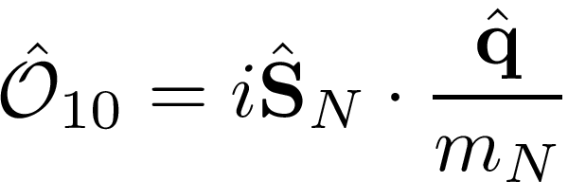
Non-Relativistic Effective Operators
Spin-independent:
Spin-dependent:
Novel interactions, such as
Acts as leading contributor to higher-energy theories [3]:
Notes:
We eliminate O2 for linearity in velocity

Slide 10
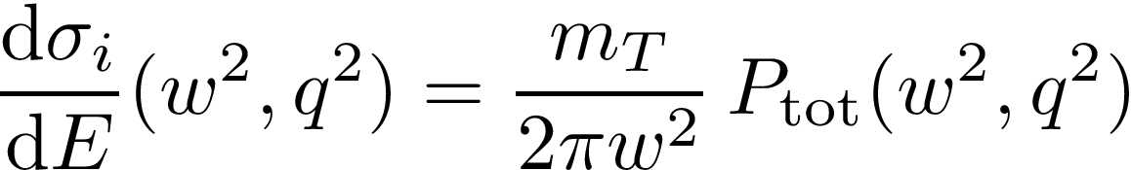
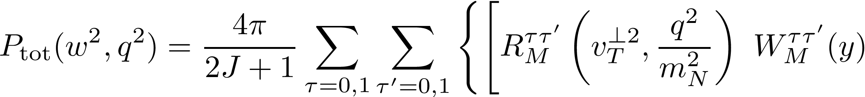
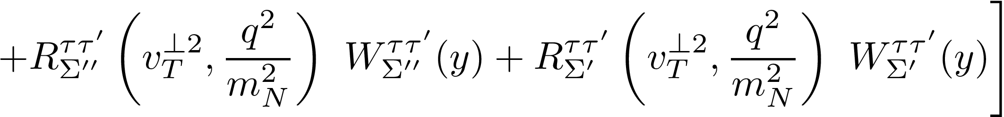
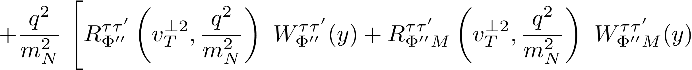
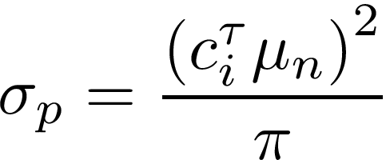
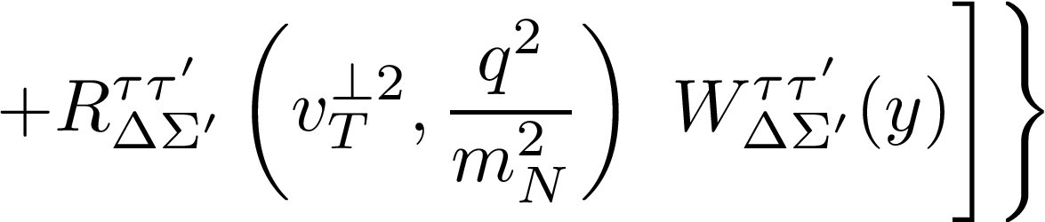
Cross Section
Cross section becomes a large sum over response functions
Effective Cross section
Notes:
Sum factors into DM and nuclear response functions
DM functions depend on the couplings
Nuclear functions are fit from Catena

Slide 11
Solar Capture

Slide 12
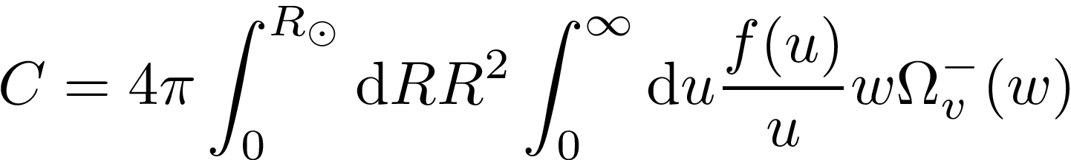
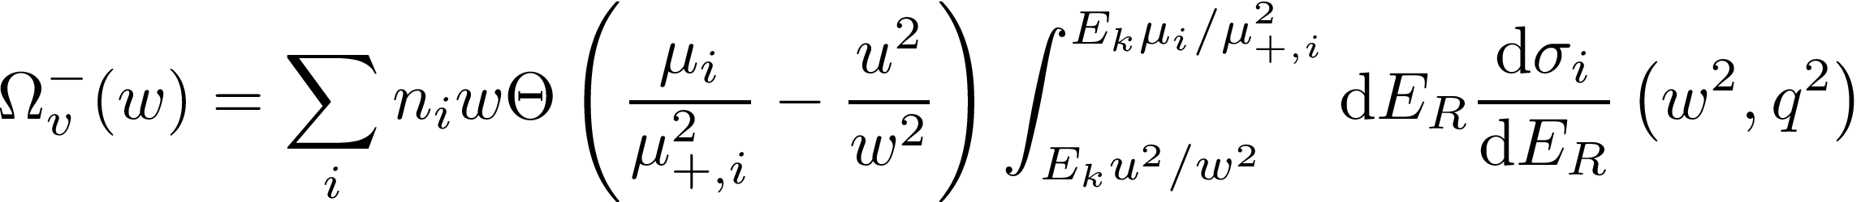
Capture Process
DM
Dark matter is captured when it scatters to below the local escape velocity in the Sun
SM
Notes:
Capture rate is integrated over Sun’s volume and DM halo velocities
Omega integrates over recoil energy of interaction

Slide 13
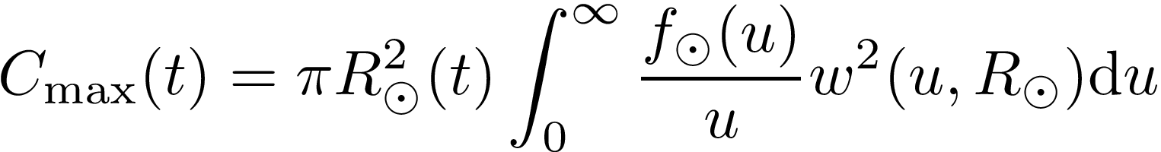
Geometric Limit
The Sun has a hard limit of dark matter capture
We take minimum of the limit and capture rate
Notes:
erf: gravitational enhancement
Stitching not correct, we are stitching optically thin and thick regimes
At the masses we work with C_max ~ 10^29 s^-1

Slide 14
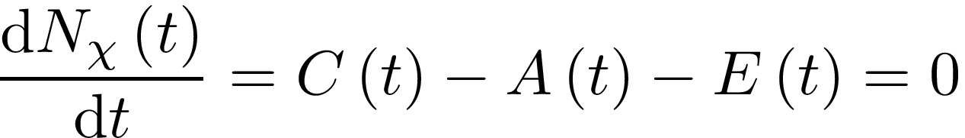
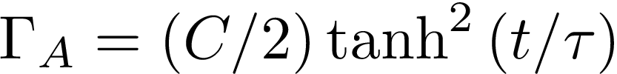
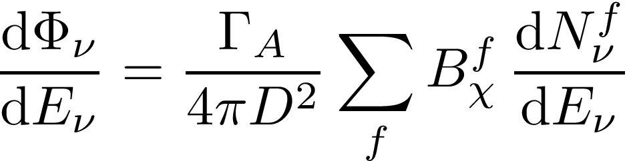
Annihilation in the Sun
The number density of dark matter is given by
At steady state, the annihilation rate only depends on the capture:
The final neutrino flux is found from branching ratios
Notes:
Evaporation doesn’t matter for DM heavier than ~4 GeV (Busoni et. al. 2017 https://arxiv.org/pdf/1703.07784.pdf)

Slide 15
Other Applications
The same calculation in other stars can be performed
  There is current work to integrate with DarkMESA
Can look at other phenomena like
  Energy transport [4,5]
  Modified main sequence lifetimes [6]
  Triggering thermonuclear explosions in stellar remnants [7-9]

Slide 16
Capt’n General
Capt’n [10] was designed for capture rate calculations
  As standalone
  GAMBIT backend
  DarkMESA companion
Capt’n uses several parameters to calculate the DM capture rate in s⁻¹
  Solar model including isotopic abundances
  Dark matter halo parameters
  Interaction model
Notes:
Abundances tabulated radially
We use the GSS09ph solar model in scans

Slide 17
GAMBIT

Slide 18
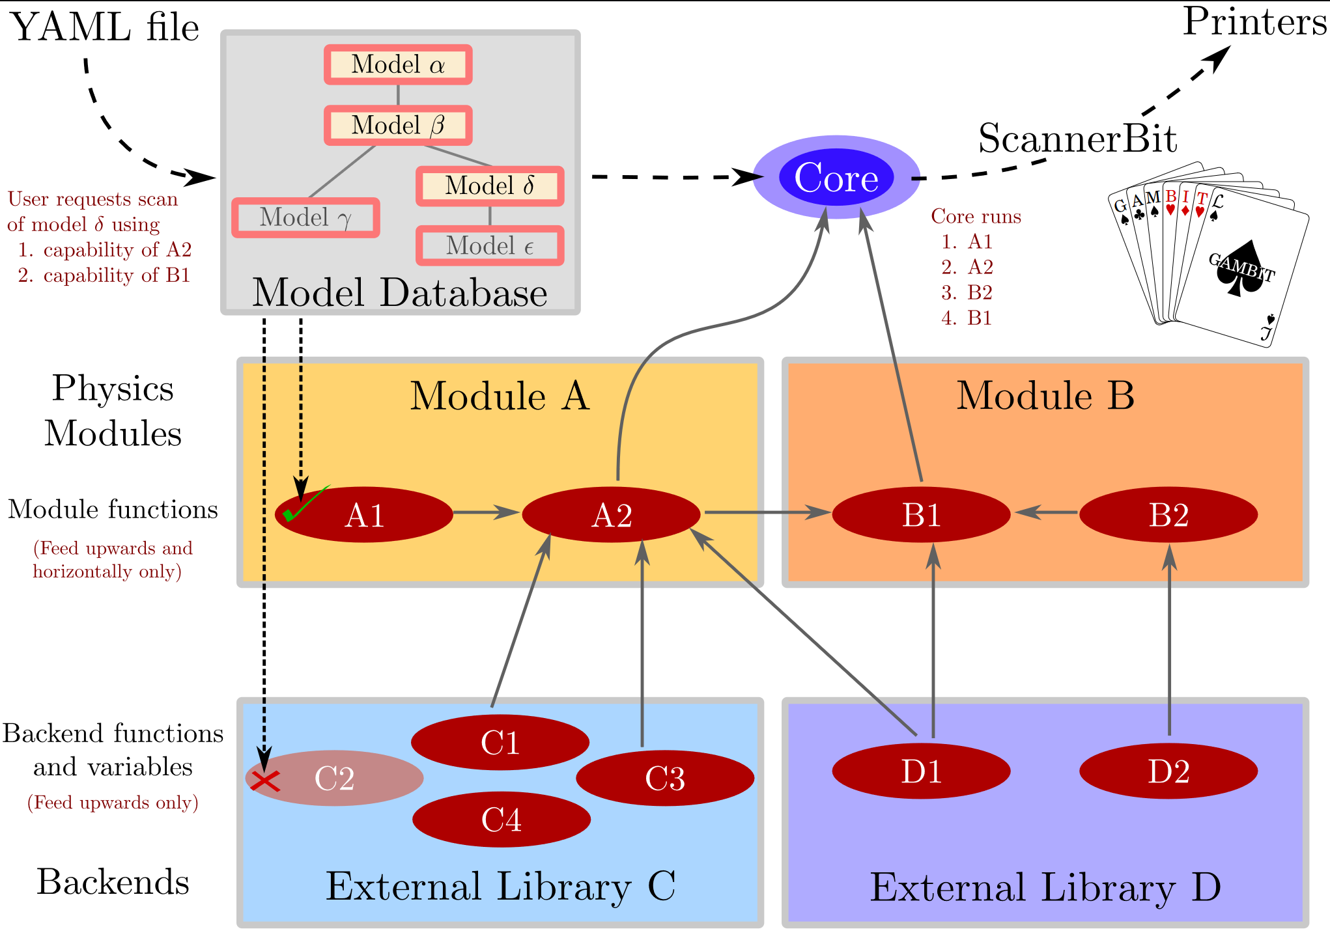
GAMBIT
GAMBIT [11] combines many separate branches of physics to perform global scans of novel physics using existing experimental data
Modular design to promote contributions
Global scans can pick out signals of new physics before single experiments
Notes:
GAMBIT can evaluate the steps to calculate quantities that compare with experimental data
Scanners control the parameter space search
External code can be called as a backend to bolster GAMBIT’s capabilities

Slide 19
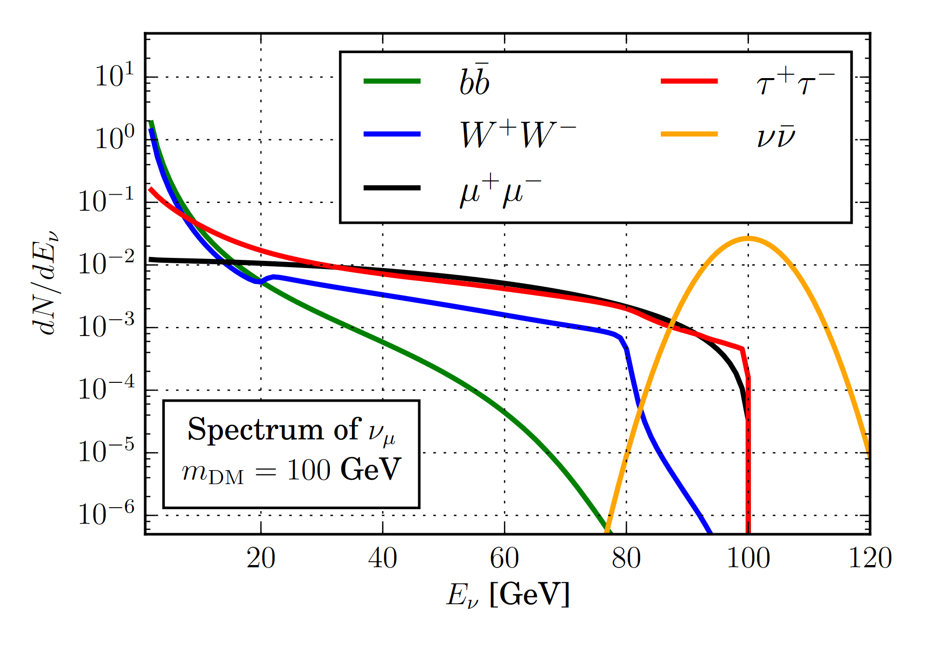
IceCube Neutrino Observatory
For the 79-string run, IceCube’s [12] digital optical modules were arranged as:
  73 strings with 125 m horizontal spacing and 17 m vertical spacing
  6 strings with less than 75 m horizontal spacing and 7 m vertical spacing in the DeepCore [13]
The data is broken into three independent streams, of two varieties:
  Low energy: exterior strings act as muon veto for the central array (Summer Low and Winter Low)
  Higher energy: no restrictions (Winter High)
IceCube performs better at higher-energy neutrino detection
[14]
Notes:
6 interior strings have higher quantum efficiency DOMs + 7 surrounding strings make up deepcore

Slide 20
Direct Detection Experiments
Eight direct detection experiments were included:
  LUX 2016 [15]
  XENON1T 2018 [16]
  PandaX-II 2016 [17] and 2017 [18]
  PICO-60 2017 [19]
  CRESST-II [20]
  CDMSlite [21]
  DarkSide-50 [22]
These are:
  Dual-phase time projection chambers (LUX, XENON1T, PandaX-II, and DarkSide-50)
  Super-heated fluorine (PICO-60)
  Cryogenic crystal detectors (CRESST-II and CDMSlite)

Slide 21
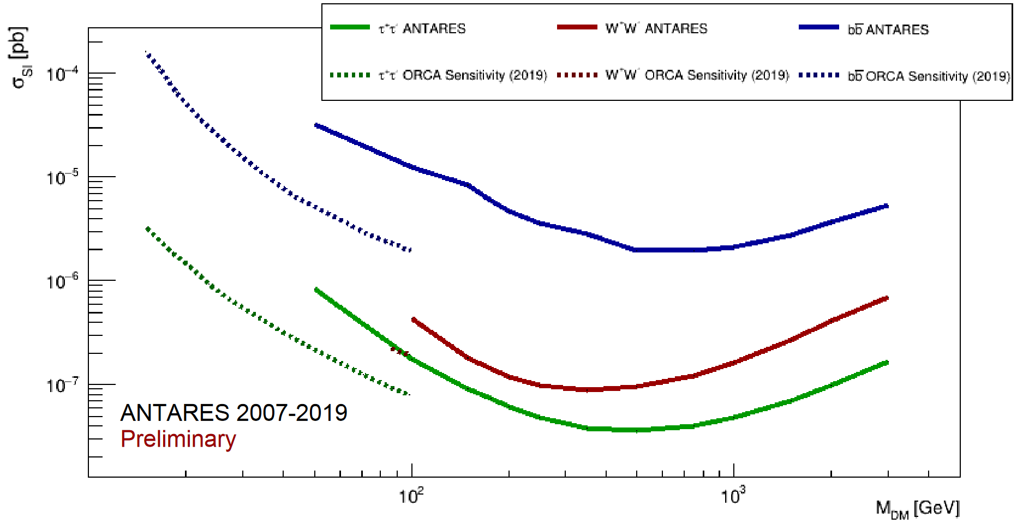
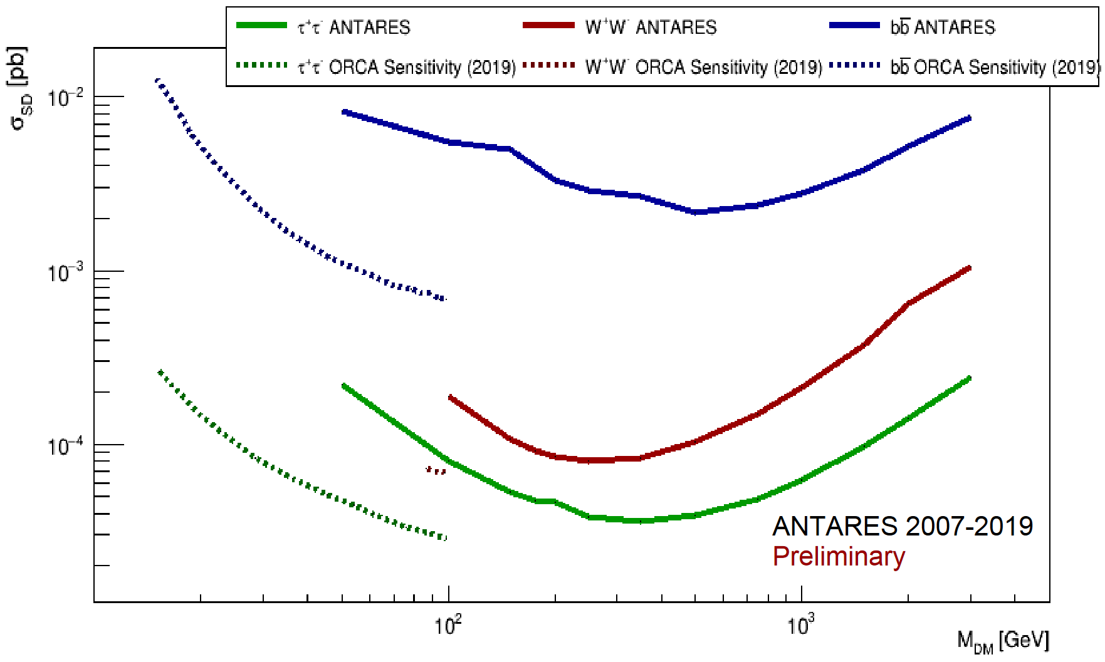
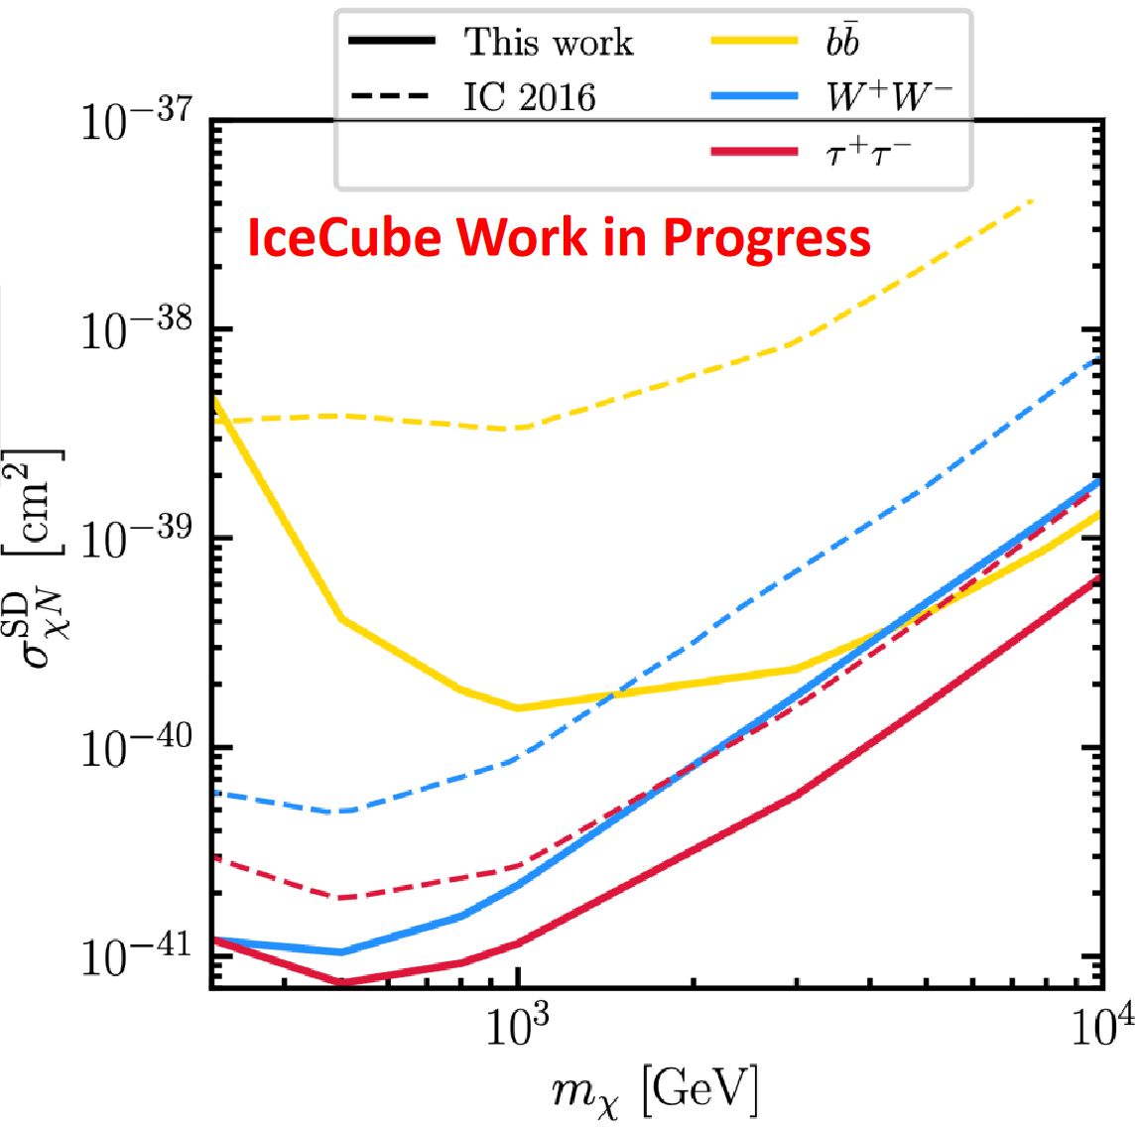
Added Experiments
Two extra experiments were included in a post processing run
  ANTARES from Dark Ghosts 2022 presented by Chiara Poirè [23]
  IceCube Update from Dark Ghosts 2022 presented by Stephan Meighen-Berger [24]

Slide 22
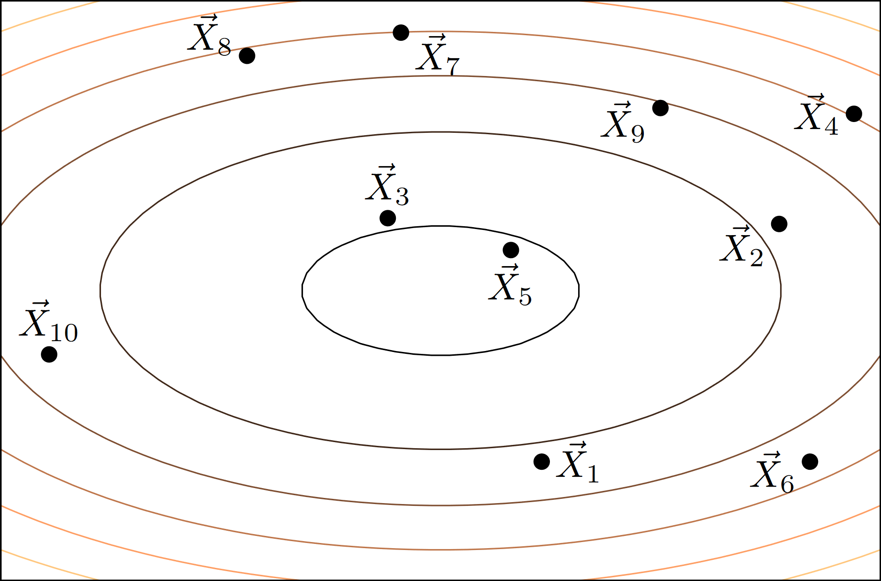
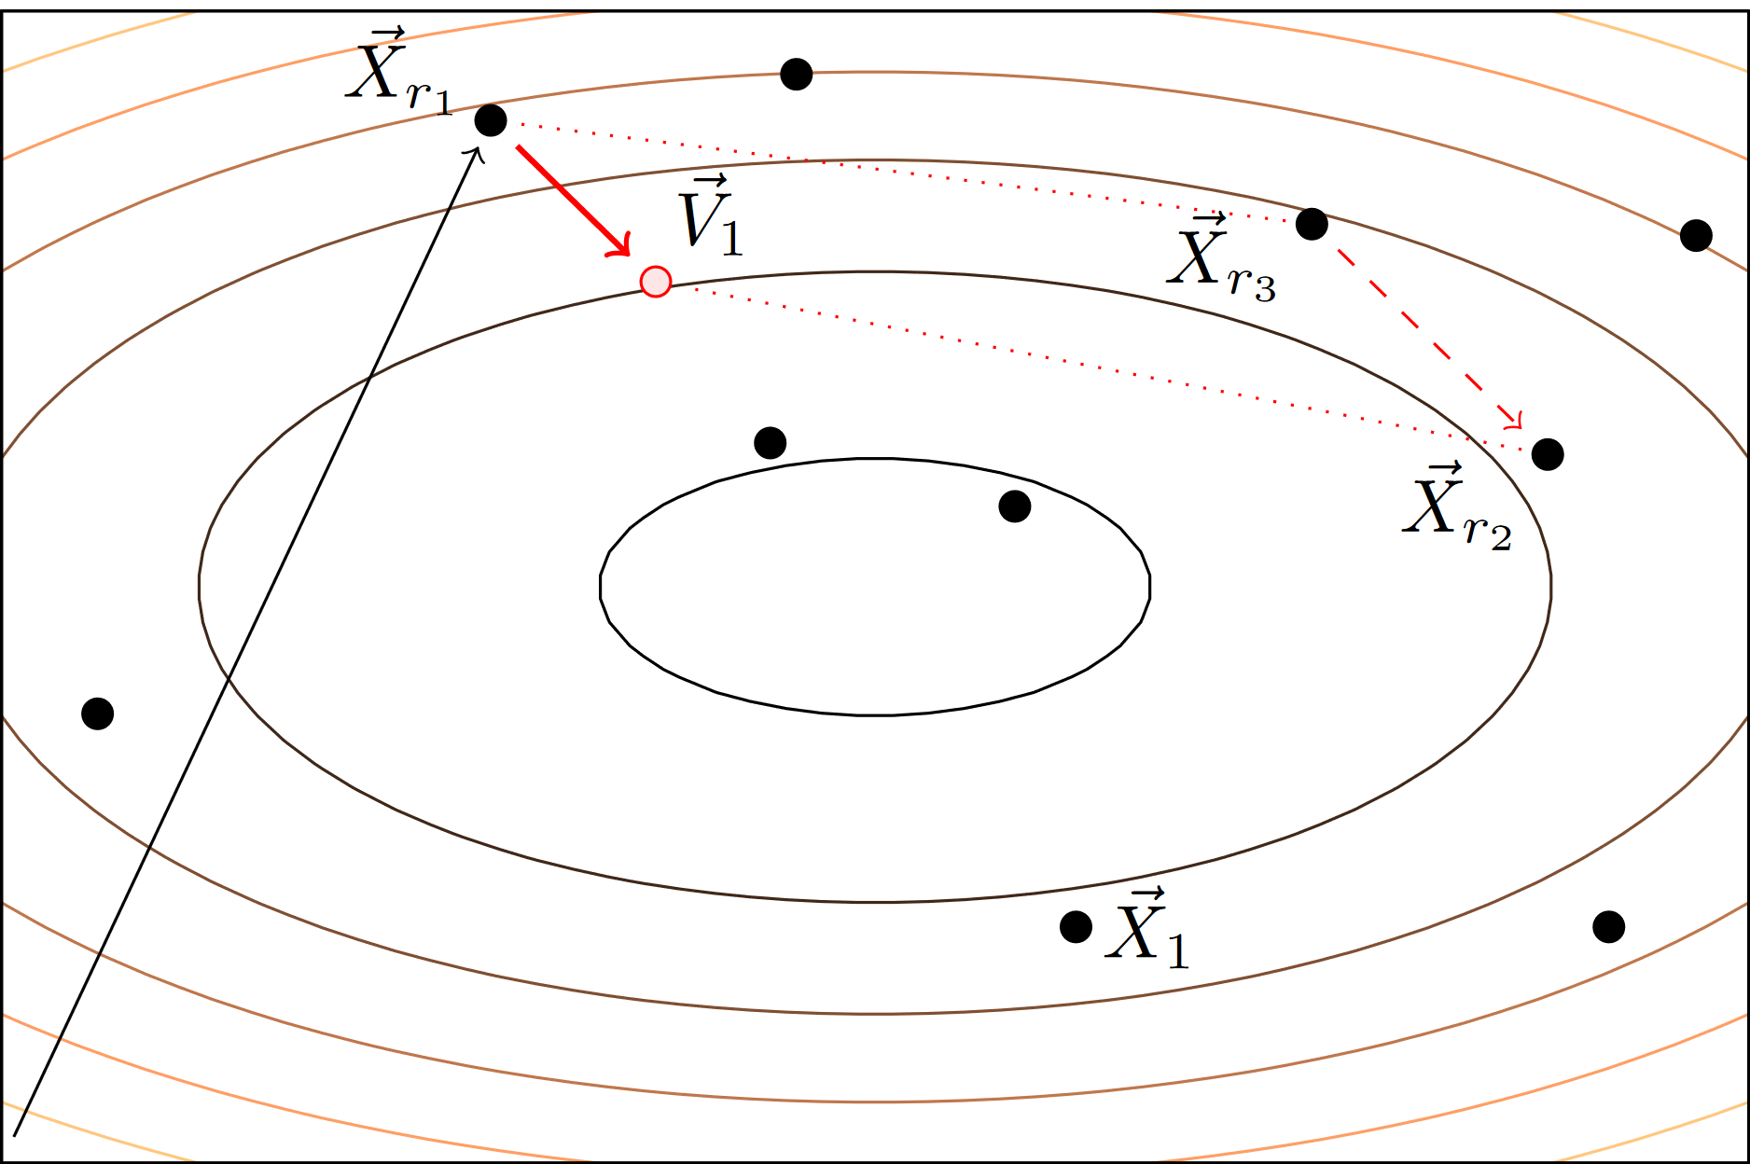
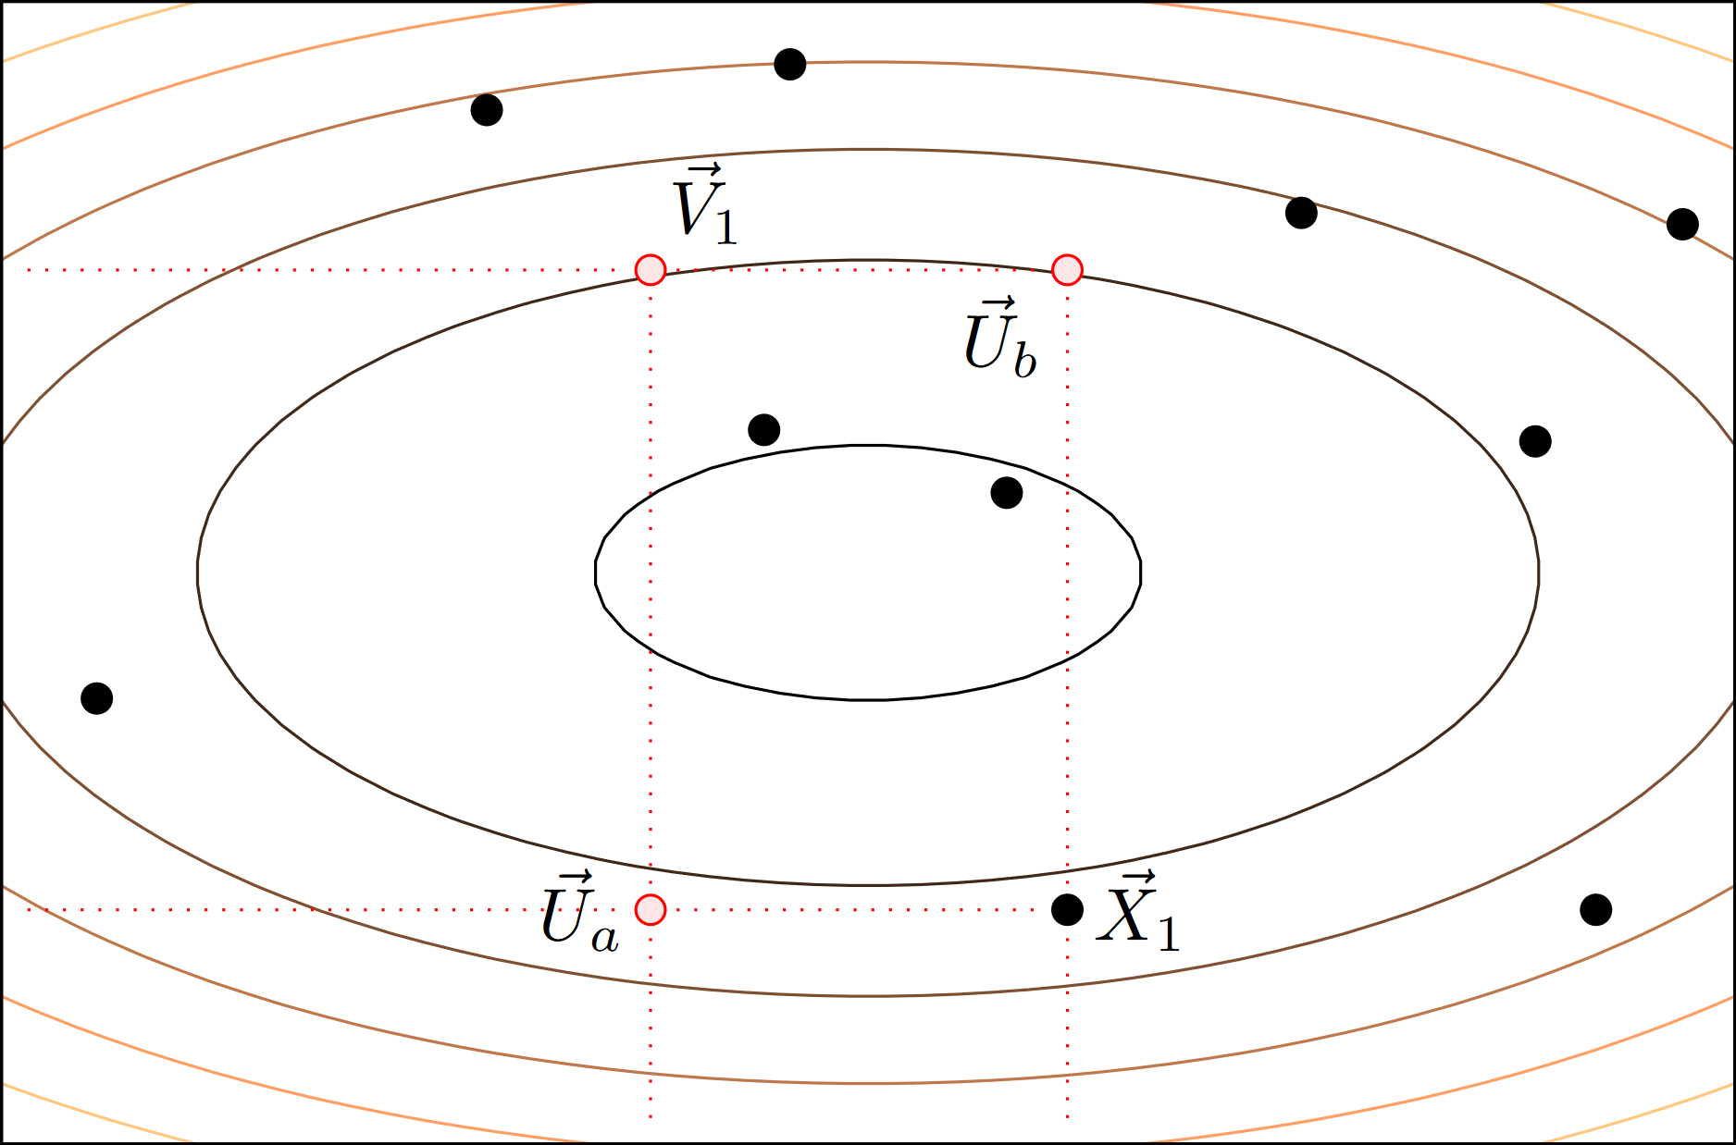
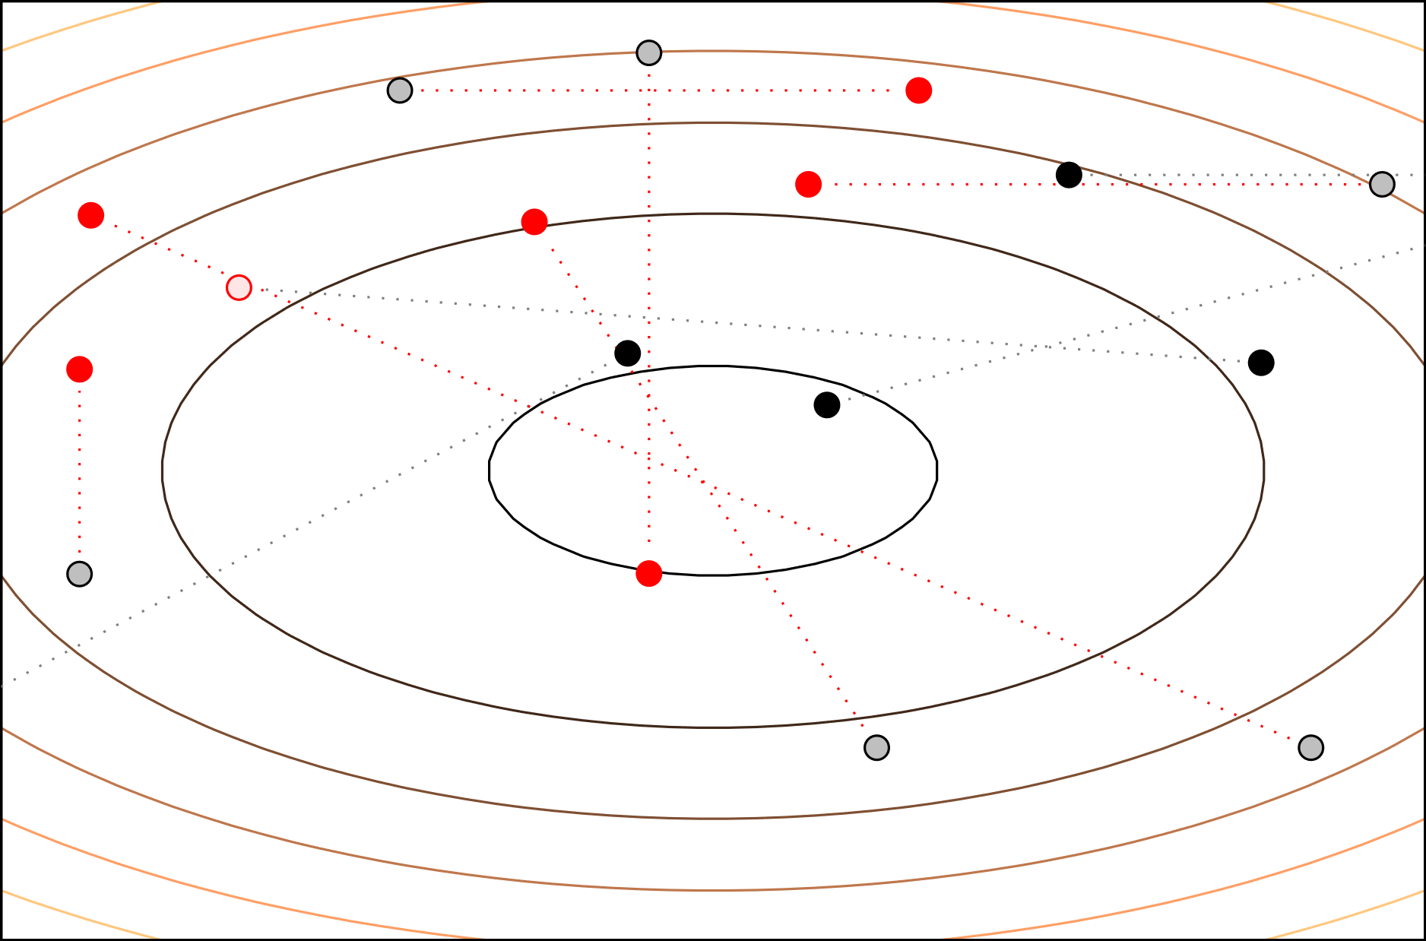
Scanning with Diver
Diver is a differential evolution scanner in GAMBIT
It can rapidly map likelihood contours
But cannot give posteriors
Differential evolution occurs in three steps
  Mutation
  Crossover
  Selection
[25]
Notes:
Mutation: create a new vector using 3 random points and scaling factor
Crossover: mix the original point’s and new vector’s components
Selection: pick either the vector or original point (vector chosen on tie breaks)
diver:
plugin: diver
like: LogLike
NP: 10000
covthresh: 0.001

Slide 23
Results and Scans

Slide 24
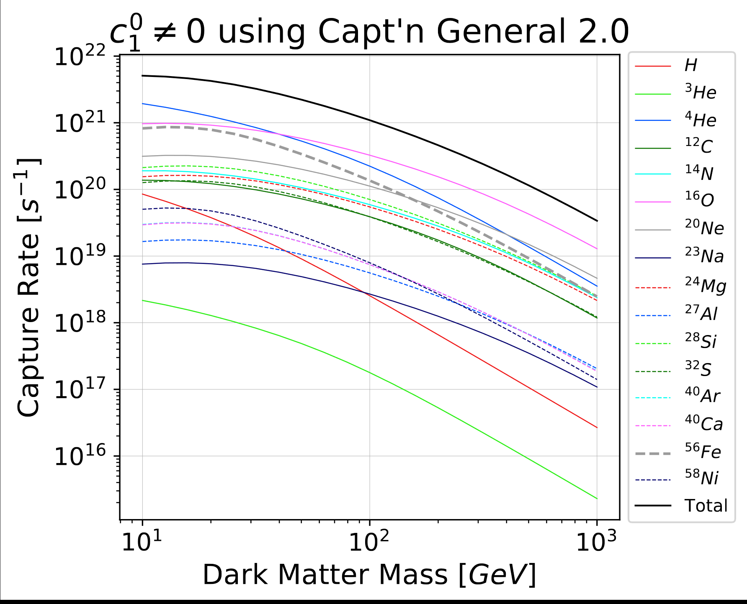
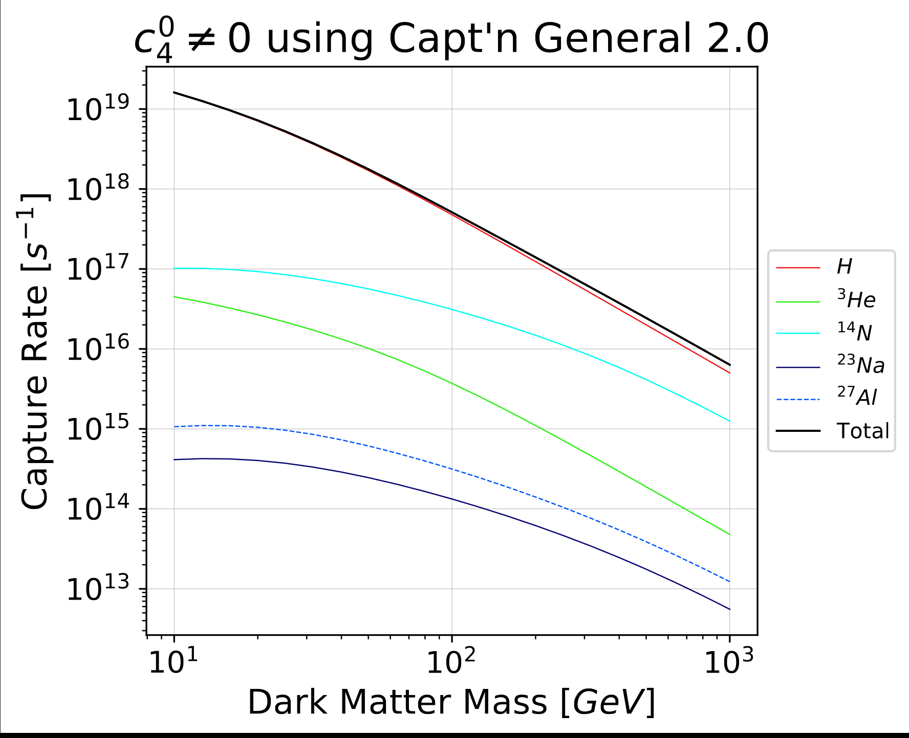
Capt’n Capture Rates c₁ and c₄
Capt’n can return capture rates per isotopic contribution
Capt’n shows accuracy around ~5% of the previous Catena and Schwabe [26]
Notes:
Generally we see either SI type interactions or SD type interactions
Halo parameters used:
rho_0 = 0.4d0
rot_vel = 235.d0
dispersion = 235.d0
esc_vel = 550.d0
(Comparisons used gs98 older solar model, apparently what Catena used)

Slide 25
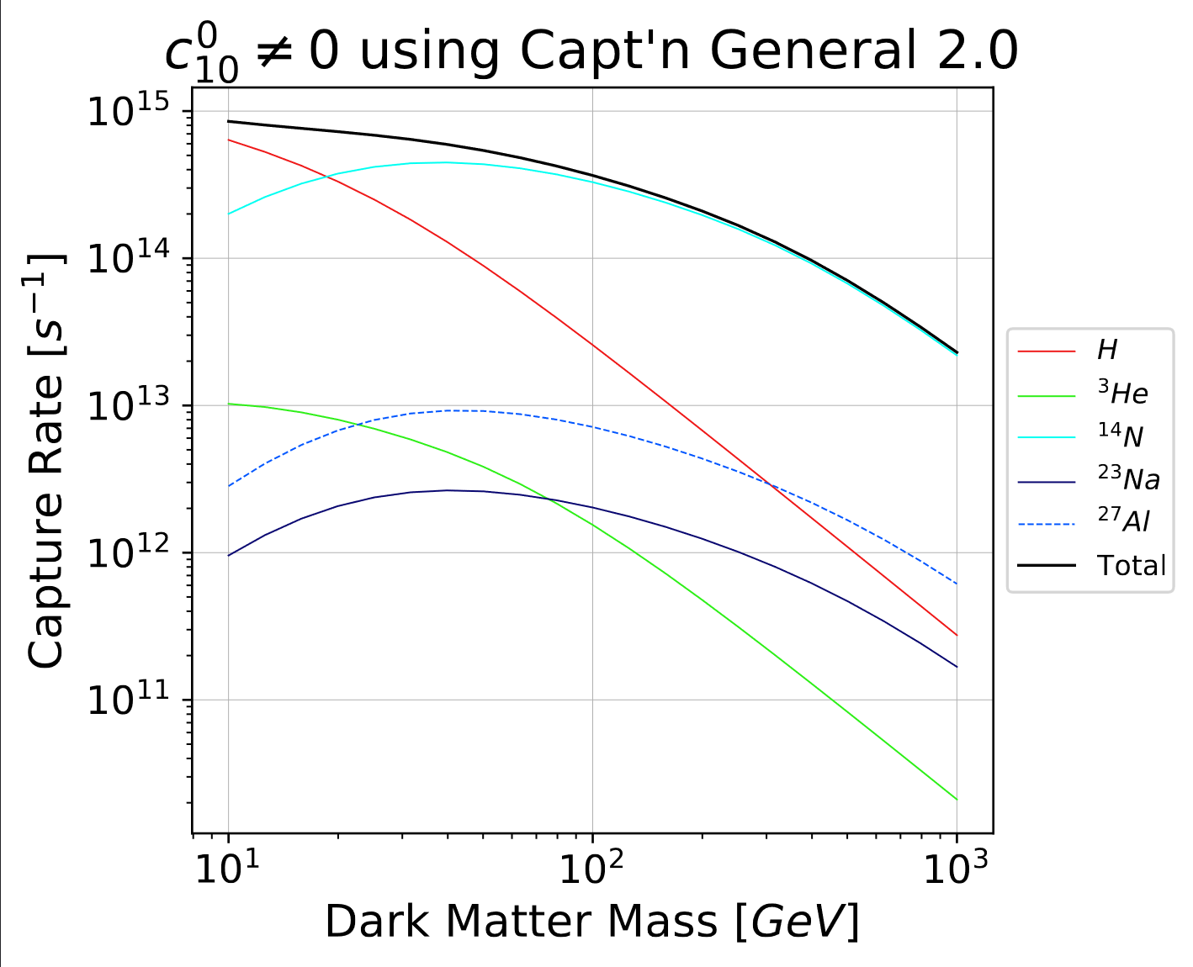
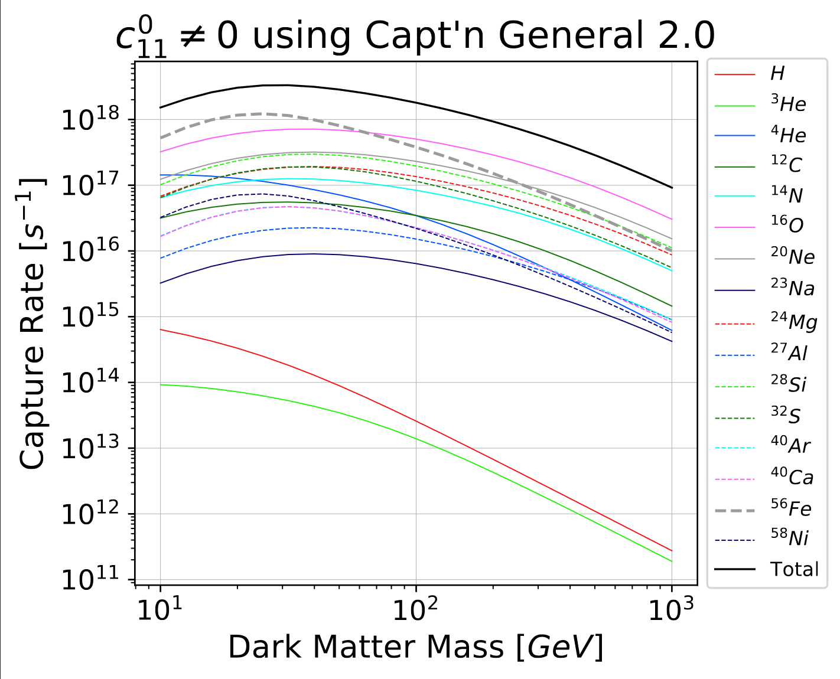
Capt’n Capture Rates c₁₀ and c₁₁
Certain isotopes dominate depending on coupling
Notes:
C10 is a spin dependent type with preference for nitrogen at higher masses
C11 is a spin independent type with preference for iron and oxygen (an has overall capture rates rivalling c4!)

Slide 26
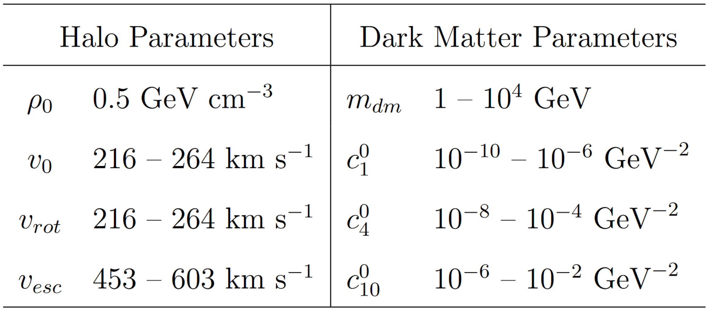

GAMBIT Scan Parameters
The halo parameters are shared between all GAMBIT scans
These scans are presented as profiled likelihoods with 90% C.L.
All scans have 2 decay channel versions: $b\overline{b}$ and $W^{+}W^{−}$
Notes:
Halo: gaussian priors from measurements
DM: log-flat priors
Density degenerate with the mass (so we just fix density)

Slide 27
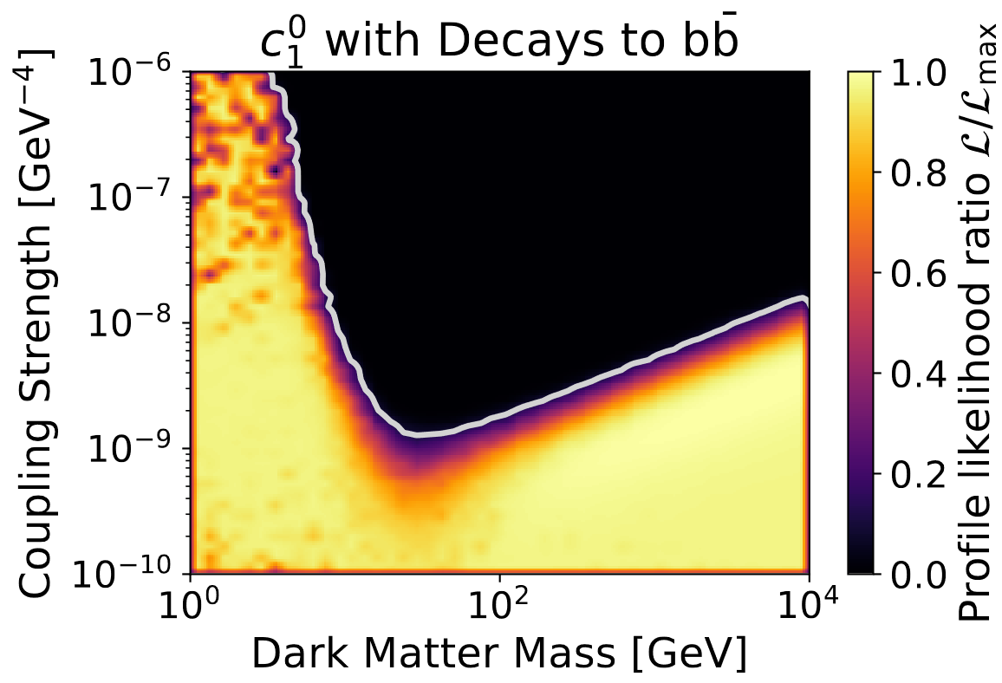
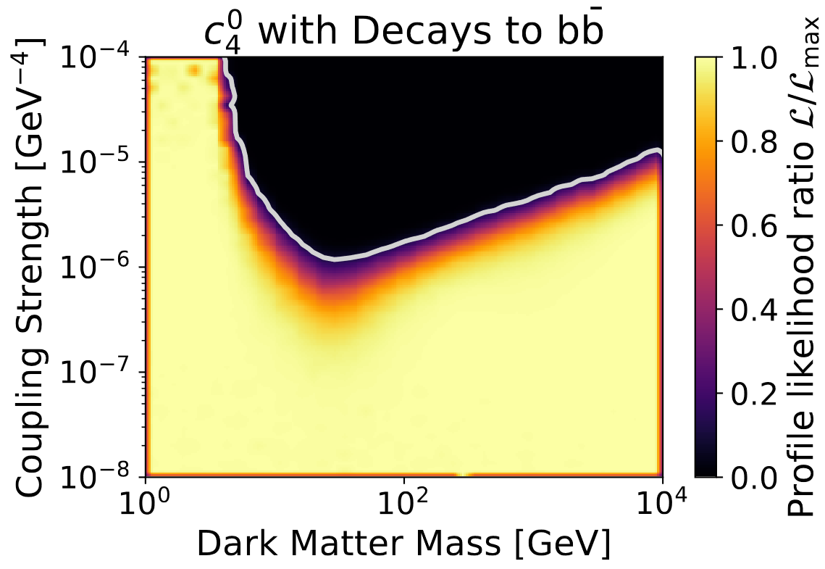
Spin-Independent and Spin-Dependent $b\overline{b}$ Channel
The bottom quark annihilation channel for c₁ (left) and c₄ (right)
Dominated by leading direct detection experiments
Preliminary
Preliminary
Notes:
bb channel sees regular DD exclusion bounds
Low mass: sensitivity limited by recoil energies
High mass: limited by number density

Slide 28
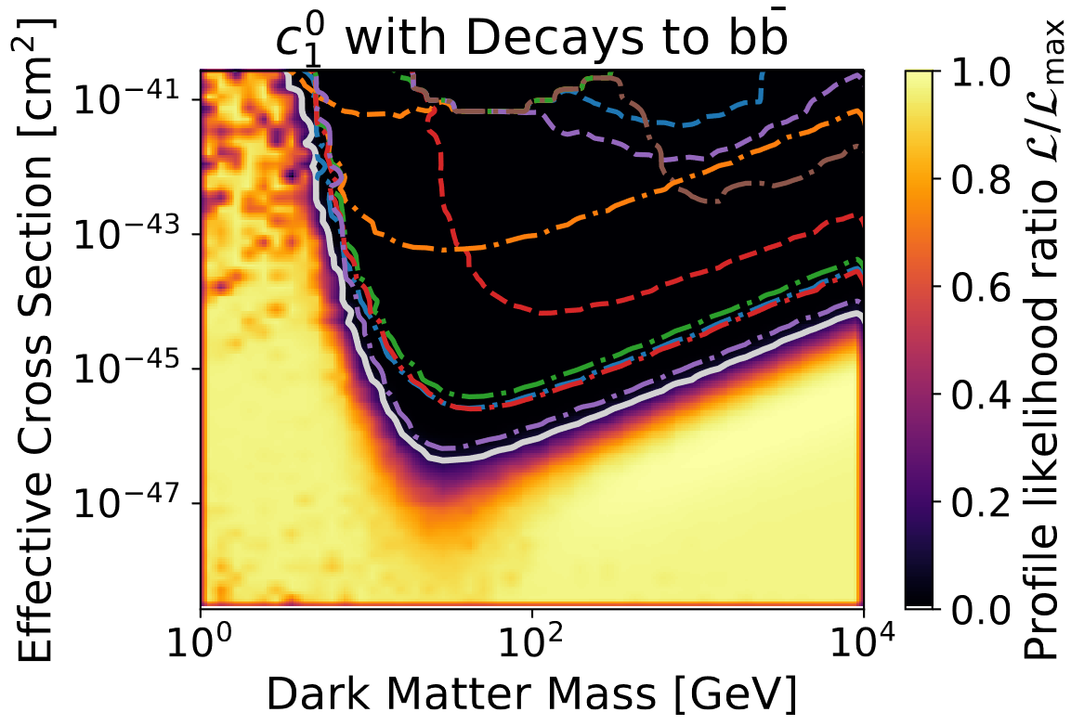
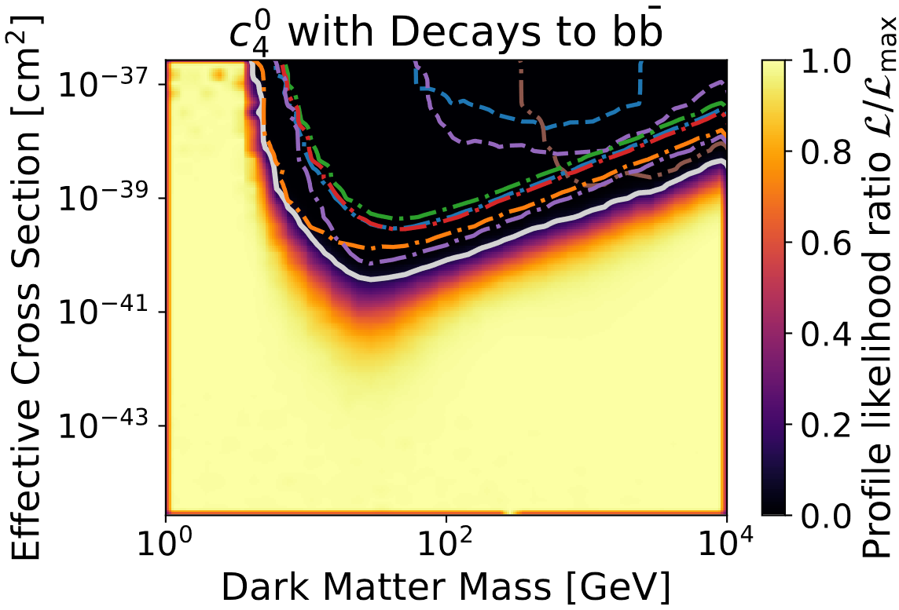
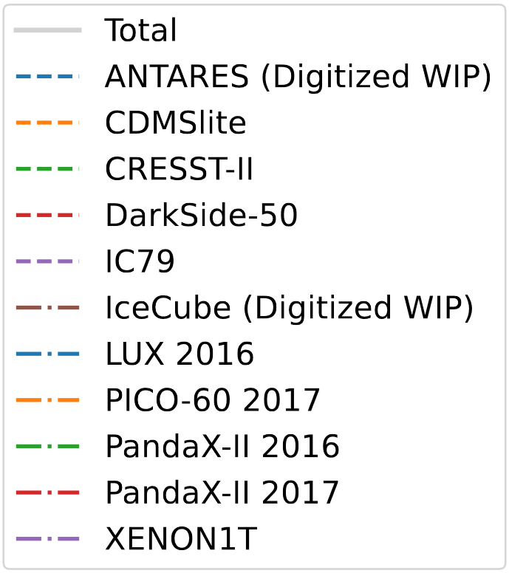
Spin-Independent and Spin-Dependent $b\overline{b}$ Channel Breakdown
The bottom quark annihilation channel for c₁ (left) and c₄ (right)
Lead by XENON1T in spin-independent, and PICO-60 in spin-dependent
Preliminary
Preliminary
Notes:
We see that IceCube not as sensitive to softer annihilation channels
(WIP IceCube gets some improvement in the bb channel)

Slide 29
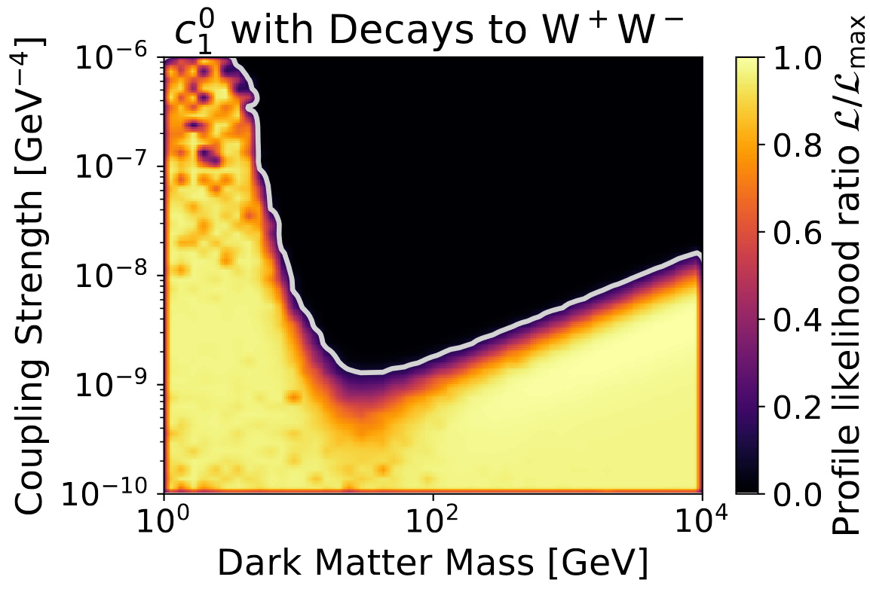
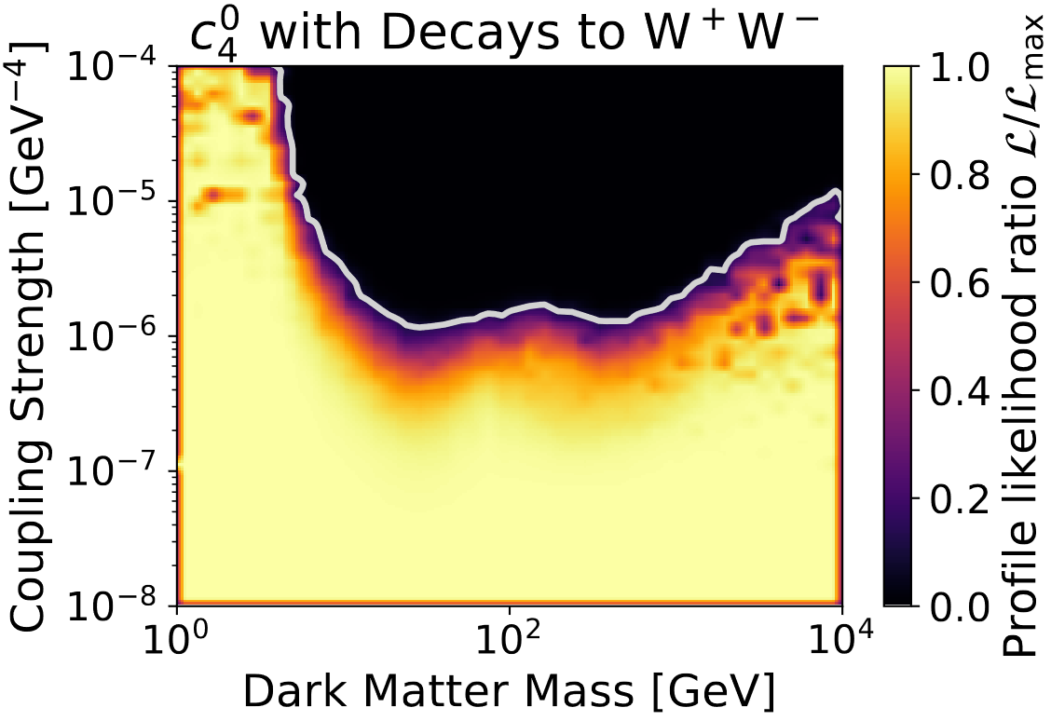
Spin-Independent and Spin-Dependent $W^{+}W^{−}$ Channel
The W boson annihilation channel for c₁ (left) and c₄ (right)
Spin-dependent channel receives solar neutrino contribution
Preliminary
Preliminary
Notes:
WW channel sees IceCube contribution in SD case!

Slide 30

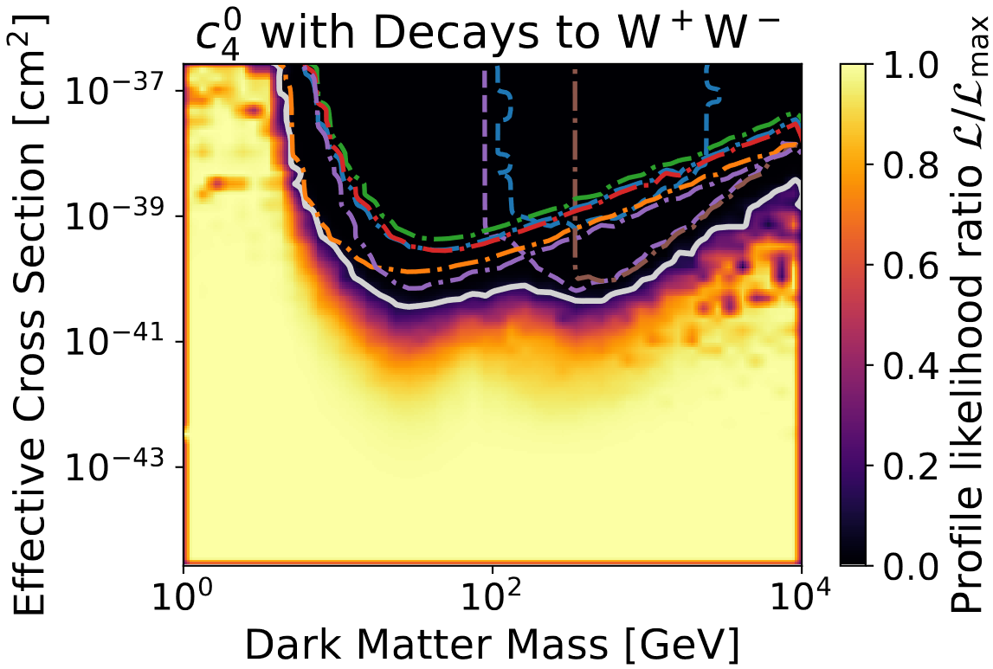
Spin-Independent and Spin-Dependent $W^{+}W^{−}$ Channel Breakdown
The W boson annihilation channel for c₁ (left) and c₄ (right)
IceCube out-competes in spin-dependent dark matter detection around ~500 GeV
Preliminary
Preliminary
Notes:
Harder channel causes IceCube to contribute more (better high energy sensitivity)

Slide 31
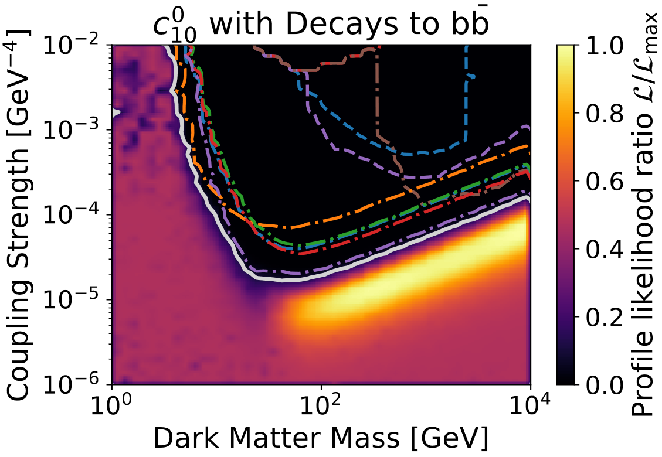


C₁₀ Coupling Experiment Breakdown
The W boson (right) and bottom quark annihilation channels for c₁₀
W boson channel sees contribution from solar neutrinos
Notes:
See similarities to the Spin-dependent case

Slide 32
Conclusions

Slide 33
Conclusions
Capt’n open to public and has already seen use by GAMBIT community (2106.02056)
Need accurate modeling of all isotopes in the Sun for accurate capture rates!
This is some of the first set of global constraints on non-relativistic effective operator dark matter from direct detection experiments in addition to solar neutrinos
IceCube solar neutrinos can assist with spin-dependent direct detection searches
Whenever new data is added to GAMBIT this work can be re-run with trivial modifications to improve constraints
This work is currently being modified for use in a Supernova scattering search lead by Christopher Cappiello
Notes:
EFT DM (GAMBIT 2021, https://arxiv.org/pdf/2106.02056.pdf)
Also see Christopher Chang’s “Global fits of s-channel simplified models for dark matter with GAMBIT” next at DM13 (Chernoff)
And see Csaba Balazs’ “GAMBIT update” next at Particle Physics 1 (1102)

Slide 34
Thank You
[1] M. Schumann, Direct Detection of WIMP Dark Matter: Concepts and Status, J. Phys. G 46 (2019) 103003, [arXiv:1903.03026].
[2] A. L. Fitzpatrick, W. Haxton, E. Katz, N. Lubbers, and Y. Xu, The Effective Field Theory of Dark Matter Direct Detection, JCAP 02 (2013) 004, [arXiv:1203.3542].
[3] J. B. Dent, L. M. Krauss, J. L. Newstead, and S. Sabharwal, General analysis of direct dark matter detection: From microphysics to observational signatures, Phys. Rev. D 92 (2015) 063515, [arXiv:1505.03117].
[4] A. C. Vincent and P. Scott, Thermal conduction by dark matter with velocity and momentum-dependent cross-sections, JCAP 04 (2014) 019, [arXiv:1311.2074].
[5] A. C. Vincent, P. Scott, and A. Serenelli, Updated constraints on velocity and momentum-dependent asymmetric dark matter, JCAP 11 (2016) 007, [arXiv:1605.06502].
[6] J. Lopes and I. Lopes, Asymmetric Dark Matter Imprint on Low-mass Main-sequence Stars in the Milky Way Nuclear Star Cluster, Astrophys. J. 879 (2019) 50, [arXiv:1907.05785].
[7] J. Bramante, Dark matter ignition of type Ia supernovae, Phys. Rev. Lett. 115 (2015) 141301, [arXiv:1505.07464].

Slide 35
Thank You
[8] J. F. Acevedo, J. Bramante, A. Goodman, J. Kopp, and T. Opferkuch, Dark Matter, Destroyer of Worlds: Neutrino, Thermal, and Existential Signatures from Black Holes in the Sun and Earth, JCAP 04 (2021) 026, [arXiv:2012.09176].
[9] N. F. Bell, G. Busoni, S. Robles, and M. Virgato, Improved Treatment of Dark Matter Capture in Neutron Stars, JCAP 09 (2020) 028, [arXiv:2004.14888].
[10] N. Avis Kozar, A. Caddell, L. Fraser-Leach, P. Scott, and A. C. Vincent, Capt’n General: A generalized stellar dark matter capture and heat transport code, in Tools for High Energy Physics and Cosmology (2021) [arXiv:2105.06810].
[11] GAMBIT: P. Athron et. al., GAMBIT: The Global and Modular Beyond-the-Standard-Model Inference Tool, Eur. Phys. J. C 77 (2017) 784, [arXiv:1705.07908]. [Addendum: Eur.Phys.J.C 78, 98 (2018)].
[12] IceCube: P. Scott et. al., Use of event-level neutrino telescope data in global fits for theories of new physics, JCAP 11 (2012) 057, [arXiv:1207.0810].
[13] IceCube: R. Abbasi et. al., The Design and Performance of IceCube DeepCore, Astropart. Phys. 35 (2012) 615–624, [arXiv:1109.6096].
[14] IceCube: M. G. Aartsen et. al., Search for Neutrinos from Dark Matter Self-Annihilations in the center of the Milky Way with 3 years of IceCube/DeepCore, Eur. Phys. J. C 77 (2017) 627, [arXiv:1705.08103].
[15] LUX: D. S. Akerib et. al., Results from a search for dark matter in the complete LUX exposure, Phys. Rev. Lett. 118 (2017) 021303, [arXiv:1608.07648].

Slide 36
Thank You
[16] XENON: E. Aprile et. al., Dark Matter Search Results from a One Ton-Year Exposure of XENON1T, Phys. Rev. Lett. 121 (2018) 111302, [arXiv:1805.12562].
[17] PandaX-II: A. Tan et. al., Dark Matter Results from First 98.7 Days of Data from the PandaX-II Experiment, Phys. Rev. Lett. 117 (2016) 121303, [arXiv:1607.07400].
[18] PandaX-II: X. Cui et. al., Dark Matter Results From 54-Ton-Day Exposure of PandaX-II Experiment, Phys. Rev. Lett. 119 (2017) 181302, [arXiv:1708.06917].
[19] PICO: C. Amole et. al., Dark Matter Search Results from the PICO-60 C3F8 Bubble Chamber, Phys. Rev. Lett. 118 (2017) 251301, [arXiv:1702.07666].
[20] CRESST: G. Angloher et. al., Results on light dark matter particles with a low-threshold CRESST-II detector, Eur. Phys. J. C 76 (2016) 25, [arXiv:1509.01515].
[21] SuperCDMS: R. Agnese et. al., New Results from the Search for Low-Mass Weakly Interacting Massive Particles with the CDMS Low Ionization Threshold Experiment, Phys. Rev. Lett. 116 (2016) 071301, [arXiv:1509.02448].
[22] DarkSide: P. Agnes et. al., DarkSide-50 532-day Dark Matter Search with Low-Radioactivity Argon, Phys. Rev. D 98 (2018) 102006, [arXiv:1802.07198].

Slide 37
Thank You
[23] ANTARES: C. Poirè, Limits for Dark Matter annihilation in the Sun with ANTARES neutrino telescope, Dark Ghosts 2022, [PDF]
[24] IceCube: S. Meighen-Berger, Dark Matter Searches with IceCube, Dark Ghosts 2022, [PDF]
[25] GAMBIT: G. D. Martinez, J. McKay, et. al., Comparison of statistical sampling methods with ScannerBit, the GAMBIT scanning module, Eur. Phys. J. C 77 (2017) 761, [arXiv:1705.07959].
[26] R. Catena and B. Schwabe, Form factors for dark matter capture by the Sun in effective theories, JCAP 04 (2015) 042, [arXiv:1501.03729].

Slide 39
Backup Slides

Slide 40

Capt’n Comparisons c₁
Notes:
Capt’n is trustworthy based on previous results from Catena (barring model choices)

Slide 41

Capt’n Comparisons c₃
Notes:
Capt’n is trustworthy based on previous results from Catena (barring model choices)

Slide 42

Capt’n Comparisons c₄
Notes:
Capt’n is trustworthy based on previous results from Catena (barring model choices)

Slide 43

Capt’n Comparisons c₅
Notes:
Capt’n is trustworthy based on previous results from Catena (barring model choices)

Slide 44

Capt’n Comparisons c₆
Notes:
Capt’n is trustworthy based on previous results from Catena (barring model choices)

Slide 45

Capt’n Comparisons c₇
Notes:
Capt’n is trustworthy based on previous results from Catena (barring model choices)

Slide 46

Capt’n Comparisons c₈
Notes:
Capt’n is trustworthy based on previous results from Catena (barring model choices)

Slide 47

Capt’n Comparisons c₉
Notes:
Capt’n is trustworthy based on previous results from Catena (barring model choices)

Slide 48

Capt’n Comparisons c₁₀
Notes:
Capt’n is trustworthy based on previous results from Catena (barring model choices)

Slide 49

Capt’n Comparisons c₁₁
Notes:
Capt’n is trustworthy based on previous results from Catena (barring model choices)

Slide 50

Capt’n Comparisons c₁₂
Notes:
Capt’n is trustworthy based on previous results from Catena (barring model choices)

Slide 51

Capt’n Comparisons c₁₃
Notes:
Capt’n is trustworthy based on previous results from Catena (barring model choices)

Slide 52

Capt’n Comparisons c₁₄
Notes:
Capt’n is trustworthy based on previous results from Catena (barring model choices)

Slide 53

Capt’n Comparisons c₁₅
Notes:
Capt’n is trustworthy based on previous results from Catena (barring model choices)

Slide 54

GAMBIT-Capt’n Dependency
Capt’n acts as a backend of DarkBit
It is used to calculate the capture rate for GAMBIT
Notes:
Capt’n is a backend that calculates capture rates
It is used in the tree that calculates the IC79 likelihoods
[14] GAMBIT Dark Matter Workgroup: T. Bringmann et. al., DarkBit: A GAMBIT module for computing dark matter observables and likelihoods, Eur. Phys. J. C 77 (2017) 831, [arXiv:1705.07920].

Slide 55

GAMBIT Direct Detection
DDCalc acts to translate the couplings to cross sections for the DD experiments
Notes:
The same couplings are used by DDCalc for DD

Slide 56

All Coupling Parameters

Slide 57



c₃ $b\overline{b}$ and $W^{+}W^{−}$ Channels
c₃ $b\overline{b}$ left and $W^{+}W^{−}$ right

Slide 58



c₅ $b\overline{b}$ and $W^{+}W^{−}$ Channels
c₅ $b\overline{b}$ left and $W^{+}W^{−}$ right

Slide 59



c₆ $b\overline{b}$ and $W^{+}W^{−}$ Channels
c₆ $b\overline{b}$ left and $W^{+}W^{−}$ right

Slide 60



c₇ $b\overline{b}$ and $W^{+}W^{−}$ Channels
c₇ $b\overline{b}$ left and $W^{+}W^{−}$ right

Slide 61



c₈ $b\overline{b}$ and $W^{+}W^{−}$ Channels
c₈ $b\overline{b}$ left and $W^{+}W^{−}$ right

Slide 62



c₉ $b\overline{b}$ and $W^{+}W^{−}$ Channels
c₉ $b\overline{b}$ left and $W^{+}W^{−}$ right

Slide 63



c₁₀ $b\overline{b}$ and $W^{+}W^{−}$ Channels
c₁₀ $b\overline{b}$ left and $W^{+}W^{−}$ right
Notes:
C10 is an example of the SD type of interaction with WW contribution

Slide 64



c₁₁ $b\overline{b}$ and $W^{+}W^{−}$ Channels
c₁₁ $b\overline{b}$ left and $W^{+}W^{−}$ right

Slide 65



c₁₂ $b\overline{b}$ and $W^{+}W^{−}$ Channels
c₁₂ $b\overline{b}$ left and $W^{+}W^{−}$ right

Slide 66



c₁₃ $b\overline{b}$ and $W^{+}W^{−}$ Channels
c₁₃ $b\overline{b}$ left and $W^{+}W^{−}$ right

Slide 67



c₁₄ $b\overline{b}$ and $W^{+}W^{−}$ Channels
c₁₄ $b\overline{b}$ left and $W^{+}W^{−}$ right

Slide 68



c₁₅ $b\overline{b}$ and $W^{+}W^{−}$ Channels
c₁₅ $b\overline{b}$ left and $W^{+}W^{−}$ right

Slide 69


Nuisance Parameters
The nuisance parameters showed no preference
Notes:
The nuisance parameters showed no preference, just reflected the gaussian priors

