Slide 1



VERITAS Observations of Gamma-ray Binary Systems
Jamie Holder for the VERITAS Collaboration
Department of Physics and Astronomy and the Bartol Research Institute
University of Delaware
TeVPA 2022, Queen’s University, Kingston

Slide 2
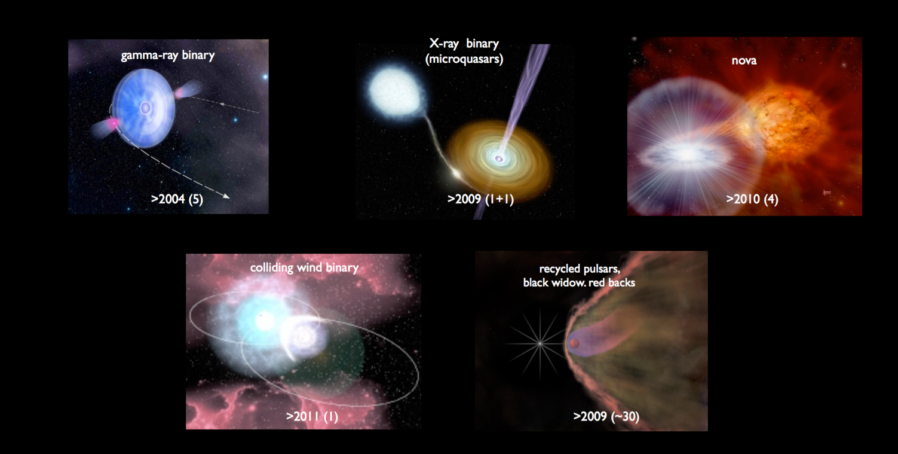
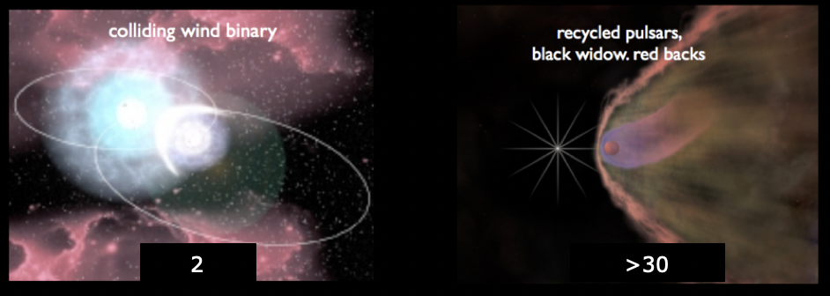
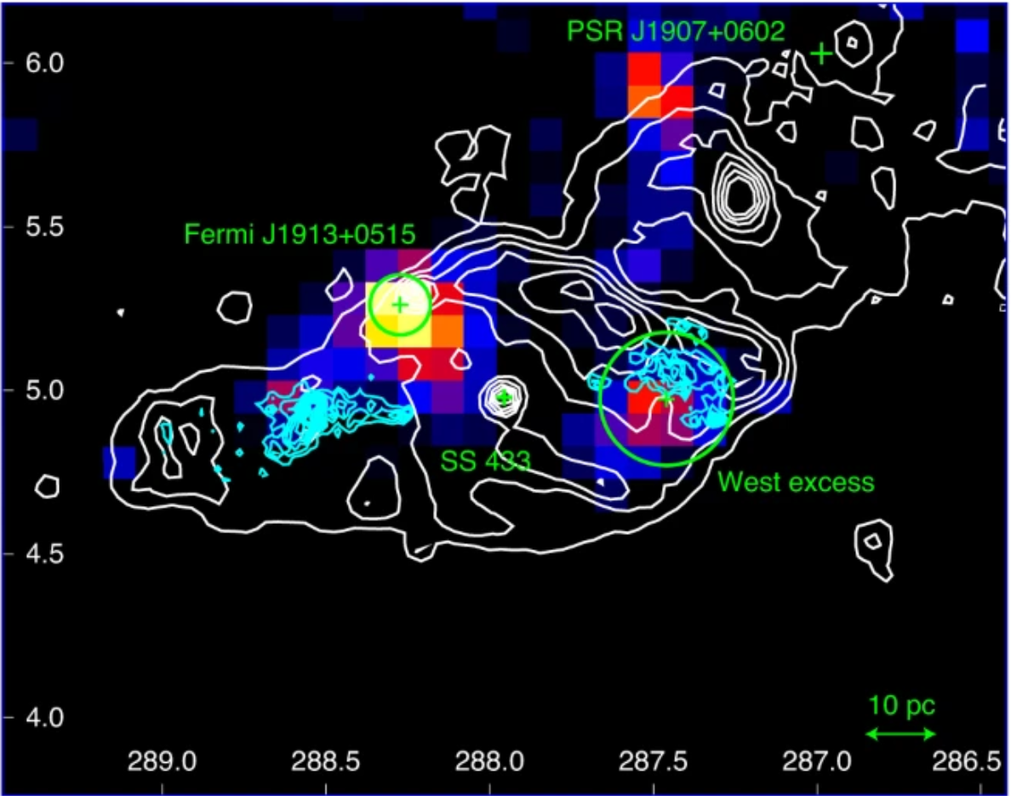
Systems with 2 objects that emit gamma-rays:
~10
2
>16
SS433
2
>30
And now V4641 Sgr. (Huentemeyer for the HAWC Collaboration, this conference)
Notes:
Cyg X-1 = black hole
Cyg-X-3 = likely
“Gamma-ray emitting X-ray binaries”

Slide 3
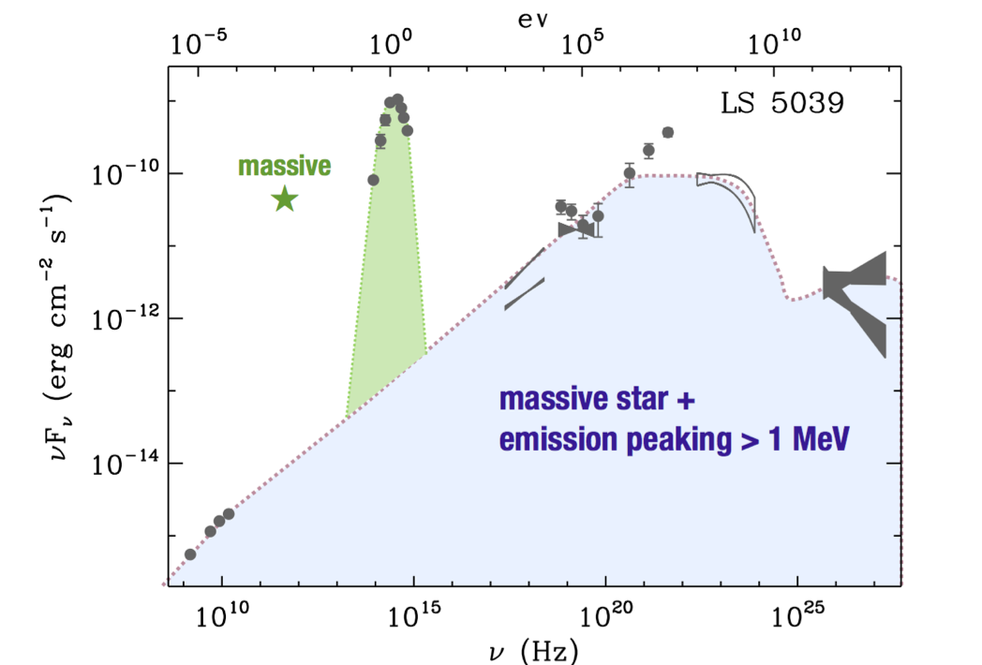
Gamma-ray binaries
Systems comprised of a massive star and a compact object (black hole or neutron star), with periodic emission that peaks at energies > 1MeV.
Credit G. Dubus

Slide 4
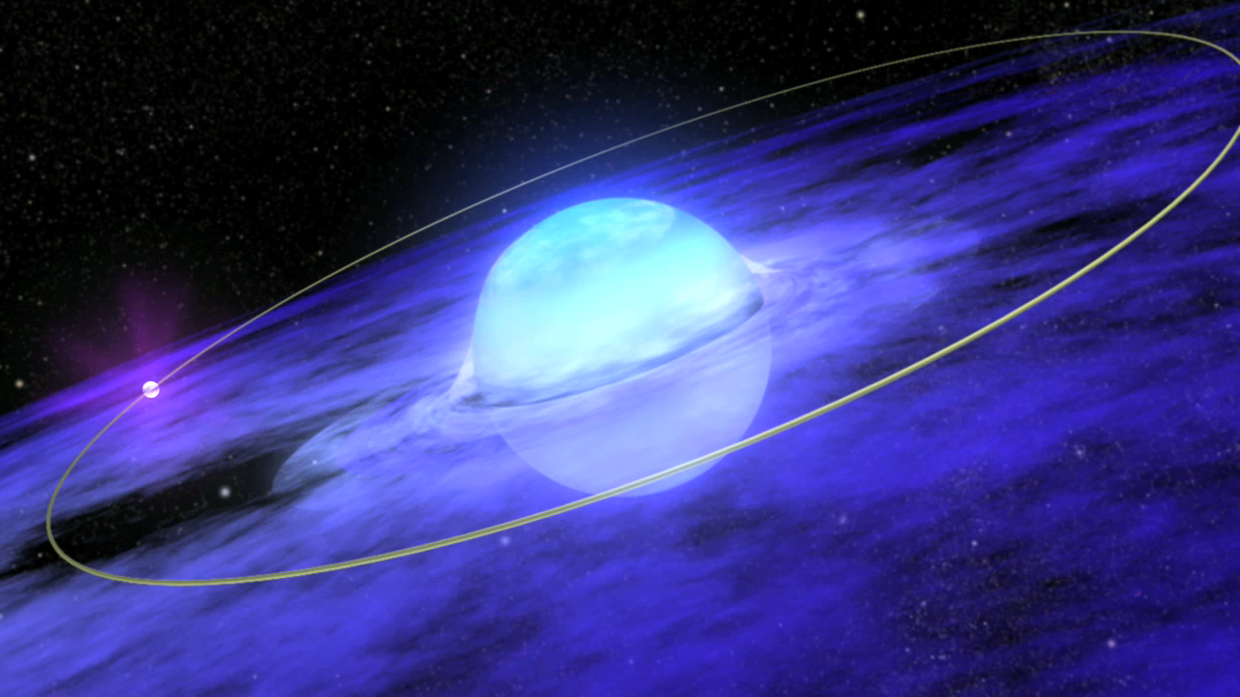
Notes:
In its first year, NASA’s Fermi Gamma-ray Space Telescope discovered GeV (billions of electron volts) intensity variations revealing orbital motion in high-mass X-ray binaries (HMXBs). These are systems where a compact companion, such as a neutron star or a black hole, rapidly orbits a hot, young, massive star. The first examples include LSI +61 303, which sports a 26-day orbital period, and LS 5039 (3.9 days). This animation shows such a system. When the compact object lies far from its host star, TeV (trillions of electron volts) gamma-rays (white) are seen by ground-based gamma-ray observatories. But, as the object plunges closer to the star, the TeV emission is quenched and GeV emission turns on. Interactions by accelerated particles from the compact source with gas encircling the star -- or in some systems, the star’s light itself – is thought to be responsible for this change.

Slide 5
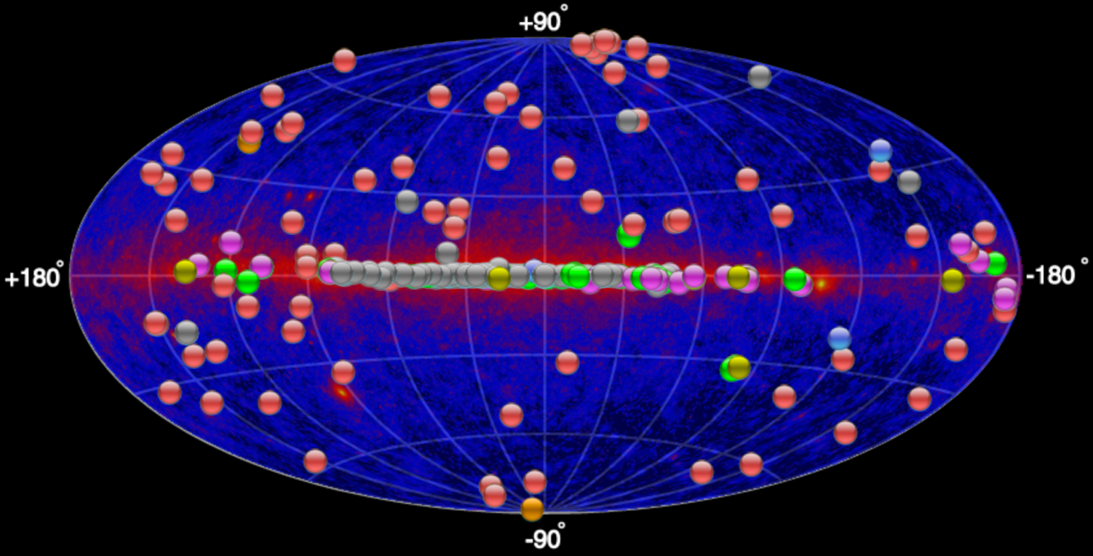
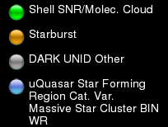
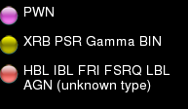
The Gamma-ray sky
Fermi-LAT + TeV

Slide 6
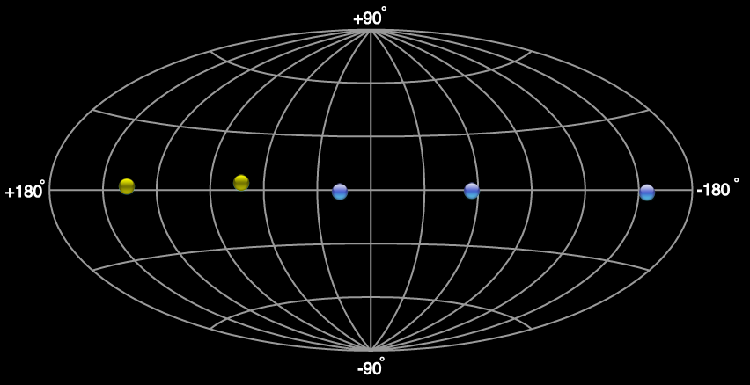
Gamma- Ray
Binaries
PSR J2032+4127
1FGL J1018.6-5856
4FGL J1405.1-6119
LS 5039
Cen X-3
LS I + 61°303
HESS J0632+057
HESS J1832-093
PSR B1259-63
LMC P3

Slide 7
Gamma- Ray
Binaries
PSR J2032+4127
1FGL J1018.6-5856
4FGL J1405.1-6119
LS 5039
Cen X-3
LS I + 61°303
HESS J0632+057
HESS J1832-093
PSR B1259-63
LMC P3

Slide 8
Why are these few so interesting?
Binaries are were(!) the only variable Galactic TeV sources.
They are natural particle accelerators operating under varying, but regularly repeating, environmental conditions.
Provide a constraining laboratory for models of particle acceleration, and gamma-ray production, emission and absorption processes.
Each system is unique – and the population, as well as the data quality, is increasing.
Caveat: The systems are complex, with many competing processes, and the orbital parameters, the nature of the binary components and the conditions in the circumstellar environment are generally not well known.
Notes:
Probably correspond to a brief period in the evolution of high-mass X-ray binaries, when the wind from the compact object is powerful enough to overpower accretion.
Allow you to e.g. place the shock at difference distances in the pulsar magnetosphere. Place the pulsar in regions of different density (and clumpy). Change the external photon fields.

Slide 9
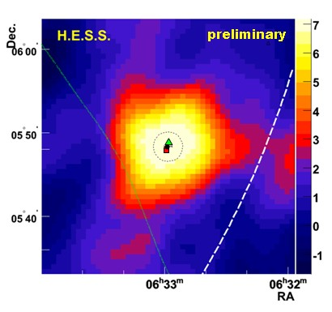
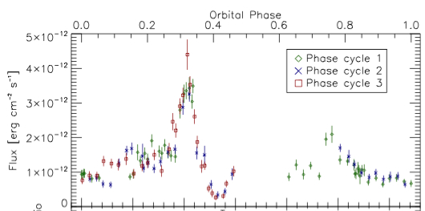
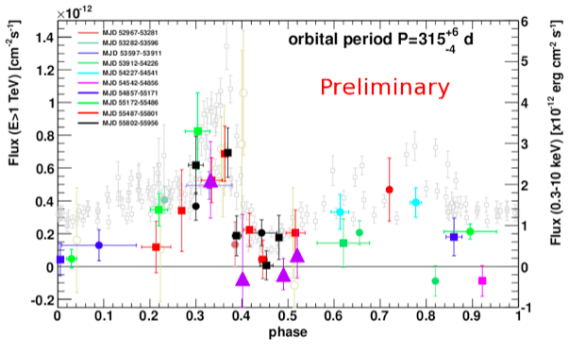
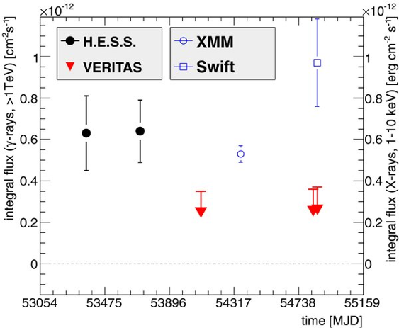
A detective story: HESS J0632+057
2007: HESS discovers a gamma-ray point source
2011: Using Swift , we identify a 315-day period in X-rays.
2009: VERITAS sees variability
2012: VERITAS light-curve matches X-ray
light-curve

Slide 10
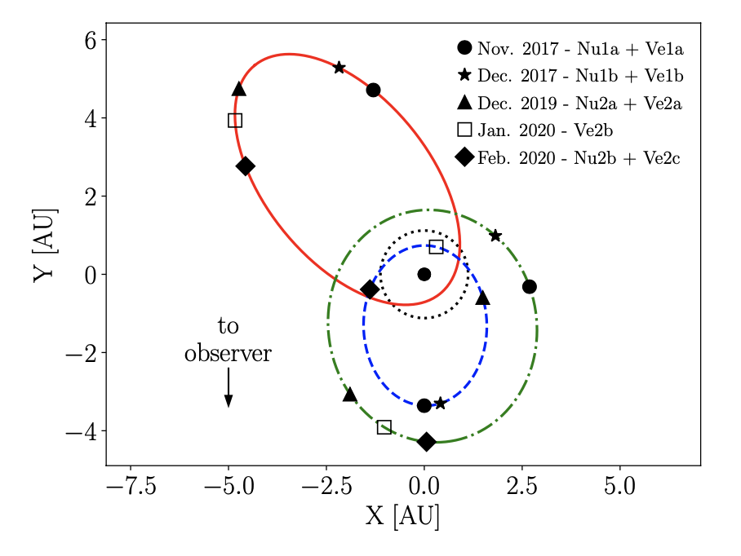
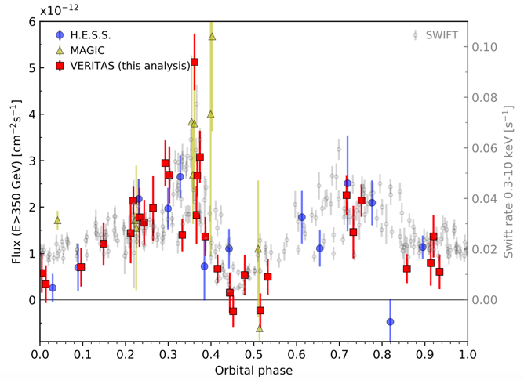
HESS J0632+057
VERITAS has now covered all of the orbit, over a decade of observations.
Orbital parameters from optical radial velocity measurements are improving.
Periodic GeV emission has now been detected – but very faint.
Casares 2012
Tokayer 2021
Moritani 2018
Tokayer, Y.M. et al., ApJ, 923, 17, 2021
Notes:
1.3–7.1 M⊙ for MWC 148
But data are sparse, and inclination very poorly constrained
The acceleration of charged particles in binary system is generally attributed to first order Fermi acceleration in strong shocks formed between the stellar wind and the wind of the pulsar (assuming that the compact object in HESS J0632+057 is a fast rotating neutron star). The shock conditions are strongly dependent on the geometry of the system, and vary significantly during one orbital period. The orbital movement and the Coriolis forces involved can lead to the formation of several shocks in regions of varying gas and photon densities [16, 17]. Further away from the shocked regions, acceleration of charged particles by occurring velocity shears of the relativistic outflows have been predicted [18]. High accretion rates during the passage of the compact object through the stellar disk or close to the massive star can lead to a quenching of the pulsar wind and might be responsible for the sharp dip in the X-ray emission at phases ≈ 0.45. Note that the extension, density and orientation of the disk of the Be star in HESS J0632+057 is mostly unknown, although recent optical dispersion measurements indicate that the disk of the Be star is likely as large as the binary orbit [19]. This setting is very similar to the flip-flop scenario suggested for the gamma-ray binary LS I +61 303 [20], where periods in which the system is in the rotationally powered regime alternate with the propeller regime. In addition, absorption of high- energy gamma rays due to pair production is expected to be most important around periastron and inferior conjunction, where HESS J0632+057 is in a low flux state (see e.g. [21]).

Slide 11
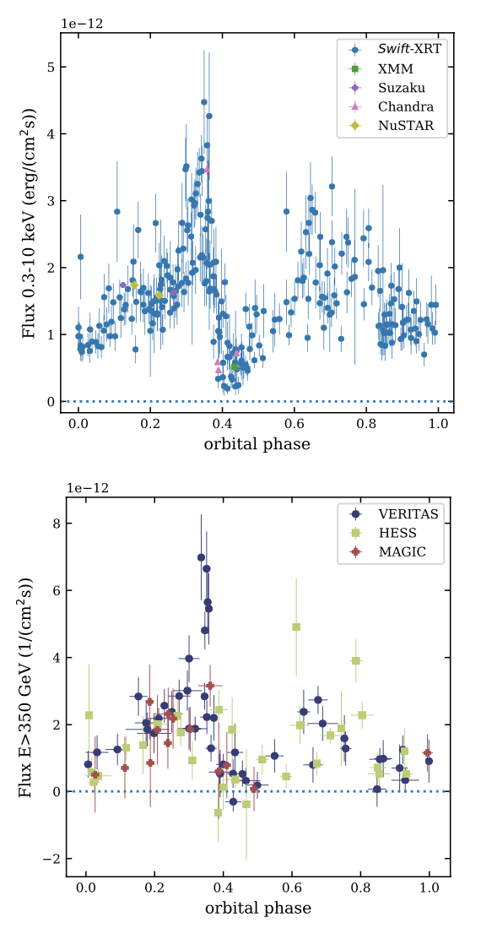
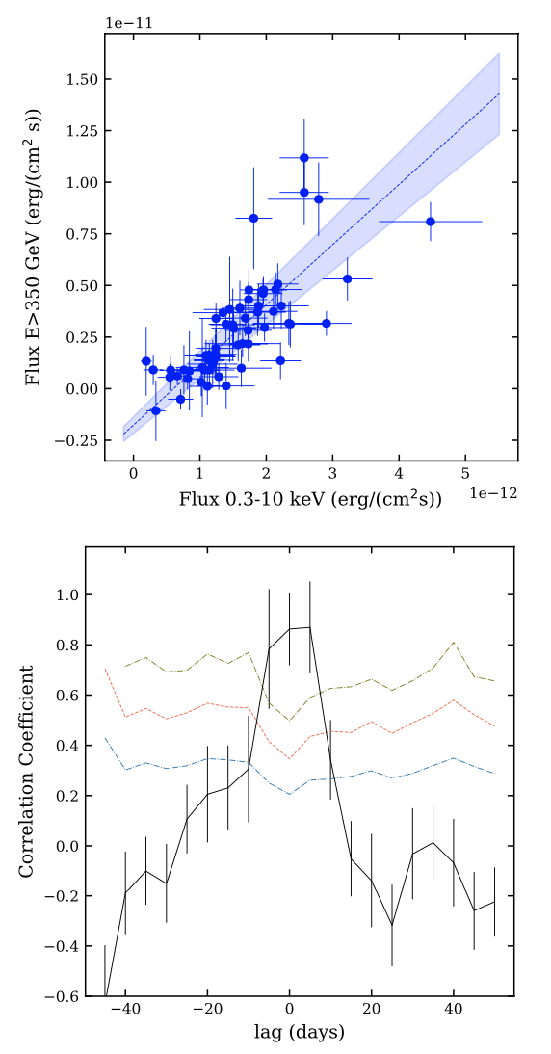
HESS J0632+057: Latest results
450 hours of H.E.S.S., MAGIC, & VERITAS data collected over 15 years. (Adams, C.B. et al., ApJ, 923, 241, 2021.)
Orbital period measured in TeV gamma-rays alone:
  316.7 ± 4.4 days, consistent with updated X-ray period (317.3 ± 0.7 days).
X-ray and TeV fluxes are highly correlated, with zero time lag. Gamma-ray energy flux dominates.
Rapid gamma-ray variability (flux decay times of 20 days), and orbit-to orbit variability.
Modelling challenged by unknown orbital geometry, disk properties and unknown compact object (but see e.g. Kim et al: https://arxiv.org/abs/2208.01189).
X-ray
X-ray – TeV correlation
Phase-folded lightcurves
TeV
X-ray - TeV
time lag
Notes:
1.3–7.1 M⊙ for MWC 148
But data are sparse, and inclination very poorly constrained
The acceleration of charged particles in binary system is generally attributed to first order Fermi acceleration in strong shocks formed between the stellar wind and the wind of the pulsar (assuming that the compact object in HESS J0632+057 is a fast rotating neutron star). The shock conditions are strongly dependent on the geometry of the system, and vary significantly during one orbital period. The orbital movement and the Coriolis forces involved can lead to the formation of several shocks in regions of varying gas and photon densities [16, 17]. Further away from the shocked regions, acceleration of charged particles by occurring velocity shears of the relativistic outflows have been predicted [18]. High accretion rates during the passage of the compact object through the stellar disk or close to the massive star can lead to a quenching of the pulsar wind and might be responsible for the sharp dip in the X-ray emission at phases ≈ 0.45. Note that the extension, density and orientation of the disk of the Be star in HESS J0632+057 is mostly unknown, although recent optical dispersion measurements indicate that the disk of the Be star is likely as large as the binary orbit [19]. This setting is very similar to the flip-flop scenario suggested for the gamma-ray binary LS I +61 303 [20], where periods in which the system is in the rotationally powered regime alternate with the propeller regime. In addition, absorption of high- energy gamma rays due to pair production is expected to be most important around periastron and inferior conjunction, where HESS J0632+057 is in a low flux state (see e.g. [21]).

Slide 12
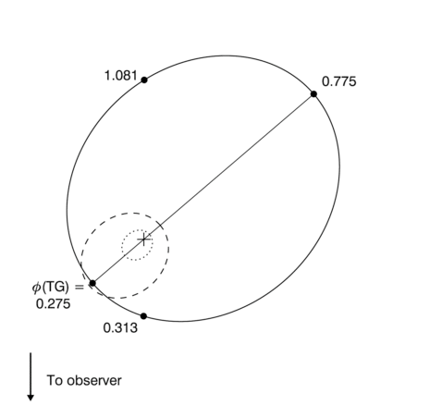
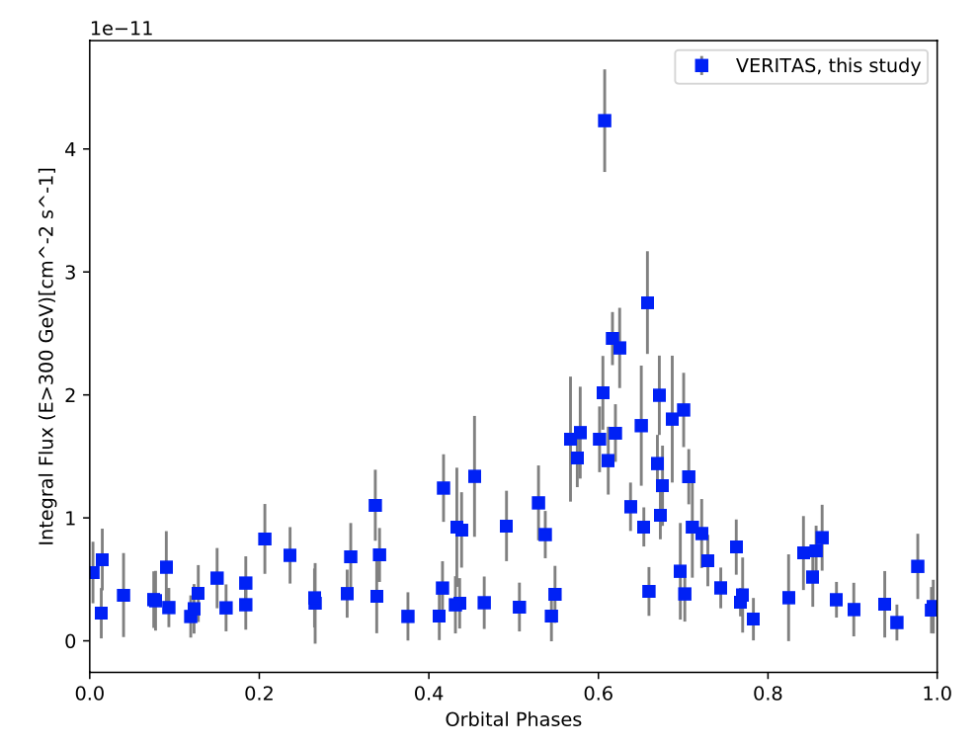
LS I +61°303
Compact object orbiting an B0Ve companion (12M_{sol})
26.5 day orbital period.
Extended radio structures, modulated by orbital phase.
Detected in TeV by MAGIC, then VERITAS. Brightest near assumed apastron (ϕ=0.5-0.8).
Also bright in Fermi-LAT, but peak emission is at periastron, and spectrum cuts off at 6 GeV.
Superior
conjunction
VERITAS
Apastron
0.7 AU
180 hours recorded over 12 years.
Peri-
astron
0.1 AU
Inferior
conjunction
Aragona et al. ApJ 2009

Slide 13
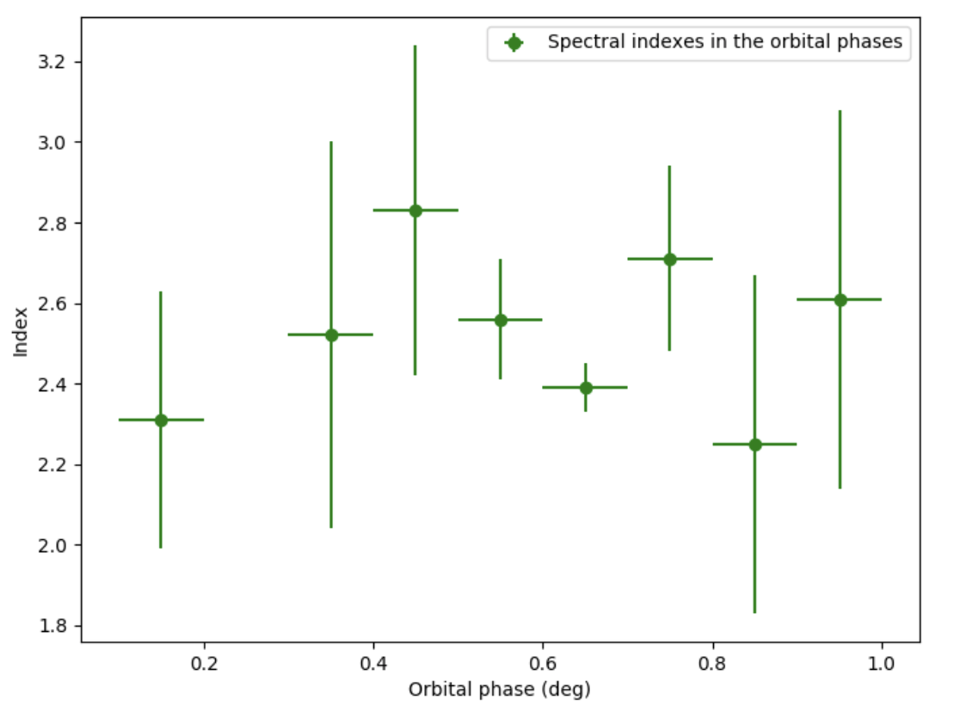
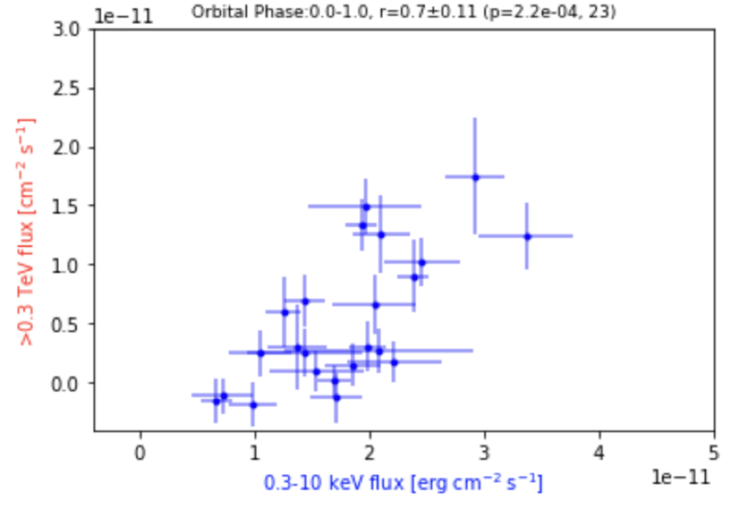
LS I +61°303: Latest VERITAS Results
180 hours recorded over 12 years. Rapid variability on <1 day timescales
Detected at all orbital phases. No evidence for spectral variability.
Long dataset also allows search for super-orbital modulation
  Super-orbital period = 4.6 years, seen at longer wavelengths and in TeV by MAGIC.
  No evidence for super-orbital variability in VERITAS data alone. Joint study with MAGIC underway.
TeV-ray and X-ray emission is well-correlated on short timescales.
Simultaneous to within 30 minutes
Notes:
54900 = March 2009

Slide 14
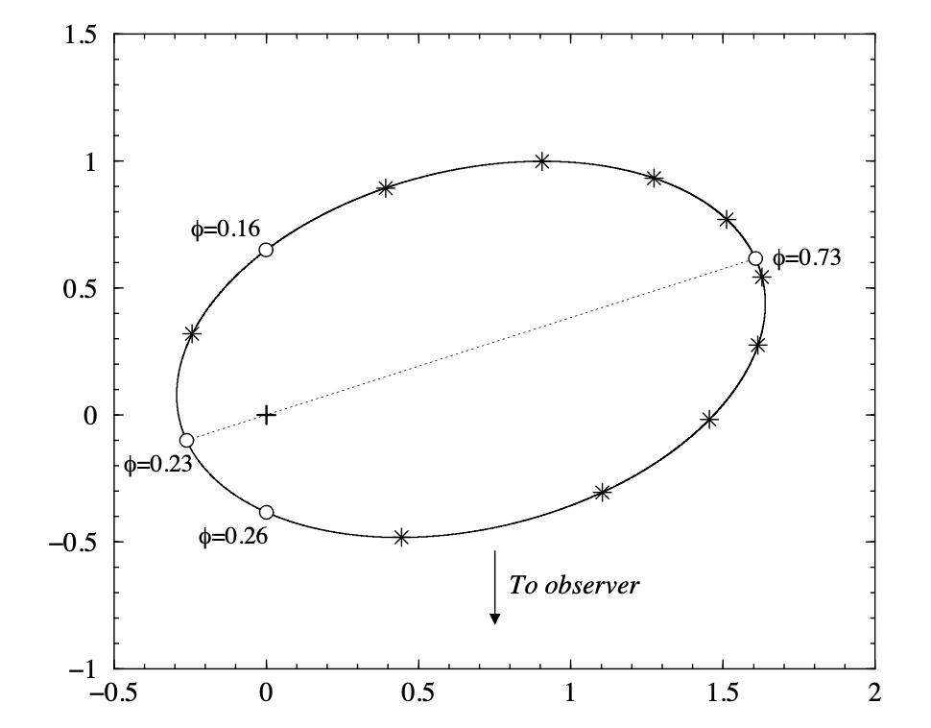
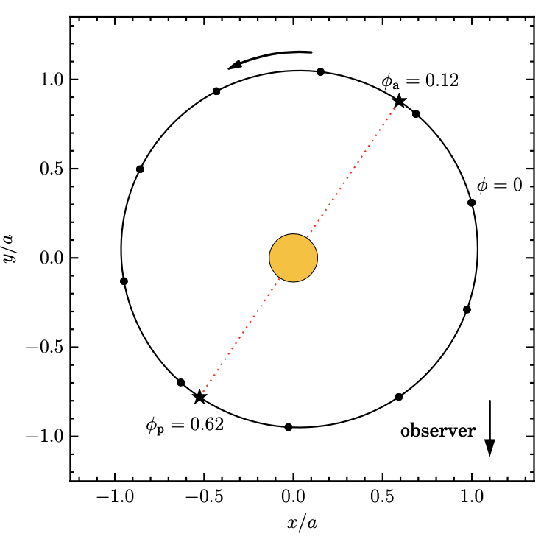
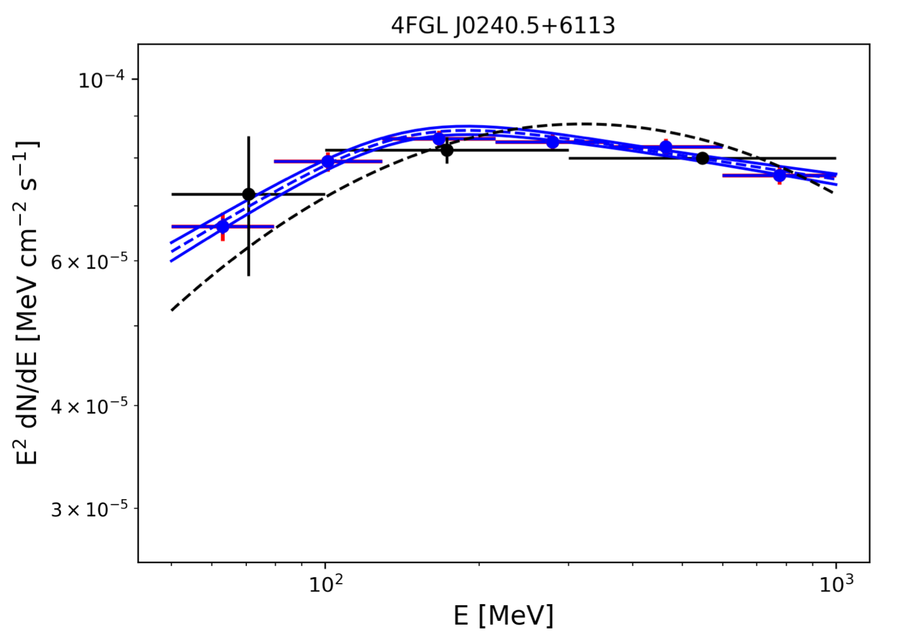
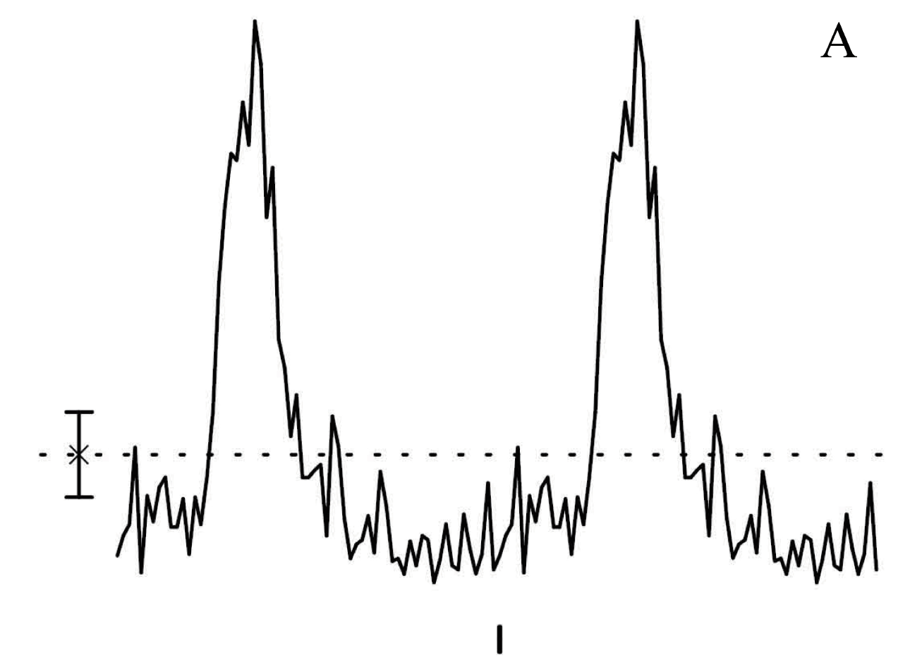
LS I +61°303: Recent updates
Kravtsov (2020)
New orbital solution suggests rather different geometry:
  No eccentricity
  Phase of periastron = 0.6
Casares (2005)
Low energy spectral break suggests pion “bump”.
Are gamma-ray binaries important cosmic ray acceleration sites?
FAST radio telescope detects pulsations with 269 ms period on one night (out of four).
“strongly argues for the existence of a rotating neutron star within LS I +61° 303”.
Phase
0.0
0.5
1.0
0.5
1.0
Fermi-LAT Collaboration arXiv:2205.03111
Weng. S. et al., Nature Astronomy, 6, 698
Notes:
New periastron phase is now close to TeV peak, which is also close to inferior conjunction

Slide 15
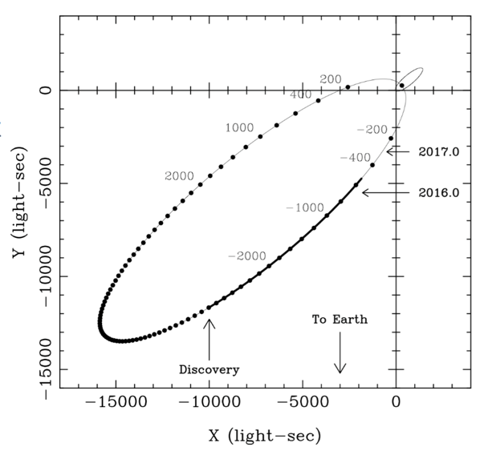
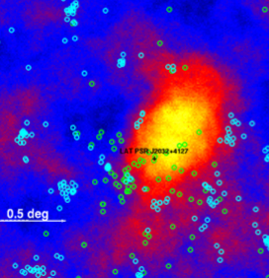
PSR J2032+4127 / MT91 213
In 2014, Lyne et al. identified PSR J2032+4127 as the compact object in a binary system with a 15 M_{sol} Be star.
The eccentricity is >0.97, and the orbital period 45 – 50 years!
Pulsar timing defined periastron very precisely (Nov 13th 2017, 9pm)
Intriguingly – the pulsar binary is located within a steady, extended TeV gamma-ray source.
Notes:
R=distance to pulsar
D=orbital separetion
Neta=ratio of wind momenta
How – may be DSA, reconnection, cold pulsar wind.
With so many variables, it may be best to start with systems we know the most about.
Systems containing a pulsar tell us:
The nature of the compact object.
The amount of available energy (spin-down).
The geometry of the system (pulsar timing).

Slide 23
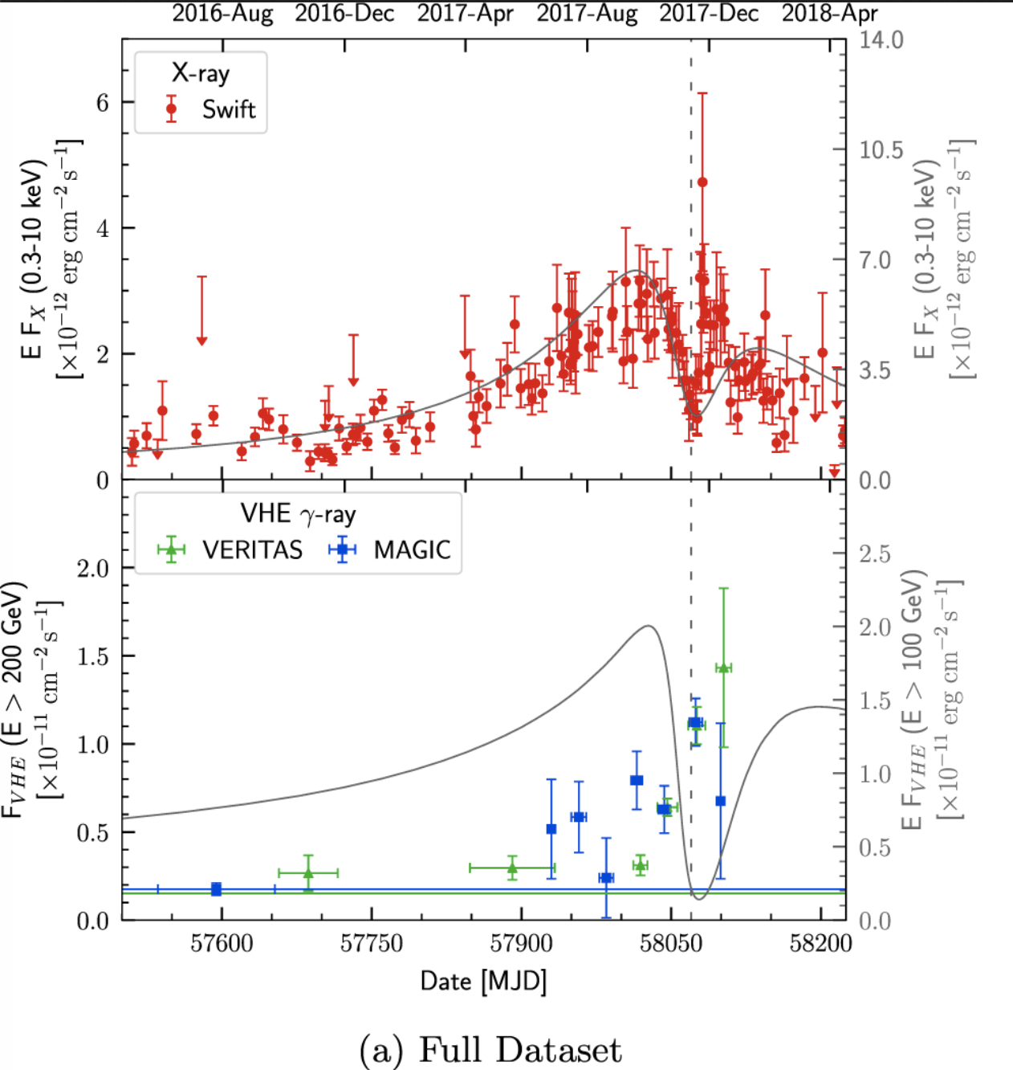
Lightcurve
Original TeV lightcurve prediction from Takata 2017 did not match the observations well.
TeV Model from
Takata et al, 2017 with parameters from Li et al 2017
Notes:
Magnetization parameter (sigma=magnetic energy/kinetic energy)
X-ray flux is maximum at sigma=0.1.
As the magnetization parameter at the shock increases near to periastron, This causes general X-ray suppression.
Doppler boosting/suppression effects then give asymmetry.

Slide 24
Lightcurve
Original TeV lightcurve prediction from Takata 2017 did not match the observations well.
Periastron
TeV Model from
Takata et al, 2017 with parameters from Li et al 2017
Notes:
Magnetization parameter (sigma=magnetic energy/kinetic energy)
X-ray flux is maximum at sigma=0.1.
As the magnetization parameter at the shock increases near to periastron, This causes general X-ray suppression.
Doppler boosting/suppression effects then give asymmetry.

Slide 25
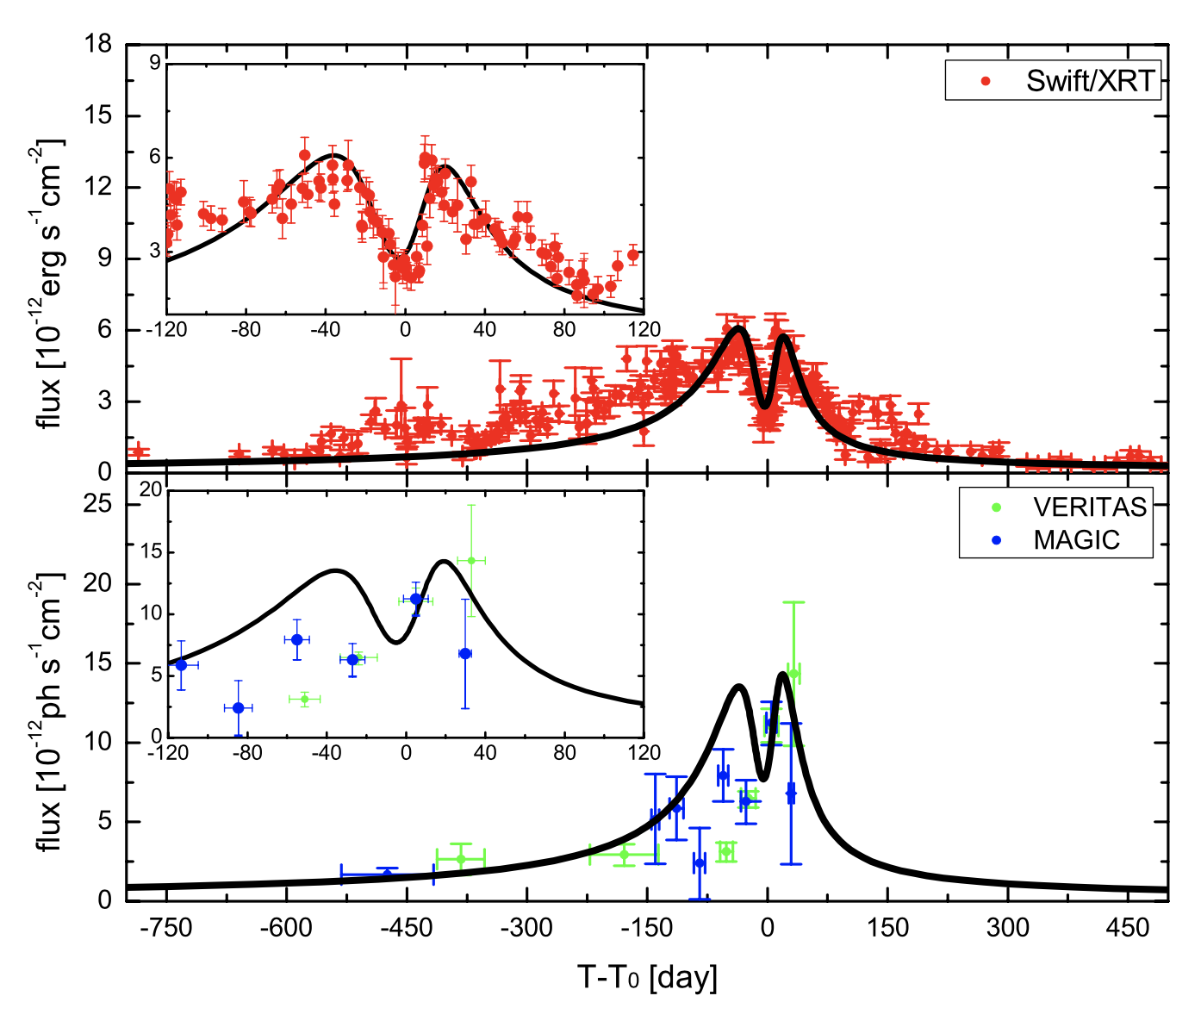
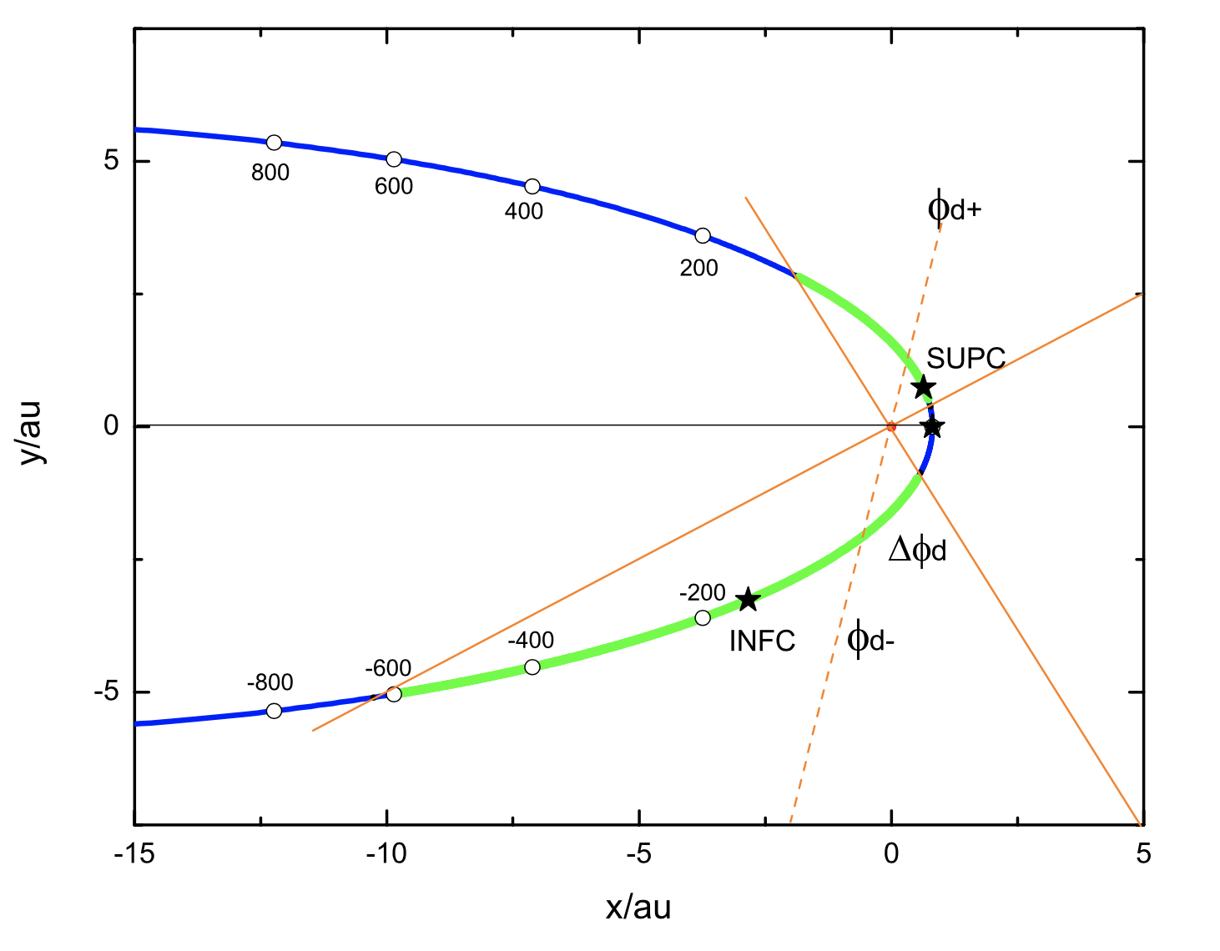
Scientific method at work!
Updated model.
Updated model from Chen & Takata, 2020.
Uses improved orbital solution and assumes an inclined disk
TeV Model from
Takata et al, 2017 with parameters from Li et al 2017
Notes:
The positions of double peaks in keV/TeV light curves are shown in green. The inclined disc projected on the orbital plane is illustrated in orange, with the dashed line being the midplane of the disc.

Slide 26
Summary
Gamma-ray binaries are excellent laboratories for high energy particle astrophysics.
VERITAS observations constitute a legacy archive, and continue to provide new insight.
Multiwavelength observations are critical to discovery, and to understanding how these systems work. Progress sometimes requires patience…
Fermi, and current generation TeV observatories including VERITAS continue to look – there may be more binaries hiding in the archives.
CTA should see at least some more - one big observational question: How many GeV-faint gamma-ray binaries are there?
Notes:
R=distance to pulsar
D=orbital separetion
Neta=ratio of wind momenta
How – may be DSA, reconnection, cold pulsar wind.

Slide 27
Backup

Slide 28
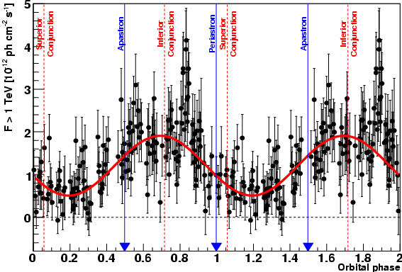
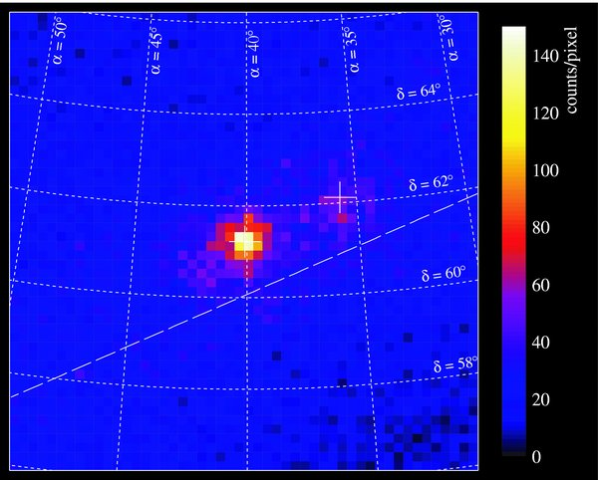
2004 – 2006: a few TeV sources strongly detected >100 GeV
  PSR B1259-63 (H.E.S.S.)
  LS 5039 (H.E.S.S.)
  LS I +61° 303 (MAGIC)
With good positions, high significance and repeatable detections, and clear, orbitally modulated variability, the associations are definitive.
Fermi-LAT provided the next leap
  Good sensitivity.
  Good source localization.
  Near continuous monitoring.
  Firm ID of LS I +61° 303, LS 5039
LS 5039, HESS
LS I +61° 303, Fermi-LAT

Slide 29
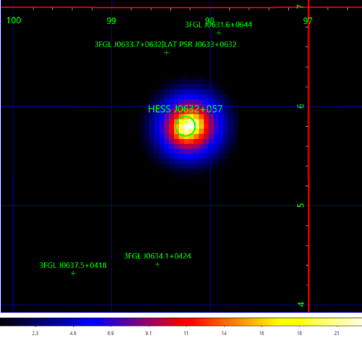
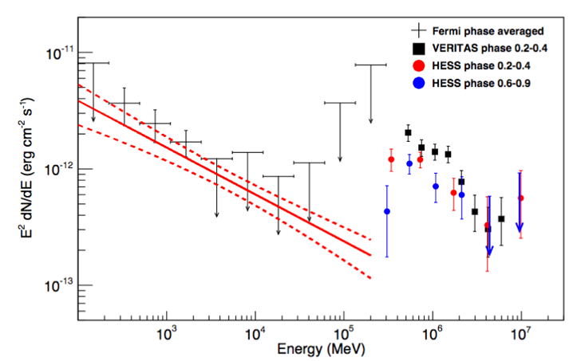
HESS J0632+057: GeV
First claimed at 3.6 σ based on two >200 GeV photons by Malyshev (2016)
Careful pass 8 analysis by Li et al (2017) reveals faint modulated lower energy (<10 GeV) emission component.

Slide 30
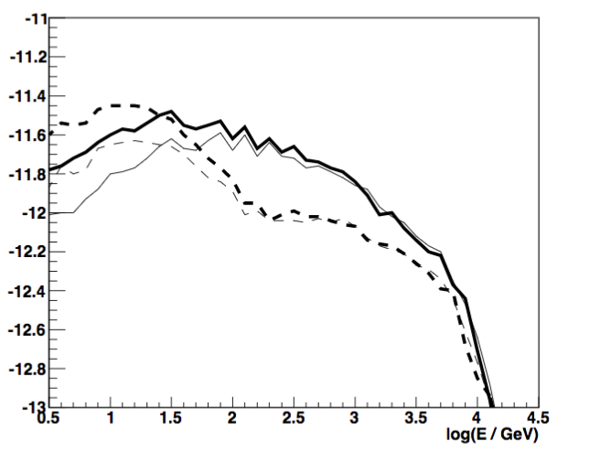
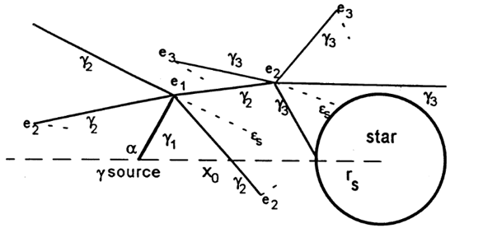
Pair cascades
Very high energy gamma-ray photons may trigger electromagnetic cascades when they pair produce.
These particles then produce inverse Compton gamma-ray emission in all directions, since the electrons/positrons are isotropized by strong magnetic fields (e.g. Bednarek 1997)
The cascade development depends upon propagation through the anisotropic stellar photon fields.
Emission from cascades within the binary volume
Emission from cascades towards the observer

Slide 31
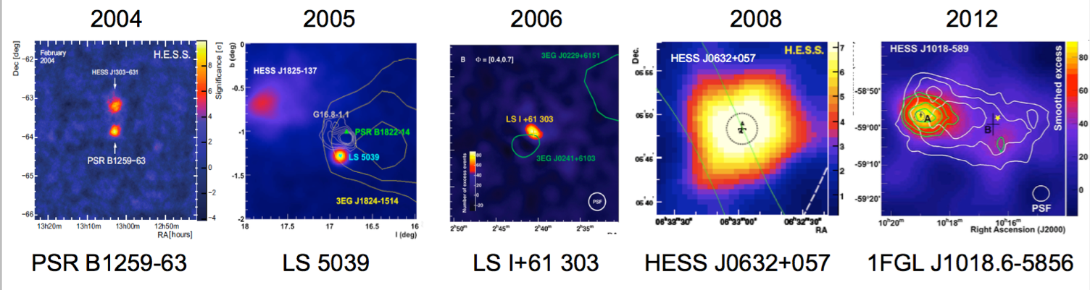
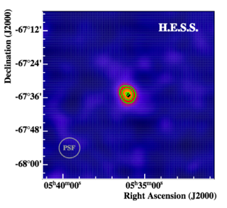
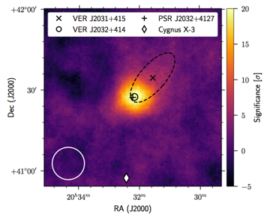
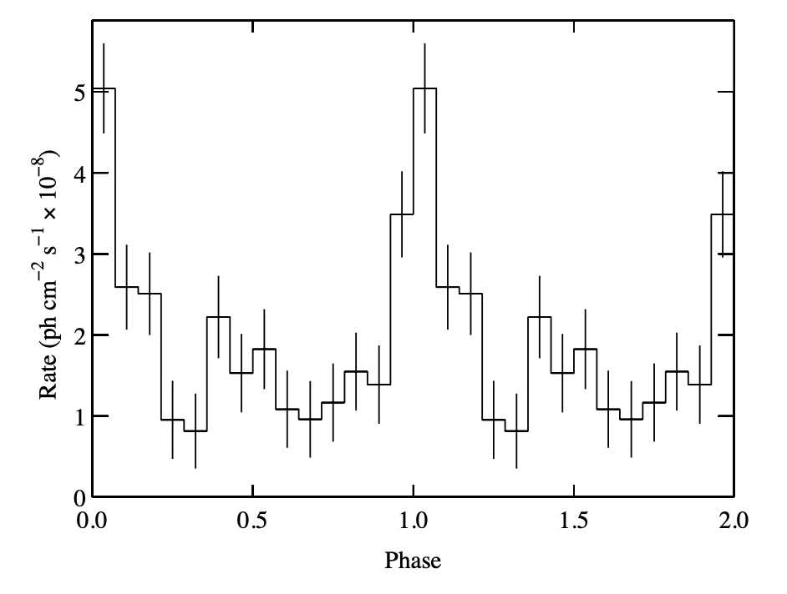
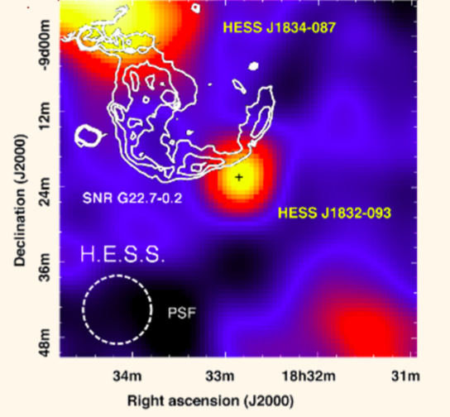
TeV Gamma-ray binaries today
All show TeV variability tied to the orbital period of the binary system.
Huge range of orbital parameters and stellar environments.
P=3.4 years
P=3.9 days
P=26.5 days
P=315 days
P= 16.6 days
MAGIC
P=10.3 days
P=50 years
P=13.7 days
P=86 days
VERITAS
LMC P3
PSR J2032+4127
4 FGL J1405.1-6119
HESS J1832-093

Slide 32
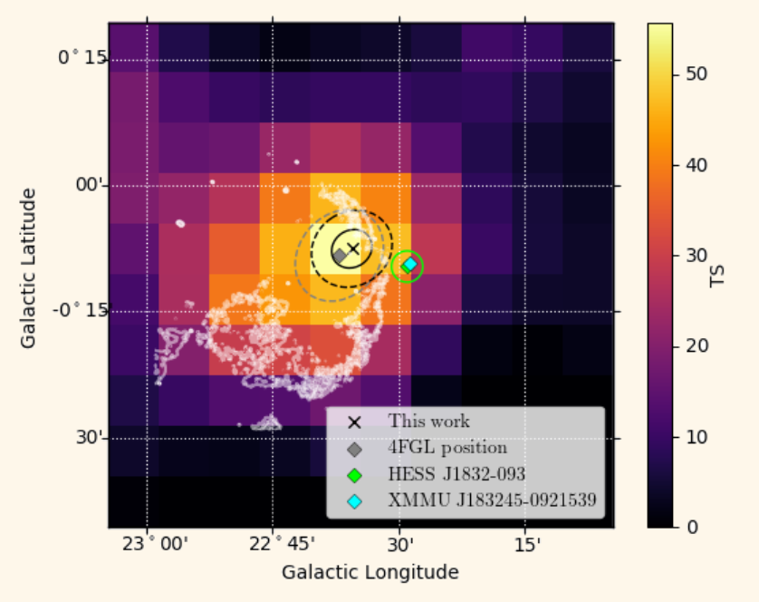
GeV Gamma-ray binaries today
GeV variability tied to the orbital period of the binary system
Faint
2017
2017
2020
2019
Faint
Pulsar only
VERITAS
LMC P3
PSR J2032+4127
4 FGL J1405.1-6119
HESS J1832-093

Slide 33
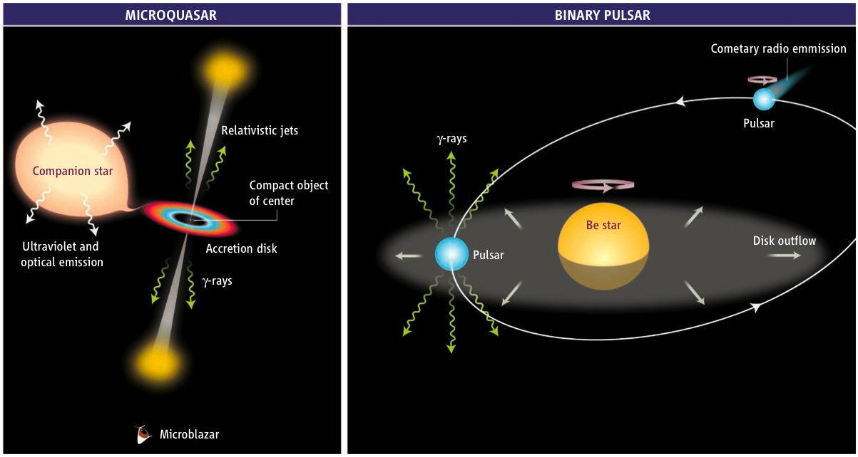
So what drives them?
Accretion powered
Wind-driven
Mirabel (Science 309, 714, 2006)

Slide 34
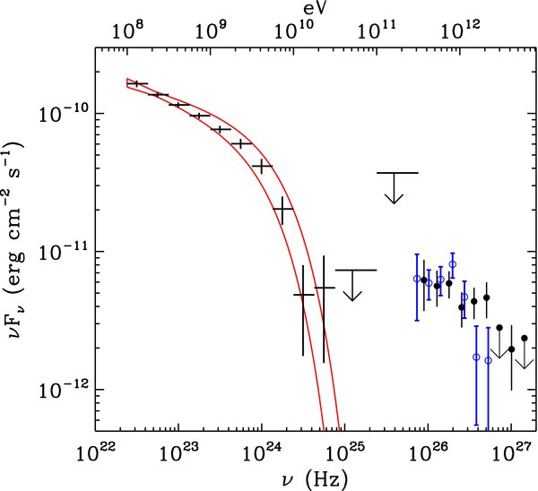
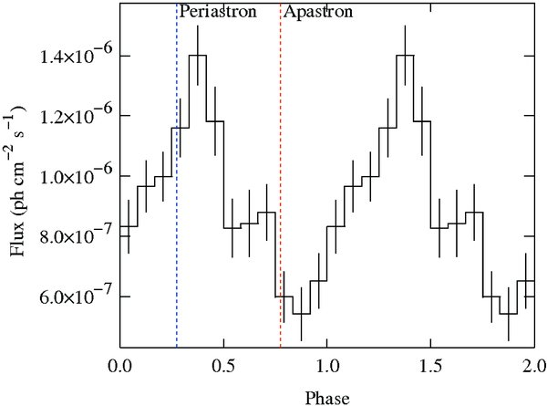
LS I +61°303
Superior
conjunction
Apastron
0.7 AU
Detected by Fermi-LAT (BSL)
Orbital modulation well measured
Emission peaks near periastron
Cut-off at 6 GeV observed between LAT and VERITAS
  The GeV and TeV spectra do not connect smoothly. Suggests different mechanisms.
Peri-
astron
0.1 AU
Inferior
conjunction
Aragona et al. ApJ 2009
Fermi
Fermi
MAGIC/
VERITAS

Slide 35
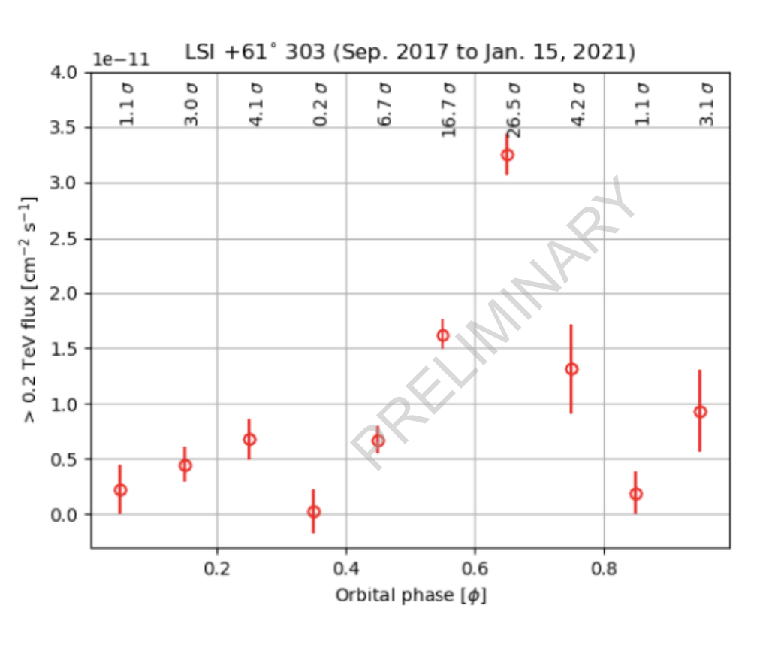

Slide 36
A few things to think about (far from exhaustive)…
What is the power source?
Accretion-powered jet
Pulsar wind
What is the particle acceleration mechanism?
Jet shocks
Magnetic reconnection
Wind shocks
What are the dominant particles?
Hadronic
Leptonic
How are the γ-rays produced?
Pion decay
Inverse Compton
Curvature Radiation
Where are the γ-rays produced?
Near the jet
Wind collision region
Pulsar wind zone
Circumstellar environment
Pulsar magnetosphere
What modulates the flux?
Geometry
Photon fields
Matter density
B-fields
Other effects?
Wind clumping
Pair cascades
Doppler boosting
Many of these are not mutually exclusive…

Slide 37
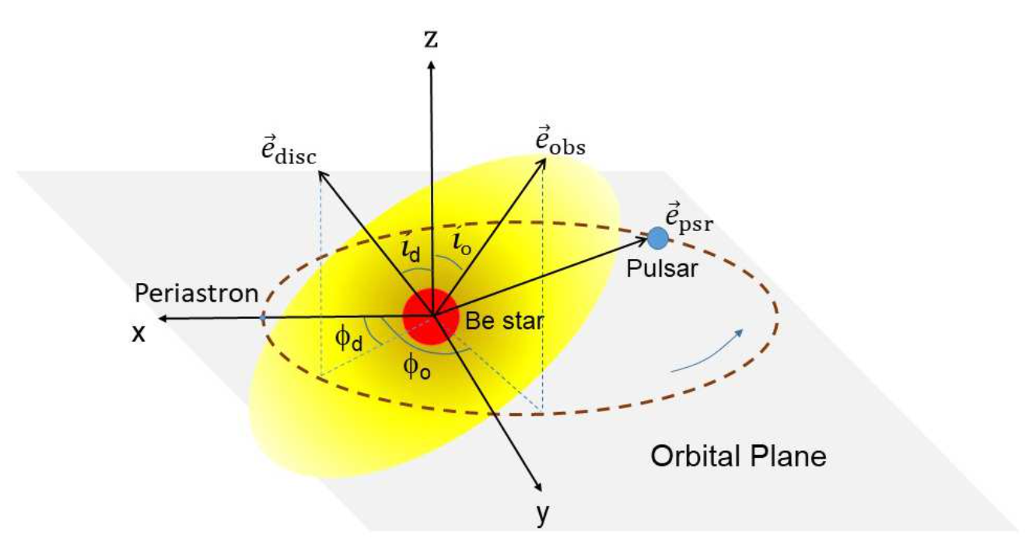
…And we rarely have complete information:

Slide 38
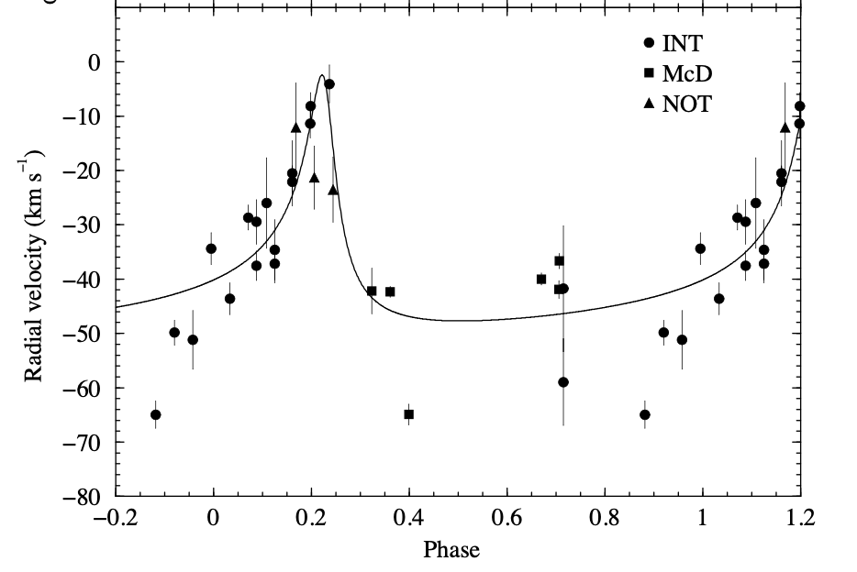
Radial velocity measured using spectral lines:
LS I+61 303

Slide 39
The material producing the spectral lines is not the star!
  It is in the circumstellar disk, or a gaseous shell around the star
It may not correlate well with the orbital motion…
Polarization measurements provide an alternative – and give a very different orbital solution for this object
Old (Casares)
New (Kravtsov)

Slide 40
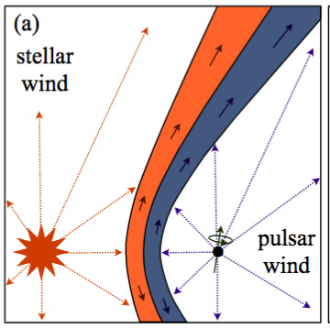

The basic picture in the wind-driven scenario
Pulsar wind and the stellar wind collide and form a shock.
Location of the shock depends upon the relative wind momenta.
Location of shock determines the magnetic field strength, and the photon and matter densities.
Shock converts pulsar wind energy into accelerating particles (but how?),
High energy particles produce gamma-rays.
Electrons/
Gamma-rays
starlight
Dubus et al, 2015
Notes:
R=distance to pulsar
D=orbital separation
Neta=ratio of wind momenta
How – may be DSA, reconnection, cold pulsar wind.

Slide 41
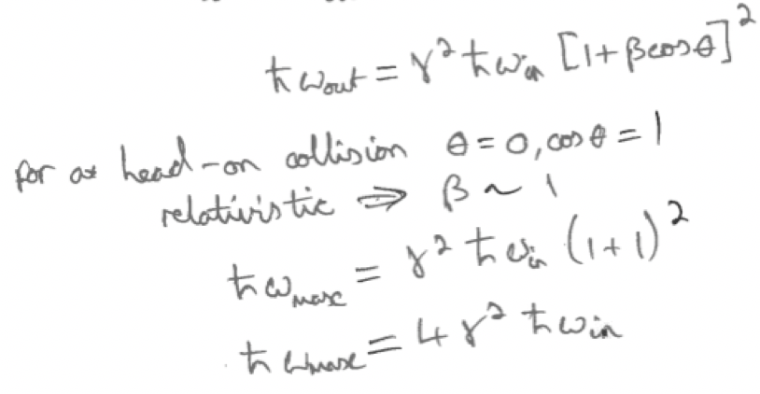
Competing processes
Inverse Compton gamma-ray production:
  High energy electrons boost stellar photons to gamma-ray energies.
  Maximum energy given by a head-on collision – natural asymmetry.
At superior conjunction, Inverse Compton production peaks over all energies.
However… gamma-rays with energies >30 GeV are absorbed by pair production with starlight!
At superior conjunction, TeV photons are most heavily absorbed.
Leads to a natural anti-correlation between GeV and TeV lightcurves
Superior
conjunction
Electrons/
Gamma-rays
starlight
Inferior
conjunction
Notes:
With so many variables, it may be best to start with systems we know the most about.
Systems containing a pulsar tell us:
The nature of the compact object.
The amount of available energy (spin-down).
The geometry of the system (pulsar timing).

Slide 42


Doppler boosting
The shocked wind is mildly relativistic, and flows away from the shock apex asymmetrically
Leads to Doppler boosting, which either enhances or suppresses gamma-ray emission
Boost factor depends upon the angle at which the shocked wind is viewed
  analogous to blazar jets.
Orbitally modulated radio structures have been observed (e.g. LS I+61 303)
Dhawan et al.
Notes:
Doopler boosting has 3 factors:
1. relativistic aberration – makes the tail appear more beamed - D²
2. Time dilation – increases the photon rate - D
3. Blueshift – boosts common low energy photons to high energy. - D^{alpha}

Slide 43

Chernyakova et al arXiv:2004.11884

