Slide 1


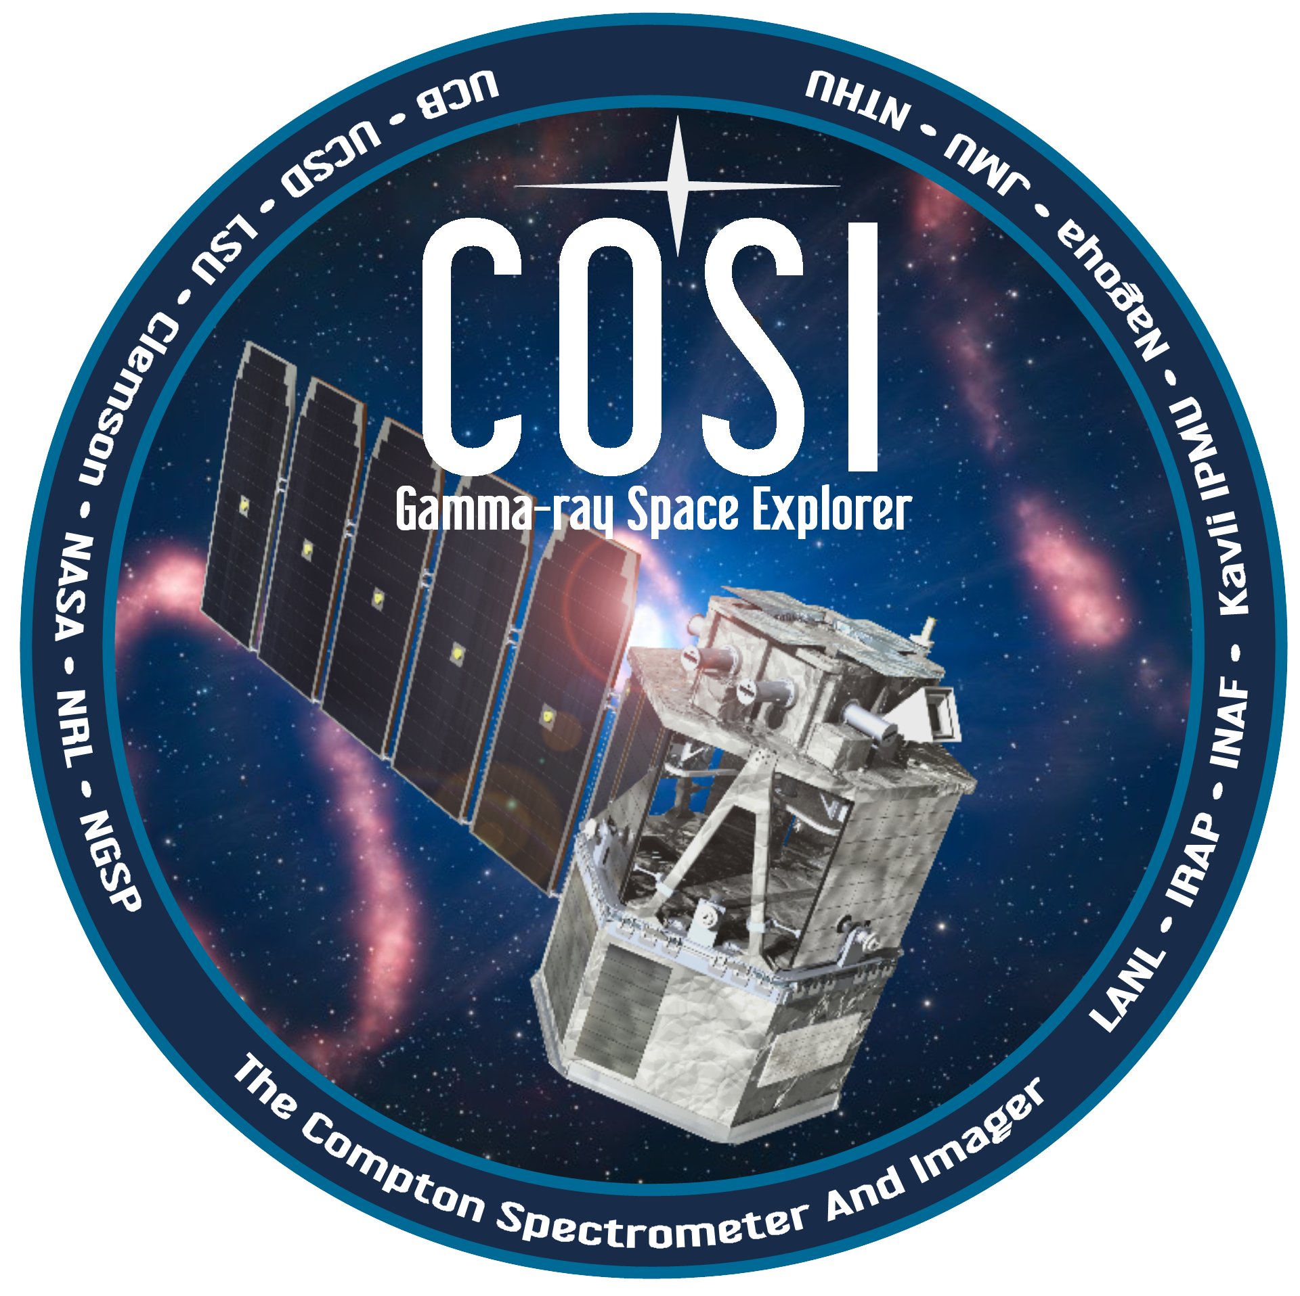
Closing In On the MeV Gap
The Compton Spectrometer and Imager
Jarred Roberts, PhD (Assistant Project Scientist)
UC San Diego
Center for Astrophysics and Space Sciences
TeVPA meeting
Kingston, ON
Aug 11, 2022
Notes:
Thank you for giving me the opportunity to have a discussion about COSI, and how this telescope will help us close in on the MeV gap
My name is Jarred, I started working on the COSI balloon instrument in 2017 as postdoc and I’m now a project scientist for the group

Slide 2
‘We need an MeV gamma-ray satellite telescope’
Notes:
Something I continue to hear during these talks is: “We need an MeV gamma-ray satellite telescope”
Whether you’re interested in neutrino multimessenger signals, setting upper limits for your exotic neutrino model, dark matter diffuse emissions, galactic bulge excess, dark matter celestial object neutrino gamma-ray emissions…
The need for an MeV satellite appears to be a common thread
COMTEL’s mission ended in 2000 and FERMI/LAT has been in extended mission mode since 2013
An MeV gamma-ray telescope seems to be in high demand

Slide 3
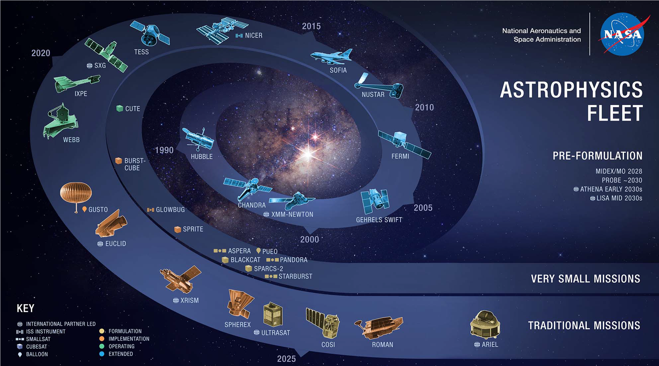
From NASA Astrophysics Town Hall: Paul Hertz
The Compton Spectrometer and Imager (COSI) was developed under NASA’s APRA program as a balloon-borne telescope and has been recently selected as a NASA Small Explorer (SMEX) satellite mission for launch in 2026.
Notes:
Here’s one. Right here, this one will be providing data products in less than 4 years.
As of today, COSI is the only MeV gamma-ray telescope that has a clear path to operate in space within a timeline of a few years
This was an image shared by Paul Hertz during the NASA Astrophysics Town Hall that shows COSI’s place among the many other iconic instruments of the past and future
COSI is a Small Explorer satellite mission due for launch in early 2026
NuSTAR and IXPE are examples of other Small Explorer class missions in the recent past
You can also see the predecessor of the ANITA neutrino telescope (PUEO), which was the project I worked in graduate school.
I want to ask you, if maybe you haven’t considered it, how the capabilities of this telescope can help you in your high-energy astrophysics research of interest
We have a few ideas, but we’d like to hear about your ideas

Slide 4
Science opportunities in the “MeV Gap”
Signals and sources in the COSI energy range (0.2-5 MeV)
  e⁻e⁺ annihilation line at 511 keV
  Gamma-ray lines from nucleosynthesis
  Accreting black holes and gamma-ray bursts (GRBs) w/polarization
  Multimessenger sources
    Merging neutron stars
    High-energy neutrinos
“MeV Gap”
The “MeV gap” is one of the least explored regions of the electromagnetic spectrum
Notes:
I’m going to start with some of the primary science opportunities we’re pursuing
COSI operates in the 0.2-5 MeV bandpass
This plot shows sensitivities from previous and current missions
We’re doing pretty good in the high-x-ray band with Chandra and NuSTAR
We’re also doing good in the GeV band with FERMI-LAT
But in-between, in this region from about 100keV up to 100MeV, is one of the least-well explored regions of the electromagnetic spectrum
This region is sometimes referred to as the “MeV Gap”
Just focusing on some of these other telescopes in this plot:
COMPTEL is a Compton telescope – COSI is a Compton telescope
SPI uses Ge detectors – COSI utilizes GeDs
FERMI/LAT has all-sky coverage - COSI does that
NuSTAR studies nuclear lines- COSI also studies nuclear lines
COSI utilizes some of the most beneficial aspects from all of these telescopes and combines them into one small package
The goal of COSI is to start closing-in on the MeV gap to help us answer some outstanding questions in a few key areas which we’ll discuss, next

Slide 5
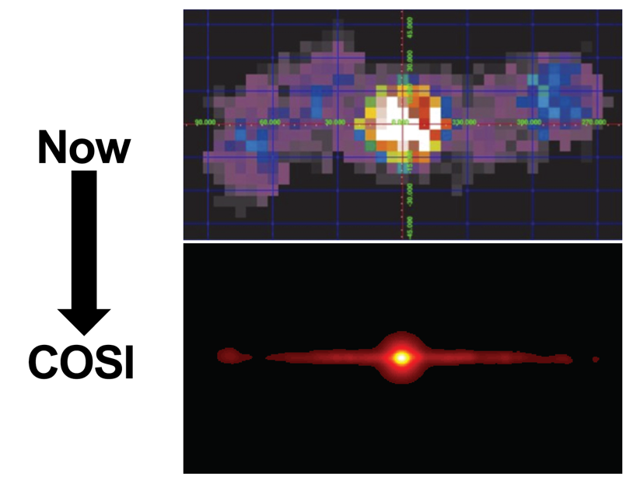
Science opportunities in the “MeV Gap”
INTEGRAL/SPI (Bouchet+10)
Signals and sources in the COSI energy range (0.2-5 MeV)
  e⁻e⁺ annihilation line at 511 keV
  Gamma-ray lines from nucleosynthesis
  Accreting black holes and gamma-ray bursts (GRBs) w/polarization
  Multimessenger sources
    Merging neutron stars
    High-energy neutrinos
Now
COSI
Bulge positron excess origin?
Is the 511 keV Galactic bulge excess:
Truly diffuse?
Made up of individual sources?
How many sources or components?
Notes:
Positron emissions
First, we’ll investigate the electron-positron annihilation line at 511keV
When electrons and positrons annihilate, they create a pair of photons with energies of 511keV
This line emission is the tracer that we see with COSI
This figure shows our current best image of the galaxy in 511keV emission
You can see emissions localized to the galactic plane in purple/blue, and strong excess coming from the galactic bulge
For the galactic plane, the measured positron rates produced by Al26 and Ti44 are about right
The excess emissions coming from the galactic bulge requires many more positrons, about 2x10^43 e+/s, to explain this excess that is seen in the galactic bulge
There were a series of talks at this conference that focused on research aimed at addressing the galactic bulge excess emissions
This is not understood
Integral recently published some evidence for some substructure there
There may be some emission from Sagittarius A*
A COSI science objective is to obtain a much shaper image of this
Here you can see a simulated result COSI’s 511keV angular resolution improvement

Slide 6
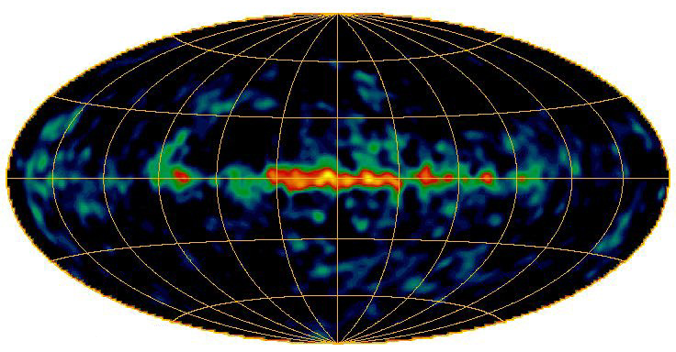
Science opportunities in the “MeV Gap”
Signals and sources in the COSI energy range (0.2-5 MeV)
  e⁻e⁺ annihilation line at 511 keV
  Gamma-ray lines from nucleosynthesis
  Accreting black holes and gamma-ray bursts (GRBs) w/polarization
  Multimessenger sources
    Merging neutron stars
    High-energy neutrinos
COMPTEL map of ²⁶Al emission (Oberlack+97)
Three windows on element formation associated with massive star evolution:
²⁶Al (1.809 MeV) traces massive stars, including pre-supernova (SN)
⁴⁴Ti (1.157 MeV) traces recent SN activity
⁶⁰Fe (1.173/1.333 MeV) traces SN activity over the past few million years
Notes:
Al26 is produced in the galaxy especially by massive stars:
It’s produced in the winds of massive stars and in supernova explosions
Has a half life of .7M yrs
What you see when you look at the galaxy is Al26 that has been produced over the past .7M years
When it decays it process a 1.8MeV gamma-ray, that COSI is able to study
One of the legacies of the COMPTEL mission is the mapping of Al26

Slide 7
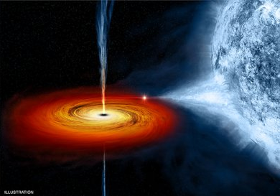
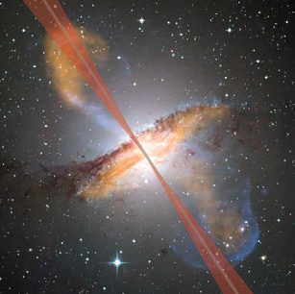
Science opportunities in the “MeV Gap”
Signals and sources in the COSI energy range (0.2-5 MeV)
  e⁻e⁺ annihilation line at 511 keV
  Gamma-ray lines from nucleosynthesis
  Accreting black holes and gamma-ray bursts (GRBs) w/polarization
  Multimessenger sources
    Merging neutron stars
    High-energy neutrinos
Potential high levels of polarization
  ~70% above 0.4 MeV for Cygnus X-1 (Laurent+11; Jourdain+12)
What about other Galactic black holes?
GRB distribution?
AGN?
Cygnus X-1
AGN: Cen A
Notes:
There have been some sources that have shown evidence for high levels of polarization in the MeV band
Crab nebula where integral has shown polarization levels of 46-98%
Cygnus X-1, an accreting black hole
The higher energy emissions appear to be highly polarized
Gamma-ray bursts there appears to be mixed results in the low statistics
COSI will provide polarization measurements of:
Galactic black holes
Active galactic nuclei
GRBs

Slide 8
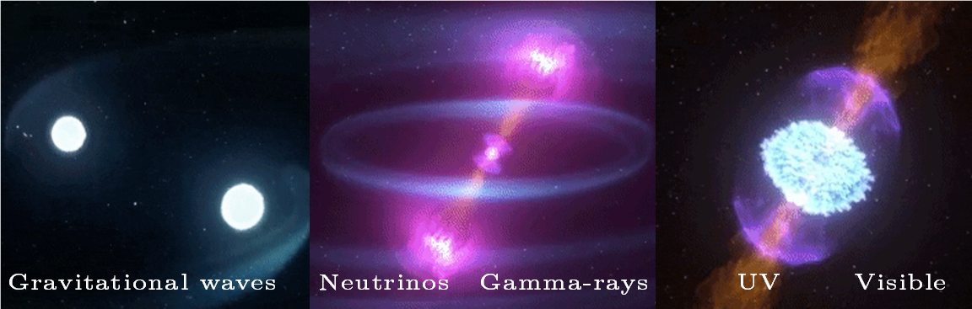
Science opportunities in the “MeV Gap”
Signals and sources in the COSI energy range (0.2-5 MeV)
  e⁻e⁺ annihilation line at 511 keV
  Gamma-ray lines from nucleosynthesis
  Accreting black holes and gamma-ray bursts (GRBs) w/polarization
  Multimessenger sources
    Merging neutron stars
    High-energy neutrinos
Credit: NASA's Goddard Space Flight Center/CI Lab
Supernovae + Gamma-rays:
SN1987A
Gravitational Waves + Gamma-rays :
GRB170817A + GW170817
Neutrinos + Gamma-rays:
IceCube-170922A + 0506+056?
gamma-ray emitting blazar
8
Notes:
Gamma-ray observations have played a crucial role in all multimessenger astrophysics (MMA) observations
For example: nearby supernovae where gamma-rays and neutrinos are seen
SN1987A in the large magellanic cloud
Gravitational waves and Gamma-rays:
GRB170817A + GW170817
Neutron-Neutron star mergers are known producers of gravitational waves (pale blue arcs in this Goddard provided illustration)
Followed by a near-light-speed jet that produced gamma rays (magenta)
expanding debris from a "kilonova" we also get some ultraviolet (violet), optical and infrared (blue-white to red)
Blazars that can produce high energy neutrinos and gamma-rays:
Given what I’ve heard in various talks here, the jury is still out on whether or not the high energy neutrino population is mostly from blazars or whether or not there are other components, as well
COSI should be able to provide some very useful data products for people interested in this topic
And of course, if there is a nearby supernova, COSI would see dozens of nuclear lines and we’d be thrilled to learn so much more about supernovae explosions
But the likelihood of this happening during the proposed 2yr mission is very low so it’s not included in out level 1 science

Slide 9
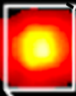


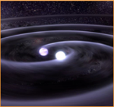
COSI science goals
Now
1. Uncover the origin of Galactic positrons
COSI
Now
2. Reveal Galactic element formation
COSI
3. Gain insight into extreme environments with polarization
4. Probe the physics of multimessenger events
Notes:
1. Imaging spectroscospy of the entire Galaxy at 511keV
2. Imaging spectroscopy of the entire Galaxy at various nuclear lines above 1 MeV
3. polarization sensitivity
4. large FOV to catch GRBs
Angular resolution for localizations
Collecting all of these science goals together, we need an instrument that provides:
Large FOV
Precision resolution spectroscopy
Polarimetry
Moderate angular resolution
The COSI instrument satisfies all of these requirements

Slide 10
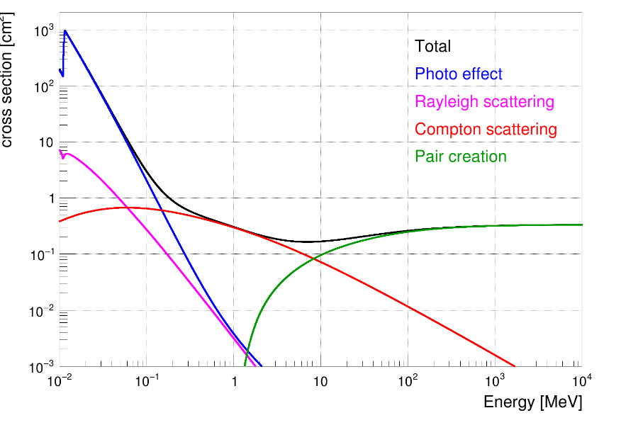
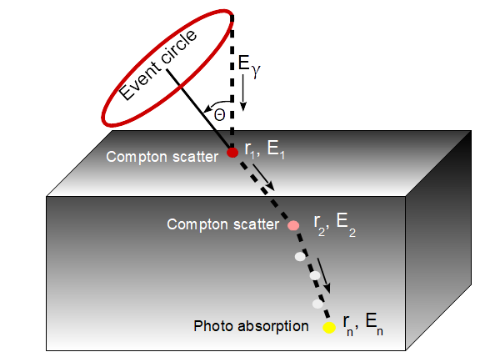
Detecting photons at MeV energies with Compton telescopes
Cross sections for germanium
Compton telescopes
(COMPTEL, COSI)
Multiple interactions within detector
E_{𝛾} = E₁ + E₂ + E₃ + …
The photon may have come from any point on the “event circle”
Pair creation telescopes
(Fermi/LAT)
Full photon absorption
(NuSTAR, etc.)
Notes:
Left side:
This plot explains why Compton telescopes are well suited for the MeV bandpass
At lower energies, a photon interaction within your detector is more likely to photo absorb like NuSTAR
At higher energies, you get pair production like FERMI/LAT
In the MeV bandpass, the most likely interaction is a Compton scatter
Right side:
When a gamma-ray enters the COSI Germanium detector, it will primarily interact through Compton scattering at one or more locations
Once the photon loses enough energy, it’s last interaction is photon absorption
COSI measures the 3-D location and energy loss for each of these interactions
Event circles are determined by inverting the Compton scatter formula
Polarized photons will preferentially scatter at right angles relative to the polarization vector, making the instrument inherently a polarimeter

Slide 11
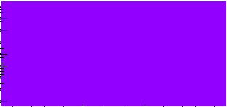
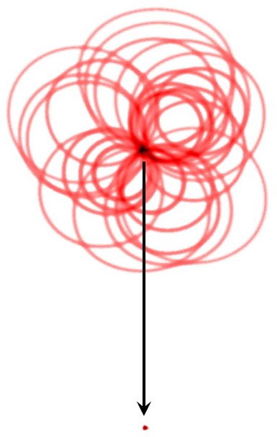
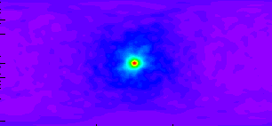
COSI Imaging Techniques
Back-projected Compton cones in image space
Iterative deconvolution to recover image
Deconvolved image of a point source
Notes:
With one photon your position uncertainty is defined by the event circle
As you receive more events, the Compton event circles intersect at some origin in image space
The animations here show both the back projected cones in image space of a point source
And the iterative deconvolution of the point source where the image is recovered
The angular resolution is defined by the width of the event circles
This is traced back to the strip width and pitch
COSI uses a software package developed by Andreas Zoglauer at Berkeley called MEGAlib.
We also have a python wrapper developed by Thomas Seigert that we’re working on for high-level analyses

Slide 12
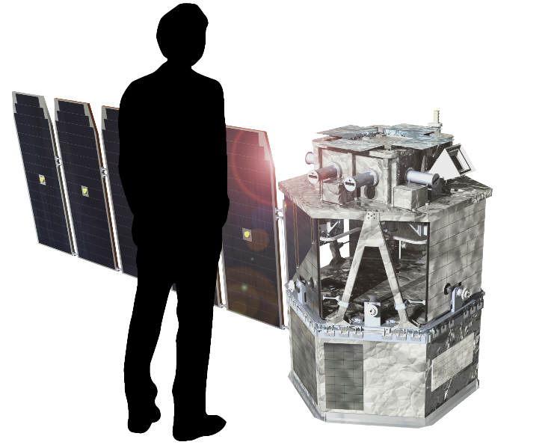
COSI: NASA Small Explorer satellite mission
Parameter | Requirements
Energy range | 0.2-5 MeV
Sky coverage | 100%-sky each day
Energy resolution | 0.2-1% FWHM
Angular resolution | 2.1º FWHM @ 1.8 MeV (²⁶Al)
Localizations | <1.0º for GRBs
Polarization sensitivity | For GRBs, AGN, Galactic BHs
COSI instrument/payload and spacecraft
Notes:
Here, you see a roughly scaled representation of COSI.
- The main instrument and germanium detectors sit on top of the spacecraft.
- The main instrument is surrounded by active shields on four sides and underneath
- The germanium detectors give us excellent energy resolution between 0.2 - 1% FWHM
- The angular resolution requirement is about 2 degrees FWHM at the Al26 line, and it will localize GRBs to better than a degree
- COSI is also a sensitive polarimeter.

Slide 13

COSI orbit and operations for daily all-sky coverage
North
Near-equatorial orbit to minimize South Atlantic Anomaly passages
Instantaneous >25%-sky field of view (FOV) and North-South repointing every 12 hours to cover the whole sky every day
22º North-South
Repointing
Equator
22º
Orbital Plane
5º Orbit
Inclination
South
  Large FOV needed for:
    GRBs (localizations and polarization measurements)
    All-Galaxy images of 511 keV and nuclear lines
Notes:
-

Slide 14
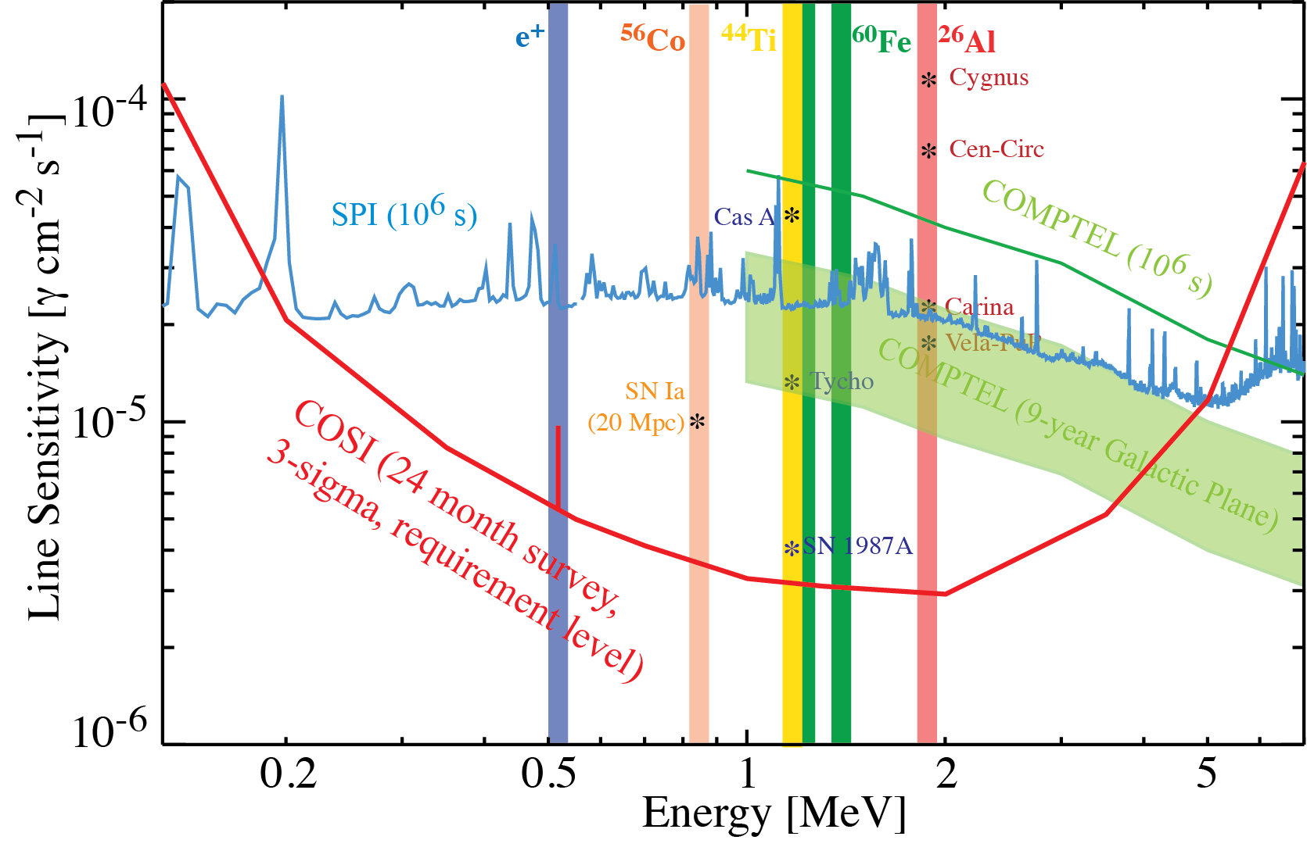
COSI required line sensitivity and grasp compared to previous and current missions
COSI is optimized for line sensitivity to enable full-Galaxy and all-sky images.
COSI’s large FOV provides a substantial improvement in grasp.
Notes:
This shows the COSI requirement levels at 3-sigma for a 2-year mission
You can see how COSI compares to both SPI and COMPTEL
One reason why we’re able to do better than these instruments is our large field of view which gives us a very large grasp which is the product o the effective area and the field of view

Slide 15
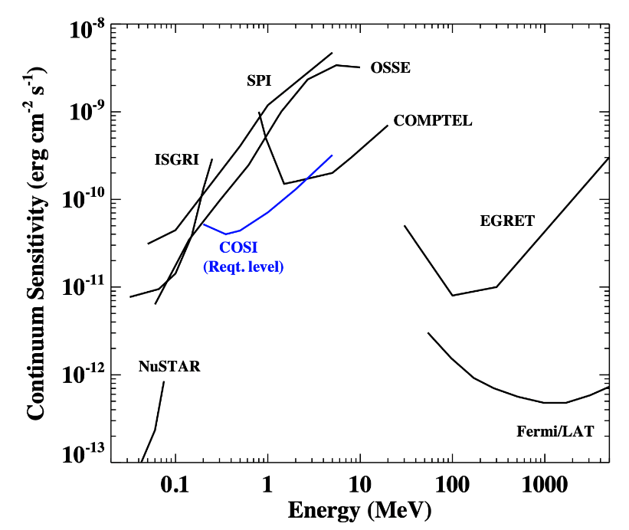
What COSI doesn’t do
Although COSI helps, it doesn’t completely close the MeV gap.
Sub-degree but not sub-arcminute GRB localizations
MeV gap
Not anticipating large number of Targets of Opportunity (TOOs).
  Survey mode’s all-sky coverage every day reduces the need
  ”Constant Zenith Angle” TOOs have some applications

Slide 16


Schedule and opportunities for involvement
Planned Schedule
Currently in Phase B
  Data Challenges in the coming months and years will be an opportunity for community involvement (http://cosi.ssl.berkeley.edu)
Additional data challenges during Phases C and D
Launch: 2026 (start of Phase E), followed by a 2-year prime mission, but no consumables, so could be significantly longer
Positrons
Nucleosynthesis
In addition to the key science goals, all-sky monitor results will be provided to the community
  Please let us know what would be most useful for you!
Polarization
Multimessenger
16

Slide 17

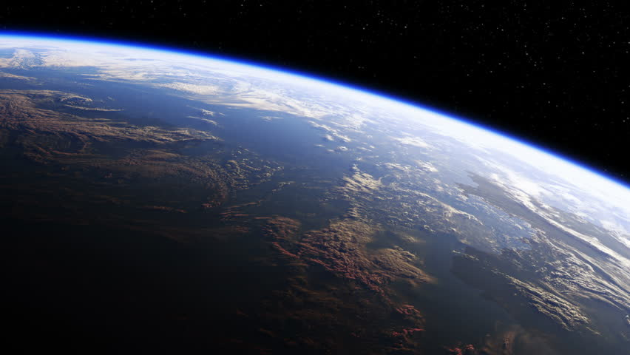
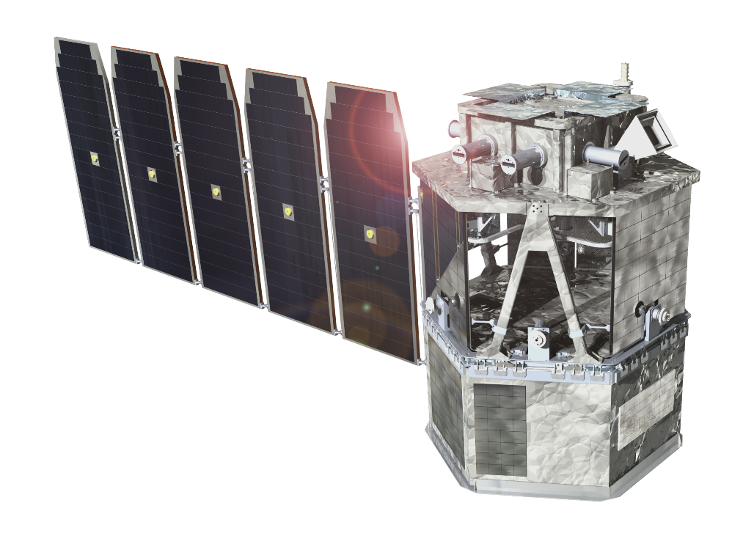



The COSI collaboration
University of California
John Tomsick (Principal Investigator, UCB)
Bryce Unruh (Project Manager, UCB)
Steven Boggs (Deputy PI, UCSD)
Jarred Roberts (Project Scientist, UCSD)
Andreas Zoglauer (Project Scientist, UCB)
J. Martinez Oliveros (Student Collaboration Lead)
P. Saint-Hilaire (SEO Lead)
H. Lazar, J. Beechert, H. Gulick
Naval Research Laboratory
E. Wulf, C. Sleator, B. Phlips
Goddard Space Flight Center
A. Shih, C. Kierans, A. Smale
Northrop Grumman
Institutions of Co-Investigators and Collaborators
Clemson University
Los Alamos National Laboratory
Louisiana State University
IRAP, France
INAF, Italy
Kavli IPMU and Nagoya University, Japan
JMU, Germany
NTHU, Taiwan

Slide 18

COSI
We’d be very happy to hear from you!
Contact Jarred Roberts: jmroberts@ucsd.edu
Gamma-Ray Space Explorer
Revolutionizing our understanding of the creation and destruction of matter within our galaxy and beyond

Slide 19
COSI requirements
Characteristic | Requirement
Sky Coverage | >25%-sky instantaneous FOV 100%-sky each day
Energy Resolution (FWHM) | 6.0 keV at 511 keV (capability ~4.7 keV FWHM) , reconstructed events 9.0 keV at 1.157 MeV (⁴⁴Ti)
Narrow Line Sensitivity (2 yr, 3σ, point source) 511 keV 1.8 MeV | [photons cm⁻² s⁻¹] 1x10⁻⁵ (Galactic bulge is 100x brighter) 3x10⁻⁶ (Galactic ²⁶Al flux is 230x brighter)
Angular Resolution (FWHM) | 5.1° at 511keV (capability ~3.6° FWHM) 2.0° at 1.8 MeV (²⁶Al)
Primarily for goals 1+2
Accreting BH polarization | Reaches bright AGN: Cen A, 3C 273, NGC 4151 Reaches several Galactic BHs (plus transients)
GRB polarization | >30 GRBs with polarization measurements
Goal 3
Short GRB detection, localization, and reporting | >10 short GRBs (~20 detections predicted) <1° localizations provided in <1 hr
Goal 4
Notes:
Efficiency 10% vs COMPTEL at 1%
Deadtime <10%

Slide 20
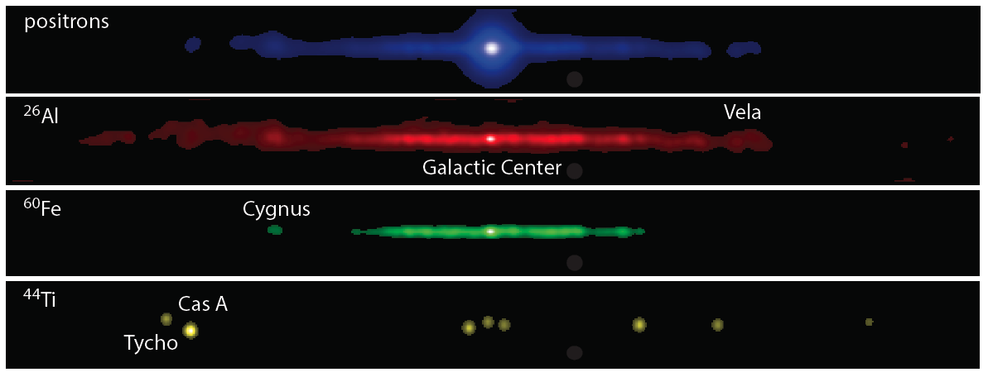
Radioactive Milky Way
Simulated COSI emission line images

Slide 21
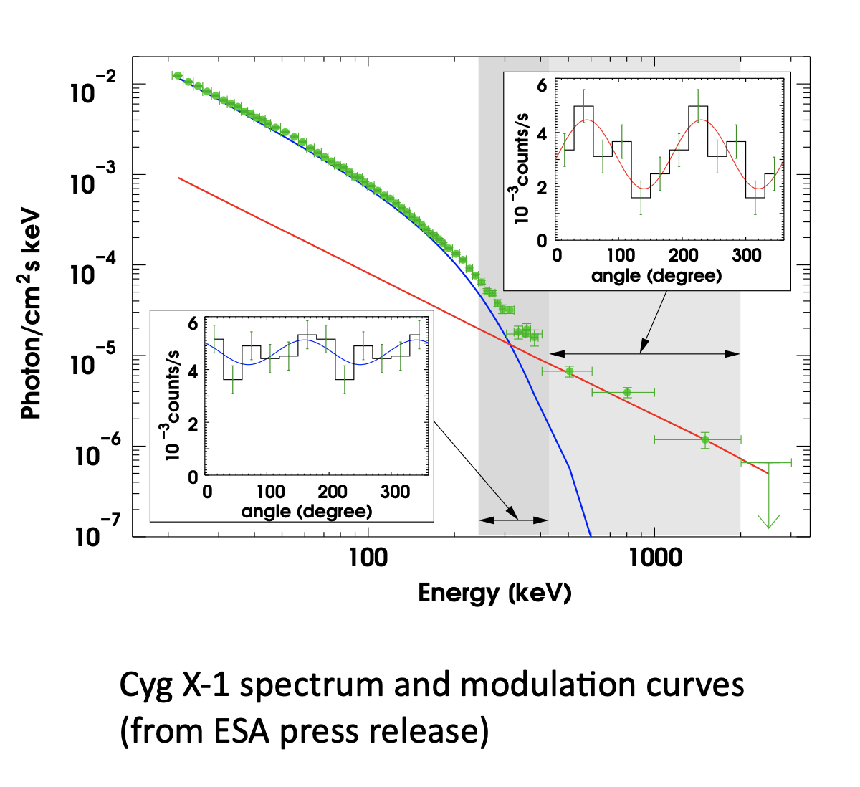
Accreting Black Holes Polarization Measurements
Cyg X-1 polarization:
0.25-0.4 MeV: <20% (low polarization)
  thermal corona of hot electrons
  photons Compton upscattered off corona
0.4-2 MeV: 67±30% (high polarization)
  points to nonthermal jet contribution
  synchrotron self-Compton (SSC)
COSI will measure polarization (50% MDP, 99% confidence, 0.2-0.5 MeV) with flux limits:
6.9x10⁻¹⁰ erg cm⁻² s⁻¹
(Galactic black hole transients, 1 month)
1.4x10⁻¹⁰ erg cm⁻² s⁻¹ (AGNs, 2 years)
COSI will measure Cyg X-1 polarization within a few weeks of launch
(Laurent et al. 2011, Nature)
Notes:
The INTEGRAL Cyg X-1 observations demonstrate the power of polarimetry over spectral measurements alone for studying accreting black holes
[discuss two bands for Cyg X-1]
[discuss COSI sensitivities]

Slide 22
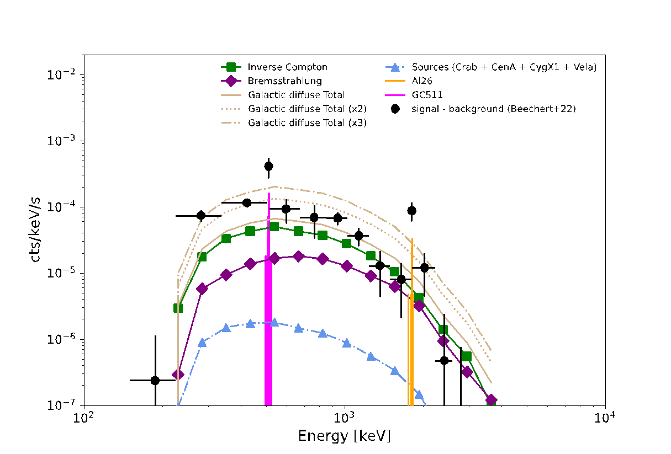
COSI continuum emissions
Preliminary analysis shows that the continuum emission level is between 1x and 3x (depending on the energy) of the GALPROP prediction for GDCE
Spectrum below 0.511 MeV shows the largest excess
  Orthopositronium continuum?
  Unresolved point sources?
Spectrum from the source region
(Karwin et al., in prep.)
Notes:
- We’ve also been working on a modified Richardson-Lucy approach to point source localization

Slide 23
Nearby SNe and Classical Novae
Nearby SNe
  ⁵⁶Co lines at 0.847 and 1.238 MeV detected from Type Ia SNe to a distance of ~20 Mpc
    COSI detections for ~1.7 per year
Galactic CCSNe
  Nuclear lines from more than ten different radioactive nuclei in the SN ejecta to probe asymmetries in the SN engine and details of the burning layers in the progenitor star
Classical novae
  Predicted 511 keV line and gamma-ray continuum have not been seen because the explosion and gamma-ray emission occur several days before the optical nova
    COSI’s large FOV gives a good chance to see this, and we would expect to see about 1 event per year

Slide 24
Production and decay chain of key isotopes
Isotope | Production | Decay chain
²⁶Al | Hydrostatic burning, proton capture by ²⁵Mg | ²⁶Al → ²⁶Mg* → ²⁶Mg Beta+ (p→n+e⁺) and 1.809 MeV gamma-ray
⁶⁰Fe (neutron rich) | He and C shell burning, explosive burning, neutron capture | ⁶⁰Fe → ⁶⁰Co → ⁶⁰Ni Both beta- (n→p+e-)
⁴⁴Ti | Si burning in the inner regions of the material ejected by CCSNe | ⁴⁴Ti → ⁴⁴Sc → ⁴⁴Ca EC and beta+ 1.157 MeV and 68/78, respectively

Slide 25
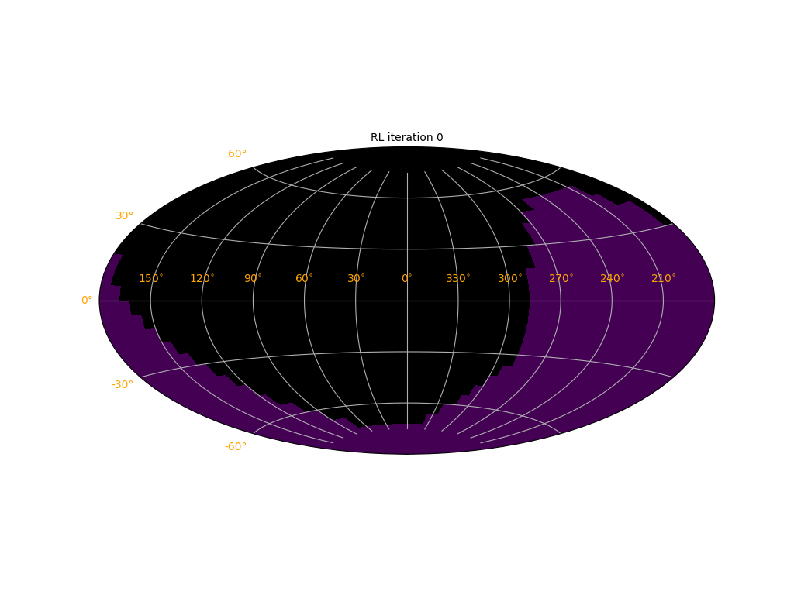
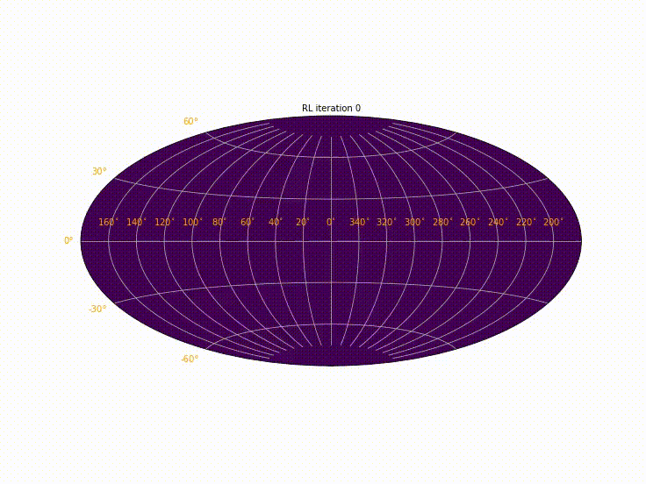
COSI Imaging Techniques
Modified Richardson-Lucy algorithmic techniques:
Background fitting
Data energy and time binning tunable full-sky imaging
Crab
(2016 Balloon Flight)
Cygnus X-1
(2016 Balloon Flight)
Notes:
- We’ve also been working on a modified Richardson-Lucy approach to point source localization

