Slide 1

The formation of γ-ray halos around SNRs through particle escape
Robert Brose, M. Pohl, I. Sushch
TeVPa, 8-12 August 2022

Slide 2
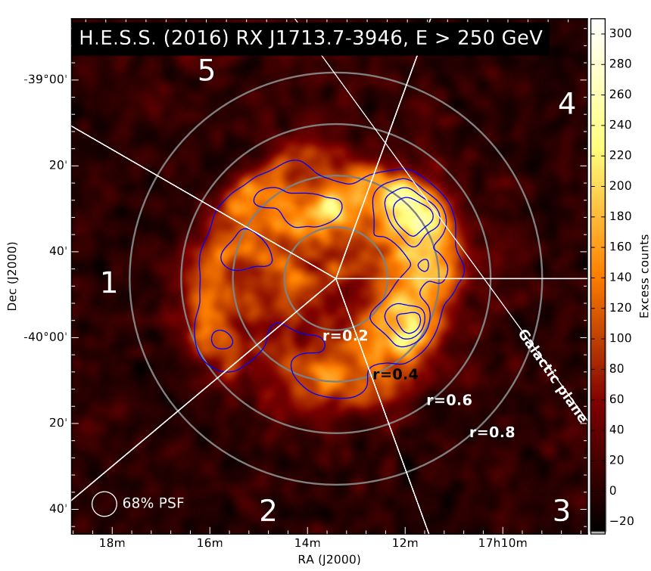
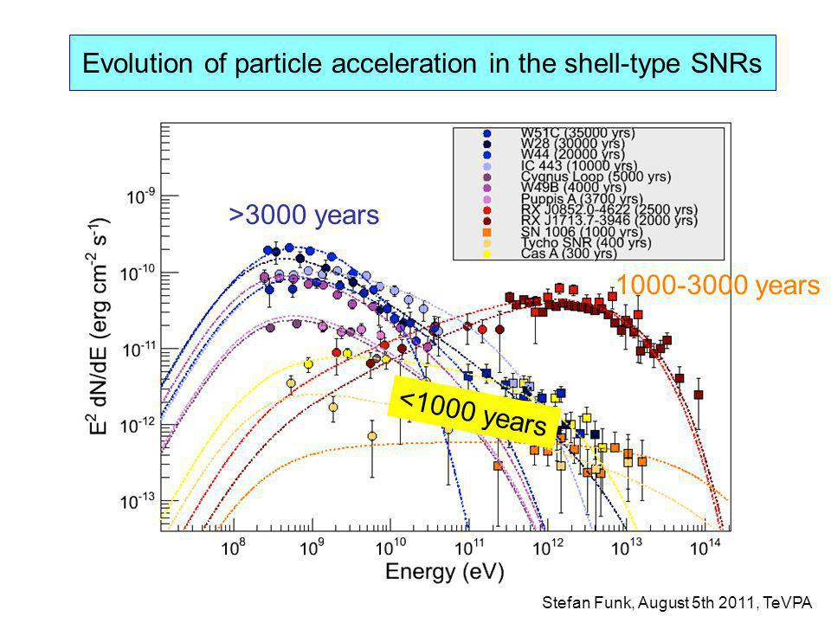
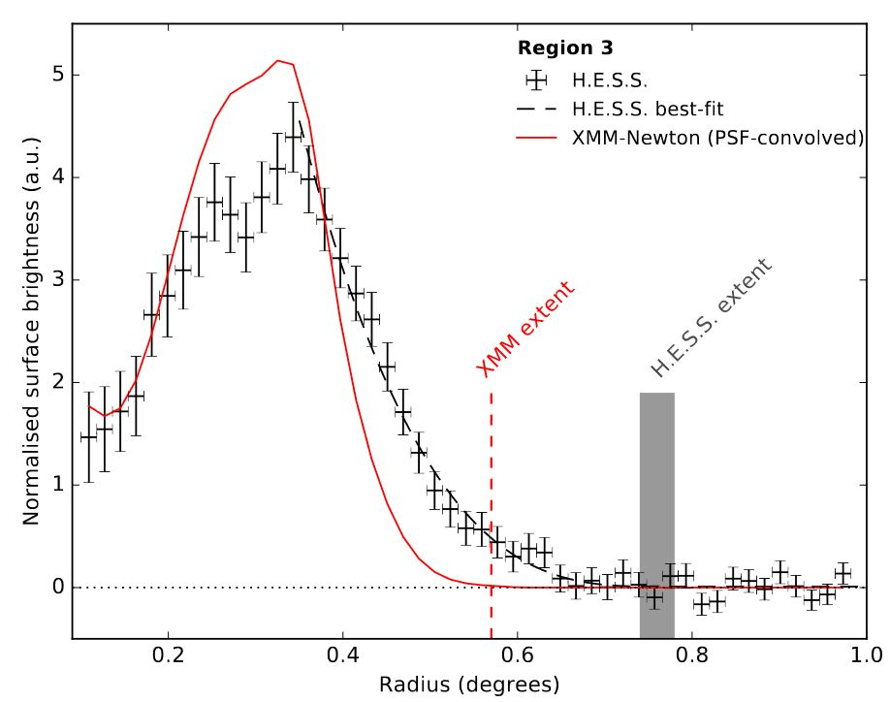
Observational overview
CRs from SNRs
More and more observational constrains:
Models need to account for spectral evolution and morphology
Figures:
(Top) Excess-count map of RX J1713.7-3946
(Left) Gamma-ray and X-ray profiles of RX J1713.7-3946 (H.E.S.S. 2018)
Figure: Gamma-ray flux from various SNRs (Funk, TeVPa 2011)

Slide 3
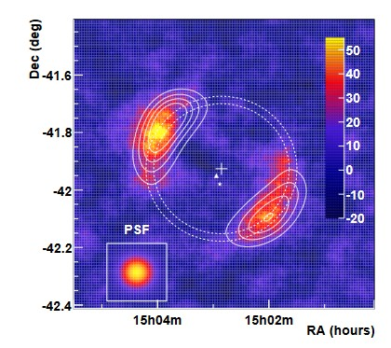
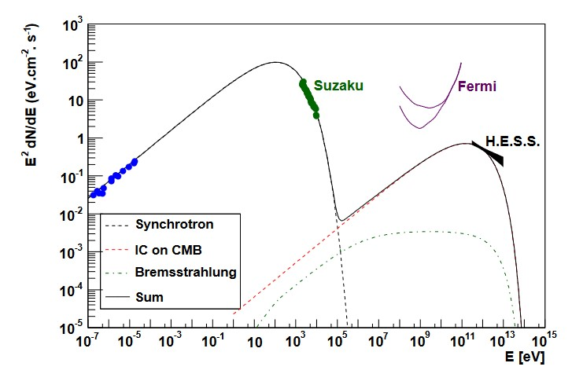
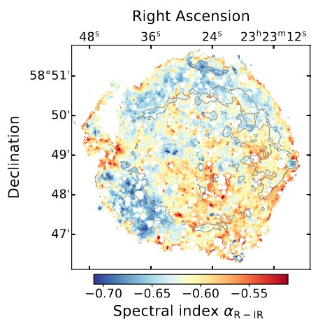
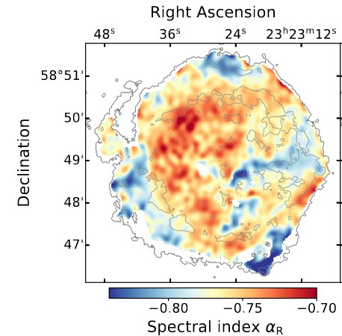
Morphological complications
CRs from SNRs
Spectral-index mismatch!
Figure: SN1006 VHE-map and leptonic SED-model (H.E.S.S. 2010)
Figure: Cas A Radio-spectral index map (right), Cas A Radio-to-IR-spectral index map (left) (Domček et al. 2021)

Slide 4

Coupled equations
Fermi acceleration
Powered by
Cosmic-ray transport equation
Well-tested code in development since 2012
10+ papers
140+ citations
Hydro equations
Magnetic Turbulence
Magnetic field
Standard DSA
Non-linear DSA
NDSA + high MF

Slide 5
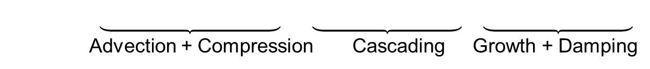
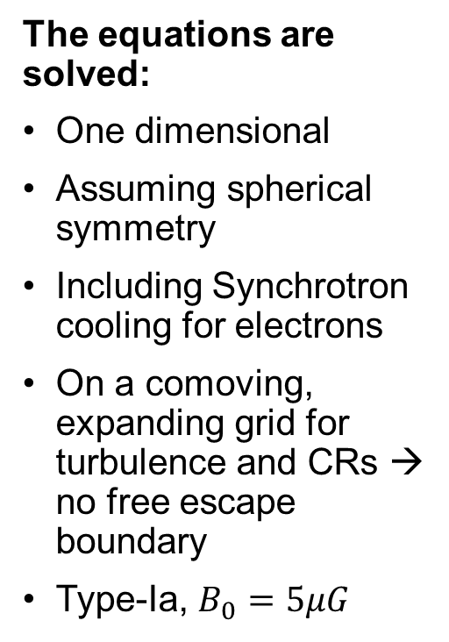

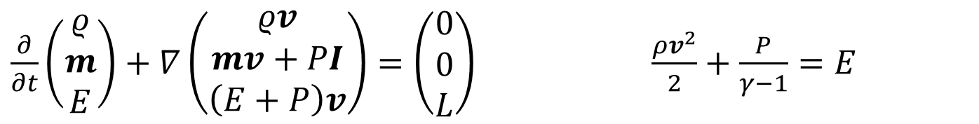
The equations
Fermi acceleration
$$\frac{∂N}{∂t} = ∇{ D}_{r}∇N − ∇vN − \frac{∂}{∂p}\left(N\dot{p} − \frac{v}{3}Np\right) + Q$$
Diffusion Advection Cooling Acceleration Injection
The equations are solved:
One dimensional
Assuming spherical symmetry
Including Synchrotron cooling for electrons
On a comoving, expanding grid for turbulence and CRs → no free escape boundary
Type-Ia, $B_{0}=5μG$
$$\frac{∂E_{W}}{∂t} = − \left(v∇_{r}E_{W}+c∇_{r}vE_{W}\right)+ k^{3}∇_{k}D_{k}∇_{k}\frac{E_{W}}{k^{3}}+2\left(Γ_{g}−Γ_{d}\right)E_{W}$$
Advection + Compression Cascading Growth + Damping
$\frac{∂}{∂t}\left(\begin{matrix}ρ \\ m \\ E\end{matrix}\right)+∇\left(\begin{matrix}ρv \\ mv+PI \\ \left(E+P\right)v\end{matrix}\right)=\left(\begin{matrix}0 \\ 0 \\ L\end{matrix}\right)$ $\frac{ρv^{2}}{2}+\frac{P}{γ−1}=E$

Slide 6
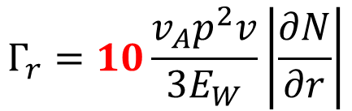
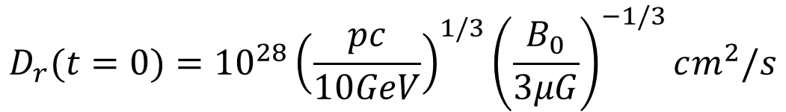
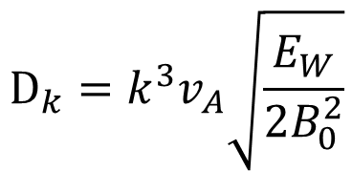
Fermi acceleration
Turbulence setup
Initial turbulence derived from 1/10th
of the Galactic diffusion coefficient
$$D_{r}(t=0)={{10}^{28}\left(\frac{pc}{10GeV}\right)}^{1/3}{\left(\frac{B_{0}}{3μG}\right)}^{−1/3}cm^{2}/s$$
Growth rate based on pressure gradient of CRs (resonant CR-instability x10)
$$Γ_{r}=10\frac{v_{A}p^{2}v}{3E_{W}}\left|\frac{∂N}{∂r}\right|$$
$$D_{k}=k^{3}v_{A}\sqrt{\frac{E_{W}}{2B_{0}^{2}}}$$
Damping as diffusion in wavenumber space

Slide 7
Results

Slide 8
The mechanism
Cosmic-ray escape
More complicated for CC-SNRs:
e.g. hot CSM softens spectra (Das et al. 2022)
t₃> t₂> t₁
Total production spectrum of the SNR
t₃
Number of particles
t₂
t₁
Particles lost to upstream
Production spectra at the shock
Downstream spectrum → detectable emission
Particle momentum

Slide 9
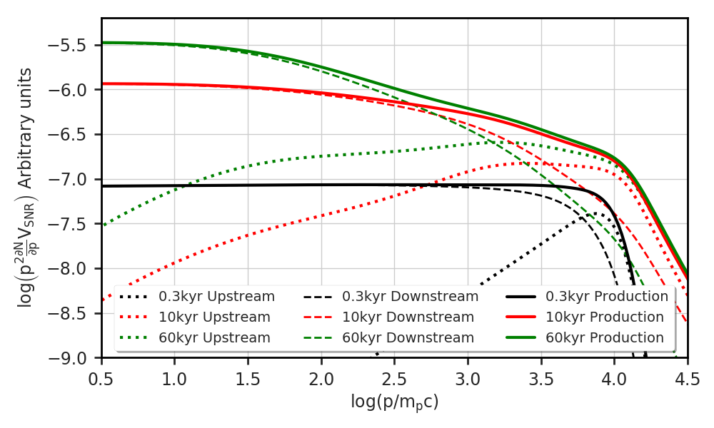


Production spectra
Cosmic-ray escape
The production spectrum agrees with galactic propagation models (Moskalenko et al. 2002)
The downstream spectra are softer than the production spectra
Particles “escape” from deep downstream to upstream
$$s≈2.4$$
$$s≈2.7$$
From: A&A, 634 (2020) A59

Slide 10
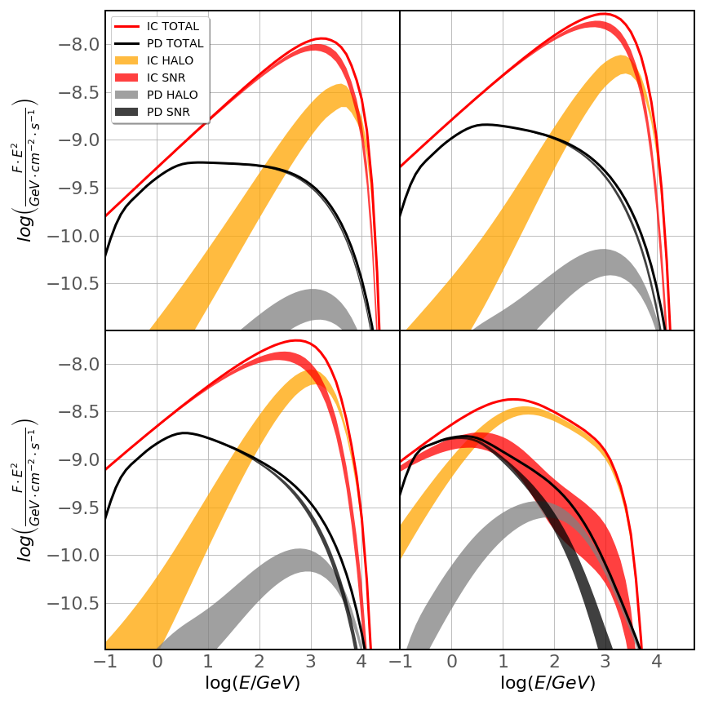

Spectral evolution: very young SNRs
<1000 yrs
Gamma-ray spectra
Model prediction:
Observation:
300 yr
1,000 yr
Sizable hadronic component for very-young SNRs!
$$s≈2$$
Figure: Gamma-ray flux from various SNRs (Funk, TeVPa 2011)
2,000 yr
10,000 yr

Slide 11

Spectral evolution: young SNRs
1000-3000 yrs
Gamma-ray spectra
Model prediction:
Observation:
300 yr
1,000 yr
$$s≈1.5$$
IC-emission might dominate in young SNRs!
Why?
Figure: Gamma-ray flux from various SNRs (Funk, TeVPa 2011)
2,000 yr
10,000 yr

Slide 12
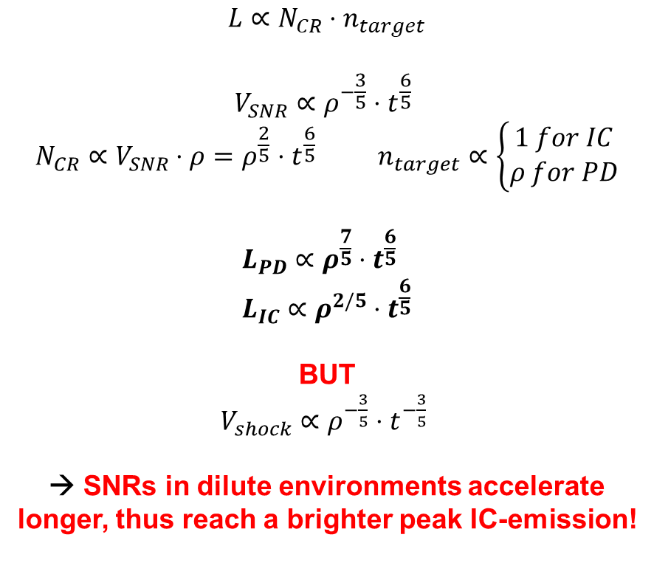
Spectral evolution: young SNRs
1000-3000 yrs
Gamma-ray spectra
Why are only leptonic SNRs detected in this age-range:
Selection effects!
Observation:
$$L∝N_{CR}⋅n_{target}$$
$$V_{SNR}∝ρ^{−\frac{3}{5}}⋅t^{\frac{6}{5}} \\ N_{CR}∝V_{SNR}⋅ρ=ρ^{\frac{2}{5}}⋅t^{\frac{6}{5}} n_{target}∝\left\{\begin{matrix}1 for IC \\ ρ for PD\end{matrix}\right.$$
$$L_{PD}∝ρ^{\frac{7}{5}}⋅t^{\frac{6}{5}} \\ L_{IC}∝ρ^{2/5}⋅t^{\frac{6}{5}}$$
BUT
$V_{shock}∝ρ^{−\frac{3}{5}}⋅t^{−\frac{3}{5}}$
→ SNRs in dilute environments accelerate longer, thus reach a brighter peak IC-emission!
(Sedov-solution)
Figure: Gamma-ray flux from various SNRs (Funk, TeVPa 2011)

Slide 13
Spectral evolution: young SNRs
1000-3000 yrs
Gamma-ray spectra
Synchrotron-emission:
downstream only
IC-emission:
all particles
Observation:
IC and X-ray emission show different spectral indices!
$$s≈1.5$$
2,000 yr
Figure: Gamma-ray flux from various SNRs (Funk, TeVPa 2011)

Slide 14

Spectral evolution: evolved SNRs
>3000 yrs
Gamma-ray spectra
Model prediction:
Observation:
Evolved SNRs tend to be interacting:
PD-emission dominates again!
300 yr
1,000 yr
$s ≥ 2.7$
Figure: Gamma-ray flux from various SNRs (Funk, TeVPa 2011)
2,000 yr
10,000 yr

Slide 15
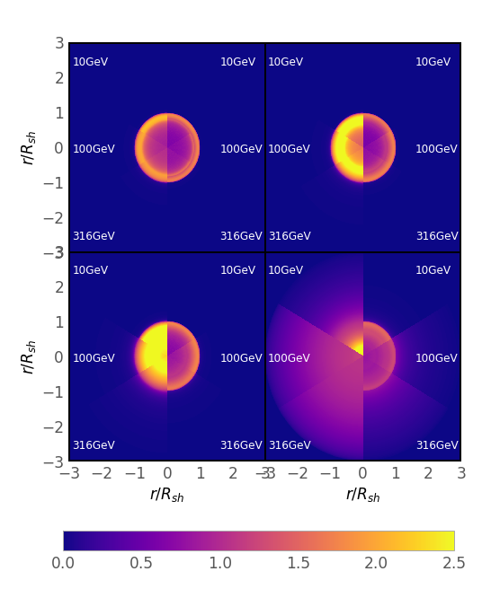
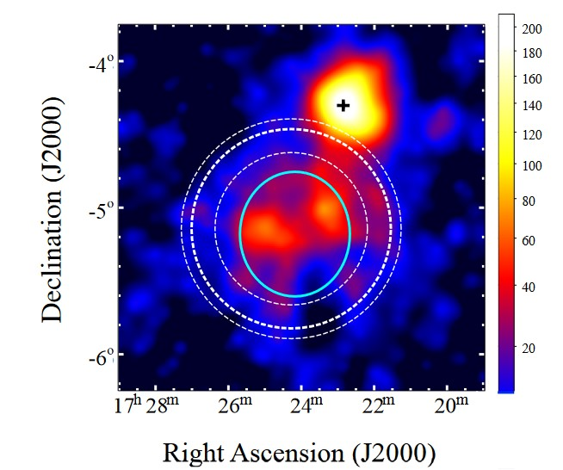
Emission maps
Gamma-ray morphology
Extended, off-plane SNRs are excellent test-beds:
→ Escape is resolvable!
IC
PD
IC
PD
PD-emission:
Shell-like morphology throughout all phases and energies
Faint halo emission
IC-emission:
Initially shell like morphology
Transition to center-filled
Halo emission already after 2kyr
Figure: Radio and GeV γ-rays from FHES J1723.5−0501 (G17.8+16.7) (Araya et al. 2021)
300 yr
1,000 yr
Radio-shell
Gamma-ray
gaussian
2,000 yr
10,000 yr
Emission maps

Slide 16
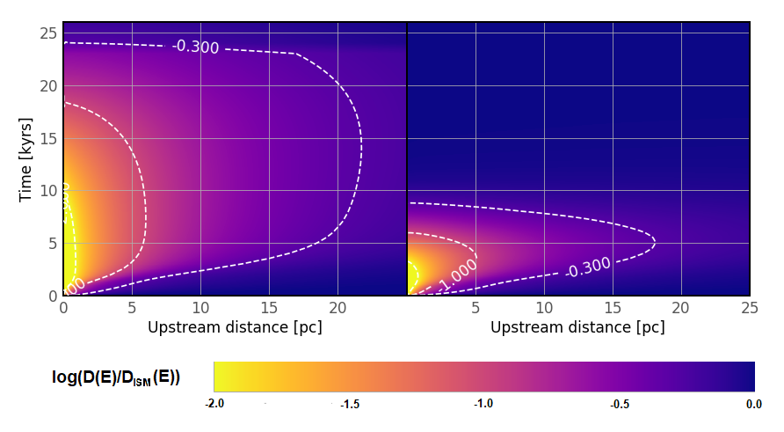
Halo diffusion coefficient
Diffusion coefficient gets reduced up to ~20pc into the upstream
Rise time similar across energies → down cascading
Escaping CRs govern diffusion for low-energetic CRs
→ Similar behavior as in PWN-halos
100 GeV
3 TeV
From: A&A, 654 (2021) A139

Slide 17
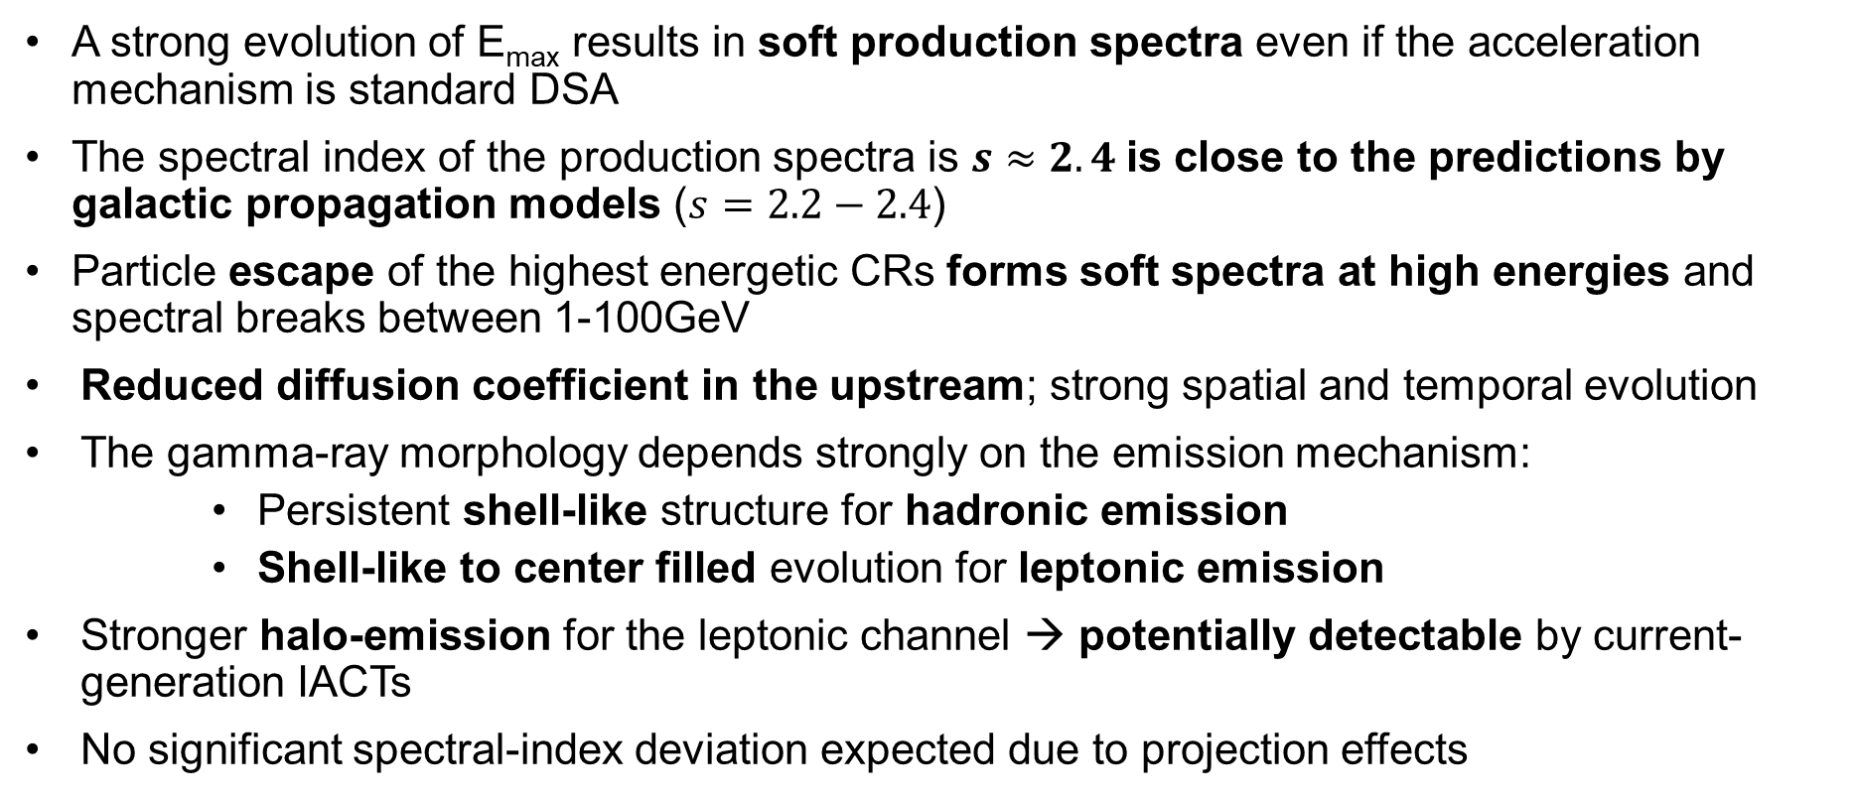
Conclusions
A strong evolution of E_{max} results in soft production spectra even if the acceleration mechanism is standard DSA
The spectral index of the production spectra is $s≈2.4$is close to the predictions by galactic propagation models ($s=2.2−2.4$)
Particle escape of the highest energetic CRs forms soft spectra at high energies and spectral breaks between 1-100GeV
Reduced diffusion coefficient in the upstream; strong spatial and temporal evolution
The gamma-ray morphology depends strongly on the emission mechanism:
    Persistent shell-like structure for hadronic emission
    Shell-like to center filled evolution for leptonic emission
Stronger halo-emission for the leptonic channel → potentially detectable by current-generation IACTs
No significant spectral-index deviation expected due to projection effects
See also: A&A, 634 (2020) A59; A&A, 654 (2021) A139

Slide 18
Thank you for your attention!

Slide 19
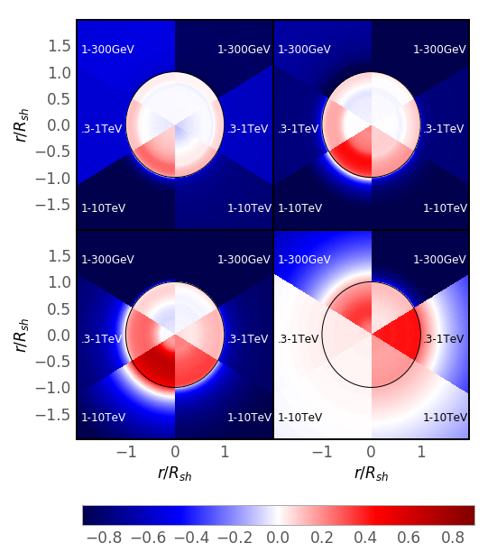
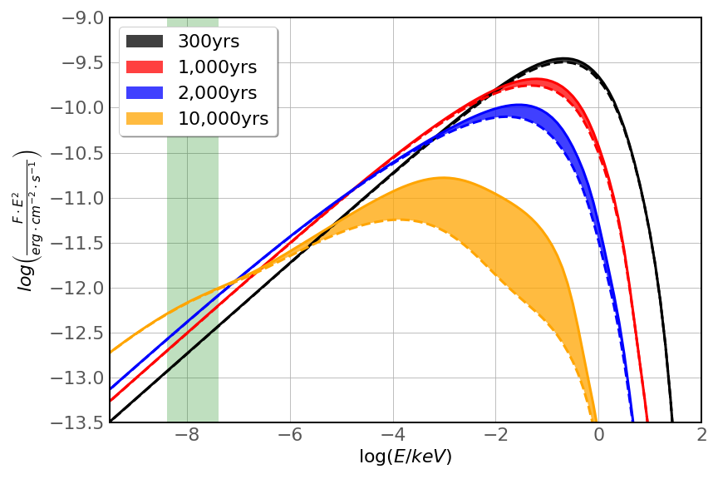
Spectral index maps and Radio emission
Gamma-ray morphology
Spectral index distribution:
No significant deviation from regions of brightest emission (gamma-rays)
Radio-emission:
Continuous Radio-brightening and X-ray fading
Escape later even affects Radio-emitting electrons → Spectral-index variations
IC
PD
IC
PD
Figure: Synchrotron-SED evolution

