Slide 1

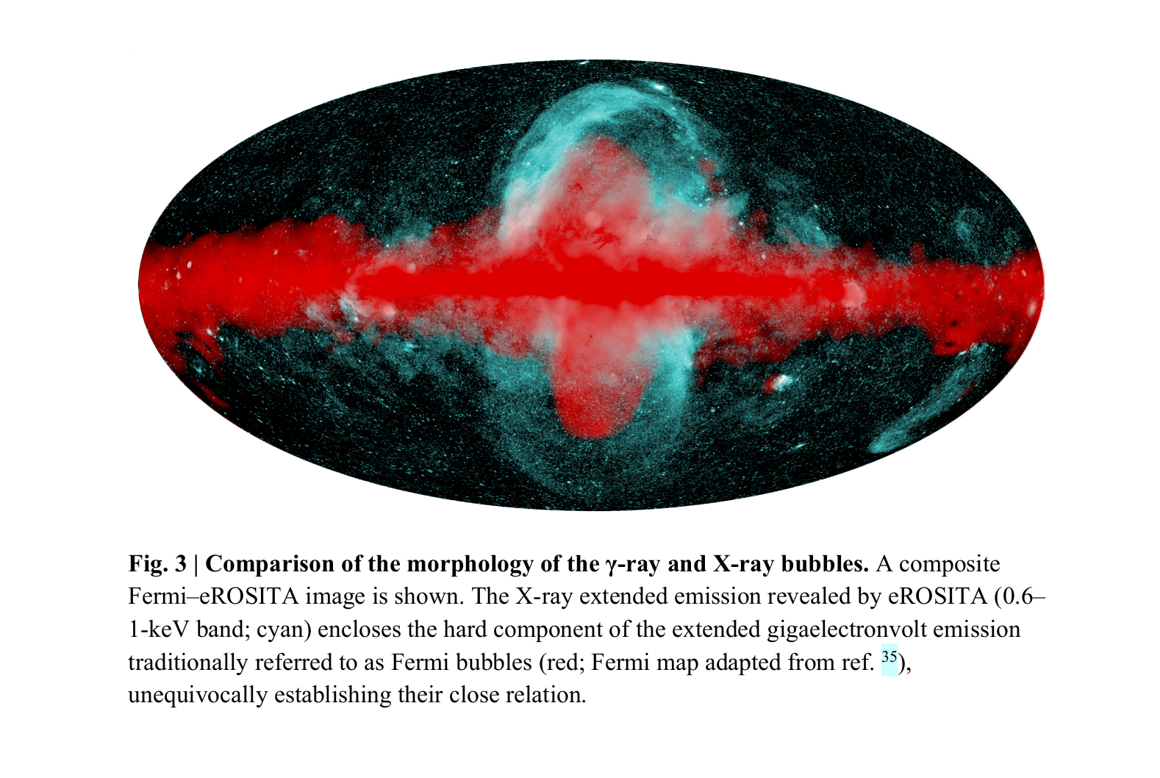
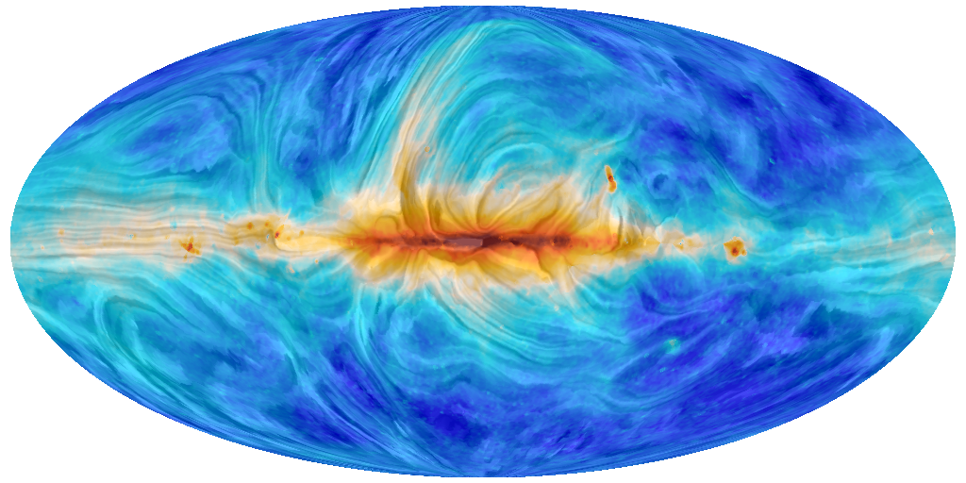
Galactic halo bubble magnetic fields and UHECRs
Vasundhara Shaw, Andrew Taylor, Arjen Van Vliet
1) https://www.cosmos.esa.int/web/planck/picture-gallery
2) Predehl, P., Sunyaev, R.A., Becker, W. et al. Detection of large-scale X-ray bubbles in the Milky Way halo. Nature 588, 227–231 (2020).

Slide 2
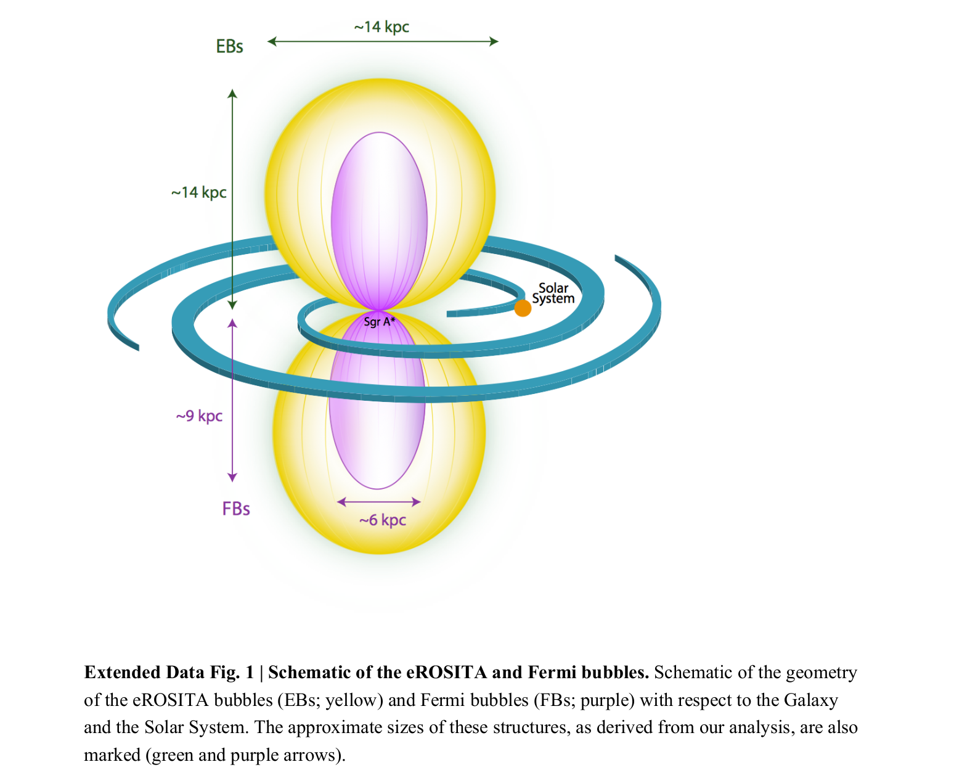
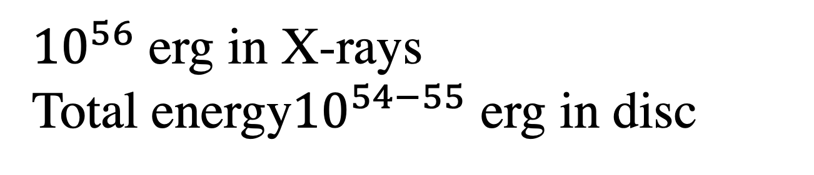
Galactic Halo Bubbles
eRosita (thermal)
Fermi (non-thermal)
${10}^{56}$ erg in X-rays
Total energy${10}^{54−55}$ erg in disc
Predehl, P., Sunyaev, R.A., Becker, W. et al. Detection of large-scale X-ray bubbles in the Milky Way halo. Nature 588, 227–231 (2020). https://doi.org/10.1038/s41586-020-2979-0
Notes:
We analyze 50 months of Fermi Large Area Telescope data between 100 MeV and 500 GeV above 10∘ in Galactic latitude to derive the spectrum and morphology of the Fermi bubbles.
The sky map from the first eROSITA all-sky survey is shown in Fig. 1. This image has been
created from calibrated events in the energy range 0.3–2.3 keV (Methods).

Slide 3
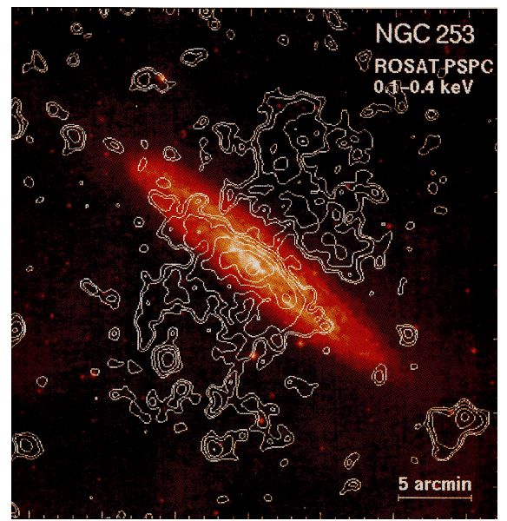
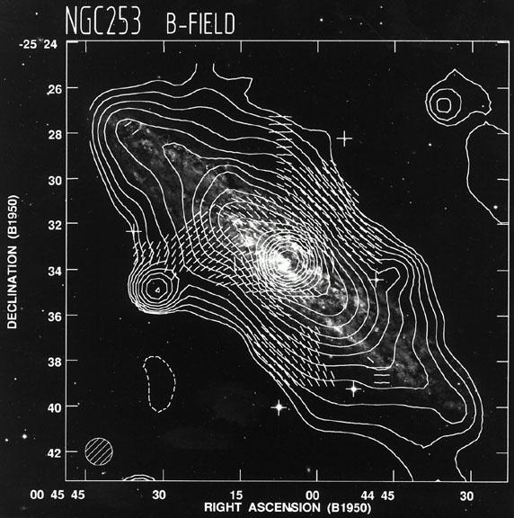
Large scale structures = large scale fields
(Pietsch et.al 1996)
(Beck et.al 1994)
Total radio intensity (contours) and magnetic field orientation of NGC 253.
Milky way is not a starburst galaxy yet it has outflow!
Notes:
”The 0.1 - 0.4 keV band contour plot of the X-ray intensities of the spiral galaxy NGC 253 overlayed on the optical image.”
50% of star formation happens in the nuclear zone for NGC while 10% of SF happens in nuclear zone for milky way uneven spread for NGC
Milky way star formation rate 1M*/year
NGC has 2M*/year

Slide 4
Galactic Halo
Galactic Halo Bubbles
Galactic Disc
Notes:
Dark matter potential is 10^3 eV for thermal gas density of 10^-3 cc
The Galactic potential is logarathmic
Temperature of halo 10^7 K
rotational velocity for ram pressure = 200 km/sec

Slide 5






Not negligible!
$U_{B_{Reg}}$ = 0.8 eV/cc
We need magnetic fields to understand deflections of cosmic rays.
Galactic Halo
Galactic Halo Bubbles
$U_{CR}$ = 0.8 eV/cc
$ρΦ=$1 eV/cc
$ρ/m≈{10}^{−3}$ cc
$P_{thermal}=$0.8 eV/cc
$U_{B_{Tur}}=4.2$ eV/cc
Note: We do not have any accurate estimates for the Halo !
Galactic Disc
Notes:
Dark matter potential is 10^3 eV for thermal gas density of 10^-3 cc
The Galactic potential is logarathmic
Temperature of halo 10^7 K
rotational velocity for ram pressure = 200 km/sec

Slide 6


Probing magnetic fields with synchrotron radiation
$$\frac{dn_{e}}{dlogE_{e}}$$
B-fields
Synchrotron

Slide 7
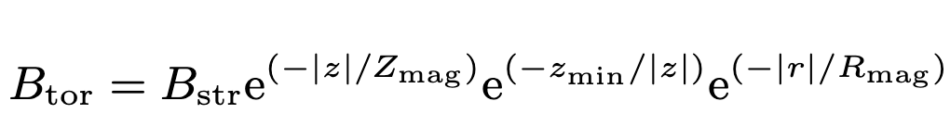
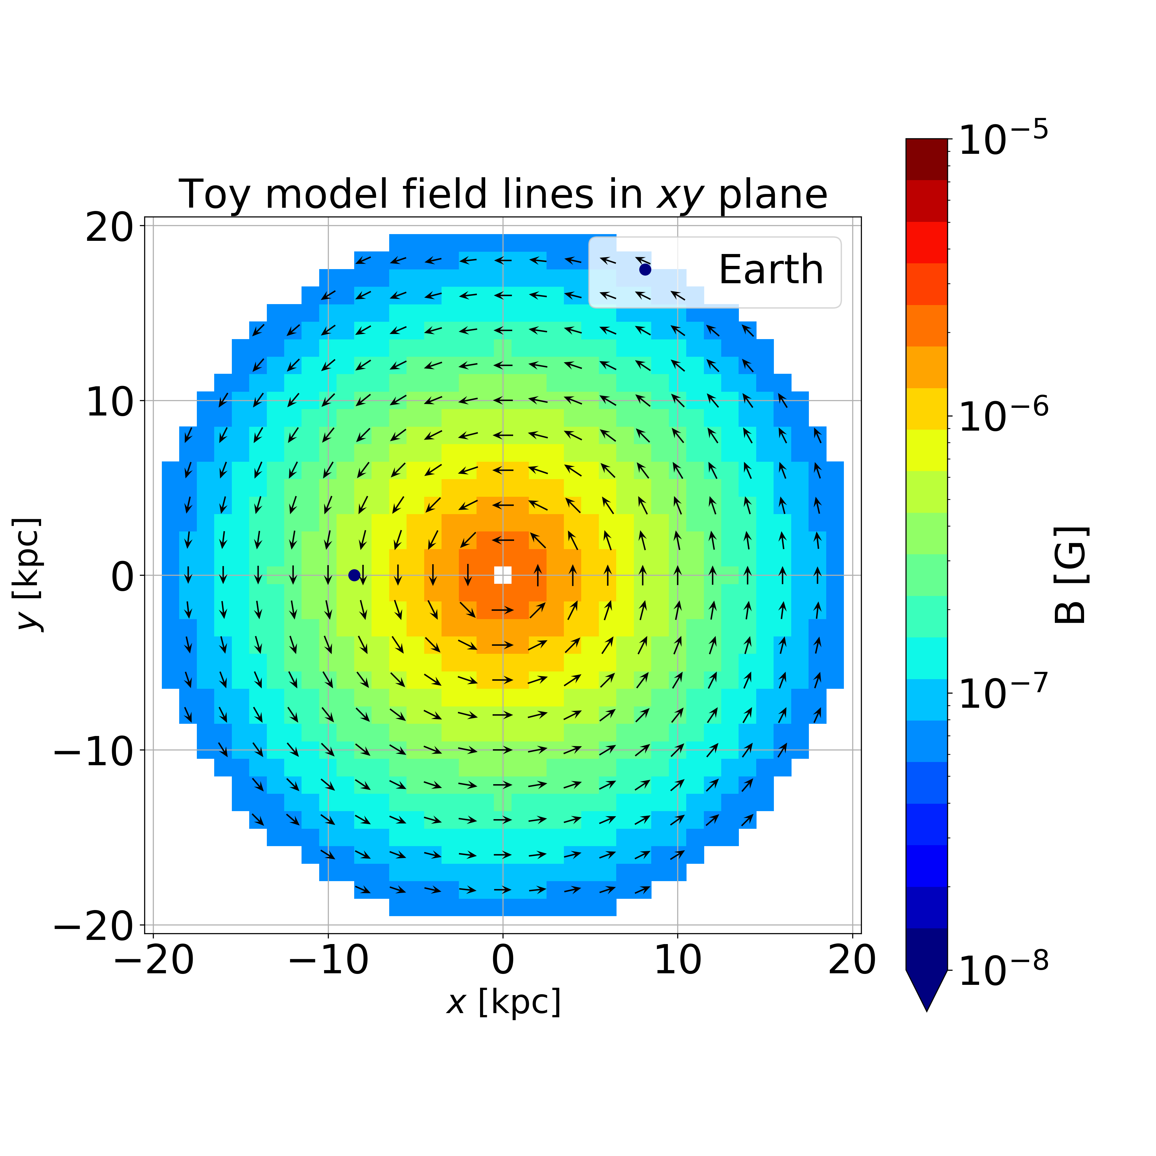
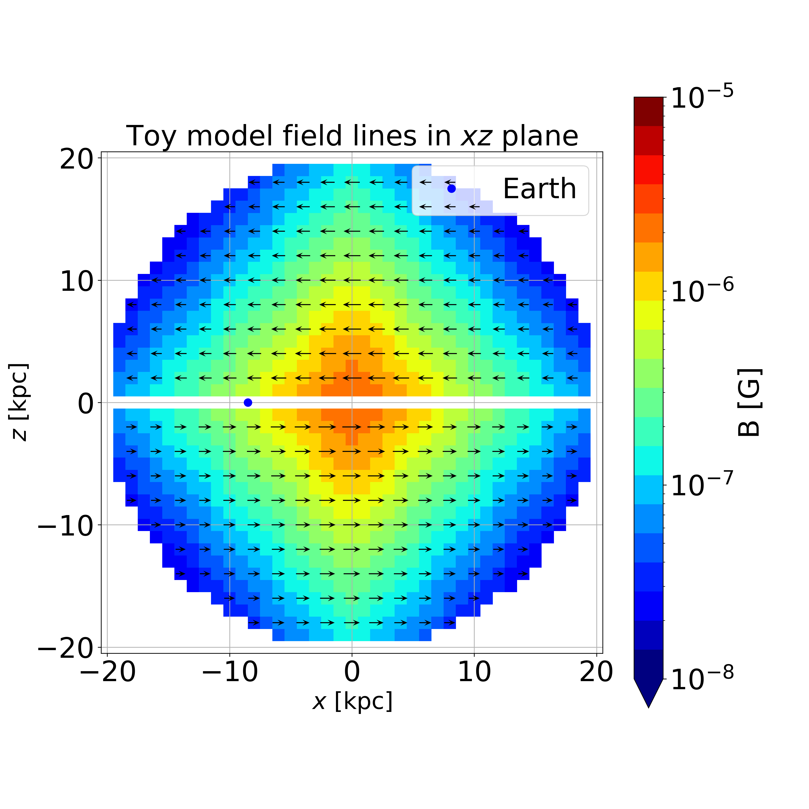
Toy Model – Structured fields
$R_{mag} \& Z_{mag}$ = 5 kpc and 6 kpc $B_{str}$ = 3.96 $μ$G

Slide 8
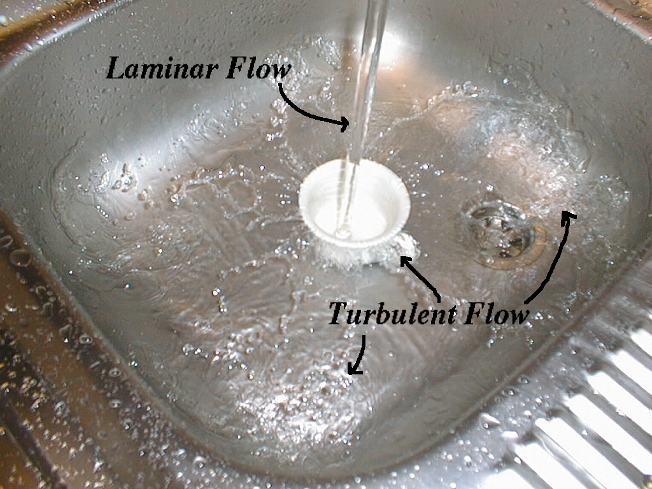
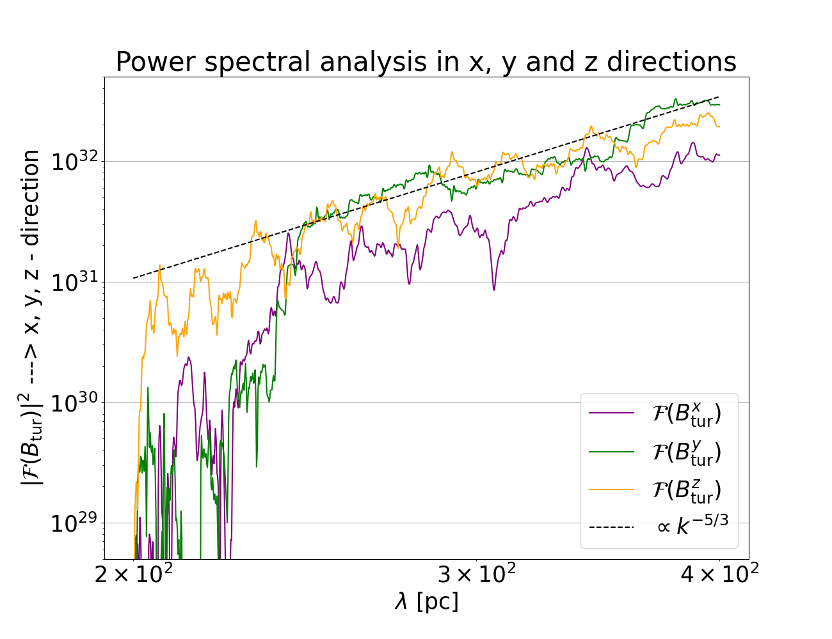

Toy Model –Turbulent fields
Outflow induces turbulent fields
$\frac{5}{3}$Kolmogorov spectrum for turbulent fields
Almost same power in each mode
1) https://www.cosmos.esa.int/web/planck/picture-gallery
2) Predehl, P., Sunyaev, R.A., Becker, W. et al. Detection of large-scale X-ray bubbles in the Milky Way halo. Nature 588, 227–231 (2020).

Slide 9
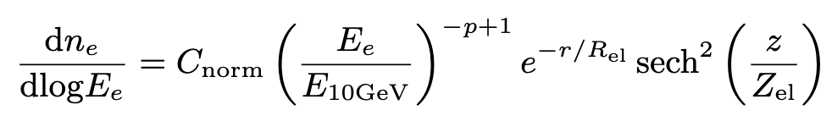
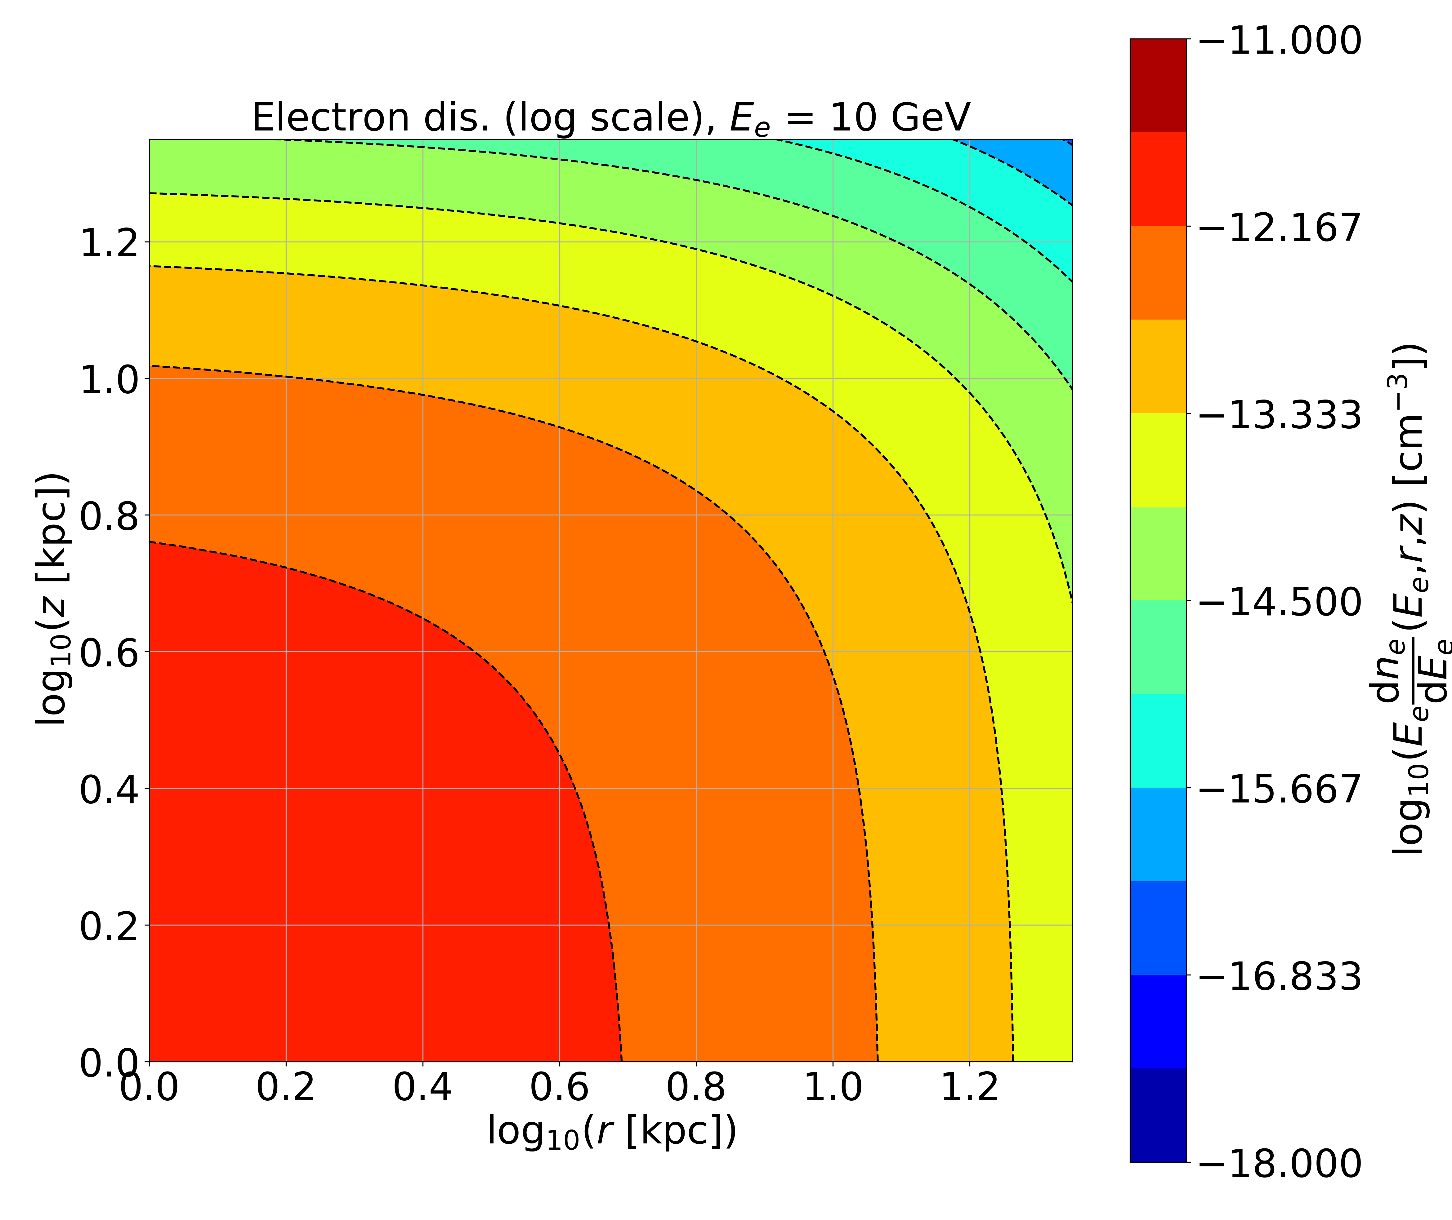


Toy Model – non-thermal electron distribution at 10 GeV
Together magnetic fields and non-thermal electrons give Synchrotron!
$$\frac{dn_{e}}{dlogE_{e}}$$
B-fields
Synchrotron
$R_{el} \& Z_{el}$ = 5 kpc and 6 kpc

Slide 10
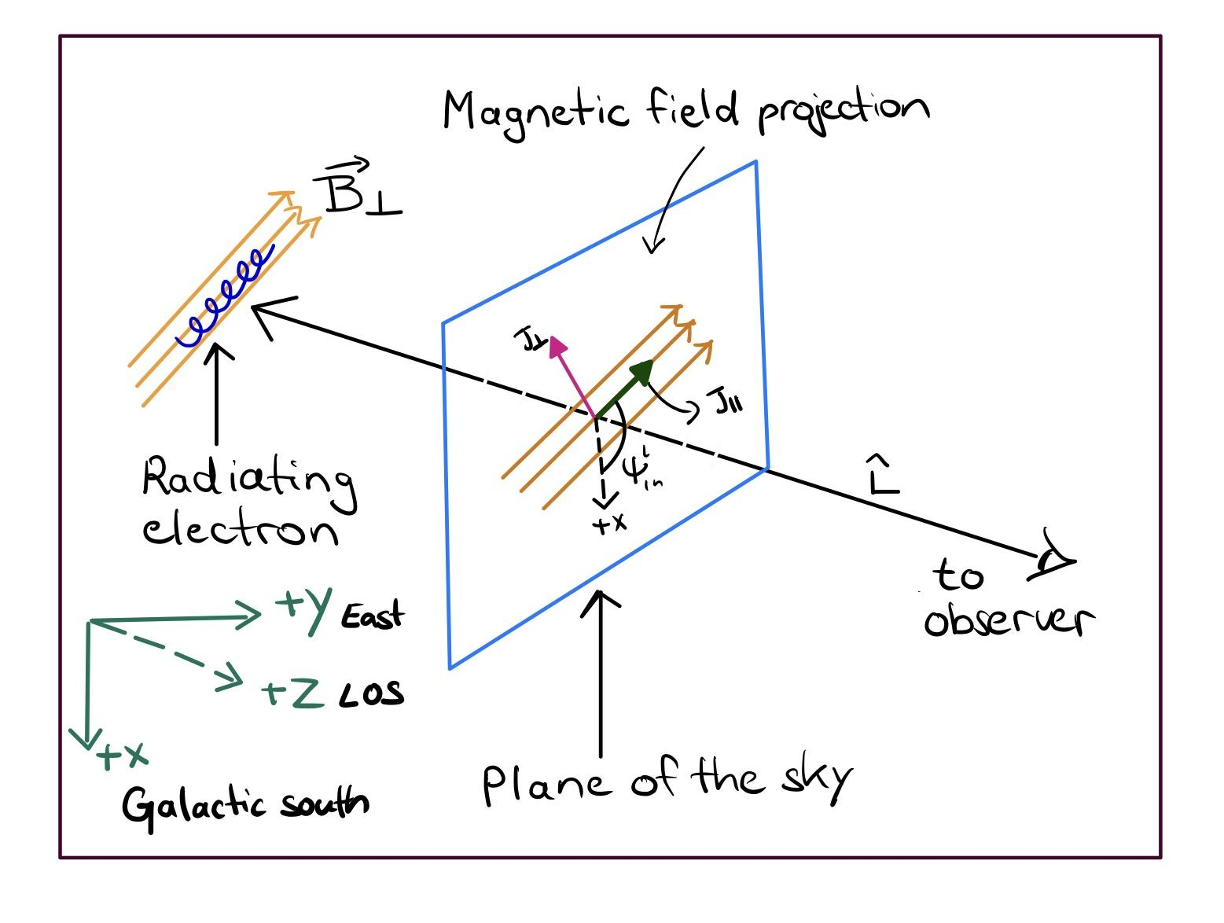

B-fields
$$\frac{dn_{e}}{dlogE_{e}}$$
Synchrotron radiation – standard picture
Synchrotron

Slide 11




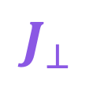
$$\frac{dn_{e}}{dlogE_{e}}$$
Synchrotron radiation – emission elipses
B-fields
Synchrotron
$$\vec{B}$$
Step 2
Step 1
$$\vec{B}$$
$$J_{⊥}$$
$$J_{∥}$$
Line of sight (Los)

Slide 12
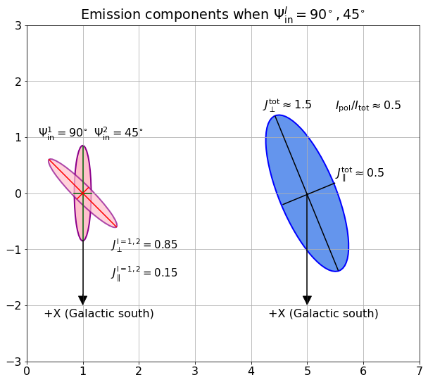
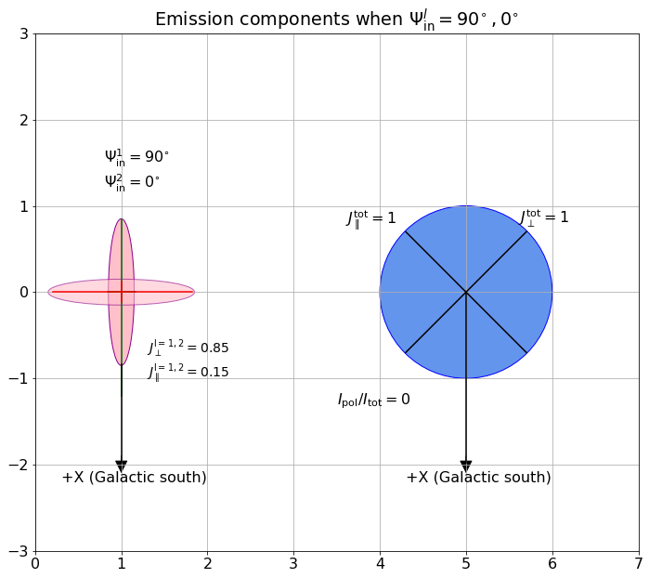


Synchrotron radiation
1
Polarised synchrotron
$$Ψ_{1,2}={45}^{∘}$$
Probes magnetic field strength and geometry
2
Unpolarised synchrotron
1
Probes magnetic field strength only
$$Ψ_{1,2}={90}^{∘}$$
2
Maximum emission is observed when the electron pitch angles are perpendicular to magnetic fields.
Los

Slide 13
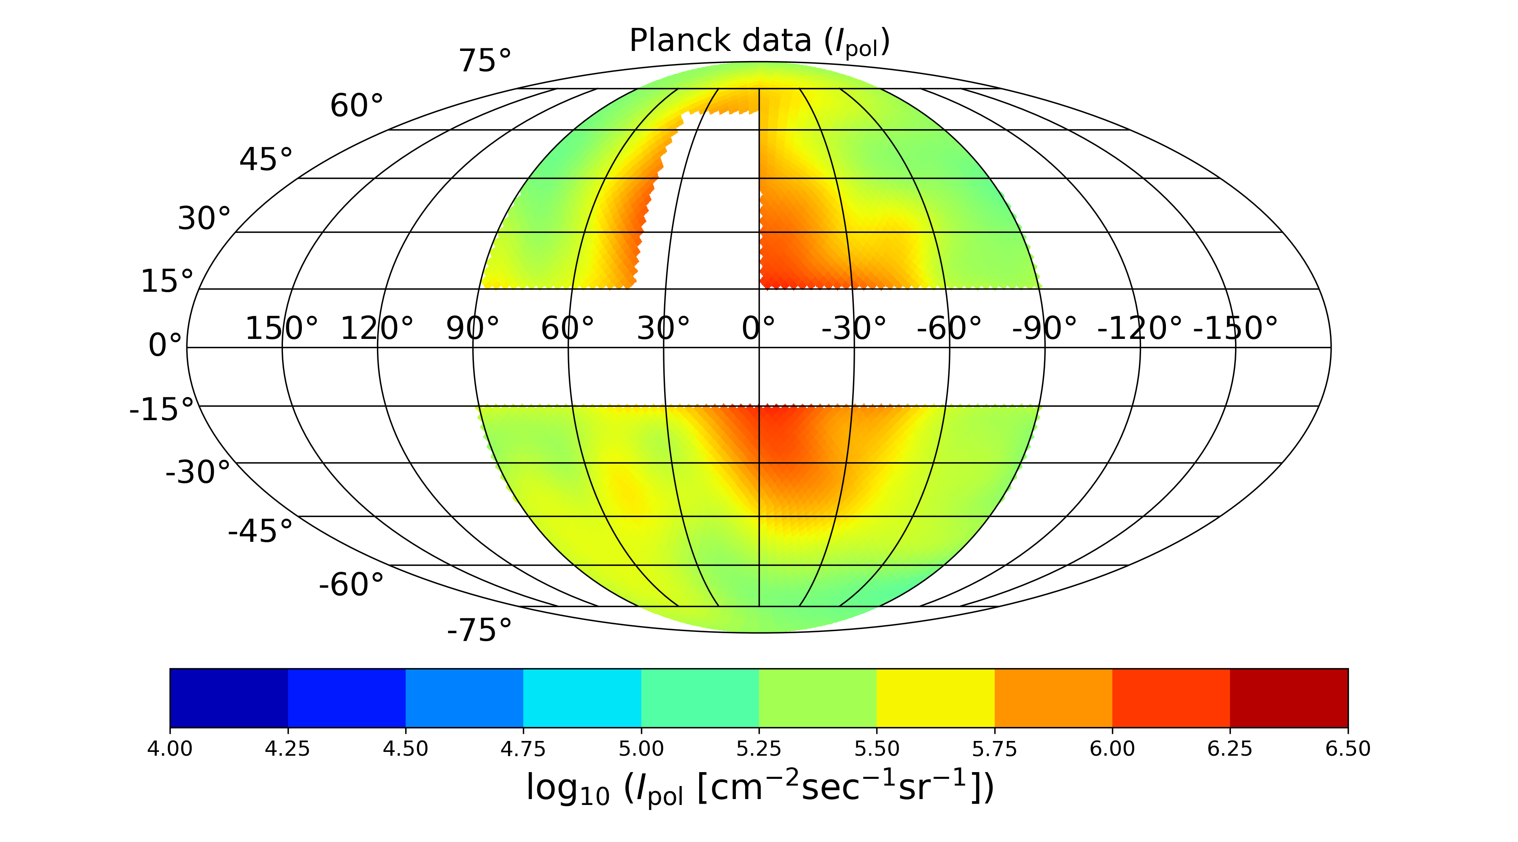
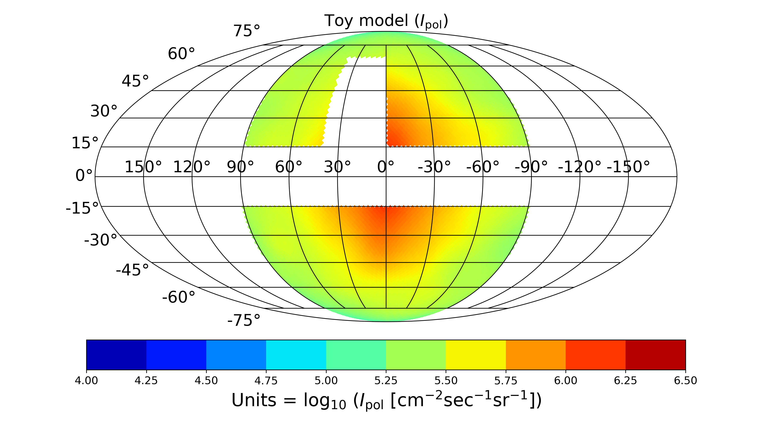



Results – Best fit case
$$NPS$$
$$Galactic Disc removed$$
$${15}^{∘} \text{Gaussian} \text{smoothening}$$

Slide 14
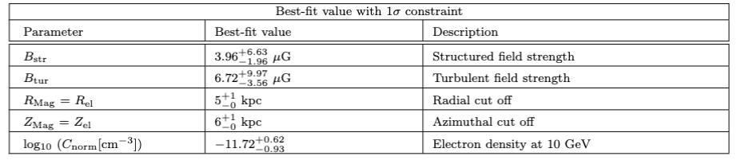
Shaw et al 2022
Constraints

Slide 15

Backtracking of UHECRs through toy model using CRPropa3
UHECR
$$\vec{B}$$

Slide 16
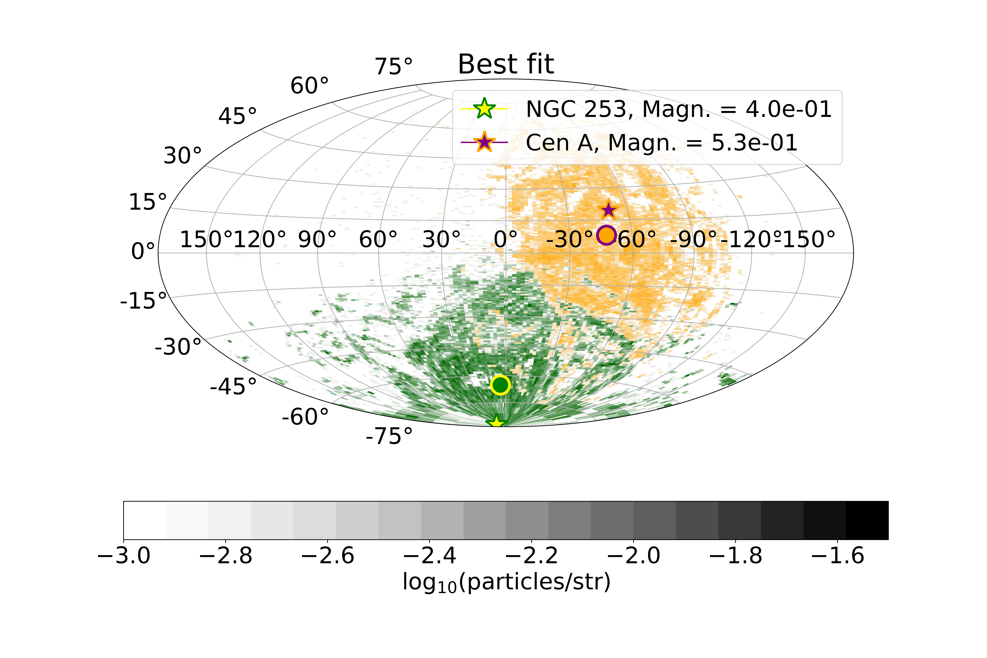
Arrival directions of UHECRs – Toy Model vs Auger (Nitrogen at 40 EeV)
Choice of rigidity & species based on PAO
Aab et al 2014 & 2018

Slide 17
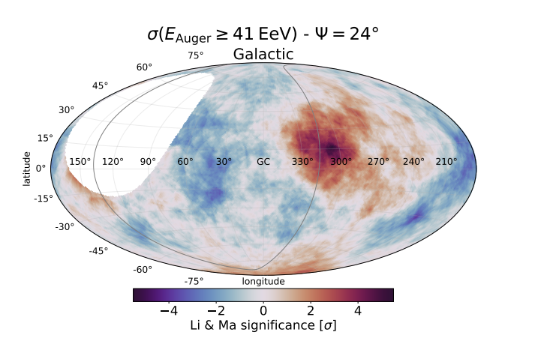
Arrival directions of UHECRs – Toy Model vs Auger (Nitrogen at 40 EeV)
Abreu et al 2022
Choice of rigidity & species based on PAO
Aab et al 2014 & 2018

Slide 18
Arrival directions of UHECRs – Toy Model vs Auger (Nitrogen at 40 EeV)
Abreu et al 2022
Toy model best fit case is similar to the PAO observations
Choice of rigidity & species based on PAO
Aab et al 2014 & 2018

Slide 19
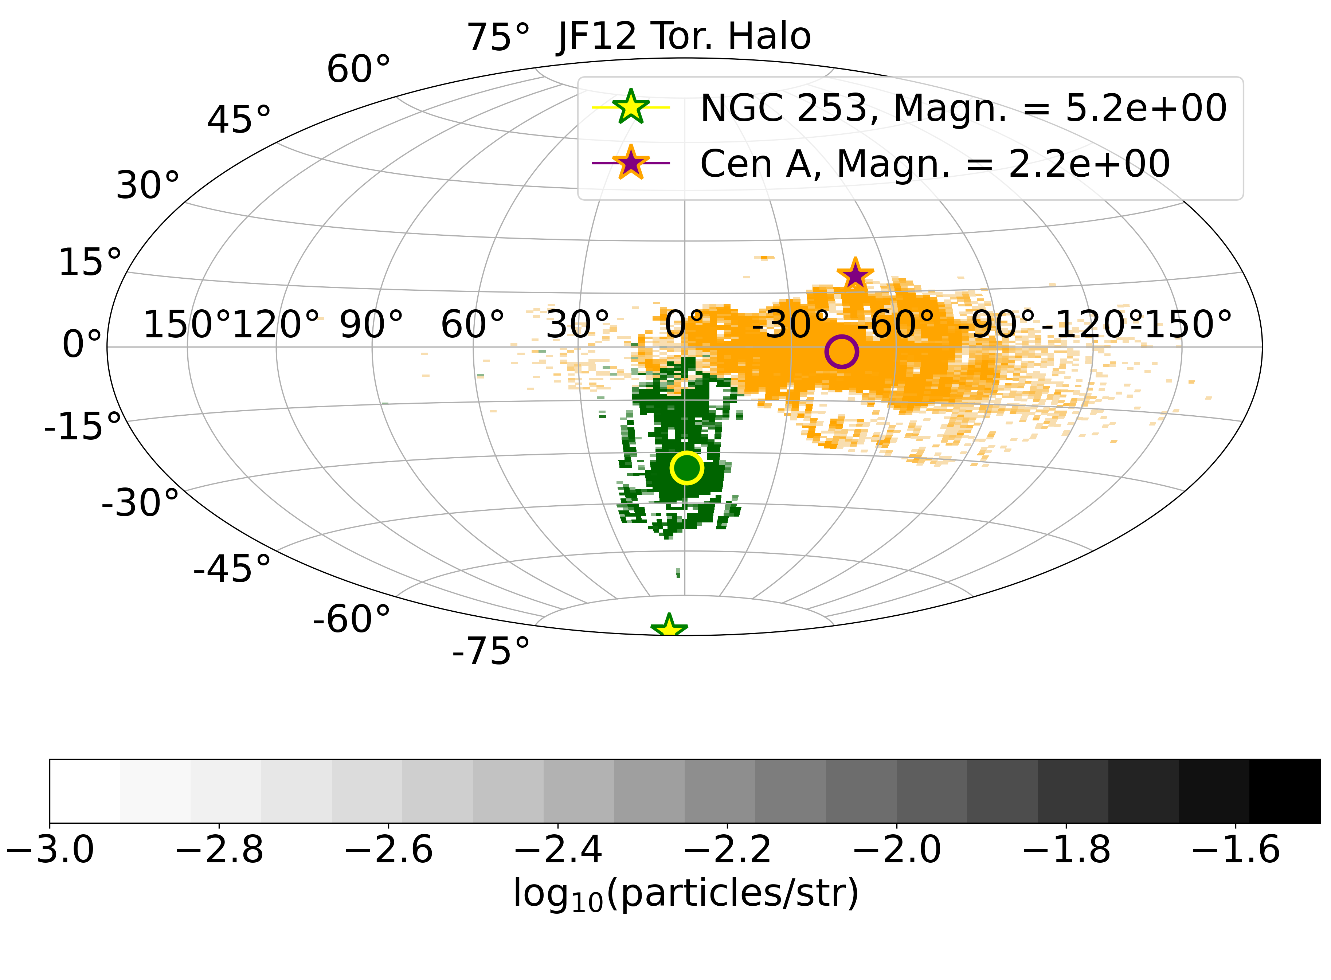


Toy Model vs JF12 Torroidal Halo
Nitrogen at 40 EeV
p
$σ_{NGC 253}$ = ${32}^{∘}$, $σ_{Cen A}={33}^{∘}$
$σ_{NGC 253}$ = $9^{∘}$, $σ_{Cen A}={22}^{∘}$

Slide 20
Toy Model vs JF12 Torroidal Halo
Nitrogen at 40 EeV
p
$σ_{NGC 253}$ = ${32}^{∘}$, $σ_{Cen A}={33}^{∘}$
$σ_{NGC 253}$ = $9^{∘}$, $σ_{Cen A}={22}^{∘}$
Structured fields - Overall coherent deflection
Turbulent fields - Spreading out the directions of the particle deflections around this overall deflected direction
Spreading Effect -Toy model 5-10 times larger than
JF12
Deflections are dominated by halo NOT disc

Slide 21
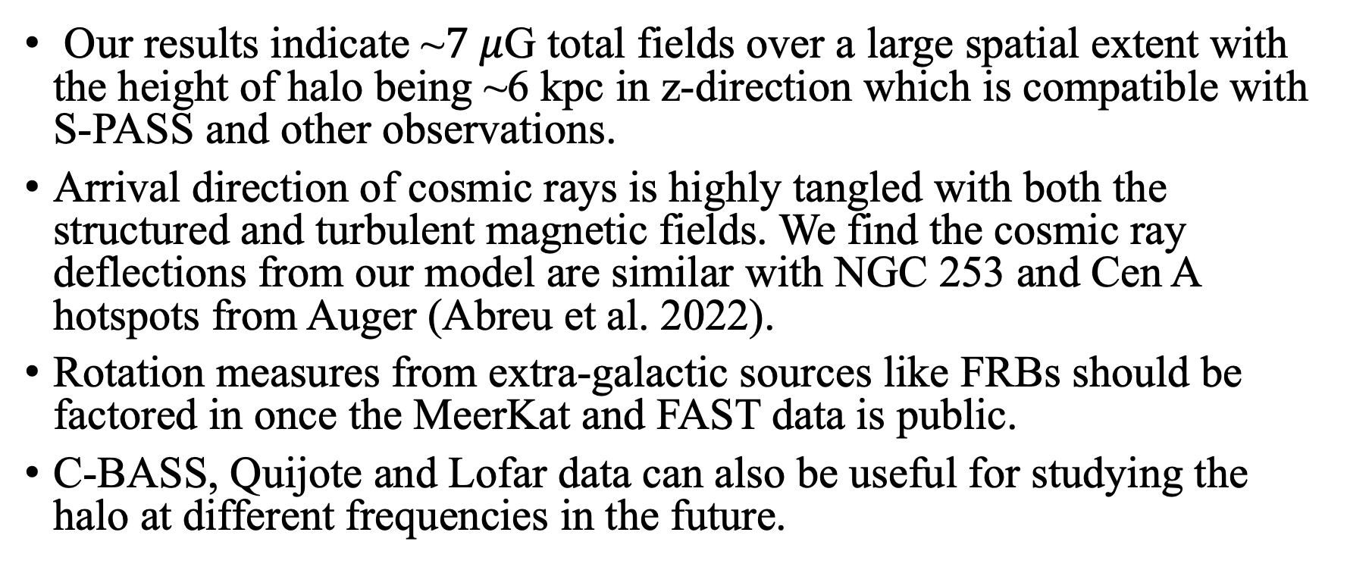
Conclusions & Outlook
Our results indicate ~$7 μ$G total fields over a large spatial extent with the height of halo being ~6 kpc in z-direction which is compatible with S-PASS and other observations.
Arrival direction of cosmic rays is highly tangled with both the structured and turbulent magnetic fields. We find the cosmic ray deflections from our model are similar with NGC 253 and Cen A hotspots from Auger (Abreu et al. 2022).
Rotation measures from extra-galactic sources like FRBs should be factored in once the MeerKat and FAST data is public.
C-BASS, Quijote and Lofar data can also be useful for studying the halo at different frequencies in the future.

Slide 22
Extras

Slide 24



B-fields
$$\frac{dn_{e}}{dlogE_{e}}$$
Synchrotron radiation – emission elipses
Synchrotron
1
$$Ψ_{1,2}={45}^{∘}$$
Polarised synchrotron
2
Los
1
$$Ψ_{1,2}={90}^{∘}$$
Unpolarised synchrotron
2
Maximum emission is observed when the electron pitch angles are perpendicular to magnetic fields
Los

Slide 25
(Pietsch et.al 1996)
Milky way is not a starburst galaxy yet it has outflow!
Outflows as seen in starburst galaxies!
(Beck et.al 1994)
Large scale structures imply large scale magnetic fields
Total radio intensity (contours) and magnetic field orientation of NGC 253.
Predehl, P., Sunyaev, R.A., Becker, W. et al. Detection of large-scale X-ray bubbles in the Milky Way halo. Nature 588, 227–231 (2020).
Notes:
”The 0.1 - 0.4 keV band contour plot of the X-ray intensities of the spiral galaxy NGC 253 overlayed on the optical image.”
50% of star formation happens in the nuclear zone for NGC while 10% of SF happens in nuclear zone for milky way uneven spread for NGC
Milky way star formation rate 1M*/year
NGC has 2M*/year

Slide 26
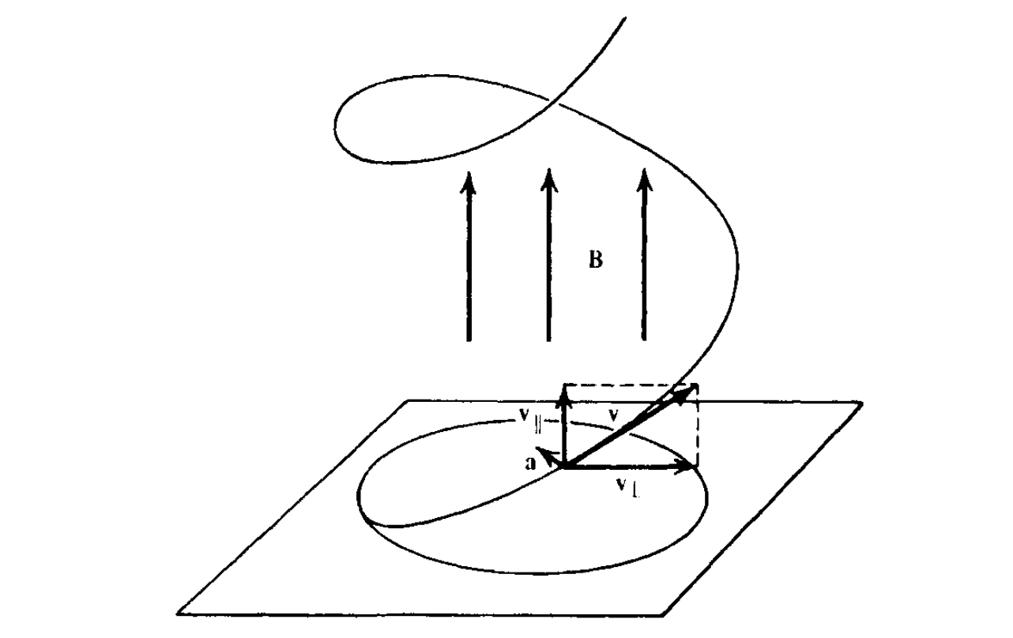
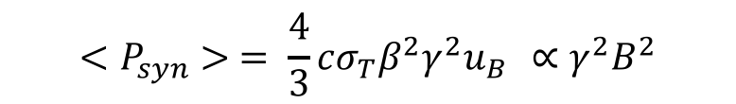
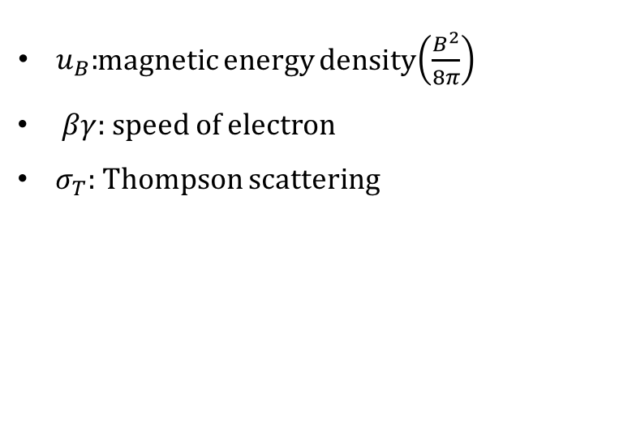
SYNCHROTRON RADIATION
"Magneto-bremsstrahlung" = Radiation emitted by relativistic charged particles (mostly electrons) due to acceleration ("gyro-motion") in a static magnetic field.
Notes:
http://www.apc.univ-paris7.fr/~semikoz/EGMF/agenda.html
FOR AN ISOTROPIC DISTRIBUTION OF VELOCITIES IT IS NECESSARY TO AVERAGE OVER ALL ANGLES FOR A GIVEN SPEED BETA.
Psyn depends on the magnetic field

Slide 27

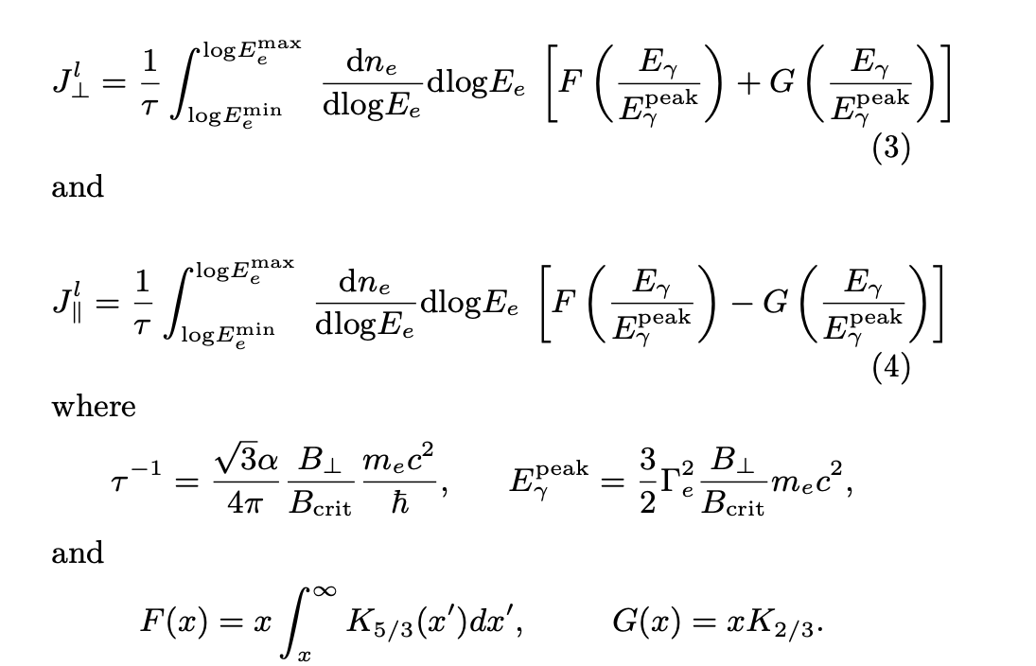
B-fields
$$\frac{dn_{e}}{dlogE_{e}}$$
Polarised synchrotron radiation
Synchrotron

Slide 28
Extras

