Slide 1

Neutrino time delay as a probe of secret neutrino interactions
Jose A. Carpio
PhD advisor: Kohta Murase
Penn State University
TeVPA 2022

Slide 2






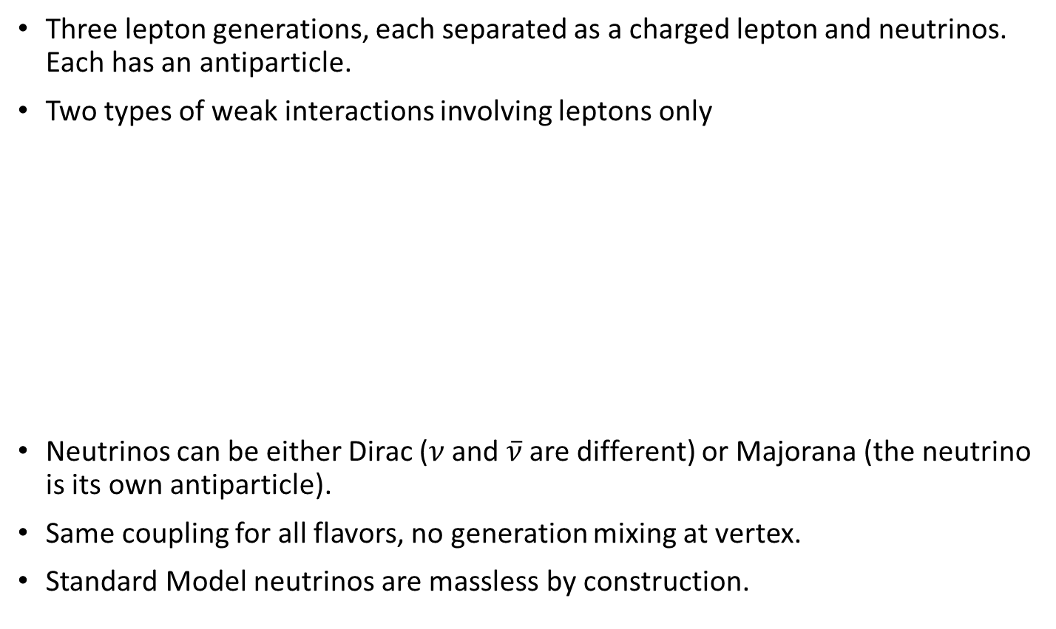









Massless neutrinos in the Standard Model
Three lepton generations, each separated as a charged lepton and neutrinos. Each has an antiparticle.
Two types of weak interactions involving leptons only
Neutrinos can be either Dirac ($ν$ and $\overline{ν}$ are different) or Majorana (the neutrino is its own antiparticle).
Same coupling for all flavors, no generation mixing at vertex.
Standard Model neutrinos are massless by construction.
e
$$μ$$
$$τ$$
$$ν_{e}$$
$$ν_{μ}$$
$$ν_{τ}$$
$$ν_{l}$$
$$ν_{l^{′}}$$
$$ν_{l}$$
$$ν_{l^{′}}$$
$$W$$
$$Z$$
$$l$$
$$l′$$
$$ν_{l}$$
$$ν_{l^{′}}$$
Charged-current
Neutral-current

Slide 3
Unanswered questions
Questions
Dark Matter?
Dirac or Majorana?
Reactor anomalies?
How does it acquire mass?
Are neutrinos Dirac or Majorana? → Neutrinoless double beta decay
How do neutrinos acquire mass? → Seesaw mechanism
Reactor anomalies? → Sterile neutrinos
Can sterile neutrinos contribute to dark matter? → Maybe

Slide 4












Introducing new physics
Add new interactions, coupling neutrinos to each other or dark matter.
This class of models avoids many lab constraints.
Interaction types:
Well motivated
  Alleviates the Hubble tension
  A new vector mediator can explain the muon anomalous magnetic moment
  Allows production of keV sterile neutrino dark matter
  Secret interactions can also halt supernova explosions by preventing shock revival
  Allows production of sub-MeV dark matter
$$ν_{κ}$$
$$ν_{α}$$
$$χ$$
$$ν_{α}$$
$$V/φ$$
$$V/φ$$
$$ν_{λ}$$
$$ν_{β}$$
$$χ$$
$$ν_{β}$$
$νν$ interactions
$νχ$ interactions

Slide 5
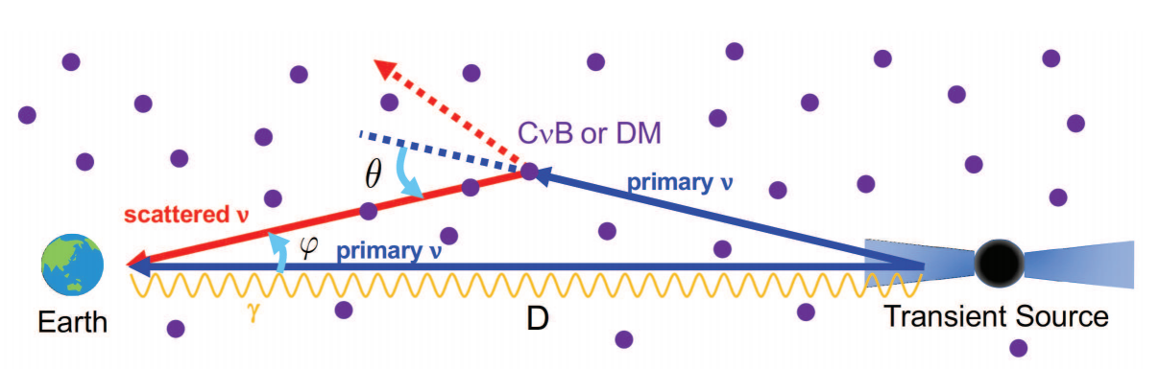
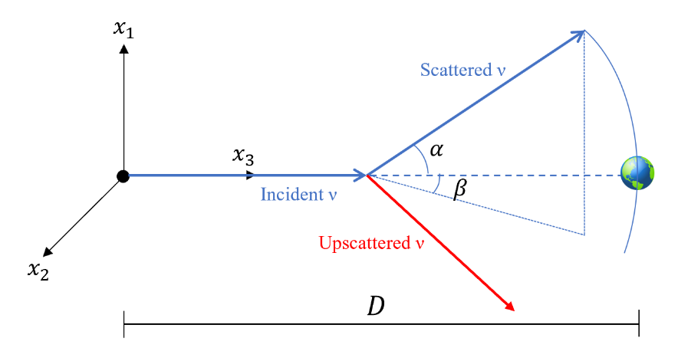
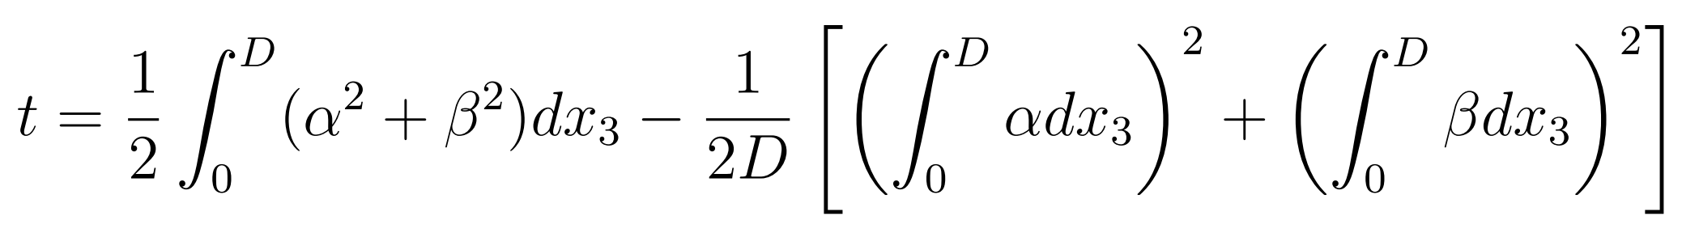

Neutrino echoes
Astrophysical neutrinos propagate through the cosmic $ν$ background and/or dark matter.
Neutrino scattering → longer trajectory → time delay $t$ with respect to photons/primary $ν$
For small angle scattering (Williamson 72, Alcock & Hatchett 78)
Easy to implement in Monte Carlo simulations
The alternative is to solve the transport equation
Murase & Shoemaker 2019

Slide 6


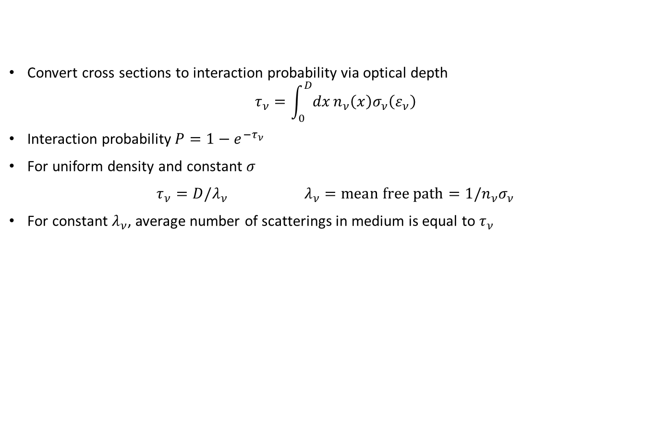



Neutrino propagation – when do scatterings occur?
Convert cross sections to interaction probability via optical depth
$$τ_{ν}=\int_{0}^{D}{dx}n_{ν}\left(x\right)σ_{ν}\left(ε_{ν}\right)$$
Interaction probability$P=1−e^{−τ_{ν}}$
For uniform density and constant $σ$
$τ_{ν}=D/λ_{ν}$ $λ_{ν}=mean free path=1/n_{ν}σ_{ν}$
For constant $λ_{ν}$, average number of scatterings in medium is equal to $τ_{ν}$
Target (C$ν$B)
$$ν$$
$$D$$
Optically thin $τ_{ν}≪1$
Optically thick $τ_{ν}≫1$
One scattering
Multiple scatterings

Slide 7
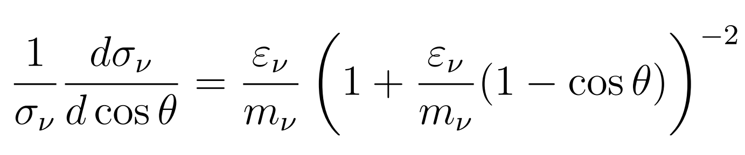
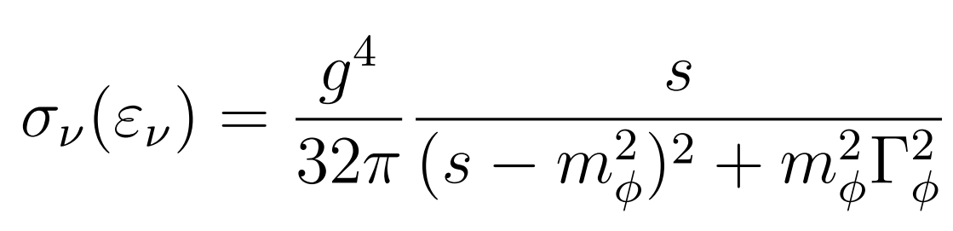
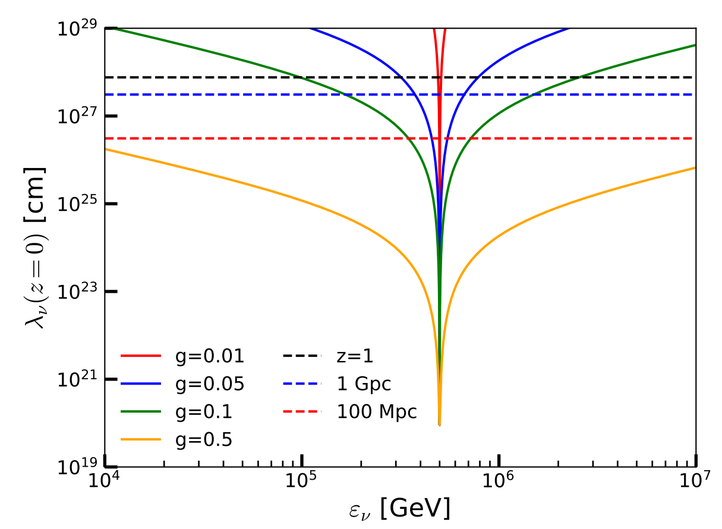






Test model: $ν$ $ν$ scattering with a scalar mediator
$ℒ_{int}⊃\frac{1}{2}g \overline{ν_{L}^{C}}ν_{L}φ+c.c.$ (Majorana neutrinos, $1ν$)
Angular distribution
Total cross section
  $s=2m_{ν}ε_{ν}$
  $Γ=g^{2}M_{φ}/16π$
  $λ_{ν}=1/n_{ν}σ_{ν}$, $n_{ν}=112 cm^{−3}$
Benchmark model
  $m_{ν}$=0.1 eV, $M_{φ}$=10 MeV (resonance at 500 TeV)
$$ν_{incoming}$$
$$ν_{β}$$
$$φ$$
$$ν_{α}$$
$$ν_{CνB}$$
Strong forward scattering
time

Slide 8
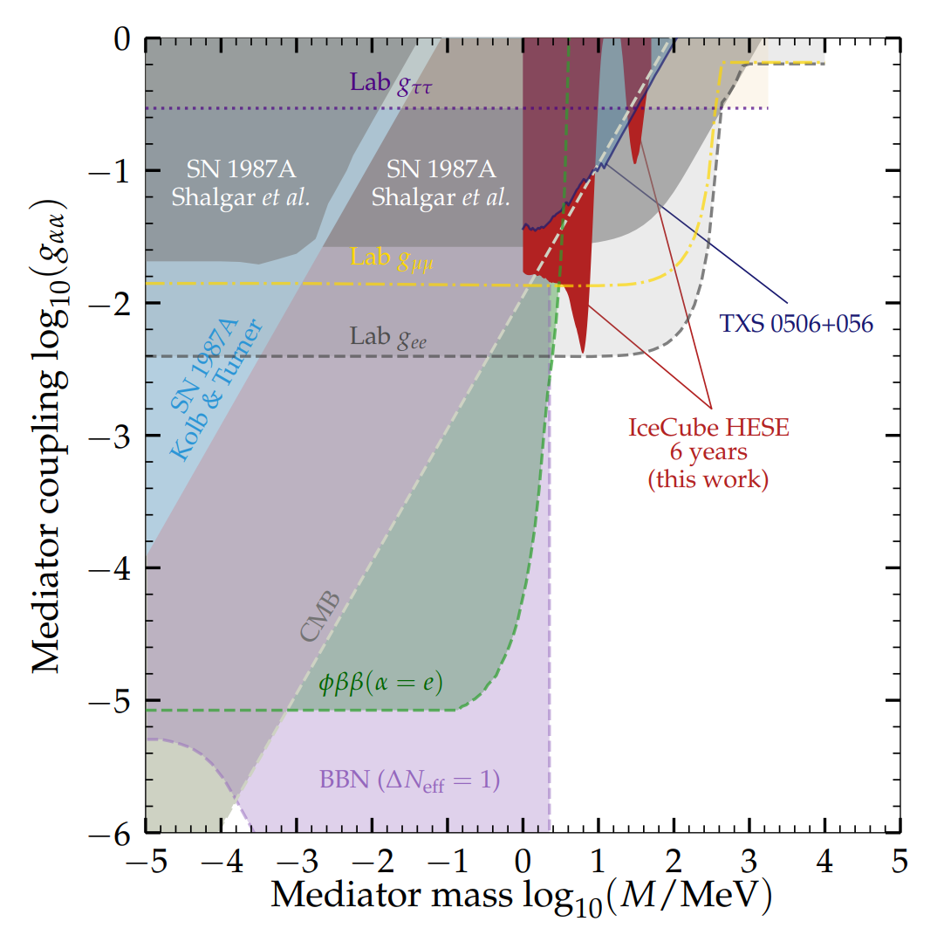
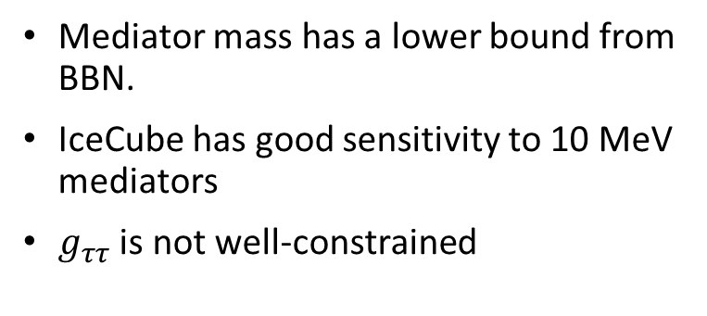
Why 10 MeV scalar mediators?
Mediator mass has a lower bound from BBN.
IceCube has good sensitivity to 10 MeV mediators
$g_{ττ}$ is not well-constrained
Bustamante et al (2020)

Slide 9
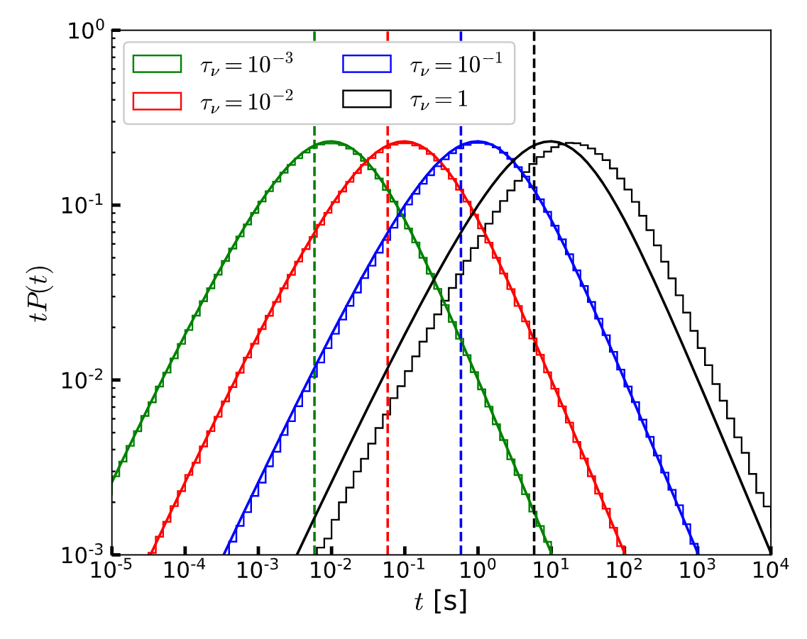
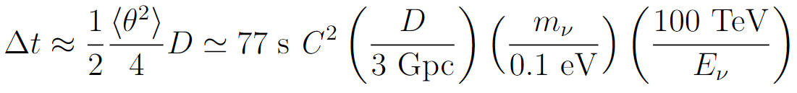
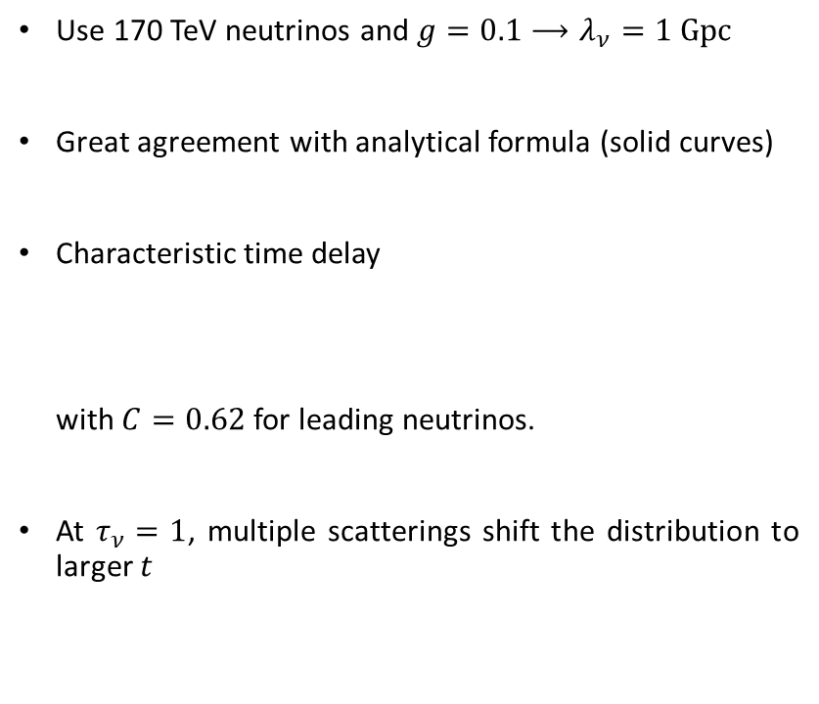
Example 1: Scattering in the $τ_{ν}≪1$ limit
Use 170 TeV neutrinos and $g=0.1⟶λ_{ν}=1 Gpc$
Great agreement with analytical formula (solid curves)
Characteristic time delay
with $C=0.62$ for leading neutrinos.
At $τ_{ν}=1$, multiple scatterings shift the distribution to larger $t$

Slide 10
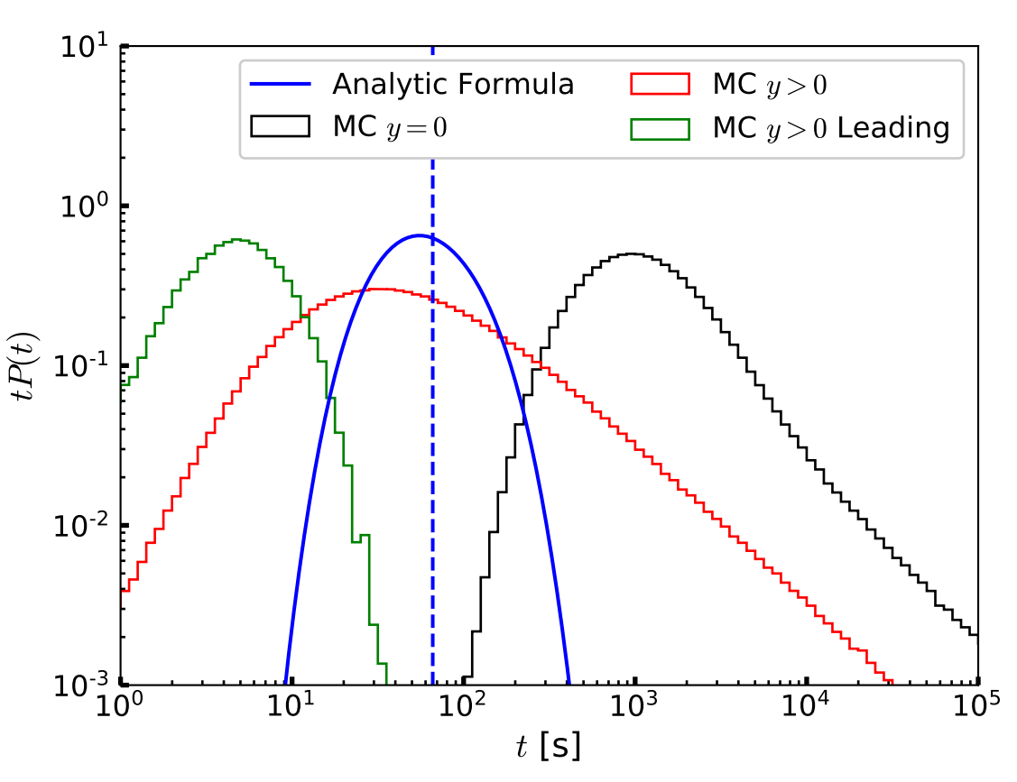

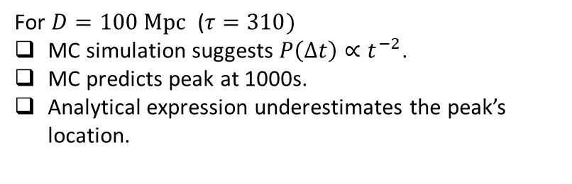
Example 2: Scattering in the $τ≫1$ limit - zero inelasticity
Inelasticity parameter $y=ε_{ν}^{′}/ε_{ν}$. $y=0 →$no upscattered neutrinos.
300 TeV neutrinos and $g=0.5⟶λ_{ν}={10}^{24}cm$ .
The $τ≫1$ limit has an analytical solution, with an exponential decay at large $t$.
For $D=100 Mpc$ ($τ=310)$
MC simulation suggests $P\left(Δt\right)∝t^{−2}$.
MC predicts peak at 1000s.
Analytical expression underestimates the peak’s location.

Slide 11
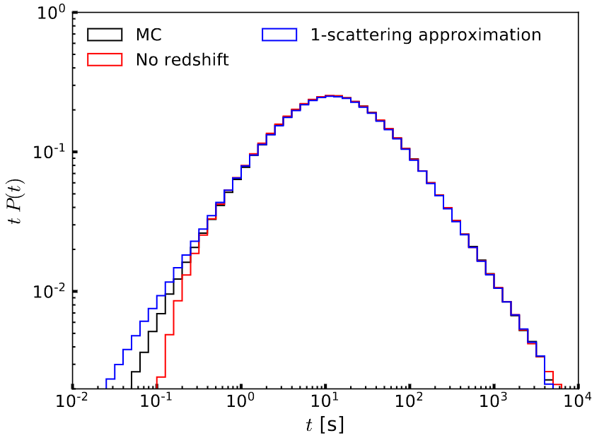

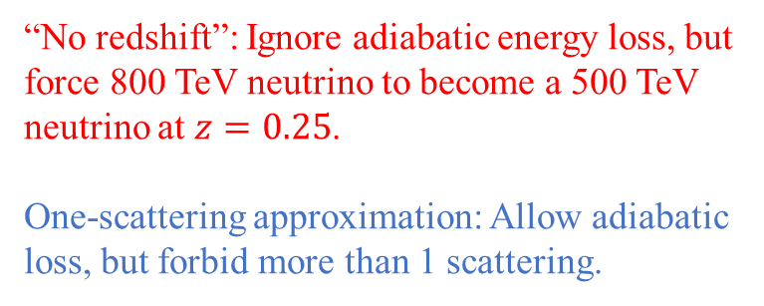
Example 3: Monoenergetic source at $z=1$
800 TeV neutrinos and g=0.01
Resonance occurs at $z=0.25$.
Compare against
“No redshift”: Ignore adiabatic energy loss, but force 800 TeV neutrino to become a 500 TeV neutrino at $z=0.25$.
One-scattering approximation: Allow adiabatic loss, but forbid more than 1 scattering.

Slide 12
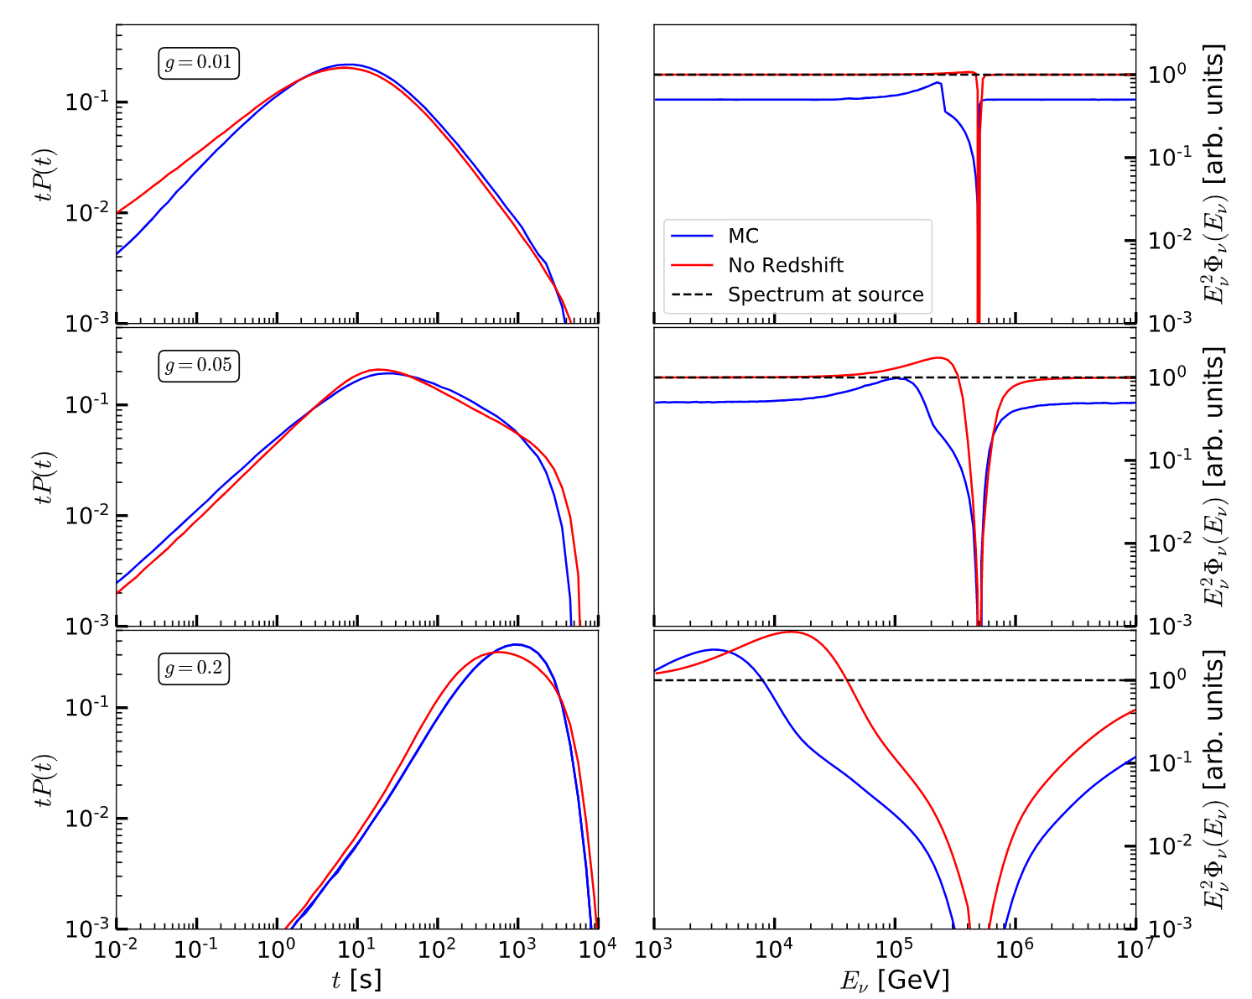
Example 4: Single source at redshift z=1 and $ε_{ν}^{−2}$ injection spectrum
Cutoffs in delay due to threshold effects
For g=0.2, the cascade effect is strong enough to overcome the flux decrease due to redshift.
Comparing against the no redshift case, there are no major differences in time delay.

Slide 13
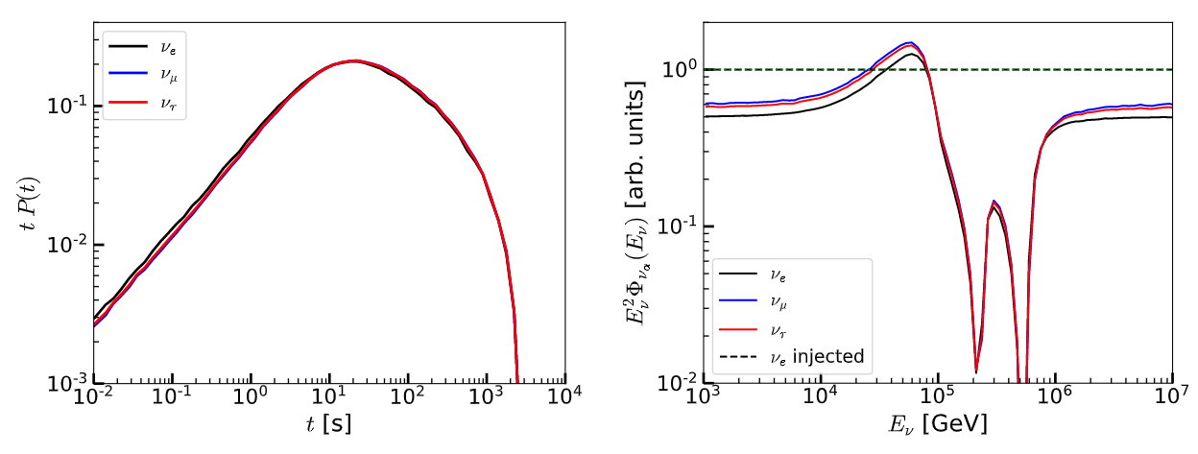
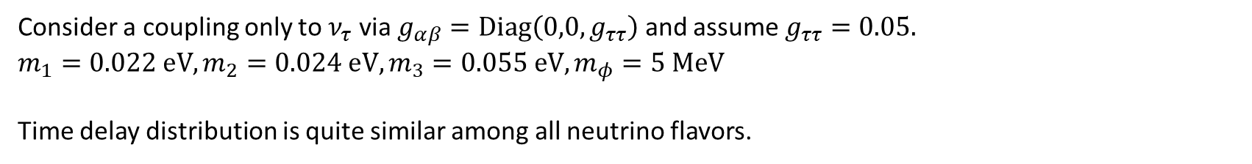
Example 5: Source at redshift z=1 and $ε_{ν}^{−2}$ injection spectrum, $3ν$
Consider a coupling only to $ν_{τ}$ via $g_{αβ}=Diag\left(0,0,g_{ττ}\right)$ and assume $g_{ττ}=0.05.$
$$m_{1}=0.022 eV, m_{2}=0.024 eV, m_{3}=0.055 eV, m_{φ}=5 MeV$$
Time delay distribution is quite similar among all neutrino flavors.

Slide 14
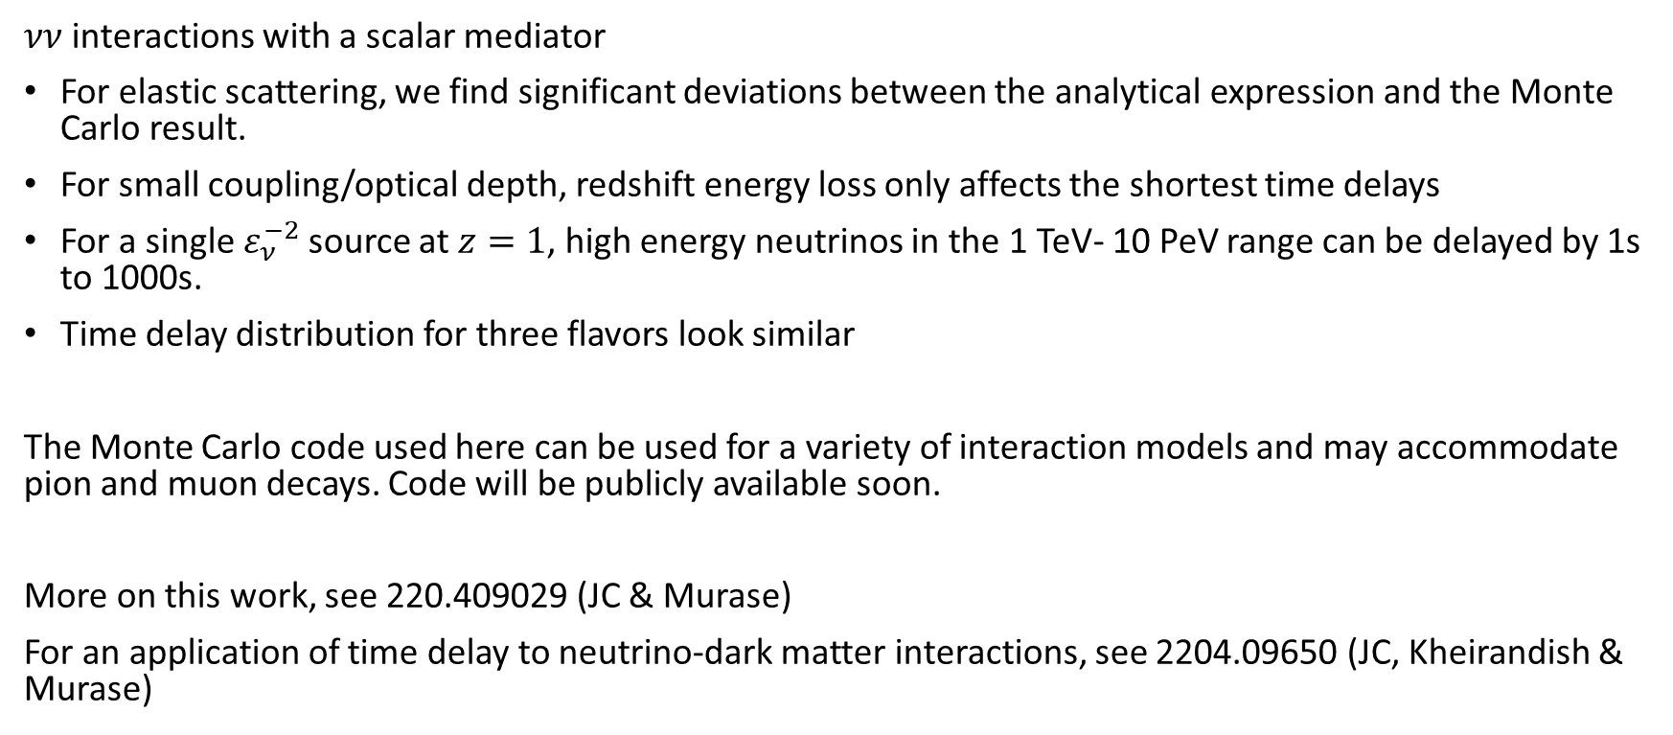
Concluding remarks
$νν$ interactions with a scalar mediator
For elastic scattering, we find significant deviations between the analytical expression and the Monte Carlo result.
For small coupling/optical depth, redshift energy loss only affects the shortest time delays
For a single $ε_{ν}^{−2}$source at $z=1$, high energy neutrinos in the 1 TeV- 10 PeV range can be delayed by 1s to 1000s.
Time delay distribution for three flavors look similar
The Monte Carlo code used here can be used for a variety of interaction models and may accommodate pion and muon decays. Code will be publicly available soon.
More on this work, see 220.409029 (JC & Murase)
For an application of time delay to neutrino-dark matter interactions, see 2204.09650 (JC, Kheirandish & Murase)

Slide 15
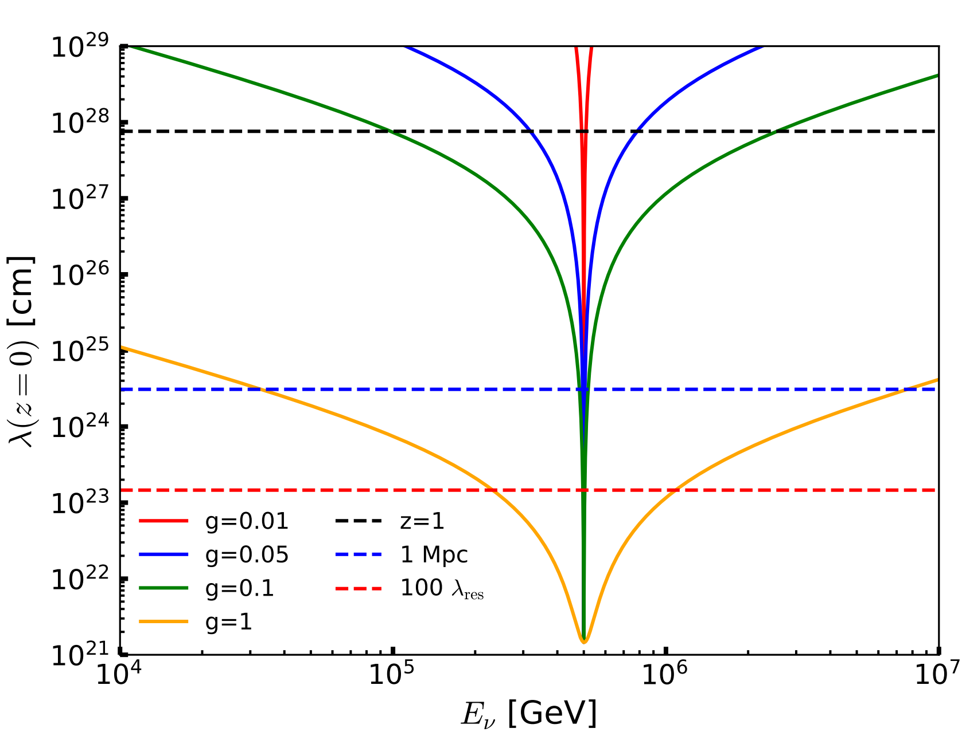

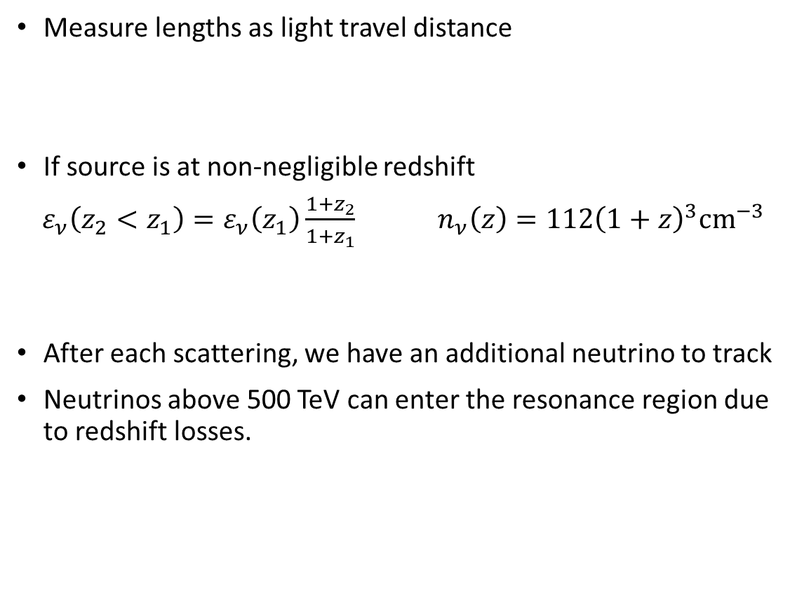
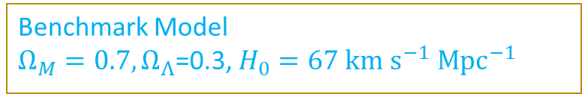

Considerations for inelastic scattering and cosmological distances
Measure lengths as light travel distance
If source is at non-negligible redshift
$ε_{ν}\left(z_{2}<z_{1}\right)=ε_{ν}\left(z_{1}\right)\frac{1+z_{2}}{1+z_{1}}$ $n_{ν}\left(z\right)=112{\left(1+z\right)}^{3}cm^{−3}$
After each scattering, we have an additional neutrino to track
Neutrinos above 500 TeV can enter the resonance region due to redshift losses.
Benchmark Model
$Ω_{M}=0.7, Ω_{Λ}$=0.3, $H_{0}=67 km s^{−1} Mpc^{−1}$
$$l =c\int_{z_{1}}^{z_{2}}{\frac{dz′}{H_{0}\left(1+z^{′}\right)\sqrt{Ω_{M}{\left(1+z^{′}\right)}^{3}+Ω_{Λ}}}}$$
Expansion losses
C$ν$B density

