Slide 1
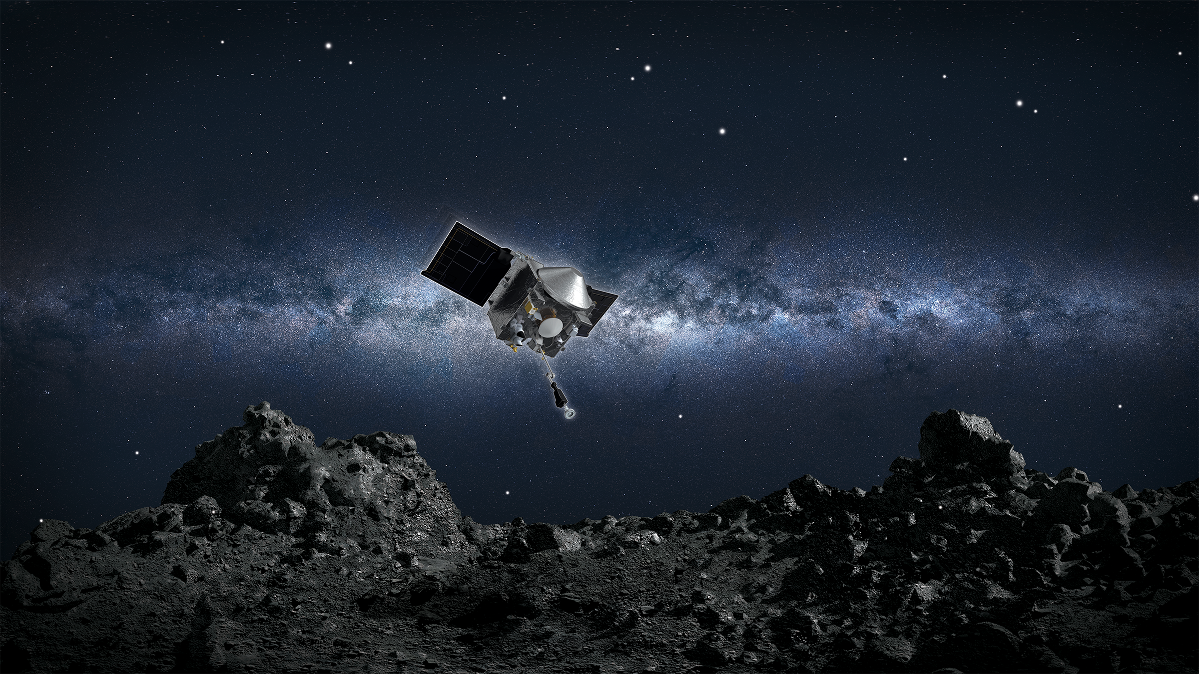
New Model Independent Constraints on Dark Matter
and Cosmic Neutrinos (while Protecting the Earth)
Yu-Dai Tsai
University of California, Irvine
with Josh Eby, Jason Arakawa, Marianna Safronova
& Davide Farnocchia (NASA)
Contact: yudait1@uci.edu
yt444@cornell.edu
To appear on arXiv next week!
“There is always a possibility that dark matter effects can modify the trajectory of an asteroid, which could wipe out all life on this planet.
The only way these people can get on with their happy lives is that
they do not know about it.” – An agent warned me about giving this talk.
NASA’s OSIRIS-REx mission readies itself to touch the surface of asteroid Bennu.
Credits: NASA/Goddard/University of Arizona

Slide 2
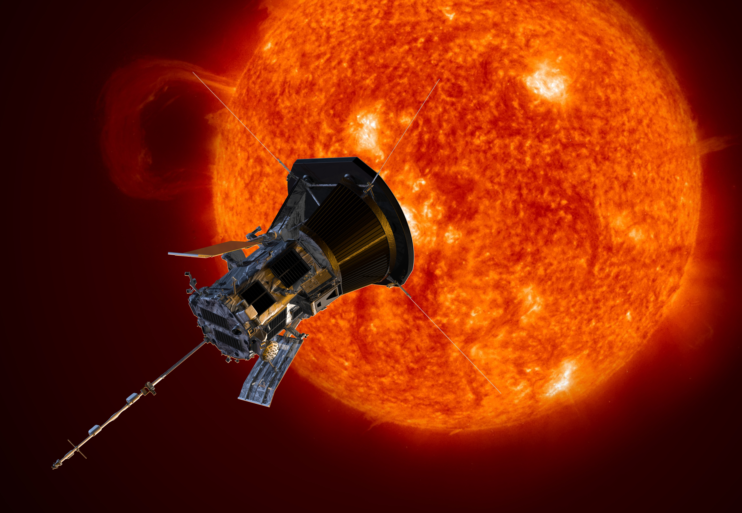
SpaceQ – Direct Detection of Ultralight Dark Matter with Space Quantum Sensor
Yu-Dai Tsai
University of California, Irvine
with Josh Eby, Marianna Safronova
+ Youjia Wu, Sunny Vagnozzi, Luca Visinelli
Contact: yudait1@uci.edu &
yt444@cornell.edu
https://arxiv.org/abs/2112.07674
To appear on Nature Astronomy!
https://arxiv.org/abs/2107.04038
Under review by Nature Astronomy
INSPIRE: https://inspirehep.net/authors/1274923
Image: Parker Solar Probe
Credit: NASA/Johns Hopkins APL/Steve Gribben

Slide 3






Collaborations on Various Projects
Quantum technologies in Space: Q-SEnSE + SpaceQ informal meeting

Slide 4
Big Questions
Can planetary data set meaningful
constraints on
Dark matter?
General Relativity?
5th forces?
Can we use current or future Space Quantum Technologies to study fundamental physics?
Clustering mechanisms of purely gravitational dark
matter or cosmic neutrinos?

Slide 5
Answers
Can planetary data set meaningful
dark matter constraints?
General Relativity?
5th forces?
Yes! Many opportunities
Can we use current or future space Quantum Technology to study fundamental physics? Yes! I will show you an example today.
Robust analyses underway utilizing NASA Sentry-II asteroid program
& OSIRIS-REx data

Slide 6
Outline
New Technologies & Ultralight Dark Matter
Space Quantum Clocks & Sensitivity
Planetary Defense & Dark Matter
Model-Independent Probes of ANY Dark Matter Candidates
(especially purely gravitational dark matter!)
Constraints on Fifth Forces

Slide 7
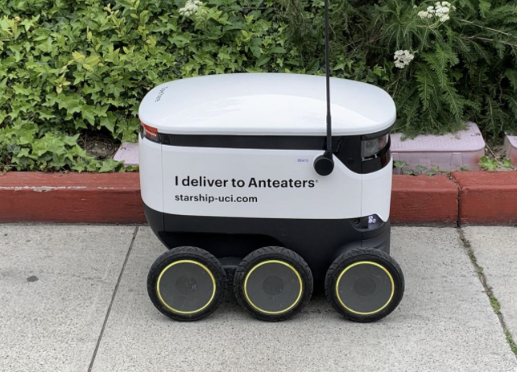
Bridging Planetary Science, Space/Quantum Technologies, and Fundamental Physics
Many real-life applications & consequences!
Photo by Oriana Gonzalez/Staff.
Sun Devils / Anteaters - Starship

Slide 8
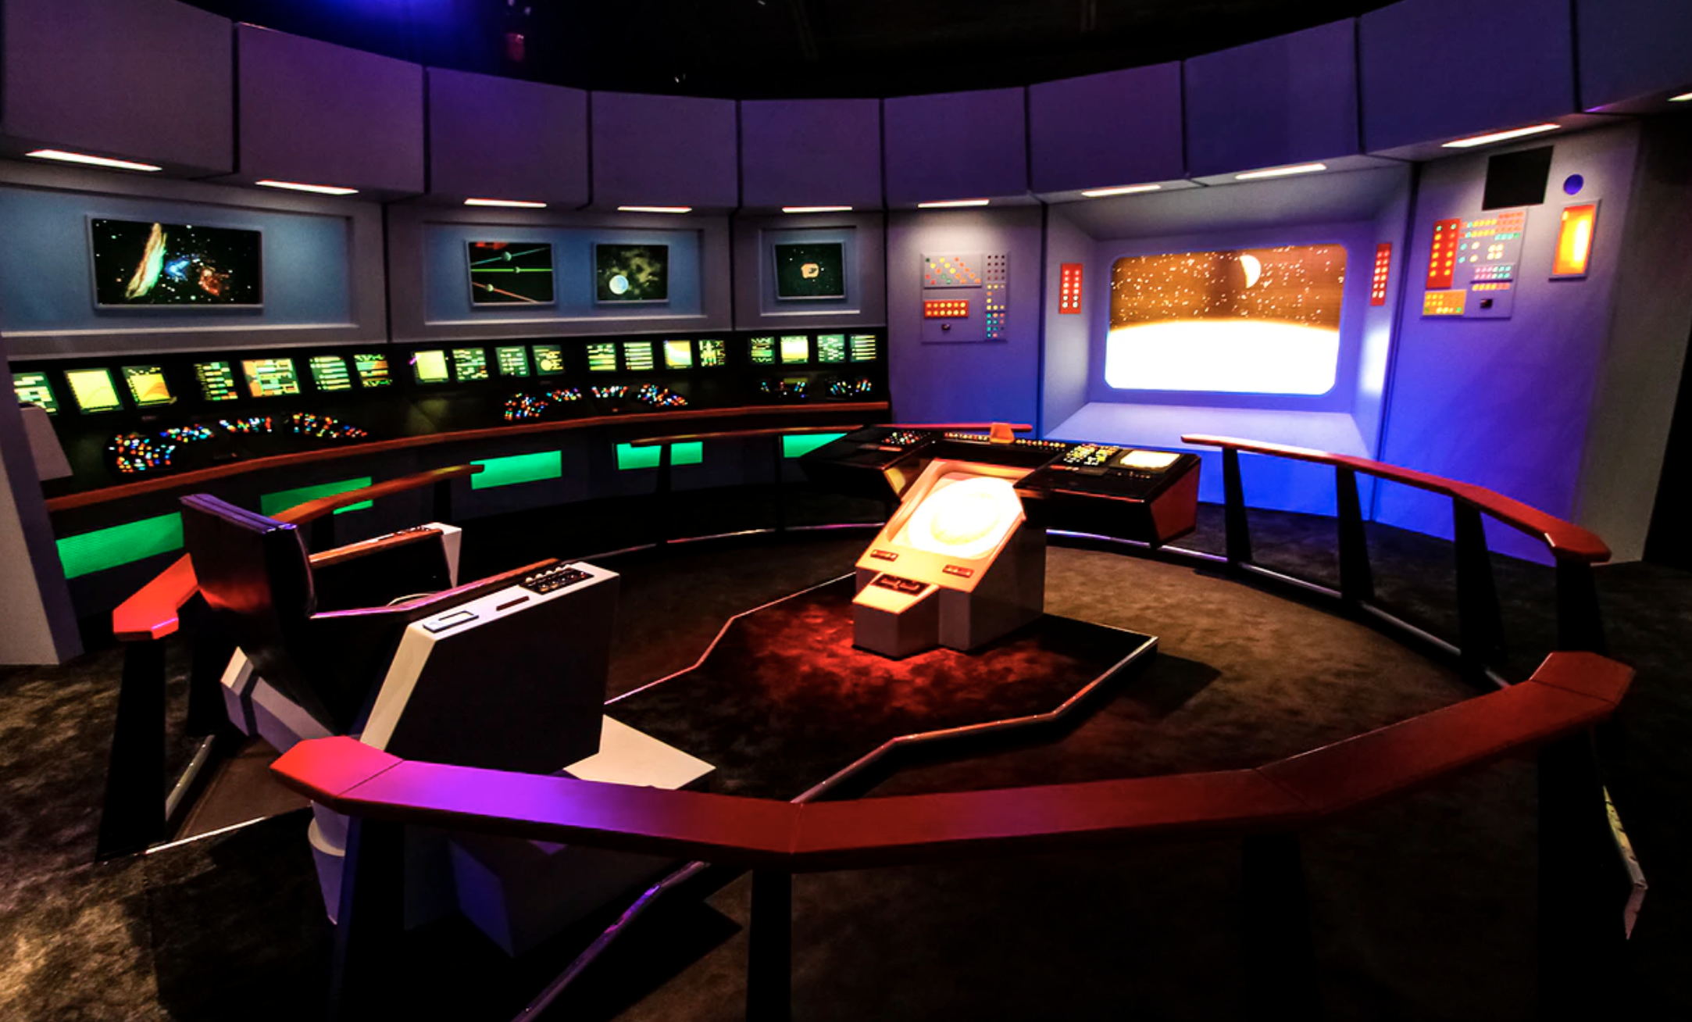
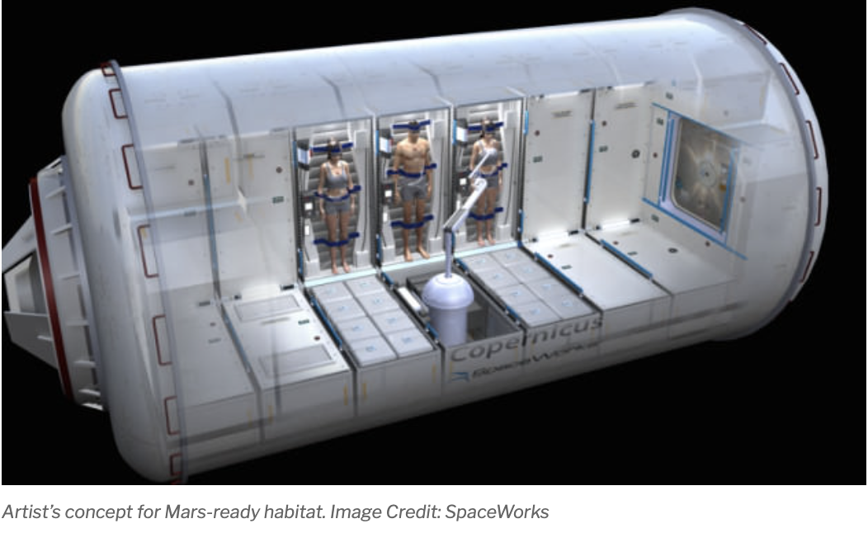
Why Space Quantum Clocks?
Auto-Navigating Spacecraft & Space Travel
Torpor/NASA future concept. SpaceWorks
NASA Kennedy Space Center's Visitor Complex (Public Domain)
Torpor/NASA collaboration
Exploring the deep space: auto-driving Spacecraft;
needs precision timing!!!
NASA Deep Space Atomic Clocks (current technology!) & Deep space and global navigation satellite system (GNSS)
Can we use the technology to study fundamental physics?
Notes:
DONE !!

Slide 9
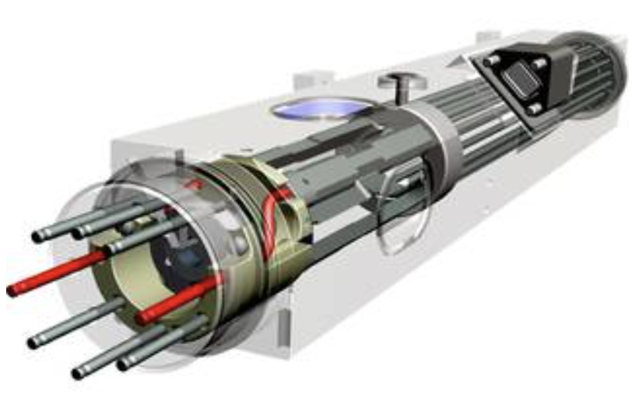
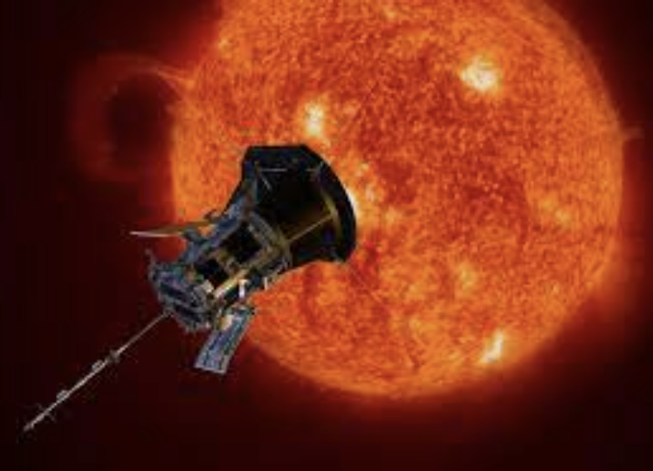
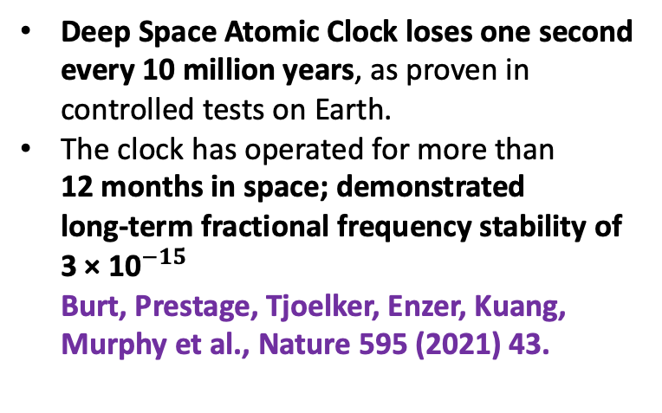
NASA DSAC & Parker Solar Probe
Deep Space Atomic Clock loses one second every 10 million years, as proven in controlled tests on Earth.
The clock has operated for more than 12 months in space; demonstrated
long-term fractional frequency stability of 3 × ${\text{10}}^{−15}$
Burt, Prestage, Tjoelker, Enzer, Kuang, Murphy et al., Nature 595 (2021) 43.
Exceeds previous space clock performance by up to an order of magnitude
Parker Solar Probe
Kasper, Klein, Lichko, Huang, Chen, Badman et al., Parker solar probe enters the magnetically dominated solar corona, Phys. Rev. Lett. (2021)
(1.0 m × 3.0 m × 2.3 m)
Why don’t we put a quantum clock on a solar probe?
What can we do with that?
Notes:
Simplify

Slide 10
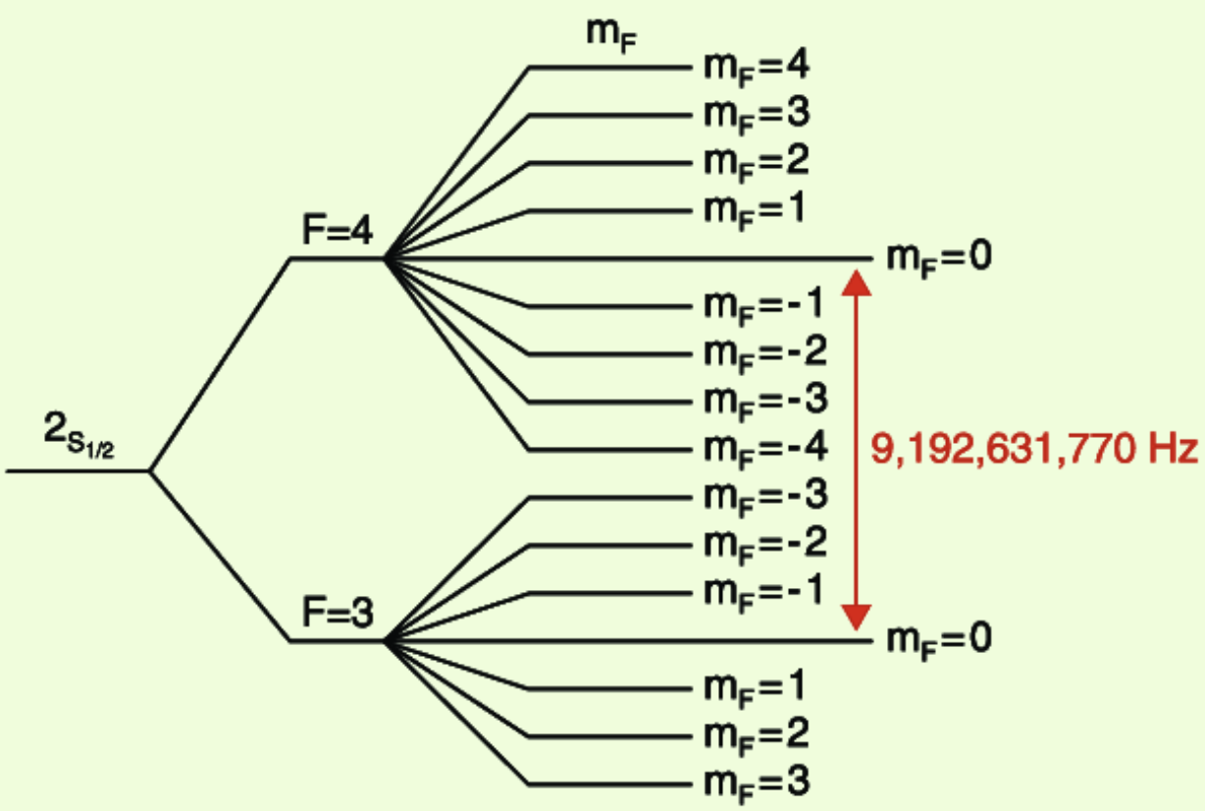
Atomic Clock & Caesium Standard
Atomic clocks: used to measure the distance between objects by timing how long it takes a signal to travel from A to B.
For space exploration, clocks must be extremely precise:
An error of even one second can mean the difference between landing on Mars or missing it by hundreds of thousands of miles.
Definition of a second!
http://hyperphysics.phy-astr.gsu.edu/hbase/acloc.html
Reference: U.S. Naval Observatory, Cesium Clocks

Slide 11
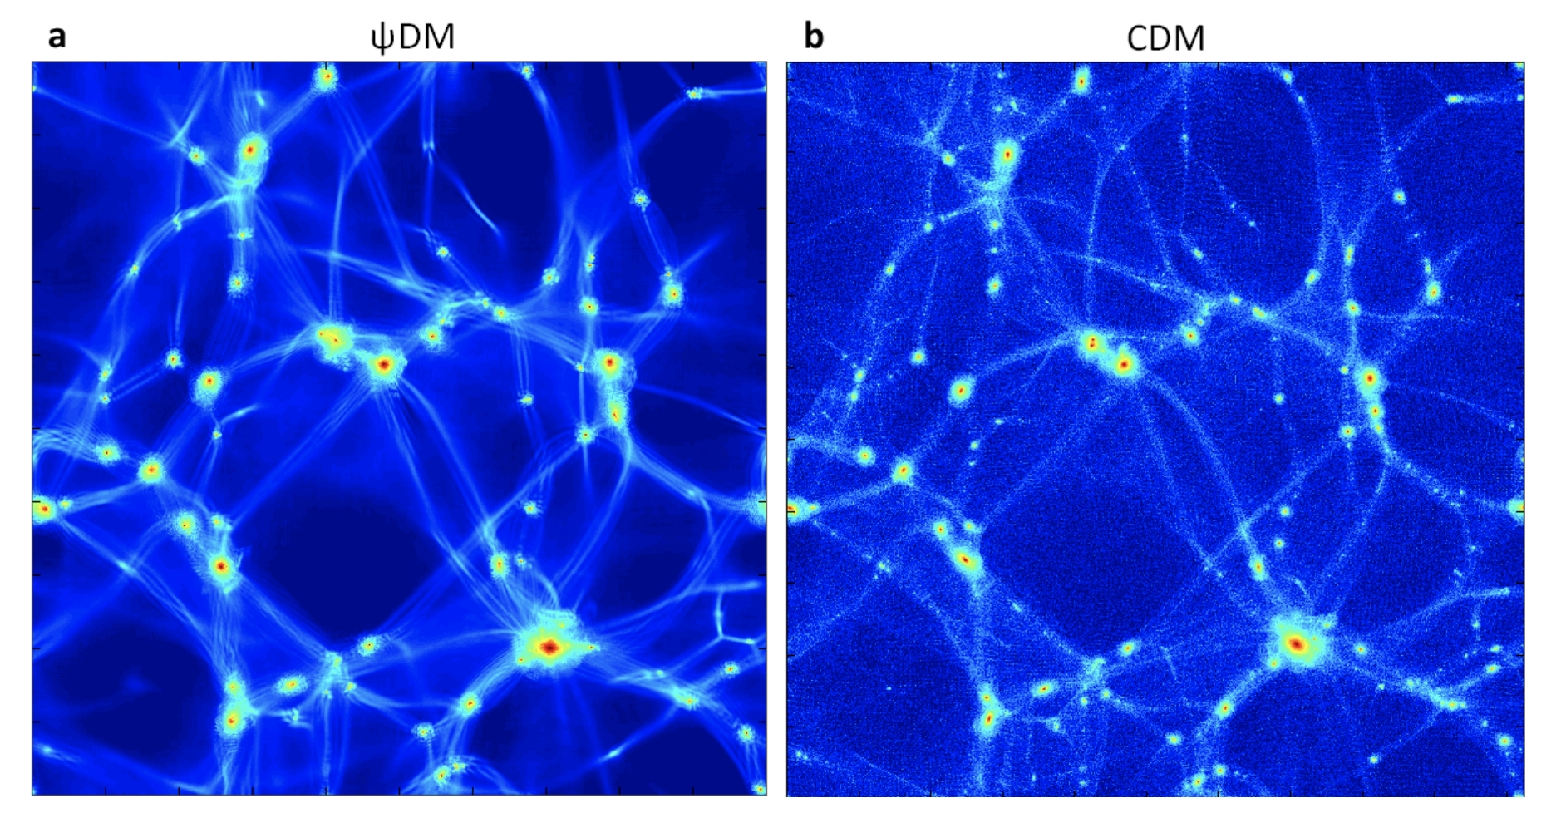
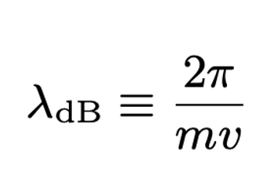
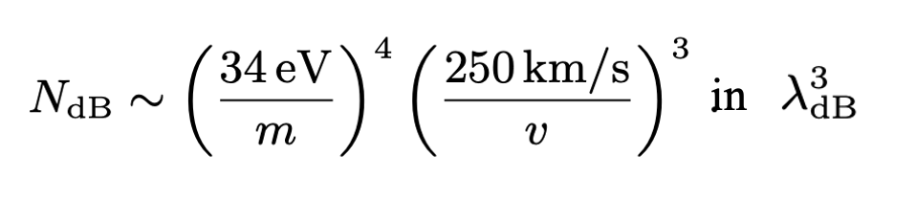
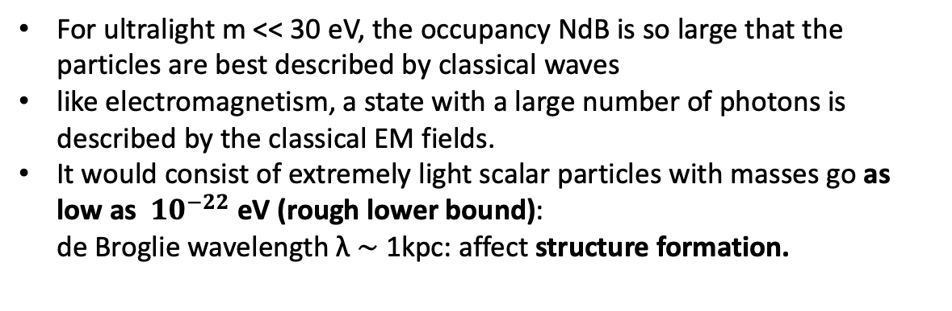
Wave-Like (Fuzzy) Particles as Dark Matter
Schive, Chiueh, Broadhurst, Nature Physics ‘14 arXiv:1406.6586,
For ultralight m << 30 eV, the occupancy NdB is so large that the particles are best described by classical waves
like electromagnetism, a state with a large number of photons is described by the classical EM fields.
It would consist of extremely light scalar particles with masses go as low as ${10}^{−22}$ eV (rough lower bound):
de Broglie wavelength λ ∼ 1kpc: affect structure formation.
Notes:
??

Slide 12
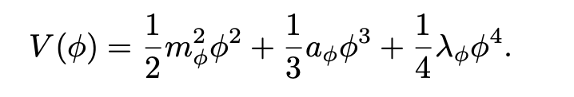
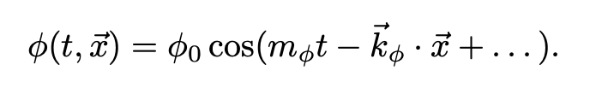
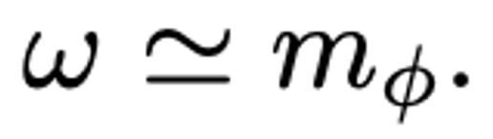
Oscillation of Wave-like Scalars
Dark matter potential
(Non-relativistic solutions)
Oscillation frequency ~ dark matter mass

Slide 13
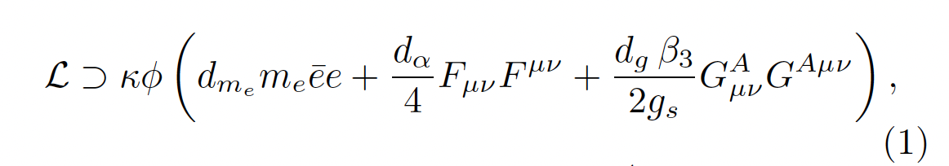
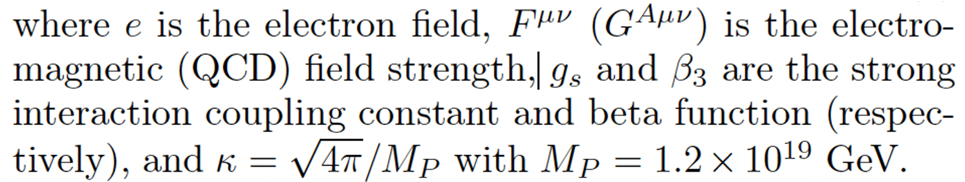
Dark Matter Coupling
Electrons
photons
gluons
Dark Matter

Slide 14
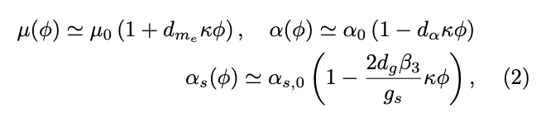
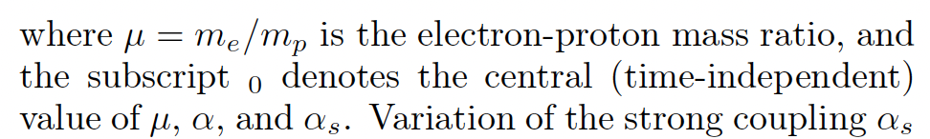
Atomic Physics Probe

Slide 15
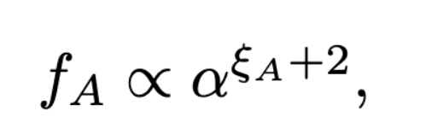
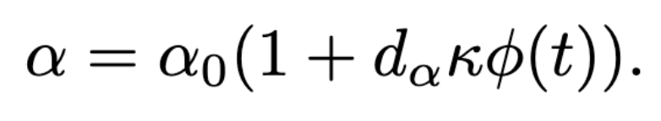
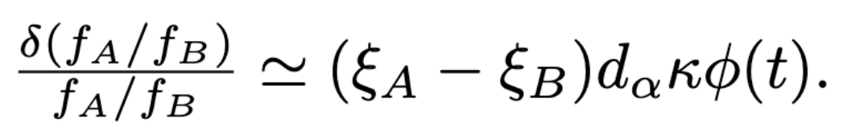
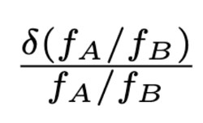
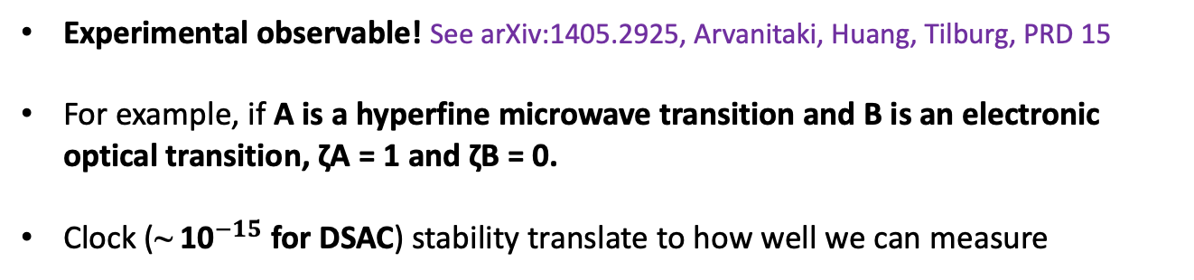

Atomic Probe Basics
$f$ is the frequency of a (clock) transition.
Experimental observable! See arXiv:1405.2925, Arvanitaki, Huang, Tilburg, PRD 15
For example, if A is a hyperfine microwave transition and B is an electronic optical transition, ζA = 1 and ζB = 0.
Clock (~ ${\text{10}}^{−15}$ for DSAC) stability translate to how well we can measure

Slide 16
Solar Bound-State Halo
An example of DM overdensity
Yu-Dai Tsai, UC Irvine, ’22
yudait1@uci.edu

Slide 17
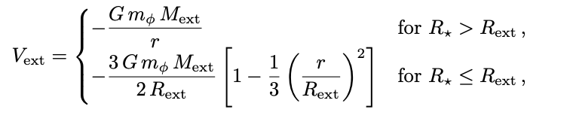
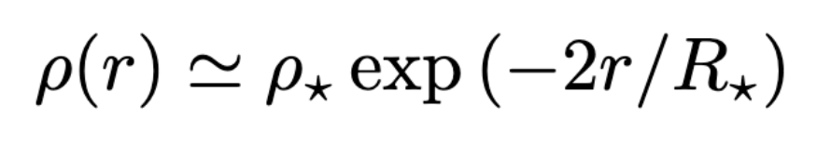

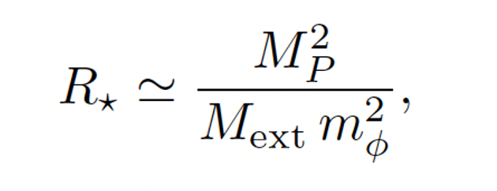
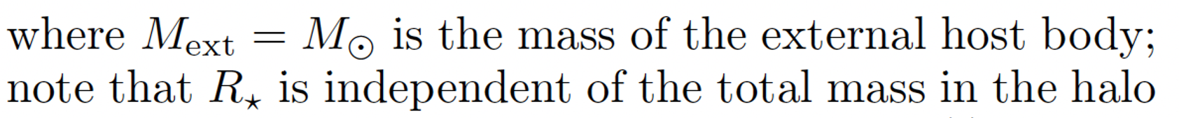

Scalar DM Halo
Stable solution can be supported by external potential
,
Banerjee, Budker, Eby, Flambaum, Kim, Matsedonskyi, and Perez, 1912.04295

Slide 18
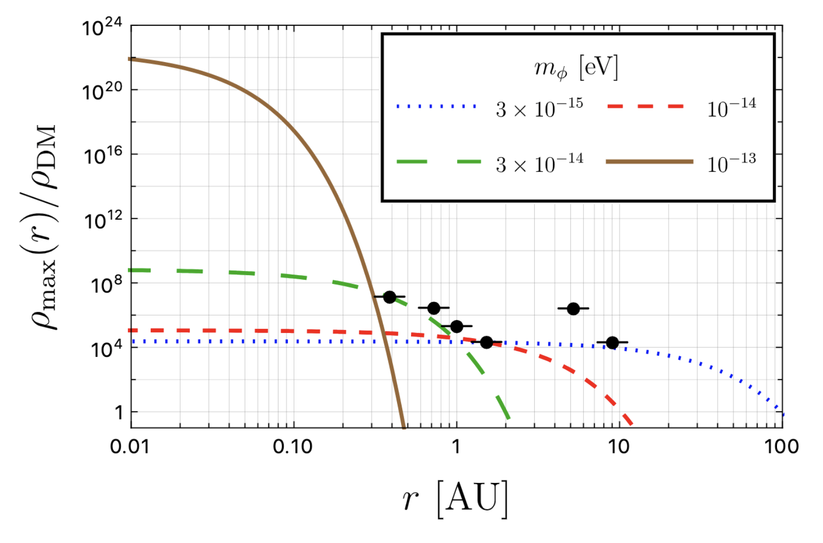
Dark matter in solar system? Planetary constraint!
Black data points are model-independent constraints!
Dark matter induce precessions to the planets
Mercury, Venus, Earth, Mars, Jupiter, Saturn
Pitjev, Pitjeva, 1306.5534, Astronomy Letters ’13
Tsai, Eby, Safronova, 2112.07674

Slide 19
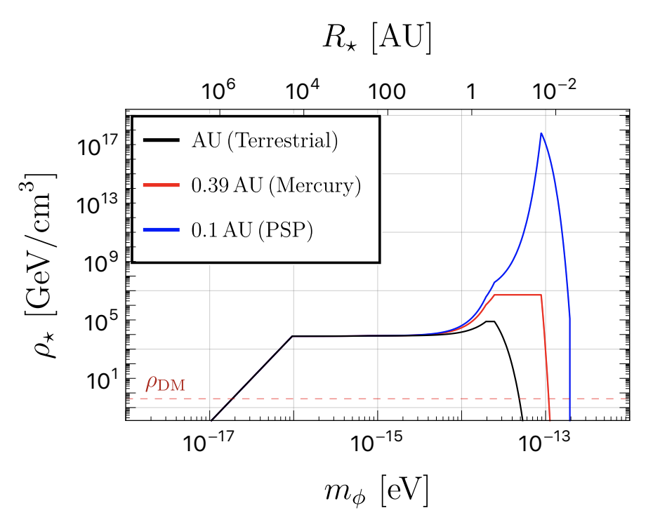
Enhancement of the DM Density
PSP: Parker Solar Probe
Tsai, Eby, Safronova, arXiv:2112.07674

Slide 20
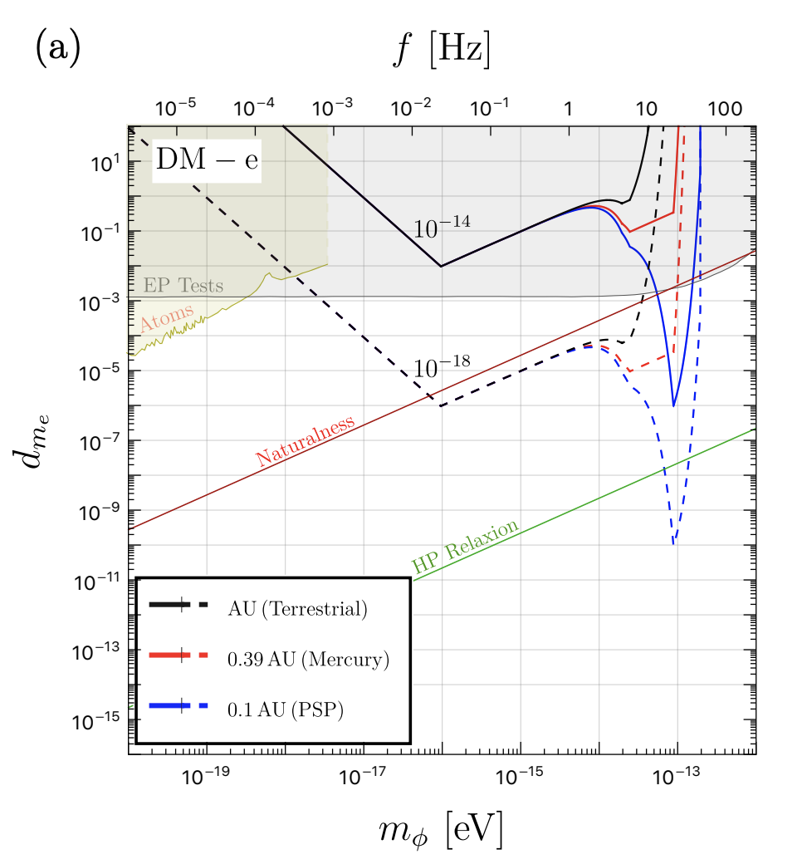
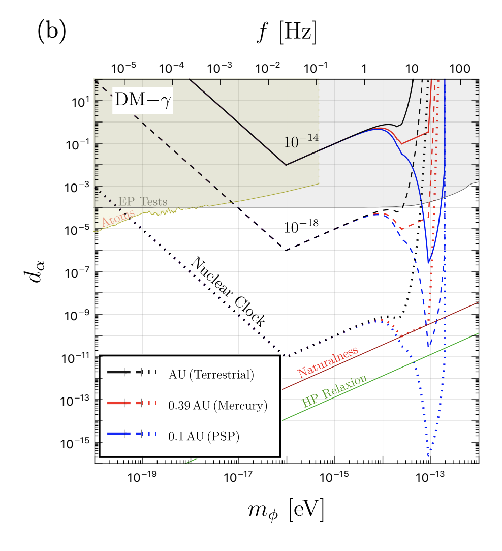
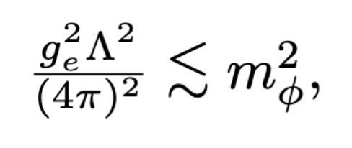
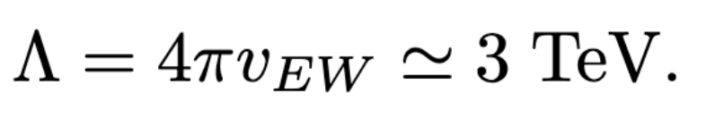
Results
Clock “Accuracy”
Clock stability
Motivate Specific Frequency Region!
Motivate Nuclear Clocks!
Tsai, Eby, Safronova, arXv:2112.07674
Naturalness condition
Notes:
Accuracy ??

Slide 21

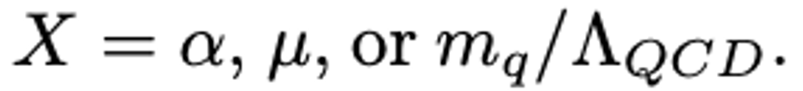


Spatial Variation of Fundamental Constants
δU: change in gravitational potential .
Earth variation.
from Earth to Solar probe at 0.1 AU.
Achieve constraints on $k_{X}$ that are a factor of ∼ 300 stronger!
Notes:
Add couplings; add why nuclear clocks ?? Difference between atomic and nuclear clocks

Slide 22
Model-Independent Constraints on Dark Matter
From here on, we only rely on gravitational effects of dark matter, so model independent
Yu-Dai Tsai, UC Irvine, ’22
yudait1@uci.edu

Slide 23
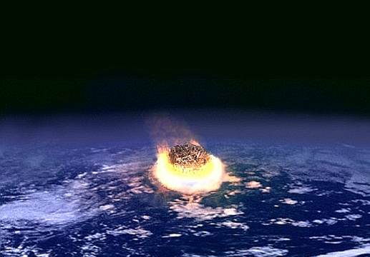
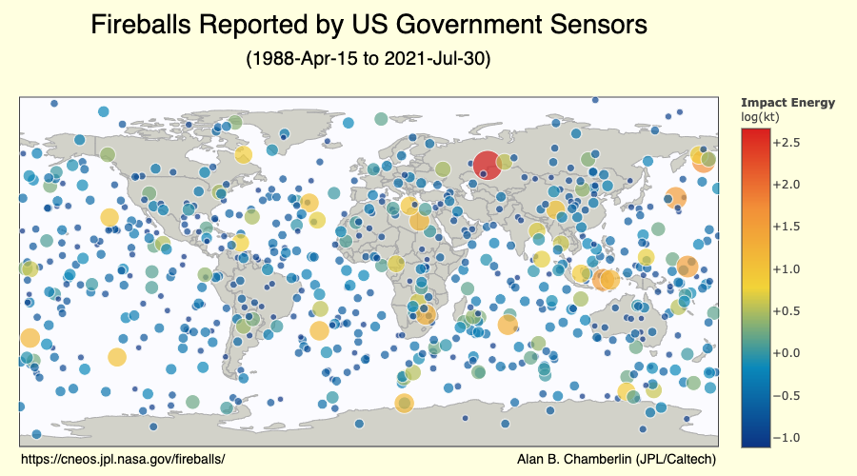
Asteroids hitting the Earth
Public Domain
Don’t Please Look Up
Engin Akyurt –Unsplash - free usage for commercial & non-commercial purposes
~ 65 million years ago
Tracking asteroids is extremely important
e.g., unexpected 2013 Chelyabinsk meteor injured >1500 people
Also, near-Earth asteroid search accidentally found ʻOumuamua

Slide 24
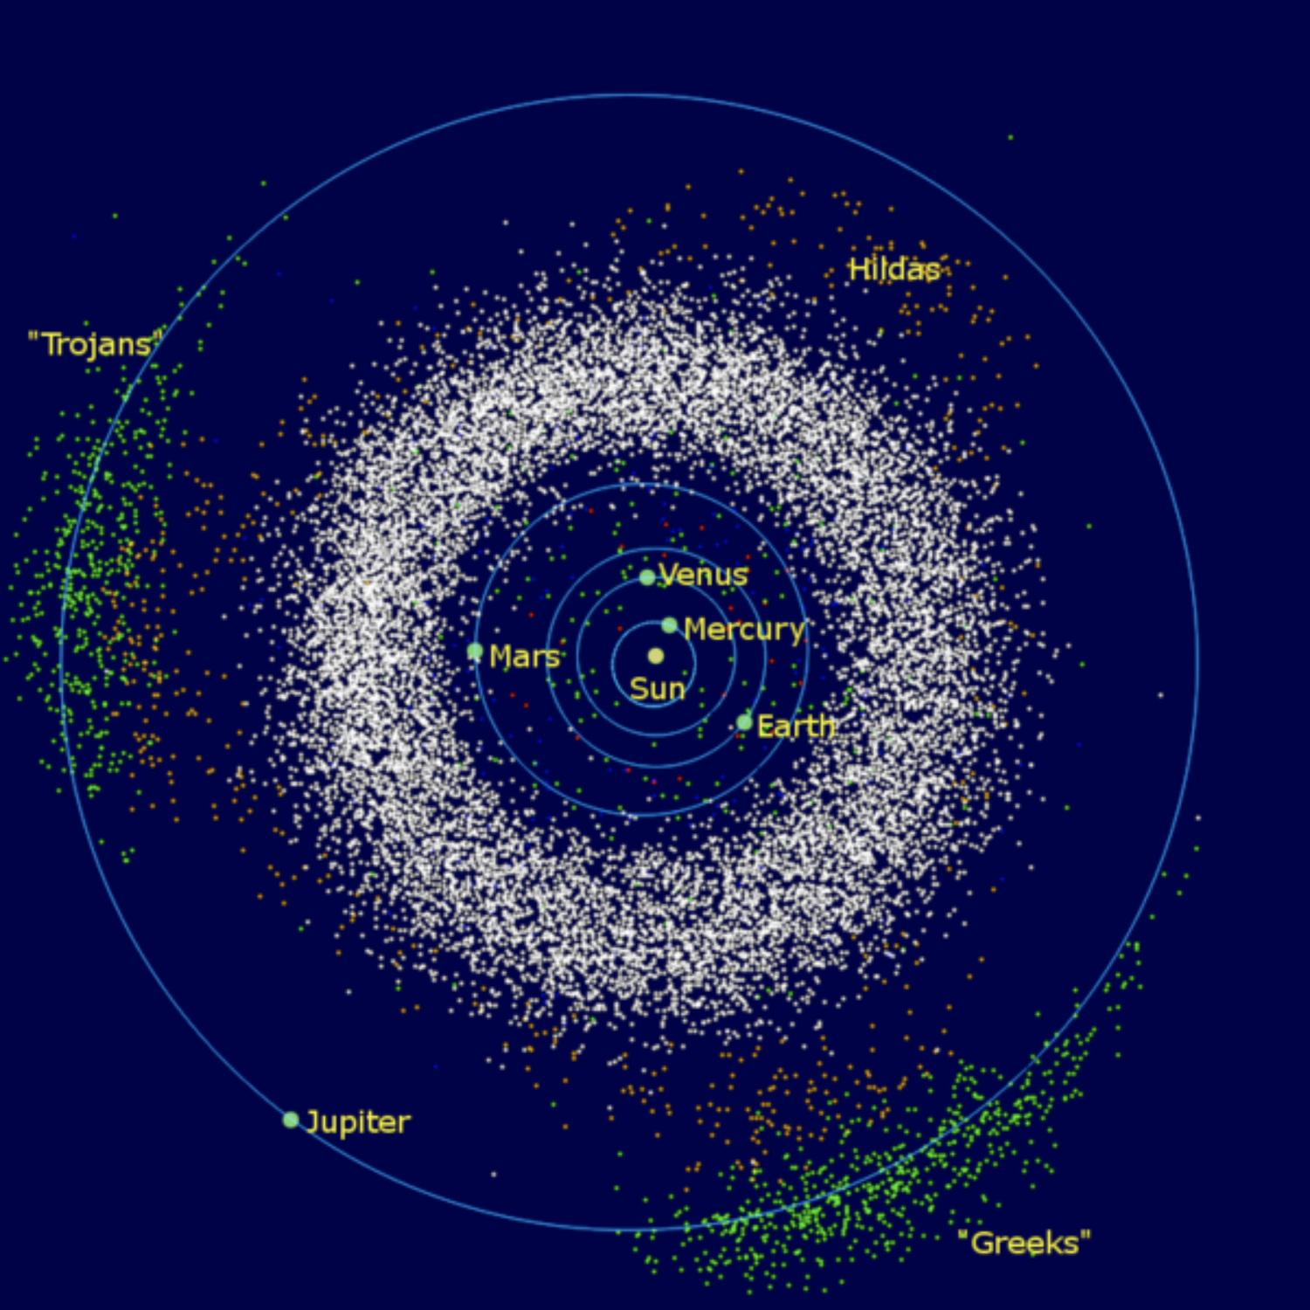
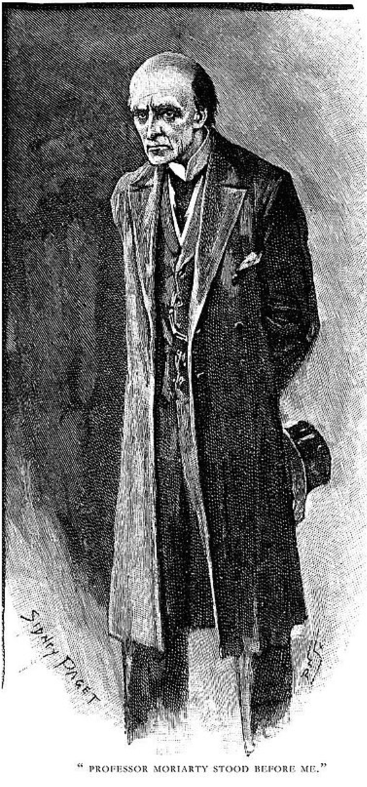

Asteroids
By Sidney Paget
“Is he not the celebrated author of The Dynamics of an Asteroid, a book which ascends to such rarefied heights of pure mathematics that it is said that there was no man in the scientific press capable of criticizing it?
— Sherlock Holmes, The Valley of Fear
https://commons.wikimedia.org/wiki/File:InnerSolarSystem-en.png, public domain, granted usage for any purposes
“The mor hazardous the asteroids,
the better for fundamental Physics”
-- Professor Moriarty (maybe)

Slide 25
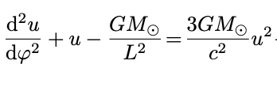
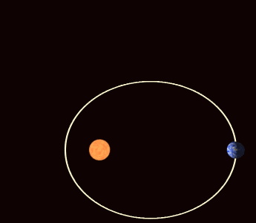
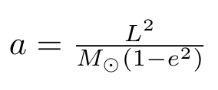
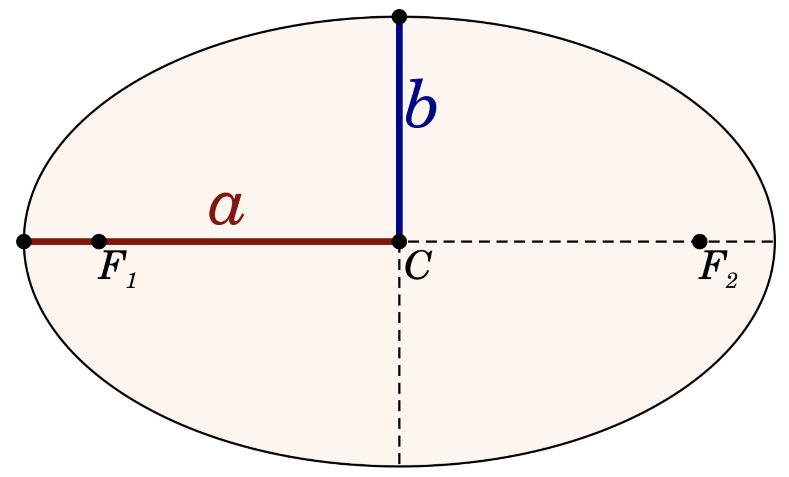

Perihelion Precession: Einstein’s Success
Precession of Mercury's perihelion (closest point to the Sun)
Made by Wikipedia User WilllowW
https://commons.wikimedia.org/wiki/User:WillowW
(GR)
Consider planar motion and fix θ = π/2.
Define inverse radius variable u ≡ 1/r = u(ϕ)
, $a$ is the semi-major axis
https://en.wikipedia.org/wiki/Apsidal_precession#/media/File:Precessing_Kepler_orbit_280frames_e0.6_smaller.gif under CC BY 3.0
M. W. Toews (CC0)

Slide 26
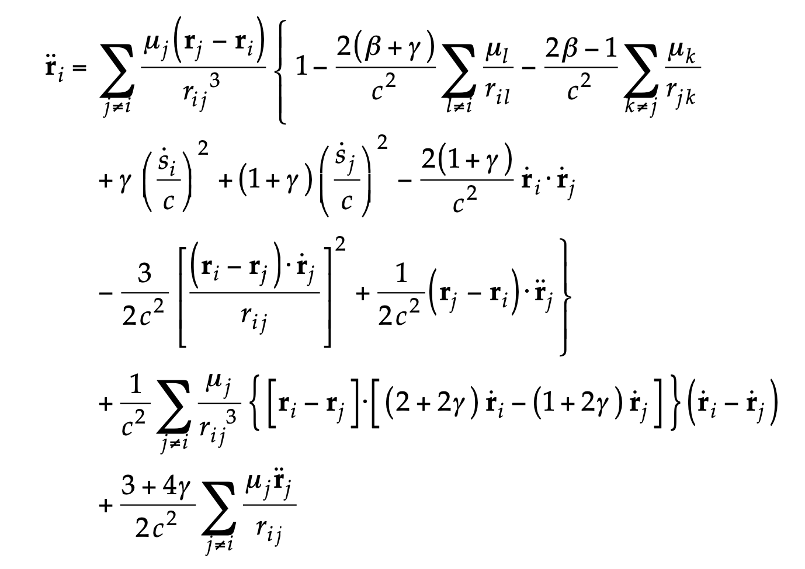
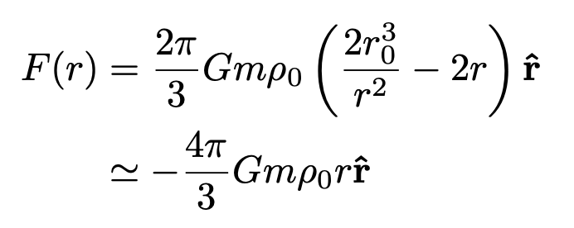
Adding Dark Matter to the Force Model
From Dr. Davide Farnocchia’s (NASA, JPL) slide
Dark matter

Slide 27
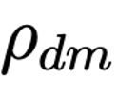
Dark Matter Profile & Planetary Precession
Dark matter

Slide 28
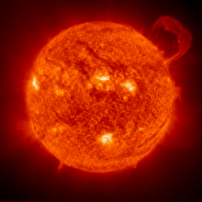
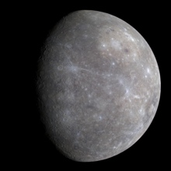
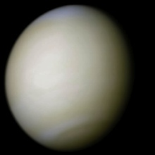












Robust Analysis (NEW):
High-fidelity force model
JPL Planetary Ephemerides DE441
Small-body perturbers
PPN formulation for relativity
Oblateness, …
Dr. Davide Farnocchia’s (NASA, JPL) slide

Slide 29
Other Sources of Perturbations
Errors in planetary trajectories and masses
Missing perturbers, errors in perturber masses & trajectories
Higher order relativistic terms
Higher order gravity terms
Poynting-Robertson drag
Simplifying assumptions in nongravitational force model (non-spherical effects, Yarkovsky, solar torque, physical parameter evolution, etc)
Solar mass loss and solar wind
Meteoroid impacts
Spacecraft interaction
Dr. Davide Farnocchia’s (NASA, JPL) slide

Slide 30

New Project: New Model Independent Constraints!
Preliminary
Bennu
565 m × 535 m × 508 m
(7.329±0.009)×10^10 kg
Tsai, Farnocchia, Eby, Arakawa, Safronova, in preparation (2022)
Tsai, Farnocchia, Eby, Arakawa, Safronova, in preparation
Obtained results from NASA JPL Sentry-II code & OSIRIS-Rex+ data
Can be applied to ideas like Solar-Basin & Axion Mini-cluster (more refs in paper)

Slide 31


Probing Fifth Force & Ultralight Mediators
LLR: Lunar Laser Ranging
Williams, Turyshev, Boggs, PRL 04
Planets:
Poddar, Mohanty, Jana, EPJC 21
Asteroidal / Planetary / Lunar Probes are the strongest for equivalence principle conserving fifth forces.
More reference & details in the backup slides
Preliminary
Preliminary
Fuzzy DM
Tsai, Wu, Vagnozzi, Visinelli, arXiv:2107.04038, under review by Nature Astronomy
Conducting a detailed study collaborating with researchers from NASA & ESA

Slide 32
Big Picture & Outlook
Bridging planetary science, space (quantum) technology, and fundamental physics
Our result is exciting now and has significant potential given the future measurements:
radar, optical, and space missions will bring tremendous progress!
Atomic clocks on the moon, spacecraft, satellite,
Asteroid Tracking Array, and Advanced Lunar Ranging:
Many exciting projects forward!
Collaborating with NIST, NASA, ESA, etc people on proposals
Yu-Dai Tsai, UC Irvine, ’21
yt444@cornell.edu

Slide 33


Exciting Research Directions for Discussions
Asteroidal/Planetary Tracking Array;
- Develop a tracking array to study bosonic ultralight dark matter (possible) and gravitational wave (difficult)
- Model independent DM constraint
Interesting Projects with the Parker Solar Probe or Similar Solar Probes?
Advanced Lunar Laser + Radar Ranging
LASER + transponder + quantum technology?
Quantum technologies in Space: Q-SEnSE + SpaceQ informal meeting

Slide 34
Let’s protect the Earth & find dark matter; happy to discuss more
Thank you!
Thank Josh, Marianna, Luca, Sunny, Youjia for comments
Outreach / interview: https://www.youtube.com/watch?v=xDX9XwLHBuM
Yu-Dai Tsai, UC Irvine, yt444@cornell.edu / yudait1@uci.edu

Slide 35
Backup Slides
Yu-Dai Tsai, UC Irvine 22
yt444@cornell.edu & yudait1@uci.edu

Slide 36
I also work on …
Fixed-target searches for dark matter & long-lived particles
(FerMINI & LongQuest) with Pospelov et al.
LHC Forward Experiments: Forward Physics Facility, FORMOSA
(a millicharge experiment I proposed), with Feng et al.
Dark matter model building (dark sector QCD, Strongly Self-Interacting Dark Matter, SIMP/ELDER), with Murayama, Slatyer, Perelstein et al.
Dark matter searches using neutron star / compact merger / multi-messenger astronomy, with Profumo, Sathyaprakash et al.
Neutrino physics (cosmic neutrino background) & neutrino BSM,
with Shoemaker et al.
My works on Inspire HEP & my outreach interview (> 76K views!)

Slide 37
More References
Seto, Cooray, arXiv:0405216, PRD 04
LLR Experiments: Williams, Turyshev, Boggs, PRL 04
Murphy , Rept. Prog. Phys 13
Atomic / nuclear clocks for fundamental physics:
Peik, Schumm, Safronova, Pálffy, Weitenberg, Thirolf, 2012.09304
GW background, Fedderke, Graham, Rajendran, PRD21
Quantum Technologies in Space, Kaltenbaek, Exp Astron 21

Slide 38
Asteroid g-2 Experiments on Fifth Forces & Ultralight Dark Matter
Yu-Dai Tsai, UC Irvine
yudait1@uci.edu

Slide 39

Extended SM Symmetries & Fifth Forces
Gauged ${U(1)}_{EM}$ (Standard Model) photons
“Gauged” ${U(1)}_{X^{′}s}$ (hypothetical) “Dark” photons
$X can be bayon number, lepton number, etc:$
$Standard Model Global Symmetries$
Motivated by baryogenesis (matter-anti matter asymmetry) & dark matter:
The ultralight mediators CAN but does not have to be dark matter
Notes:
Get better ref. What is a large-scale structrure, rulers to show length, another magnify lense and ruler, Cluster: million ly: clusters ??

Slide 40



Radar Observations
Radar – Goldstone Observatory:
Provide very precise location and velocity information of the asteroids
Radar astronomy:
observing nearby astronomical objects by reflecting microwaves off target objects and analyzing the reflections.
Round-trip light time (RTLT): The elapsed time taken by a signal travelling from the Earth to a spacecraft or other celestial body
Doppler shift:
https://www.desertusa.com/desert-california/goldstone-deep-space.html
By Charly Whisky, CC BY-SA 3.0 https://en.wikipedia.org/wiki/Doppler_effect#/media/File:Dopplerfrequenz.gif

Slide 41




5th force and Yukawa Potential
(fifth force)
Gauge boson, dark photon of ${U(1)}_{B}$ or scalar coupled to baryon number
g is new physics coupling constant, and m is the mediator mass
See, e.g., Poddar et al, https://arxiv.org/abs/2002.02935
Notes:
Get better ref. What is a large-scale structrure, rulers to show length, another magnify lense and ruler, Cluster: million ly: clusters

Slide 42


Ultralight Bosons
1. Spin 0: ultralight scalars coupled to Standard Model particles
Spin 1: Dark photon of gauged ${U(1)}_{B}$,
with coupling $g_{A′}$ charging all baryons equally
charge: $q_{ p}$= $q_{n}$= 1
${U(1)}_{B}$ has chiral anomaly, so extra heavy particle is needed,
and there may be additional constraints & model building needed for those constraints
(Constraints: Dror, Lasenby, Pospelov, arXiv:1705.06726, arXiv:1707.01503)
(Models to alleviate bounds: Green, Schwarzy, PLB 87, Kaplan, NPB 91)
Our study can also be applied to ${U(1)}_{B−L}$, $L_{e}−L_{μ, τ}$, etc. ,
Need to understand the asteroid compositions for these.

Slide 43



Precession (Analytical) at Low-Mass Limit
(fifth force)
$m_{p}$ is proton mass
for low mass, m << 1/ $a$ (Natural Unit)
The term gets larger with $a$
That’s why we should explore objects further away from the Sun: not just Mercury or other planets
Not depending on target celestial bodies’ mass

Slide 44





Results for the new physics
Recast
Verma, Margot, Greenberg, APJ ‘17
Optimal 2022 results,
Fuzzy DM
Best reach:
TU3, MN, BD19
Tsai, Wu, Vagnozzi, Visinelli, arXiv:2107.04038

Slide 45

Asteroid Constrain EP Conserving 5th forces
LLR: Lunar Laser Ranging
Williams, Turyshev, Boggs, PRL 04
Planets:
Poddar, Mohanty, Jana, EPJC 21
Asteroidal / Planetary / Lunar Probes are the strongest for equivalence principle conserving fifth forces.
Fuzzy DM
Tsai, Wu, Vagnozzi, Visinelli, arXiv:2107.04038
We are conducting a detailed study using MONTE with people from JPL & ESA

Slide 46


Equivalence Principle-Breaking Fifth Forces
Best reach: TU3, MN, BD19
Torsion Balance Exp:
Schlamminger, Choi, Wagner, Gundlach, Adelberger, PRL 08
Superradiance:
Baryakhtar, Galanis, Lasenby, and Simon, PRD 21
LLR: Lunar Laser Ranging
Williams, Turyshev, Boggs, PRL 04
Planets:
Poddar, Mohanty, Jana, EPJC 21
$g_{p}$= $g_{n}$= $g_{φ}$.
Fuzzy DM
Tsai, Wu, Vagnozzi, Visinelli, arXiv:2107.04038
We are conducting a detailed study using MONTE with people from JPL & ESA
Notes:
Update ??

Slide 47

Future objects of interest
Tsai, Wu, Vagnozzi, Visinelli, arXiv:2107.04038
Can also probe dark matter, primordial black hole, etc

Slide 48


Torsion Balance: Modern-Day Tower of Pisa experiment
The Eöt-Wash Group, University of Washington
https://www.npl.washington.edu/eotwash/torsion-balances
Wikipedia

Slide 49
Compilations of Various Probes
LLR: Lunar Laser Ranging
Williams, Turyshev, Boggs, PRL 04
Planets:
Poddar, Mohanty, Jana, EPJC 21
Asteroidal / Planetary / Lunar Probes are the strongest for equivalence principle conserving fifth forces.
Preliminary
Preliminary
Fuzzy DM
Tsai, Wu, Vagnozzi, Visinelli, arXiv:2107.04038
We are conducting a detailed study using MONTE with people from JPL & ESA

Slide 50


Adding Fifth Forces or Dark Matter to the Force Model
From Dr. Davide Farnocchia’s (NASA, JPL) slide
Fifth forces
General dark matter

Slide 51
Some Upcoming Observations
Yu-Dai Tsai, UC Irvine, ’22
yudait1@uci.edu

Slide 52

Space Mission: Visiting Asteroids!
NASA/SwRI and SSL/Peter Rubin - https://www.nasa.gov/press-release/nasa-selects-two-missions-to-explore-the-early-solar-system
Lucy is a planned NASA space probe that will complete a 12-year journey to seven different asteroids. Human landing?

Slide 53

Observations - Optical
https://www.aura-astronomy.org/centers/nsfs-oir-lab/rubinobservatory/
Optical – Vera Rubin Observatory: increase the number of solar-system objects by 5 times.

Slide 54

GAIA
Optical – GAIA provides stellar reference for asteroid localization

Slide 55
Finding Dark Matter While Protecting the Earth
Yu-Dai Tsai
University of California, Irvine
with Josh Eby, Marianna Safronova
with Youjia Wu, Sunny Vagnozzi, Luca Visinelli
Contact: yudait1@uci.edu &
yt444@cornell.edu
https://arxiv.org/abs/2112.07674
To appear on Nature Astronomy!
https://arxiv.org/abs/2107.04038
Under review by Nature Astronomy
INSPIRE: https://inspirehep.net/authors/1274923
NASA’s OSIRIS-REx mission readies itself to touch the surface of asteroid Bennu.
Credits: NASA/Goddard/University of Arizona

