Slide 1

Session: Potential UK EIC Accelerator Contributions
Overview, ERLs, Polarized Source, 2nd IP (Peter Williams – STFC Daresbury)
Crab Cavities and Low-Level RF Control (Graeme Burt – Lancaster U)
Superconducting Linac RF Technology (Peter McIntosh – STFC Daresbury)
Peter Williams, Daresbury Laboratory & Cockcroft Institute
2nd UK Electron-Ion Collider Workshop
28th July 2020

Slide 2
Session: Potential UK EIC Accelerator Contributions
Overview, ERLs, Polarized Source, 2nd IP (Peter Williams – STFC Daresbury)
Crab Cavities and Low-Level RF Control (Graeme Burt – Lancaster U)
Superconducting Linac RF Technology (Peter McIntosh – STFC Daresbury)
Peter Williams, Daresbury Laboratory & Cockcroft Institute
2nd UK Electron-Ion Collider Workshop
28th July 2020

Slide 3
Electron-Ion Collider: UK Accelerator Interest / Status
Project status: DOE Budget is for one detector and one IR - Second detector and IR from international contributions + US NSF - Contributions to accelerator can offset cost of second detector/IR - construction 2023/24 – 2029/30
UKRI Infrastructure Process April 2020: UK EIC interested groups invited by STFC – 3 strands: Physics, Accelerator & Detector:
  Cockcroft proposed accelerator contributions (ASTeC - Daresbury, Lancaster, Liverpool, Manchester):
    Energy Recovery Linacs for Strong Hadron Cooling (Williams, Muratori)
    Crab Cavities (Burt)
    SRF Component design & build (McIntosh)
    Polarised Electron Source (Militsyn)
    Second Interaction Region (Appleby, Wolski, Liverpool detector group)
  Activity split into preliminary (2021 - 2024) – accelerator £5.4M of total £12.6M and full (2024 – 2030) – accelerator £43M of total £96M

Slide 4
Electron-Ion Collider: UK Accelerator Interest / Status
Decision: June 2020: STFC shortlisted EIC to be taken forward to UKRI ☺ … but without accelerator component ☹ at the preliminary stage. Crab cavities only retained as option for full phase.
Nevertheless, in this session we describe how we would contribute should the situation change
In all the selected topics we have strong relevant historical interaction and we emphasise synergies with other projects / subjects – for example…
  Light sources – including Free-Electron Lasers and Compton sources, particularly the UK-XFEL proposal for a domestic ~£1 Bn facility for science and industry https://www.clf.stfc.ac.uk/Pages/UK-XFEL-science-case.aspx#
  High energy physics facilities – High-Luminosity LHC, LHeC, FCC, DUNE/PIP-II
  Neutron Sources - ESS

Slide 5
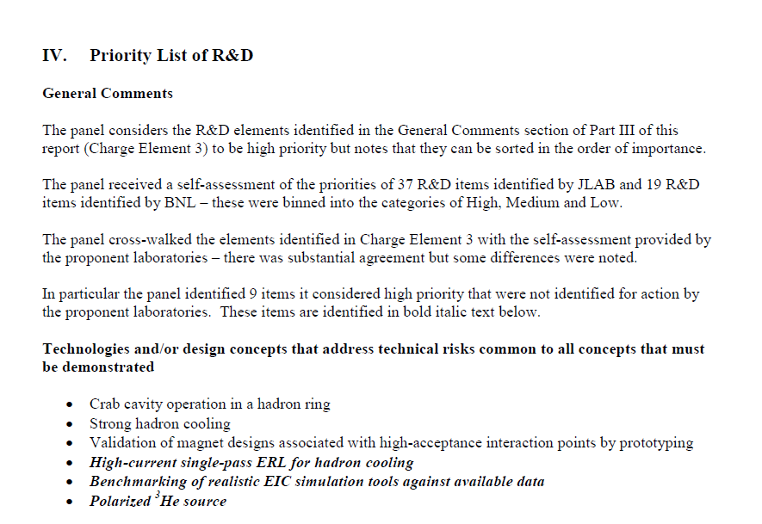
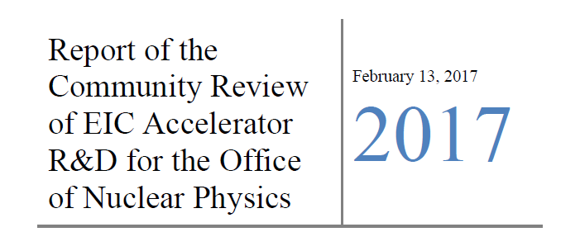
Electron-Ion Collider: Priority Accelerator R&D
Page 48
*
*
*

Slide 6
Energy Recovery Linacs

Slide 7
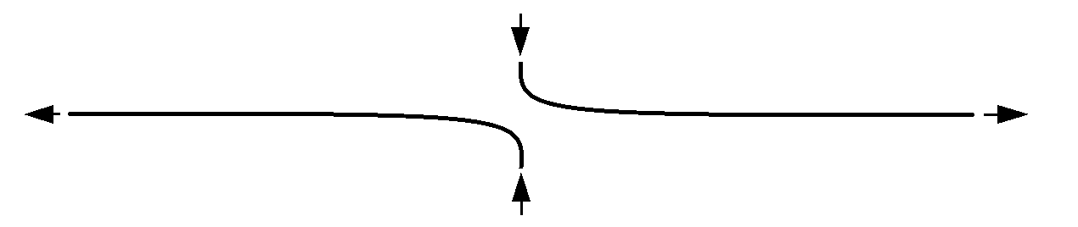
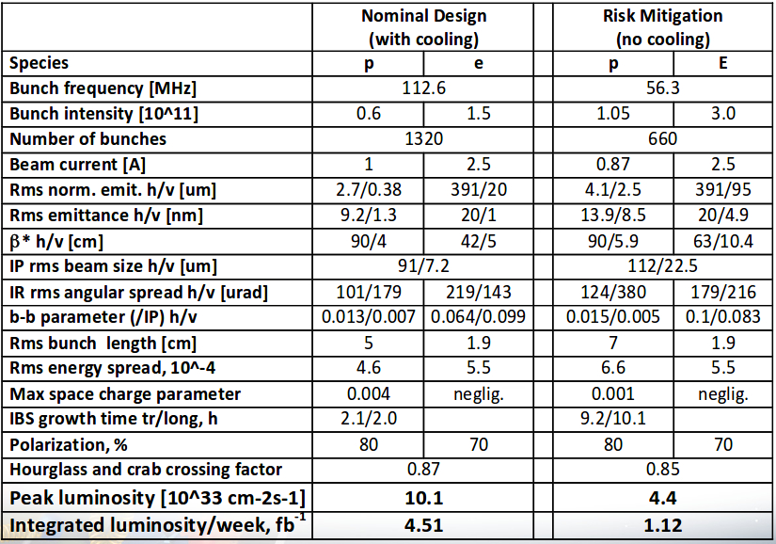

Electron-Ion Collider Needs Hadron Cooling
Intrabeam scattering = Lorentz boosted multiple Coulomb scattering within bunches
IBS is dominant limit on both luminosity and luminosity lifetime because emittance increases with time
IBS growth rate
Factor γ in Δp
longitudinal
transverse
$\frac{1}{τ_{ibs}}∝ \frac{N_{p}}{ε_{x}ε_{y}ε_{s}}$
Start: maximum luminosity without cooling
Then: increase luminosity, for example by
Increase n_{b}➔ N_{p} , 1/t_{ibs} scales with n_{b} ➔ need cooling
Decrease β ➔ need to decrease σ_{s} by incr U_{rf} ➔ σ_{e} larger + more nonlin beam-beam ➔ need cooling
Ferdi Willeke - 2018 EIC Accelerator Meeting, JLab

Slide 8
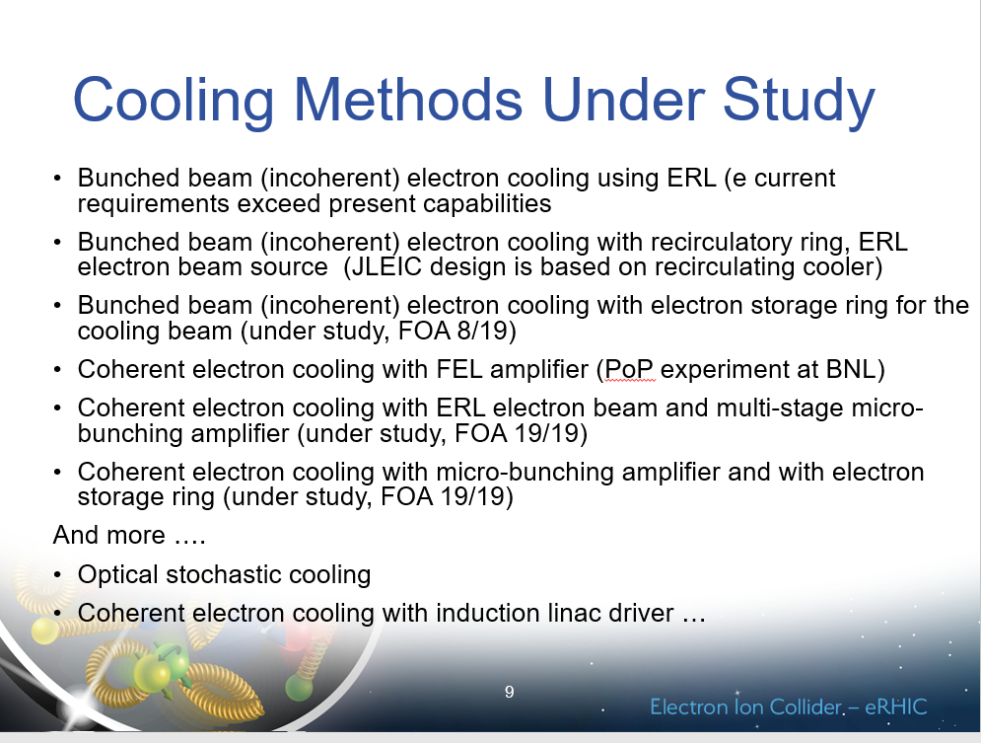
Electron-Ion Collider – How to Cool?
Proton and electron beams must have identical relativistic gamma, for example 100 GeV p ⇒ 54 MeV e- , 275 GeV p ⇒ 150 MeV e-
These electron energies are well beyond capabilities of standard DC coolers used since 1960s - new technology required
Of the cooling methods currently under study (from Ferdi Willeke – 2018 EIC Accelerator Meeting) 4 of the 8 listed utilise an Energy Recovery Linac (ERL) (others: 2 storage ring, 1 laser, 1 induction linac)
All need high power: tens or hundreds of mA = e-beam power 1 MW to 50 MW and excellent quality = small energy spread
It is this combination that makes ERLs attractive solutions – perhaps 2 required! 1 for incoherent at low energy + 1 to drive CeC at high energy?
1

Slide 9
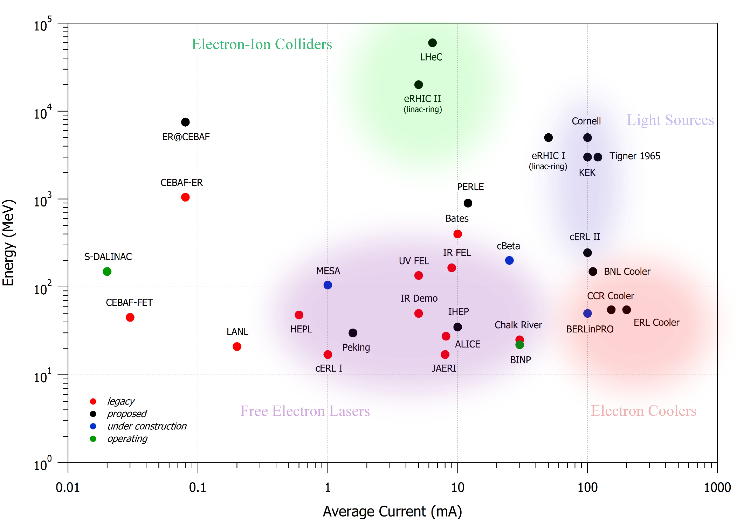
What is an Energy Recovery Linac?
Linear
Accelerator
Recirculated
Linac
Energy Recovery
Linac
Ring
(Cyclotron, Synchrotron
Storage Ring…)
Excellent beam quality
Beam disruption tolerant
Average beam current limited
High average beam current
Lower cost than linac
Beam quality limited
Beam disruption limited
High average beam current
Beam start
Excellent beam quality
Beam disruption not limited
Average beam current limited
Expensive
Beam end
Accelerating cavity

Slide 10
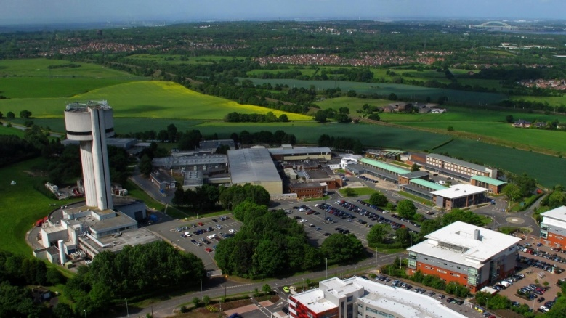
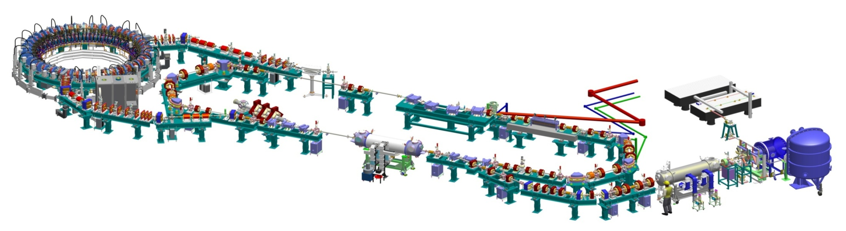
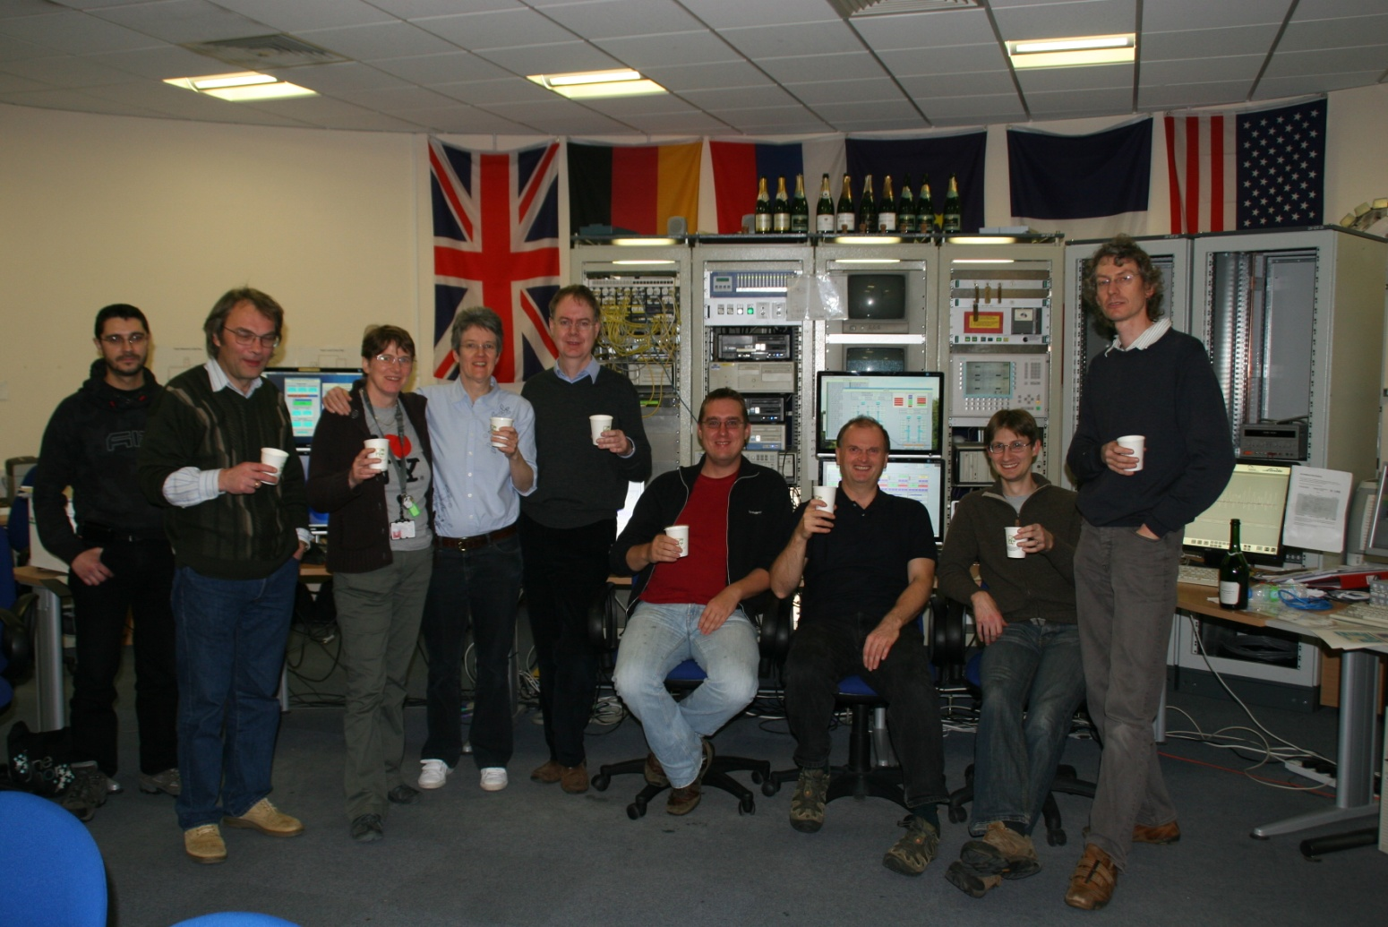
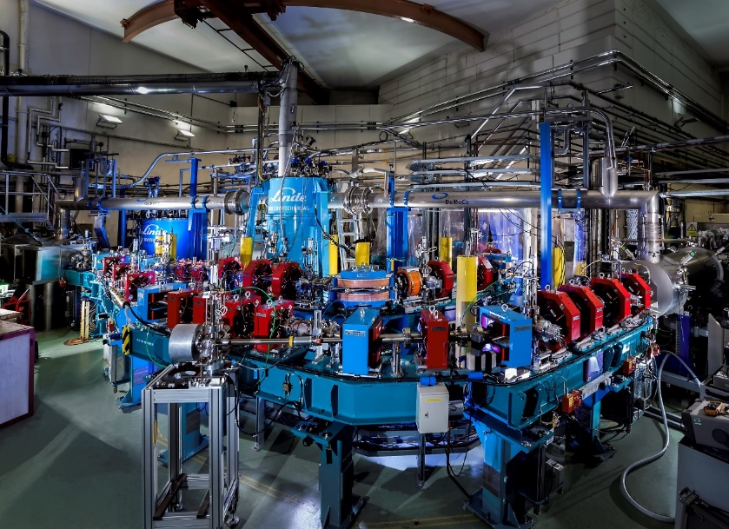
Why are we well placed to engage in ERLs?
From 2004 – 2016 Daresbury conceived, designed, built, commissioned, operated for users and then decommissioned ALICE
ALICE (initially called ERLP) was Europe’s first ERL, and the second of only four worldwide – so unlike linacs & storage rings ERL operational experience is very rare
Situated under the old NSF tower at Daresbury, ALICE successes include:
          First SCRF linac operating in the UK
          First DC photoinjector gun in the UK
          First ERL in Europe
          First FEL driven by ERL in Europe
          First transmission IR-SNOM imaging

Slide 11

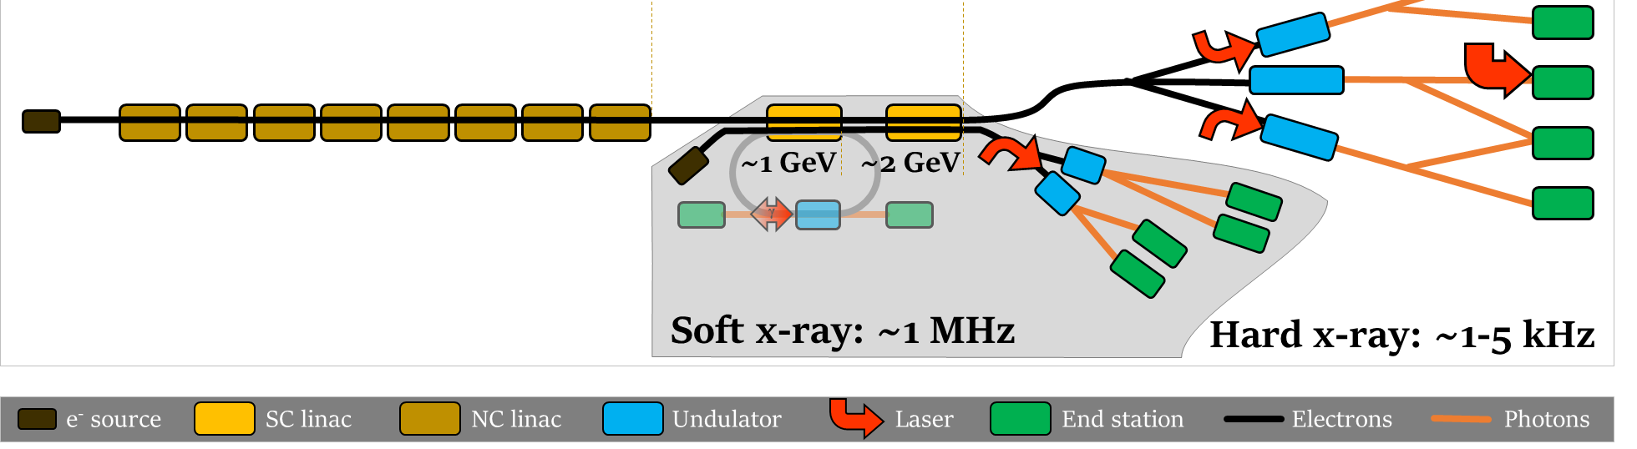
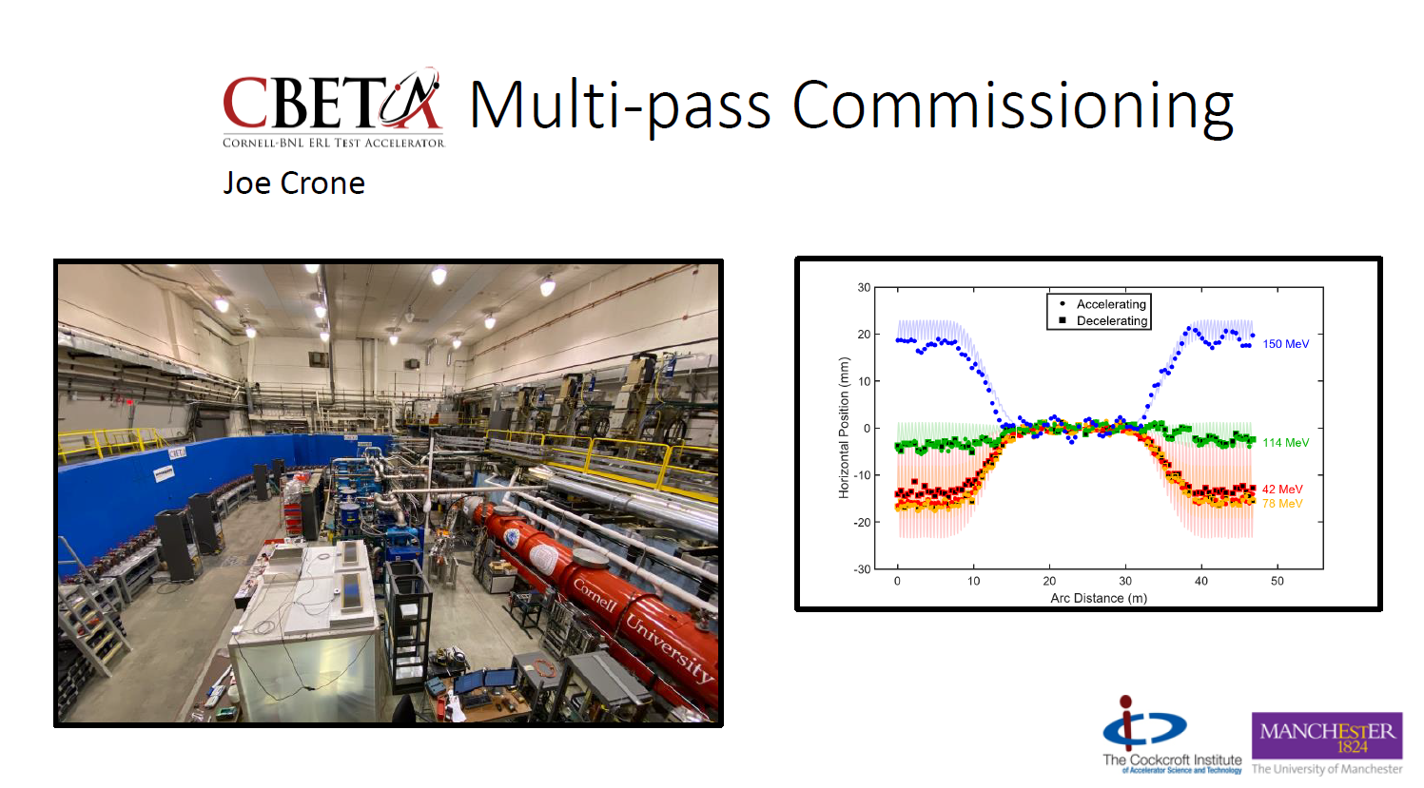
Why are we well placed to engage in ERLs?
Since ALICE decommissioning in 2016 we remain at the forefront of ERL development
UK-XFEL Science Case https://www.clf.stfc.ac.uk/Pages/UK-XFEL-science-case.aspx – potential of a UK based XFEL facility of ~£1Bn scale. Case includes science that could be addressed by incorporating a ~1 GeV ERL into the larger facility
Existing EIC involvement - CBETA: contributed to 2019 Cornell / BNL multipass ERL demonstration: https://link.aps.org/doi/10.1103/PhysRevLett.125.044803
  “In particular, only ERL technology currently seems capable of producing the beam power required to efficiently cool ions at the Electron-Ion Collider (EIC)”

Slide 12

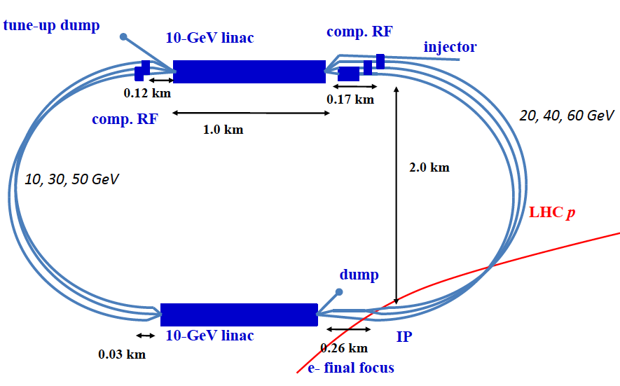
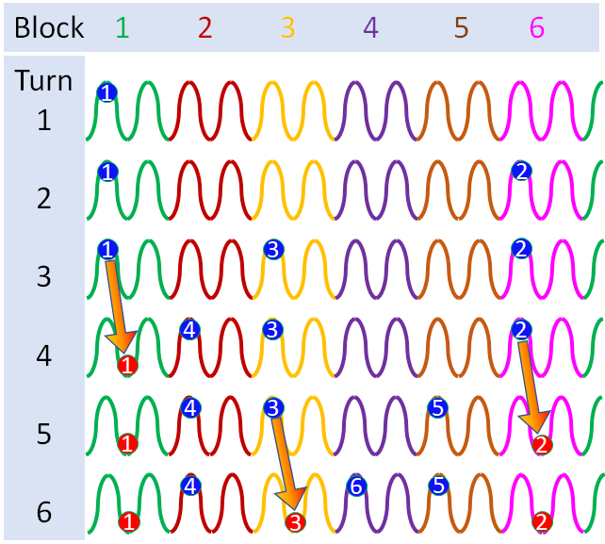
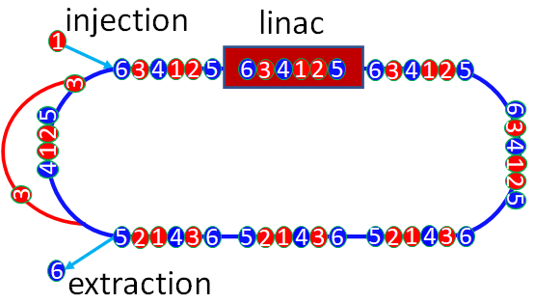
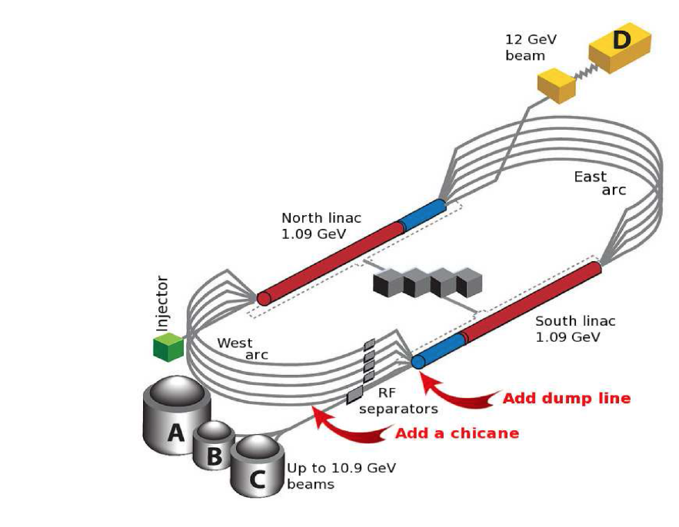
Why are we well placed to engage in ERLs?
Part of PERLE collaboration to construct facility at IJC, Orsay in support of LHeC – a proposed ERL to enable e-p at HL-LHC.
  For example: “Implications of beam filling patterns on the design of recirculating energy recovery linacs” S. Setiniyaz, R. Apsimon, and P. H. Williams, Phys. Rev. Accel. Beams 23, 072002 – Published 17 July 2020
ER@CEBAF: part of experimental effort to demonstrate GeV-scale multipass ERL through adaptation of CEBAF, JLab – scheduled for 2021
Filling pattern [1 4 3 6 5 2]

Slide 13
Polarized Source

Slide 14
Polarised Electron Source for EIC (Militsyn – STFC Daresbury):
Scientific and technological challenges of PES’es:
Photocathode
  Maximum polarisation
  Potential Quantum Efficiency (QE)
  Response time
  Life time
Photocathode activation infrastructure:
  Extra High Vacuum (EHV) conditions
  (p<1.0·10⁻¹¹ mbar with O₂ pressure <1.0·10⁻¹⁶)
  Activation procedure (traditional Cs-O or new Cs-Sb)
  Resulting QE (>0.1%)
  Photocathode transport system
Photocathode gun
  EHV vacuum conditions at any regime
  Accurate HV design (E<10 MV/m)
  Accurate beam optics design
Specification of PES for EIC according to
2019 EIC Design Study
  Electron polarisation > 85%
  Bunch charge – 10-20 nC
  Bunch repetition rate - 2 Hz
  Bunch length – 2 ns
  Beam emittance – 10-50 mm·mrad
Derived specification
  Bunch current – 5-10 A
  Average beam current – 4 nA
  Duty factor – 4.0·10⁻⁹
Conclusion
  Photocathode life time is defined by vacuum at switched HV on
  Significantly improve photocathode lifetime may be reached by using pulsed HV, see
  M.J.J. van den Putte et al., “Photocathode lifetime improvement by using a pulsed high voltage on the photocathode gun of the polarized electron source at NIKHEF”, NIM A406 (1998) 50-52

Slide 15
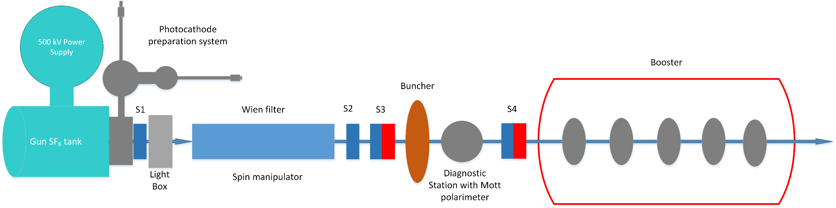
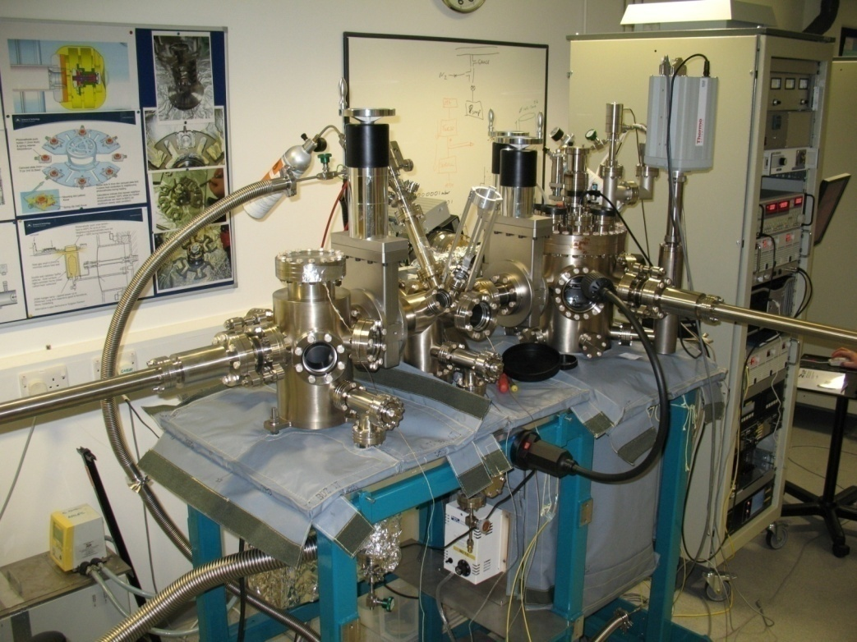
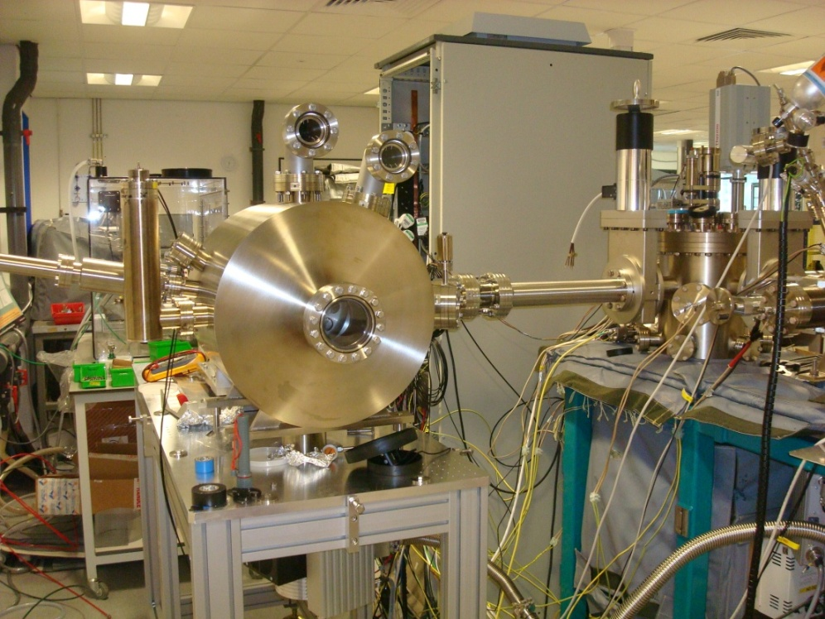
Possible UK contributions to PES (Militsyn – STFC Daresbury):
Polarised Electron Source for PERLE:
Photocathode preparation and characterisation:
Extra High Vacuum GaAs photocathode preparation system
Transverse Energy Spread Spectrometer (TESS)

Slide 16
Second Interaction Region

Slide 17
Interaction Region Design Example 1: HL-LHC (Wolski – Liverpool)
Developed optics for the “squeeze”: the transition from injection (relaxed β*) to collision (minimized β*) optics.
A range of demanding constraints had to be met:
  Maintain matching into the arcs (Achromatic Telescopic Squeeze)
  Respect aperture limitations
  Respect limitations on SC quad strengths, dI/dt…
  Maintain appropriate phase advance for dynamic aperture requirements
Studied effects of fringe fields in IR quads
Studies made an important contribution to HL-LHC TDR.
“Optics transition between injection and collision optics for the HL-LHC upgrade project”, M.Korostelev, A.Wolski, R. De Maria, S. Fartoukh, proceedings of IPAC’13.
“Inner Triplet Quadrupole Fringe Fields in the High Luminosity Large Hadron Collider”, S. Jones, PhD Thesis (University of Liverpool), 2020.
Snapshots of HL-LHC IR optics during the “squeeze”
M. Korostelev et al, proceedings of IPAC’13.

Slide 18
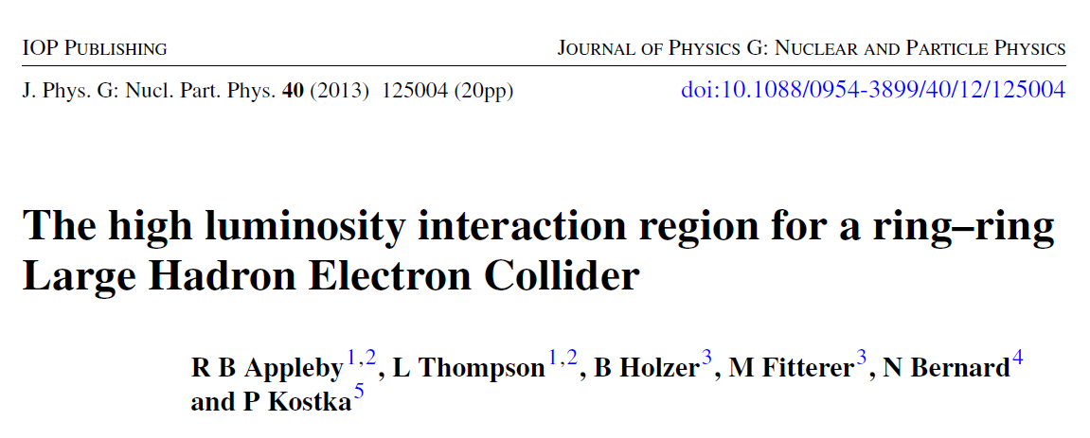
Interaction Region Design Example 2: LHeC
(Wolski – Liverpool, Appleby – Manchester)
ERL-Ring LHeC optics, to be integrated into HL-LHC (Wolski)
  Design needed to meet constraints on:
    magnet parameters (strength and aperture)
    IR geometry (including beam separation)
    beam dynamics (chromaticity…)
    synchrotron radiation loads
“LHeC IR optics design integrated into the HL-LHC lattice”, M.Korostelev, E. Cruz-Alaniz, D. Newton, A.Wolski, O. Bruning, R. Tomas, proceedings of IPAC’13.
“LHeC IR optics design integrated into the HL-LHC lattice”, E. Cruz-Alaniz, M. Korostelev, D. Newton, R. Tomas, proceedings of IPAC’14.
“Modelling the effects of high-luminosity optics in the upgrades of the Large Hadron Collider”, E. Cruz-Alaniz, PhD Thesis (University of Liverpool), 2016.
LHeC Ring-ring IR design (Appleby)

Slide 19
Session: Potential UK EIC Accelerator Contributions
Overview, ERLs, Polarized Source, 2nd IP (Peter Williams – STFC Daresbury)
Crab Cavities and Low-Level RF Control (Graeme Burt – Lancaster U)
Superconducting Linac RF Technology (Peter McIntosh – STFC Daresbury)
Peter Williams, Daresbury Laboratory & Cockcroft Institute
2nd UK Electron-Ion Collider Workshop
28th July 2020

