Slide 1


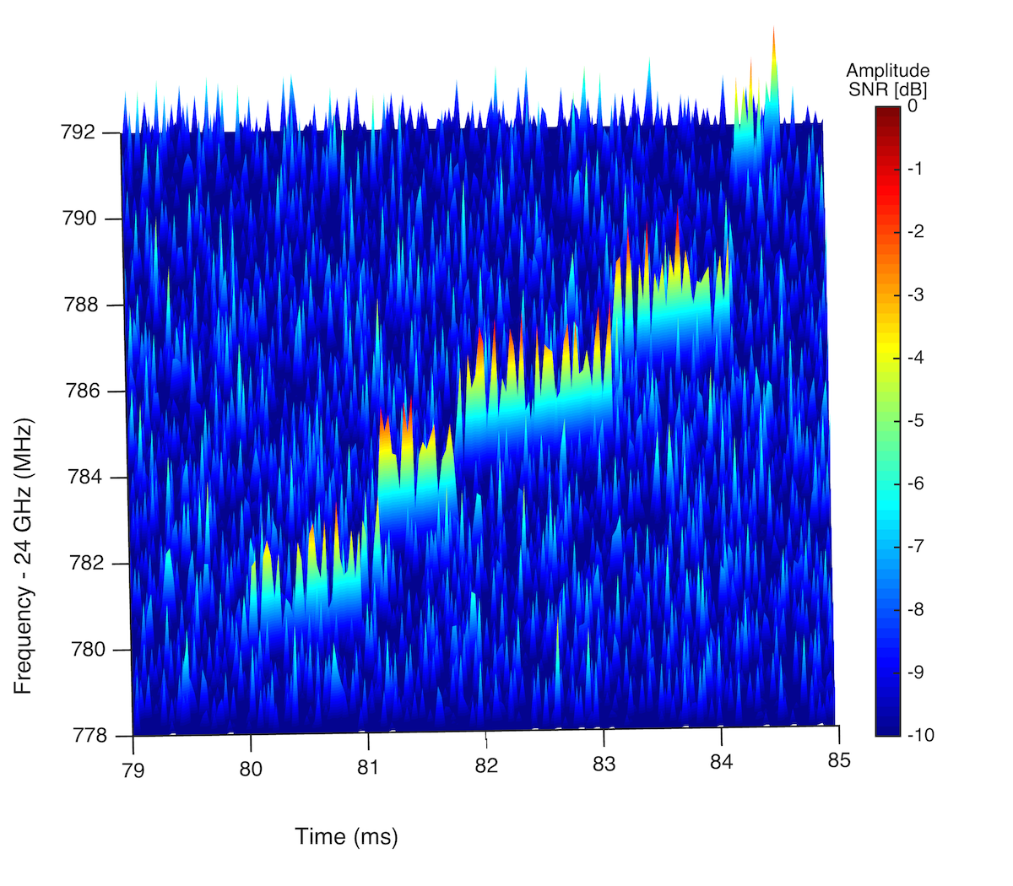
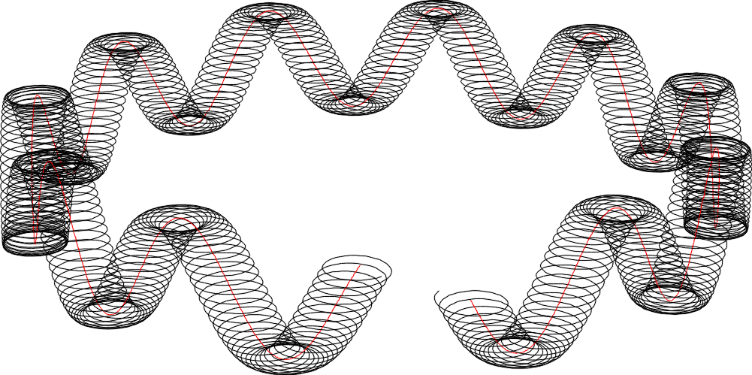
Measuring the Neutrino Mass with the Project 8 Experiment
Grad-B (ωg)
Cyclotron (ωc)
Axial (ωa)
Frequency -24GHz (MHz)
B-field
Time (ms)
Luiz de Viveiros - Penn State
Project 8 Collaboration

Slide 2
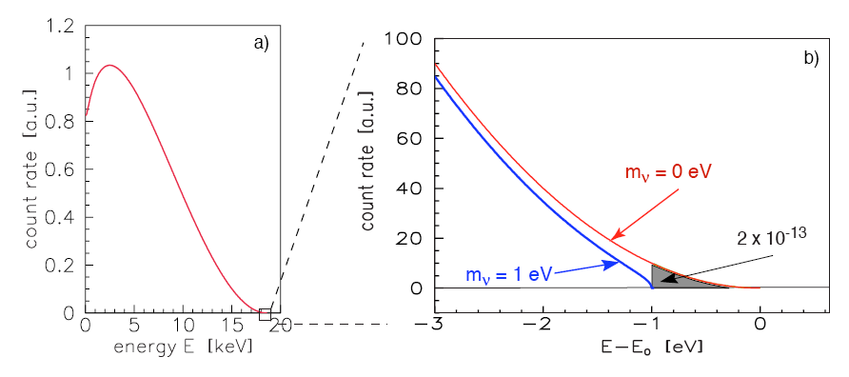
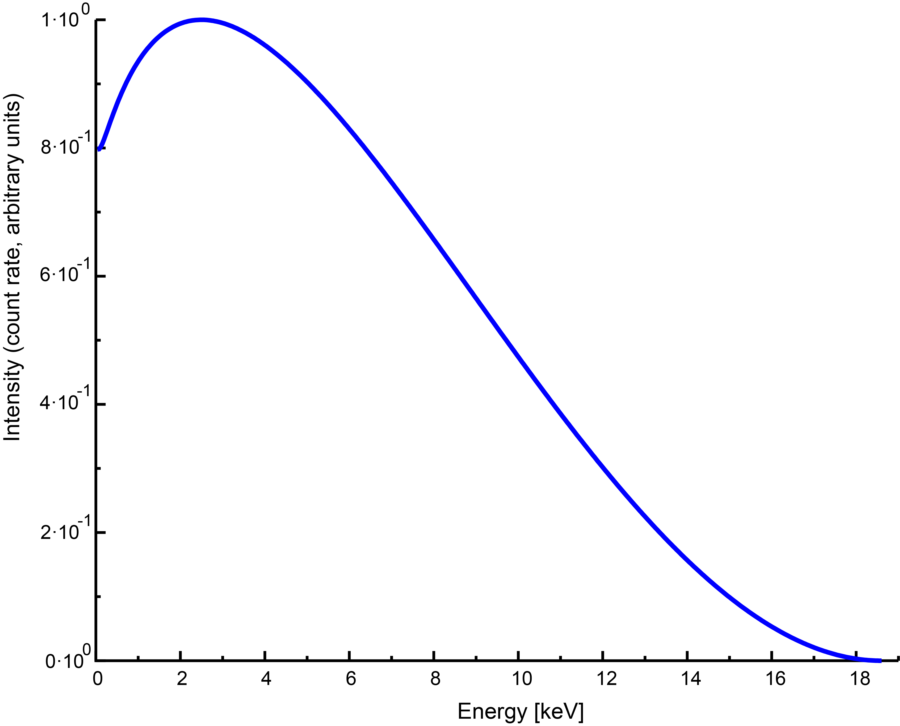


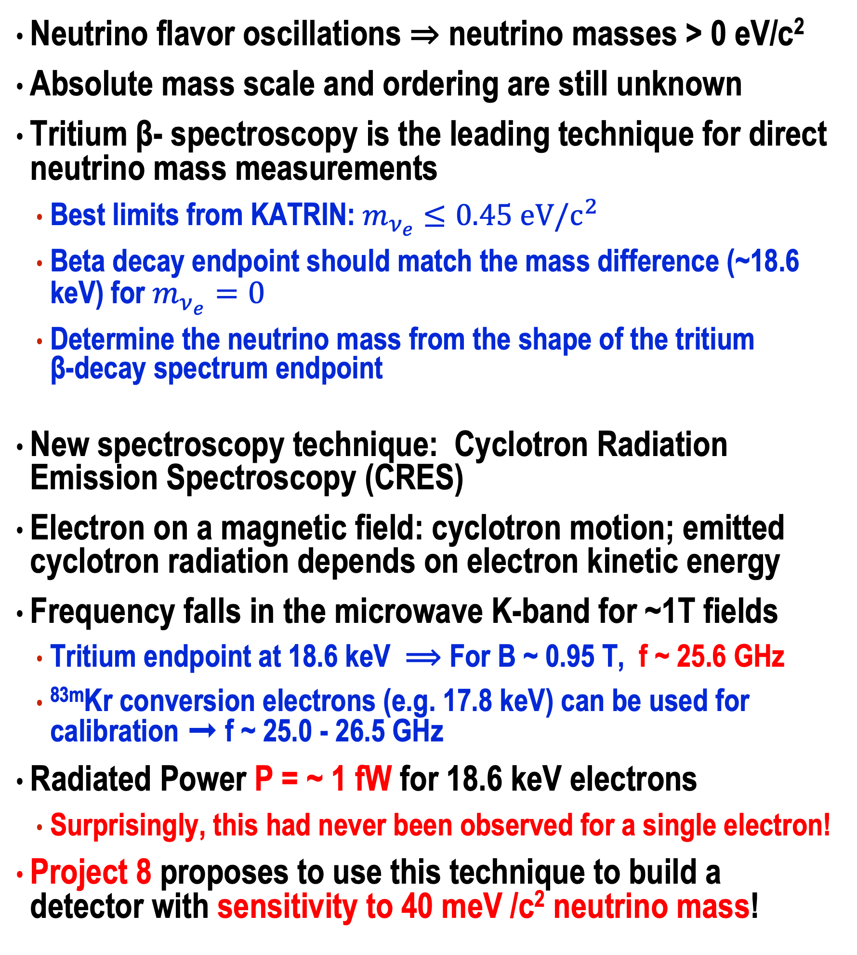
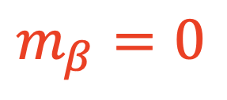
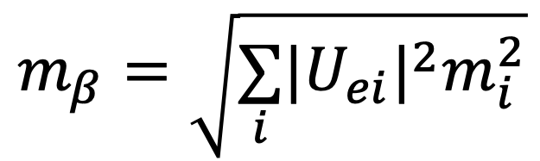

Project 8: Measuring the Neutrino Mass with CRES
Neutrino flavor oscillations ⇒ neutrino masses > 0 eV/c²
Absolute mass scale and ordering are still unknown
Tritium β- spectroscopy is the leading technique for direct neutrino mass measurements
Best limits from KATRIN: $m_{ν_{e}}≤0.45 eV/c^{2}$
Beta decay endpoint should match the mass difference (~18.6 keV) for $m_{ν_{e}}=0$
Determine the neutrino mass from the shape of the tritium β-decay spectrum endpoint
New spectroscopy technique: Cyclotron Radiation Emission Spectroscopy (CRES)
Electron on a magnetic field: cyclotron motion; emitted cyclotron radiation depends on electron kinetic energy
Frequency falls in the microwave K-band for ~1T fields
Tritium endpoint at 18.6 keV ⟹ For B ~ 0.95 T, f ~ 25.6 GHz
^{83m}Kr conversion electrons (e.g. 17.8 keV) can be used for calibration ➞ f ~ 25.0 - 26.5 GHz
Radiated Power P = ~ 1 fW for 18.6 keV electrons
Surprisingly, this had never been observed for a single electron!
Project 8 proposes to use this technique to build a detector with sensitivity to 40 meV /c² neutrino mass!
$$m_{β}=\sqrt{\underset{i}{∑}|U_{ei}|^{2}m_{i}^{2}}$$
decay rate [arb. units]
anti-neutrino
$$m_{β}=0$$
n
n
𝜈e
p
e⁻
only 2×10⁻¹³ of decays in the last 1eV interval
³H
β-decay
electron
n
p
p
$$m_{β}=1eV$$
³He
electron energy [keV]
Superconducting Magnet
$$f_{γ}=\frac{eB}{2π\left(m_{e}+\frac{K}{c^{2}}\right)}$$
n
anti-neutrino
n
p
𝜈e
e⁻
³H
β-decay
p
electron
n
p
B-field
³He
Superconducting Magnet

Slide 3
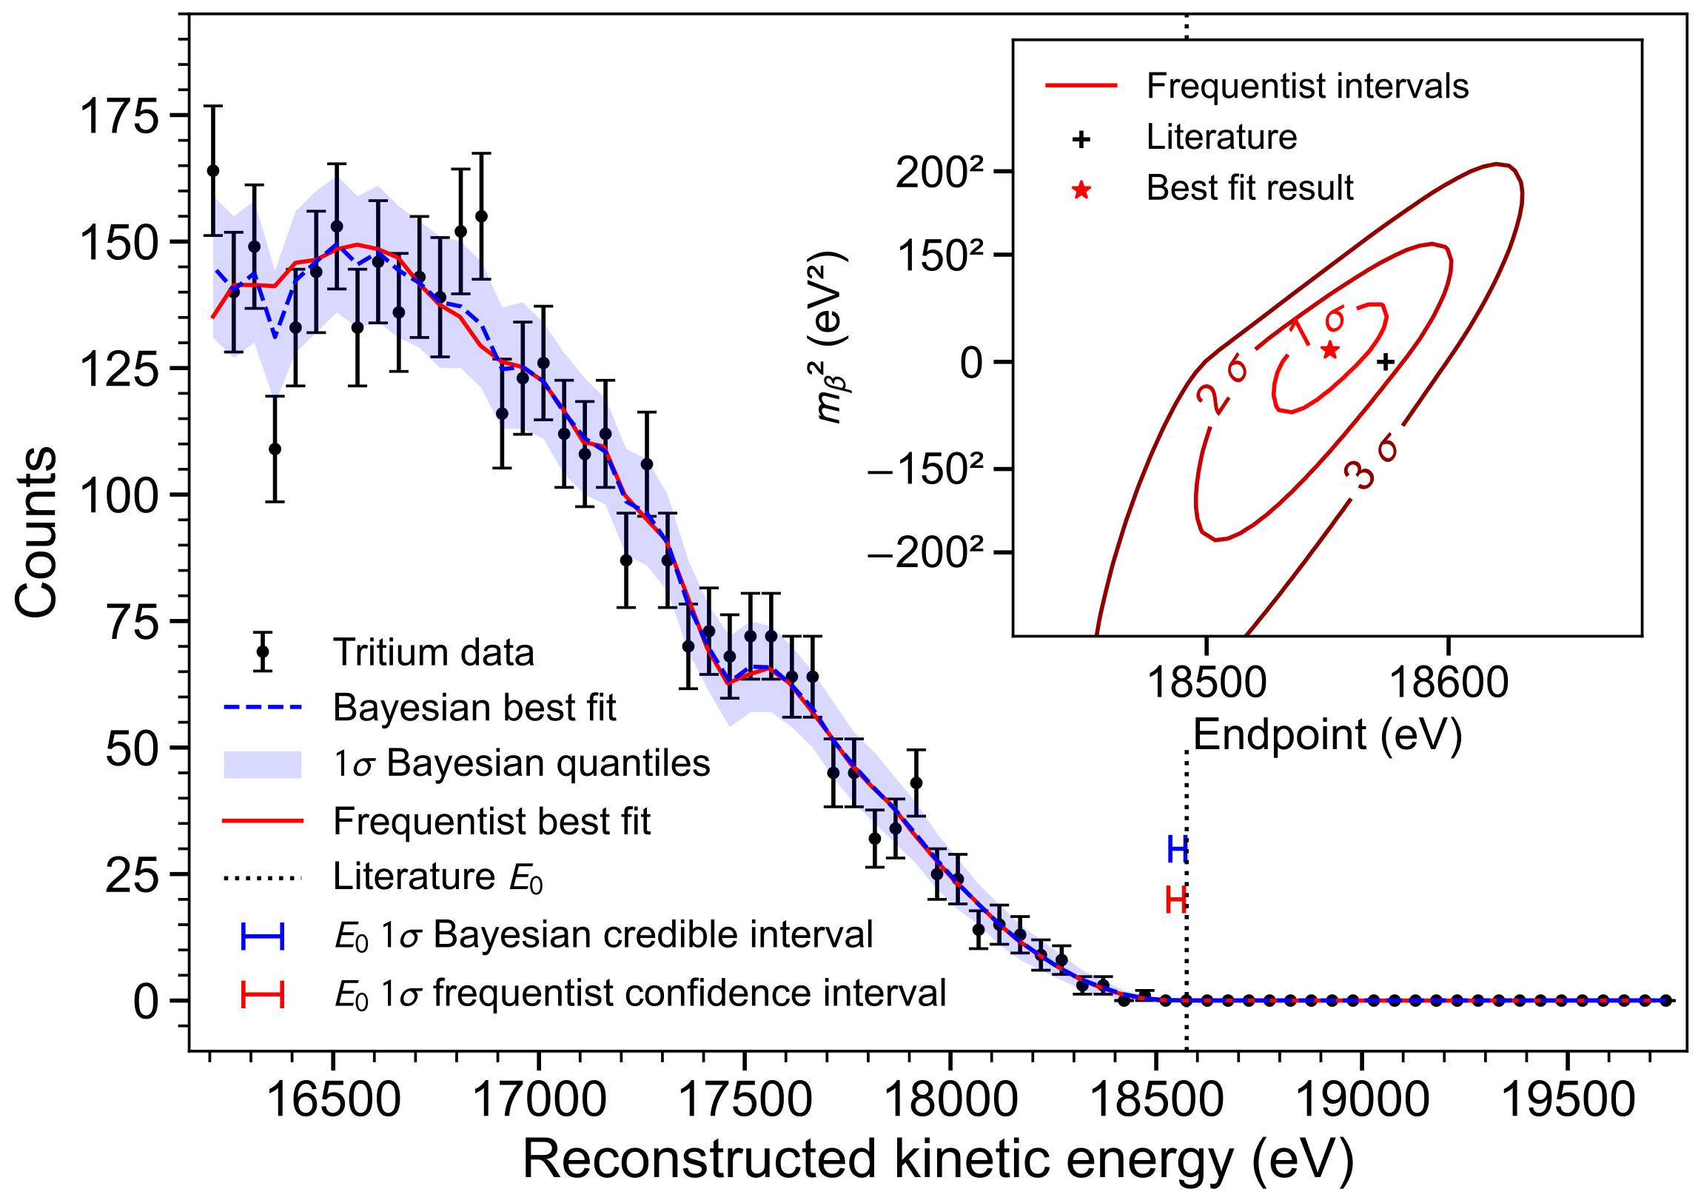
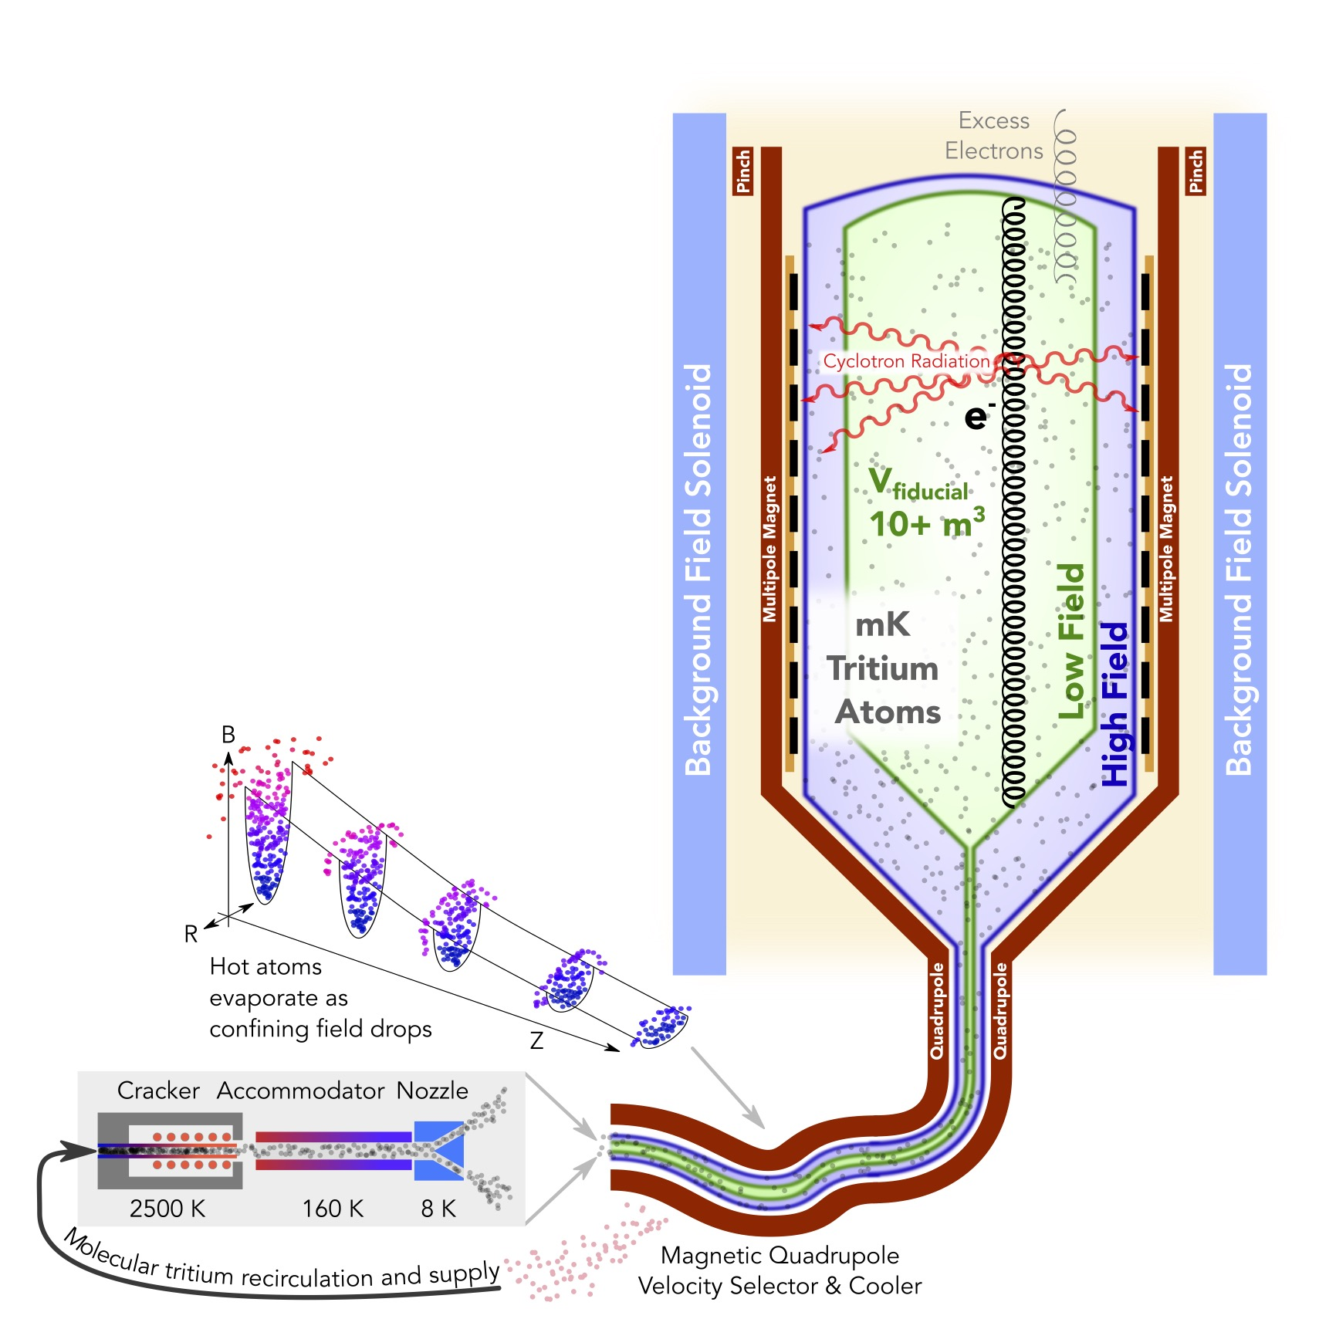

The Project 8 Scientific Programme: A Phased Approach
Phase I:
Demonstrate CRES technique on ^{83m}Kr mono-energetic electrons.
Phase II:
Measure Tritium spectrum endpoint. Study systematics and backgrounds.
Phase III:
(a) “Large Volume” CRES
(b) Atomic tritium production and trapping at high densities
n
anti-neutrino
$$e^{−}$$
n
p
𝜈e
e⁻
³H
β-decay
n
p
electron
³He
p
Phase IV:
Large atomic tritium experiment. Inverted mass ordering reach (40 meV)

Slide 4
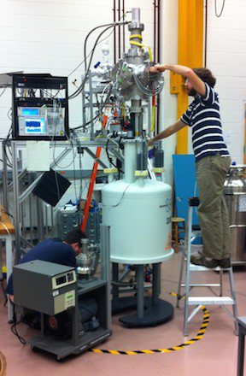




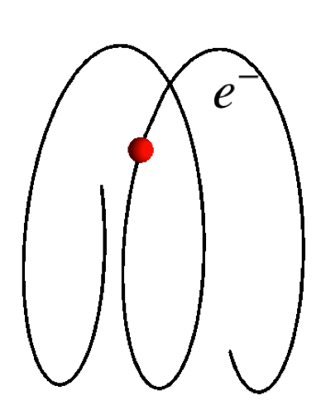
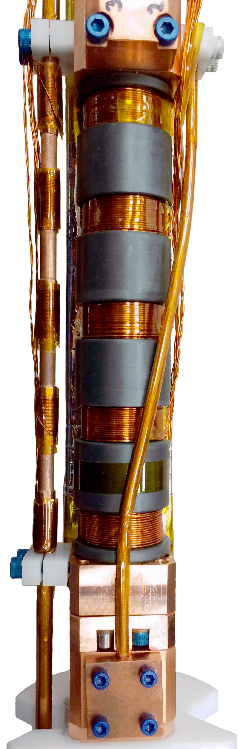


Phases I and II - The Detector
Assembled at the University of Washington in Seattle, WA
Phase I: ^{83m}Kr only (2016); Phase II: ^{83m}Kr and T2 (2024)
Waveguide to amplifiers
10 mm
Receiver
40 K cold head
2x cryogenic low-noise
microwave amplifiers
(54 dB)
pre
amp
signal
windows
130 mm
Bmin
^{83m}Kr gas system
waveguide
trap
coils
repurposed NMR
superconducting
magnet ~ 1 T,
52 mm warm bore
Grad-B (ωg)
Cyclotron (ωc)
Axial (ωa)
Insert:
Gas Cell, Magnetic Trap, and Waveguide
(inside)
B-field
Phase I setup
Phase II
Insert
B-field

Slide 5
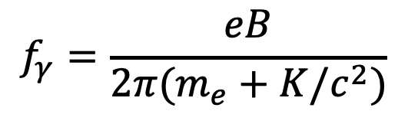
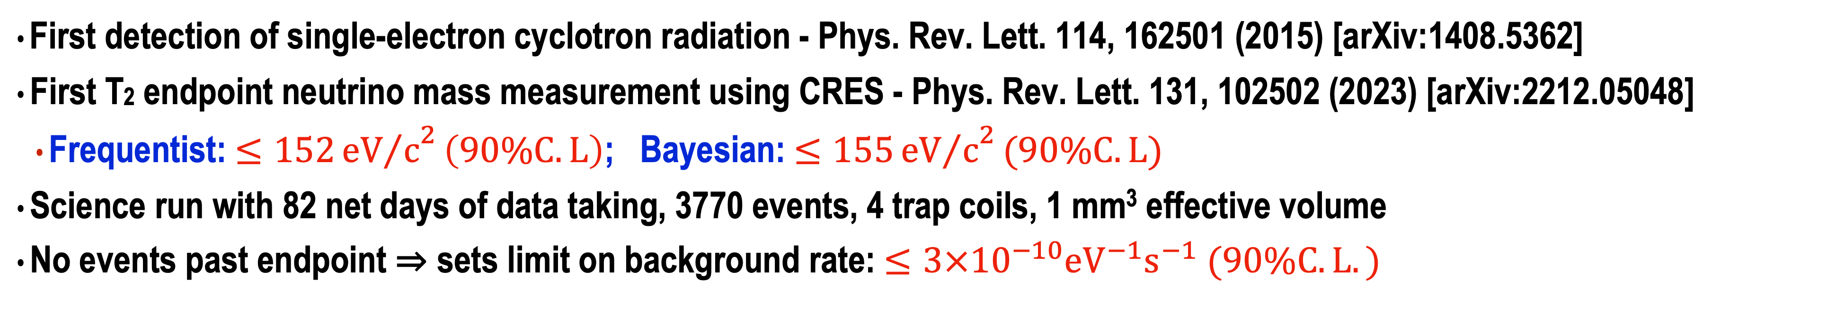
Measuring the Cyclotron Radiation and the Tritium Spectrum
First detection of single-electron cyclotron radiation - Phys. Rev. Lett. 114, 162501 (2015) [arXiv:1408.5362]
First T2 endpoint neutrino mass measurement using CRES - Phys. Rev. Lett. 131, 102502 (2023) [arXiv:2212.05048]
Frequentist: $≤152{{eV}/c}^{2}\left(90\%C.L\right)$; Bayesian: $≤155{{eV}/c}^{2}(90\%C.L)$
Science run with 82 net days of data taking, 3770 events, 4 trap coils, 1 mm³ effective volume
No events past endpoint ⇒ sets limit on background rate: $≤3×{10}^{−10}{eV}^{−1}s^{−1} (90\%C.L.)$
jumps: electrons scatters of gas molecule, losing energy and changing pitch angle
linearly rising frequency: radiative energy loss, slope ~ 1fW
Frequency of first track gives initial electron kinetic energy
$$f_{γ}=\frac{eB}{2π(m_{e}+K/c^{2})}$$
scale: 1 MHz ~ 20 eV
time (ms)

Slide 6
The Project 8 Scientific Programme: A Phased Approach
Phase I:
Demonstrate CRES technique on ^{83m}Kr mono-energetic electrons.
Status: Complete! Technique demonstrated.
Phase II:
Measure Tritium spectrum endpoint. Study systematics and backgrounds.
Status: Complete! First Tritium spectrum!
Phase III:
(a) “Large Volume” CRES
(b) Atomic tritium production and trapping at high densities
n
anti-neutrino
$$e^{−}$$
n
p
𝜈e
e⁻
³H
β-decay
n
p
electron
³He
p
Phase IV:
Large atomic tritium experiment. Inverted mass ordering reach (40 meV)

Slide 7
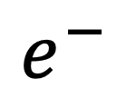
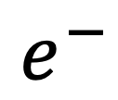
Large Volume CRES
We need a new CRES technology to reach cubic meter volumes!
Waveguide-centric design is no longer suitable
Project 8 has considered and investigated an antenna array design significantly in the last few years (arXiv:2504.15387). A number of challenges identified during R&D have focused development on resonant cavities
Large volume efficiency, high SNR, and small channel count
Antenna Arrays
Cavities
$$e^{−}$$
$$e^{−}$$

Slide 8
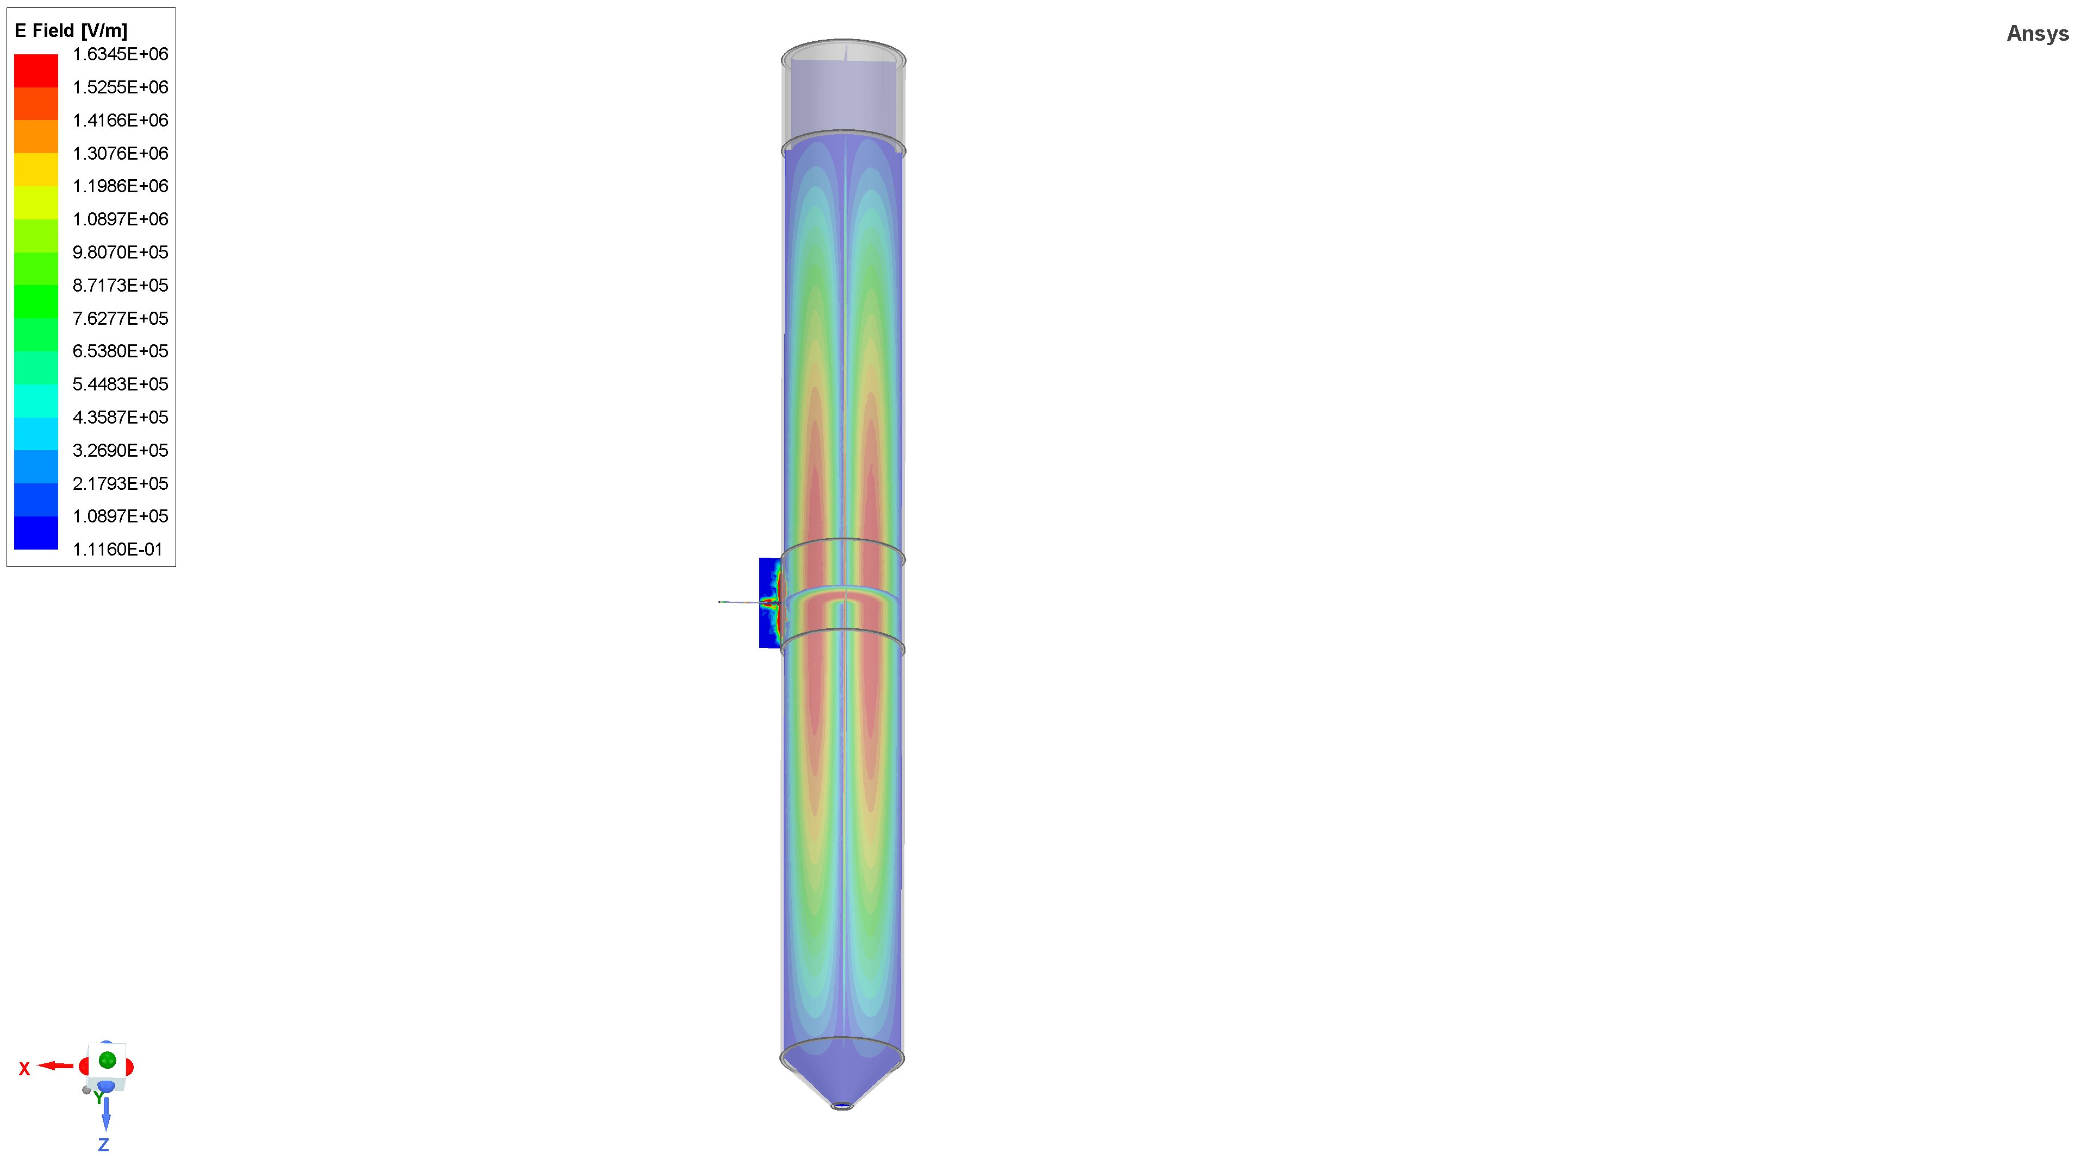
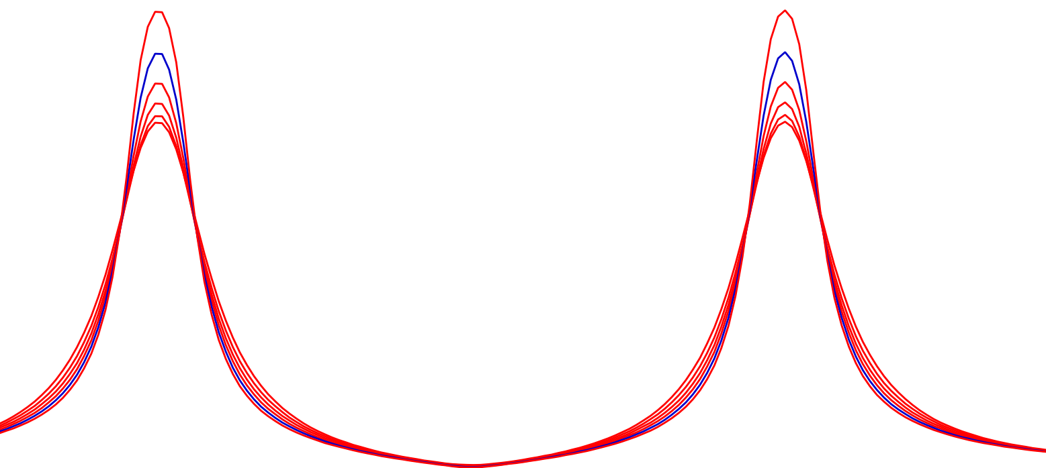
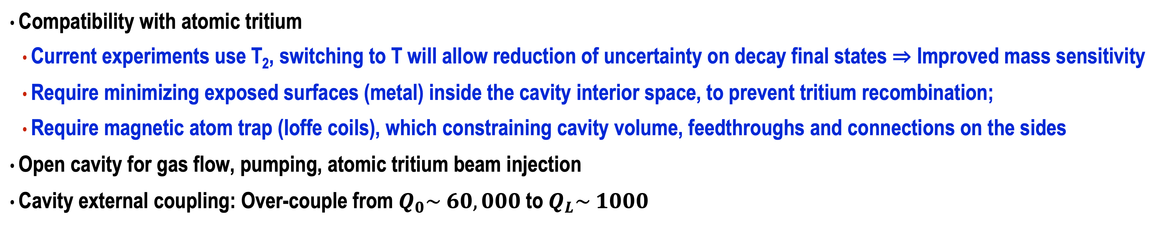

Desirable cavity characteristics
Compatibility with atomic tritium
Current experiments use T₂, switching to T will allow reduction of uncertainty on decay final states ⇒ Improved mass sensitivity
Require minimizing exposed surfaces (metal) inside the cavity interior space, to prevent tritium recombination;
Require magnetic atom trap (Ioffe coils), which constraining cavity volume, feedthroughs and connections on the sides
Open cavity for gas flow, pumping, atomic tritium beam injection
Cavity external coupling: Over-couple from $Q_{0}\sim 60,000$to $Q_{L}\sim 1000$
Pinches & solenoid
Mid-section readout
Loop antennas
$$e^{−}$$
TE011 electric field
Cavity Termination
Atomic trap coils
Richard Mueller

Slide 9
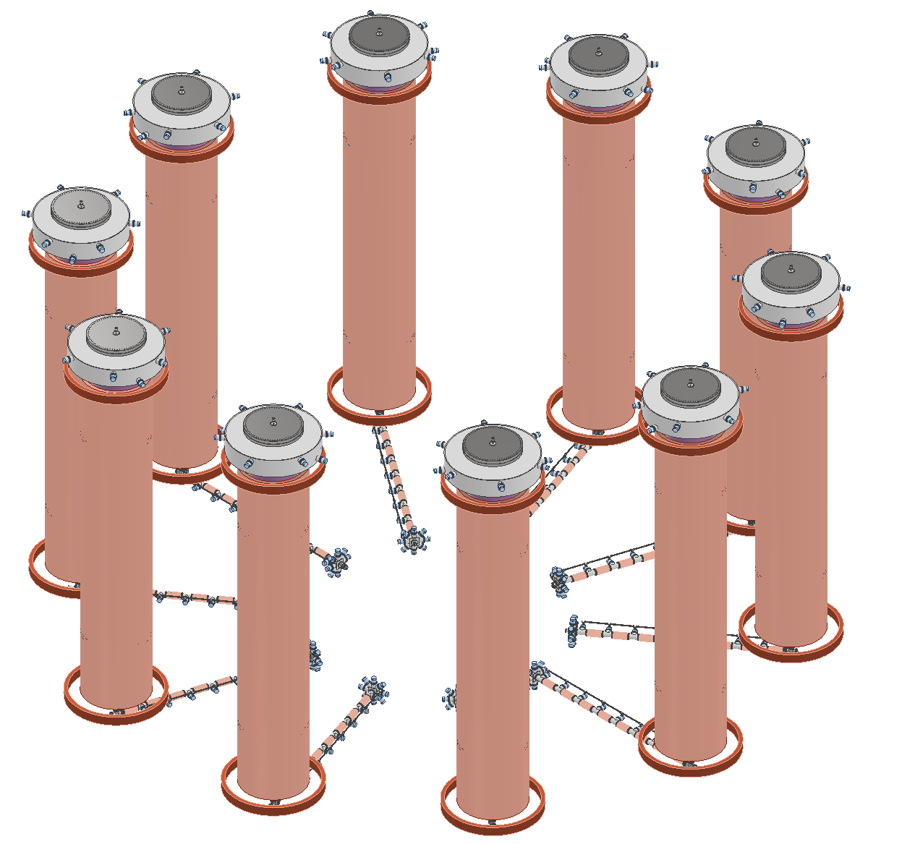
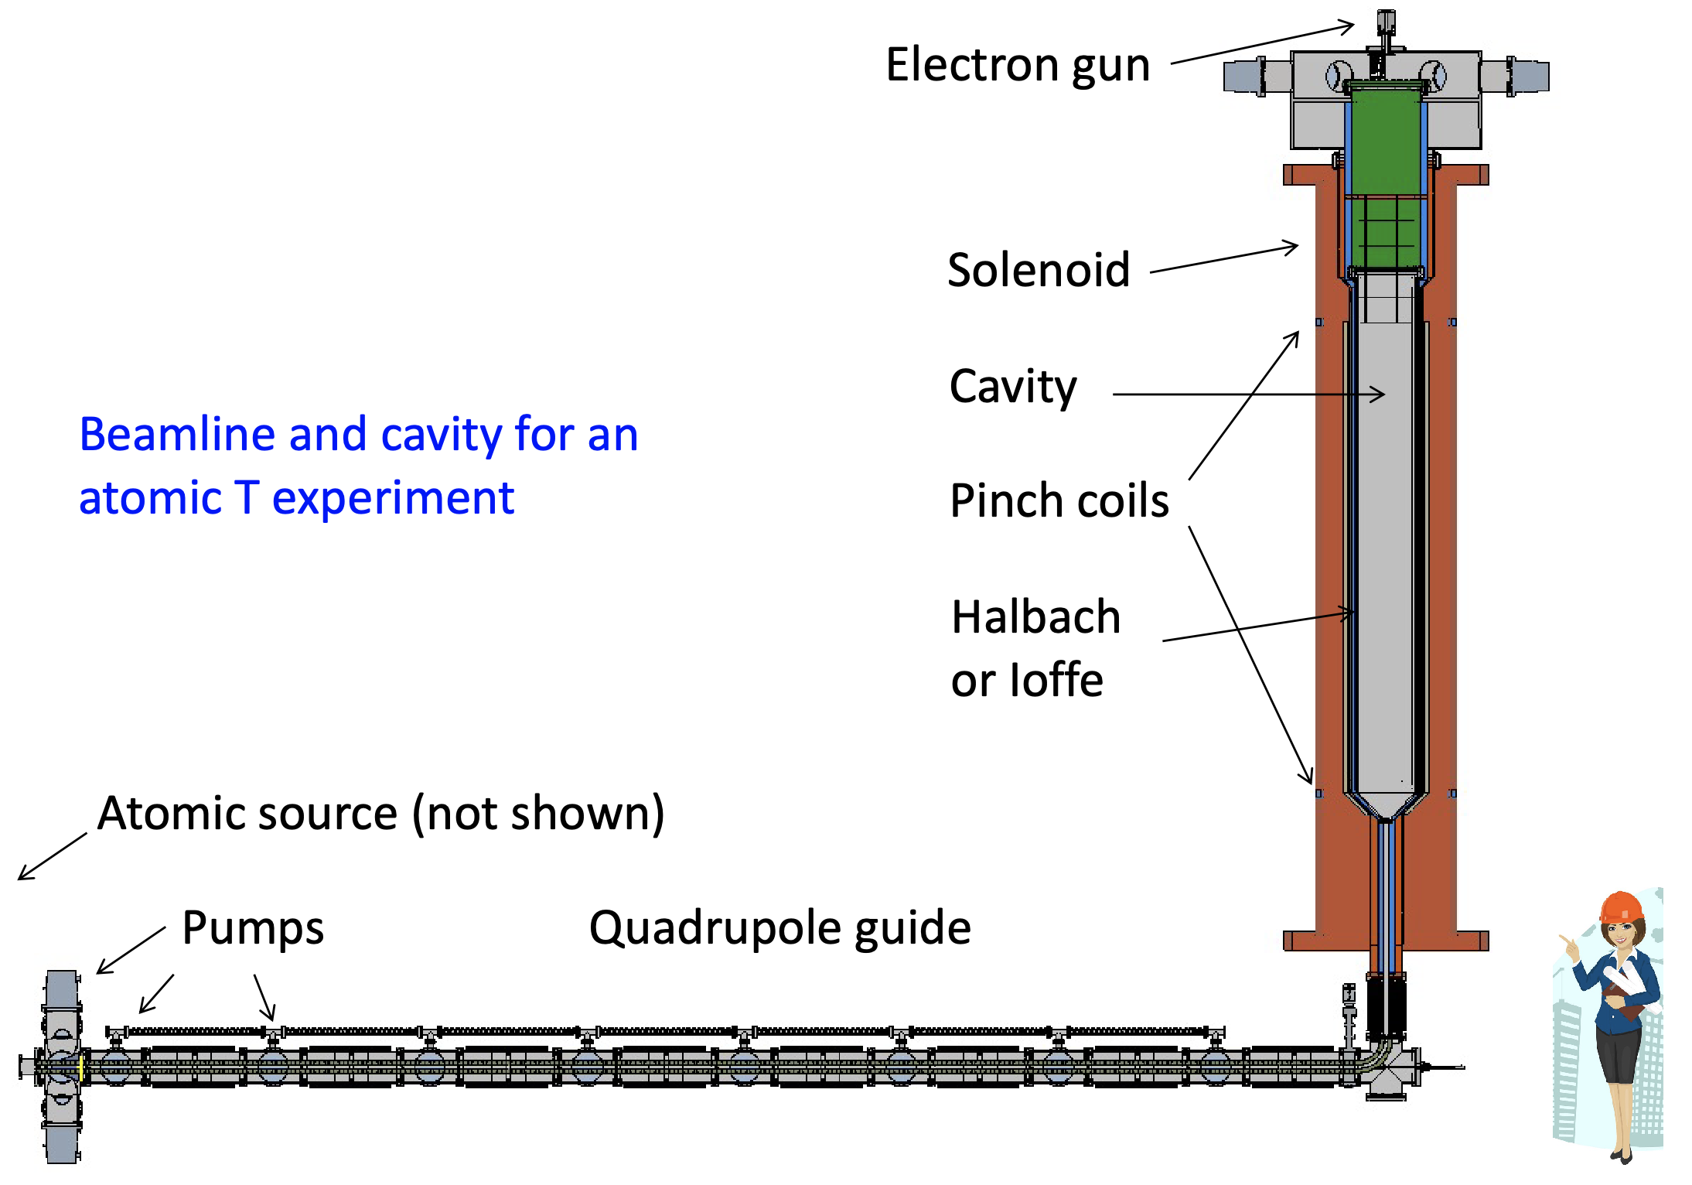
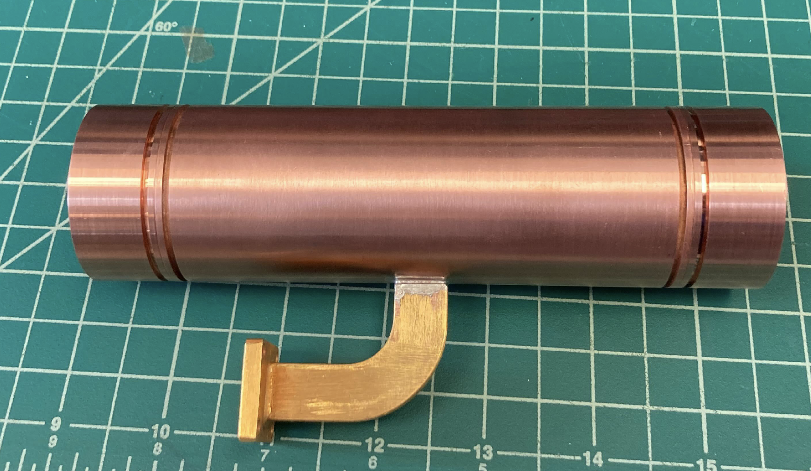
Cavity Development Program
Scaling up cavity design to 10-100 m³
Multiple detectors planned to demonstrate key technologies
CCA: Cavity CRES Apparatus (L ~ 14 cm, 26 GHz)
LFA: Low Frequency Apparatus (L ~ 5 m, 560 MHz)
~20 m
5 m
cavity length: 14 cm
Credit: J. Stachurska
Credit: M. Huehn, R. G. H. Robertson
Cavity CRES Apparatus (CCA)
Low Frequency Apparatus (LFA)
150 MHz Pilot
Phase IV
26 GHz
560 MHz
~150 MHz

Slide 10
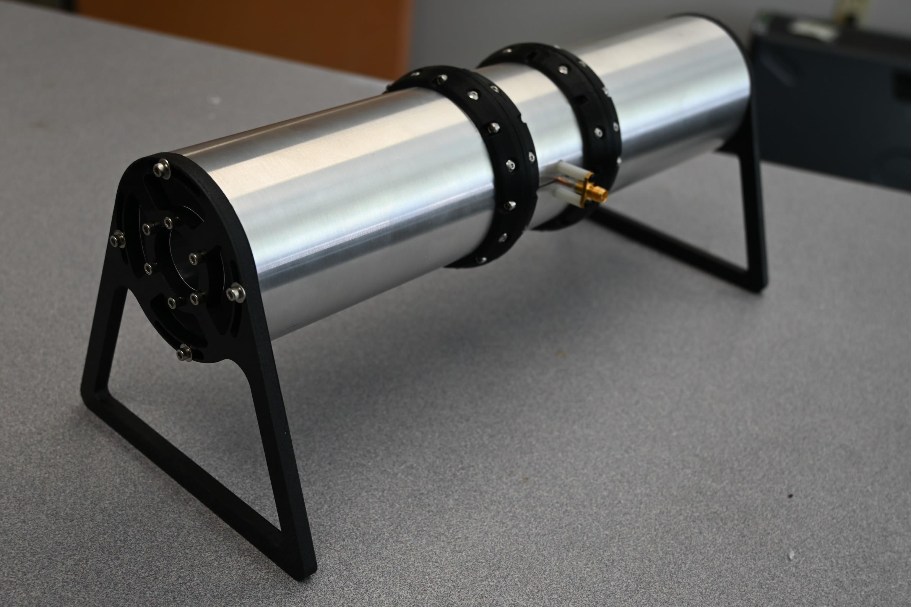
Cavity Development Program
Scaling up cavity design to 10-100 m³
Multiple detectors planned to demonstrate key technologies
CCA: Cavity CRES Apparatus (L ~ 14 cm, 26 GHz)
LFA: Low Frequency Apparatus (L ~ 5 m, 560 MHz)
6 GHz Prototype at Penn State: Cavity design and readout tests
~20 m
cavity length: 21.5 cm
radius:
3.2 cm
6 GHz Open Cavity
@ Penn State
5 m
cavity length: 14 cm
6 GHz Cavity
Credit: J. Stachurska
Credit: M. Huehn, R. G. H. Robertson
Cavity CRES Apparatus (CCA)
Low Frequency Apparatus (LFA)
150 MHz Pilot
Phase IV
26 GHz
6 GHz
560 MHz
~150 MHz

Slide 11
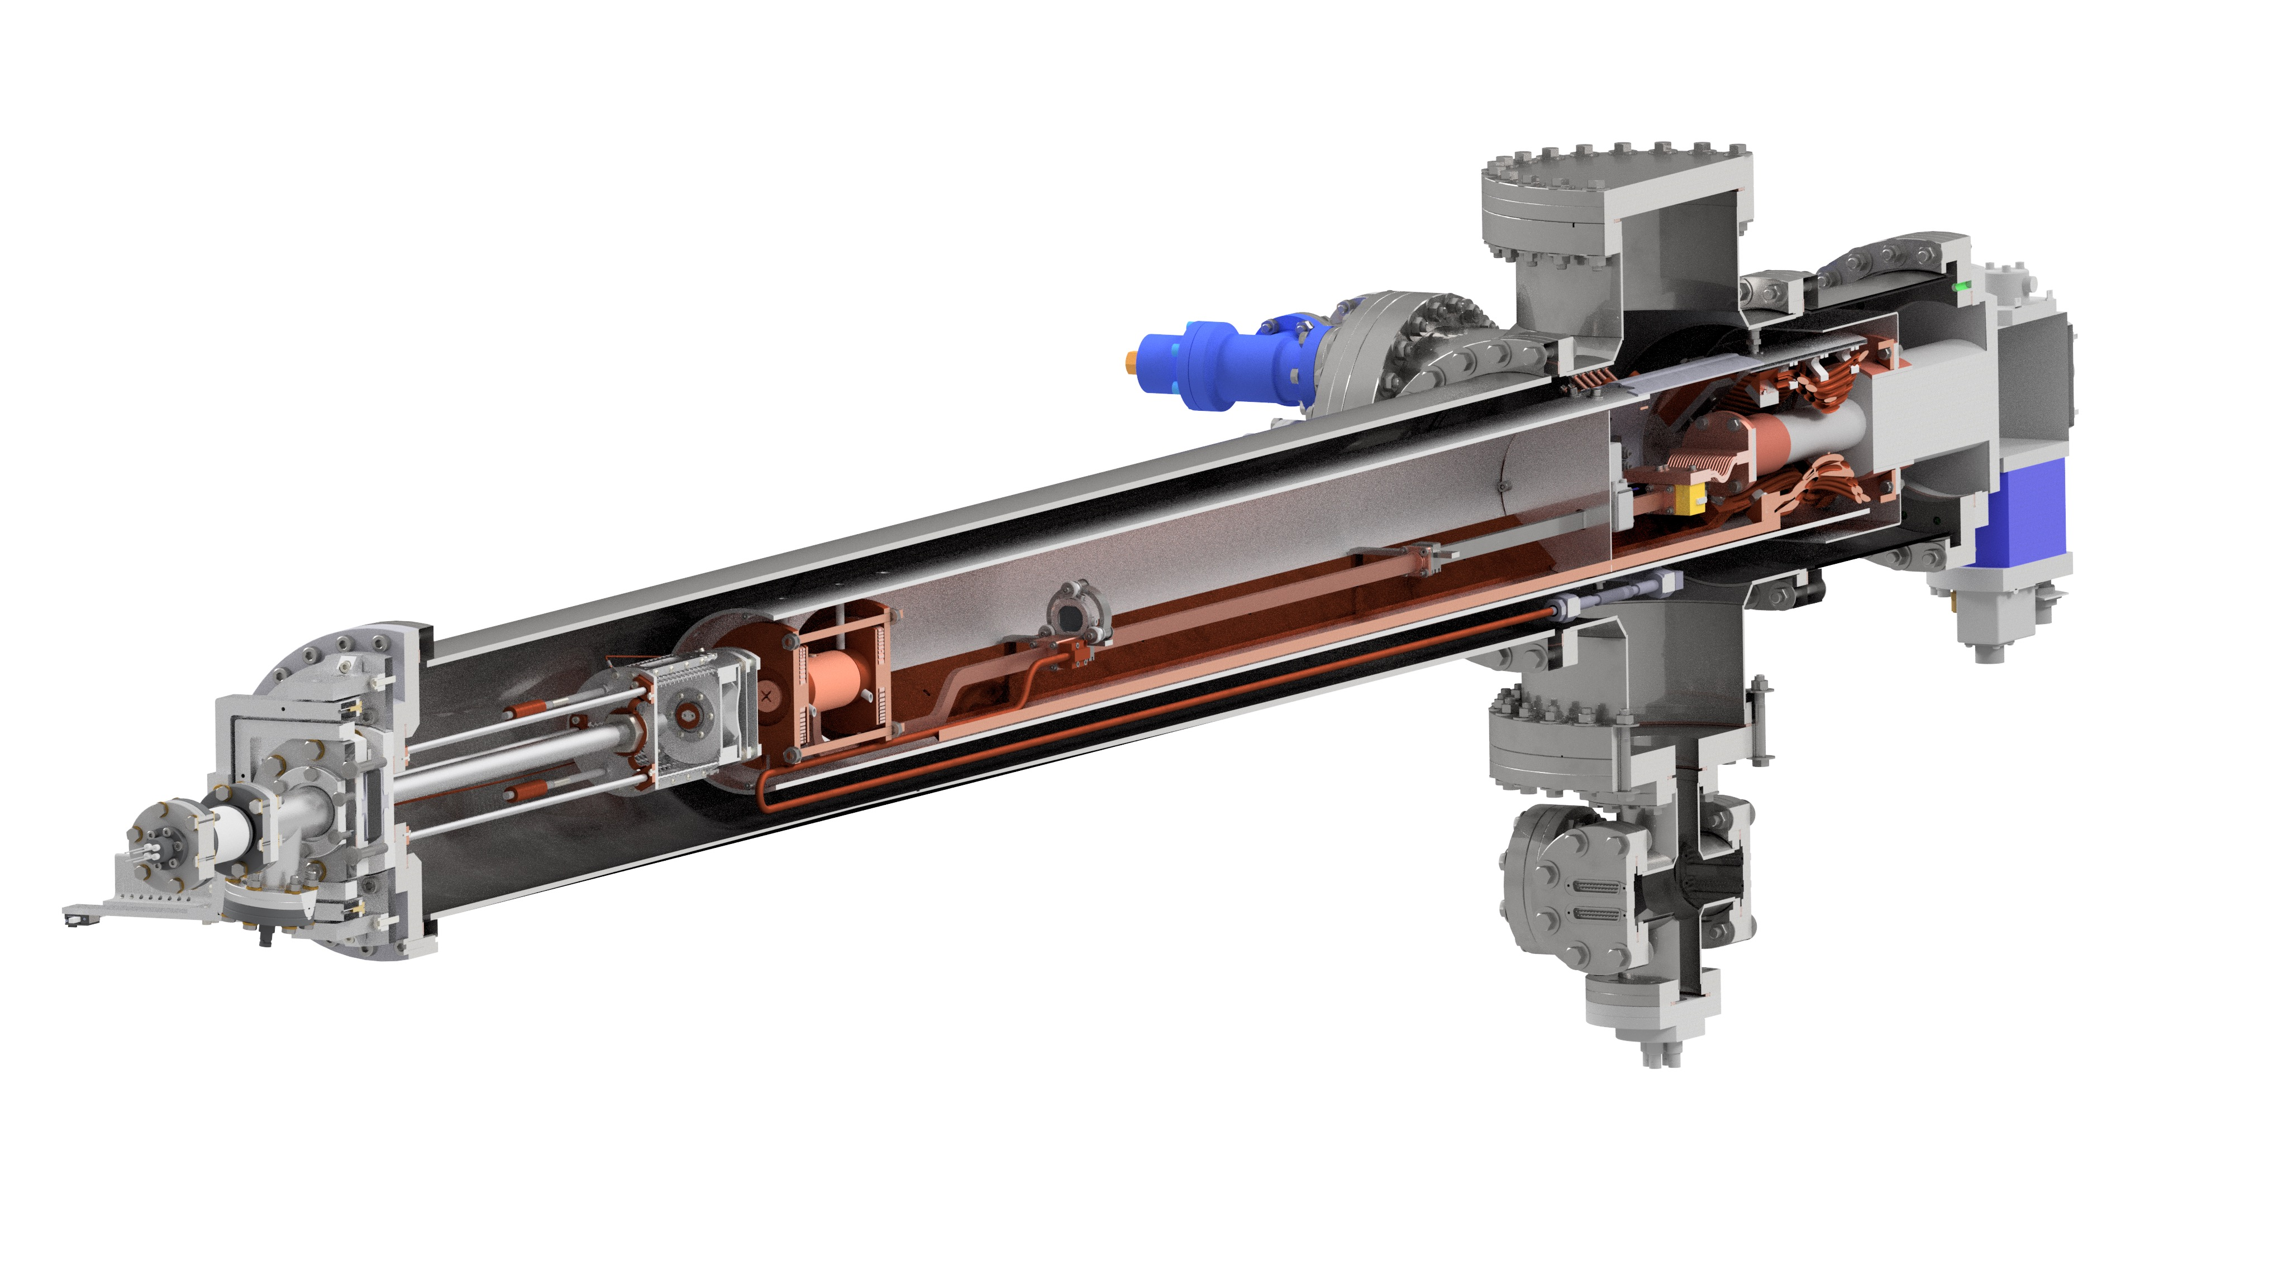
Cavity CRES Apparatus (CCA):
Demonstrate small scale cavity at high frequency (26 GHz) with large SNR
L = 14 cm, R = 0.7 cm, V ~ 20 cm³
Magnetic Field of 1 T
Electron gun source
R&D goal: improve CRES precision
Goal: <0.3 eV FWHM resolution
Built at the University of Washington in Seattle, WA
trapping coils
electron gun
RF waveguide carrying cyclotron radiation
amplifiers
cavity
CCA

Slide 12
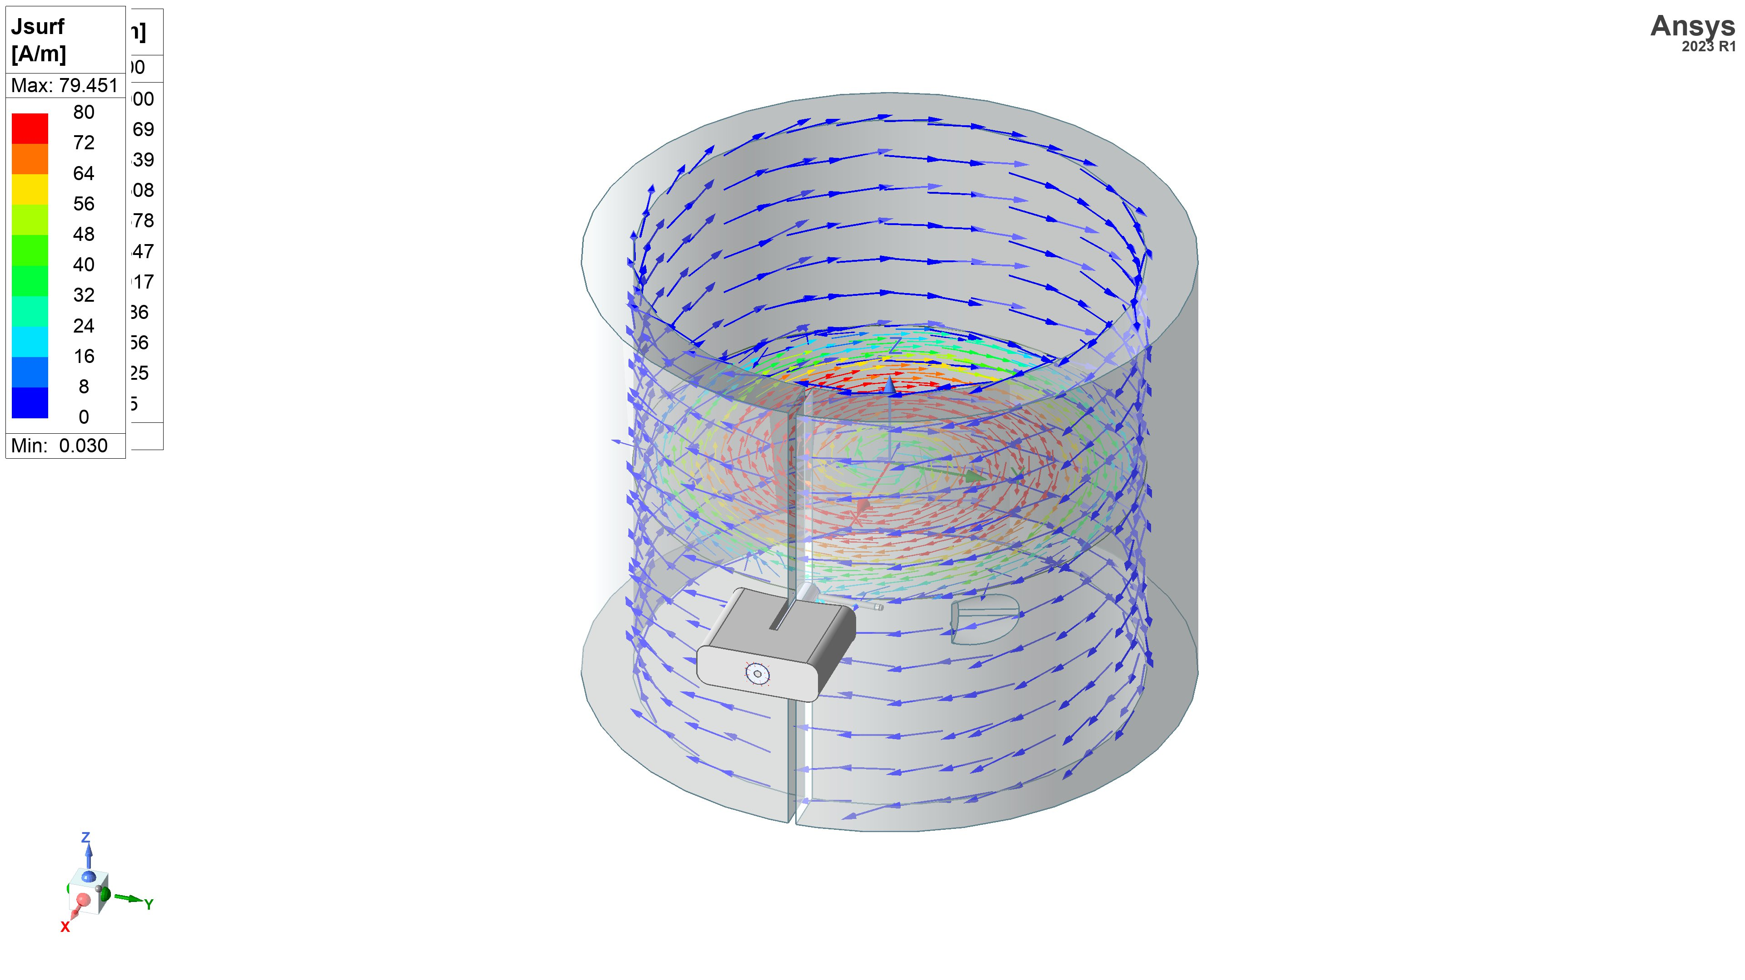
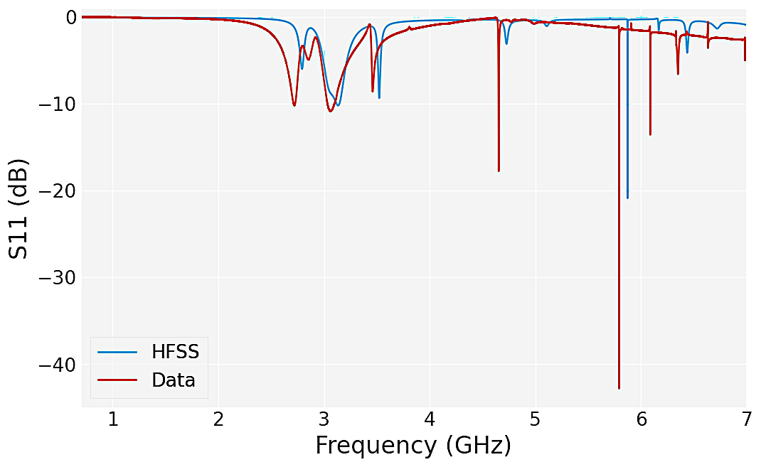

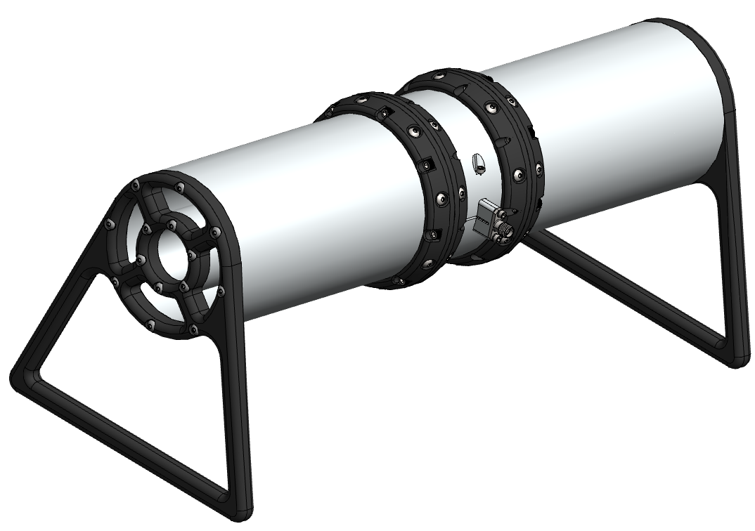
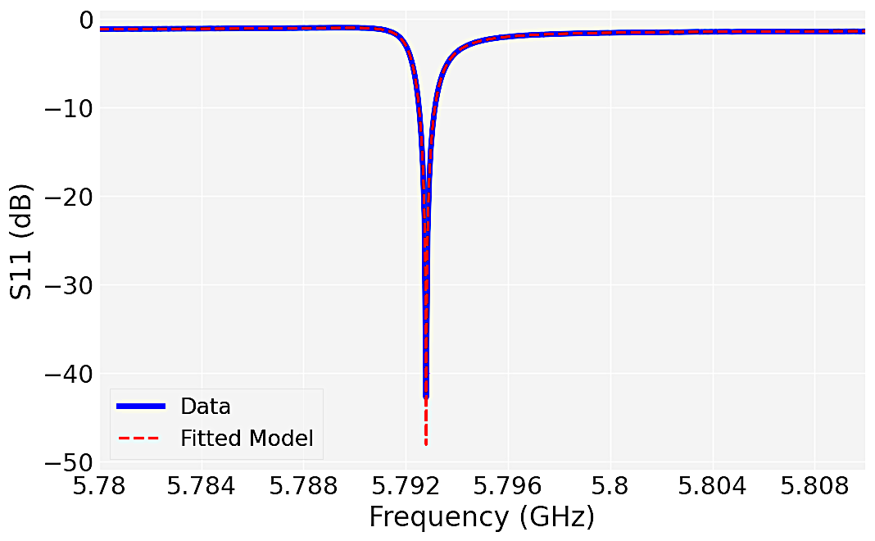
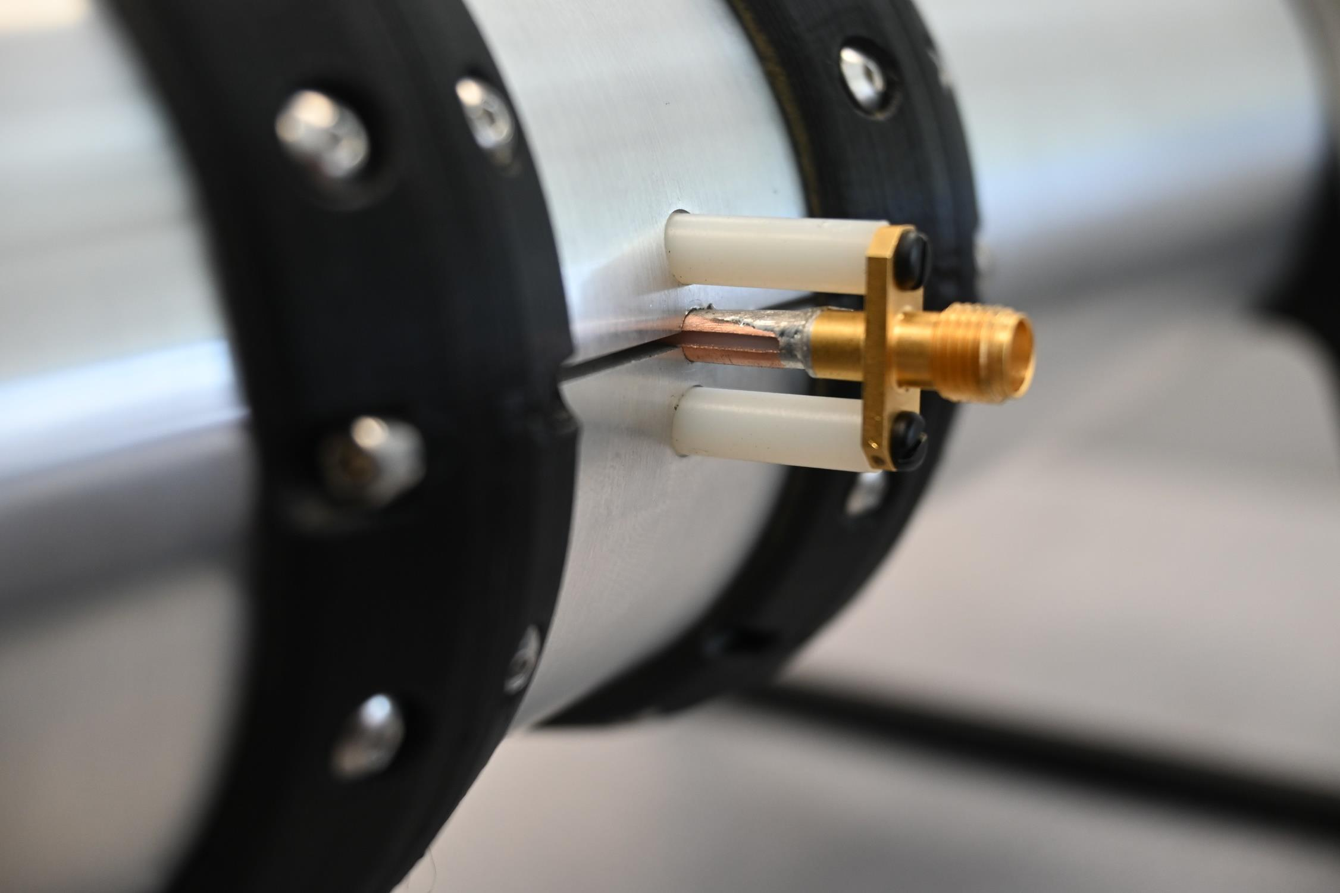
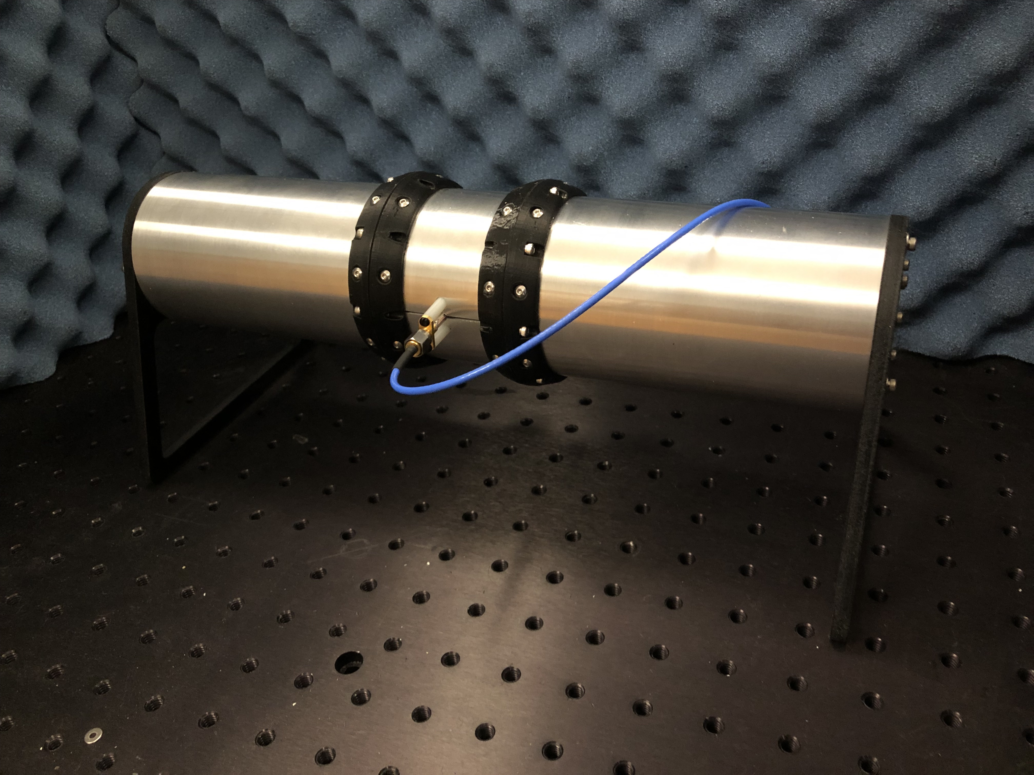

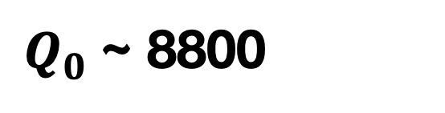
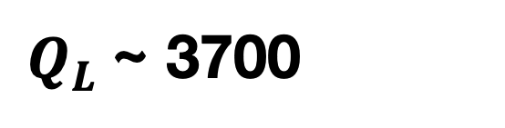
Scaling up Cavity Size
Small 6 GHz Cavity Prototype tests high Q open cavity design, use of grooves for mode filtering, new readout techniques
Room Temperature, open to air, in small anechoic chamber
S11 sweeps identify and measure resonant modes
Top: Data vs Simulation | Bottom: Fitted S11 gives mode Q
Credit: B. DiLella
TE011
Cut-ring readout with split barrel connector
cavity length: 21.5 cm
cavity radius: 3.2 cm
terminator length: 5.2 cm
Interior is grooved to limit inductive coupling
TE011
$Q_{L}$~ 3700
$Q_{0}$~ 8800
Cavity built by ARL

Slide 13
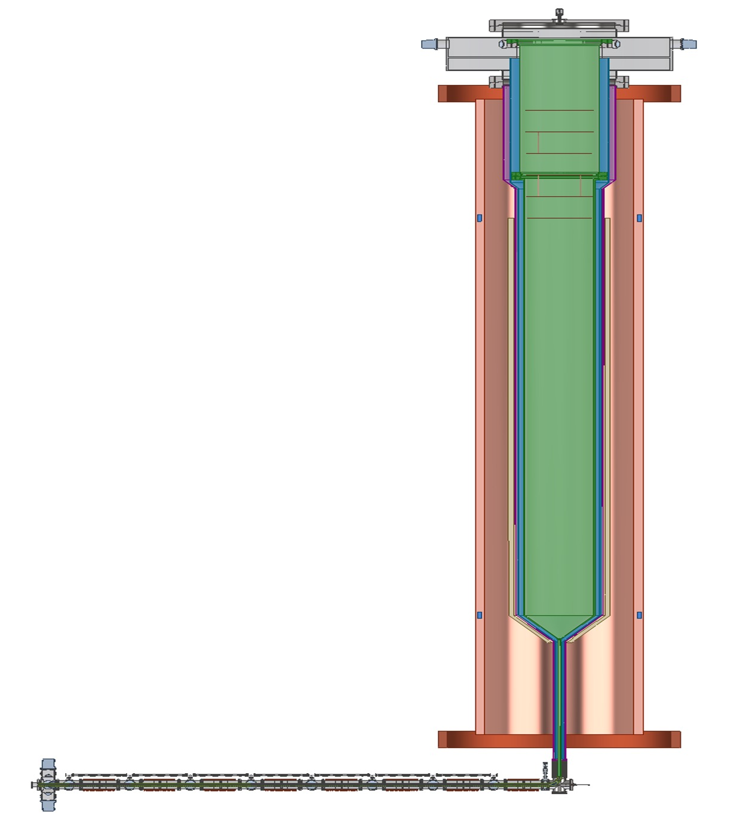

Low-Frequency Apparatus (LFA)
First test of CRES in a large volume at lower frequency => Prove compatibility of CRES with large volume atomic trap (Ioffe coils)
highly stable, homogeneous magnetic fields at lower field
Frequency of ~560 MHz
L ~ 5 m, V ~ 1.5 m³
Magnetic Field of ~0.020 T
Collected power is O(1 aW = 10⁻¹⁸ W)
Sources: ^{83m}Kr and electron gun; upgrade to T for neutrino mass measurement
Sensitivity aim: $m_{β} \sim 0.3−0.7$eV (90 % CL) (one-year with atomic source)
Blueprint for Phase IV
TE011
E-fields
inside
cavity
Cavity
Pinch coil
Solenoid
5 m
T atom source
(not shown)
Injection
line
Magnetic guide
Credit: M. Huehn, R. G. H. Robertson

Slide 14
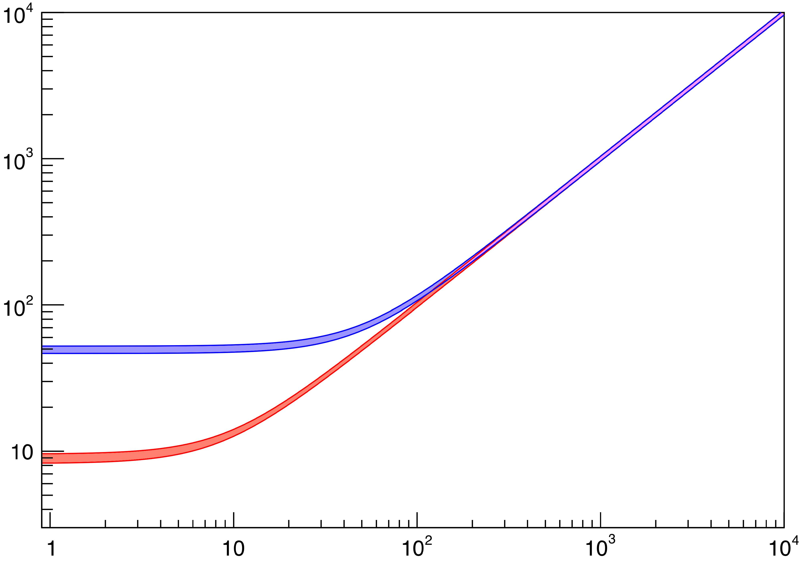
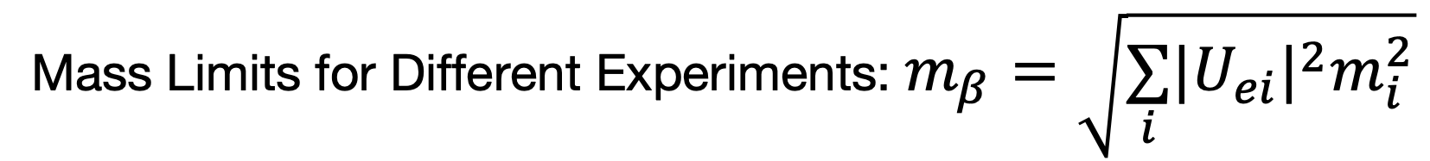
Phase IV
Atomic tritium experiment with large (100s m³) instrumented volume ⇒ Target Mass Sensitivity: mβ ~ 40 meV
Resolve the inverted ordering case (mβ ≳ 50 meV)
Collaboration is working to provide predictions for dependence of sensitivity against key systematics.
Energy resolution: σE ~ 90 ± 2 meV
Mass Limits for Different Experiments: $m_{β}=\sqrt{\underset{i}{∑}|U_{ei}|^{2}m_{i}^{2}}$
Mass Limits vs Lifetime
mβ (meV)
Mainz, Troitsk
KATRIN (2024)
Preliminary
KATRIN (Goal)
Systematic Limit with T2
Inverted Ordering
Project 8 with T (Goal)
Normal Ordering
lifetime (years)
mass of lightest mass eigenstate (meV)
(T. Weiss)
(K. Kazkaz)

Slide 15



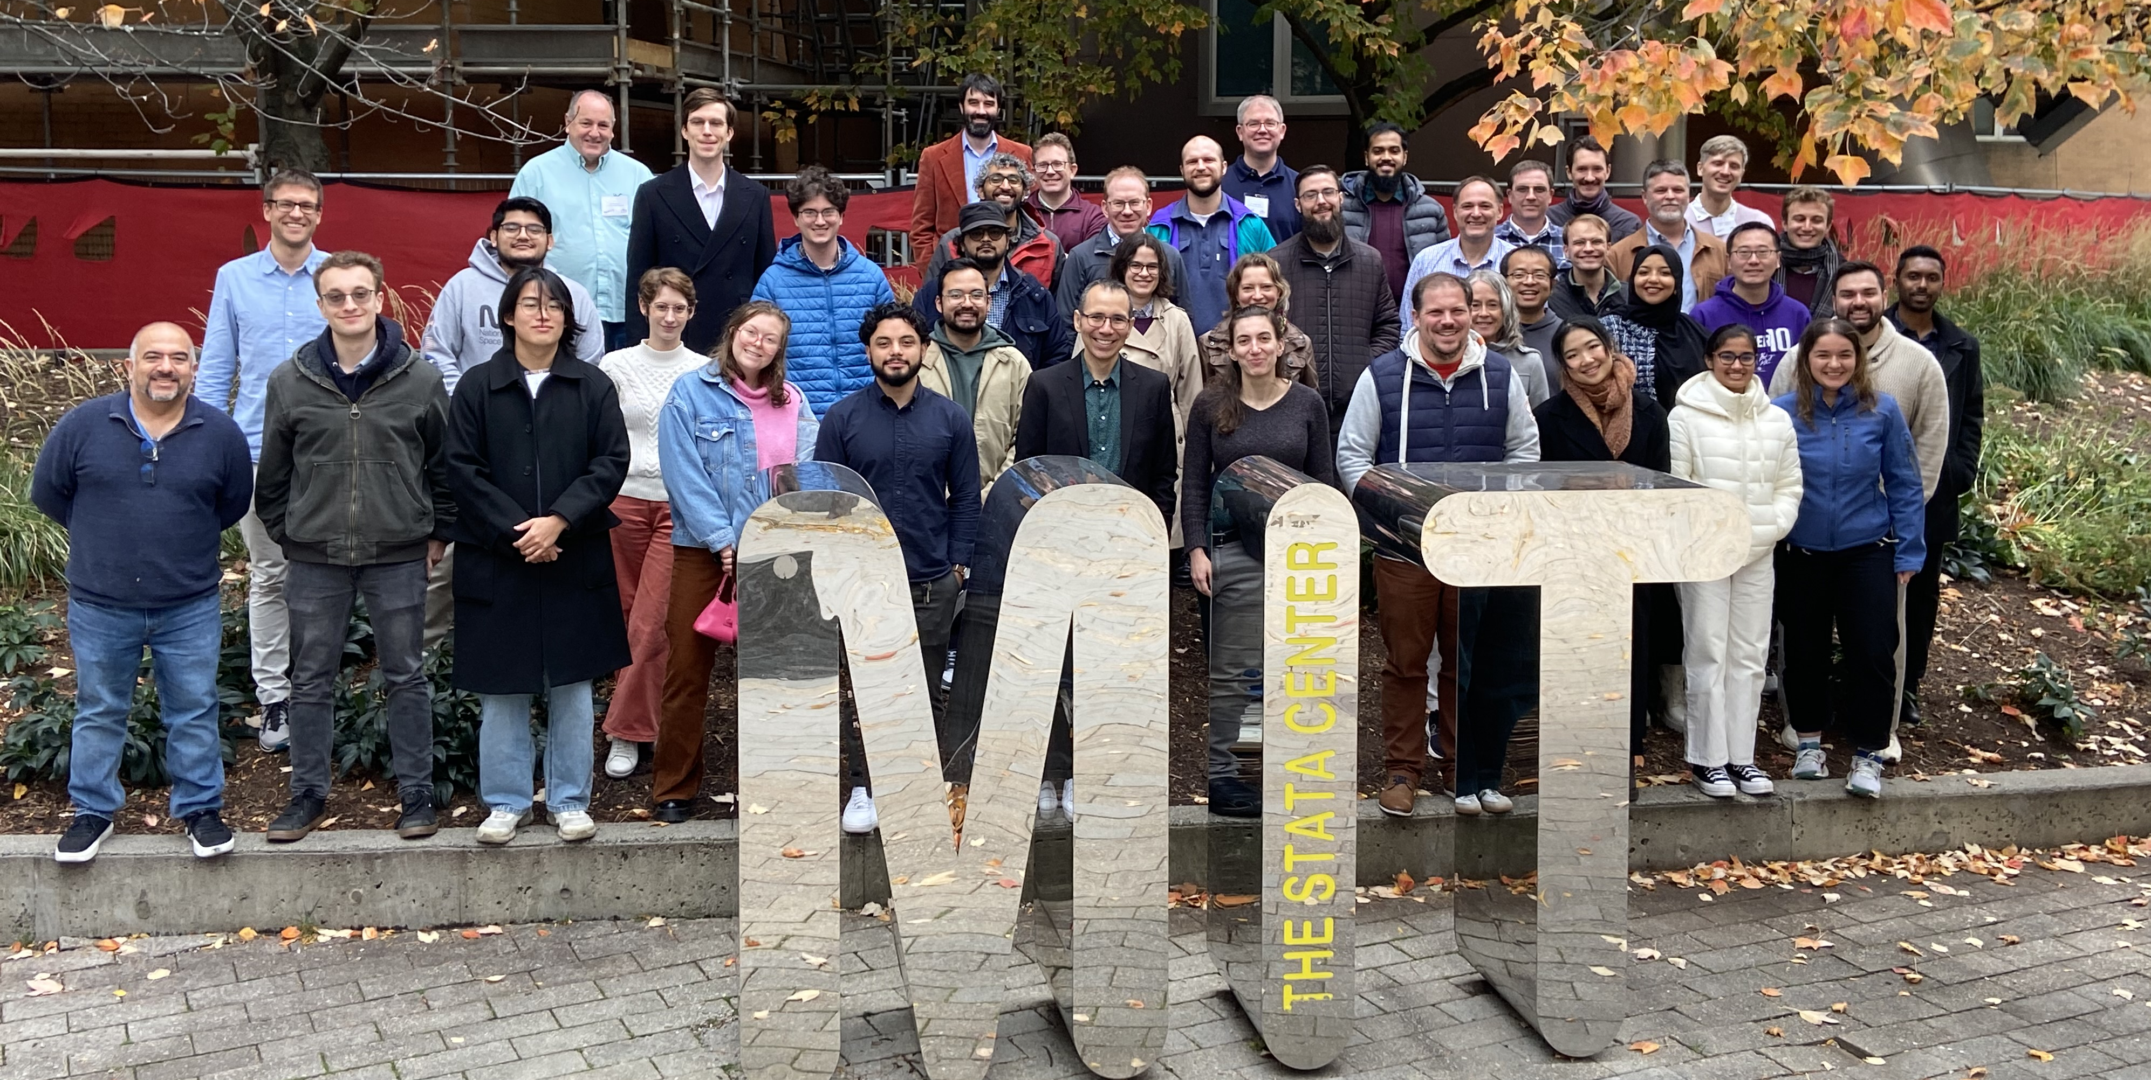



















Thank You!
Project 8 has demonstrated the potential of the CRES technique, and charts a promising path towards a direct neutrino mass measurement!
Carnegie Mellon University
Colorado School of Mines
Case Western Reserve University
Ghent
University
Indiana
University
Johannes Gutenberg University, Mainz
Heidelberg
University
Karlsruhe Institute
of Technology
Lawrence Berkeley National Laboratory
Lawrence Livermore National Laboratory
Massachusetts Institute of Technology
Pacific Northwest National Laboratory
Penn State University
University of Illinois
University of Pittsburgh
Project 8 Collaboration Meeting October 2025 – MIT
University of Texas, Arlington
University of Washington
Yale
University
This work is supported by the US DOE Office of Nuclear Physics, the US NSF, the PRISMA+ Cluster of Excellence at University of Mainz, and internal investments at all institutions.
Interested in joining Project 8?
We are looking for a Postdoc at Penn State !
Please contact ldeviveiros@psu.edu !
Notes:
This material is based upon work supported by the following sources: the U.S. Department of Energy Office of Science, Office of Nuclear Physics, under Award No.~DE-SC0011091 to the Massachusetts Institute of Technology (MIT), under the Early Career Research Program to Pacific Northwest National Laboratory (PNNL), a multiprogram national laboratory operated by Battelle for the U.S. Department of Energy under Contract No.~DE-AC05-76RL01830, under Early Career Award No.~DE-SC0019088 to Pennsylvania State University, under Award No.~DE-FG02-97ER41020 to the University of Washington, and under Award No.~DE-SC0012654 to Yale University; the National Science Foundation under Award Nos.~1806251 to MIT; This work has been supported by the Cluster of Excellence “Precision Physics, Fundamental Interactions, and Structure of Matter” (PRISMA+ EXC 2118/1) funded by the German Research Foundation (DFG) within the German Excellence Strategy (Project ID 39083149); Laboratory Directed Research and Development (LDRD) 18-ERD-028 at Lawrence Livermore National Laboratory (LLNL), prepared by LLNL under Contract DE-AC52-07NA27344; the MIT Wade Fellowship; the LDRD Program at PNNL; the University of Washington Royalty Research Foundation. A portion of the research was performed using Research Computing at PNNL. The isotope(s) used in this research were supplied by the United States Department of Energy Office of Science by the Isotope Program in the Office of Nuclear Physics. We further acknowledge support from Yale University, the PRISMA+ Cluster of Excellence at the University of Mainz, and the Karlsruhe Institute of Technology (KIT) Center Elementary Particle and Astroparticle Physics (KCETA).

Slide 16
Questions?

