Slide 1
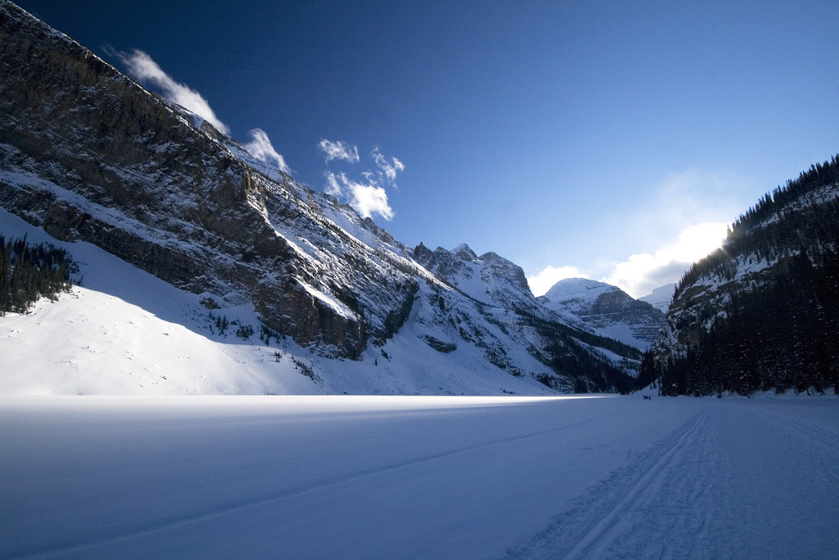
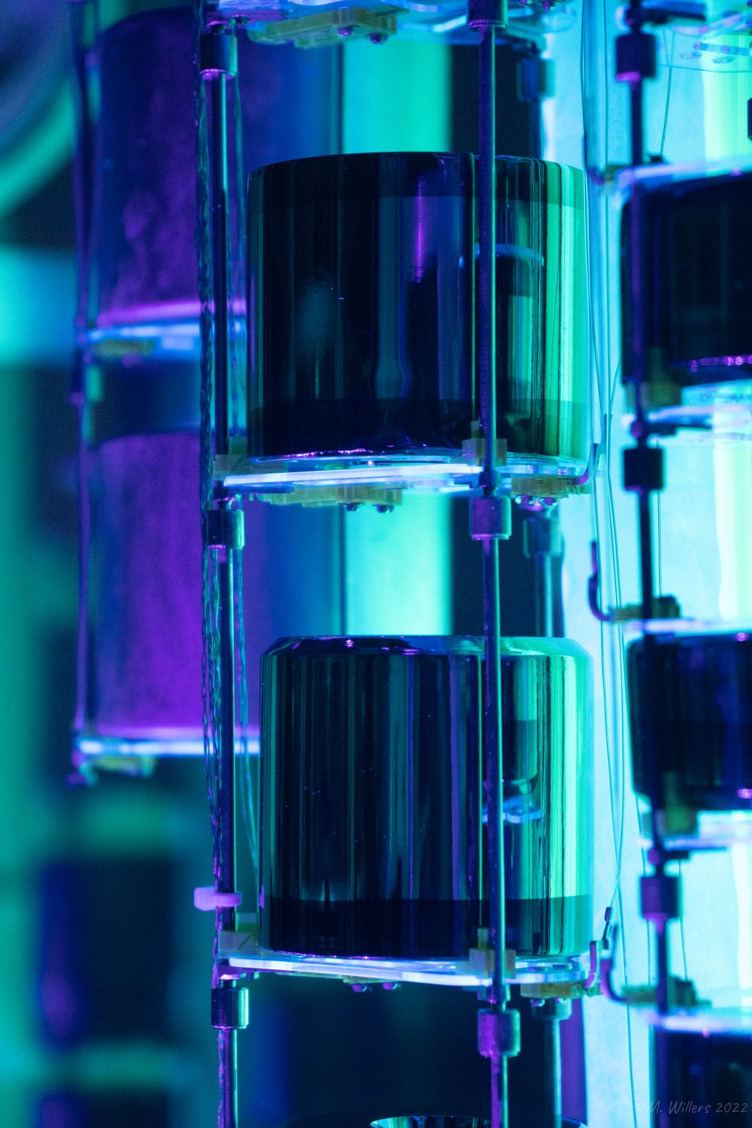


Probing neutrino nature: First results from LEGEND-200 experiment in search for neutrinoless double beta decay
March 04, 2026, LLWI 2026,
Lake Louise, Alberta, Canada
Harisree Krishnamoorthy
Physics division, Oak Ridge national lab
On behalf of the LEGEND collaboration
Photo by Michael Willers

Slide 2
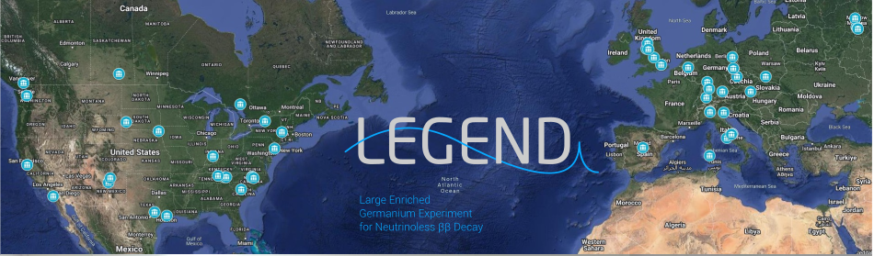
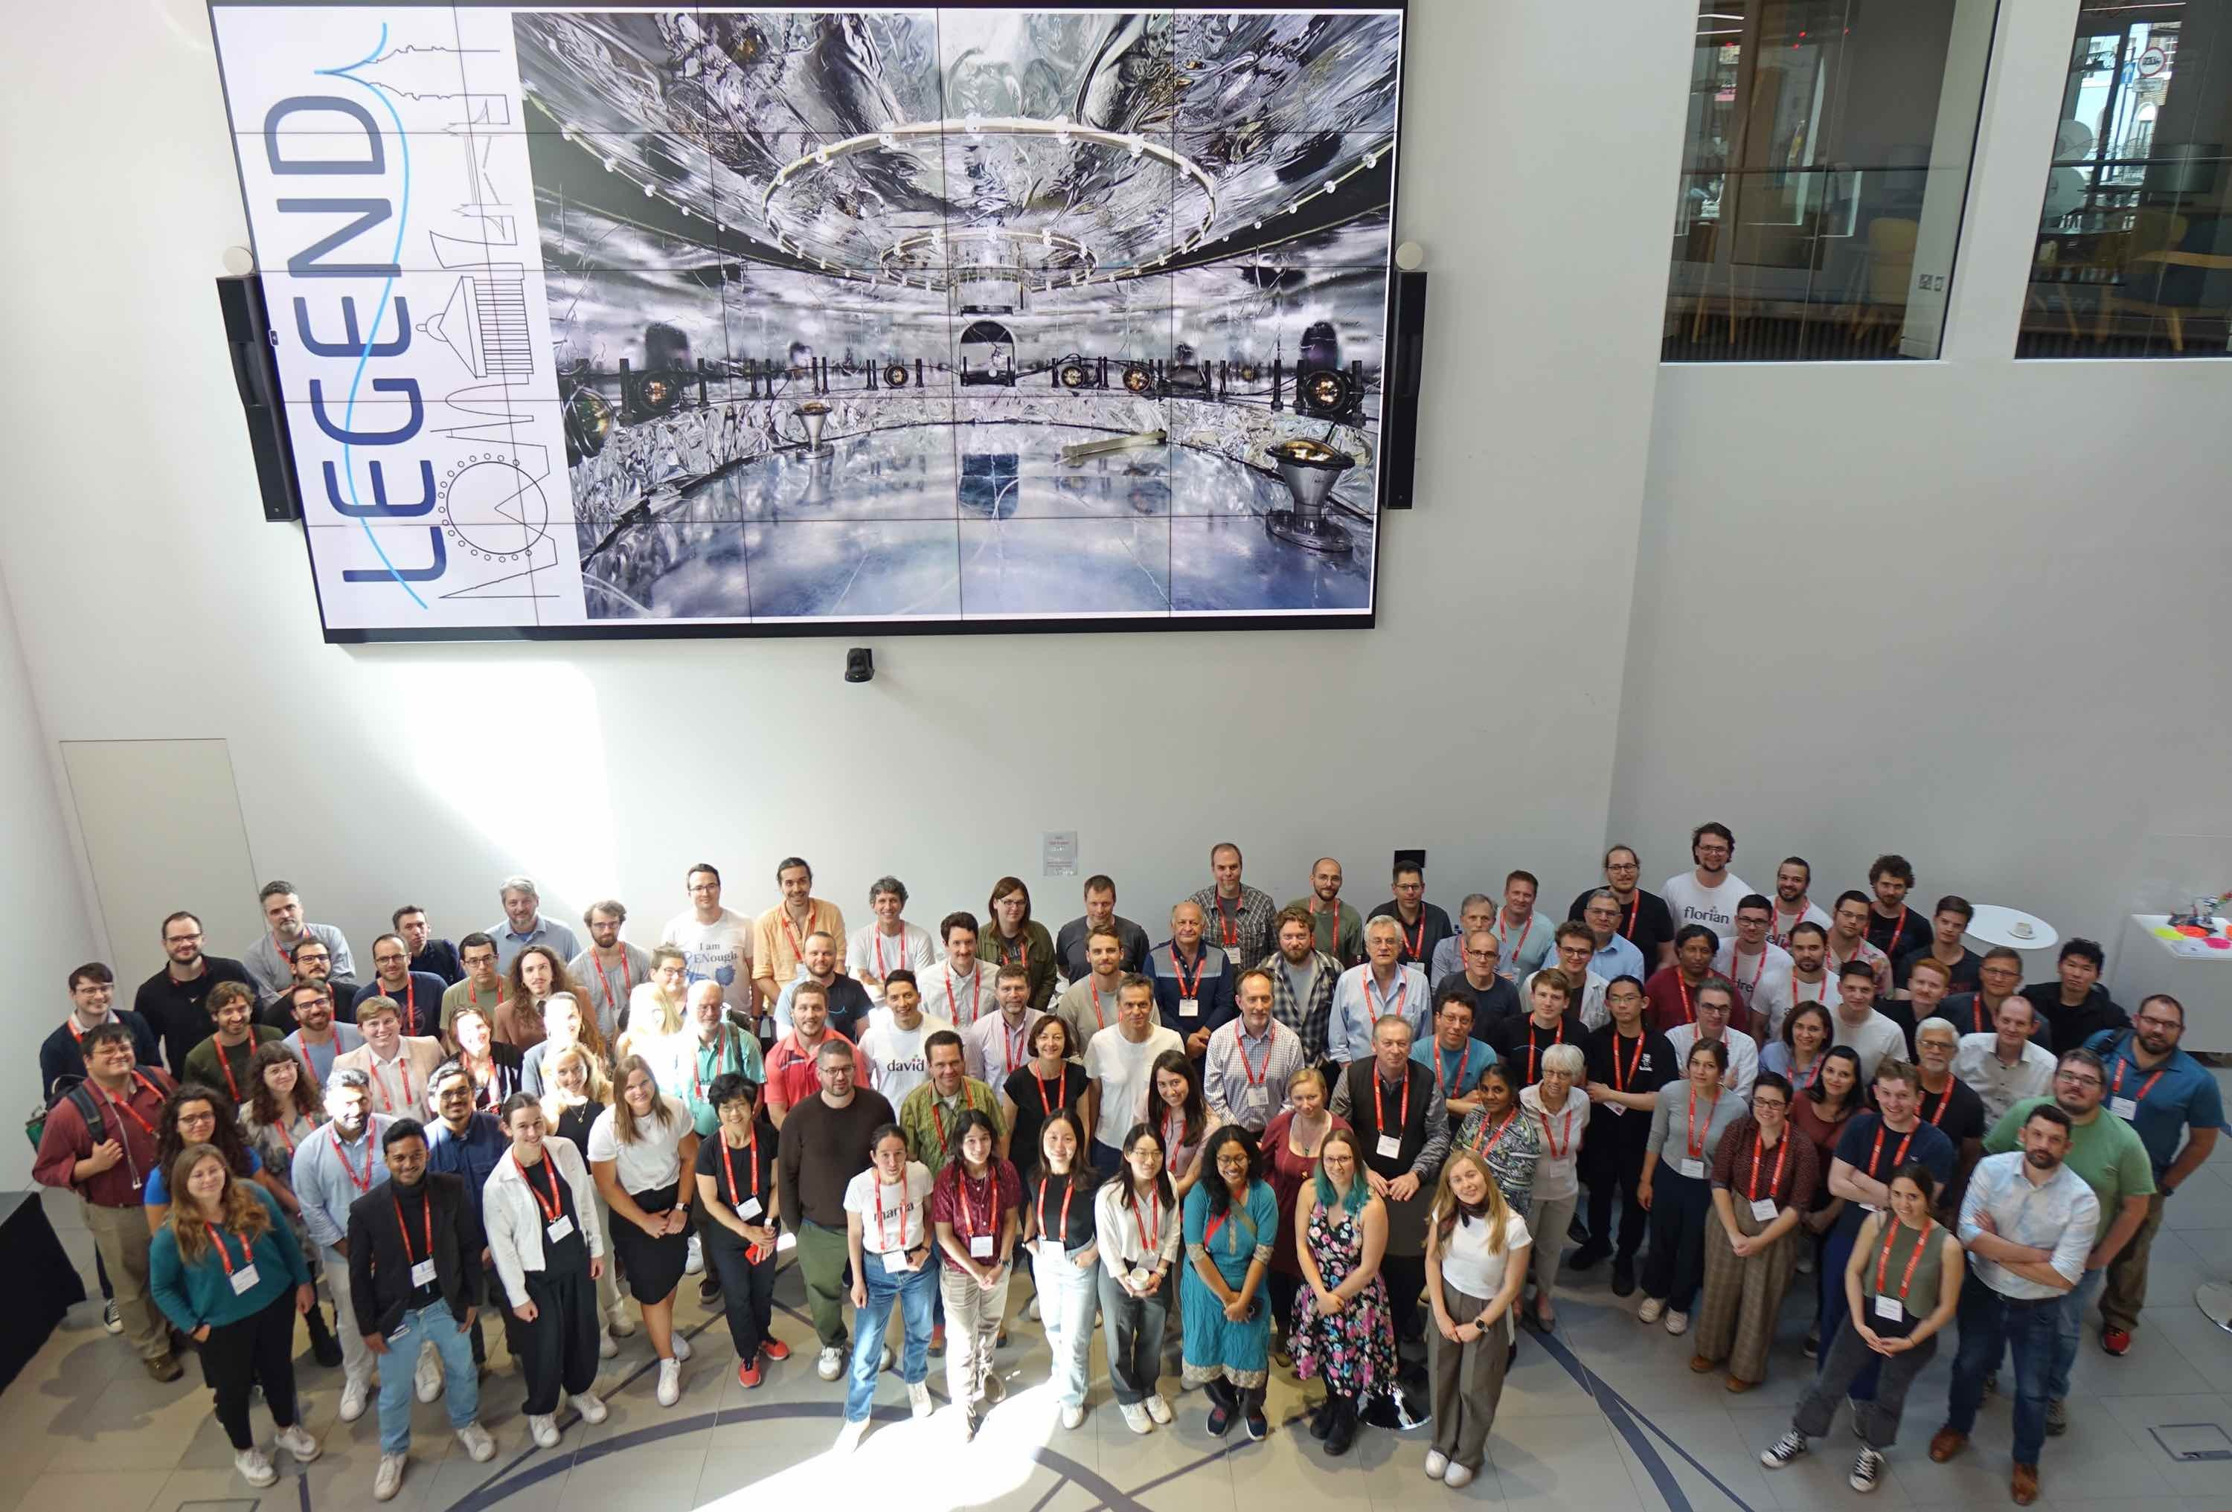
The
Collaboration
Large Enriched Germanium Experiment
for Neutrinoless ββ Decay
11 countries, ~60 institutions, ~300 members..
LEGEND mission:
The collaboration aims to develop a phased, ⁷⁶Ge-based double-beta decay experimental program with discovery potential at a half-life beyond 10²⁸ years, using existing resources as appropriate to expedite physics results

Slide 3
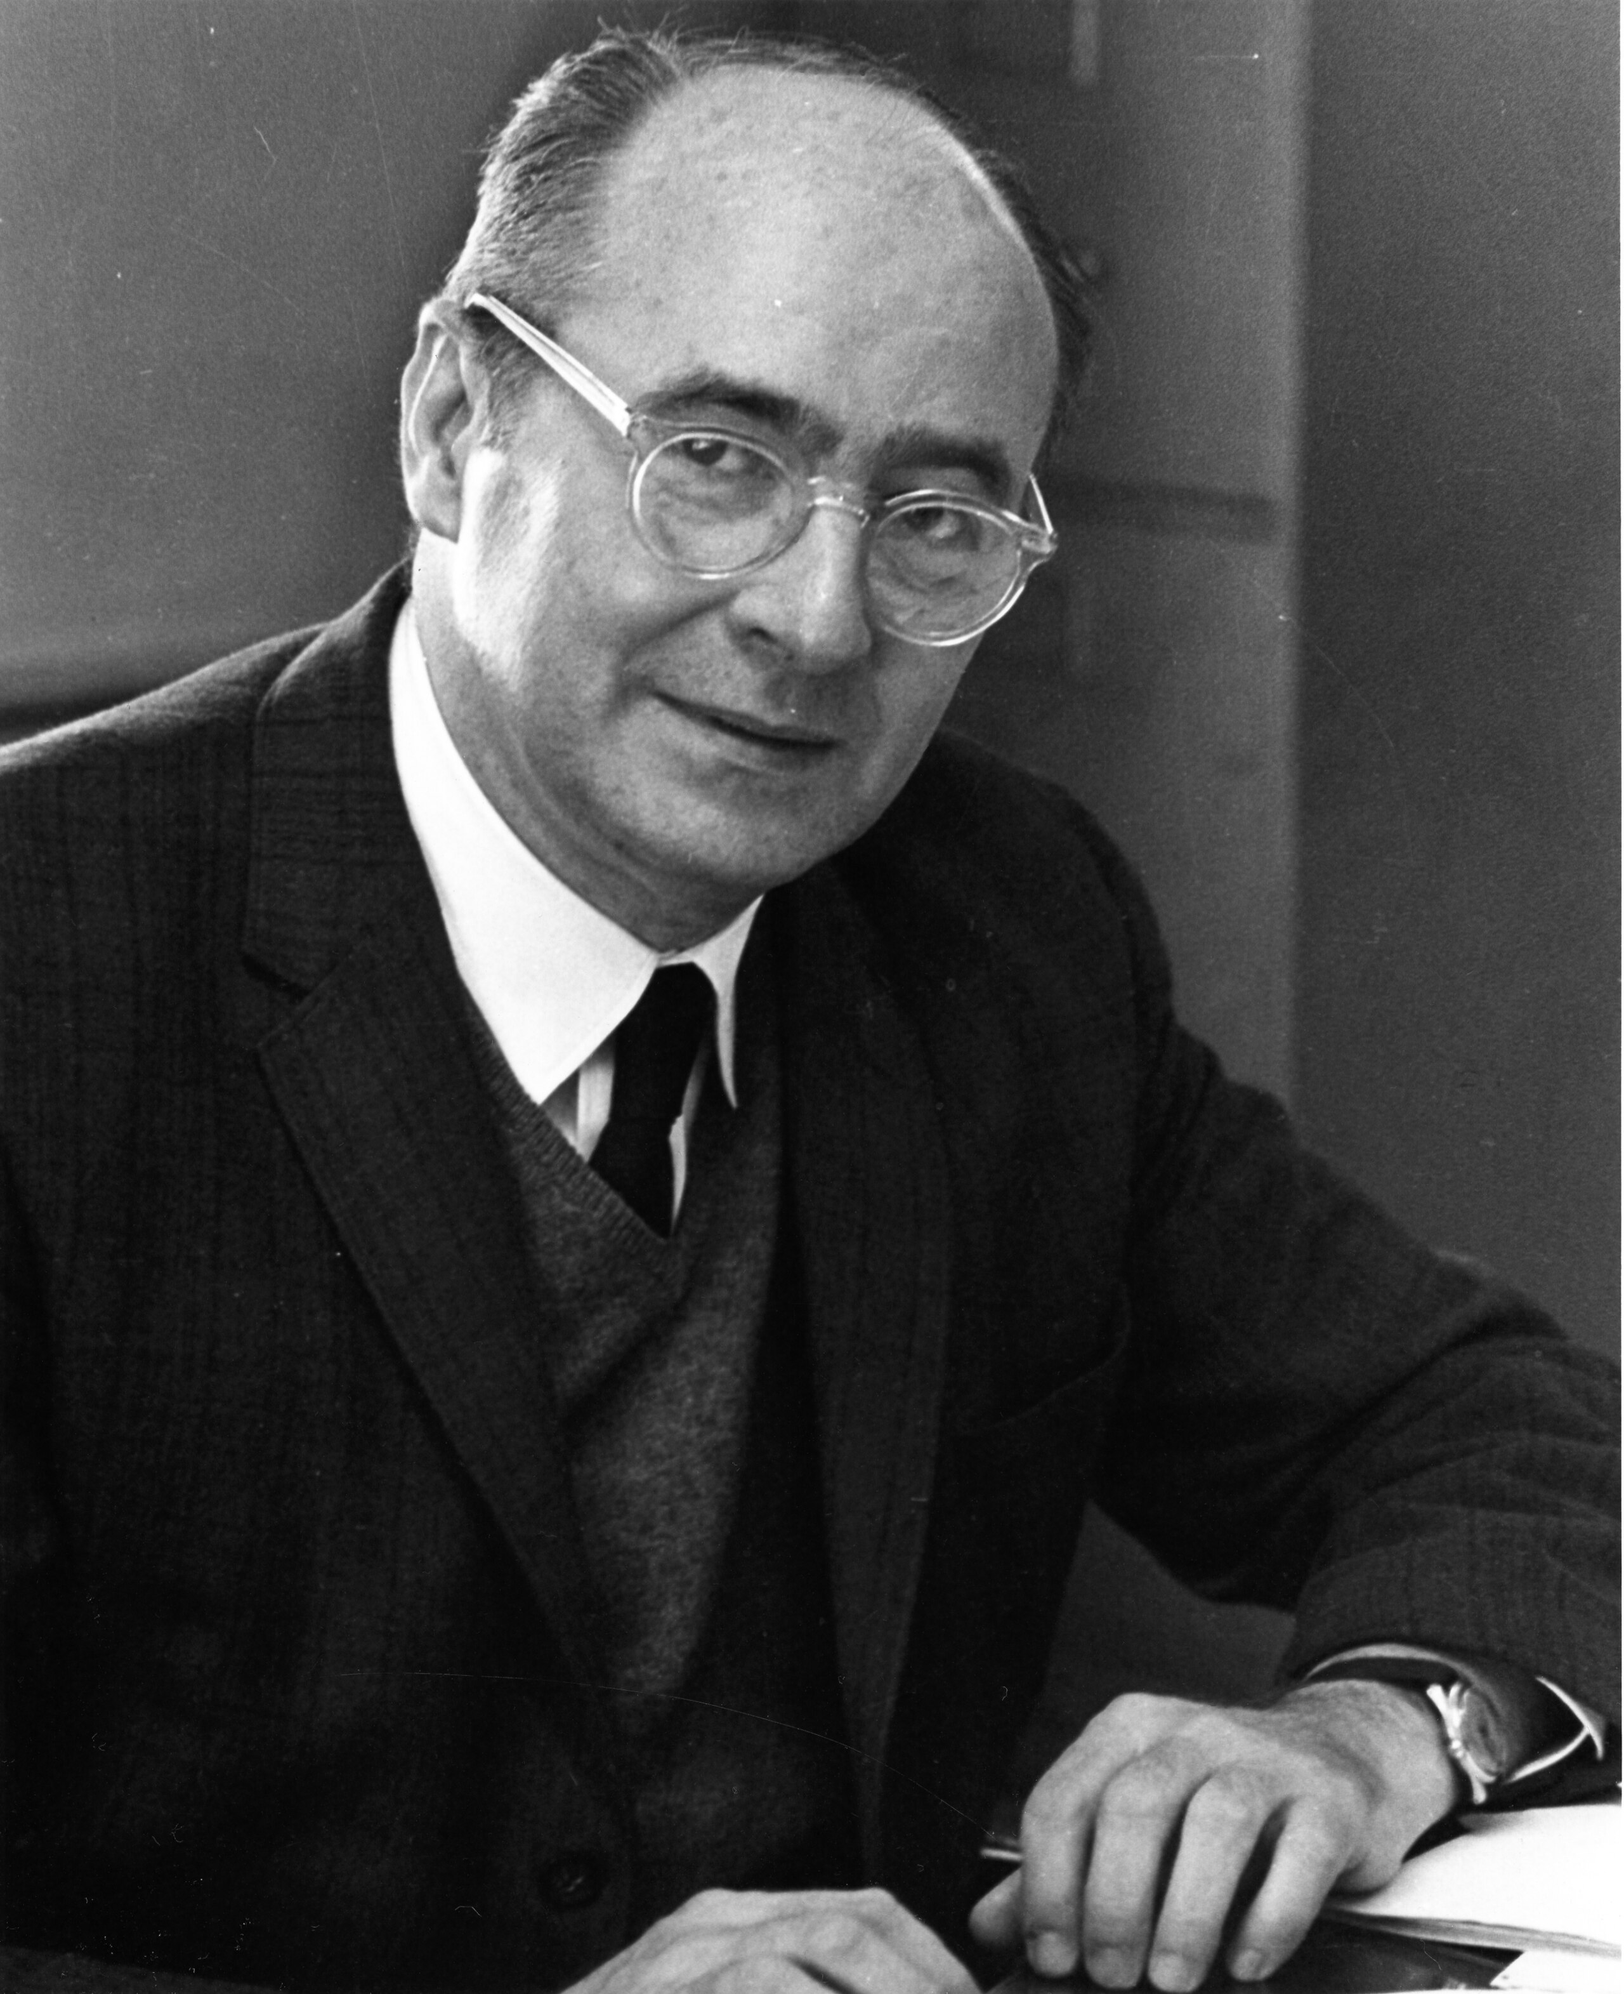
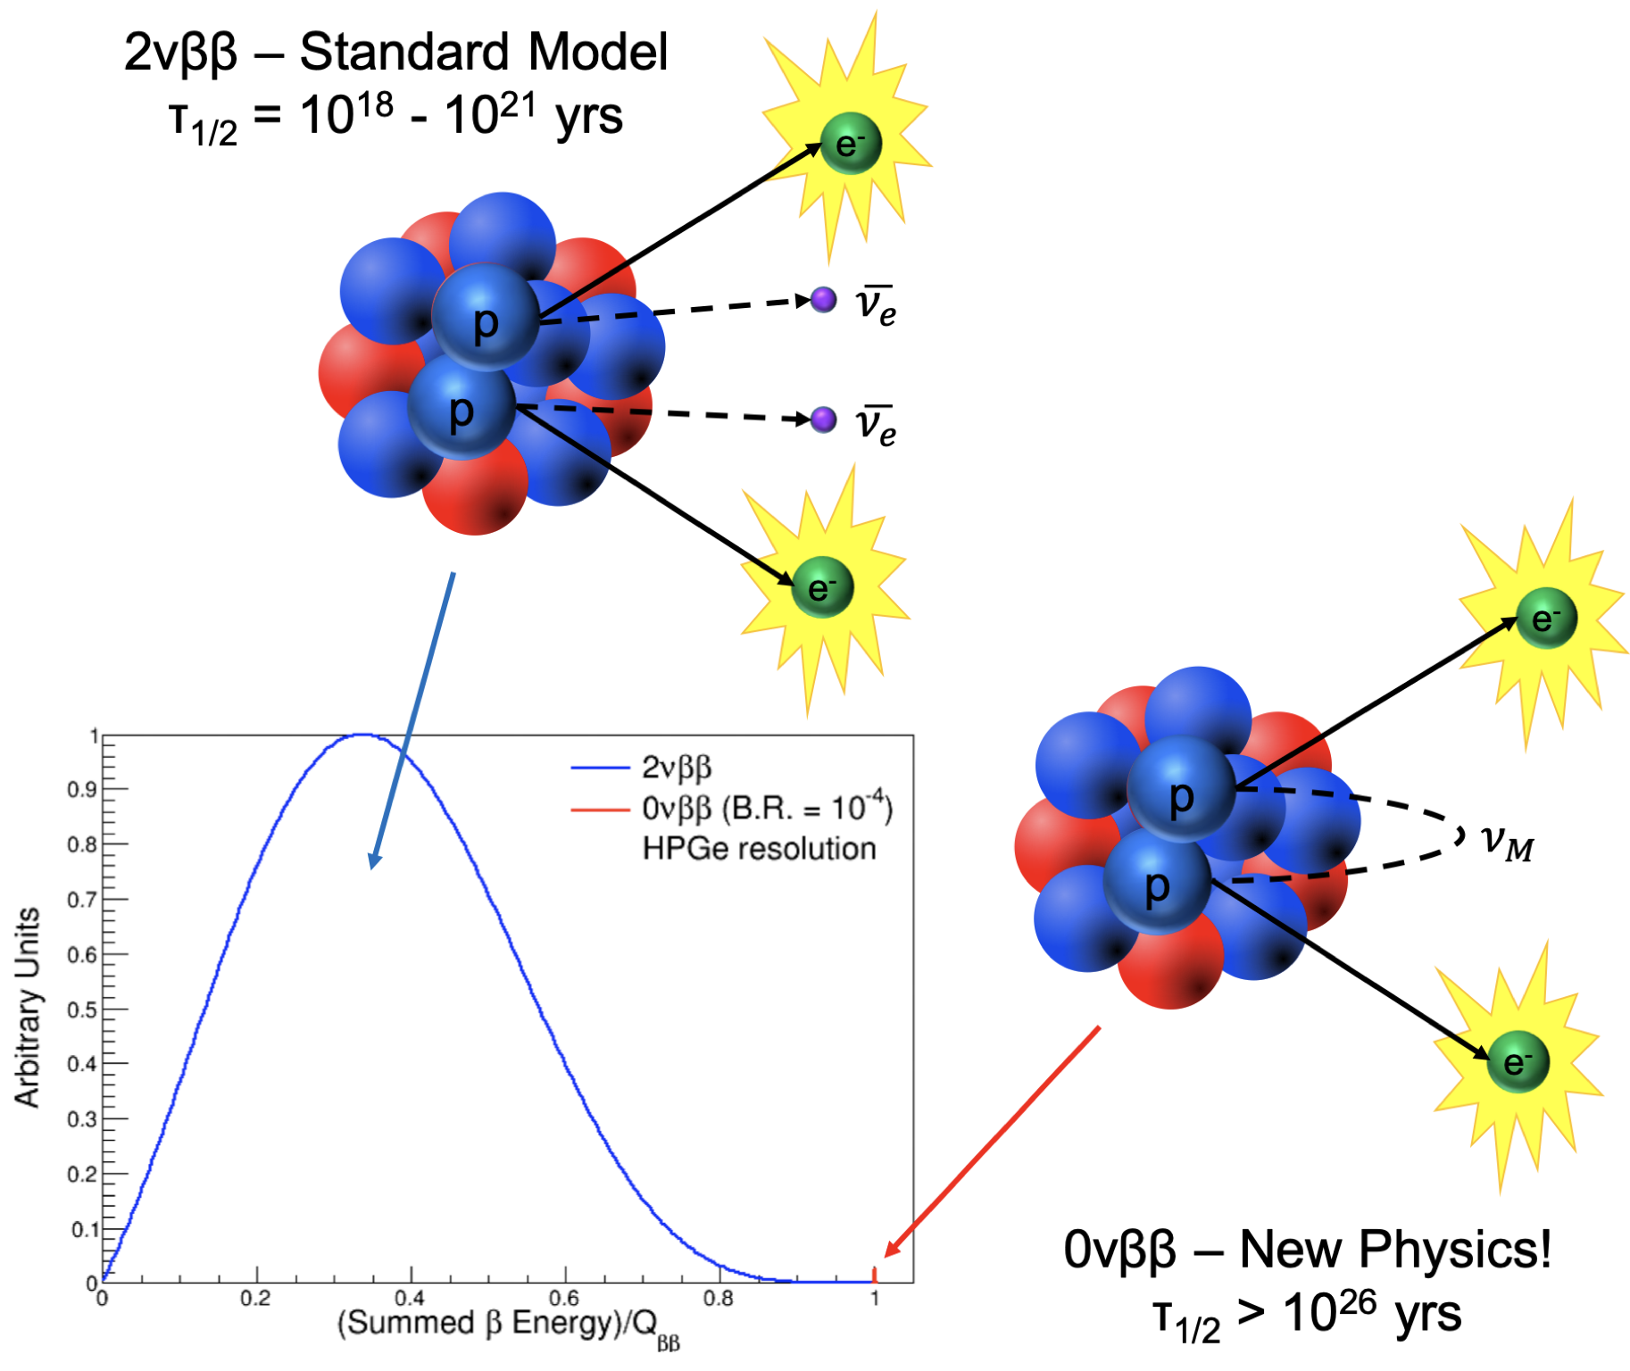
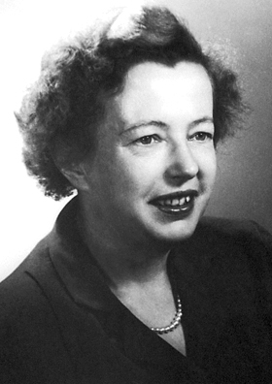
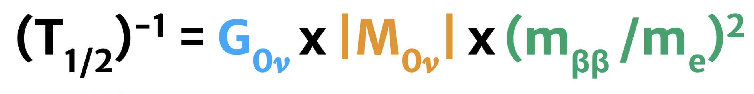
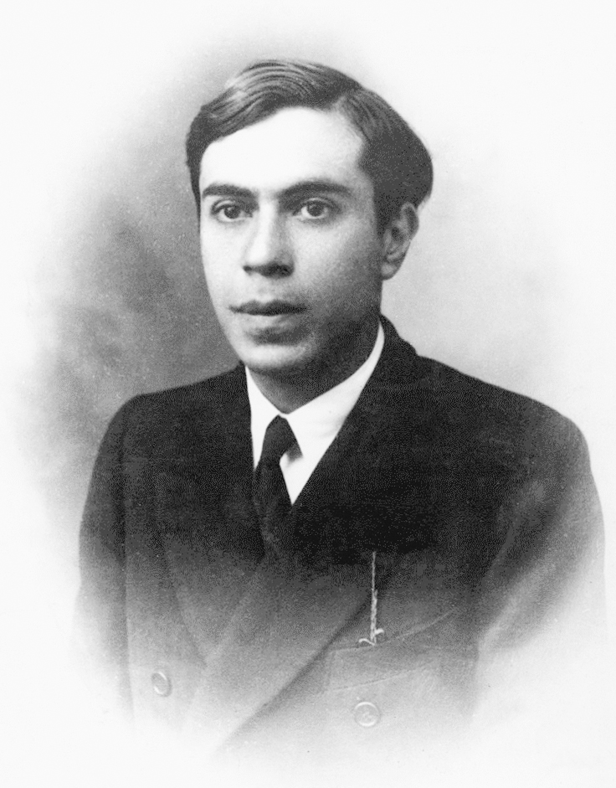
Neutrinoless double beta decay (0𝜈𝛽𝛽) is an excellent (and perhaps the only) probe to Majorana nature of neutrinos
Implications if 0𝜈𝛽𝛽 is observed (assuming light 𝜈 exchange)
2𝜈ββ
0𝜈ββ
Neutrinos are Majorana fermions
B-L is not conserved
(ΔL=2), m_{ββ} ≠ 0
Absolute neutrino mass scale can be constrained

Slide 4
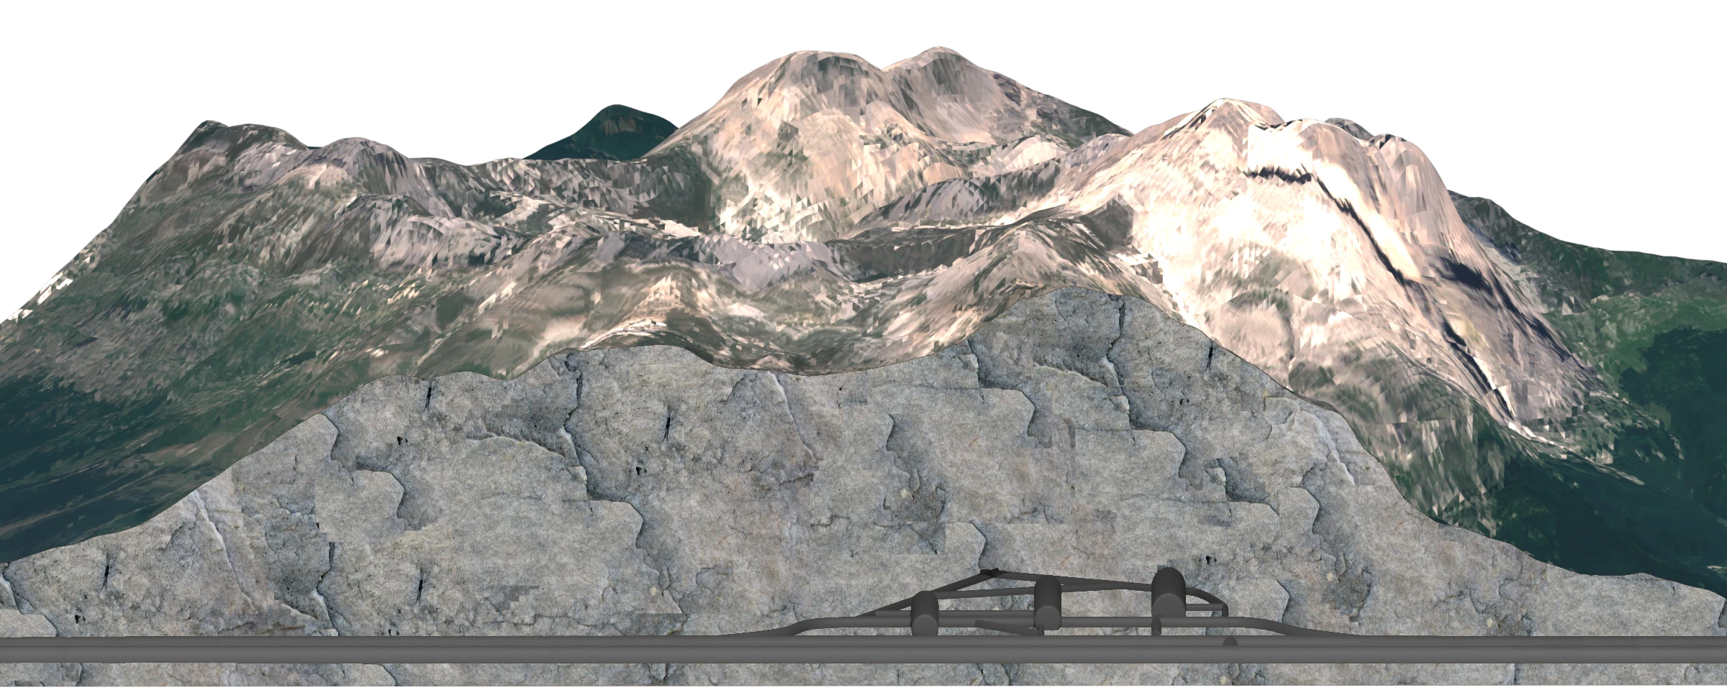
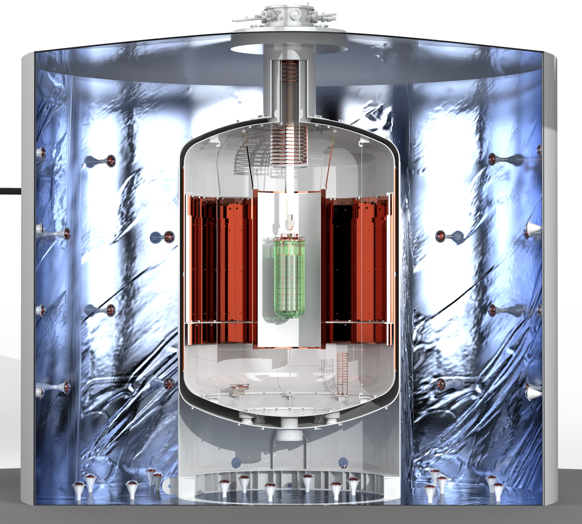
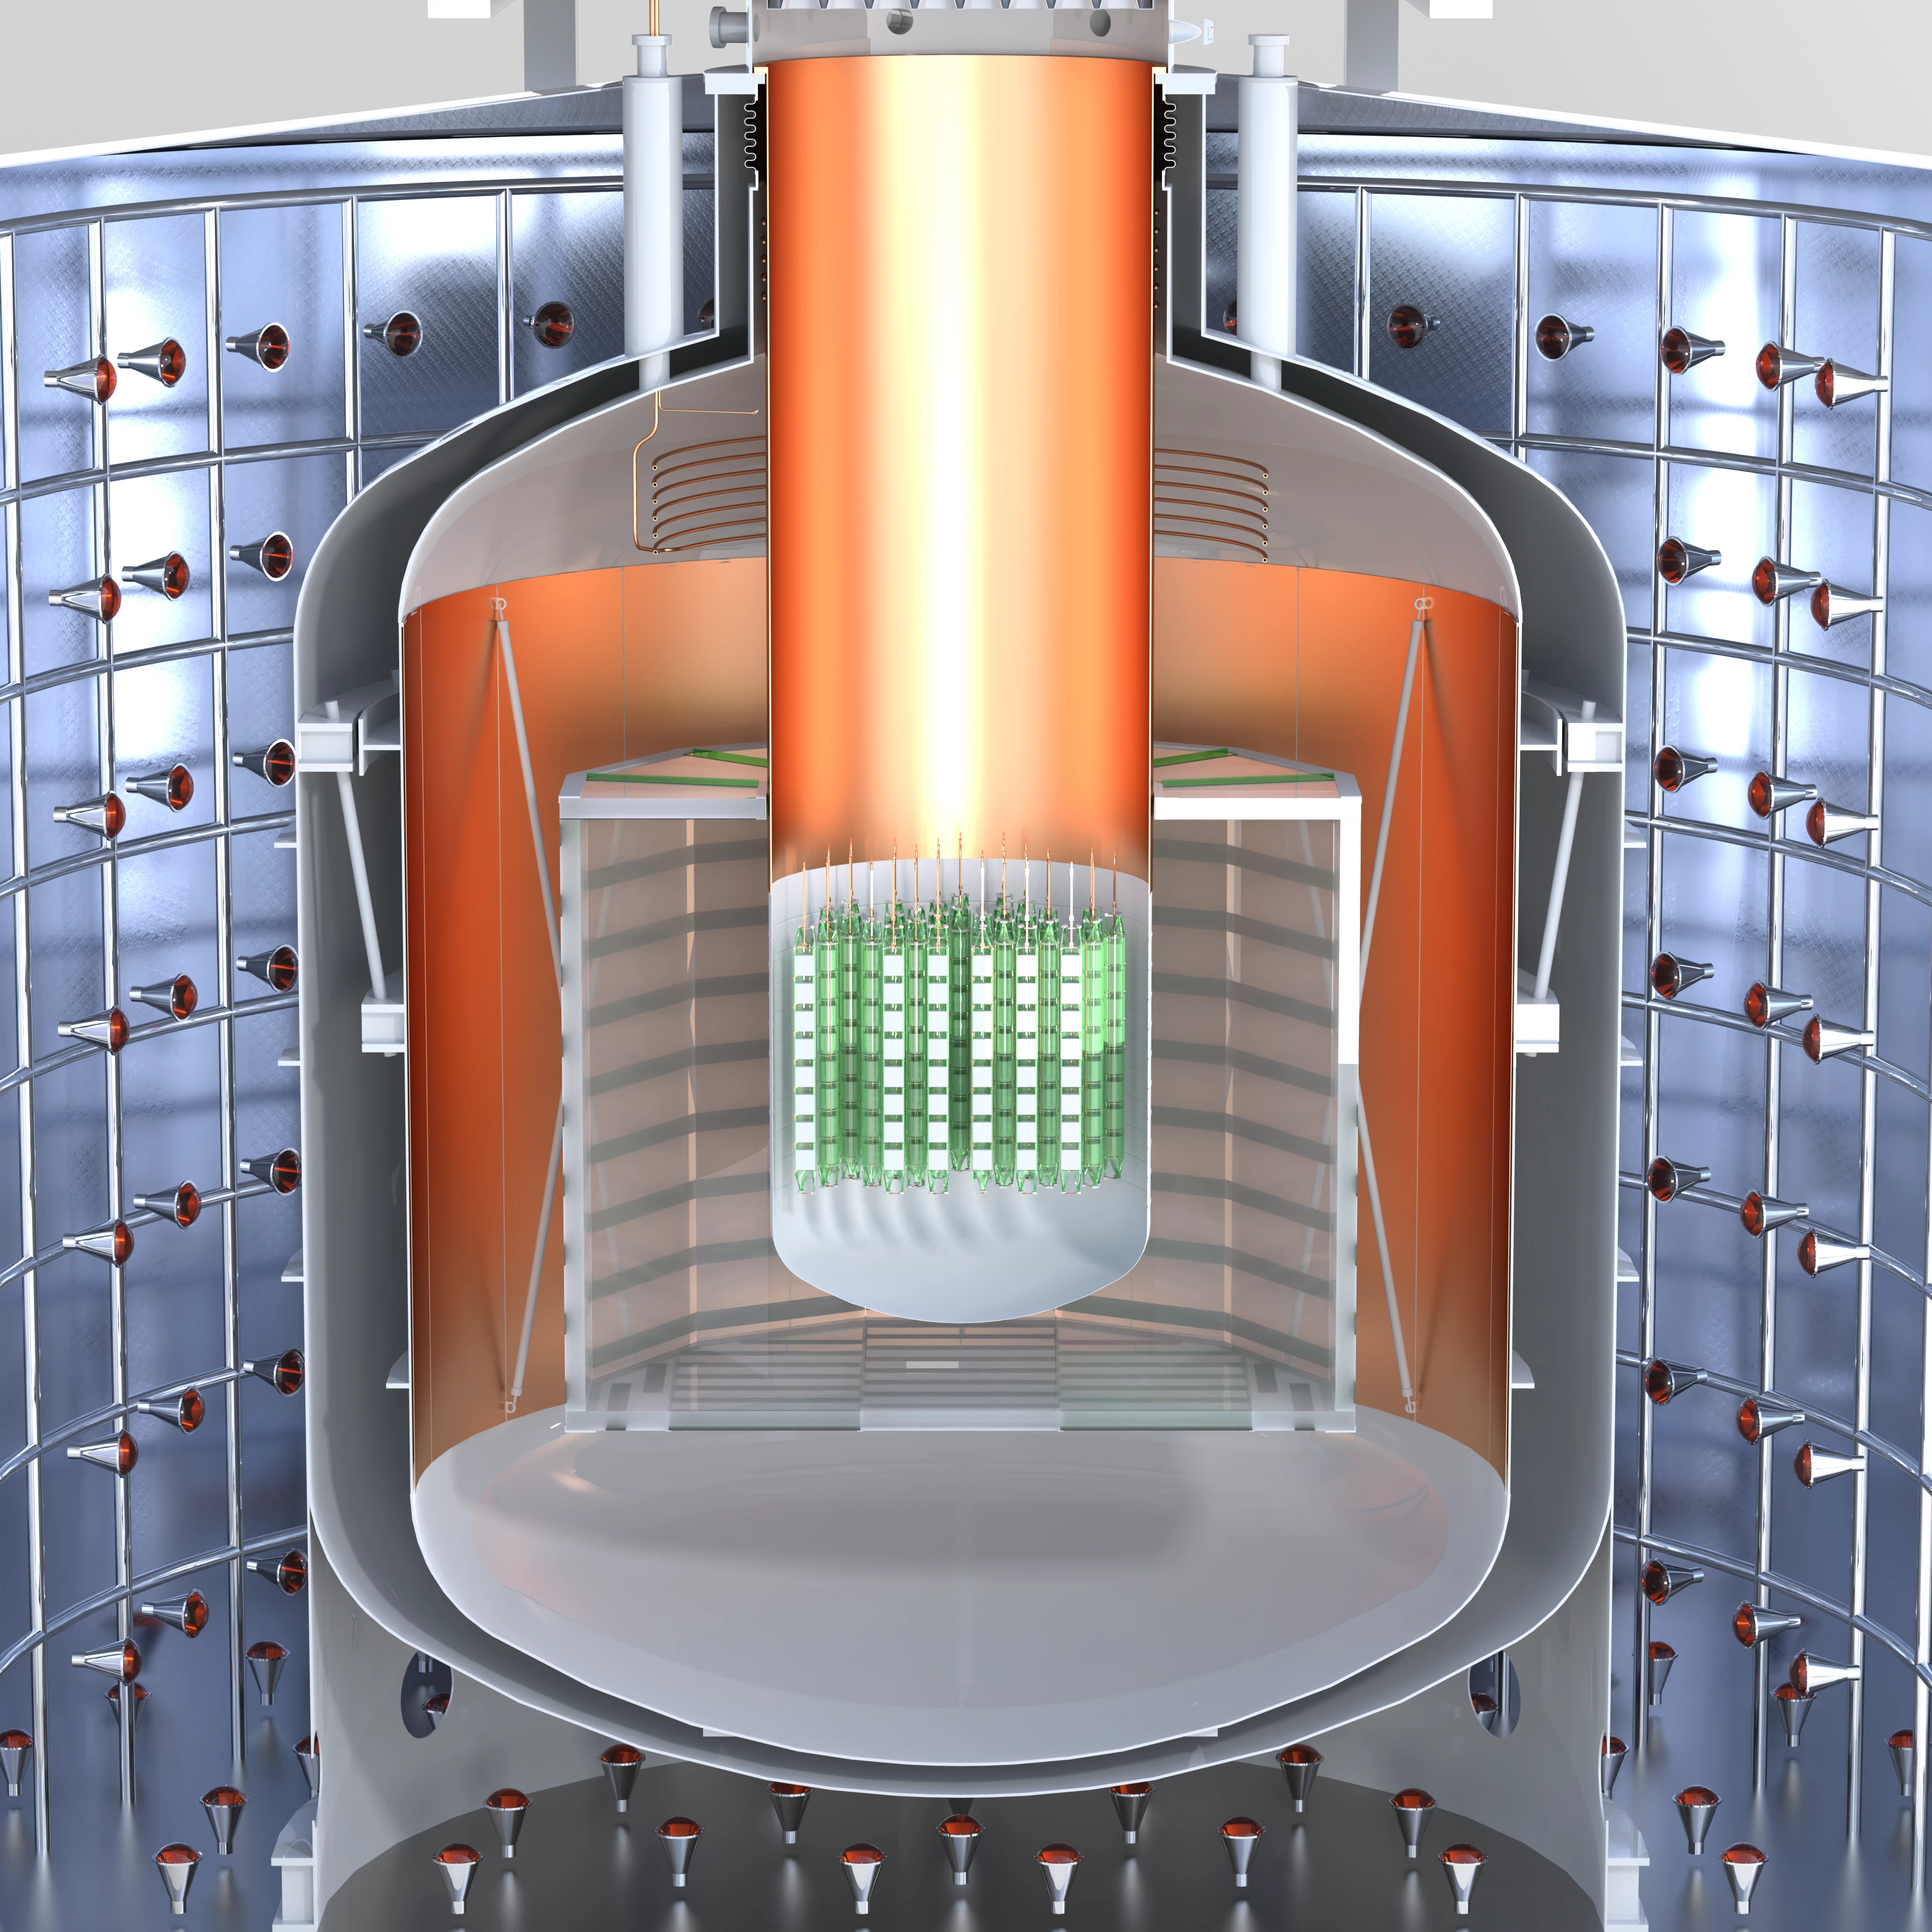
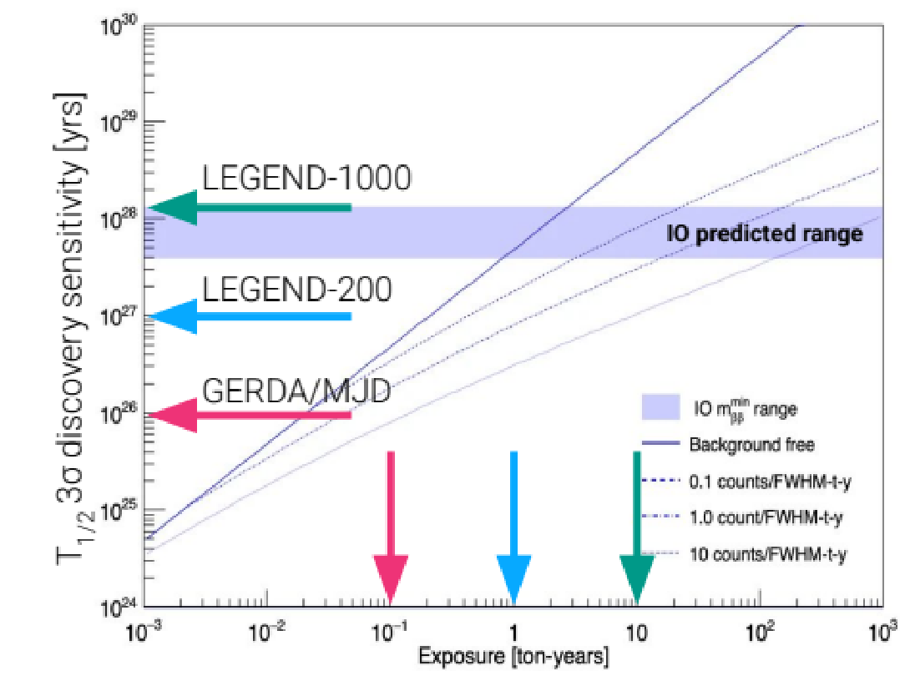
- 200
- 1000
Exposure goal
200 kg (x 5 yr)^{enriched}Ge
Background goal
1000 kg (x 10 yr) ^{enriched}Ge
2 x 10⁻⁴ cts/(keV kg yr)
Half-life sensitivity
< 10⁻⁵ cts/(keV kg yr)
T_{1/2} (0𝜈)> 10²⁷ yr
Absolute neutrino mass range
T_{1/2} (0𝜈)> 10²⁸ yr
m ~ 30 - 70 meV
m ~ 10 - 20 meV
@LNGS Hall A
3600 m.w.e

Slide 5
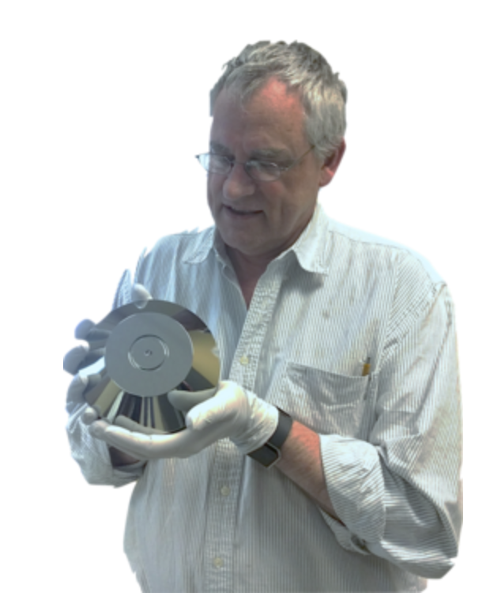
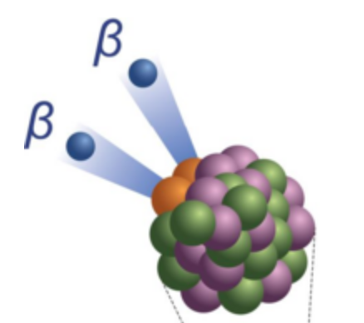
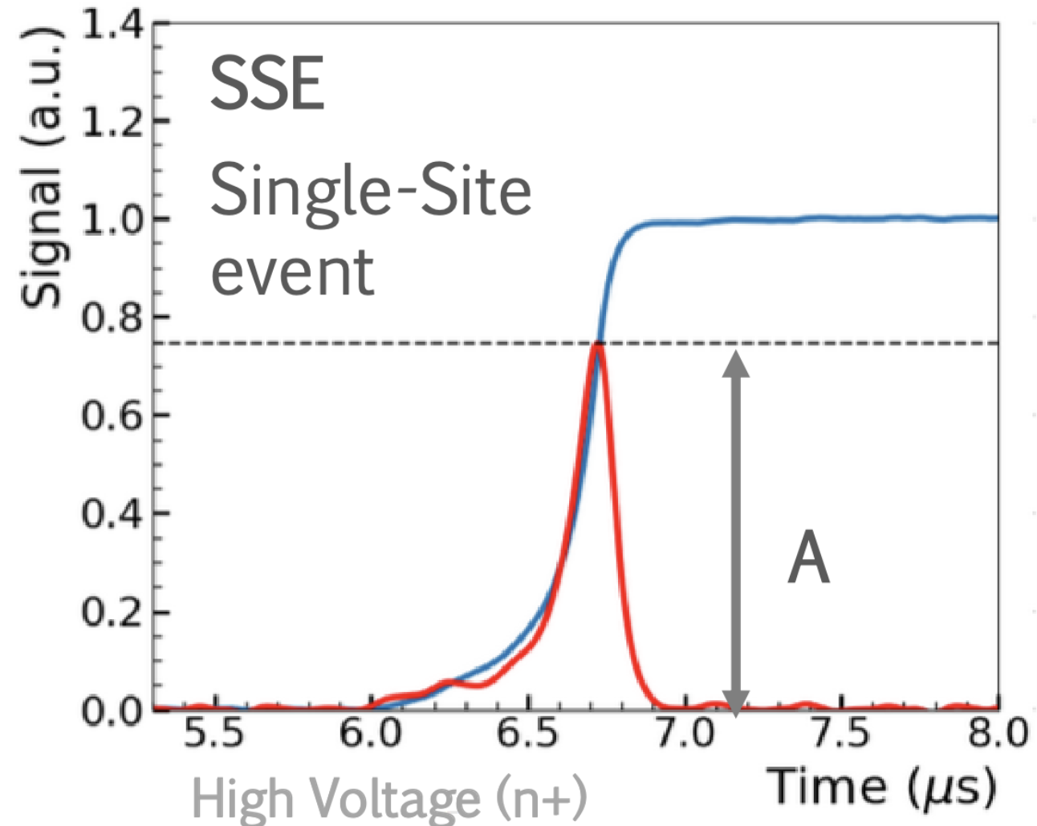
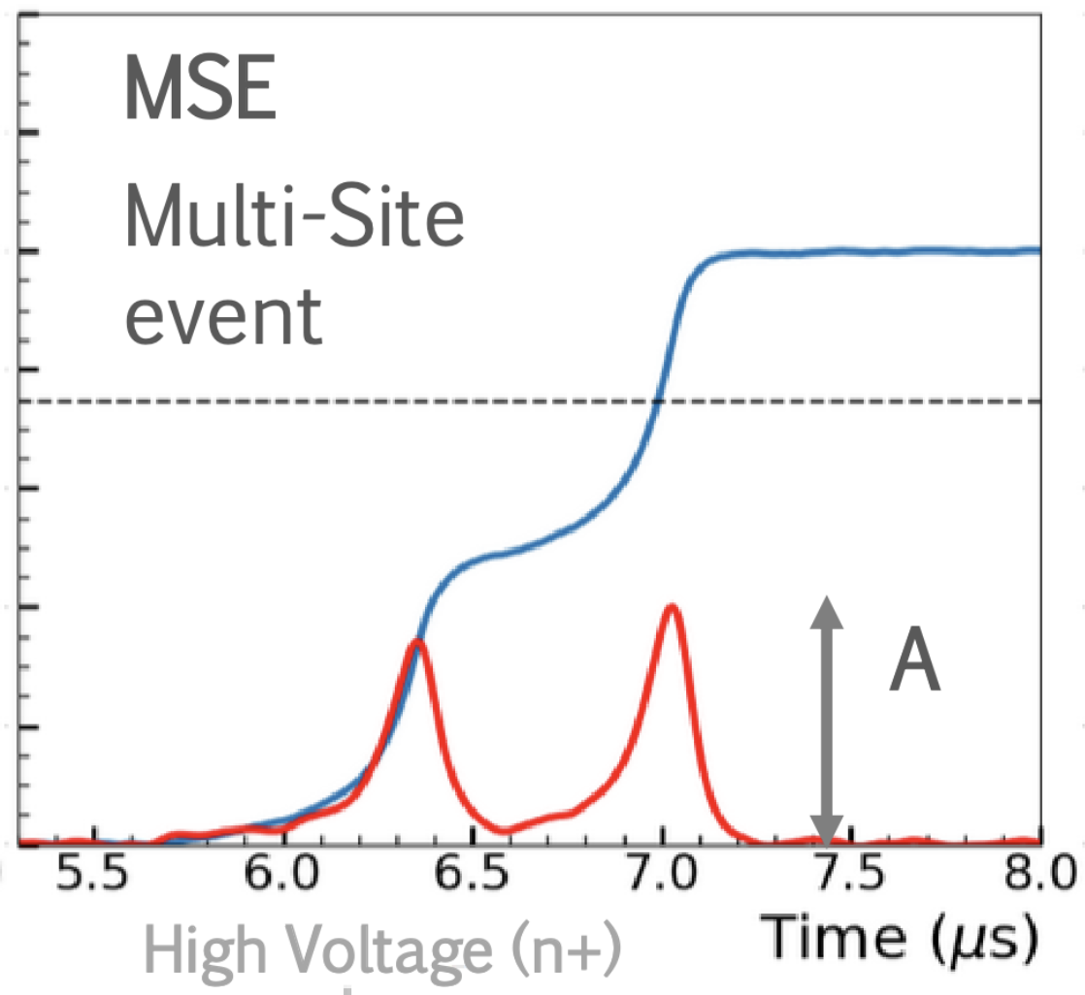
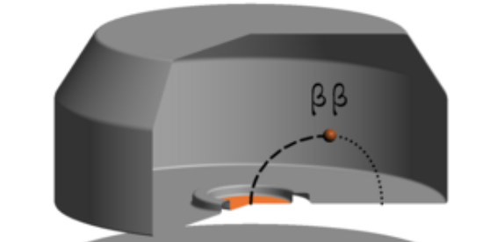
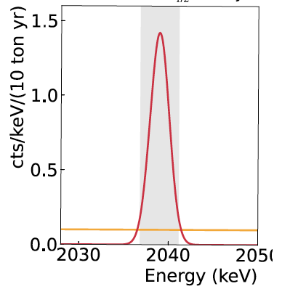
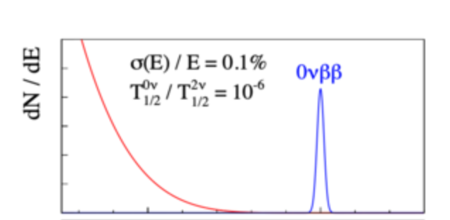

Well-established
detector
technology
⁷⁶Ge
Background rejection using event topology
Low intrinsic background
Germanium detectors have many advantages that make them well suited for 0νββ decay searches
Q-value = 2039 keV
⁷⁶Se + 2e⁻
Sharp peak above
flat, well-understood background
Source = detector, Energy resolution ~ 0.1% FWHM at Q_{ᵝᵝ}

Slide 6
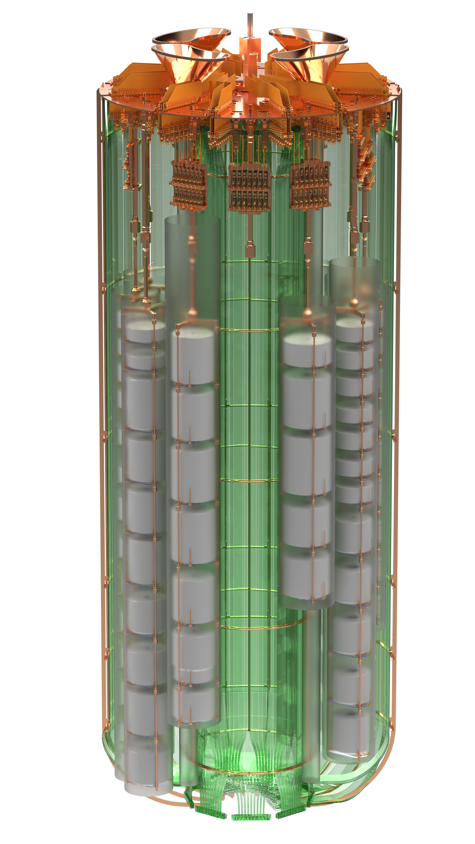
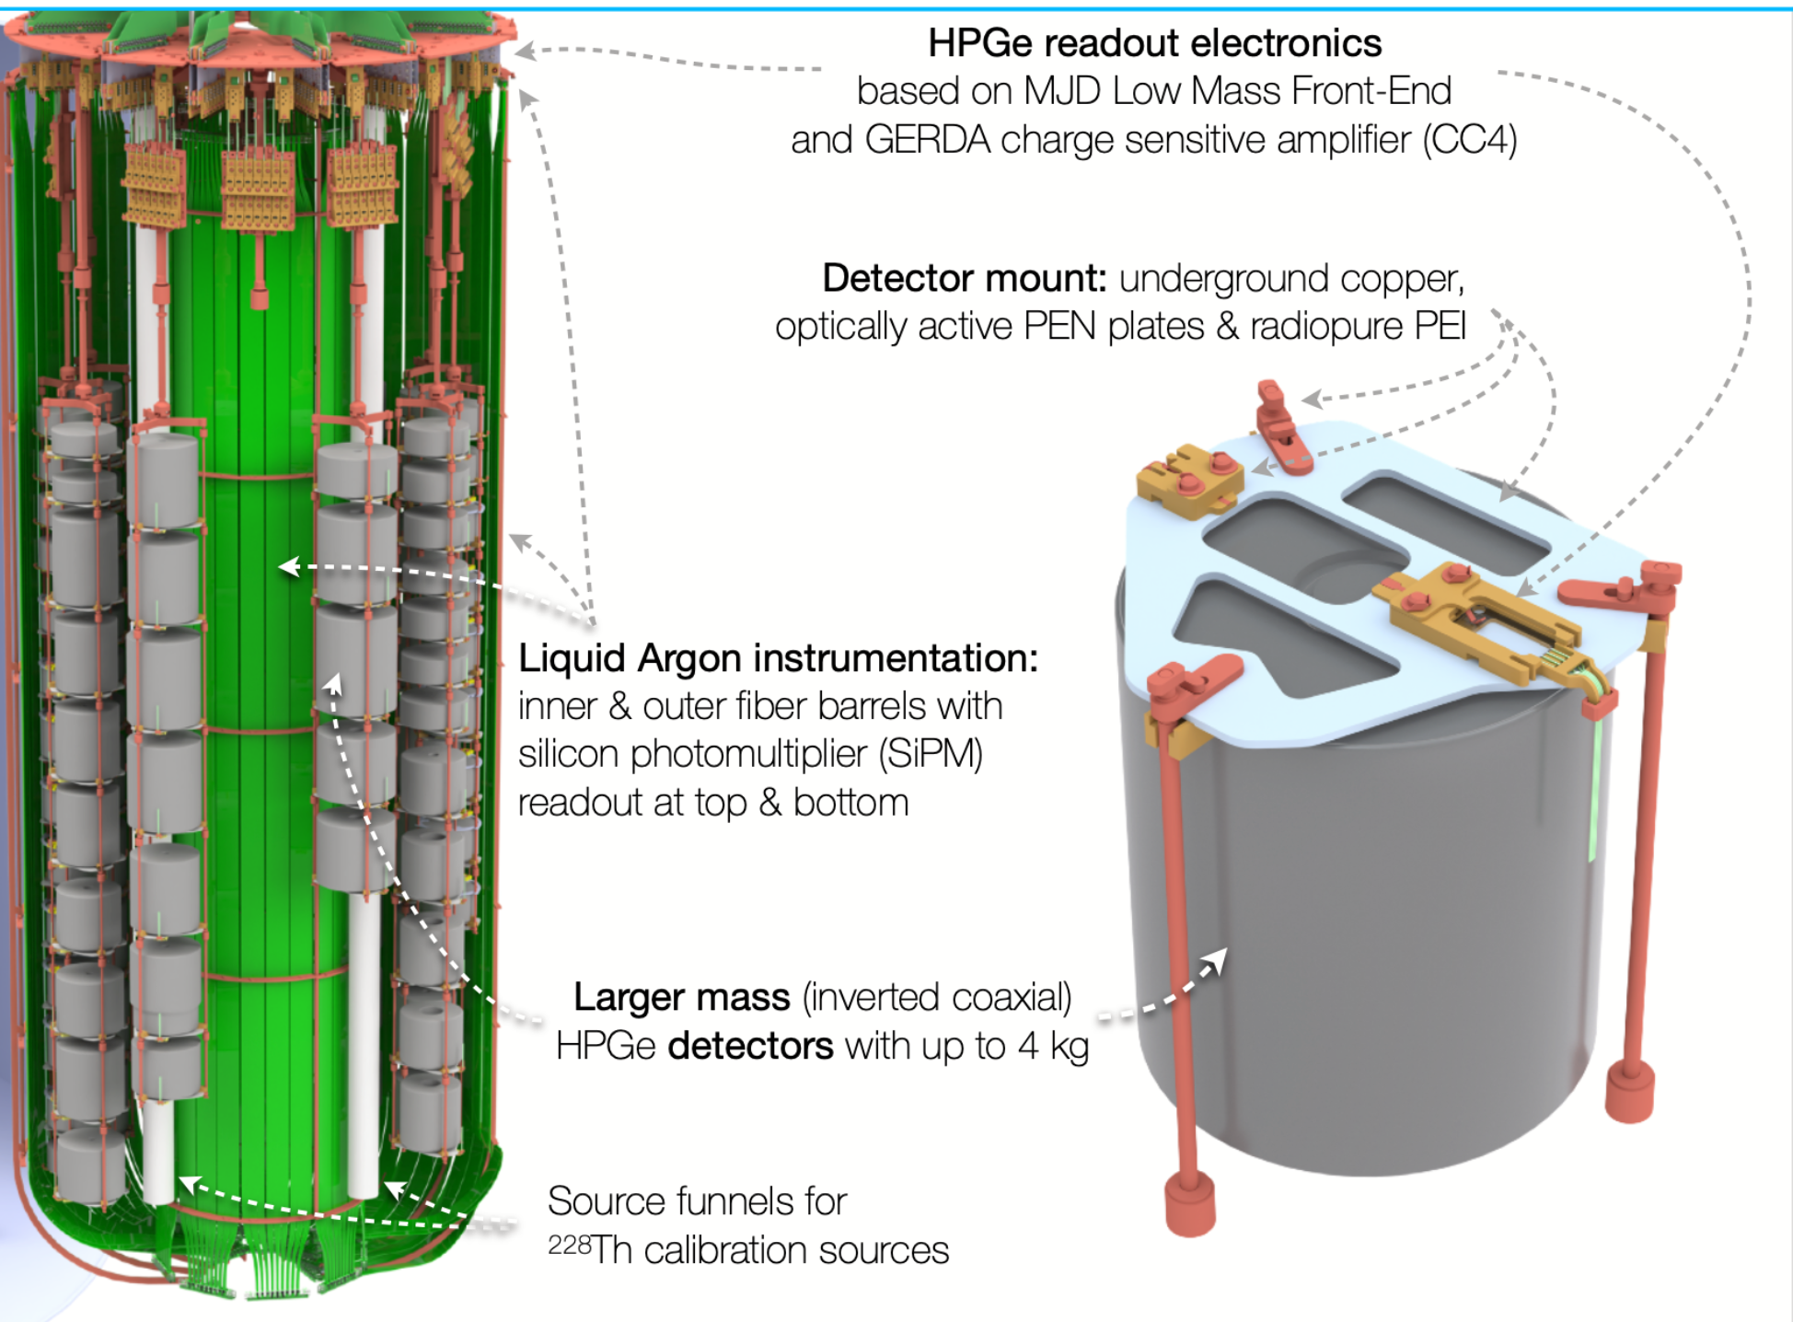
The - 200 experiment
Lock system for Ge array deployment
Water Cherenkov
Muon veto (590 m³)
HPGe readout electronics based on
MJD Low Mass Front-end
And GERDA charge sensitive amplifier (CC4)
Detector mount: underground copper,
Optically active PEN plates & radiopure PEN
Wavelength shifting reflector
Scintillating,
self-vetoing
Stainless steel LAr cryostat (64 m³)
Liquid Argon instrumentation:
Inner & outer fiber barrels with
silicon photomultiplier (SiPM)
readout at the top & bottom
Larger mass (inverted coaxial)
HPGe detectors up to 4 kg
Source funnels for calibration sources
Illustration by Michael Willers

Slide 7
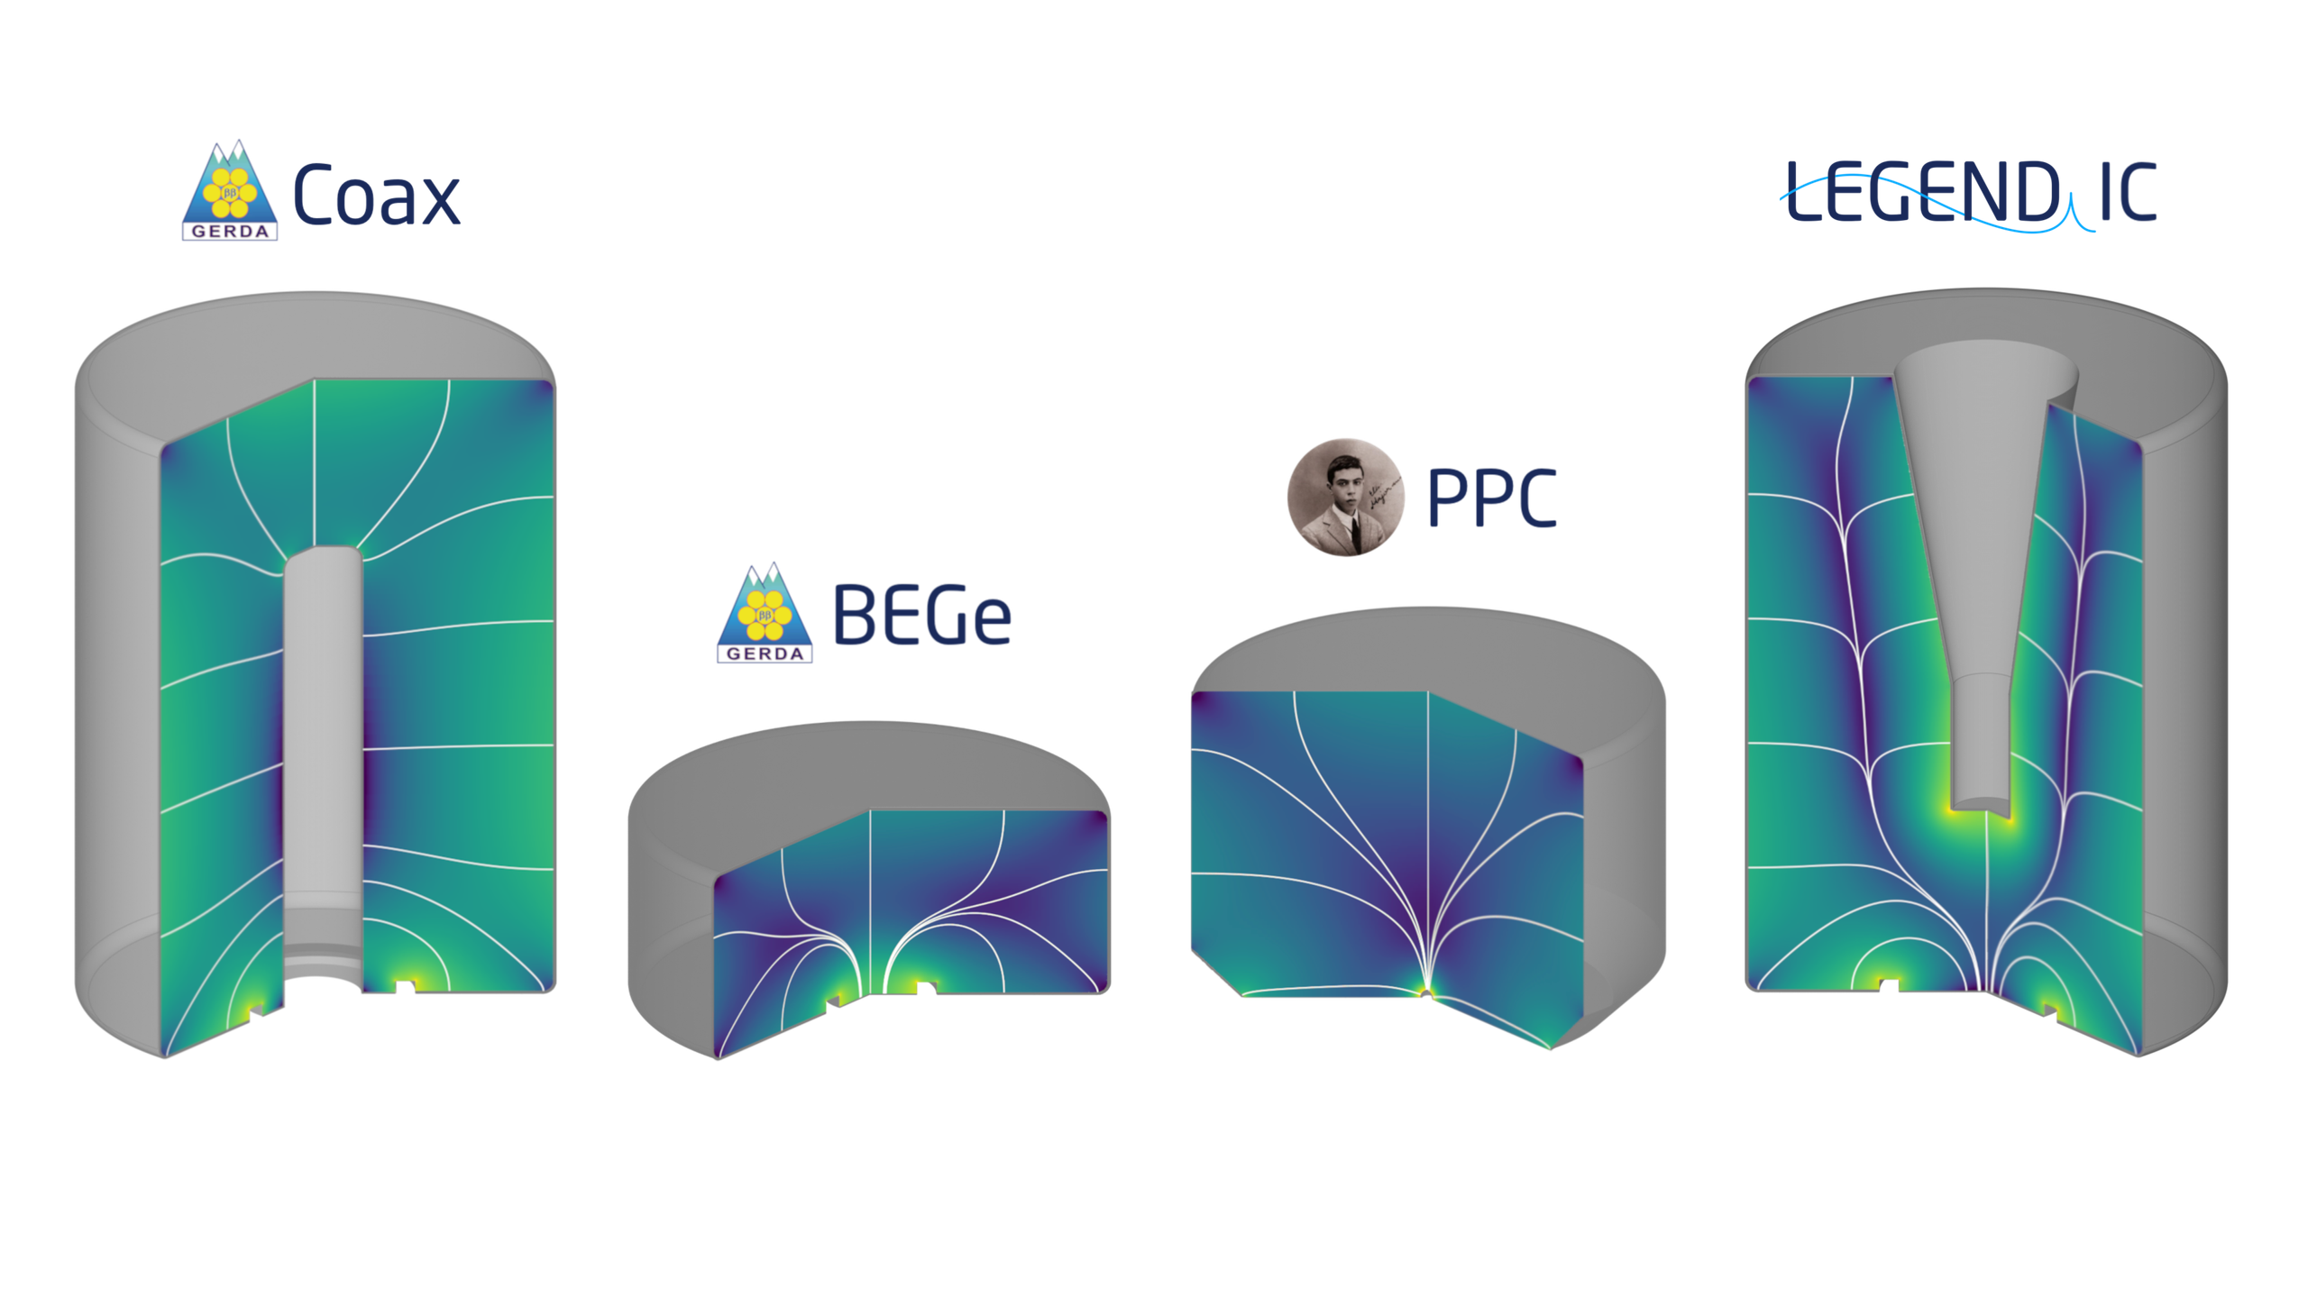
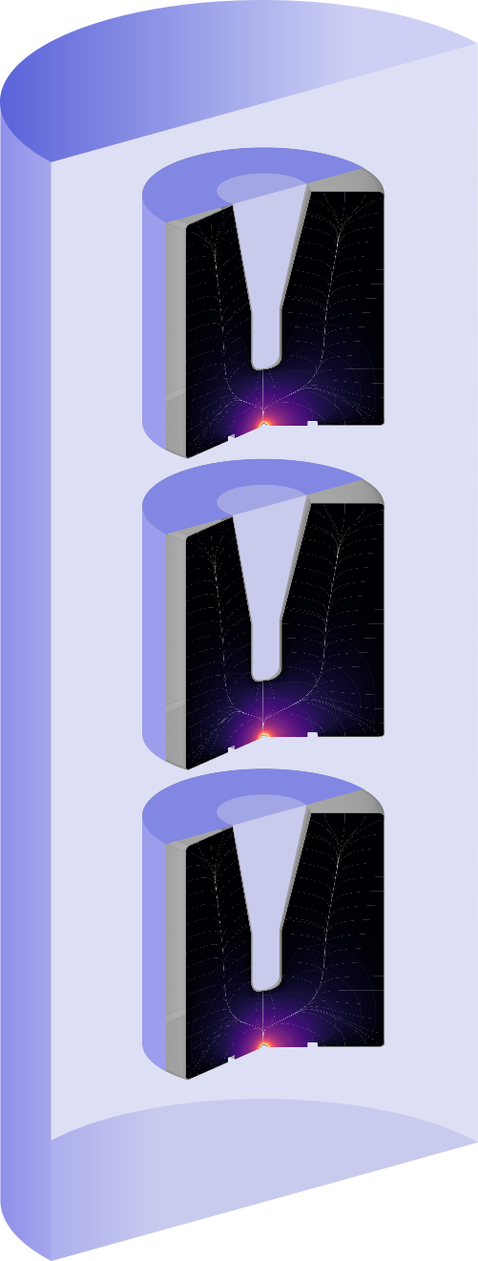

The LEGEND-200 detectors include the detectors from the past experiments and new ICPC detectors
Removed after the first deployment.
Replaced by new ICPC detectors
Liquid Argon (LAr)
ββ – signal-like
Background event topologies are removed by various analysis cuts
14.7 kg
19.0 kg
22.1 kg
86.7 kg
𝛾
Point contact detectors
Removed by LAr anti-coincidence
Multi-site event. Removed by pulse shape discrimination cut
Total Ge detector mass: ~142 kg
𝛾
Detector composition by mass in the first LEGEND-200 deployment

Slide 8
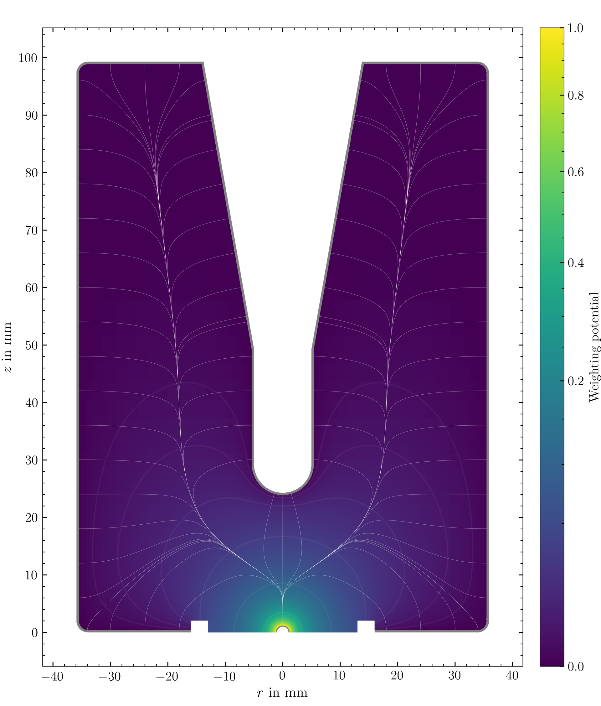
The point contact detector geometry plays a crucial role in
Pulse Shape Discrimination (PSD)
n+ electrode (HV application)
Largely uniform electric field.
Strongly increases in the close vicinity of the point contact
Similar waveforms in large part of the volume
Surface events: faster pulses close to p+
and slower near n+
Multi-site events: can be treated as superposition of single interactions
Passivated ditch
P+ electrode (signal readout)

Slide 9
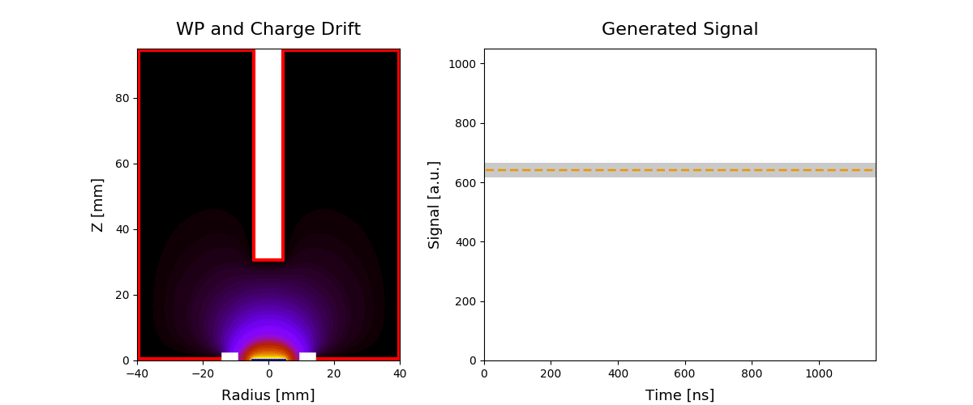
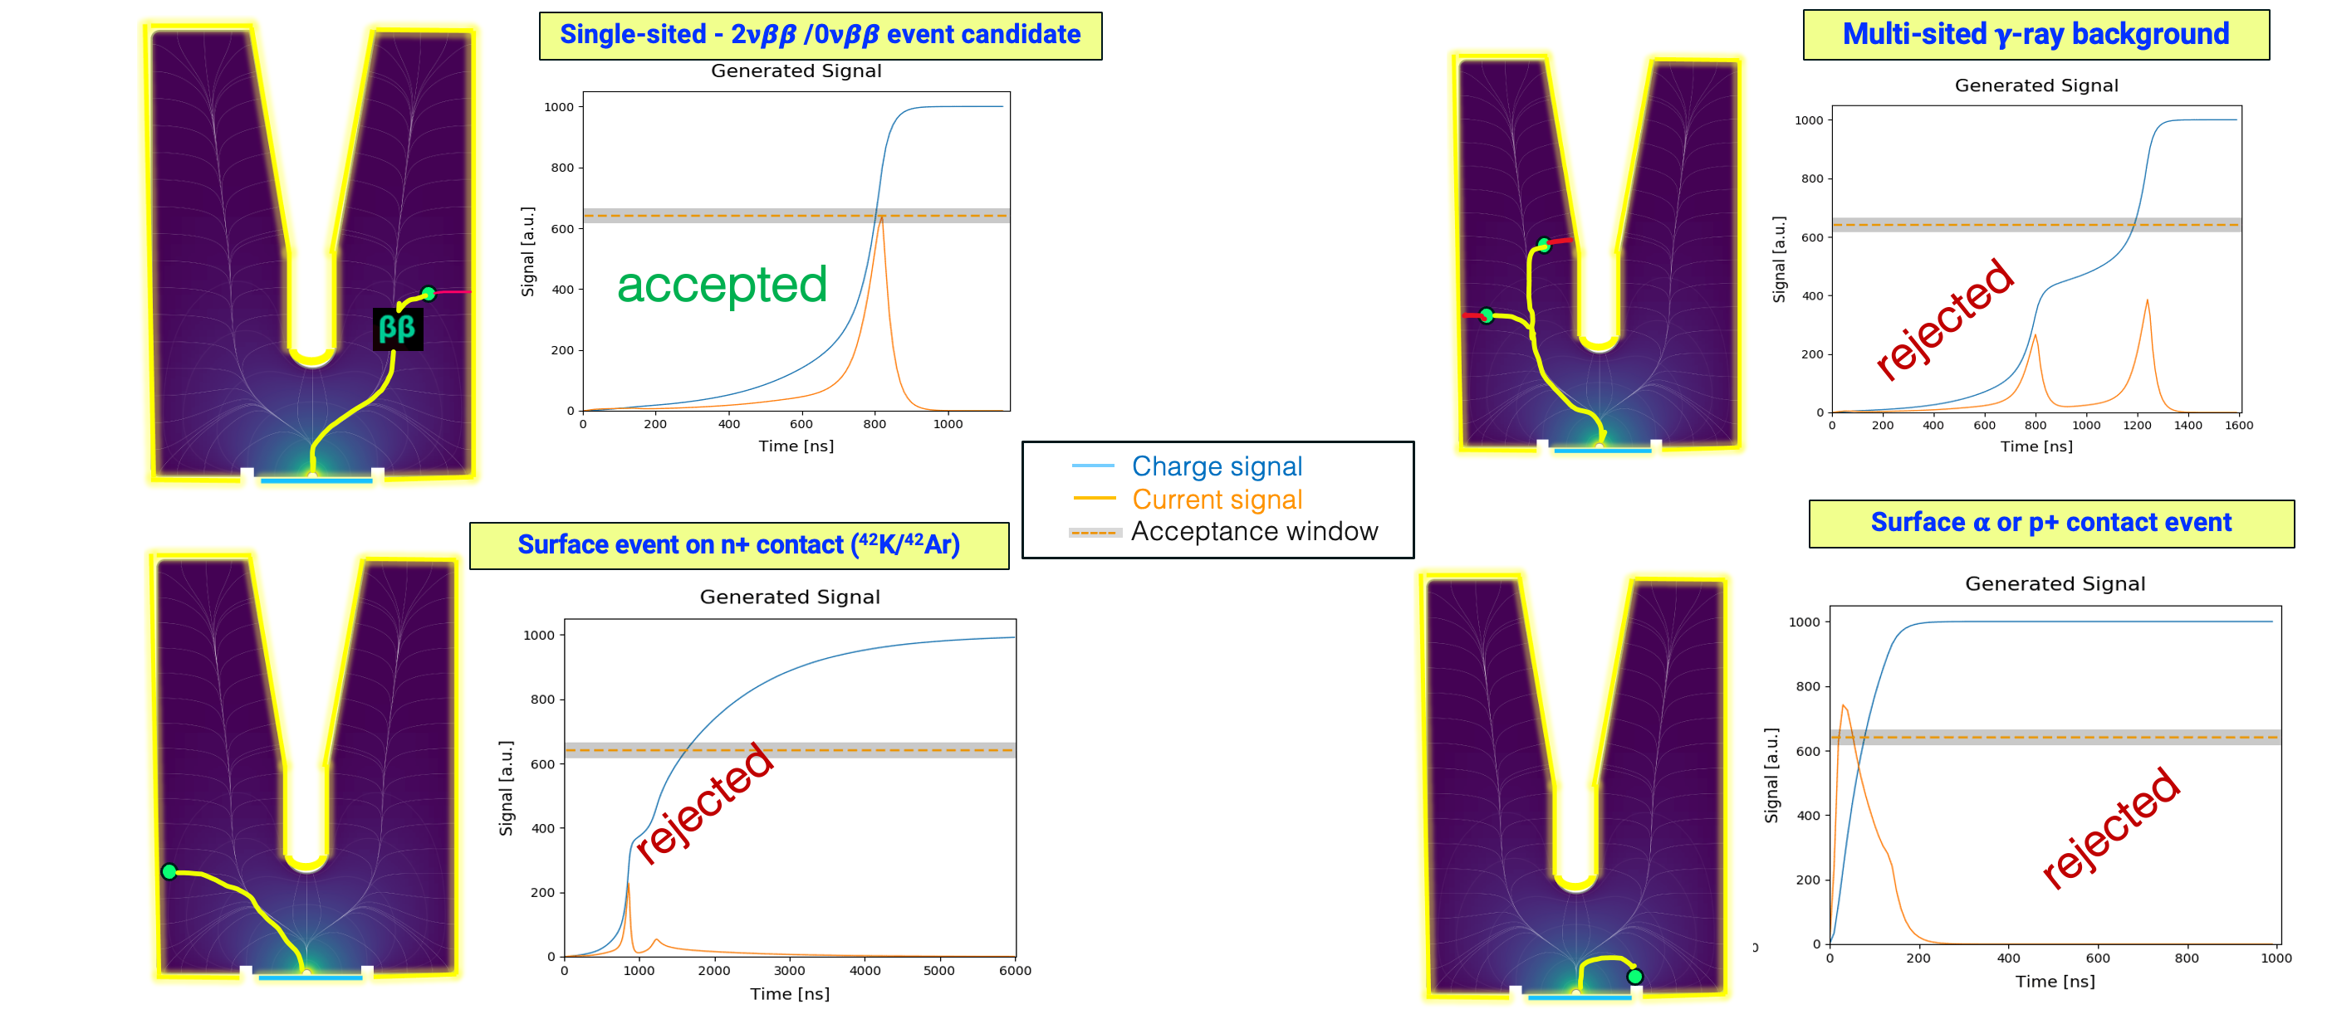
WP and charge drift
Generated signal
10000
80
----- Charge signal
----- Current signal
Acceptance window
8000
60
Z [mm]
6000
Current is smoothed derivative of the waveform
Signal [a.u.]
40
4000
20
2000
0
0
-40 -20 0 20 40
2000 4000 6000 8000 10000
Radius [mm]
Time [ns]
Rejection of multi-site and surface events with
A/E classifier. A/E = (current)Amplitude/Energy

Slide 10
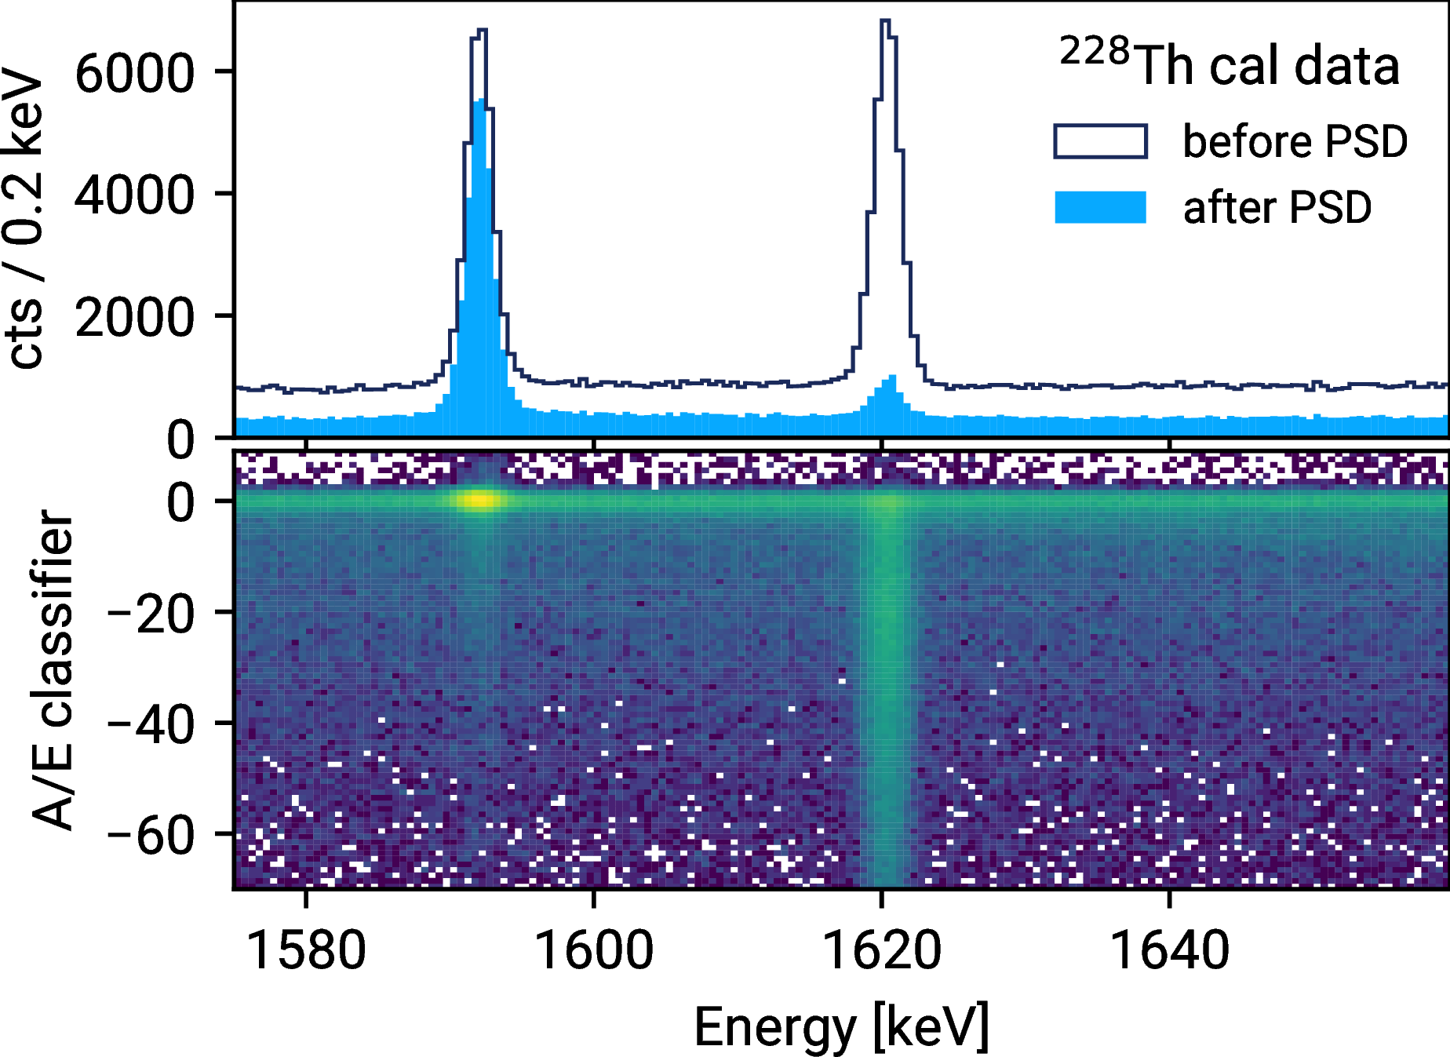
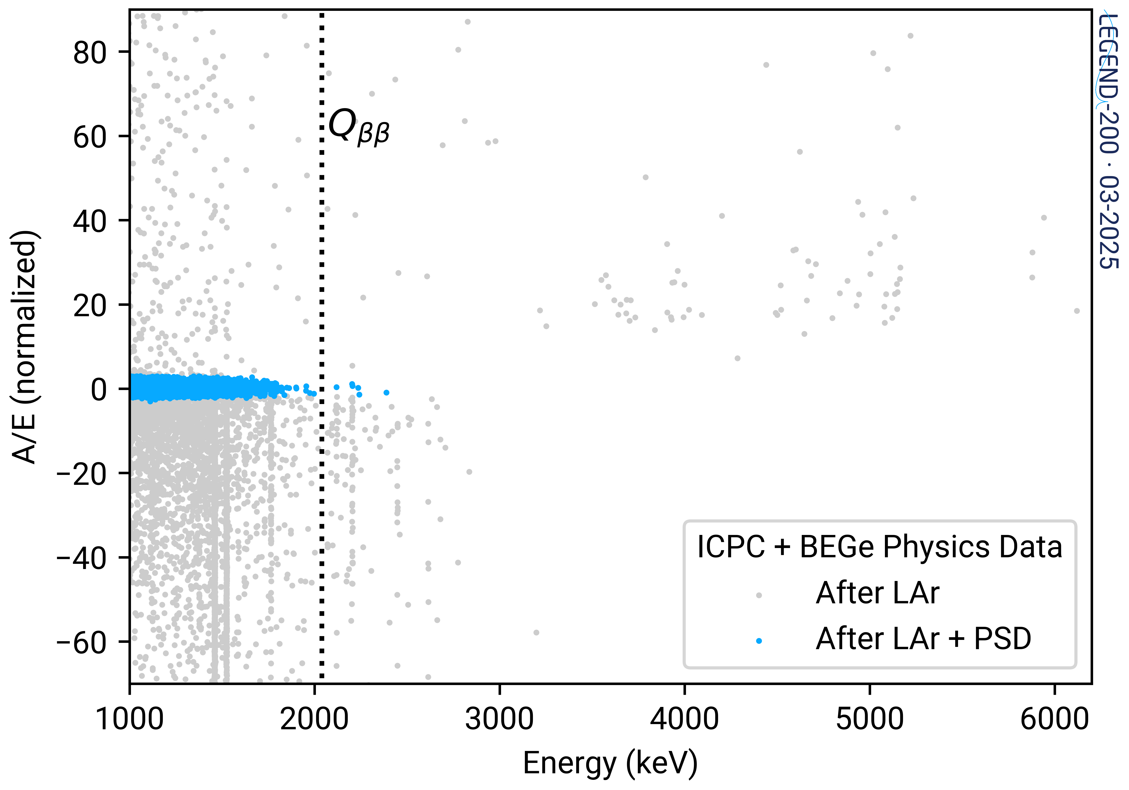
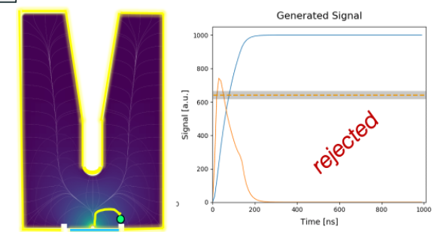
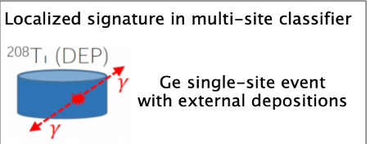
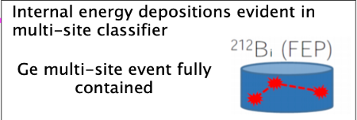
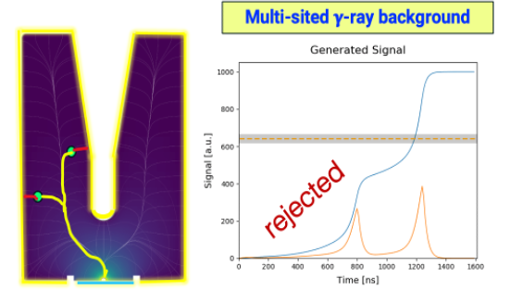
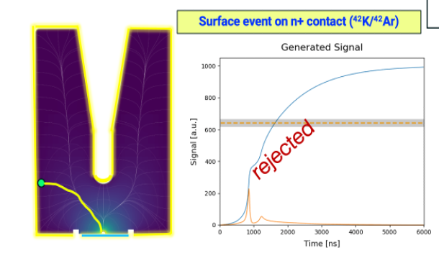
Rejection of multi-site and surface events with A/E classifier A/E = (current)Amplitude/Energy
Calibration data
Background data
²⁰⁸Tl
Double escape peak
²¹²Bi
Full
Energy
Peak
Removed by high A/E
𝛂 background
P+ contact
Single-site events (accepted)
Removed by low A/E
Multi-site
n+ contact

Slide 11
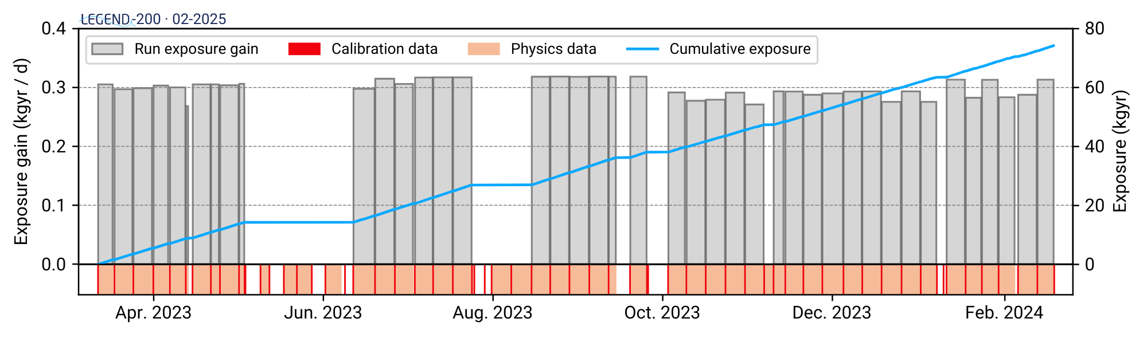
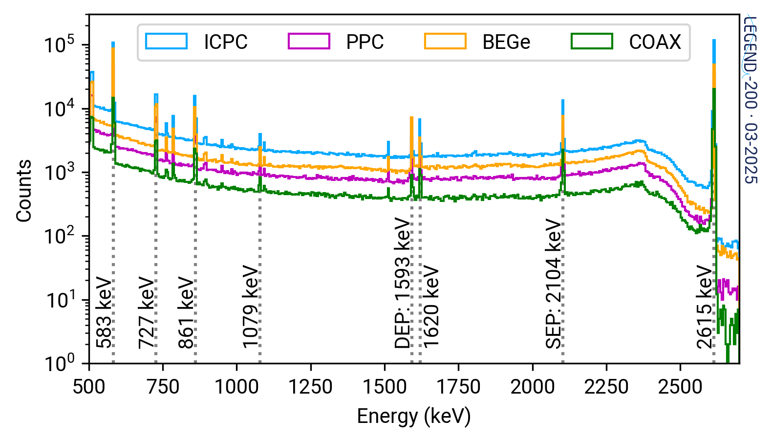
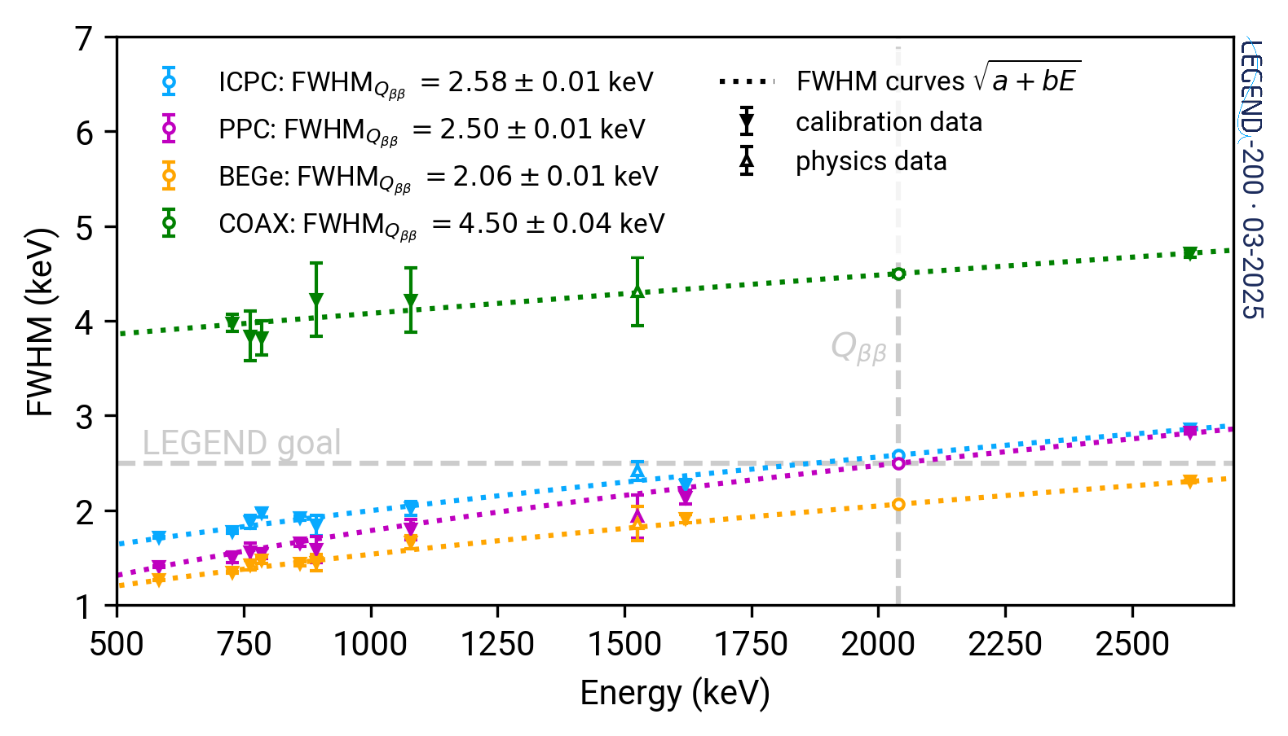
Summary of the Cumulative data from March 2023:
61 kg.yr of exposure
LEGEND-200 had stable energy observables over the first year of data-taking
The stability is monitored with ²²⁸Th weekly calibration data
~0.1% FWHM at Q_{ββ}
HPGe detector spectra
HPGe detector resolution

Slide 12
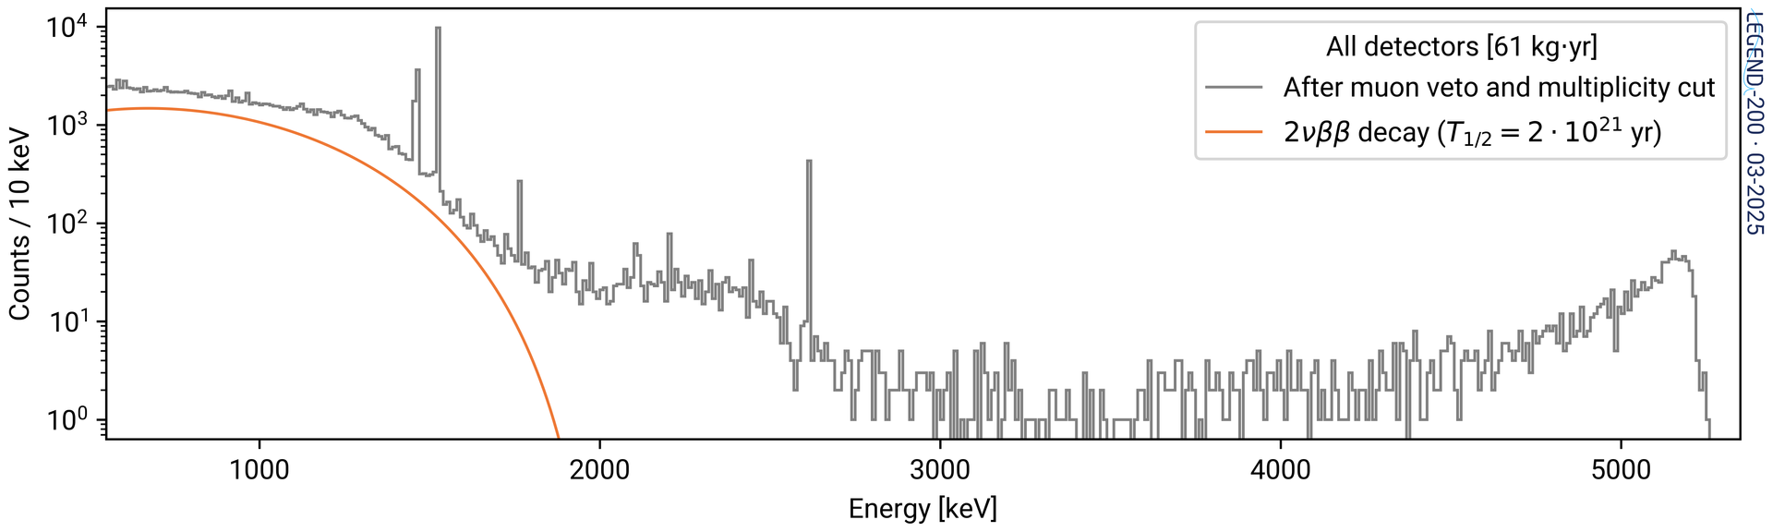
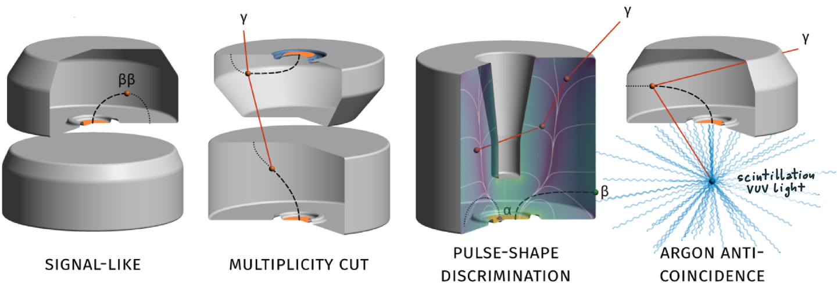
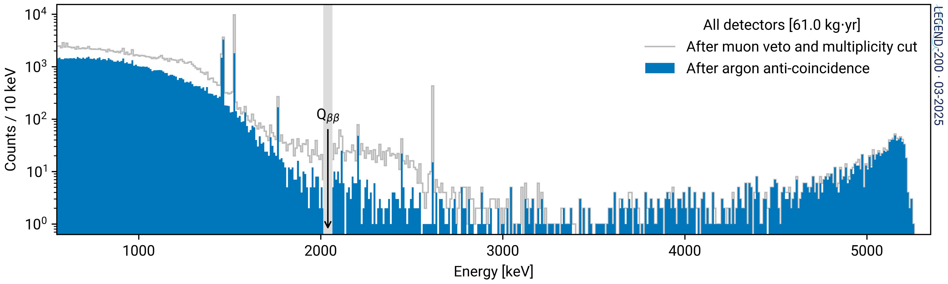
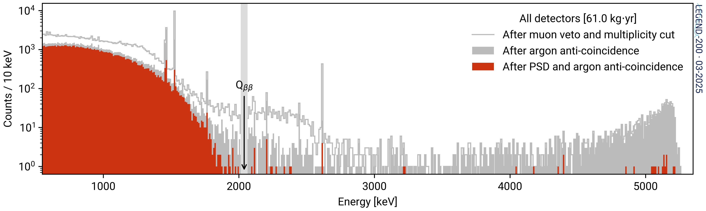

⁴⁰K
⁴²K
50 keV blinded window
LEGEND-200 HPGe detector spectrum corresponding to 61 kg.yr of exposure.
Data-cleaning, muon veto and multiplicity cuts applied.
²¹⁴Bi
$$Q_{ββ}$$
²⁰⁸Tl
𝛂 background region
2𝜈ββ region
⁴⁰K
⁴²K
²¹⁰Po
⁴⁰K
⁴²K
²¹²Bi
After the application of LAr Veto (blue filled) to the above spectrum. Background above 2𝜈ββ strongly suppressed. ~93% signal acceptance
50 keV blinded window
²¹⁴Bi
²⁰⁸Tl
𝛂 background region
2𝜈ββ region
²¹⁰Po
The spectrum after applying data cleaning PSD, and LAr anti-coincidence (red filled).
Strong suppression of backgrounds. 0𝜈ββ survival fraction of ∼60%
⁴⁰K
⁴²K
50 keV blinded window
²¹⁴Bi
²⁰⁸Tl
𝛂 background strongly suppressed
~ pure 2𝜈ββ
²¹⁰Po

Slide 13
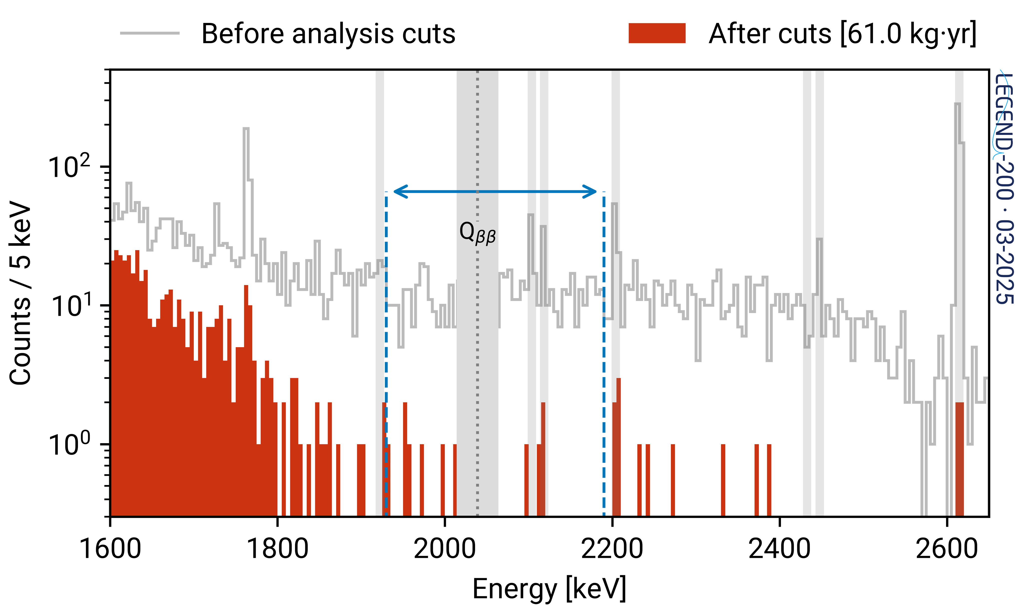

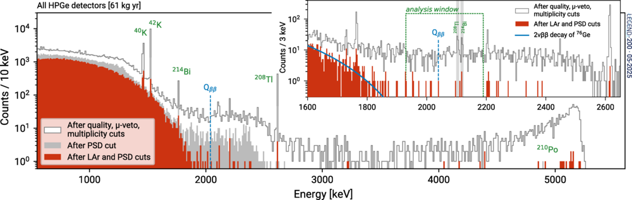

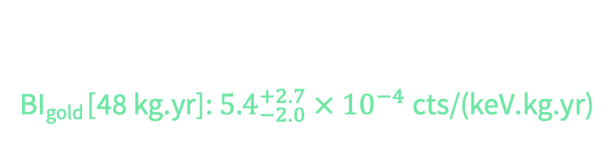
After the analysis cuts, 9 events survive in the
Background estimation window (1930 to 2190 keV)
Blinded window (50 keV)
Prior to unblinding
Unblinded!
Only 2 additional events after unblinding
Background indices:
BI_{gold} [48 kg.yr]: ${5.4}_{−2.0}^{+2.7} × {10}^{−4}$ cts/(keV.kg.yr)
World leading among 0𝜈ββ experiments, Comparable to GERDA
BI_{silver} [13 kg.yr]:${13}_{−5.4}^{+8.0} × {10}^{−4}$ cts/(keV.kg.yr)
Primarily coaxial detectors with seemingly worse background rejection

Slide 14
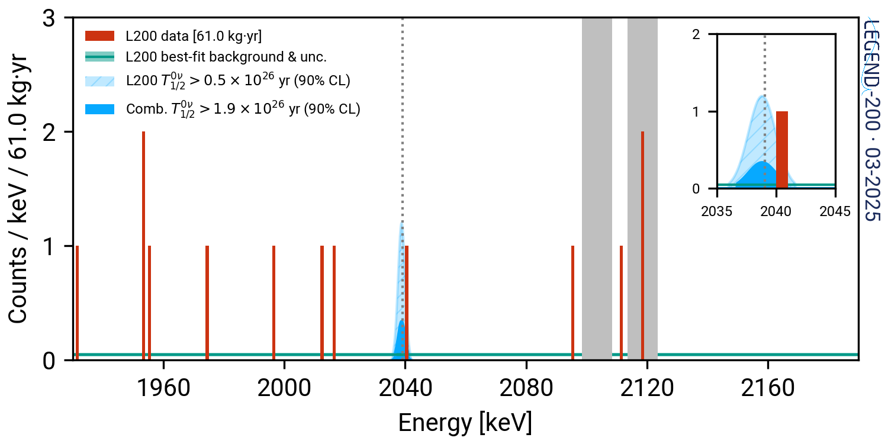
T_{1/2} (0𝜈ββ) lower limits (90% frequentist C.L.)
(combined fit from GERDA, Majorana and LEGEND)
(252.7 kg.yr)
Half life: T_{1/2} (0𝜈ββ) >1.9 x 10²⁶ yr
Median sensitivity: 2.8 x 10²⁶ yr (world-leading)
m_{ββ} < 75 -200 meV
One event at 1.4σ from Q_{ββ} weakens combined limit
(background-only p-value = 0.1, does not reach 3𝜎 significance for discovery)
Known gamma lines excluded from the fit
After maintenance and background characterization, detectors have been recommissioned.
LEGEND-200 is presently taking data from the second physics deployment with new additional ICPC detectors.

Slide 15
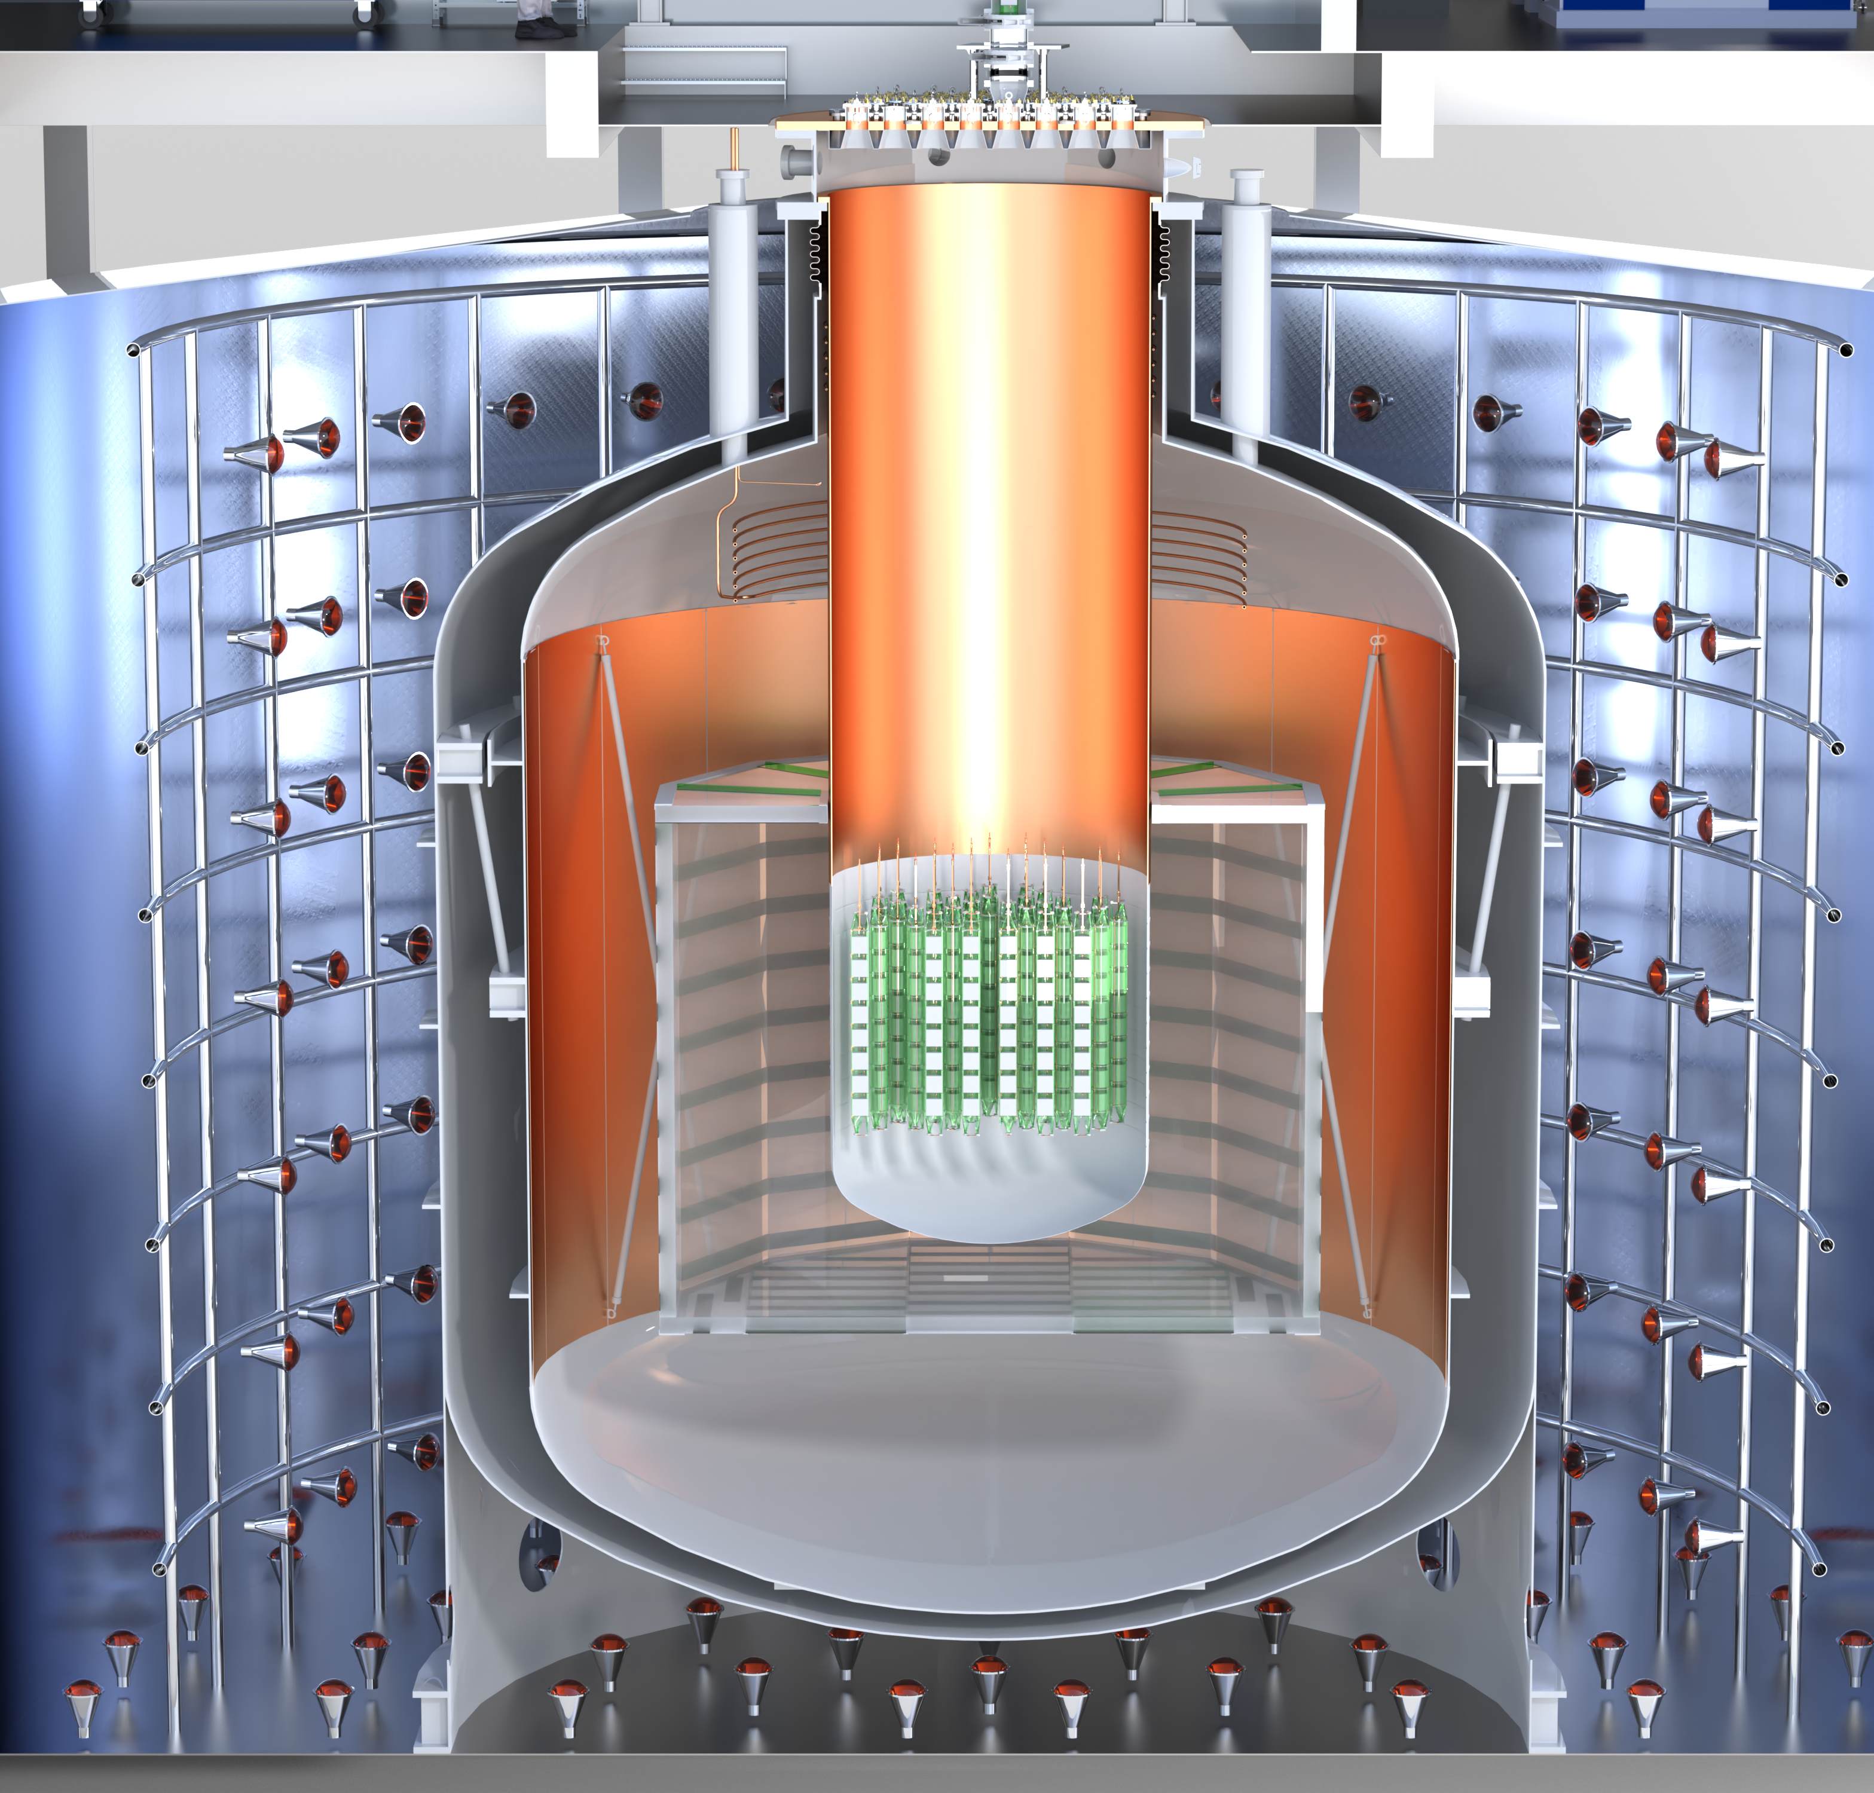
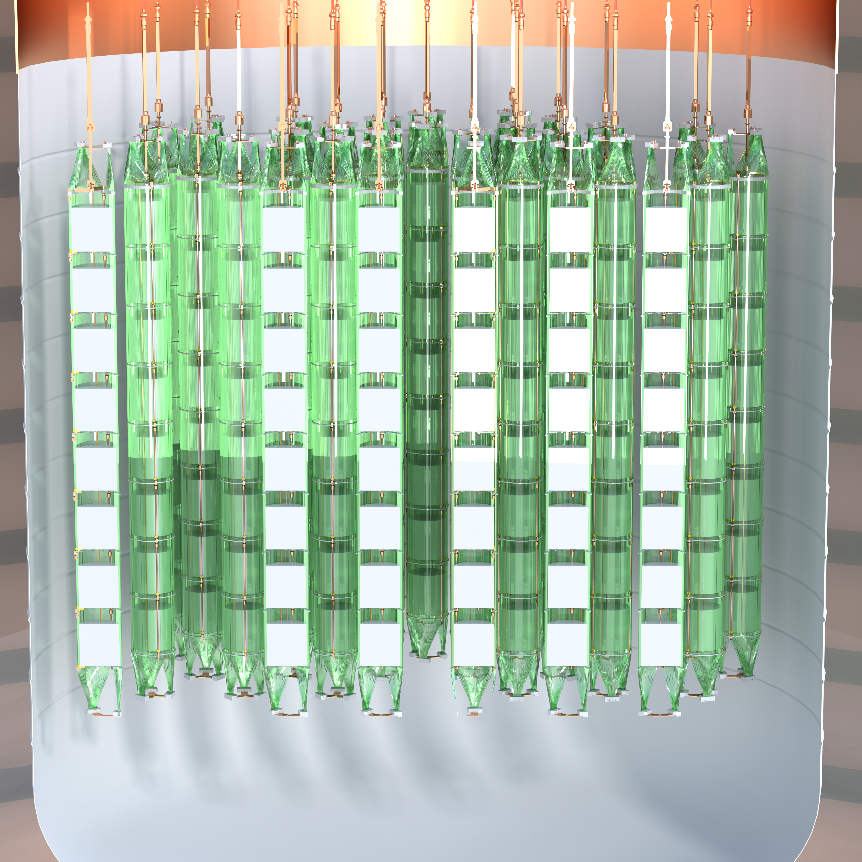
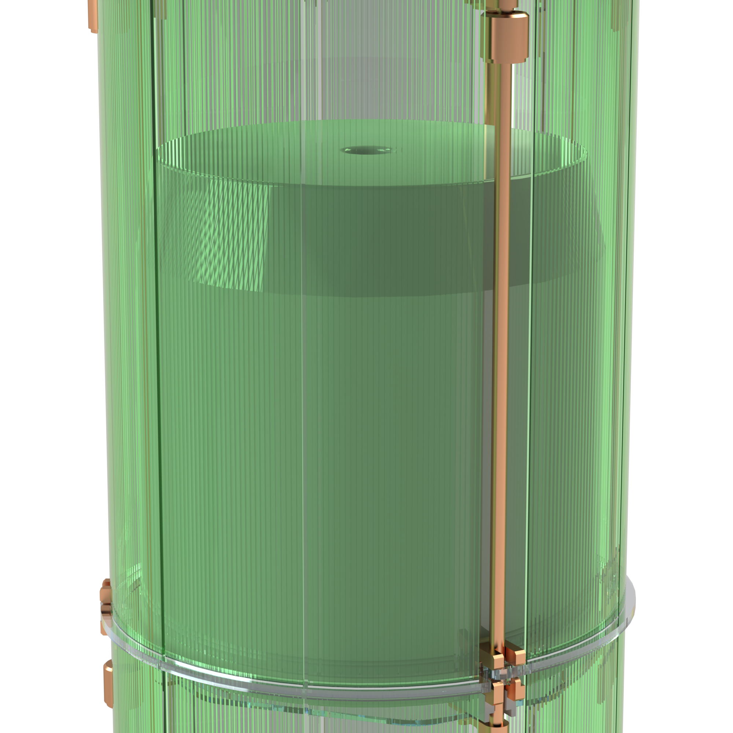
Towards Ton-scale: - 1000
336 detectors distributed among 42 strings
WLS Fiber Curtain
Ge Strings
Large-mass (3 kg) high purity p-type ICPC detectors
Enriched to more than 90% in ⁷⁶Ge
Reentrant Tube
Water Shield
Radiopure electronics and cables
Neutron Moderator
Underground LAr
Atmospheric LAr
Underground-sourced Argon (UGLAr) to mitigate the ⁴²Ar background

Slide 16
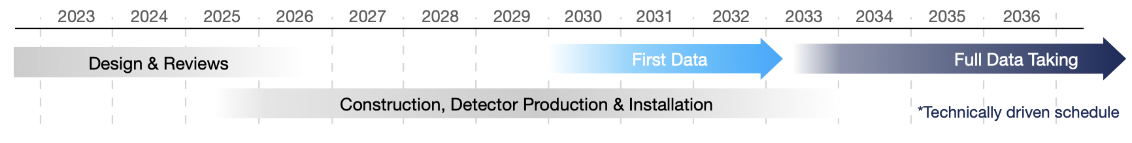
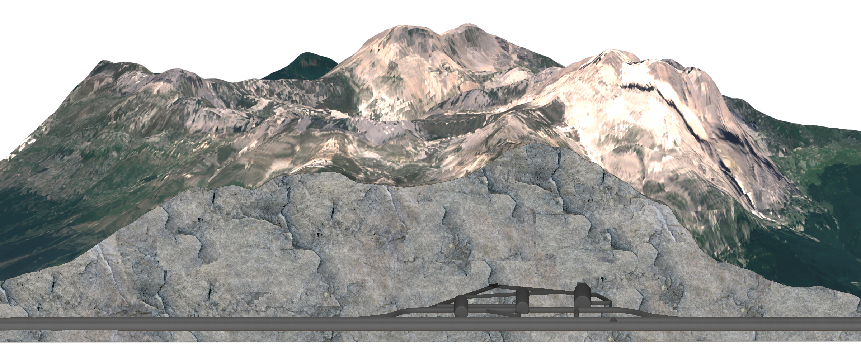

LEGEND-1000 is optimized for a quasi-background-free 0νββ search fully
covers the inverted neutrino masses
Low backgrounds, excellent resolution, and event topology discrimination allow for an unambiguous discovery of 0νββ decay at T_{1/2} = 10²⁸ years

Slide 17



THANK YOU
⁷⁶Ge is a leading isotope for 0𝜈ββ searches, LEGEND will be commissioned in two stages
Questions?
LEGEND-200 completed its first 0𝜈ββ unblinding with 61 kg yr of exposure, results published in PRL
LEGEND-200 achieved
world-leading background level among 0𝜈ββ experiments, comparable to GERDA
LEGEND-1000 is optimized for a quasi-background-free 0𝜈ββ search, has a low-risk path to meeting its background goal of
10⁻⁵ counts/(keV kg yr) with discovery sensitivity beyond 10²⁸ years
https://legend-exp.org/
H. Acharya et al., PRL 136, 022701 (2026)

Slide 18
Back up slides

Slide 19



LEGEND brings the innovation + expertise from its very successful, ⁷⁶Ge-based, predecessors
The GERmanium Detector Array
Majorana Demonstrator
Sanford Underground Research Facility (SURF) in Lead, SD
Laboratori Nazionali del Gran Sasso, INFN, Italy
2015-2021
2011-2020
T_{1/2} (0𝛎ββ) > 8.3 x 10²⁵ y
(90% C.L.)
T_{1/2} (0𝛎ββ) > 1.8x10²⁶ yr
(90 % C.L.)
64.5 kg yr
127.3 kg yr
Achieved the best energy resolution
2.5 keV at 2039 keV
Achieved the best background index
5 x 10⁻⁴ cts/(keV kg yr)
Demonstrated the operation of Ge detectors in liquid Argon
For excellent background suppression
Phys. Rev. Lett. 130, 062501 (2023)
Phys. Rev. Lett. 125, 252502 (2020)

Slide 20

Rejection of surface events with the Late Charge (LQ) classifier
Passivated surface and n+ events exhibit slow charge rerelease
Quantified by the slow component above the rising edge after 80% of charge is collected – area above the waveform
These events are energy degraded - can contribute to the background

Slide 21
Rejection of surface events with the Late Charge (LQ) classifier
Removed by LQ
Accepted events

Slide 22
The PSD cuts are tuned using gamma lines from ²²⁸Th source
²⁰⁸Tl
Double escape peak
²¹²Bi
Full
Energy
Peak
Signal proxy – Double escape peak (DEP) from ²⁰⁸Tl
Low A/E cut set at
90% DEP acceptance
High A/E cut set at 3𝜎 –
> 96% DEP acceptance
LQ cut set at 3𝜎 –
> 98% DEP acceptance
Multi-site rejection is measured by Single escape peak (SEP), full energy peak (FEP)
and Compton continuum

Slide 23


Artificial Neural network (ANN) is Used to discriminate single and Multi-site events for Coaxial detectors
In the case of coaxial detectors, P+ contact events are rejected Using a cut based on the pulse Risetime. Similar method to GERDA Phys. J. C 82, 284 (2022)
Artificial Neural network (ANN) is Used to discriminate single and Multi-site events
PSD acceptances of LEGEND detectors with systematic errors

Slide 24

The LEGEND-200 background model reproduces the data well, the model is flat at Q_{ββ}
Fit to the data
Flat background at Q_{ββ}

Slide 25

Simulations and material radioassay underpredict ²²⁸Th in physics data (before analysis cuts)
Background excess identified (holder assembly, fibers).
Significant reduction of ²¹⁴Bi and ²⁰⁸Tl lines
after re-cleaning and installation
Hard to estimate systematic uncertainty on the assay results
Background excess compared to assay expectations
Not a fit to the data!

Slide 26


Slide 27

Background from the beta decay of ⁴²K is strongly suppressed after LAr anti-coincidence
⁴⁰K
⁴²K
EC
(uniform)
β
(surface)
Blinded window
²¹²Bi
²⁰⁸Tl
2𝜈ββ region

Slide 28


Simulated example spectrum: after cuts from 10 ton-years of data for LEGEND-1000
<10⁻⁶ 2νββ events leak into in Q_{ββ}±2σ
0νββ
T1/2 = 10²⁸ yr 3-4 events
For 10 years of live time, LEGEND-1000 will probe 0νββ decay with 99.7% CL discovery sensitivity (a 50% chance of measuring a signal of at least 3σ significance for T1/2 of 1.3 × 10²⁸ years) corresponding to a mββ upper limit in the range of 9–21 meV.
Flat, featureless background
No background peaks are expected close to Q_{ββ}

Slide 29




Photos by Michael Willers

