Slide 1
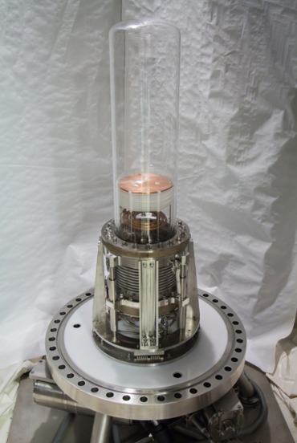


PICO
Quinn Malin, University of Alberta
On behalf of the PICO Collaboration
Lake Louise Winter Institute, March 2nd 2026

Slide 2
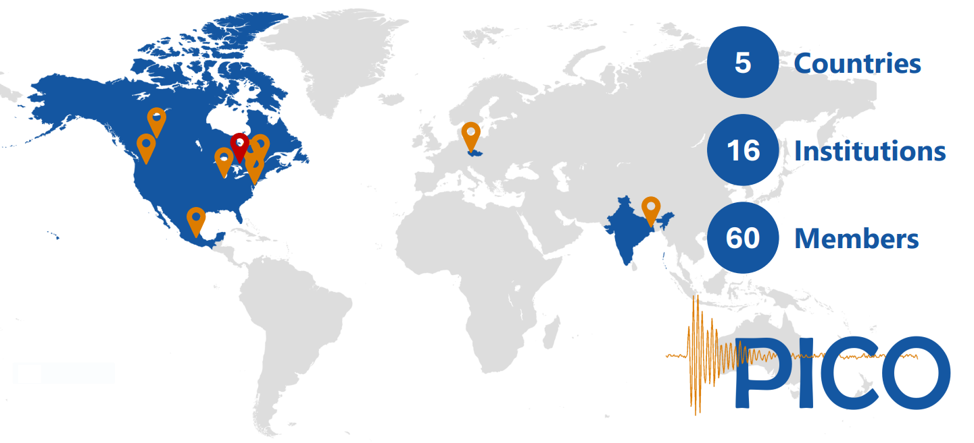
The PICO Collaboration
5
16
35

Slide 3
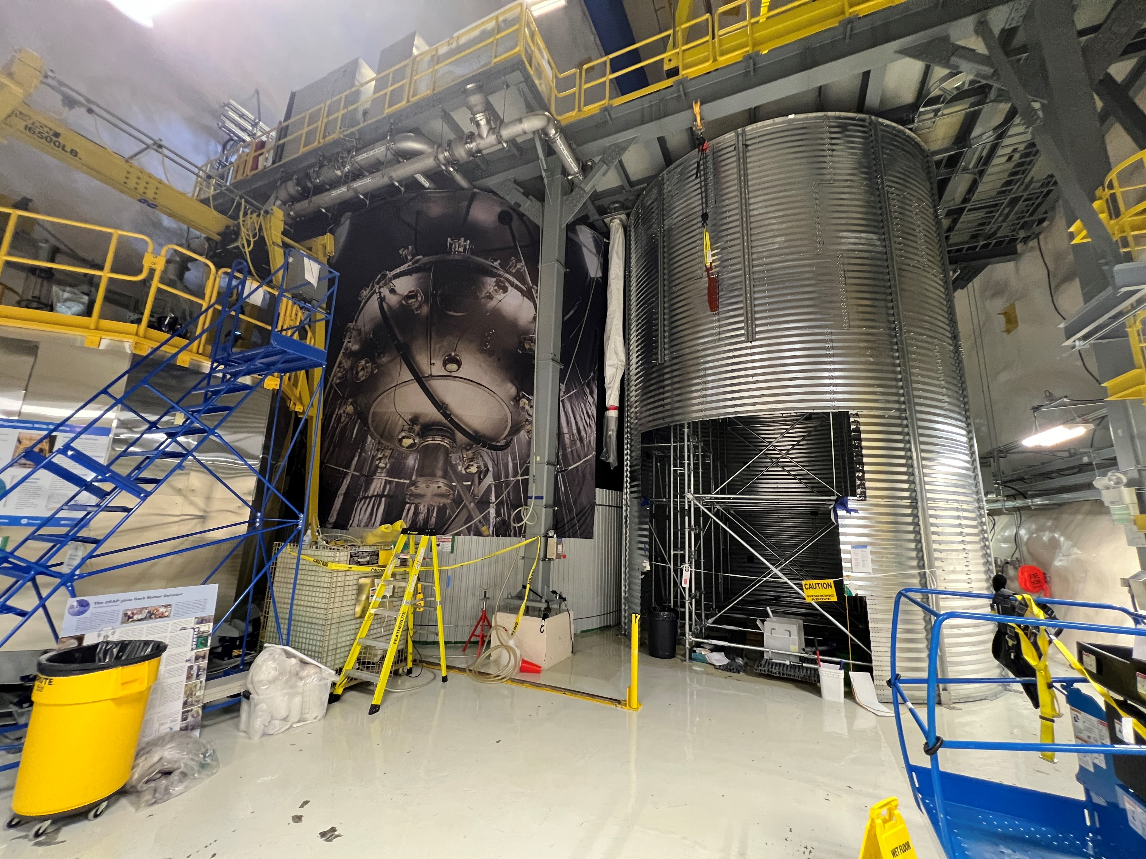
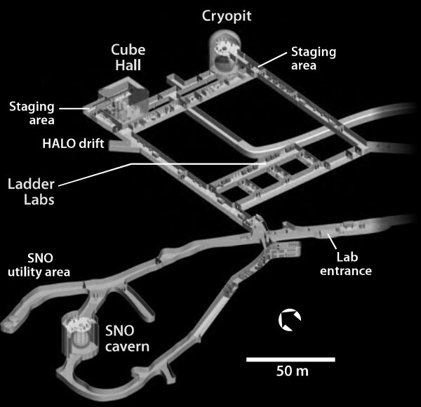
The PICO Collaboration
PICO-500
DEAP
NEWS-G
Notes:
6800 meters water equivalent, shields from cosmic rays

Slide 4
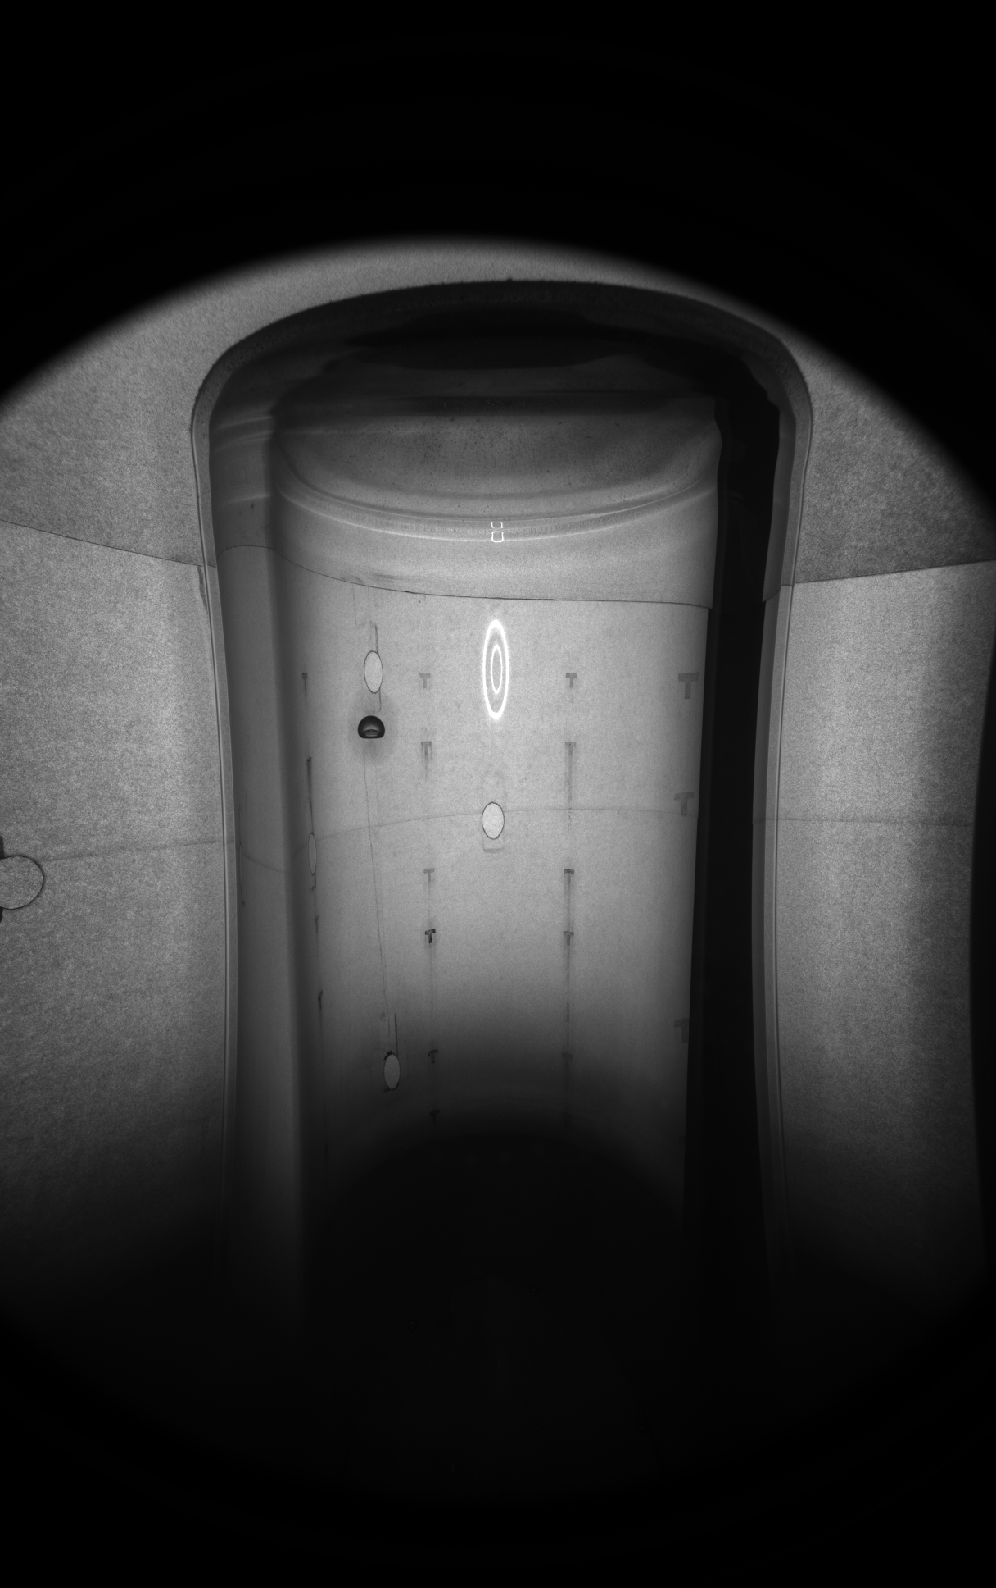
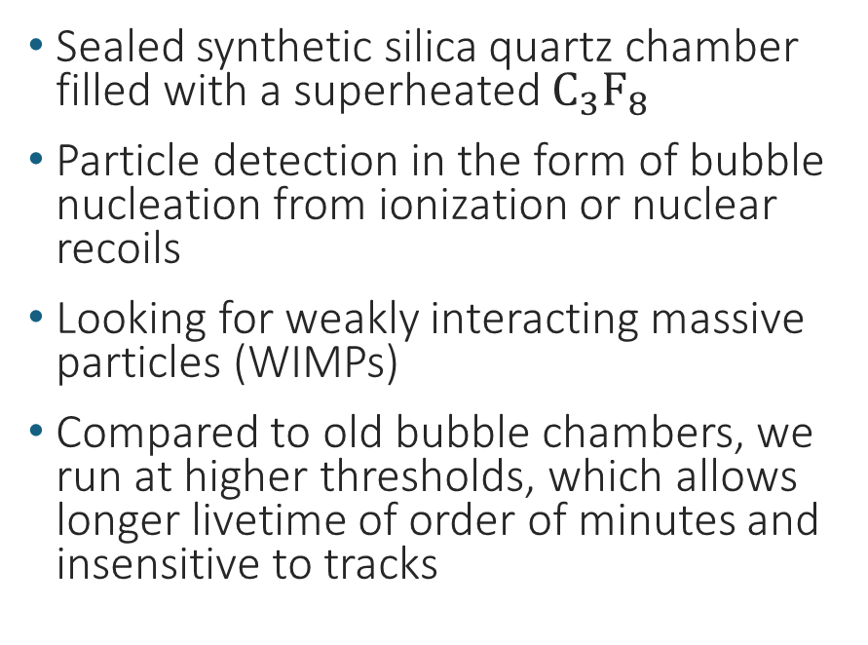
PICO Bubble Chambers
Sealed synthetic silica quartz chamber filled with a superheated $C_{3}F_{8}$
Particle detection in the form of bubble nucleation from ionization or nuclear recoils
Looking for weakly interacting massive particles (WIMPs)
Compared to old bubble chambers, we run at higher thresholds, which allows longer livetime of order of minutes and insensitive to tracks

Slide 5
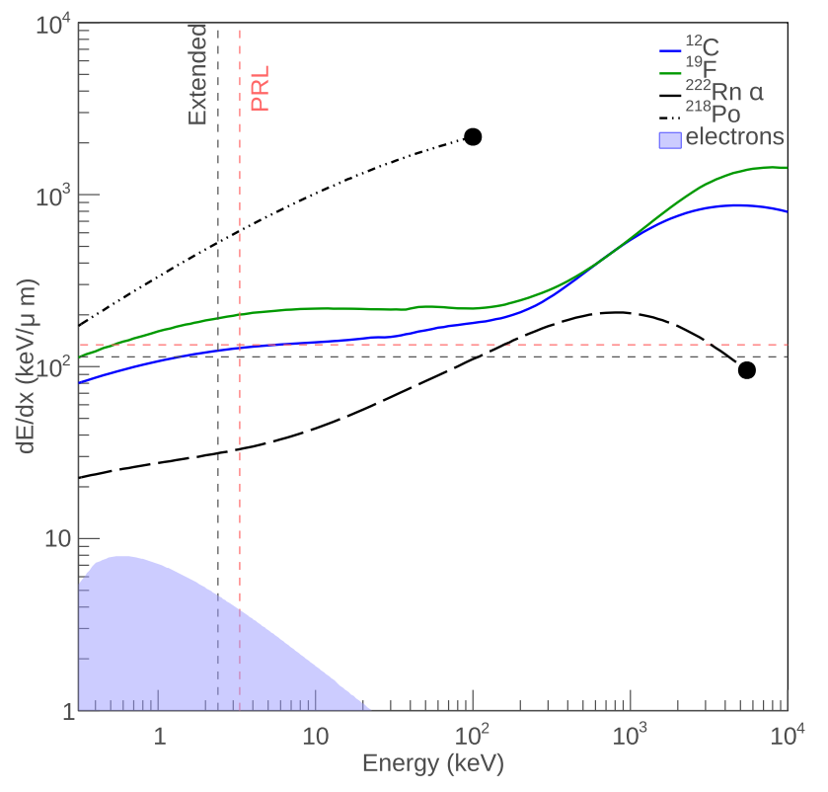
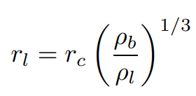
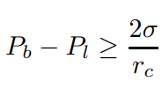
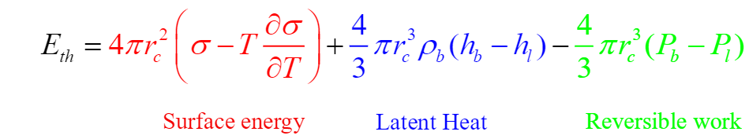

Seitz Threshold
Energy deposition greater than the Seitz threshold ($E_{th}$) in a radius less than critical radius ($r_{c}$) will cause a bubble large enough to overcome surface tension (Seitz hot-spike model)
Insensitive to electrons at our thresholds
Notes:
Explain graph and equations, conditions for bubbles

Slide 6
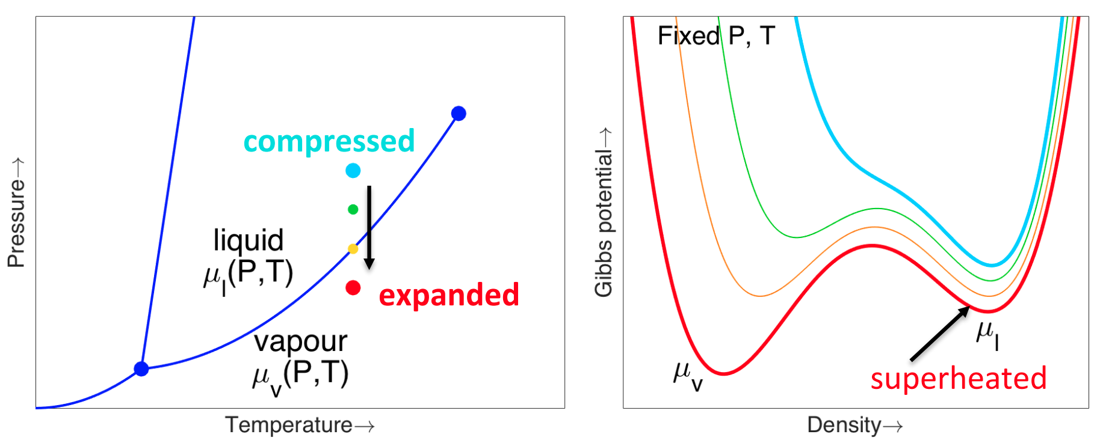
Operating Principle
Active Volume
Active Volume
Active Volume
Active Volume
27.5 psi
200 psi
140 psi
80 psi
Notes:
Gas phase has lower E than liquid, use color to guide eyes, make plot larger

Slide 7
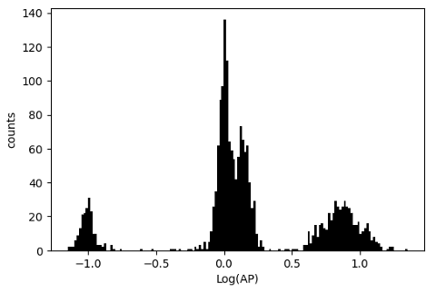
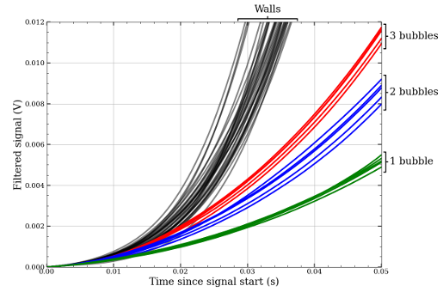

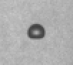
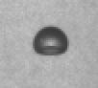
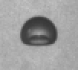
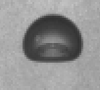
Methods of Detection
Acoustics
Pressure
Cameras
Record acoustic data of bubbles
Distinguishes nuclear recoils and alphas
Acoustic parameter (AP), which represents energy of the signal
Record pressure in active volume
Excellent discrimination between bulk and wall events
Record 41 frames (20 before, 20 after) event genesis at 100 fps across 4 camera
Differentiate spatial location with stereo reconstruction

Slide 8
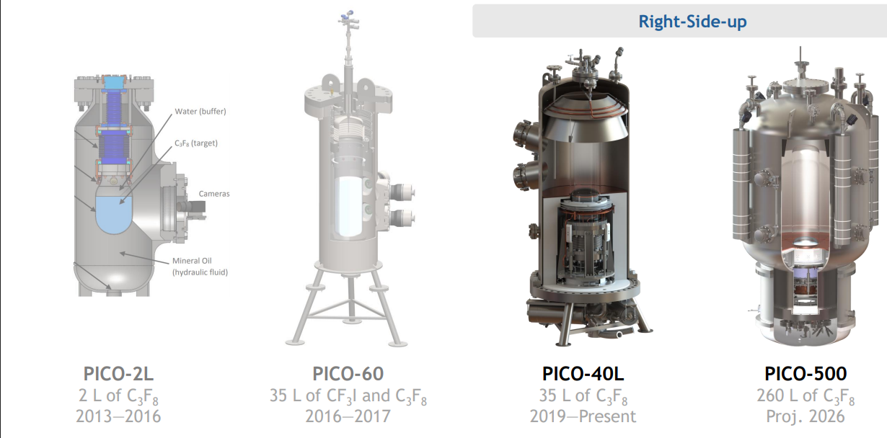
PICO Bubble Chambers

Slide 9
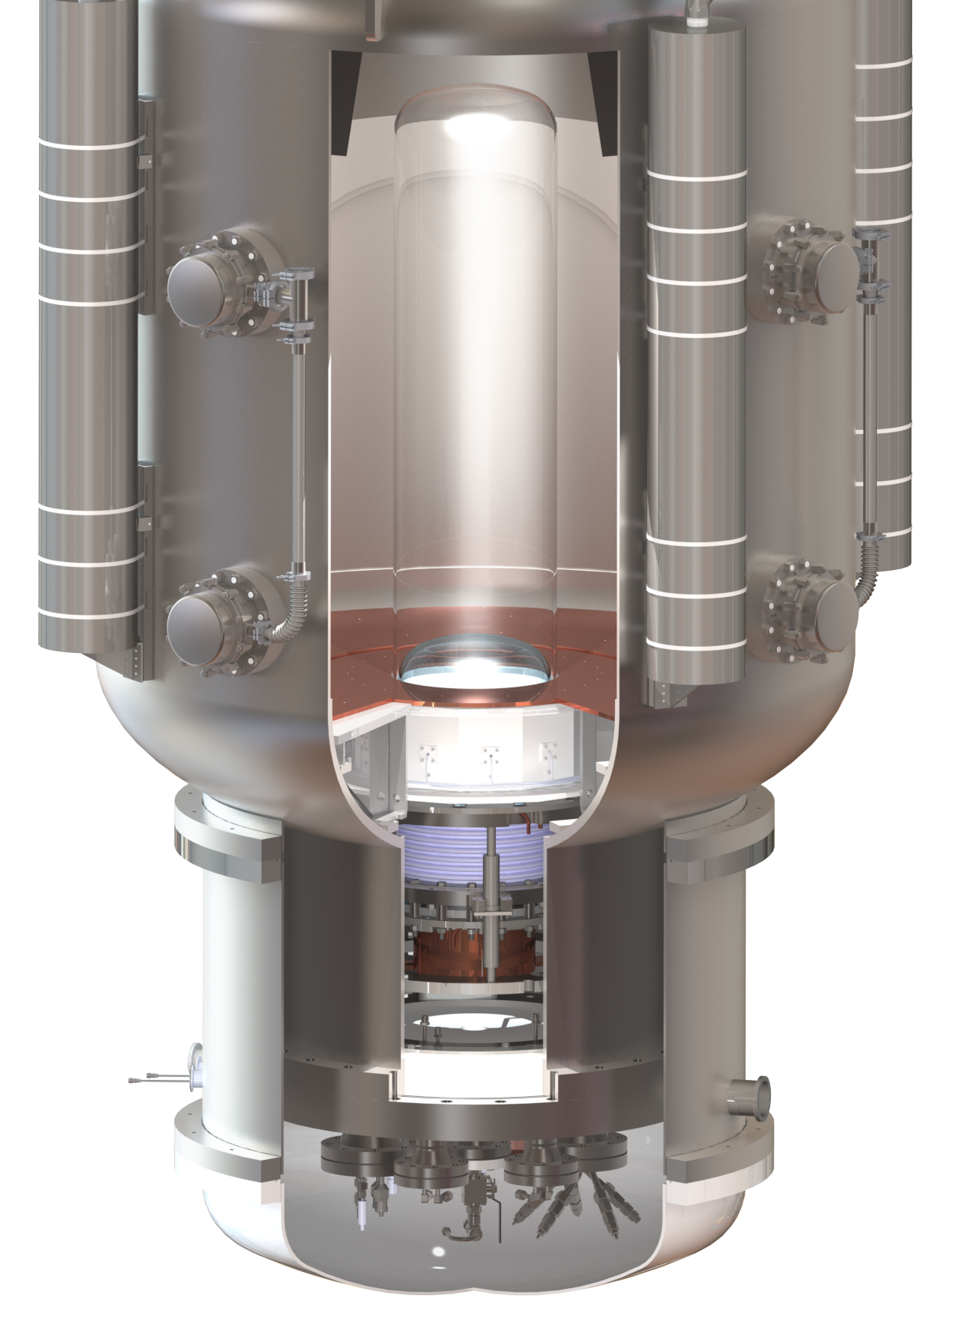
PICO Bubble Chambers
1m
Notes:
Mention size of PV for 500, built for the possibility of a larger jar but currently we own the largest silica quartz jars manufacturable

Slide 10
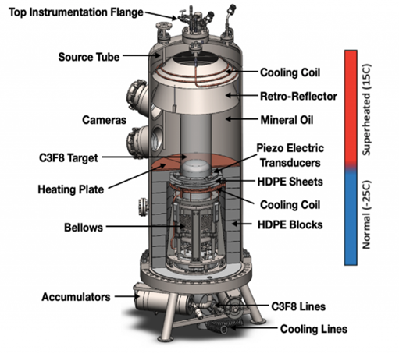
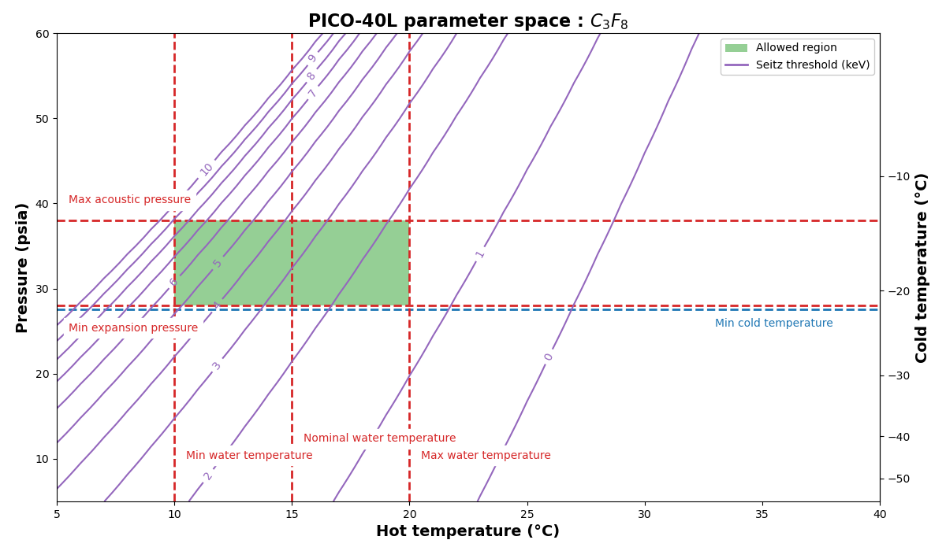
PICO-40L
Proof of concept for PICO-500, currently built at SNOLAB
Hot and cold region to prevent boiling outside the camera view
Detector paper on arXiv in the next week or so
Target
Notes:
Detector paper will give a full technical description of the RSU chamber

Slide 11
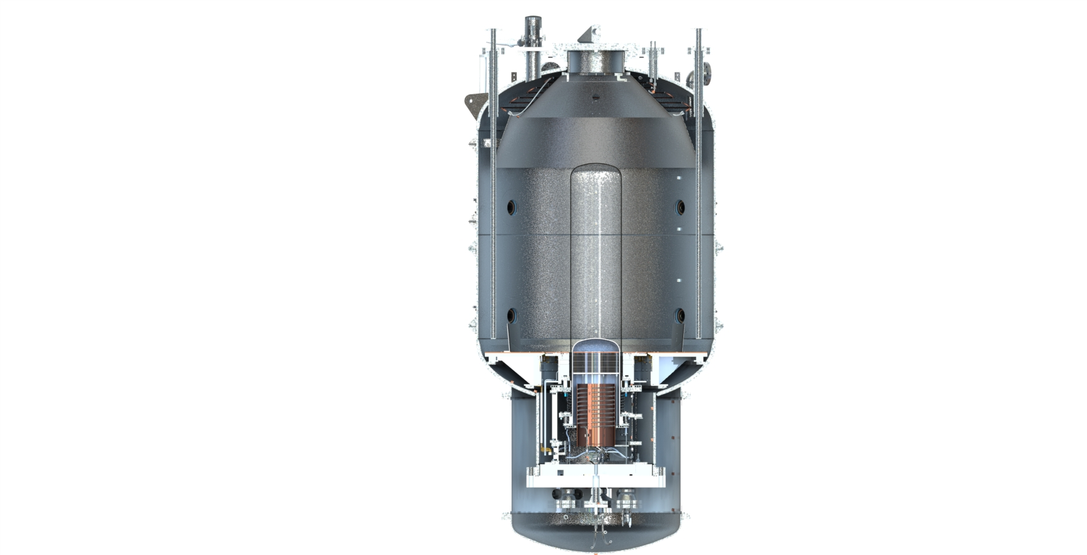

PICO-500
Source Tube
Source Tube
Larger version of PICO-40L
Improvements to PICO-500
  More rigorous cleaning and radon mitigation techniques
  Improved heater design
  Vacuum jacket for temperature stability
  Spring energized PTFE seals
    Low radon permeation
    Operate at larger temperature ranges
  Muon veto system
  Variable gain piezos
Cooling Coil
Retro-Reflectors
Mineral Oil
Outer Jar
Cameras
$C_{3}F_{8}$ Target
Inner Jar
Piezo Electric Transducers
Heating Plate
Vacuum Jacket
Notes:
Diameter of 2m

Slide 12

Expected Interactions: Alpha decays
Large acoustic signature
α
Po218
Small acoustic signature
$$r_{c}$$
Alphas create a much larger bubble initially => record a much larger acoustic amplitude
Rn222
Po218
α
The Rn-222 chain is our largest source of backgrounds

Slide 13
Expected Interactions: Nuclear Recoils
PICO-40L
WIMPS are indistinguishable from single neutrons or CEνNS visually and acoustically
n
Neutron
<1.4 multiples, <0.59 singles per live year
No neutrons seen in the physics data runs for PICO-40L
χ
Dark matter (WIMPS)
Expect 0.05 per live year
There’s also gammas, muons, and other non-particle mechanism that cause events
ν
Neutrinos
(CEνNS)
0.1 per live year

Slide 14
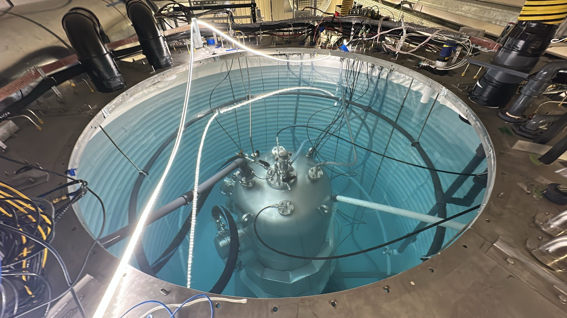
Background Mitigation
Water tank added for protection against neutrons
Thermal bath for temperature stability

Slide 15
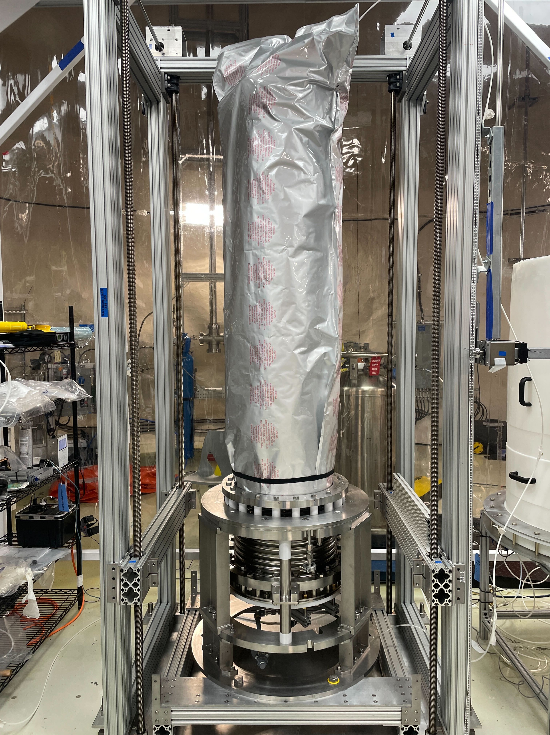
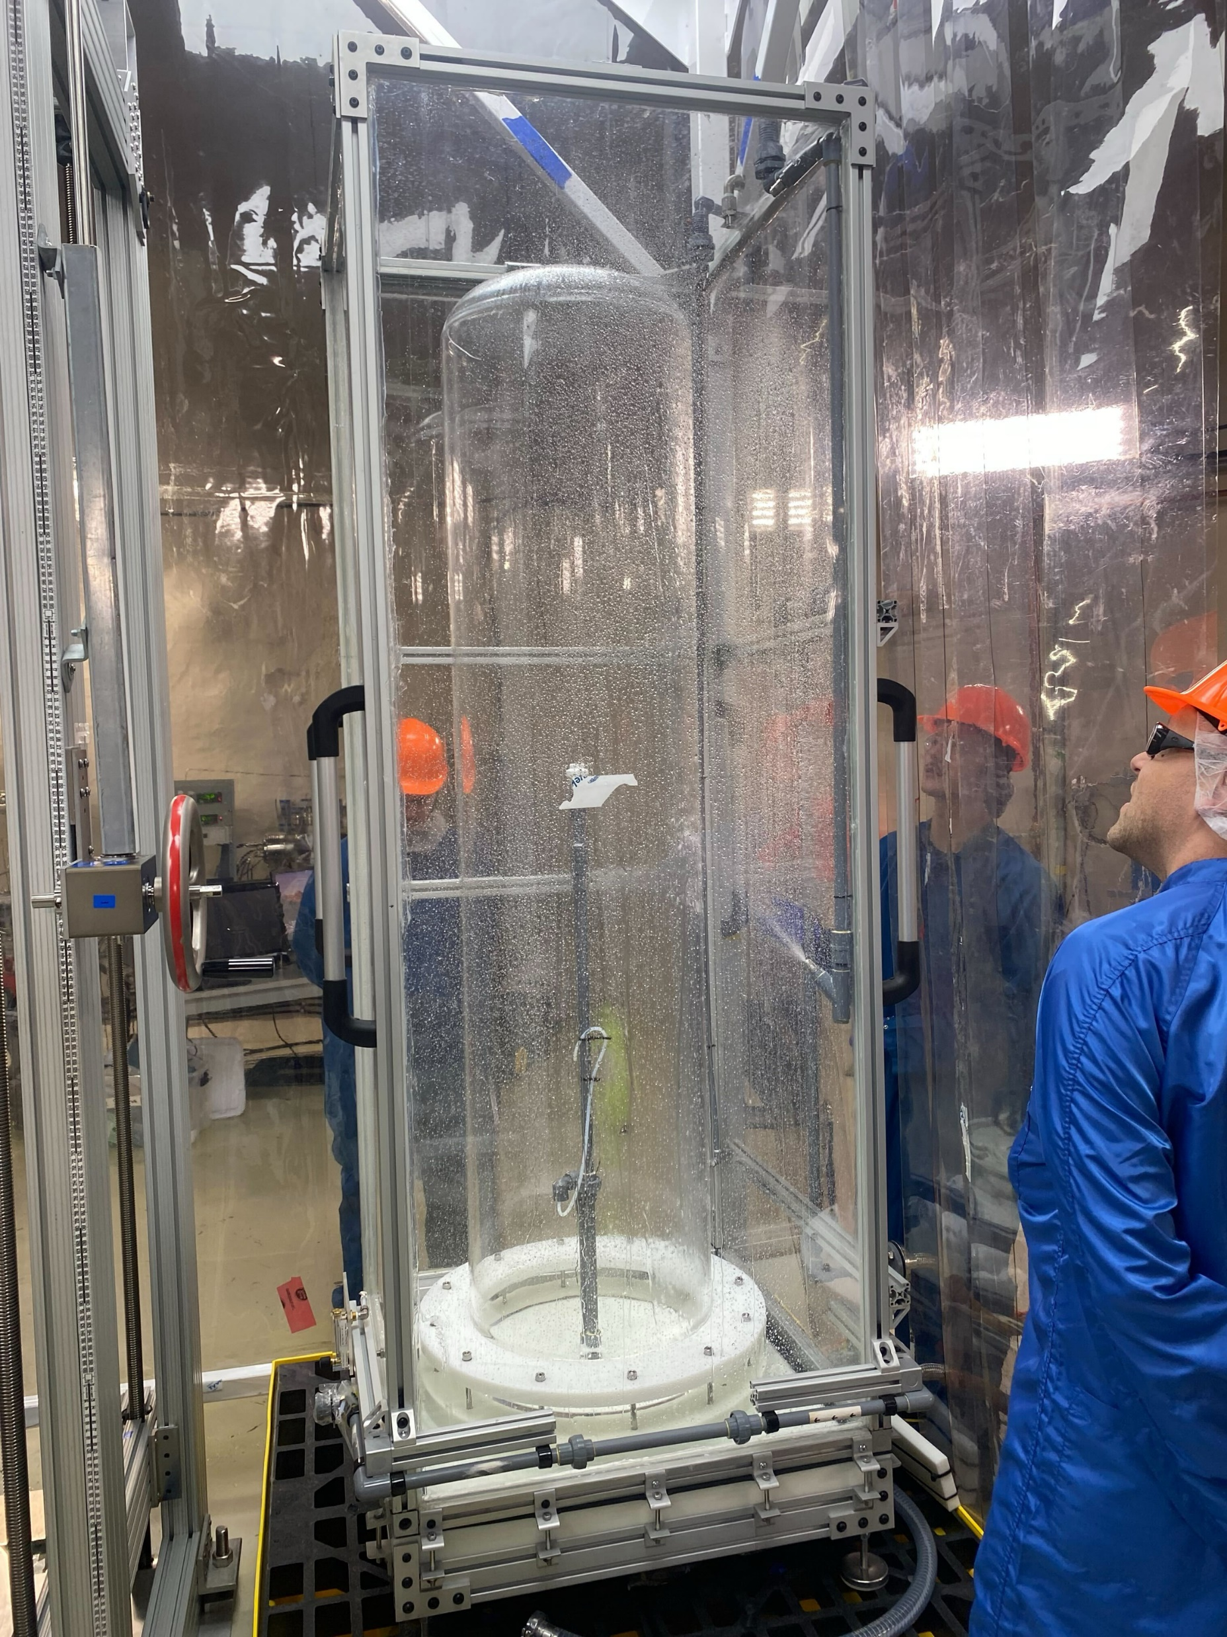
Background Mitigation
Low background materials
  Synthetic quartz, SS, PTFE, etc
  With sample counting to calculate expected rates
Extensive cleaning and radon mitigation effort
  Achieved a 0.5 μm particulate concentration of < 4 particulates L⁻¹
  Working on a technical paper

Slide 16
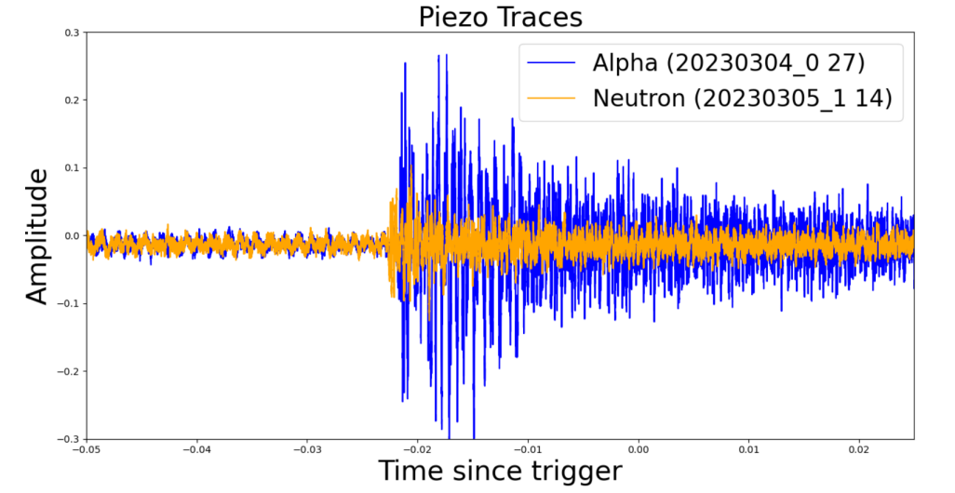
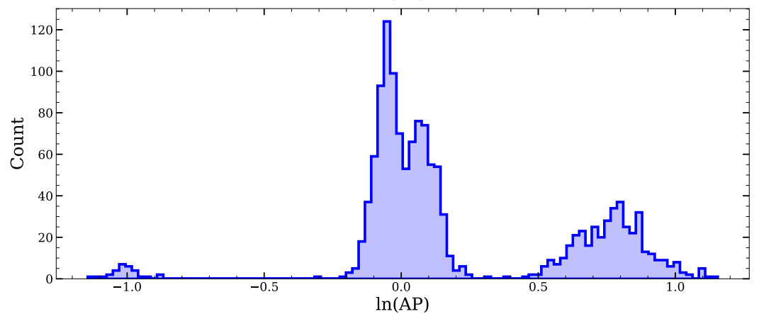
Background Rejection
Acoustic Parameter (AP) is calculated from a sum of position-corrected resonant energies recorded by the piezoelectric sensors
Allows for excellent discrimination between nuclear recoil and alphas
Working on an alpha spectroscopy paper
Rn222
Po218
Po214
NR

Slide 17
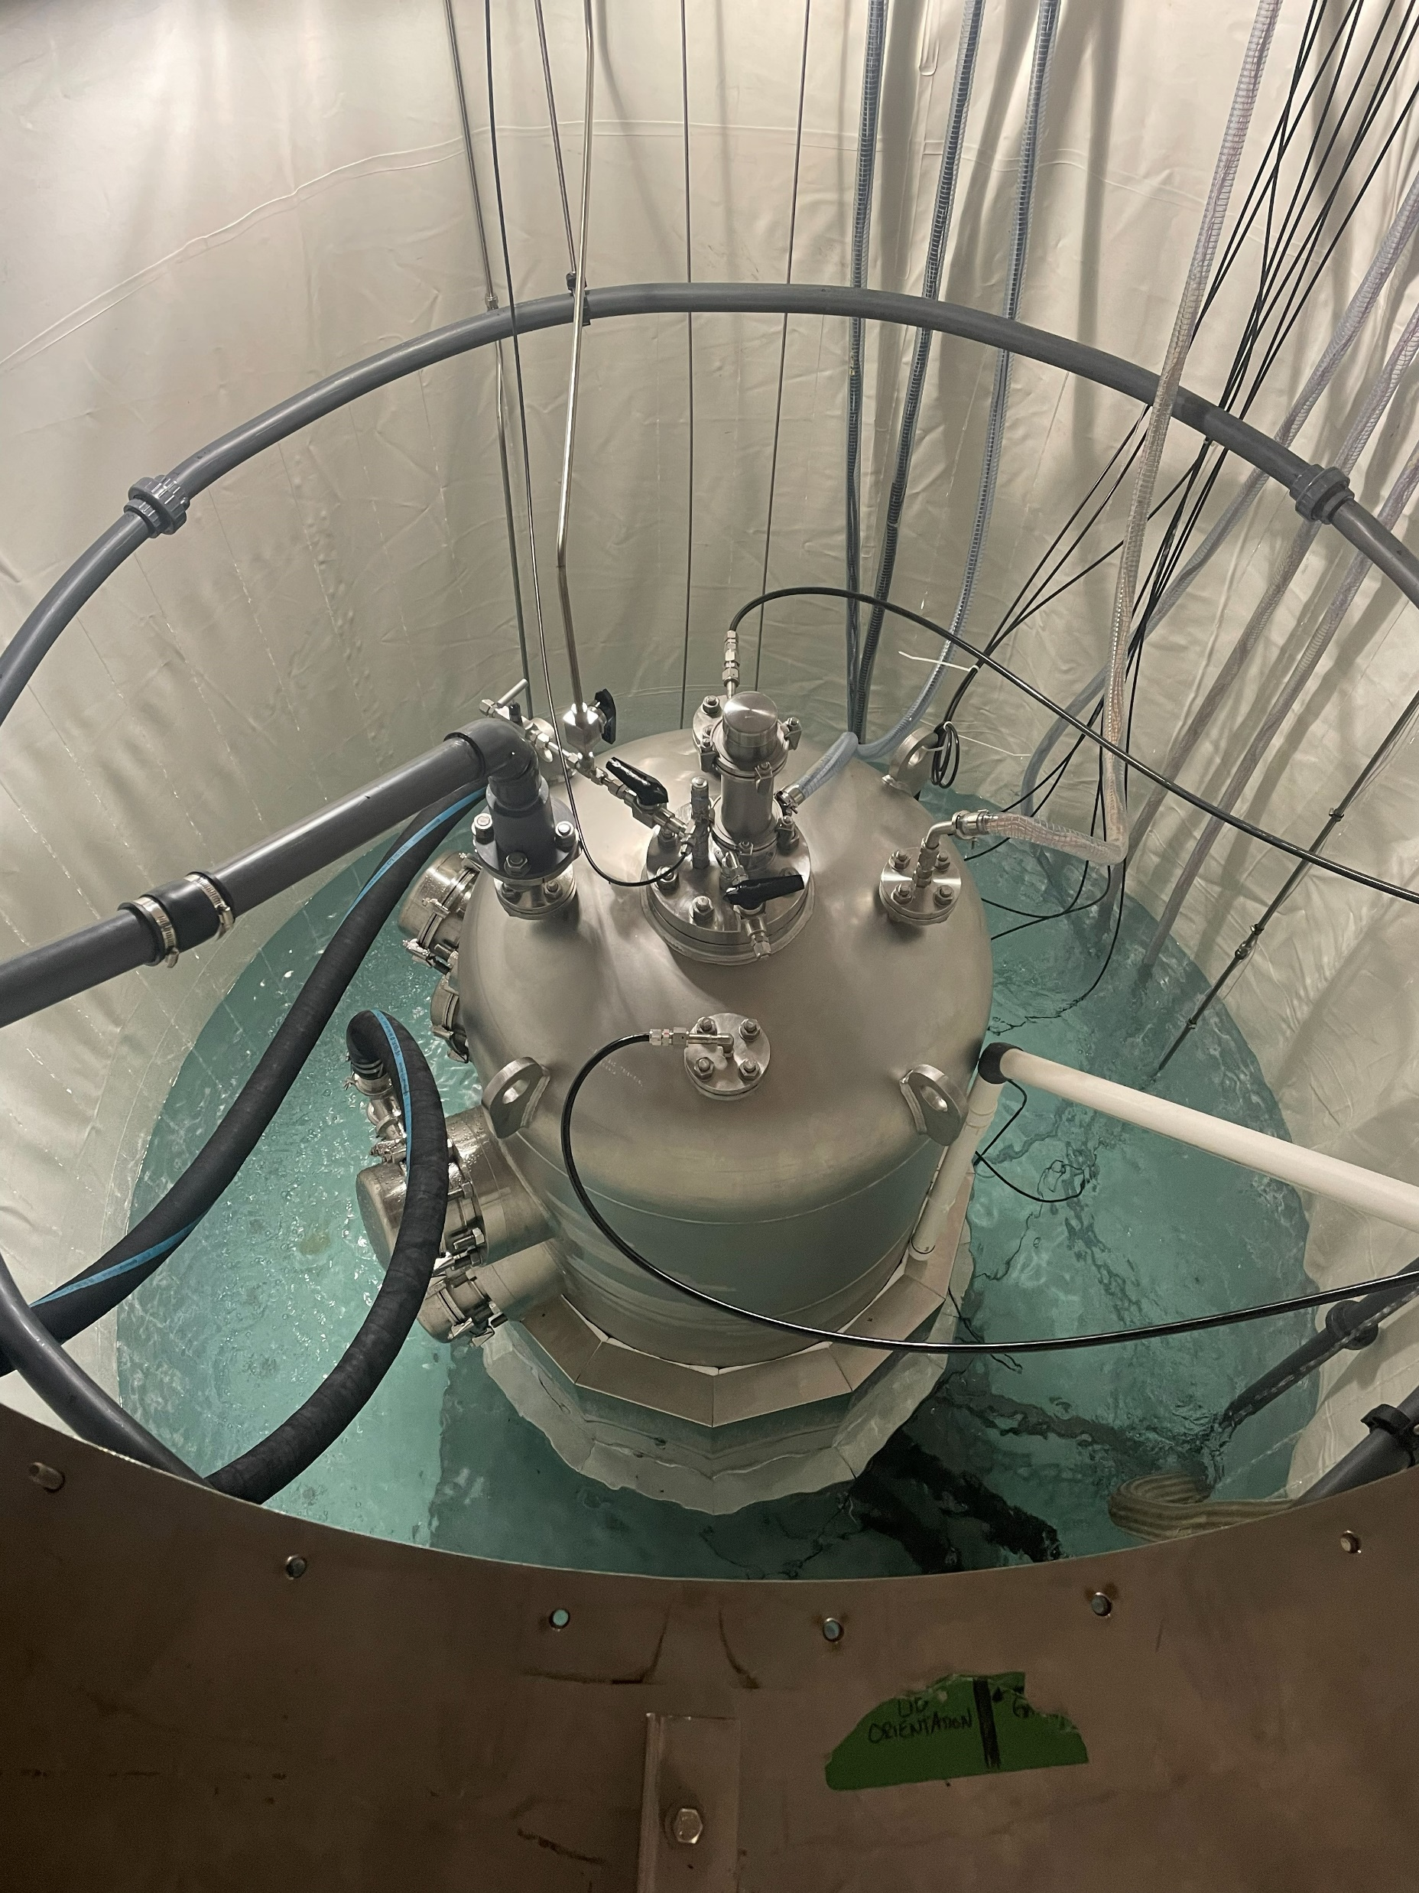
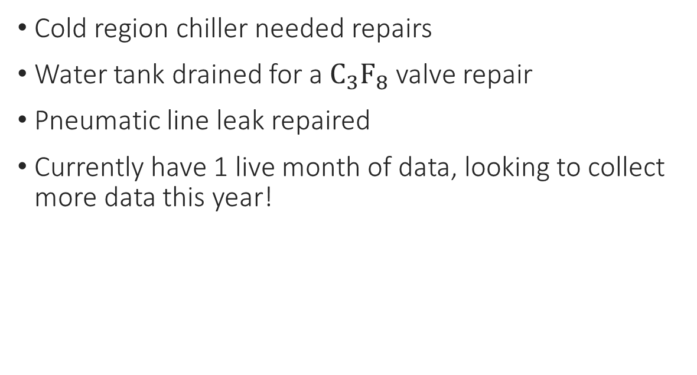
Current Work on PICO-40L
Cold region chiller needed repairs
Water tank drained for a $C_{3}F_{8}$ valve repair
Pneumatic line leak repaired
Currently have 1 live month of data, looking to collect more data this year!
PICO-40L has an irreducible background that impacts the detector, which we believe to be from the Rn222 chain. We are currently working on it, and do not believe will be present in PICO-500
Notes:
MoL methanol order, halting our use of chillers

Slide 18
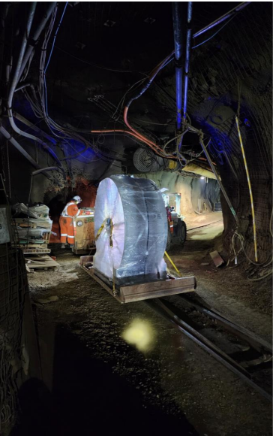
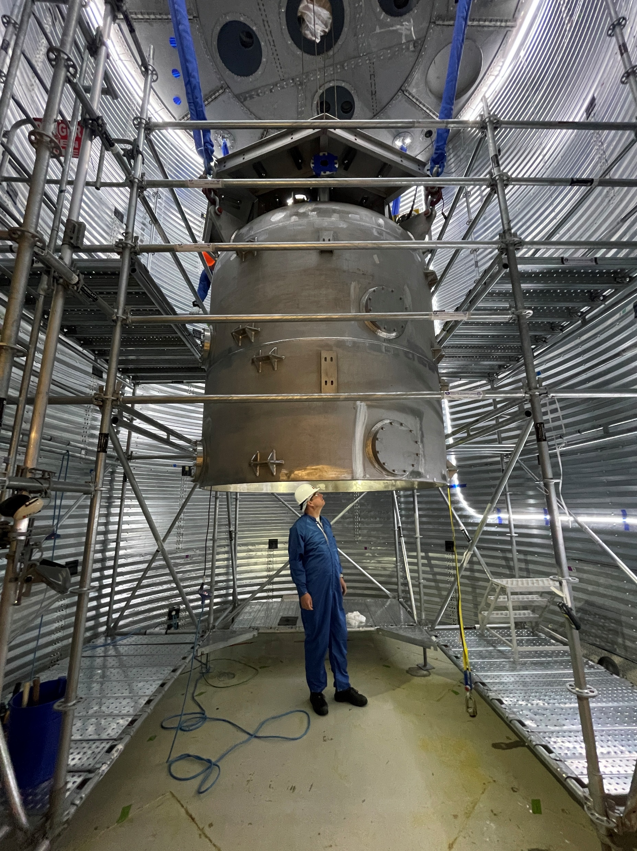
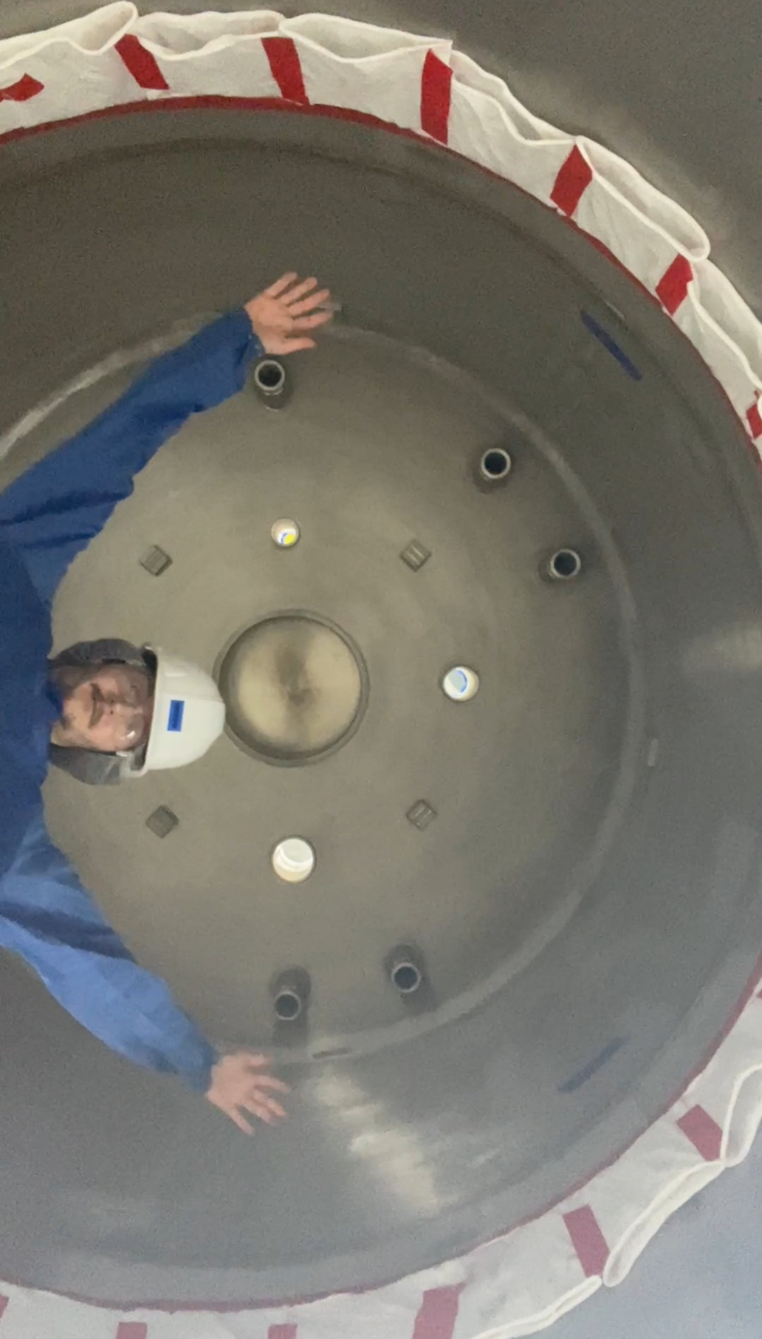
Current Work on PICO-500: Pressure Vessel
The pressure vessel has been assembled and welded inside the water tank in the Cube Hall
Leak checking and radon assay are now completed
Notes:
2m wide PV, extra BK reduction, more oil between the steel and c3f8. UG welding in cleanroom, task mastered. So larger we had to weld it UG. Vessel glows in the dark

Slide 19
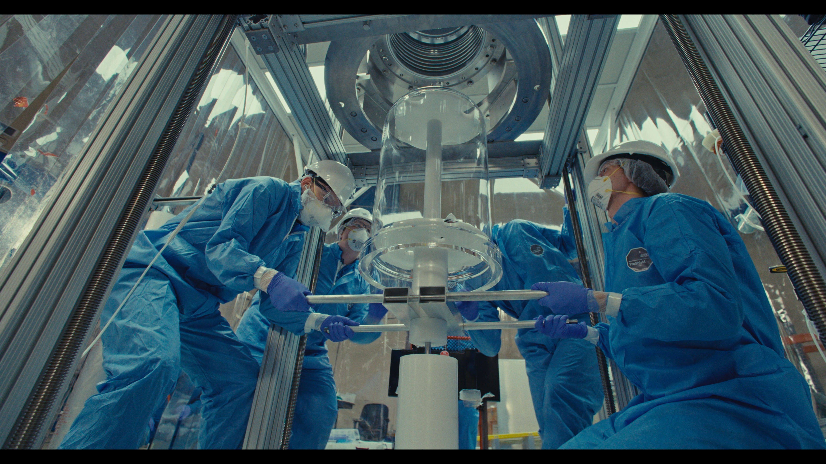
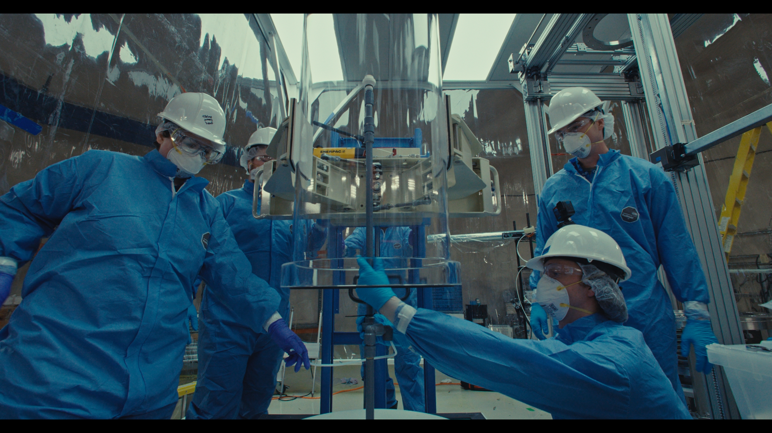
Current Work on PICO-500: Inner Vessel
Near finished with Inner Vessel assembly, to be inserted into the pressure vessel
Active fluid fill around fall 2026

Slide 20
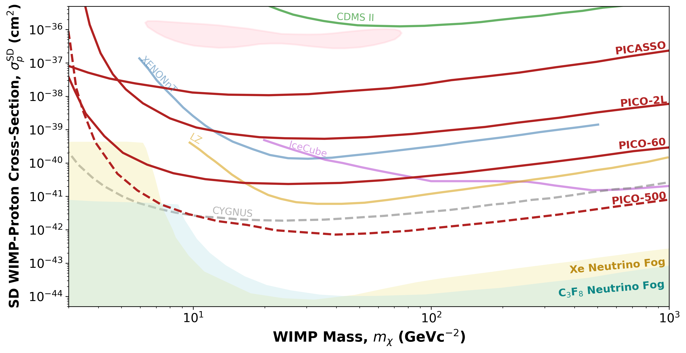
Projected Sensitivities
PICO-500 is expected to place world leading limits in the SD WIMP cross section

Slide 21
Summary
PICO-40L informs background model and operation of PICO-500
A few papers in the works including technical papers for PICO-40L and particulate/radon mitigation for PICO-500, and an alpha spectroscopy paper
PICO-500 is near completion, with commissioning at end of the year.
With results, we expect to set world leading limits on the SD WIMP dark matter interactions

Slide 22
