Slide 1
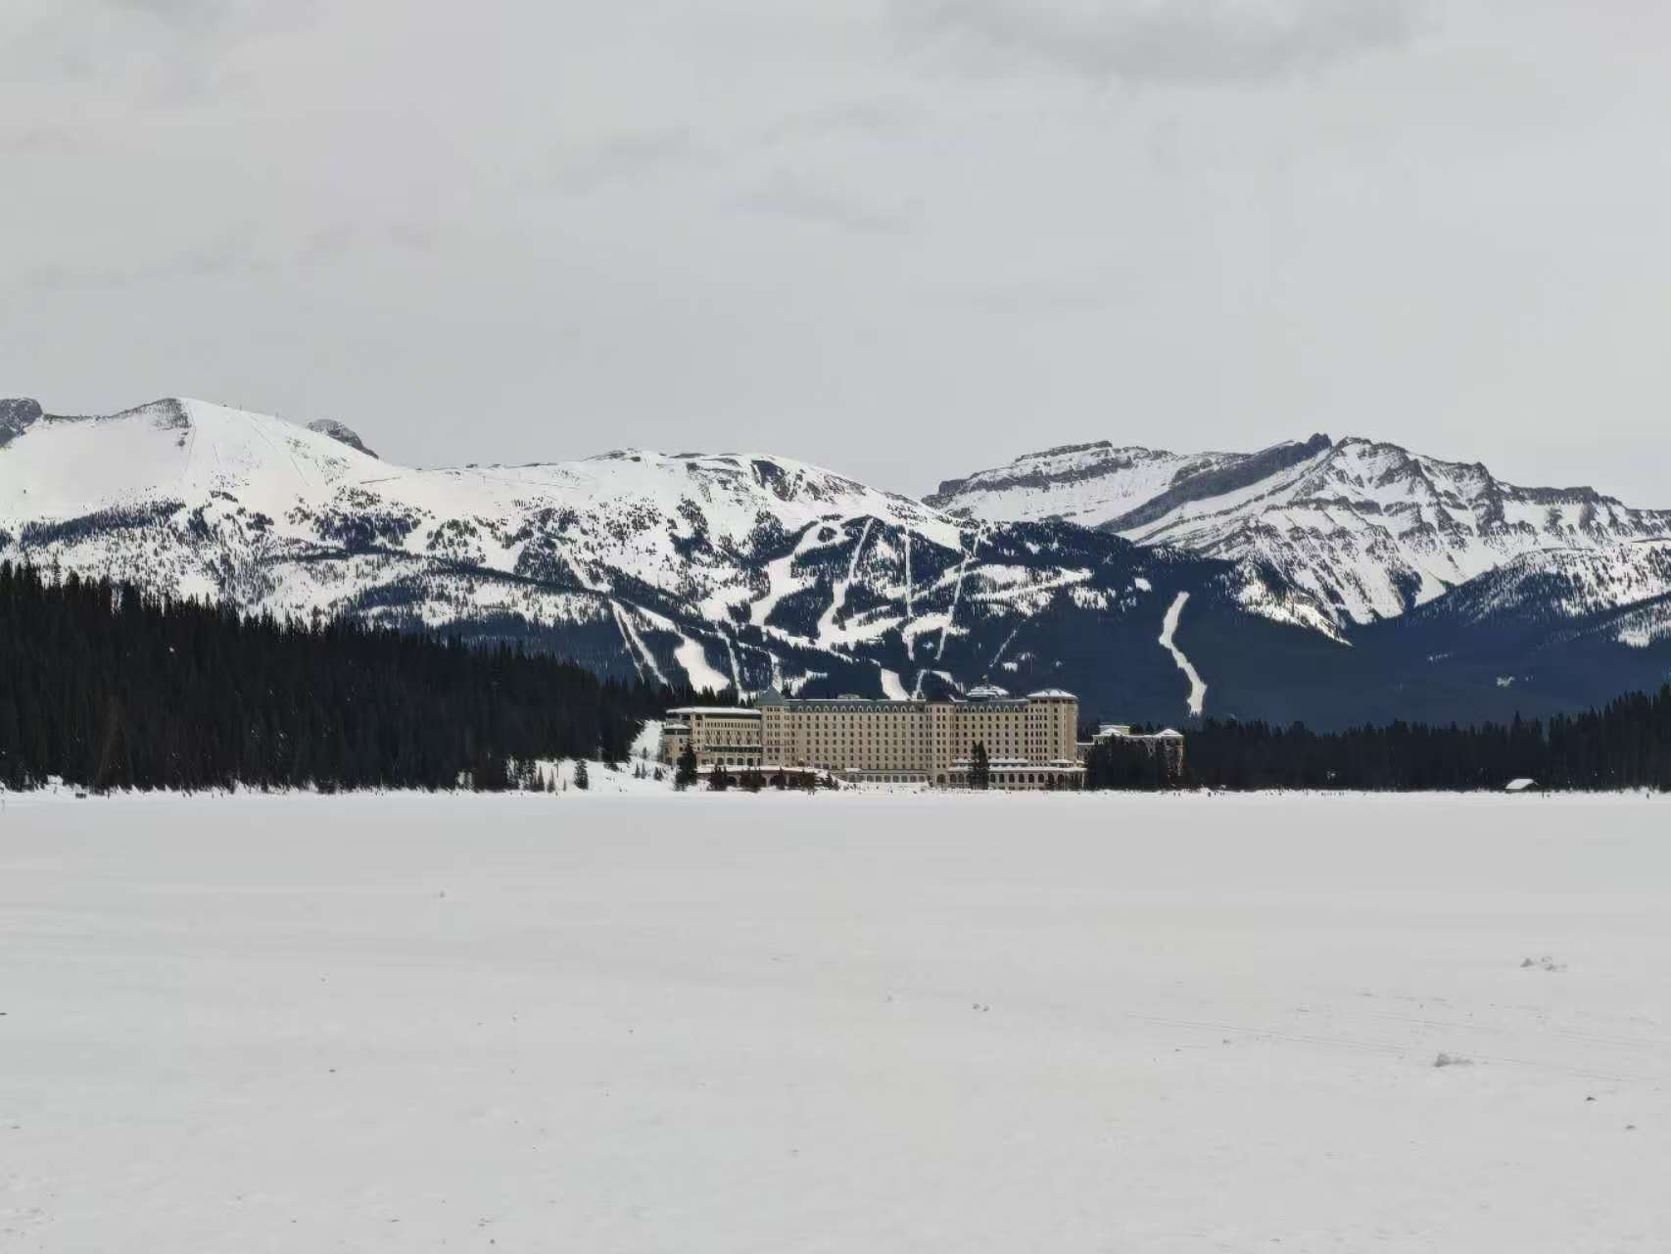


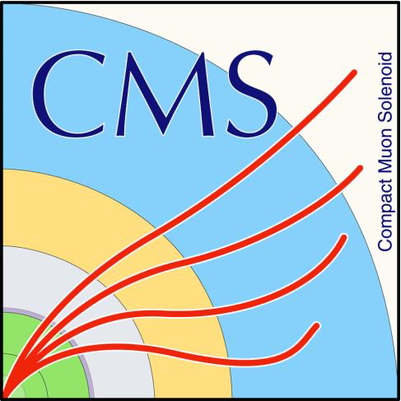
Observation of a family of all-charm tetraquarks with spin-2 and positive parity at CMS
Xining Wang
Tsinghua University / Nanjing Normal University
LLWI
Mar 4, 2026

Slide 2
Outline
Motivation
𝐽/𝜓𝐽/𝜓 updated result
𝐽/𝜓𝜓(2S) result
Spin-parity measurement
Summary
2

Slide 3
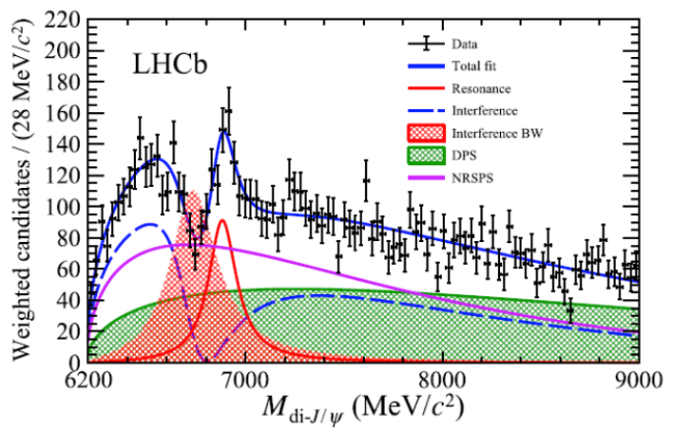
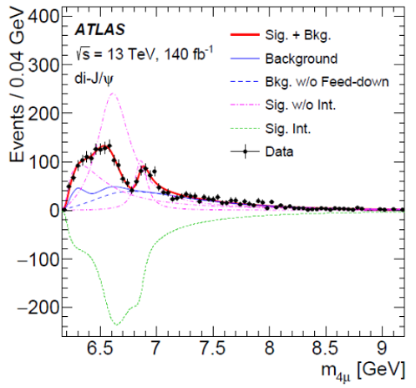
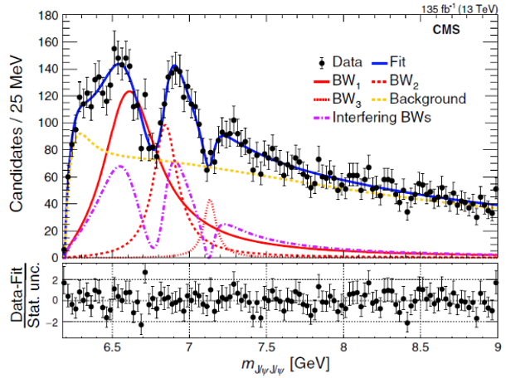
Status
All-charm Tetraquark on LHC in J/ψJ/ψ channel
Sci. Bull., 65(23):1983, 2020
Phys. Rev. Lett., 131(15):151902, 2023
Phys. Rev. Lett. 132:111901, 2024
ALL exp observe X(6900)
+ additional structure
Only CMS claimed X(6600) & X(7100)
Hump @ 6.6 GeV: Different modeling
Hint @ 7.2 GeV: LHCb not consider; ATLAS 3σ hint in $J/ψψ(2S)$
All exp use interference, but in diff ways
LHCb: extra BW interfere with SPS, X(6900) NOT interfering!
ATLAS and CMS: different multi-resonance interference
A number of unresolved questions !
All exp see a threshold excess, NOT explained! Classified as background
3

Slide 4
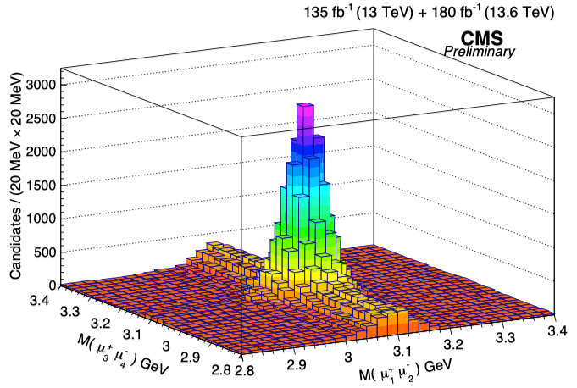
𝐽/𝜓𝐽/𝜓 yield: two-dimensional fit
Luminosity
Run 2 135 fb⁻¹
Run 3 180 fb⁻¹
$J/ψJ/ψ$ yield
Run 2: 12622 ± 165
Run 2+3 44936 ± 692
$J/ψJ/ψ$ yield per unit luminosity
Run 2 ~ 93 events / fb⁻¹
Run 3 ~ 177 events / fb⁻¹
CMS-PAS-BPH-24-003
Run 2+3 $J/ψJ/ψ$ yield is 3.6X of Run 2
Run 2+3 luminosity is 2.3X of Run 2
4

Slide 5
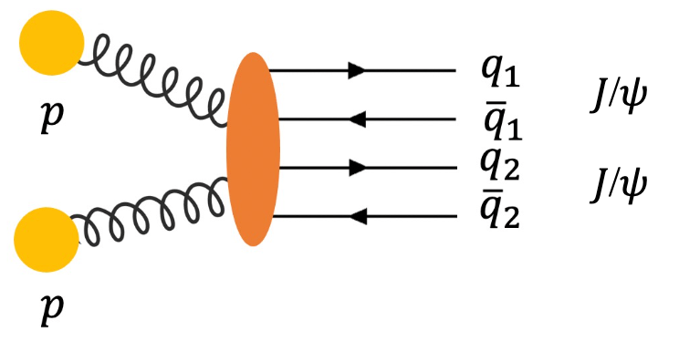
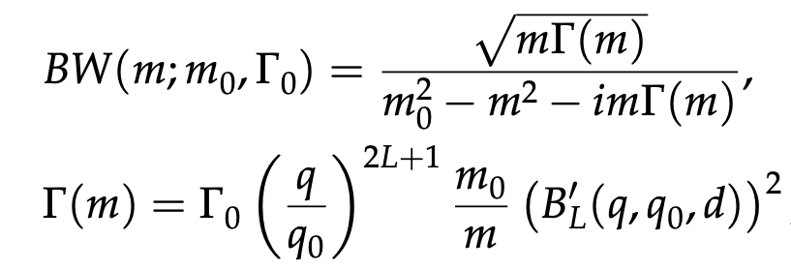
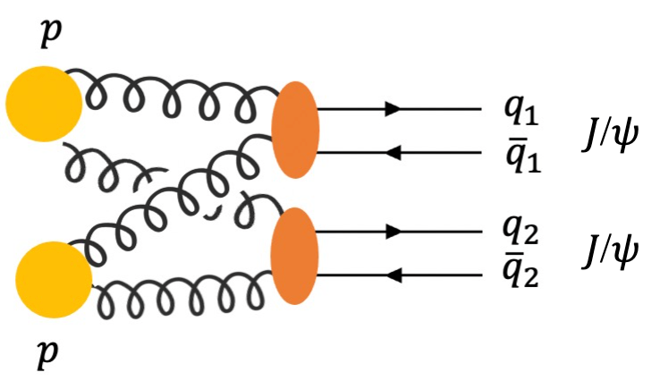
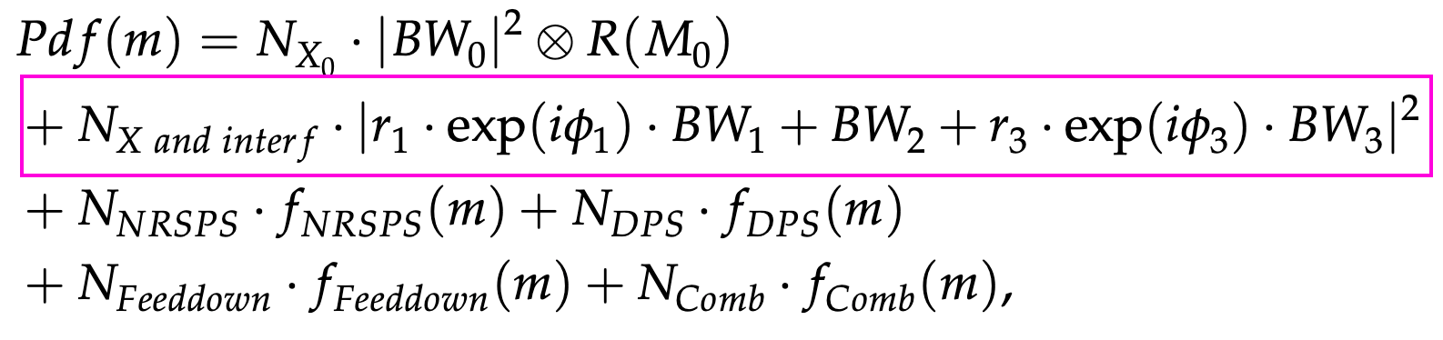
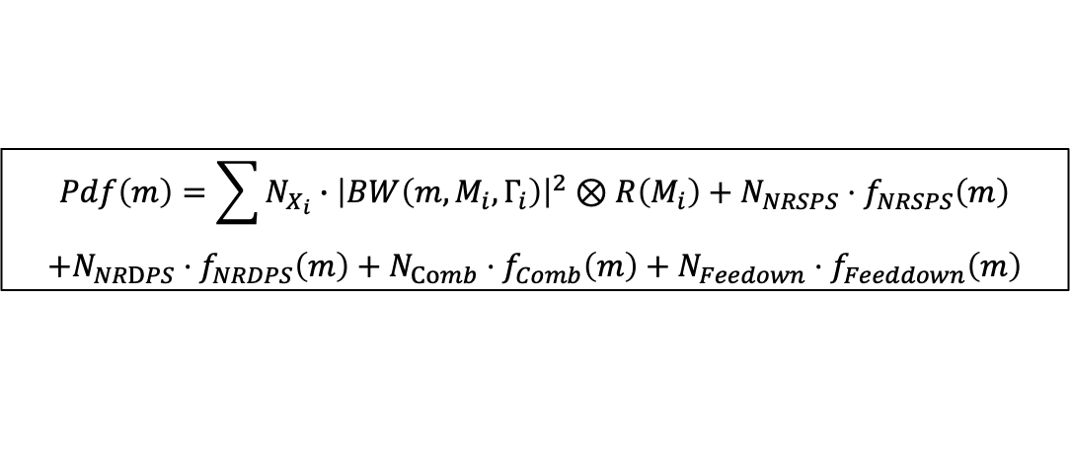
Signal and background models
Signal shape: Relativistic Breit-Wigner
SPS
Background component: NRSPS + NRDPS + Feeddown + Comb + BW0
DPS
Non-interference model:
Signal-hypothesis: NRSPS + NRDPS + Comb + Feeddown + BW0 + BW1 + BW2 + BW3
$$Pdf\left(m\right)=\sum{N_{X_{i}}∙{\left|BW\left(m,M_{i},Γ_{i}\right)\right|}^{2}⊗R\left(M_{i}\right)}+N_{NRSPS}⋅f_{NRSPS}\left(m\right)$$
$$+N_{NRDPS}⋅f_{NRDPS}\left(m\right)+N_{Comb}⋅f_{Comb}\left(m\right)+N_{Feedown}⋅f_{Feeddown}\left(m\right)$$
Interference model:
Signal-hypothesis: NRSPS + NRDPS + Comb + Feeddown + BW0 + BW123 Interf. Term
5

Slide 6
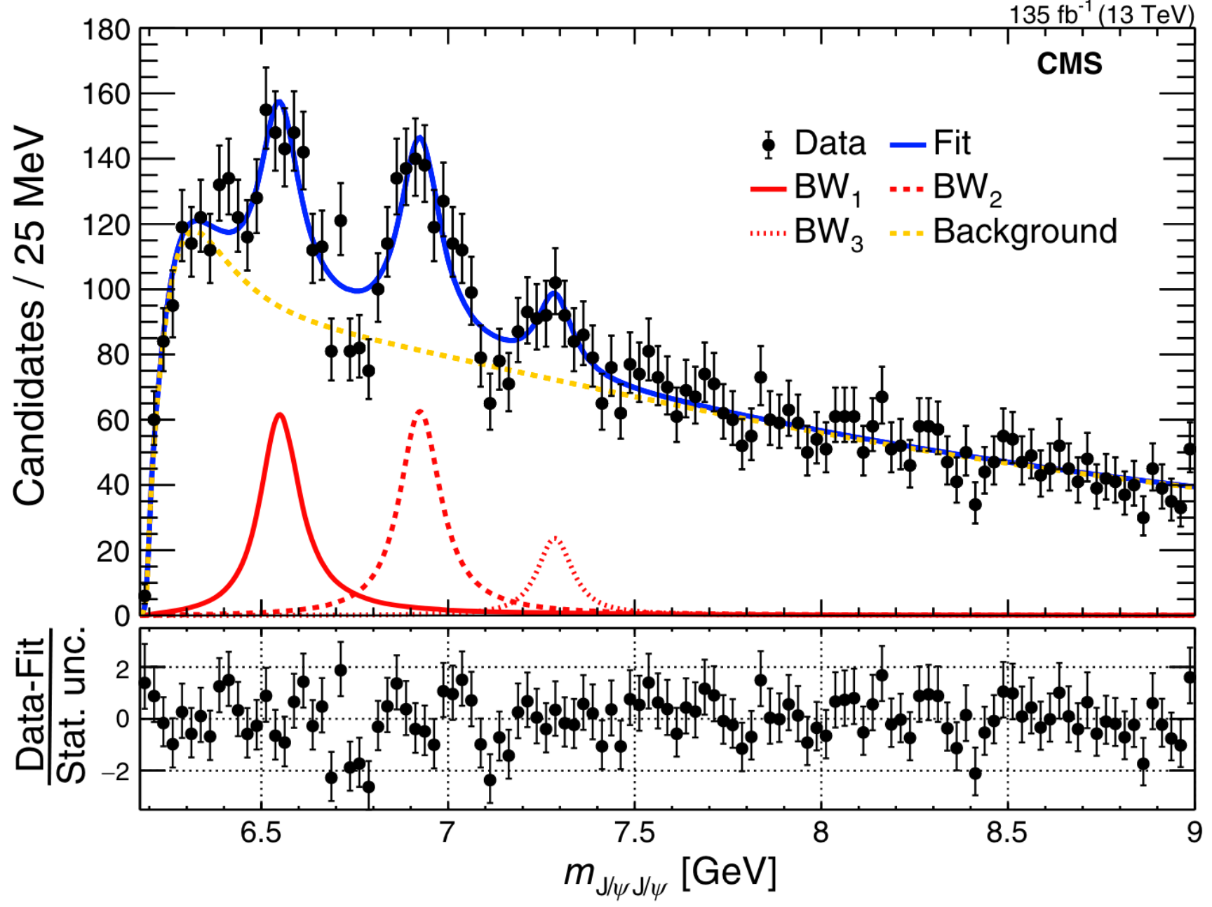
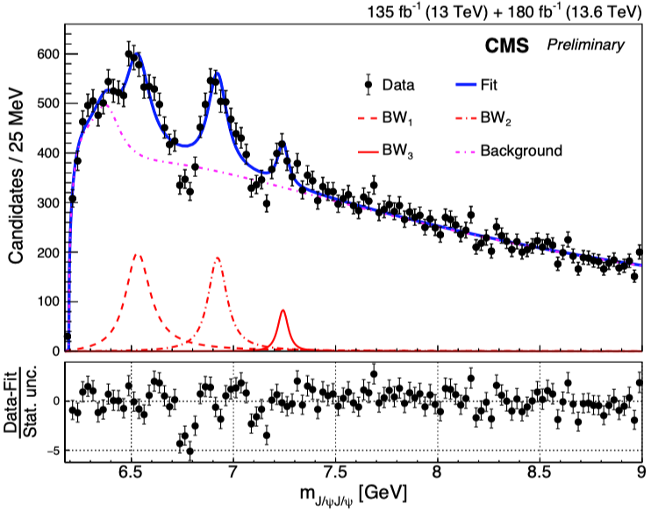
Run 2 & 3 no-interference fit result
No-interference model:
Signal-hypothesis: NRSPS + NRDPS + Comb + Feeddown + BW0 + BW1 + BW2 + BW3
$$Pdf\left(m\right)=\sum{N_{X_{i}}∙{\left|BW\left(m,M_{i},Γ_{i}\right)\right|}^{2}⊗R\left(M_{i}\right)}+N_{NRSPS}⋅f_{NRSPS}\left(m\right)$$
$$+N_{NRDPS}⋅f_{NRDPS}\left(m\right)+N_{Comb}⋅f_{Comb}\left(m\right)+N_{Feedown}⋅f_{Feeddown}\left(m\right)$$
Phys. Rev. Lett. 132:111901, 2024
CMS-PAS-BPH-24-003
Run 2 No-Interf
Run 2+3 No-Interf
Dips poorly described — no-Interf. model no longer sufficient !
6

Slide 7
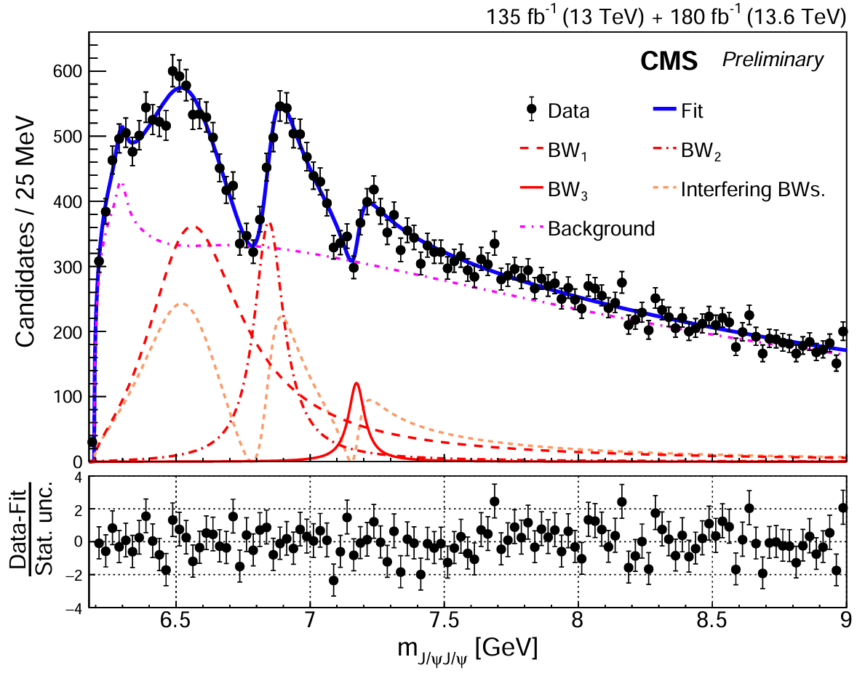
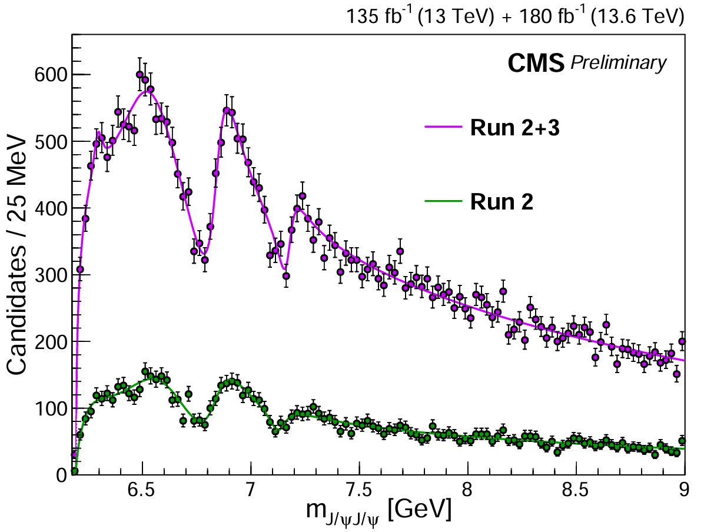
Run 2 & 3 interference fit result
Interference model with Run 2 + 3:
CMS-PAS-BPH-24-003
CMS-PAS-BPH-24-003
15σ
17σ
8σ
Dip1: 10σ
Dip2: 7σ
All states and dips well above 5σ !
Quantum interference among structures validated!
Strongly imply that they have same $J^{PC}$
7

Slide 8
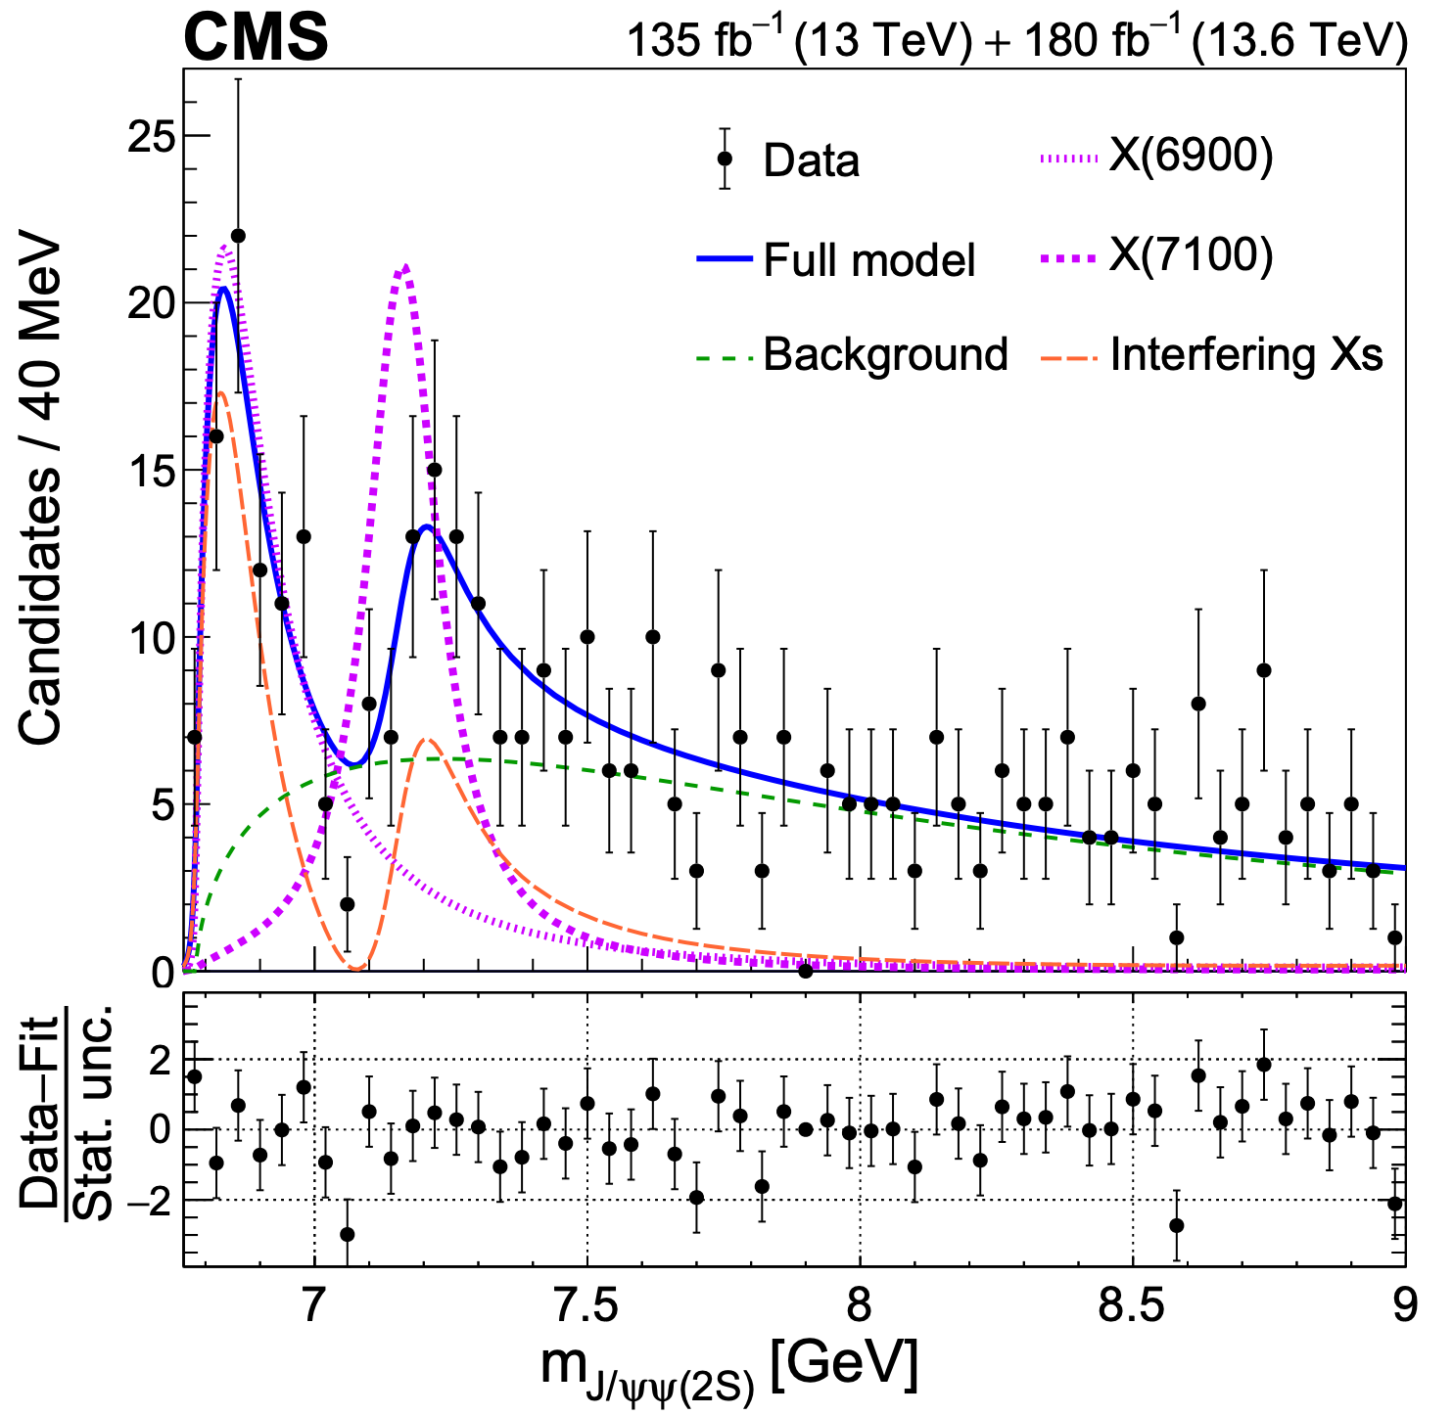
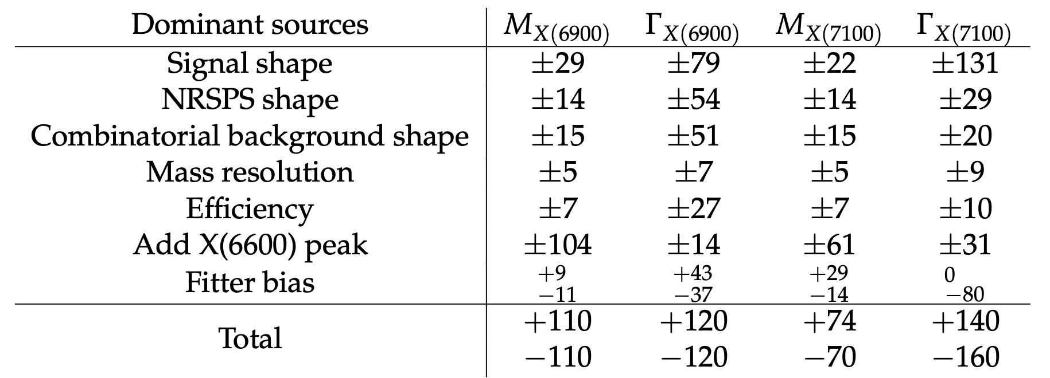
Explore 𝐽/𝜓𝜓(𝟐𝐒) channel with Run 2 & 3 data
Params | 𝐽/𝜓𝜓(2S) [MeV] | 𝐽/𝜓𝐽/𝜓 [MeV]
M(BW2) | $${6876}_{−29−110}^{+46+110}$$ | $$6847±10±15$$
Γ(BW2) | $${253}_{−100−120}^{+290+120}$$ | $${135}_{−14}^{+16}±14$$
M(BW3) | $${7169}_{−52−70}^{+26+74}$$ | $${7173}_{−10}^{+9}±13$$
Γ(BW3) | $${154}_{−82−160}^{+110+140}$$ | $${73}_{−15}^{+18}±10$$
arXiv:2602.02252
Significance of X(6900) = 7.9σ
Significance of X(7100) = 4.0σ
Consistent with 𝐽/𝜓𝐽/𝜓 result!
Confirmed in a different channel!
ATLAS only claim X(6900) 4.7σ in 𝐽/𝜓𝜓(𝟐𝐒) channel
8

Slide 9
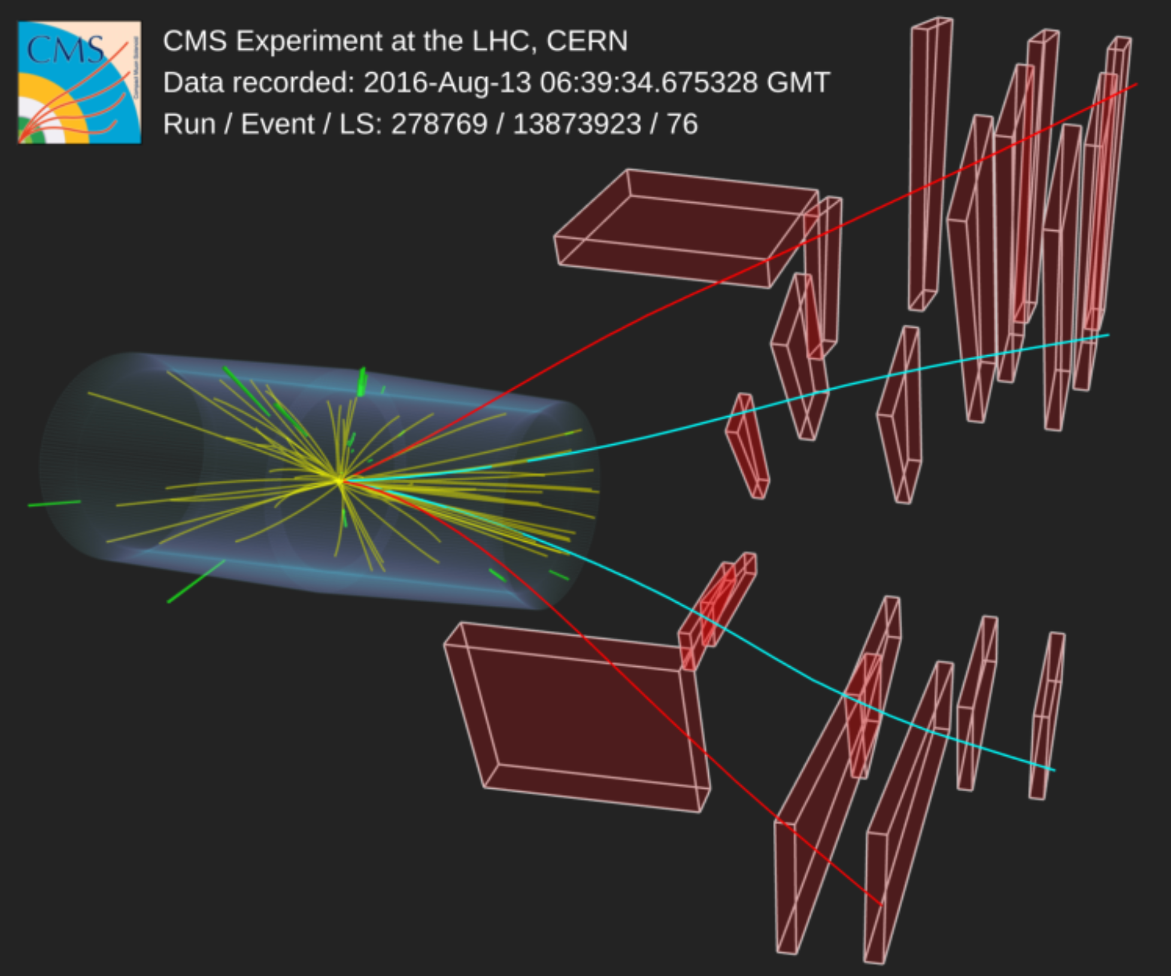
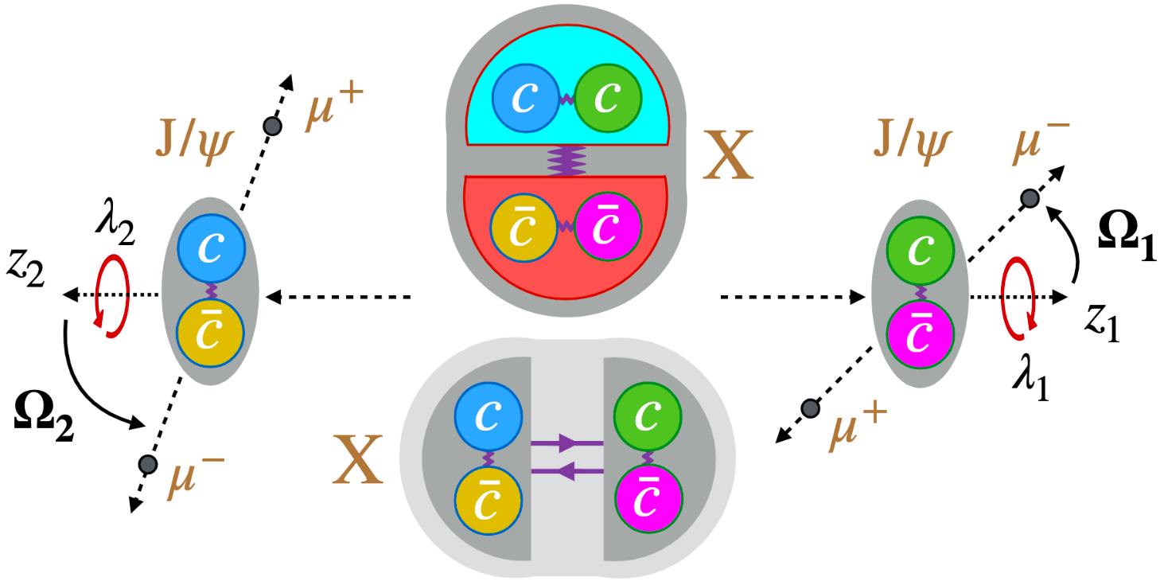

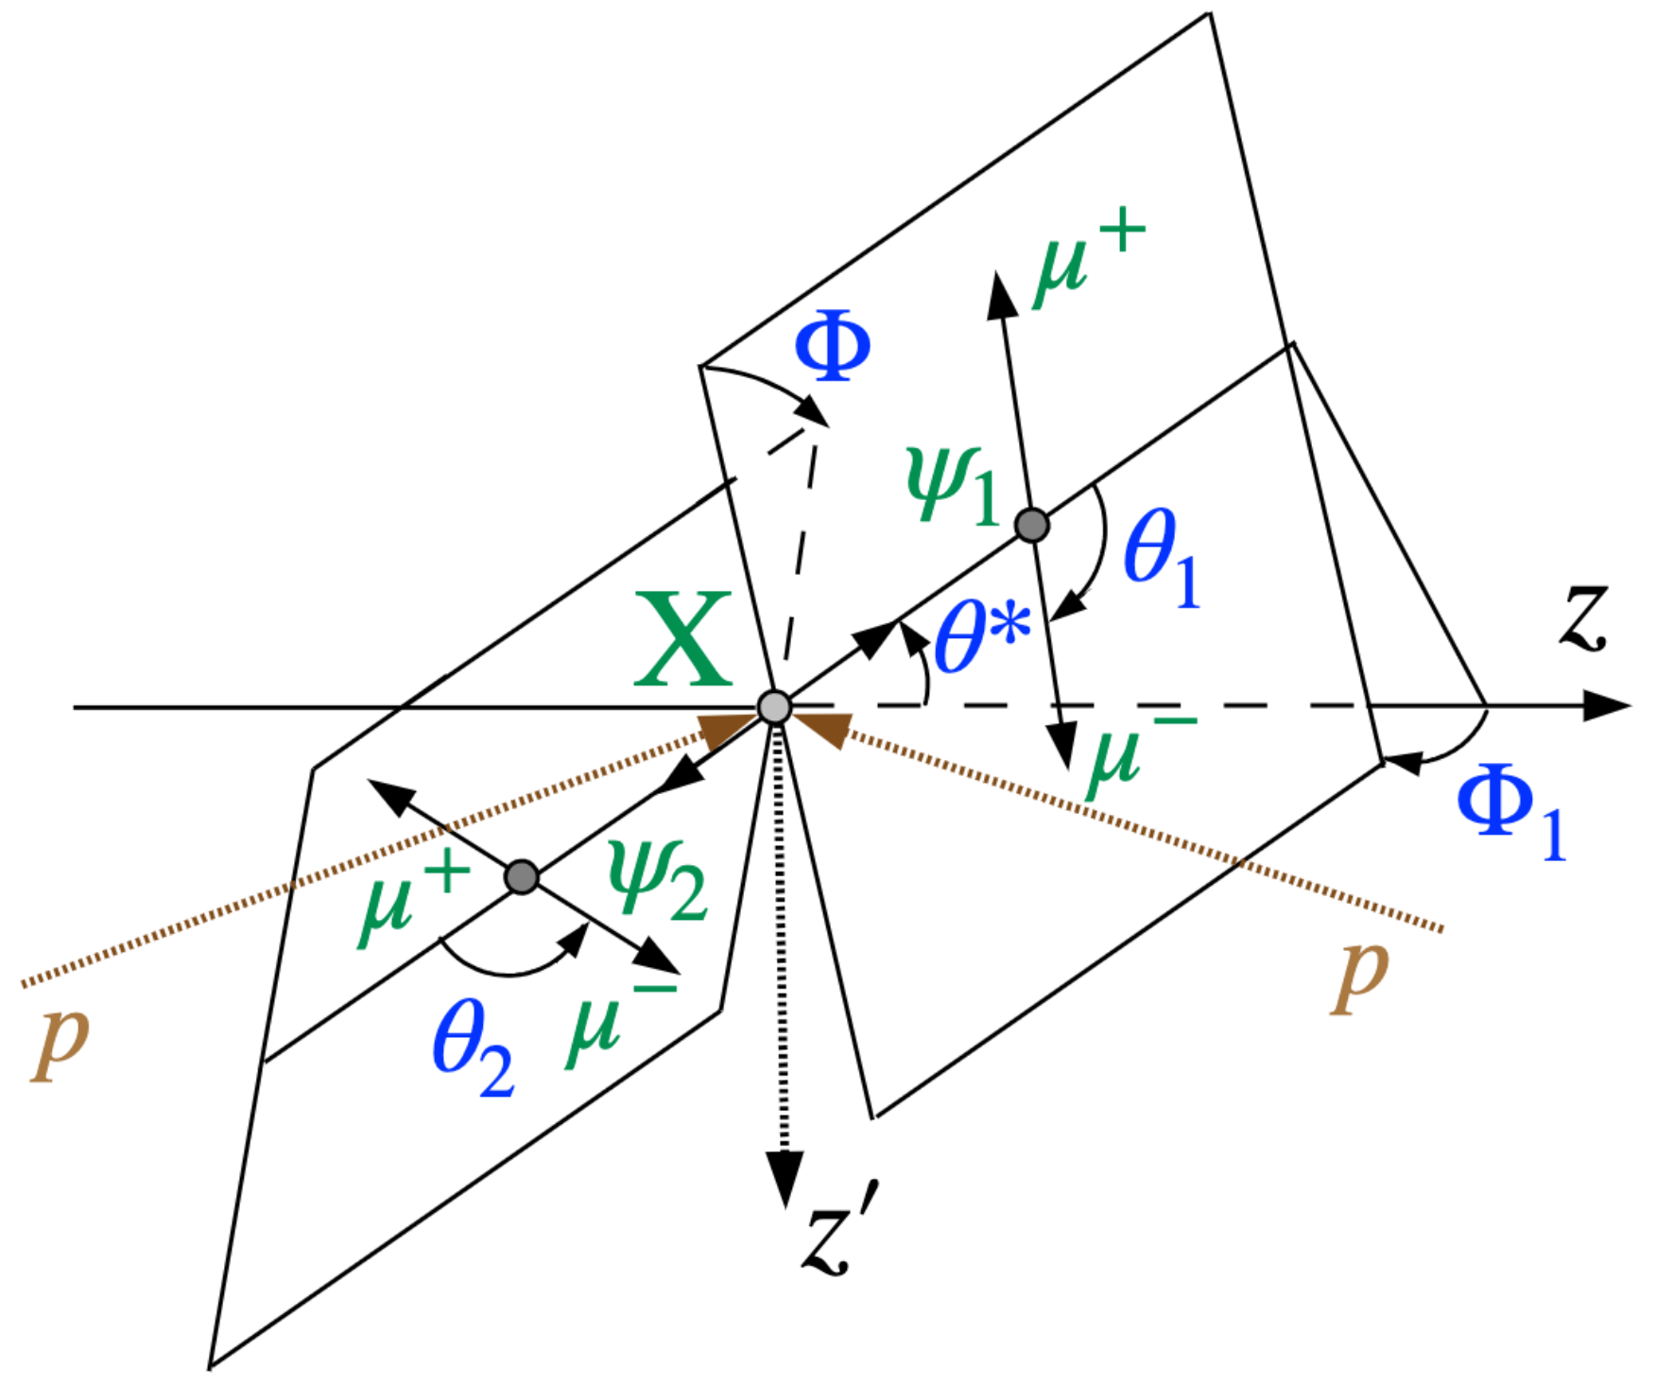

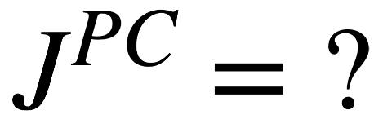

Spin parity analysis
9

Slide 10
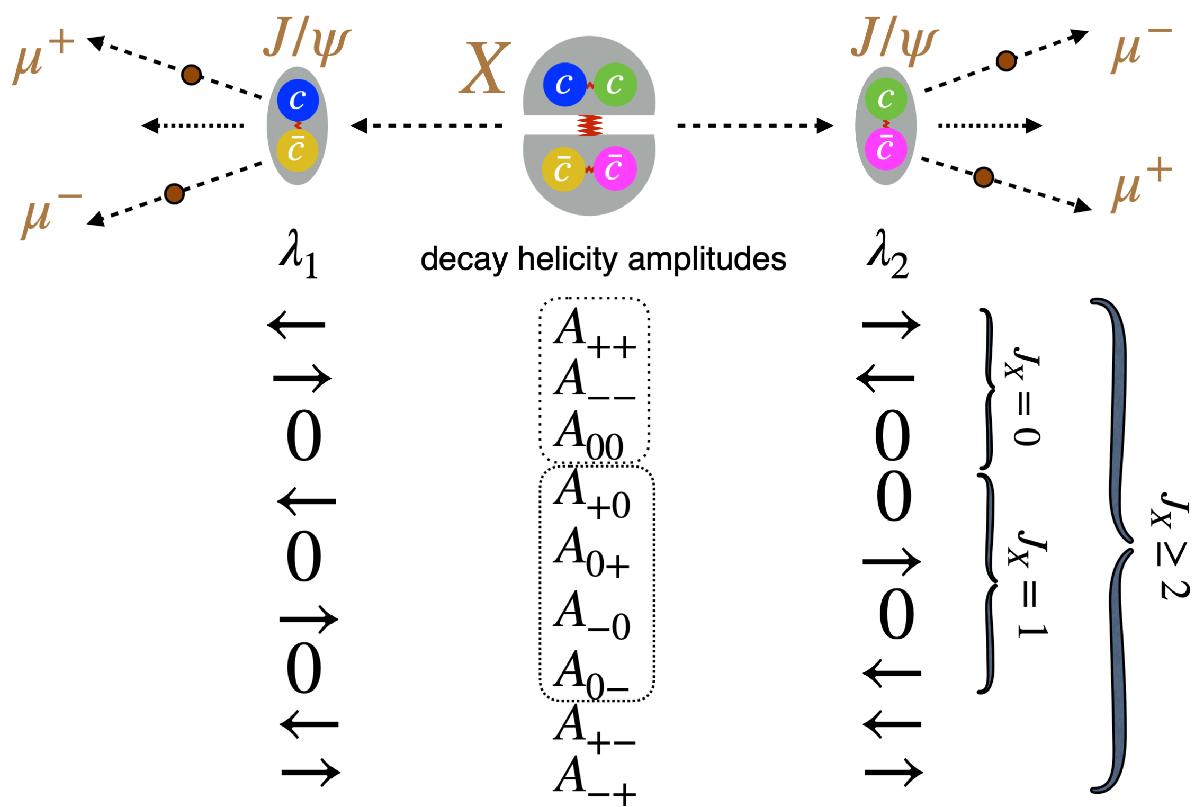
$J/ψ$ polarizations
10

Slide 11
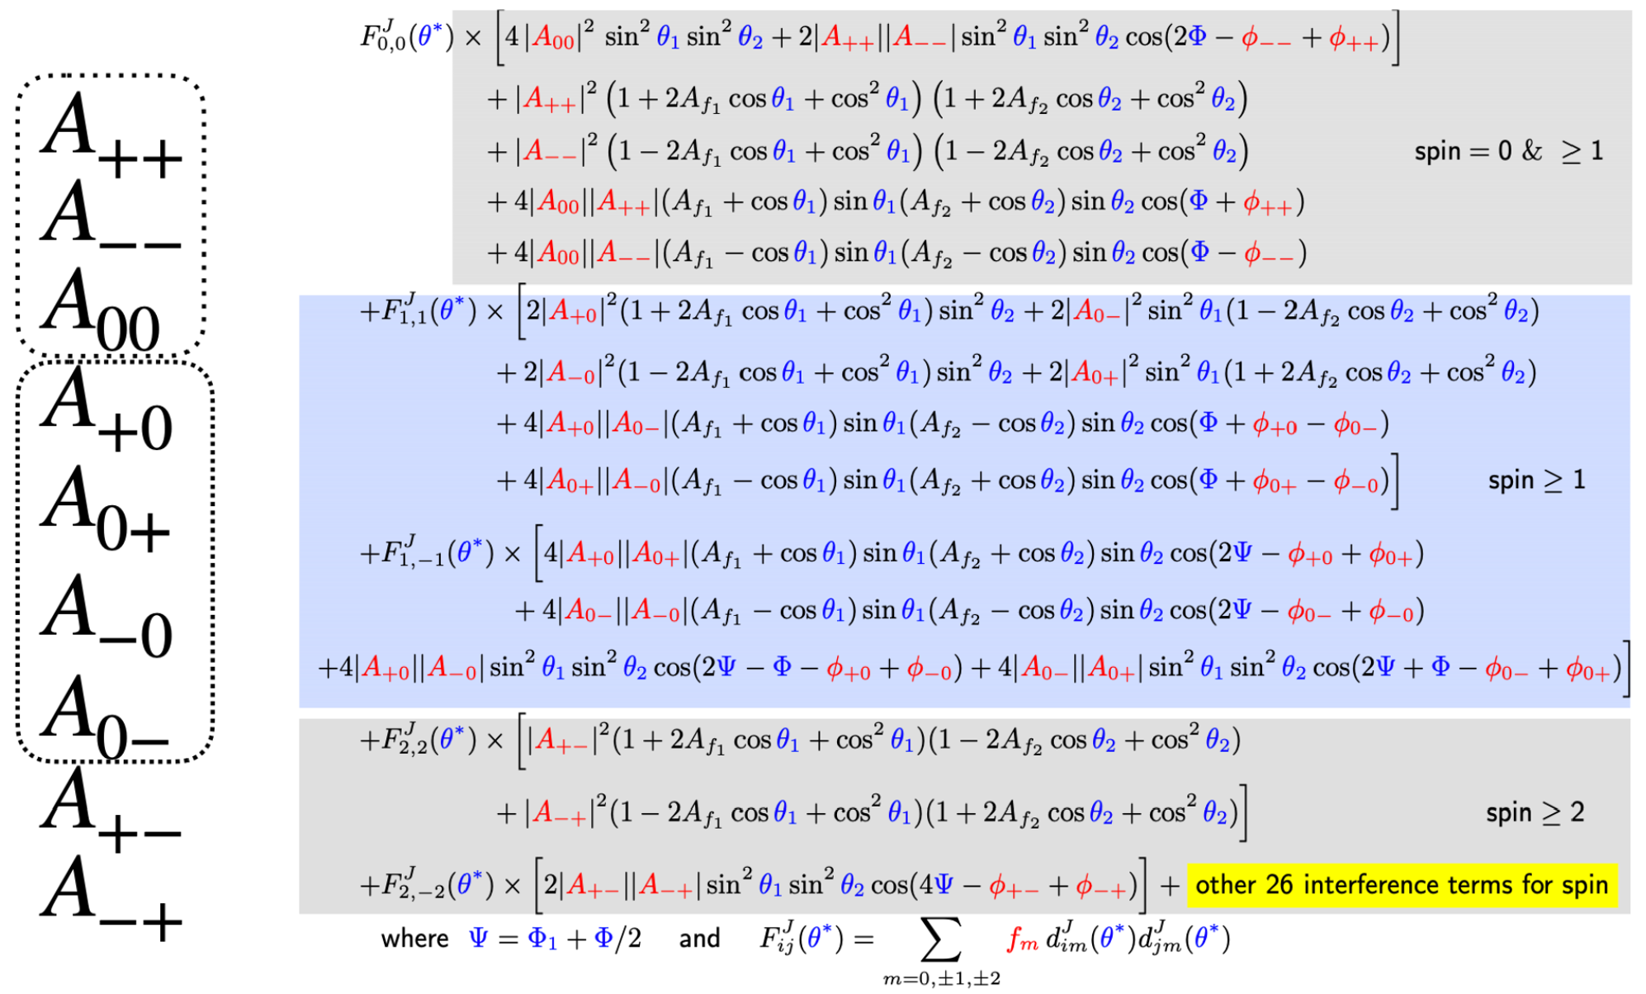
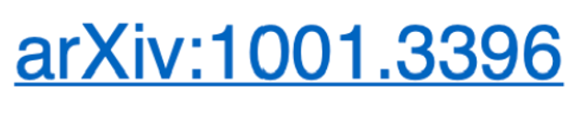
Angular Analysis
Valid
for any J
11

Slide 12
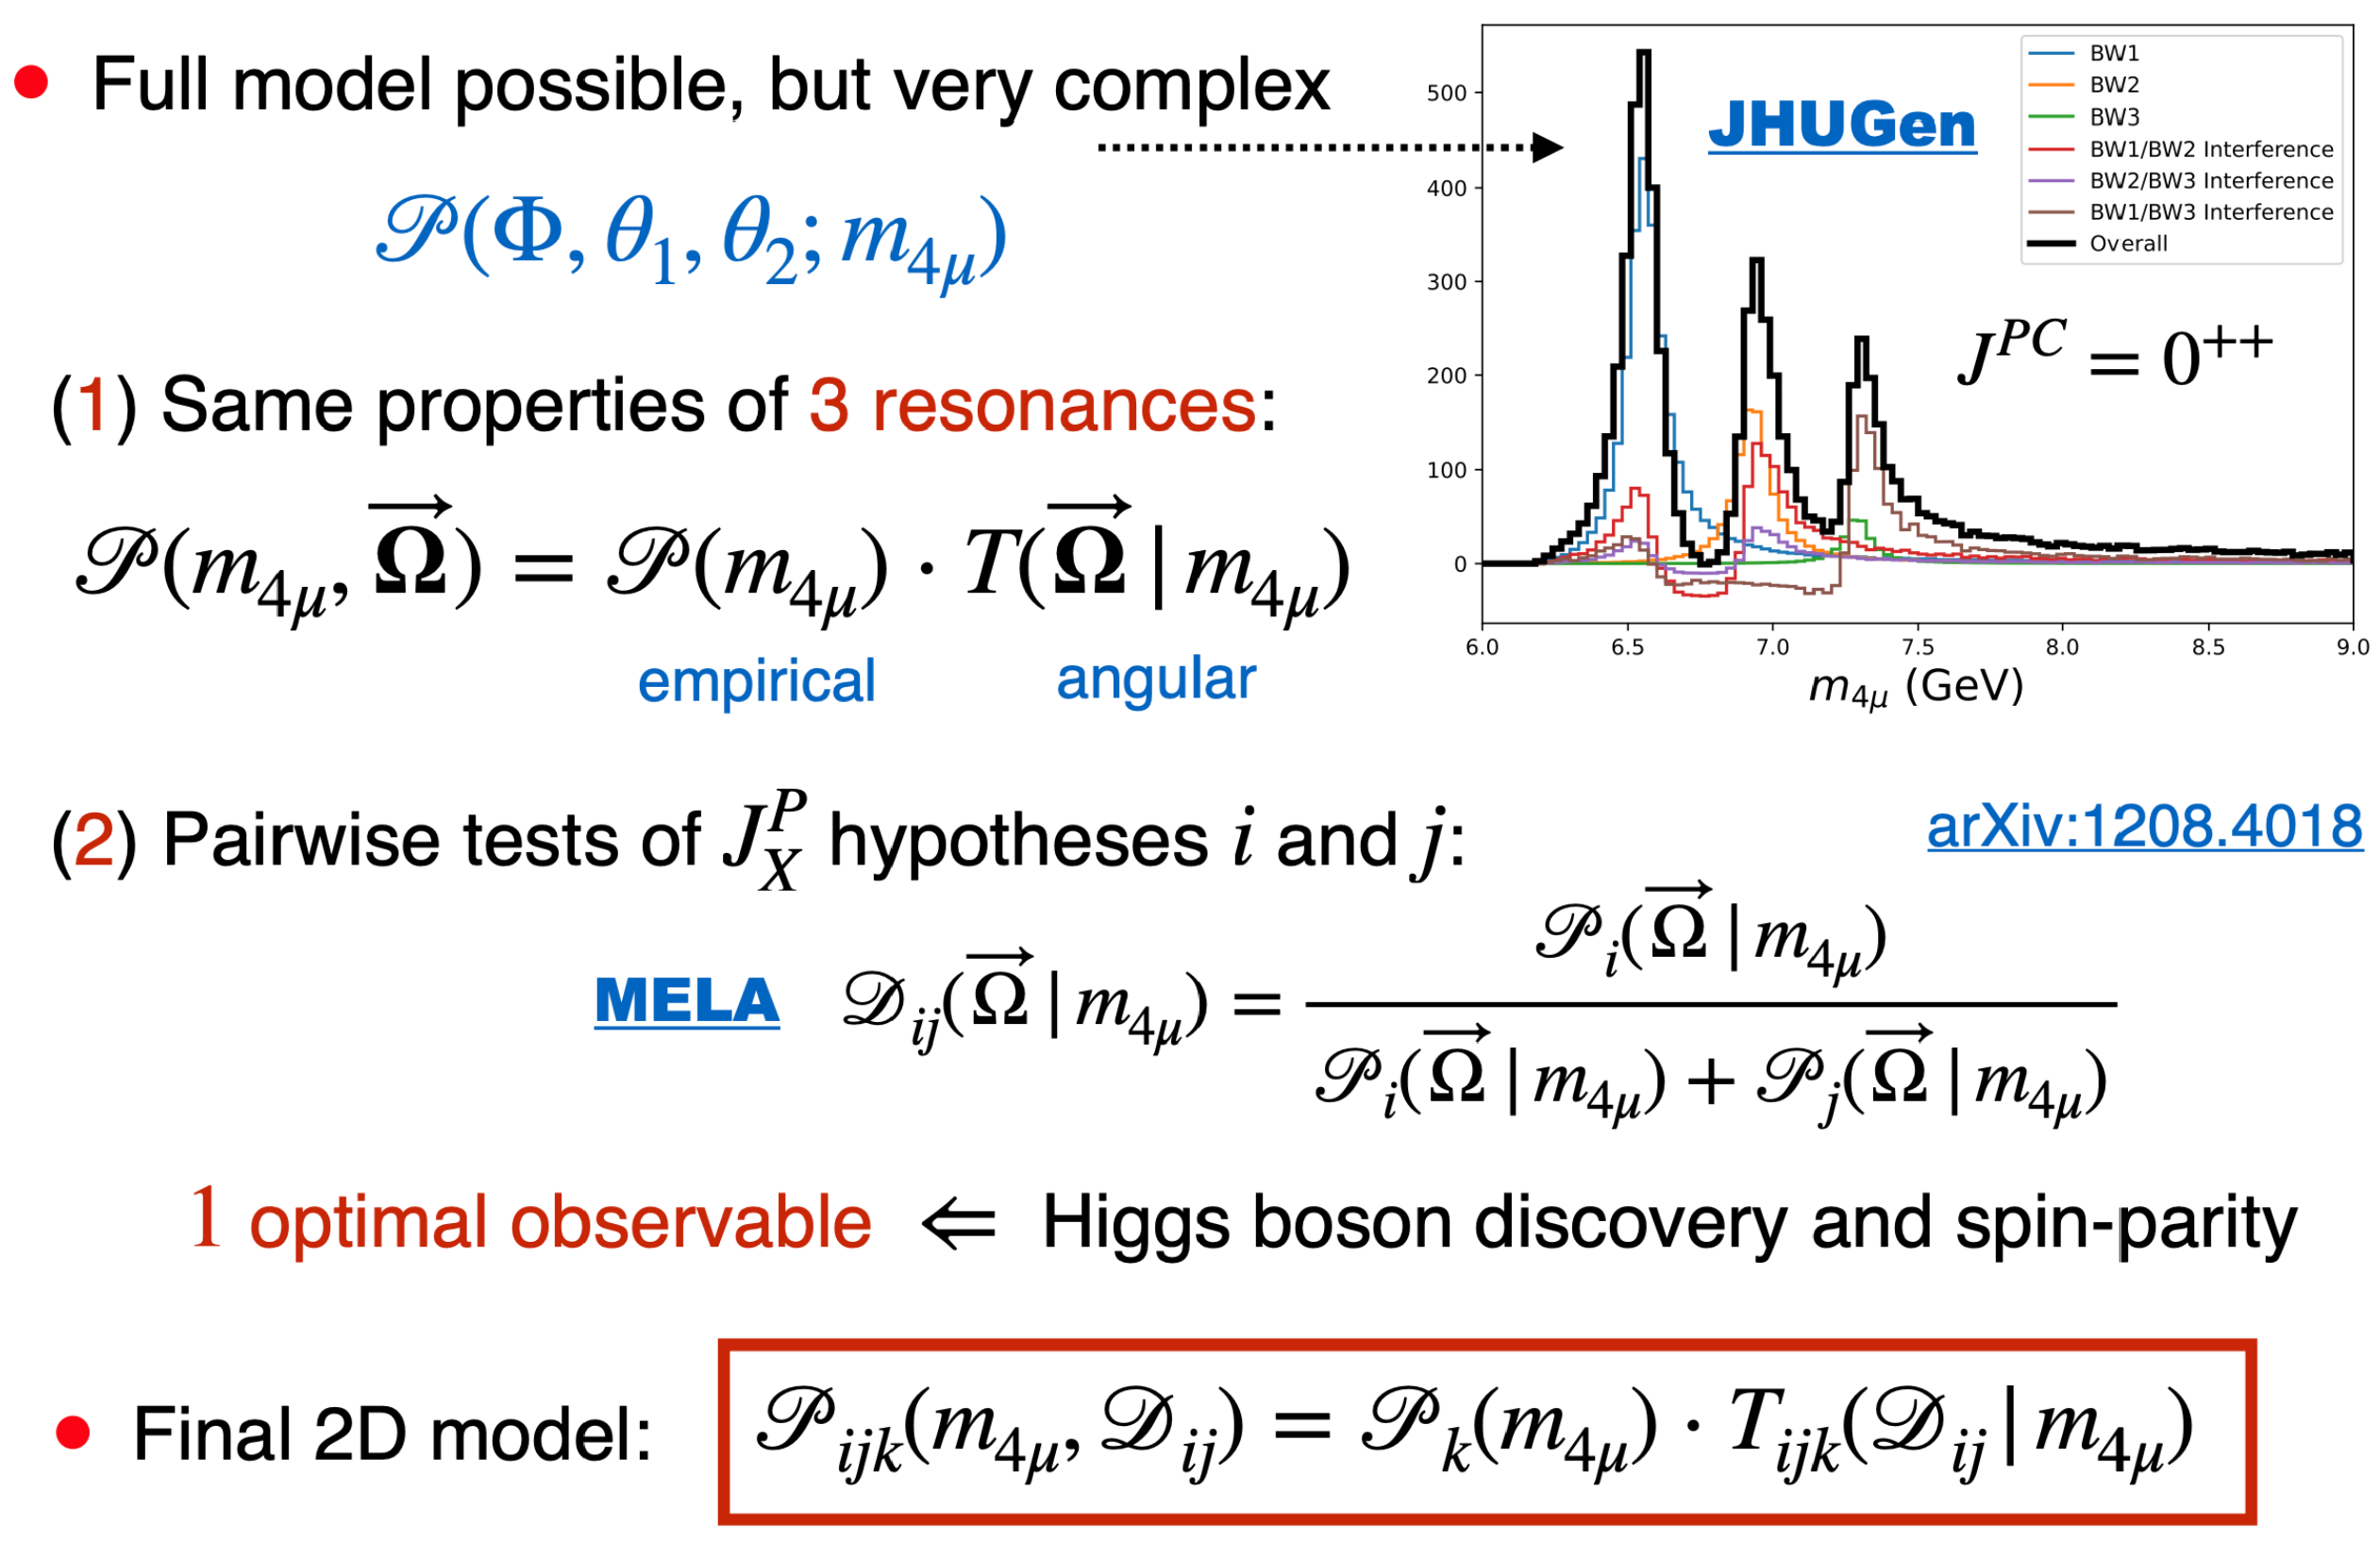

Simplification in Angular Analysis
12

Slide 13
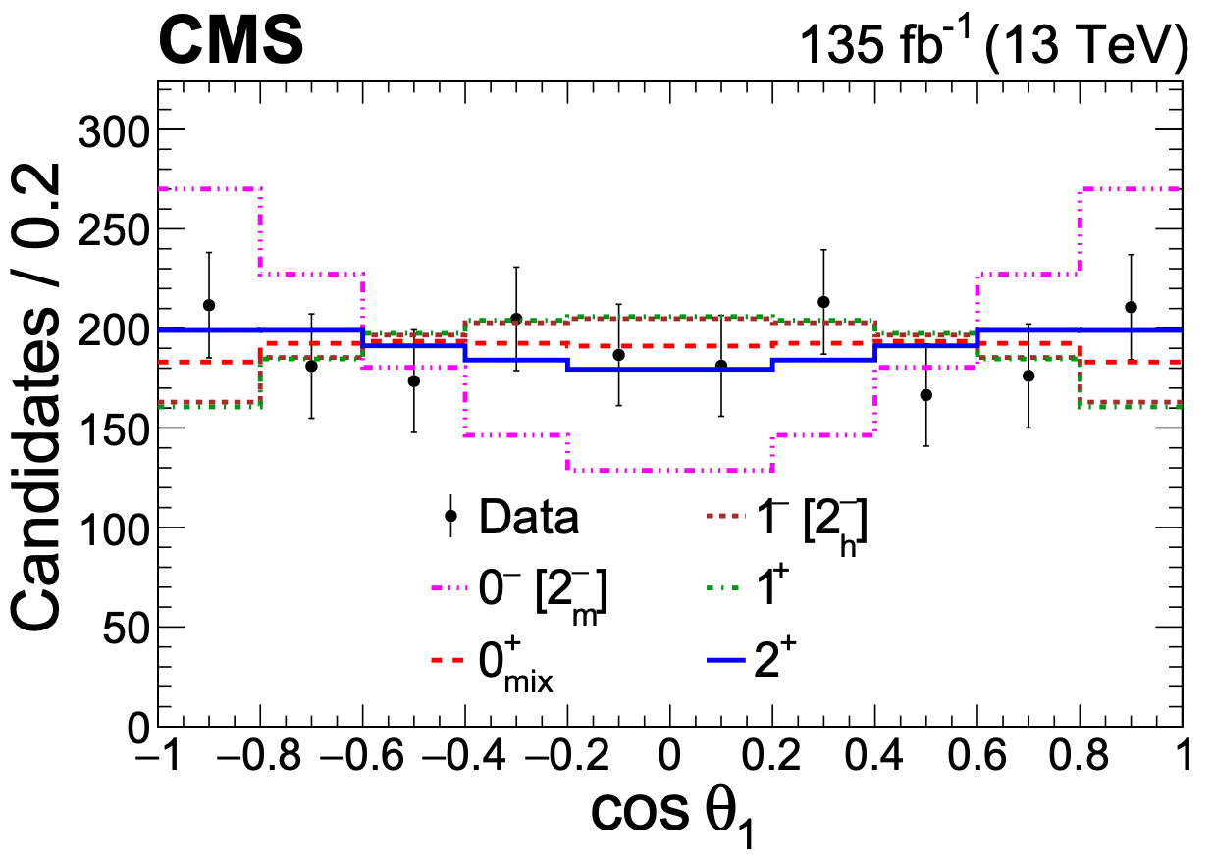
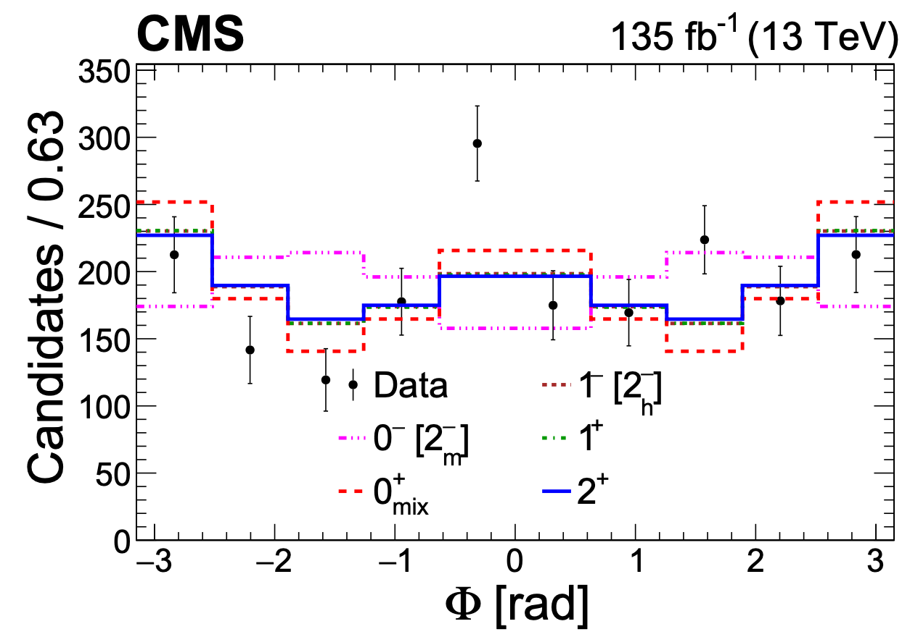


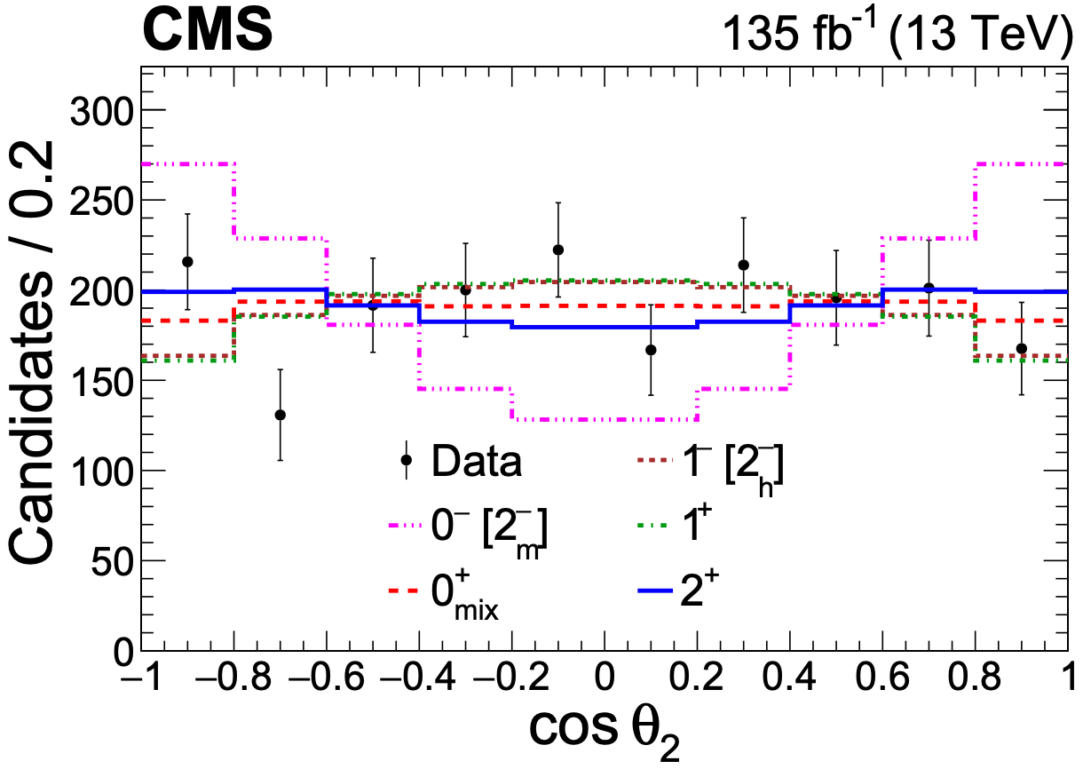
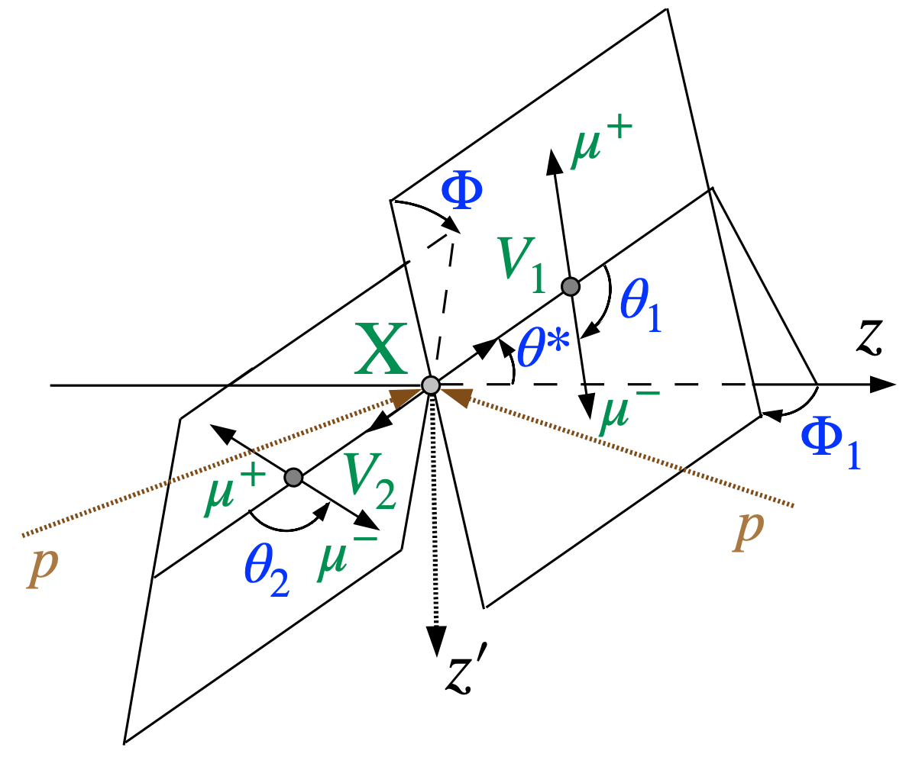






Decay Angles
$$0^{−}$$
$$0^{−}$$
$$cosθ_{1}$$
$$Φ$$
Nature 648 (2025) 58
$$0^{−}$$
$$cosθ_{2}$$
1D projections from 4D
(limited information)
13

Slide 14
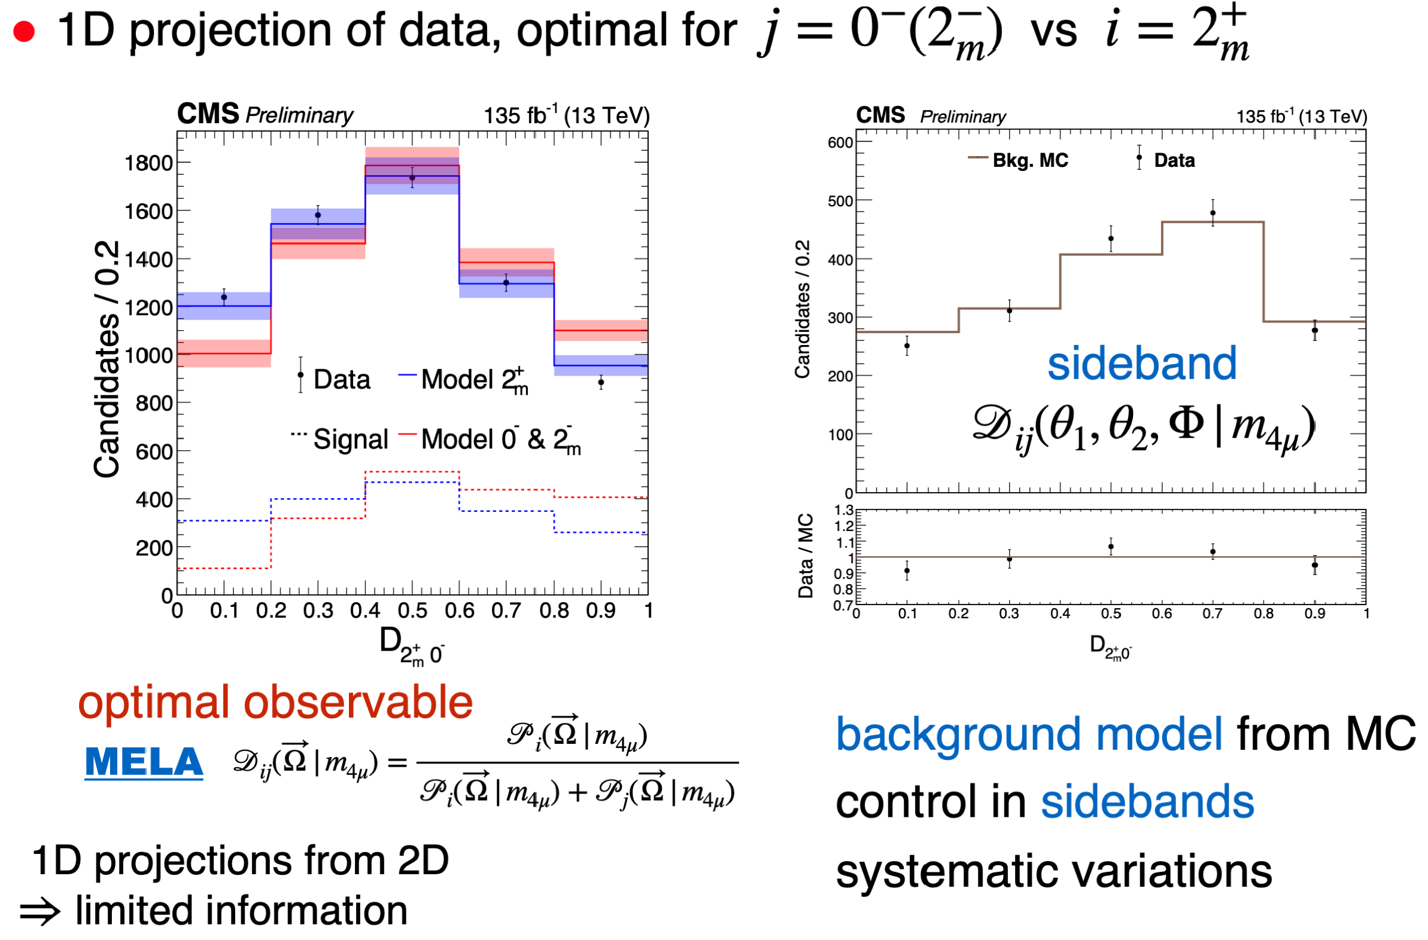

Optimal Observable
Nature 648 (2025) 58
14

Slide 15
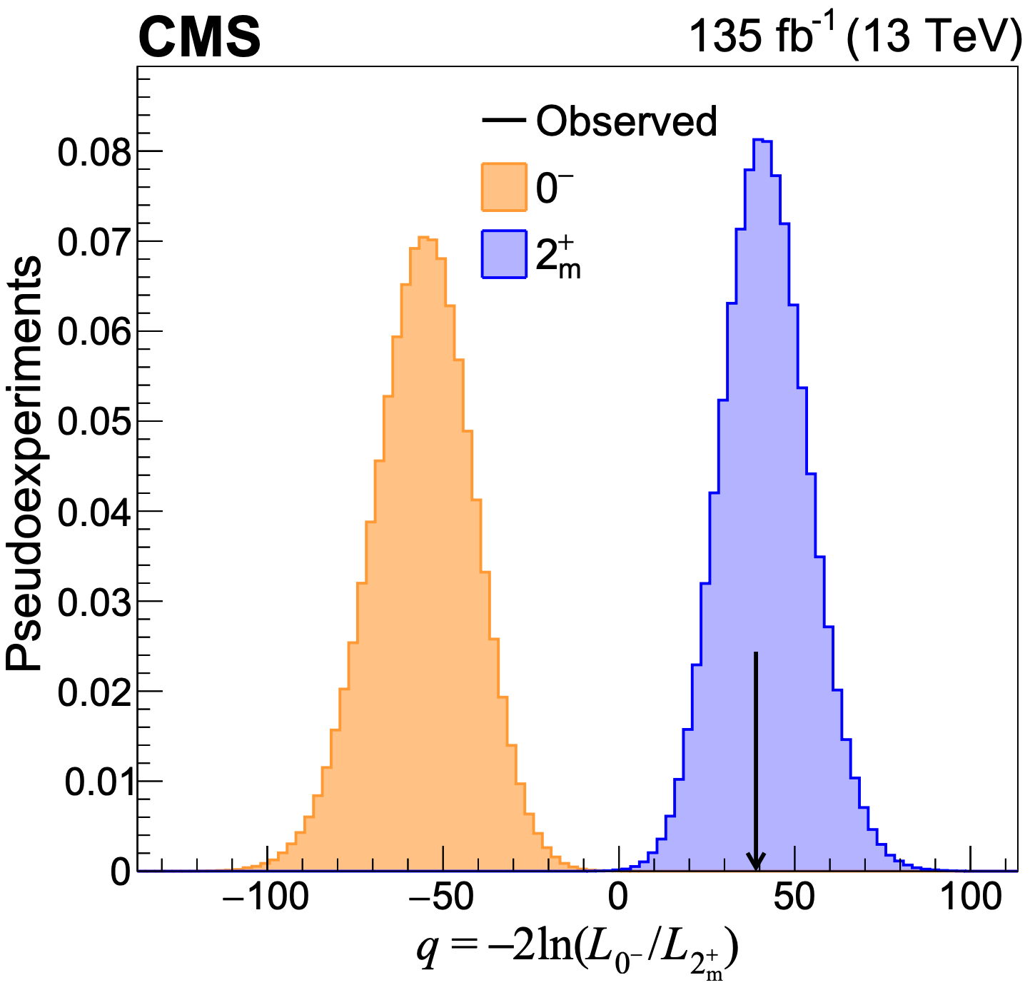
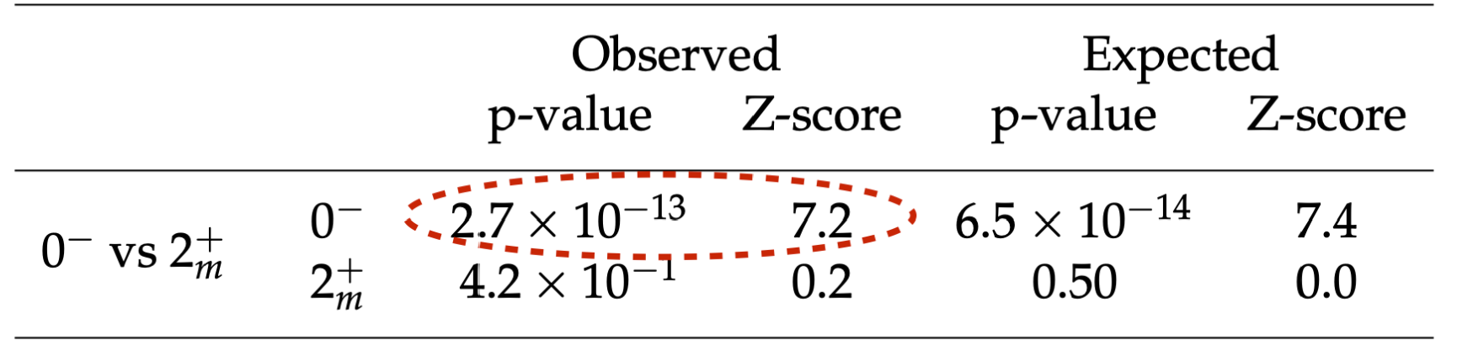
Statistical Analysis
Hypothesis test with toy MC for $J_{1}^{P}=$ $2_{m}^{+}$ vs $J_{2}^{P}=0^{−}$
Test statistic $q=−2ln⁡(ℒ_{J_{2}^{P}}/ℒ_{J_{1}^{P}})$
Consistency of data with $J_{1}^{P}/J_{2}^{P}$ using p-value:
$$p=P(q≤q_{obs}|J_{1}^{P}+bkg)$$
$$p=P(q≥q_{obs}|J_{2}^{P}+bkg)$$
Significance:
Converted from p-value
via Gaussian one-sided tail integral
Confidence level
$$0^{−}$$
$$2_{m}^{+}$$
observed $q_{obs}$
Nature 648 (2025) 58
$$CL_{s}=\frac{P(q≥q_{obs}|J_{2}^{P}+bkg) }{P(q≥q_{obs}|J_{1}^{P}+bkg) }$$
15

Slide 16
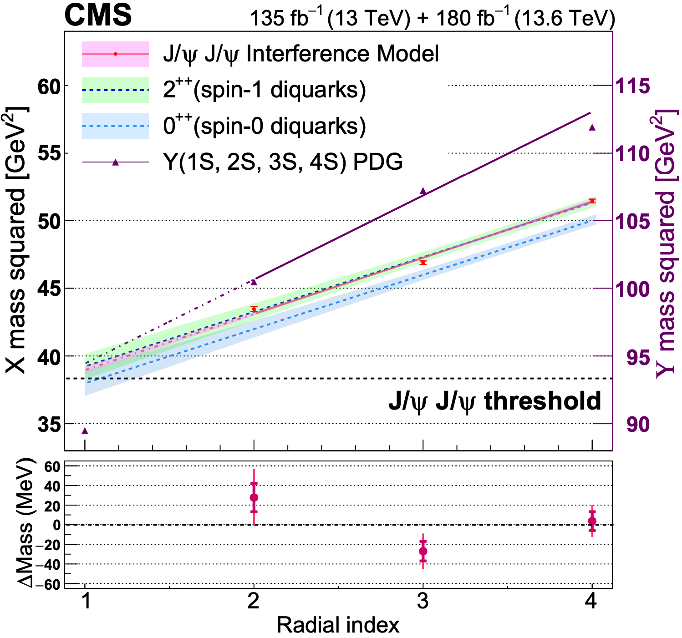
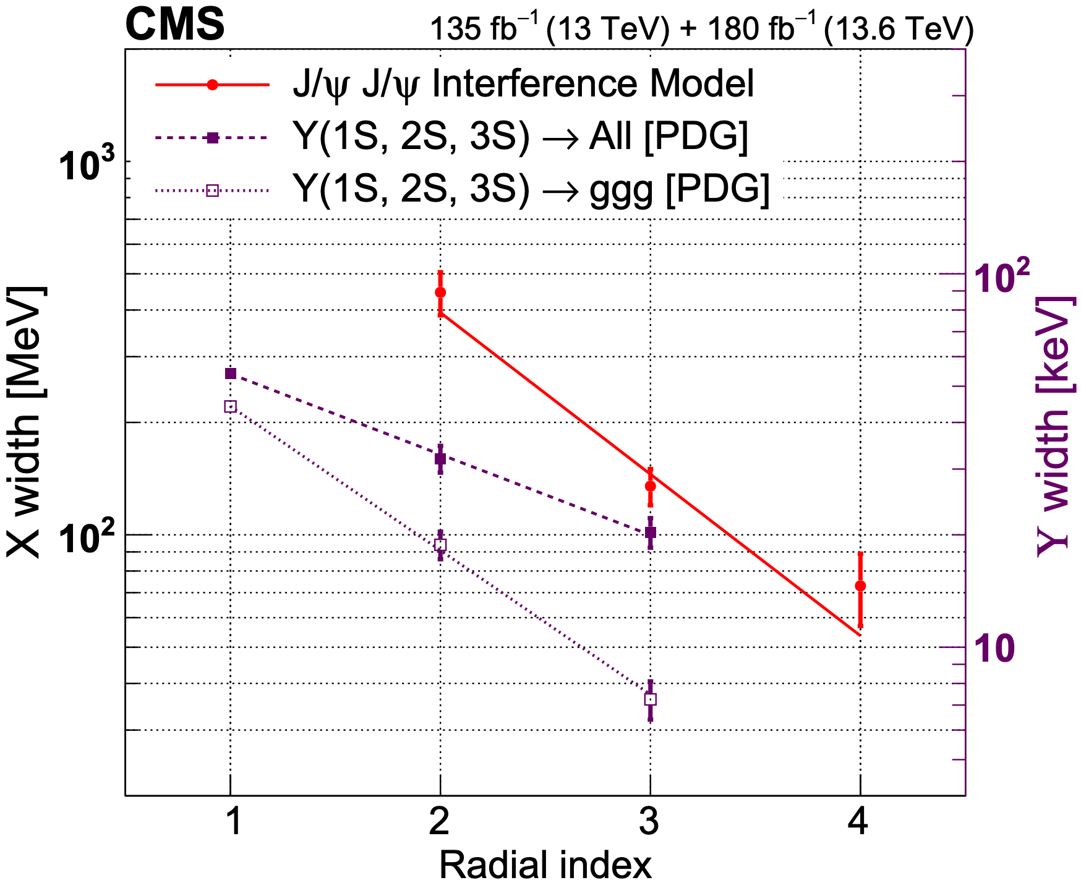
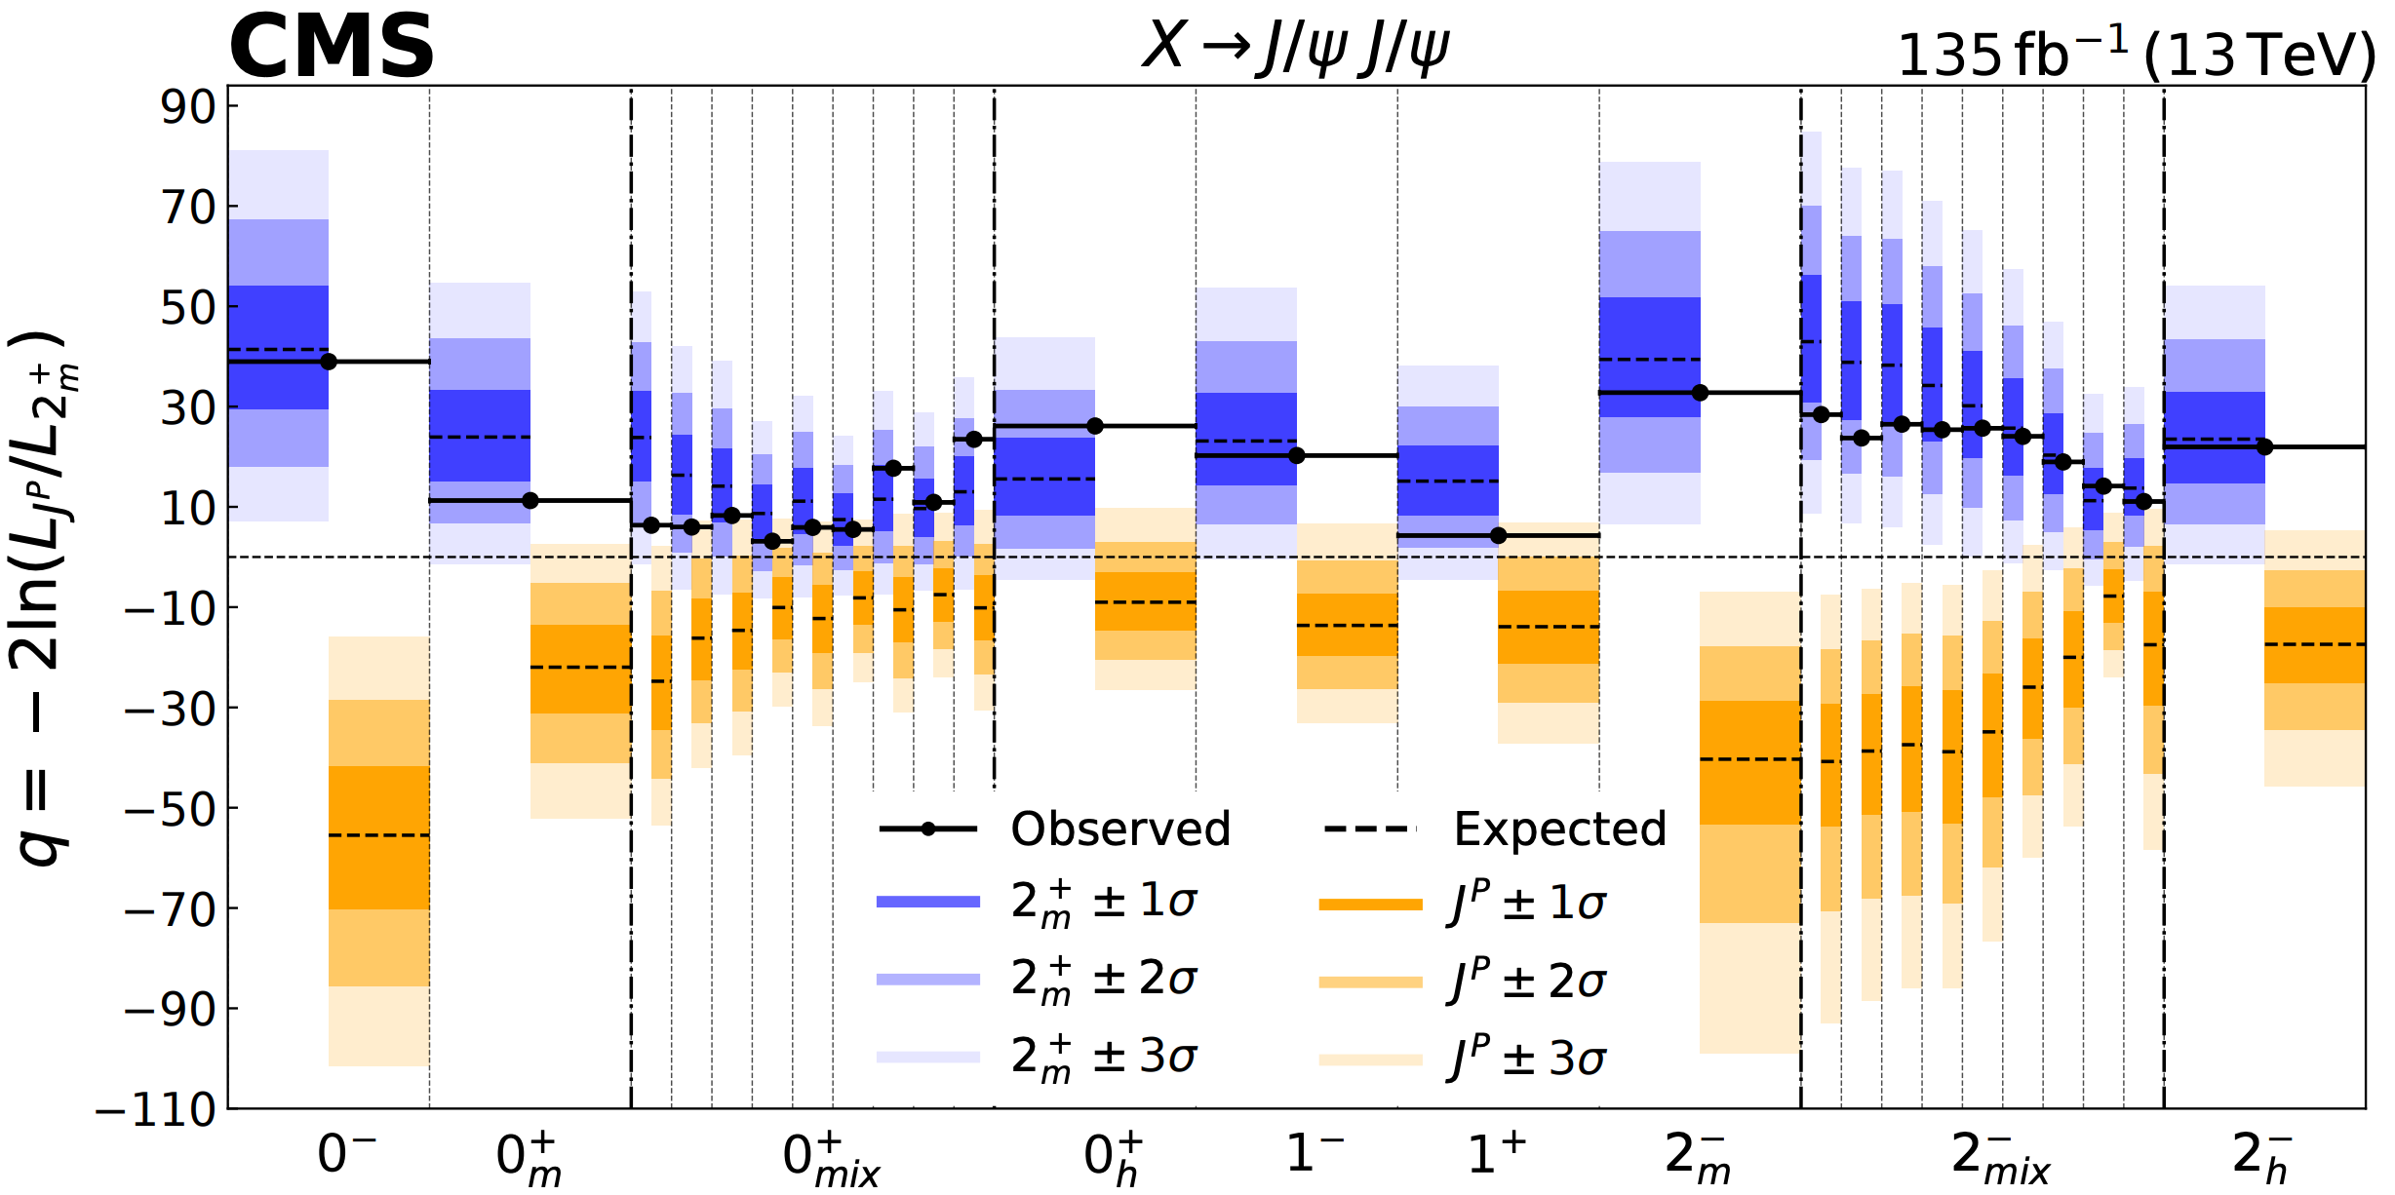
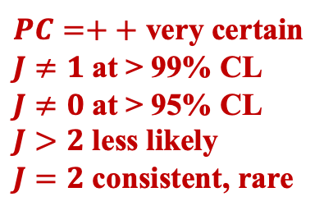
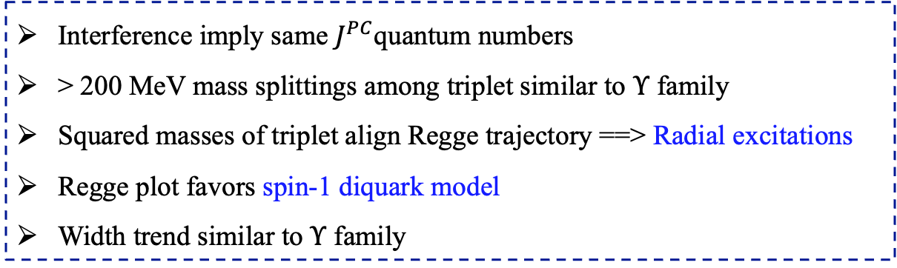
Discussion
Nature 648 (2025) 58
arXiv:2602.02252
$PC=++$ very certain
$J≠1$ at > 99% CL
$J≠0$ at > 95% CL
$J>2$ less likely
$J=2$ consistent, rare
Interference imply same $J^{PC}$quantum numbers
> 200 MeV mass splittings among triplet similar to $Υ$ family
Squared masses of triplet align Regge trajectory ==> Radial excitations
Regge plot favors spin-1 diquark model
Width trend similar to $Υ$ family
A FAMILY of all-charm tetraquark states with same $J^{PC}$
16

Slide 17
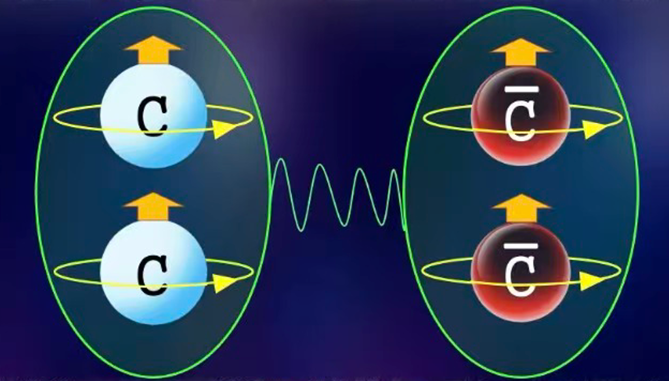
Summary
A family of all-charm tetraquarks with $J^{PC}=2^{++}$
Three structures X(6600), X(6900), X(7100) established with significances > 5σ
The first two analyses including 2024 data among LHC 3 exps
Precision improved by factor of 3
Multiple states makes comparisons possible
Quantum interference among structures validated with significances > 5σ
==> States have common J^{PC}, measured as $2^{++}$
Large mass splittings, Regge trajectory
==> radial family of states
CMS is painting a coherent picture of $J/ψJ/ψ$ structures
THANKS!
17

Slide 18

18

Slide 19
Datasets, MC, trigger, and event selection
Data samples (315 fb⁻¹)
Run 2: 135 fb⁻¹ data taken in 2016, 2017 and 2018
Run 3: 180 fb⁻¹ data taken in 2022, 2023 and 2024
Triggers
Run 2 trigger:
Level 1 requirements: 3 muons
$2.95<M\left(μ^{+}μ^{−}\right)<3.25 GeV$
$p_{T}\left(μ\right)>3.5 GeV$
Run3 trigger (new):
Level 1 requirements: 2 muons
$0.2<M\left(μ^{+}μ^{−}\right)<8.5 GeV$
One muon $p_{T}\left(μ\right)>4 GeV$; The other $p_{T}\left(μ\right)>3 GeV$
$p_{T}\left(μ^{+}μ^{−}\right)>4.9 GeV$
increase 30% $J/ψJ/ψ$ statistics compared to old trigger
Signal and Background simulated events:
Signal $X→J/ψJ/ψ→μ^{+}μ^{−}μ^{+}μ^{−}$by JHUGen
NRSPS and Feeddown by Pythia8
DPS event-mixing
Feeddown: $X\left(6900\right)→J/ψψ(2S)→J/ψJ/ψ+anything$
Event selection
Follow Run 2 cuts + new trigger for Run 3
SPS
DPS
19

Slide 20
Signal and background models
Signal shape: Relativistic Breit-Wigner
Background component: NRSPS + NRDPS + Feeddown + Comb + BW0
Non-interference model:
Signal-hypothesis: NRSPS + NRDPS + Comb + Feeddown + BW0 + BW1 + BW2 + BW3
$$Pdf\left(m\right)=\sum{N_{X_{i}}∙{\left|BW\left(m,M_{i},Γ_{i}\right)\right|}^{2}⊗R\left(M_{i}\right)}+N_{NRSPS}⋅f_{NRSPS}\left(m\right)$$
$$+N_{NRDPS}⋅f_{NRDPS}\left(m\right)+N_{Comb}⋅f_{Comb}\left(m\right)+N_{Feedown}⋅f_{Feeddown}\left(m\right)$$
Interference model:
Signal-hypothesis: NRSPS + NRDPS + Comb + Feeddown + BW0 + BW123 Interf. Term
20

Slide 21
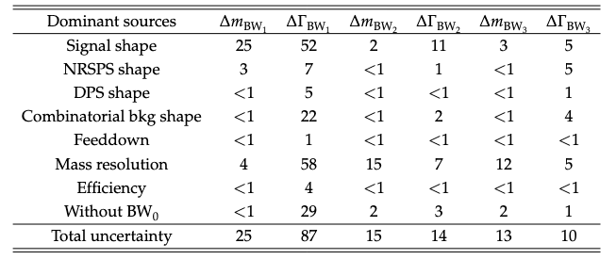
Run 2 & 3 interference fit result
Params | M(BW1) | Γ(BW1) | M(BW2) | Γ(BW2) | M(BW3) | Γ(BW3)
Run II & III Interf. [MeV] | $${6593}_{−14}^{+15}±25$$ | $${446}_{−54}^{+66}±87$$ | $$6847±10±15$$ | $${135}_{−14}^{+16}±14$$ | $${7173}_{−10}^{+9}±13$$ | $${73}_{−15}^{+18}±10$$
Run II Interf. [MeV] | $${6638}_{−38−31}^{+43+16}$$ | $${440}_{−200−240}^{+230+110}$$ | $${6847}_{−28−20}^{+44+48}$$ | $${191}_{−49−17}^{+66+25}$$ | $${7134}_{−25−15}^{+48+41}$$ | $${97}_{−29−26}^{+40+29}$$
VS. Run 2 result
Statistical uncertainty reduced by a factor of 3
Systematic uncertainty reduced by about a factor of 2
Large mass splittings (> 200MeV) still exist, with improved precision
21

Slide 22
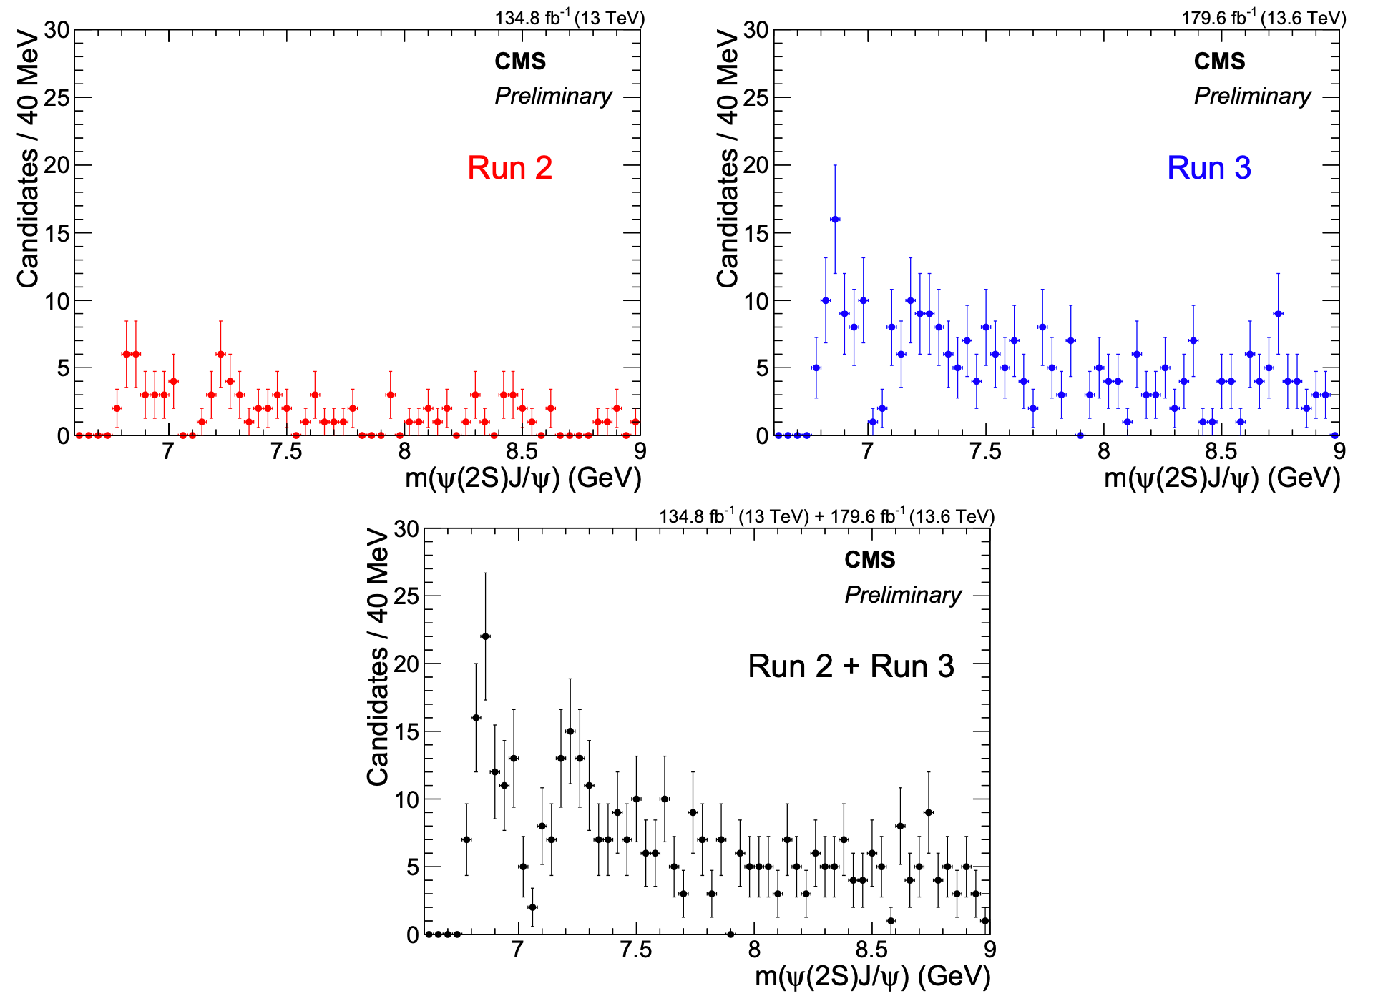
Explore 𝐽/𝜓𝜓(𝟐𝐒) channel with Run 2 & 3 data
X(6900) near threshold obvious
X(7100) is visible
According to $J/ψJ/ψ$ channel, should be an X(6900) and an X(7100)
Signal dominated by Run 3
Two dimensional fit for $J/ψψ(2S)$yield ~2.6 X of Run 2
Run 2 ~109 ± 14
Run 3 ~281 ± 22
Run 2+3 ~386 ± 26
22

Slide 23
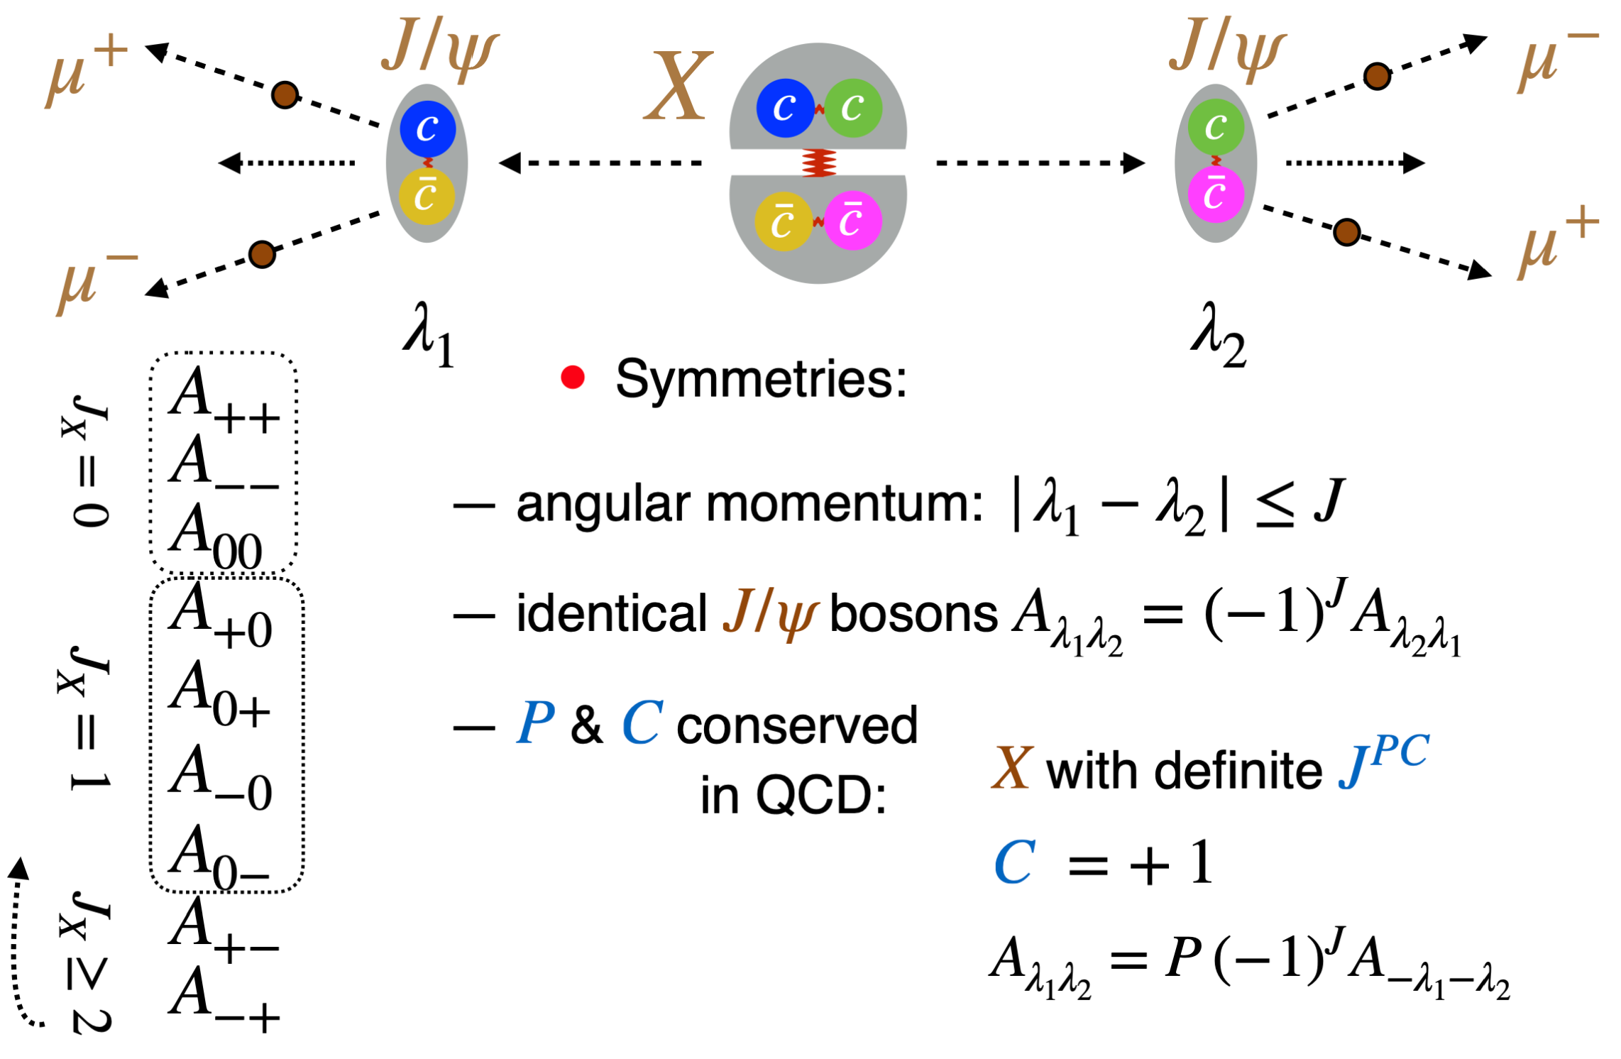
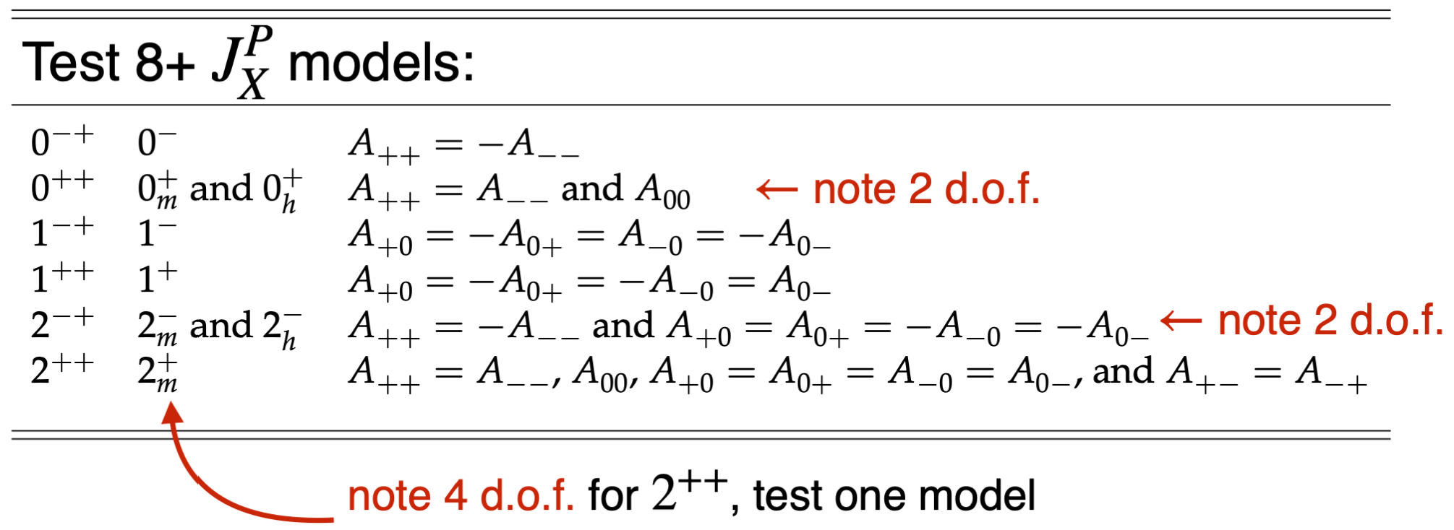
$J/ψ$ polarizations
23

Slide 24
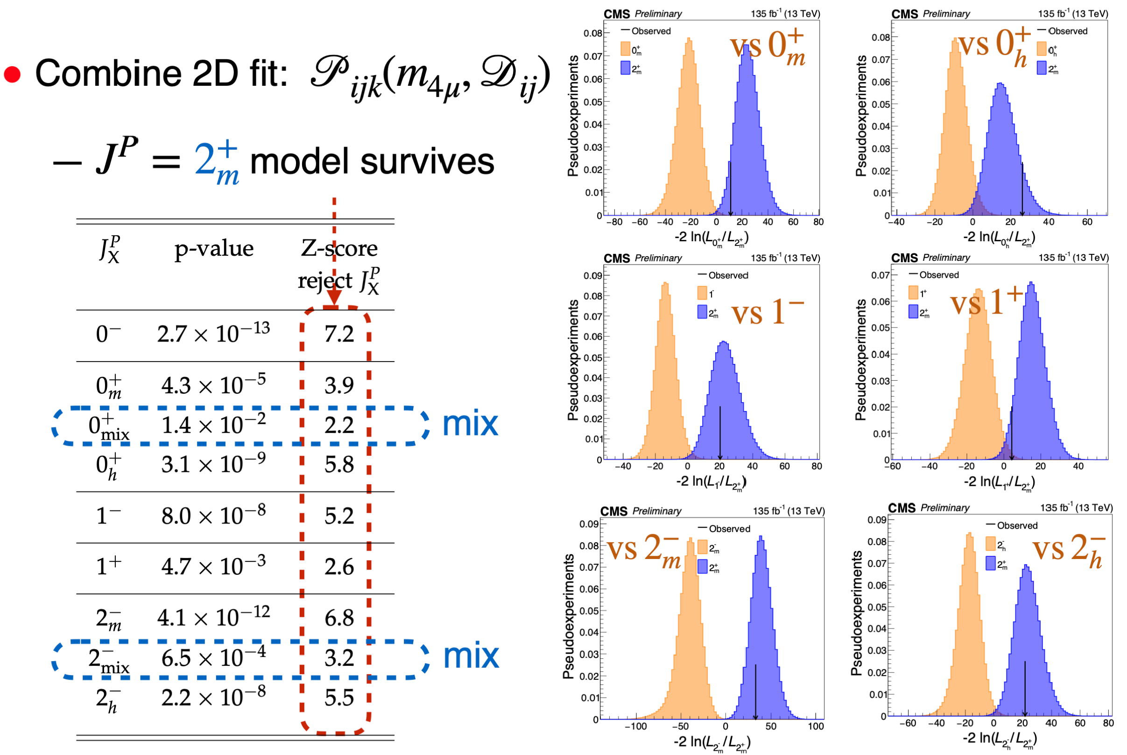
Hypothesis test
$PC=++$ very certain
$J≠1$ at > 99% CL
$J≠0$ at > 95% CL
$J>2$ less likely
$J=2$ consistent, rare
24

Slide 25
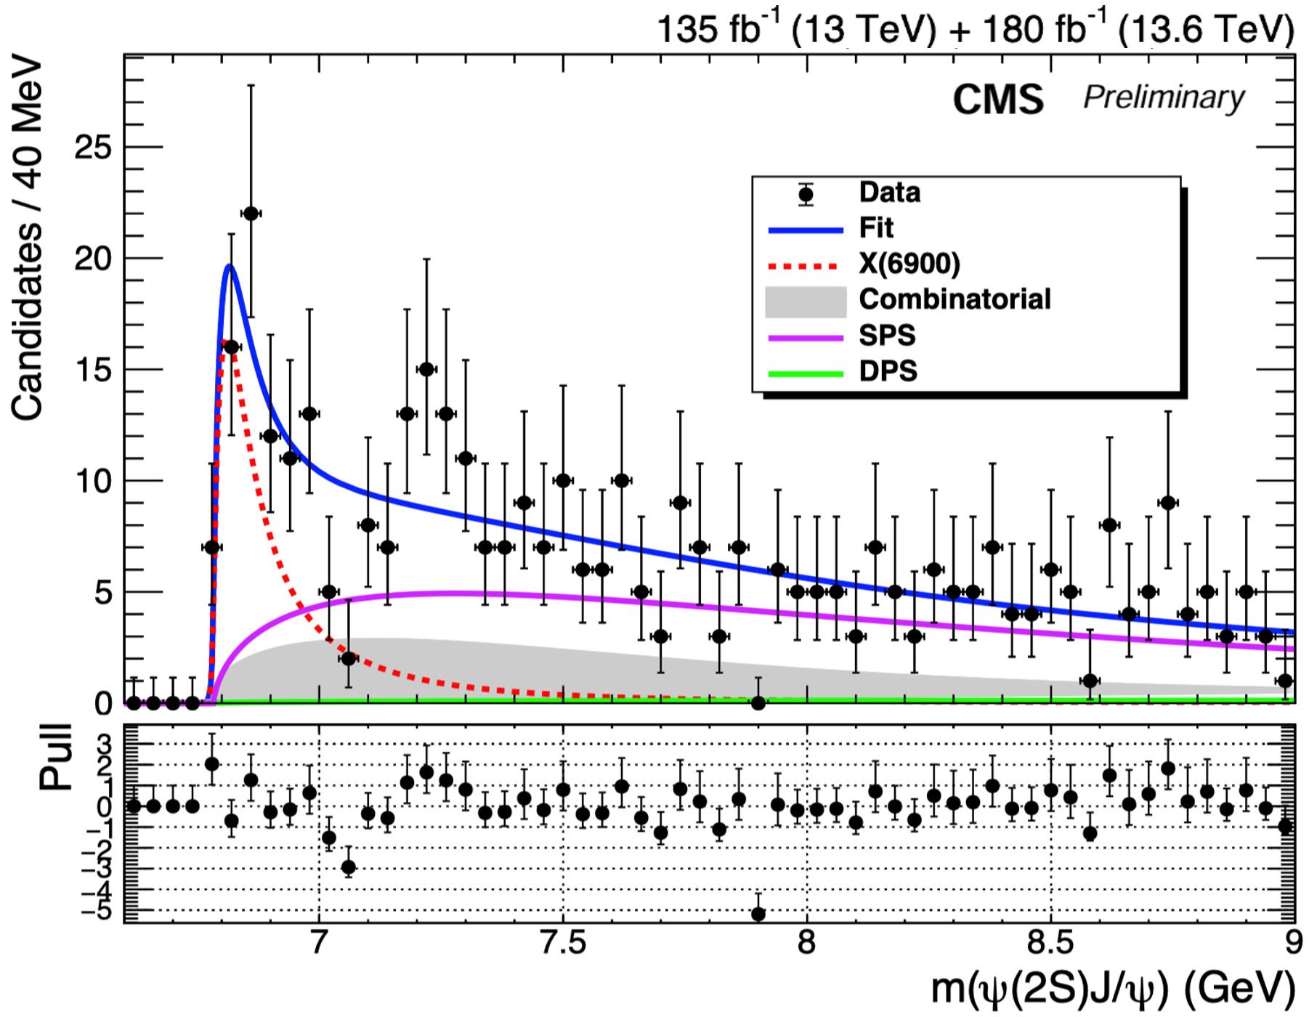
Explore 𝐽/𝜓𝜓(𝟐𝐒) channel with Run 2 & 3 data
Only consider X6900 in 𝐽/𝜓𝜓(𝟐𝐒) channel
$$M\left(X(6900)\right)=6841±14 MeV$$
$$Γ\left(X(6900)\right)=150±28 MeV$$
Significance of X(6900) = 7.5 σ
25

Slide 26
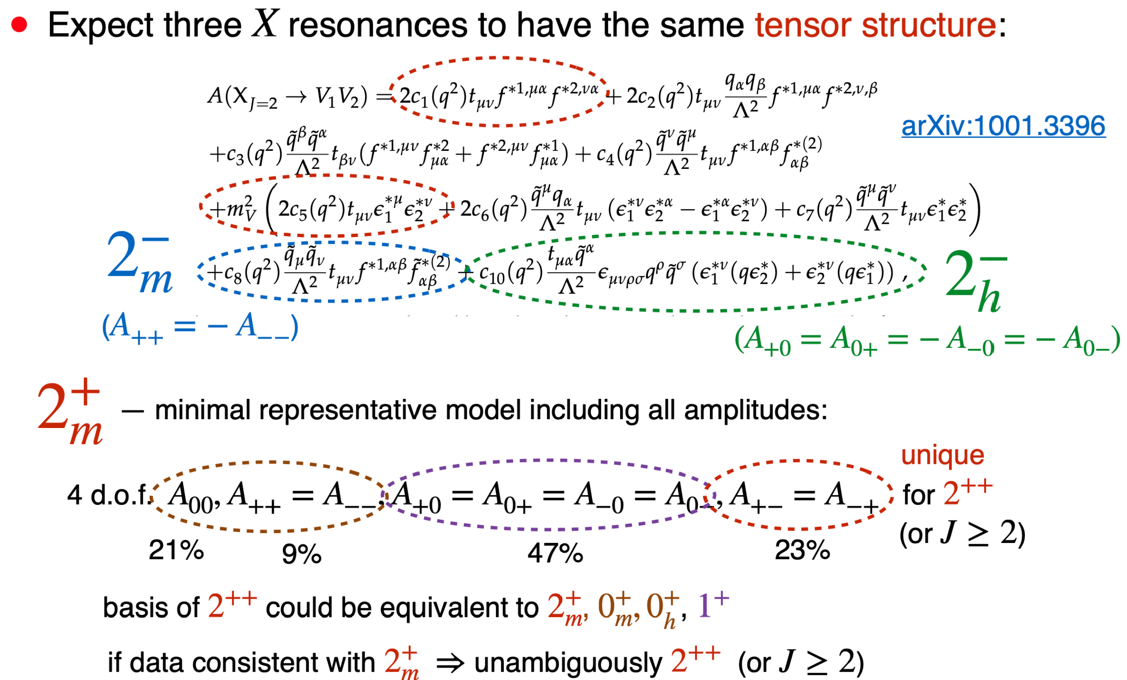
Lorentz-Invariant Amplitude
26

Slide 27
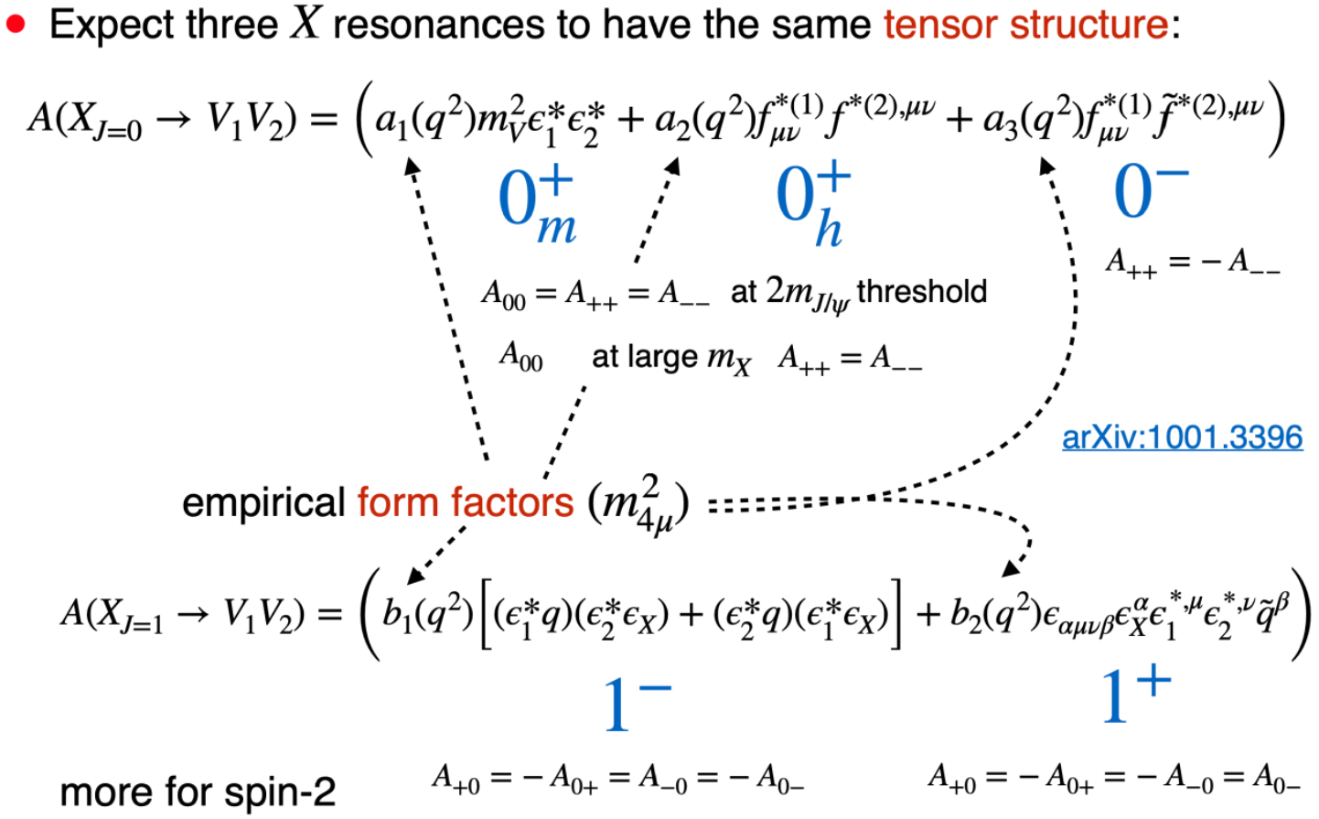
Lorentz-Invariant Amplitude
Backup
27

Slide 28
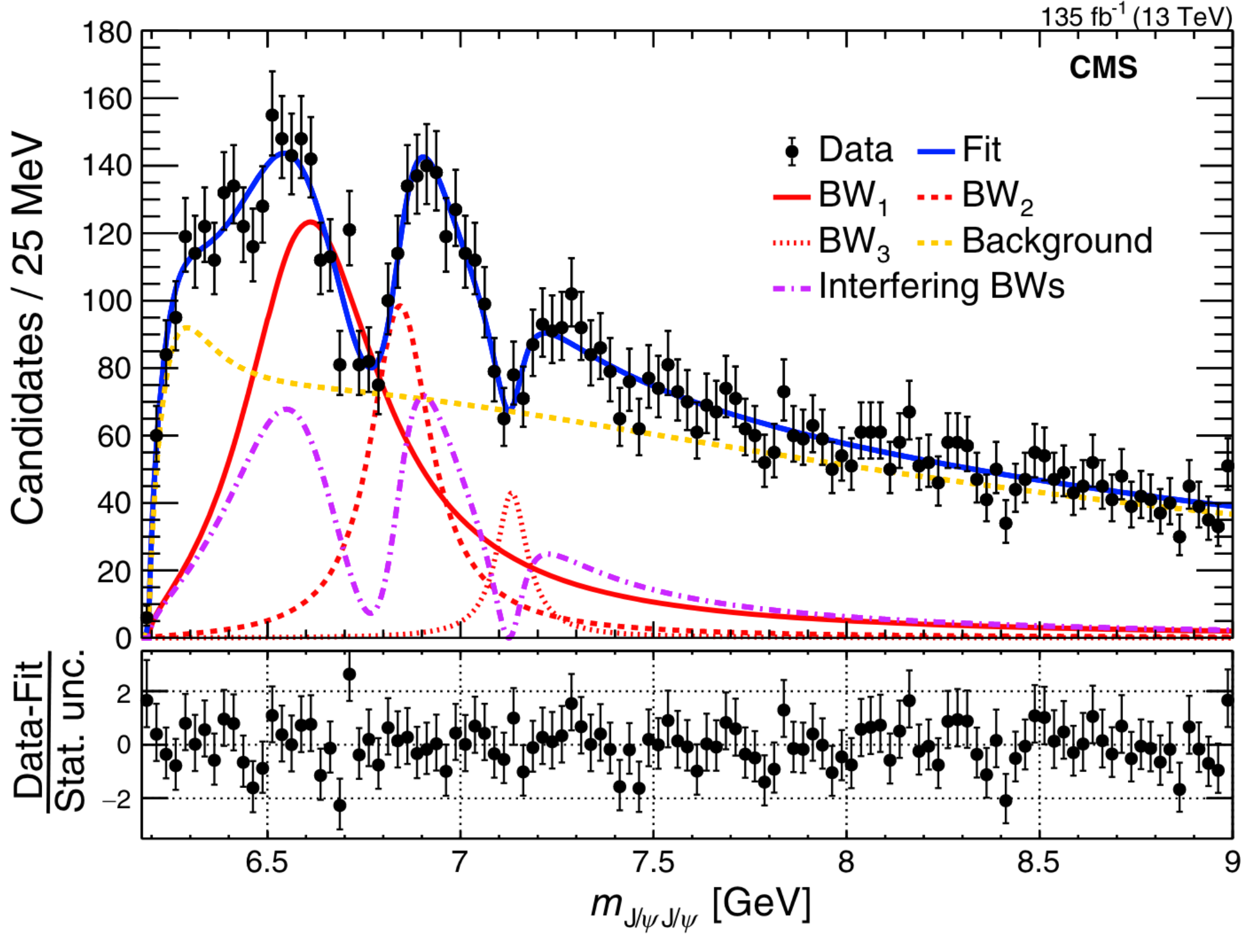
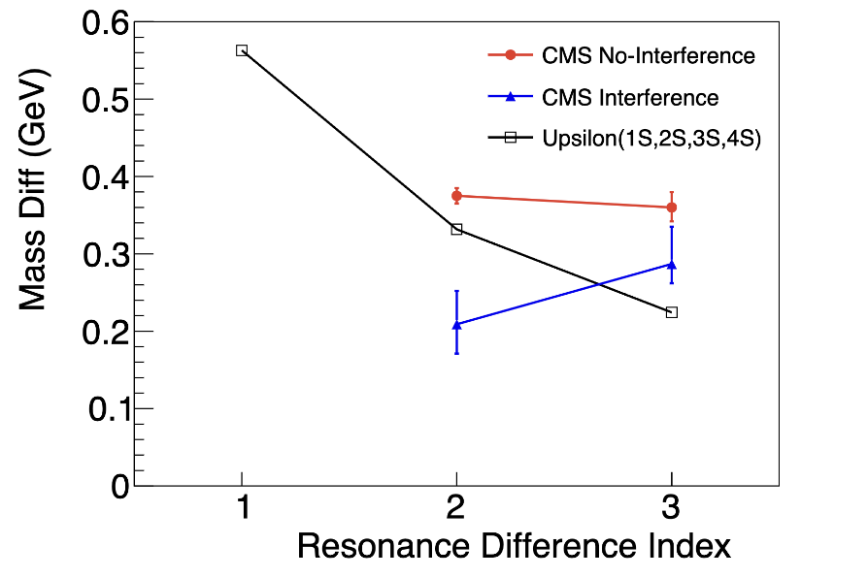
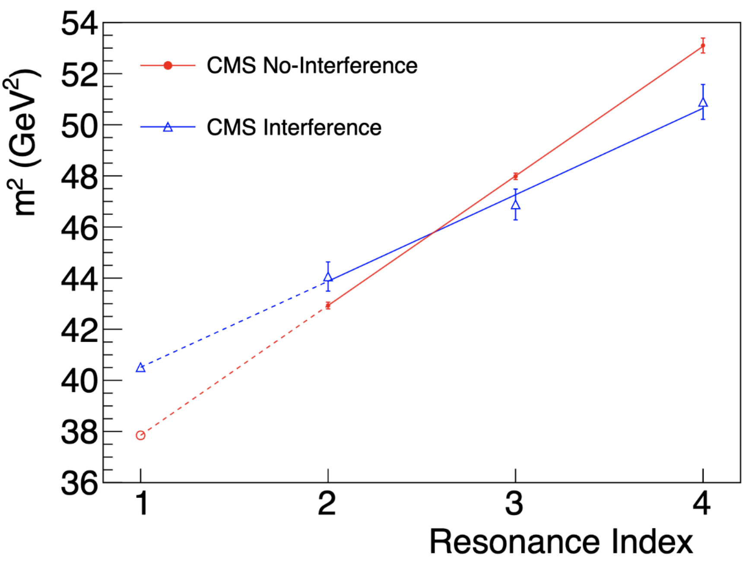
Status
Phys. Rev. Lett., 132(11):111901, 2024
Chinese Phys. Lett. 41 111201
Run II
Run II
Run II
$Υ$ Family
Res. Diff Indices:
1: Y(2S)-Y(1S)
2: Y(3S)-Y(2S), X(6900)-X(6600)
3: Y(4S)-Y(3S), X(7100)-X(6900)
Run 2 result:
X(7100): 4.7σ
Interference < 4σ
Interference imply same $J^{PC}$quantum numbers
> 200 MeV mass splittings ==> Radial excitations ?
A family of all-charm tetraquarks ?
With 3.6X statistics:
Significance of ALL states over 5σ ?
Significance of interference over 5σ ?
A FAMILY of all-charm tetraquark states with same $J^{PC} ?$
28

Slide 29
New conventional hadrons at LHC
29

Slide 30
New exotic hadrons at LHC
30

Slide 31
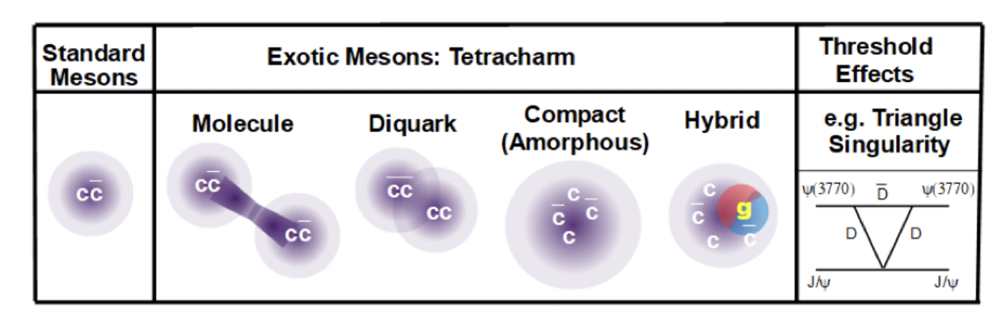
Status
Models of potential quark conﬁgurations for J/ψJ/ψ mesons.
Meson-meson “molecule” ($c\overline{c}$- $c\overline{c}$)
Pair of diquarks ($cc$-$\overline{c}\overline{c}$)
Hybrid with a valence gluon
Peaks as artifact of dicharmonia production thresholds
……
Family of all-charm tetraquarks with same $J^{PC}$
offers new perspectives on interpretation for exotics
31

Slide 32


𝐽/𝜓𝐽/𝜓: 6-15 GeV fits
32

Slide 33
Fit model
Final 2D fit model ($0^{+} vs. 0^{−}$):
${P(m_{X},D}_{0^{−}})=$……
$+N_{\left(interf−BW1BW2BW3\right)}∗\left[f_{0_{m}^{+}}∗P_{0_{m}^{+}\left(interf−BW1BW2BW3\right)}{(m_{X},D}_{0^{−}}\right)$
$+\left(1−f_{0_{m}^{+}}\right)∗P_{0^{−}\left(interf−BW1BW2BW3\right)}{(m_{X},D}_{0^{−}})]$
$f_{0_{m}^{+}}$: fraction of $0_{m}^{+}$ signal component
33

Slide 34


Concept of Analysis: Production
match $p_{z}^{X}$
match $p_{T}^{X}$
34

Slide 35

Concept of Analysis: Production
35

Slide 36

Angular Analysis
36

Slide 37

Polarization in Production
37

Slide 38

Production Angles
38

Slide 39

Production Angles
39

Slide 40

Discriminant Distributions
40

Slide 41

Hypothesis test
41

Slide 42


Summary of Results
42

