Slide 1

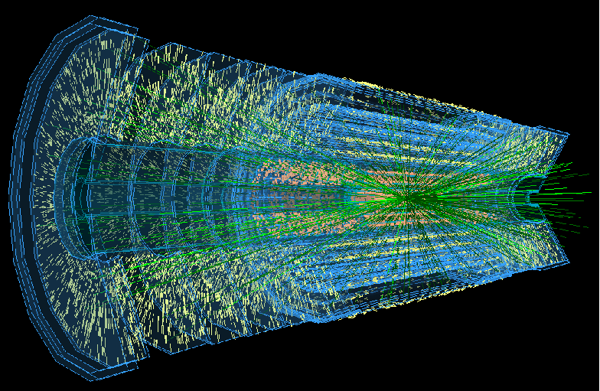
ATLAS Silicon Tracker and BILPA
Phil Allport, Matt Baca, James Broughton, Andy Chisholm, Laura Gonella, Kostas Nikolopoulos, Simon Pyatt, Juergen Thomas, John Wilson
30/09/15
Introduction
ATLAS UK Tracker Upgrade
AIDA-2020 Transnational Access Facility
Current Facilities
Hybrid/Module Read-out
ALiBaVa Set-up
Future Capabilities
1

Slide 2
Introduction
The Birmingham group is a key player in the development and preparations for production of a significant fraction of the silicon micro-strip part of the new ATLAS inner tracker (the ITk) required for operation at the HL-LHC
University of Birmingham operates the UK’s only AIDA 2020 (EU funded) Transnational Access Facility for irradiations using the MC40 cyclotron
With significant University investment we are building a new cleanroom facility (BILPA) suitable for the ATLAS construction activity and better able to support future activities based on semiconductor detector development
New appointments are planned in support of this and medical applications where there is a long history of involvement in proton therapy activities (silicon strip modules for the PRaVDA consortium built at Birmingham)
Longer term sensor interests include the development of radiation-hard monolithic pixel detectors as central to optimal outer tracking and digital calorimetry at future facilities. In this context we (incl Nige) are bidding (PRD) with RAL and Sussex to explore realising these in a common technology (HV-CMOS), emphasising particle flow capabilities and linking with CALICE and EM Calorimeter triggering expertise at Birmingham.
2

Slide 3

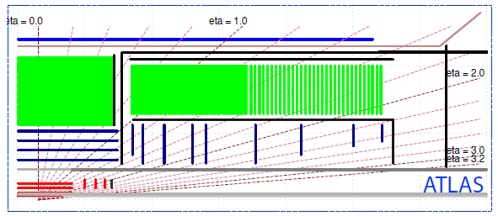
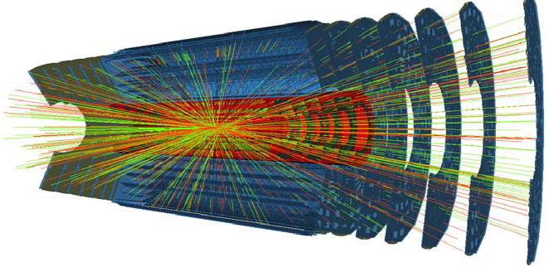
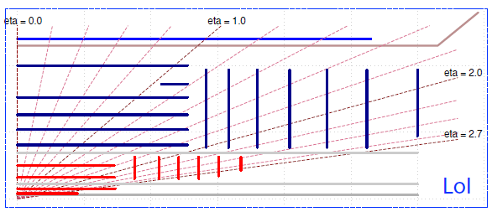
ATLAS UK Tracker Upgrade
HL-LHC: 10× LHC integrated luminosity, 7.5× LHC nominal instantaneous luminosity
10× radiation levels, data volumes and data rates
7.5× hit densities (pile-up) per beam crossing
Need major upgrades and new tracker
Opportunity for tracking in Level-1 trigger
25 m
45 m
3

Slide 4
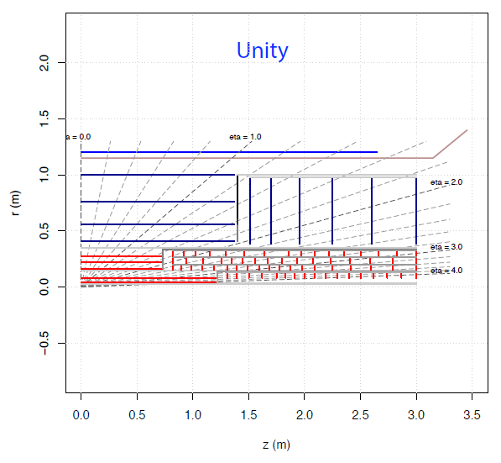
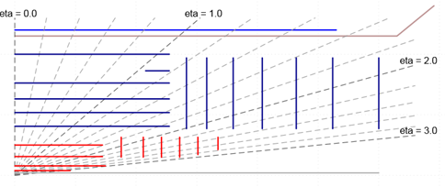
ATLAS UK Tracker Upgrade
The most recent public description of the ATLAS upgrade plans can be found at https://cds.cern.ch/record/2055248/
Note the layout of the tracker continues to evolve with an expectation that the barrel will be formed of 5 pixel and 4 strip layers, but the strip layers will be longer, resulting in a small decrease in total number of modules required
The desire is also to increase the pixel coverage in η
Forward Strips
Long Barrel Strips
Short Barrel Strips
Stub
Strip barrels
Strip discs
Higher eta
Forward pixel
UK originally built 600 barrel strip modules for current ATLAS with 60m² of silicon strips.
New tracker 200m² of silicon strips
(20,000 modules)
Barrel pixel
4

Slide 5
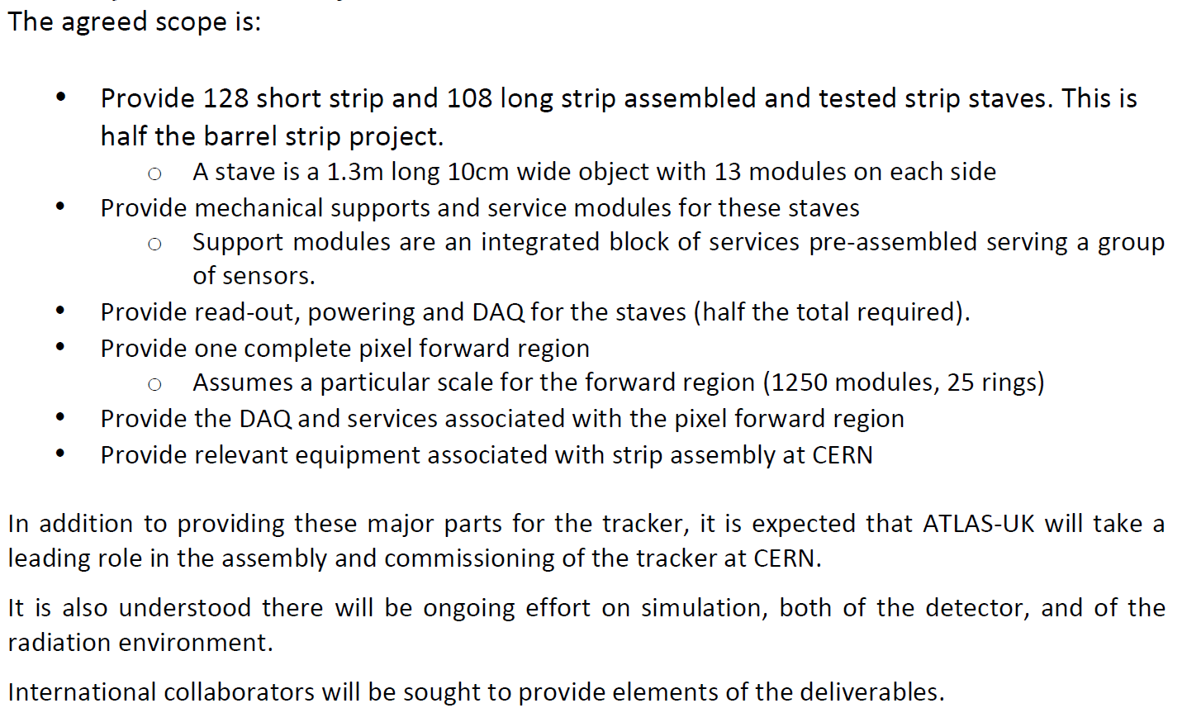
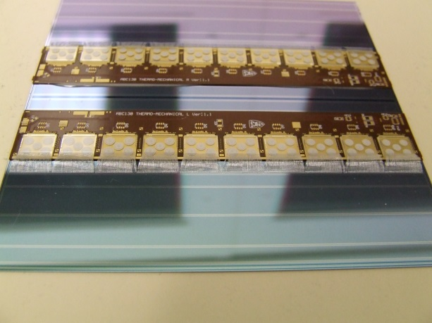
ATLAS UK Tracker Upgrade
(
For the UK, the contribution is expected to be half the total strip barrel of area
Birmingham R&D has focussed on glue studies, assembly techniques, development of strip module read-out and Quality Assurance
Birmingham currently involved in 3 production programme areas:
  Barrel Hybrid assembly and QA (with Liverpool)
  Barrel Module assembly and QA (with Cambridge, Glasgow, Liverpool, Oxford, RAL, Sheffield)
  Radiation testing (with Sheffield)
(~6000 modules)
10 chip 2560 channel read-out hybrid
10 chip 2560 channel read-out hybrid
5120 strip sensor
(4 rows of 1280 strips)
10cm×10cm ITk Strip Module
5

Slide 6

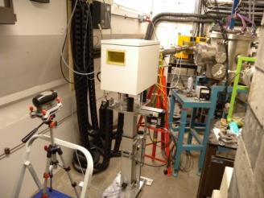
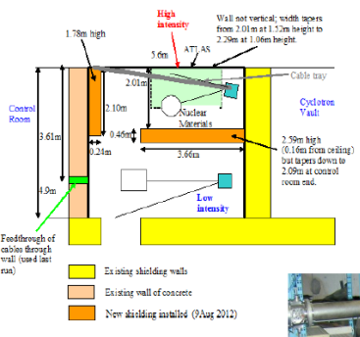
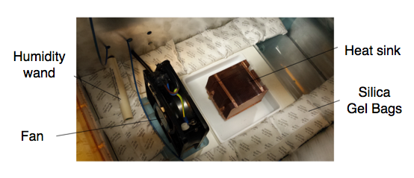
AIDA-2020 UoB MC40
The MC40 cyclotron at the University of Birmingham is primarily used for overnight radio-isotope production for mainly medical applications. However, thanks to a joint activity initiated by Sheffield, Liverpool and Birmingham, it can now provide irradiations for particle physics during daytime.
Irradiation facility was commissioned in early 2013 and has irradiated ~300 samples in total.
Now a Transnational Access Facility
Samples studied so far include:
  Composites, carbon fibre support structures
  Pixel (hybrid and CMOS) and strip sensors
  ASICs. microelectronics, optical fibres
  Hybrid and PCB materials
  JFETs, HV-switches, …
27 MeV continuous 1cm² proton beam can achieve HL-LHC fluences of inner layer strip system (10¹⁵ 1 MeV neq cm⁻²) in 80 s with 1 μA beam current (max energy of 37 MeV, max current of ~2 μA)
See AIDA 2020 link: http://aida2020.web.cern.ch/content/uob#contact
Layout of
Radiation Zone
6

Slide 7
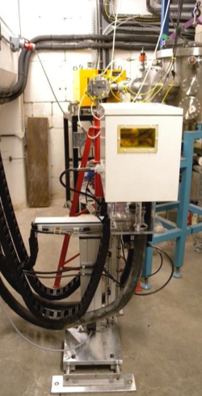
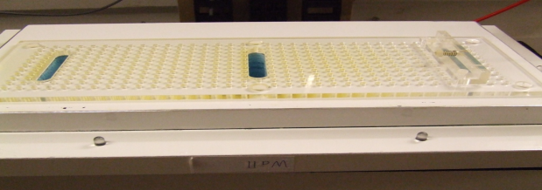
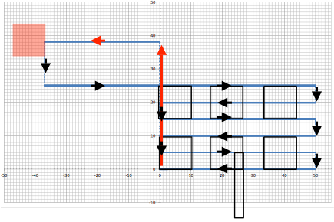
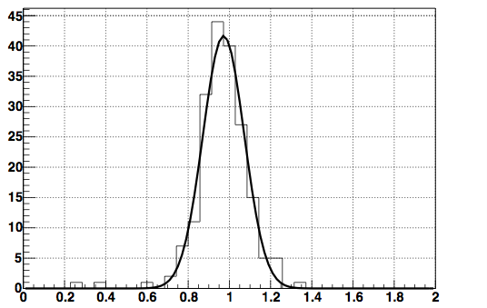
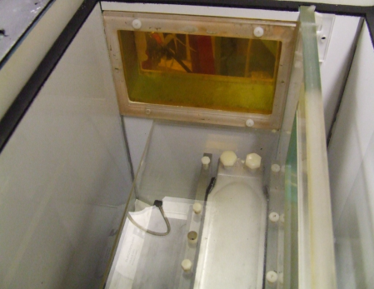
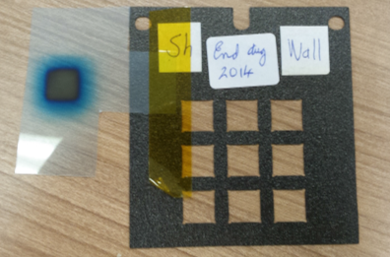
AIDA-2020 UoB MC40
XY-axis (45cm×40cm) scanning system installed in the irradiation area to allow areas of 15cm×15cm (orthogonal) to be uniformly irradiated at low temperatures
Samples are suspended from the lid in the thermal chamber which is mounted on the scanning system operating down to -50ºC
Sealed feed-throughs allow external read-out and monitoring to be connected or space in the box can house shielded electronics
Similar arrangement provided for use at CERN PS by UK Irradiation Group
Beam pipe
Thermal
chamber
Scanning
system
Lid
Scan
Number of measurement = 194
Average = 0.97
Sigma = 0.10
  Dosimetry using Faraday cup and cross-check using gamma spectroscopy of irradiated Ni foils (10% accuracy)
Box
Holder
Fluence Received / Target Fluence
7

Slide 8
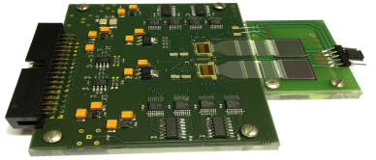
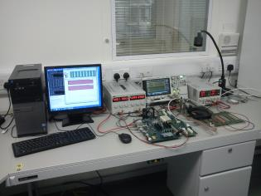
Current Cleanroom Facilities
Hesse & Knipps BondJet 820 automatic wire bonder
Delvotec 5430 semiautomatic table top wire bonder
Dage 4000 wire-pull and shear strength tester
Dima Dotmaster with the DD-5097 upgrade
Cascade Microtech REL 4800 manual probe station
Cammax Precima DB600 die bonder pick and placer
Inspection microscopes, electrical test equipment, N₂ storage, environmental chamber, precision scales, …
Access to shared facilities with astrophysics group
Readout for ATLAS ABC250 ASICs, hybrids and modules: HSIO DAQ system
For ABC130 hybrid plus module read-out: have successfully commissioned Digilent Atlys board
8

Slide 9
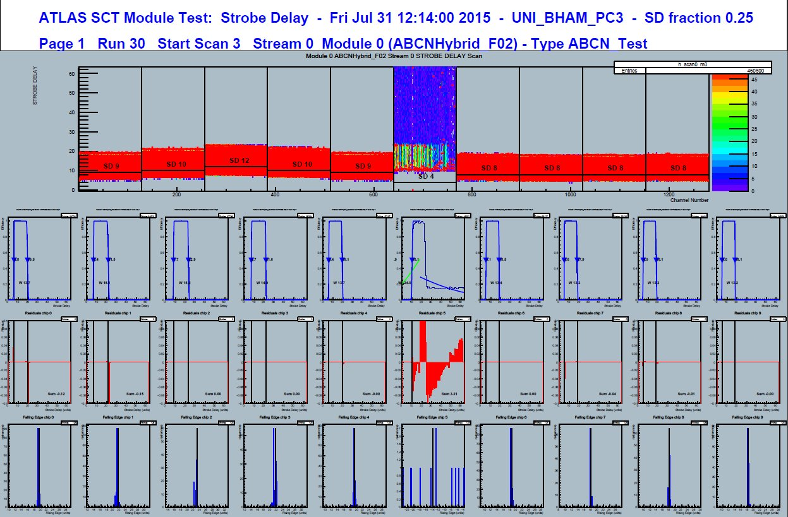
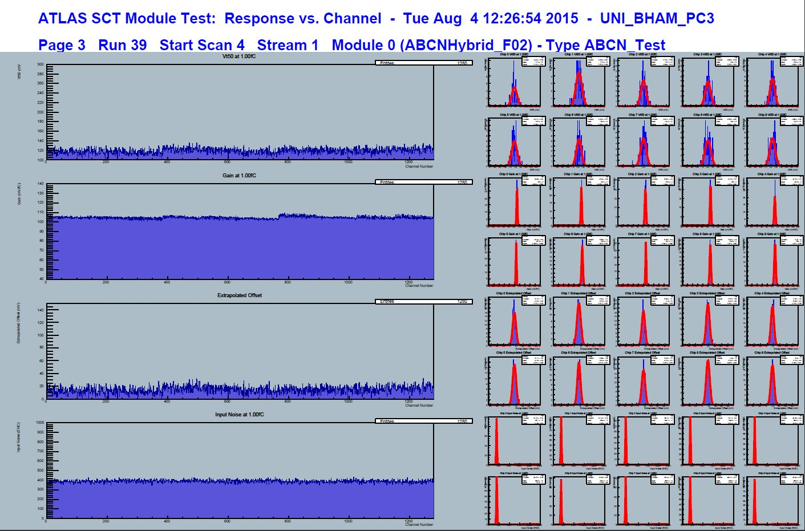
ITk Hybrid and Module Readout
  (left): Output from StrobeDelay 0.25, using ABCN250 hybrid, (bottom): 3PointGain 1fC, second row of hybrid
Ready for electrical ABC130 hybrids and modules
  Good preparation for ABC130 hybrid tests: Synchronisation with SVN, compiling, Root6
  Can easily swap between SLC6 and Win7 PCs: Swap ethernet cable into Atlys
  Run tests from office desktop
9

Slide 10
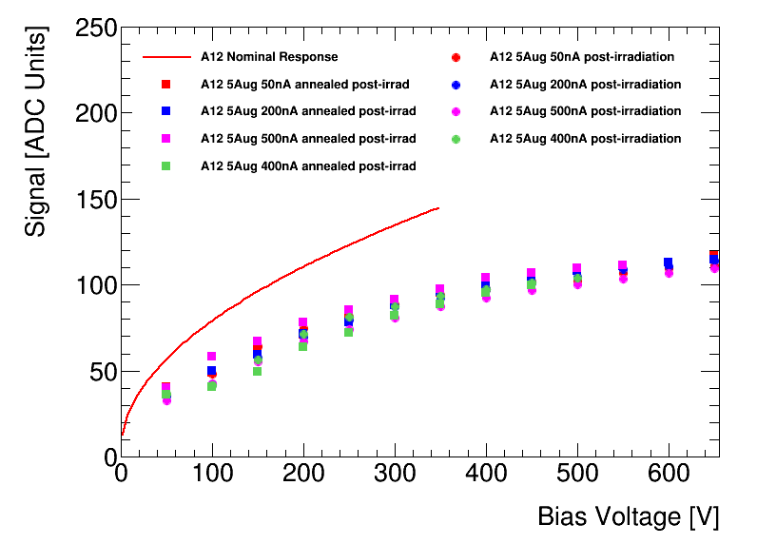
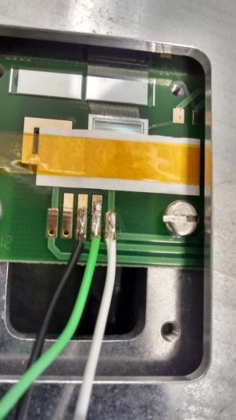
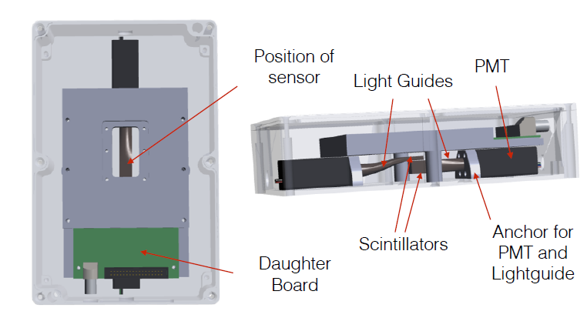
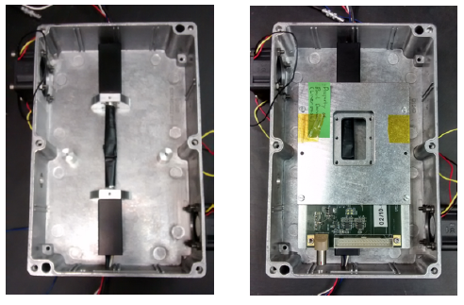
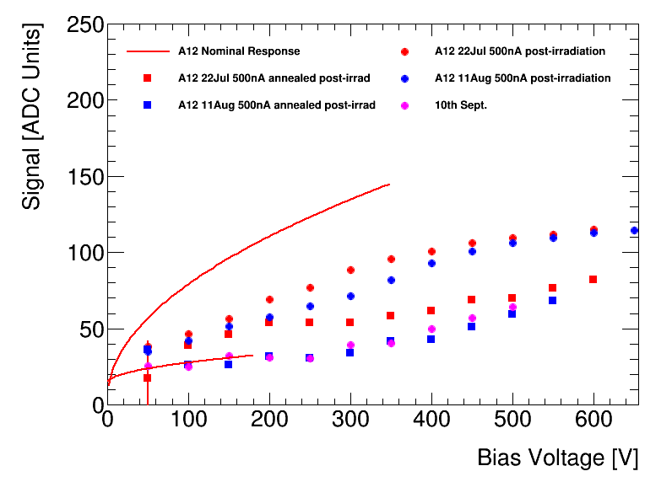
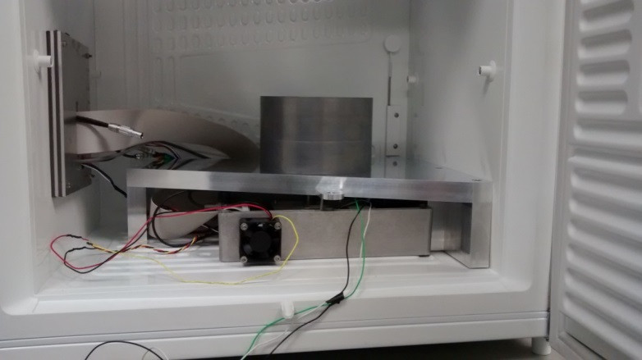
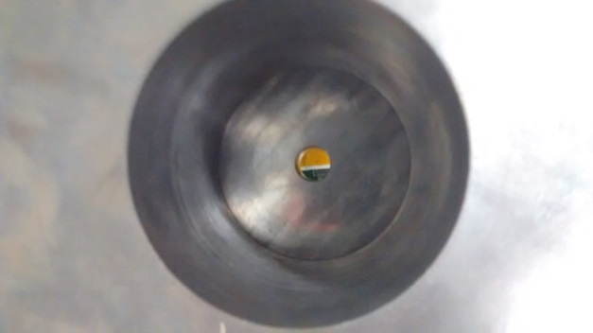

ALiBaVa Set-up
Typical irradiation to doses of order (5-10 × 10¹⁴ 1 MeV neq cm⁻²)
See expected signal(V) unirradiated and for some dosed samples with cold operation with N₂ flush of enclosure
80MBq ⁹⁰Sr source allows very high data taking rate
Purchased thanks to Miriam’s Royal Society grant
150V
-18ºC
$$\sqrt{V}$$
-25ºC
However, sometimes results are not as we expect so further work is needed ….
10

Slide 11

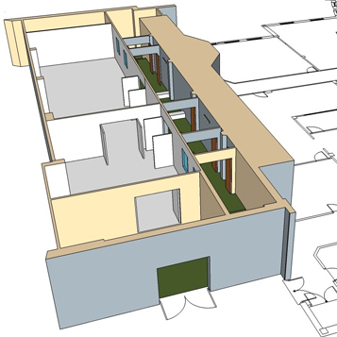
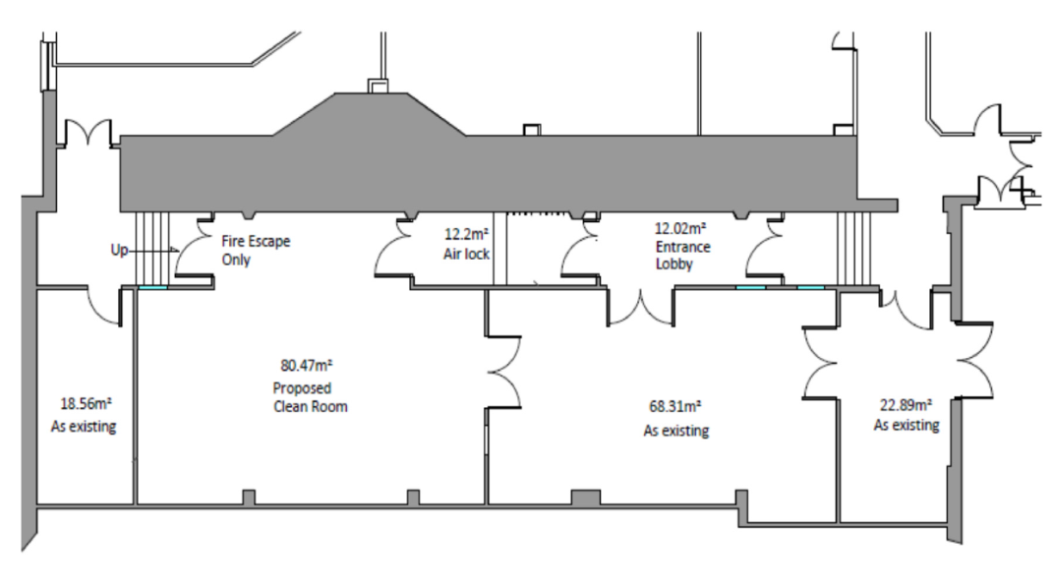
Future Capabilities
i
    Major University investment in academic staff and capabilities linked to concept of Birmingham Instrumentation Laboratory for Particle physics and Applications
    ~ 170m² of new and reconditioned cleanroom laboratory space for both ITk strip module production and R&D on novel radiation-hard detectors
Hope will be like the caves, only cleaner …
11

