Slide 1
Current Group
Simone
Nigel (also small % ILC)
Cristina (also NA62)
Sasha (also ATLAS)
Tonino (also NA62)
Mark S. (also everything)
Students
  Jimmy McCarthy – started teaching job 1-Sep-2015
  Luca Pescatore, Pete Griffith
  Nathanael Farley
  Tim Williams
  Kristian Zarebski, Georgios Chatzikonstantinidis

Slide 2
Wide interest in LHCb - rare decays
Using heavy flavour measurements, two routes to finding physics beyond the SM
CP violation
  Clearly must exist
Rare decays
  FCNC
  Only via loop, box diagrams as forbidden at tree level
  Br typically ~10⁻⁶ or less
New physics participant may enter in loops as virtual particles
Indirect probe accesses higher energy scale than direct searches
  Convenient detection mechanism
  Not so straightforward to identify the origin - modelling
SM
>SM
Notes:
Don’t patronise!

Slide 3
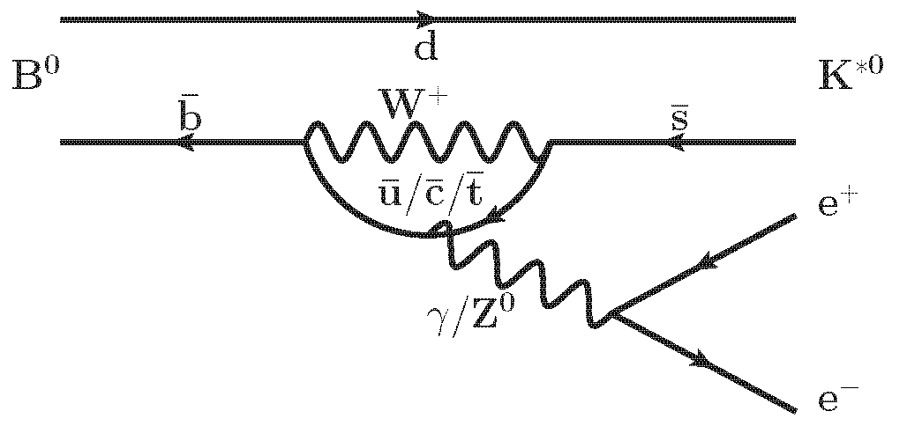
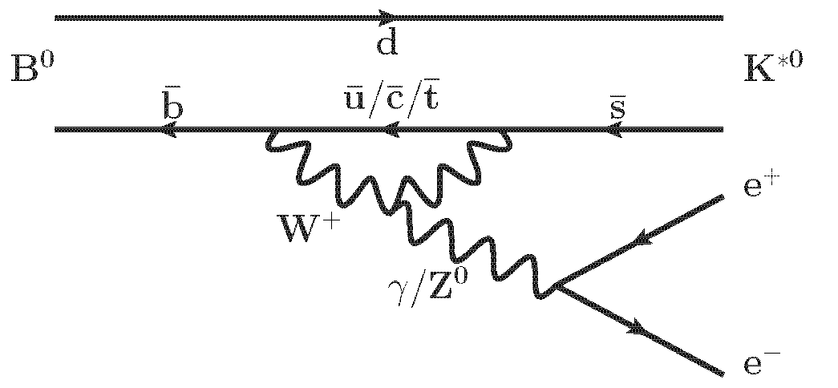
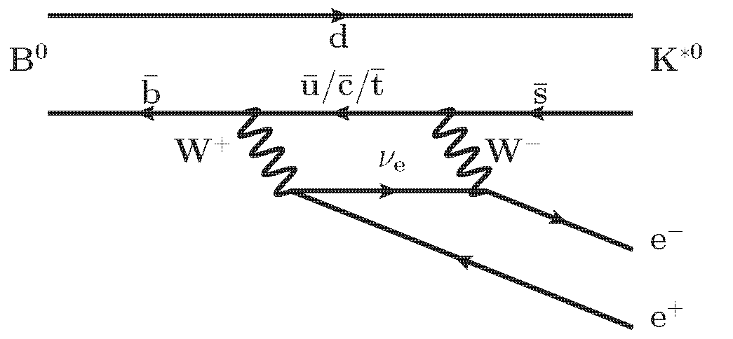
b→ s ⁺⁻ processes
FCNC themselves are highly attractive for experiments
  Wide variety of angular observables accessible in 4 particle final states
  Experimental signatures
    Clean
    Low backgrounds
New physics may be apparent via
  Rate
  Angular distributions
  Asymmetries
  Often as f(dilepton invariant mass), q²
Predictions well-established
  Varying degrees of theoretical uncertainty
  Hadronic form factors

Slide 4
Recent Physics Analyses
Electroweak, rare decays, charmless B decays
  Measurement of the forward W boson cross-section in pp collisions at s√=7 TeV
    JHEP12(2014)079 Simone Bifani et al.
  Search for the Λ_{b}⁰ → Λη′ and Λ_{b}⁰ → Λη decays with the LHCb detector
    JHEP09(2015)006 (Jimmy McCarthy et al. – PhD approved 25/9/2015)
  Differential branching fraction and angular analysis of Λ_{b}⁰ → Λμ⁺μ⁻ decays
    JHEP06(2015)115 (Luca Pescatore et al. – writing up), see e.g. following slides
  In review…
    Measurement of W and Z production cross sections at 8 TeV – Simone et al.
    W and Z boson cross-section at 13 TeV using muon final states – Simone et al.
  To enter review…
    Search for Λ_{b}⁰ → pKμ⁺μ⁻ (Pete Griffith, to enter review ~1 month)
    R_{K*} (B⁰→K^{*0} μμ / B⁰→ K^{*0} ee) (Luca, Simone, …)
  In progress
  B⁺_{c} decays (Nathanael Farley)
  Search for Λ_{b}⁰ → pKη′ (Tim Williams)

Slide 5
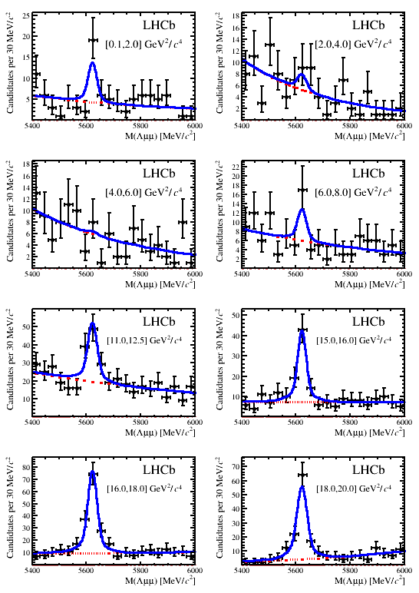
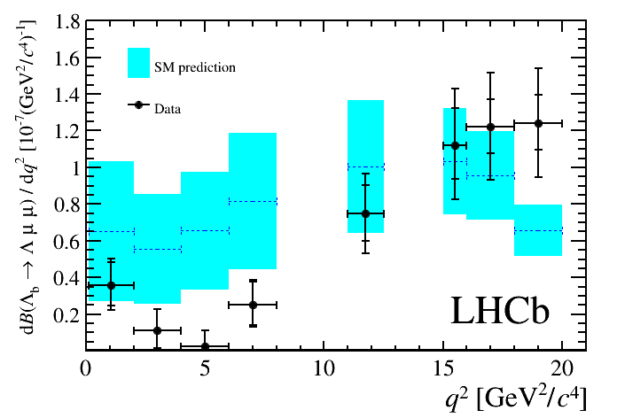
  Λ_{b}⁰ → Λμ⁺μ⁻ differential branching fraction

Slide 6
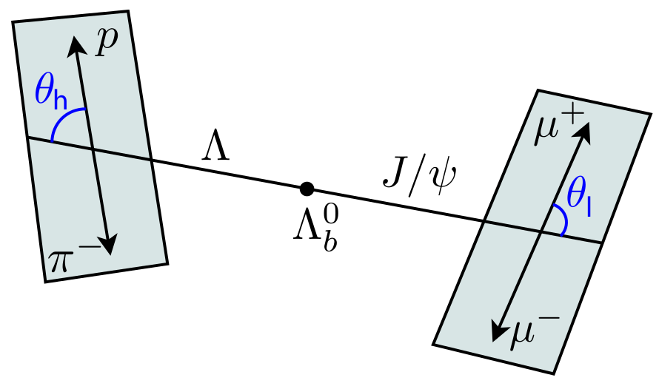
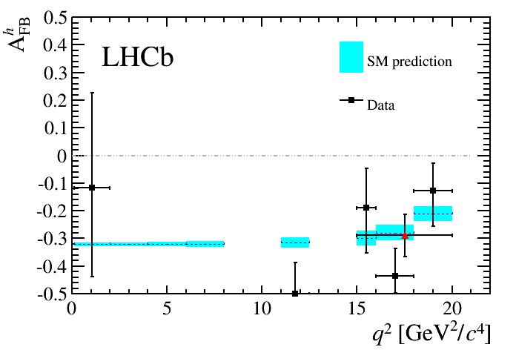
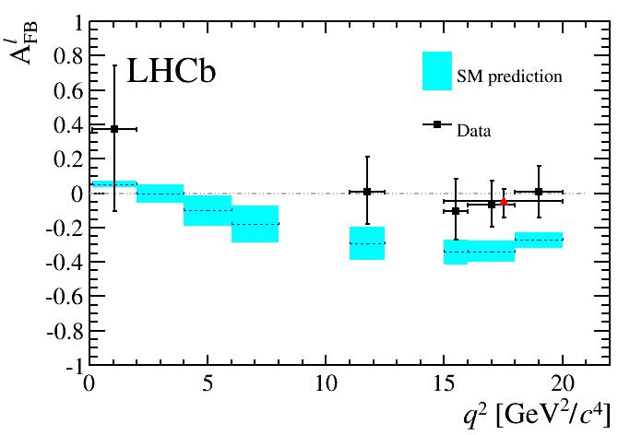
Λ_{b}⁰ → Λμ⁺μ⁻ angular analysis
Compare angular asymmetries for hadronic and leptonic sides of decay vs. q²
Hadronic side
Leptonic side

Slide 7
Technical
Geant4 (in LHCb) release management, responsible - NKW
  Verifications/validations of Geant4 physics, see e.g. following slides
  Likewise in LHCb simulation application (‘Gauss’)
  New G4 v10…
  Fast sim. – Delphes or Geant4?
Validation testing framework (‘LHCbPR’) - Sasha
  Tests for Geant4, Gauss
  Framework itself
Geometry restructuring within Geant4/LHCb – t.b.d.
Grid Expert on Call and Distributed Analysis Support - Mark (+Ganga development for LHCb and core Ganga)
Physics WG liaisons (e.g. Luca – MC liaison for Rare Decays; Jimmy – trigger liaison for Charmless B decays)
Paper reviewing, shift leaders, Editorial Board (NKW just ended sentence as deputy chairperson)

Slide 8
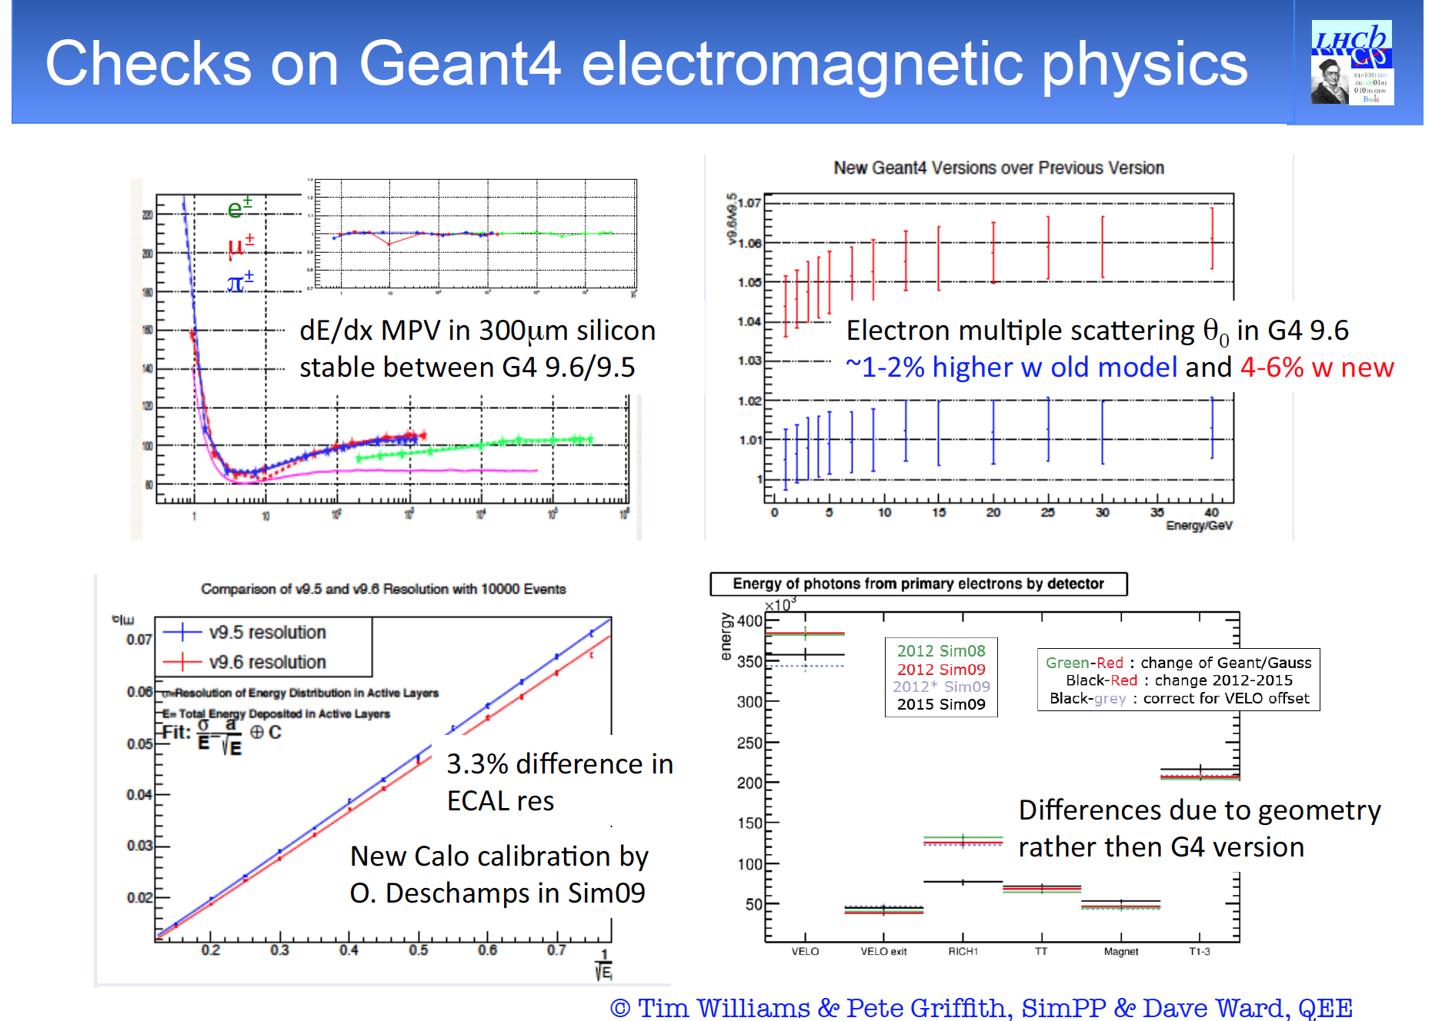

Slide 9
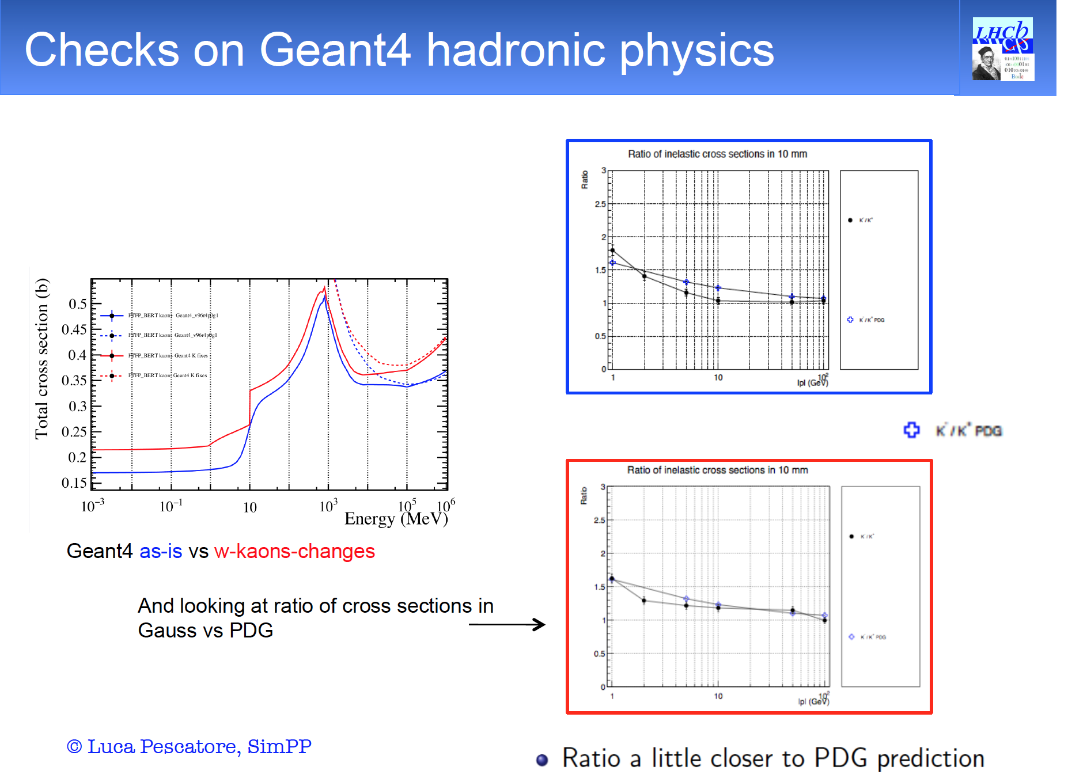

Slide 10
What we do
Geant4 (in LHCb) release management, responsible
  Verifications/validations of Geant4 physics
  Likewise in LHCb simulation application (‘Gauss’)
Validation testing framework (‘LHCbPR’)
  Tests for Geant4, Gauss
  Framework itself
Geometry restructuring within Geant4/LHCb
Grid Expert on Call and Distributed Analysis Support (+Ganga development for LHCb and core Ganga)
+paper reviewing + shift leader + Editorial Board (NKW just ended sentence as deputy chairperson)

Slide 11
Upgrade and future
Funded by STFC now
UK projects are RICH and VELO
Although we are not really in either detector group, we do
  Ageing tests for new PMTs
  Firmware for RICH
    Benefit hugely from the overlap with NA62 expertise!
  Component testing for radiation hardness at cyclotron
  Especially for VELO, for upgrade need 8e15 n/cm²
    Benefit hugely from the overlap with ATLAS expertise!
All groups joined since 2011 are being reviewed by LHCb…
  Includes us but we don’t anticipate any problems!

Slide 12
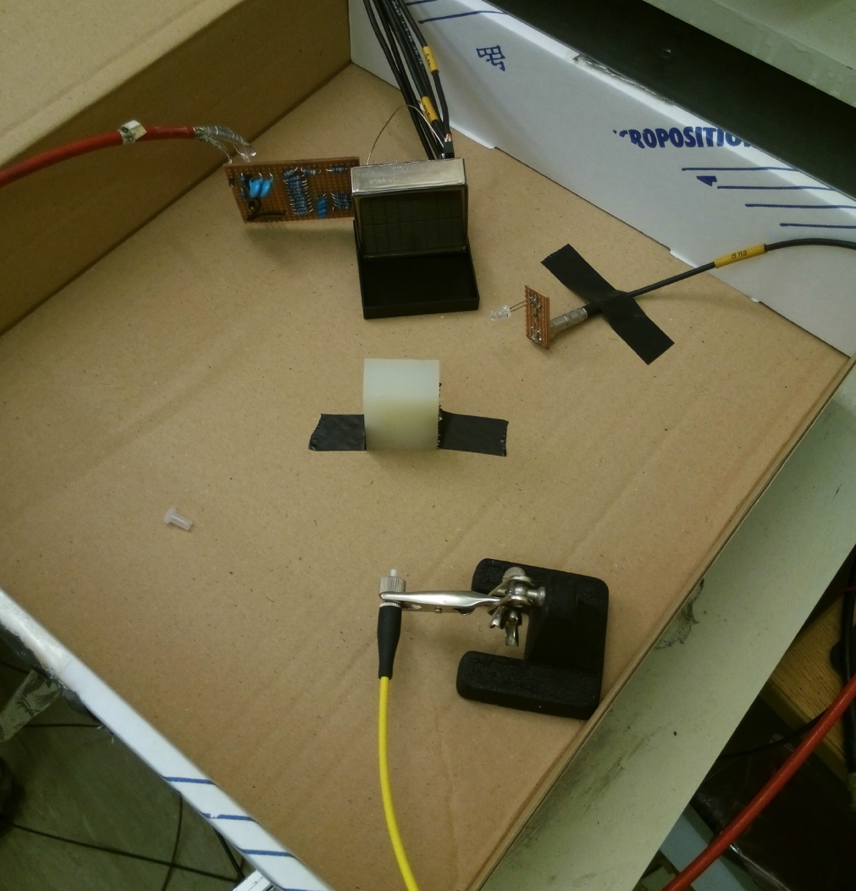
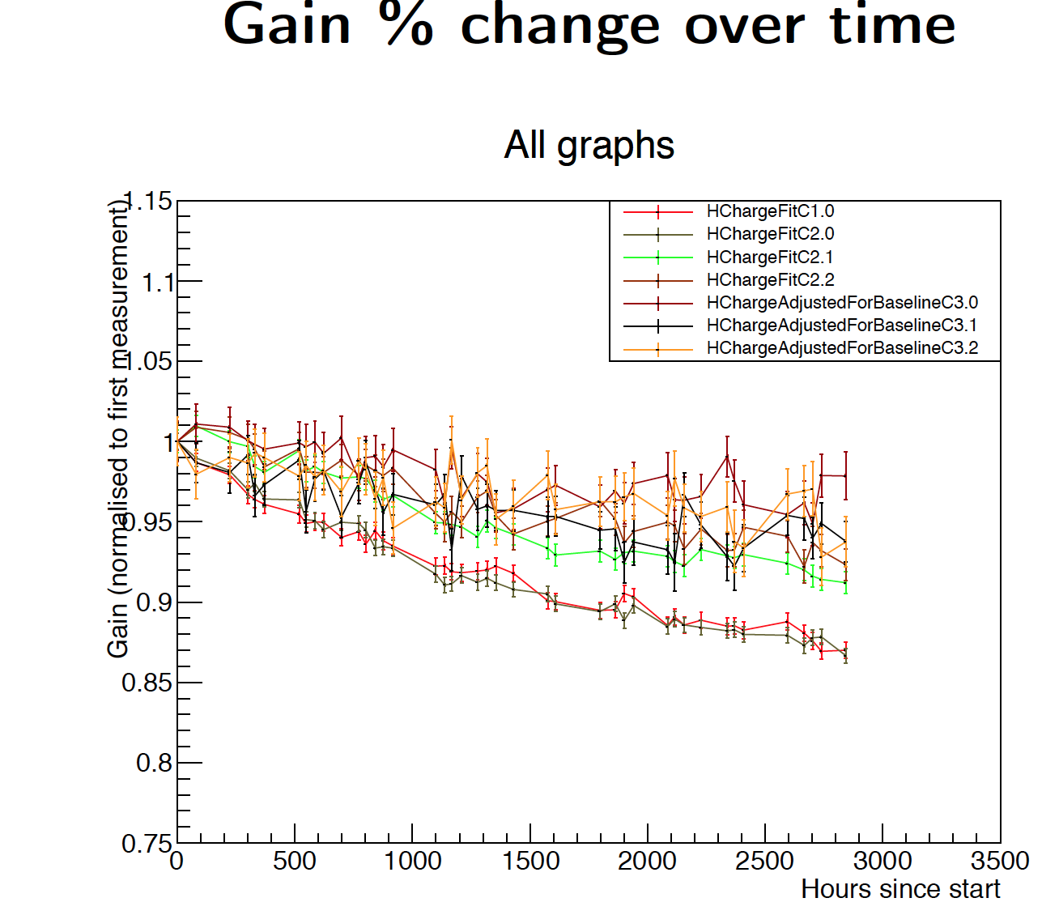
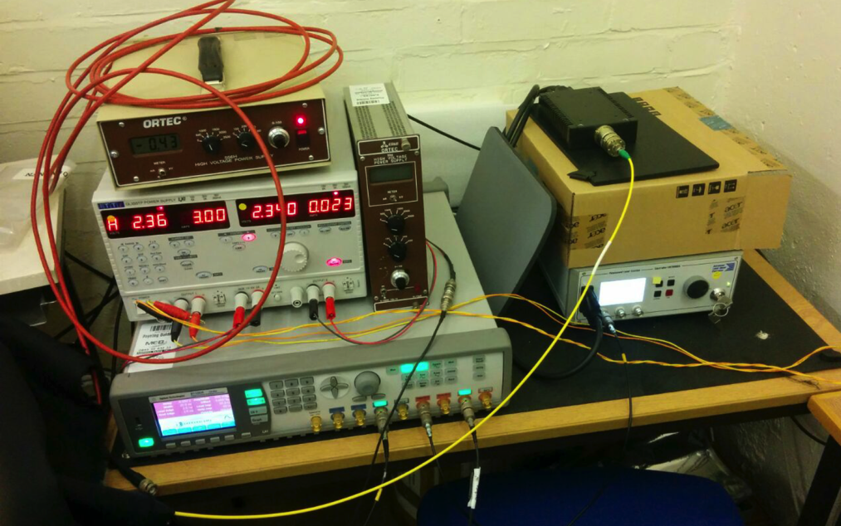
PMT Gain Tests

Slide 13
Upgrade and future
Funded by STFC now
UK projects are RICH and VELO
Although we are not really in either detector group, we do
  Ageing tests for new PMTs
  Firmware for RICH
    Benefit hugely from the overlap with NA62 expertise!
  Component testing for radiation hardness at cyclotron
  Especially for VELO, for upgrade need 8e15 n/cm²
    Benefit hugely from the overlap with ATLAS expertise!
All groups joined since 2011 are being reviewed by LHCb…
  Includes us but we don’t anticipate any problems!

