Slide 1
ATLAS Tracker Upgrade
Team
Simon, Sam, Juergen, JW + Kostas and Chris
Main activities (responsible for WP 3.5: hybrid production)
Gluing, bonding, vacuum (Simon, Sam)
Readout tests (Juergen)
Irradiation tests on cyclotron (JW) : WP 5.7 (Paul Dervan)

Slide 2
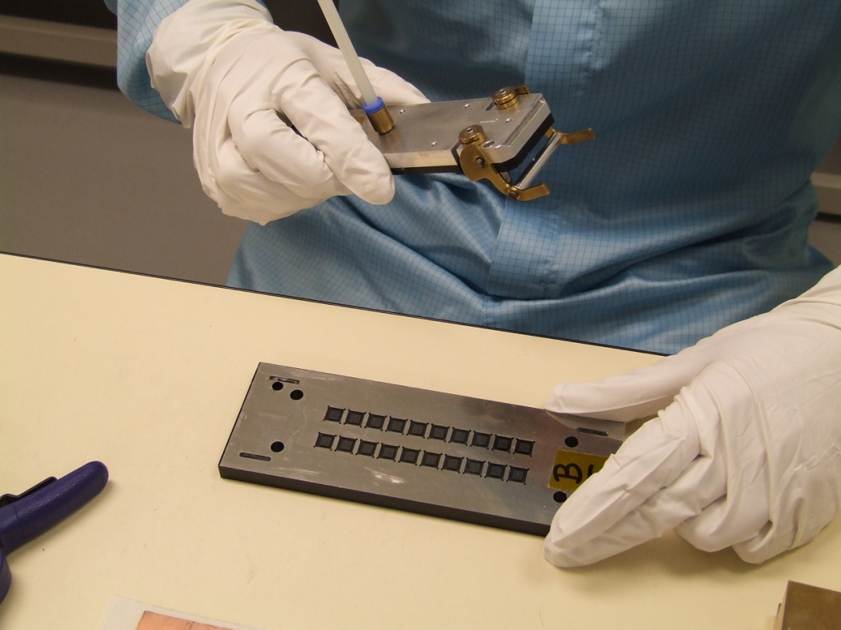
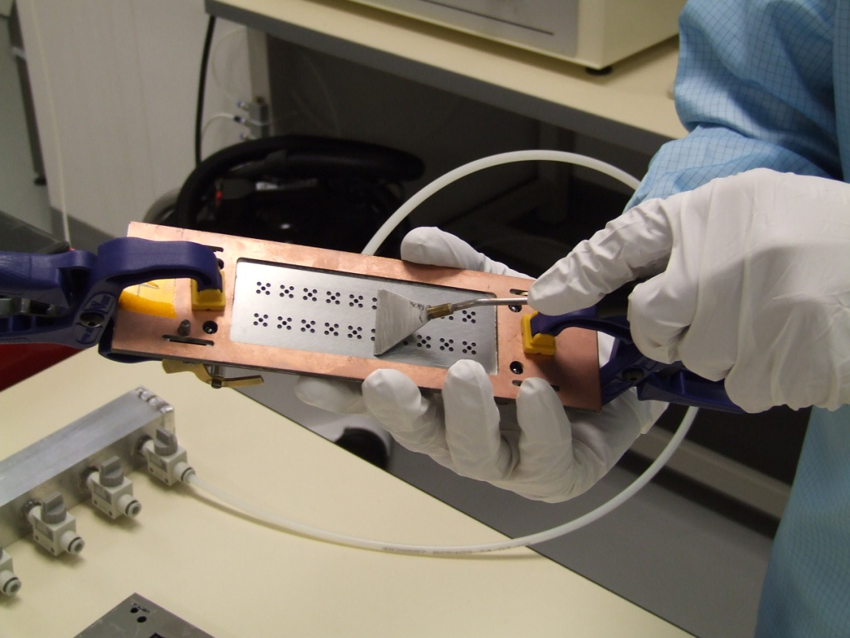
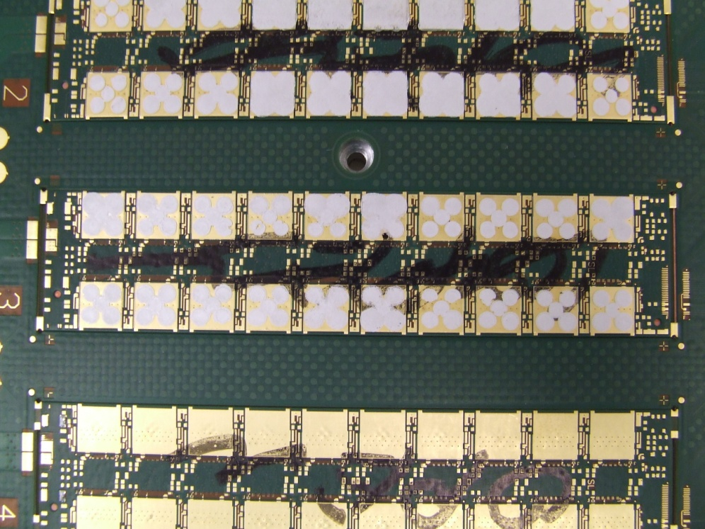
Gluing: getting up to speed
+ tests
Measure glue thickness with Astro CMM ?
+ new ideas
Rather than curing the glue at room temp (i.e. leave devices under vacuum overnight), can glue be cured at slightly raised temp (+35C) ?
→ develop heating panels etc
Advantage: curing in a few hours; faster throughput
to be tested by Simon and Sam

Slide 3
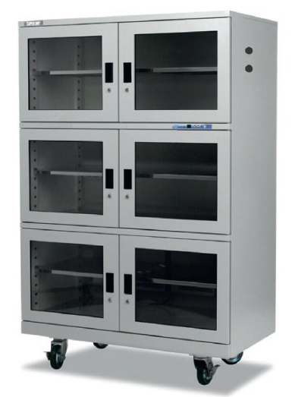
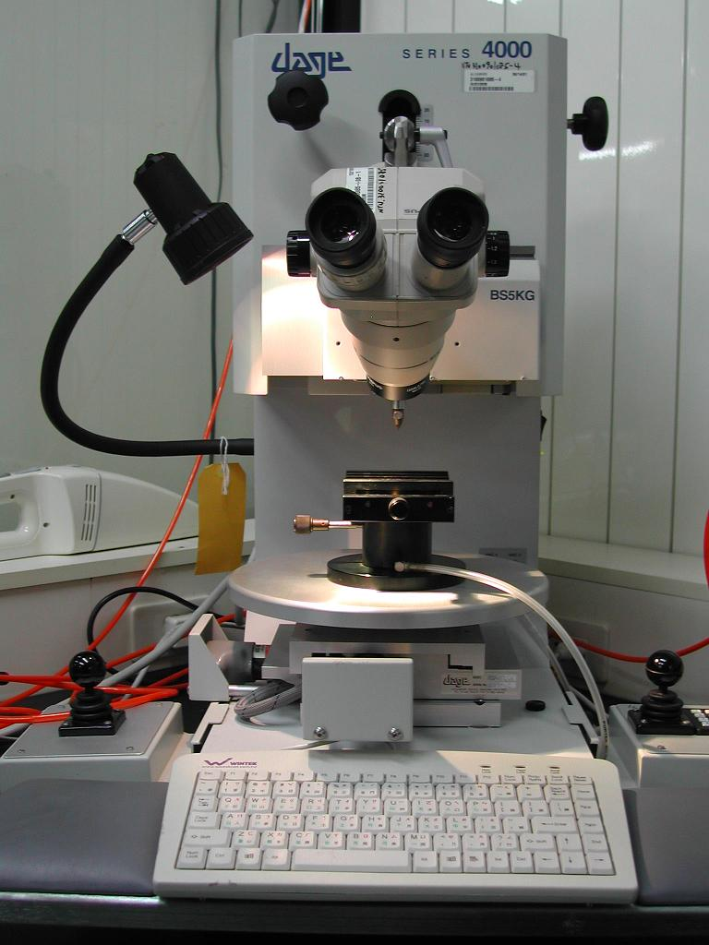
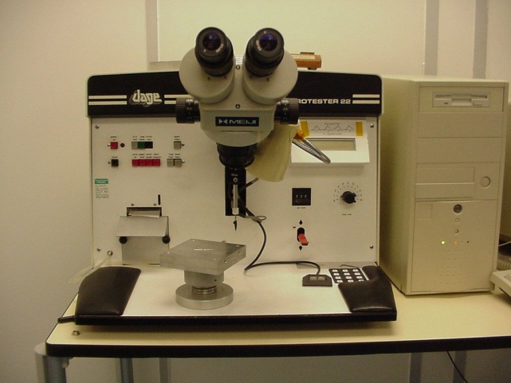
Cleanroom
New bonder well exercised by Simon
bid for new apparatus:
Bond Pull Tester Dry Storage
Proposed purchase
Current model
Dage BT 22
Dage 4000

Slide 4
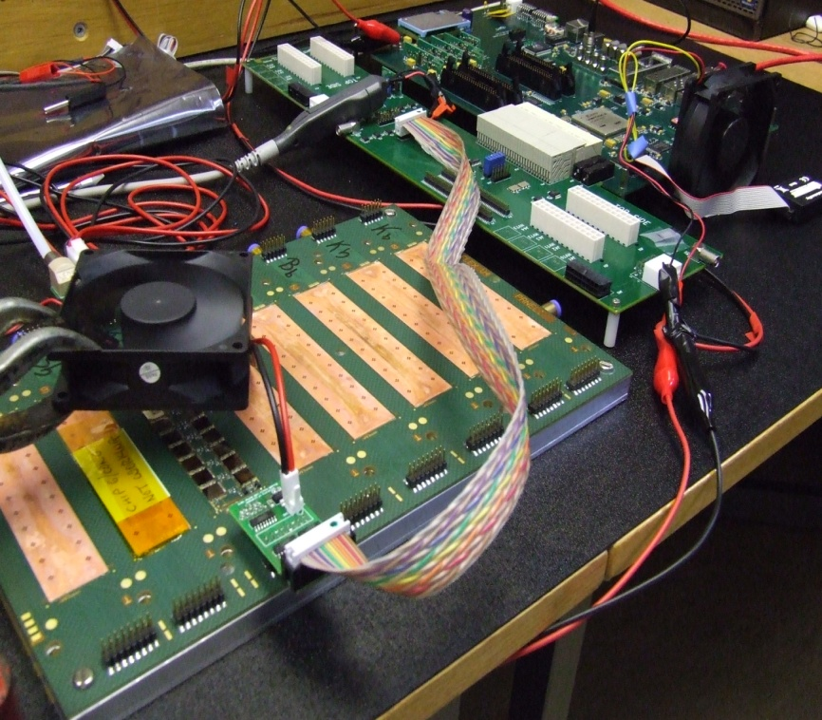
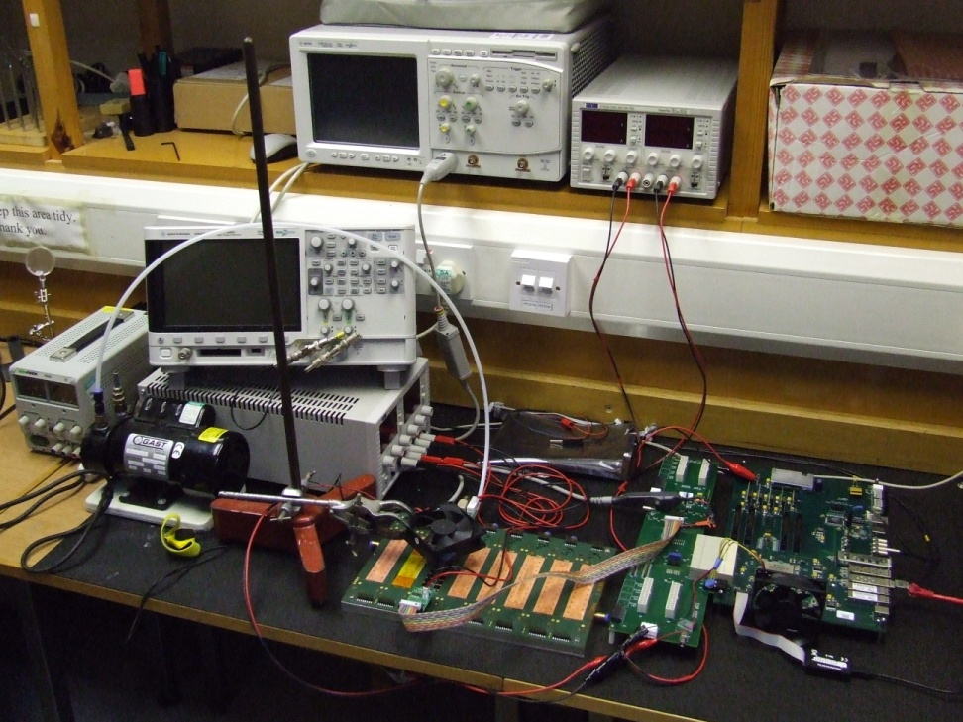
Testing hybrid (ex-Liverpoool)
Lots of technical details overcome by Juergen
cooling
maintain flat via vacuum plate
sensitive to power supply settings; noise
Next
Test hybrid glued and bonded in Bham
Understand hybrid operation in detail (plots, as for SCT)

Slide 5
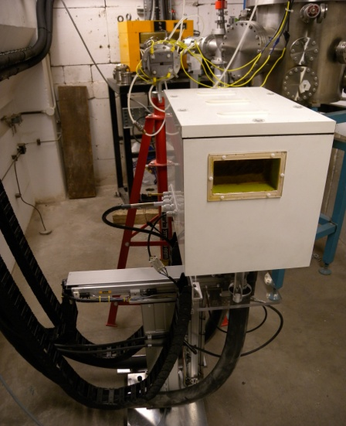
Irradiations
Irradiation group:
David Parker’s cyclotron ream;
Kerry Parker and Paul Hodgson (Sheffield; scanning) ;
Paul Dervan (Liverpool; testing) ;
JAW (fluence measurement).
Hardware: Richard French and Hector Marin-Reyes (Sheffield)
Programme
Irradiate devices in Bham; test in ATLAS institutes (L’pool mainly so far)
Plan
Continue – lots to do + plan a combined testing effort: bond irradiated devices to pcbs in Bham and then test in Sheffield.
Problems: local heating
1μA beam of 27MeV protons deposits 1W approx in 300μm of silicon. So, although in cold box (nitrogen at -10C), devices may anneal.

Slide 6

Irradiations so far
Regular Tuesday runs on cyclotron → 105 objects irradiated
4 carbon fibre
3 materials
2 sets of JFETs
96 ATLAS prototype silicon sensors
→ Main Barrel ATLAS12 finished
Imminent:
Barrel ATLAS12 mixed irradiation
Barrel ATLAS12 glued sensors
Endcap ATLAS12 (+60 sensors)
Pixel V (+8 single sensors)
Full size ATLAS12 (Standard and Slim Edge)
Summary: programme well under way.
Group meeting, 2nd Sept 2013, JAW

