Slide 1

Electric dipole moment searches
E.A. Hinds
Centre for Cold Matter
Imperial College London
Birmingham 11th July 2011

Slide 2

EDM: from particles to atoms and molecules
field theory
CP model
electron/quark
level
nucleon
level
nuclear
level
atom/molecule
level
Higgs
SUSY
Left/Right
d_{e}
YbF
d_{q}
d^{c}_{q}
neutron
Schiff
moment
NNNN
mercury
Strong
CP
~
θGG

Slide 3
Measurement principle
Measure Larmor spin precession freq in
parallel & antiparallel B and E fields
B
E
d makes precession
faster...
μ_{B}
... or slower.
Reverse E relative to B, look for freq shift.

Slide 4
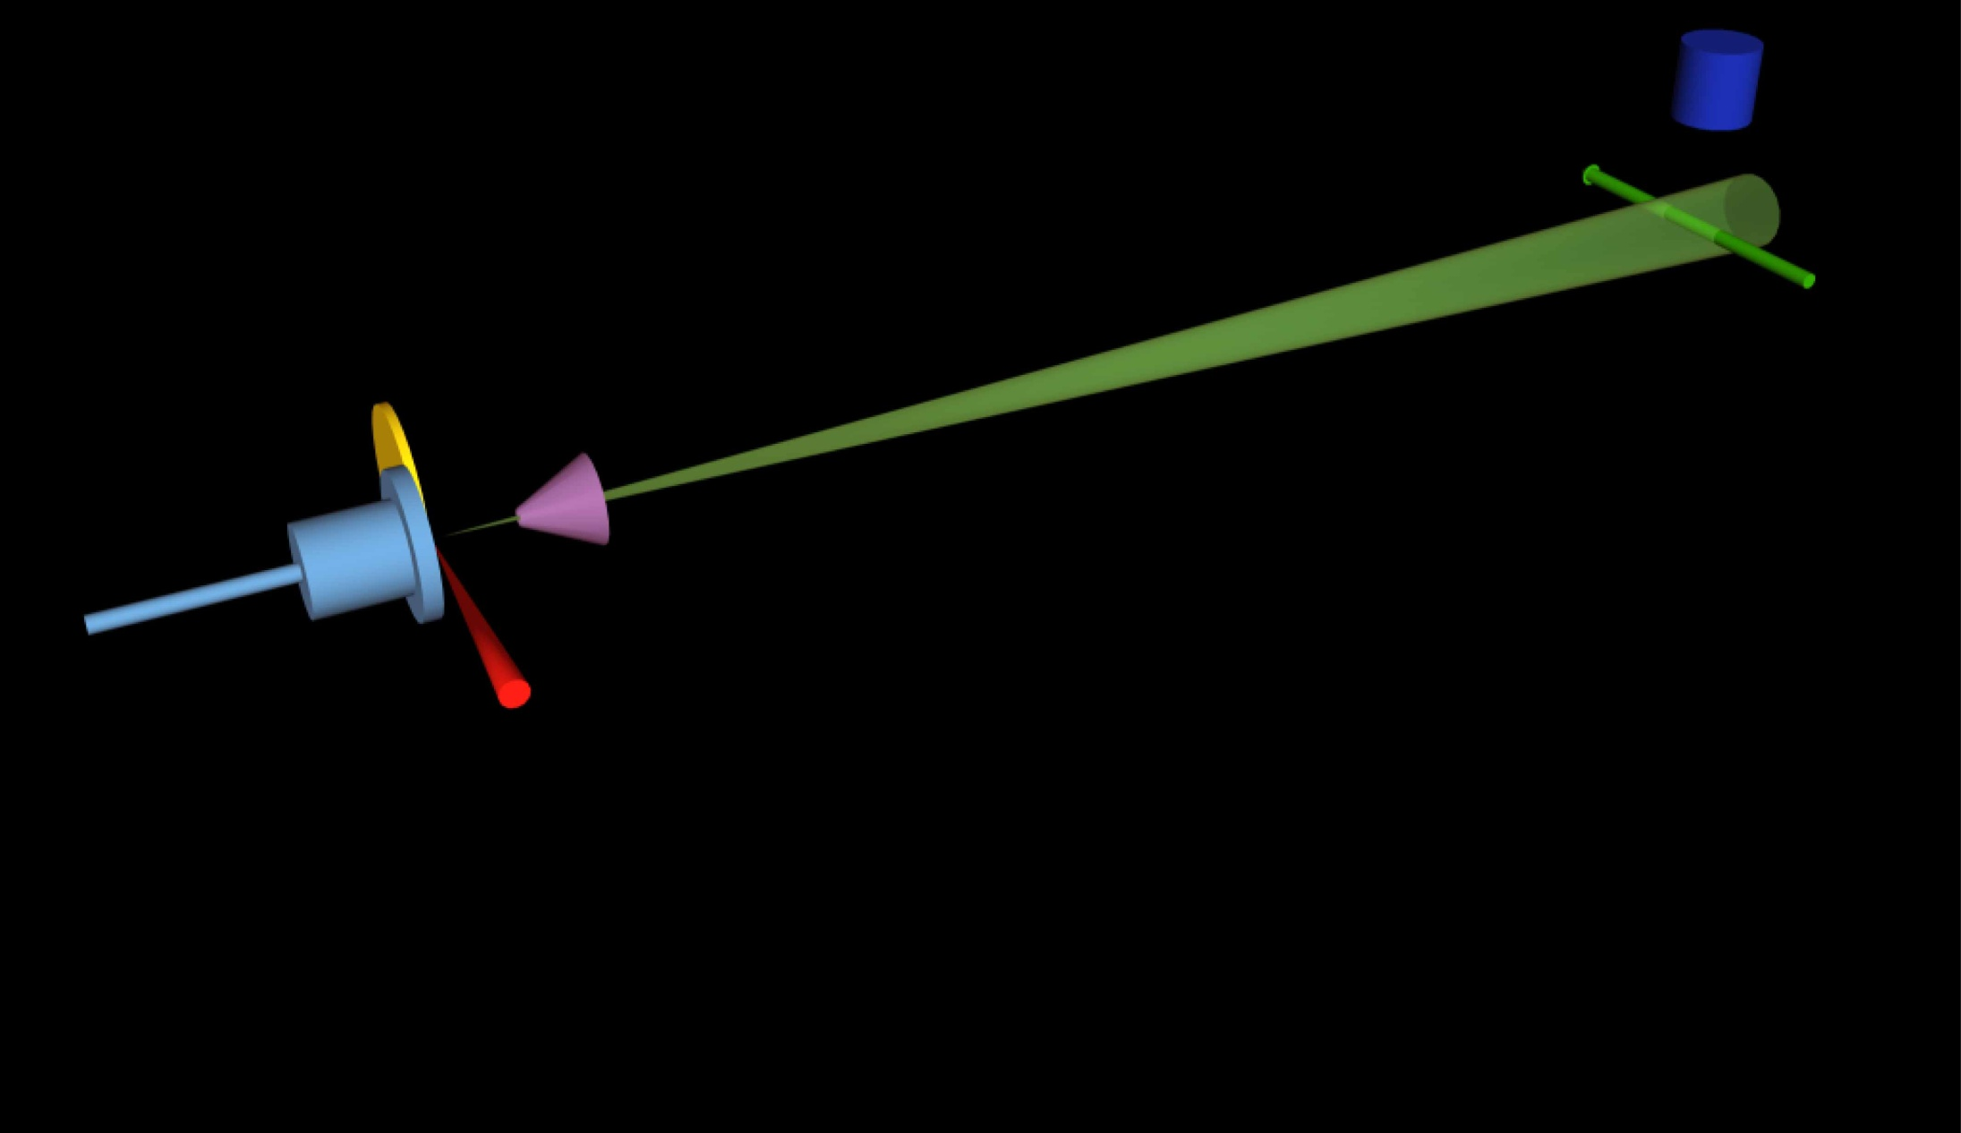
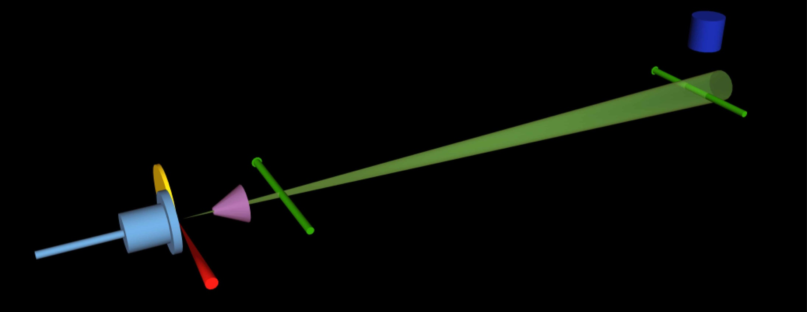
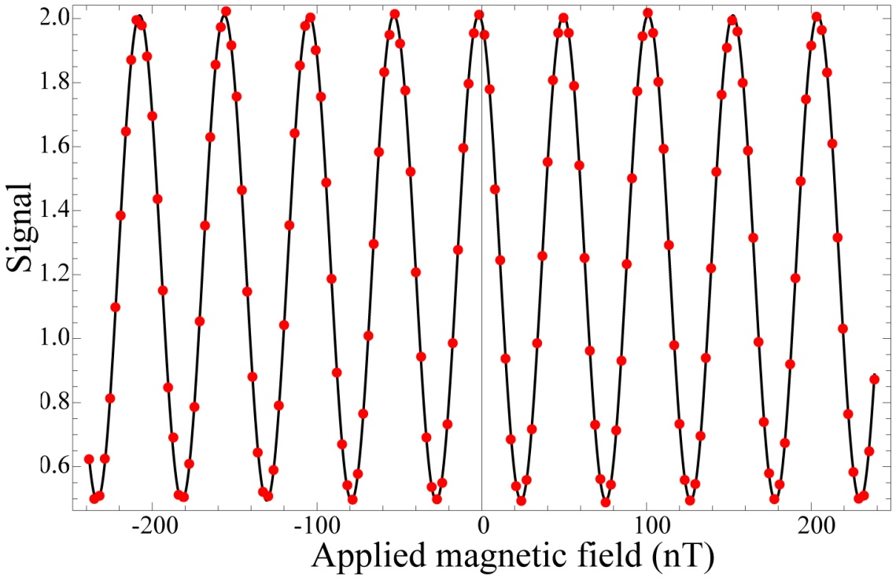
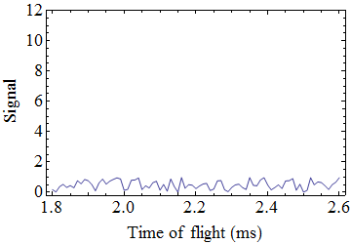
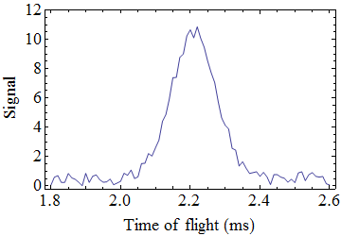
PMT
3K beam
Pulsed YbF
beam
Probe
A-X Q(0) F=0
Pump
A-X Q(0) F=1
F=1
F=0

Slide 5



nEDM in practice
High voltage lead
Magnetic shielding
Magnetic field coil
Storage cell
E
B
Approx scale 1 m
S
N
Magnet & polarizing foil
/analysing
Ultracold neutrons
(UCN)
foil
UCN detector

Slide 6
Status of eEDM and nEDM
    Previous eEDM result - Tl atoms
    Regan et al. (PRL 2002)
    Nataraj et al. (PRL 2011)
    d_{e} < 2.0 × 10⁻²⁷ e.cm with 90% confidence
    New eEDM result – YbF – Hudson et al. (Nature 2011)
    d_{e} = (-2.4 ± 5.7 ± 1.5) ×10⁻²⁸ e.cm
    systematic - limited by statistical noise
    68% statistical
Current upper limits
    d_{e} < 1 × 10⁻²⁷ e.cm with 90% confidence
    d_{n} < 3 × 10⁻²⁶ e.cm with 90% confidence

Slide 7
eEDM (e.cm)
10⁻²²
Excluded region
10⁻²⁴
Imperial eEDM (2011)
MSSM
φ ~ 1
Multi Higgs
10⁻²⁶
d_{e} < 1.0 x 10⁻²⁷ e.cm
Left -Right
10⁻²⁸
MSSM φ ~ α/π
Imperial eEDM
starting to explore
this region
10⁻³⁰
10⁻³²
e.g. Pospelov and Ritz
arXiv:hep-ph/0504231(2005)
10⁻³⁴
10⁻³⁶
Standard Model

Slide 8
Constraints on SUSY parameters
M_{SUSY} = 500 GeV
tan β = 3
e
Pospelov & Ritz, hep-ph/0504231

Slide 9
SUSY again
Lebedev et al., hep-ph/0402023
Tl
YbF (2011)
n (2006)
n

Slide 10
Where do we go from here?
nEDM
Better polarisation
Higher E field
Longer spin coherence time
More neutrons
CryoEDM
10 x better
eEDM
Better field control
Longer spin coherence time
More YbF molecules
CryoYbF
10 x better

Slide 11
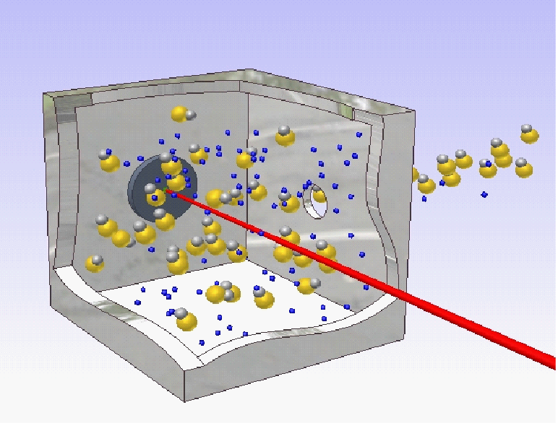
Cryogenic YbF experiment (Imperial)
Uses new molecular beam source
YbF beam
Yb+AlF₃
target
YAG
ablation
laser
3K He gas cell
New J. Phys. 11 123026 (2009)
Physical Review A (2011)
S. M. Skoff et al.

Slide 12
eEDM prospects with new source
15 × more molecules
3 × longer interaction time
=> 10 × better signal:noise ratio
will improve systematics as well as statistics
=> access to few x 10⁻²⁹ e.cm range

Slide 13
Other electron EDM searches
Gadolinium Garnets
E
GGG (LANL), GIG (Amherst)
Huge number of electrons
Cs atoms
Fountain (LBL),
Trapped (Penn State), Trapped (Texas)
Long coherence time
E
Molecules
Large effective E field
squid
magnetometer
Metastable ThO beam (Yale/Harvard)
similar to YbF
PbF beam (Oklahoma)
garnet
similar to YbF
Trapped HfF⁺ ions (JILA)
1 molecule; very long coh.time
none competitive with YbF in the immediate future

Slide 14
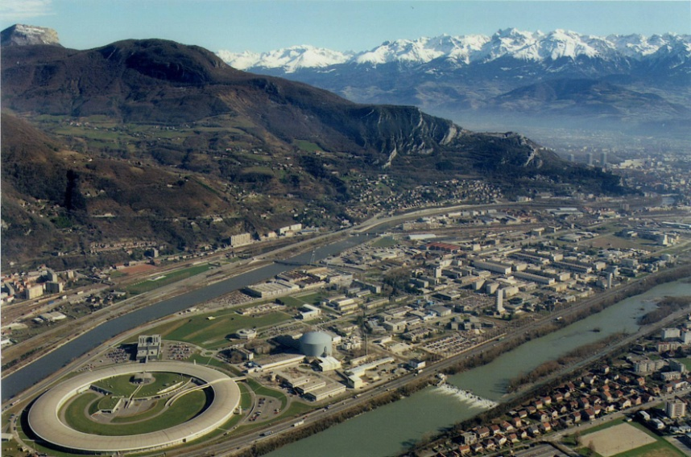
Cryogenic nEDM experiment
Sussex, RAL, Oxford, ILL,Kure
Neutrons produced, transported,
& stored. Need lower losses.
10 kV/cm applied;
aiming for 20-30 kV/cm
Polarisation observed, but must improve
Detector efficiency set to improve significantly
Magnetic field stability to be improved by factor 1000

Slide 15
Other nEDM experiments
PSI (50 people) aim 5 10⁻²⁷ by 2015
ORNL (90 people) construction 2017;
aims eventually for 5 10⁻²⁸ e.cm
ILL: Russian group. Reinstating system from 1990 measurement. Perhaps 1 10⁻²⁶ e.cm eventually.
FRM, Munich: hoping to install UCN source. Nothing firm yet
Masuda, Japan: observed resonance, but very low stats. Move to TRIUMF?

Slide 16
... and other particles
Muon EDM: from g-2
(7E-19 e.cm; proposed upgrades
could reach ~10⁻²⁴ e.cm by ~2020)
Deuterium EDM: similar
principle (claimed potential reach ~10⁻²⁹ e.cm)
Tau weak dipole moment – look for CP-odd observables in diff. x-sec at Z res.
(6E-18 e.cm from LEP data)
Sensitivity to physics BSM depends on source of CPv

Slide 17
Conclusions
    d_{e} < 1 × 10⁻²⁷ e.cm
    d_{n} < 3 × 10⁻²⁶ e.cm
Current upper limits
These place strong constraints on
CP-violation beyond std model
UK leads the world in both
Will continue to do so if projects funded.

