Slide 1
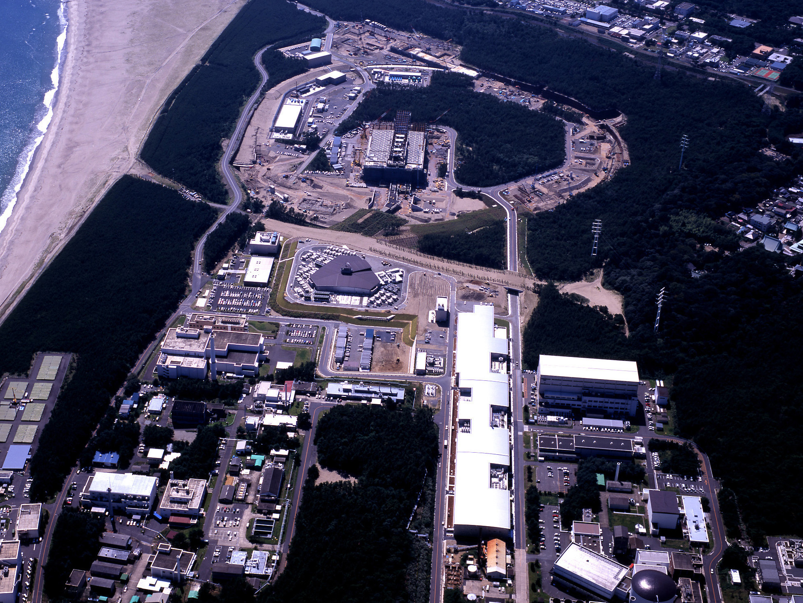


Long-baseline neutrino experiments: present and future
PPAP Town Meeting
Univ. of Birmingham
July 11th, 2011
Dave Wark
Imperial/RAL

Slide 2
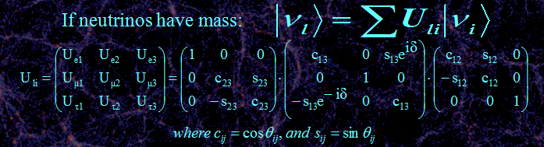
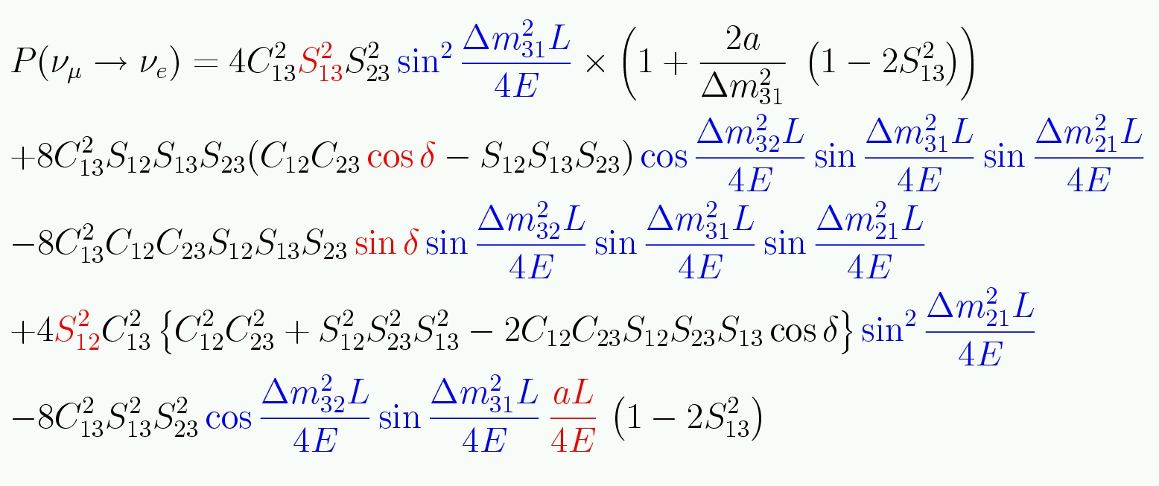
Three neutrino mixing.
Remember degeneracies
And covariances!
~0.03
∼π/4

Slide 3
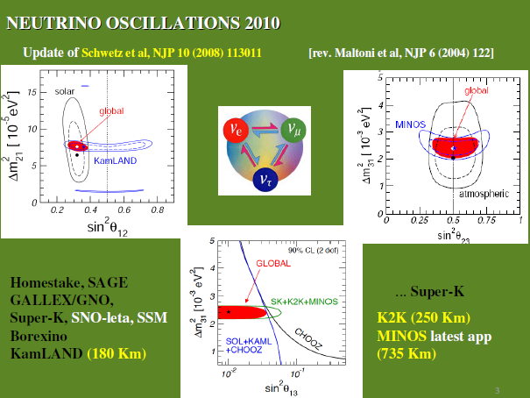
From Jose Valle

Slide 4
What are the ν oscillation goals now?
The only logical candidate for “atmospheric” oscillation is ν_{μ} → ν_{τ} , but OPERA should confirm (1st τ-appearance candidate observed, where is the second?).
Either measure or limit the value of θ₁₃ with as much sensitivity as possible.
Make the most sensitive possible test of the deviation of θ₂₃ from 45º.
Determine the mass hierarchy.
Measure the angle δ!
Are there any surprises?

Slide 5
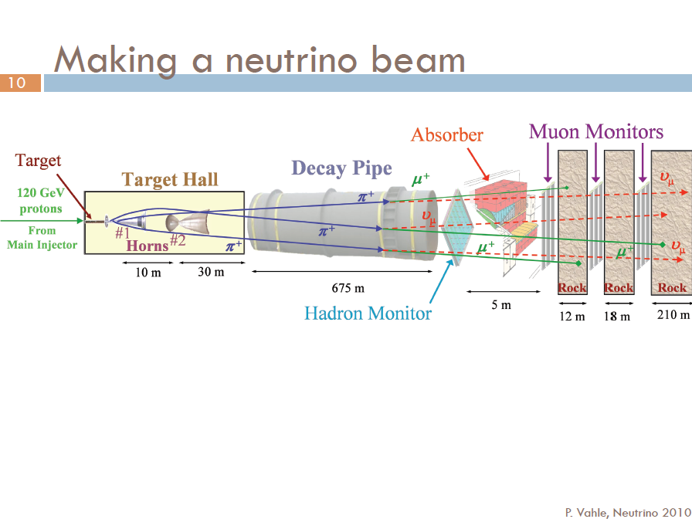
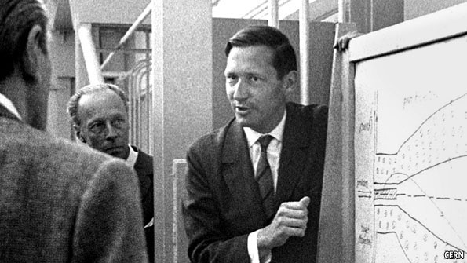
Simon van der Meer, 1925 - 2011
From Patricia Vahle’s presentation at Neutrinos 2010

Slide 6

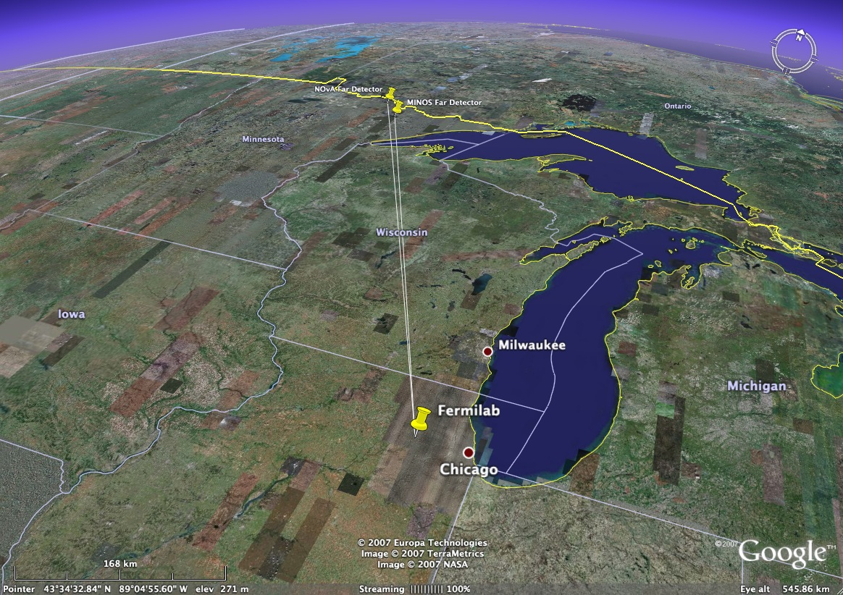
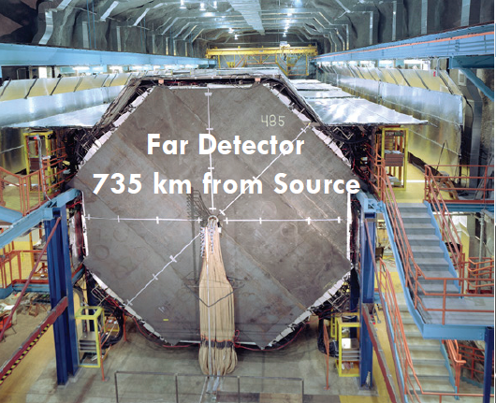
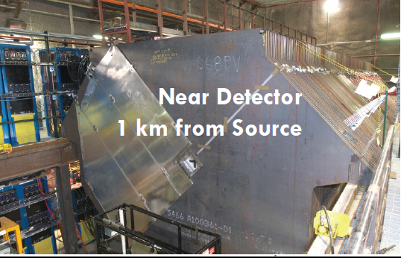
ICHEP talk by Justin Evans
735km
MINOS

Slide 7
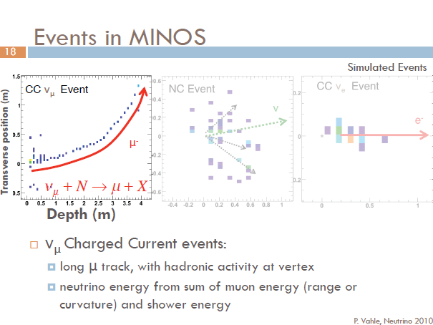

Slide 8
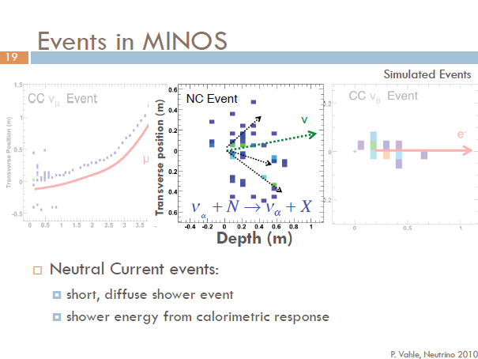

Slide 9
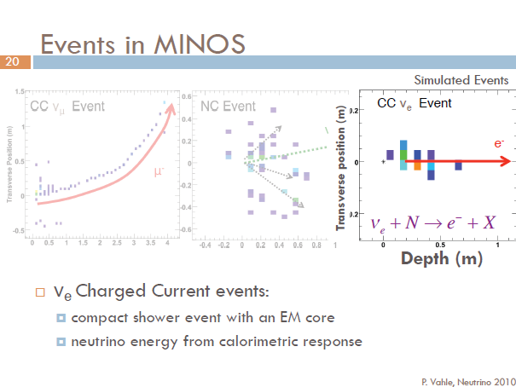
Cross-sections for all processes very poorly known!

Slide 10
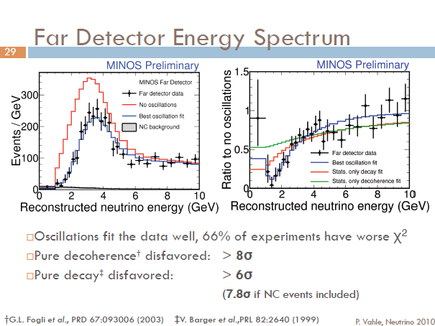

Slide 11

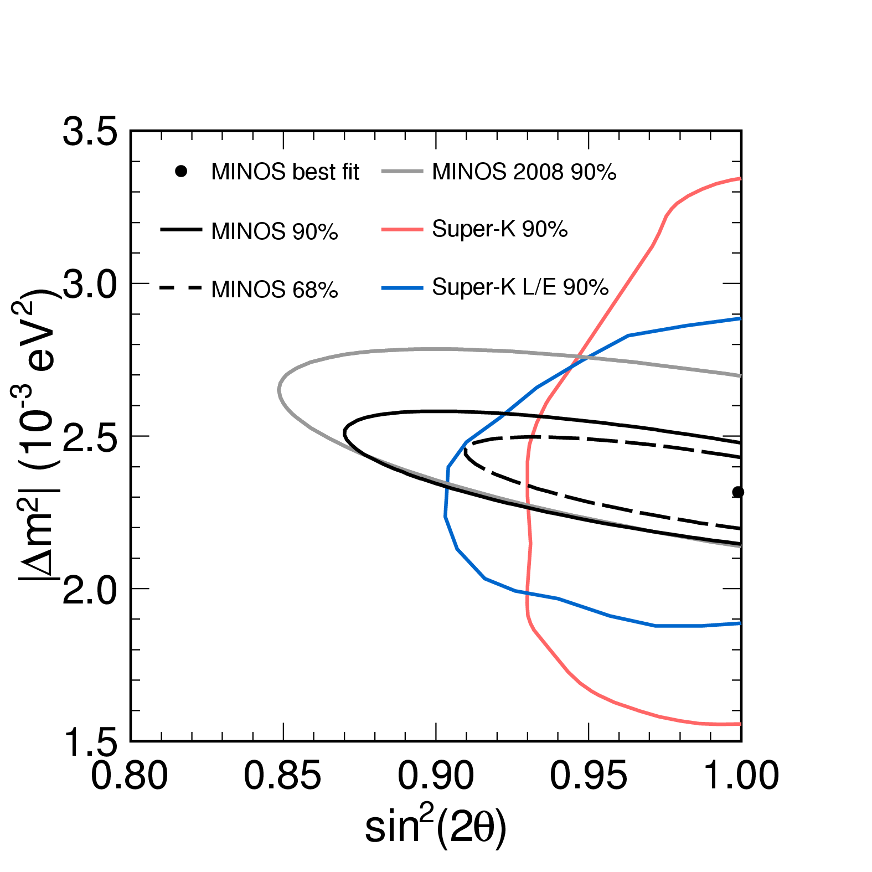
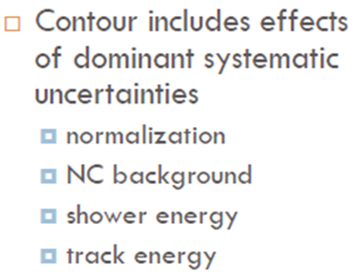
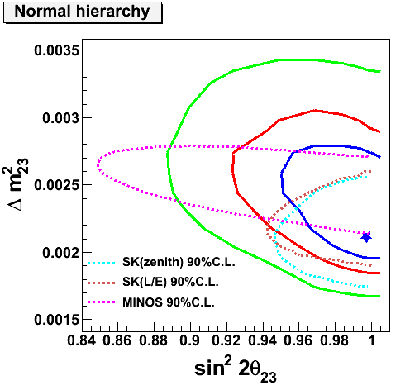
SK 3ν Analysis
Takeuchi’s talk from ν2010

Slide 12
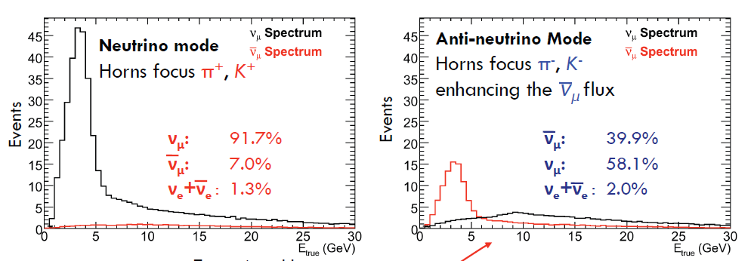
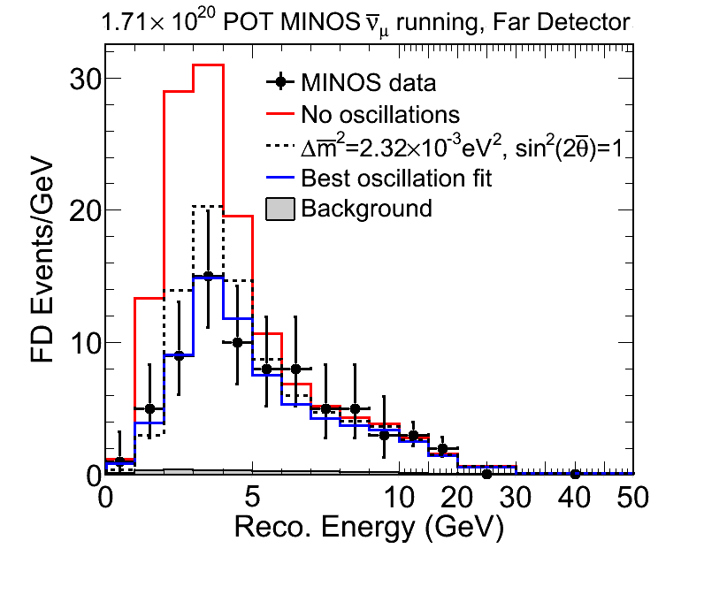
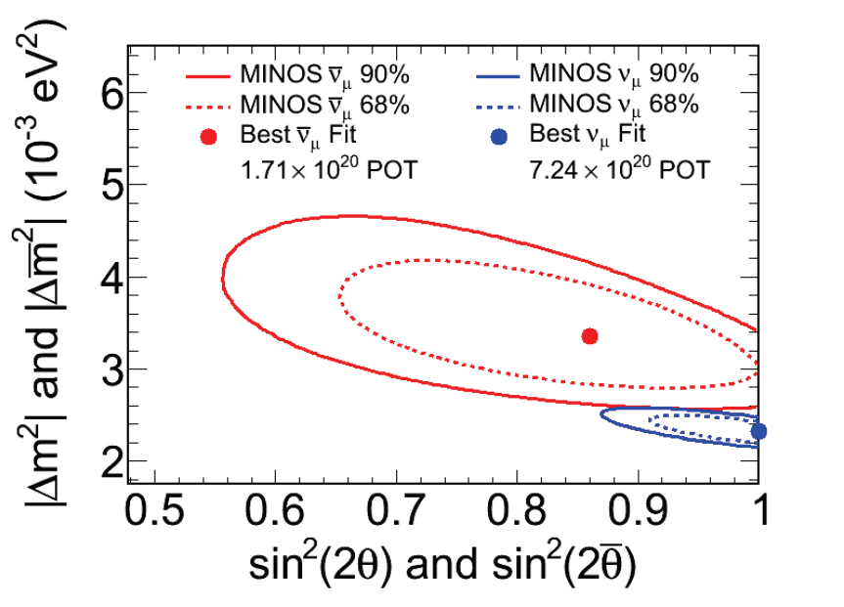
Measurements with Anti-neutrinos

Slide 13
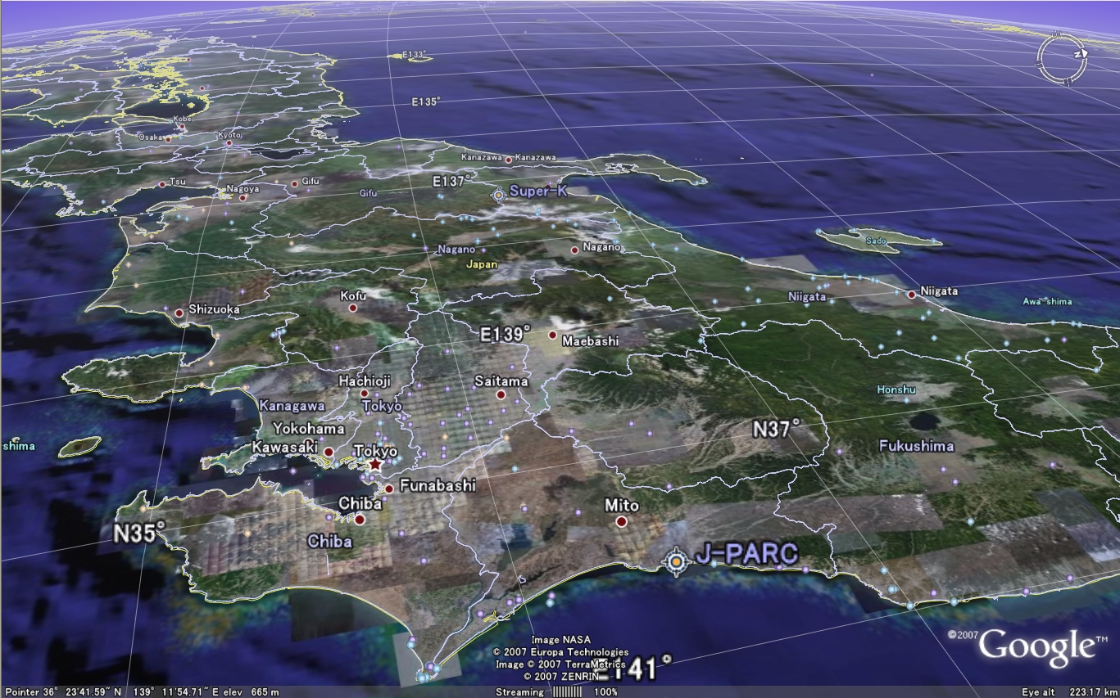
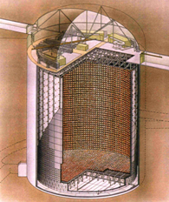
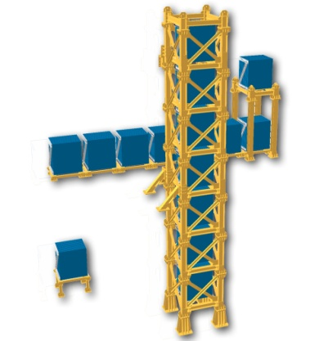
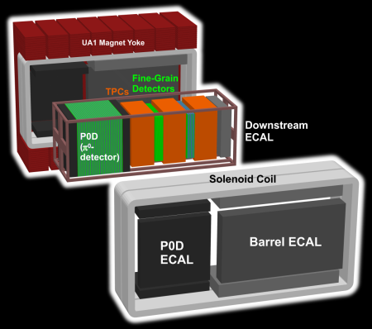
#

Slide 14
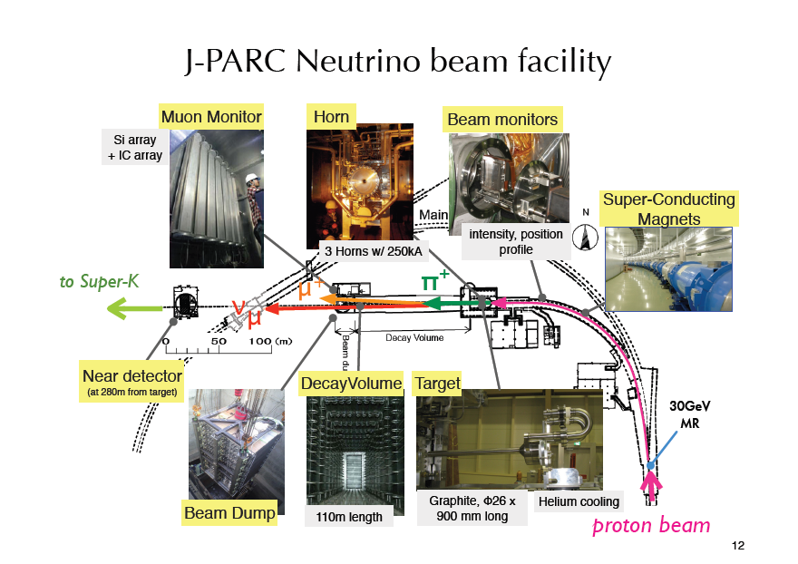

Slide 15
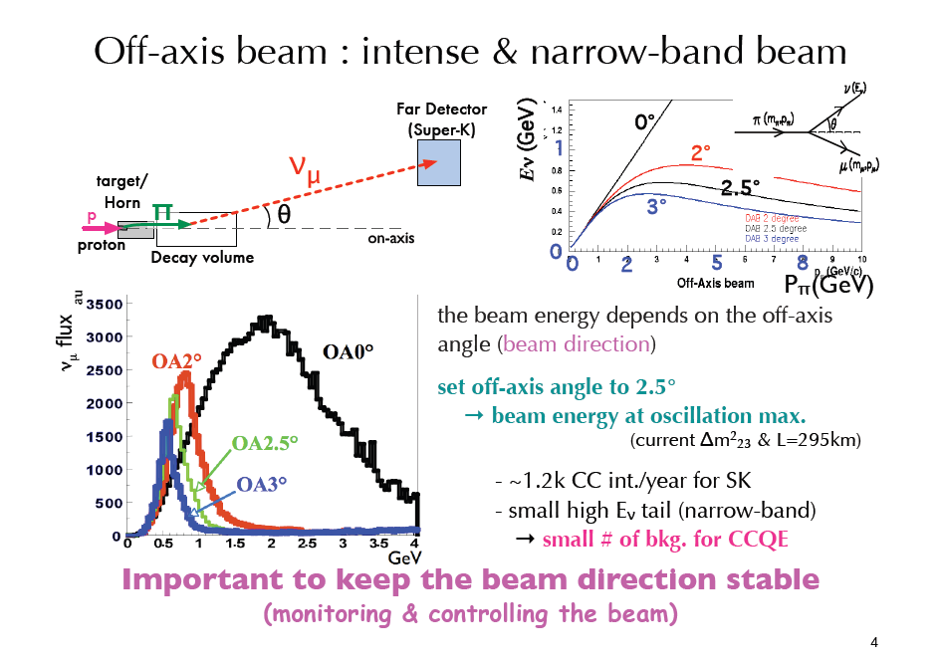

Slide 16
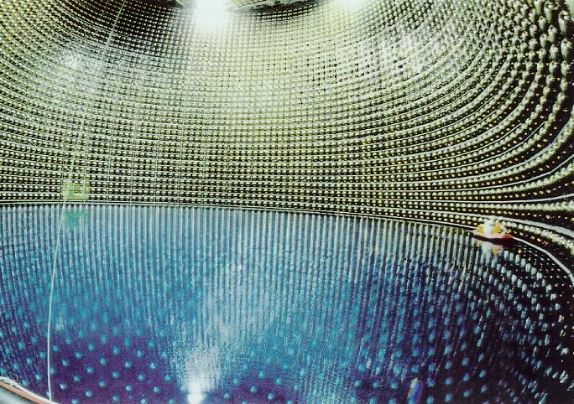

Slide 17
Background
from NC
interactions
e
ν_{μ}
disappearance
signal
π⁰
ν_{e}
appearance
signal
μ
Super Kamiokande
well understood,
Excellent for separating
Electrons, μ, π⁰

Slide 18
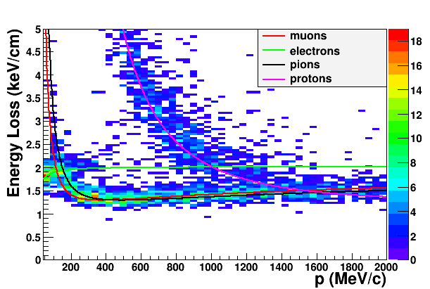
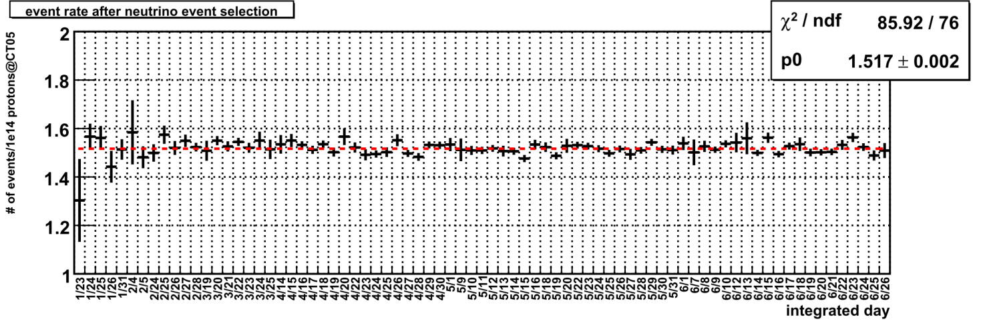
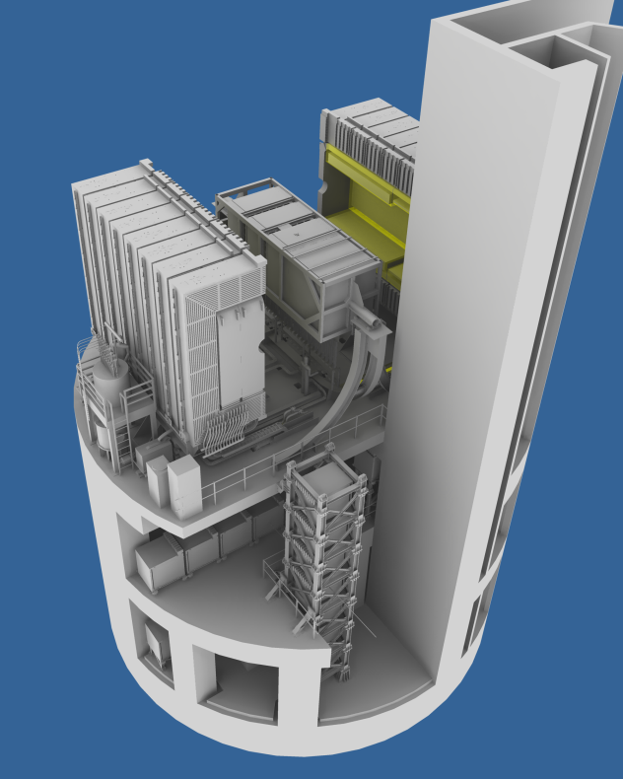
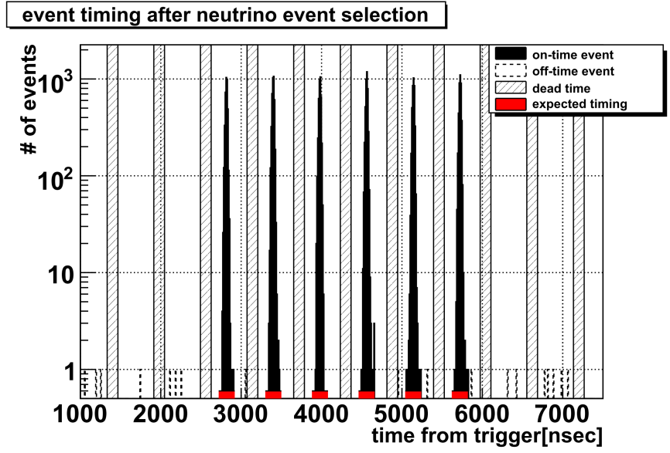
Near Detector Neutrino Measurements
dE/dx by TPC (positive)
Neutrino interaction
proton
electron
MIP (μ/π)
ICHEP talk by Flor de Maria Blaszczyk
Neutrino event rate
( INGRID)
From Nakaya-san’s presentation at ICHEP
Neutrino event timing
( INGRID)
Jan. 23rd
June 26th

Slide 19
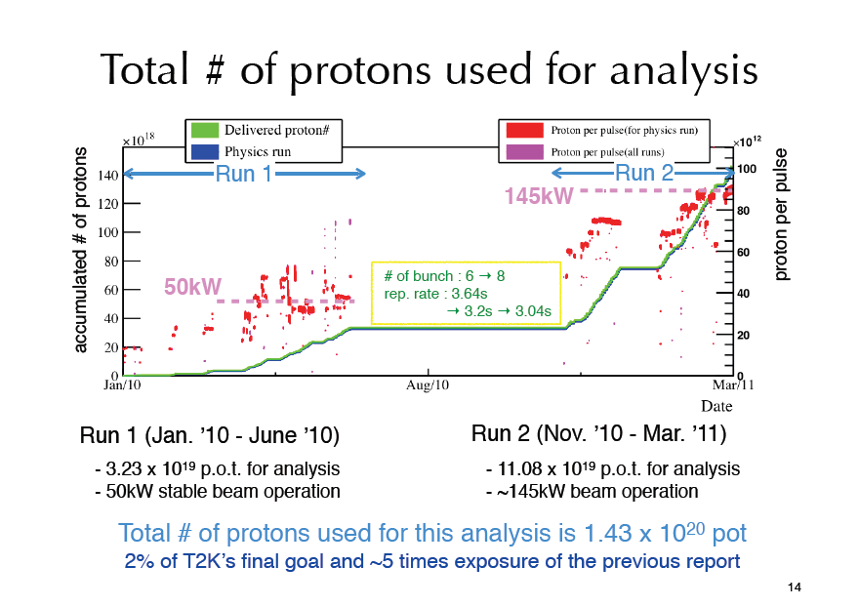
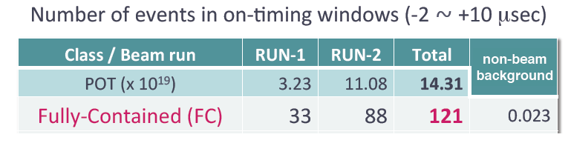

Slide 20
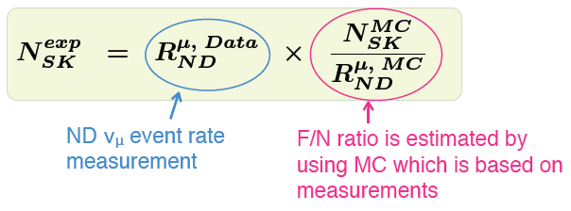
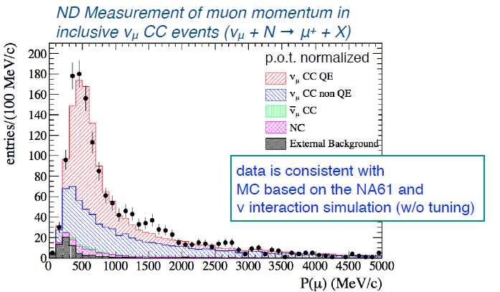
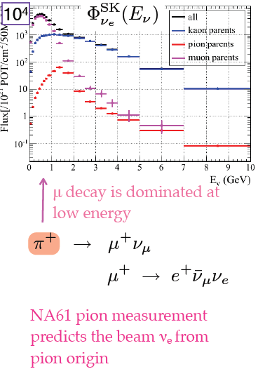

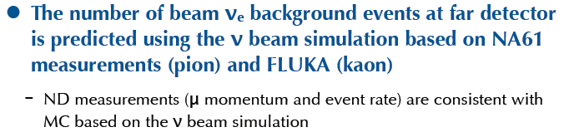
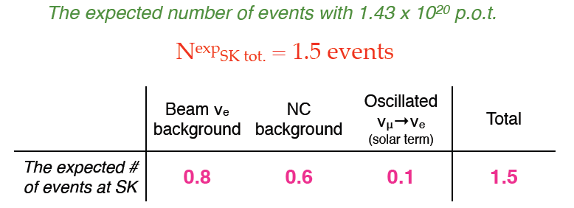


Slide 21
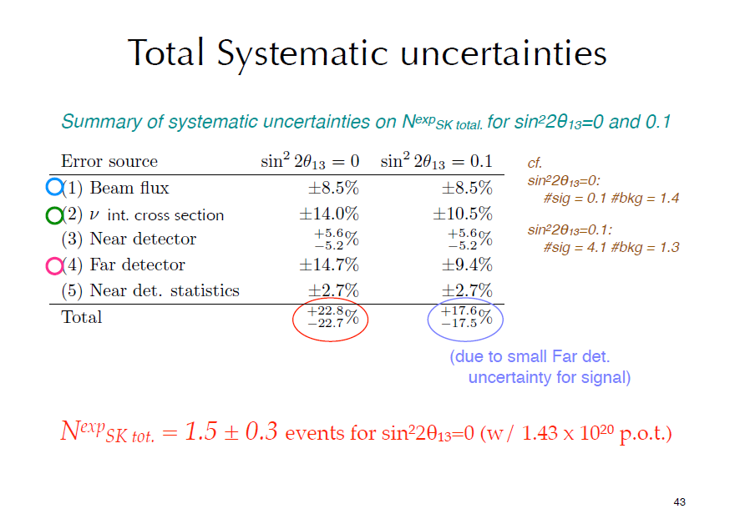

Slide 22
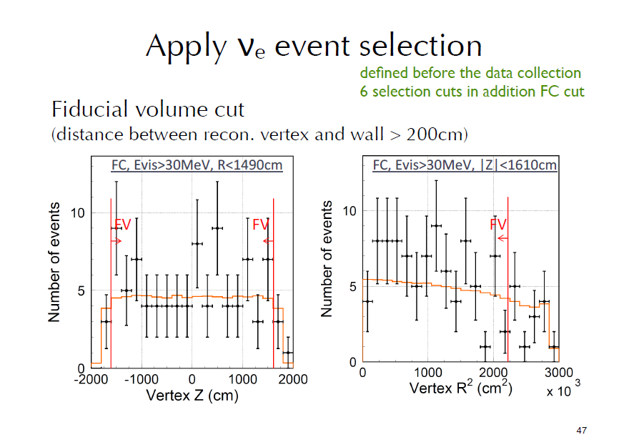

Slide 23
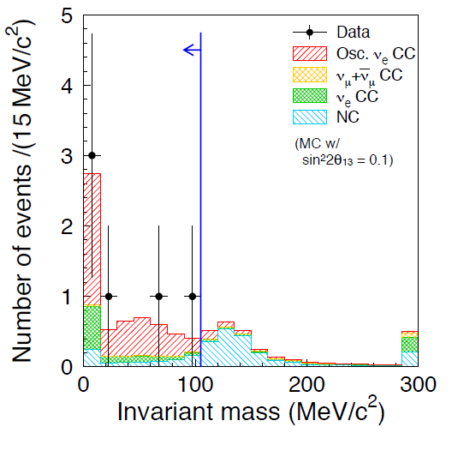
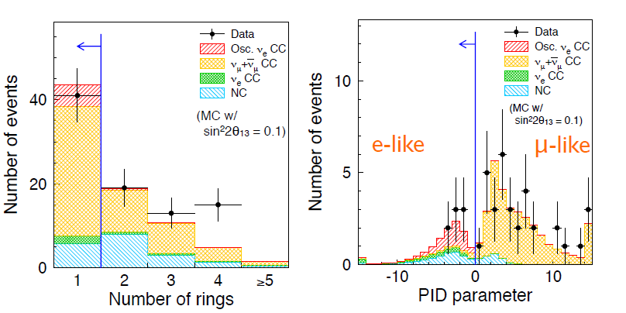
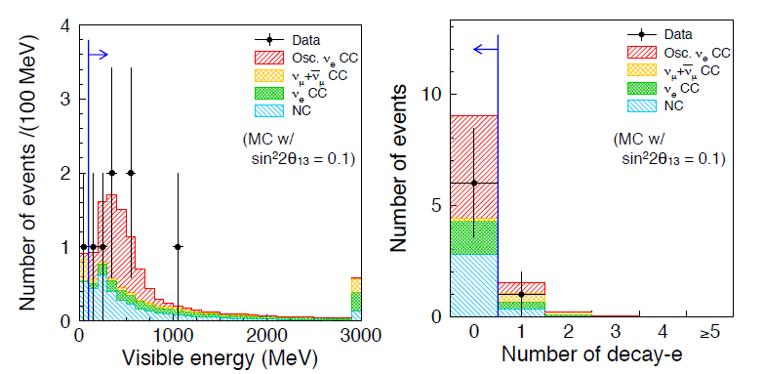
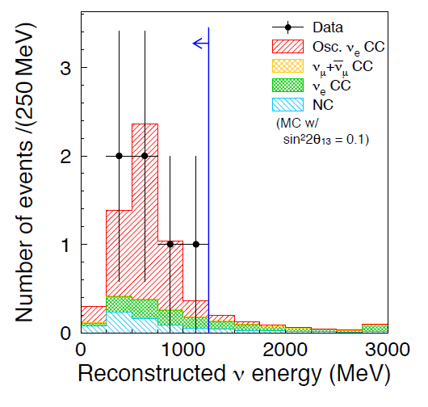
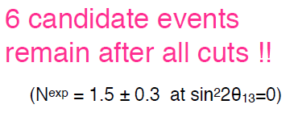

ν_{e} Appearance Data Reduction
All cuts optimized for low statistics
and fixed before data taken.

Slide 24
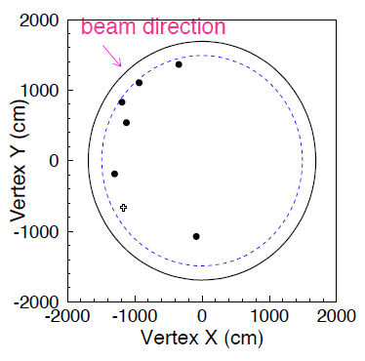
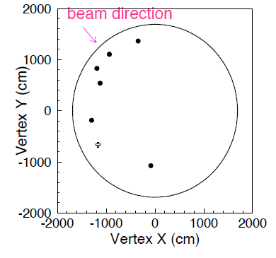
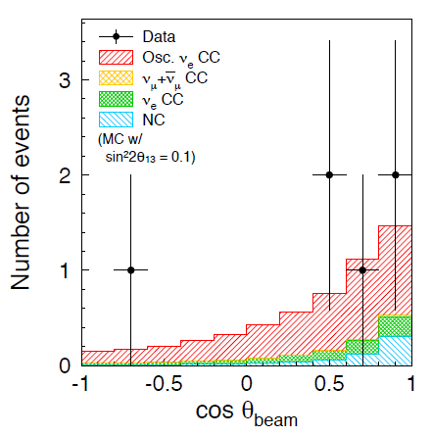
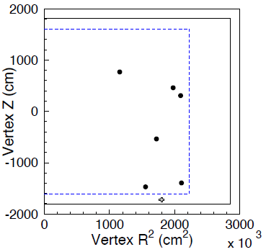
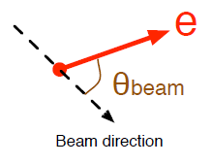
Check many distributions....
No excess outside FV or in OD,
but KS prob. for R² is ~3%
You win some...
You lose some.

Slide 25
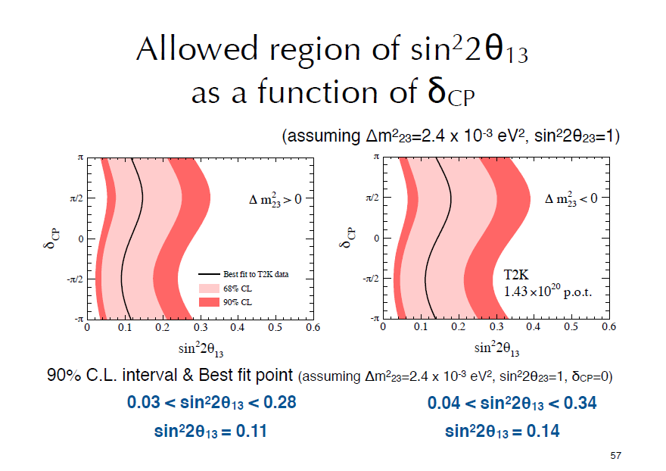
Now back to MINOS →

Slide 26


Slide 27
Library Event Matching
MINOS has minimal information
  Strip position
  Strip energy
Make a template library of signal and background events to compare each data event with
  Infinite number of events would be ideal (but hard so..)
    Tricks needed for offsetting events wrt strip boundaries
  Determine for each data event which 50 templates match best
3 higher level quantities (fraction of events which are signal, EM shower content and fractional charge) used to..
Create Neural Net for final probability
(this slide provided by Jenny Thomas)

Slide 28




Slide 29


Slide 30




Slide 31

Where are we now, and what’s next?
Interesting indications from experiments that sin²2θ₁₃ ≥ ~0.01 , which would put us in the regime where long baseline experiments can search for CP violation in neutrino oscillations.
More data from T2K would be a strong test, but there was this little earthquake.
Damage to the accelerator and
Next new data likely to come from semi-Double Chooz, which is taking data now.
detectors seems mercifully light.
We hope to restart accelerators
this year and T2K in early 2012.

Slide 32


Slide 33




Semi-Double-Chooz now taking data with
the far detector, 1st results within the year. If
θ₁₃ near top of indicated range they
will have early sensitivity.

Slide 34


Slide 35


Slide 36


Slide 37

Where will those get us?
Even some 90% CP violation sensitivity...
sin²2θ₁₃ = 0.1, NH

Slide 38


MINOS+
MINOS+ will look for new physics in a precision long-baseline neutrino measurement
Use on-axis high flux in MINOS detector
Improves hugely on precision in 4-10 GeV range

Slide 39


MINOS and MINOS+
After 1 year MINOS+ continues to dominate Δm² measurement
Combination of counting and shape different from LE beam
If new physics here, MINOS+ will be able to unravel it with the energy spectrum giving model discrimination (hard for NOVA)
2nd year of MINOS+ with antineutrino running
Compare purple and blue contours to see neutrino-antineutrino difference at many sigma if present parameters persist

Slide 40

Non Standard Interactions*
Our anti-neutrino result has motivated some work from other theorists*
Note the NSI has a measurable effect in neutrinos as well as antineutrinos
Comparison of low energy to high energy behavior could disentangle this without anti-nu running
*Alexander Friedland , Cecilia Lunardini, Phys.Rev.D74:033012,2006.
*J. Kopp, P.A.N. Machado and S.Parke, Phys.Rev.D82:113002 (2010).

Slide 41


MINOS+ : ν_{μ}➔ν_{s}
Using CC disappearance
Including NC and CC disappearance probes mixture of θ₂₄+ θ₃₄

Slide 42

Extra Dimensions
Assumes heavy RH (sterile) neutrino + extra dimensions!
P.A.N.Machado, H.Nunokawa,R.Zukanovich Funchal, hep-ph/1101.003v1
MINOS data has already put limit on extra dimensions at about 1 micron level.
This is just an example of the breadth of subjects which can be studied in the long baseline neutrino beam at higher energy

Slide 43
OK, then what?
Assuming current indications of sin²2θ₁₃ ≥ ~0.01 are confirmed with further data, there are three plans to exploit with new long-baseline experiments:
An upgrade of T2K based on reaching 1.6 MW beam power and a new far detector.
LBNE – a plan to build a new neutrino beam at Fermilab aimed at Homestake, where either a large water Cerenkov detector or a LAr tracking calorimeter would be built.
LAGUNA-LBNO – three different options for new long baseline in Europe.

Slide 44





Slide 45

Funds have been requested to
build a ~few x 100 ton LAr to
be put in a new pit at Tokai
UK T2K are invited to join
in this effort. We will begin
work on an SoI immediately.

Slide 46



US: Long Baseline Neutrino Experiment
CD 0: January 2010
1300 km
Collaboration:
288 members from 54 institutions (India, Italy, Japan, UK, US)
Continue to grow!

Slide 47


Slide 48


Alternative is
34 kT of LAr
LAr Slight cheaper but riskier – Marx Committee

Slide 49



Slide 50


Slide 51



Possible synergy with a β beam

Slide 52


In the systematics dominated era
such measurements are even more important
One slide on hadron production

Slide 53

One slide on cross sections....
Dedicated cross-section measurements ala SciBooNE and MInERVA even more critical....

Slide 54





LSND Starts it all...
Short baselines
(L/E ~ 1)
and sterile ν.
MiniBooNE says....
No!
Yes?

Slide 55
Conclusions
Neutrino oscillations are the first confirmed physics beyond the SM, and their continued study is essential to extend our knowledge of fundamental interactions.
Current indications are that sin²2θ₁₃ ≥ ~0.01, which would make further long baseline experiments the most attractive option for first searches for CP violation in the neutrino sector.
Do not assume we know everything that is going on – redundancy is essential!
Continued operation of existing experiments (T2K, MINOS+, Double Chooz) is the highest priority.
There are three next-generation projects, with UK interest in all of them – we need to carefully targeted involvement where we can be effective, but there is no reason to restrict ourselves to one project.
In my opinion, a large LAr tracking calorimeter will be used in at least one experiment, making UK involvement in LAr development a high priority.
A ~100 ton LAr may be developed in the near term at Tokai, and we should be involved.
There will be many other opportunities for smaller-scale involvement in cross-section, hadron production, and perhaps short-baseline projects.
Neutrino oscillations offers a very wide range of experiments, which must happen, no matter what we do at the energy frontier. This is an area of particle physics with a guaranteed future, and the UK should play a full and diverse role.
Dave Wark
Imperial College/RAL

