Slide 1


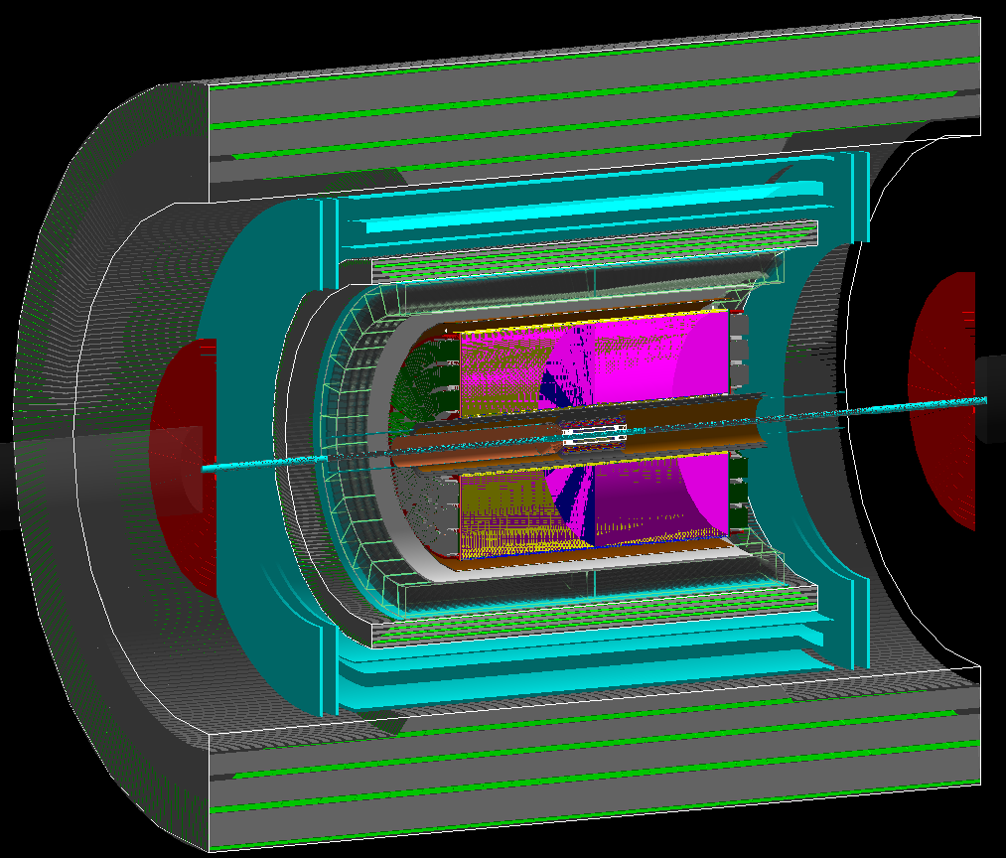
EIC Yellow Report
Volume I
Athavan Ramalingam
Journal club – 12/12/2024

Slide 2

Volume I – Executive Summary
Electron Ion Collider
Physics Measurements and Requirements
Detector Concepts
Opportunities for detector Concepts

Slide 3
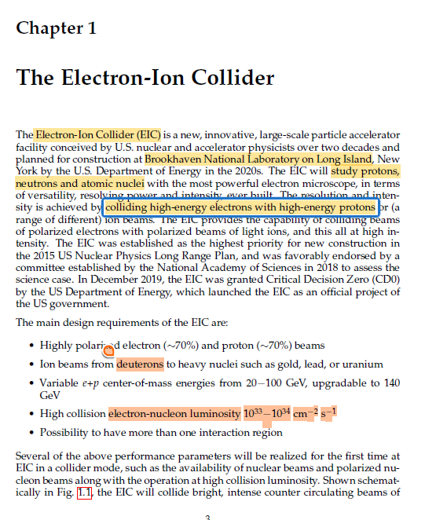

1. The Electron-Ion Collider
Highly polarised electron and proton beams ($\sim 70\%$)
Ion beams from deuterons to heavy nuclei (gold, lead, uranium etc.
Centre of mass energies from 20-100 GeV, upgradeable to 140 GeV
Luminosity ${10}^{33}−{10}^{34}cm^{−2}s^{−1}$
More than one interaction region
Deuterium: ²₁H
Deuteron: ²₁H⁺

Slide 4
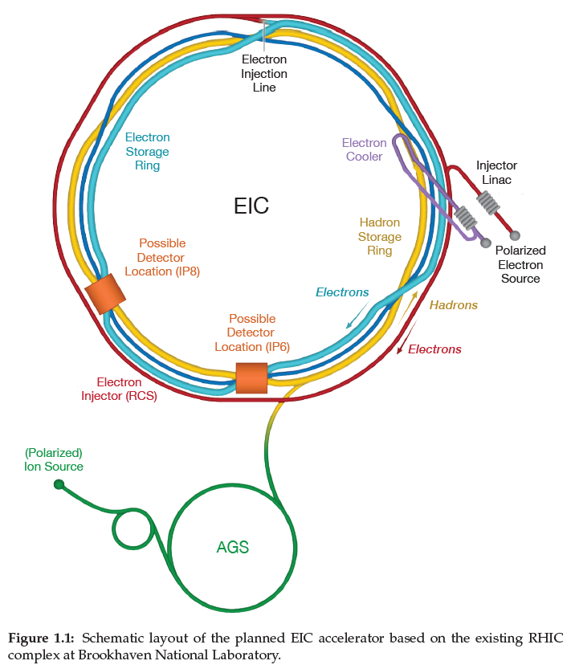
1. The Electron-Ion Collider
Ion Ring
Electron Acceleration
Electron Ring
Ion Cooling
Collision Zone

Slide 5
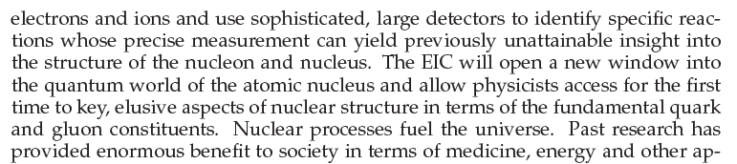
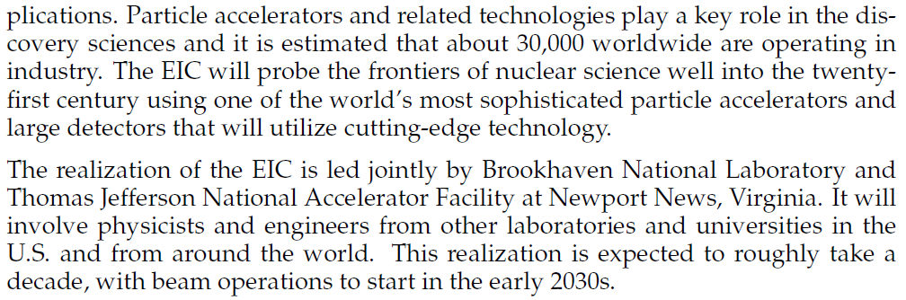
1. The Electron-Ion Collider
Reasoning and histiry

Slide 6

1. The Electron-Ion Collider
More History

Slide 7
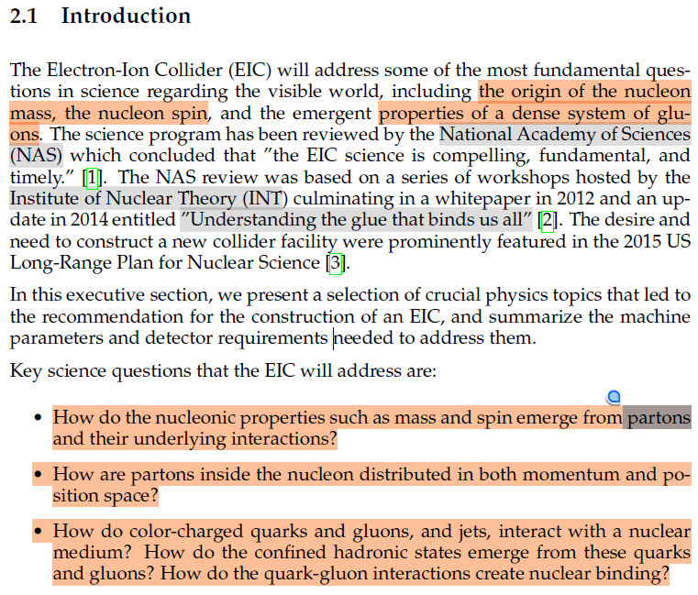
2.1 Introduction
Addressing fundamental questions:
Origin of the nucleon mass
Nucleon spin
Properties of a dense system of gluons
Key questions:
How do the nucleonic properties such as mass and spin emerge from partons and their underlying interactions?
How are partons inside the nucleon distributed in both momentum and position space?
How do colour-charged quarks and gluons, and jets, interact with a nuclear medium?
How do the confined hadronic states emerge from these quarks and gluons?
How do the quark-gluon interactions create nuclear binding?

Slide 8
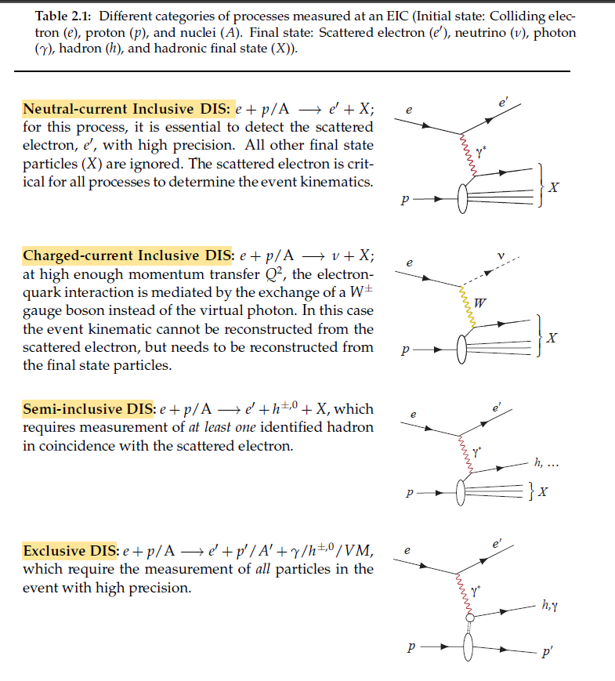

2.1 Introduction
Deep Inelastic Scattering (DIS)
$e$ - colliding electron
$p$ - proton
$A$- nuclei
$e′$- final state: scattered electron
$ν$ - neutrino
$γ$ - photon
$h$ - hadron
$X$ -Hadronic final state

Slide 9

2.1 Introduction
Neutral Inclusive DIS:
Only scattered electron
Charge-current Inclusive DIS:
Only final state particles
Semi-inclusive DIS:
F($x$,$Q^{2}$)
At least one final state particle
Exclusive DIS:
All particles

Slide 10
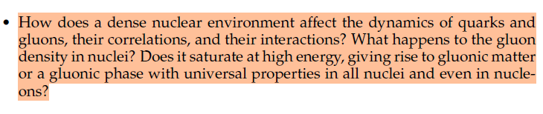
2.1 Introduction
How does a dense nuclear environment affect the dynamics of quarks and gluons, their correlations, and their interactions?
What happens to the gluon density in nuclei?
Does it saturate at high energy, giving rise to gluonic matter or a gluonic phase with universal properties in all nuclei and even in nucleons?

Slide 11
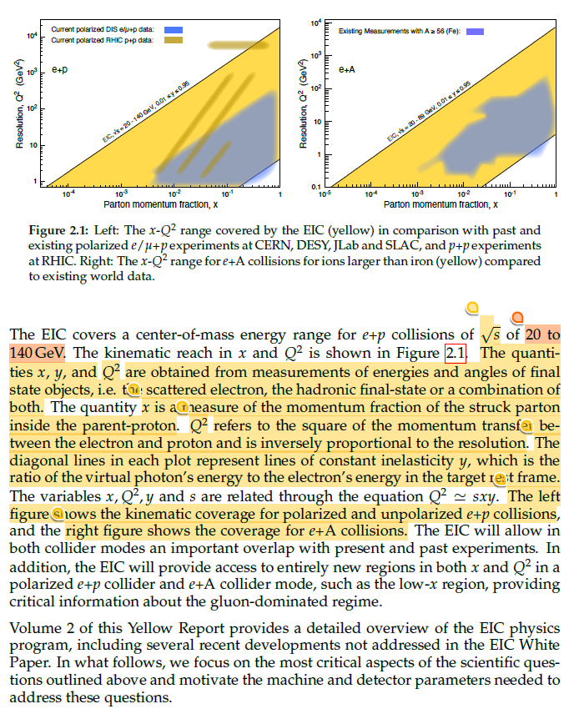

2.1 Introduction
LH - polarised and unpolarised $e+p$collisions
RH - $e+A$collisions
$x$ - measure of the momentum fraction of the struck parton inside the parent-proton
$Q^{2}$- the square of the momentum transfer between electron and proton and is inversely proportional to the resolution
Diagonal lines - lines of constant inelasticity y, which is the ratio of the virtual photon's energy to the electron energy in the target rest frame
Maximum value is 1 for y.
$Q^{2}≃sxy$
Energy range for $e+p$ collisions of $\sqrt{s}$ is 20 to 140GeV

Slide 12
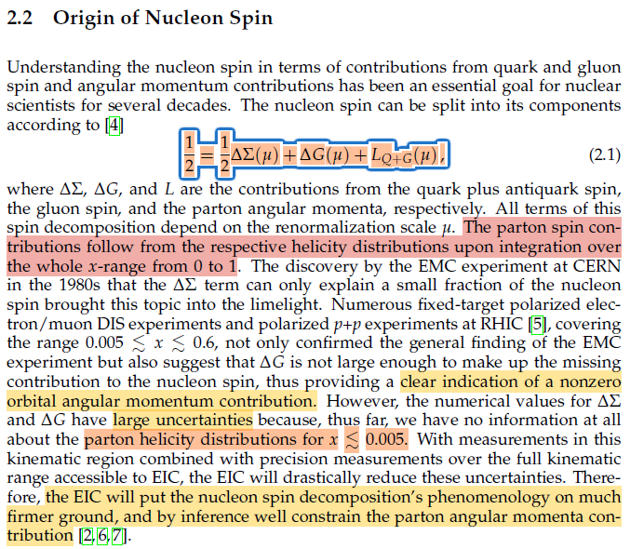

2.2 Origin of Nuclear Spin
Understanding of Nucleon spin from quark and gluon spin and angular momentum
$\frac{1}{2}=\frac{1}{2}∆Σ\left(μ\right)+∆G\left(μ\right)+L_{Q+G}\left(μ\right)$ - Nuclear Spin
$ΔΣ$ - quark plus anti quark spin
$ΔG$ - gluon spin
$L$- the parton angular momenta
$μ$ - renormalisation scale

Slide 13
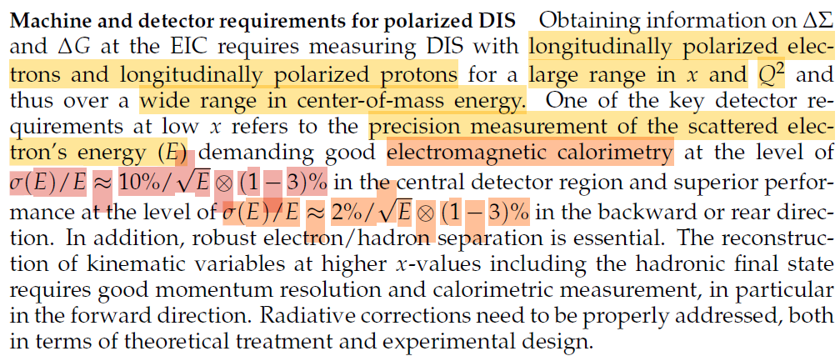

2.2 Origin of Nuclear Spin
To obtain info on $ΔΣ$ and $ΔG$
Requires assuring DIS with
Longitudinally polarised electrons
Longitudinally polarised proton
Good electromagnetic calorimetry
Central detector
$σ(E)/E≈10\%/√E ⨂(1−3)\%$at midrapidity)
Backward rapidities
$σ(E)/E≈2\%/√E ⨂(1−3)\%$

Slide 14
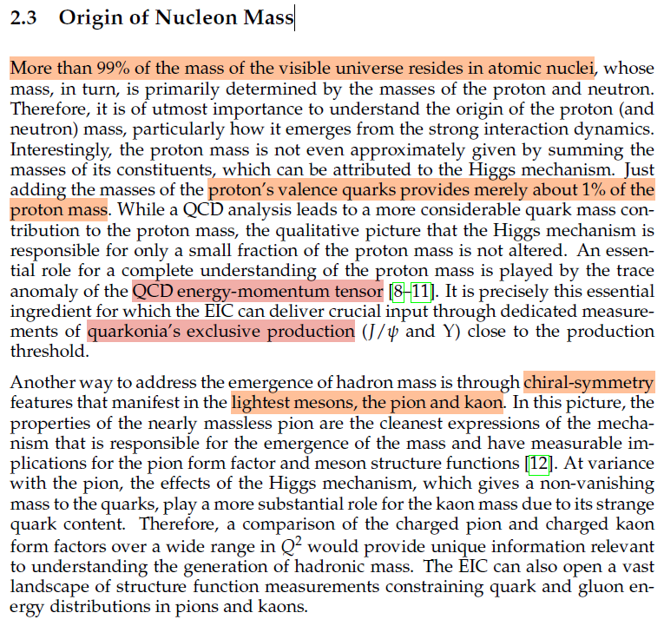
2.3 Origin of Nucleon Mass
Once upon a time…

Slide 15
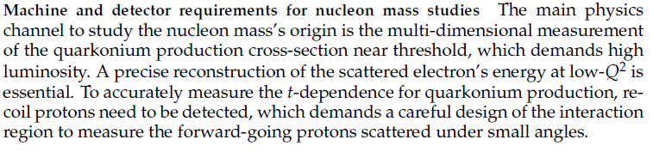
2.3 Origin of Nucleon Mass
The multi-dimensional measurement for the quarkonium production cross-section near threshold, which demands high luminosity

Slide 16
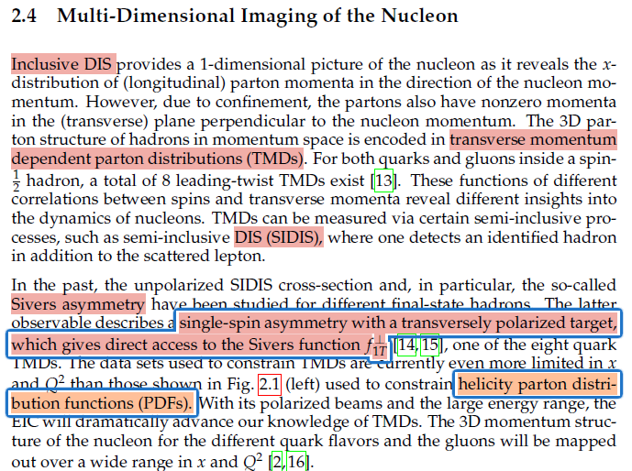

2.4 Multi-Dimensional Imaging of the Nucleon
Inclusive DIS (See chapter 2.1)
E.g. For Inclusive neutral current DIS:
$e+p/A→e′ +X$
Transverse Momentum Depended parton distributions(TMDs)
Probability of finding a parton (quark or gluon) inside a hadron with a given longitudinal momentum fraction x and a specified transverse momentum$k_{g}$
Inside a spin 1/2 hadron, a total of 8 leading-twist TMDS exists.
Semi-inclusive DIS (SIDIS)
$e+p/A→e′++h^{±,0}+X$

Slide 17
2.4 Multi-Dimensional Imaging of the Nucleon
Left-Right Symmetry
In a perfect scenario the distribution of quarks and gluons in a spin 1/2 hadron that is polarised transversely to its momentum would be left-right symmetric w.r.t the plane spanned by the momentum and spin directions
https://ar5iv.labs.arxiv.org/html/1504.04332
Sivers asymmetry
In reality the distribution of quark and gluons in a spin 1/2 hadron that is polarized transversely to its momentum need not be left-right symmetric w.r.t. The plane spanned by the momentum and spin. This asymmetry is called the Sivers effect.
Sivers function - One of the eight quark TMDS

Slide 18
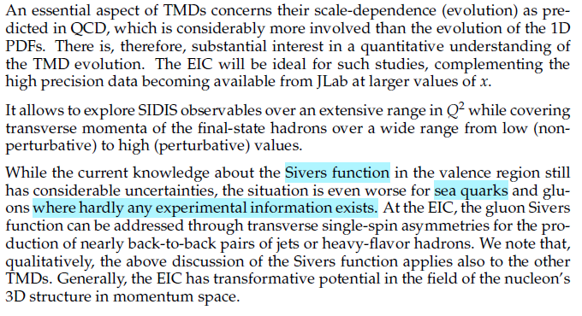
2.4 Multi-Dimensional Imaging of the Nucleon
Interest in quantitative understanding of the TMD evolution
How to address the gluon Sivers function

Slide 19
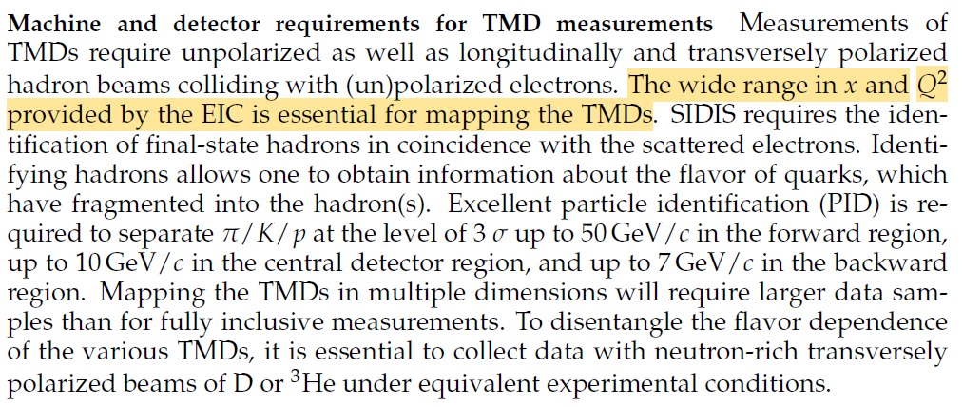

2.4 Multi-Dimensional Imaging of the Nucleon
To measure TMDs
Require unpolarized hadrons beams
Requires longitudinally and transversely polarised hadron beam
Colliding with (un)polarised electron beam
Excellent PID is required to separate $π/K/p$
Forward region up to 50 GeV/c
Central detector region up to 10 GeV/c
Backward region up to 7 GeV/c

Slide 20
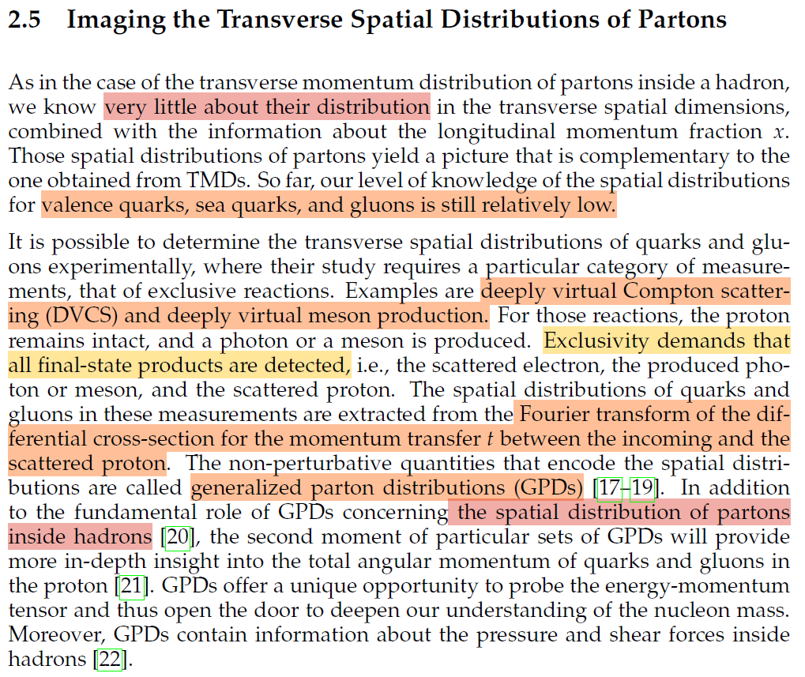
2.5 Imaging The Transverse Spatial Distribution of Partons
Deeply Virtual Crompton Scattering (DVCS)
Electron scattering a virtual photon on a hadron, where the hadron remains intact and a real photon is produced
Deep Virtual Meson Production (DVMP)
Electron scattering a virtual photon on a hadron, where the hadron remains intact and a meson is produced
DVCS measures GPDs, giving insights into the spatial structure and angular momentum of the partons
GPDs offer a unique opportunity to probe energy-momentum tensor.

Slide 21
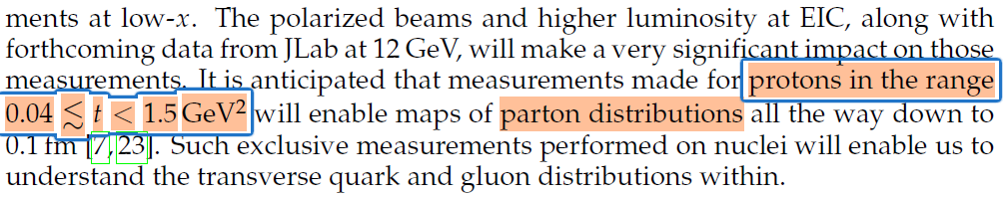
2.5 Imaging The Transverse Spatial Distribution of Partons
GPDs on DVCs knowledge is limited, etc.
Data from Jlab enable maps of Parton distribution down to 0.1fm

Slide 22
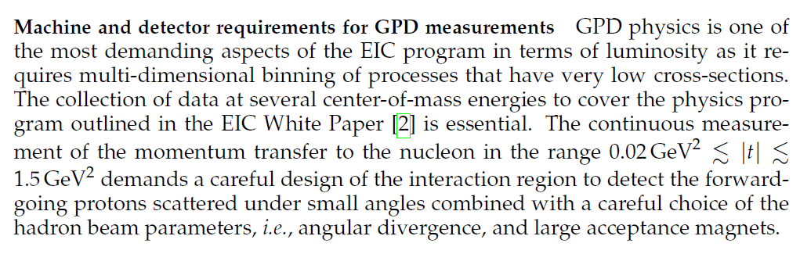
2.5 Imaging The Transverse Spatial Distribution of Partons
GPD physics

Slide 23
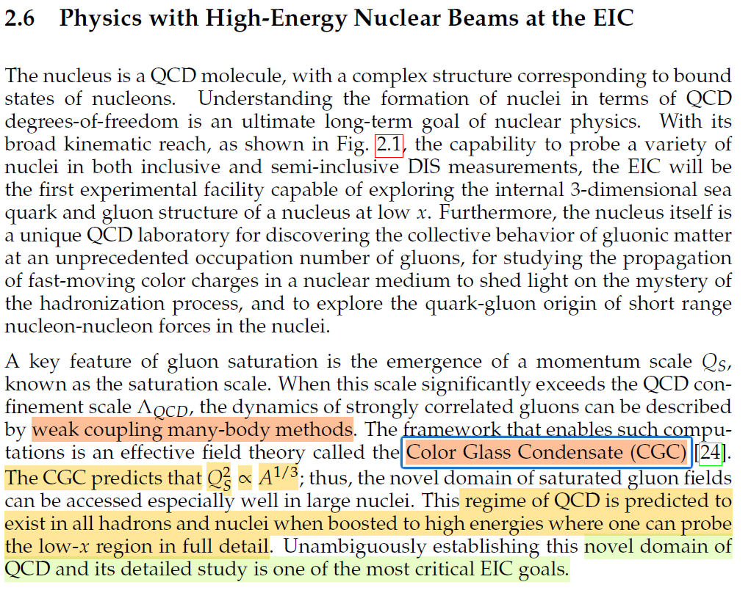

2.6 Physics with High-Energy Nuclear Beams At The EIC
Gluon saturation
$Q_{s}$= saturation scale
$Λ_{QCD}$= $QCD$ confinement scale
$Q_{s}>Λ_{QCD}$
The dynamics of strongly related gluons can be described by weak coupling many-body methods.
Color Glass Condensate (CGC)
Saturated gluonic matter
Most prominent at small x, corresponding to high energy collisions / photons

Slide 24
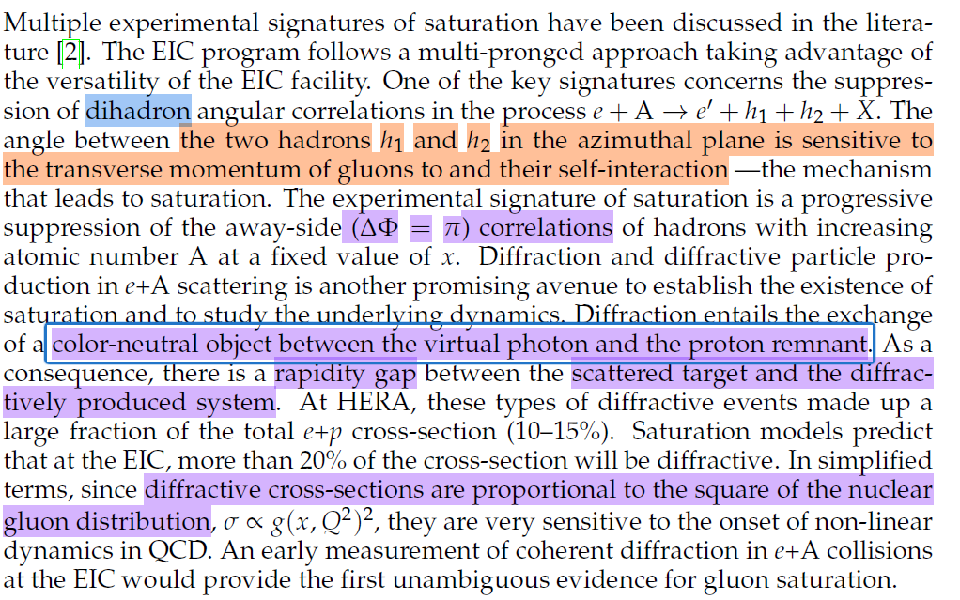
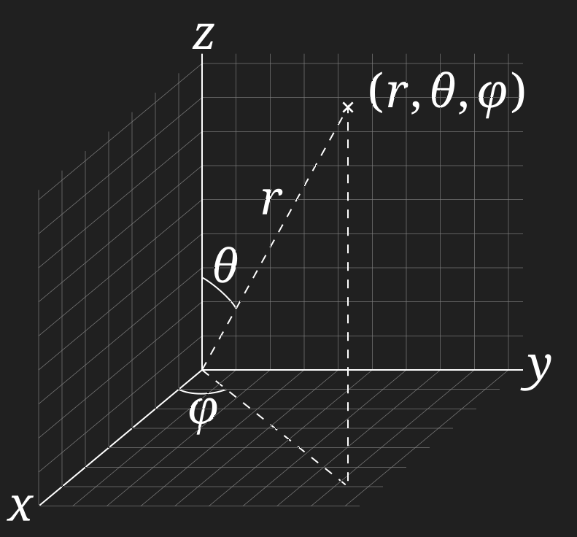
2.6 Physics with High-Energy Nuclear Beams At The EIC
Dihadron - pair hadron production
Azimuthal plane - plane of ϕ

Slide 25
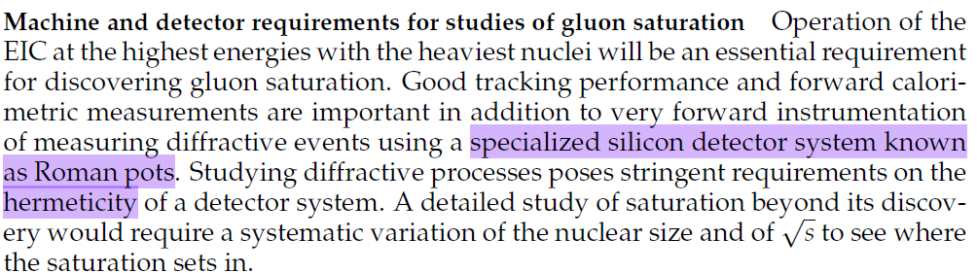
2.6 Physics with High-Energy Nuclear Beams At The EIC
Gluon saturation study requirement
Require the highest energy and heaviest nuclei
Roman pots

Slide 26
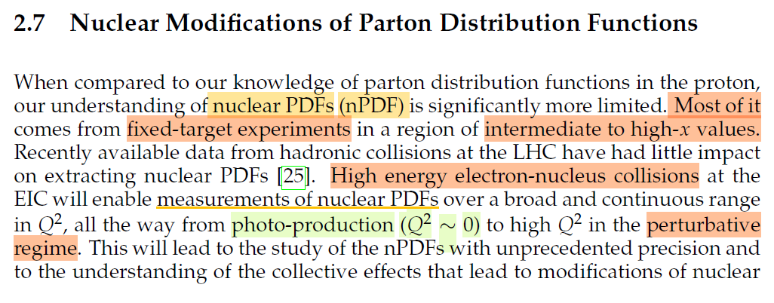
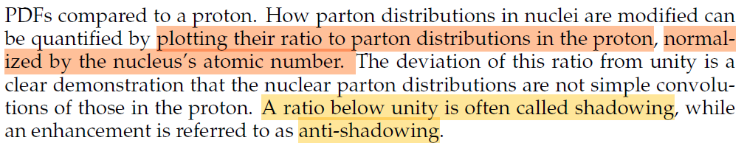

2.7 Nuclear Modifications Of Parton Distribution Functions
Nuclear Parton Distribution Function (nPDF)
The parton distribution inside of a nucleus (instead of an isolated proton.)
E.g. Heavy ion collisions
$f_{u}^{A} (x,Q^{2}):$Up quark distribution in a nucleus A
Photo-production
$Q^{2}\sim 0$

Slide 27
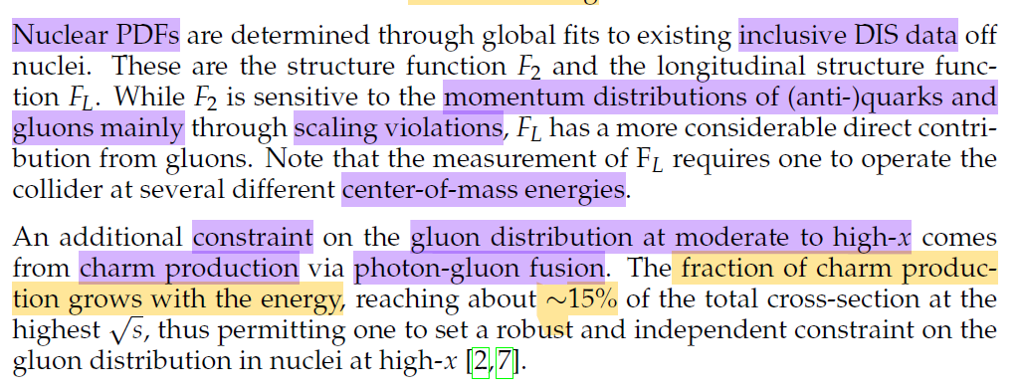
2.7 Nuclear Modifications Of Parton Distribution Functions
Charm production
Photon-gluon fusion

Slide 28
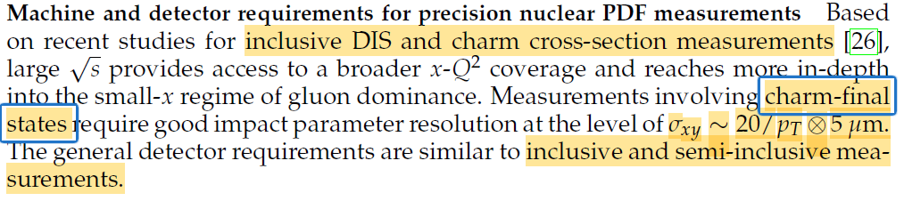

2.7 Nuclear Modifications Of Parton Distribution Functions
Requirements for precision nuclear PDF Measurement
Good impact parameter resolution
$σ_{xy}\sim 20/p_{T} ⨂5μm$

Slide 29
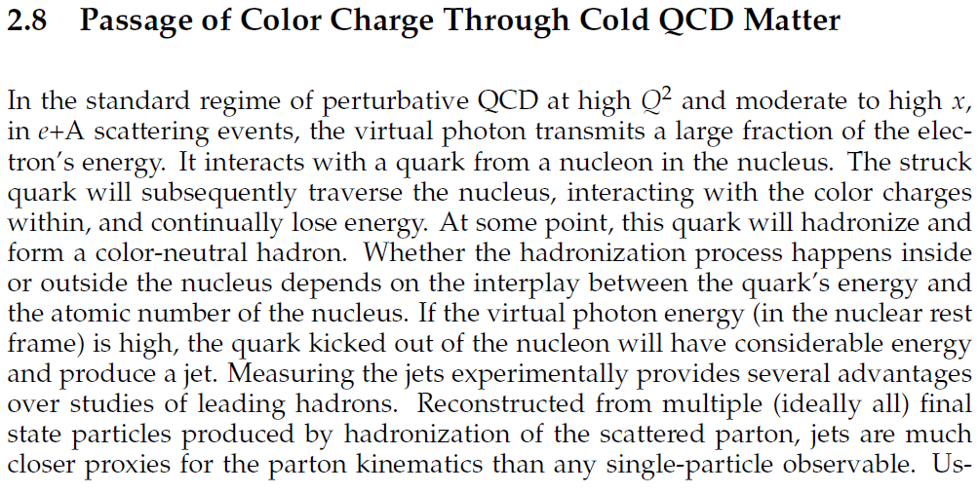
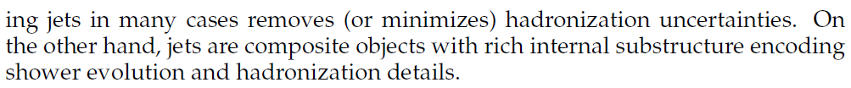
2.8 Passage of Color Charge Through Cold QCD Matter
Jets!
All about jets!

Slide 30
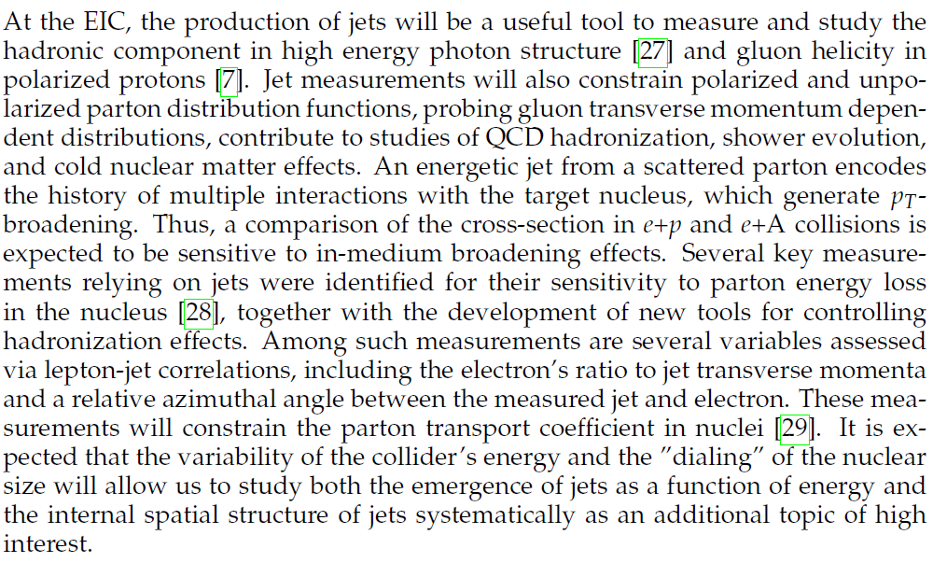
2.8 Passage of Color Charge Through Cold QCD Matter
Even more jets!

Slide 31
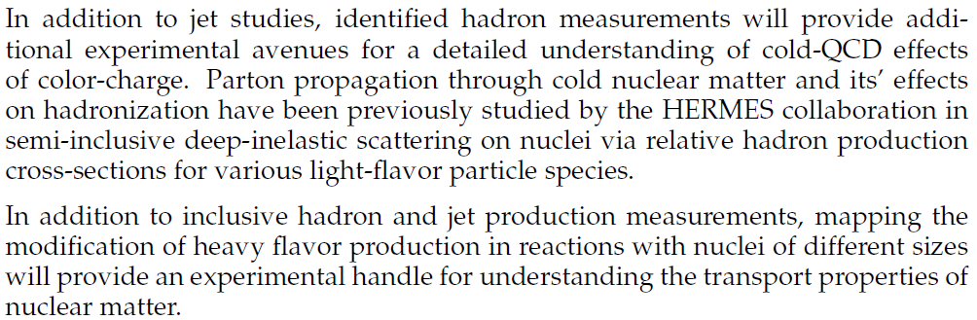
2.8 Passage of Color Charge Through Cold QCD Matter

Slide 32
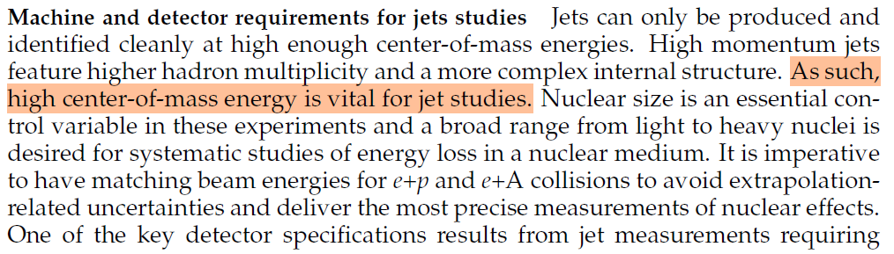
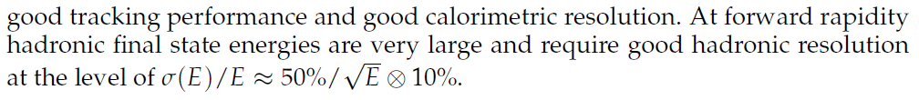

2.8 Passage of Color Charge Through Cold QCD Matter
Good hadronic resolution
Forward region $σ(E)/E≈50\%/√E⨂10\%$

Slide 33
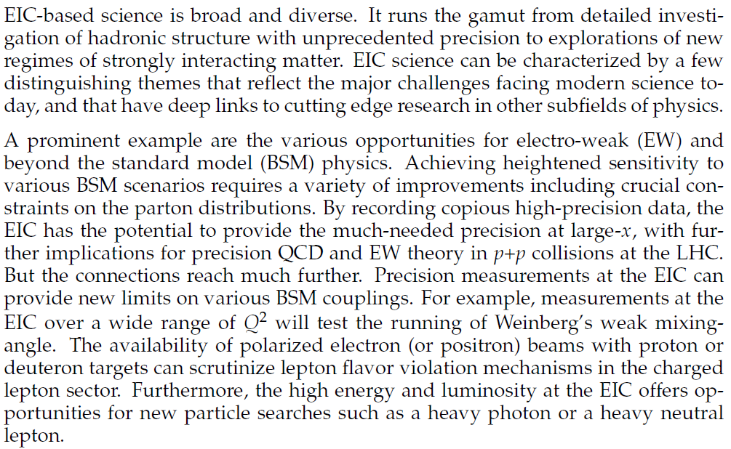
2.9 Connections to Other Fields
Mainly about what impact the EIC will have on other fields…

Slide 34
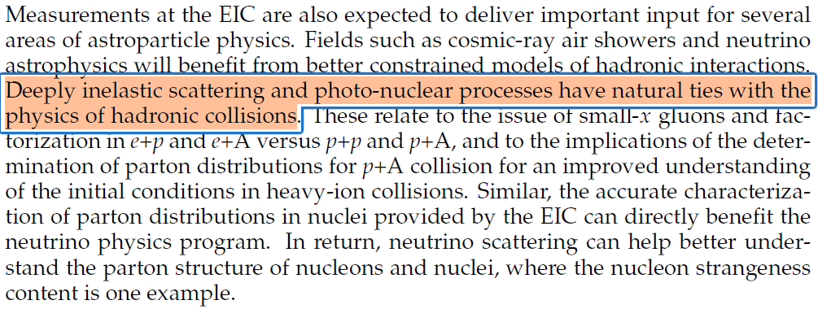
2.9 Connections to Other Fields

Slide 35
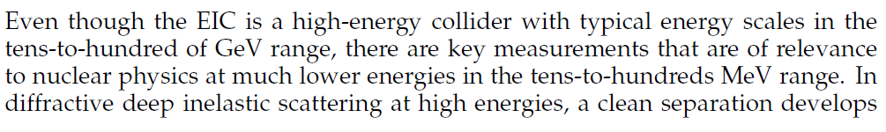
2.9 Connections to Other Fields

Slide 36
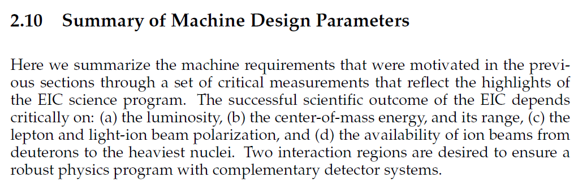
2.10 Summary of Machine Design Parameters
Summary on machine requirements:
Depends critically on:
Luminosity
Centre-of-mass energy and its range
Lepton and light-ion beam polarization
Availability of ion beams from deuterons to heavy nuclei
Two interaction regions

Slide 37
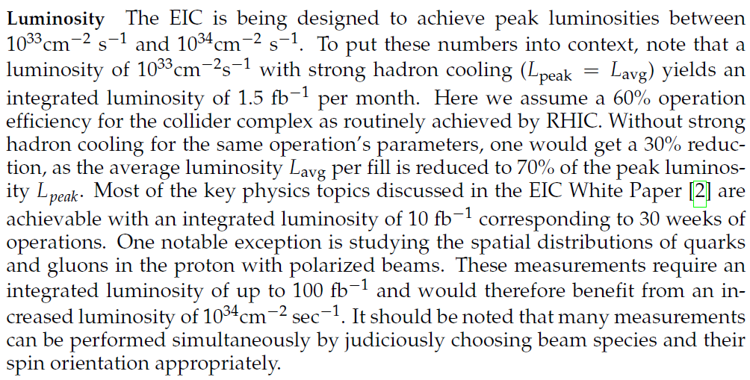

2.10 Summary of Machine Design Parameters
Luminosity:
${10}^{33}cm^{−2}s^{−1}−{10}^{34}cm^{−2}s^{−1}$

Slide 38
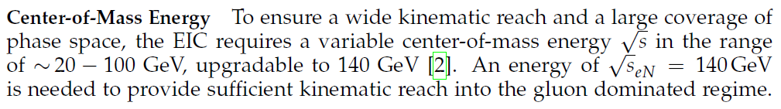
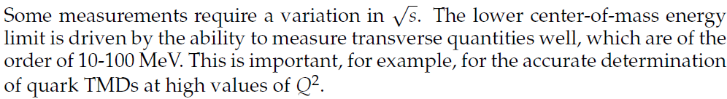
2.10 Summary of Machine Design Parameters
Centre-of-Mass:
20 −100GeV upgradeable to 140GeV

Slide 39
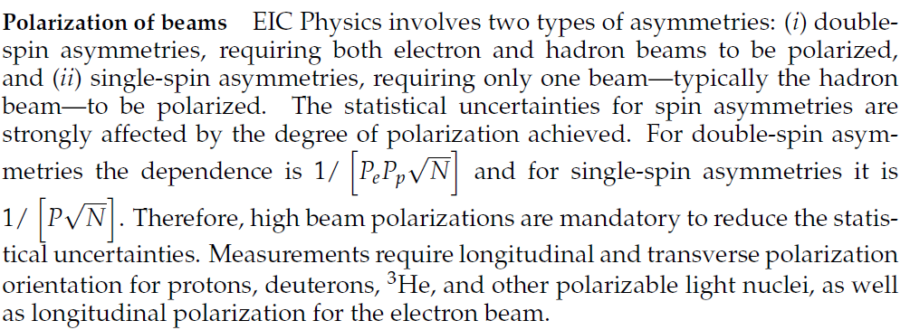

2.10 Summary of Machine Design Parameters
Two types of asymmetries:
Double-spin asymmetries
Requires both electron and hadron beams to be polarised
Single-spin asymmetries
Requires only one beam to be polarised (typically the hadron beam
The statistical uncertainties for spin asymmetries are strongly affected by the degree of polarisation achieved
Double-spin asymmetries $1/[P_{e} P_{p} \sqrt{N}]$
Single-spin asymmetries $1/[P\sqrt{N}]$
∴ High beam polarisation’s are mandatory to reduce the statistical uncertainty
Measurements require longitudinal and transverse polarisation orientation
- Protons, deuterons, $3He$, other polarizable light nuclei
Longitudinal polarisation for the electron beam

Slide 40
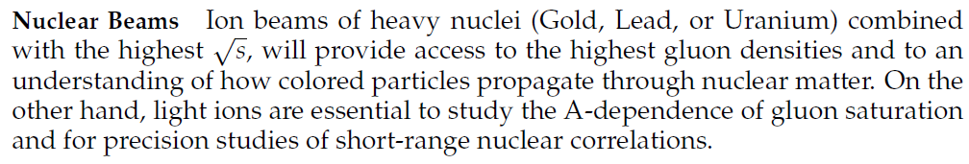

2.10 Summary of Machine Design Parameters
Ion beams of heavy nuclei (Gold, Lead or Uranium) + highest $\sqrt{s}$ = access to the highest gluon densities
Increase understanding to how colored particles propagate through nuclear matter
Light ions are essential to study A-dependence of gluon saturation and for precise studies of short-range nuclear correlations

Slide 41
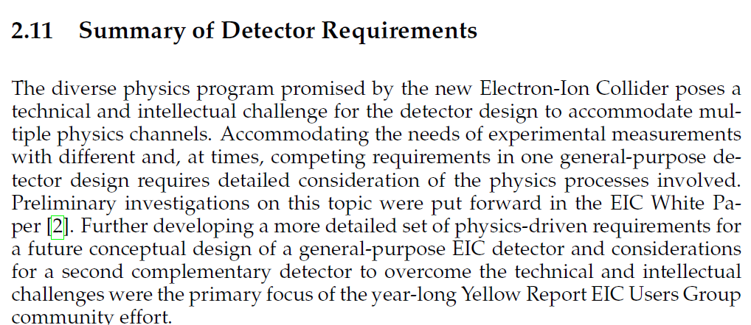
2.11 Summary Of Detector Requirements

Slide 42
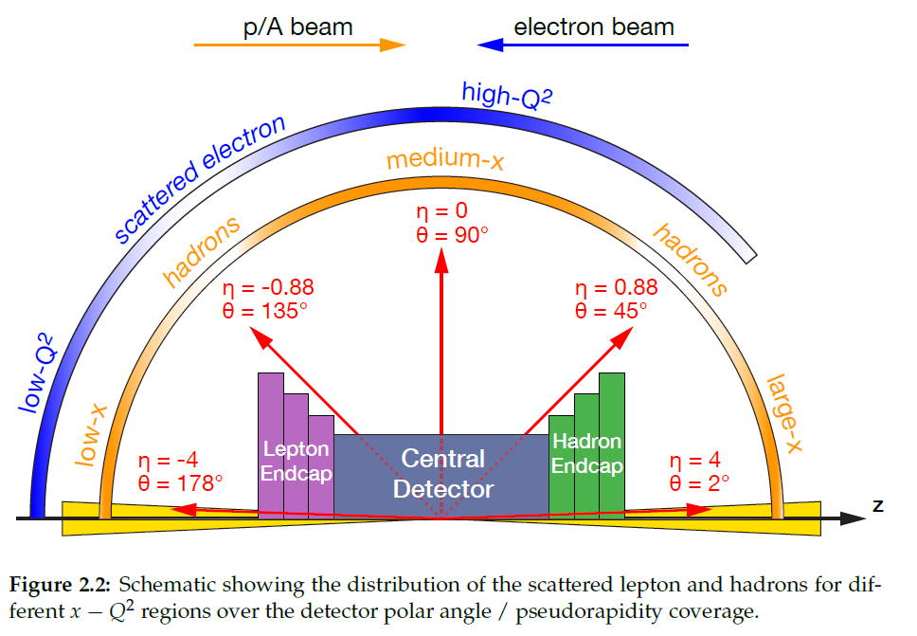
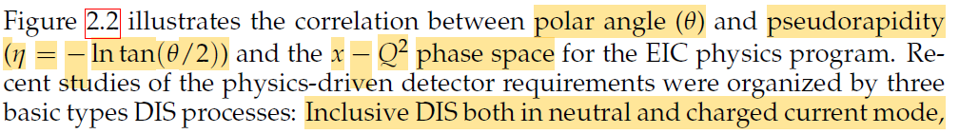

2.11 Summary Of Detector Requirements
Polar angle - $θ$
Pseudorapidity - $η=−ln⁡tan⁡(θ/2)$
$x−Q^{2}$ phase space
Detector requirement were organised by:
- Inclusive DIS (Neutral and Charged)
- Semi-inclusive DIS
- Exclusive DIS

Slide 43
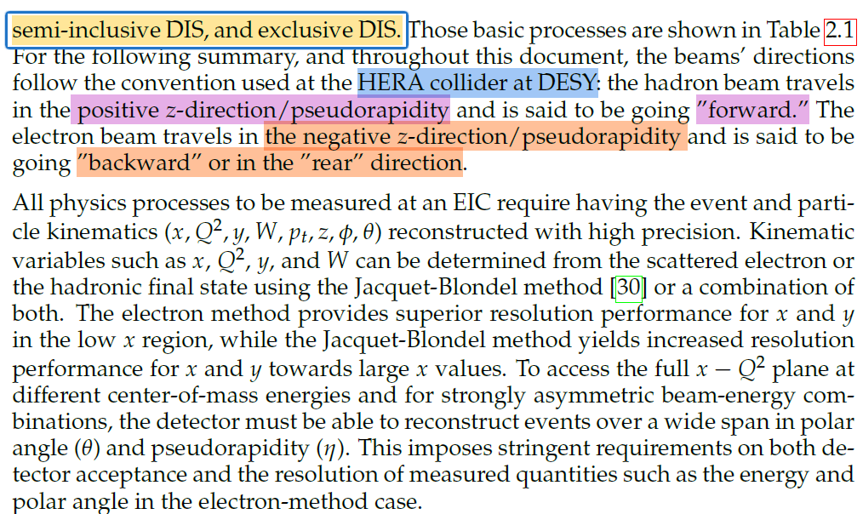

2.11 Summary Of Detector Requirements
Beam direction follows HERA collider at DESY
Forwards
- Positive z-direction/pseudorapidity
Backward/rear
- Negative z-direction/pseudorapidity
Particle kinematics
$x,Q^{2}, y,W, p_{t}, z, φ,θ$
$x,Q^{2}, y,W$
- Determined by the scattered electron
- Determined by the hadronic final state using the Jacquet-Blondel method
- Or a combination of both
Electron method
- Superior in resolution performance for x and y in low x region
Jacquet-Blondel method
- Superior in resolution performance for x and y in high region
- (only really in the charge current)

Slide 44
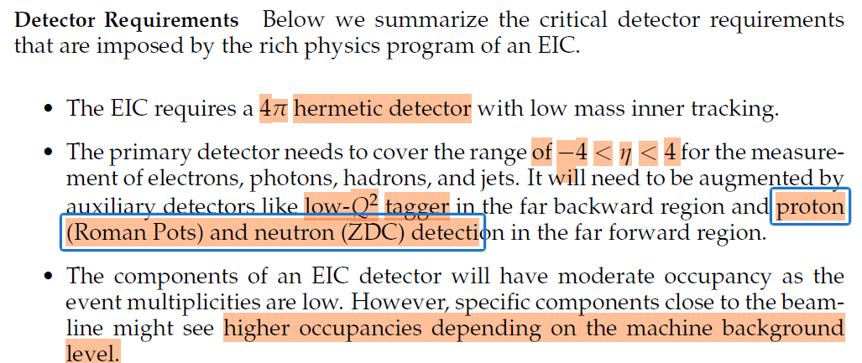
2.11 Summary Of Detector Requirements
Detector requirement
4π hermetic detector with low mass inner tracking
Primary detector
- Range of −4<η<4
- For electrons, photons, hadrons, and jets measurements.
Auxiliary detector
- Low-Q^2 tagger in the far backward region
- Proton detection (Roman Pots) in the far forward region
- Neutron detection (ZDC) in the far forward region
Moderate occupancy as the event multiplicities are low
Higher occupancy for specific components closer to the beamline due to machine background level
Moderate radiation harness requirements compared to the LHC

Slide 45
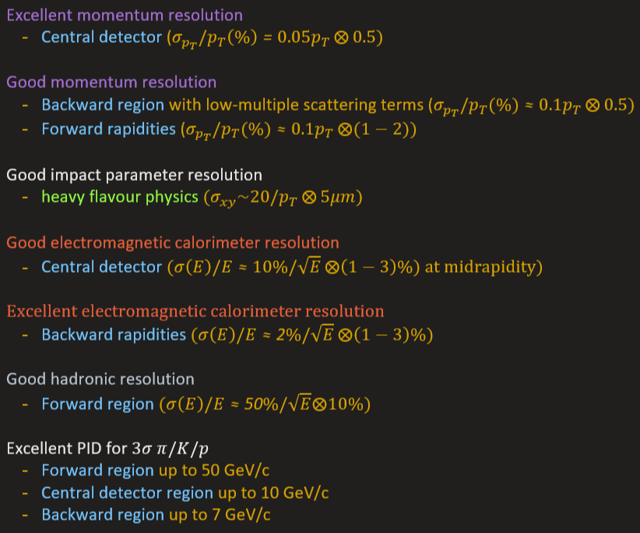

2.11 Summary Of Detector Requirements

Slide 46


2.11 Summary Of Detector Requirements
Further details in Volume 2 of the Yellow report
Quick summary of the questions and reasoning the build of the EIC

Slide 47

3. Detector Concepts
First e+p collider facility HERA at DESY, Germany
First e+p collisions at HERA in 1992
2 EIC detectors to carry out the extensive scientific program

Slide 48


3. Detector Concepts
EIC detector requirement
Space is constrained due to the requirements of high luminosity
Must have strong integration of forward and backward detectors
Multiple hermetic functionalities (precision energy measurement and particle tracking and identification)
Determine the energy-momentum four-vector of final-state particle over a large range of energies: $\sim 10MeV$to $\sim 10GeV$
To the major detector facilities:
Collision luminosity must be determined by special purpose detectors close to the beam
Precise knowledge of the polarisation’s of the electron and ion beams is essential for spin-dependent measurements
Obtained by using special purpose polarimeters

Slide 49

3. Detector Concepts
Design of Detectors:
Centred around solenoidal superconductive magnets with bipolar fields
Achieved by either modifying BABAR/SPHENIX magnet at 1.5T or a new superconductive magnet at 3T
Solenoidal configuration:
Tracking and vertexing
Particle Identification
Calorimetry systems organised in a configuration with barrel and endcap detectors

Slide 50


3. Detector Concepts
Contrasts to $ee$and $pp$colliders:
Unique collision environment
Hadron endcap, barrel and electron endcap detector systems
Performance requirements for theses detectors vary significantly (see Ch 2.11)

Slide 51

3.1 Tracking And Vertexing Detector Systems
Tracking and vertexing systems
Based on semiconductor detector technologies
Based on gaseous tracking detector technologies
Or a combination of both
Silicon semiconductor-based sensors
Collect electron/hole pairs caused by the passage of charged particles
Tracking and vertexing detector requirements
High Granularity
Satisfy tracking (vertexing) requirement = >5μm (around 3μm)
Lower material budget = <0.8% (0.1%) of a radiation length in the barrel (endcap)
Monolithic Active Pixel Sensors (MAPS)
First gen. 180nm by STAR and ALICE
Second gen. To the 150.180nm Depleted MAPS (D-MAPS)
Third Gen. 65nm under development by the EIC and ALICE ITS3 vertex tracker upgrade

Slide 52

3.1 Tracking And Vertexing Detector Systems

Slide 53


3.1 Tracking And Vertexing Detector Systems
Gaseous tracking chambers
The ionisation caused by track drifts to anode planes in endcaps where it is collected
Potentially after additional amplification
Time Projection Chamber (TPC)
A double-sided TPC
Central cathode and gas amplification modules at the endcaps
Under construction for sPHENIX experiment (may be modified for EIC)

Slide 54

3.2 Particle Identification Detector Systems
Gaseous tracking chambers
The ionisation caused by track drifts to anode planes in endcaps where it is collected
Potentially after additional amplification
Time Projection Chamber (TPC)
A double-sided TPC
Central cathode and gas amplification modules at the endcaps
Under construction for sPHENIX experiment (may be modified for EIC)

Slide 55

3.2 Particle Identification Detector Systems

Slide 56

3.2 Particle Identification Detector Systems

Slide 57

3.3 Calorimeter Detector Systems
Third major detector system: calorimetry
Measures particle energy, includes both electron and hadron calorimetry effects
Only light-collecting calorimeters are considered here
Electromagnetic calorimetry (ECAL)
Requires excellent resolution
To constrain the electron scattering kinematics
Aids in separating electrons from hadrons
The detection of neutral particles
The separation of the two photons from neutral pion decay
Hadron calorimetry (HCAL)
Requires determination of the total energy in hadronic jets
In particular for neutral components which are not tracked

Slide 58

3.3 Calorimeter Detector Systems
Possible detectors
Homogenous detectors (PbWO4, scintillating glass, and lead glass)
Sampling calorimeters (Scintillator fibers in tungsten powder and layered shashlyk detectors)

Slide 59

3.4 Auxiliary Detector Systems
Far-forward region
Silicon detectors in Roman pots can detect very forward hadrons
Up to 5 mrad with high timing resolution of Low Gain Avalanche Diodes (LGADs).
Similar technology used in the off-momentum detectors to tag nuclear breakup of Lambda decay products
Neutron and low-energy photons n the forward direction will be detected in the Zero-Degree Calorimeter (ZDC)

Slide 60


3.4 Auxiliary Detector Systems
Far-backward region
Bremsstrahlung photons detected in an electromagnetic zero-degree calorimeter or a pair of spectrometer
Used to determine luminosity.
Very low $Q^{2}$ electron will be tagged in far-backward position-sensitive detectors or segmentation in the Zero-degree calorimeter
In other sections of the EIC
Electron and hadron polarimeters will non-destructively measure the polarisation
To a systematic precision better than 1%

Slide 61
3.4 Auxiliary Detector Systems
For the electron beam
A Crompton polarimeter
Reach the necessary luminosity
  using a diode laser
  high repetition frequency
  Fiber amplifier to reach powers up to 20W
To measure both longitudinal and transverse polarisation
  Position sensitive detectors such as diamond strip or HV-MAPS detectors can be used.

Slide 62

3.4 Auxiliary Detector Systems
For the hadron beam
Use existing polarimeters at THIC
  The atomic hydrogen jet for absolute measurements combined with a fast carbon ribbon for relative measurements.
At the higher proton current of the EIC
  Require additional hydrogen jet detectors and alternative ribbon targets
  For 3He beams the hydrogen jet may be replaced by a polarized 3He target
Use a streaming readout approach without trigger electronics that control whether or not to read to record events.
Similar to the LHCb upgrade...
On the software side, new approaches using AI are being explored

Slide 63

3.5 Two Complementary Detectors
Requires a 4π detector with strong integration of forward and backward detection capabilities
Requires multiple hermetic functionalities
Precision energy measurement
Particle tracking and identification
Must cover large and versatile range of energies
Spanning from nuclear energy scales to multi-GeV electron ion beam energies.

Slide 64

3.5 Two Complementary Detectors
Table 3.1
Summarizes the high-level performance of different subdetectors based on a 3 T solenoid for a future EIC detector
Need two detectors that differ in their basic features (e.g. Solenoid field and sub-detectors) to optimise science output
Since the scientific community usually only becomes convinced of exciting new discoveries when two different experiments with different systematics arrive at the same conclusion.

Slide 65

3.5 Two Complementary Detectors

Slide 66

4. Opportunities For Detector Technology And Computing

Slide 67


4. Opportunities For Detector Technology And Computing

Slide 68

4. Opportunities For Detector Technology And Computing

Slide 69


4. Opportunities For Detector Technology And Computing

Slide 70

4. Opportunities For Detector Technology And Computing

Slide 71

4. Opportunities For Detector Technology And Computing

Slide 72

4. Opportunities For Detector Technology And Computing

Slide 73

4. Opportunities For Detector Technology And Computing

Slide 74

Volume II
To Be Continued…

