Slide 1


The Mu2e Experiment at Fermilab:
Overview, Status, and Prospects for Uncovering New Physics
Kamal Benslama (Drew University)
For The Mu2e Collaboration
Lake Louise Winter Institute 2025

Slide 2
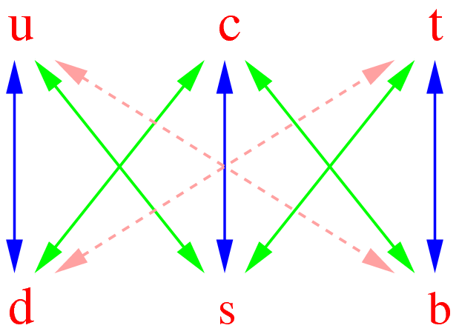
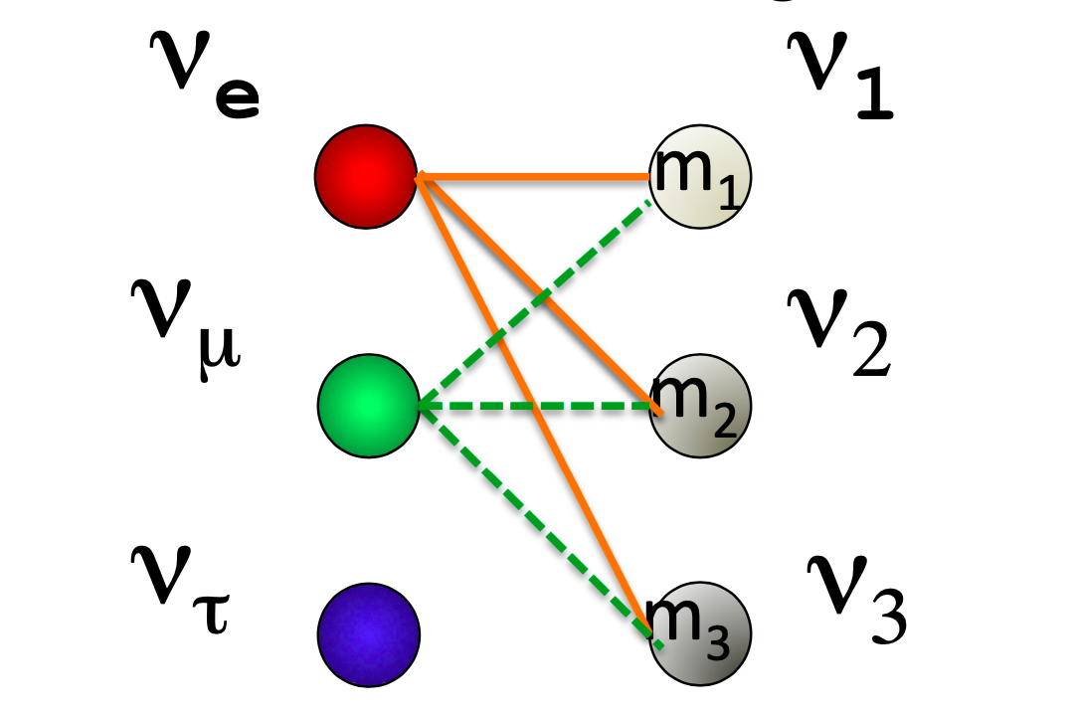

Why μ → e Conversion?
We know since long time ago that quarks mix violating flavor
conservation
(CKM matrix)
We know since few years that also neutrinos mix violating neutral lepton flavor conservation
(PMNS matrix)
Why should not charged leptons mix?
Charged Lepton Flavor Violation

Slide 3
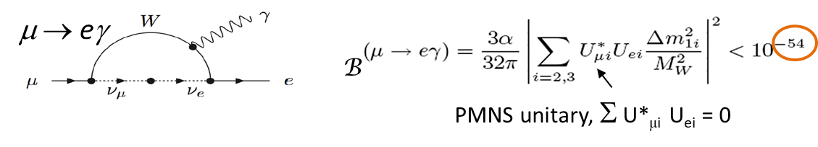
What we know about CLFV?
CLFV is forbidden in the SM, since charged lepton number is accidentally conserved when neutrinos are massless.
But…
CLFV can arise at loop level in the SM with massive neutrinos, but the rates are extremely suppressed due to the GIM mechanism and the tiny neutrino masses
Petcov, Marciano, Shandra, Lee, Shrock, ….

Slide 4
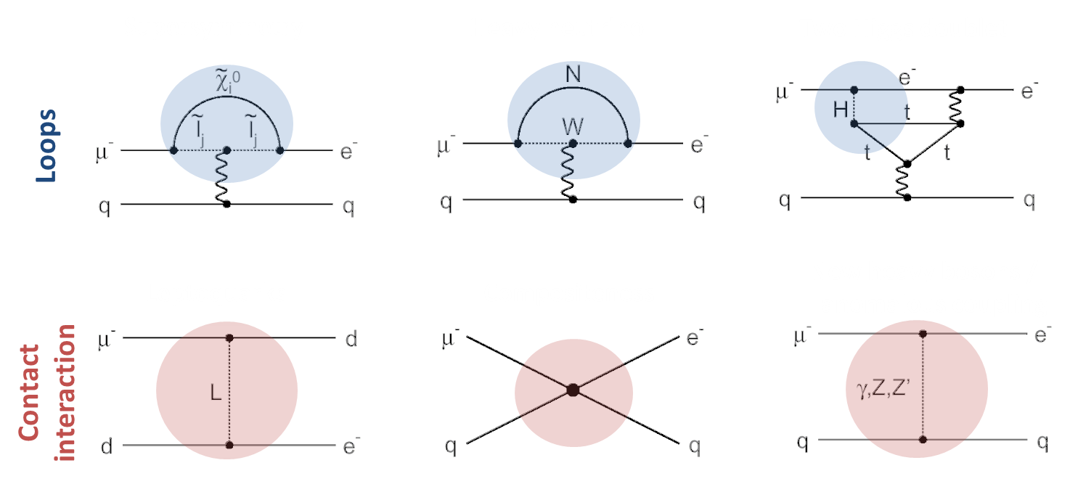
What we know about CLFV?
Many BSM theories could greatly enhance CLFV effects and predict rates close to the sensitivity of the current generation of experiments (10⁻¹⁷ – 10⁻¹⁵)
Supersymmetry
Heavy neutrino
Two Higgs doublet
Leptoquark
Compositness
New heavy boson
See e.g. Calibbi et al., JHEP 1211 (2012) 40; Hambye, NPB 248 (2014) 13; Lee et al., PRD 88 (2013) 093010; Arnold et al., PRD 88 (2013) 035009; P. Pattori. EPJC 75 (2015) 579

Slide 5
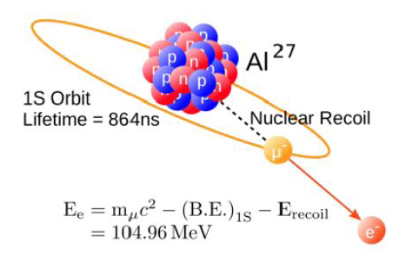
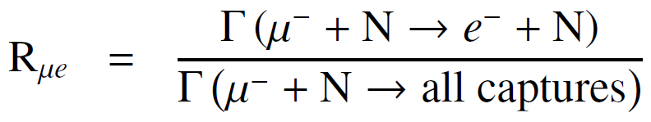
Scientific Objectives of the Mu2e Experiment
μ⁻N→e⁻N process
The conversion signal is an almost monochromatic electron of ~105 MeV
Muonic aluminum lifetime is ~864 ns
Improve by a factor 10⁴ the sensitivity on:
Current limit (SINDRUM II @PSI using an Au target, 2006)*:
Rμe<7·10⁻¹³ (90% CL)
There are BSM models predicting Rμe O(10⁻¹⁵)
Good discovery Potential !
*W. Bertl et al., Eur.Phys.J. C47,337 (2006)

Slide 6




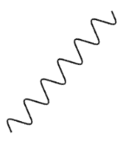
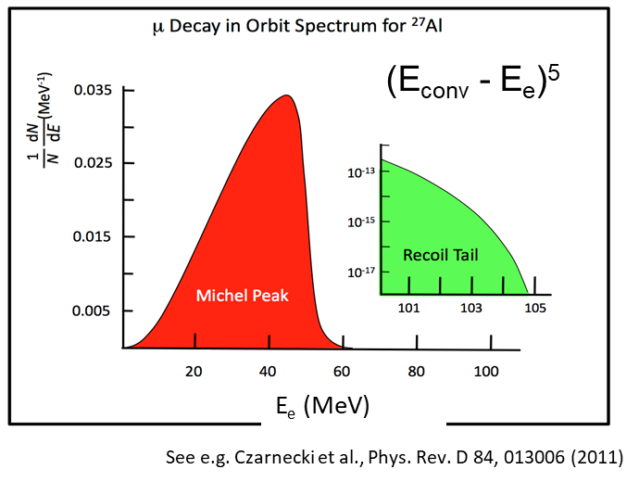
Experimental Concept
Produce beam of muons via pions decay by hitting protons on target
Collect and stop low momentum muons in stopping target
Muons are captured and cascade to K shell firing off X-rays
Measure X-rays spectrum to estimate the number of captures
The muon circles the nucleus and will
Convert into an electron, the signal is a mono-energetic electron with E_{me}= 104.973 MeV
Be captured by the nucleus (~61% for Al)
The excited nucleus can emit particle that will
produce background electrons
Decay in orbit (~39% for Al). The free muon spectrum (Michel spectrum)
is distorted by the presence of the nucleus and the electron can be at the
conversion energy
²⁷Al
²⁷Mg*
ν_{μ}
p
n

Slide 7
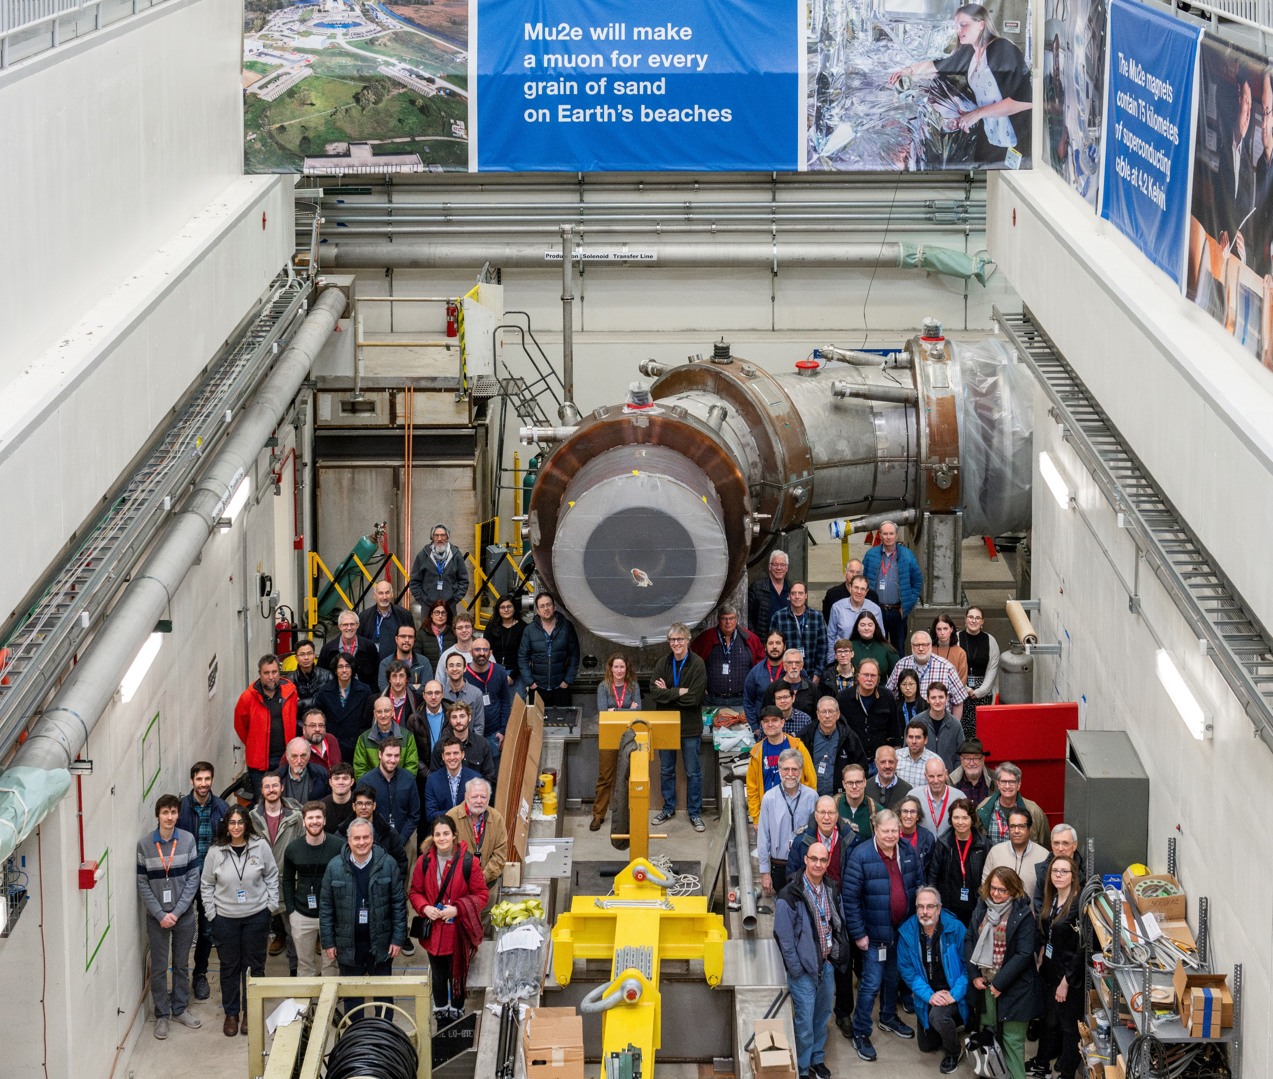







The Mu2e Collaboration
Over 200 scientists from 40 institutions
Co-spokespersons:
Bob Bernstein
Stefano Miscetti
Welcome
Bienvenue

Slide 8
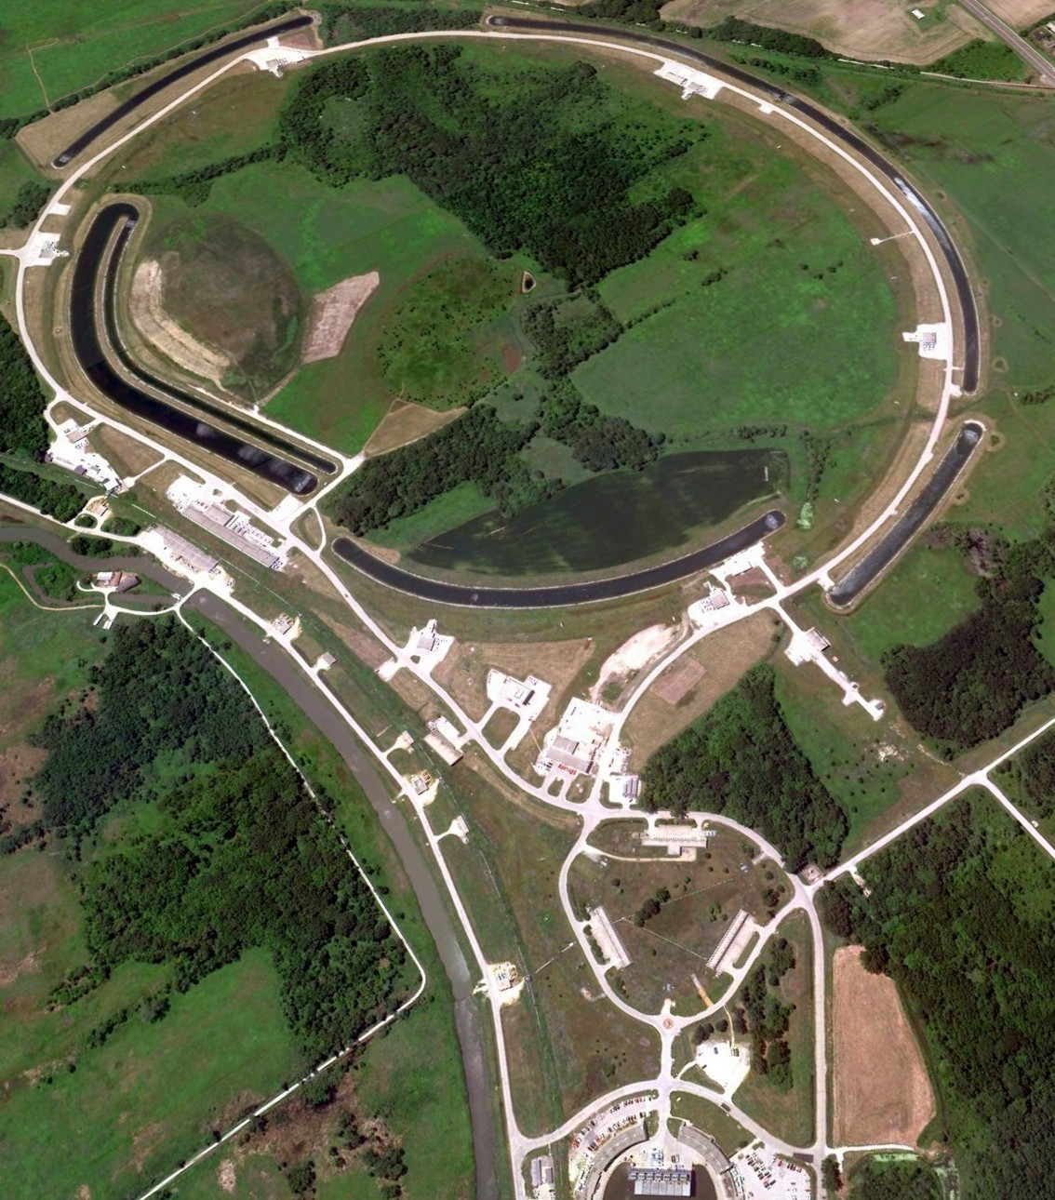
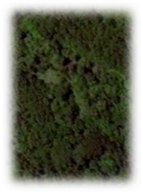



Fermilab Accelerator
Linac 0 → 400 MeV
Booster 400 MeV → 8 GeV
Recycler re-bunches protons
Delivery Ring slow extracts protons
Mu2e production target produce pions
Recycler Ring
Delivery Ring
Mu2e
Booster Ring
g-2

Slide 9
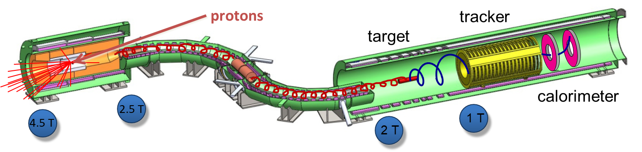
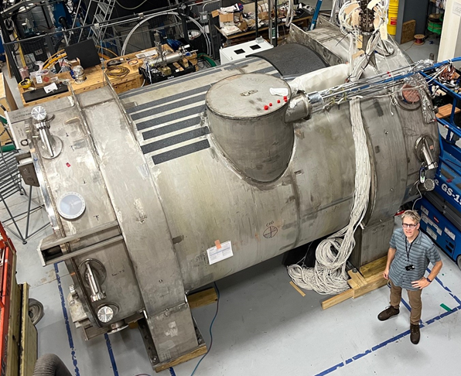
The Mu2e Experiment (1)
Production Target / Solenoid:
Proton beam strikes target, producing mostly pions
decaying to muons
Graded magnetic field contains pions/muons and
collimate them into the transport solenoid → high
muons intensity
Extinction monitor downstream of the target to monitor primary proton beam

Slide 10
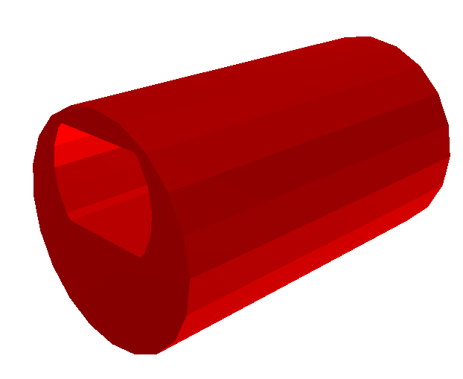
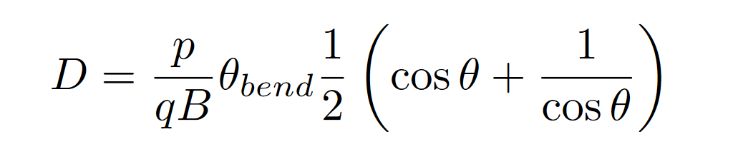
The Mu2e Experiment (2)
Transport Solenoid (TS)
  Collimator selects low momentum, negative muons
  Antiproton absorber
  The S shape eliminates photons and neutrons, and restore beam at center of detector magnet
The center of the helical trajectory in a curved solenoidal field drifts vertically as
Oppositely charged muons drift in opposite directions
→ collimator to select specific charge

Slide 11
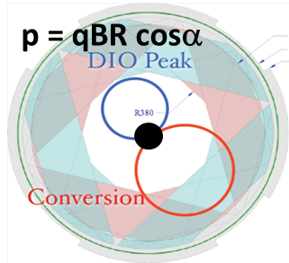
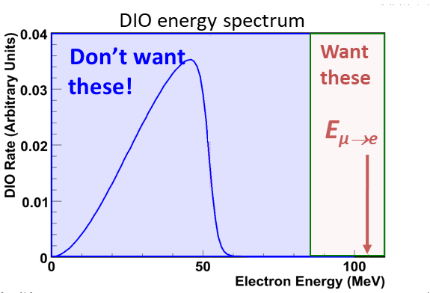
The Mu2e Experiment (3)
Target, Detector and Solenoid (DS)
  Capture muons on Al target
  Graded magnetic field “reflects” conversion electrons, improving efficiency
  Annular detector let low-momentum particles (beam flash, DIO,…) go through w/o interacting

Slide 12
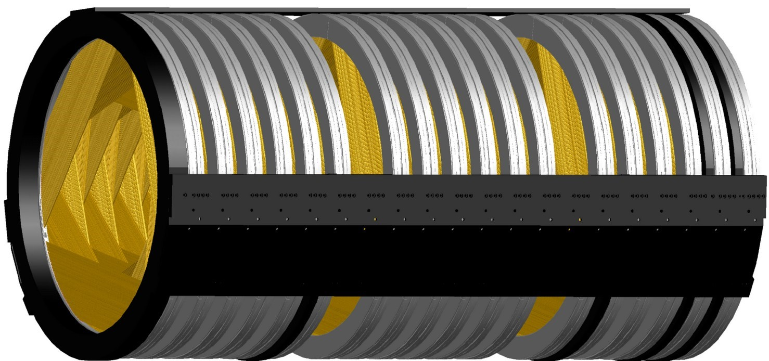
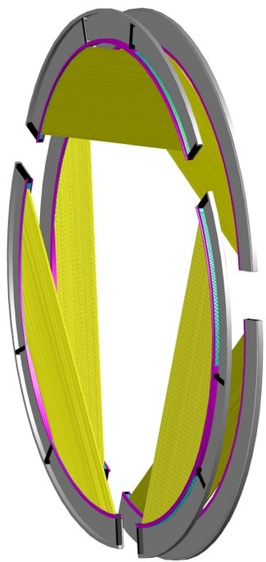
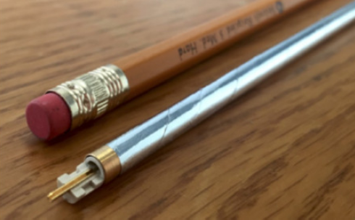
Mu2e Tracking
1620
mm
3196
mm
The electron tracker is low mass straw tube design
with 18 station of tubes transverse to the
secondary beam, with 21 000 straws in total.
It provides precision momentum measurement.
Expect completion and installation by Fall 2025

Slide 13
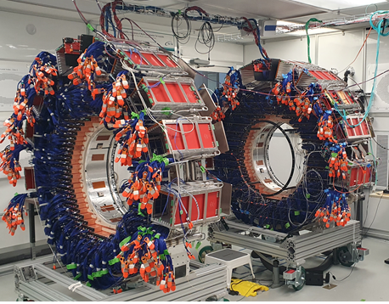
Mu2e Calorimeter
CsI crystal calorimeter
  Two annular disks separated by 70 cm
  (half the “conversion wavelength”)
  674 pure CsI crystals per disk read out by two SiPMs
  Provide e/μ separation, photon and conversion trigger,
  input to pattern recognition
  Two disks are built, installation in Mu2e Hall soon.

Slide 14
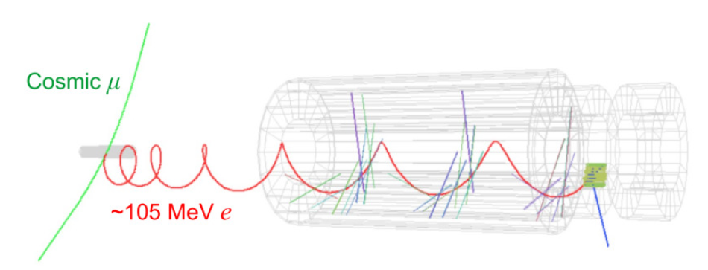
Cosmic Ray Background
About 1 cosmic event/day can mimic a 105 MeV electron

Slide 15
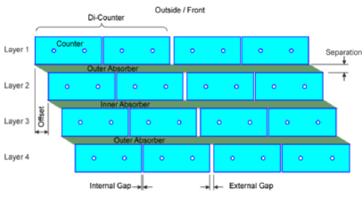
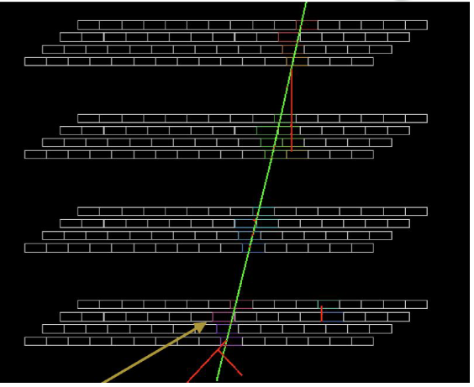
Mu2e Cosmic Ray Veto (CRV)
3 out of 4 layers
provide a veto efficiency >99.99%
4 layers of scintillator counter modules read by WLS and SiPMs
CRV cover DS and Lower TS

Slide 16
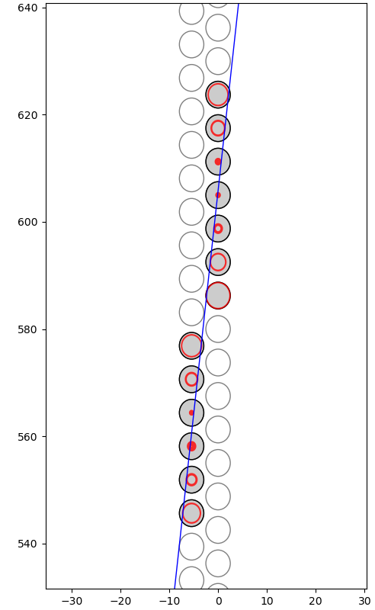
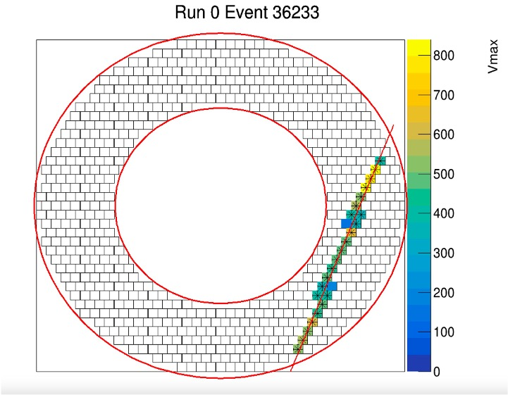
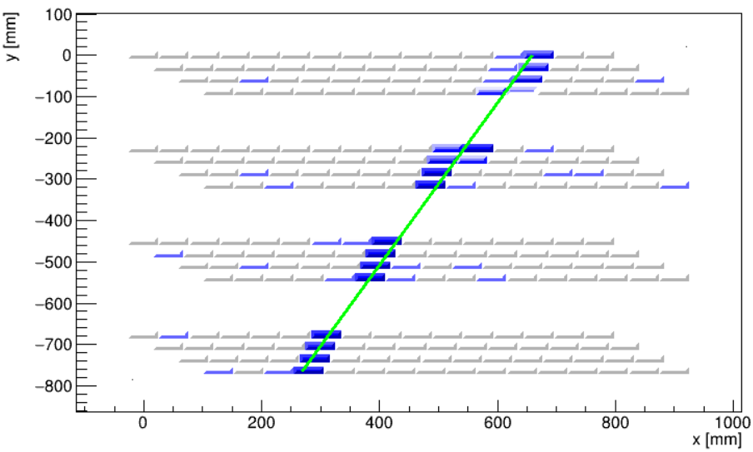
Cosmic Ray Tests
Examples of event displays of cosmic ray tracks as seen at different detector’s test stations: (Left) Tracker station, (Middle) Calorimeter disk, and (right) CRV test station.

Slide 17
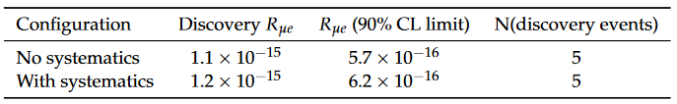
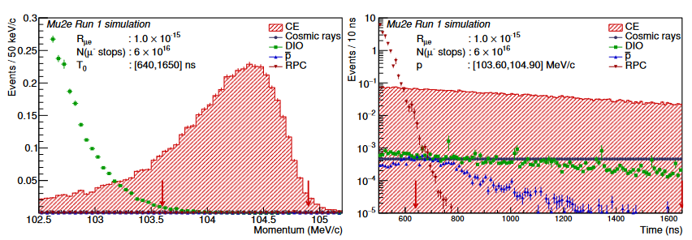
Mu2e Sensitivity Projections
Mu2e - Run 1 sensitivity estimate*
  Recent study based on about 10% of the total data that we will ultimately collect
  Expected sensitivity and 5σ discovery potential, including systematics
  A 5σ discovery will require Mu2e to observe just 5 events of muon conversion
Improve sensitivity
by x1000
over SINDRUM II
In the first running phase
(data taking scheduled
to start at
the beginning of 2027)
Also see “Mu2e-II: Muon to electron conversion with PIP-II”,
arxiv: 2203.07569
*See “Mu2e Run I Sensitivity Projections for ... Search in Aluminum”, Universe 9 (2023) 1, 54, arxiv:2210.11380

Slide 18
Summary and Conclusion
Mu2e detector installation in Mu2e hall has started.
Mu2e tracker and calorimeter will be installed in the detector hall in 2025.
Detector commissioning without magnetic field and beam will start in 2025.
First beam expected early 2027.
First Mu2e run aims to improve Sindrum II result by a factor 10³.
Accelerator shutdown for neutrino beam upgrade expected in 2028.
A second Mu2e run, starting after shutdown, will have higher average beam intensity, aiming to achieve the final 10⁴ improvement goal.
A Mu2e upgrade proposal (Mu2e II) has been inserted in the Snow Mass white paper: it aims to exploit the higher intensity and lower energy PIP-II proton beam to obtain a further x10 improvement in sensitivity to muon conversion

Slide 19
THANK YOU

Slide 20
Backup Slides

Slide 21
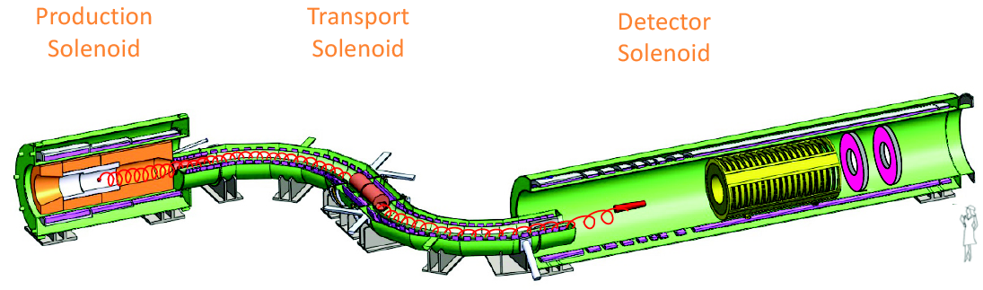
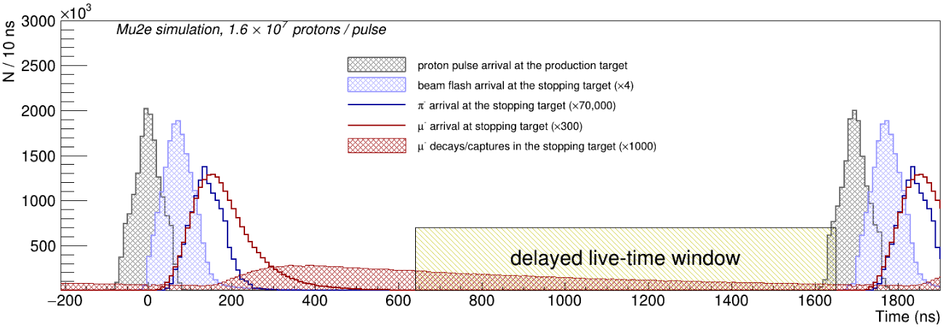
The pulsed proton beam structure
Full Beam intensity:
3.9 ·10⁷ p/pulse
(±50%)
Analysis
window starts
~700 ns
after the pulse
to suppress
prompt
backgrounds
Extinction
Factor <10⁻¹⁰
(fraction of protons
out of bunch)
Pulsed Proton Beam Structure:
Proton pulse period: 1.695 μs ~ 2τ_{μ}^{Al} (τ_{μ}^{Al} = 864 ns)
Delayed analysis window to suppress prompt backgrounds
Out of bunch proton fraction (“extinction factor”) < 10⁻¹⁰
(measured by an extinction monitor downstream of the beam)

Slide 22
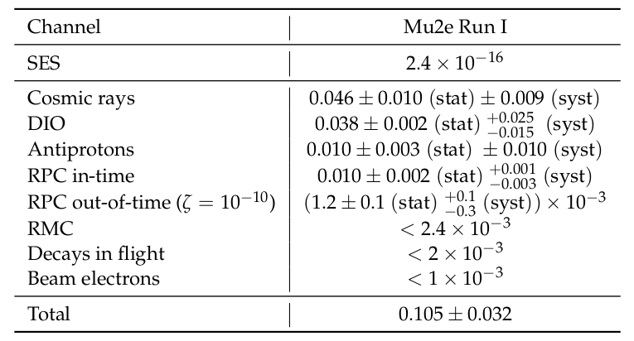
Mu2e expected backgrounds for Run 1 (assuming 6·10¹⁶ stopped muons,
mostly at half proton beam intensity*)
* More details in “Mu2e Run I Sensitivity Projections for the Neutrinoless mu- --> e- Conversion
Search in Aluminum”, Universe 9 (2023) 1, 54 (38 pages)
http://arxiv.org/abs/2210.11380

Slide 23
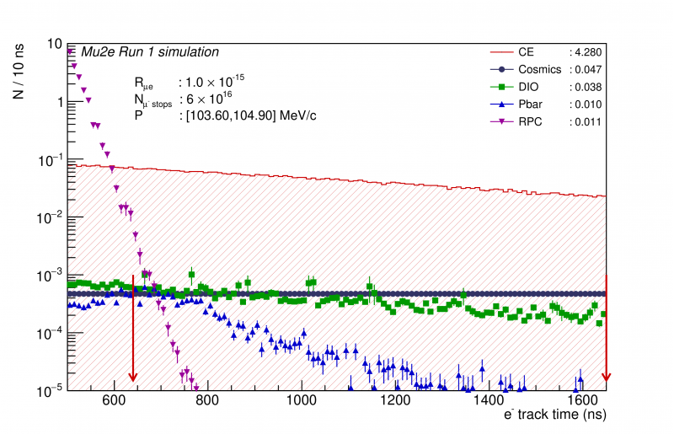
Radiative Pion Capture Suppression
Radiative Pion Captures (RPC) in the Al target producing photons converting in e⁺e pairs can be suppressed by a time window cut
Also delayed pions coming from antiproton annihilation can be suppressed
Time and momentum windows optimized to get the best discovery sensitivity

Slide 24
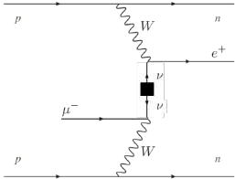
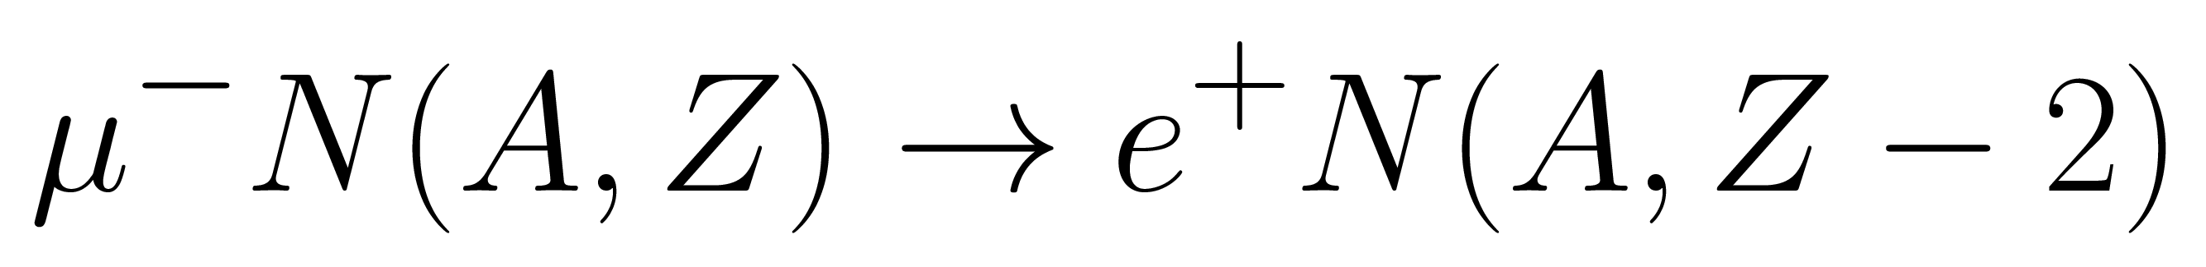
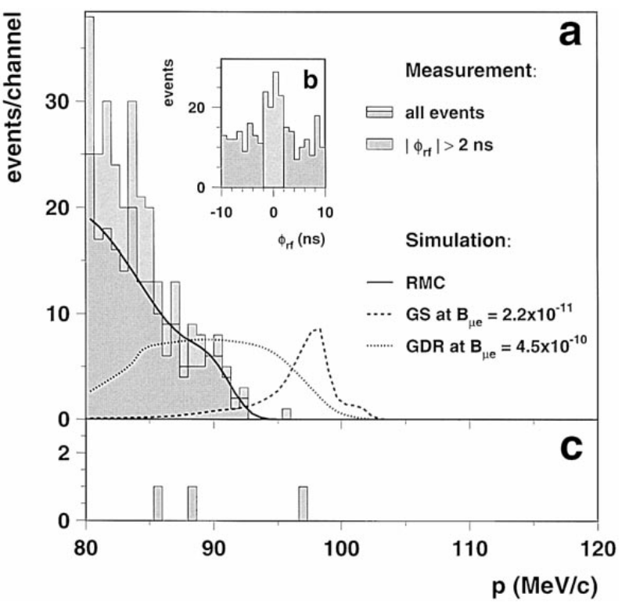
μ-→ e+ expected sensitivity
Mu2e will also be able to search for the CLFV and lepton number (ΔL=2) violating process:
The current limit on Rμe+ is 1.7·10⁻¹² (Sindrum II ‘98).
Also for this channel if the error is dominated by signal statistics Mu2e should achieve a factor 10³ improvement in Run 1 and a factor 10⁴ after Run 2

Slide 25
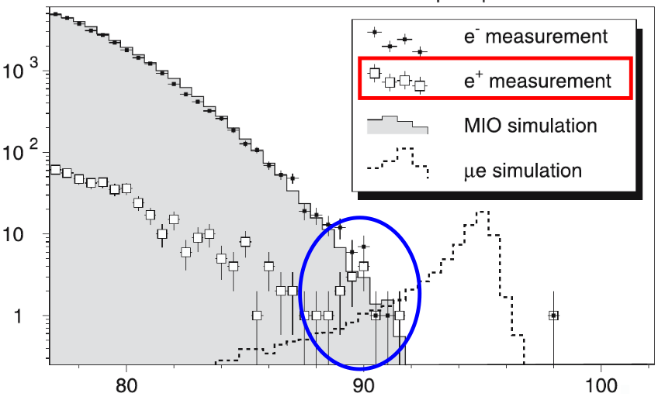
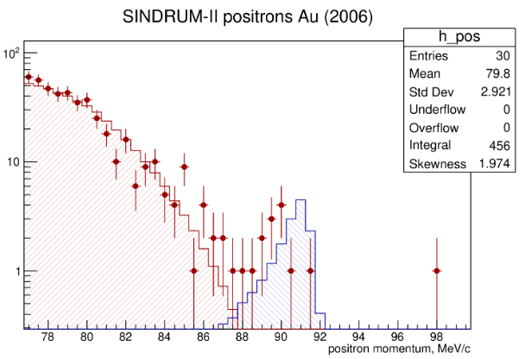
μ-→ e+ possible limitation to sensitivity
Sindrum II μ⁻→e⁻ 2006 paper also shows the positron spectrum (not elsewhere published):
Sindrum II μ⁻→e⁻ 2006 paper
Positron spectrum shows an unexpected bump in the signal region
An a posteriori convolution of the signal with the Sindrum II momentum resolution, including energy losses, shows that the bump is not compatible with the signal ( arXiv:2009.00214v1)
A possible explanation could be the Radiative Muon Capture (RMC)γ spectrum model.
The commonly used closure approximation:
dN/dx ∼ (1−2x+2x² )·x·(1 − x)² , x = k /kmax
assumes an end point kmax.TRIUMF data fit gives an end point lower than the kinematic limit.
arXiv:2009.00214v1

