Slide 1


Testing the Electroweak Theory in Mutliboson Measurements in ATLAS
(ATLAS public results from 2023)
Gia Khoriauli
University of Würzburg
On behalf of ATLAS Collaboration
Lake Louise Winter Institute
Lake Louise, Canada, 18-24 February 2024

Slide 2
Electroweak Multiboson Interactions
The Standard Model (SM) of elementary particles predicts triple and quartic gauge couplings between the electroweak bosons due to the non-Abelian structure of the electroweak interaction
  Experimental studies of multiboson interactions are therefore important tests of the SM electroweak theory
  Effective Field Theory (EFT) frameworks are typically used in model independent searches for new physics effects
According to the SM, the massive electroweak bosons obtain their masses and hence, can have longitudinal polarisations via the Higgs mechanism of the spontaneously broken electroweak symmetry
  Measurements of polarisation observables in the multiboson interactions are the direct probes of this mechanism
The latest measurements and first observations of the production of different multiboson final states in the ATLAS detector are presented

Slide 3

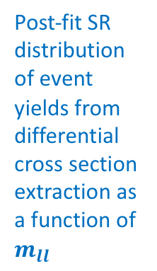

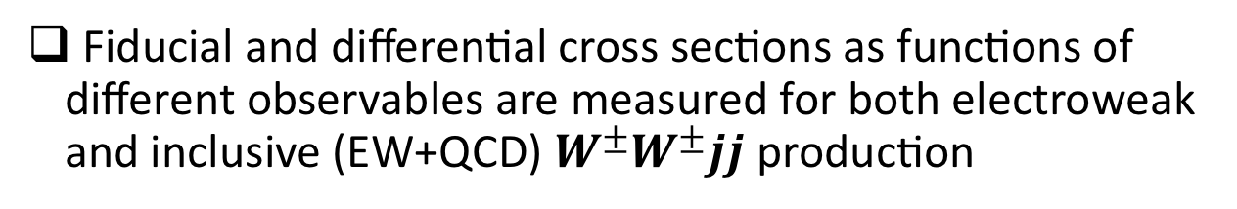
Same Sign $W^{±}W^{±}jj$ Measurement
arXiv:2312.00420
$\sqrt{s}=13 TeV$, ${139 fb}^{−1}$
$W^{±}W^{±}jj$ has the largest ratio of the electroweak to QCD production cross sections among all vector boson scattering (VBS) sensitive $VVjj$ final states
  As the QCD leading order diagrams with initial gluons are forbidden
Fiducial and differential cross sections as functions of different observables are measured for both electroweak and inclusive (EW+QCD) $W^{±}W^{±}jj$production
Post-fit SR distribution of event yields from differential cross section extraction as a function of $m_{ll}$
Good agreement is found for the fiducial cross sections with the SM predictions

Slide 4
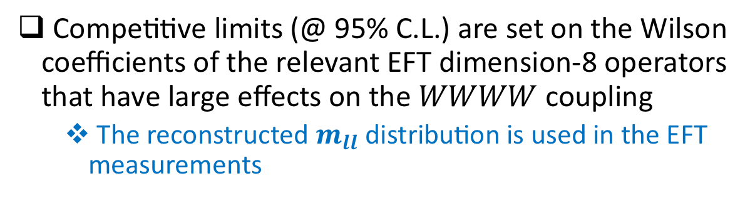
Same Sign $W^{±}W^{±}jj$ Measurement
Competitive limits (@ 95% C.L.) are set on the Wilson coefficients of the relevant EFT dimension-8 operators that have large effects on the $WWWW$ coupling
  The reconstructed $m_{ll}$ distribution is used in the EFT measurements

Slide 5

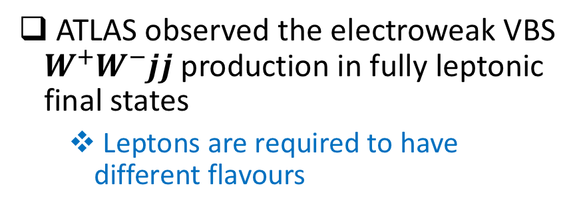
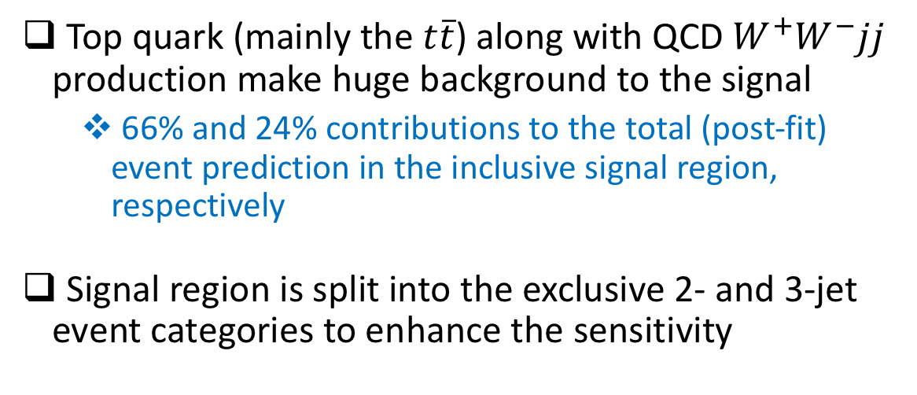
Observation of Opposite Sign $W^{+}W^{−}jj$
ATLAS-CONF-2023-039
$\sqrt{s}=13 TeV$, ${140 fb}^{−1}$
ATLAS observed the electroweak VBS $W^{+}W^{−}jj$production in fully leptonic final states
  Leptons are required to have different flavours
Top quark (mainly the $t\overline{t}$) along with QCD $W^{+}W^{−}jj$ production make huge background to the signal
  66% and 24% contributions to the total (post-fit) event prediction in the inclusive signal region, respectively
Signal region is split into the exclusive 2- and 3-jet event categories to enhance the sensitivity
Control region for the top quark background is defined by requiring one of the two leading jets to be b-tagged

Slide 6
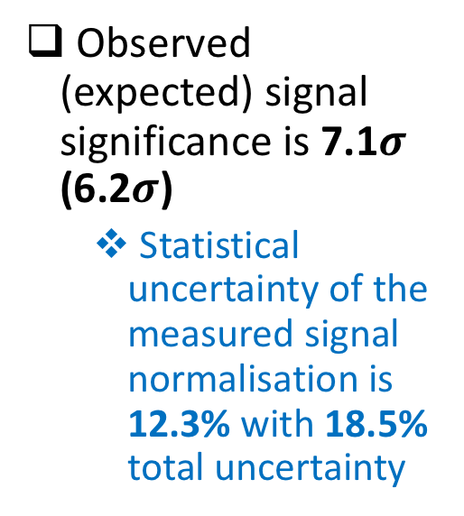
Observation of Opposite Sign $W^{+}W^{−}jj$
Neural Network based discriminant is used to distinguish the signal from background
  Signal, top quark and QCD background events are used in the NN training
Profile-likelihood fit method is used to fit simultaneously the signal, top and QCD background normalisations in the NN output in the 1 control and 2 signal regions
Observed (expected) signal significance is 7.1$σ$ (6.2$σ$)
  Statistical uncertainty of the measured signal normalisation is 12.3% with 18.5% total uncertainty
Signal fiducial cross section is measured to ${2.65}_{−0.48}^{+0.52} fb$ vs. predicted ${2.20}_{−0.13}^{+0.14} fb$
  Fiducial volume defined closely to detector level selection but requiring $m_{jj}>500 GeV$

Slide 7
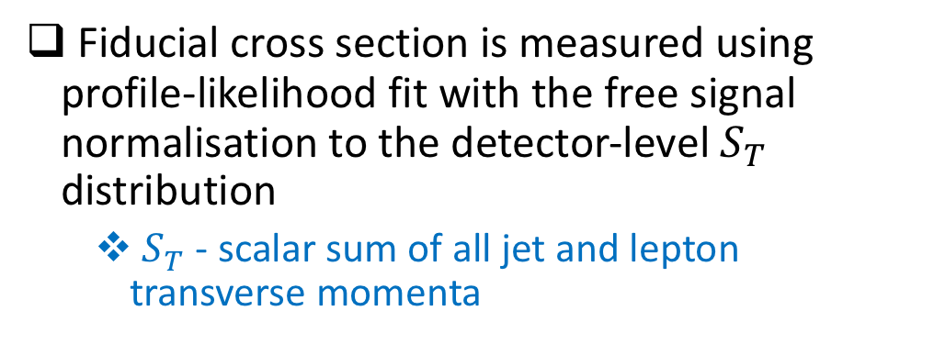

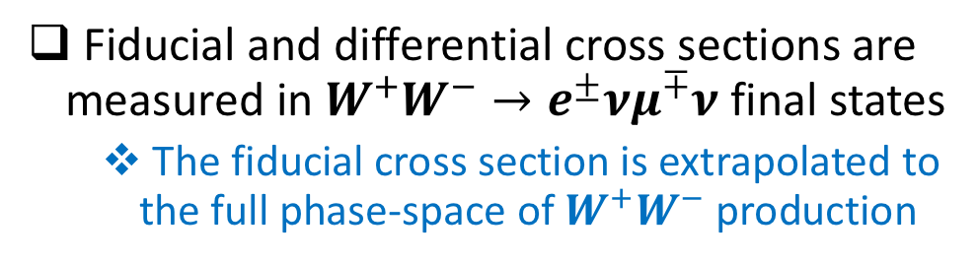
Opposite Sign $W^{+}W^{−}$ Cross-Sections
ATLAS-CONF-2023-012
$\sqrt{s}=13 TeV$, ${140 fb}^{−1}$
Fiducial and differential cross sections are measured in $W^{+}W^{−}→e^{±}{νμ}^{∓}ν$ final states
  The fiducial cross section is extrapolated to the full phase-space of $W^{+}W^{−}$ production
Provides ~5% contibution in the $WW$ production rate
Top-quark background is precisely estimated in bins of the signal region with the help of two dedicated control regions
  Defined by requiring exactly 1 and exactly 2 b-jets, respectively
  No constraints on the jet multiplicity
Fiducial cross section is measured using profile-likelihood fit with the free signal normalisation to the detector-level $S_{T}$ distribution
  $S_{T}$ - scalar sum of all jet and lepton transverse momenta

Slide 8
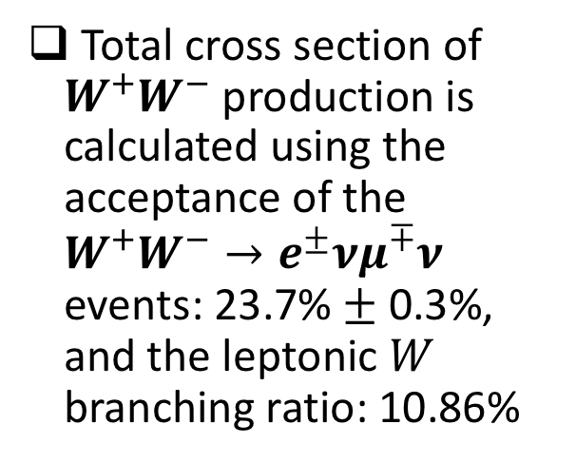

Opposite Sign $W^{+}W^{−}$ Cross-Sections
Fiducial cross section is measured with the 3.1% (!) total uncertainty
  Excellent agreement with the MATRIX 2.0.1 prediction at nNNLO in QCD
Total cross section of $W^{+}W^{−}$ production is calculated using the acceptance of the $W^{+}W^{−}→e^{±}{νμ}^{∓}ν$ events: 23.7% $±$ 0.3%, and the leptonic $W$ branching ratio: 10.86%
Differential cross sections are measured for twelve observables
  Iterative Bayesian unfolding used
  Good agreement with predictions observed
NNLO $qq→WW$ + NLO $gg→WW$

Slide 9
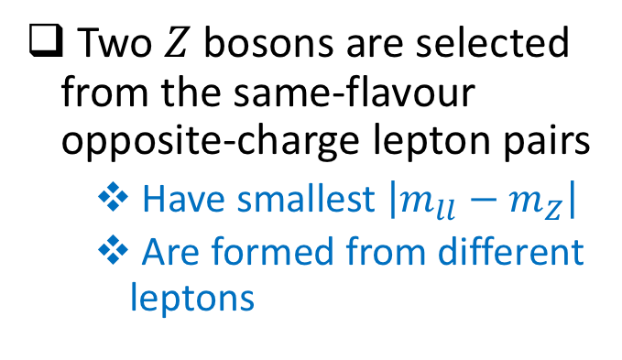
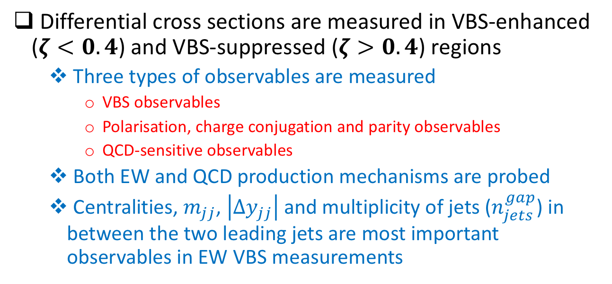
$ZZ(→4l)jj$ Differential Cross Sections
JHEP 01 (2024) 004
$\sqrt{s}=13 TeV$, ${140 fb}^{−1}$
Differential cross sections are measured in VBS-enhanced ($ζ<0.4$) and VBS-suppressed ($ζ>0.4$) regions
  Three types of observables are measured
    VBS observables
    Polarisation, charge conjugation and parity observables
    QCD-sensitive observables
  Both EW and QCD production mechanisms are probed
  Centralities, $m_{jj}$, $\left|∆y_{jj}\right|$ and multiplicity of jets ($n_{jets}^{gap}$) in between the two leading jets are most important observables in EW VBS measurements
Two $Z$ bosons are selected from the same-flavour opposite-charge lepton pairs
  Have smallest $\left|m_{ll}−m_{Z}\right|$
  Are formed from different leptons

Slide 10
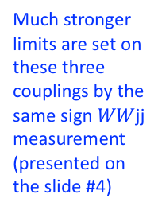
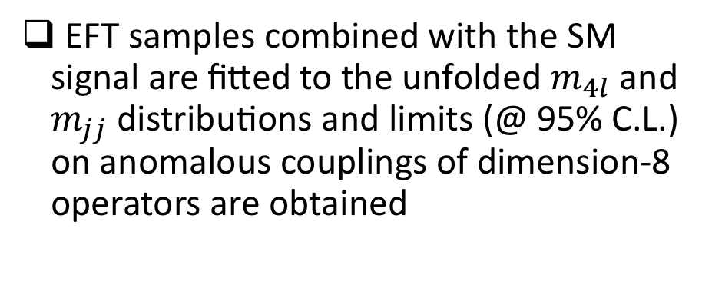
$ZZ(→4l)jj$ Differential Cross Sections
Iterative Bayesian unfolding is used to measure differential cross sections
EFT samples combined with the SM signal are fitted to the unfolded $m_{4l}$ and $m_{jj}$ distributions and limits (@ 95% C.L.) on anomalous couplings of dimension-8 operators are obtained
Much stronger limits are set on these three couplings by the same sign $WW$jj measurement (presented on the slide #4)

Slide 11
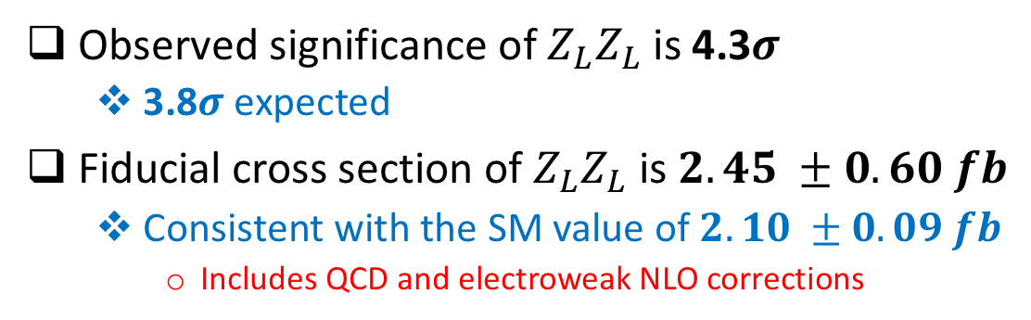
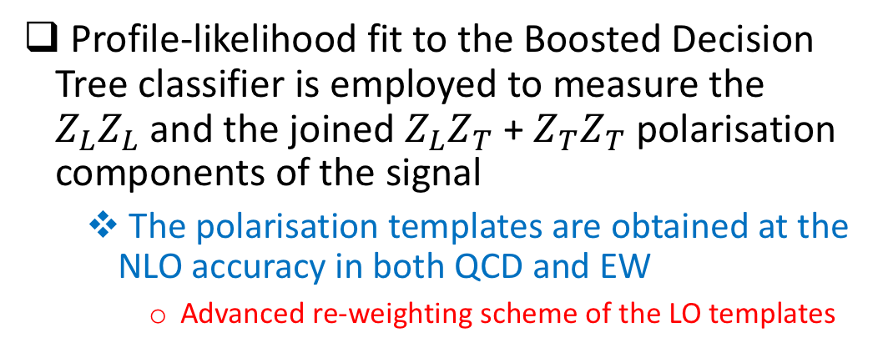
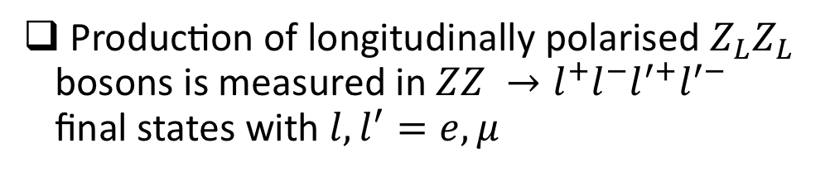
$ZZ→4l$ Polarisation and CP Properties
JHEP 12 (2023) 107
$\sqrt{s}=13 TeV$, ${140 fb}^{−1}$
Production of longitudinally polarised $Z_{L}Z_{L}$ bosons is measured in $ZZ →l^{+}l^{−}l^{′+}l^{′−}$ final states with ${l,l}^{′}=e,μ$
Profile-likelihood fit to the Boosted Decision Tree classifier is employed to measure the $Z_{L}Z_{L}$ and the joined $Z_{L}Z_{T}$ + $Z_{T}Z_{T}$ polarisation components of the signal
  The polarisation templates are obtained at the NLO accuracy in both QCD and EW
    Advanced re-weighting scheme of the LO templates
Observed significance of $Z_{L}Z_{L}$ is 4.3$σ$
  3.8$σ$ expected
Fiducial cross section of $Z_{L}Z_{L}$ is $2.45 ±0.60 fb$
  Consistent with the SM value of $2.10 ±0.09 fb$
    Includes QCD and electroweak NLO corrections

Slide 12
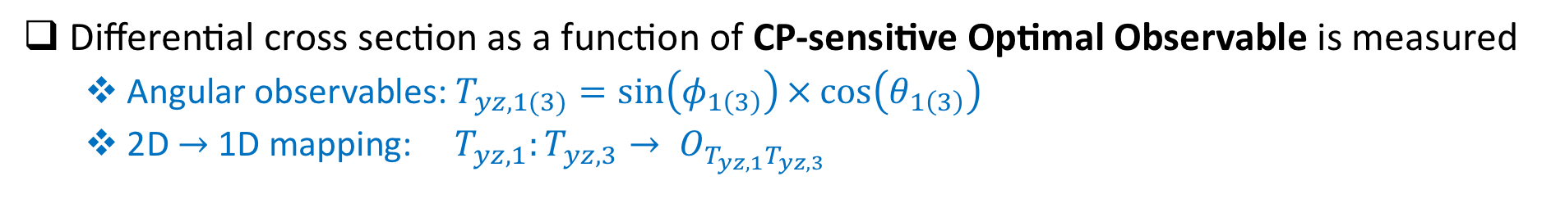
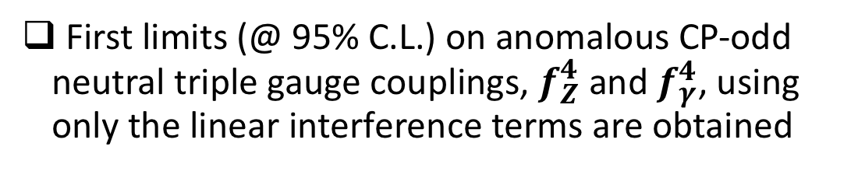
$ZZ→4l$ Polarisation and CP Properties
Differential cross section as a function of CP-sensitive Optimal Observable is measured
  Angular observables: $T_{yz,1(3)}=\sin\left(φ_{1\left(3\right)}\right)×\cos\left(θ_{1\left(3\right)}\right)$
  2D $→$ 1D mapping: $T_{yz,1}:T_{yz,3}→ O_{T_{yz,1}T_{yz,3}}$
First limits (@ 95% C.L.) on anomalous CP-odd neutral triple gauge couplings, $f_{Z}^{4}$ and $f_{γ}^{4}$, using only the linear interference terms are obtained

Slide 13



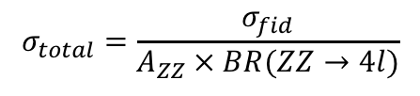
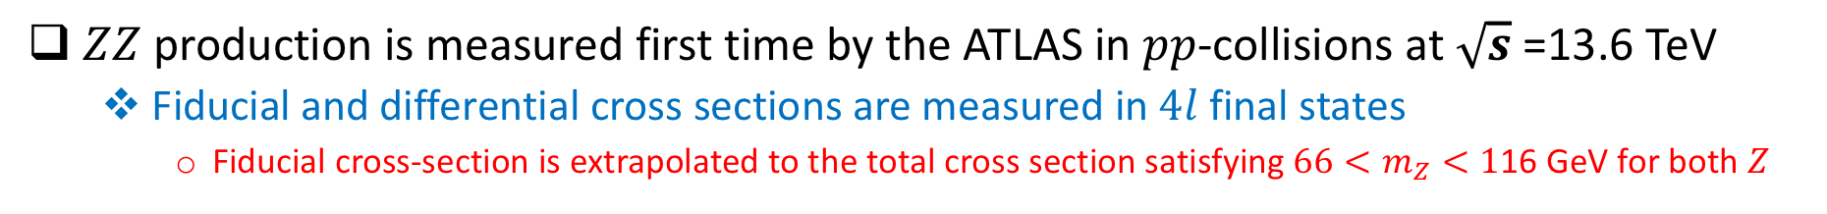
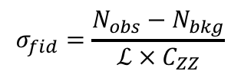

$ZZ→4l$ Cross Sections at $\sqrt{s}$ =13.6 TeV
arXiv:2311.09715
$\sqrt{s}=13.6 TeV$, ${29 fb}^{−1}$
$ZZ$ production is measured first time by the ATLAS in $pp$-collisions at $\sqrt{s}$=13.6 TeV
  Fiducial and differential cross sections are measured in $4l$ final states
    Fiducial cross-section is extrapolated to the total cross section satisfying $66<m_{Z}<1$16 GeV for both $Z$
Cut-and-count approach is used
Iterative Bayesian unfolding is used
$$σ_{fid}=\frac{N_{obs}−N_{bkg}}{ℒ ×{ C}_{ZZ}}$$
$$C_{ZZ}=0.555±0.022$$
$$σ_{total}=\frac{σ_{fid}}{A_{ZZ} × BR(ZZ→4l)}$$
$$A_{ZZ}=0.482±0.003$$
MATRIX calculations @
nNNLO QCD $⊗$ NLO EW

Slide 14
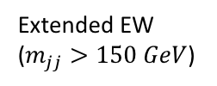
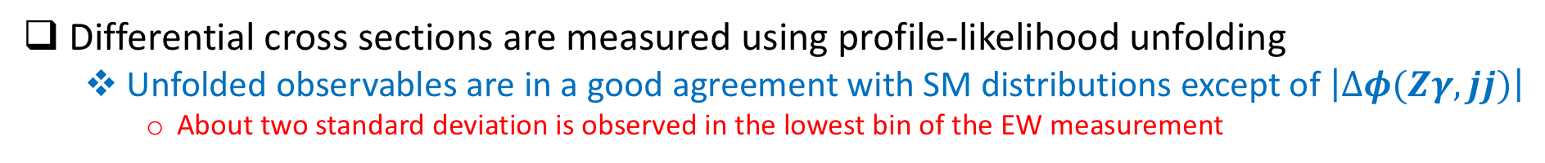
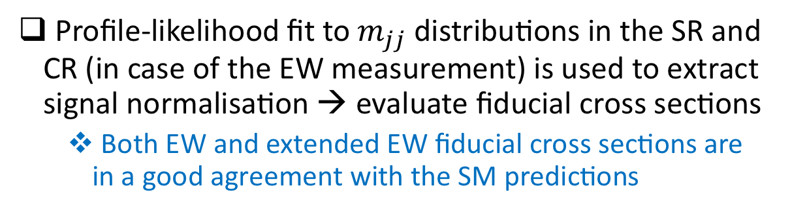
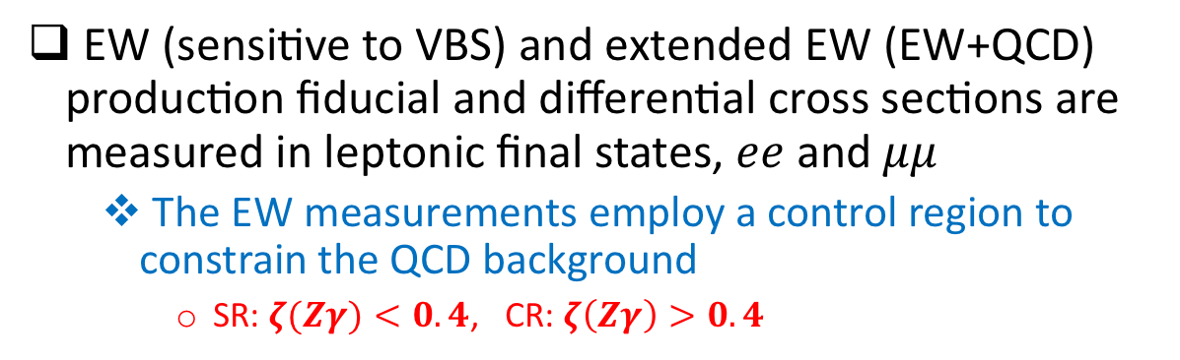
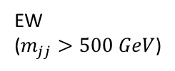
$Zγjj$ Measurement
Phys. Lett. B 846 (2023) 138222
$\sqrt{s}=13 TeV$, ${140 fb}^{−1}$
EW (sensitive to VBS) and extended EW (EW+QCD) production fiducial and differential cross sections are measured in leptonic final states, $ee$ and $μμ$
  The EW measurements employ a control region to constrain the QCD background
    SR: $ζ(Zγ)<0.4$, CR: $ζ\left(Zγ\right)>0.4$
Profile-likelihood fit to $m_{jj}$ distributions in the SR and CR (in case of the EW measurement) is used to extract signal normalisation → evaluate fiducial cross sections
  Both EW and extended EW fiducial cross sections are in a good agreement with the SM predictions
EW
($m_{jj}>500 GeV$)
Extended EW ($m_{jj}>150 GeV$)
Differential cross sections are measured using profile-likelihood unfolding
  Unfolded observables are in a good agreement with SM distributions except of $\left|∆φ(Zγ,jj)\right|$
    About two standard deviation is observed in the lowest bin of the EW measurement

Slide 15

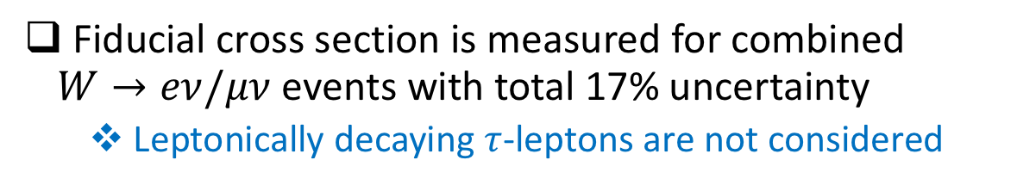
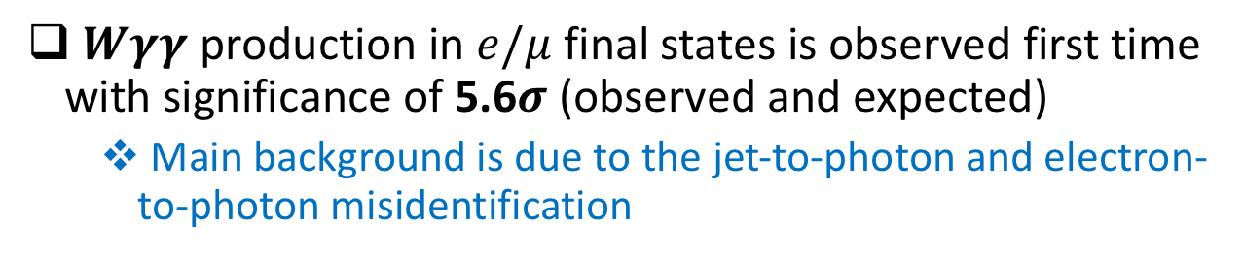
Observation of $Wγγ$
Phys. Lett. B 848 (2024) 138400
$\sqrt{s}=13 TeV$, ${140 fb}^{−1}$
$Wγγ$ production in $e/μ$ final states is observed first time with significance of 5.6$σ$ (observed and expected)
  Main background is due to the jet-to-photon and electron-to-photon misidentification
$$σ_{fid}^{e/μ}=\frac{N_{signal}}{ℒ × C}$$
Fiducial cross section is measured for combined $W→eν/μν$ events with total 17% uncertainty
  Leptonically decaying $τ$-leptons are not considered

Slide 16
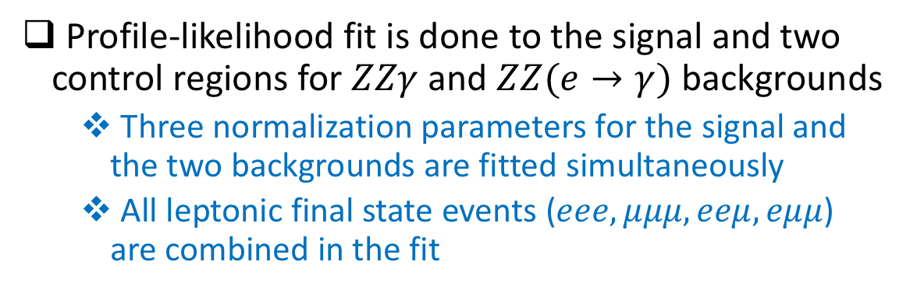
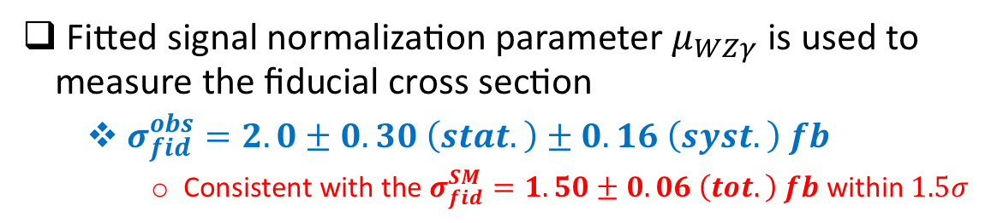
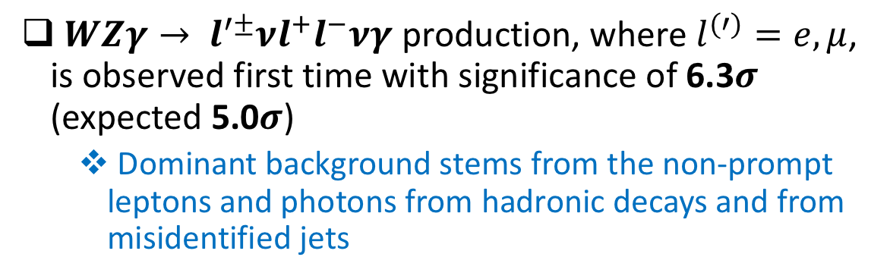
Observation of $WZγ$
Phys. Rev. Lett. 132 (2024) 021802
$\sqrt{s}=13 TeV$, ${140 fb}^{−1}$
$WZγ→ l^{′±}νl^{+}l^{−}νγ$ production, where $l^{(′)}=e,μ$, is observed first time with significance of 6.3$σ$ (expected 5.0$σ$)
  Dominant background stems from the non-prompt leptons and photons from hadronic decays and from misidentified jets
Profile-likelihood fit is done to the signal and two control regions for $ZZγ$ and $ZZ(e→γ)$ backgrounds
  Three normalization parameters for the signal and the two backgrounds are fitted simultaneously
  All leptonic final state events ($eee, μμμ, eeμ, eμμ$) are combined in the fit
Fitted signal normalization parameter $μ_{WZγ}$ is used to measure the fiducial cross section
  $σ_{fid}^{obs}=2.0±0.30 \left(stat.\right)±0.16 \left(syst.\right) fb$
    Consistent with the $σ_{fid}^{SM}=1.50±0.06 \left(tot.\right) fb$ within $1.5σ$

Slide 17
Summary
Measurements of multiboson production processes allow to test the gauge interactions of the SM electroweak theory and its symmetry breaking mechanism
Multiboson production final states have relatively small cross sections even at the LHC energy and can be very sensitive to new physics effects leading to anomalous triple and quartic gauge couplings
First time observations and precise measurements of various multiboson production processes became possible in proton-proton collision data collected by the LHC experiments, CMS and ATLAS
Latest results of the experimental studies of multiboson interactions in the ATLAS detector were discussed
  All presented results are consistent with the Standard Model predictions within the measurement uncertainties
Thank you!

Slide 18
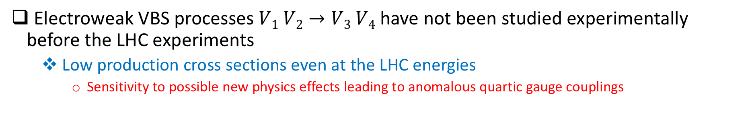
Electroweak Vector Boson Scattering
Electroweak VBS processes $V1 V2→V3 V4$ have not been studied experimentally before the LHC experiments
  Low production cross sections even at the LHC energies
    Sensitivity to possible new physics effects leading to anomalous quartic gauge couplings
VBS can involve all or some of the leading order diagrams shown below
  Depending on the involved vector bosons

Slide 19

Electroweak Vector Boson Scattering
Diagrams with Higgs boson are crucial to avoid a unitarity violation due to the rising scattering cross section of the longitudinally polarized $W$ bosons: $W_{L}W_{L}→W_{L}W_{L}$
A. Denner & T. Hahn, Nucl.Phys.B525:27-50,1998

Slide 20
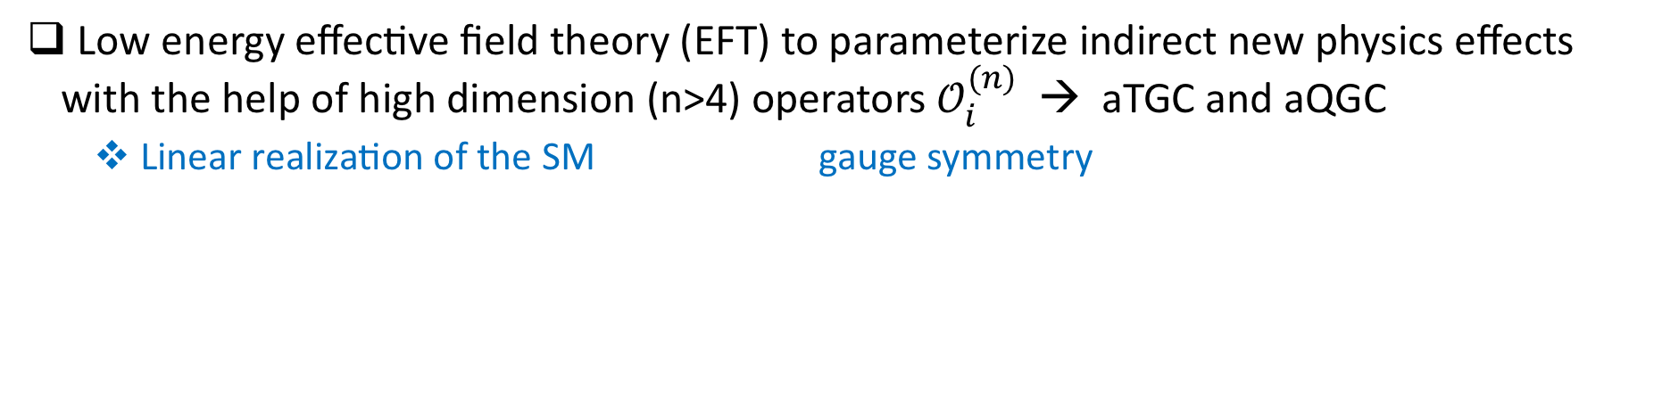
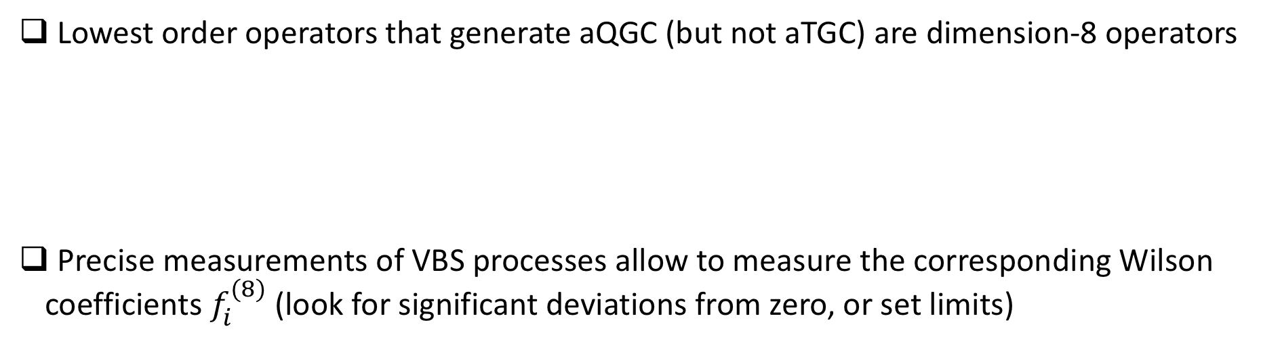
New Physics Searches – Anomalous Gauge Couplings
Low energy effective field theory (EFT) to parameterize indirect new physics effects with the help of high dimension (n>4) operators $𝒪_{i}^{(n)}$ → aTGC and aQGC
  Linear realization of the SM gauge symmetry
Eboli et al., 2020
Lowest order operators that generate aQGC (but not aTGC) are dimension-8 operators
Precise measurements of VBS processes allow to measure the corresponding Wilson coefficients $f_{i}^{(8)}$ (look for significant deviations from zero, or set limits)
Degrande et al., 2013

Slide 21
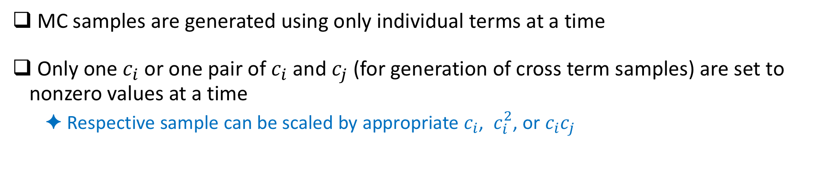
EFT Samples in EW Measurements
EFT “model” for the new physics: only dimension-8 operators have non-zero coefficients
  New physics affects only the quartic gauge couplings
Amplitude of a VBS process with EFT contributions:
Standard Model, interference, quadratic and cross terms of the total squared amplitude:
MC samples are generated using only individual terms at a time
Only one $c_{i}$ or one pair of $c_{i}$ and $c_{j}$ (for generation of cross term samples) are set to nonzero values at a time
  Respective sample can be scaled by appropriate $c_{i}$, $c_{i}^{2}$, or $c_{i}c_{j}$

Slide 22
Same Sign $W^{±}W^{±}jj$ Measurement
Monte-Carlo signal and background samples

Slide 23
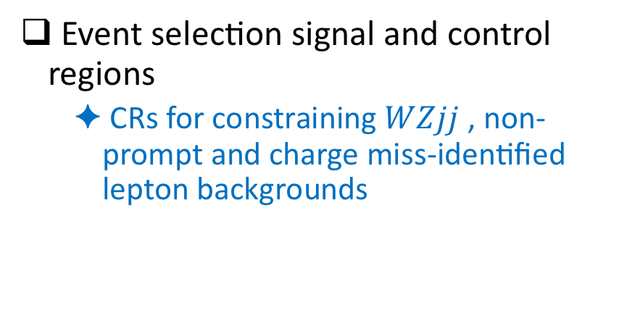
Same Sign $W^{±}W^{±}jj$ Measurement
Event selection signal and control regions
  CRs for constraining $WZjj$ , non-prompt and charge miss-identified lepton backgrounds
Data, signal and background pre-fit event yields in the SR
  Sub-regions defined by the same sign lepton flavours
    2 sub-regions for electron-muon pairs by distinguished by the leading pT lepton flavour

Slide 24
Same Sign $W^{±}W^{±}jj$ Measurement
Unfolding results obtained with maximum likelihood fit method

Slide 25
Same Sign $W^{±}W^{±}jj$ Measurement
Unfolding results obtained with maximum likelihood fit method

Slide 26
Same Sign $W^{±}W^{±}jj$ Measurement
Search for the doubly charged Higgs boson of the GM (Georgi and Machacek) model
Excess observed at the $m_{T}=450$ GeV with a local (global) significance of $3.3σ$ ($2.5σ$)

Slide 27
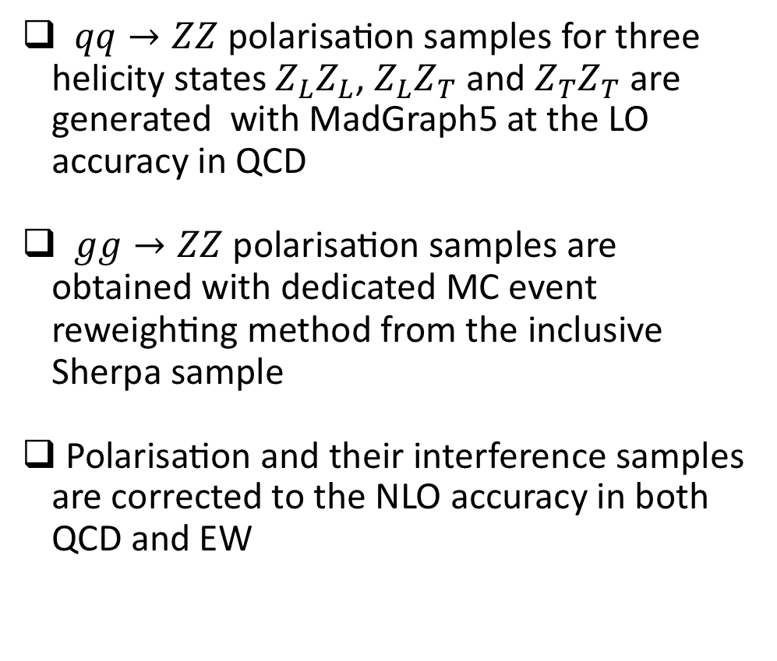
$ZZ→4l$ Polarisation and CP Properties
$qq→ZZ$ polarisation samples for three helicity states $Z_{L}Z_{L}$, $Z_{L}Z_{T}$ and $Z_{T}Z_{T}$ are generated with MadGraph5 at the LO accuracy in QCD
$gg→ZZ$ polarisation samples are obtained with dedicated MC event reweighting method from the inclusive Sherpa sample
Polarisation and their interference samples are corrected to the NLO accuracy in both QCD and EW
Boosted Decision Tree classifier is used to discriminate signal from background

Slide 28
$ZZ→4l$ Polarisation and CP Properties
Supporting material

