Slide 1

Measurements of QCD with the
Jon Butterworth
On behalf of the ATLAS collaboration
University College London
Lake Louise Winter Institute
20/2/2024
Notes:
Experiments.
Would we have found it anyway?
DIS
4l
Roman villa/cms. Traces of the SM will exist as long as there is a civilisation.

Slide 2
Motivation
“If the Large Hadron Collider finds a Higgs boson and supersymmetry, nature will have missed a golden opportunity to force us to understand strongly-interacting quantum field theories”
(M. Veltman, paraphrase, sometime in the 1990s)
Well, it did, and it didn’t. And we can take the opportunity anyway…
(Me, now)
Notes:
Not only to be open such a meeting of stars, but also to be representing the work of some many others over so many years.

Slide 3
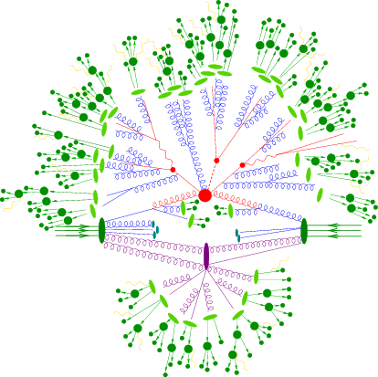
Recent Highlights
Measurement of jet substructure in boosted 𝒕 𝒕 ̄ events with the ATLAS detector using 140 fb⁻¹ of 13 TeV pp collisions
2312.03797 [hep-ex]
Measurements of Lund subjet multiplicities
STDM-2023-07
A precise determination of the strong-coupling constant from the recoil of 𝒁 bosons with the ATLAS experiment at √𝒔 = 8 TeV
2309.12986 [hep-ex]

Slide 4
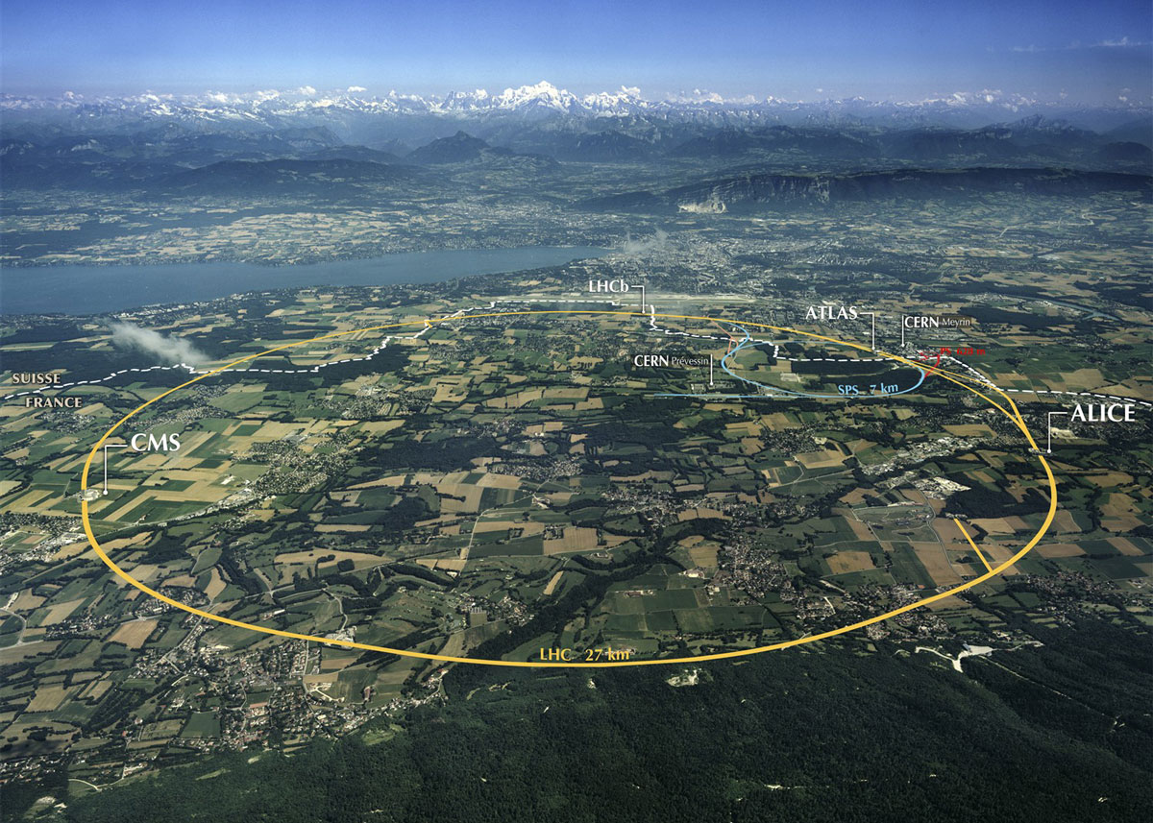
… the shoulders of giants.

Slide 5
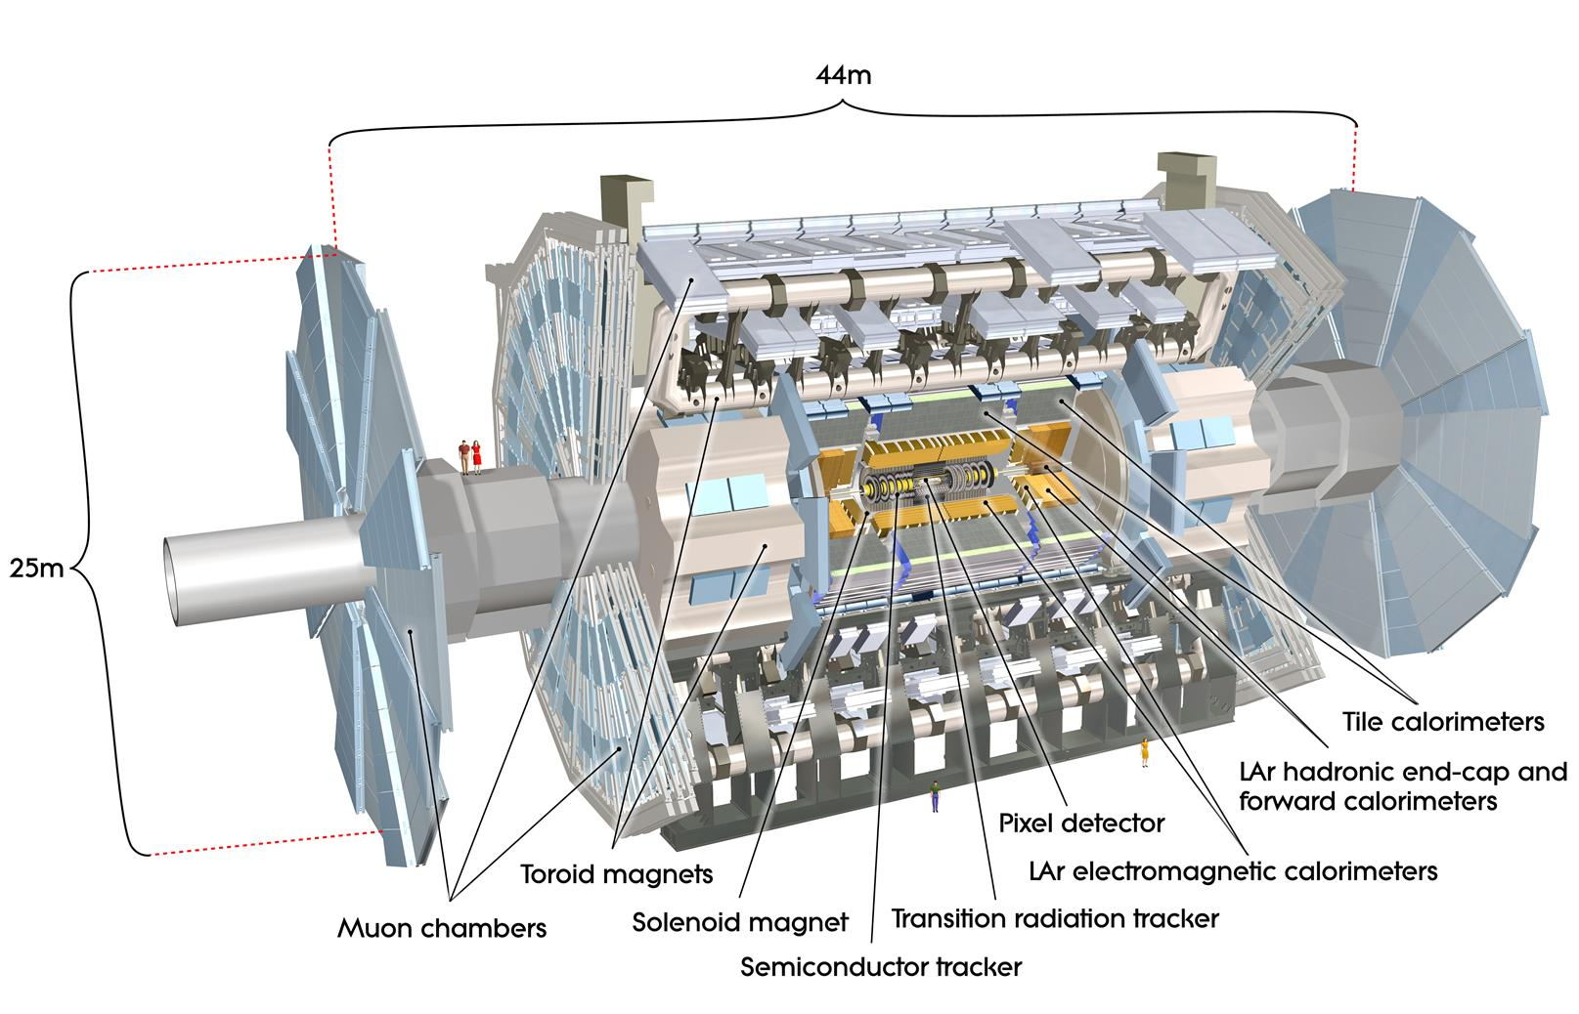
… the shoulders of giants.

Slide 6
Jet substructure
Jet substructure, if carefully defined, is calculable in perturbative QCD, and an important probe of the interaction
At the LHC, for the first time, electroweak objects are abundantly produced with high boost
If they decay hadronically, the decay products may form a single jet, with distinct substructure
Precision understanding of jet substructure is increasingly important for many analyses at the LHC
Two measurements taking this forward

Slide 7
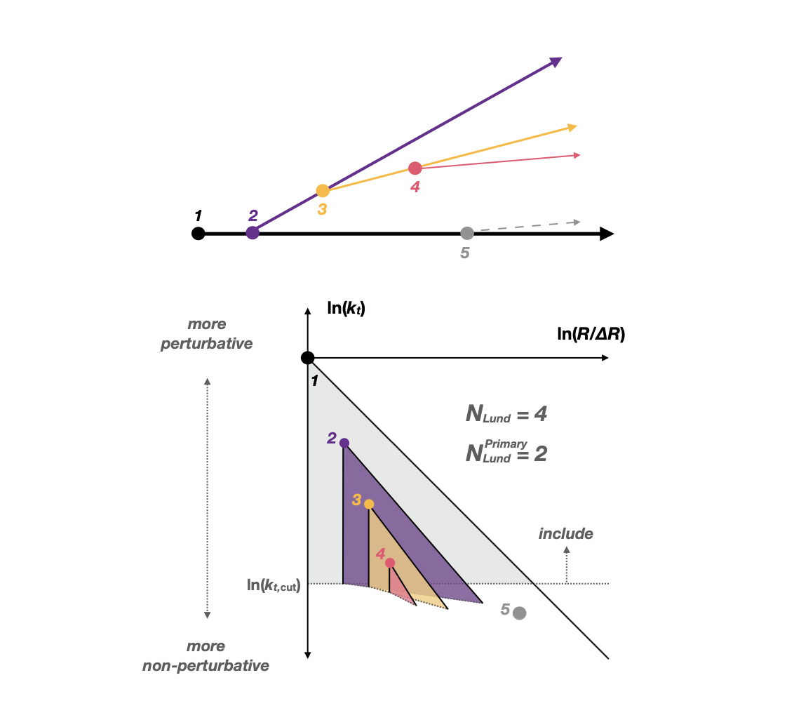
Lund Subjet Multiplicities
Identify “balanced” dijet events (anti k_{T}, R=0.4), using particle-flow object/particles, where the second jet has at least 2/3 of the lead jet p_{T}
Recluster particles in the jet with Cambridge-Aachen algorithm
Count the number of subjets above a specified transverse momentum requirement in the jet’s clustering history: Lund Multiplicity
Counted either in the full, fractal Lund jet plane (𝑁_{Lund}), or along the primary clustering sequence (𝑁_{Lund} ):
  different levels of sensitivity to perturbative and non-perturbative effects.
All unfolded for detector effects
^{Primary}

Slide 8
Lund Subjet Multiplicities
^{Primary}
Measure 𝑁_{Lund} and 𝑁_{Lund} differentially in up to five bins of jet p_{T} between 300 GeV and 4500 GeV, for eight different emission k_{T} requirements ( k_{T} > 0.5 GeV, 1 GeV, 2 GeV, 5 GeV, 10 GeV, 20 GeV, 50 GeV and 100 GeV)
Examples, of 16 double-differential measurements (d²σ/dNdp_{T})

Slide 9
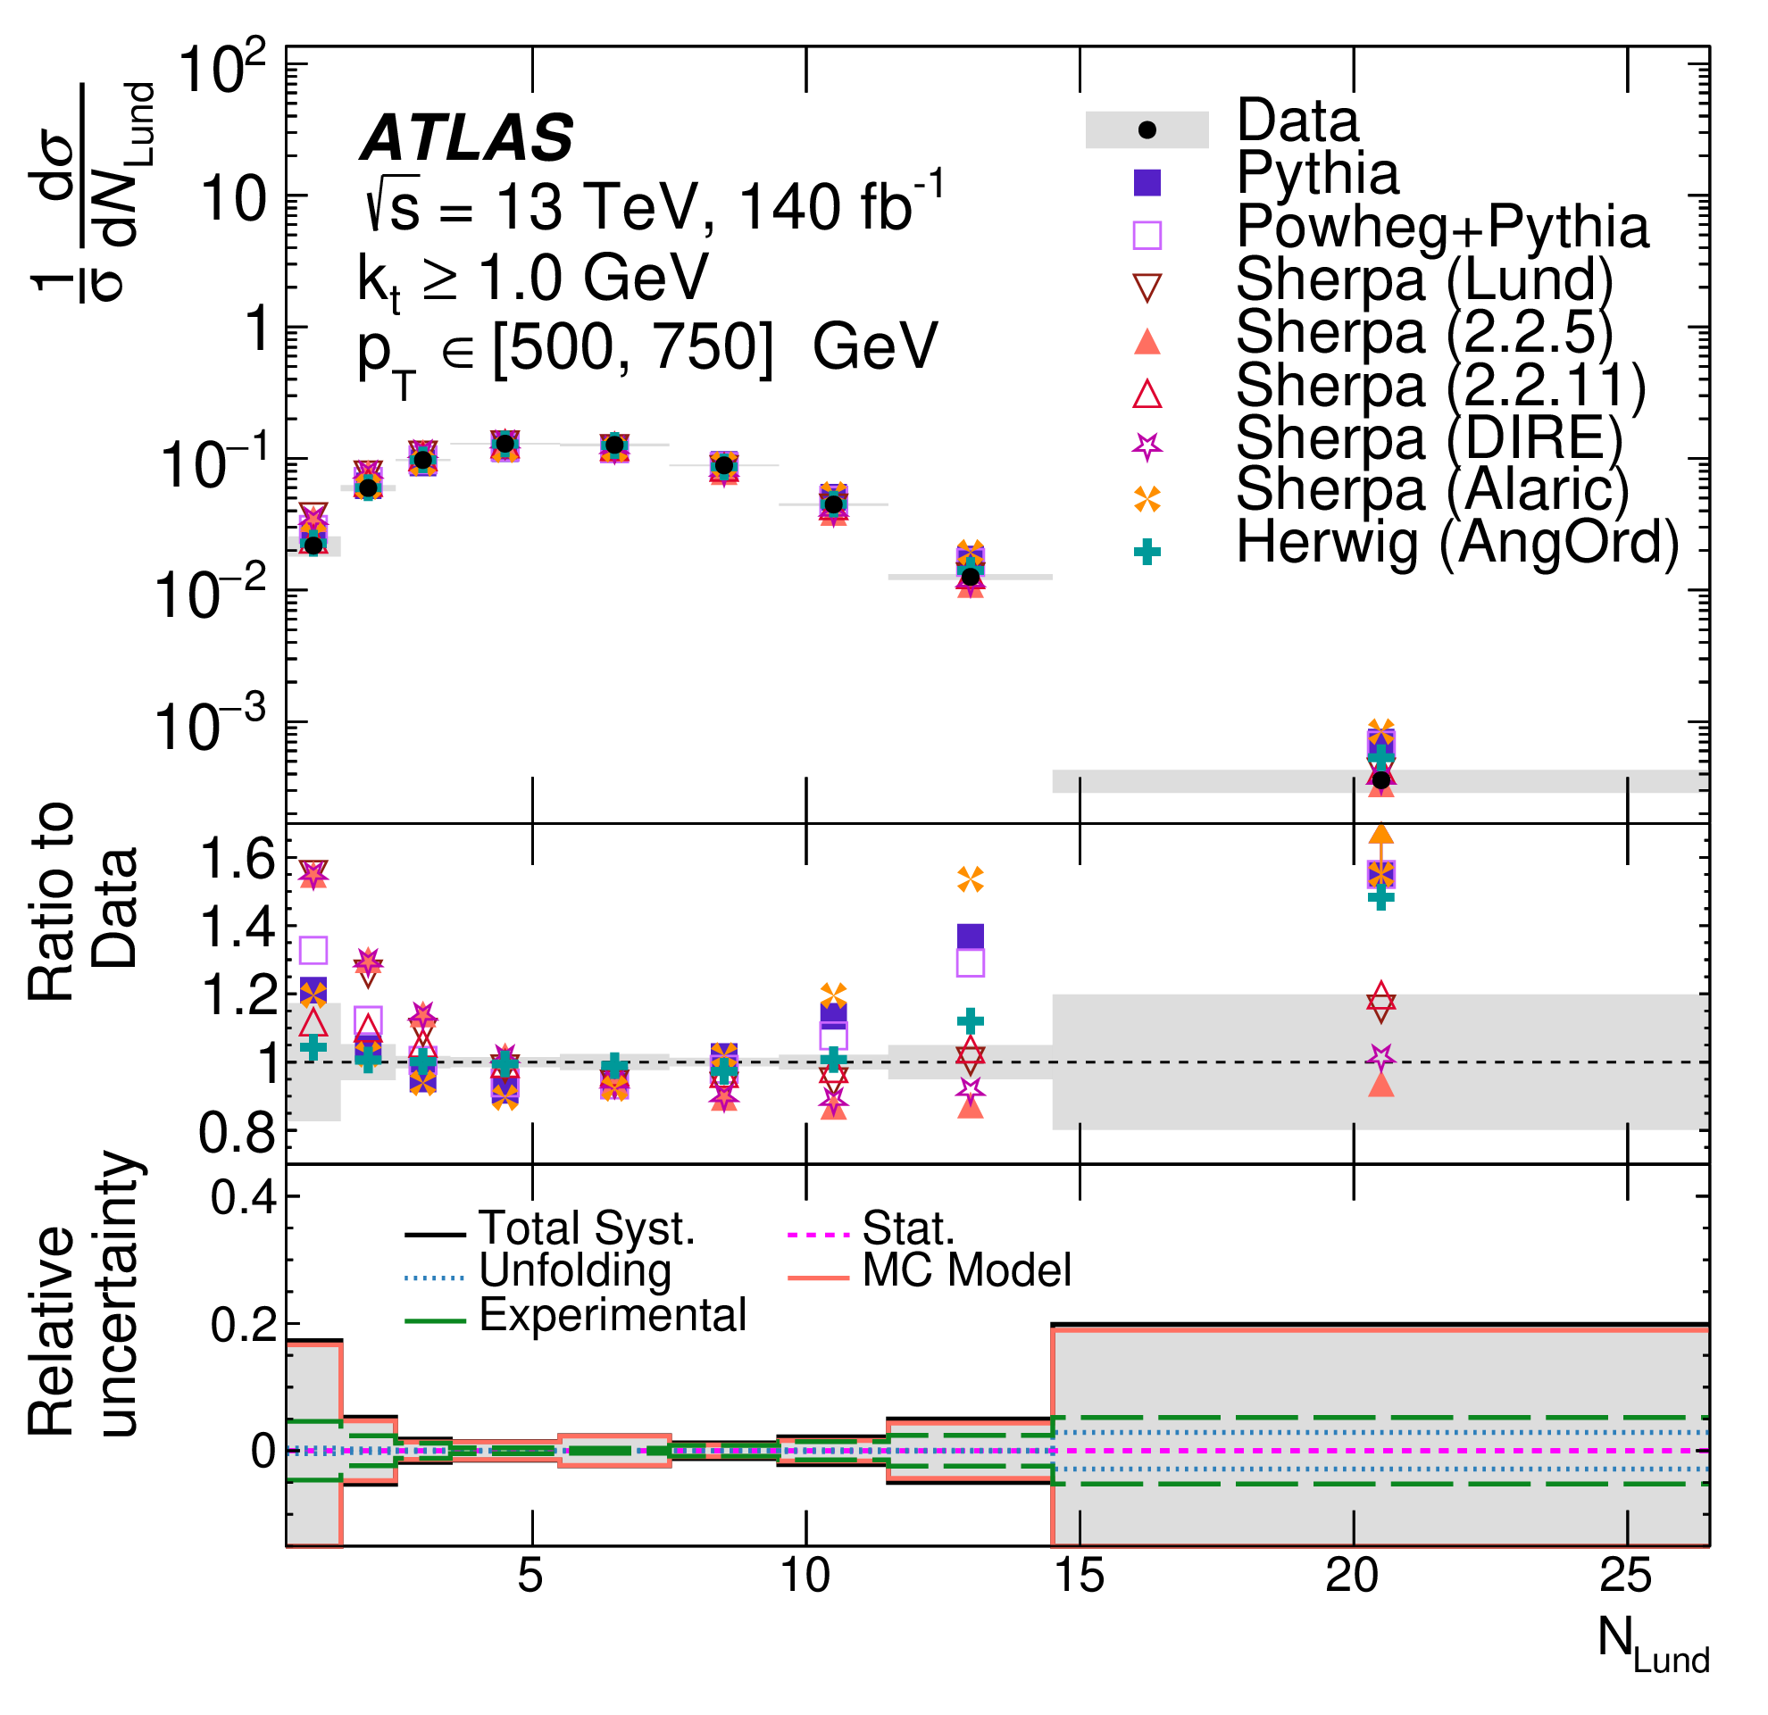
Lund Subjet Multiplicities
^{Primary}
Measure 𝑁_{Lund} and 𝑁_{Lund} differentially in up to five bins of jet p_{T} between 300 GeV and 4500 GeV, for eight different emission k_{T} requirements ( k_{T} > 0.5 GeV, 1 GeV, 2 GeV, 5 GeV, 10 GeV, 20 GeV, 50 GeV and 100 GeV)
Examples, of 16 double-differential measurements (d²σ/dNdp_{T})

Slide 10
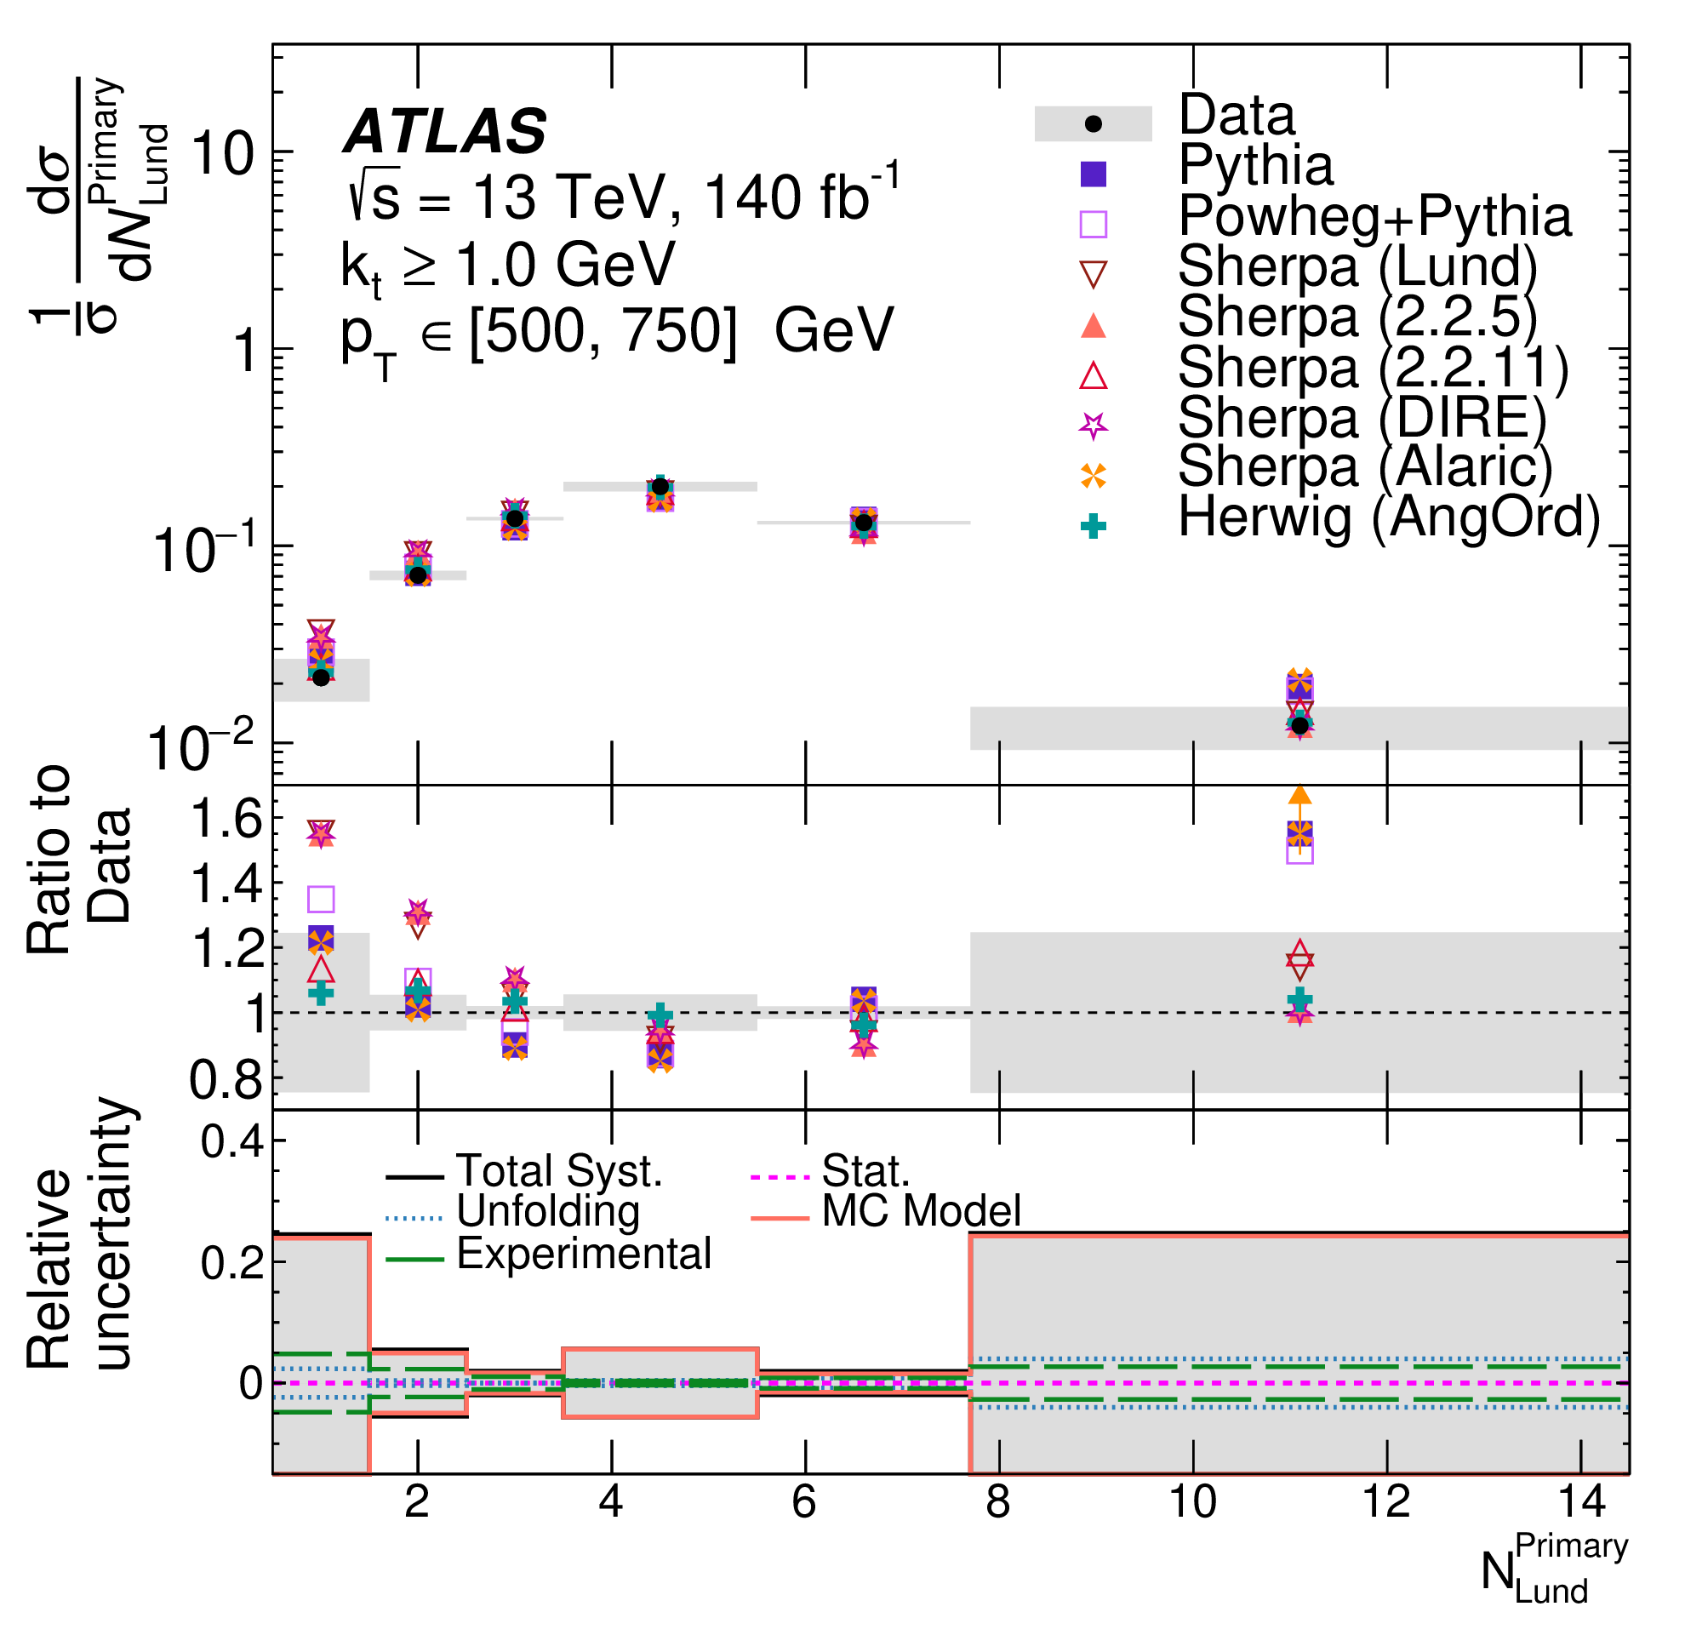
Lund Subjet Multiplicities
^{Primary}
Measure 𝑁_{Lund} and 𝑁_{Lund} differentially in up to five bins of jet p_{T} between 300 GeV and 4500 GeV, for eight different emission k_{T} requirements ( k_{T} > 0.5 GeV, 1 GeV, 2 GeV, 5 GeV, 10 GeV, 20 GeV, 50 GeV and 100 GeV)
Examples, of 16 double-differential measurements (d²σ/dNdp_{T})

Slide 11
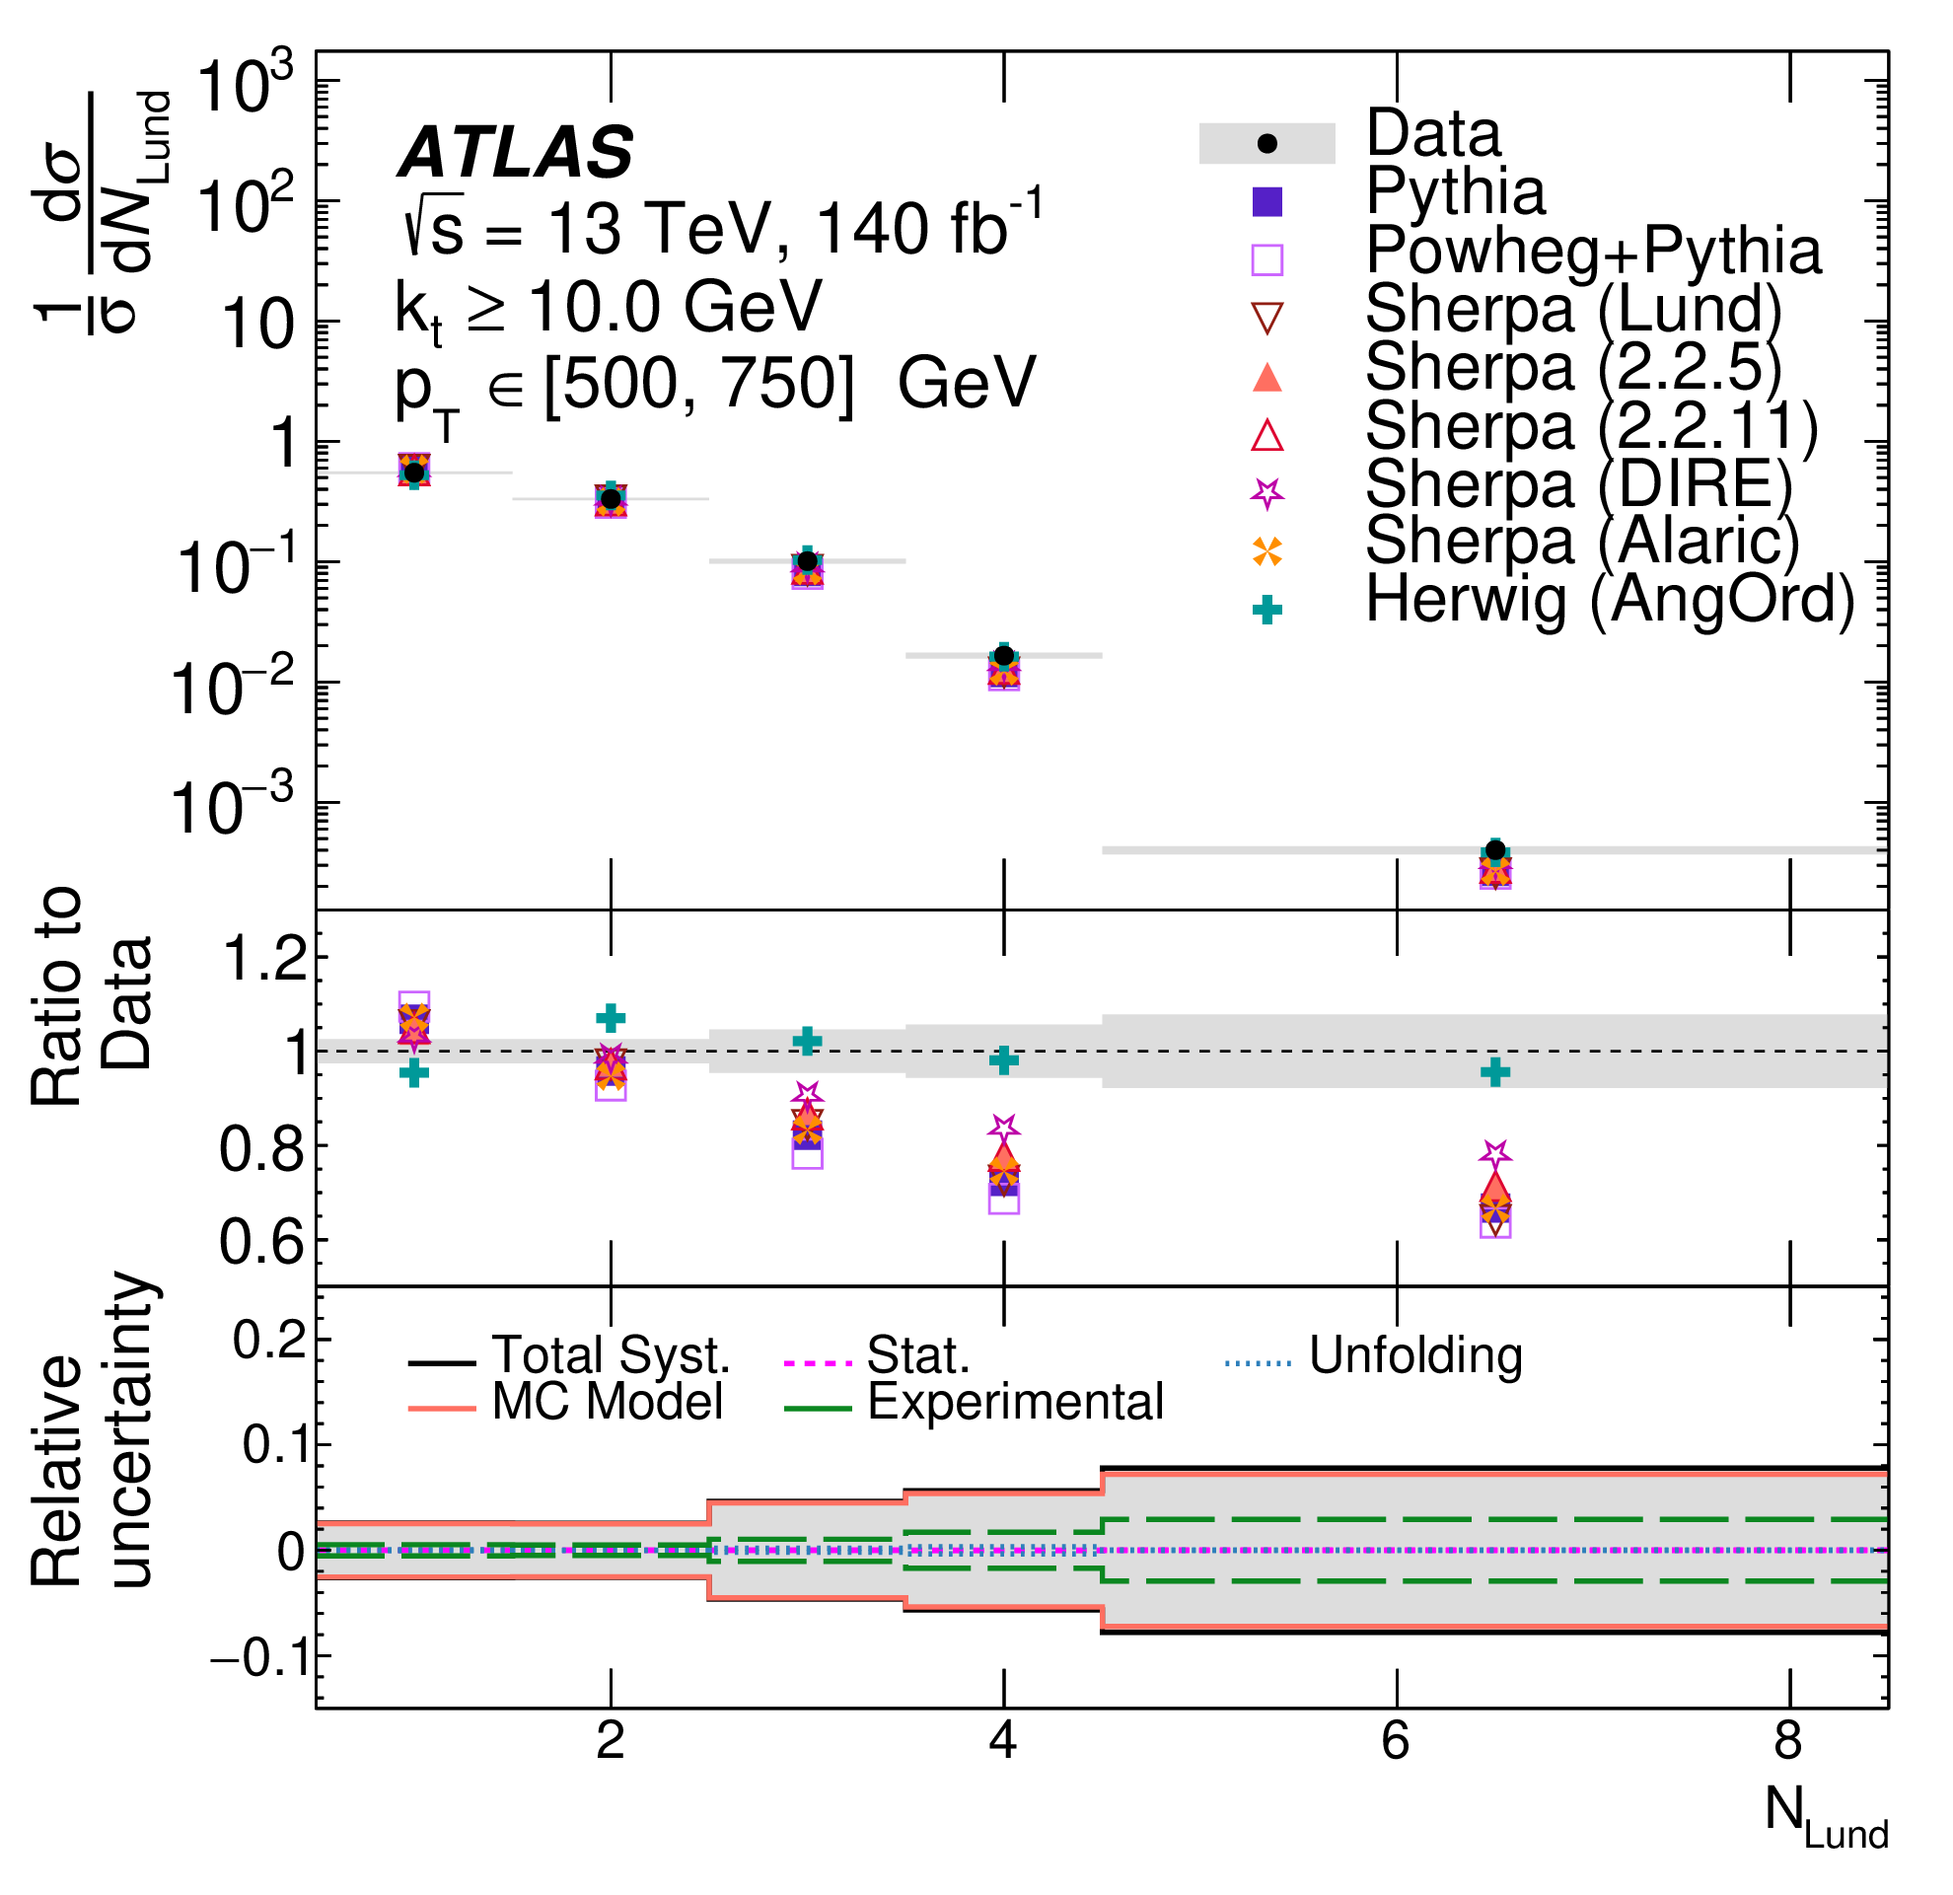
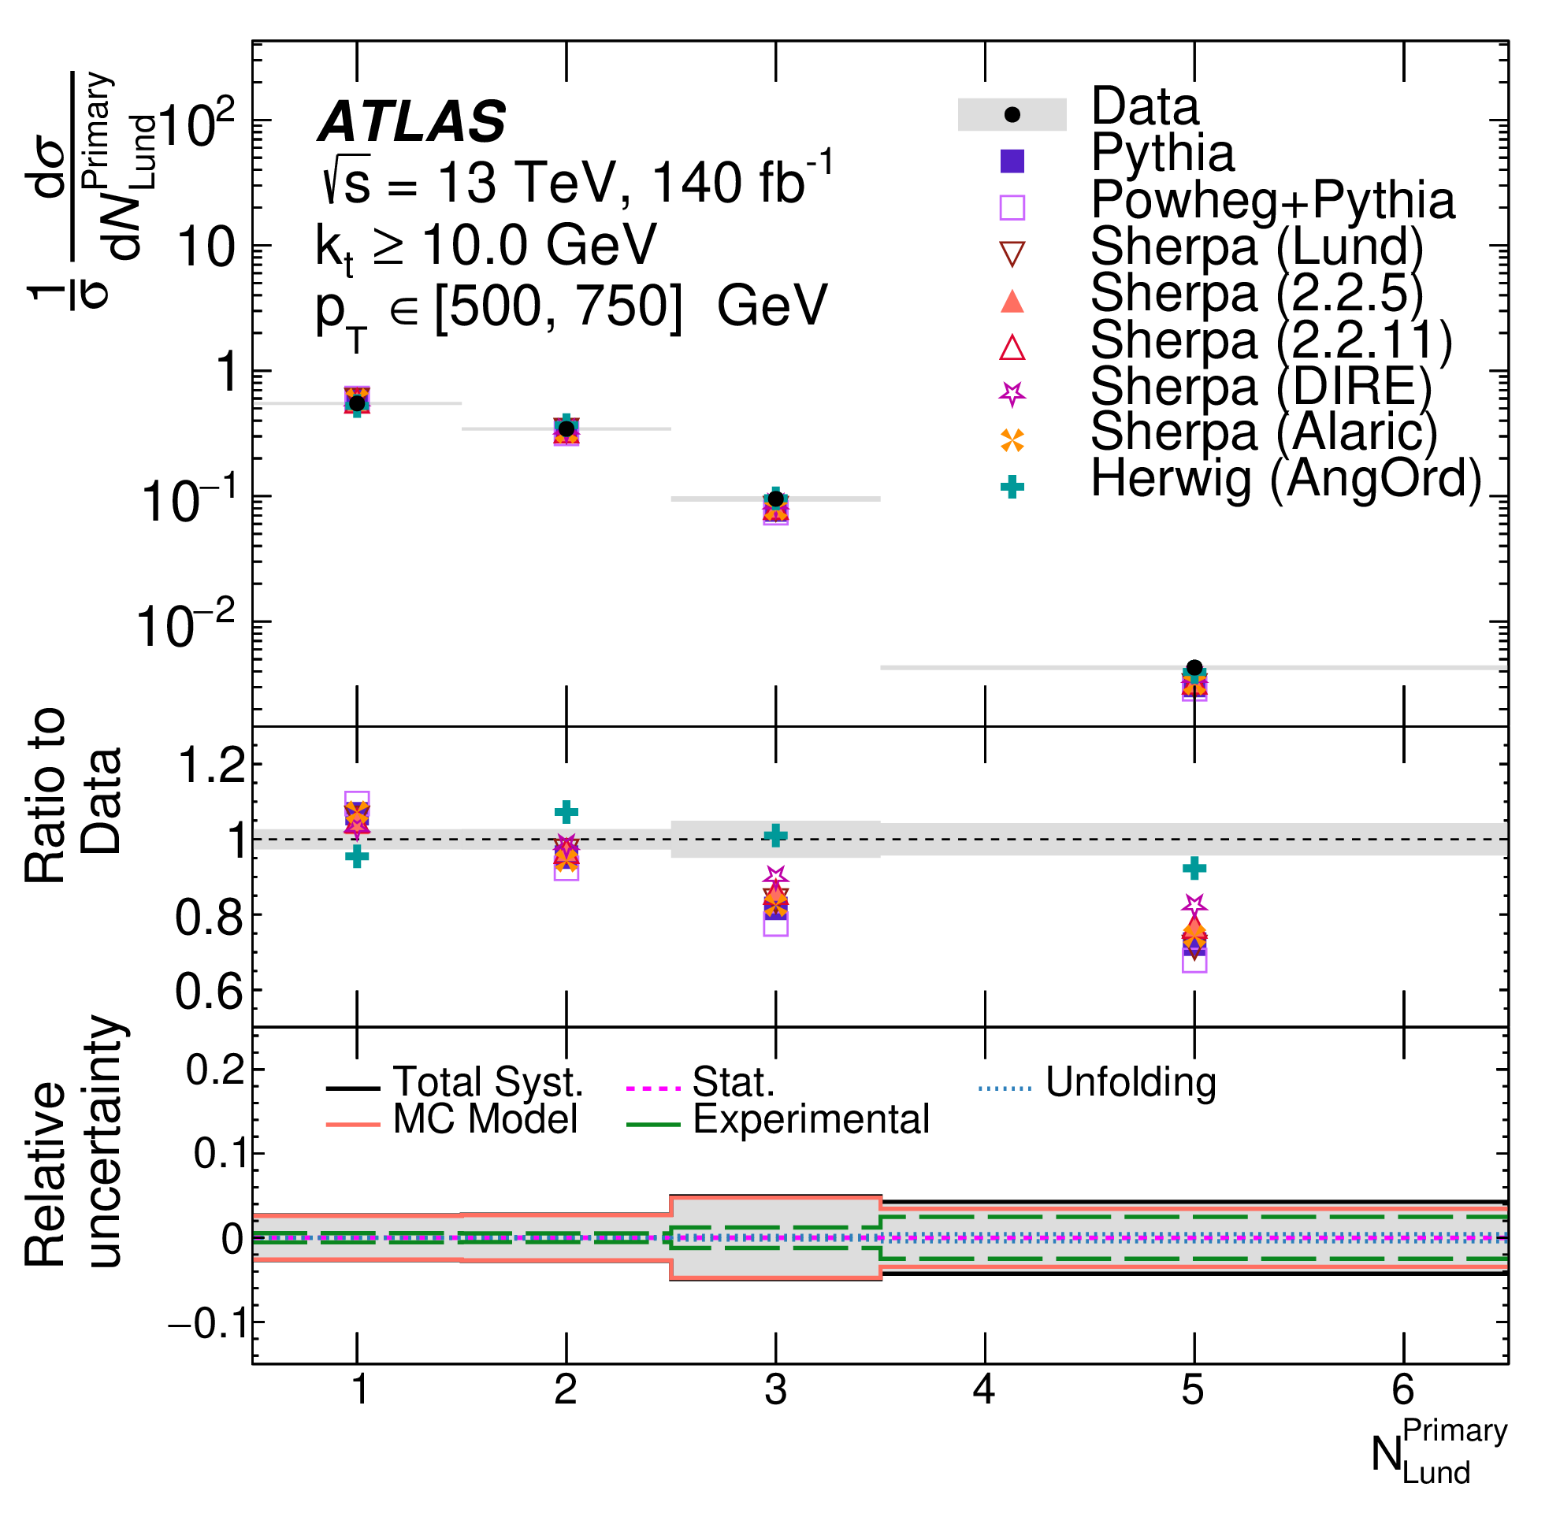
Lund Subjet Multiplicities
^{Primary}
Measure 𝑁_{Lund} and 𝑁_{Lund} differentially in up to five bins of jet p_{T} between 300 GeV and 4500 GeV, for eight different emission k_{T} requirements ( k_{T} > 0.5 GeV, 1 GeV, 2 GeV, 5 GeV, 10 GeV, 20 GeV, 50 GeV and 100 GeV)
Examples, of 16 double-differential measurements (d²σ/dNdp_{T})

Slide 12
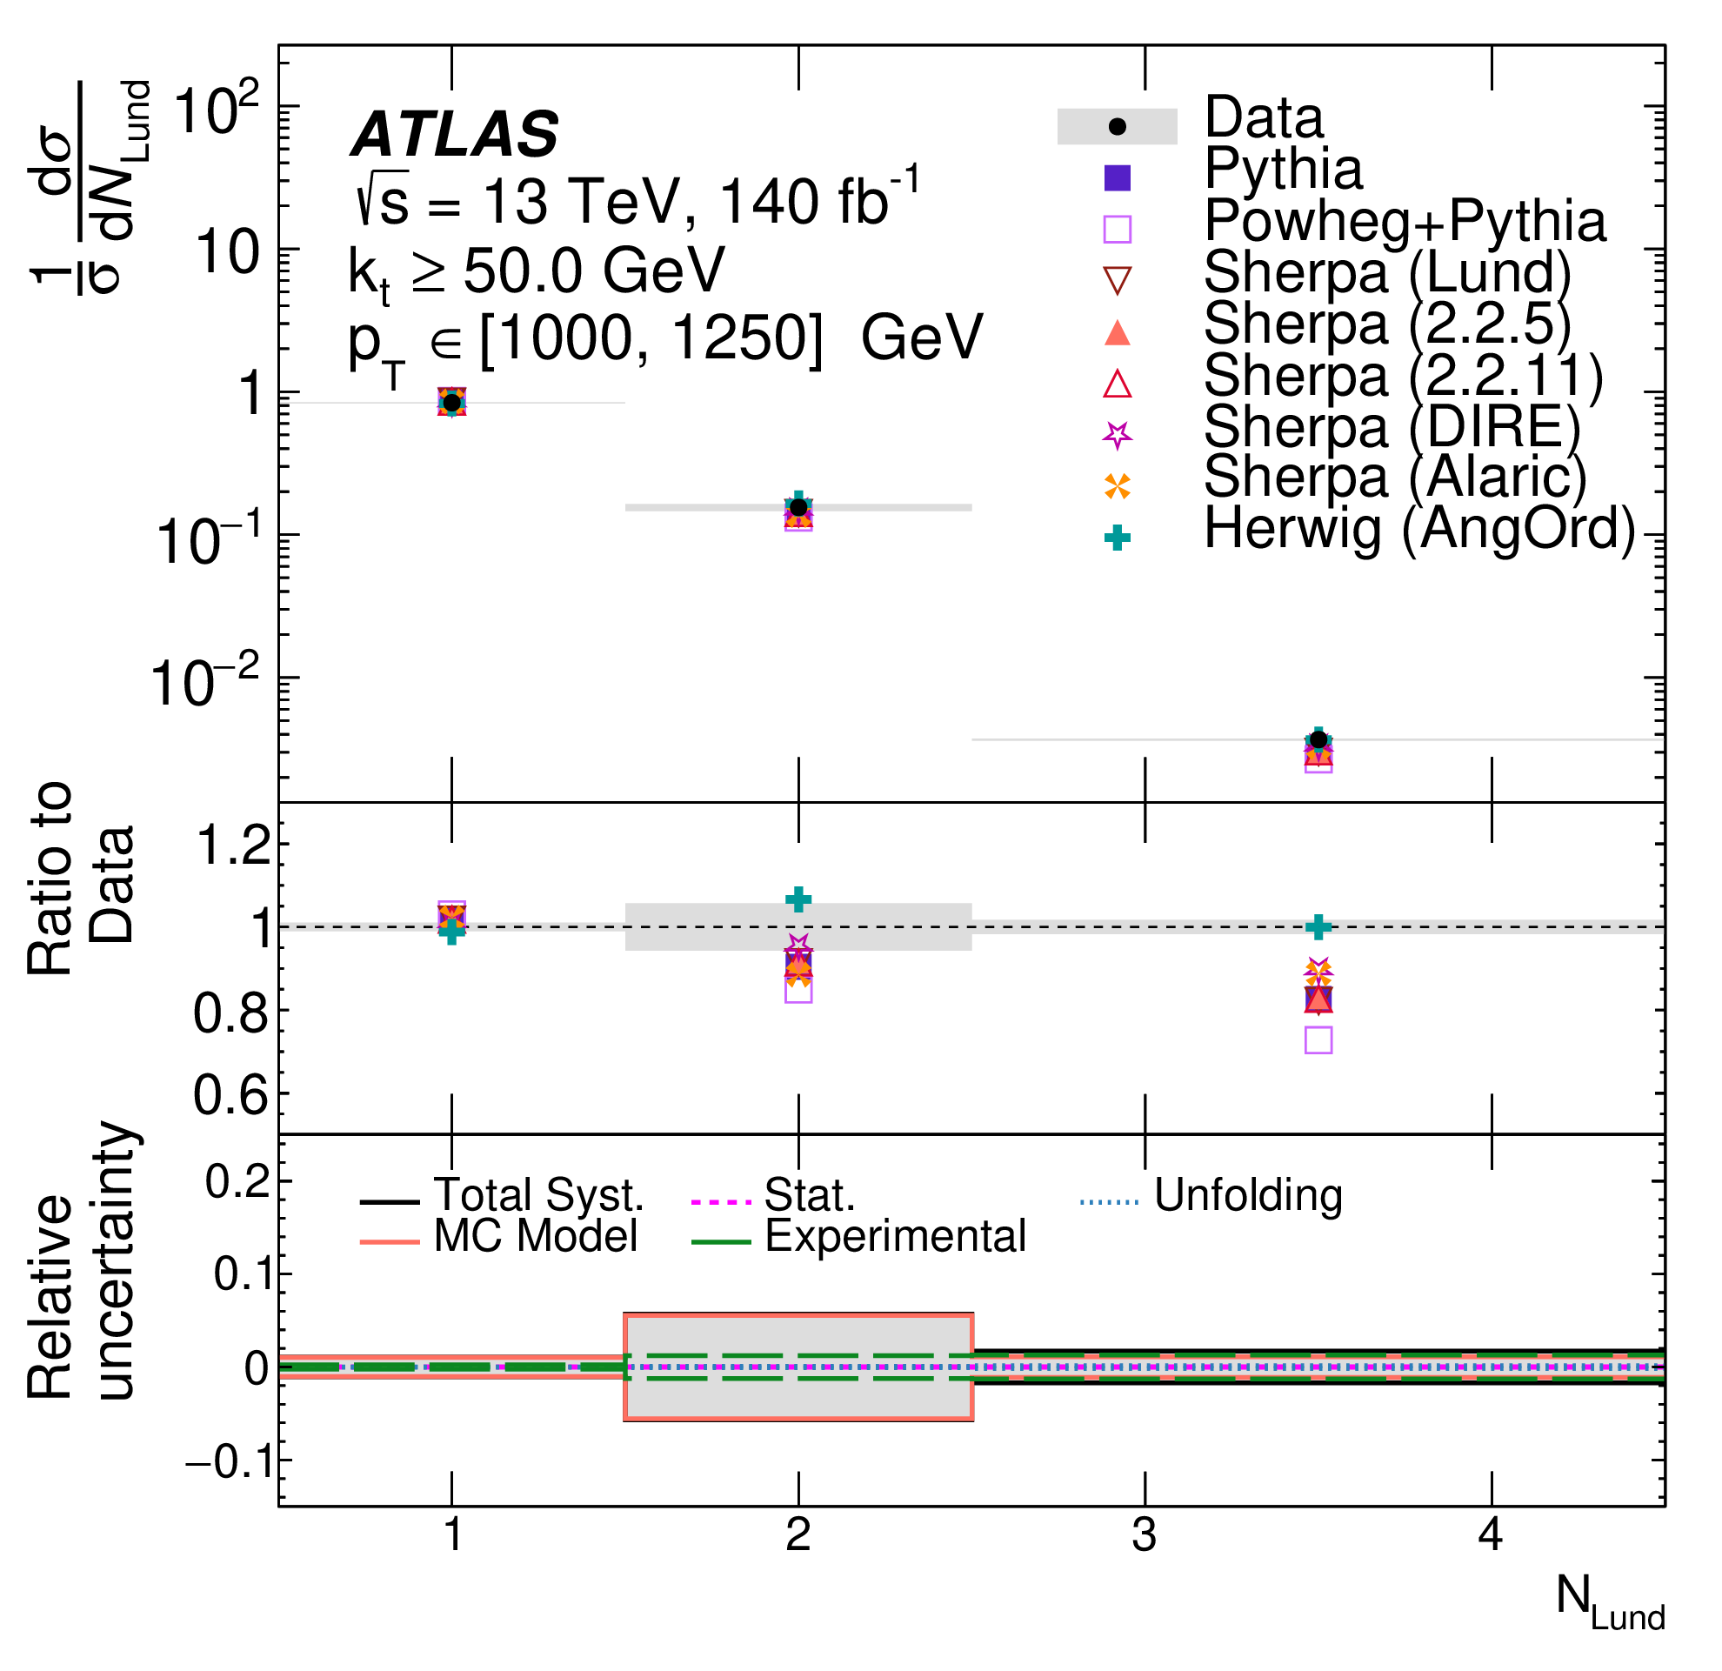
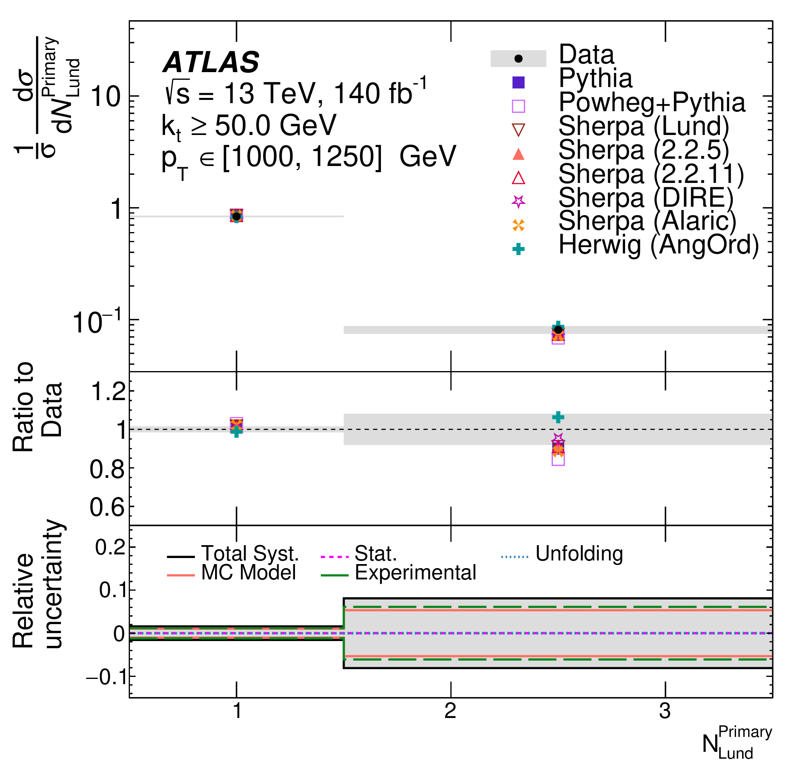
Lund Subjet Multiplicities
^{Primary}
Measure 𝑁_{Lund} and 𝑁_{Lund} differentially in up to five bins of jet p_{T} between 300 GeV and 4500 GeV, for eight different emission k_{T} requirements ( k_{T} > 0.5 GeV, 1 GeV, 2 GeV, 5 GeV, 10 GeV, 20 GeV, 50 GeV and 100 GeV)
Examples, of 16 double-differential measurements (d²σ/dNdp_{T})

Slide 13
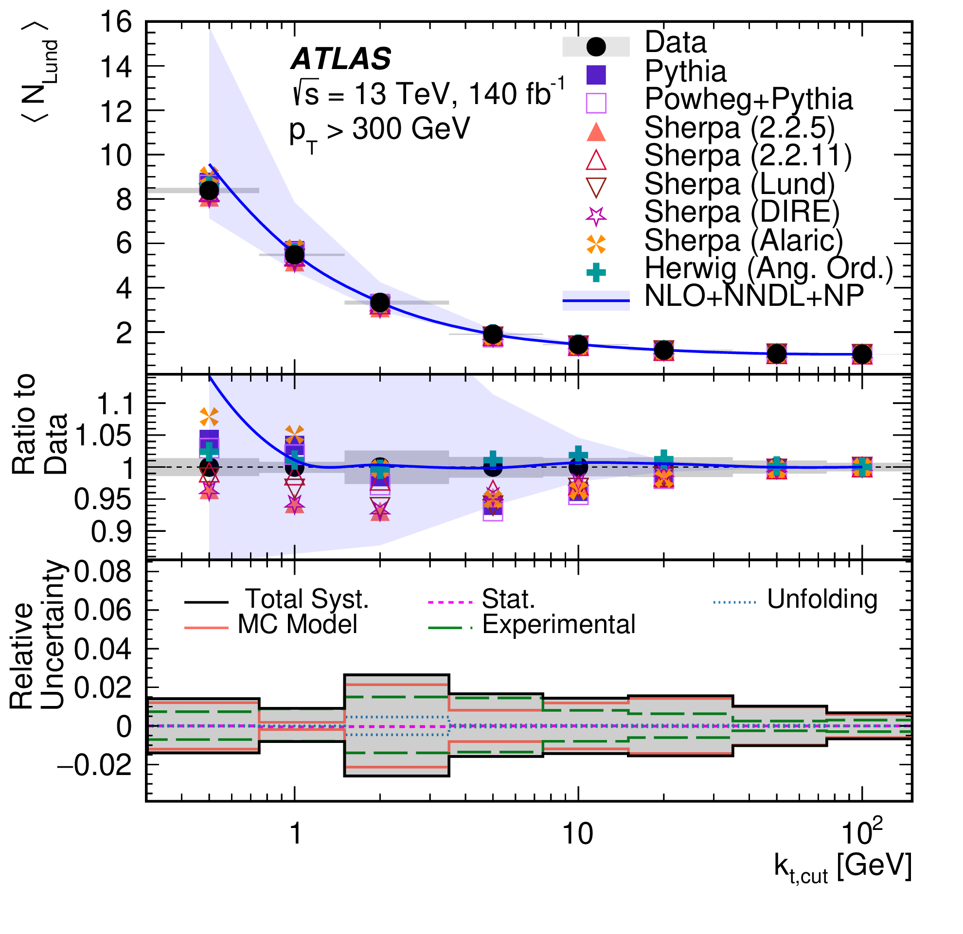
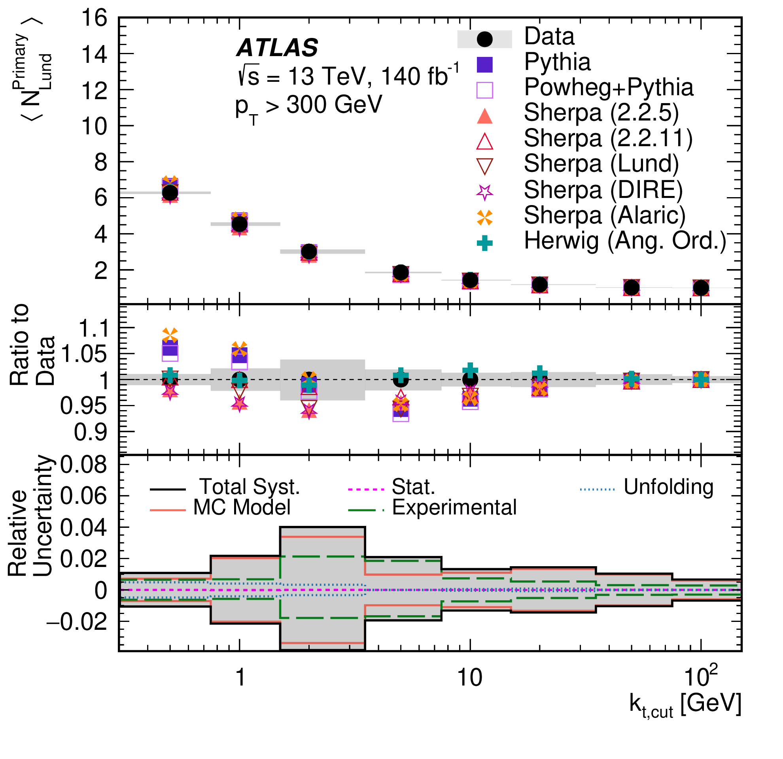
Lund Subjet Multiplicities
Measure 𝑁_{Lund} and 𝑁_{Lund} differentially in up to five bins of jet p_{T} between 300 GeV and 4500 GeV, for eight different emission k_{T} requirements ( k_{T} > 0.5 GeV, 1 GeV, 2 GeV, 5 GeV, 10 GeV, 20 GeV, 50 GeV and 100 GeV)
Examples, of 16 double-differential measurements (d²σ/dNdp_{T})
⟨𝑁_{Lund}⟩ prediction provided by Medves, Soto-Ontoso, Soyez, 2212.05076 [hep-ph] also compared to data
^{Primary}
p_{T} > 300 GeV

Slide 14
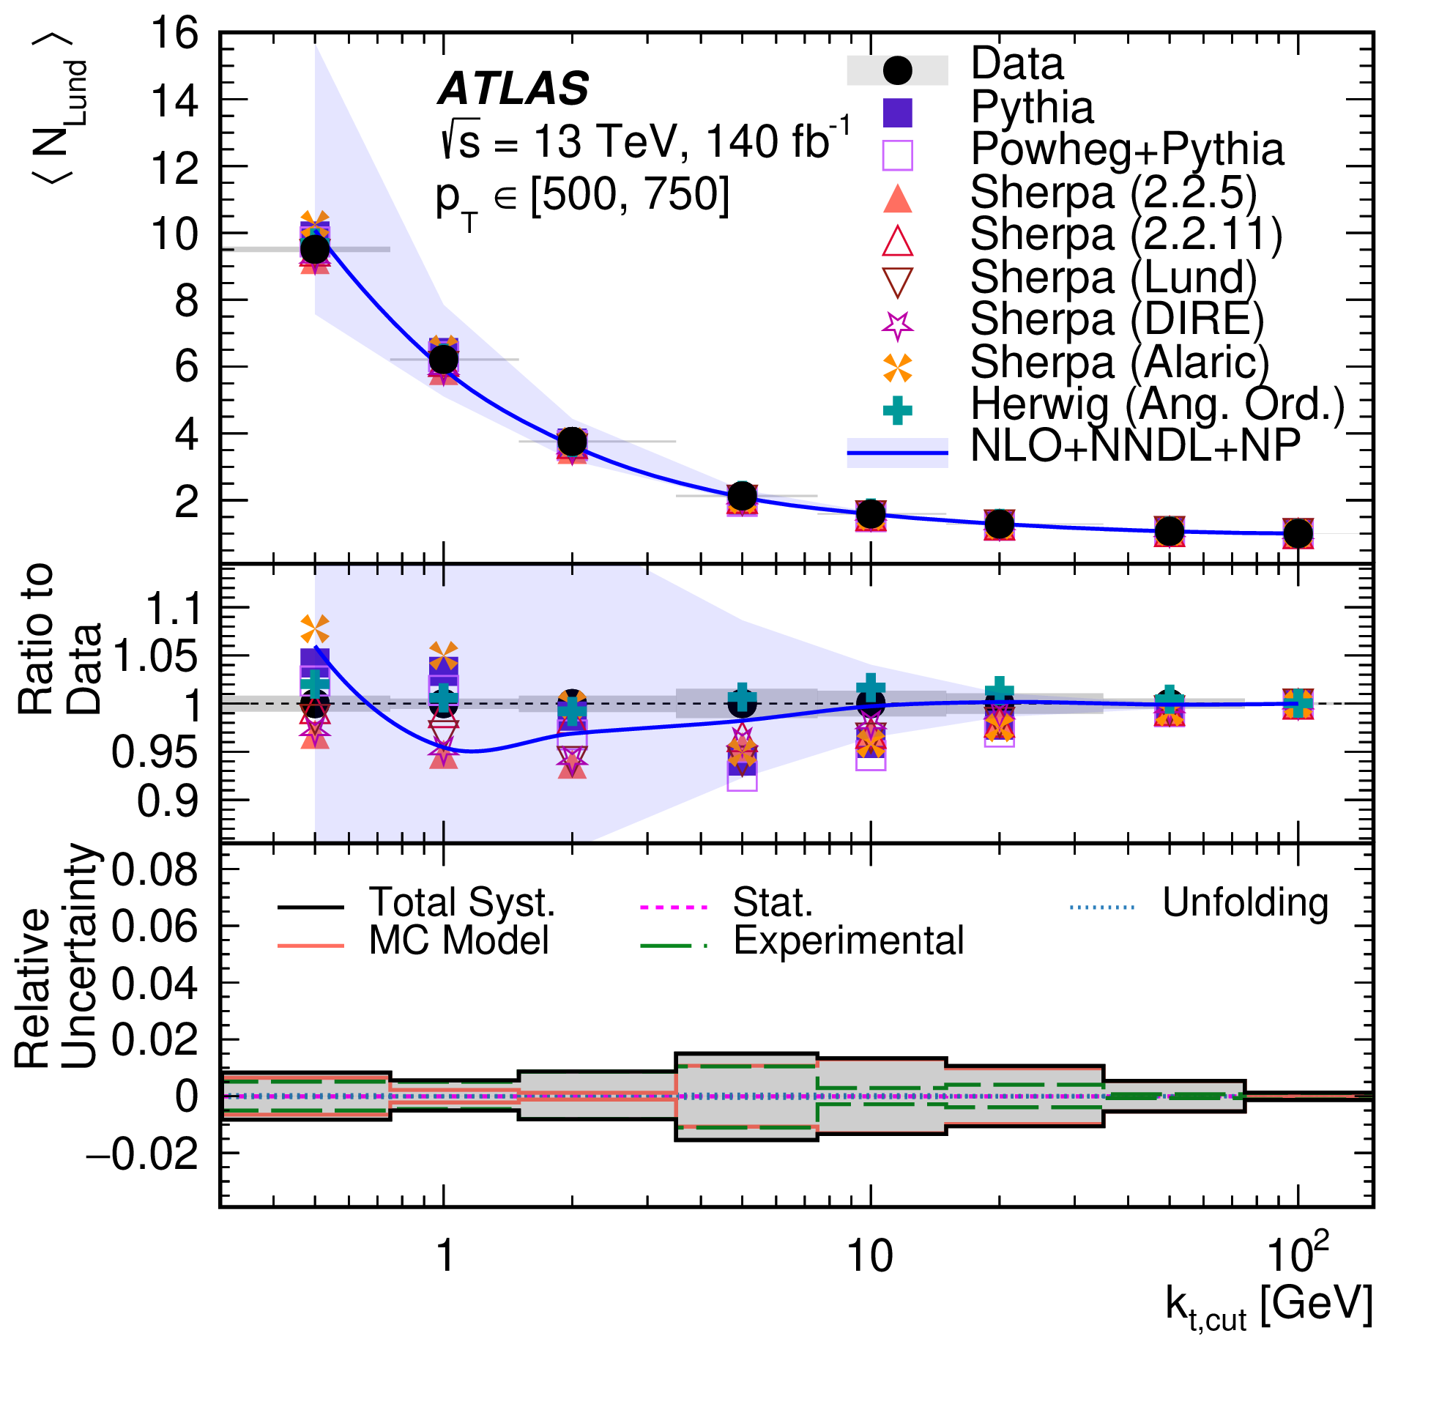
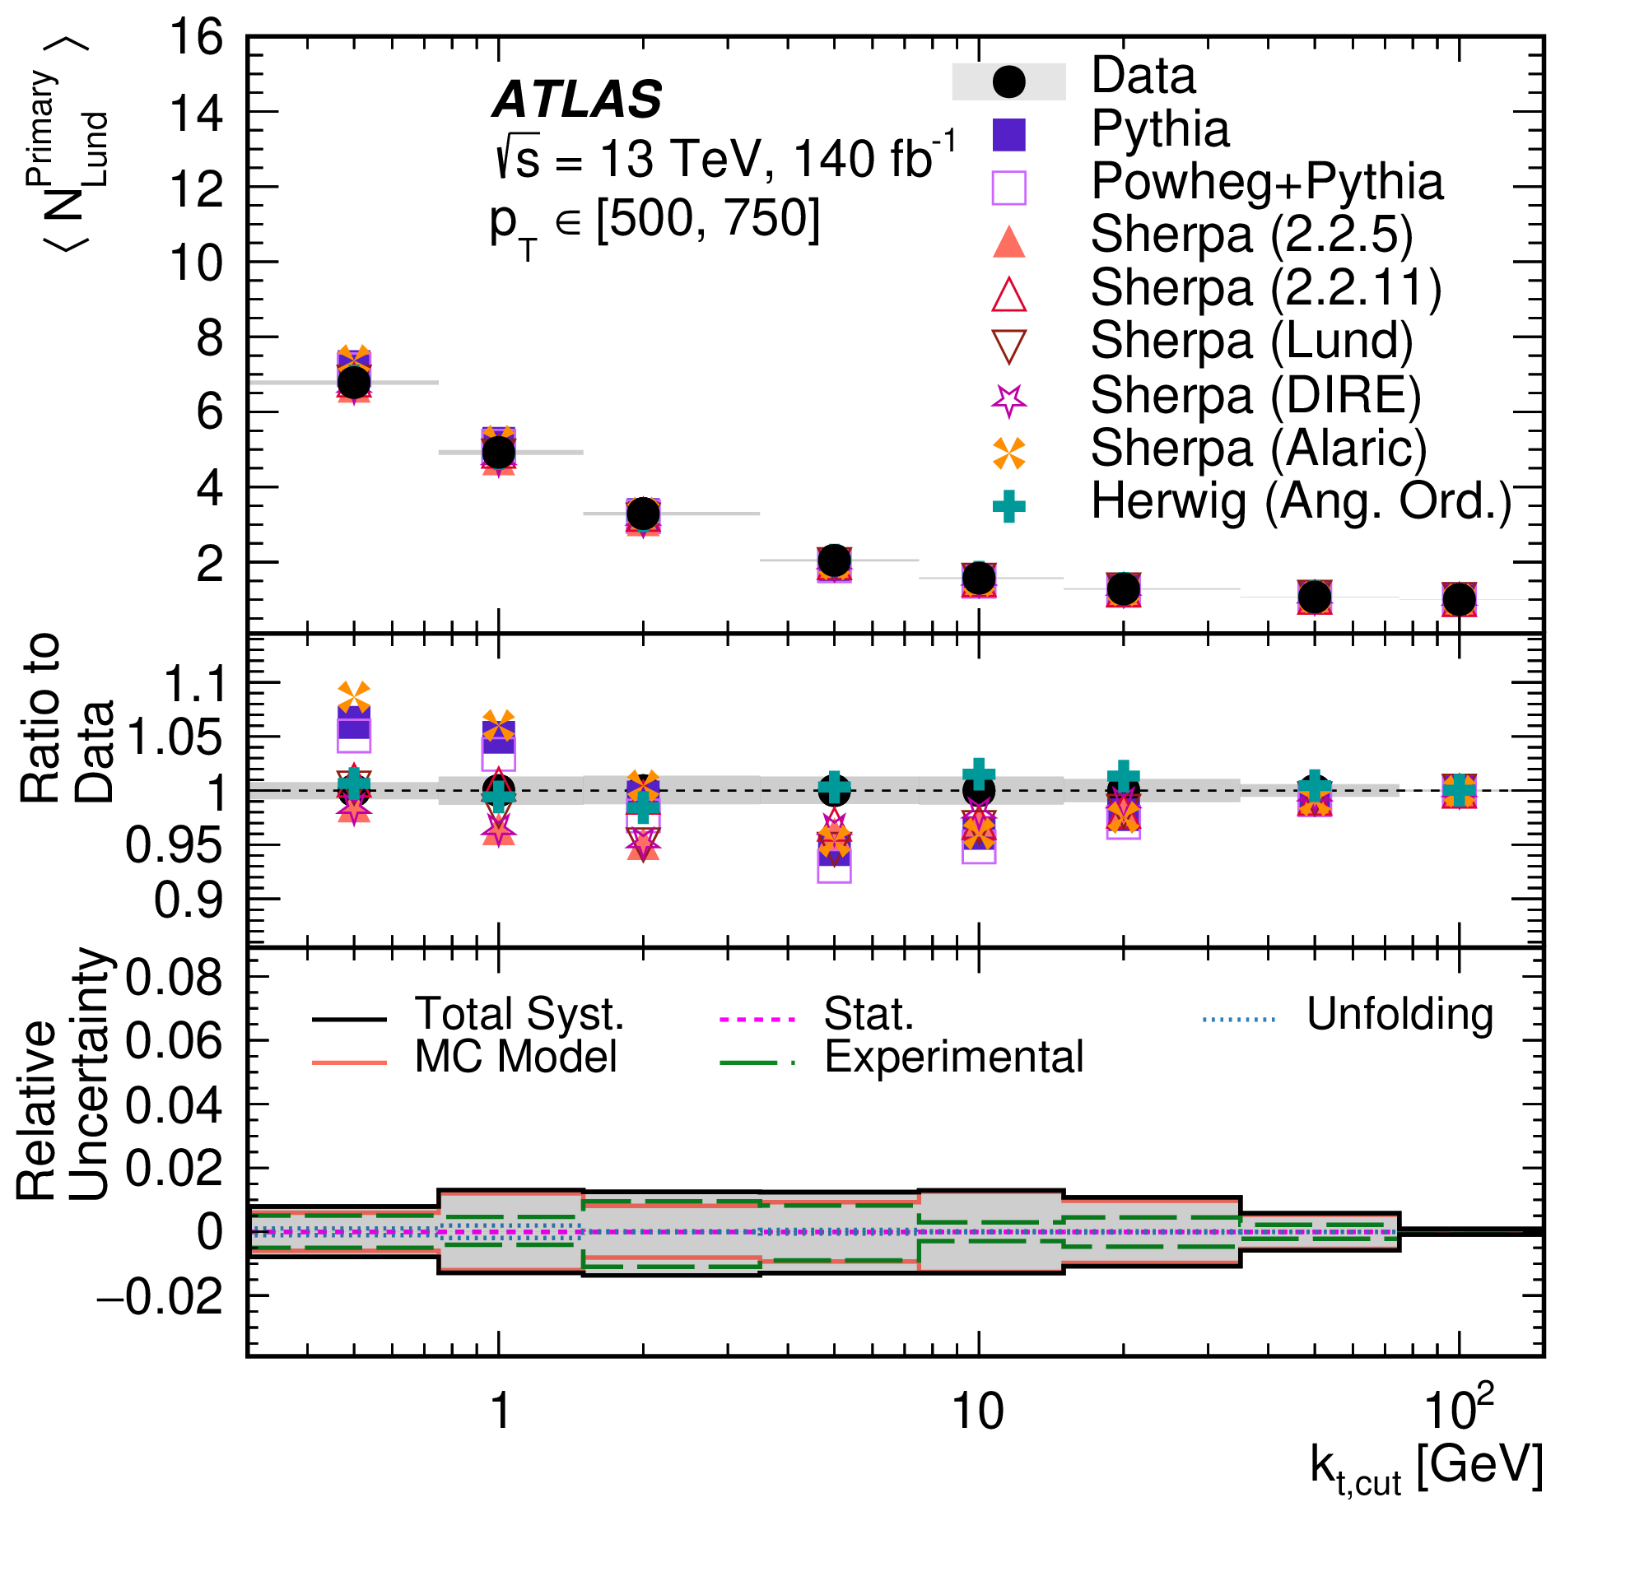
Lund Subjet Multiplicities
Measure 𝑁_{Lund} and 𝑁_{Lund} differentially in up to five bins of jet p_{T} between 300 GeV and 4500 GeV, for eight different emission k_{T} requirements ( k_{T} > 0.5 GeV, 1 GeV, 2 GeV, 5 GeV, 10 GeV, 20 GeV, 50 GeV and 100 GeV)
Examples, of 16 double-differential measurements (d²σ/dNdp_{T})
⟨𝑁_{Lund}⟩ prediction provided by Medves, Soto-Ontoso, Soyez, 2212.05076 [hep-ph] also compared to data
500 GeV < p_{T} < 750 GeV

Slide 15
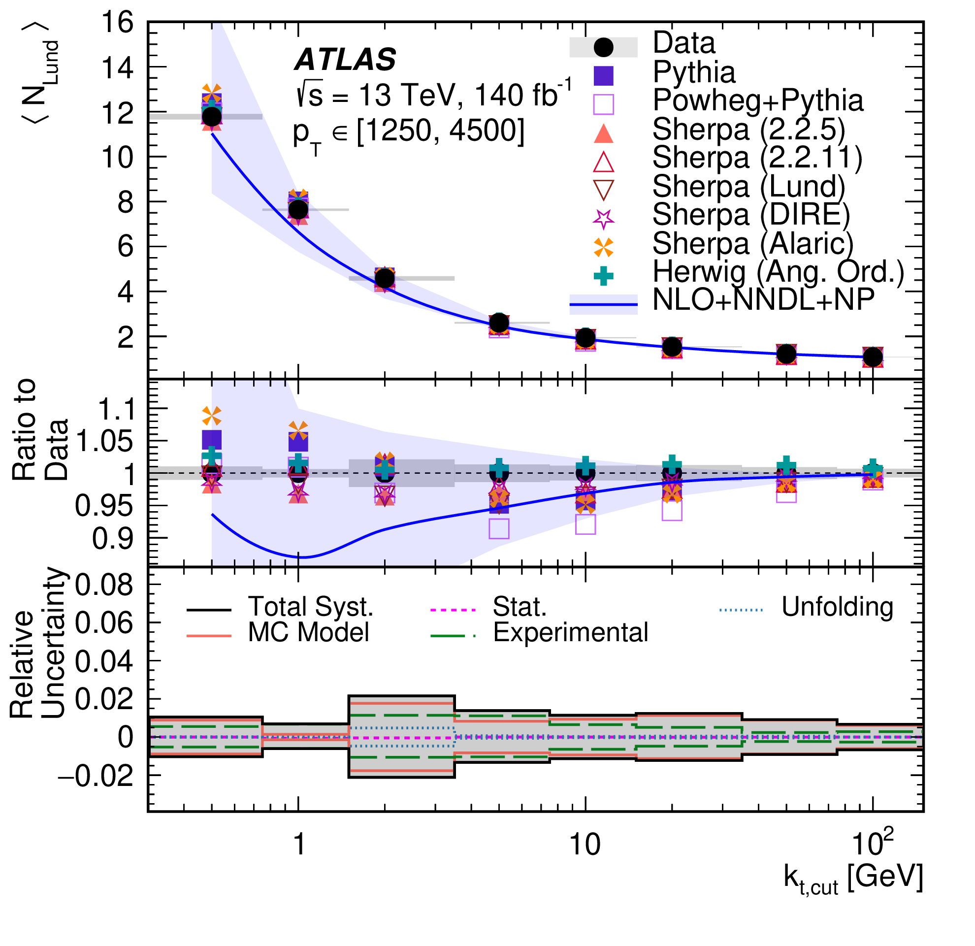
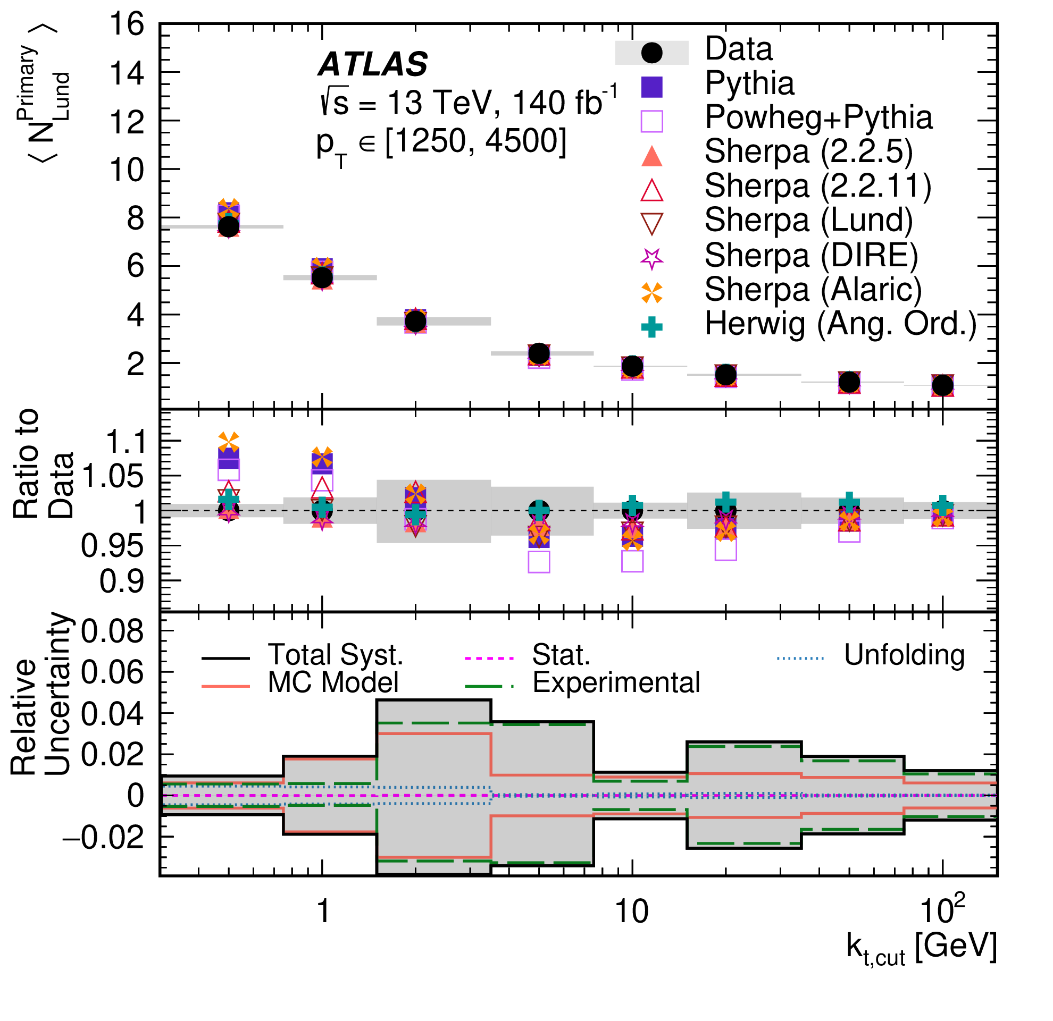
Lund Subjet Multiplicities
Measure 𝑁_{Lund} and 𝑁_{Lund} differentially in up to five bins of jet p_{T} between 300 GeV and 4500 GeV, for eight different emission k_{T} requirements ( k_{T} > 0.5 GeV, 1 GeV, 2 GeV, 5 GeV, 10 GeV, 20 GeV, 50 GeV and 100 GeV)
Examples, of 16 double-differential measurements (d²σ/dNdp_{T})
⟨𝑁_{Lund}⟩ prediction provided by Medves, Soto-Ontoso, Soyez, 2212.05076 [hep-ph] also compared to data
1250 GeV < p_{T} < 4500 GeV

Slide 16
Lund Subjet Multiplicities
Herwig default angle-ordered PS agrees best overall
  Some Sherpa setups describe the differential multiplicity distributions quite well when more non-perturbative emissions are allowed (k_{T} < 2 GeV).
  Other PSMC models often fail to accurately describe the measured data
  In particular, often too many jets at low N_{Lund}
Resummed analytic prediction is in good agreement with mean measurement in the perturbative region (k_{T} > 2 GeV), particularly for jets with low p_{T} (e.g. 300 - 500 GeV)
  In this region, the performance matches the best PSMC models
  Underestimates multiplicity in data in highest p_{T} bins
Regions of consistency between data, best PS and analytic calculation are important
  Probing fundamental properties of QCD and jet formation at the TeV-scale.
Measurement will be important input to future parton shower developments.
  Rivet routine is available, Data points on HEPData

Slide 17
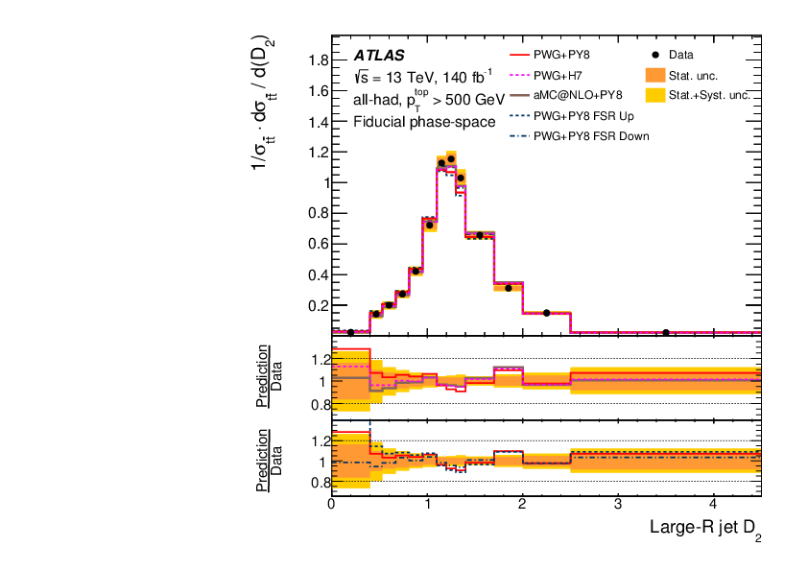
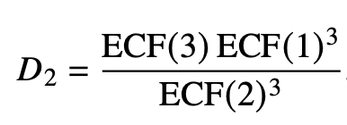
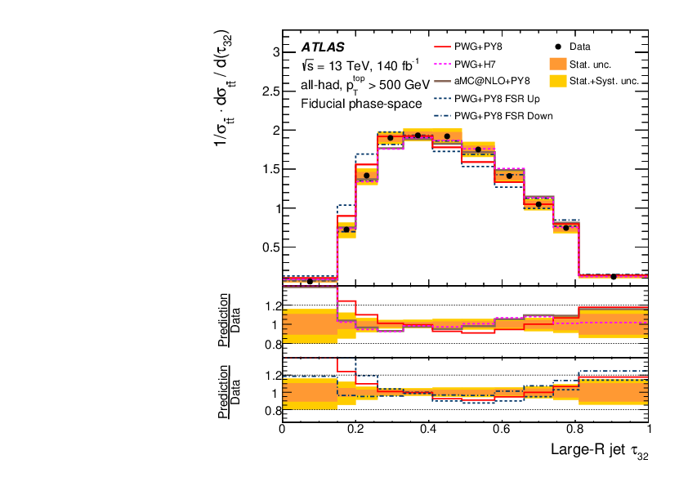
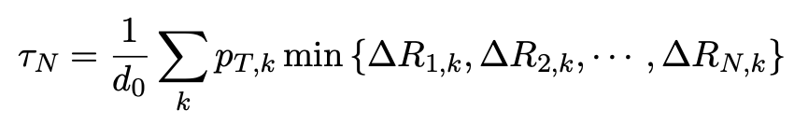

Jet Substructure in Boosted 𝒕 𝒕 ̄ Events
Ratio of energy correlation functions
Larkoski, Salam, Thaler
Probe the structure of the jets produced by hadronically decaying top quarks
Using charged component only (angular resolution)
Using fully hadronic and semi-leptonic top-antitop events
Ratio of N-subjettiness variables,
Thaler & van Tilburg

Slide 18
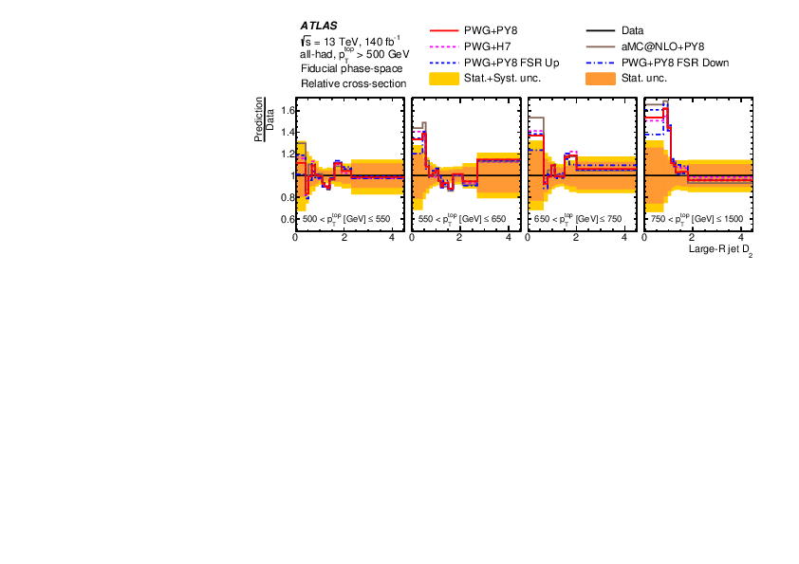
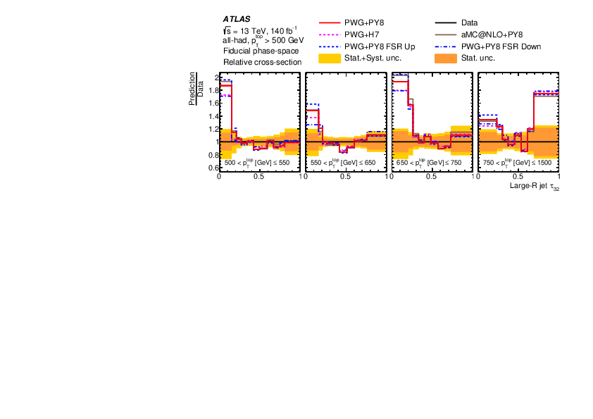
Jet Substructure in Boosted 𝒕 𝒕 ̄ Events
Also measured double-differentially in the jet p_{T} and the relevant substructure variable
Overall conclusion
  “2-jet-like” variables described fairly well
  Modelling of “3-jet-like” variables less good; favours lower scale/higher α_{s} than in the nominal FSR

Slide 19
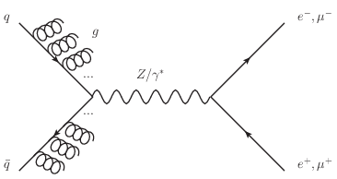
Strong-coupling Constant from the Recoil of 𝒁 Bosons
Strong coupling constant; the free parameter unique to the strong interaction
  World average: 𝛼_{s}(𝑄 = 𝑚_{𝑍}) = 0.1179 ± 0.0009
Use a novel measurement of “Z boson” over full phase space (2309.09318 [hep-ex])
  Assume spin-1 intermediate particle in Drell-Yan
  Decompose into the leptons’ cos 𝜃 and 𝜙 angular distributions in the Collins–Soper frame into nine spherical harmonic polynomials, multiplied by angular coefficients.
  Extract cross sections in the full lepton phase space, i.e. without fiducial kinematic requirements on the p_{T} and y of the leptons, and without sensitivity to FSR
Sudakov factor describes probability of no hard emission: resummed, depends on 𝛼_{s}
Soft physics quadratically suppressed with p_{T}, linear model at low p_{T}
See KM talk for more on the theory context & contributions

Slide 20
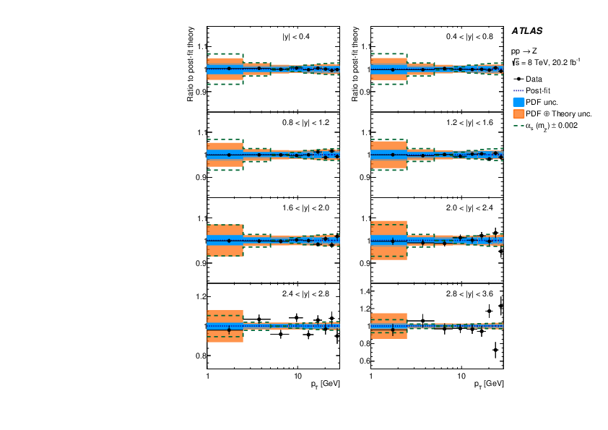
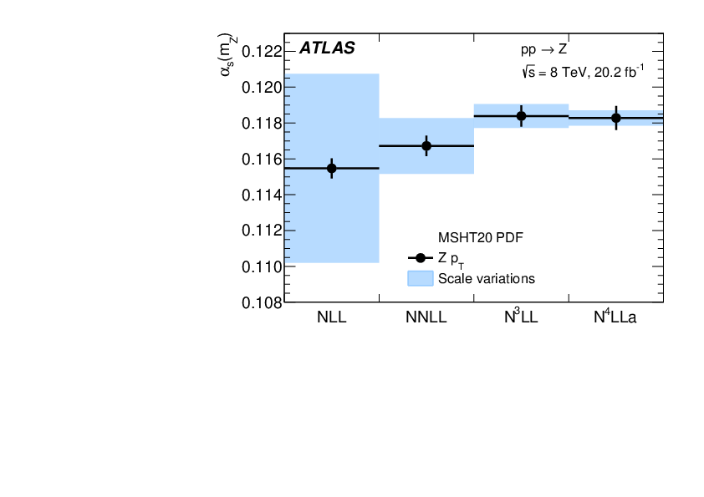
Strong-coupling Constant from the Recoil of 𝒁 Bosons
Fit for 𝛼_{s}, including NP parameters
(Relatively small) dependence on PDF evaluated using alternative set, and also a combined fit
Scale uncertainties well understood
Most sensitivity to 𝛼_{s} for p_{T} ~ 5-10 GeV

Slide 21
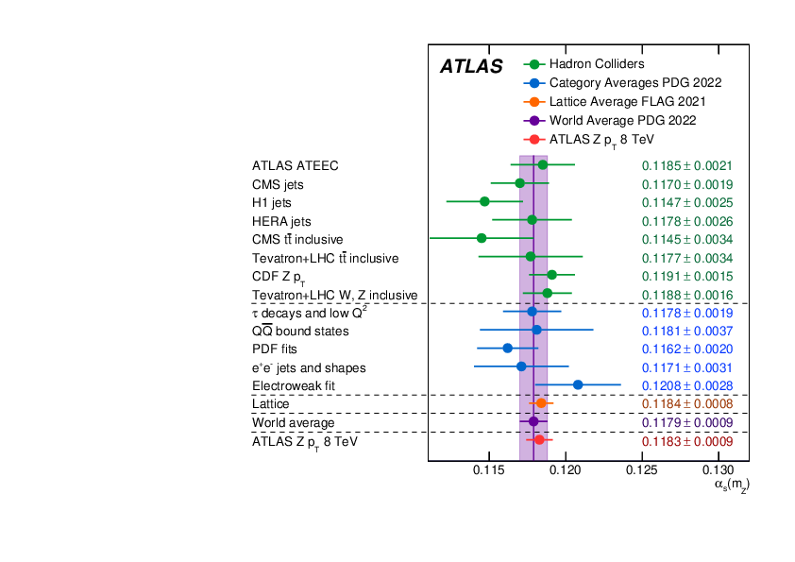
Strong-coupling Constant from the Recoil of 𝒁 Bosons
World average: 𝛼_{s}(𝑄 = 𝑚_{𝑍}) = 0.1179 ± 0.0009
This measurement: 𝛼_{s}(𝑄 = 𝑚_{𝑍}) = 0.1183 ± 0.0009

Slide 22
Summary
Key probes of the accuracy and consistency of parton shower implementations in MCEG and analytic resummation, in QCD dijets and in top decays
  Continuing to show the predictiveness of QCD in this regime, and improve its utility for EW and BSM physics as well as QCD
  Data tend to favour somewhat more radiation
Novel and precise measurement of the fundamental parameter of the theory
Nature didn’t miss the chance…

