Slide 1

The Axion Dark Matter Experiment
Lake Louise Winter Institute
February 20th , 2024
Thomas Braine
University of Washington PhD Student
Email: tbraine@uw.edu , braine1@llnl.gov

Slide 2
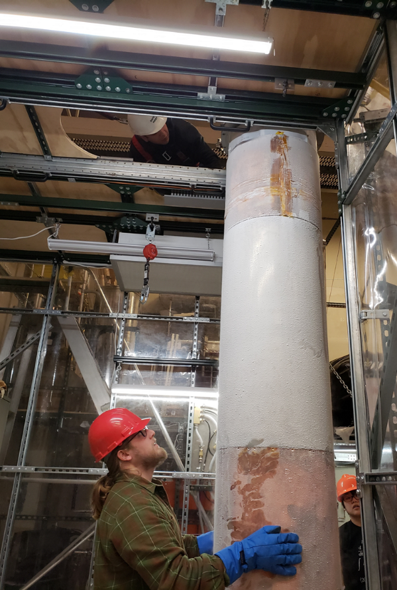
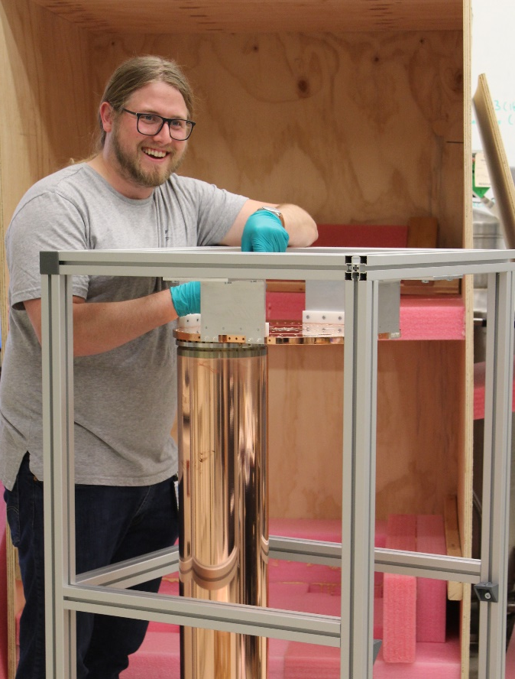
Outline of Today’s Talk
What are axions?
How ADMX currently operates
  Haloscope 101
  Current Limits and Run
Future of ADMX
  ADMX sidecar
  ADMX-EFR
ADMX Run 1B extraction procedure at CENPA
Run 2 4-Cavity System assembly at LLNL

Slide 3

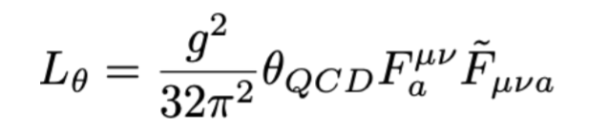
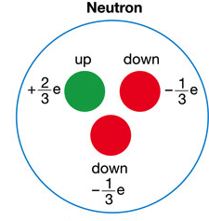

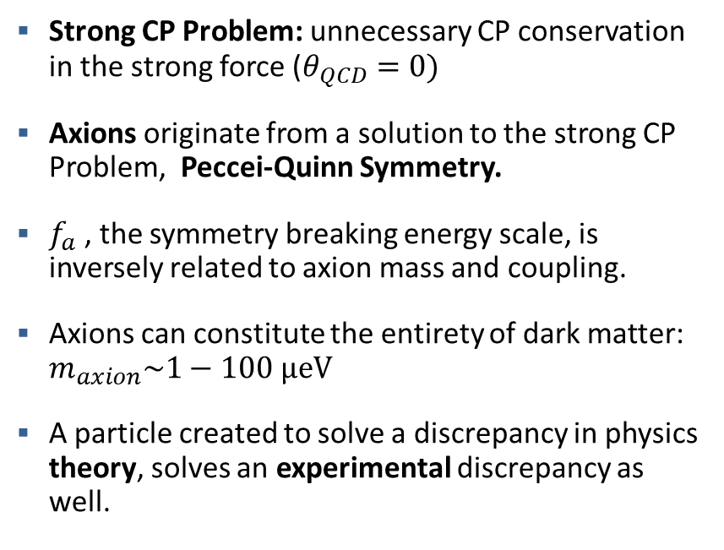

What are axions?:
The Dark Matter Problem and Axions
Strong CP Problem: unnecessary CP conservation in the strong force ($θ_{QCD}=0)$
Axions originate from a solution to the strong CP Problem, Peccei-Quinn Symmetry.
$f_{a}$ , the symmetry breaking energy scale, is inversely related to axion mass and coupling.
Axions can constitute the entirety of dark matter: $m_{axion}\sim 1−100 μeV$
A particle created to solve a discrepancy in physics theory, solves an experimental discrepancy as well.
$$d_{n}≈θ_{QCD} e\frac{m_{q}}{m_{n}^{2}}$$
$$m_{a}\sim \frac{1}{f_{a}}$$
Dark Matter | Axions
Feebly-interacting with Photons | ✓
Gravitationally interacting | ✓
Non-baryonic | ✓
Very stable | ✓
Cold (non-relativistic) | ✓

Slide 4
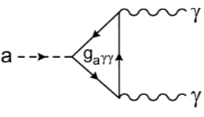
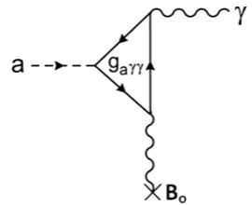
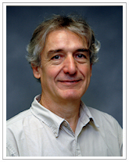
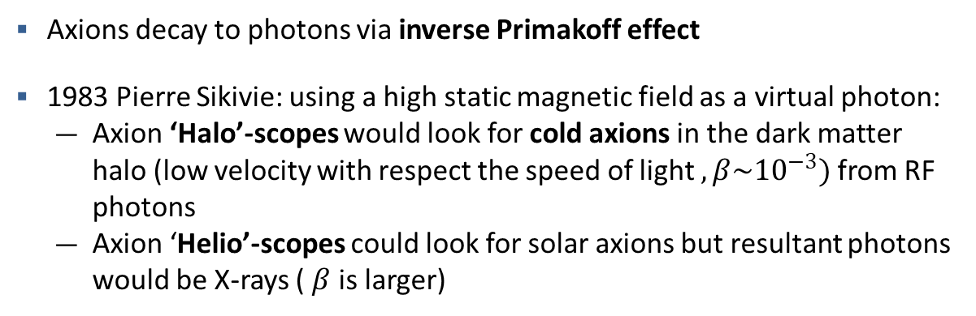

What are axions?
Coupling to photons and detection schemes
$$ℒ_{Aγγ}=−g_{Aγγ}E∙{Bφ}_{A}$$
Axions decay to photons via inverse Primakoff effect
1983 Pierre Sikivie: using a high static magnetic field as a virtual photon:
  Axion ‘Halo’-scopes would look for cold axions in the dark matter halo (low velocity with respect the speed of light $, β\sim {10}^{−3})$ from RF photons
  Axion ‘Helio’-scopes could look for solar axions but resultant photons would be X-rays ( $β$ is larger)
Pierre Sikivie
Notes:
Primakoff effect: axions produced by double photons (Solar axion generation
Inverse: axion decay
Haloscope: small beta means a very narrow lineshape for the halo axions, hence the need to scan in frequency

Slide 5
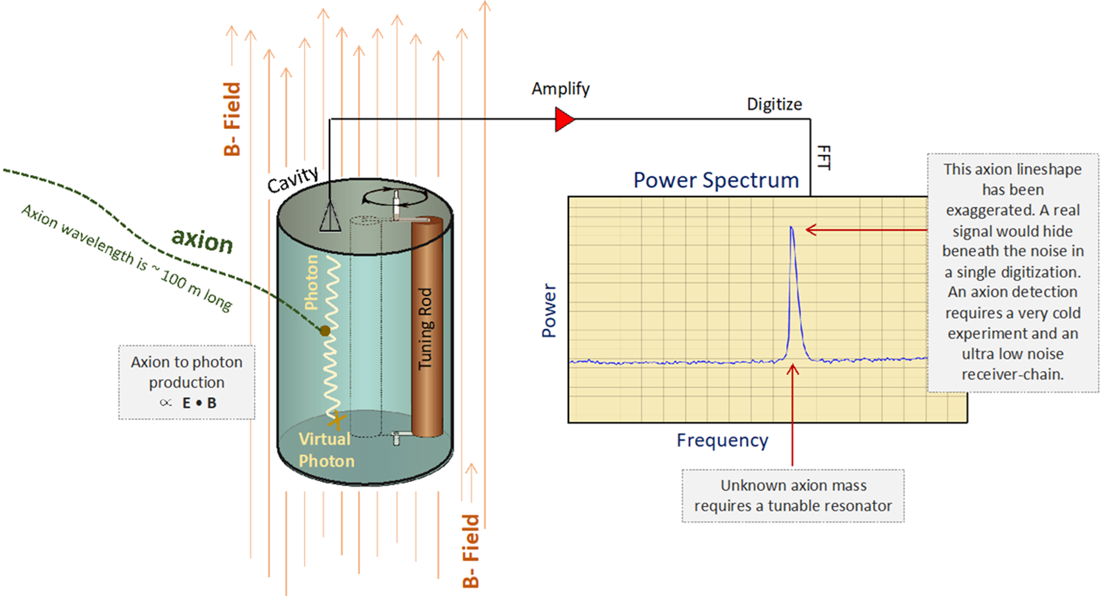
How does ADMX currently operate?
The Axion Haloscope

Slide 6
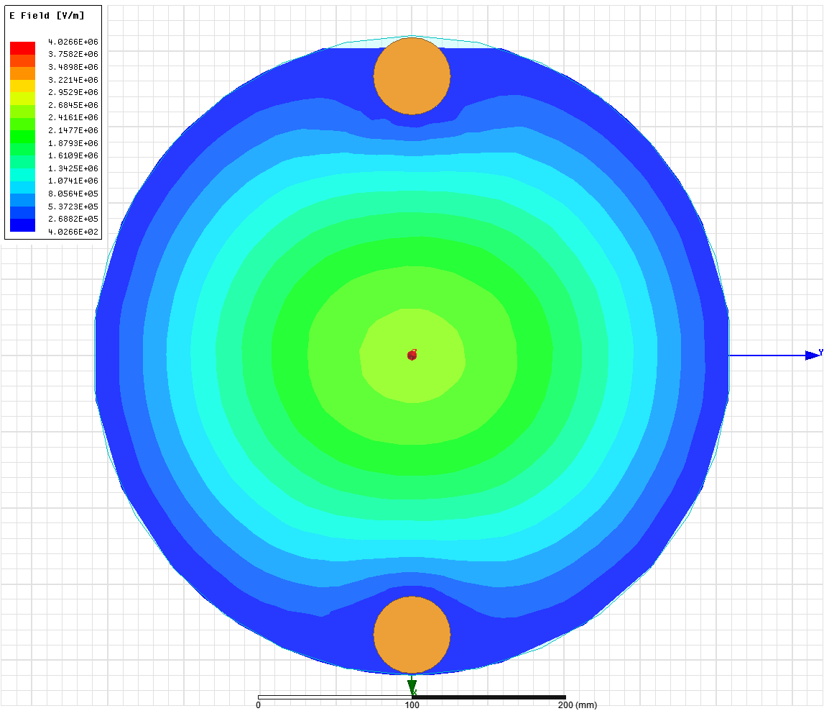
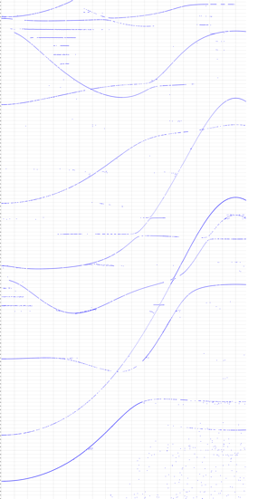
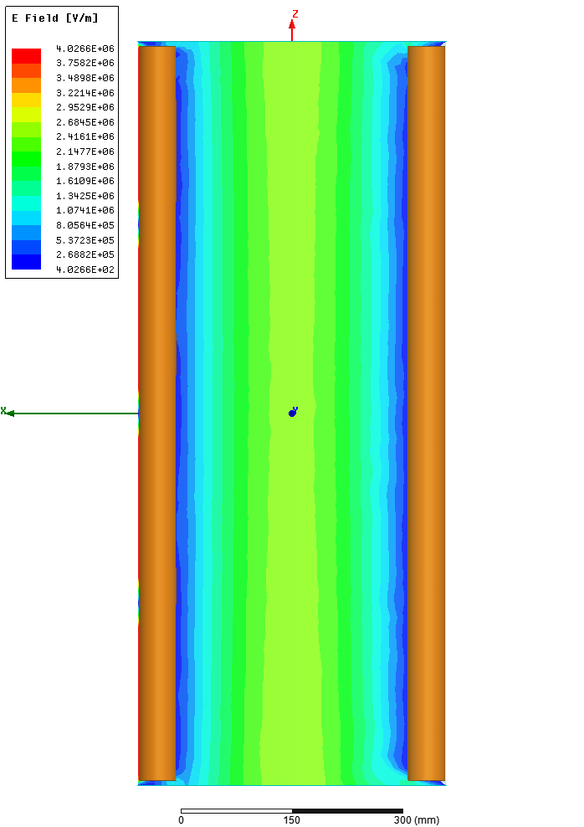
How does ADMX operate?
Scanning Masses via Tuning Rod
Mode Map
Frequency
Tuning Rod Angle

Slide 7
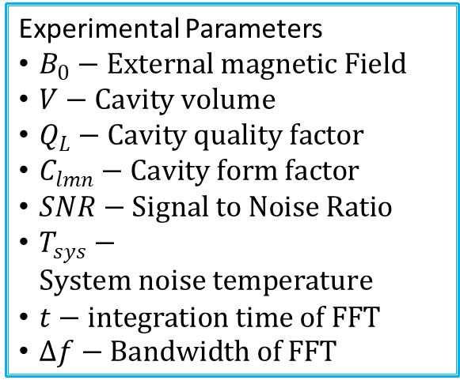
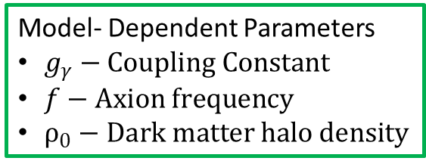

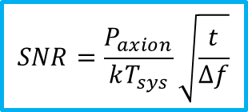
How does ADMX currently operate?
Axion Scan Rate Equation
$\frac{ⅆf}{ⅆt}≈1.98\frac{GHz}{year}{\left(\frac{g_{γ}}{0.36}\right)}^{4}\left(\frac{f}{1 GHz}\right){\left(\frac{ρ_{0}}{0.45\frac{GeV}{cc}}\right)}^{2}∙{\left(\frac{5}{SNR}\right)}^{2}{\left(\frac{B_{0}}{7.6T}\right)}^{4}{\left(\frac{V}{136l}\right)}^{2}\left(\frac{Q_{L}}{30,000}\right){\left(\frac{C_{lmn}}{0.4}\right)}^{2}{\left(\frac{0.35K}{T_{sys}}\right)}^{2}$*
Combining signal power with SNR we can arrive at the instantaneous scan rate for a haloscope
Experimental Parameters
$B_{0}−External magnetic Field$
$V−Cavity volume$
$Q_{L}−Cavity quality factor$
$C_{lmn}−Cavity form factor$
$SNR−Signal to Noise Ratio$
$T_{sys}−System noise temperature$
$t−integration time of FFT$
$∆f−Bandwidth of FFT$
*Does not include deadtime (Candidate rescans, engineering studies, pandemics, etc.)
$$SNR=\frac{P_{axion}}{kT_{sys}}\sqrt{\frac{t}{∆f}}$$
$$P_{axion}\sim {{ g}_{γ}}^{2}∙ρ_{0}∙f∙V{∙B_{0}}^{2}∙Q_{L}∙C_{lmn}$$
Model- Dependent Parameters
$g_{γ}−Coupling Constant$
$f−Axion frequency$
$ρ_{0}−Dark matter halo density$

Slide 8
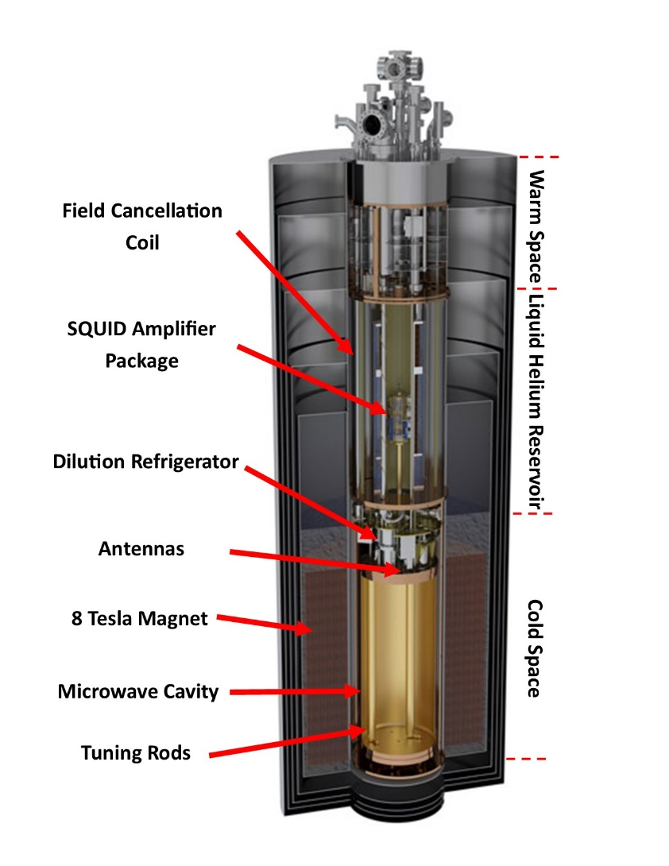
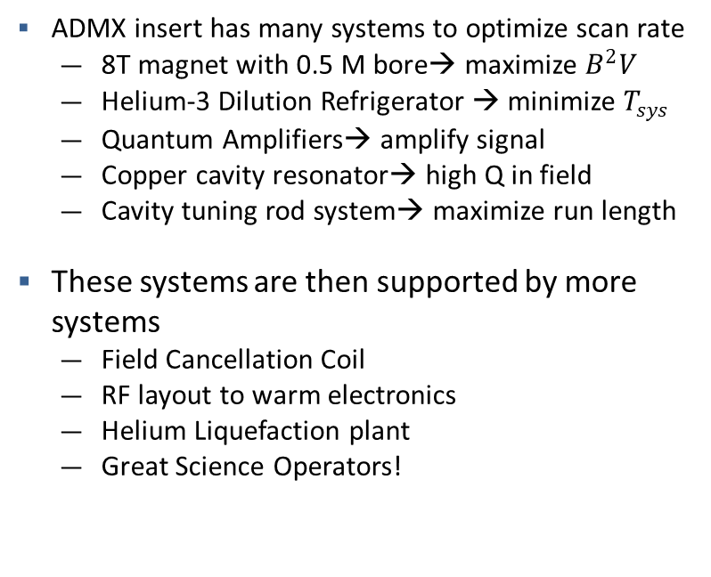
How does ADMX currently operate?
ADMX Insert
ADMX insert has many systems to optimize scan rate
  8T magnet with 0.5 M bore→ maximize $B^{2}V$
  Helium-3 Dilution Refrigerator → minimize $T_{sys}$
  Quantum Amplifiers→ amplify signal
  Copper cavity resonator→ high Q in field
  Cavity tuning rod system→ maximize run length
These systems are then supported by more systems
  Field Cancellation Coil
  RF layout to warm electronics
  Helium Liquefaction plant
  Great Science Operators!

Slide 9
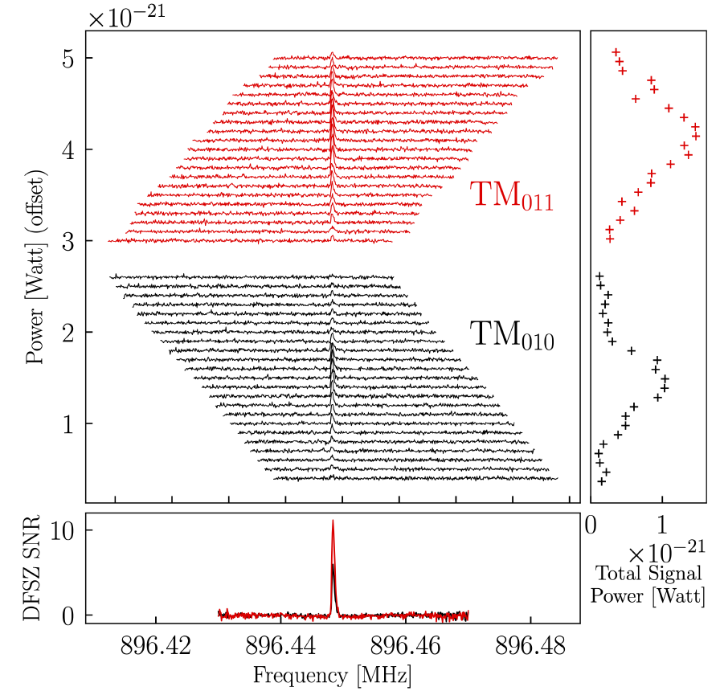




How Does ADMX Operate?
Experimental Cadence
The cavity frequency is scanned over a frequency region until the desired SNR is achieved
The receiver system is periodically characterized to monitor SNR (JPA biasing, NA measurements, etc.)
Examine the combined power spectrum for signs of excess; these can be statistical fluctuations, synthetic signals, RF interference, or axions!
Excess power regions are rescanned to see if they persist
Persistent candidates are subjected to confirmation tests (Ex: scan outside cavity or ramp magnet)
Example Candidate
Notes:
Look for better picture

Slide 10
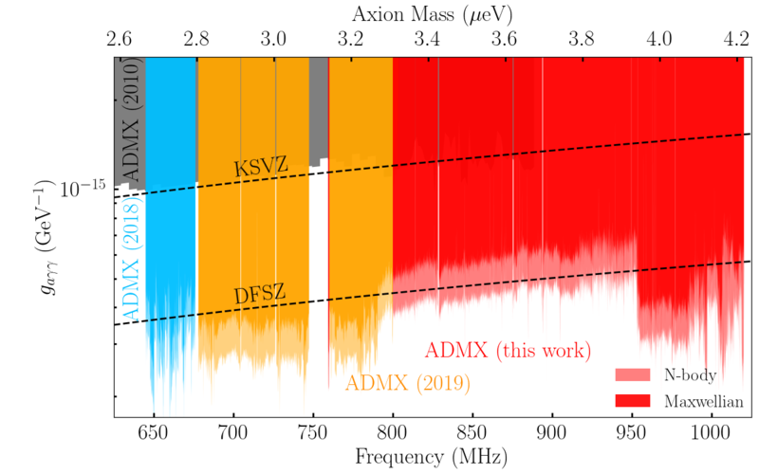
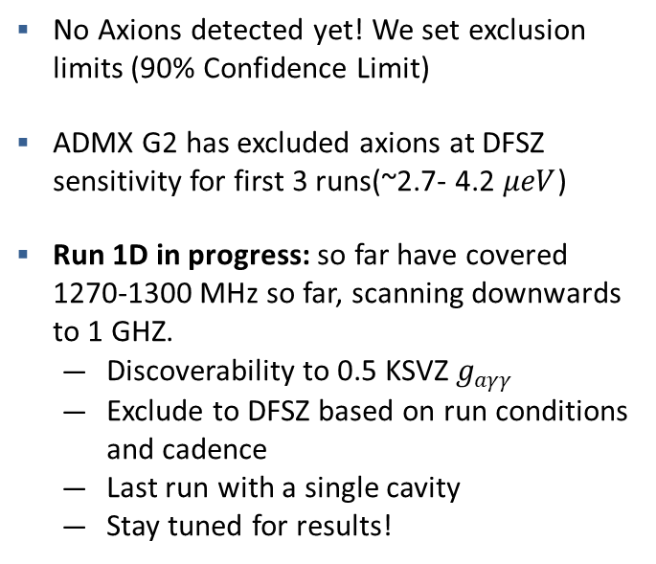
How does ADMX currently operate?
Current Limits
Currently scanning up here!
No Axions detected yet! We set exclusion limits (90% Confidence Limit)
ADMX G2 has excluded axions at DFSZ sensitivity for first 3 runs(~2.7- 4.2 $μeV$)
Run 1D in progress: so far have covered 1270-1300 MHz so far, scanning downwards to 1 GHZ.
  Discoverability to 0.5 KSVZ $g_{aγγ}$
  Exclude to DFSZ based on run conditions and cadence
  Last run with a single cavity
  Stay tuned for results!
Run 1A
Run 1C
Run 1B
Current Axion Limits set by ADMX G2.
From Most Recent PRL results (2021)

Slide 11
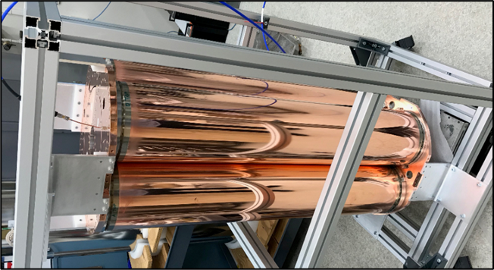
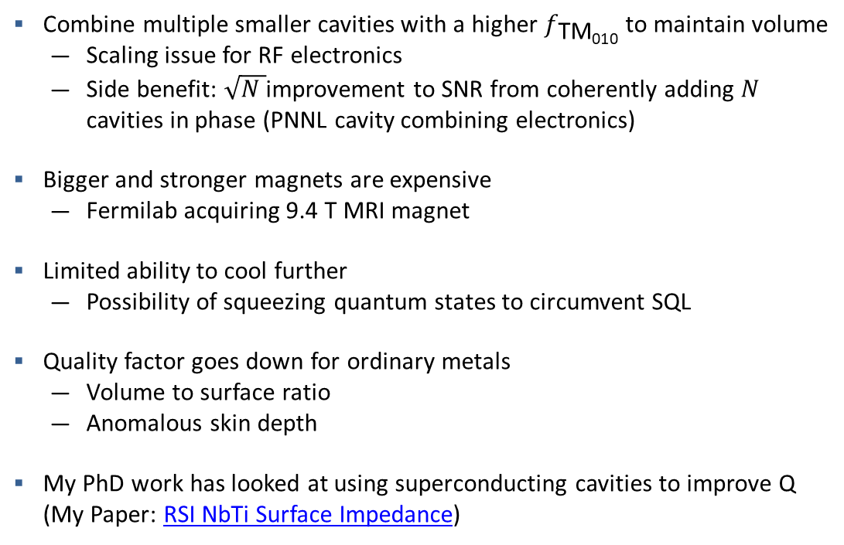
Future of ADMX
Challenges and strategies at Higher Frequencies
Combine multiple smaller cavities with a higher $f_{\text{TM}\text{010}}$ to maintain volume
  Scaling issue for RF electronics
  Side benefit: $\sqrt{N }$improvement to SNR from coherently adding $N$ cavities in phase (PNNL cavity combining electronics)
Bigger and stronger magnets are expensive
  Fermilab acquiring 9.4 T MRI magnet
Limited ability to cool further
  Possibility of squeezing quantum states to circumvent SQL
Quality factor goes down for ordinary metals
  Volume to surface ratio
  Anomalous skin depth
My PhD work has looked at using superconducting cavities to improve Q (My Paper: RSI NbTi Surface Impedance)
Run 2 4-cavity system (Covers 1.4- 2GHz)

Slide 12
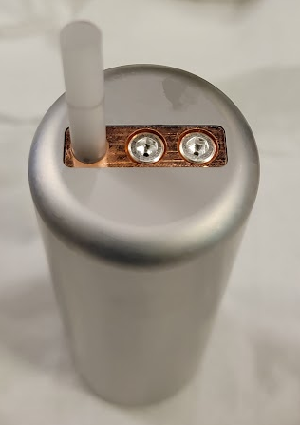
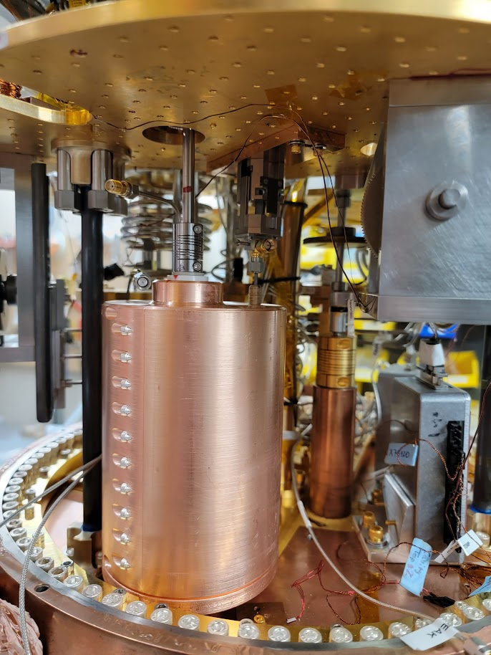
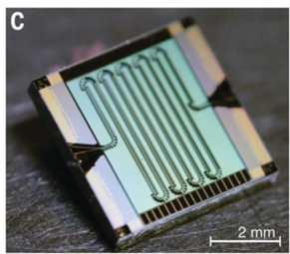
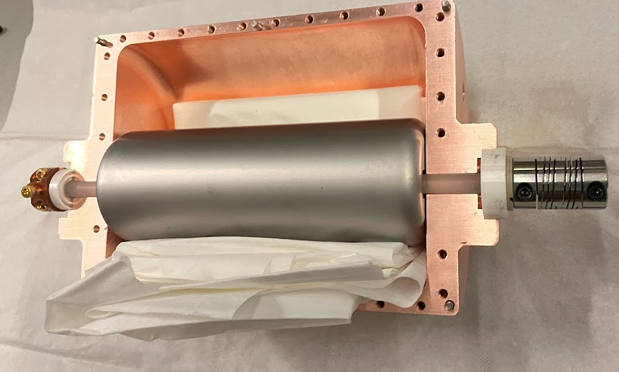
ADMX Sidecar
‘Testbed’ High Frequency cavity above the main cavity (~3.5 T) for emerging tech
  Piezo Motors
  JTWPA amplifier
  Nb₃Sn coated tuning rod
‘Clam-shell’ Cavity can tune 3.6-6.2 GHz
Currently running at 5.5 GHz
10x KSVZ or lower sensitivity goal
Nb₃Sn Rod has not achieved the desired boost in Q-factor for reasons we are currently studying.
Stay tuned for in-depth results in my thesis

Slide 13
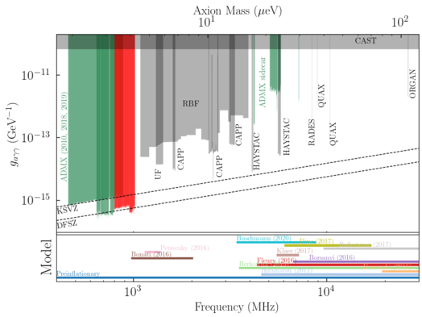
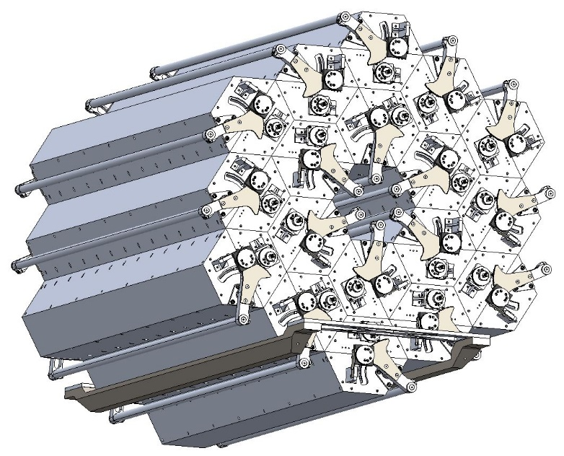
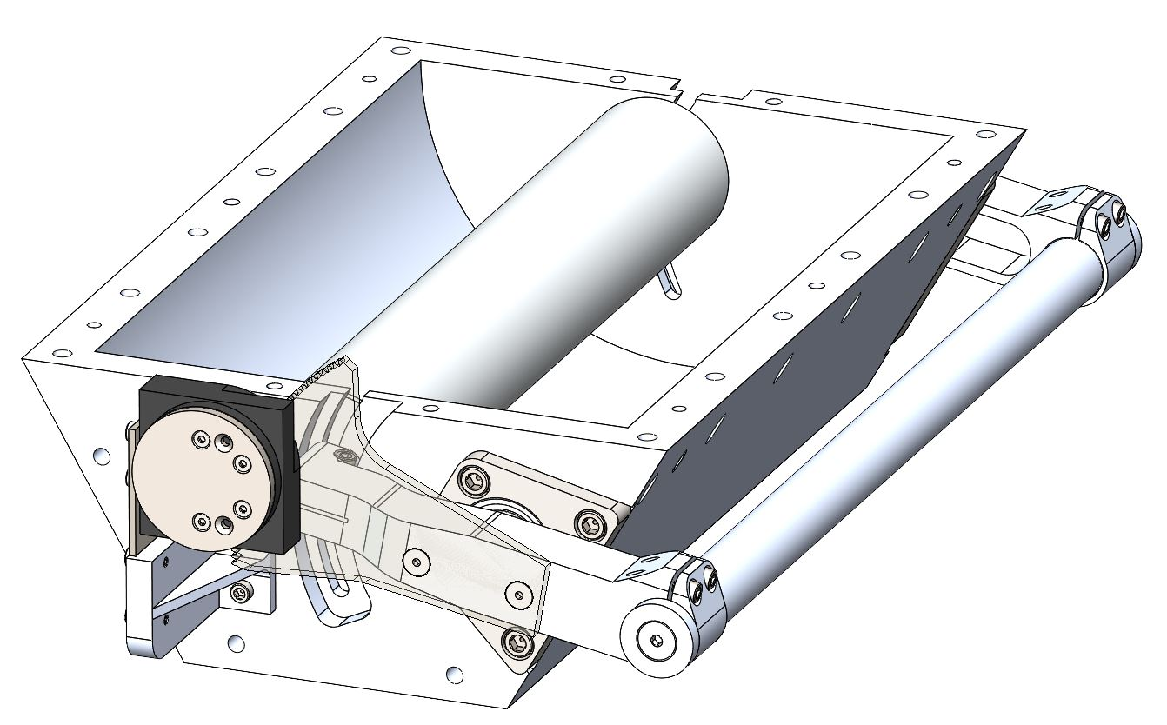
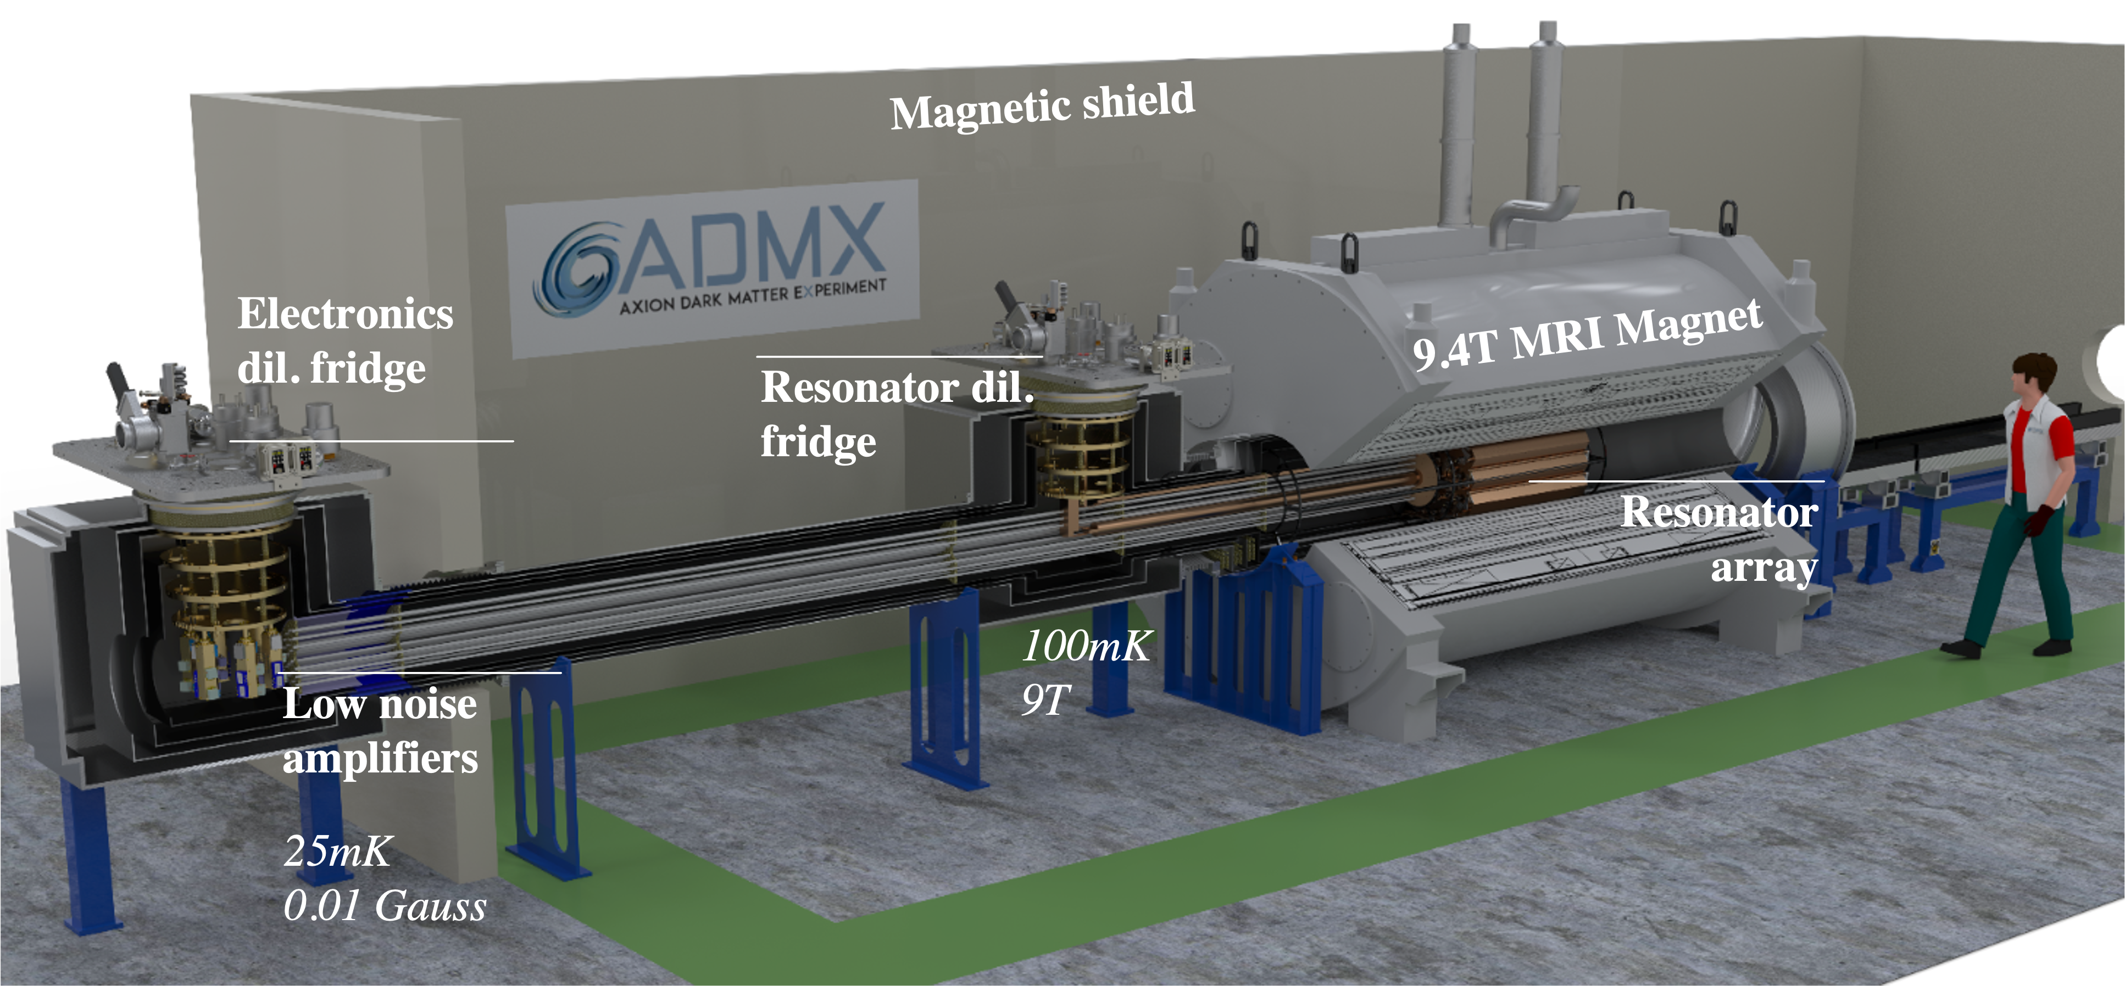
The Future of ADMX: ADMX-EFR
14 cavity array in development, potentially Superconducting (SRF), covering 2-4 GHz sited at Fermilab (Paper coming soon!)
In progress
Run 1D
ADMX R&D
Run 2
ADMX-EFR
Planned coverage of Axion parameter space

Slide 14
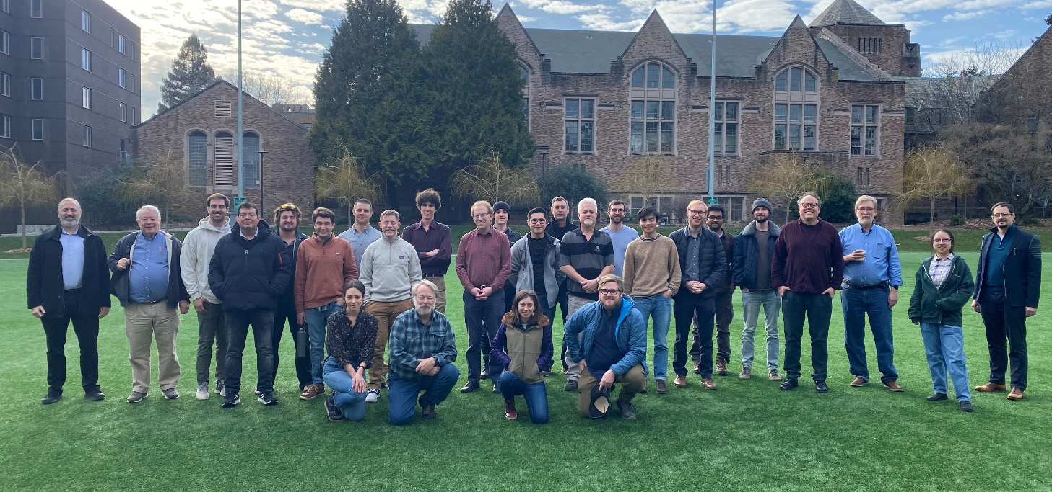







Thank You! Questions?
Acknowledgements:
This work was supported by the U.S. Department of Energy through Grants No DE-SC0009800, No. DE-SC0009723, No. DE-SC0010296, No. DE-SC0010280, No. DE-SC0011665, No. DEFG02-97ER41029, No. DE-FG02-96ER40956, No. DEAC52-07NA27344, No. DE-C03-76SF00098 and No. DE-SC0017987. Fermilab is a U.S. Department of Energy, Office of Science, HEP User Facility. Fermilab is managed by Fermi Research Alliance, LLC (FRA), acting under Contract No. DE-AC02-07CH11359. Additional support was provided by the Heising-Simons Foundation and by the Lawrence Livermore National Laboratory and Pacific Northwest National Laboratory LDRD offices.
Disclaimer
This document was prepared as an account of work sponsored by an agency of the United States government. Neither the United States government nor Lawrence Livermore National Security, LLC, nor any of their employees makes any warranty, expressed or implied, or assumes any legal liability or responsibility for the accuracy, completeness, or usefulness of any information, apparatus, product, or process disclosed, or represents that its use would not infringe privately owned rights. Reference herein to any specific commercial product, process, or service by trade name, trademark, manufacturer, or otherwise does not necessarily constitute or imply its endorsement, recommendation, or favoring by the United States government or Lawrence Livermore National Security, LLC. The views and opinions of authors expressed herein do not necessarily state or reflect those of the United States government or Lawrence Livermore National Security, LLC, and shall not be used for advertising or product endorsement purposes.

Slide 15
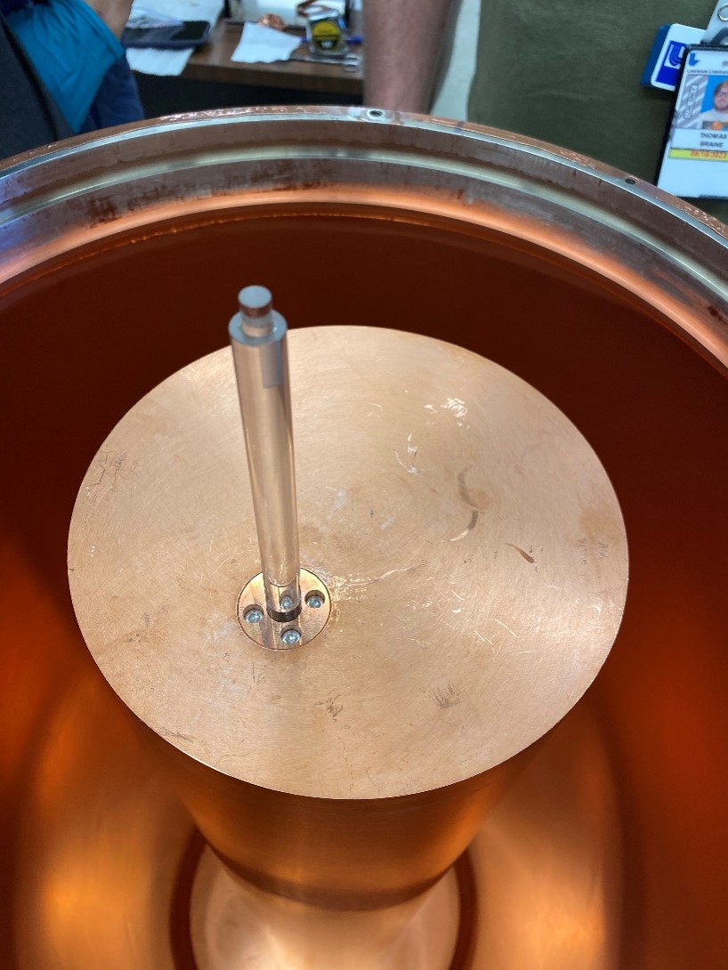
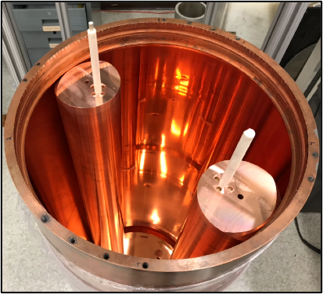
Run 1C and Run 1D cavity pictures
Run 1C: Two Rods
Run 1D: Single 8” Rod

Slide 16
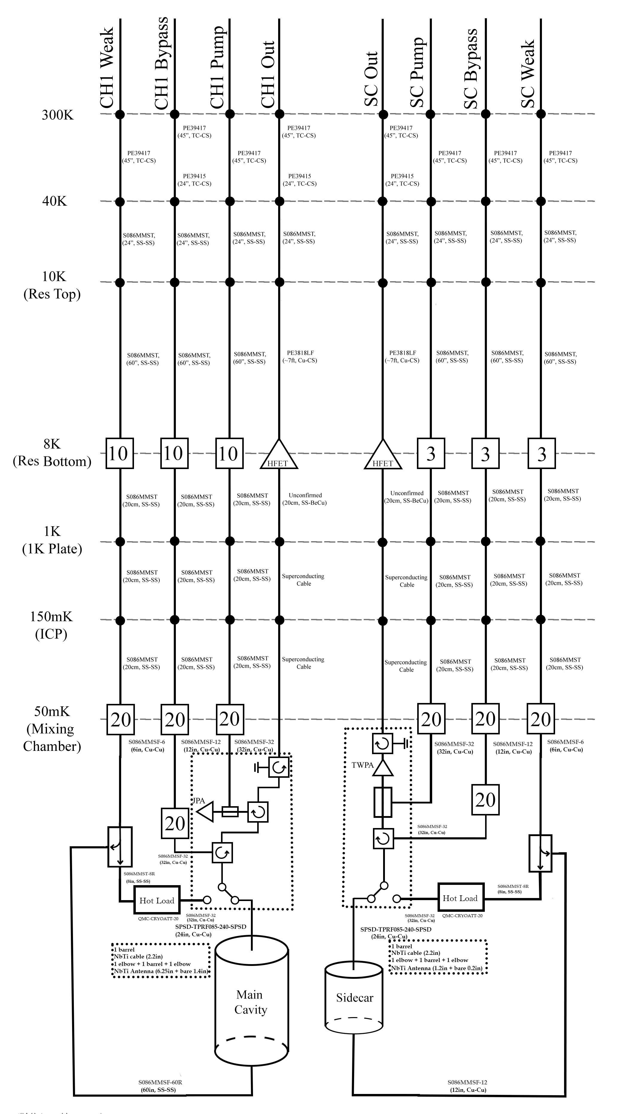
Run 1D RF layout

Slide 17
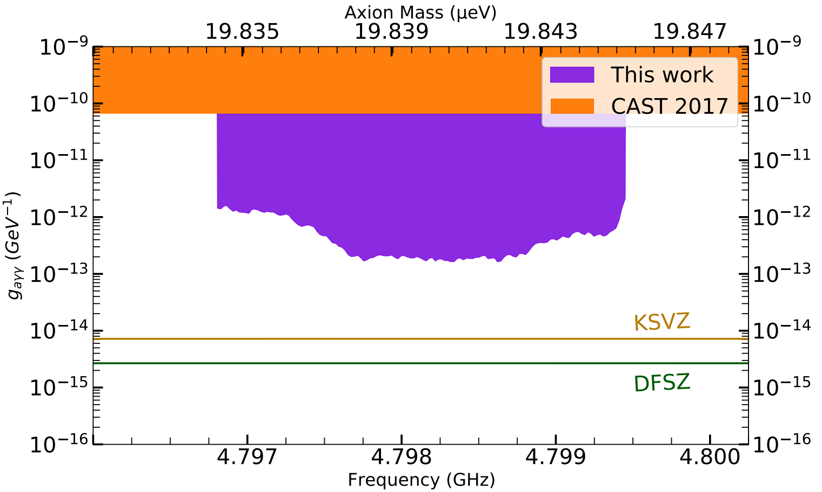
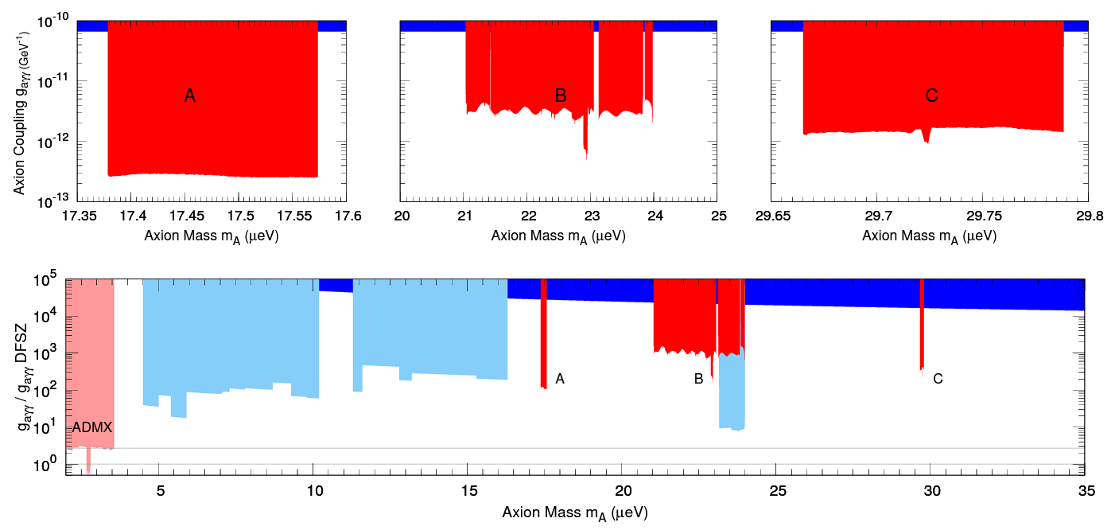
Previous Sidecar Limits
Typically have achieved 10-100x KSVZ

Slide 18
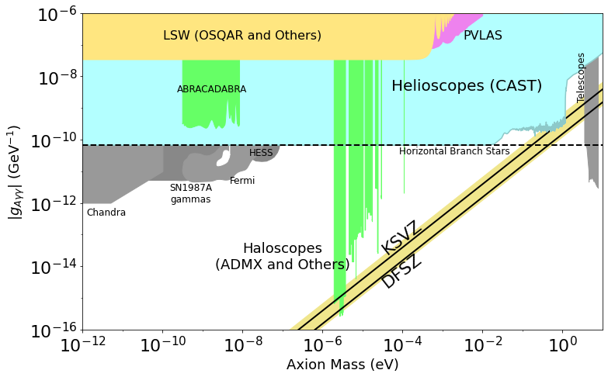
What are axions:
Types of Axion Search Experiments
Haloscopes: DM Halo Axions
  ADMX, RBF
  low Mass: DM Radio, ABRACADABRA
  high mass: MADMAX
Light Shining Through Walls: Laser photon-axion mixing
  OSQAR, ALPS
  Future: ALPS-II
Helioscopes: Solar Axions
  CAST, Sumico
  Future: IAXO
ADMX only experiment to exclude at DFSZ!
Image credit: PDG

Slide 19
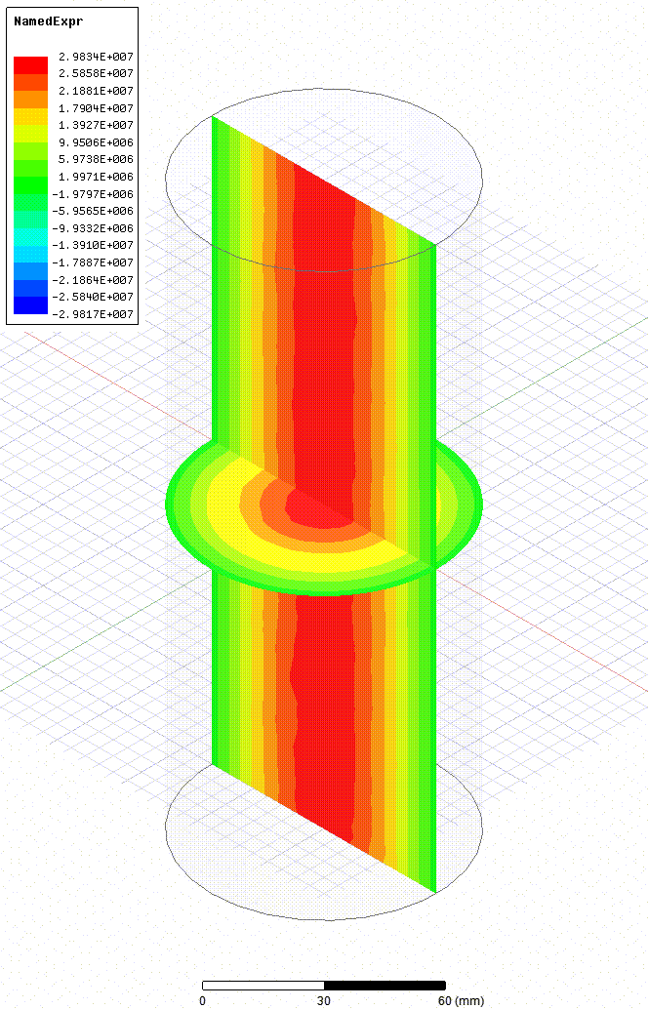
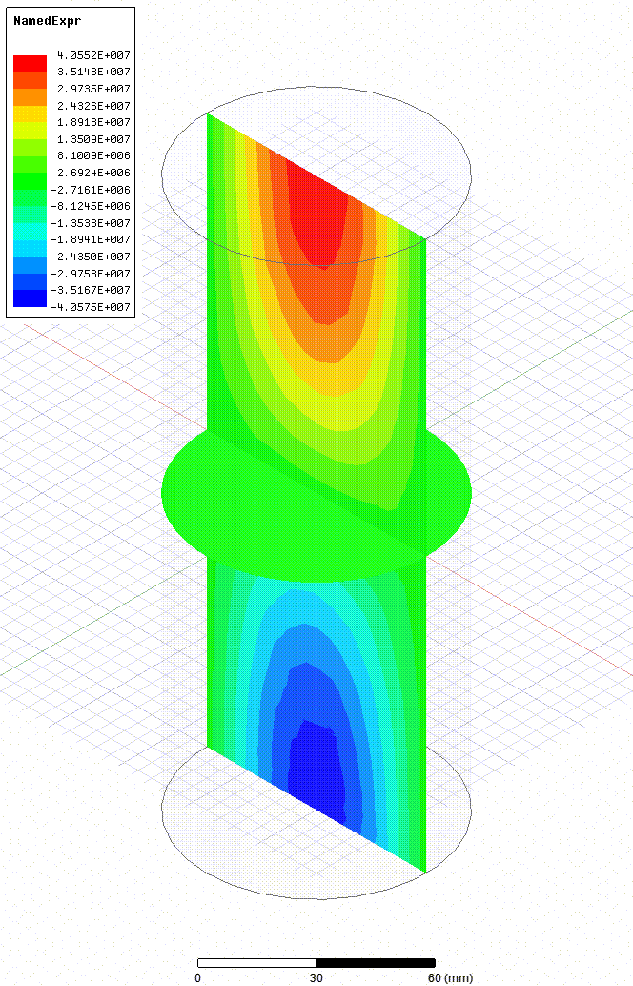
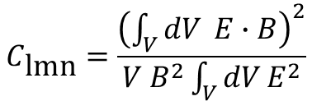
How does ADMX operate?
Cavity Form Factor
E-Field
TM010
TM011
$$C_{\text{lmn}}=\frac{{\left(\int_{V}^{ }{dV} E∙B\right)}^{2}}{V B^{2}\int_{V}^{ }{dV}E^{2}}$$
E-Field
The cavity form factor is a function of the mode structure of the cavity.
TM010 has the maximum form factor of ~0.7
The majority of modes have a negligible form factor.
Due to the tuning rod ADMX typically achieves ~0.4

Slide 20
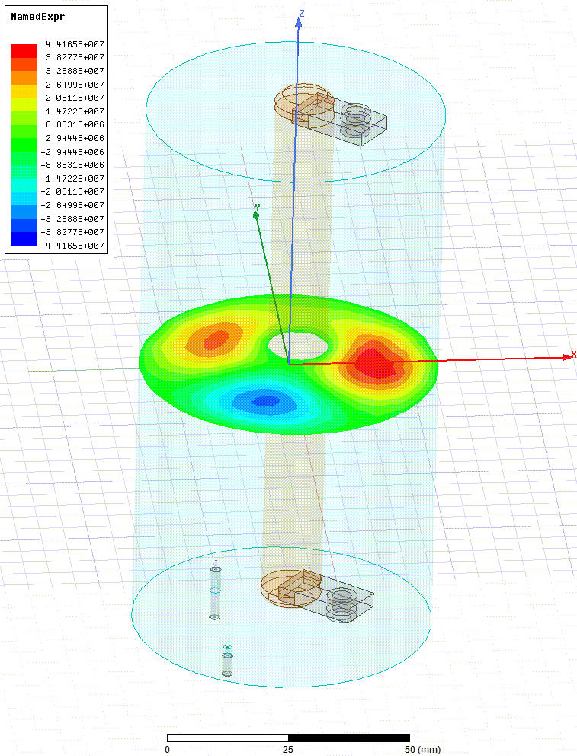
Higher Order Modes
Modes other than the TM010 have non-zero form factors.
The TM020 has a form factor of ~0.1.
Has been demonstrated in the Sidecar cavity.
Extends the scannable range to 6.4-7.2GHz

Slide 21
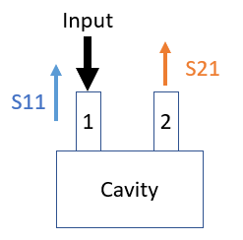
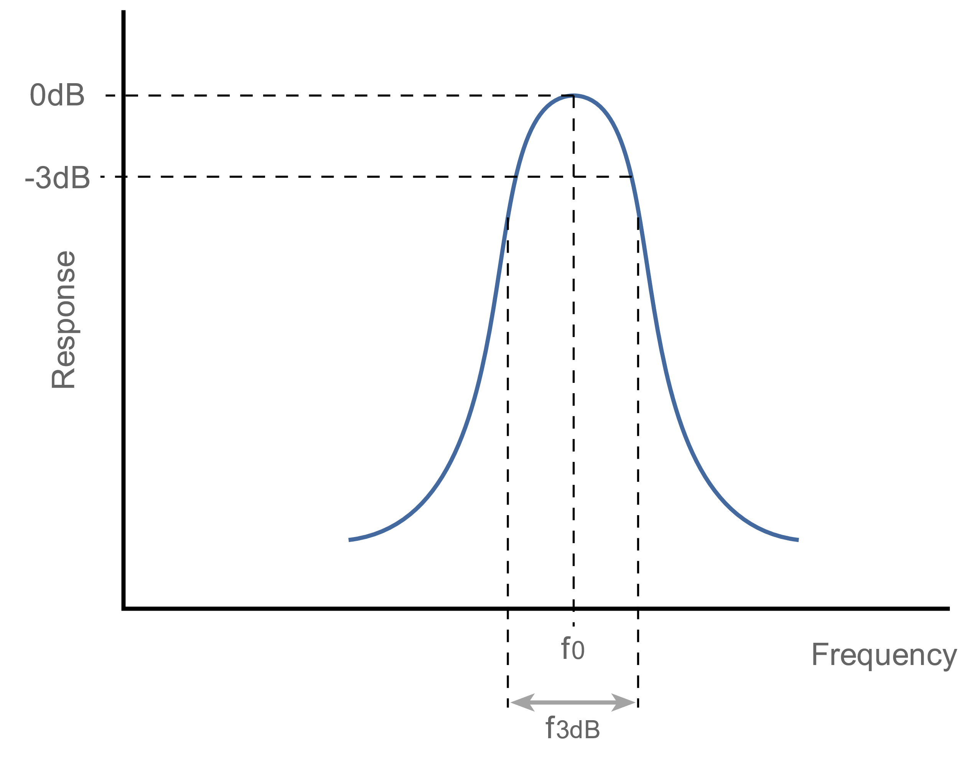
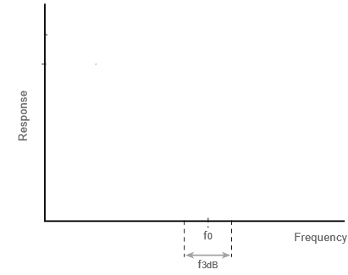
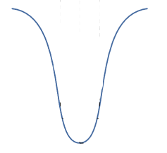
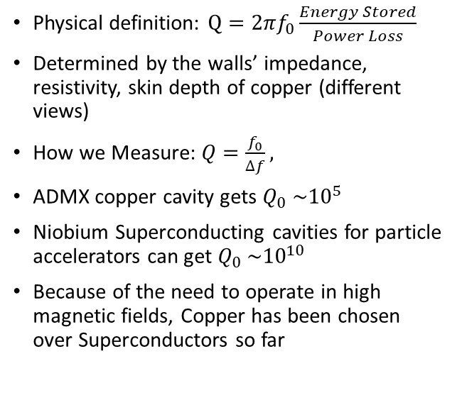
Quality factor
Physical definition: $Q=2πf_{0}\frac{Energy Stored}{Power Loss}$
Determined by the walls’ impedance, resistivity, skin depth of copper (different views)
How we Measure: $Q=\frac{f_{0}}{∆f},$
ADMX copper cavity gets $Q_{0} {\sim 10}^{5}$
Niobium Superconducting cavities for particle accelerators can get $Q_{0} {\sim 10}^{10}$
Because of the need to operate in high magnetic fields, Copper has been chosen over Superconductors so far
S21
S11
Image credit: S parameters, Wikipedia original graphic by Jon Bauman

Slide 22
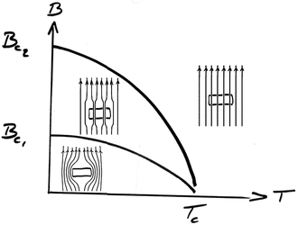
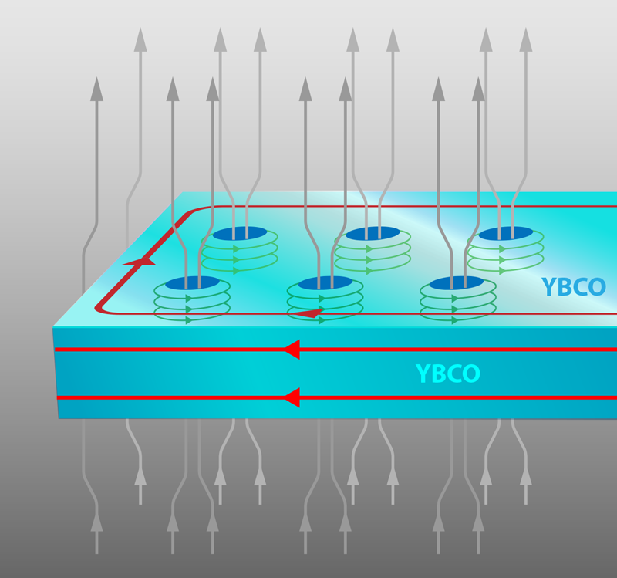
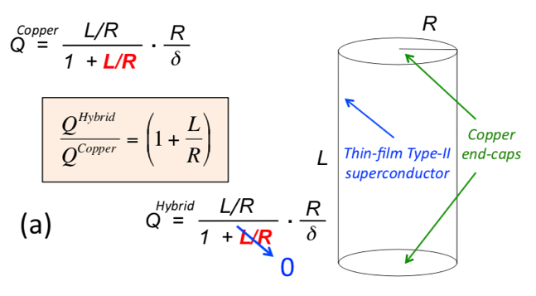

Model for Hybrid Superconducting Cavity
Type II superconductors have two critical magnetic field values, $B_{c1}$, below which the field is repelled completely, and $B_{c2}$, in which the field penetrates partially creating a mixed vortices state
  Vortice motion is primary source of resistivity and dissipation in the mixed state
  A thin film thickness can be tuned to mitigate these effects
  Parallel Surfaces may still have low RF resistivity!
For an empty cavity, Q of the ${TM}_{010}$ mode improves by a factor of $\left(1+L/R\right)$when the barrel is coated with a thin-film superconductor.
Image: Flux Vortices in Mixed State
Credit: APS, https://physics.aps.org/articles/v10/129
Image: Type 2 Superconductors Wikipedia

Slide 23


ADMX Systems
Cryogenics
Cryocooler
  Actively cools baffle to 40K
  First heatsinking stage
Two 1K pots
  Large 1K pot for the shielding, gearbox and electricals.
  Small 1K pot for Dil Fridge
Dilution fridge was custom built by Janis Research Company
800 µW of cooling at 100 mK
Cools the resonator and amplifiers.

Slide 24


ADMX Systems
Quantum RF electronics
For frequencies above 1GHz Josephson parametric amplifiers are more suitable.
A pump tone is used to excite squid loops which in turn amplify the incoming signal.
Produced by the Siddiqi Group at UC Berkeley
Testing of the quantum electronics took place at Livermore before being shipped to the experiment.
Gain
20dB

Slide 25

ADMX Systems
Synthetic Axion Generator
To calibrate the detector a ‘synthetic axion’ signal can be injected into the cavity. This both verifies the electronics and the analysis procedure.

