Slide 1
ePIC Silicon Vertex Tracker
Concepts for a
4 LAS Wide Stave
Adam Huddart

Slide 2
4 LAS Wide Stave
Moving to 4 LAS wide staves increases options for stave layouts (odd number of modules along the stave length
Currently each FPC carries the data/power/control for 2 modules (4 LAS), a 4 LAS wide stave would need double the FPC width (7 mm) per 4 LAS module
Layer/Radius (mm) | Length (mm) | Number of 5 RSU LAS | Number of 6 RSU LAS
L3 / 270 | 540 | 4.98 (5) | 4.15 (4)
L4 / 420 | 840 | 7.76 (8) | 6.46
Current
Option
5 RSU Length | =5*21.667 = 108.3 mm
6 RSU Length | =6*21.667 = 130.0 mm

Slide 3
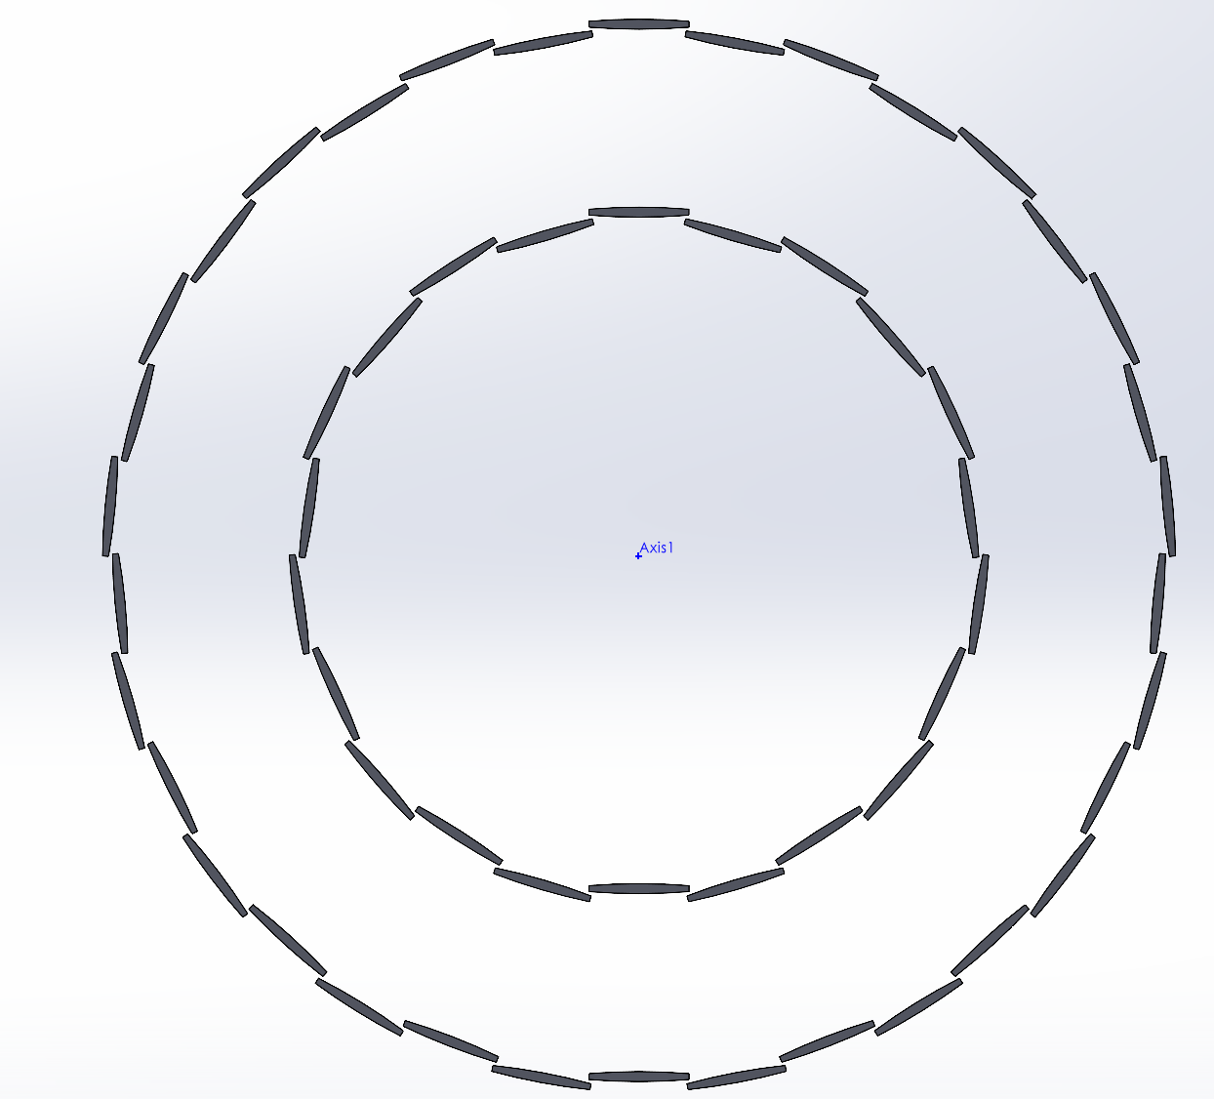
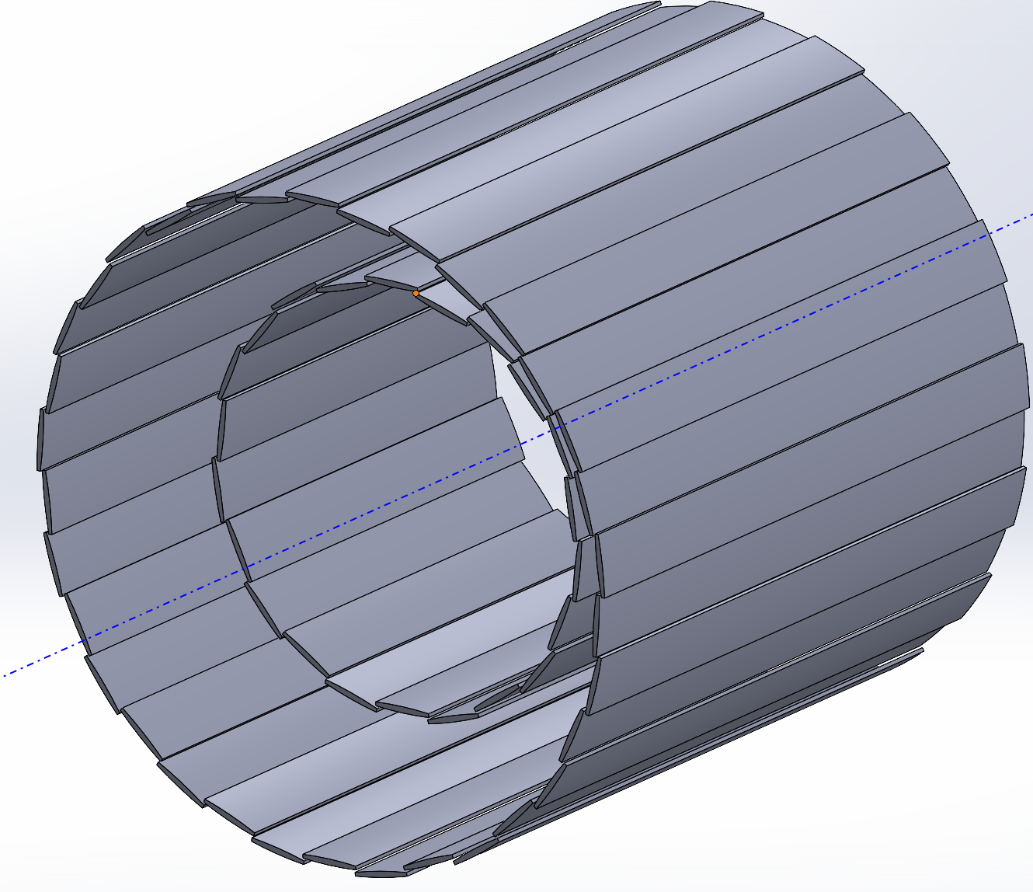
Stave Layout
L4 (34 Stave)
  Outer 424 mm
  Inner 416 mm
L3 (22 Stave)
  Outer 274 mm
  Inner 266 mm

Slide 4
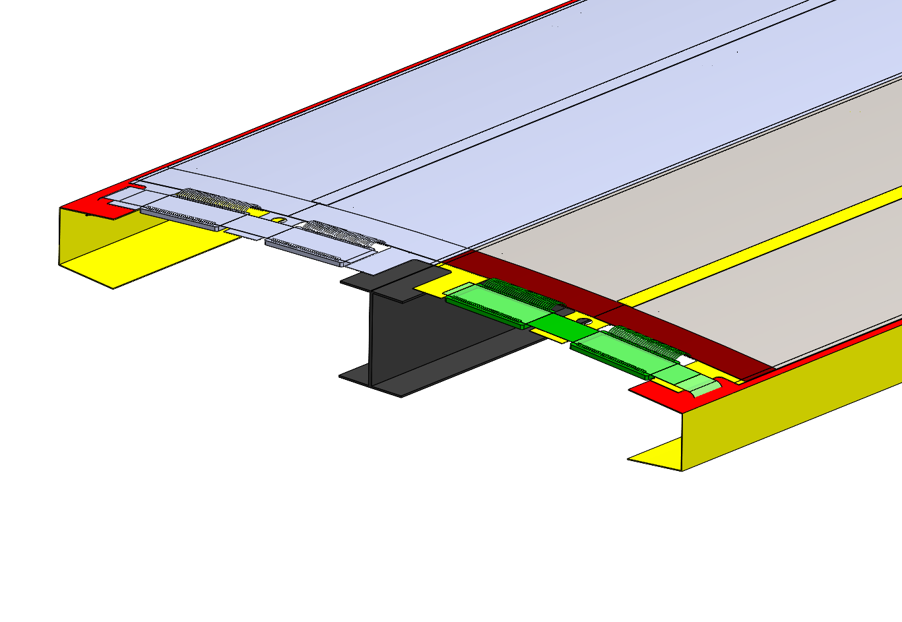
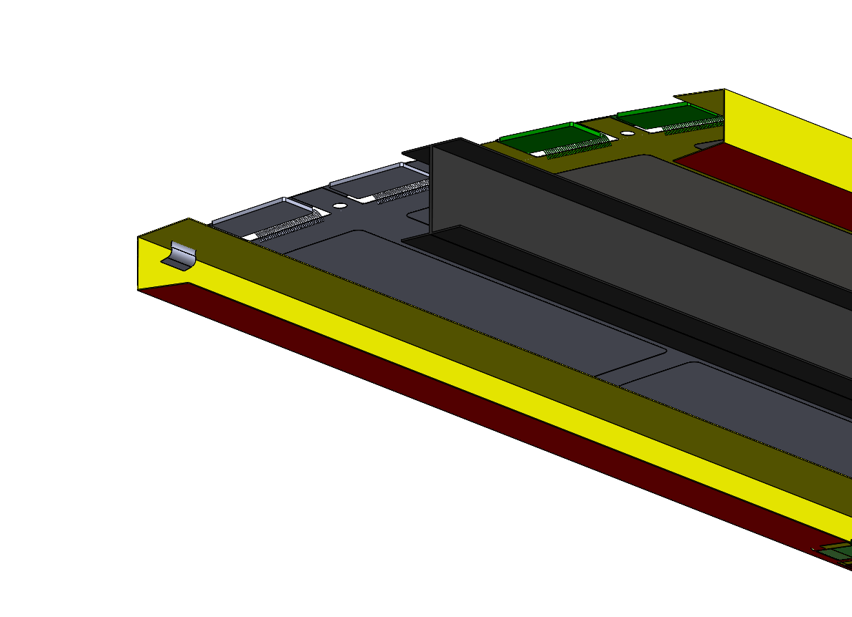

Internal Structure
Previous FPC arrangements only had traces on one C-channel “wing”
Options:
  Have 2 bridge FPC per module
    Need left/right-handed modules
    Bridge FPC exits opposite side on half of the modules
  OR
  Bridge FPC joins 4 LAS
More symmetric FPC layout
  TBD if asymmetry of FPC traces will cause issues with stave deformation
Internal pressure more of an issue for wider staves
  ⌀ 400 curvature or angled end LAS to reduce deformation due to internal pressure
RVC Foam
⌀ 400 mm
OR

Slide 5
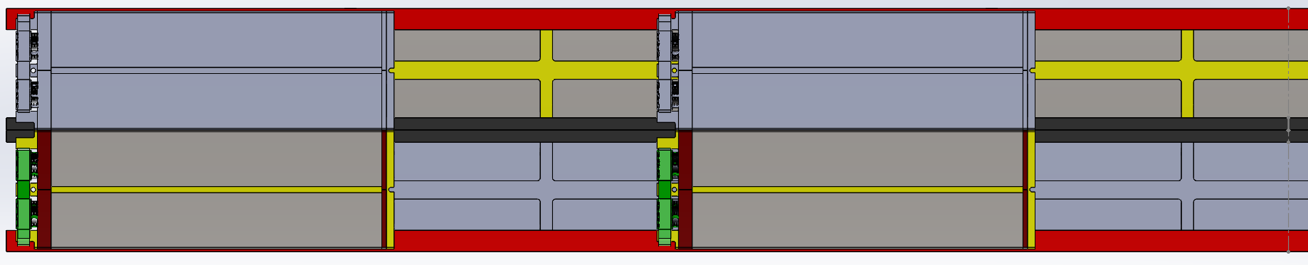
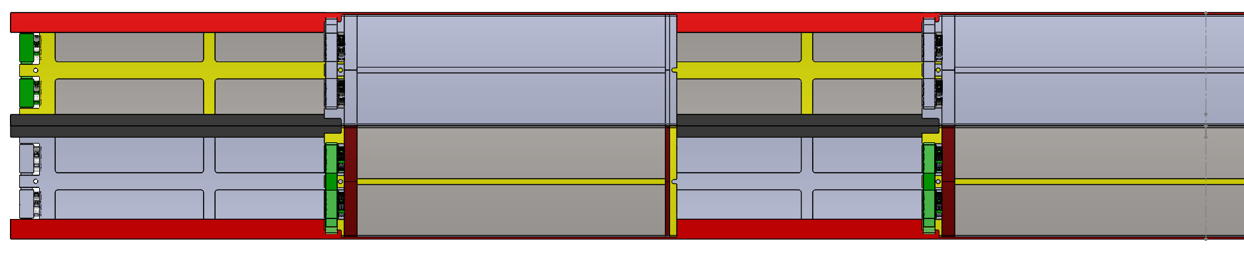
L4 FPC Arrangement – 2 LAS Module
Stave Centre
1,2
3,4
Top Side
1,2
3,4
1,2
3,4
Bottom Side
1,2
3,4

Slide 6
L4 FPC Arrangement – 4 LAS Module
Stave Centre
1,2,3,4
Top Side
1,2,3,4
1,2,3,4
Bottom Side
1,2,3,4

Slide 7
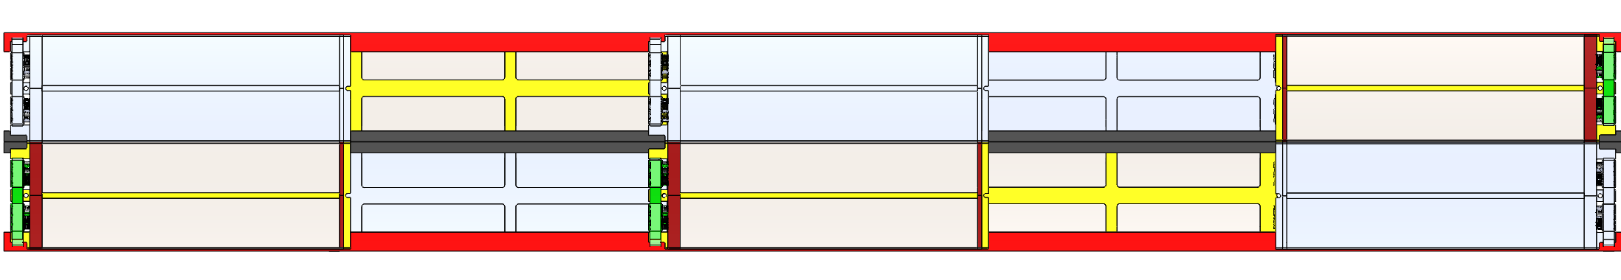
5 RSU L3 Considerations
Need to find room for an additional FPC location
  Along Central I beam
  Flip modules so bridge FPCs connections meet in the middle
1,2
3,4
1,2
1,2
3,4
3,4

Slide 8
Conclusions
Benefits
  Could build all staves from 5 RSU LAS
    If disc layers need 6 RSU, is this a benefit?
  Higher tortional stiffness
  Less service connections for coolant
  L4 FPC more symmetric
  Half as many staves to manufacture
Drawbacks
  May require multiple module versions (flipped bridge FPC)
  LAS deformation due to internal pressure likely to be higher
  Each stave is more complex

