Slide 1
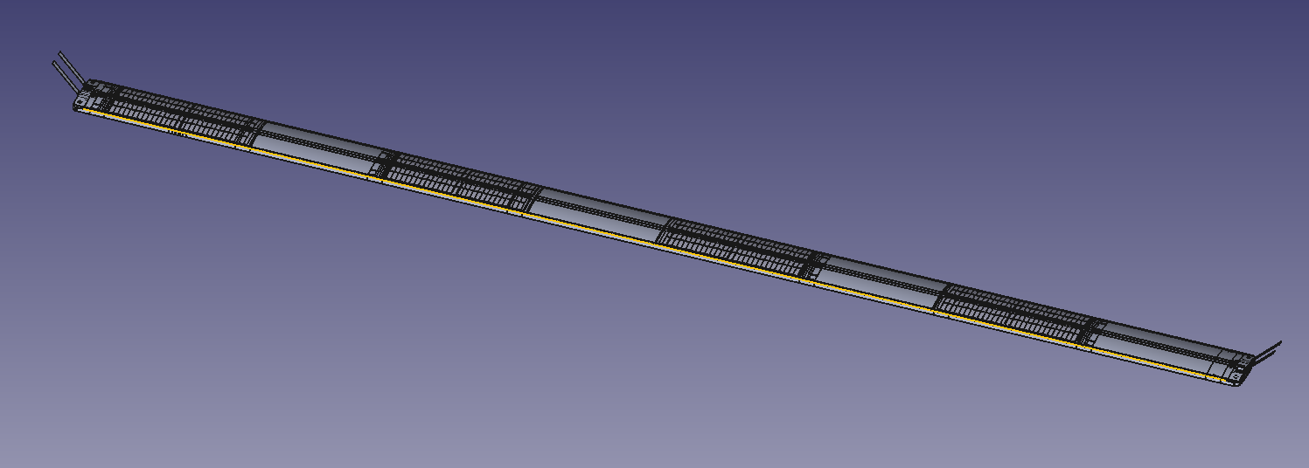
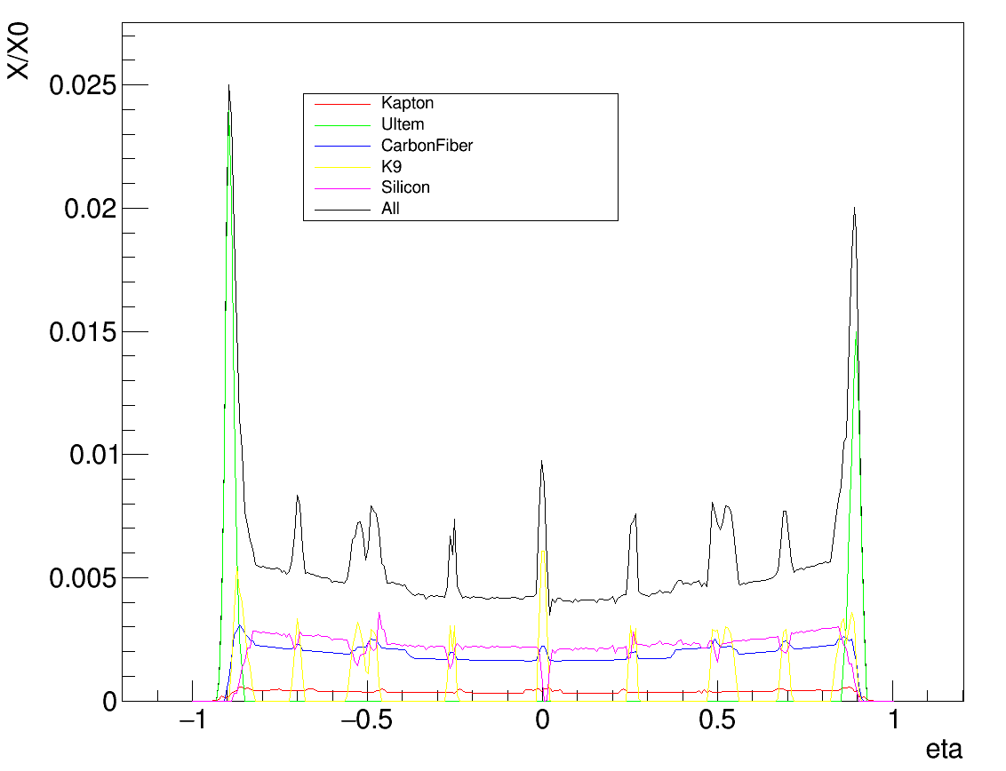
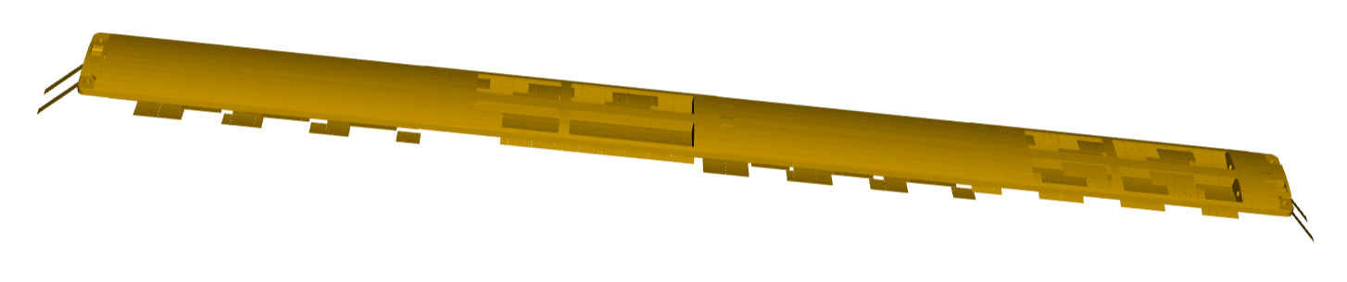


ePIC SVT – Simulation Updates and Next Steps
Sam Henry, Tuna Tasali, Long Li
Simulation software and the SVT outer barrels
Simulations with Fun4All (Long Li)
Converting CAD to DD4HEP (Tuna Tasali)
Material thickness mapping
Update to epic simulation geometry
Tracking performance studies
Next steps
UK

Slide 2
ePIC Simulation Software
Repositories:
EPIC Geometry: https://github.com/eic/epic
EICRecon: https://github.com/eic/EICrecon
EDM4eic: https://github.com/eic/EDM4eic
DD4hep: https://github.com/AIDAsoft/DD4hep
Tutorials:
https://www.youtube.com/@eicusergroup1532
https://eic.github.io/tutorial-setting-up-environment/
https://eic.github.io/tutorial-geometry-development-using-dd4hep/
https://eic.github.io/tutorial-simulations-using-ddsim-and-geant4/
https://eic.github.io/tutorial-jana2/
https://eic.github.io/tutorial-analysis/
https://github.com/cipriangal/eicGenTutorials
Mattermost forum: https://chat.epic-eic.org/ (helpdesk channel)
Software and computing mailing list: https://lists.bnl.gov/mailman/listinfo/eic-projdet-compsw-l
eic-shell
.hepmc event files
epic geometry
ddsim (Geant4 in DD4HEP framework)
eicrecon (event reconstruction – ACTS framework)
.edm4hep.root files
Analyse with root or pyroot

Slide 3
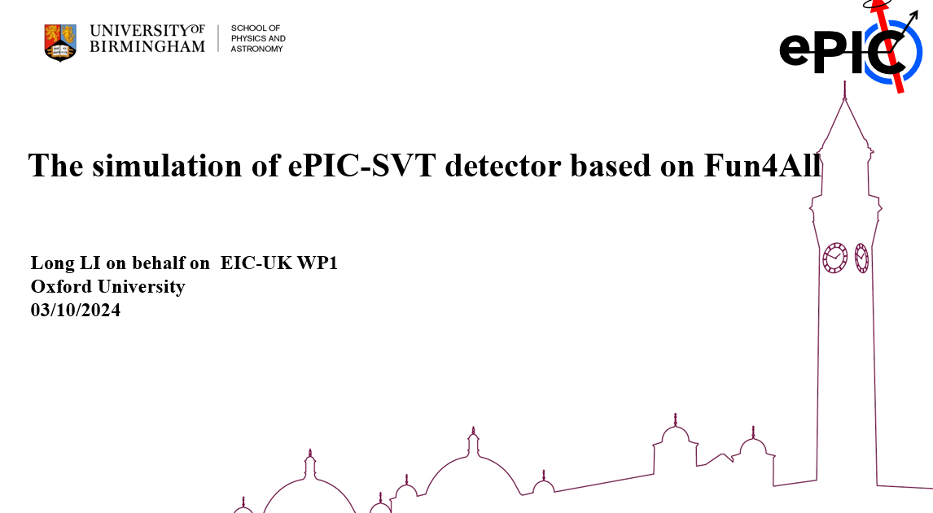
SVT Simulation – first results with Fun4All
https://indico.bnl.gov/event/24804/contributions/97254/attachments/57706/99121/ePIC_SVT_simulation_F2F_Oxford_241003.pdf
See slides by Long Li:

Slide 4
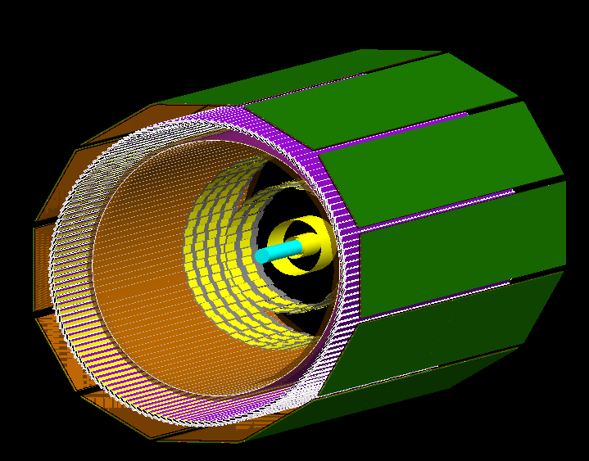
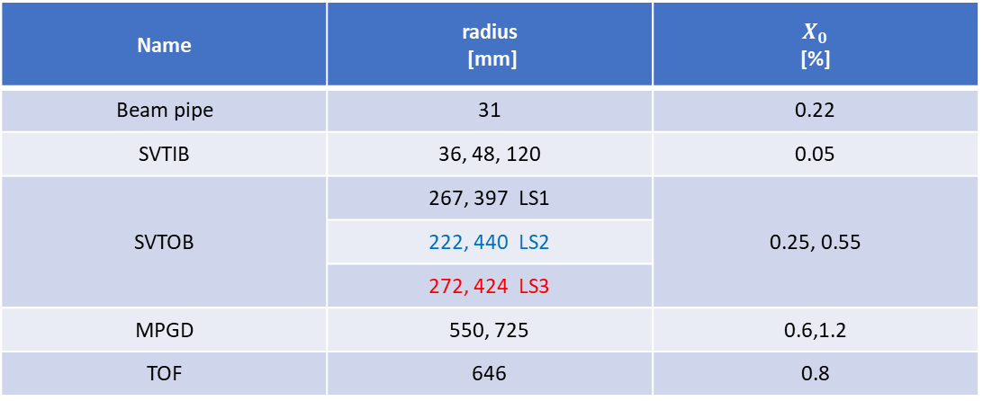
Geometry description of Tracking system in Fun4All
Beam pipe
SVT-IB
SVT-OB
MPGD
AC-LGD TOF
Generic beam pipe for EIC in Fun4All
Construct SVT detectors in Geant4 with 2 potential OB layout
Construct MPGD & TOF detector in Geant4 with default parameters in eic-shell
Name | radius [mm] | $$X_{0}$$ [%]
Beam pipe | 31 | 0.22
SVTIB | 36, 48, 120 | 0.05
SVTOB | 267, 397 LS1 | 0.25, 0.55
 | 222, 440 LS2
 | 272, 424 LS3
MPGD | 550, 725 | 0.6,1.2
TOF | 646 | 0.8
EIC-UK WP1 F2F Oxford
4

Slide 5
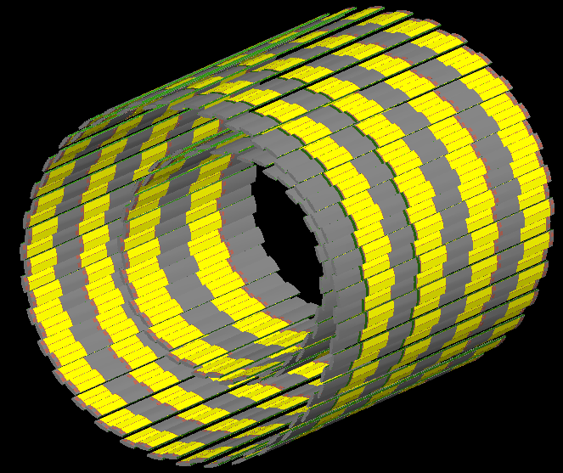
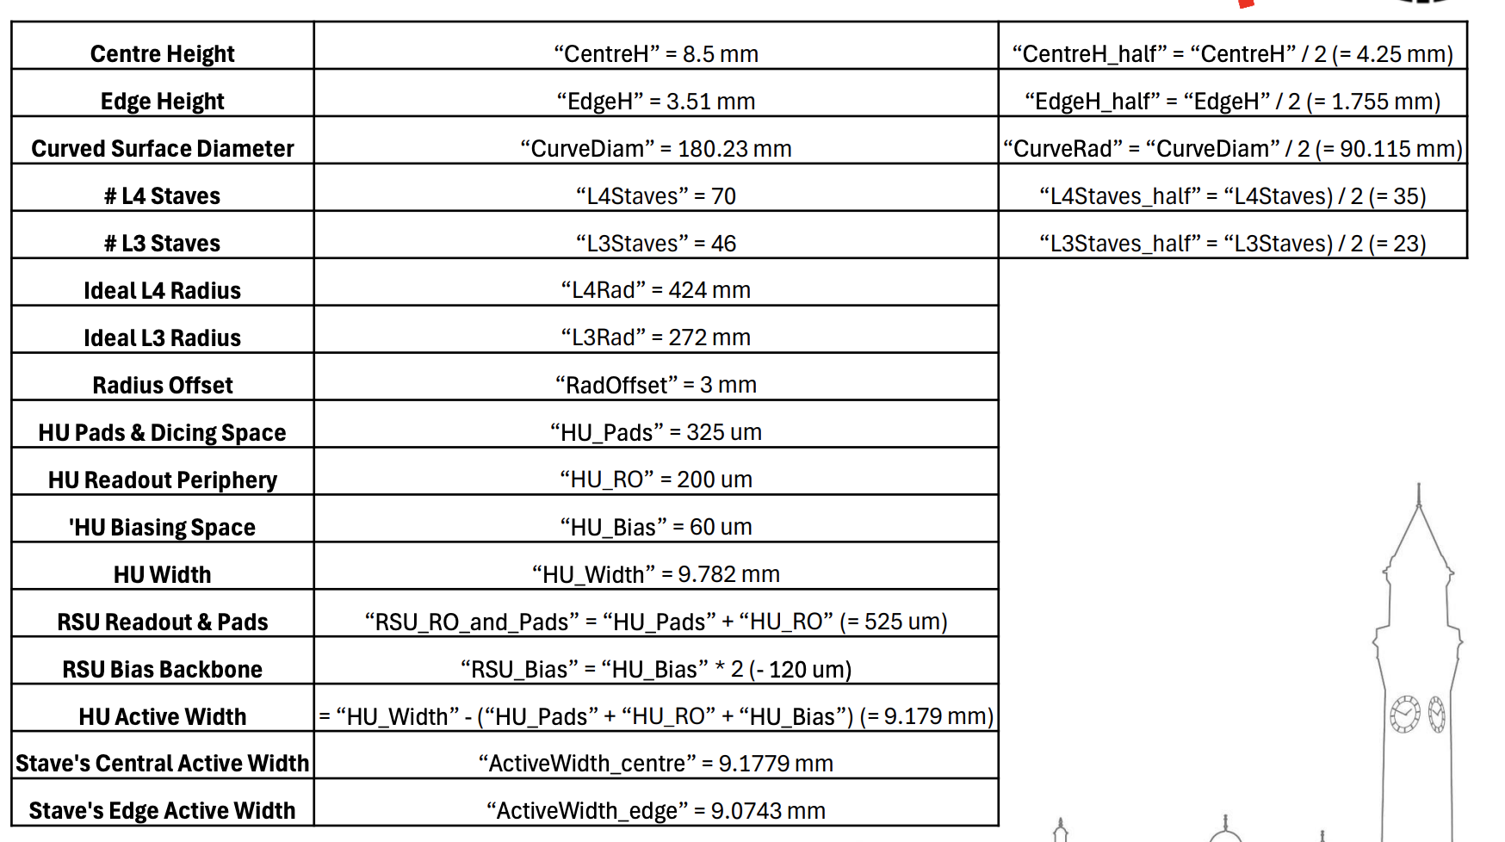
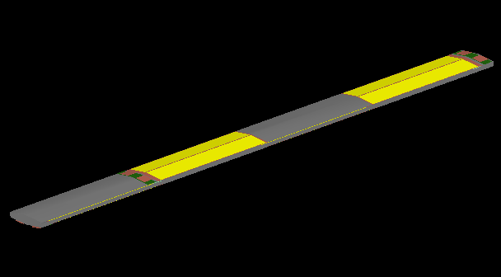
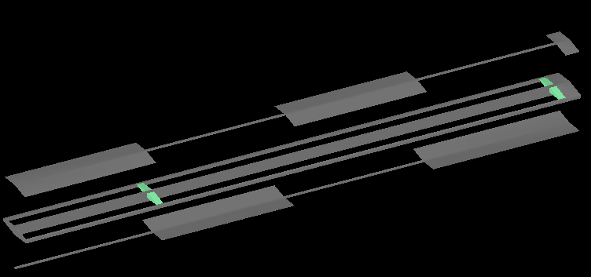
Geometry description of Curved OB layers
https://indico.bnl.gov/event/23878/contributions/93119/attachments/55368/94740/24-06-19_ePIC_SVT_OB_JGlover_r1.pdf
EIC-UK WP1 F2F Oxford
5

Slide 6
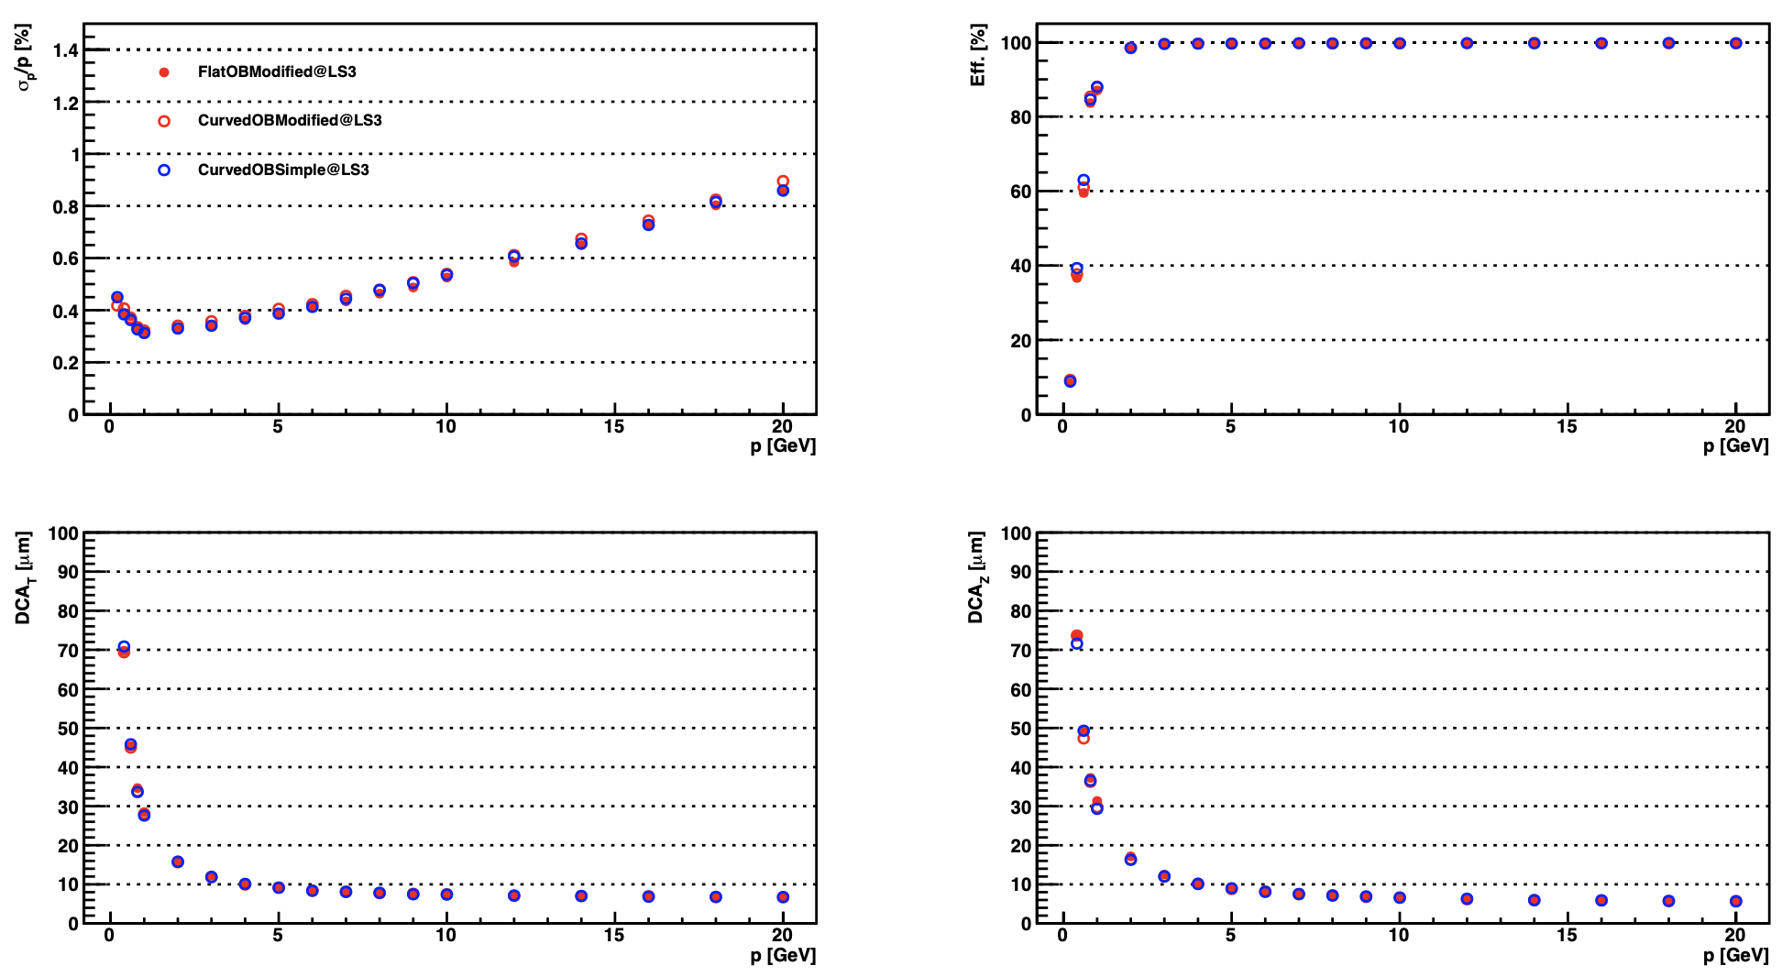
Results with modified OB Geometry
EIC-WP1 UK
6

Slide 7
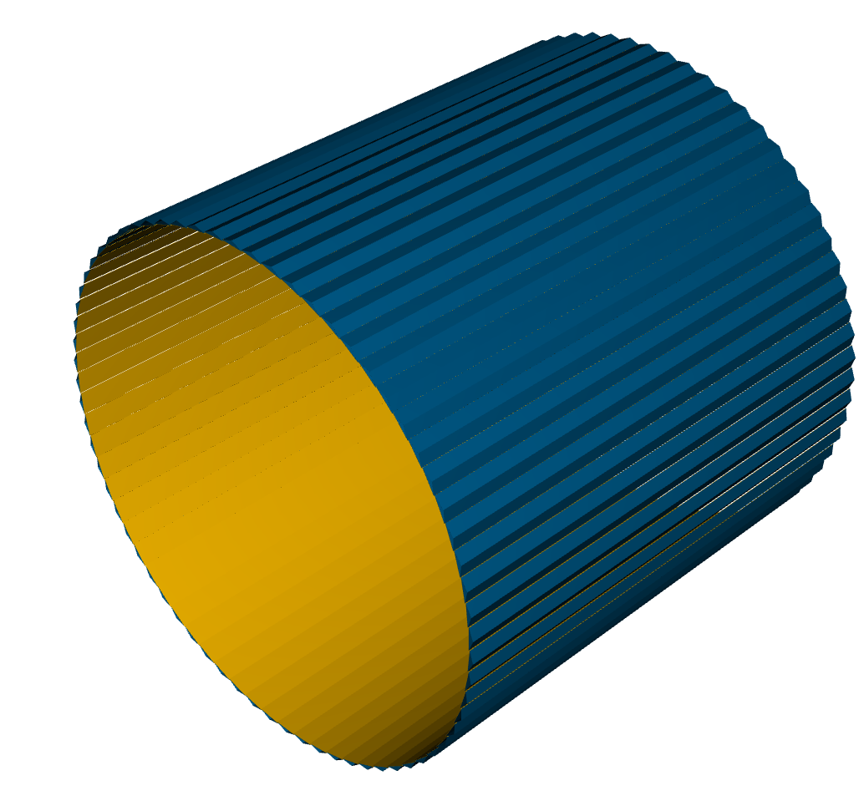
SVT – standard epic geometry
Simple model of L3, L4 barrels
Flat staves
Layers of silicon, carbon fibre, aluminium to give material thickness
X/X0 = 0.25% (L3)
X/X0 = 0.55% (L4)
Tracking performance benchmark analysed by Shyam Kumar
Tracking group now wish to update geometry and freeze it to run simulations for TDR

Slide 8
ePIC SVT – detailed geometry from CAD files
Project work by Oxford intern student Tuna Tasali
(Mostly) automated process to convert CAD files to DD4HEP geometry
Conversion Script
FreeCAD API
.STL (mesh)
.gdml (mesh)
sensitive=«true»
Set automatically by the .gdml file name.
.STL (mesh)
.gdml (mesh)
.STEP
.FCStd
silicon_barrel.xml
.STL (mesh)
.gdml (mesh)
Sensitive volume handled differently by
.STL (mesh)
.gdml (mesh)
BarrelTrackerOuter_geo_standardized.cpp
https://github.com/Tunat66/epicUK/tree/UK_Contribution
See slides: https://indico.bnl.gov/event/23274/contributions/96308/attachments/57308/98404/InternationalPresentation_CADDesignsInDD4Hep.pptx

Slide 9
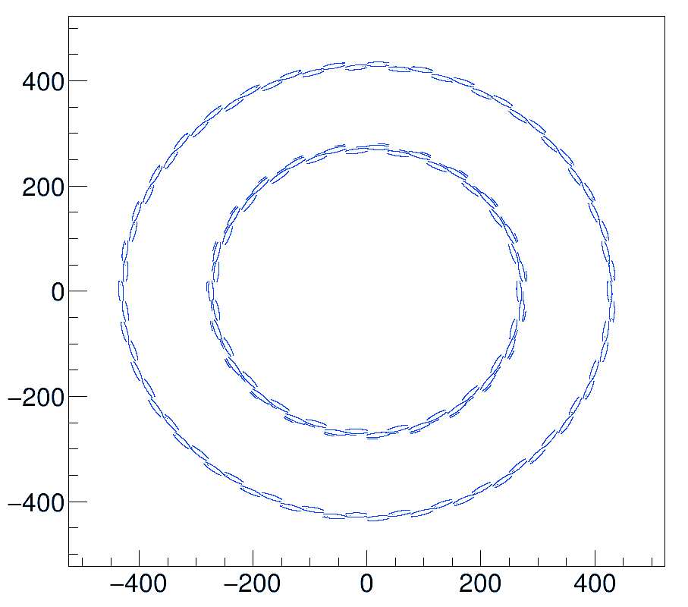
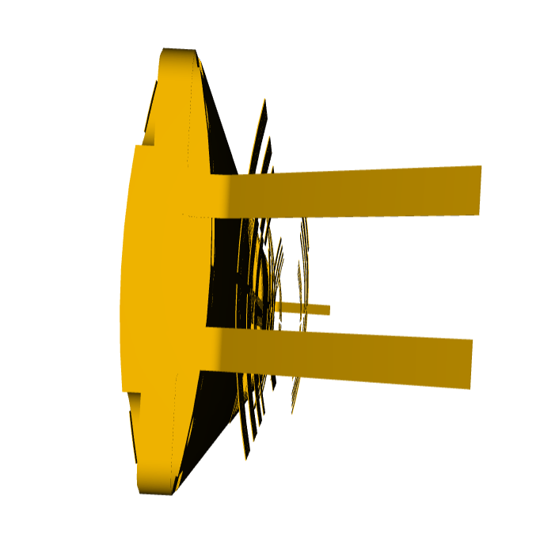

ePIC SVT – detailed geometry from CAD files

Slide 10
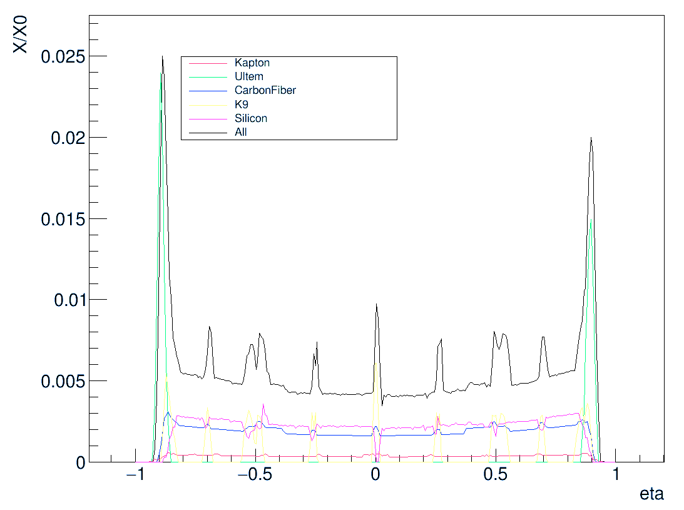
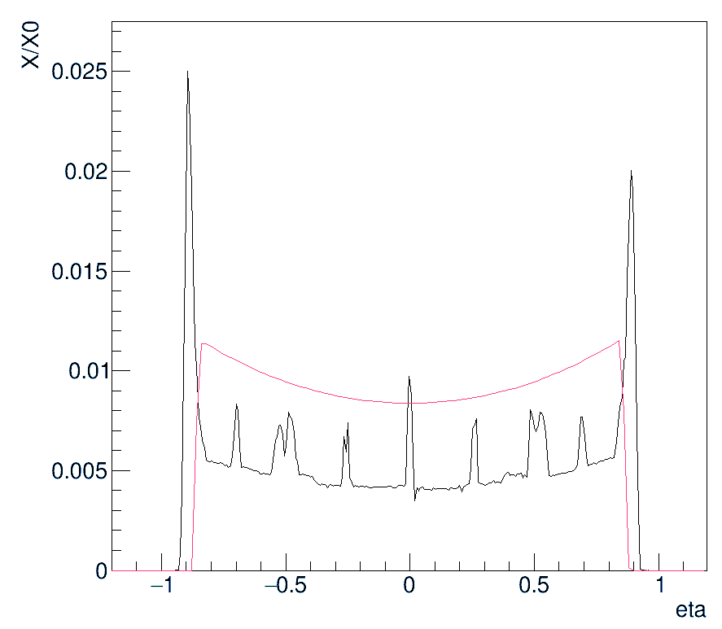
ePIC SVT – Material Thickness
Using epic/bin/g4MaterialScan_to_csv script by Chao Peng
Lower baseline thickness than standard geometry

Slide 11
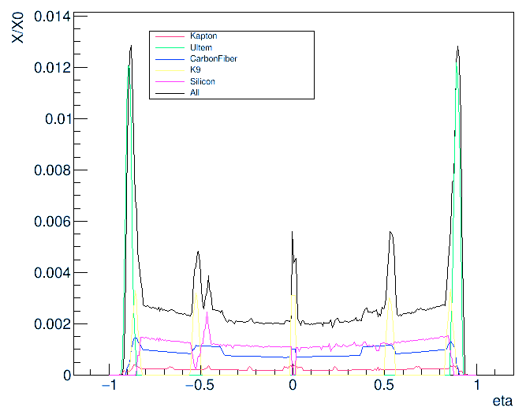
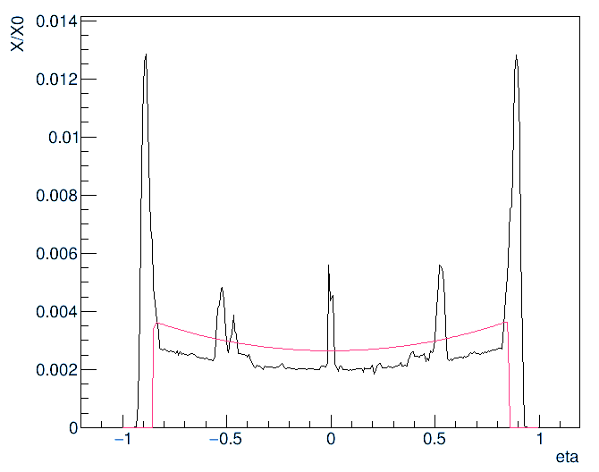
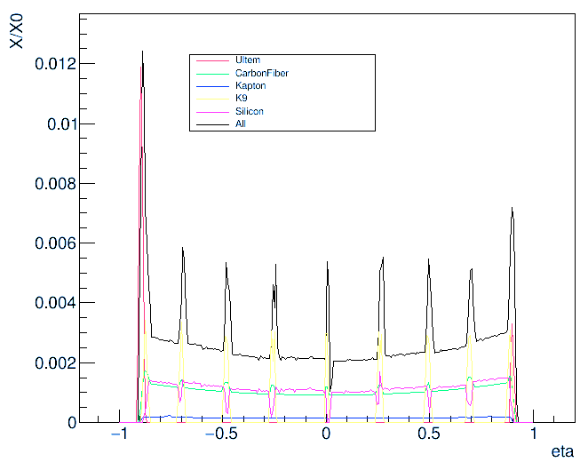
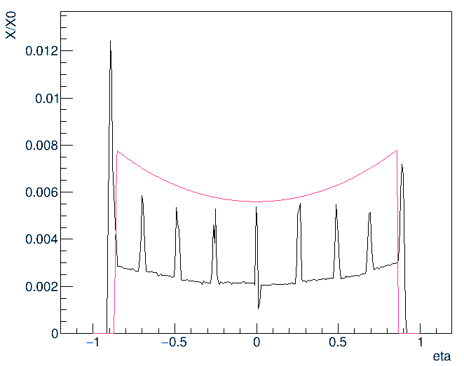
L3
Average ratio:
0.85
L4
Average ratio:
0.42

Slide 12
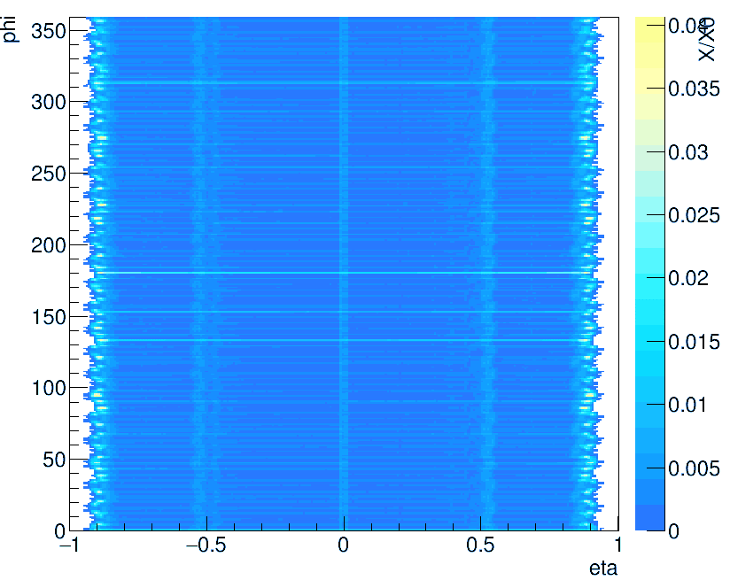
L3

Slide 13
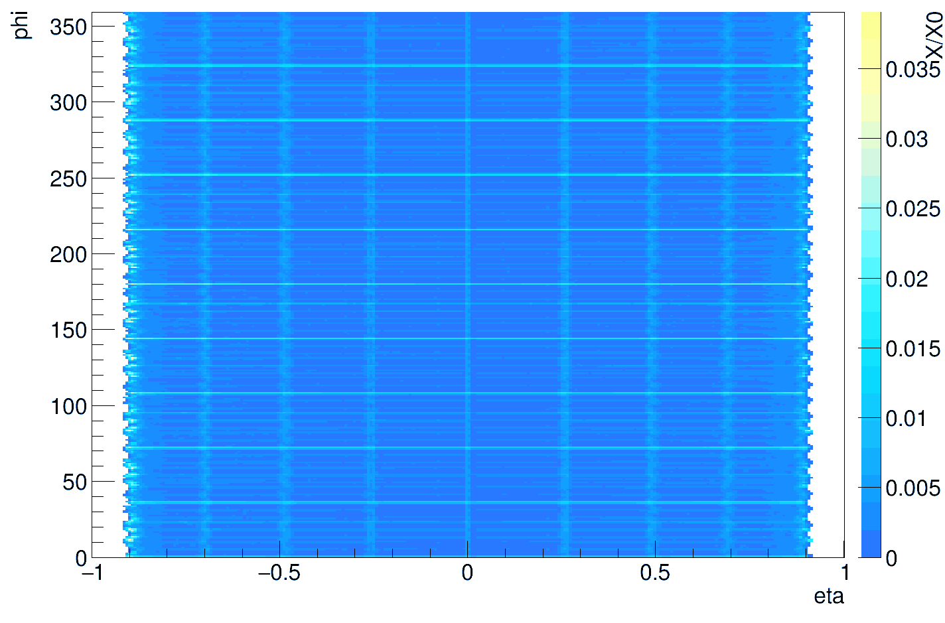
L4

Slide 14
Summary / Change to epic geometry
Simulations show material thickness in CAD design is significantly less than in design specs and standard epic geometry
Simulations show similar thickness for L3,L4
Is this reliable? There are bugs, but it seems about right
But doesn’t include glue, bonding wires, additional support material …
Will this be significant?
Options:
  Reduce thickness of aluminium layer in epic geometry to match average X/X0 of detailed simulation?
  Reduce thickness of L4 aluminium layer to give X/X0=0.25% (to match L3)?
  Keep the existing model?

Slide 15
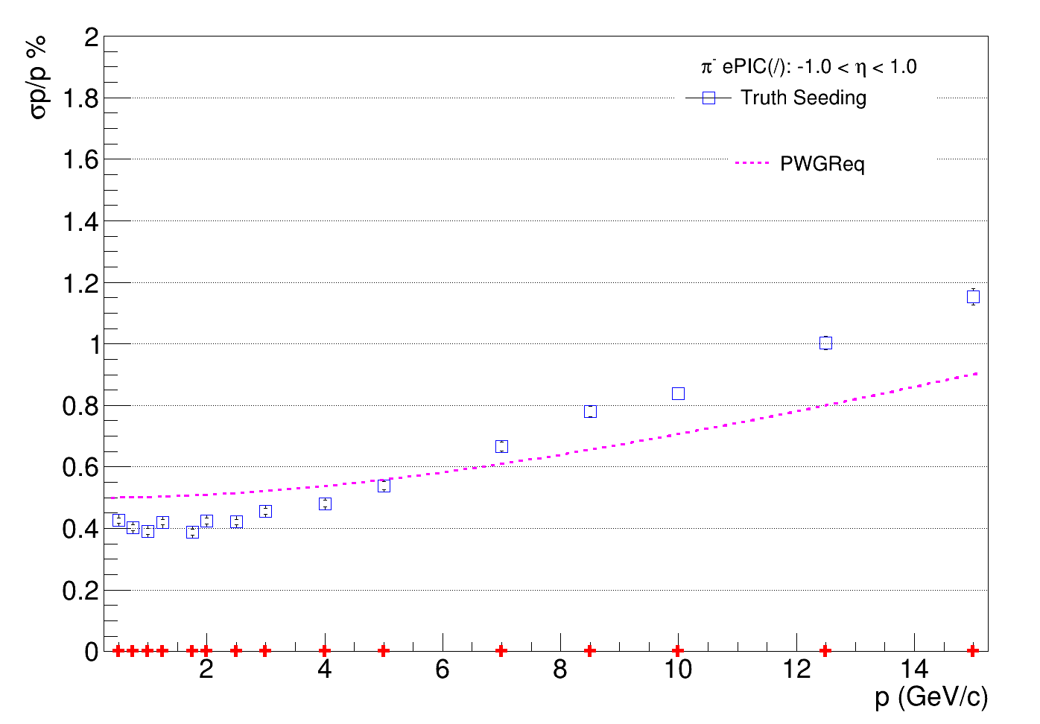
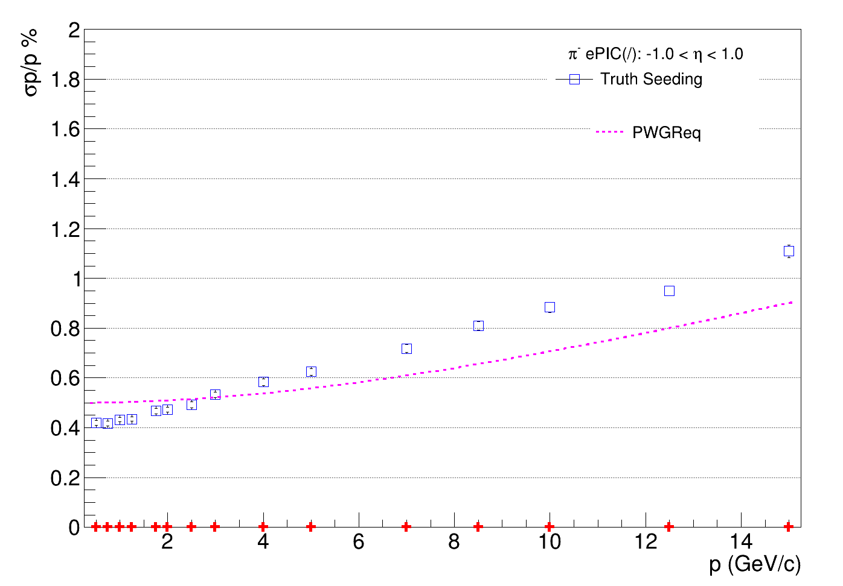
ePIC SVT simulation test results
Using tracking performance benchmark script by Shyam Kumar, epic_craterlake_tracking_only.xml https://github.com/eic/detector_benchmarks/tree/master/benchmarks/tracking_performances
New geometry from CAD files
epic-24.10.0 geometry
Run time: 92±25 minutes
Run time: 10±3 minutes
Running ddsim and eicrecon on 10,000 events

Slide 16
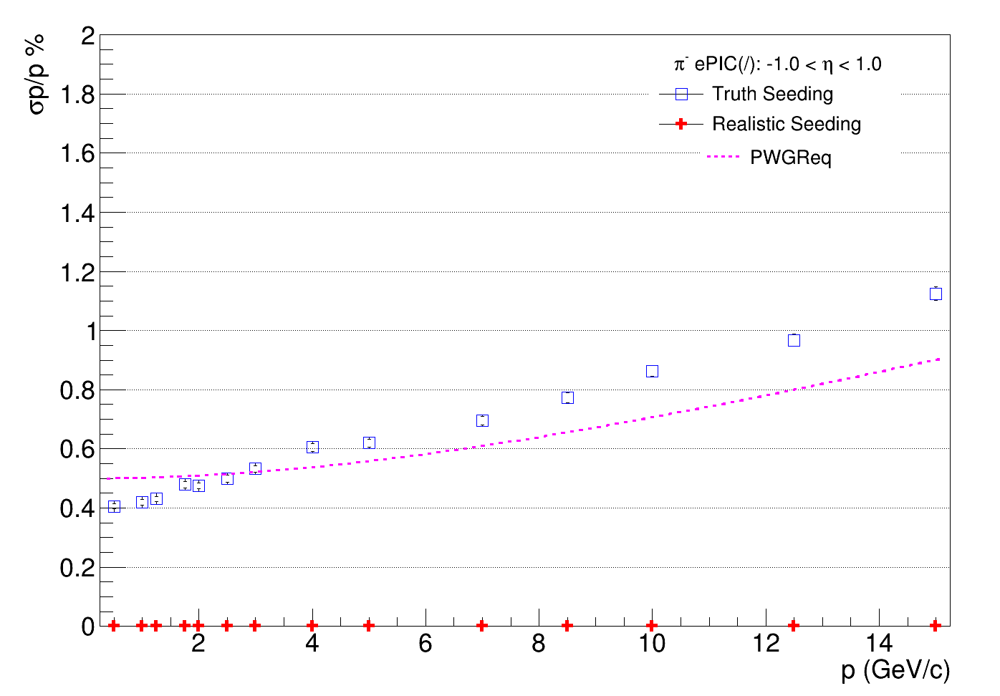
ePIC SVT simulation test results
Using tracking performance benchmark script by Shyam Kumar, epic_craterlake_tracking_only.xml https://github.com/eic/detector_benchmarks/tree/master/benchmarks/tracking_performances
New geometry from CAD files
epic-24.10.0 geometry
L4 aluminium layer
reduced from 0.37 to 0.15
Run time: 92±25 minutes
Run time: 10±3 minutes
Running ddsim and eicrecon on 10,000 events

Slide 17

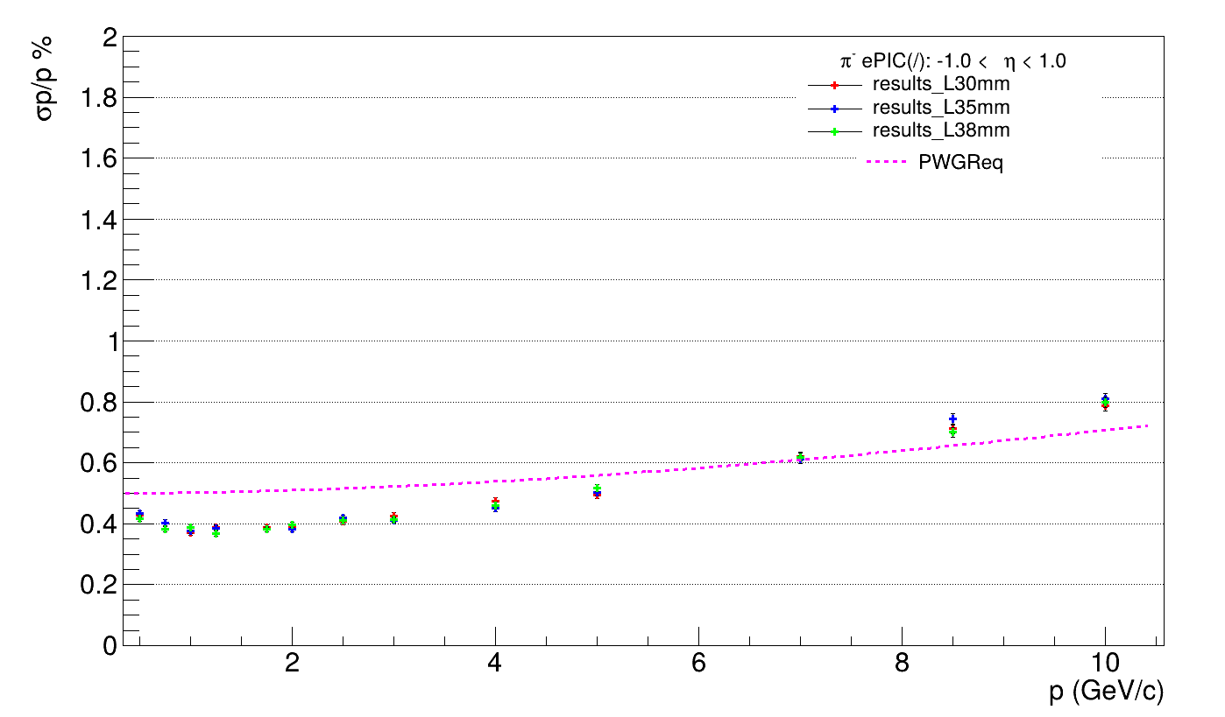
Overlap Study (in L3 only): deltap/p
UK
L3_0mm Overlap
L3_5mm Overlap
L3_8mm Overlap
Pion momentum:
0.5-10GeV/c

Slide 18
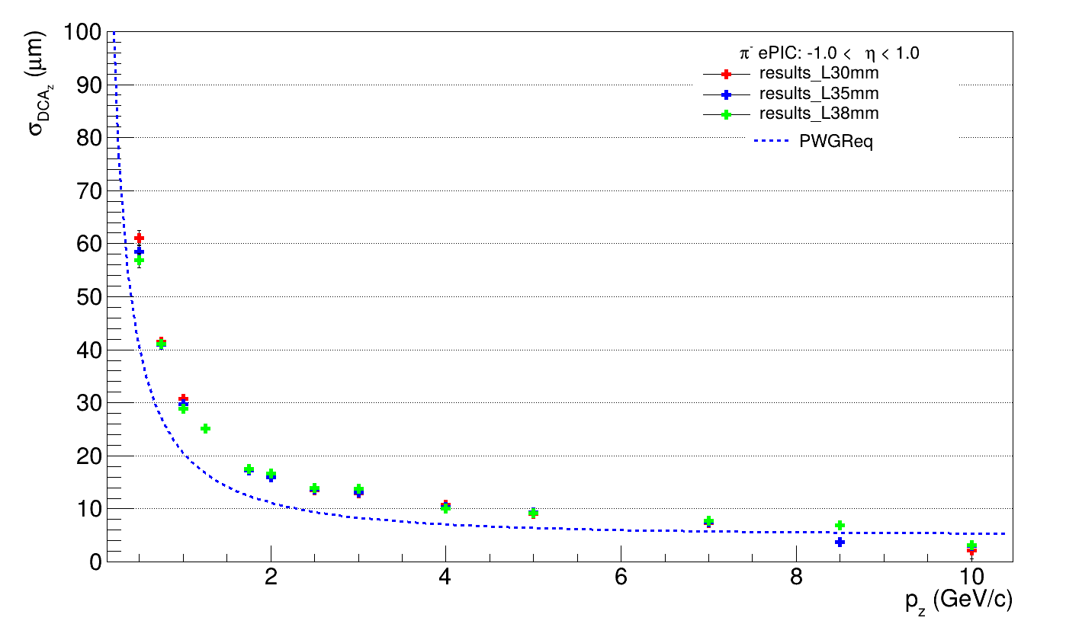
Overlap Study (in L3 only): dca_z
UK

Slide 19
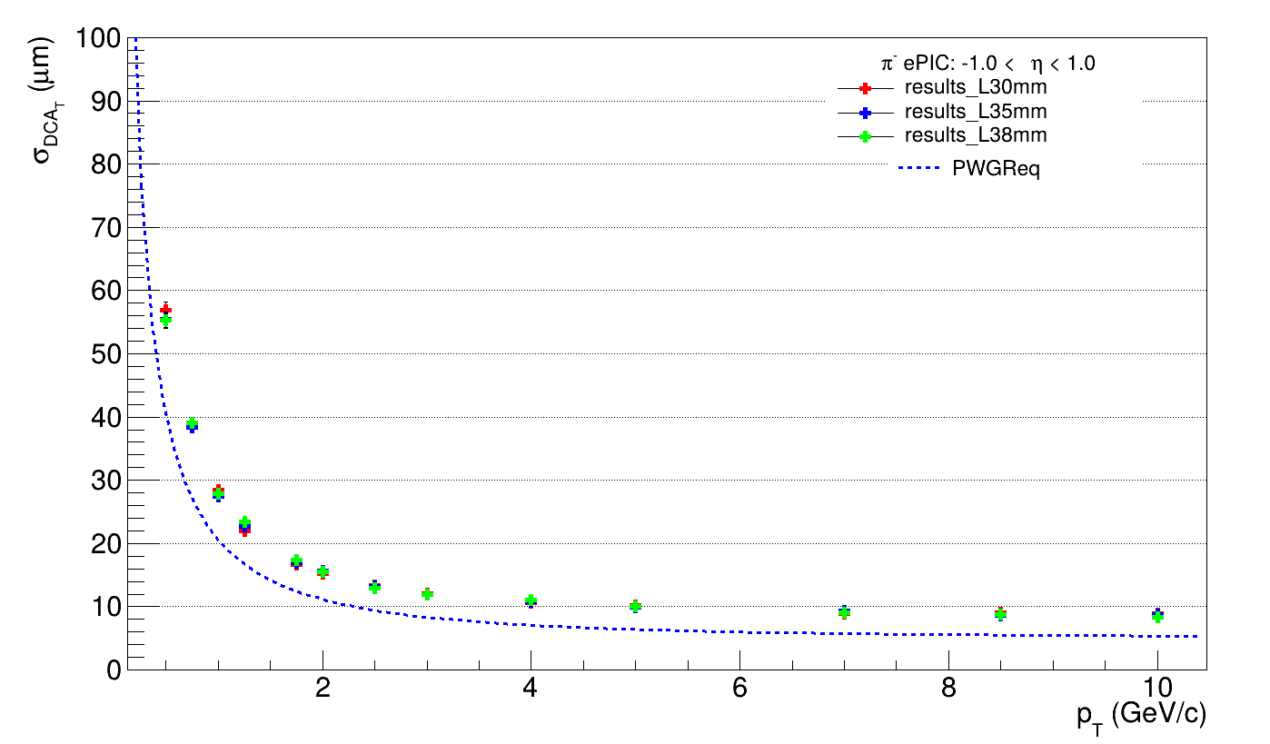
Overlap Study (in L3 only): dca_T
UK

Slide 20
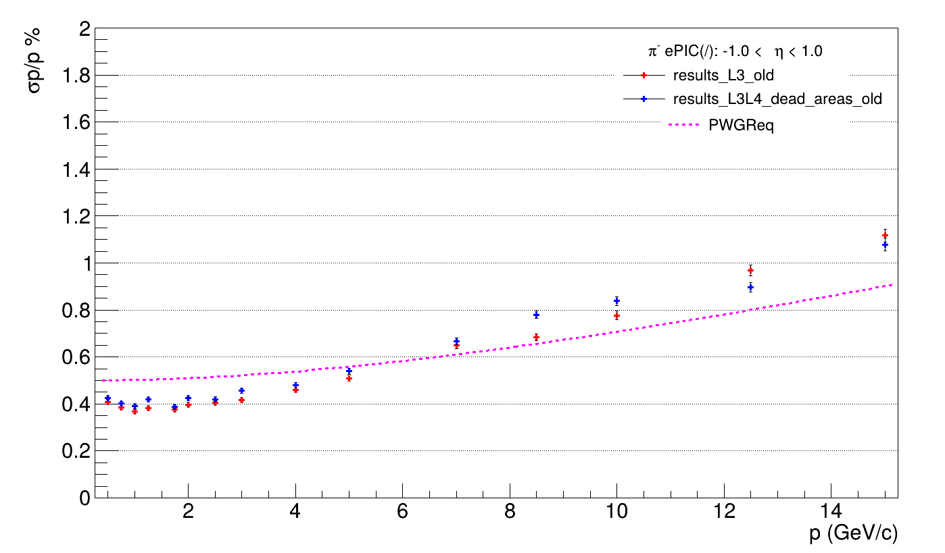
Sensitive Area Study (both layers)
UK

Slide 21
ePIC SVT Simulations: Next Steps
Debug code
Index CAD design files with version numbering
Further investigation of tracking performance on detector design
Create more accurate simplified geometry for routine simulations
When do we need detailed geometry?
Further develop techniques to convert CAD files to DD4HEP

