Slide 1
FPC Mechanical geometry and bond areas

Slide 2
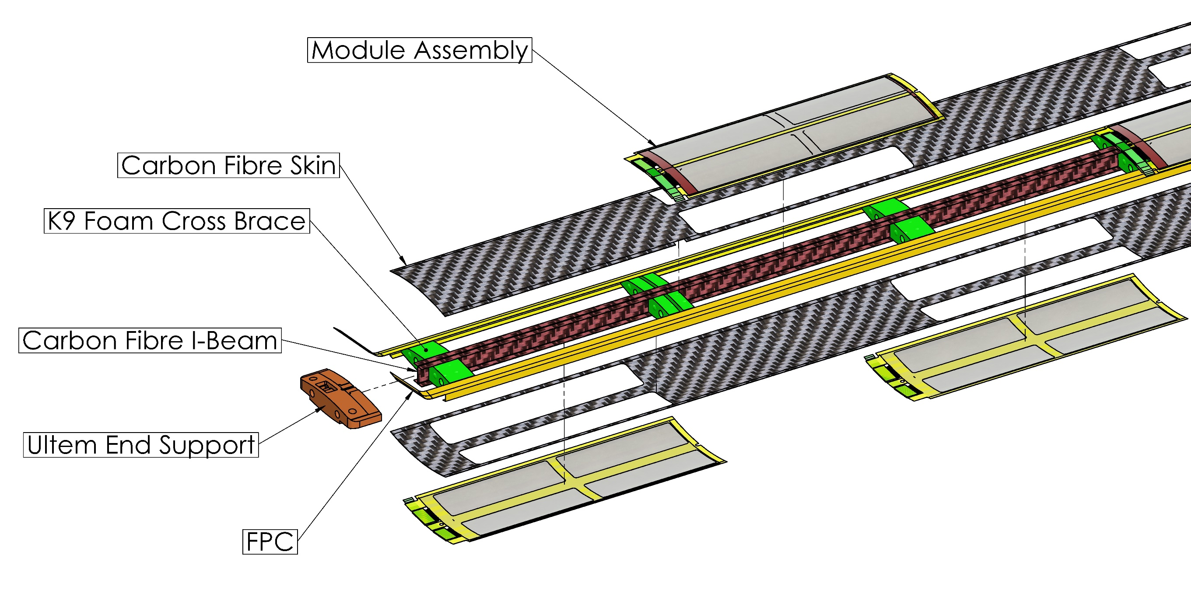
L3/L4 Stave Structure Overview

Slide 3
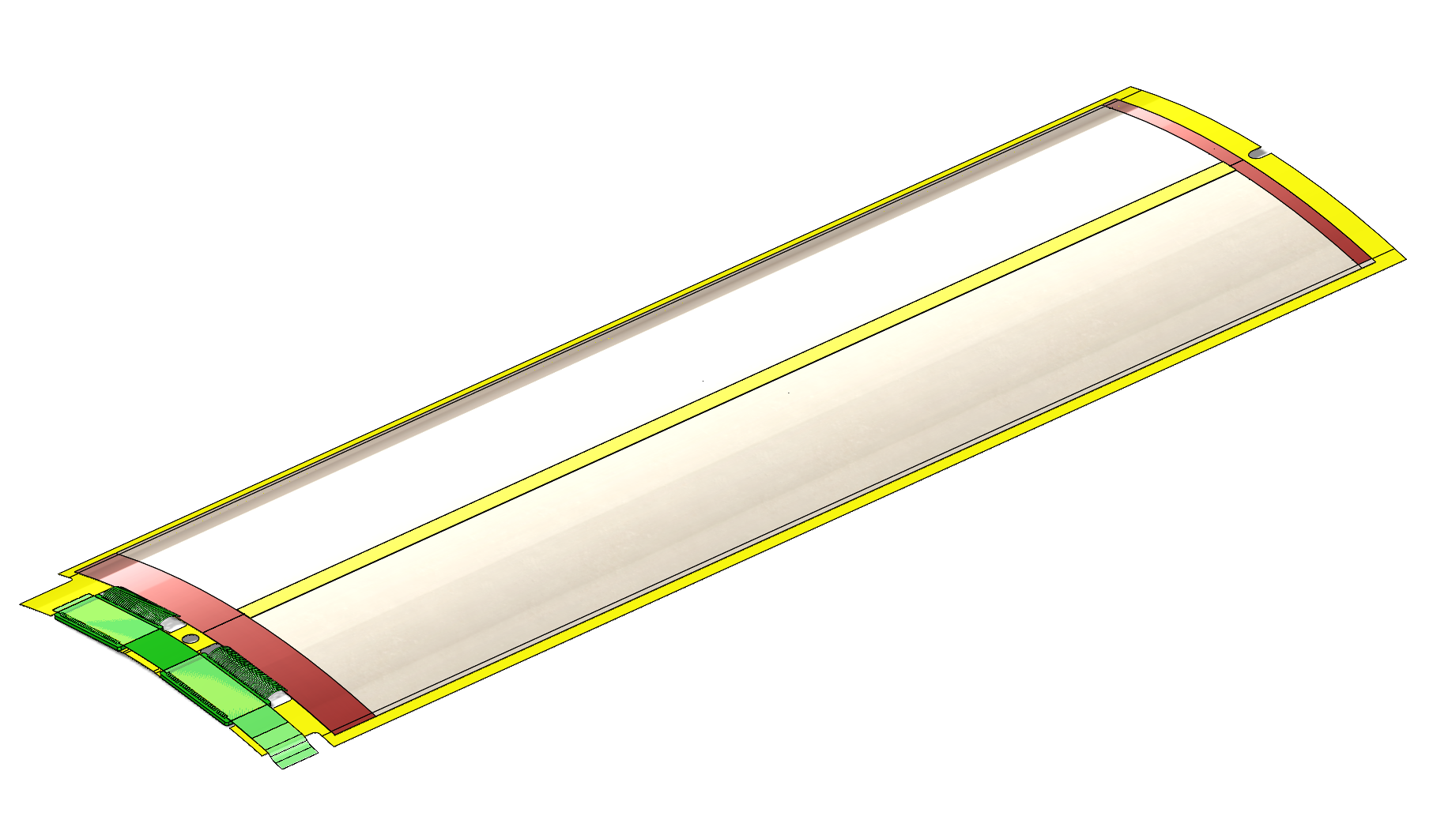
EIC-LAS Module
Module Consists of:
  2 EIC-LAS
  2 ASIC
  Bridge FPC
  Kapton Carrier
Modules are assembled on tooling and transferred with sensors held into a curved shape with vacuum tooling
Module transfer tooling will be tested on quarter length stave

Slide 4
FPC geometry
FPC will constitute side-closeout of stave
No traces from top to bottom, no traces on the side
Kapton
Silicon
Al
Carbon fibre
Thermal forming
Inside stave
TAB
Bridge FPC
Connection main – bridge FPC

