Slide 1
Next Steps for Stave Prototyping
Adam Huddart

Slide 2
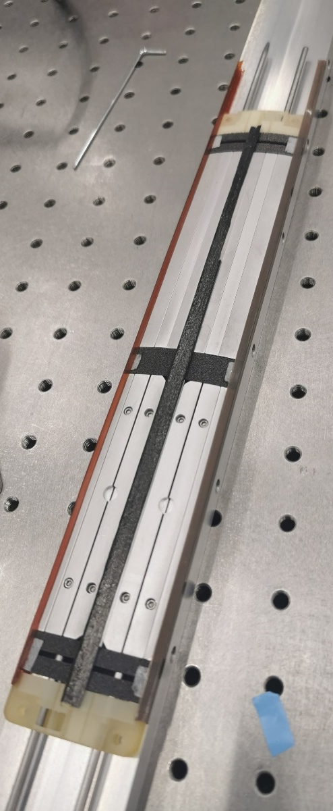
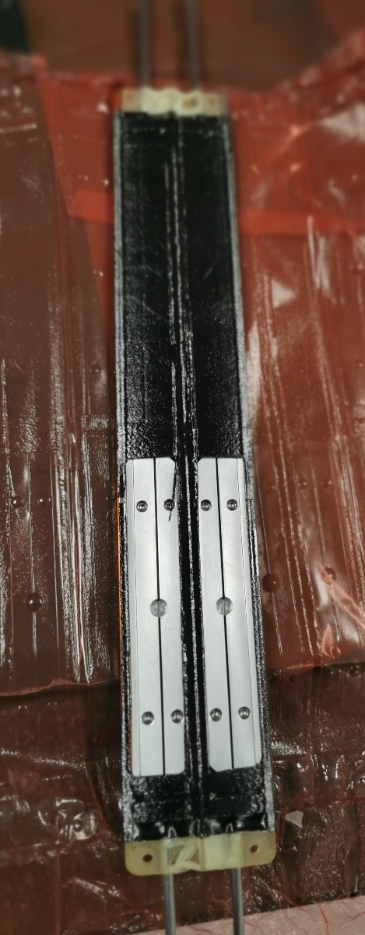
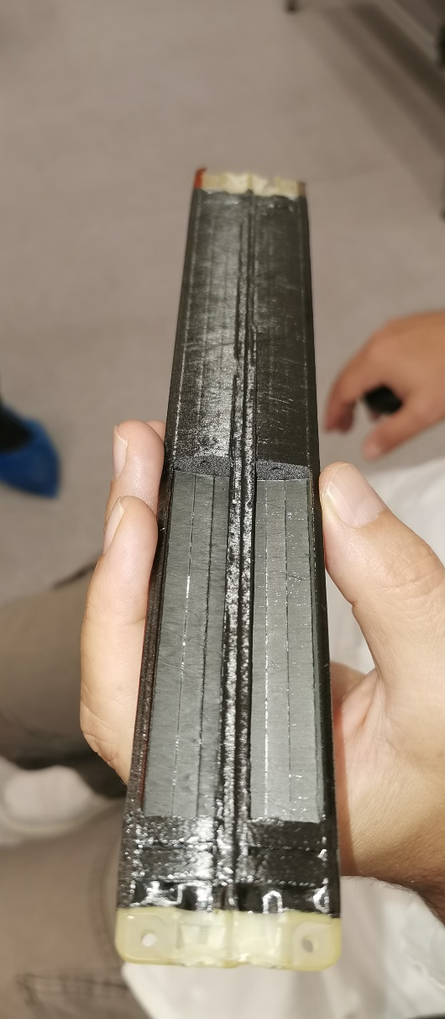
Intro to Existing ¼ Stave Prototype
1/4 of an L4 stave
  One top one bottom module
Preformed I beam and Kapton C Channel FPC Mock-ups
SLA 3D printed end supports
Multipart aluminium internal tooling
2 x 3mm rod runs through end supports, K9 foam cross braces & internal tooling to constrain and align stave components

Slide 3
Prototype Components - Tooling
Tested
  Co-curing tooling (for ¼ length stave)
    Carbon fibre I beam Tooling
    Kapton C-channel Tooling
    Internal formers
Untested but manufactured
  Sensor curve former
  LAS curved carriers
  Module assembly tooling
  Module installation tooling (for full length L4)

Slide 4
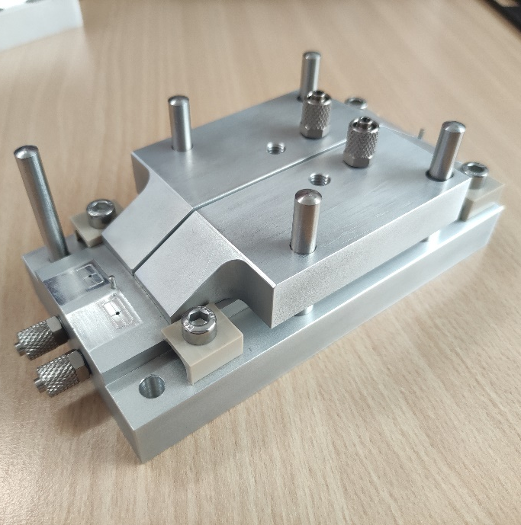
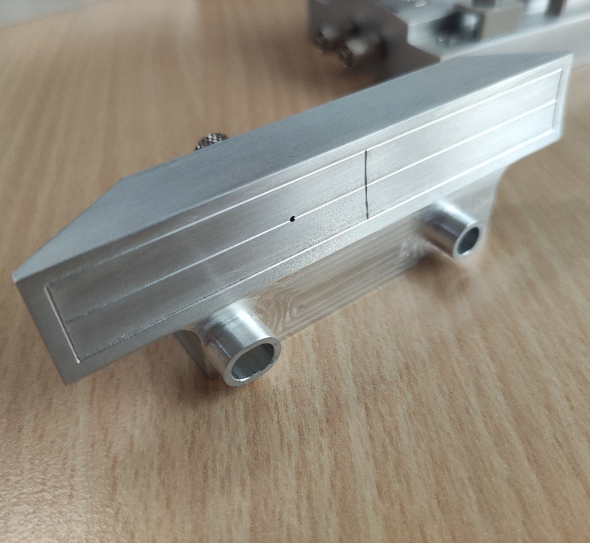
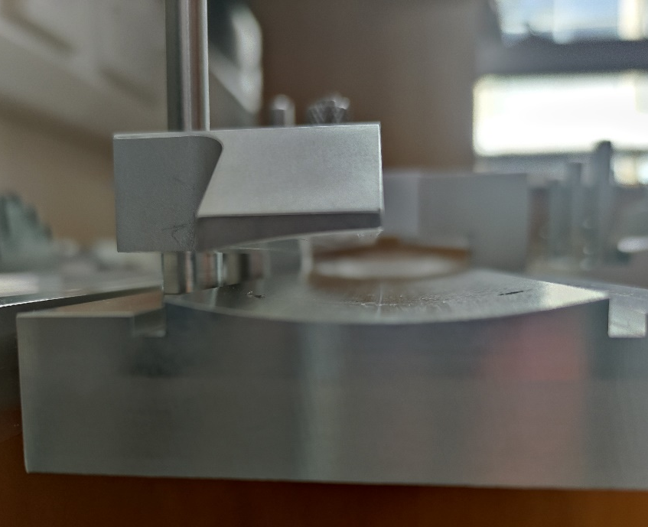
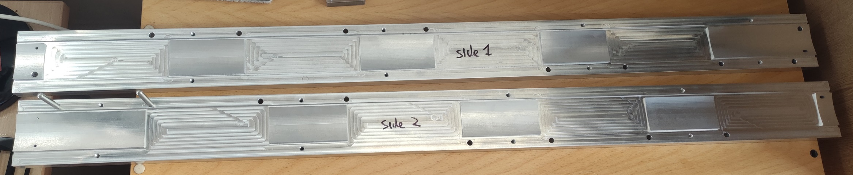
Module Tooling
Module Assembly Tool
LAS Vacuum Chuck
Vacuum Chuck on Module Installation Tooling

Slide 5
Prototyping Plan
First ¼ length stave proved production method is feasible but failed 3D printed end support means we can’t use it for structural/thermal tests.
  Can be used for first attempt at module mounting
Design is not suitable for required structural and thermal testing
  Revised end support required which can withstand autoclave conditions and gives mounting points for vibrational analysis and air inlet/outlet for flow testing needed
Cure another quarter stave
  Automated knife cutter
  Improved trimming of I-beam
  Cure with rubber sheets as intensifier
  Use revised end support design

Slide 6
Module Testing
Transfer EIC-LAS mock-ups from wafer mount to vacuum chuck
Use electronics suction cups to move LAS from vacuum chuck to curved sensor former
Show curved vacuum pad can be used to transport the EIC-LAS securely
Build a module mock-up on the module assembly tooling
  Drag knife cut Kapton carrier
  2 EIC-LAS mock-ups
  Options for ASIC mock-up?
Adhesively mount 2 modules onto 1st prototype quarter length stave assembly.
  Repeat static deflection test
  Stiffness of module bonding will impact stave first mode

Slide 7
2nd Quarter Length Stave
Will replace one end support of quarter stave with large square mounting block to give high stiffness mount location for cantilevered structural stiffness testing
  First test without modules
  Bond module using module transfer tooling and repeat vibration testing.
Thermal Testing
  Modify flow rest rig at Oxford
  Add temperature monitoring to stave (or use non-contact measurement)
  Pressure transducers on inlet & outlet to measure pressure drop across stave.

