Slide 1
ePIC Silicon Vertex Tracker
Stave End Region Ideas
Adam Huddart

Slide 2
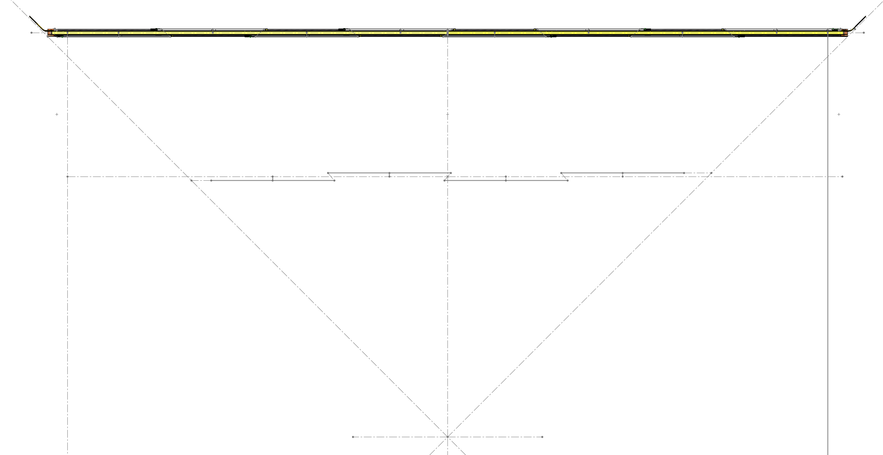
L4 Layout
Length of stave has been reduced to get stave ends to fit within 45-degree cone
Reducing the end cap size would allow the overlap to be reduced and maximise active area

Slide 3
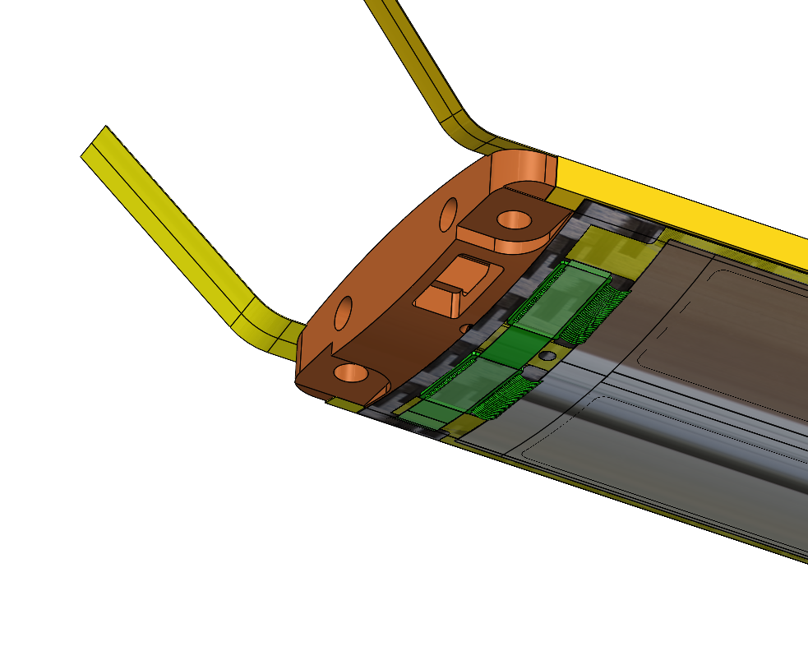
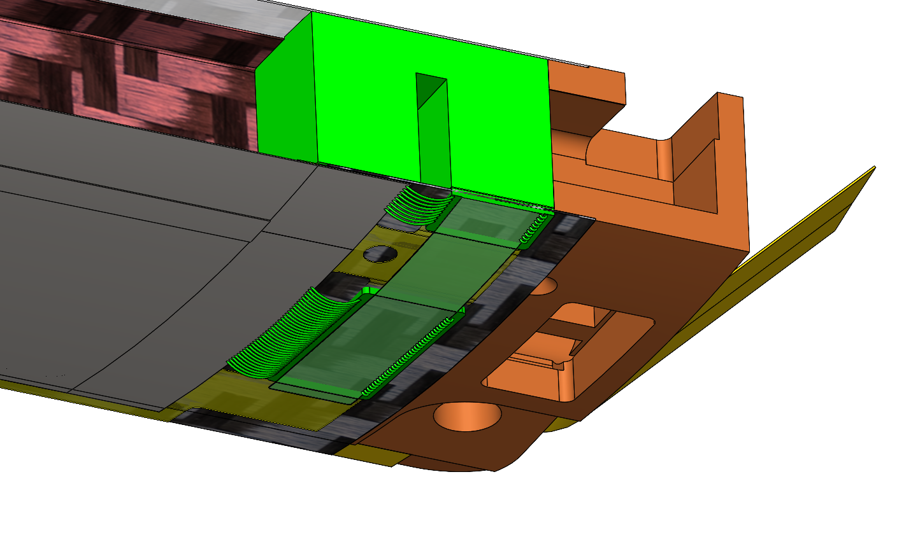
Stave End Support
Combined flow distributer/air interface and structural support
Interfaces with support cone
Current version mounts with 2 x m2.5 screws from underside
Mounting solution must accommodate tolerance in stave length

Slide 4
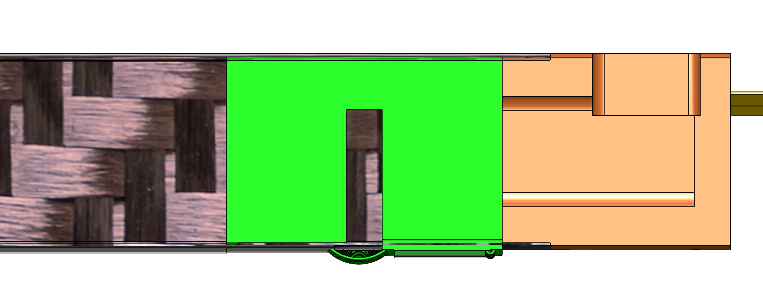
Reducing Stave Length
Design Considerations
Need K9 foam under LEC & ASIC for thermal management
First ASIC and LEC are near flow inlet (low coolant temperature) so can accommodate sub-optimal thermal path
Current solution adds 8 mm to the end of each stave
Stave End
LEC
ASIC
Limit of length reduction

Slide 5
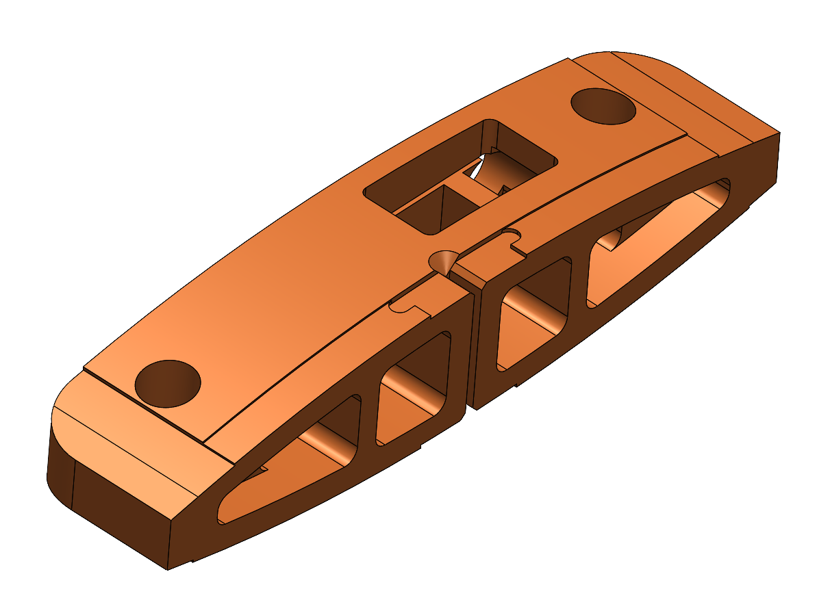
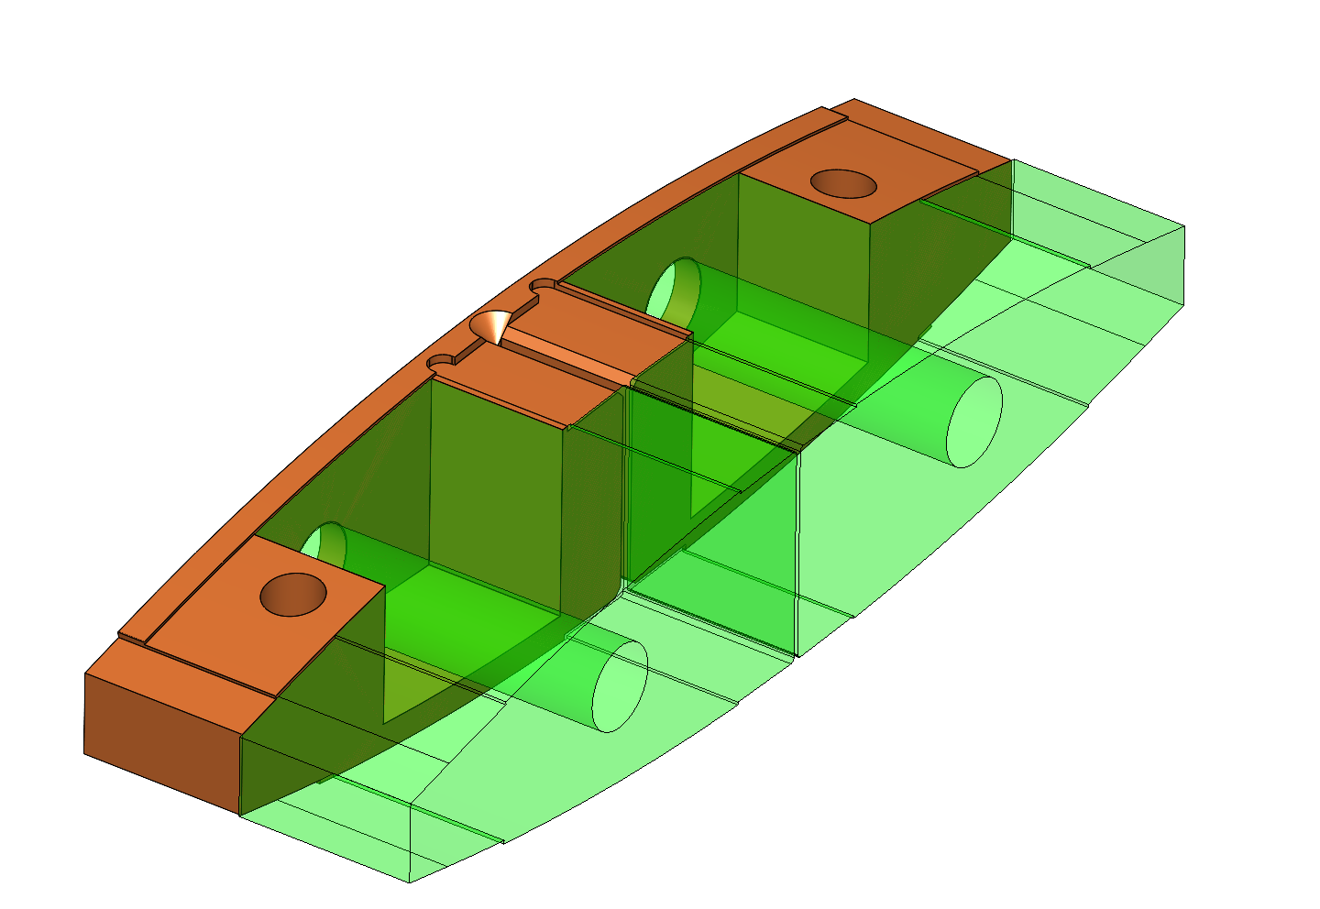
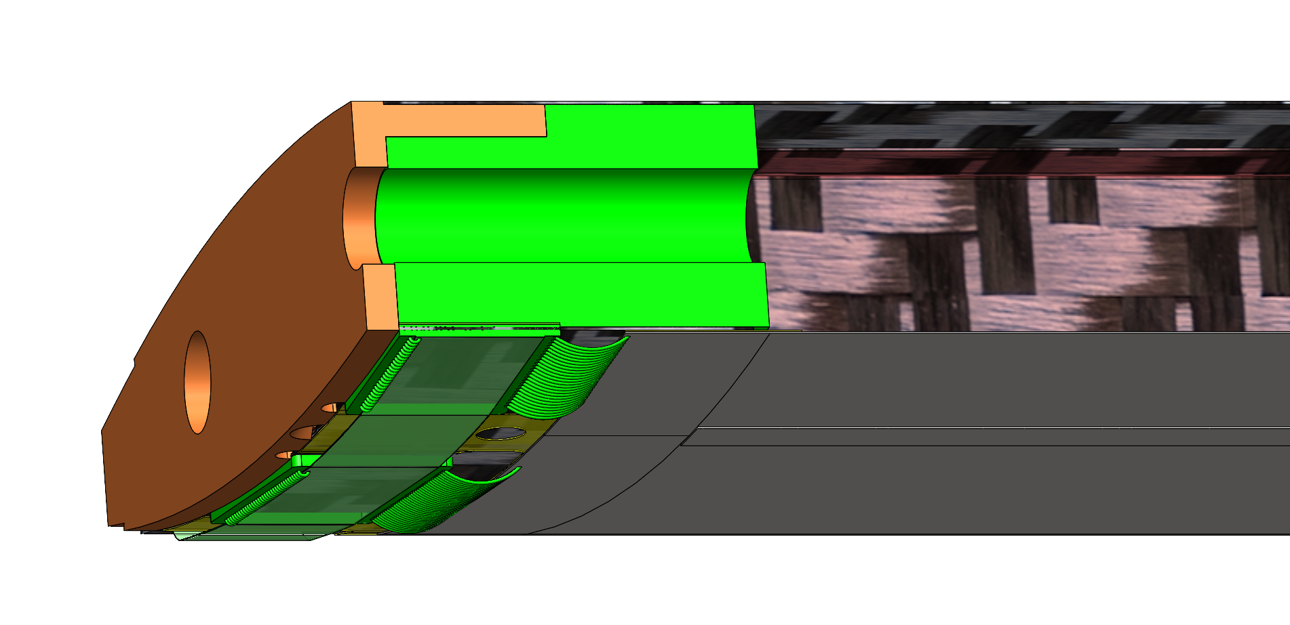
Revised Design
New Design
  ASIC supported on K9 foam (identical thermal resistance to other modules)
  End support only 1.5 mm longer than module end
  Coolant inlet/outlet must be on stave end face
    Difficult to arrange inlets for counterflow, easy to achieve co-current flow.
Old Design
New Design

Slide 6
Revised Design
Support cones need to be sided
  Left side module is on bottom side of the stave structure
    Cone interface must be on top surface
  Right side module is on the top side
    Cone support must be on the bottom surface or end face
Coolant
ASIC
LAS
Exhaust
Stave Structure
Fasteners
ASIC
LAS
Alternate mounting point

Slide 7
Conclusions
Revised design reduces extension to 1.5 mm from 8 mm
Any further reductions would require reversing of modules (ASIC on far side to end support)
  Increases FPC power loss (longer traces)
  ASIC/LES for multiple modules would likely overlap
Current air inlet only ⌀3 mm → Increased pressure drop over inlet/outlet
More limited stave support options, difficult to achieve counterflow arrangement

