Slide 1



Sensor and AncASIC Updates
Notes:
The abstract pattern can be removed or repositioned if required. Be careful to ‘Send to Back’ so that it does not obscure any important information.

Slide 2
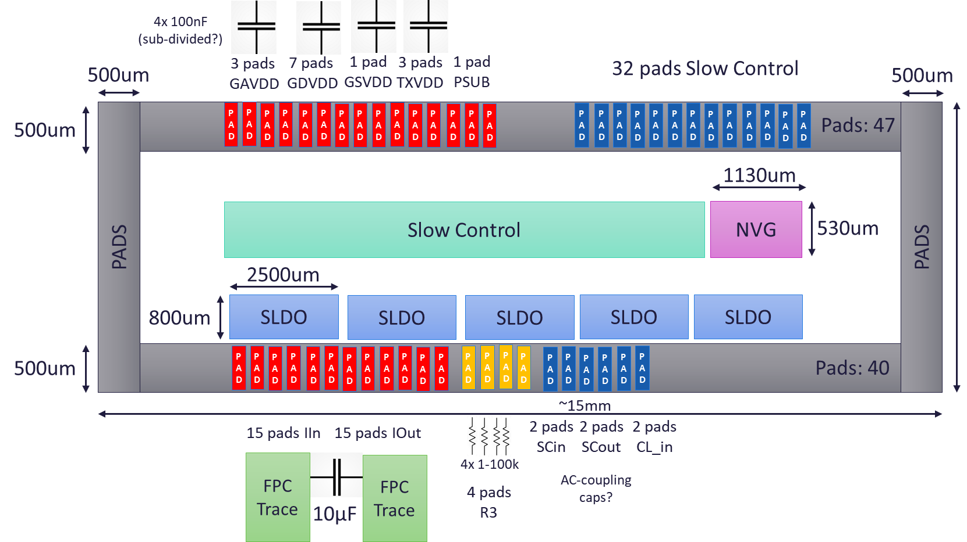
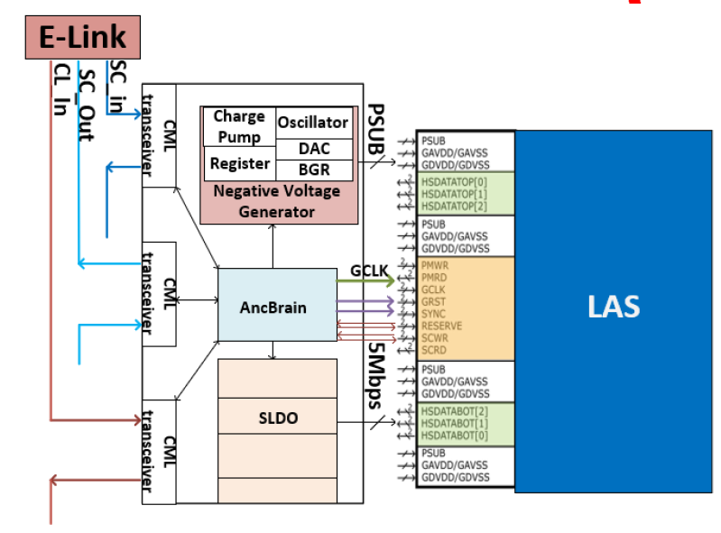
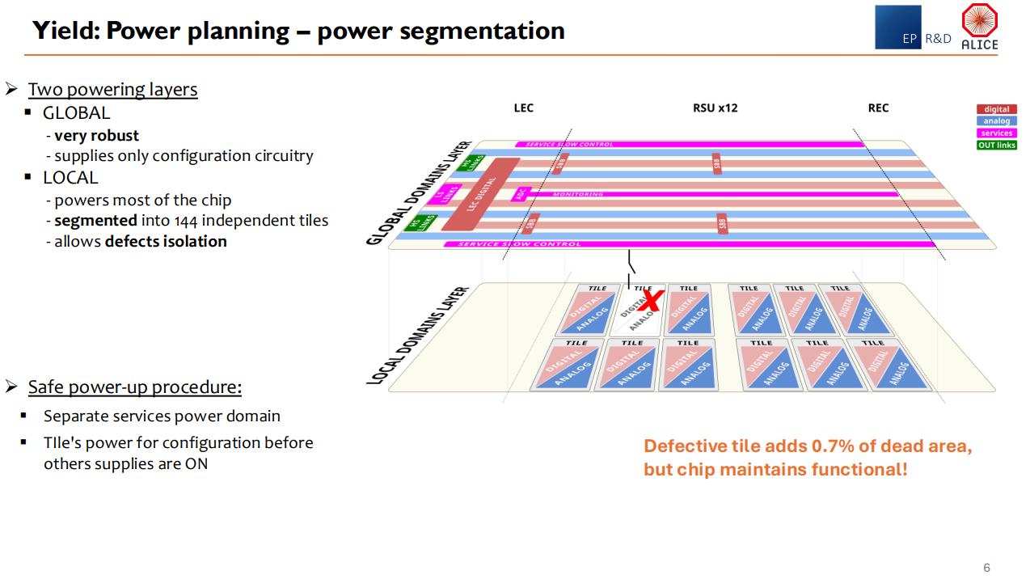
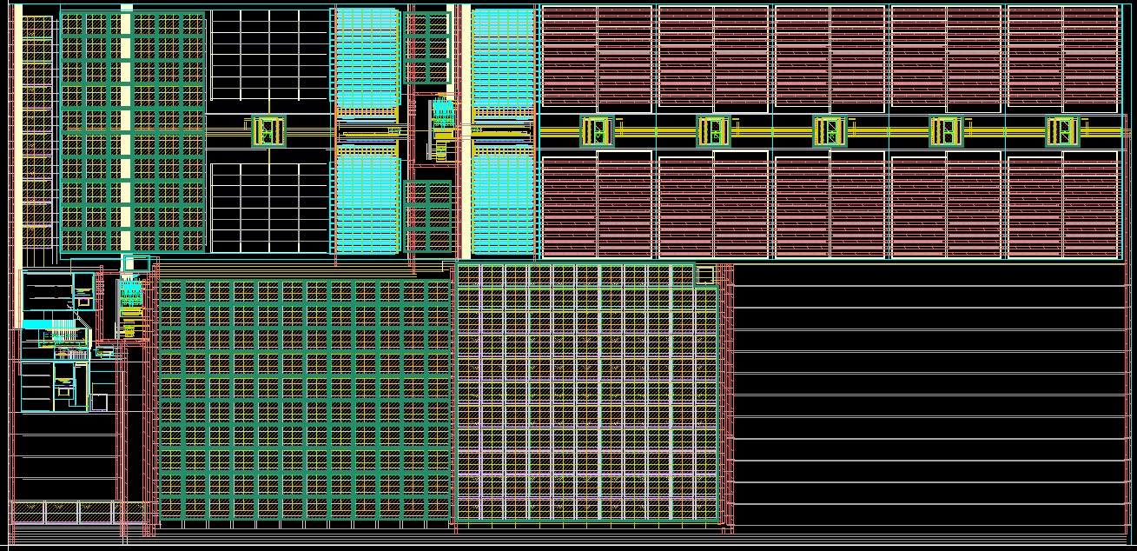
Introduction
AncASIC
  Background and Features
  NVG
  SLDO
  Size and Pads
  Progress
Introduction
  Background and Overview
MOSAIX
  Overview of MOSAIX
  Progress
EIC-LAS
  Changes to MOSAIX
  Assist with Stave Design
  Progress

Slide 3
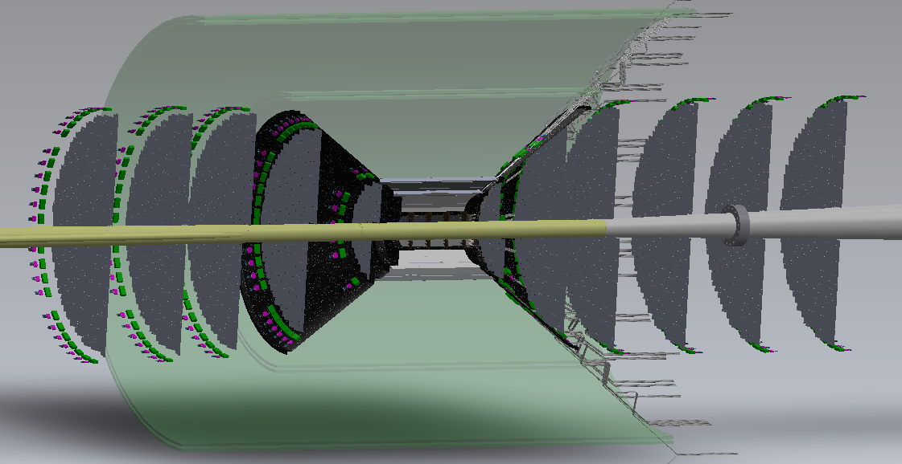
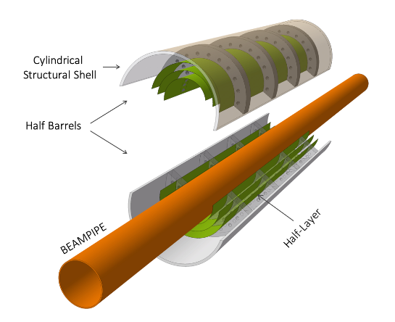
Introduction
Outer Barrel and Discs
  Smaller Verion of MOSAIX with minimal changes (EIC-LAS)
  Supporting AncASIC
Inner Barrel
  Thinned silicon bent around beampipe
  USE MOSAIX from ITS3

Slide 4
Introduction
Three strands
  Partner with ITS3 for MOSAIX access
  Develop EIC-LAS based on MOSAIX
  Develop AncASIC to support EIC-LAS
Requirement for ePIC | Work currently under way | Institutes involved
Partner with ITS3 | LLDFM logic cells Cross-RSU data transmission VFM ADC SRAM Digital design – RSU serialiser | RAL, LBNL BNL BNL MIT
Reduced number of RSUs | N/A – requires database | ????
Multiplexing to single data link | N/A – requires database | ????
TX Voltage reduction for SP | N/A – requires database | ????
Multiplexed slow control | Definition | BNL
Serial powering | 110nm schematic complete | RAL/Oxford/LBNL
Negative bias generation | First layout complete | BNL
ITS3 Partnership (WBS 1.1)
EIC-LAS (TPSCo 65nm)
(WBS 1.2)
Ancillary Chip (XFAB 110nm)
(WBS 1.3/4/5/6)

Slide 5


MOSAIX
Notes:
The abstract pattern can be removed or repositioned if required. Be careful to ‘Send to Back’ so that it does not obscure any important information.

Slide 6
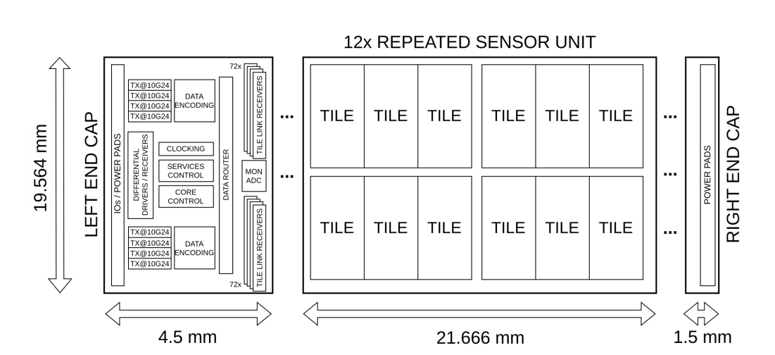
MOSAIX Overview

Slide 7
MOSAIX Progress
Progress
  ER1 has been taped out and is in testing
    Development of a Stitched Monolithic Pixel Sensor prototype (MOSS chip) towards the ITS3 upgrade of the ALICE Inner Tracking System
    The Monolithic Stitched Sensor (MOSS) Prototype for the ALICE ITS3 and First Test Results
    Yield Characterisation and Failure Analysis of the Monolithic Stitched Sensor MOSS for ALICE ITS3
    Evaluation of efficiency, radiation hardness, and timing performance of the Analogue Pixel Test Structure for ALICE ITS3
  ER2 (the first MOSAIX chip) is currently being finalised. Tapeout Q4 23/Q1 24
    Development of the MOSAIX Chip for the ALICE ITS3 Upgrade
    Power Distribution over the Wafer-Scale Monolithic Pixel Detector

Slide 8
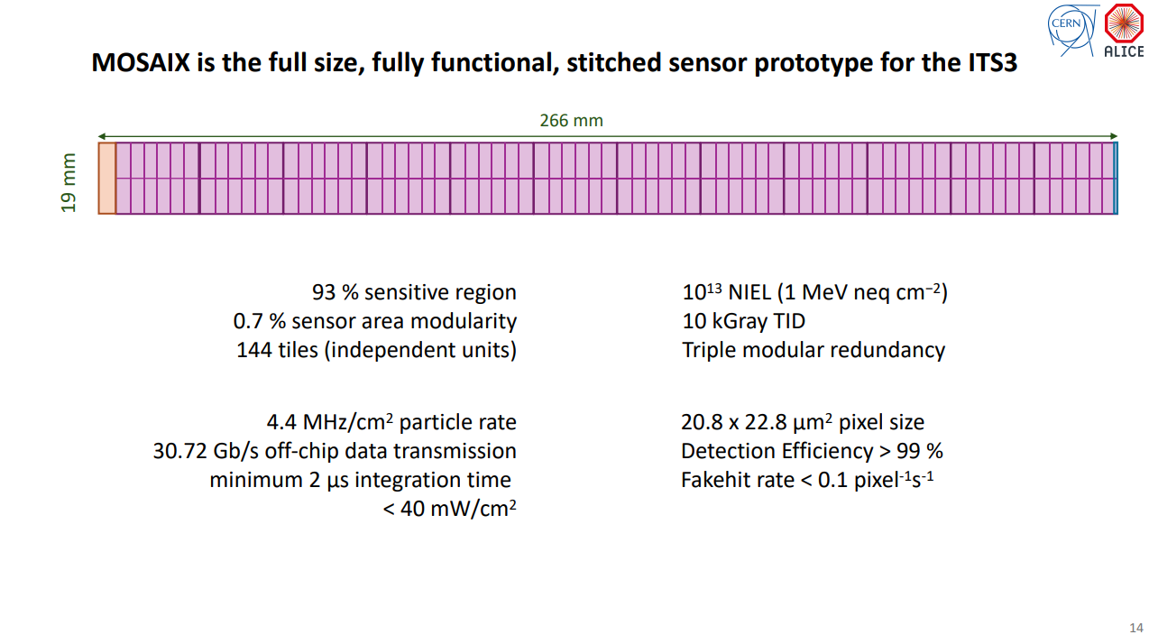
MOSAIX Progress
Key Physics/Engineering Interface Question:
  How many tiles can we lose?

Slide 9
EIC-LAS
Notes:
The abstract pattern can be removed or repositioned if required. Be careful to ‘Send to Back’ so that it does not obscure any important information.

Slide 10
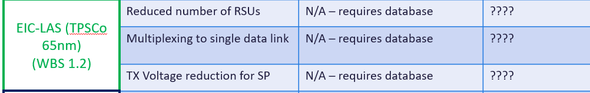
EIC-LAS
Changes to MOSAIX
  To reduce risk, we try and limit ourselves to three changes from MOSAIX to LAS:
    Reduce number of RSUs
    Edit data multiplexer to put everything on one link
    Alter serialiser power scheme to match serial powering
Requires DOE-CERN agreement – currently in negotiation

Slide 11
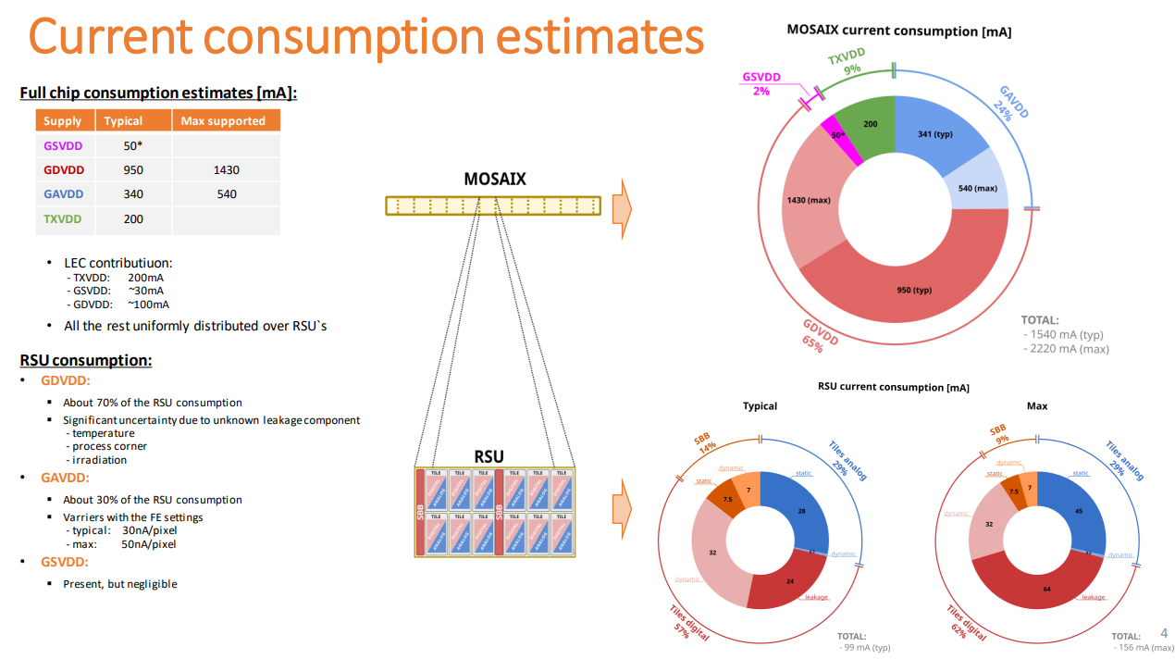
EIC-LAS
Assist with Stave Design
  In spite of challenges, need to provide some numbers (esp. power) to allow AncASIC and stave design
  Make some assumptions based on available data:
    Latest MOSAIX Power numbers
    Assume 6 RSU LAS
    Numbers in red do not have “Max” estimates in the previous slide, so assumed +50% on typ number (since this is true for supplies that do have it)
    EIC-LAS is one LEC and 6 RSU
 | Voltage(V) | Typ Current Consumption (mA) |  |  | Max Current Consumption (mA)
 |  | RSU | LEC | EIC-LAS | RSU | LEC | EIC-LAS
GAVDD | 1.32 | 28 |  | 168 | 45 |  | 270
GDVDD | 1.32 | 71 | 100 | 526 | 111 | 150 | 816
GSVDD | 1.32 | 1.6 | 30 | 40 | 2.4 | 45 | 59.4
TXVDD | 1.2 |  | 200 | 200 |  | 300 | 300
Total |  |  |  | 934 |  |  | 1445

Slide 12
EIC-LAS Progress
Progress
  What we want to do is clear
  Further understanding (esp. of the LEC) is needed to determine how to handle link reduction
  Making any changes to the MOSAIX design other than stitching plan changes requires database access. Currently in negotiation at DOE-CERN level
  Fallback options could exist in case this is not forthcoming or we have timeline/risk/effort issues:
    Settle for non-optimal numbers of links
    Different scheme to power serialiser

Slide 13
Ancillary ASIC
Notes:
The abstract pattern can be removed or repositioned if required. Be careful to ‘Send to Back’ so that it does not obscure any important information.

Slide 14
Ancillary ASIC
Background
  Some features of EIC-LAS not amenable to stave operation:
    Point-to-point slow control
    Point-to-point powering
  Adding these to the EIC-LAS/MOSAIX design is high risk, complex and perhaps technically unfeasible
  Develop supporting ASIC instead

Slide 15
Ancillary ASIC
Features
  Shunt-LDO (SLDO)
    For serial powering
    5 per AncASIC (4 EIC-LAS supplies and AncASIC)
  Negative Voltage Generator (NVG)
    MOSAIX/EIC-LAS need small negative back bias
  AncBrain
    Slow Control Multiplexing
    Control of rest of AncASIC

Slide 16
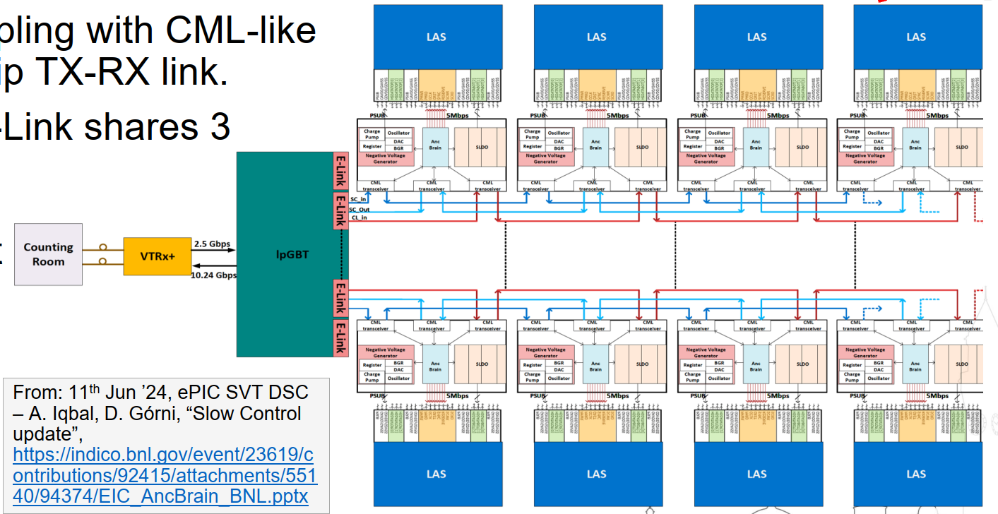
Ancillary ASIC Stave

Slide 17
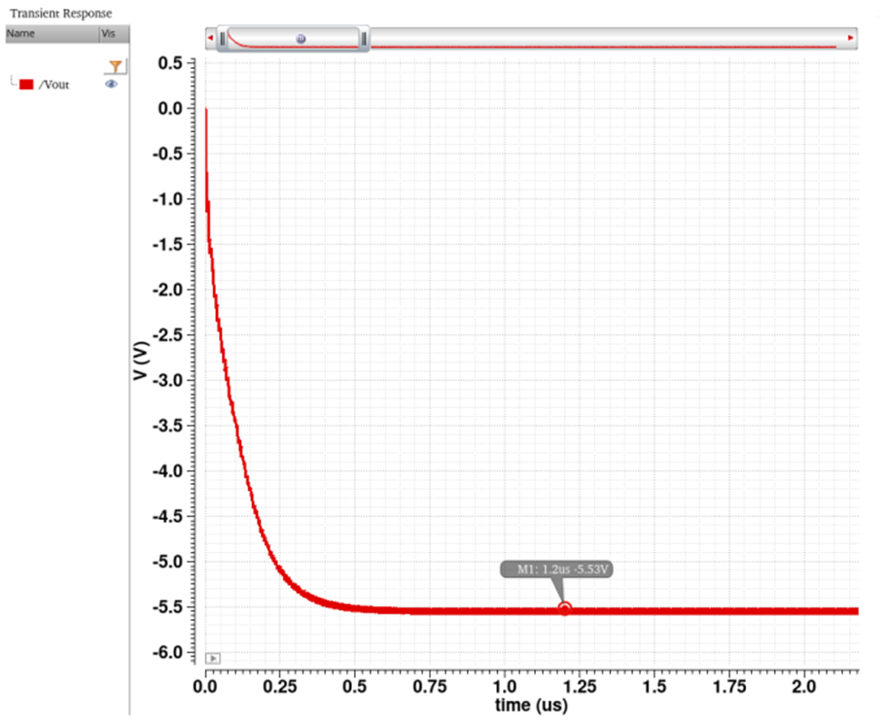
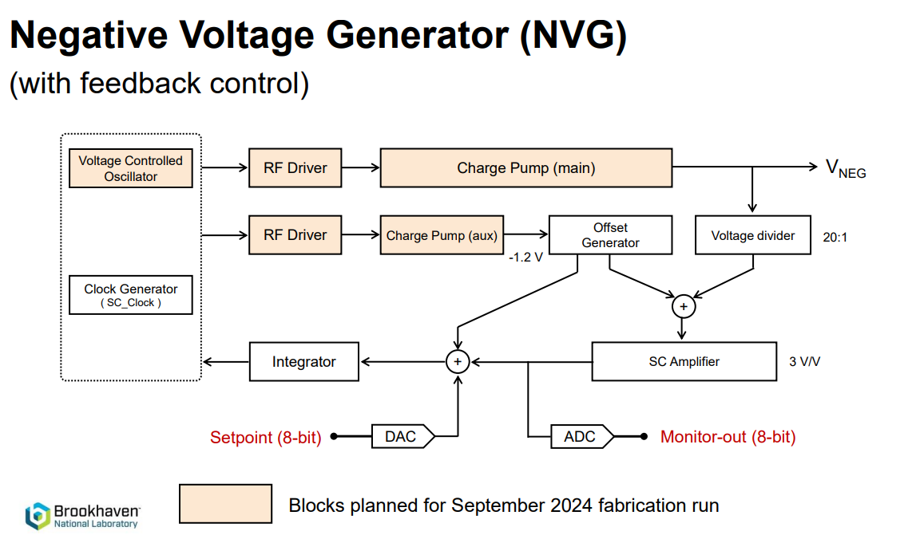
Negative Voltage Generator

Slide 18
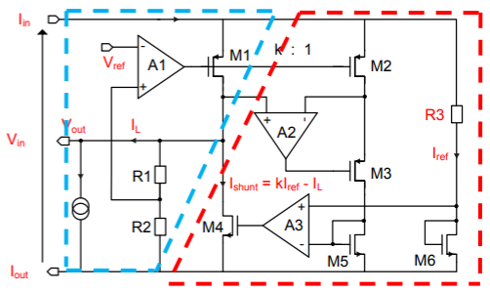
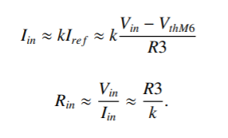
SLDO
What is an SLDO?
  The Shunt-LDO (SLDO) is a combination of a Low Drop Out (LDO) regulator and a Shunt Regulator.
  The LDO loop keeps the output voltage constant and the shunt loop ensures the correct corresponding load current is supplied.
  The LDO loop keeps Vout constant by dropping the difference between the desired output voltage and the input voltage across a pass transistor.
  The shunt regulator loop makes sure the same current is always drawn by the SLDO by shunting the difference between the load and input current.
  The SLDO has an ohmic IV characteristic.
[1]

Slide 19
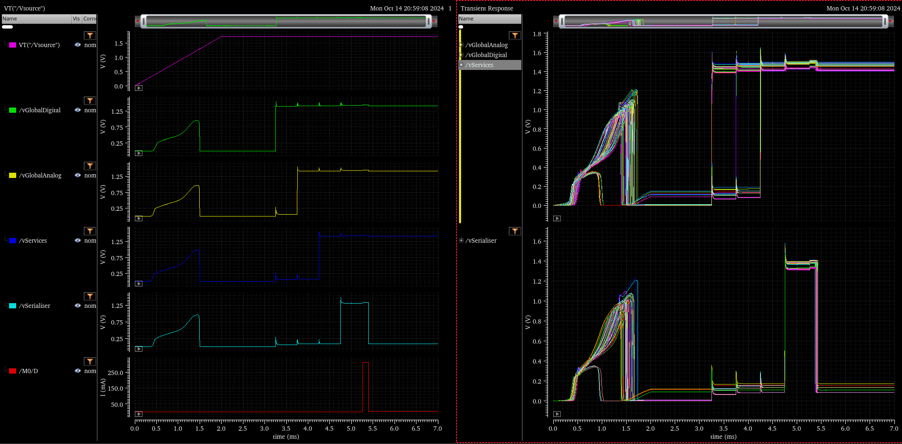
SLDO
Corners (partial)
Supply Ramping
GD Start
GA Start
Services Start
Serialiser Start
Overcurrent
MODE 0 – overcurrent on serialiser

Slide 20

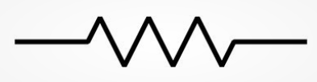
AncASIC Size and Pads
4x 100nF (sub-divided?)
500um
3 pads
GAVDD
7 pads
GDVDD
1 pad GSVDD
3 pads TXVDD
1 pad
PSUB
32 pads Slow Control
500um
500um
PAD
PAD
PAD
PAD
PAD
PAD
PAD
PAD
PAD
PAD
PAD
PAD
PAD
PAD
PAD
PAD
PAD
PAD
PAD
PAD
PAD
PAD
PAD
PAD
PAD
PAD
PAD
PAD
Pads: 47
1130um
Slow Control
NVG
530um
>1.5mm
PADS
PADS
2500um
800um
SLDO
SLDO
SLDO
SLDO
SLDO
500um
PAD
PAD
PAD
PAD
PAD
PAD
PAD
PAD
PAD
PAD
PAD
PAD
PAD
PAD
PAD
PAD
PAD
PAD
PAD
PAD
PAD
PAD
Pads: 40
~15mm
15 pads IIn
15 pads IOut
2 pads
SCin
2 pads
SCout
2 pads
CL_in
FPC Trace
FPC Trace
4x 1-100k
Preliminary – Treat as fully subject to change
4 pads R3
AC-coupling caps?
10µF

Slide 21
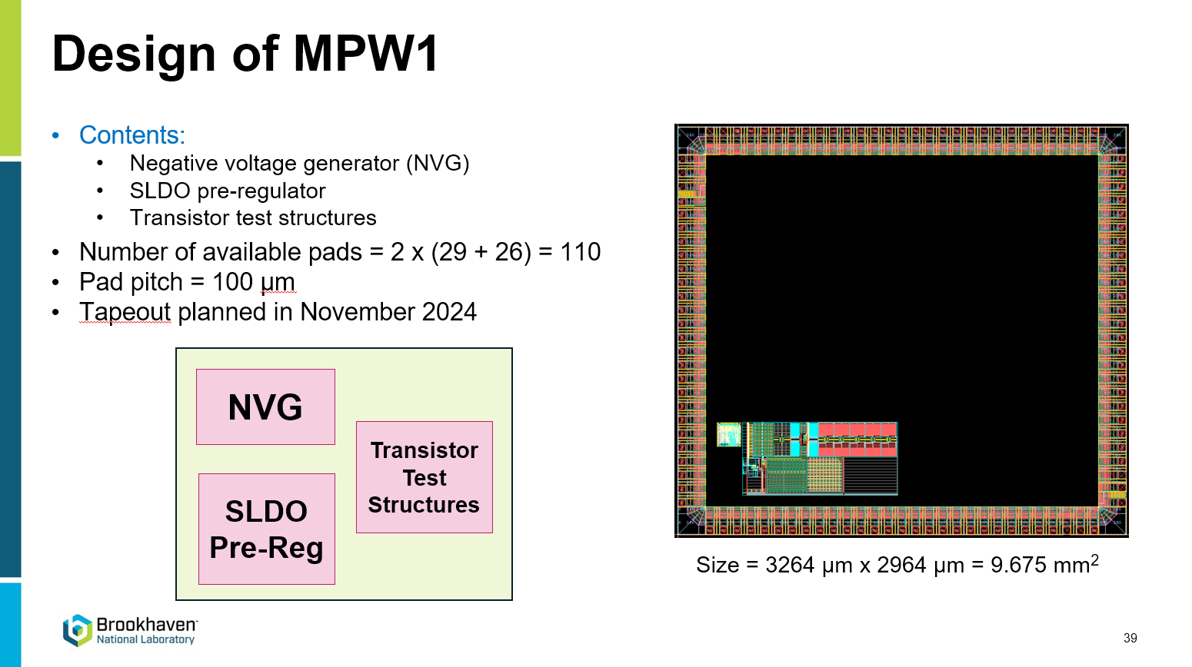
AncASIC Progress
Transistor Test Structures
  Complete
  Planned for November Submission
Negative Voltage Generator
  First version complete
  Planned for November Submission
  More Detail
Shunt LDO
  Schematically Complete
  Layout underway
  Pre-reg complete and planned for November Submission
  More Detail
AncBrain
  Scoping
  FPGA Emulator Planned
Towards higher level design
  Much AncASIC work so far focussed on providing information to higher level designs:
    Stave Power Consumption
    Cooling
    FPC Design
  But be aware all the underlying numbers are still subject to change!
AncASIC assembly requires DSA
November Submission at risk due to procurement issues

Slide 22
Conclusion
MOSAIX
  Watching brief
  Waiting for DOE-CERN Agreement
  Starting to think about resource allocation
Negative Voltage Generator
  Well advanced, first layout ready
AncBrain
  Scoping
  Hopefully funding for BNL emulator this FY
Shunt LDO
  Well advanced, first layout in preparation
Overall
  Good technical progress
  A number of legal and administrative concerns:
    DOE-CERN Agreement
    Design Share Agreement
    Procurement Issues
  Do we need to be thinking about mitigations for some of these?

Slide 23


Notes:
The abstract pattern can be removed or repositioned if required. Be careful to ‘Send to Back’ so that it does not obscure any important information.

Slide 24
Backup

Slide 25
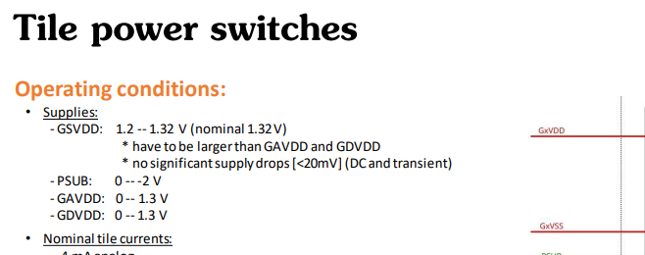
MOSAIX Supply Complexities
GA, GD and Services
  Remaining voltages are all driven at 1.32V
  It is necessary that services should always be above the other two, but this is handled internally by assuming that only GA and GD droop.
  Therefore we assume GA, GD and Services at 1.32V.
Testing MOSAIX with AncASIC
  James suggested it would be useful to be able to test the AncASIC powering MOSAIX when ER2 returns
  Ran some simulations to check if it is possible
  Seems that it is (for the Expected 25 case) because designing for Max45 EIC-LAS leaves a lot of headroom

Slide 26
MOSAIX Supply Complexities…
The 1.8V Problem…
  MOSAIX requires not just a 1.2V supply, but also 1.8V to run the serialisers
  The AncASIC itself will need a 1.8V supply for logic and the NVG
  However, all SLDOs need to be in parallel, and if we run them at 1.8V, the 1.2V supplies will waste considerable power
What can we do?
  Run the SLDOs at 1.8V
  Two serial powering chains
  Use the NVG?
  Tap power from the next stage?
  Remove serialiser LDO from 65nm IP (serialiser itself is 1.2V)
  Supply 1.8V externally to each LAS
Considerable waste of power - ~1.1W
Impossible – shared ground at various points
Could it step 1.2V up to 1.8V? Noise issues?
Routing complexity. Stability? Still a power waste - ~300mW. What about the last one?
1.2V
1.2V
0.4V
EIC-LAS
Would need 8 lines (supply and return for each of 4 LAS).
V= ~1.4V
1.2V
1.2V
EIC-LAS
V=0V

Slide 27
MOSAIX Supply Complexities…
The 1.8V Solution?
  João’s idea to edit the 65nm database to skip the LDO seems like a good one.
  We do not yet have a solution to powering the AncASIC circuits that run at 1.8V.
  It does seem that the serialiser could be separated from it’s LDO
  So for the rest of this presentation, I will assume that the serialiser can be powered at 1.2V in order to get an overall power number.
  We should perhaps suggest to the higher SVT that they think about point-to-point powering of the 1.8V system just in case (would mean 8 extra wires)
https://indico.cern.ch/event/1376523/contributions/5785064/attachments/2789901/4865135/ALPIDE_65_30_01_2024.pdf

Slide 28
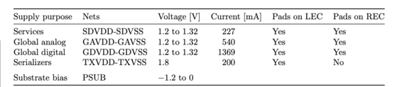
LAS Power Consumption – Earlier Estimates
 |  | Power Consumption
 | Unit | 5 RSU LAS | 6 RSU LAS | MOSAIX
LEC | mW | 696 | 696 | 696
RSUs | mW | 543 | 651 | 1303
Total | mW | 1240 | 1348 | 2000
Expected 25
2 published sources of data (power densities, and supply current breakdown)
LEC does not vary at all in the power density figures
Separation into supplies does not include Expected/Max variation
How to reconcile?
 |  | Power Consumption
 | Unit | 5 RSU LAS | 6 RSU LAS | MOSAIX
LEC | mW | 696 | 696 | 696
RSUs | mW | 889 | 1066 | 2133
Total | mW | 1585 | 1763 | 2829
Max 25
 |  | Power Consumption
 | Unit | 5 RSU LAS | 6 RSU LAS | MOSAIX
LEC | mW | 696 | 696 | 696
RSUs | mW | 1280 | 1536 | 3072
Total | mW | 1976 | 2235 | 3768
Max 45

Slide 29

LAS Power Consumption – Earlier Estimates
Towards individual supply estimates
  Can only really make worst case assumptions:
    6 RSU LAS
    Expected 25 to Max 45 is 65% variation.
    Apply this also to the LEC and assume published number is Expected 25.
    Worst case numbers are then 1536mW for the RSUs and 1148mW for the LEC.
    Total 2684mW
  How does this compare to the published supply numbers (MOSAIX – 12RSU)?
N.B. We can make better case assumptions if we like, but we should do it consciously
Scale to EIC-LAS ->
+65% ->
272mW
648mW
1643mW
360 mW
XXXXXX
272mW
270mW
821mW
360 mW
XXXXXX
449mW
445mW
1354mW
594 mW
XXXXXXX
Total: 2923mW 1723mW 2842mW
Good match to our worst case Max45 estimate, so can probably assume the original numbers are for the Expected 25 case

Slide 30
LAS Power Consumption – Earlier Estimates
LAS, Best and Worst
  Knowing the EIC-LAS current requirements is key for the SLDO design
  Since the SLDO dominates the AncASIC (we need a better name…) power consumption, it is also key to get a power number for that chip
  Current numbers needed for simulation
Power
Voltage
Current
Expected 25
Max 45
Expected 25
Max 45
Services
Global Analog
Global Digital
Serialisers
272mW
270mW
821mW
360 mW
449 mW
445 mW
1354 mW
594 mW
1.32V
1.32V
1.32V
1.2V
206 mA
205 mA
622 mA
300 mA
340 mA
337 mA
1026 mA
495 mA
Assume 1.2V for serialisers (if we can skip the on-chip LDO)

Slide 31
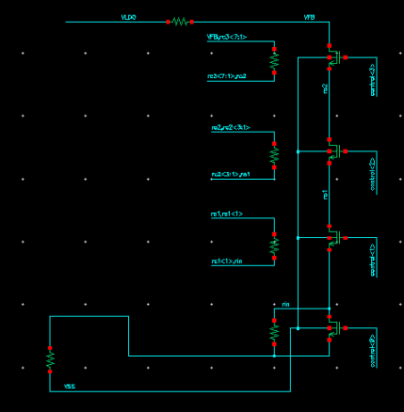
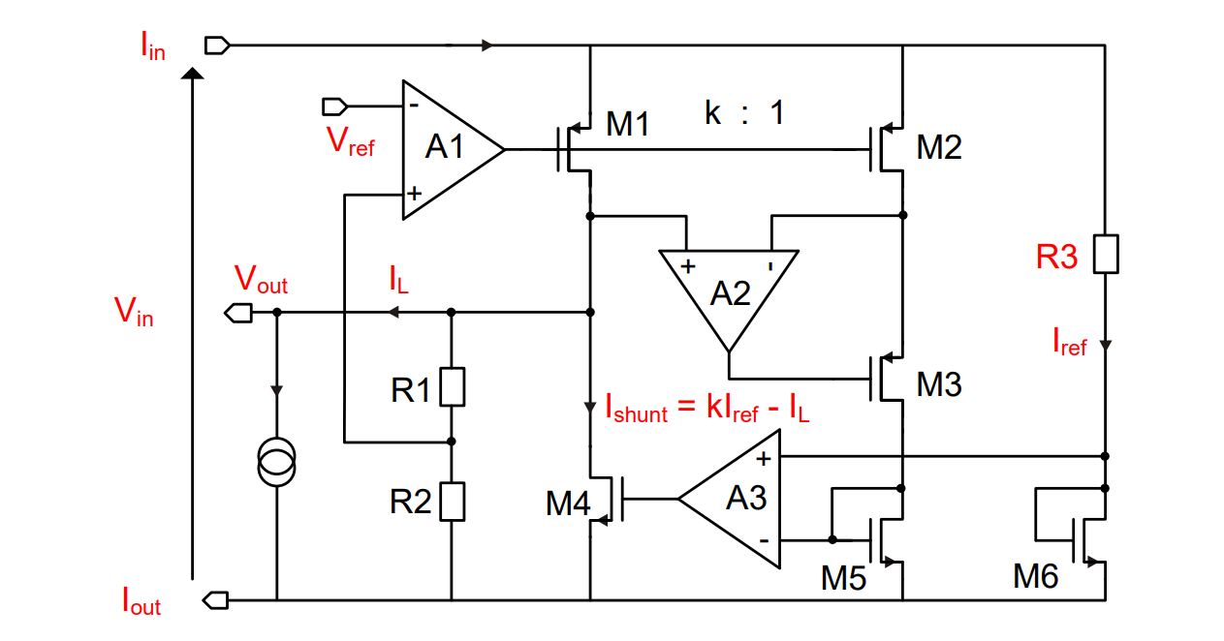
Ancillary Chip Adjustability
Programmable Output Voltage
  Compared to earlier presentations (v7 and before), need to simulate case where GA=GD=Services=1.32V and Serialiser=1.2V. Requires adjustable SLDO output.
  Since we also want some control over SLDO output to allow adjustment in real world, prefer to implement real circuit.
  Implemented variable resistor (4bit) to allow this. Should give swing between 1.1 – 1.5V

Slide 32
AncASIC Power Consumption
Notes:
The abstract pattern can be removed or repositioned if required. Be careful to ‘Send to Back’ so that it does not obscure any important information.

Slide 33
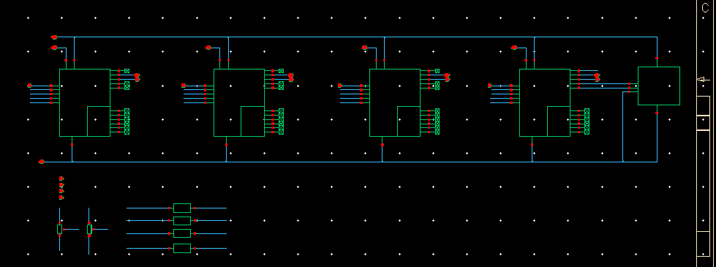
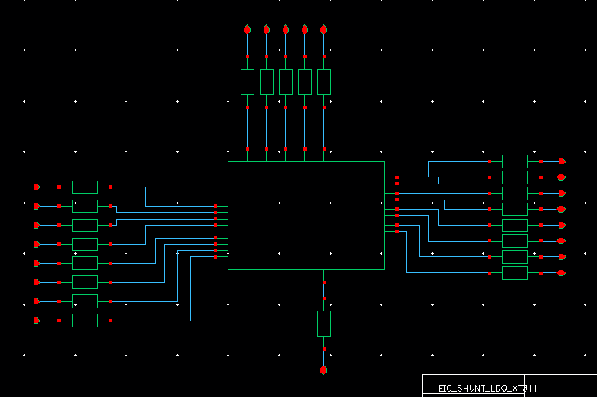
Towards Increased Realism
Build an “AncASIC”
  4x SLDO plus OVP
  No NVG, slow control, AncASIC SLDO
AncASIC Packaging
  Determine number of pads per supply based on EM limits
  Assume Max condition and 20% shunt overhead
  Iout must equal Iin to cover case where all current is shunted
  N.B. These are only the supply pads. Does not includes controls, NVG, Slow Control etc.
ANC_ASIC
Supply | Current (mA) | Pads Required
Iin/Iout | 1734 | 15/15
GAVDD | 270 | 3
GDVDD | 816 | 7
Services | 59.4 | 1
Serialiser | 300 | 3
ANC_ASIC_packaged

Slide 34
MOSAIX Power Consumption
MOSAIX Engineering Specification Review
  Current consumption numbers for MOSAIX were updated in the engineering review.

Slide 35
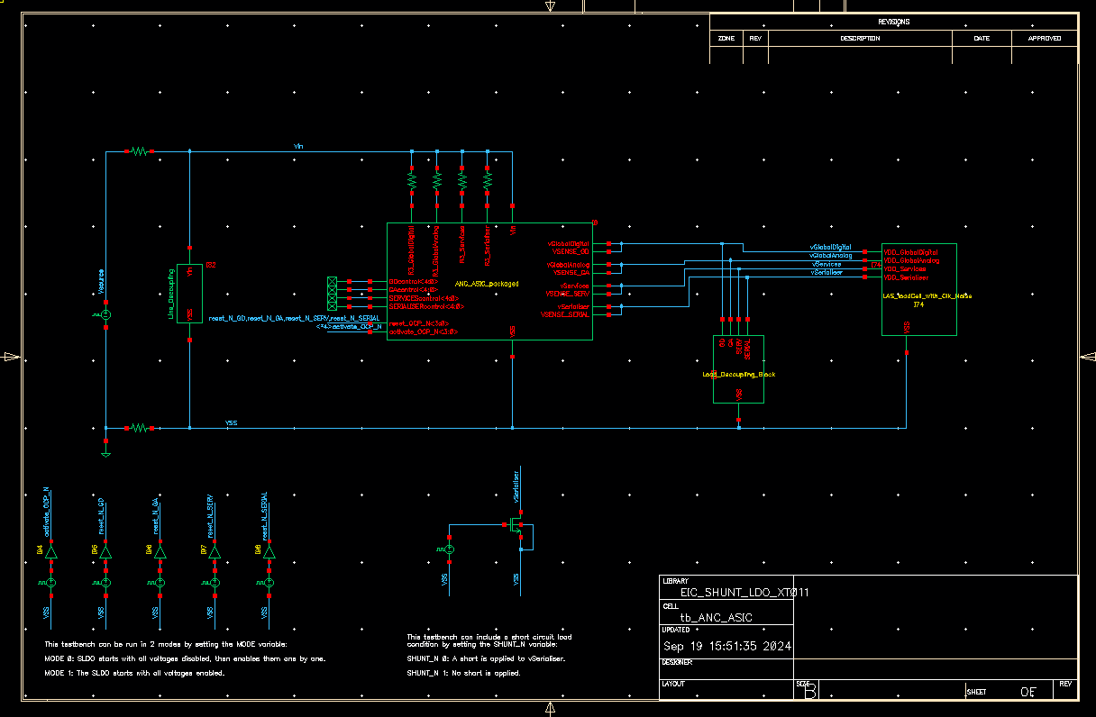
Towards Increased Realism
FPC Trace Resistance
  Using input and output trace resistance provided by Marcello – 94.6mOhm
MOSAIX Loads
  Unknown, so using:
    capSerialiser – 10nF
    capServices – 100nF
    capGlobalAnalog – 1uF
    capGlobalDigital – 10uF
    R3 Values
  Ideal (no tolerance or E series)
  Tolerance and non-ideal value will reduce power efficiency
Decoupling
  10uF Line Decoupling
  100nf Load Decoupling

Slide 36
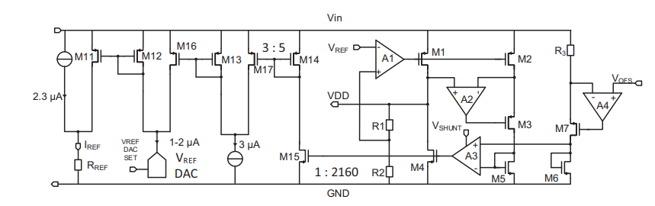
Overcurrent Protection
Over-current protection
  Change from that described in this paper
    Detect under-shunt condition
    Voltage limit by output voltage reduction
    Still some short circuit current
  Use more traditional LDO overcurrent protection
    Detect under-shunt condition
    Short pass transistor
    Effectively make output high impedance, and shunt behaves like an open circuit
    Some transient immunity

Slide 37
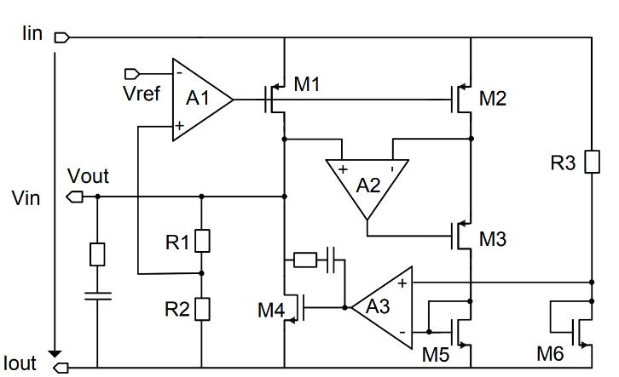
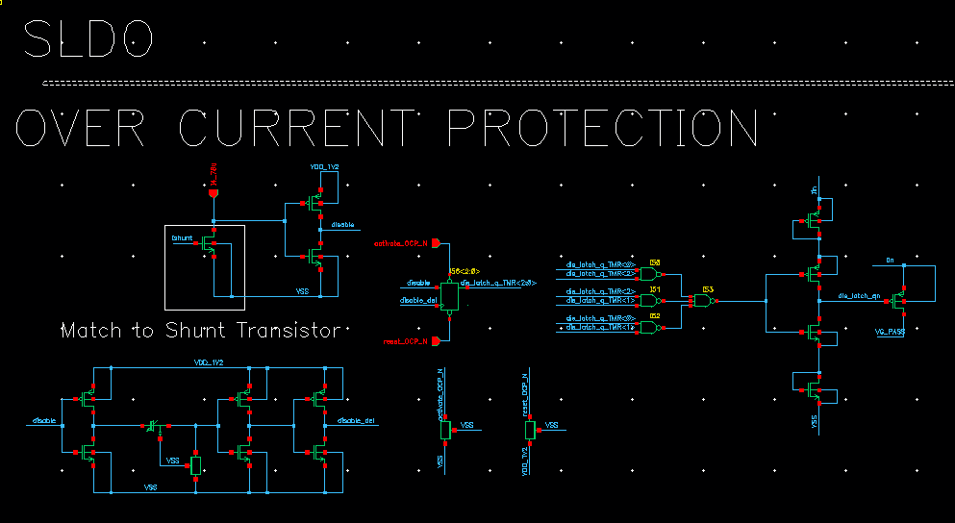
Overcurrent Protection
Over-current protection
  Use more traditional LDO overcurrent protection
    Detect under-shunt condition
    Short pass transistor
    Effectively make output high impedance, and shunt behaves like an open circuit
    Some transient immunity
    Locks into overcurrent state until reset
    TMR protection
    Pull-ups for default operation
Overcurrent Detection
Register
Voltage buffer
TMR
PT Short
Transient Protection
Defaults

Slide 38
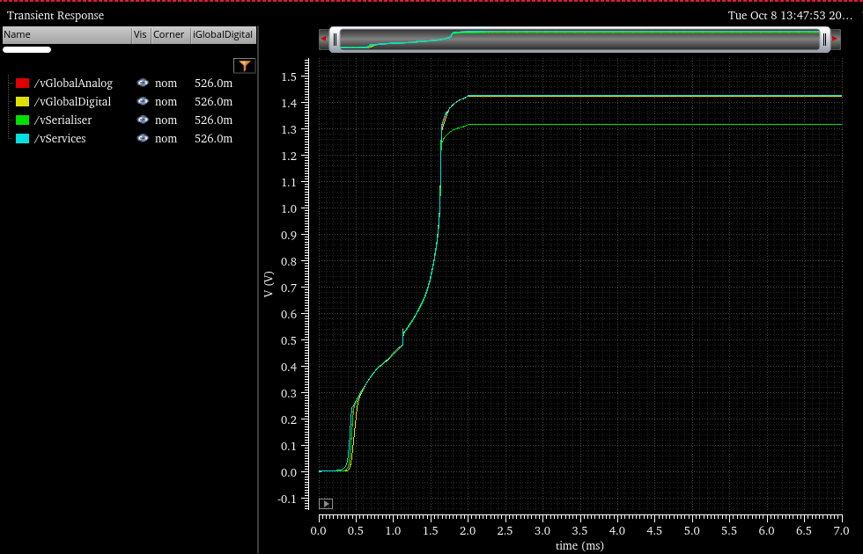
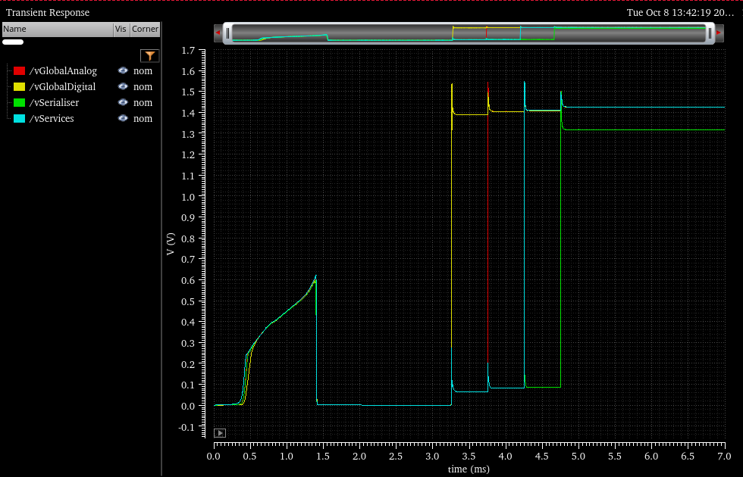
AncASIC Performance
Boundary Conditions
  3 Conditions
    6 RSU LAS – Expected
    6 RSU LAS – Max
    MOSAIX (12 RSU) – Expected
  2 Modes
    MODE 0: SLDOs disabled at startup and turned on individually
    MODE 1: SLDOs enabled at start-up
  +10% shunt overhead based on https://cds.cern.ch/record/2292628/files/CR2017_385.pdf
MODE 1
MODE 0

Slide 39
AncASIC Performance
Corners
  MOS
    tm,wp,ws,wo,wz
  RES
    tm,wp,ws
  CAP
    tm,wp,ws
  BJT
    tm,wp,ws
  TEMP
    -20, 30, 60, 105
  540 corners / 2 Modes / 3 Conditions
    3240 combinations
MODE 1
MODE 0

Slide 40
AncASIC Performance
Simulation Specifications
  Voltages
    vGlobalAnalog – 1.28-1.37
    vGlobalDigital – 1.28-1.37
    vServices – 1.28-1.37
    vSerialiser – 1.15 – 1.25
  Shunt Percentage
    vGlobalAnalog – 5-15%
    vGlobalDigital – 5-15%
    vServices – 20-25% (min 10mA)
    vSerialiser – 5-15%
  Dropout Voltage
    vGlobalAnalog – 0.175 – 0.25V
    vGlobalDigital – 0.175 – 0.25V
    vServices – 0.175 – 0.25V
    vSerialiser – 0.3 – 0.35V
  Shunt Power <35% of Load Power
MODE 1
MODE 0

Slide 41
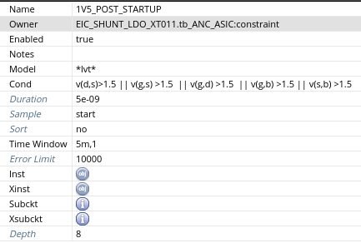
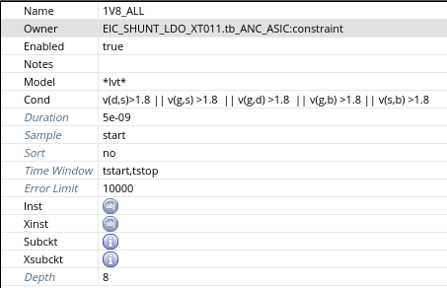
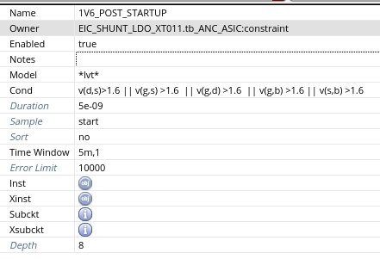
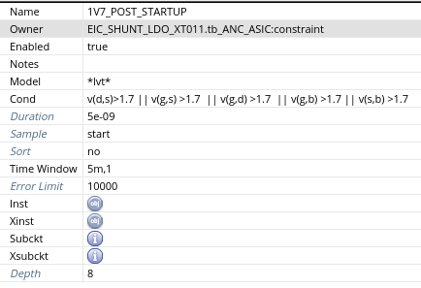
AncASIC Performance
Device Checks

Slide 42
AncASIC Performance
Corners (partial)
Supply Ramping
GD Start
GA Start
Services Start
Serialiser Start
Overcurrent
MODE 0 – overcurrent on serialiser

Slide 43
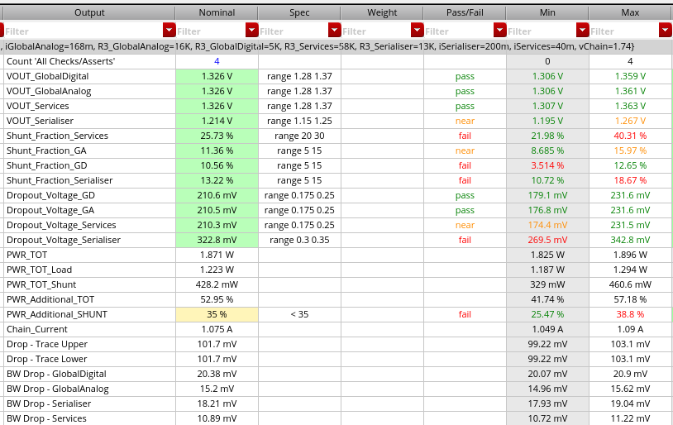
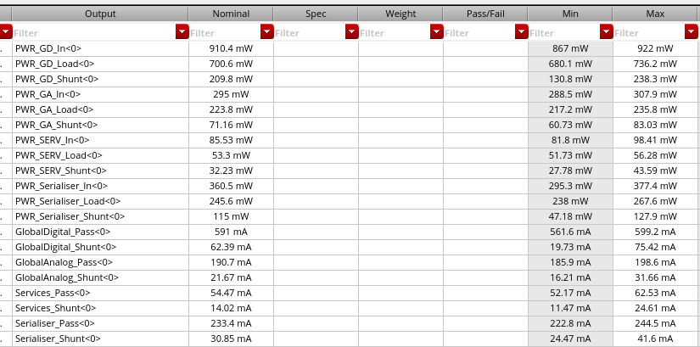
AncASIC Performance
Mode 0 - Typical
Also for Mode 0 Max and Mode 1 Typ and Max (see back up slides)

Slide 44
AncASIC Performance
Overall Power Consumption
EIC-LAS, AncASIC and Total Power (mW) | MODE 0
 | Typ |  |  |  | Max |  |  |  | Total
 | EIC-LAS | AncASIC |  |  | EIC-LAS | AncASIC |  |  | Min | Nom | Max
 |  | Min | Nom | Max |  | Min | Nom | Max
Global Digital | 701 | 131 | 210 | 238 | 1088 | 193 | 341 | 394 | 832 | 911 | 1482
Global Analog | 224 | 61 | 71 | 83 | 360 | 88 | 111 | 147 | 285 | 295 | 507
Services | 53 | 28 | 32 | 44 | 80 | 18 | 41 | 66 | 81 | 85 | 146
Serialiser | 246 | 47 | 115 | 128 | 369 | 37 | 172 | 246 | 293 | 361 | 615
Total | 1224 | 267 | 428 | 493 | 1897 | 336 | 665 | 853 | 1491 | 1652 | 2750
AncASIC Power Fraction |  | 21.81% | 34.97% | 40.28% |  | 17.71% | 35.06% | 44.97%
N.B. FPC traces add another 200mW
Prev values:
1702
2581

Slide 45
AncASIC Performance
AncASIC Power Variation in Corners
AncASIC Power Fraction
  Graph shows power consumed by the AncASIC as a fraction of LAS power over the corners
  Typ and Max cases for LAS shown
  No major variation since presented as a percentage

Slide 46
AncASIC Performance
Total Power Variation in Corners
FPC Consumption
  FPC traces consume considerable power
  Increase from ~35% to 50-60% of LAS
  Due to >1A through 200mohm
  Varies with Typ and Max corner due to current increase
  Cooling problem or not? To be included in model?

Slide 47
Power Caveats…
Caveats to the numbers
  Best estimate from MOSAIX. Not a warranty.
  Possibility that LEC value will rise (additional functions)
  For GAVDD, it is likely that EIC-LAS will be in the Max case, since we want the fastest frontend speed
  We may be able to reduce TXVDD consumption if we don’t need all the transmitters (or can run slower)
  Need to add consumption of non-SLDO AncASIC
  Mis-match in GAVDD, GDVDD consumption may require different input voltages (waste of power in serial powering chain)
  Irradiation
Future Updates
  May be future releases from MOSAIX
  AncASIC will need to be updated once porting to XT011 is completed
  Test results from ER2

Slide 48
AncASIC Sizing
Notes:
The abstract pattern can be removed or repositioned if required. Be careful to ‘Send to Back’ so that it does not obscure any important information.

Slide 49
AncASIC Size and Pads
4x 100nF (sub-divided?)
500um
3 pads
GAVDD
7 pads
GDVDD
1 pad GSVDD
3 pads TXVDD
1 pad
PSUB
32 pads Slow Control
500um
500um
PAD
PAD
PAD
PAD
PAD
PAD
PAD
PAD
PAD
PAD
PAD
PAD
PAD
PAD
PAD
PAD
PAD
PAD
PAD
PAD
PAD
PAD
PAD
PAD
PAD
PAD
PAD
PAD
Pads: 47
1130um
Slow Control
NVG
530um
>1.5mm
PADS
PADS
2500um
800um
SLDO
SLDO
SLDO
SLDO
SLDO
500um
PAD
PAD
PAD
PAD
PAD
PAD
PAD
PAD
PAD
PAD
PAD
PAD
PAD
PAD
PAD
PAD
PAD
PAD
PAD
PAD
PAD
PAD
Pads: 40
~15mm
15 pads IIn
15 pads IOut
2 pads
SCin
2 pads
SCout
2 pads
CL_in
FPC Trace
FPC Trace
4x 1-100k
Preliminary – Treat as fully subject to change
4 pads R3
AC-coupling caps?
10µF

Slide 50
Size Caveats
Very preliminary
  Only producing at this stage to assist with requests for stave design
  Not discussed with other designers yet
  Chip has 3 components:
    Negative Voltage Generator
      Size unknown
    Slow Control Multiplexing
      Size unknown
    SLDO
      Size unknown, but will probably dominate
      Size dominated by a few transistors, so some guess at chip size can be made
      However:
        Design at early stage
        Sizes taken from 65nm design (not 110nm)
  Of course, this also means we can be open to comments
  Need someone to do thermal FEA – now that size and power are known
Preliminary – Treat as fully subject to change

Slide 51
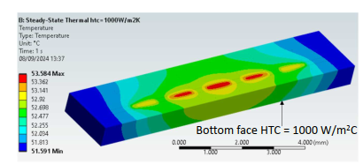
Thermal Studies
All Stephanie’s work. See later! ☺

Slide 52
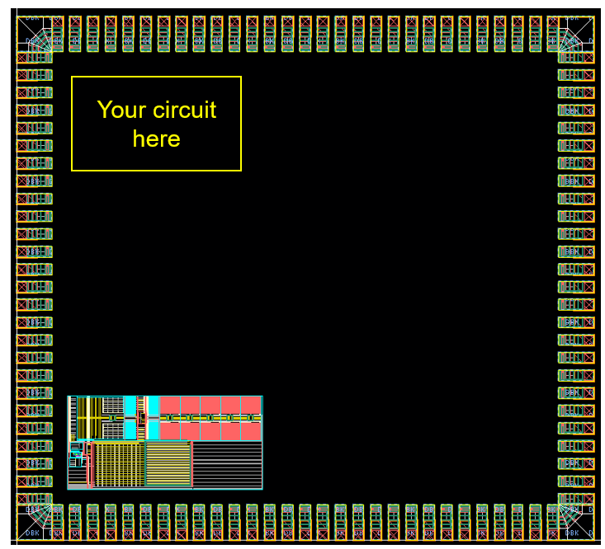
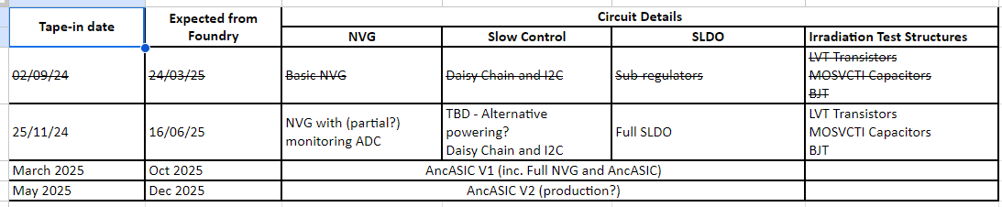
AncASIC Progress
Progress
  A lot of work in simulation and estimation to allow mechanical/thermal design to proceed
  Target schedule of submissions towards AncASIC
  NVG: Simulated and layout well underway. Virtually complete for November run
  SLDO: Verification sims still ongoing. Layout started. Targeting November but very resource challenged.
  Slow Control: Conceptual. BNL plan to have funding next FY to start design on FPGA
  In general, many legal and procedural hurdles at the moment.

