Slide 1


Modelling the Underlying Event in Photon-Initiated Processes
J. M. Butterworth, I. M. Helenius, J. J. Juan Castella, B. Pattengale, S. Sanjrani, and M. Wing
2408.15842
Notes:
Hello everyone and welcome to this talk. For those of you who don’t know me, my name is Bradley Pattengale and I will be presenting the findings from our recent work around modelling the underlying event in photon-initiated processes using the Monte-Carlo generator PYTHIA. This work is from a paper that is available on the arXiv and has just been accepted to the SciPost journal.

Slide 2
Observations and motivations
The Underlying Event (UE) makes up most of the background data
Qualitative models from Monte-Carlo generators are needed to describe these “softer” interactions
A large part of UE comes from multiple interactions between partons (MPI)
Current models have been tuned to describe data in specific kinematic regions
No current tune describes photon-proton (ɣp) collisions at colliders like EIC
AIM: Test models of MPI for ɣɣ, ɣp, and pp collisions using current data
Notes:
I would like to start by making a few observations that motivate the work done here. First, the underlying event makes up most of the background data seen in detectors, and due to its softness, qualitative models from Monte-Carlo generators typically required to describe this data. A large part of the underlying event comes from multiple interactions between partons from incoming hadrons (MPI). And lastly, the current models have all been tuned to specific collision types and kinematic regions, for example there is no current MPI tune for photon-proton collisions like the ones that will be seen at the EIC. So this motivates the work done here which was to test current MPI models against current data (in new kinematic regions) and for the three different collision types: photon-photon, photon-proton, and proton-proton.

Slide 3


Outline
Multiple interactions with hadrons
Multiple interactions with photons
PYTHIA MPI model
Experimental data considered
Some results
Conclusions and outlook for EIC
RIVET 3.1.8
PYTHIA 8.310
Notes:
So for a quick outline for what I will be talking about: I’ll start with a qualitative description of MPI with hadrons and photons, then talk about the MPI model used in PYTHIA, then look at the experimental data considered in this study and lastly show some results. This work was all done using the Monte-Carlo generator PYTHIA and using the analysis software RIVET.

Slide 4
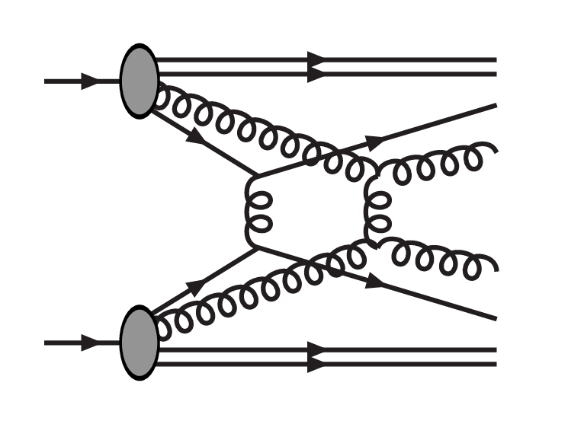
Multiple interactions with hadrons
Collisions with hadrons can have multiple partons interact simultaneously
Probabilities derived from 2→2 scattering cross sections
Calculations become divergent for low transverse momentum p_{T}, so a “screening” parameter p_{T0} is needed to regulate these interactions
Fig 1: An example of an MPI¹
Notes:
So as I mentioned before, multi-parton interactions come from simultaneous interactions between partons inside hadrons. An example of this is shown in figure 1. These interactions can be calculated from 2 to 2 scatterings, but when calculated, these interactions give divergent cross sections for low transverse energies/momenta. Because of this, a screening parameter must be included, pT0, that suppresses these low transverse momentum interactions and regulates the cross sections. This pT0 parameter is the main idea that these MPI models are built on (although not the only one)

Slide 5
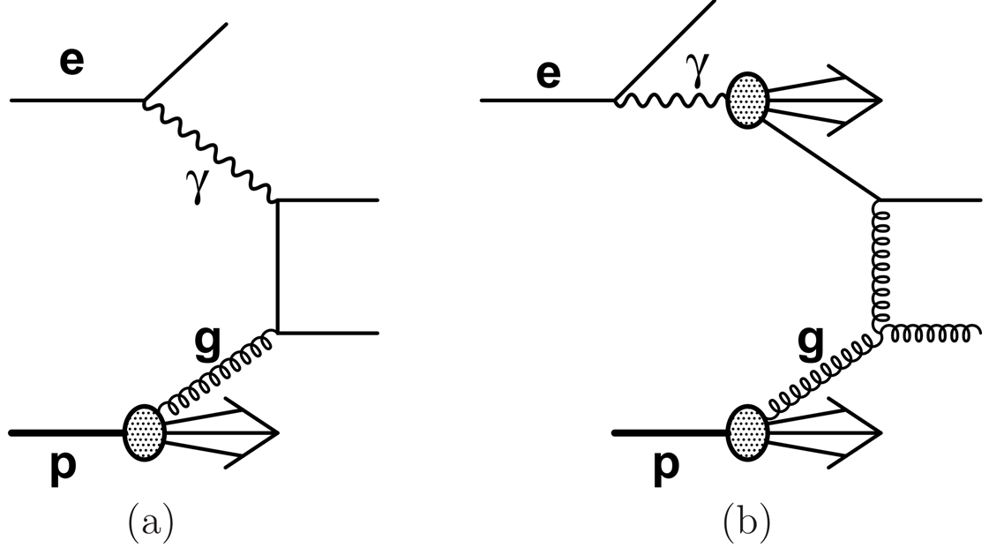
Multiple interactions with photons
Low-Q² virtual photons (~1 GeV) can fluctuate into qq and develop hadronic structure
“Resolved” photons give conditions necessary for multiple interactions in ee and ep colliders (and EIC!)
Fig 2: An example of direct and resolved photoproduction²
Notes:
So you might ask how do we get MPI with photons. And the answer is, for leptons interacting with low-Q^2, virtual photons (on the order of 1 GeV), these photons are can fluctuate into quark-antiquark pairs and develop a hadronic structure (referred to as resolved photons). Interactions with these resolved photons allow for hadronic collisions and MPI in any lepton collider including LEP, HERA, and the EIC. An example of direct and resolved photons interacting in “photoproduction” can be seen in Figure 2. Because this photon now interacts like a hadron, it will also have hadronic properties such as a fraction of the momentum participating in the collision (x-gamma), and photon remnants. This x-gamma should be (close to) 1 for direct photons, and lower for resolved photons.

Slide 6


PYTHIA MPI model
Screening parameter p_{T0} parameterises MPI activity
Scales with centre-of-mass energy
Two scaling laws: power and logarithmic
 | LEP (ɣɣ) | LHC (pp)
p_{T0}^{ref} | 1.54 GeV | 2.28 GeV
√s^{ref} | 100 GeV | 7000 GeV
α | 0.413 | 0.215
Default scale | Log | Power
Flipped scale | Power | Log
Notes:
As mentioned before, the main thing these MPI models are built on is this pT0 parameter. This parameter scales with center-of-mass energy, and in PYTHIA there are two scaling laws: power scaling (the top equation) and logarithmic scaling (the bottom equation). Notice that both of these scaling laws have three parameters: a reference momentum pT0-ref, a reference energy sqrt-s-ref, and a scaling factor alpha. Now this PYTHIA model has been validated for LEP (the photon-photon case) and the LHC (the proton-proton case), and their parameters can be seen in this table on the right. Notice that the LEP parameters use the log scaling by default and the LHC parameters use the power scaling. These parameters can also be used with the scaling flipped, and this offers more tunes to consider later. The flipped scaling will provide the same description of MPI at the reference energy (100 GeV or 7 TeV), but scale differently to different energies. These four possibilities (LEP/LOG, LEP/POWER, LHC/POWER, and LHC/LOG) make up the four main MPI tunes considered.

Slide 7
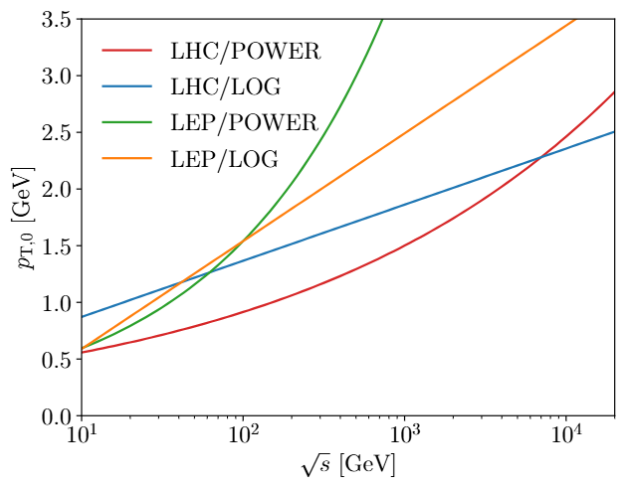
PYTHIA MPI model
LHC/POWER (Monash)
LHC/LOG
LEP/POWER
LEP/LOG
Detroit (lower energy pp data)
2C (lower energy pp data)
“No MPI”
Fig 3: Energy scaling of p_{T0} parameter for different MPI tunes
Notes:
So here is a list of every MPI tune that is tested below. We have our four default options from the LEP and LHC parameters with the power and log scales. The scaling with center-of-mass energy can be seen in figure 3 on the right. We have also included two other proton-proton tunes: Detroit and 2C, which were both tuned for lower energy proton-antiproton data from the Tevatron. These were included because they offer proton-proton MPI models that are closer in collision energies to the HERA data that is the main focus of this study, and therefore offer good comparisons of MPI between photon-proton and proton-proton. Lastly, we have also included PYTHIA with the MPI set to off.

Slide 8
Experimental data considered
Dijet production from ɣɣ collisions (LEP2)
Dijet photoproduction at various transverse jet energies (HERA)
Multi-jet photoproduction (HERA)
Charged particle production in photoproduction (HERA)
Charged hadron production from ɣɣ collisions (LEP2)
Charged particle production in pp collisions (LHC)
Notes:
Now the experimental data we have used to test these MPI models include both jet production and charged particle multiplicities. We have also considered data from LEP (the photon-photon collisions), HERA (the photon-proton / photoproduction collisions), and the LHC (proton-proton collisions). So the data we tested was for dijet photon-photon data, dijet photoproduction data for different jet energies, multi-jet photoproduction data, and charged particle production for all three collision types.

Slide 9
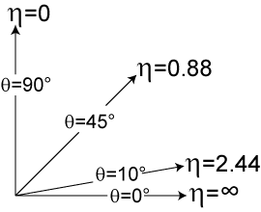
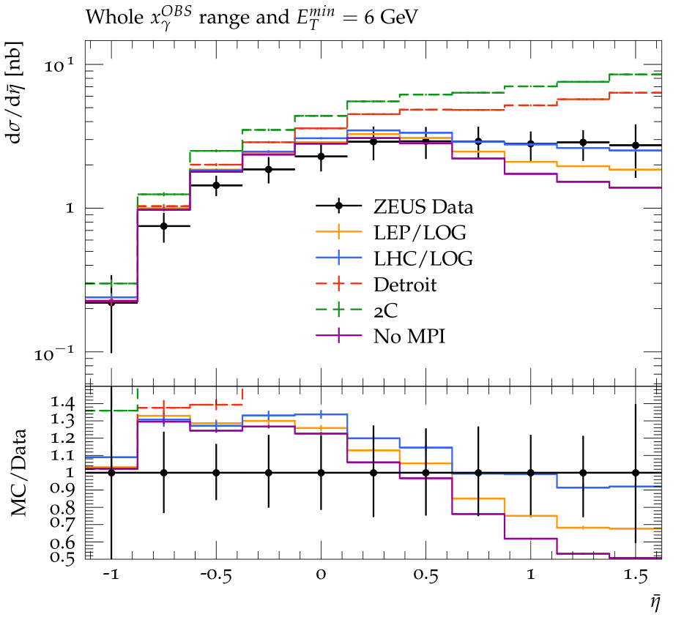
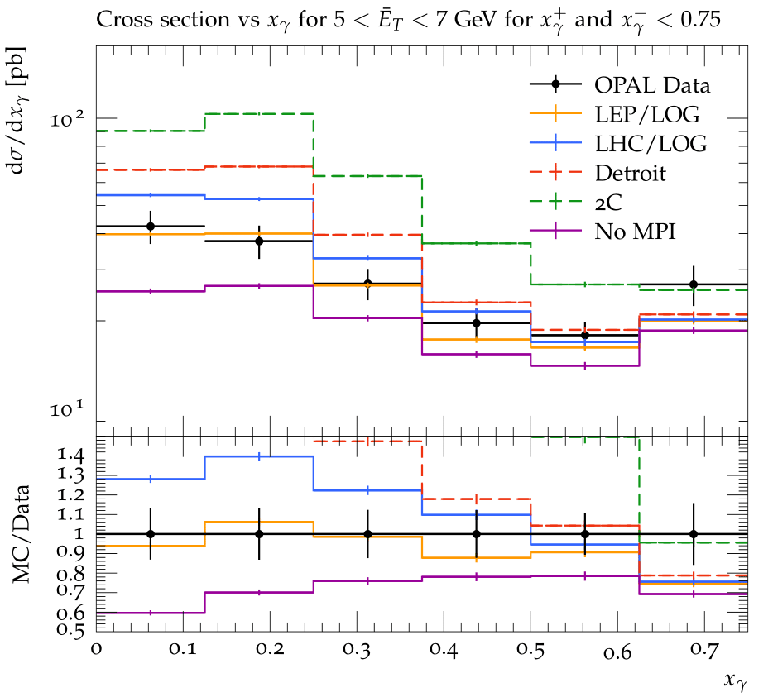
Low energy dijet data (ɣp and ɣɣ)
Fig 4: (Left) HERA low minimum energy dijet photoproduction data, and (right) LEP dijet data compared to models of the underlying event in Pythia.
Observations
MPI is required to describe data
pp tunes do a poor job describing data (Detroit and 2C)
LEP/LOG and LHC/LOG provide reasonable descriptions of data
Notes:
The first results shown here are the lower energy dijet production for photoproduction on the left and LEP (photon-photon collisions) on the right. The photoproduction cross section is a function of average pseudo rapidity eta bar, and the LEP cross section is a function of the fractional photon momentum x-gamma. Here we can see a few things, first of all that MPI is required to describe the data in both plots, as indicated by the “No MPI” tune sitting well below the data. Also noteworthy is that the proton-proton tunes do a poor job describing both sets of data (having far too much MPI activity) especially in the regions most sensitive to MPI, which is forward eta and low x-gamma (more resolved photons at low x_ɣ). Here we can see that the LHC/LOG tune best describes ɣp data, and the LEP/LOG best describes the ɣɣ data (as expected).

Slide 10
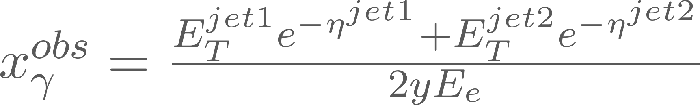
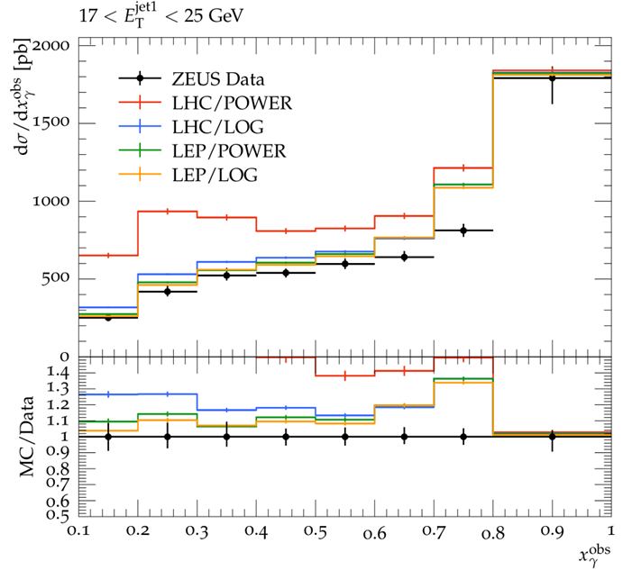
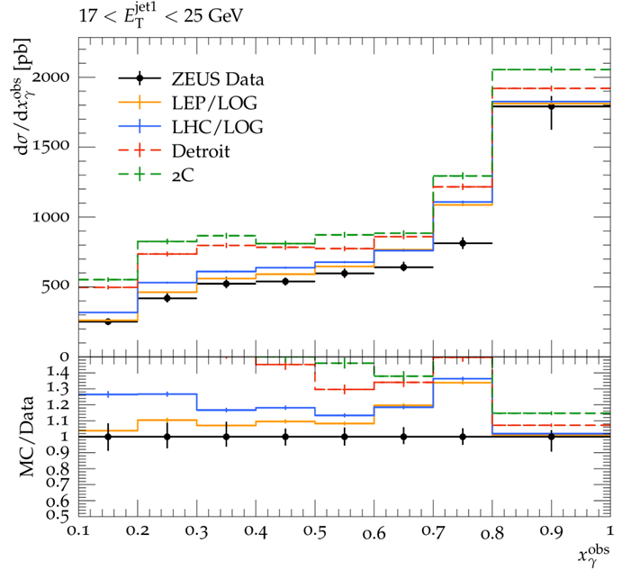
High energy dijet data (ɣp)
Fig 5: Higher energy dijet photoproduction data compared to models of the underlying event in Pythia.
Observations
All standard pp tunes do a poor job describing data
LEP tunes and LHC/LOG provide reasonable descriptions of data
Notes:
The next data considered was higher jet-energy photoproduction. Here we can see it plotted as a function of x_ɣ-obs (which is an estimation of x_ɣ as defined by the equation in the top right). Here we can see again, now also including the LHC/POWER in the right plot, that all standard proton-proton tunes provide a poor description of the data in the low x_ɣ (MPI sensitive) regions. All proton-proton tunes seem to overestimate the MPI activity in these lower x_ɣ regions with more resolved photons, indicating that much more MPI activity occurs in proton-proton collisions than ɣp collisions. Also to note here is that the LEP tunes, as well as LHC/LOG, provide good descriptions of the data.

Slide 11
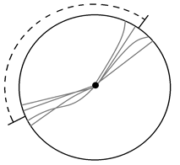

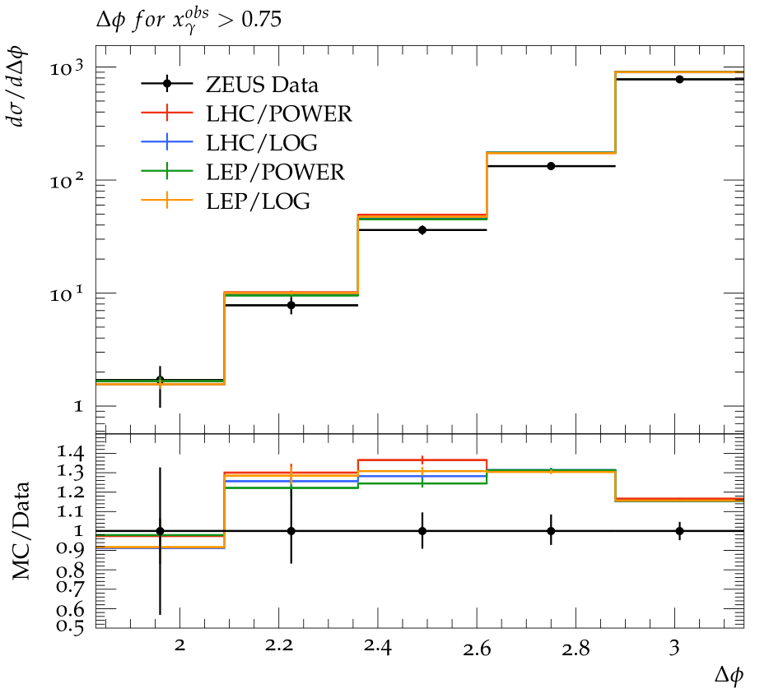
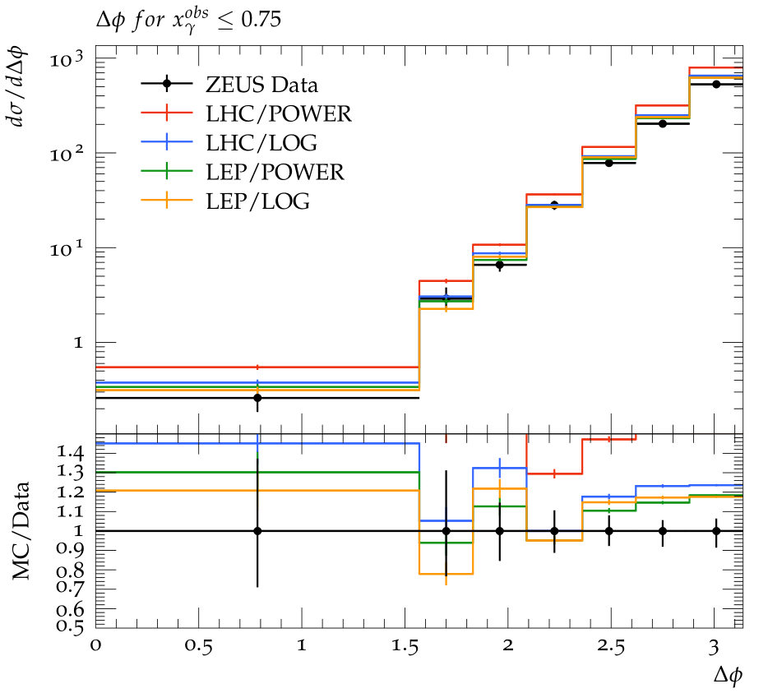
More high energy dijet data (ɣp)
Fig 6: High energy dijet photoproduction data compared to models of the underlying event in Pythia.
Observations
LHC/POWER rising above data around Δφ~π
So far: LEP tunes are favored for ɣp data
Notes:
The next data considered is still for high energy dijets from photoproduction, now with cross sections as a function of the angle between jets, Δφ which is sensitive to hard QCD radiation. These plots split up the data based on the x_gamma, with the high x_gamma (more direct photons) on the left and the low x_gamma (more resolved photons) on the right. Here we see that all MPI tunes provide similar descriptions of the data in the direct case, but larger differences can be seen in the resolved case (as expected). Also for the resolved case, we can see more significant differences in the MPI tunes further away from the Δφ~π case. Here again the LHC/POWER tune sits above the data and the LEP tunes provide the best description. Up to now, it was considered that the LEP tunes provided the best description of all photoproduction data, and a “simultaneous” description of the photon-photon and photon-proton data was found.

Slide 12
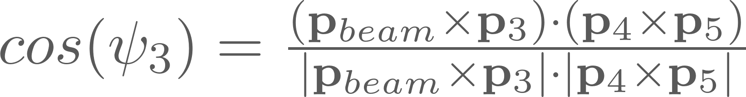
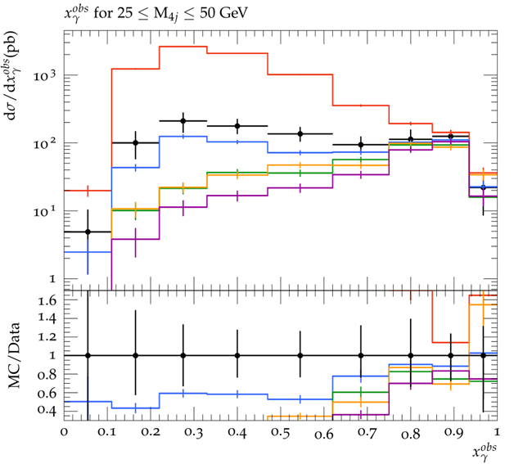
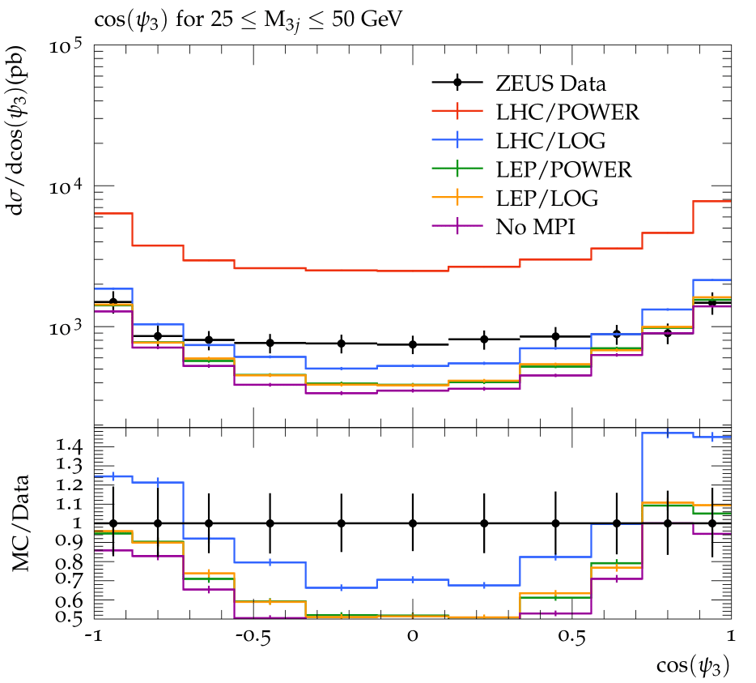
Lower energy multi-jet data (ɣp)
Fig 7: Low energy 3- and 4-jet photoproduction data compared to models of the underlying event in Pythia.
Observations
LEP tunes now sit well below the data
LHC/LOG provides best description
All tunes rise too steeply around cos(ψ₃) ~ 1, -1
Notes:
The next comparison done was for three and four jet photoproduction events from HERA, with lower minimum transverse jet energy. This is the data that should be the most sensitive to MPI. Here, in the x_gamma plot it is clear that: there is the most MPI activity, the LEP tunes sit far below the data (estimate too few MPI), and the LHC/LOG provides the best description of the data. This was an interesting development in our findings and showed the limitations of the LEP tunes. On the right plot, this cross section is shown as a function of the angle cos(psi_3) which is defined in the upper right hand corner and indicates the relative orientation of the third (third highest E_T) jet and is sensitive to initial state gluon radiation as well as higher order processes. (ISR is often in the direction of the proton/photon and leads to cos(psi3) of +/-1, and higher order processes/MPI lead to more spread out and central values of cos(psi3)) Here we can see every MPI tune rise around the +/-1 regions and drop in the central regions, which is an interesting behaviour that seems almost independent of MPI. Regardless, now the LHC/LOG is by far the favored tune.

Slide 13
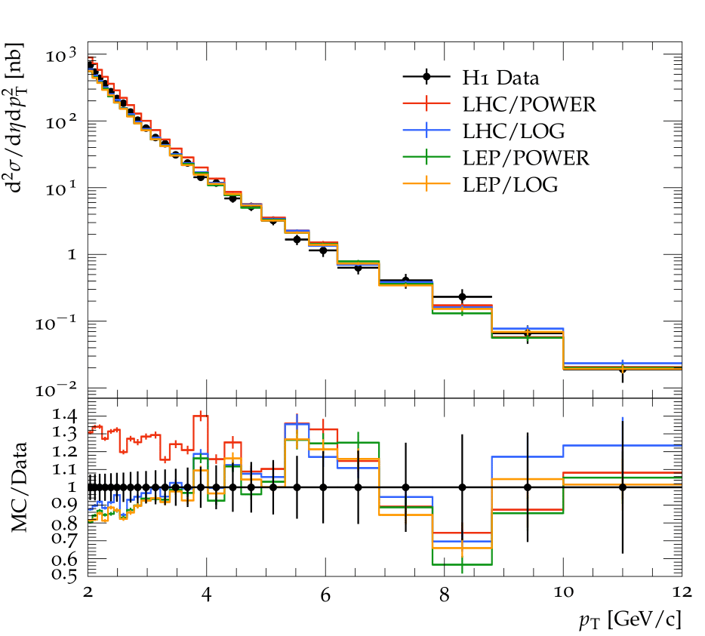
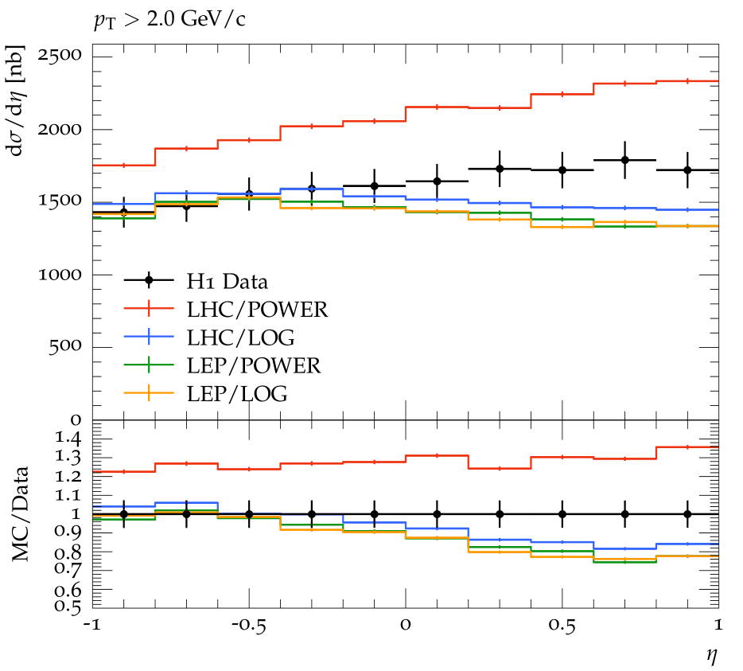
Charged particle distributions (ɣp)
Fig 8: Charged particle distributions of photoproduction data compared to models of the underlying event in Pythia.
Observations
LEP tunes and LHC/LOG provides best descriptions
Tunes underestimate data in forward η region
LHC/POWER still sits above data
Notes:
Moving on to charged particle production measurements, here we have distributions of transverse momentum pT and pseudorapidity eta. As mentioned before, these measurements should be more sensitive to MPI since they reach lower values of pT, but offer less direct connections to hard scattering events/kinematics. Here we can see that as the MPI tunes reach the most MPI sensitive regions, similar behavior can be seen to the jet data, where the LHC/POWER tune rises above the data and the LEP tunes start to drop below. Here, however, we see even the LHC/LOG tune drop in the forward eta region despite providing good descriptions of this region in the dijet data. Still, the LHC/LOG tune (and LEP tunes) provide the best description(s) here

Slide 14
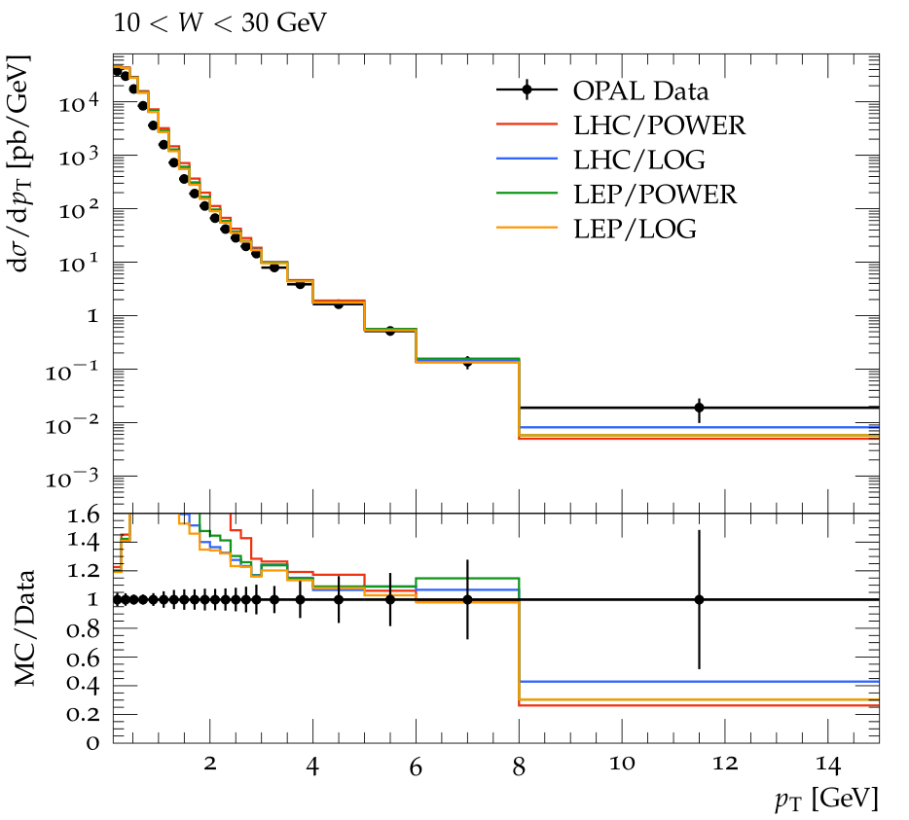
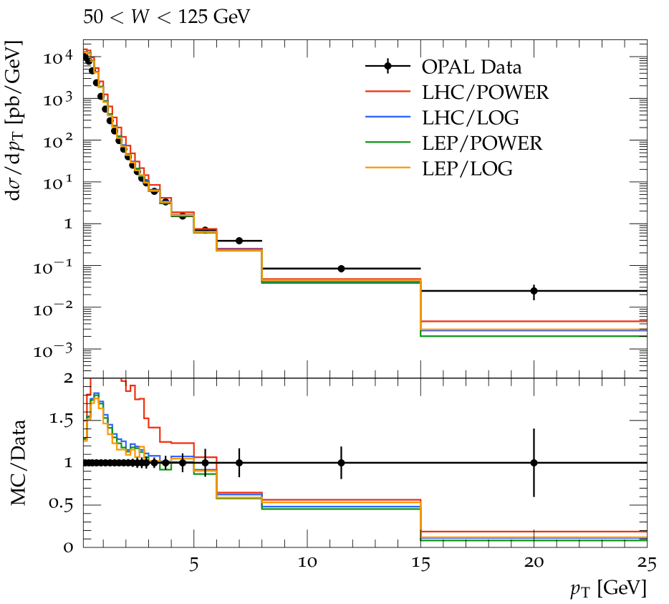
Charged particle distributions (ɣɣ)
Fig 9: Charged particle distributions of ɣɣ data compared to models of the underlying event in Pythia.
Observations
All tunes rise above the data at lowest p_{T} values
All tunes drop below the data at the highest p_{T} values
Notes:
Now it is interesting to compare these MPI tunes with charged particle data from photon-photon collisions at LEP. Here we see every MPI tune rise above data at low pT and drop below data at high pT. This indicated all tunes providing too “soft” of a pT spectrum.

Slide 15
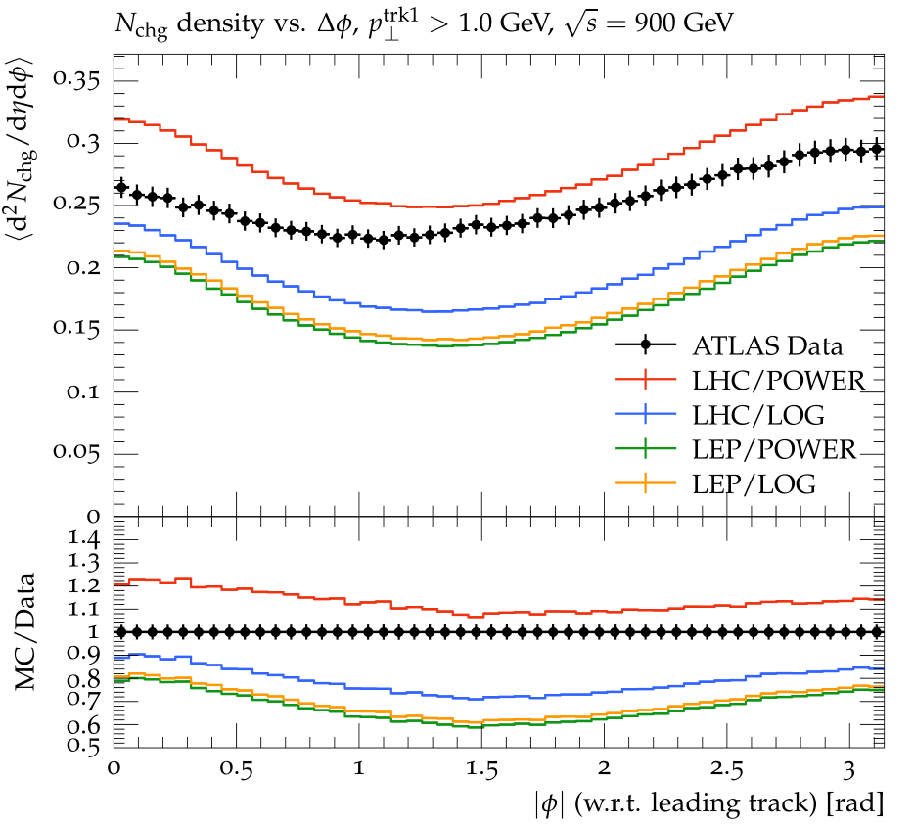
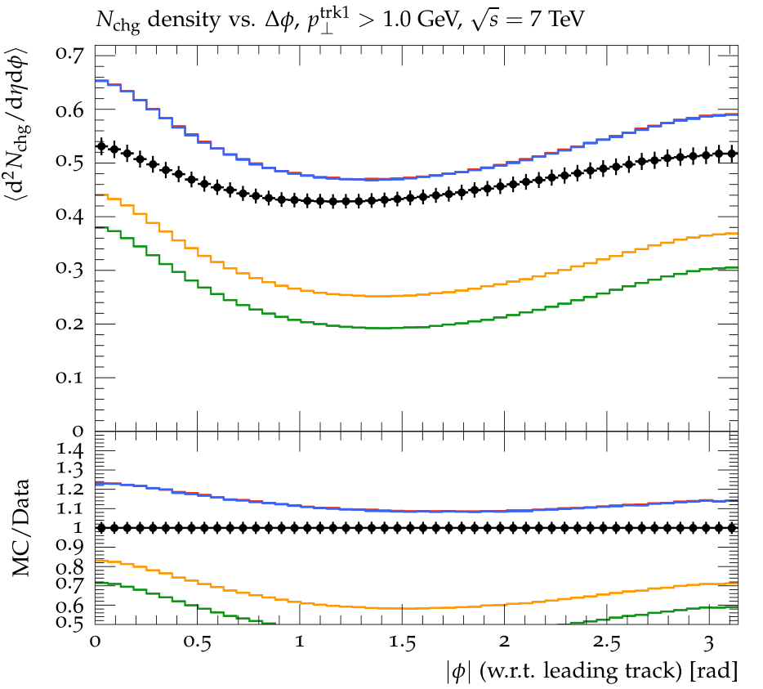
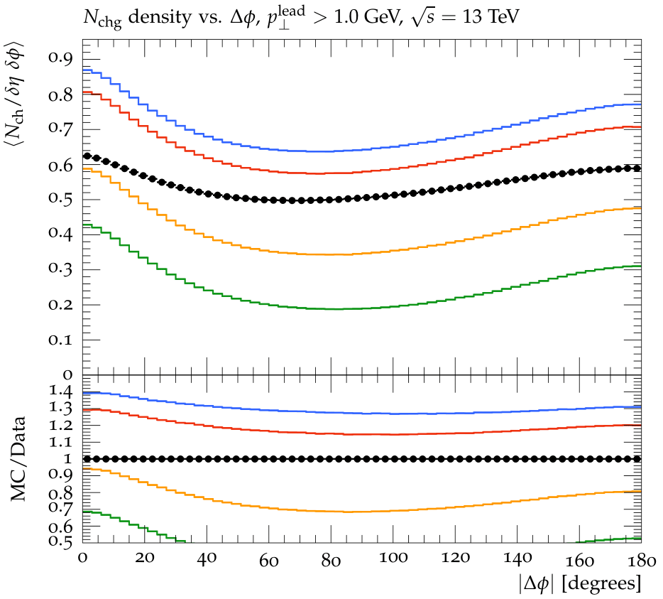
Charged particle distributions (pp)
Fig 10: Charged particle distributions of underlying event data from the LHC compared to models of the underlying event in Pythia.
Observations
LHC/POWER provides best description
LHC/LOG does not scale properly with C.O.M. energy
LEP tunes provide poor description
Notes:
The last data considered is proton-proton (underlying event) data from the LHC. The four MPI tunes were tested at three different centre of mass energies: 900 GeV, 7, and 13 TeV. These plots show an interesting behavior in that the only tune which provides a solid description of all three cases is the LHC/POWER (validated) tune, whereas the LHC/LOG tune only does well at the reference energy (sqrt s ref = 7 TeV) and diverges from the data as it gets further away from this energy. This observation shows the sacrifice taken when switching the LHC tune from the power scale to the log scale: it may describe the photon-proton data significantly better, but it loses the ability to describe a variety of proton-proton data (scale properly). It is also perhaps no surprise that the LEP tunes provide poor descriptions of this data.

Slide 16
Summary & Outlook for EIC
Considered data provide further constraints for dedicated ɣɣ and ɣp tunes
Standard pp models generate too many MPI for ɣɣ, ɣp collisions
LHC/LOG provides best description of data across all collisions types and energies and should be used for future colliders like EIC
May be useful to investigate matter distributions / impact parameter dependence of photons
Notes:
So I know that was a lot of information, but now I will give a summary of the main results. Firstly (and most generally) we looked at new kinematic regions and data to see where these MPI tunes did well and poorly. The standard proton-proton tunes (LHC/POWER, Detroit, and 2C) strongly overestimated ɣp data, predicting too many MPI. The LEP tunes provided good descriptions of the ɣɣ and high ET ɣp data, and the LHC parameters with the logarithmic scaling (LHC/LOG) provided the best “universal” description of all ɣp data. Although using this adjusted scaling means that the tune can no longer accurately describe proton-proton data at a range of COM energies. For these reasons, we recommend the LHC/LOG MPI tune for future ɣp collision data (unless the kinematics match one of the LEP-preferred regions). A possible future consideration to test would be the matter distribution of the photon, which would affect the impact parameter dependence of MPI, and could allow for the same energy scaling as for the proton-proton case. There is currently a gaussian-like, but a more peaked distribution could affect the energy dependence.

Slide 17
Supplementary Slides

Slide 18
Kinematics of experimental data
ɣp1 (fig 4) – “Dijet cross-sections in photoproduction at HERA” required E_{T}^{jet1,2} > 6 GeV
ɣp2 (fig 5) – “Dijet photoproduction at HERA and the structure of the photon” required E_{T}^{jet1,2} > 14, 11 GeV
ɣp3 (fig 11) – “Photoproduction of Dijets with High Transverse Momenta at HERA” required E_{T}^{jet1,2} > 25, 15 GeV
ɣp4 (fig 6) – “High-E_{T} dijet photoproduction at HERA” required E_{T}^{jet1,2} > 20, 15 GeV
ɣp5 (fig 7) – “Three- and four-jet final states in photoproduction at HERA” required E_{T}^{jet} > 6 GeV
ɣp6 (fig 8) – “Charged particle cross sections in photoproduction and extraction of the gluon density in the photon” required p_{T} > 2 GeV
ɣɣ1 (fig 4) – “Di-Jet Production in Photon-Photon Collisions at √s_{ee} from 189 GeV to 209 GeV” required E_{T}^{jet} > 5 GeV
ɣɣ2 (fig 9) – “Inclusive Production of Charged Hadrons in Photon-Photon Collisions” required p_{T} > 1.5 GeV
pp1 (fig 10) – “Measurement of underlying event characteristics using charged particles in pp collisions at √s = 900 GeV and 7 TeV with the ATLAS detector”
pp2 (fig 10) – “Measurement of charged-particle distributions sensitive to the underlying event in √s =13 TeV proton-proton collisions with the ATLAS detector at the LHC”

Slide 19
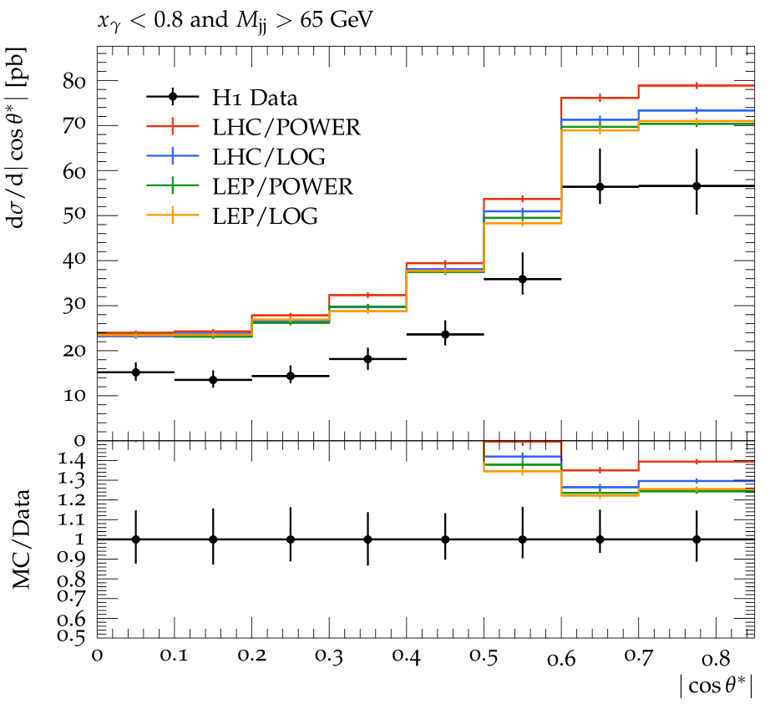
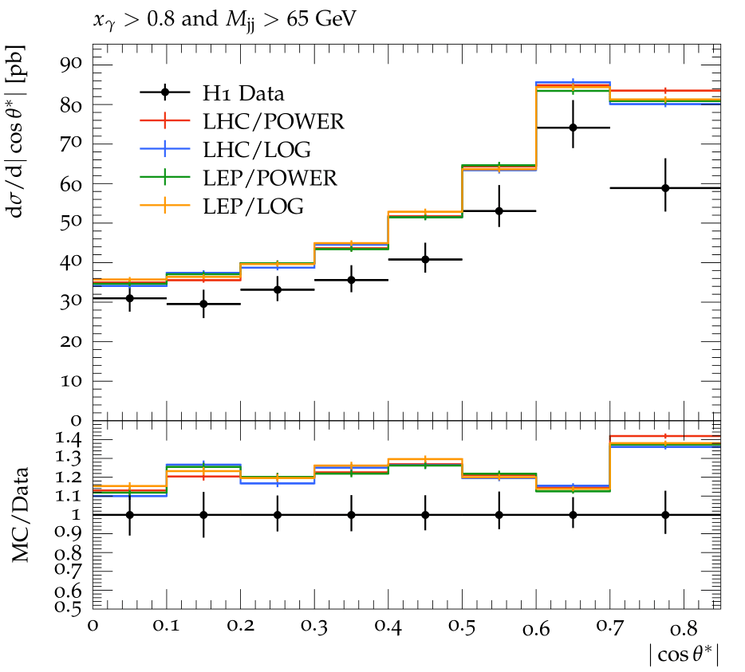
*More high energy dijet results (ɣp)
Fig 11: High energy dijet photoproduction data compared to models of the underlying event in Pythia.
Observations:
Overestimation for entire range (likely from x_{ɣ}^{obs} ~ 0.6-0.8)
Little differences in MPI tunes (low MPI sensitivity)
Notes:
Mention difference in x_ɣ regions of plots

Slide 20
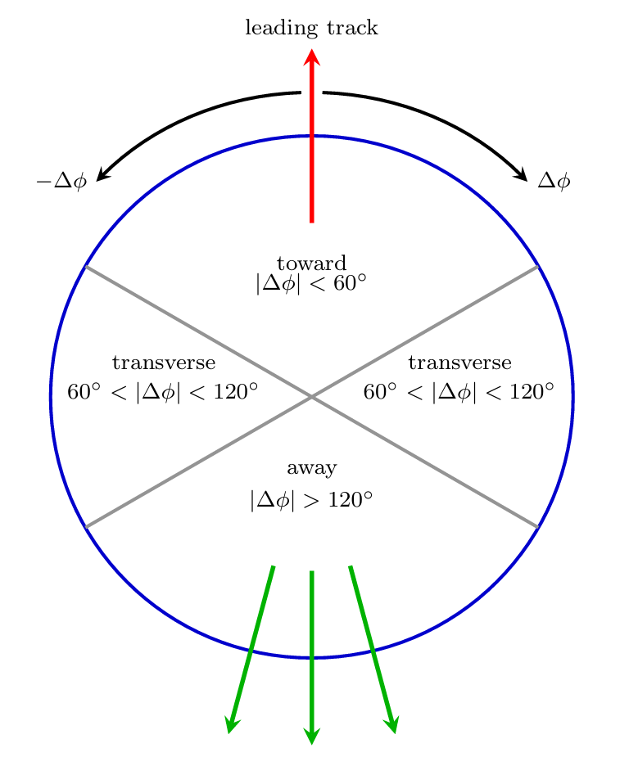
for charged particle measurements

Slide 21
Extra Notes
LEP/LOG validated from charged particle production from photon-photon collisions with 10 < W < 125 GeV but not extensively tested
Detroit validated for RHIC p-p bar collisions at 200 GeV, and CDF data at 300, 900, 1960 GeV with newer proton PDF than Monash
2C predates Monash tune validated for lower energy CDF data
Detroit and 2C have more adjusted parameters than just p_{T0} which are related to overlap profiles

Slide 22

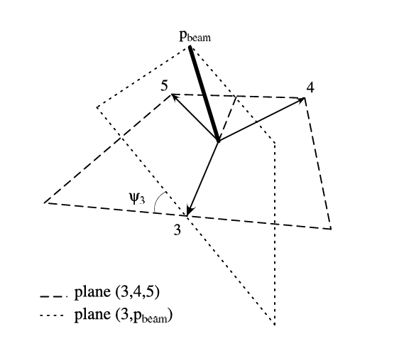
Extra Notes
Cross section is divergent like 1 / p_{T}⁴ so the screening parameter is implemented with the factor

Slide 23
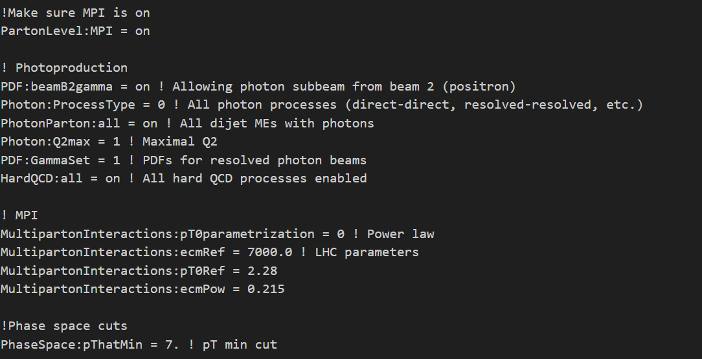
Extra Notes

