Slide 1
EIC - UK Accelerator WP
Niklas Templeton CEng MEng MIMechE
Projects & Mechanical Engineering Group
STFC Daresbury Laboratory
EIC UK Gathering
University of Birmingham
19th Nov24

Slide 2

Accelerator Work Package Plans
Who?
Where?
Why?
What?
TBD…

Slide 3
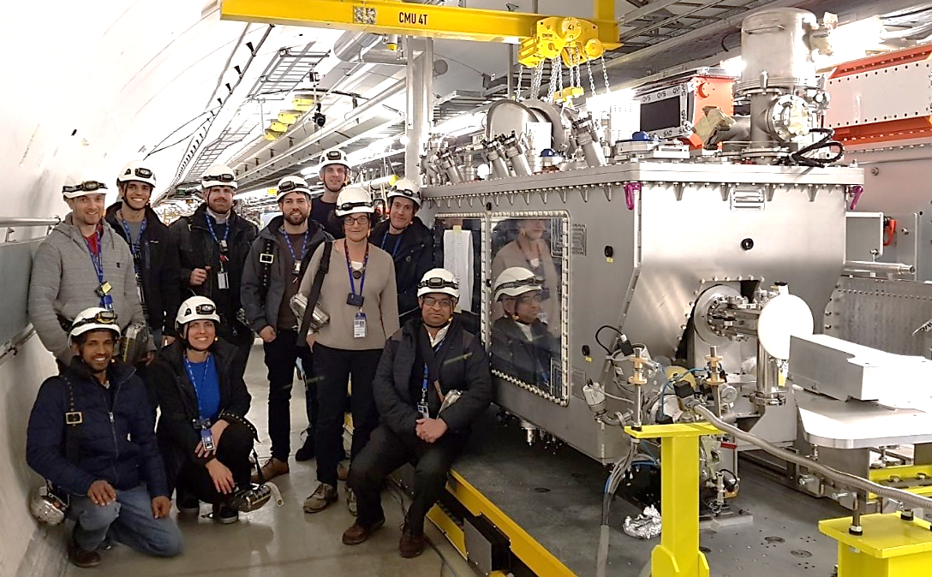
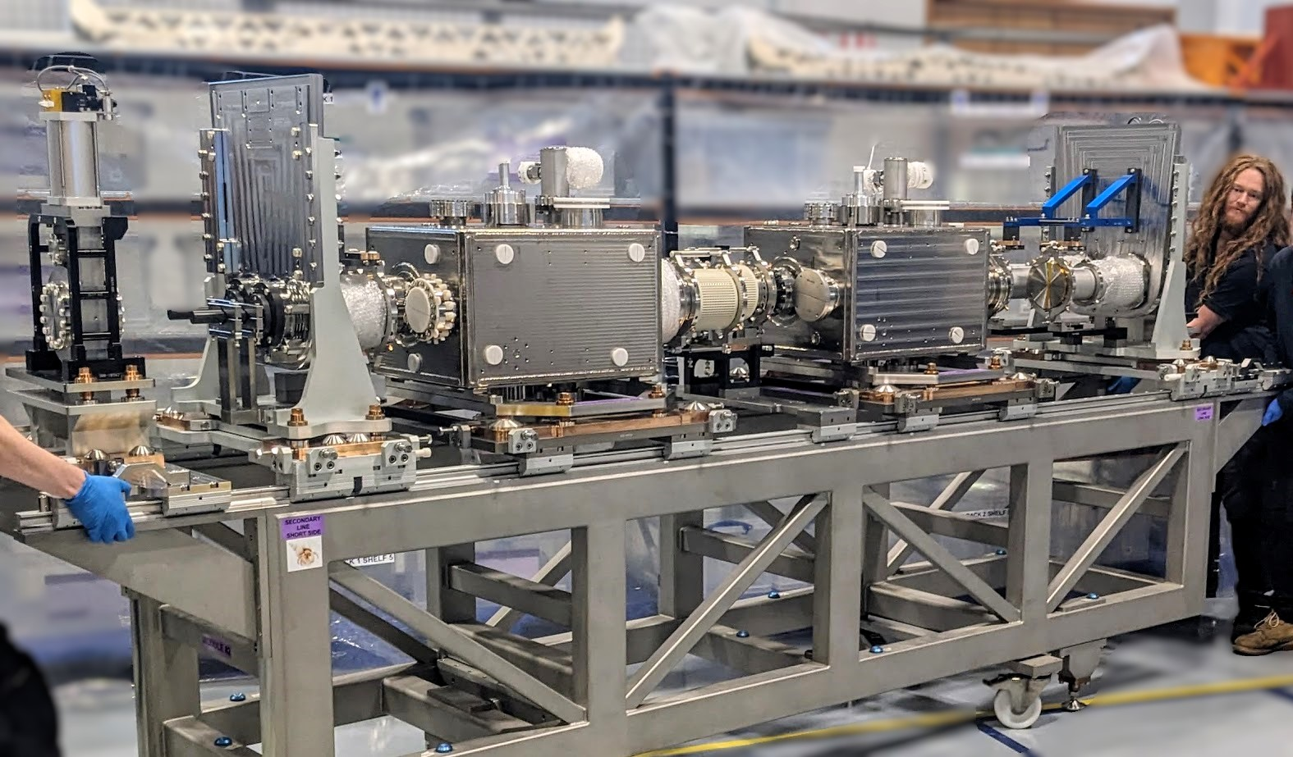
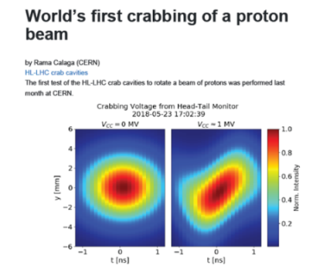




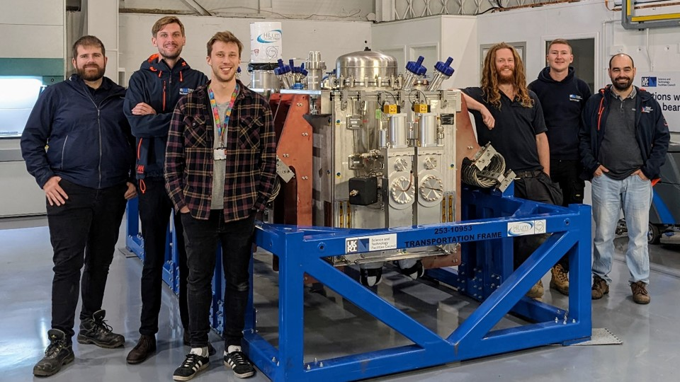
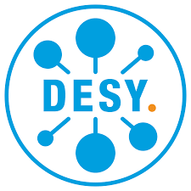
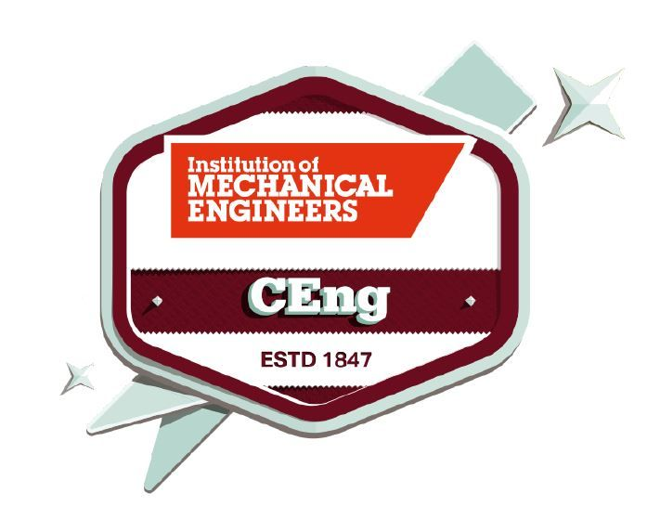
About Me
Project & Mechanical Engineer
WP-Lead UK Crab Cavity Cryomodules for Hi Lumi LHC
→WP-Lead EIC – UK Accelerators
Placement CERN
DQW-SPS Cryomodule
DQW-LHC Cavity String (1st of 4)
Joined STFC
APM PMQ
2012
2025
Mechanical Engineering (MEng)
Placement DESY Zeuthen
CEng
IMechE
RFD-SPS Cryomodule

Slide 4
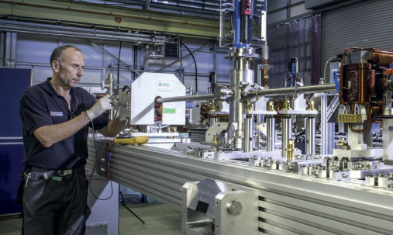
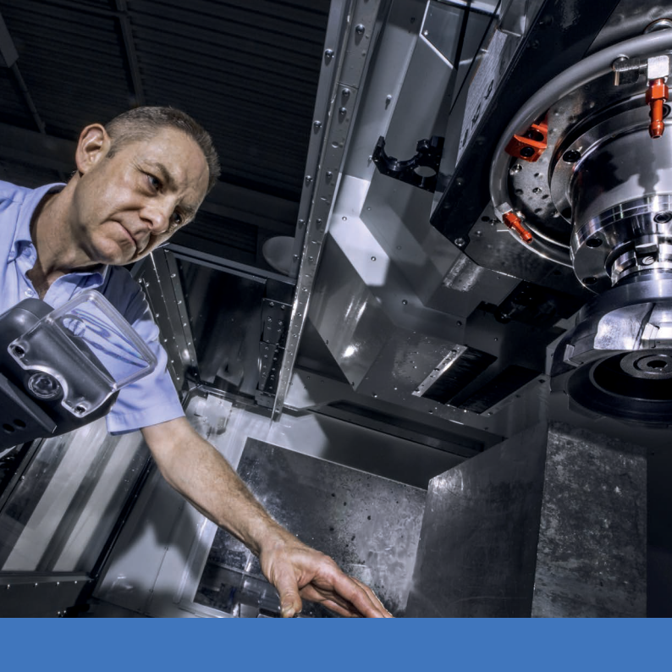
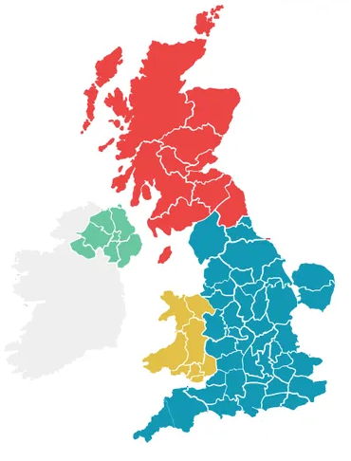
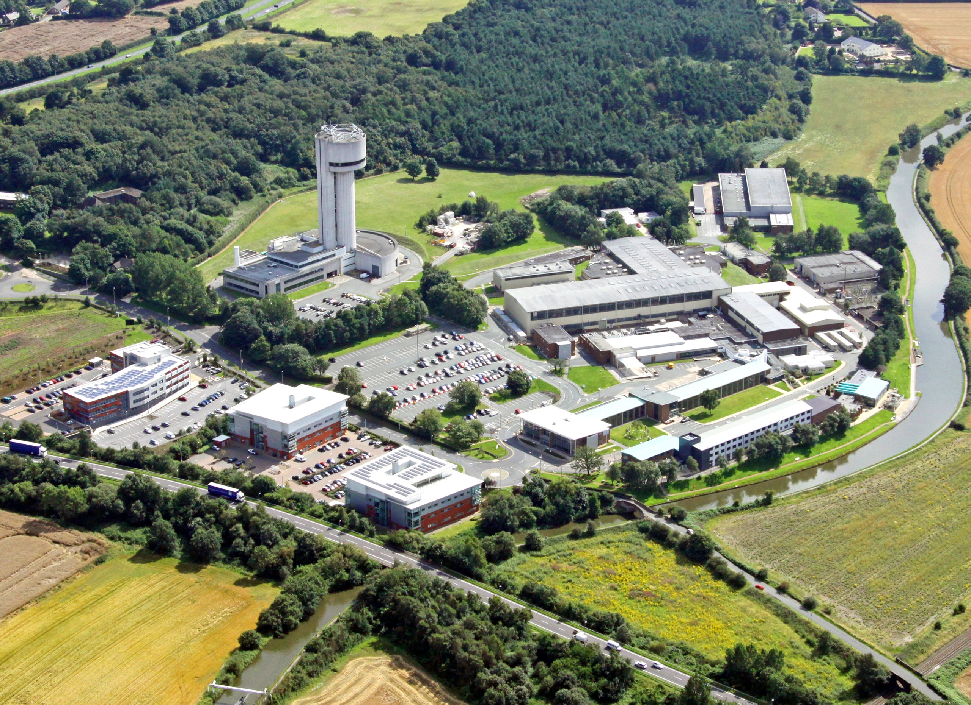
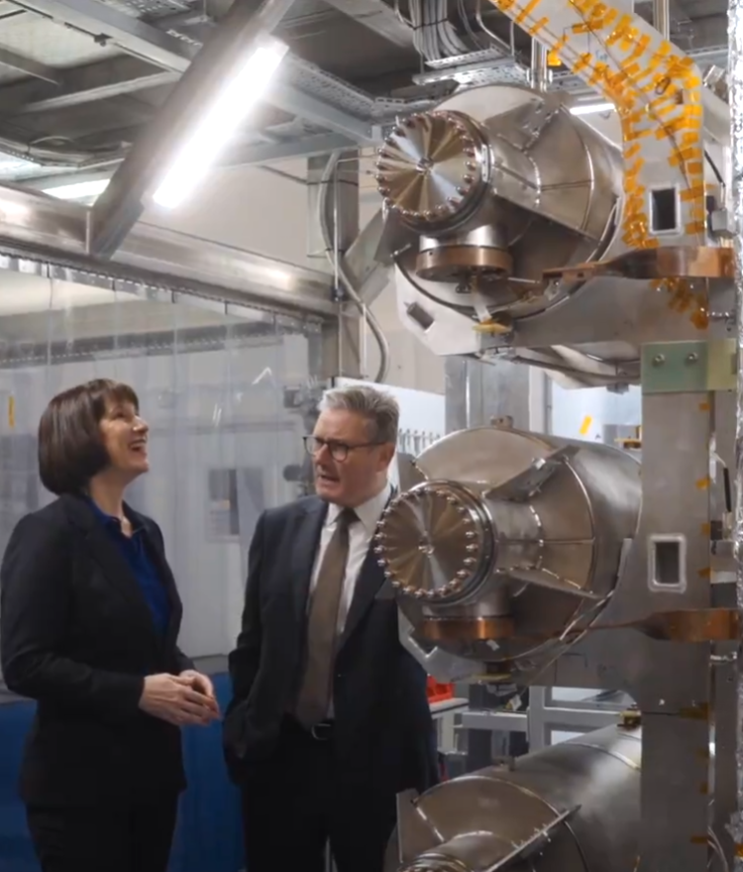

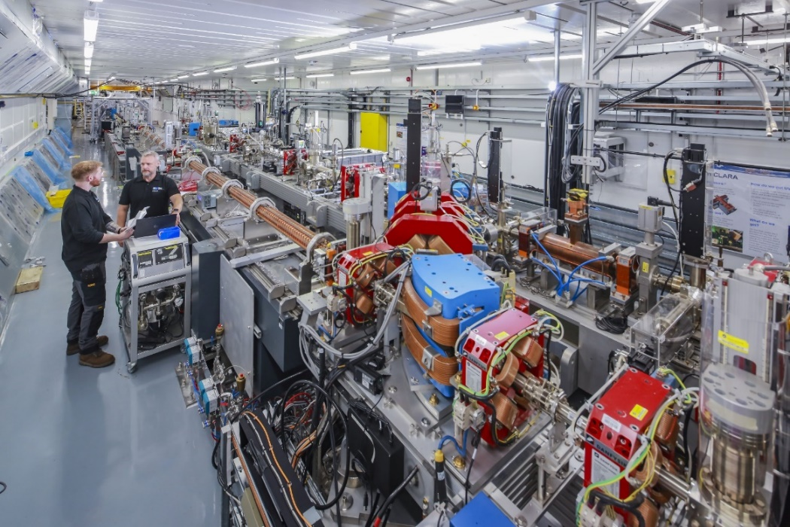

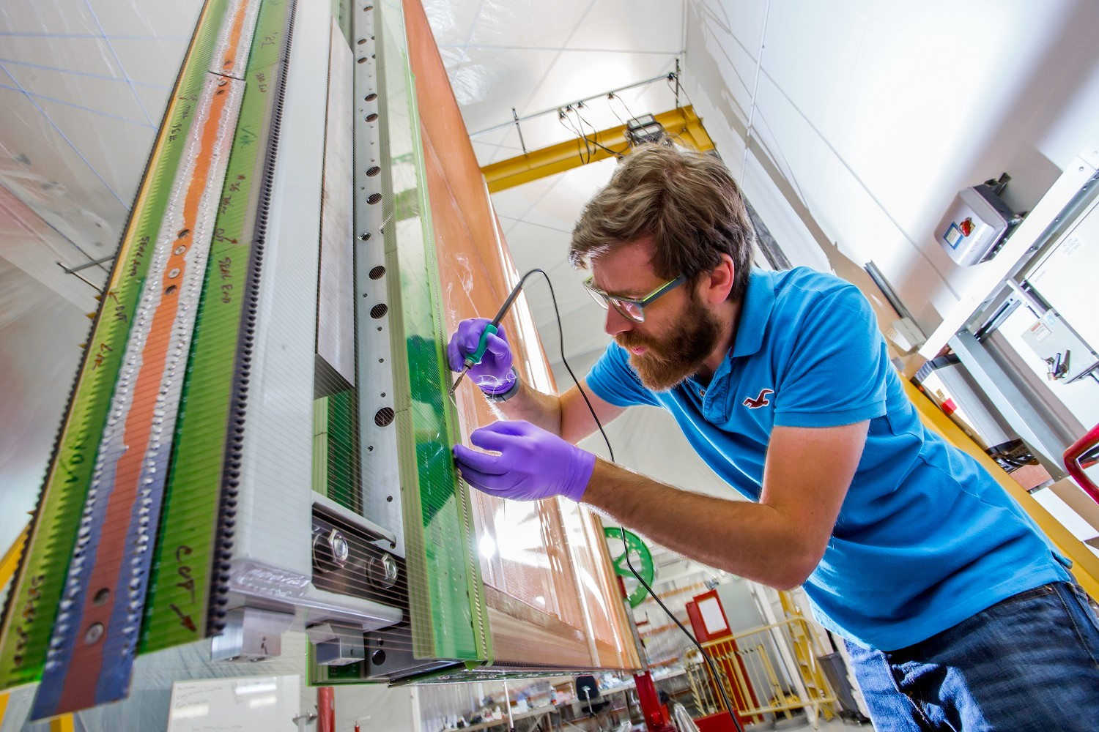
Daresbury Laboratory
Accelerator Physics
Supercomputing
Nuclear Physics
Detector Systems
SRF Engineering
Engineering Technology Centre
Technology Department
Accelerator Science & Technology Centre (ASTEC)
Hartree Centre
Business & Innovation
CLARA
SuRF Lab
DUNE APAs

Slide 5
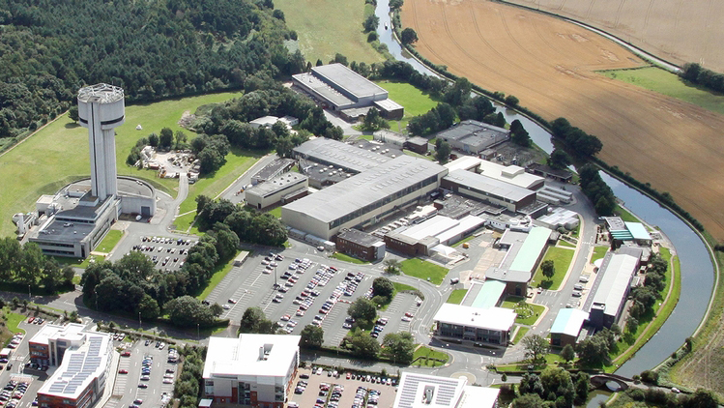
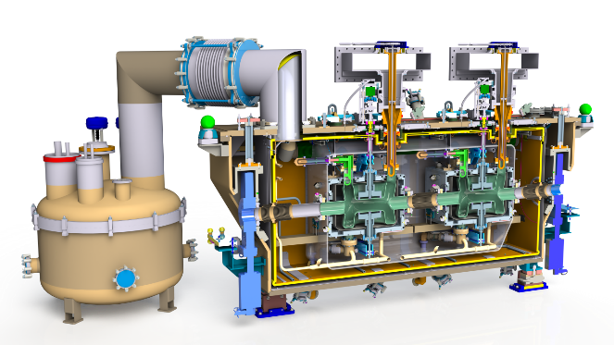
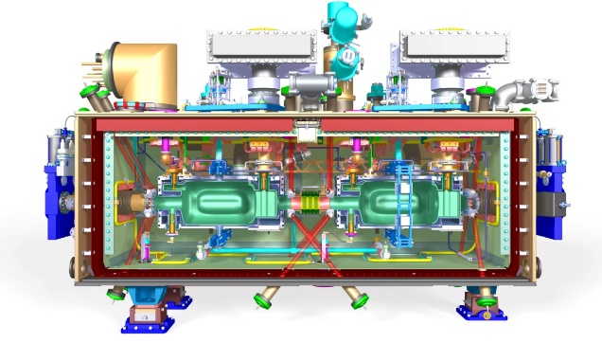
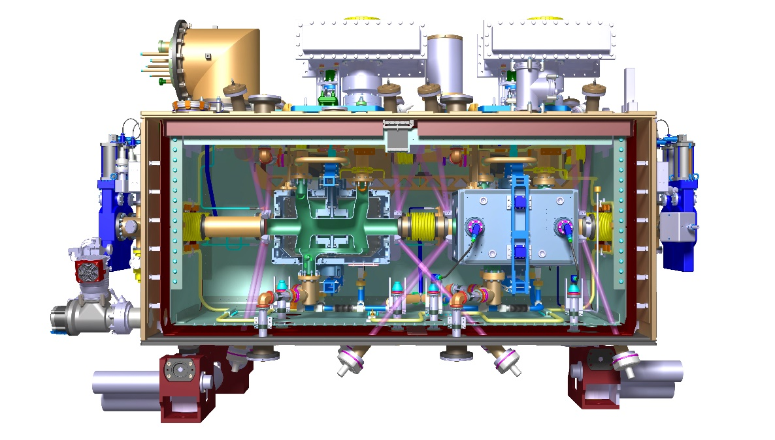
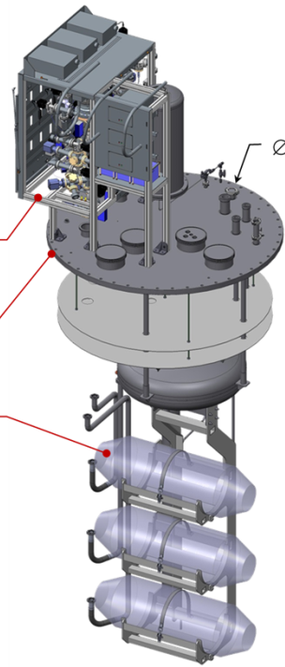
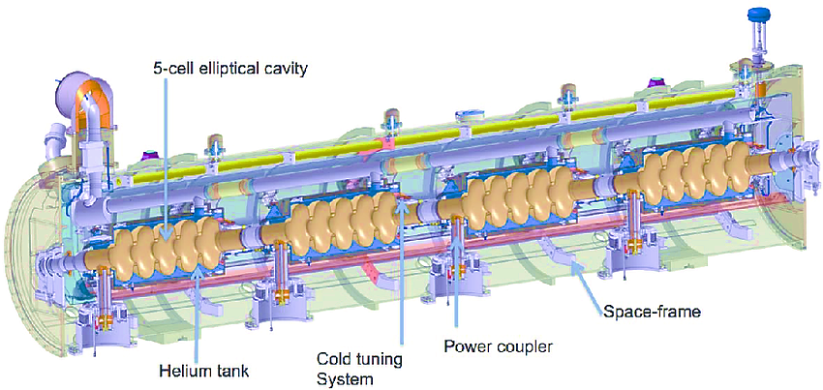
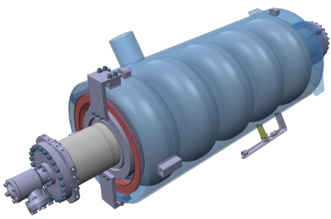
Daresbury Lab - SRF Roadmap
HI LUMI CRAB CAVITIES
DQW SPS Cryomodule
RFD SPS Cryomodule
DQW LHC Cryomodules
EIC Accelerators
ESS HIGH β
PIP II HIGH β CAVITIES
Hβ Cavity Testing
Hβ Cavity Procurement & Testing
High β Cryomodules
Hβ Cavity Procurement
DL SRF CAPABILITIES
Vacuum vessels
Cryogenic engineering
Thermal screens
Magnetic shielding
MLI
Cavity procurement
Cavity testing
High Pressure Rinse (HPR)
Cavity mech design
Coupler mech design
Tuner design
Cryomodule testing

Slide 6
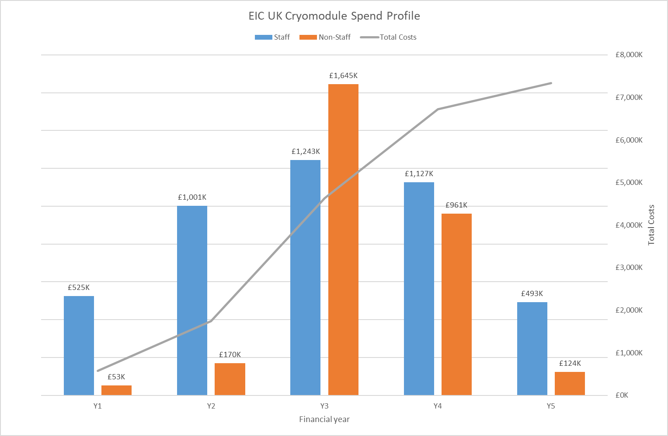
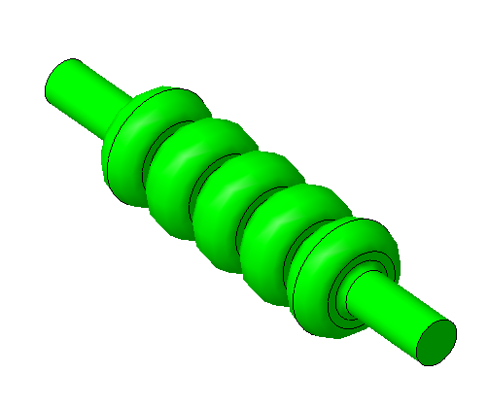
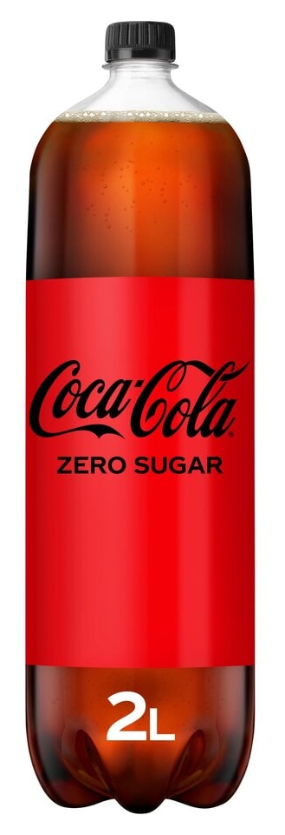
(Original) Accelerator WP Grant
5-year project Starting Apr26
Budget £5.4M Incl. ~33 FTE (yrs)
2x 1773MHz Cavity Cryomodules
  2 cavities per CM
Part of Energy Recovery Linac (ERL)
De-scoped following kick-off mtg Jun24
Design & Development
Procurement
Delivery
1773 MHz Cavities
≈ Ø180 x 790 mm
~2x size of 2l soda bottle

Slide 7
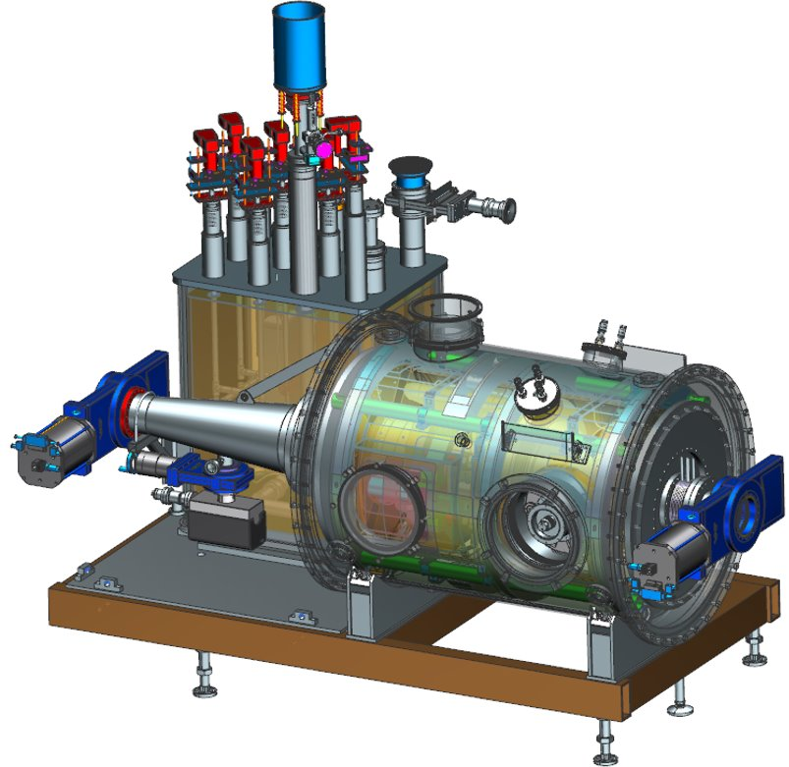
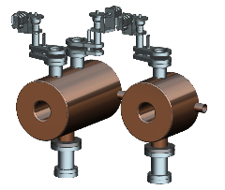
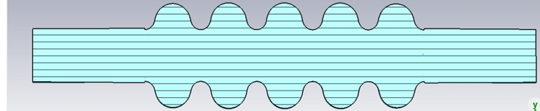
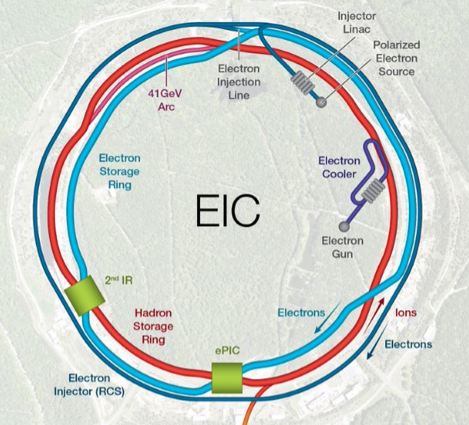
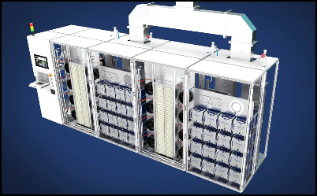
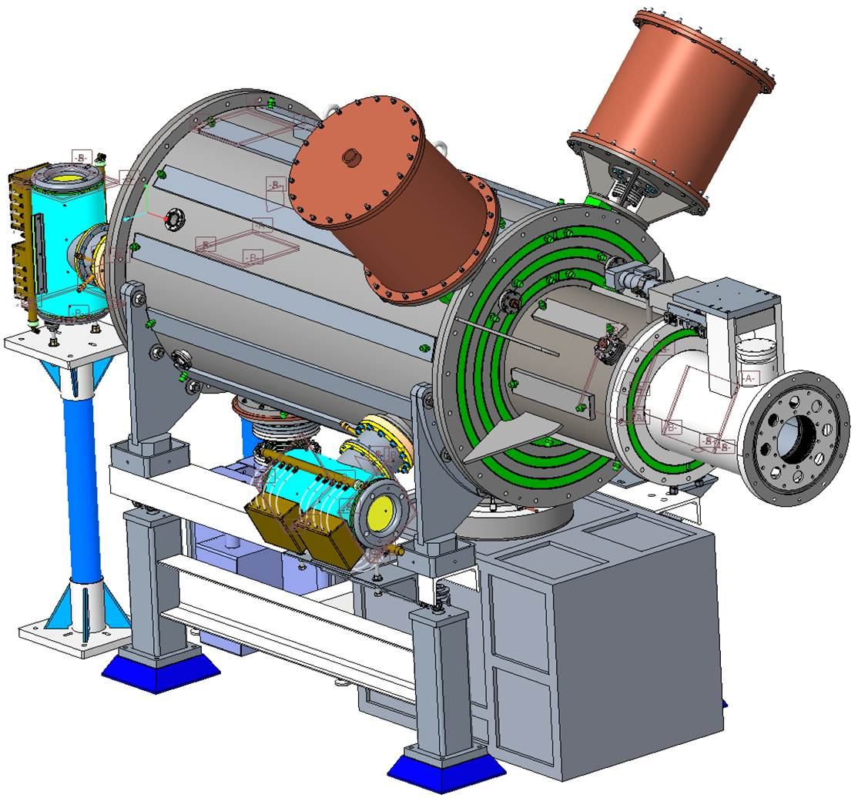
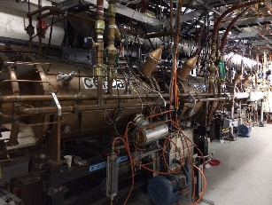
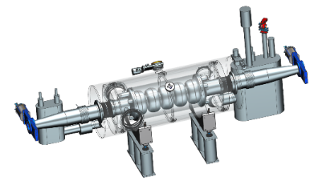
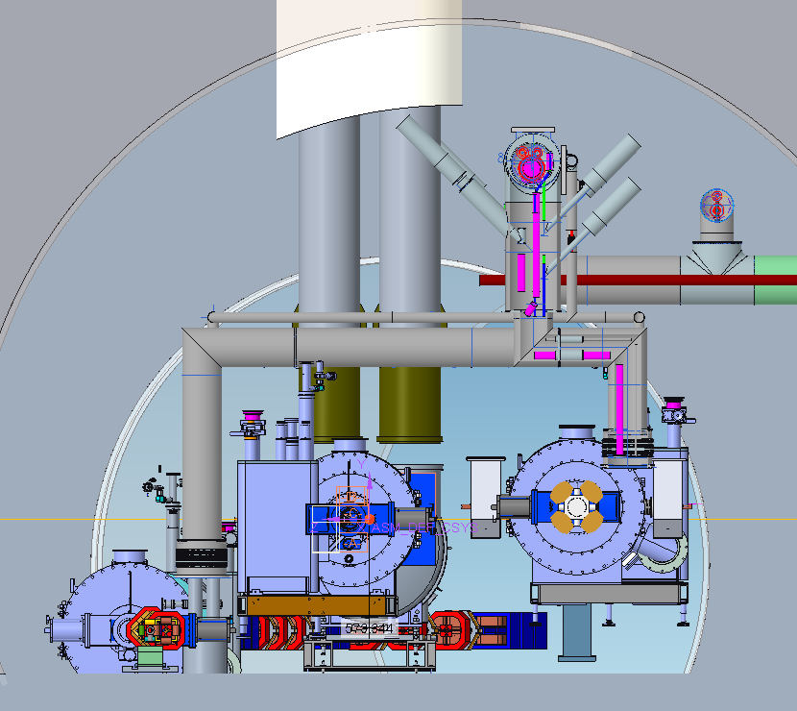
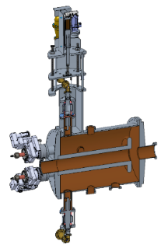
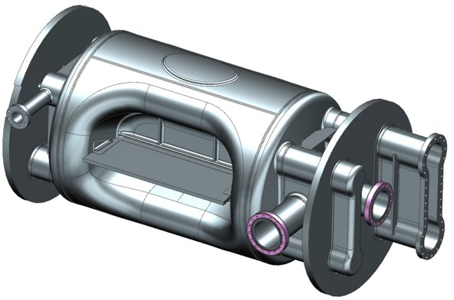
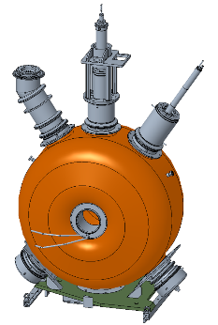
EIC – RF Systems
The Project is pre-CD2 and in the design phase.
Many systems are still developing.
Hadron Cooling – 10 591 MHz acceleration cavities &
RCS injection harmonic RF kicker, IR12
4 1773 MHz 3rd Harmonic Cavities (Not shown)
Electron Cooler, IR02
6 ea 197 QWR, 3 ea 591 SC Cavities (Not shown)
3 CMs, ERL Injector, IR02
400 kW Amplifier
OG Grant
Electron Storage Ring & Hadron Storage Ring
591 MHz 800 kW 2 K
1-Cell Cavity Cryomodules
ESR = 17 CMs, IR10
HSR = 5 CMs, IR10
IR10 Tunnel with RCS, HSR and ESR (Left to Right)
Hadron Storage Ring
24.6 MHz Accelerating Cavity, IR04
HSR – 24.6 MHz acceleration cavity IR04
First Article 197 MHz Crab Cavity
HSR – 49.2 MHz and 98.5
MHz bunch splitter cavities IR04
Rapid Cycling Synchrotron
591 MHz Five-Cell Acceleration Cavity Cryomodule
3 CMs, IR10
Crab Cavities (per IR) | HSR (Cavities /CMs) | ESR (Cavities /CMs)
197 MHz | 8/4 | –
394 MHz | 4/4 | 2/2
HSR - 197 MHz bunch compression cavity IR04
Interim Project
New WP

Slide 8


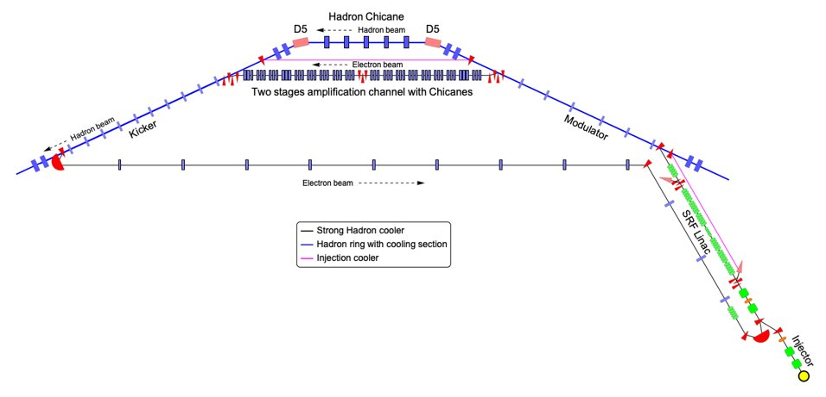

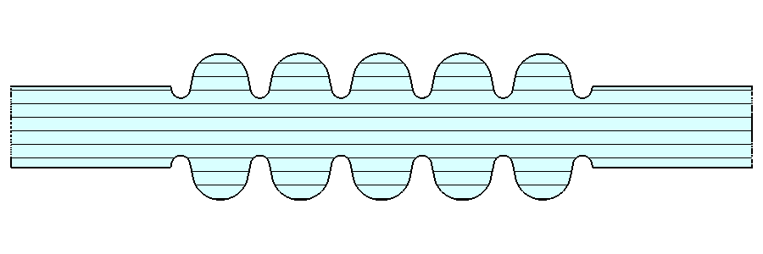
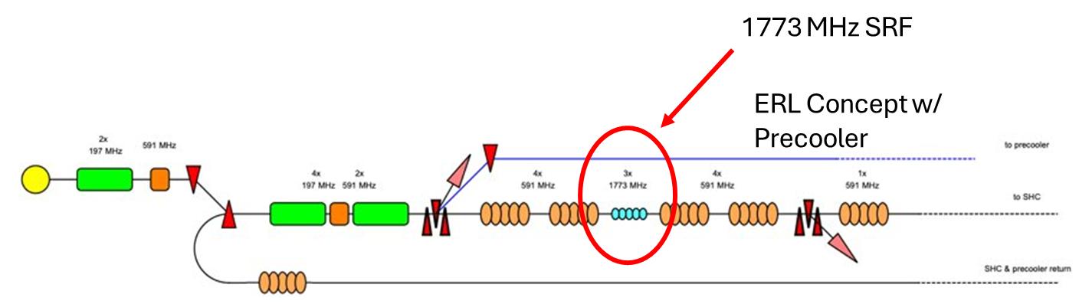
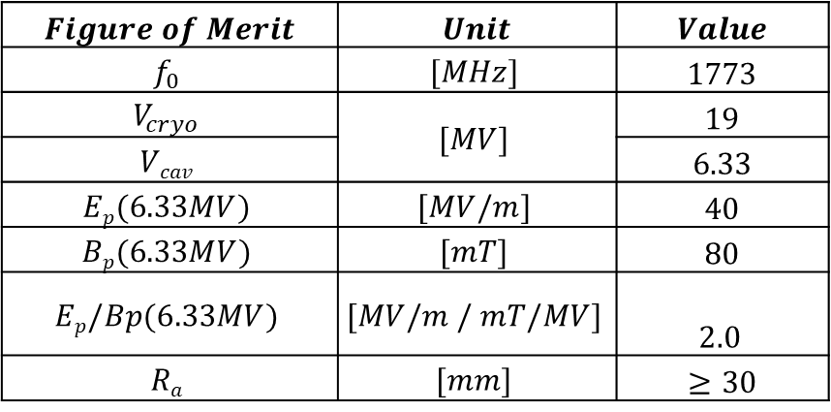
1773 MHZ Cavity Design
SHC-ERL: Precooler
The main linac is a 5-cell, 591MHz SRF cavity complimented by our 1773MHz Third Harmonic SRF cavities
  3rd harmonics provide bunch lengthening, or linearisation of the electron bunch phase space
$$Figure of Merit$$ | $$Unit$$ | $$Value$$
$$f_{0}$$ | $$[MHz]$$ | $$1773$$
$$V_{cryo}$$ | $$[MV]$$ | $$19$$
$$Vcav$$ |  | $$6.33$$
$$Ep(6.33MV)$$ | $$[MV/m]$$ | $$40$$
$$Bp(6.33MV)$$ | $$[mT]$$ | $$80$$
$$Ep/Bp(6.33MV)$$ | $$[MV/m / mT/MV]$$ | $$2.0$$
$$Ra$$ | $$[mm]$$ | $$≥30$$
Sara Toole & Graeme Burt

Slide 9
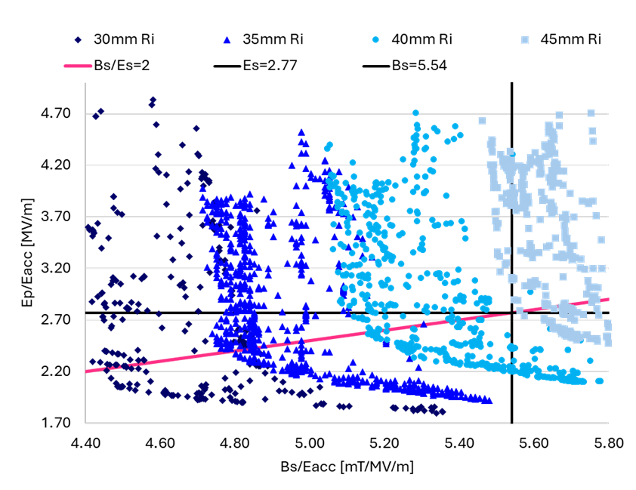
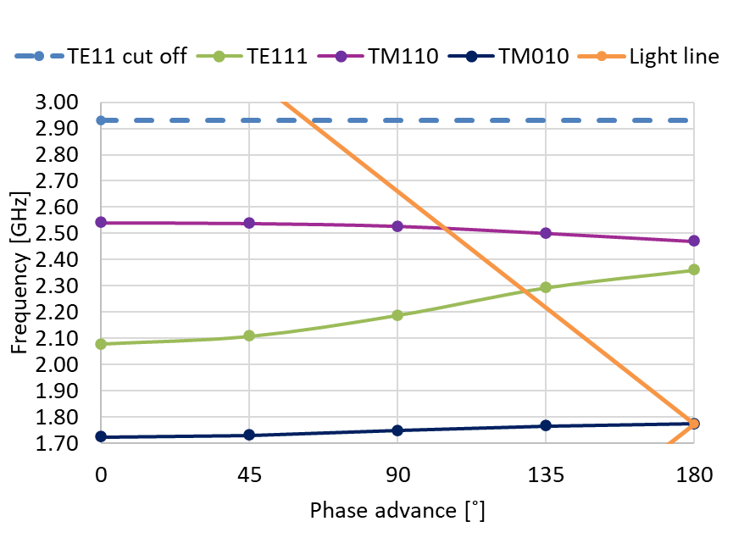
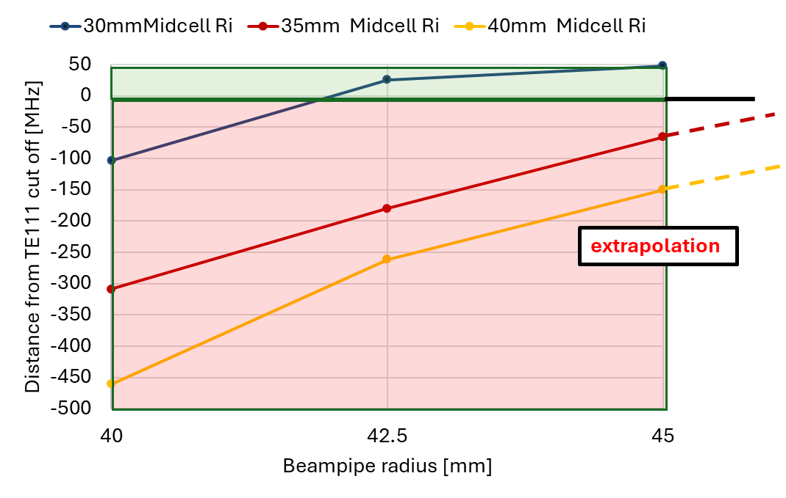
1773 MHz – Single Cell Optimisation
Small iris aperture allow higher gradients
Large beampipe apertures are good for propagating out higher order modes but large apertures in the iris push down the dipole mode frequency
Solution: mid-cell radius < beampipe radius
Sara Toole & Graeme Burt
4
Notes:
Phase advance in cavity cell represents the phase advance of the RF wave as it propagates along the cavity
TE111 modes are resonant, can be trapped
TE11 mode is the cut off

Slide 10
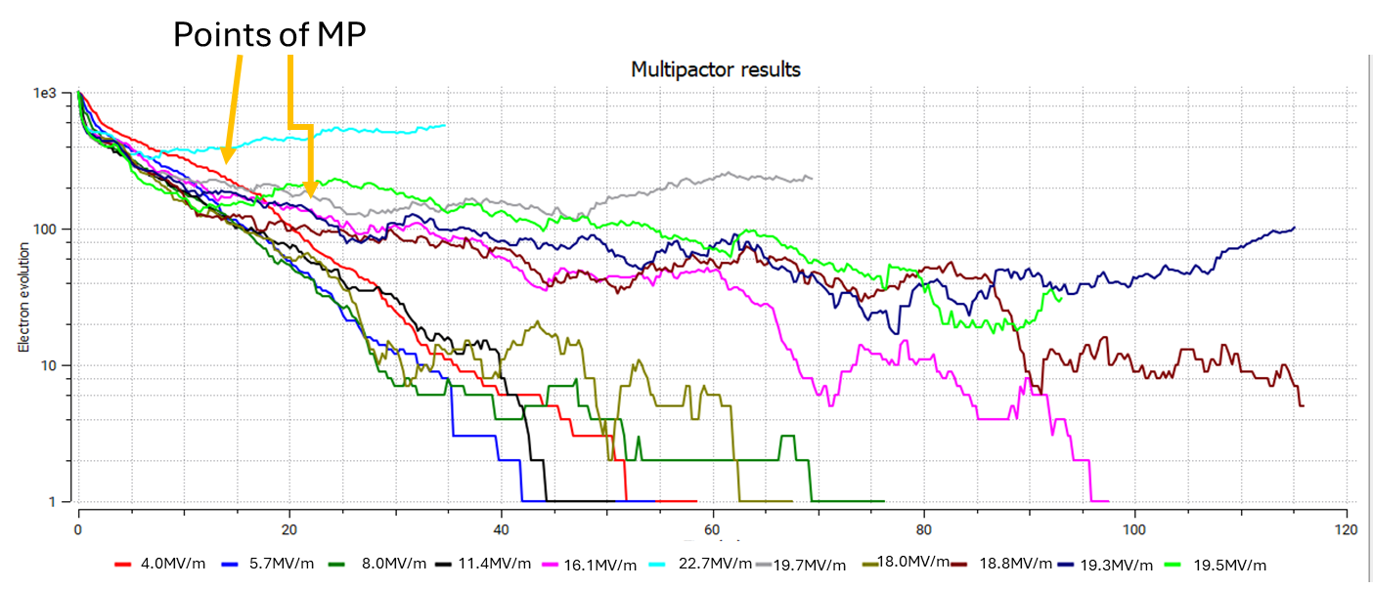
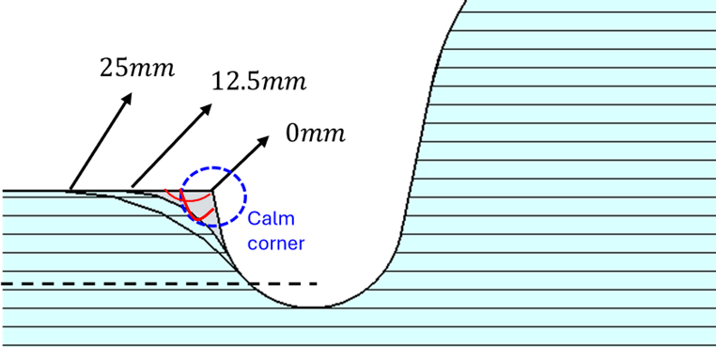
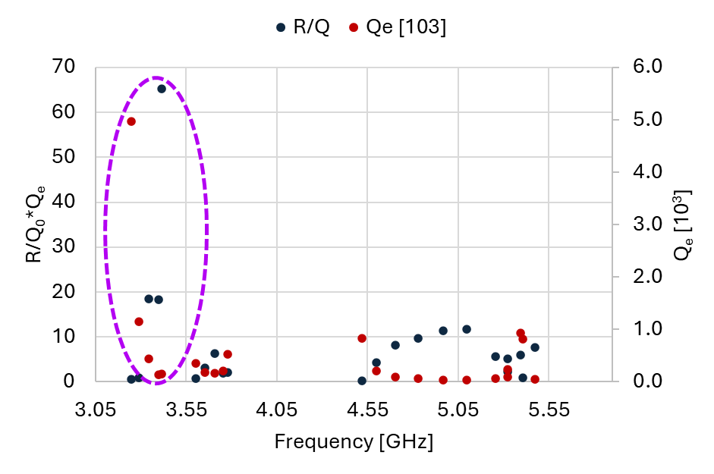
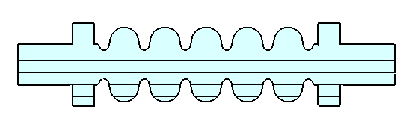
1773 MHz - Lip optimisation Multipacting & HOMs
Points of MP
Initial design showed multipacting due to a field null behind the lip, this can be removed by smoothing the corner.
We are now optimising higher order mode dampers to meet the very tight ERL impedance limits.
Sara Toole & Graeme Burt
7
Notes:
MP simulation carried out using SEY values of Nb when treated with 300˚C bakeout
Slide 1: Multipactor in this region
Slide 2: Miller force

Slide 11
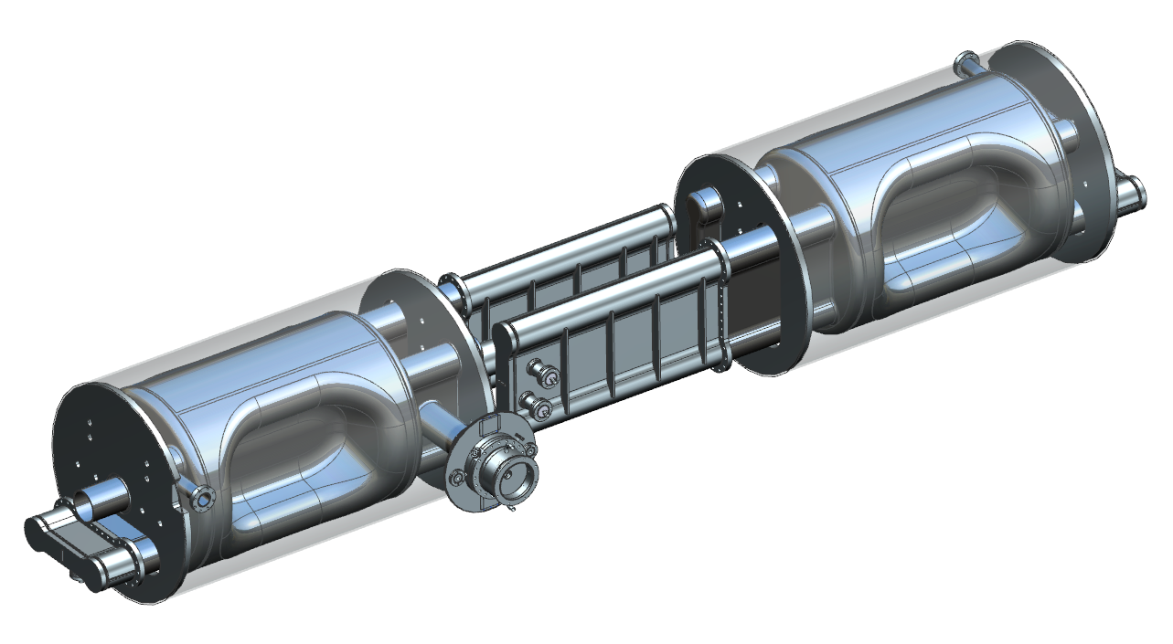
197 MHz Crab Cavity Cryomodule First Article
1yr interim project start: Apr’25
£220k
mechanical design only
Scope & Deliverables
Cavity-string assembly design for Preliminary Design Review (PDR)
PDR recommendations
Other cryomodule sub-system designs, as determined by the PDR
Detailed design & handovers
197 MHz Crab Cavity String
1 per Cryomodule
First Article PDR planned Q3-24
Notes:
Challenges; size, mass, precision alignment, cleanliness, N2 overpressure, coupler insertion, allowable materials, fasteners, no lubricants

Slide 12
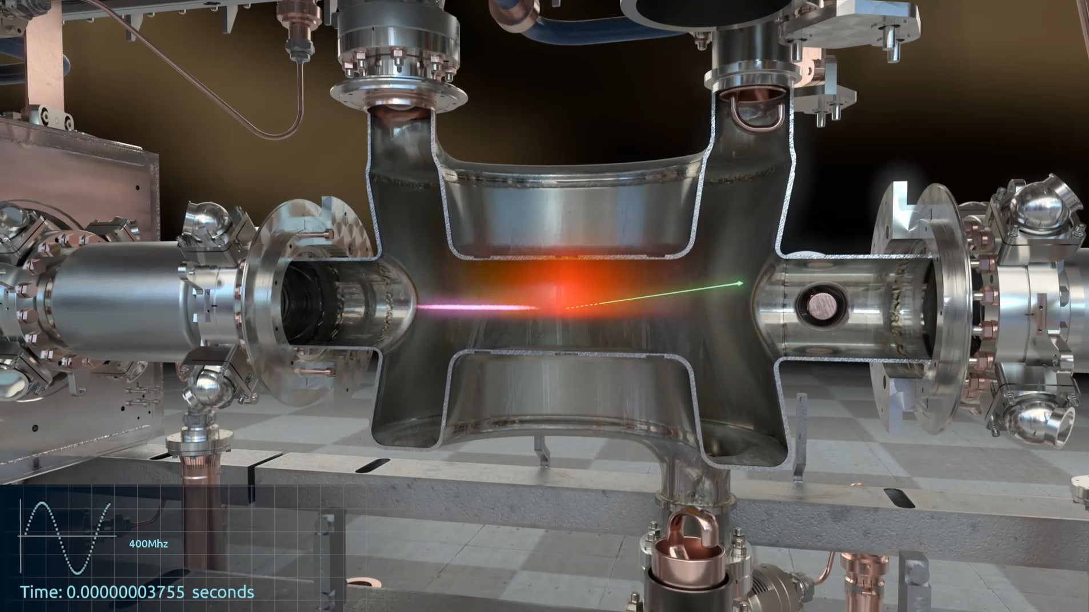
394 MHz Crab Cavity Cryomodules
Electron Storage Ring (ESR)
UK to deliver (2x) single-cavity-cryomodules
Phase1 grant: £5.4M
JLAB match funding up to 150% (including in-kind)
Sub-WPs
Cavity & Coupler Design (25 FTE-yrs across 2 yrs)
Cavity Manufacture & Cold Testing (£2M + 3 FTE-yrs management)
Cryomodule Manufacture & Assembly (£3.3M + 11 FTE-yrs)
Cryomodule Infrastructure (tbd)
New plan & scope - in-work
394 MHz Crab Cavity
394 MHz Crab Cavity
Crab Cavity Animation – Hi Lumi LHC Double Quarter Wave (DQW)

Slide 13
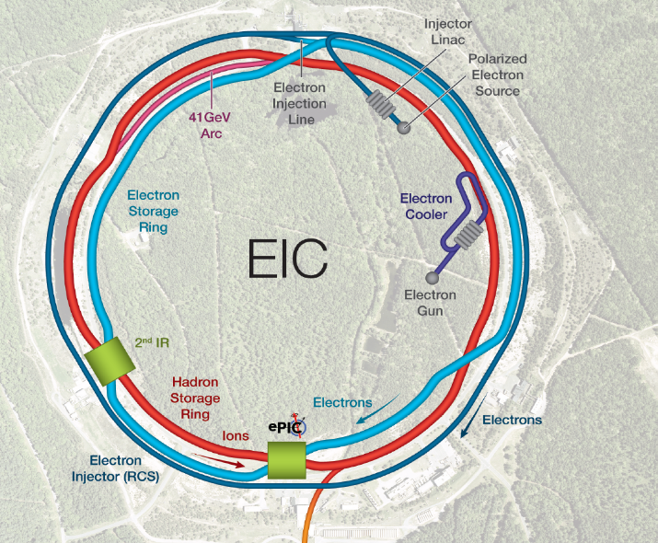
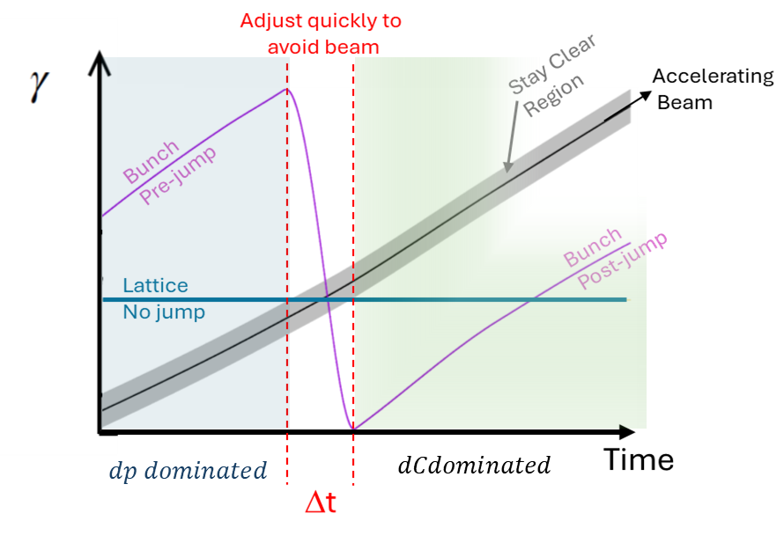

Transition crossing for the EIC
Collaboration between University of Huddersfield & Brookhaven National Lab
H. Lovelace^{1,2} , S. Peggs² , A. Drees², R. Seviour¹, B. Lepore², G. Robert-Demolaize²
In a circular machine increasing energy of electron bunches creates competing increases in velocity & trajectory length.
Below the transition energy the velocity increases faster than the length.
Above transition energy, the opposite is true.
At the transition energy, variation in velocity is compensated by variation in trajectory.
Crossing transition energy involves a perturbation of the longitudinal beam dynamics enhanced by space charge and chromatic effects.
(1) University of Huddersfield (UK)
(2) Brookhaven National Lab (USA)
Prof Rebecca Seviour

Slide 14




Transition crossing for the EIC
Sept 2024 APEX BPM measurements
showing 4 island formation
Resonant island
Beam
Prof Rebecca Seviour

Slide 15
Thanks! Questions?
Niklas Templeton CEng MEng MIMechE
Projects & Mechanical Engineering Group
STFC Daresbury Laboratory
EIC UK Gathering
University of Birmingham
19th Nov24
more info: https://www.bnl.gov/eic/explore/

Slide 16









197 MHz Crab Cavity Prototype
Courtesy of Zack Conway & Naeem Huque
Not the First Article.
Building a prototype cavity, Finish 2025.
Demonstrate that we can build it, process it and it can achieve the basic RF parameter set.
Prototype cavity, HOM Power, and Coupling Impedance to Beam: B. Xiao & S. De Silva
Al Part Fabrication Co: N. Huque and JLab
Co: M. Marchlik

Slide 17



197 MHz Crab Cavity Cryomodule First Article
Courtesy of Zack Conway & Naeem Huque
First Article Cavity Optimization
Z. Li (SLAC, B. Xiao (BNL), S. De Silva (ODU)
~FA 197 MHz Crab Cavity String
1 per Cryomodule
Position optimized
~FA 197 MHz Crab Design
N. Huque
First Article PDR planned May 2024

Slide 18







Hi Lumi Crab Cavities – UK Collaboration
UK 4-Rod
Crab Cavity
DQW Prototype CM
RFD-SPS CM
DQW-LHC CMs
2011
2027

