Slide 1
ePIC Silicon Vertex Tracker
OB Mechanics and Cooling
Adam Huddart

Slide 2
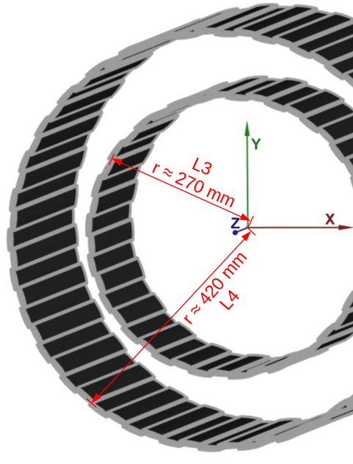
Introduction
L3
  Inner - 23 staves with a (centre of mass) radius of 269 mm
  Outer - 23 staves with a (centre of mass) radius of 275 mm
L4
  Inner - 35 staves with a (centre of mass) radius of 421 mm
  Outer - 35 staves with a (centre of mass) radius of 427 mm
Equal overlap between sensors, overlap set to fit stave within 45-degree cone.
L3 and L4 support structure identical except for difference in length/number of and type of LAS
OB L3 (6RSU segments)

Slide 3
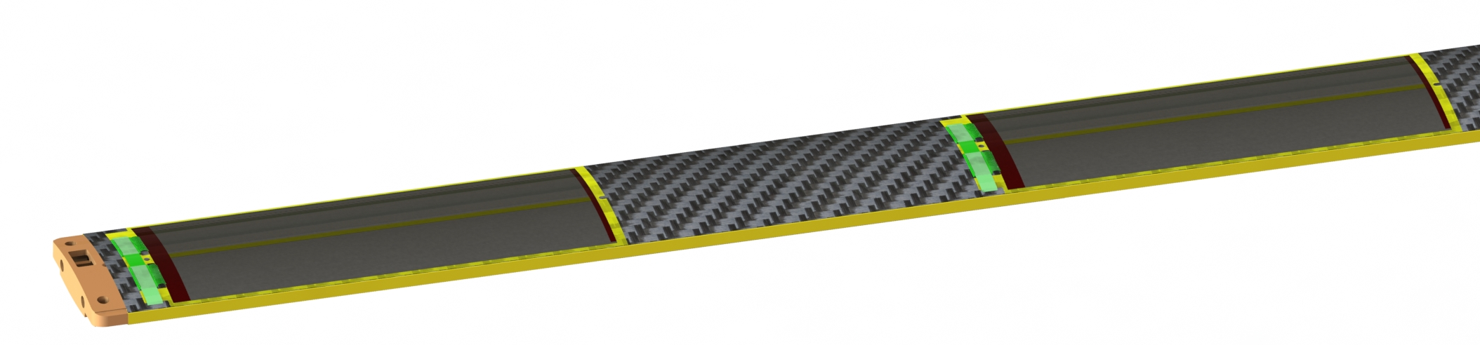
Introduction
Stave structure is internally hollow to form channels for coolant airflow
Majority of the stave structure is carbon fibre/foam
  Assembled in a single co-curing operation
  Preform FPC C channel and Central I-Beam
  Vacuum bagged in autoclave with removable internal tooling
Sensors are adhesively mounted as “modules” consisting of 2 EIC-LAS, ASICs, Bridge FPC and a Kapton carrier
Focused on L4
  More difficult in terms of structural and thermal targets.

Slide 4
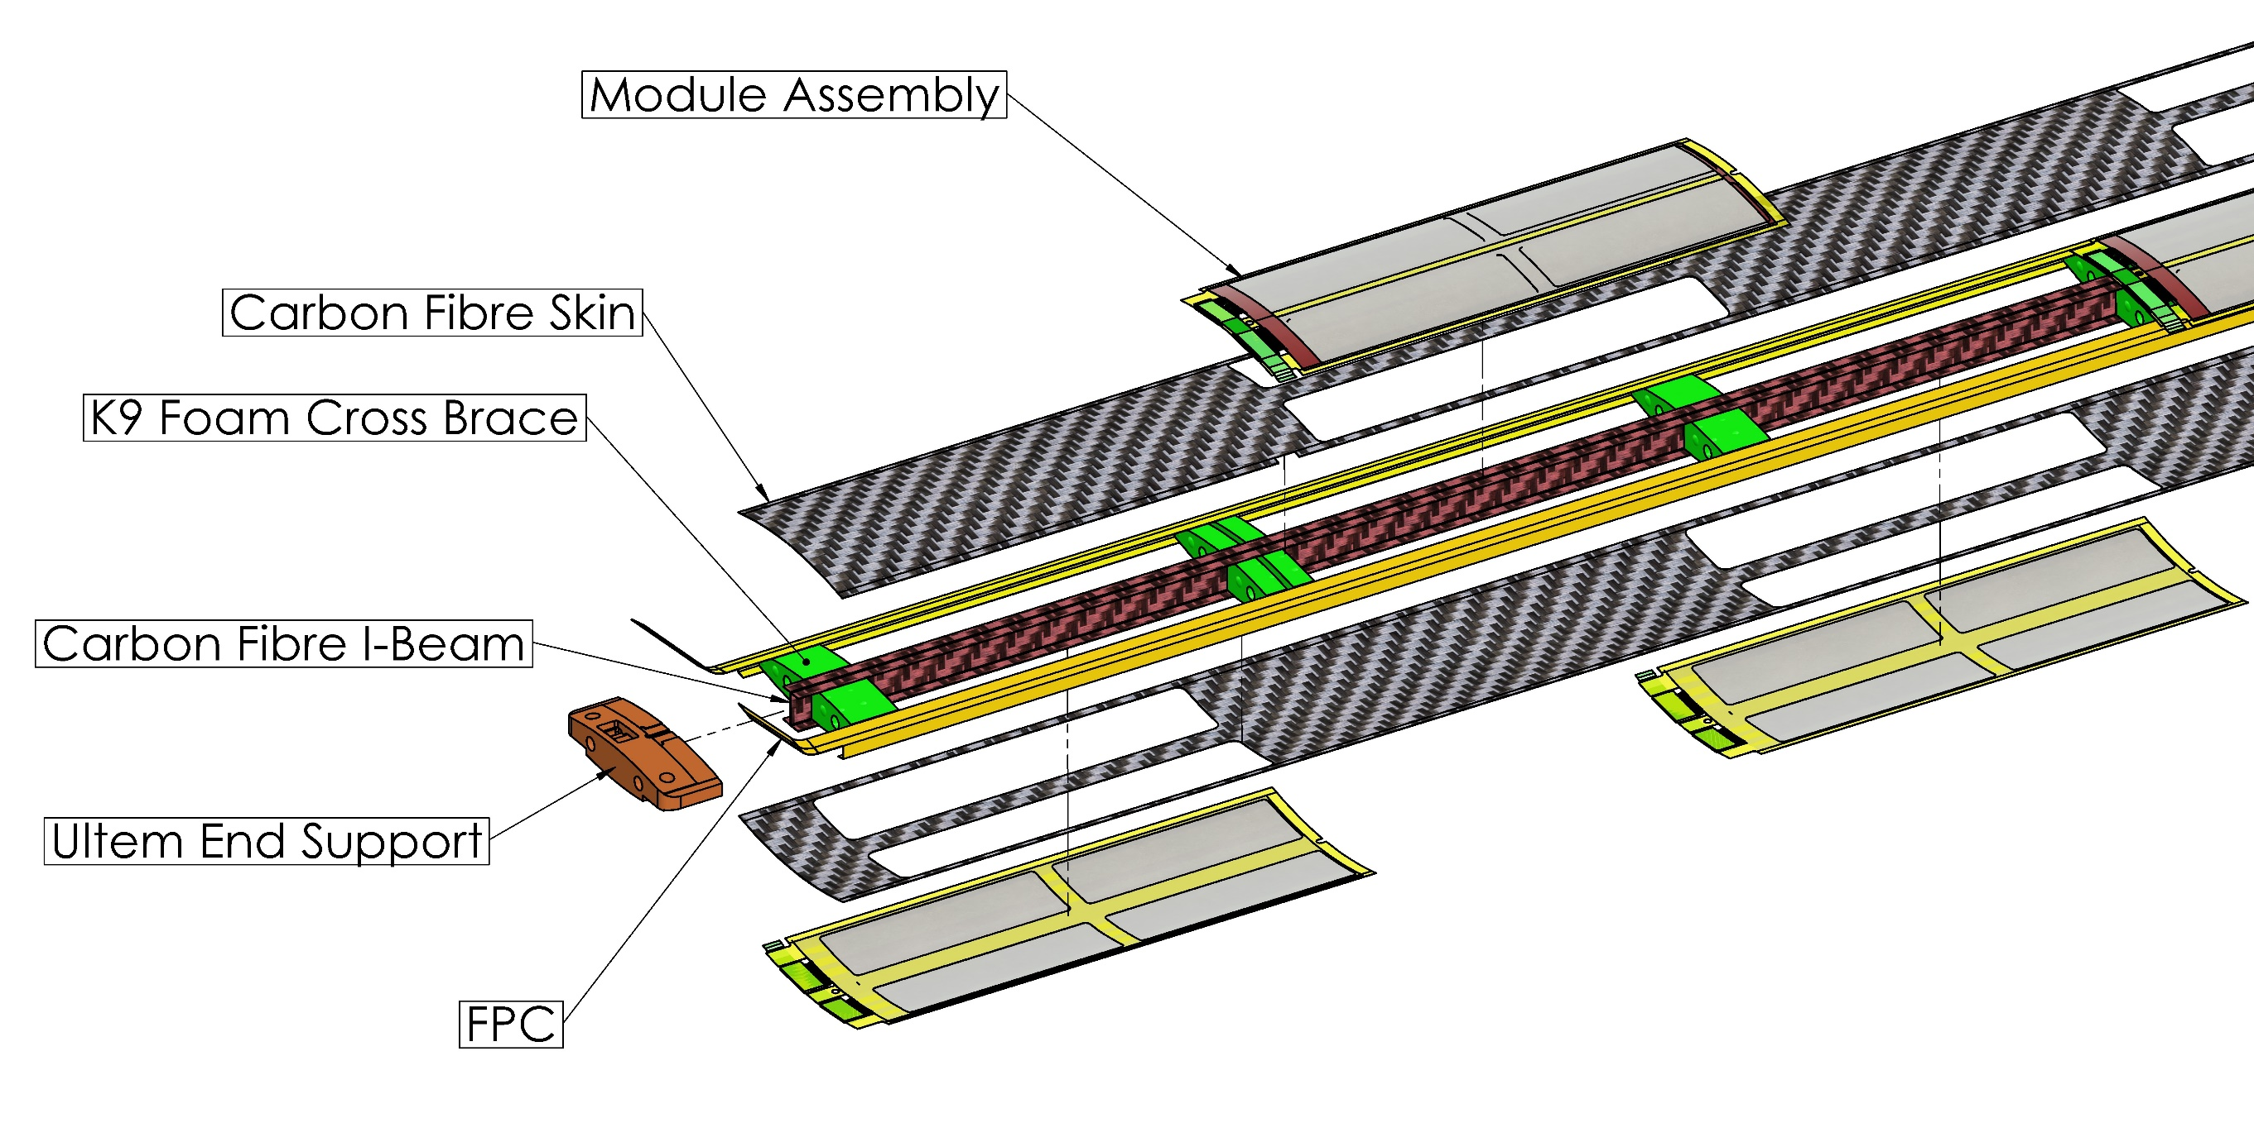
L3/L4 Stave Structure Overview

Slide 5
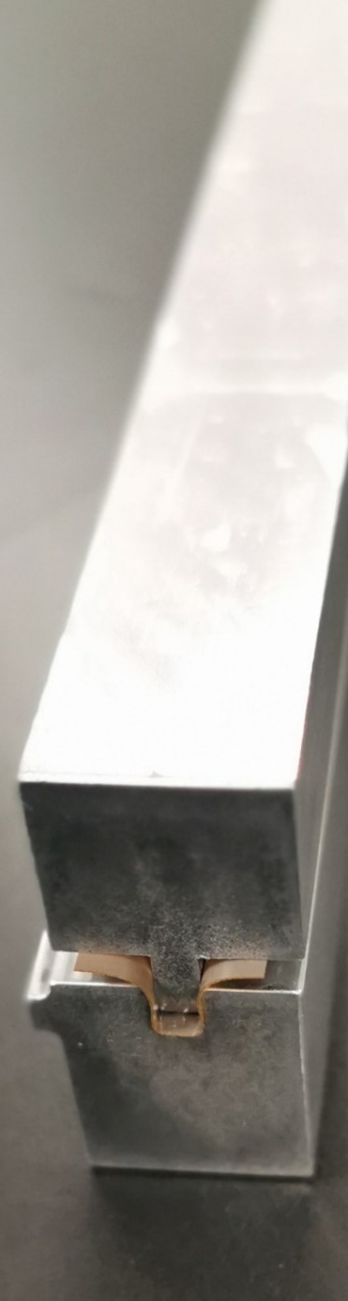
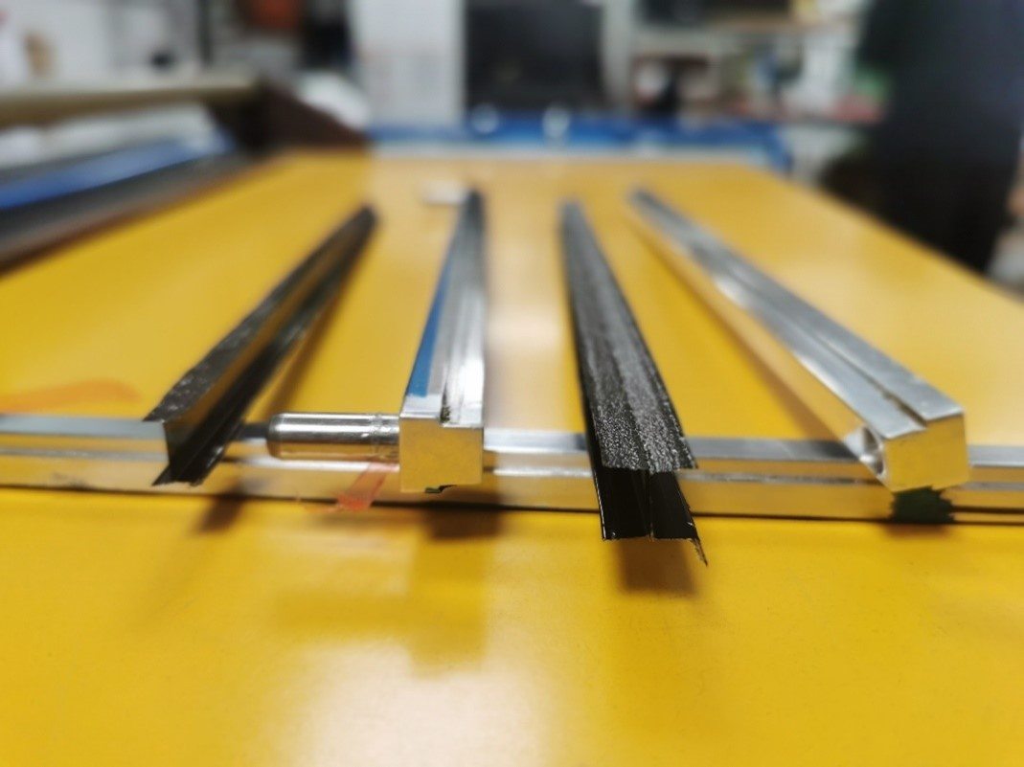
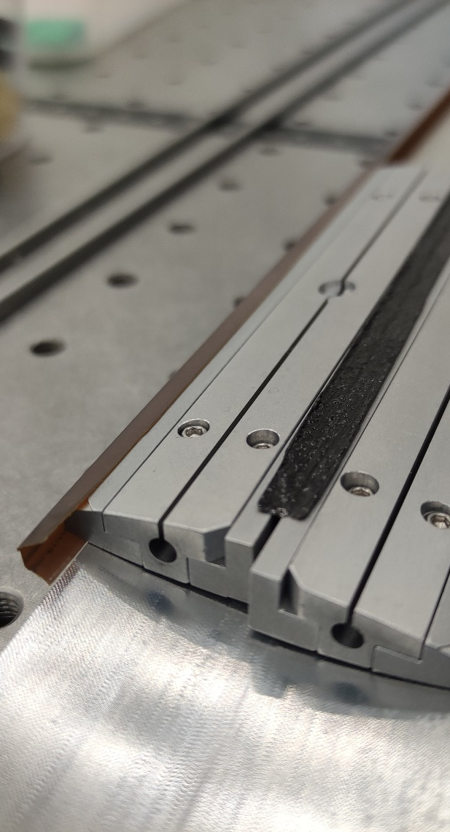
Brief Overview of ¼ Stave Prototype
1/4 of an L4 stave
  One top one bottom module
Preformed I beam and Kapton C Channel FPC Mock-ups
SLA 3D printed end supports
Multipart aluminium internal tooling
2 x 3mm rod runs through end supports, K9 foam cross braces & internal tooling to constrain and align stave components
Kapton Former
Carbon Fibre I-beam Mould
Internal Formers

Slide 6
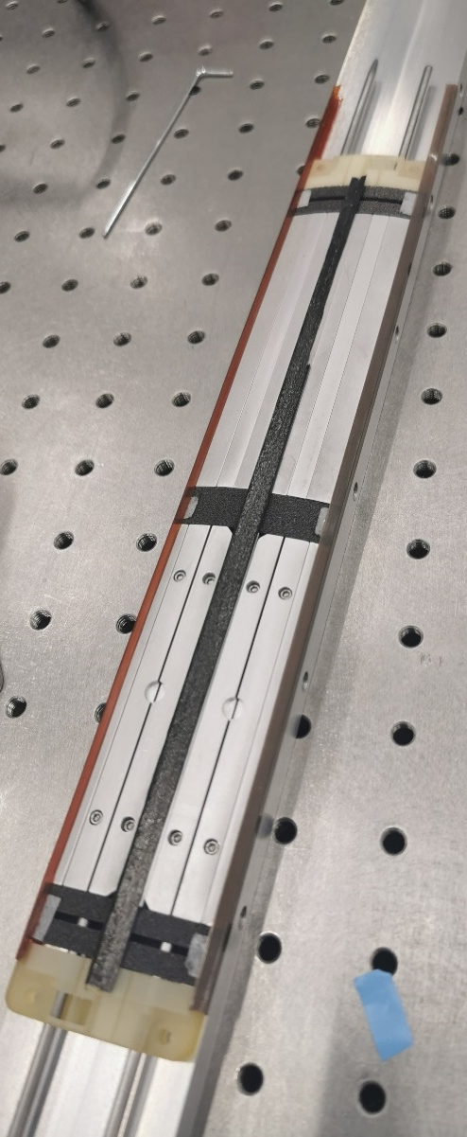
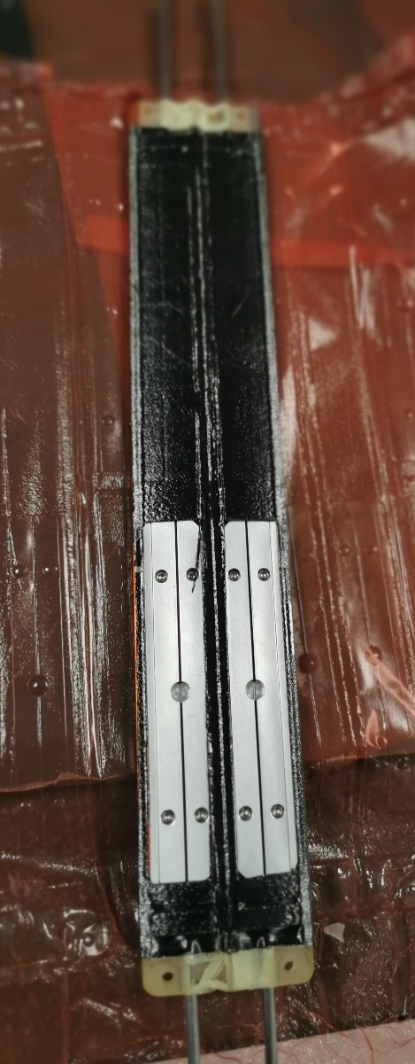
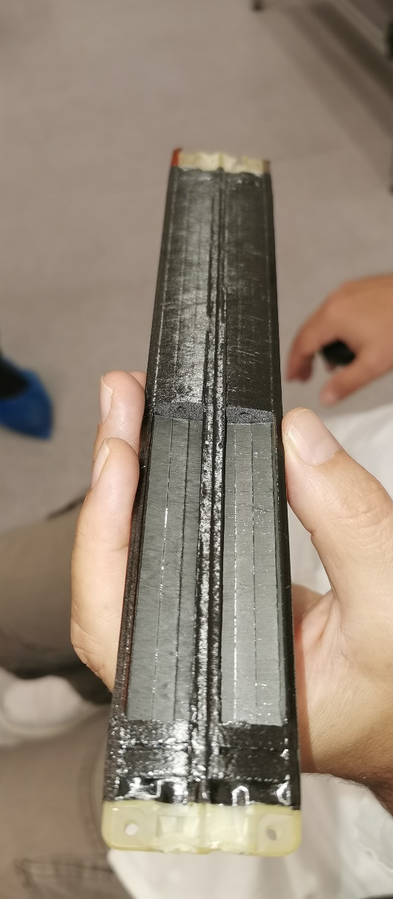
Brief Overview of ¼ Stave Prototype
1/4 of an L4 stave
  One top one bottom module
Preformed I beam and Kapton C Channel FPC Mock-ups
SLA 3D printed end supports
Multipart aluminium internal tooling
2 x 3mm rod runs through end supports, K9 foam cross braces & internal tooling to constrain and align stave components

Slide 7
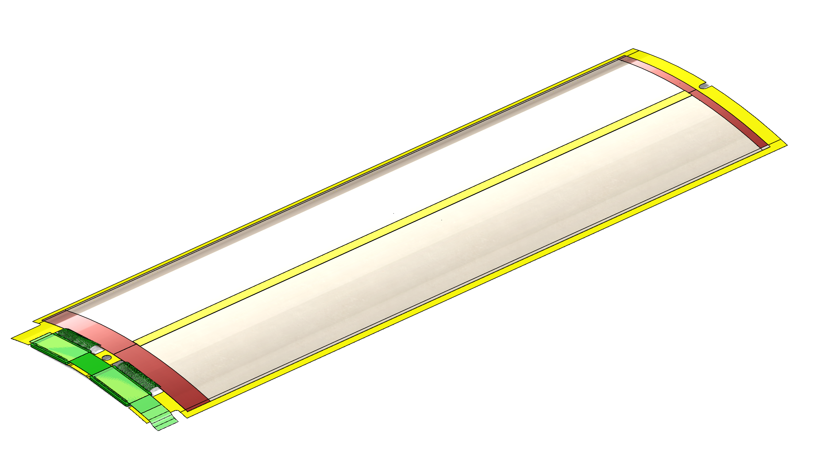
EIC-LAS Module
Module Consists of:
  2 EIC-LAS
  2 ASIC
  Bridge FPC
  Kapton Carrier
Modules are assembled on tooling and transferred with sensors held into a curved shape with vacuum tooling
Module transfer tooling will be tested on quarter length stave

Slide 8
What we Need to Prove
Structure is sufficiently stiff
  Does not vibrate excessively due to internal airflow
  Stave structure must withstand internal pressure requirements
Electronics temperatures stay within their target temperature window
  FEA and CFD studies have informed prototype stave design
  For prototype testing we will use dummy heat loads, measure temperature of LEC & ASIC mock-ups on stave prototypes
Planned manufacturing methods are achievable and resulting assembly is within required dimensional tolerances.

Slide 9
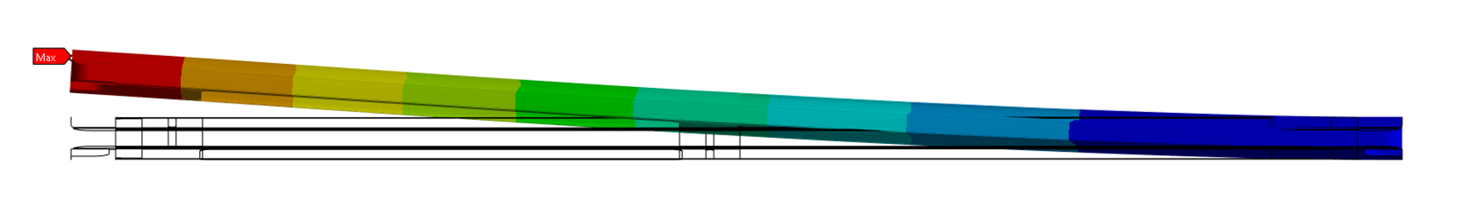
Proving Mechanical Stiffness
Modal Analysis through FEA
  Must include the mass and stiffness or all components (and bonding methods) of the stave
  Target first mode of 100 Hz
  FEA analysis can be validated using piezo driven vibration table
Prove pressure capacity of stave through pressure testing
  Difficult to model/predict adhesive bond strength when surfaces are not rigid.
Quarter Length Stave FEA – First mode 97 Hz

Slide 10
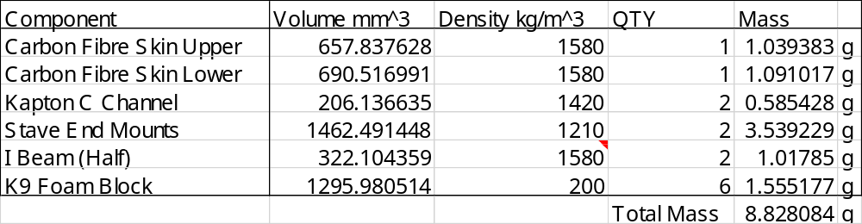
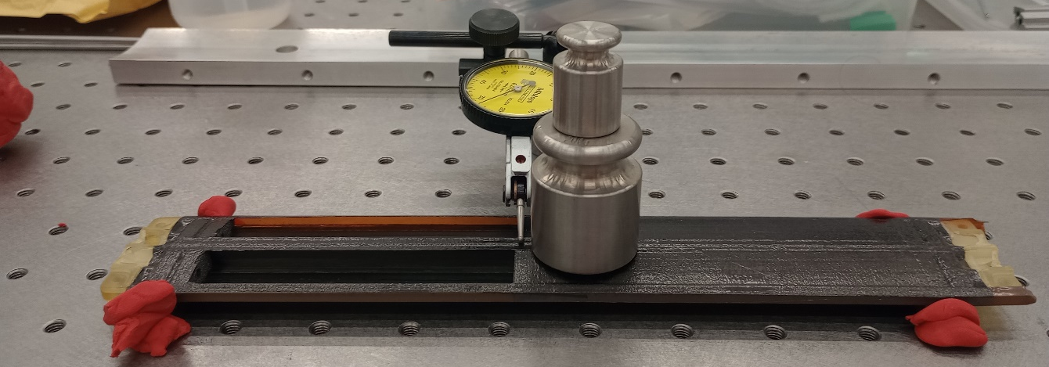
Quantitative Structural Results
Mass estimate
3pt bend test
Measured: 8.95 g

Slide 11
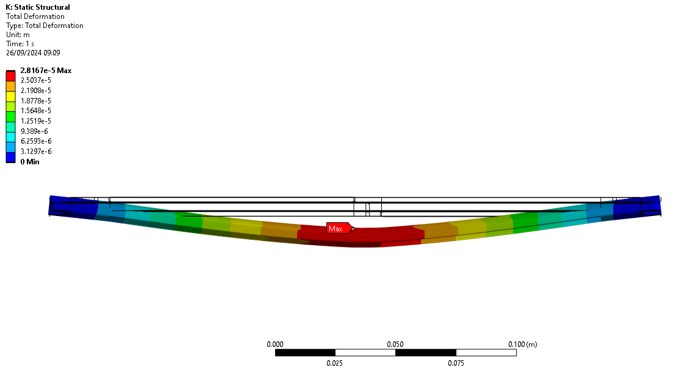
¼ Stave Finite Element Analysis
0.981N
Vertical load applied at central K9 foam block

Slide 12
Thermal Modelling
FEA/CFD models of the L4 stave and ASIC
  Detailed modelling of thermal pathway for ASIC cooling to optimise it’s layout
  L4 model to estimate required flow velocity, coolant outlet temperatures and pressure drop.
Keeping LEC and ASIC close to 25°C significantly decreases thermal output

Slide 13
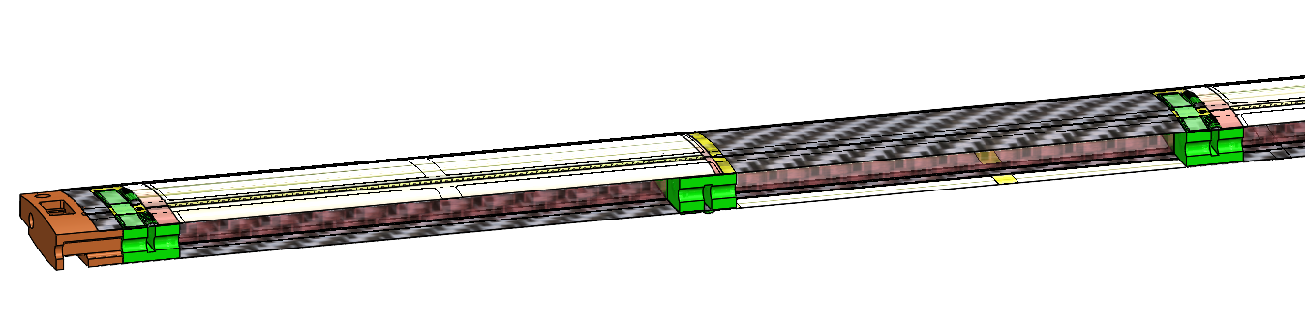
Cooling Requirements
Target delta T between all LEC or coolant or RSU of 10K
Coolant (low pressure) enters the stave at the end support and flows down central air channel in the stave
High power density components LEC and ASIC in close thermal contact with K9 foam for enhanced cooling
  Porosity (and strategically positioned holes) allows air to pass cross braces

Slide 14
Numbers used
OB and disks
Power [mW] | 5 RSU |  |  | 6 RSU
 | LAS | AncASIC | FPC | LAS | AncASIC | FPC
Nominal | 1092 | 382 (35% of LAS) | 218 (20% of LAS) | 1224 | 428 (35% of LAS) | 245 (20% of LAS)
Max | 1689 (+55%) | 759 (45% of LAS) | 507 (30% of LAS) | 1897 (+55%) | 853 (45% of LAS) | 569 (30% of LAS)
OB |  | # of LAS/stave | # of staves | Total # of LAS
L4 | 5-RSU LAS | 16 | 70 | 1120
L3 | 6-RSU LAS | 8 | 46 | 368
disks | Total # of LAS
5-RSU LAS | 1104
6-RSU LAS | 1312

Slide 15
Stave Temperature & Flow
L4 Stave Power
  Nominal – 27.1 W
  Max – 47.3 W
L3 Stave Power
  Nominal – 13.2 W
  Max – 22.0 W
Stave CSA = 260 mm²
Required flow velocity
  Nominal – 9,8 m/s (135 l/min)
  Max – 17.0 m/s (235 l/min)

Slide 16
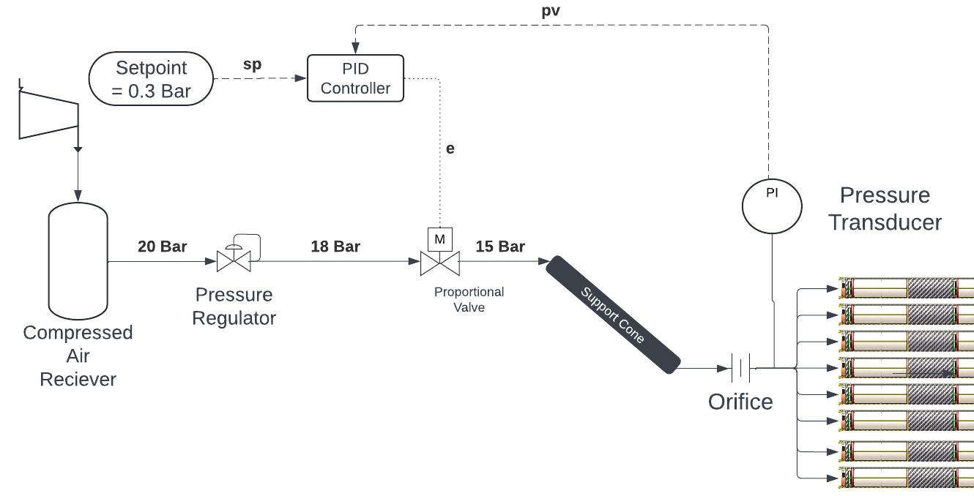
Air Supply
OB airflow requirement – 12500 – 21500 L/min (0.2-0.35 m³/s)
  Equivalent flow velocity through 30cm (12”) duct = 3-5 m/s
Could we supply at pressure and locally reduce
  15 Bar through 16 x 10mm ID tubes
  Flow Velocity - 11 to 19 m/s
  System will need to be well tested and tolerant to blockages to avoid rupturing staves

Slide 17
Next Steps
Build another ¼ Length stave for flow testing
  Dummy heat loads to represent LEC, RSU and ASIC
  Compare CFD studies with experimental results
Feasibility of flat staves
  Significantly easier for module assembly
  Preliminary FEA studies show this has a limited effect on global stave stiffness
  Further modelling of effect of internal pressure needed

Slide 18
Conclusions
First ¼ Stave prototype was both successful and informative
  Static load testing showed similar (slightly better) stiffness than FEA
  Redesign end supports & try with silicone intensifier to reduce imperfections in the carbon fibre skins.
Second ¼ Stave will allow us to test modal response of stave and validate thermal models
More extensive analysis of a flat sensor stave needed

Slide 19
Additional Slides

Slide 20
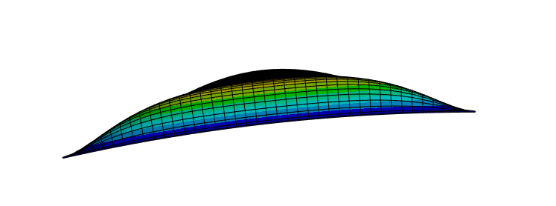
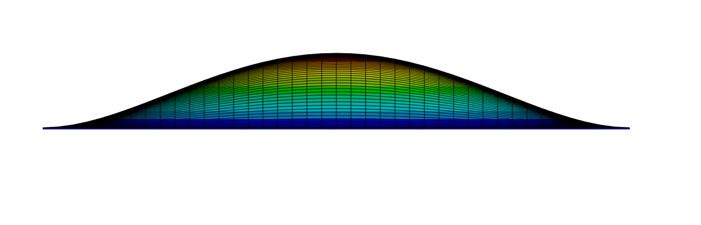
Local Stiffness of EIC-LAS
Air velocities in flow channel will be high
  High pressure drop/high inlet pressure
Modelled assuming rigid mounting around glue locations
Curvature reduces deformation due to internal pressure
Sensor/module curvature of Ø180 mm results in micron level deformation due to 1000 Pa internal pressure
Notes:
Sensor modules will form an integral part of the pressurised wall of the stave. We expect that we’ll need quite high flow velocities to cool the sensors which will result in high inlet pressures acting on the stave internal surfaces
Having a small curvature to the sensor dramatically reduces deformation due to internal pressure. The plot shows the sensor surface deformation for a range of curve diameters, our current design has a diameter of 0.18m

Slide 21
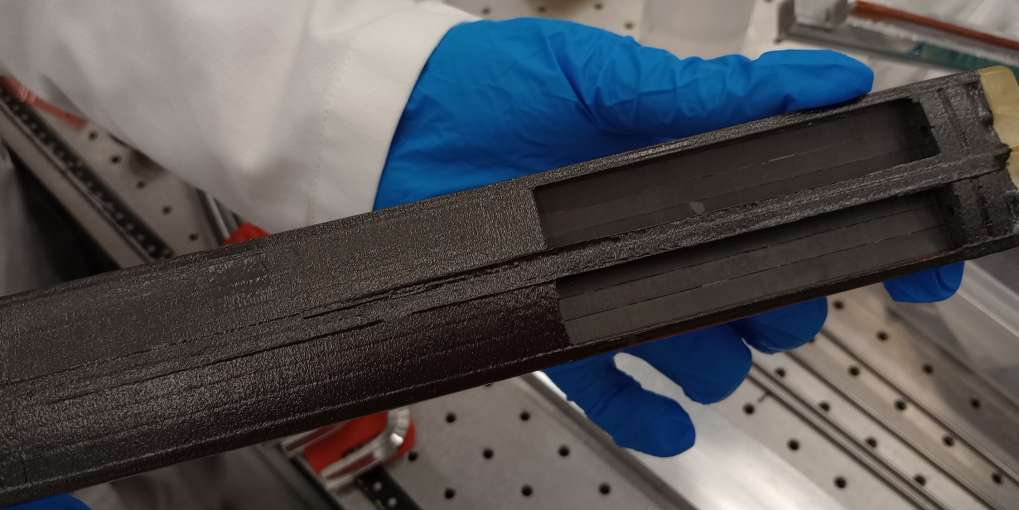
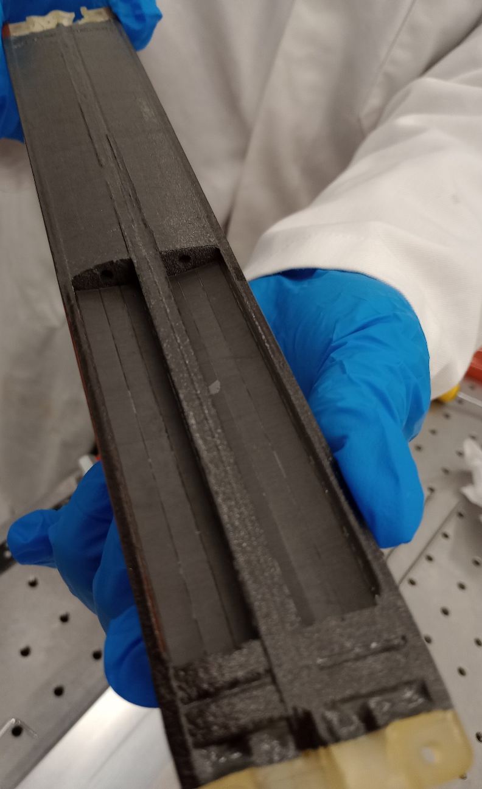
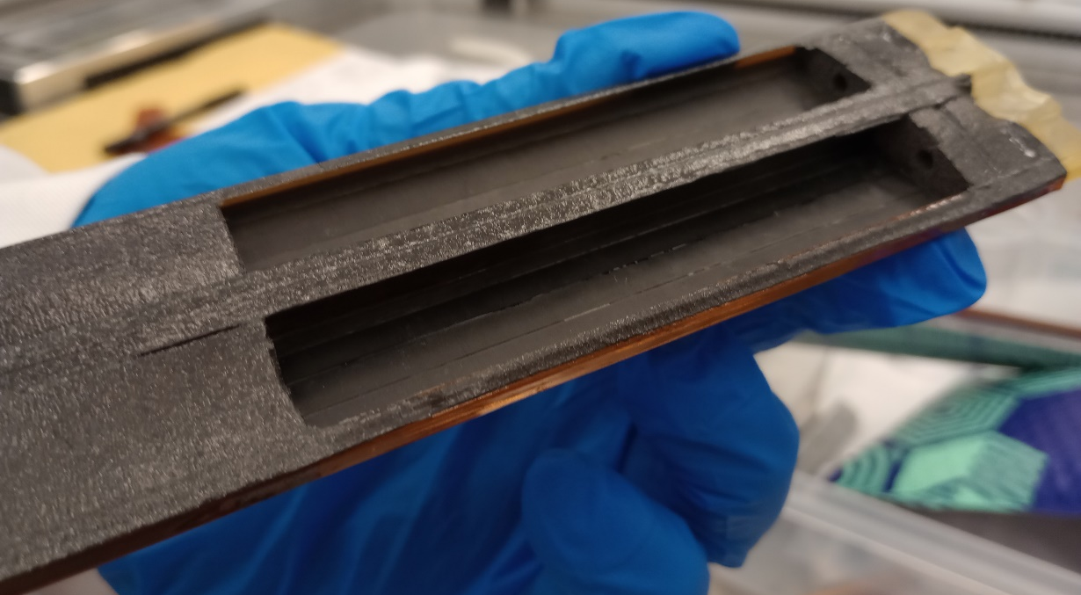
Pictures

Slide 22
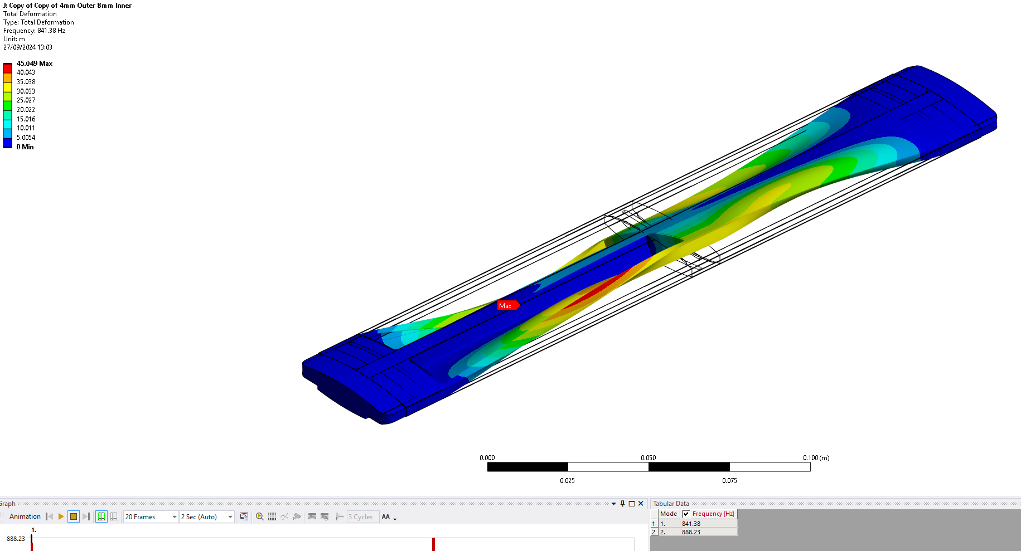

Slide 23


Slide 24
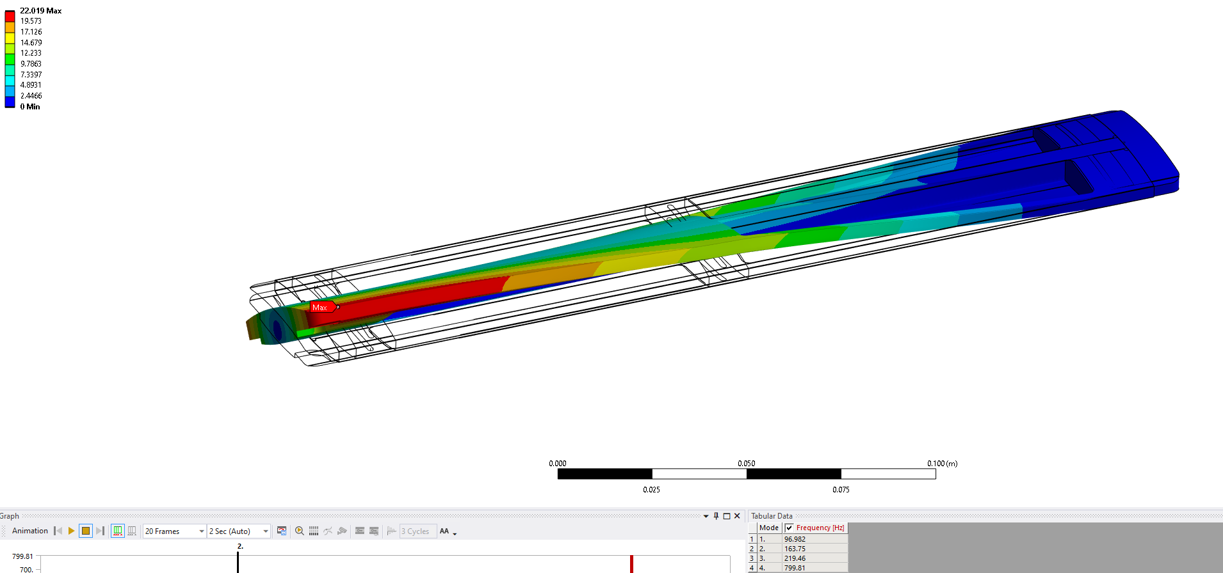

Slide 25
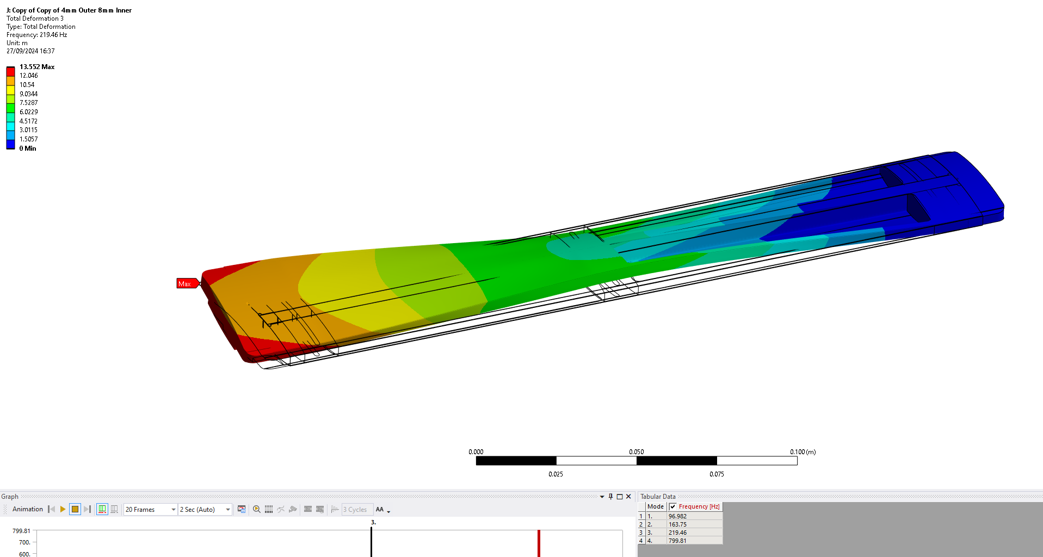

Slide 26
Future Design Work
Current Staves have a dia 180 mm curvature
  Curved surfaces may be difficult for wire bonding
  FEA studies suggest curvature has minimum impact on structure stiffness
  Future iterations may use a flat sensor/module

