Slide 1
ePIC Silicon Vertex Tracker
Overview, layout, production and integration
Georg Viehhauser

Slide 2
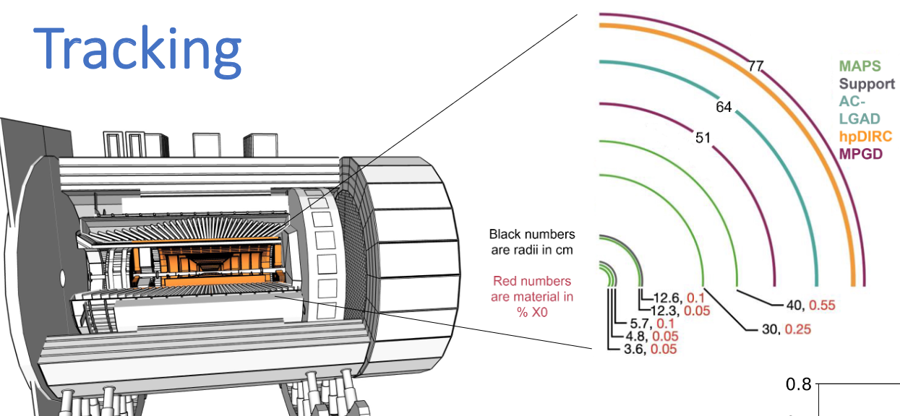
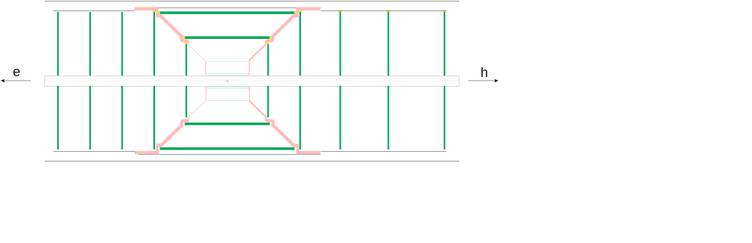
SVT
5 barrels, 5 disks (each end)
Barrel
  3 layers inner barrel (IB): Half-cylinders out of bent silicon (like ALICE ITS3) – IT and US
  2 layers outer barrel (OB): Individual staves with carbon fibre structure – UK
    ~1/3 of SVT
  All barrel layers supported by carbon fibre support cone
Disks: corrugated carbon-fibre half-disks - US
Sensor will be an ultra-thin (40 μm), wafer-stitched CMOS sensor
  Developed by ATLAS ITS3: MOSAIX
  We will use MOSAIX for IB, and modification (EIC-LAS) for OB and disks
Air cooling with flow contained in local support structures
Radiation levels at EIC are significantly below LHC

Slide 3
Layer properties
Barrel nominal dimensions |  | Layer radius [mm] | Layer lengths [mm] | X/X₀ [%]
IB | L0 | 36 | 270 | 0.05
 | L1 | 48 | 270 | 0.05
 | L2 | 120 | 270 | 0.05
OB | L3 | 270 | 540 | 0.25
 | L4 | 420 | 840 | 0.55
Electron side | disk | z [mm] | Hadron side | disk | z [mm] | Outer radius [mm] | X/X₀ [%]
 | ED1 | -250 |  | HD1 | 250 | 240 | 0.25
 | ED2 | -450 |  | HD2 | 450 | 415 | 0.25
 | ED3 | -650 |  | HD3 | 750 | 421 | 0.25
 | ED4 | -850 |  | HD4 | 1000 | 421 | 0.25
 | ED5 | -1050 |  | HD5 | 1350 | 421 | 0.25

Slide 4
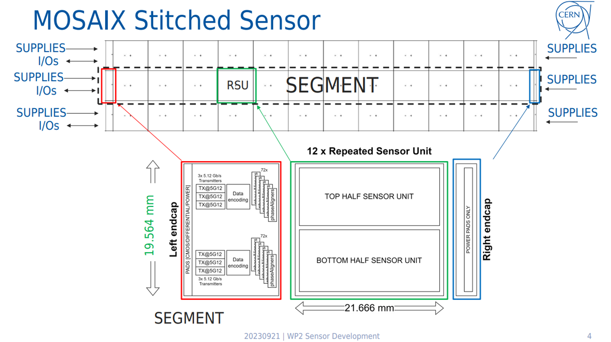
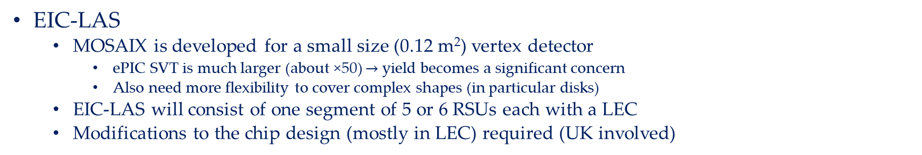
Sensors
MOSAIX (ALICE ITS3)
  CMOS Monolithic Active Pixel Sensors
    Front-end electronics is integrated with sense elements
  Repeated Sensor Unit (RSU) – 12 off
    Contains sense elements & power/read-out distribution
  Left and Right End-cap (LEC and REC)
    Chip-common functions (control, power, multi-plexing, etc.)
  Internal connections between sections by stitching
    No external cables required, connections only to LEC (by wire-bonding)
  MOSAIX sensors with 3, 4 or 5 segments (rows) of 12 RSUs each
  Silicon is thinned down to 40 μm
    This makes it flexible enough that it can be bent
EIC-LAS
  MOSAIX is developed for a small size (0.12 m²) vertex detector
    ePIC SVT is much larger (about ×50) $→$ yield becomes a significant concern
    Also need more flexibility to cover complex shapes (in particular disks)
  EIC-LAS will consist of one segment of 5 or 6 RSUs each with a LEC
  Modifications to the chip design (mostly in LEC) required (UK involved)

Slide 5
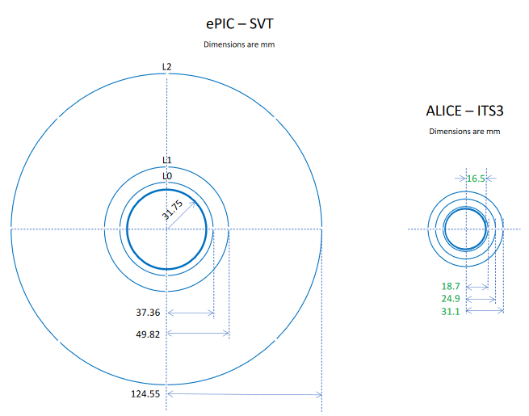
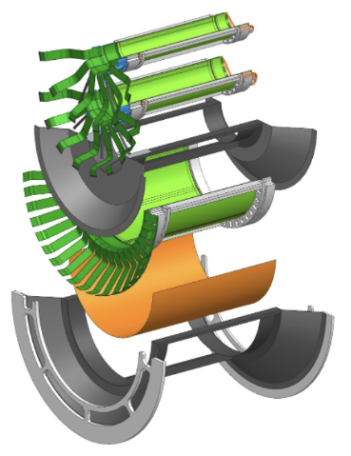
ALICE ITS3 and ePIC IB
L0
L1
L2
IB will follow ALICE ITS3 design in barrel
But already with significant changes
  ePIC IB is more than 2 times larger than ITS3
  Due to the beam pipe geometry, and the need for full disk acceptance services need to be routed along service cones

Slide 6
Power and cooling
Due to large size of SVT we need to supply individual LAS with cables
  Flexible Printed Circuits (FPCs) – 14 μm Al traces on 25 μm Kapton carrier
  To reduced number of lines (material) use serial powering
    Supply current flows through four consecutive LAS
    To cope with load variations this requires a set of auxiliary electronics, called a shunt Low-Drop-Out (LDO) regulator
    This, and other circuitry required for control and powering will be integrated into an ancillary chip (AncASIC) – designed for ePIC with UK involvement
      One AncASIC per LAS
The heat generated by the sensors (1-2 W per LAS), and AncASIC (35-45% of LAS power), and by ohmic losses in the FPC (20-30% of LAS power) needs to be removed by a cooling system
  Like ALICE ITS3 we plan to do this by flowing air close to the heat sources
    Eliminates material associated with liquid or evaporative cooling
  In ePIC SVT this air flow will be contained within mechanical support structures of OB staves and disks
    This gives us reliability and predictability
  Required air speeds (for a coolant ΔT=10°C between input and output) will be around 10 m/s
    This is significant, and will induce mechanical loads on the support structures

Slide 7
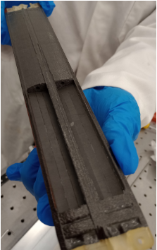
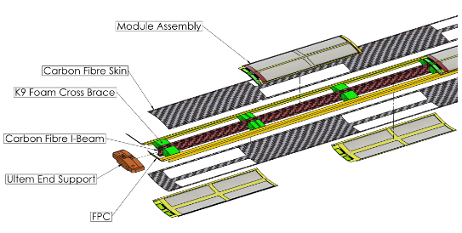
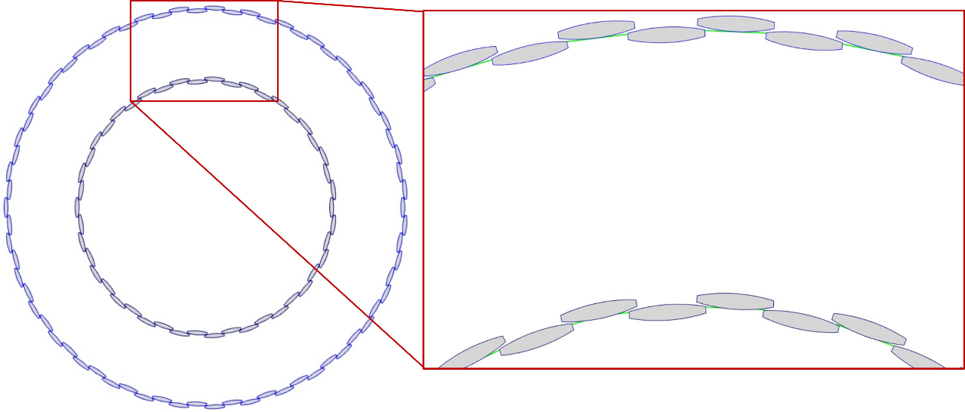
OB
Segmented into staves as long as each barrel
  Supported from support cones at each end – this includes service connections
Modules (2 LAS side-by-side + 2 AncASICs on common carrier)
  Glued on openings in stave skin
Hollow stave core with CF central spar and face sheets
Cross-ribs from thermally conductive carbon foam
Side close-outs from Kapton (FPCs)
Current design has curved surfaces (with curved silicon modules)
  Evaluate layout benefits vs manufacturing challenges (bonding)
Layer | Innermost radius [mm[ | Outermost radius [mm] | RSU/LAS | Staves/layer | LAS/stave AncASIC/stave | LAS/layer AncASIC/layer | Power/stave (max) [W]
L3 | 264.75 | 279.25 | 6 | 46 | 8 | 368 | 22.0
L4 | 416.75 | 431.2 | 5 | 70 | 16 | 1120 | 47.3

Slide 8
The UK SVT project
The UK deliverable to the SVT will be the L3 and L4 staves
  All aspects: modules (with LAS and AncASICs), FPCs + RDOs, stave structures, all electrical connections bonded
  Fully tested
  Will be shipped to BNL for integration on support cones
    We probably also want to be part of that integration
Within the UK two centres of construction activity
  Modules, module wire bonding, module testing: Birmingham, Daresbury Lab, Liverpool
  Staves, stave integration (incl. TAB) and testing: Oxford, RAL
  Other test activities (wafer probing etc.): Birmingham, Daresbury, RAL, Brunel
The wide field of construction activities, and of the expertise we bring to the project means that we are already involved in the project at all levels
  One co-TC and in almost all international WPs one WP coordinator from the UK

Slide 9
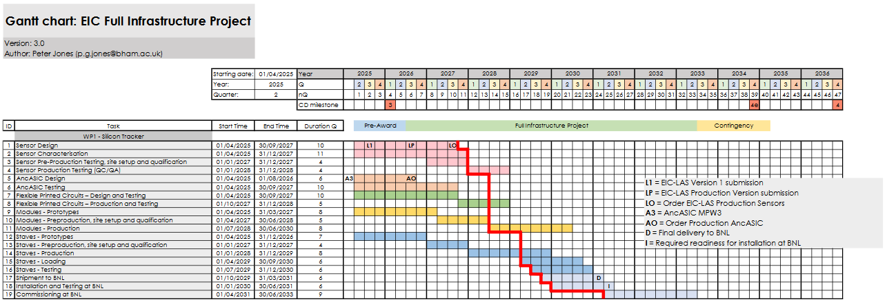
Timeline
Aligns with the EIC Project Schedule and UKRI/STFC profile restrictions
Production starts 2027/2028
Stave delivered to BNL 2030-2031

Slide 10
Summary
The ePIC SVT is an extremely challenging project
  Very aggressive material requirements
It involves state-of-the-art (and beyond) technologies
It builds on developments for ALICE ITS3, but is a project with its own challenges
The UK is committed to deliver an critical part of the SVT, the OB staves
  This constitutes about 1/3 of the silicon area
  We will deliver components which will contain all components of the system (sensors, ancillary chips, FPC, cooling) and will be fully tested in the UK
    We participate in all aspects of the project
  The UK project is shared among several UK institutions
However, the project is US driven, and we rely on them providing critical infrastructure
  And we rely on the ALICE collaboration for design of and access to the MOSAIX chip
  These exposures are out biggest project risks
The other big challenge will be competing demands from LHC upgrades

