Slide 1
Measurement of the muon anomalous magnetic moment with the Fermilab g-2 experiment
Saskia Charity, University of Liverpool
Birmingham EPP Seminar, 06 December 2023

Slide 2
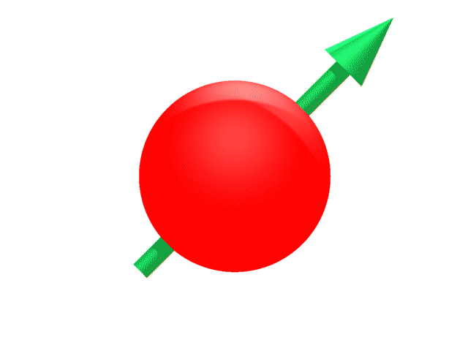
Muons & magnetic moments
g determines spin precession frequency in a magnetic field
B
Torque in B-field
Magnetic Moment

Slide 3
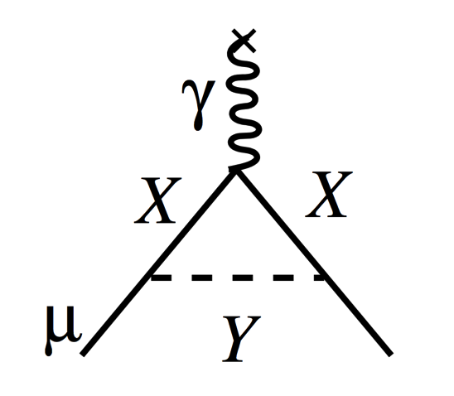
Muons & magnetic moments
g determines spin precession frequency in a magnetic field
B
Torque in B-field
Magnetic Moment
For a pure Dirac spin-½ charged fermion, g is exactly 2
Interactions between the muon and virtual particles alter the value: X & Y particles could be SM or new physics

Slide 4
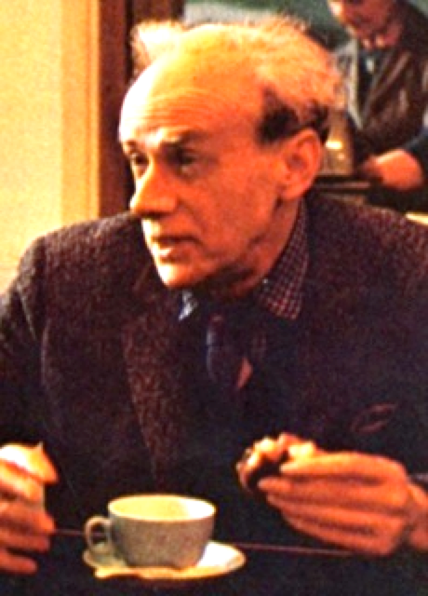
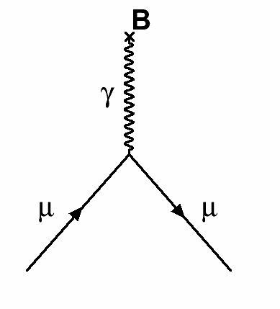
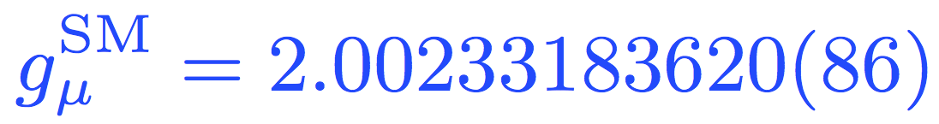
Standard Model components of g_{μ}
Dirac
Charged,
spin ½

Slide 5
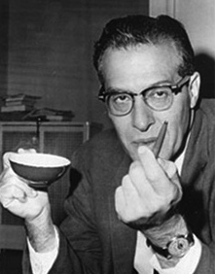
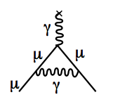
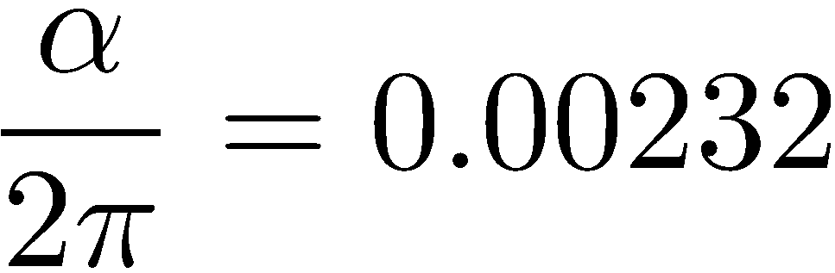
Standard Model components of g_{μ}
Dirac
Charged,
spin ½
Schwinger
1st Order QED

Slide 6

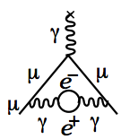
Standard Model components of g_{μ}
Dirac
Charged,
spin ½
Up to 10th Order QED
Kinoshita
+12671 diagrams
Schwinger
1st Order QED

Slide 7
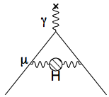
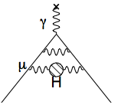
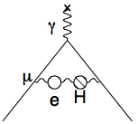
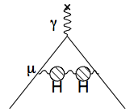
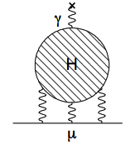
Standard Model components of g_{μ}
Dirac
Charged,
spin ½
Up to 10th Order QED
Kinoshita
+12671 diagrams
Hadronic
Schwinger
1st Order QED

Slide 8
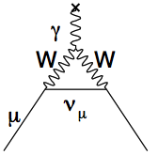
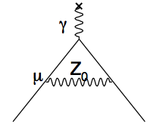
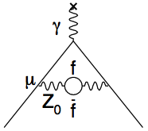
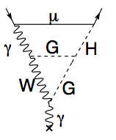
Standard Model components of g_{μ}
Dirac
Charged,
spin ½
Up to 10th Order QED
Kinoshita
+12671 diagrams
Electroweak
Hadronic
Schwinger
1st Order QED

Slide 9
Standard Model components of g_{μ}
Dirac
Charged,
spin ½
Up to 10th Order QED
Kinoshita
+12671 diagrams
Electroweak
Hadronic
BSM?
Schwinger
1st Order QED

Slide 10
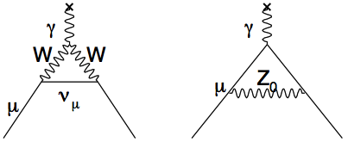
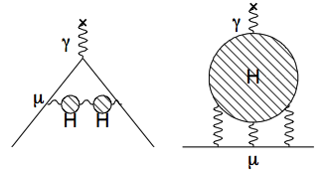
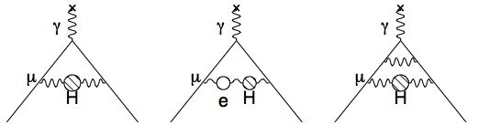
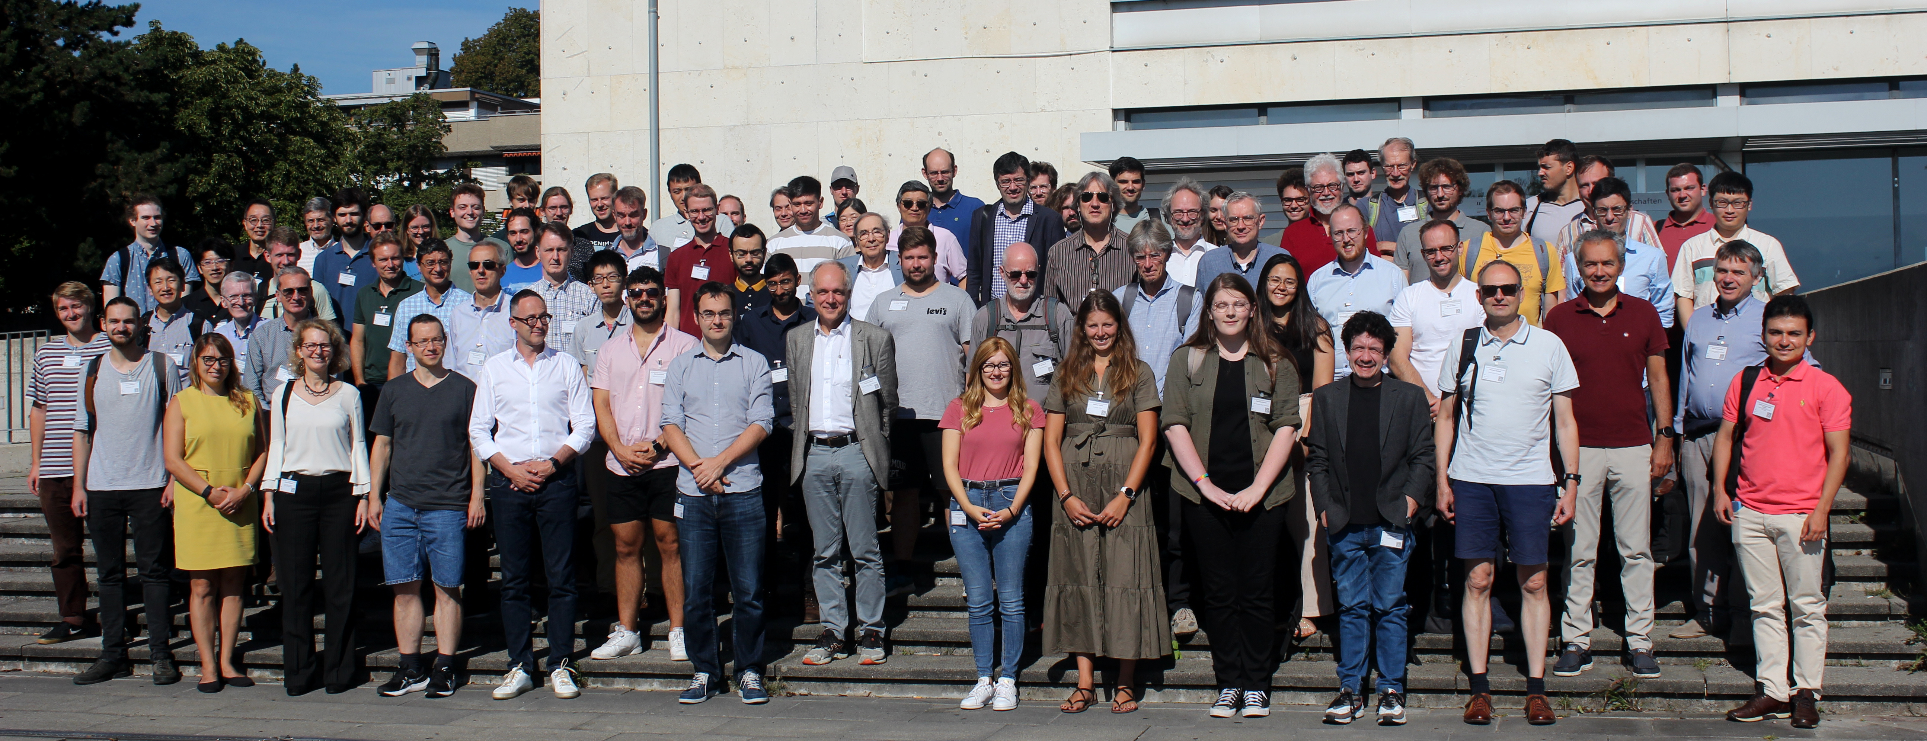
Muon g-2 Theory Initiative
Dirac Equation
Hadronic Light-by-Light
Hadronic Vacuum Polarization
QED
Electroweak
SM values taken from the Muon g-2 Theory Initiative
Consortium of 100+ theorists who compile the theoretical inputs and provide recommendations
Last compilation in 2020:
White Paper: Phys. Rept. 887 (2020) 1-166
https://doi.org/10.1016/j.physrep.2020.07.006
https://muon-gm2-theory.illinois.edu/
TI in Bern, September 2023

Slide 11
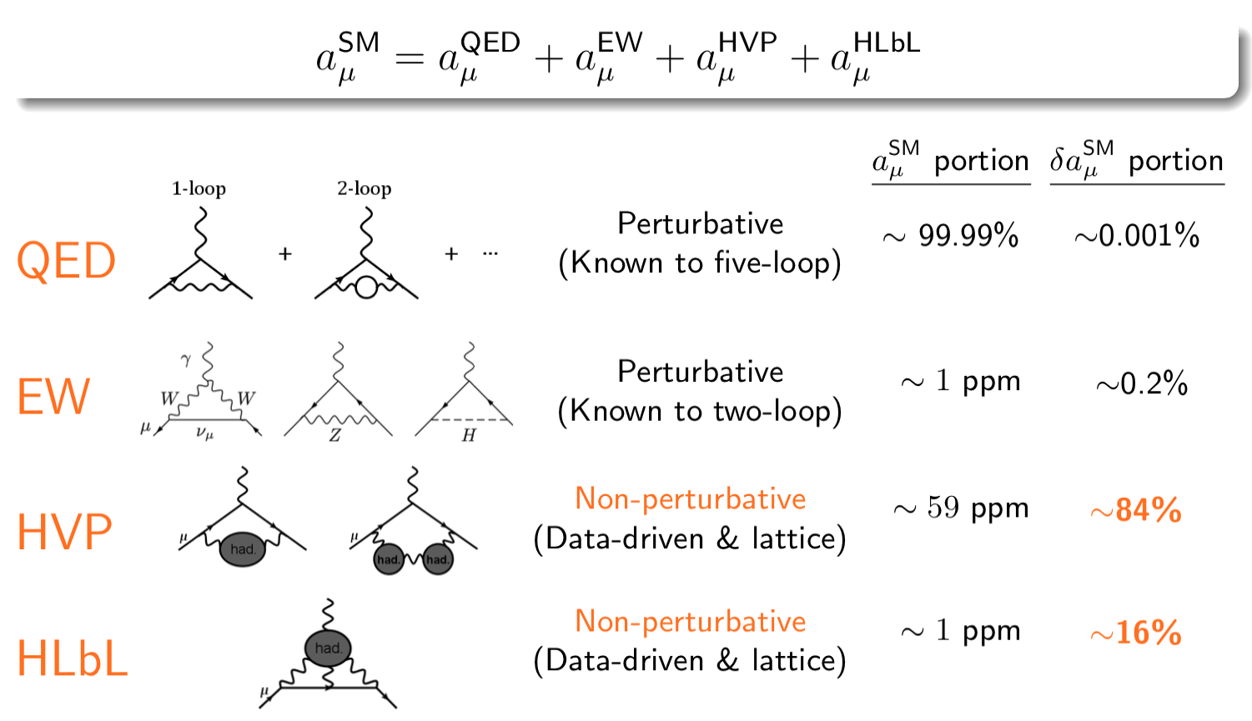
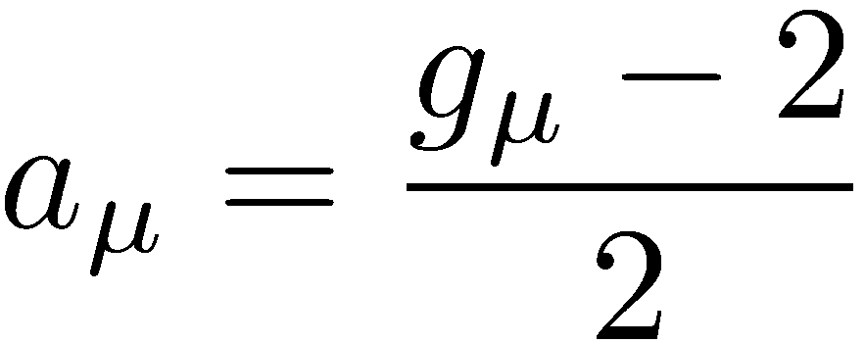
The muon anomalous magnetic moment
Define the quantity a_{μ} : muon anomalous magnetic moment
QED dominates the value
a_{μ} arises due to higher-order interactions / loop contributions
All SM particles contribute
Calculate & sum all sectors of the SM
Hadronic terms dominate the uncertainty

Slide 12
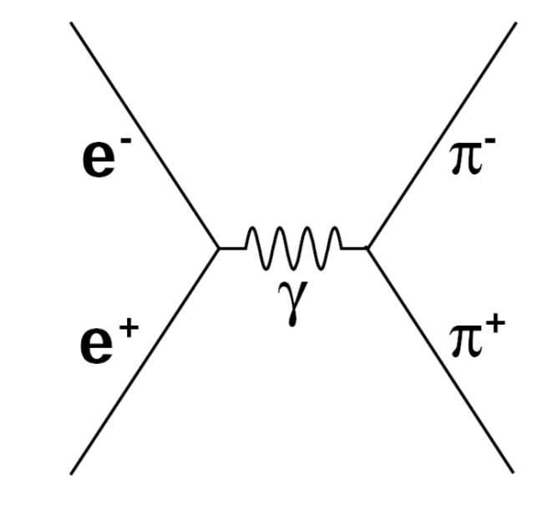
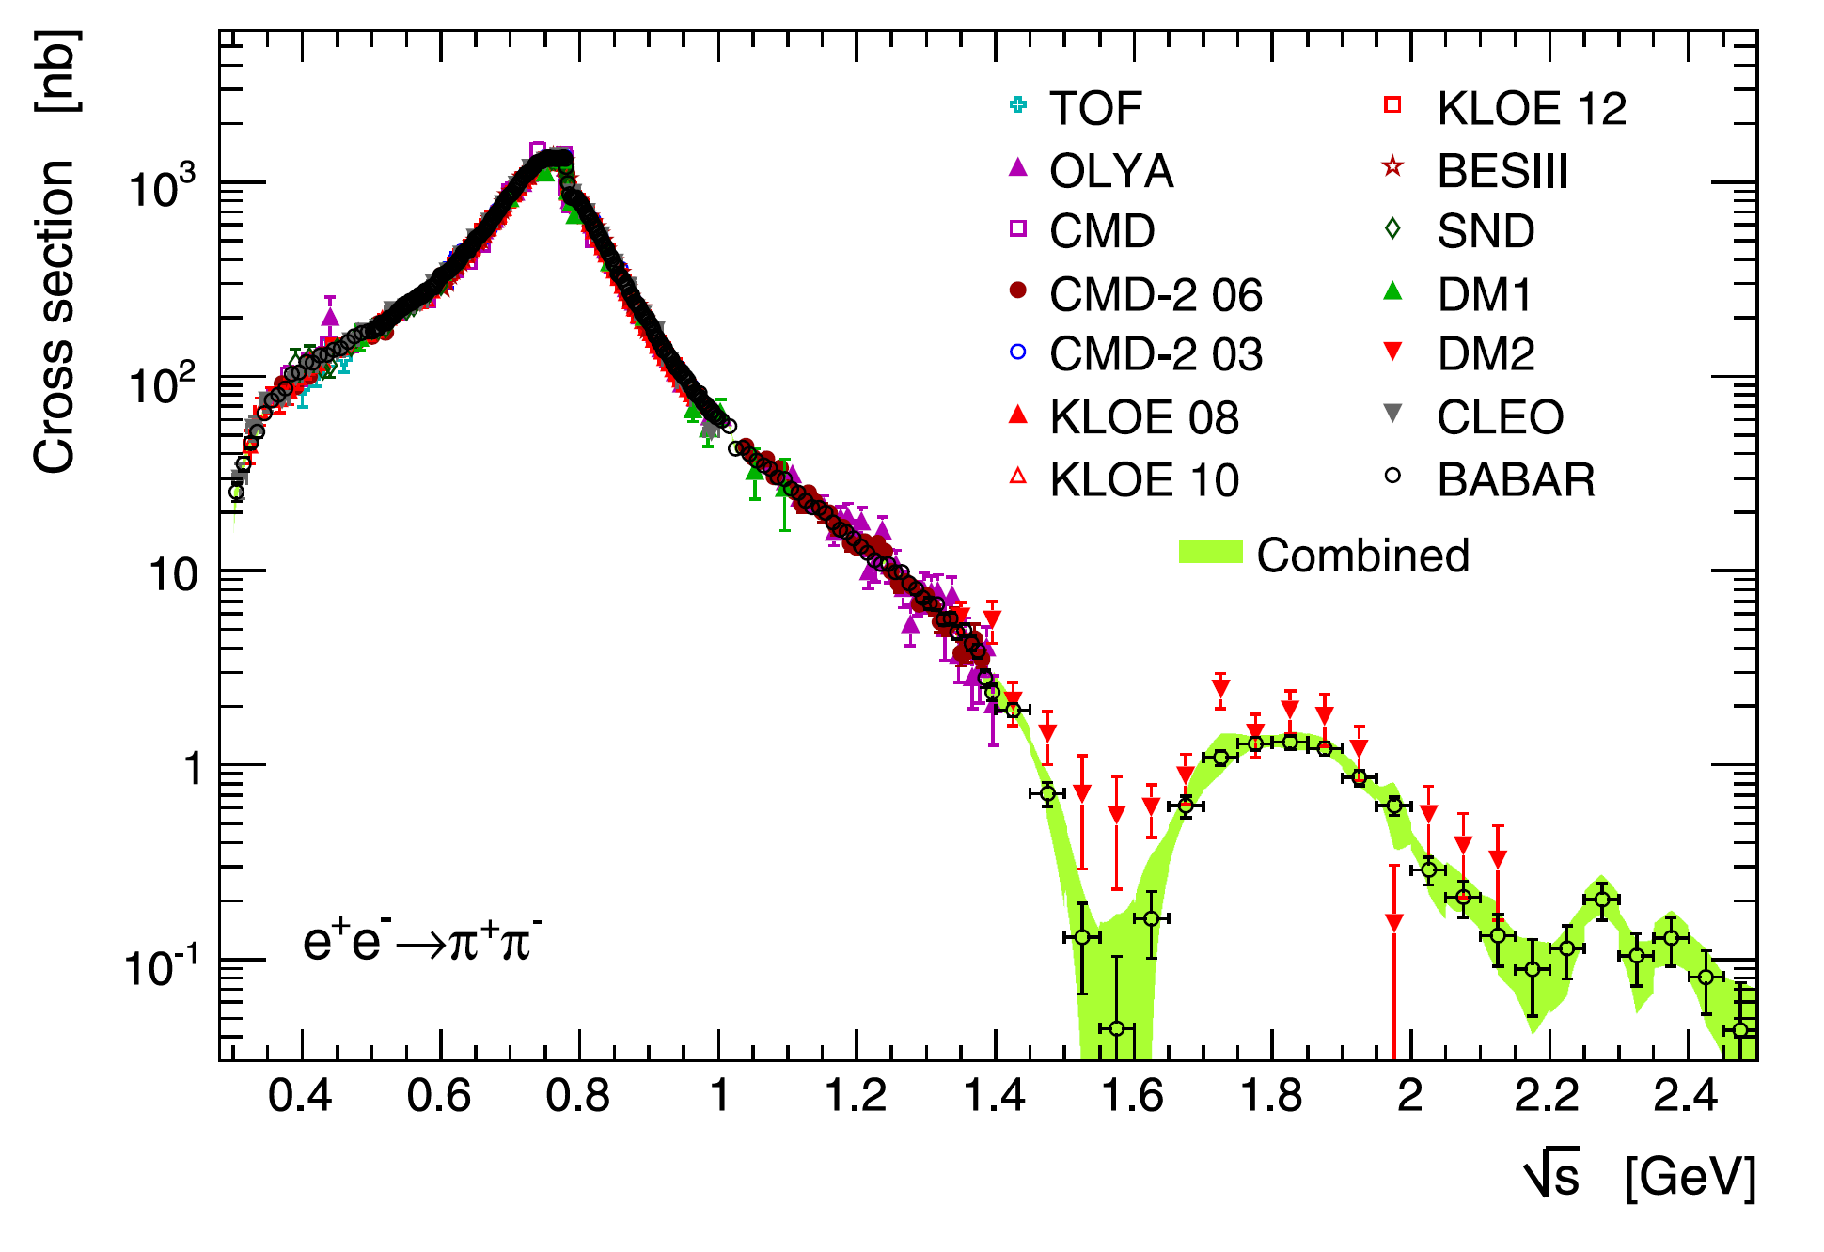
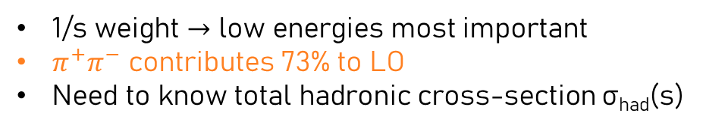
Hadronic Vacuum Polarisation (HVP): dispersion relation
1/s weight $→$ low energies most important
$π^{+}π^{−}$ contributes 73% to LO
Need to know total hadronic cross-section σ_{had}(s)
Dispersion Relation
follows from causality
Cross section data used in TI 2020 $a_{μ}^{HVP}$ prediction
Optical Theorem
follows from unitarity
of scattering matrix
Davier et. al, Eur. Phys. J. C. 80 (2020)

Slide 13
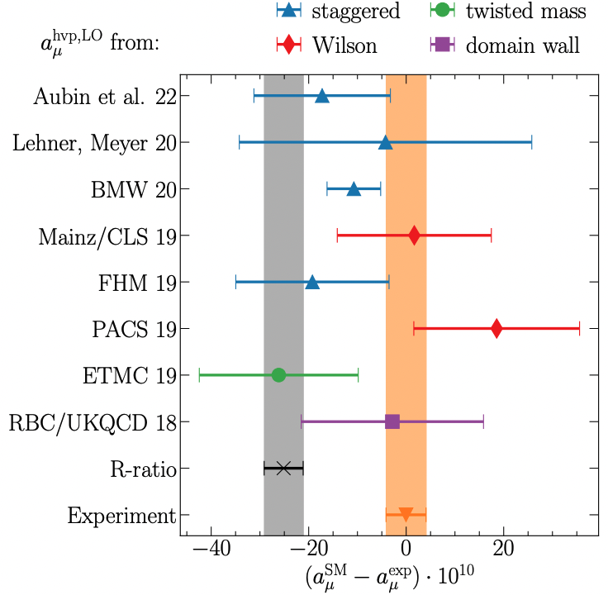
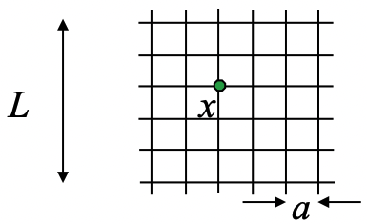
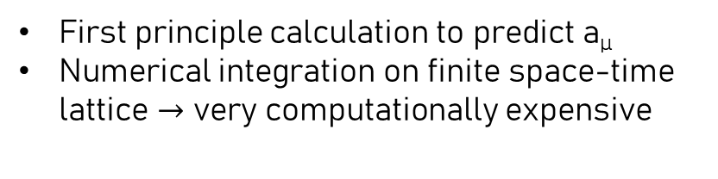
Hadronic Vacuum Polarisation (HVP): lattice approach
First principle calculation to predict a_{µ}
Numerical integration on finite space-time lattice $→$ very computationally expensive
Dispersive (TI 2020)
Exp. (FNAL Run-1)
First prediction with <1% uncertainty by BMW
Lattice results not included in TI 2020 white paper due to low precision
So far, no other high-precision a_{µ} from different group
Ongoing cross-checks by many groups at different energies
Preliminary agreement in ‘intermediate energy window’

Slide 14
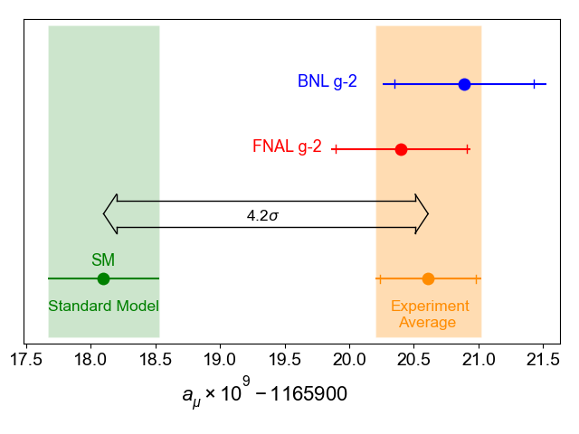
FNAL Measurement: status in 2021
First announcement of the FNAL experiment using Run-1 (2018) data in April 2021
Using the TI(2020) value for the SM comparison (data-driven HVP only)

Slide 15
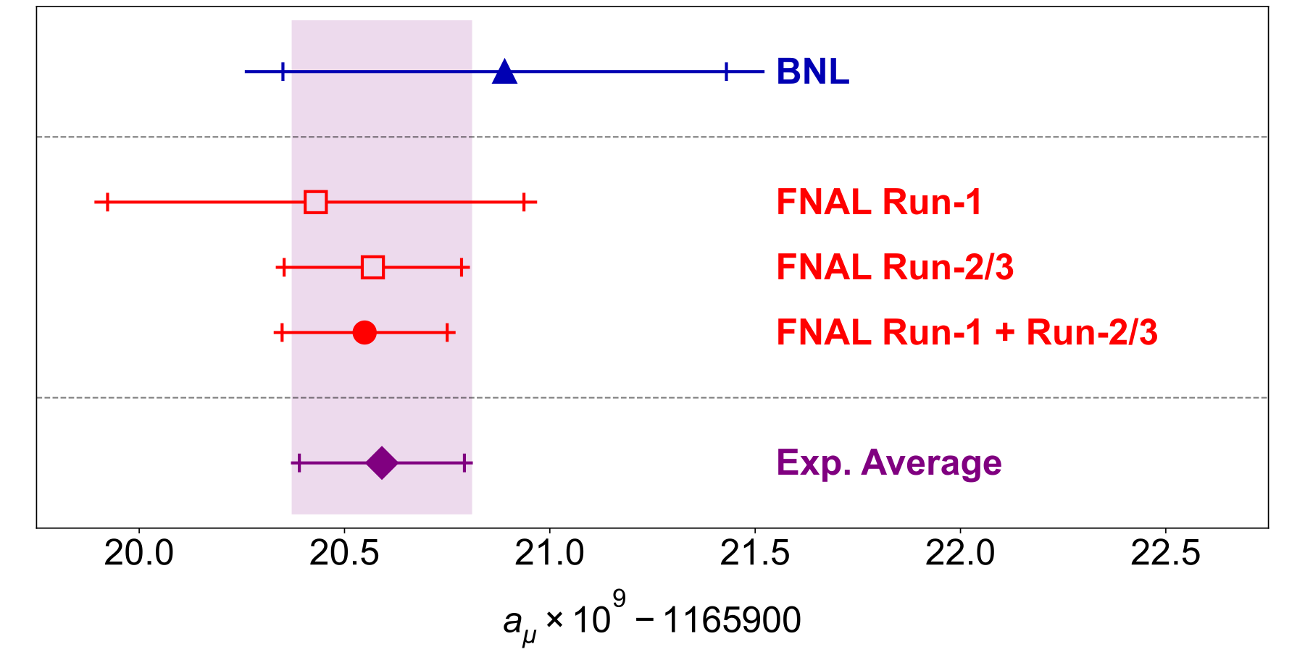
FNAL Measurement: status in 2023
In August 2023, FNAL published updated result using Run-2 (2019) and Run-3 (2020) data
>4x higher statistics than the Run-1 result
Excellent agreement with Run-1 and BNL
BNL, Run-1 and Run-2/3 statistics dominated
Assume 100% correlated systematics
World Average dominated by FNAL

Slide 16
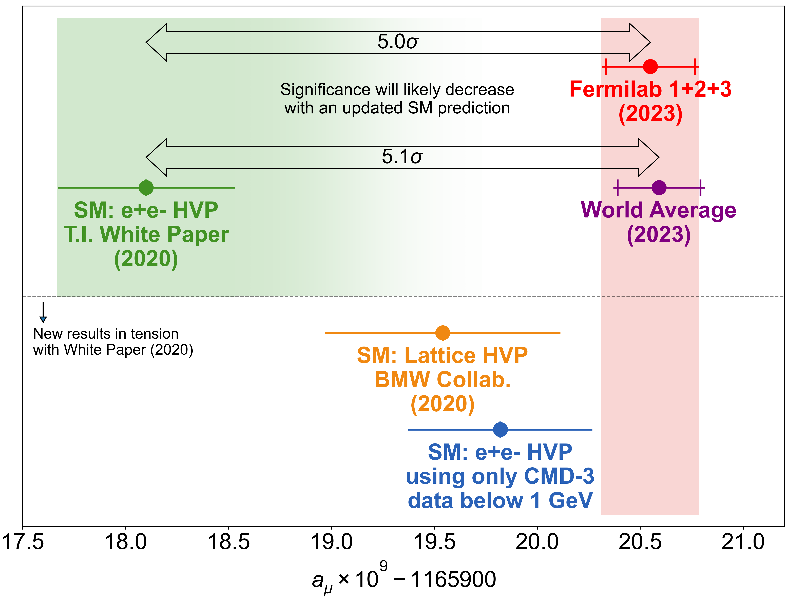
Comparison with the Standard Model
Tension between dispersive and lattice approaches to HVP
Lattice result needs independent confirmation
Long-standing tension between experiment and dispersive result approaches 5σ
New cross-section results from CMD-3 makes the dispersive situation quite puzzling
Very dynamic situation: huge effort to reconcile differences and tensions

Slide 17
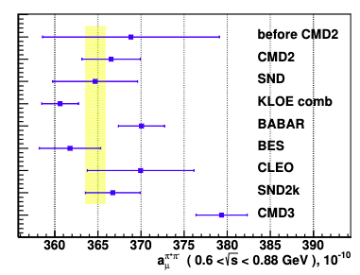
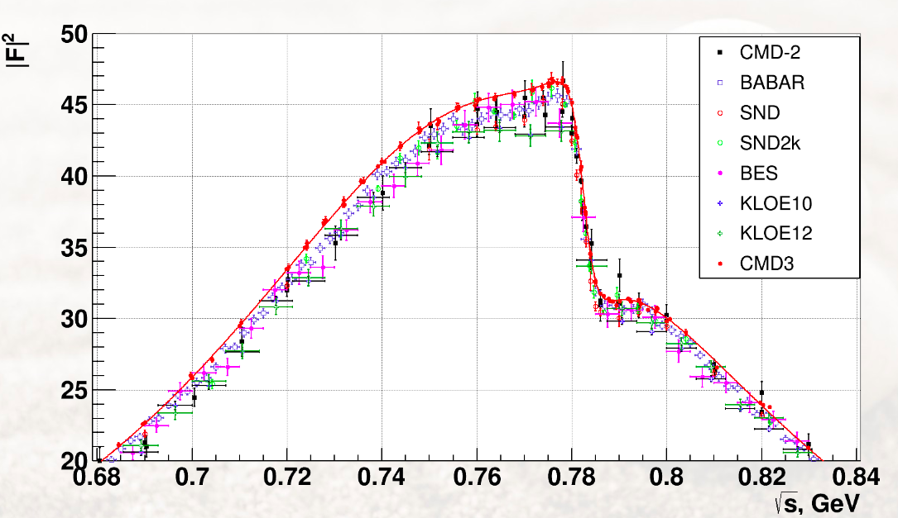
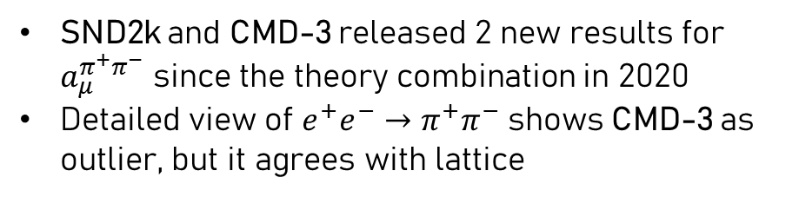
The CMD-3 result
In WP2020
Plot by F. Ignatov
SND2k and CMD-3 released 2 new results for $a_{μ}^{π^{+}π^{−}}$ since the theory combination in 2020
Detailed view of $e^{+}e^{−}→π^{+}π^{−}$ shows CMD-3 as outlier, but it agrees with lattice
2 new HVP LO results since WP2020

Slide 18
The Fermilab g-2 Experiment

Slide 19
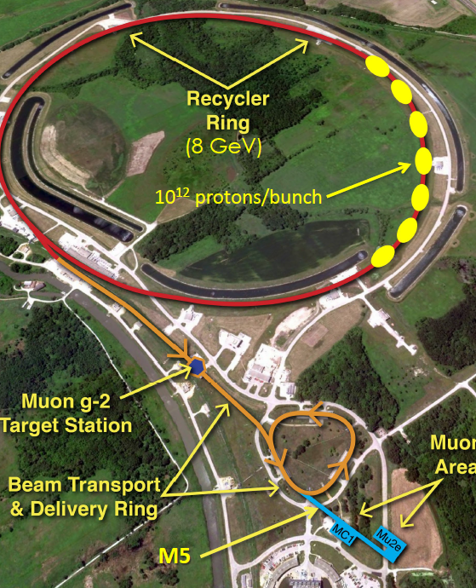
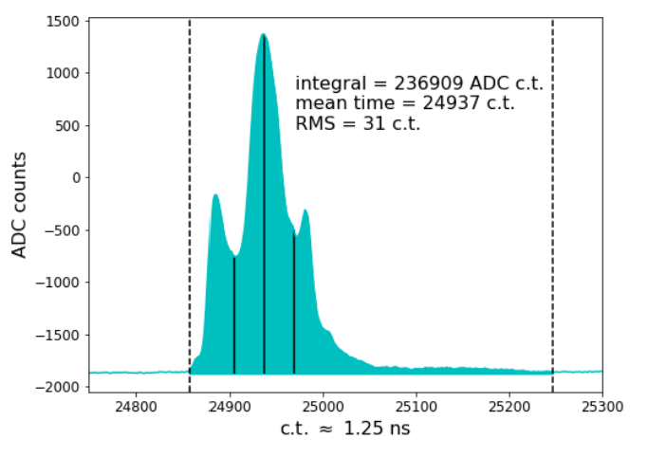
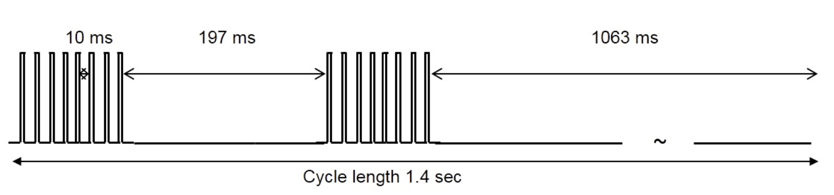
The FNAL Muon Campus
Recycler ring: 8 GeV protons
  10¹² protons / bunch ; 10k stored muons / bunch
8 GeV protons → pion production target
Pions → delivery ring → decay to μ⁺ and momentum-selected
3.09 GeV μ⁺ → g-2 storage ring magnet
Beam arrives in 120 ns wide bunches
Each bunch corresponds to a “fill” → 1 ms

Slide 20
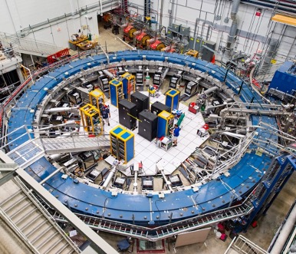
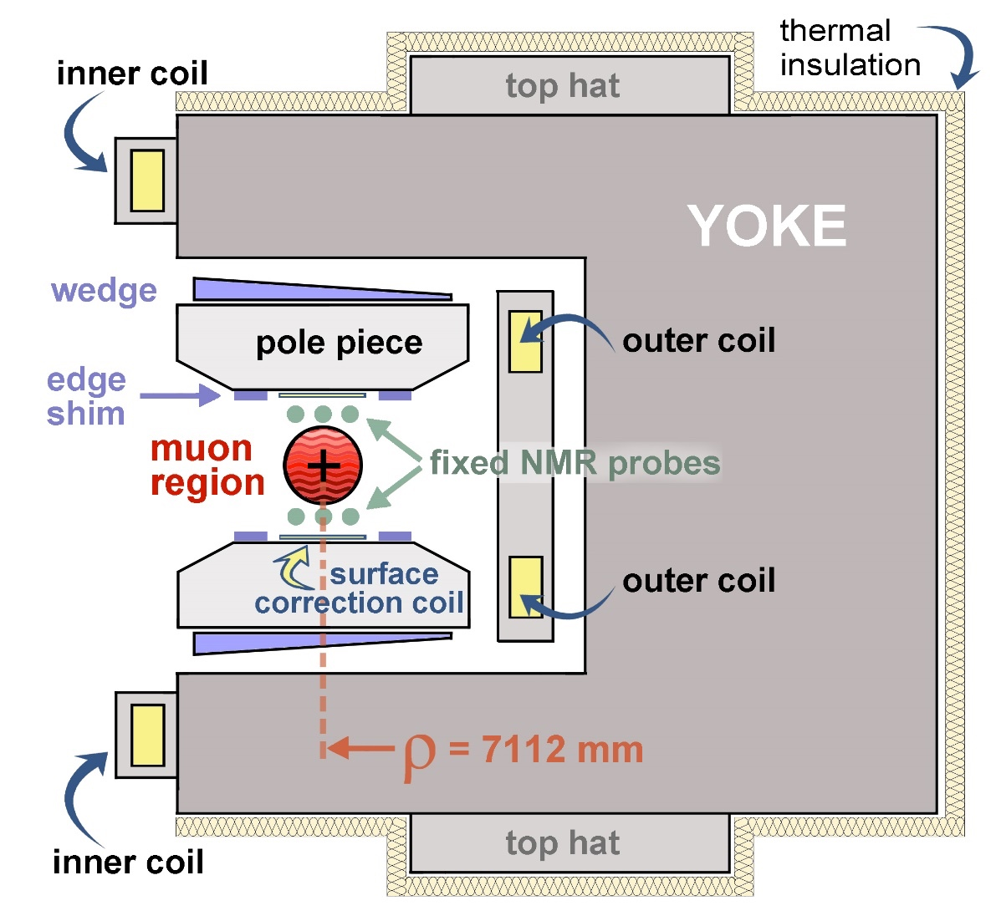

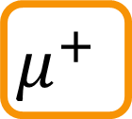
The Storage Ring
$$μ^{+}$$
B
$$14m$$
Cross-section slice of magnet
1.45 T vertical B field in muon region

Slide 21
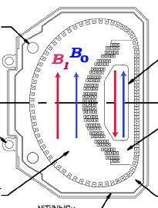
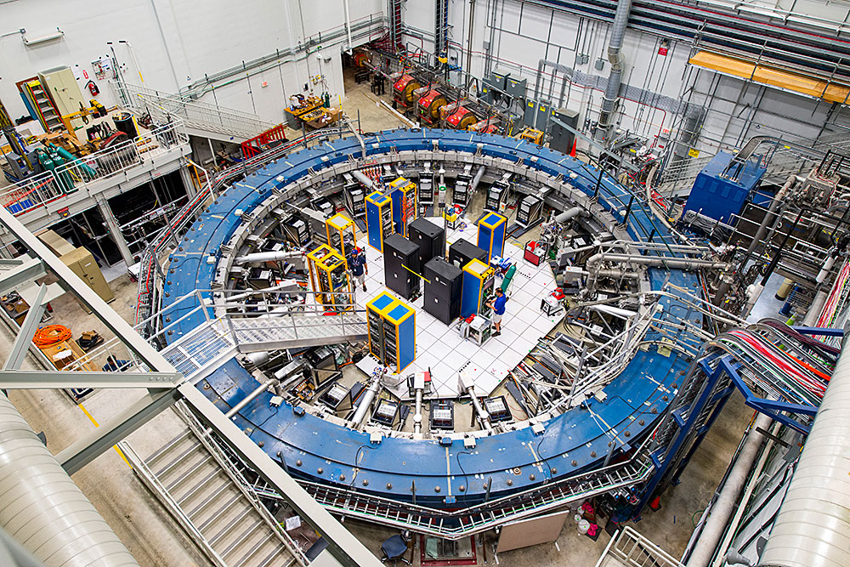
Injecting and storing the beam
Beam injected through inflector magnet → cancel main magnetic field

Slide 22
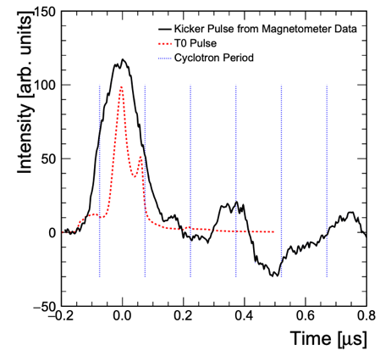
Injecting and storing the beam
Beam injected through inflector magnet → cancel main magnetic field
Kicker magnet applies fast radial magnetic field on first turn

Slide 23
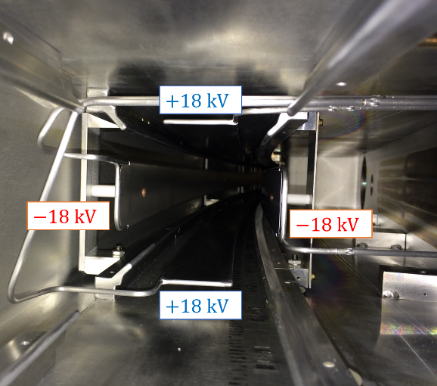
Injecting and storing the beam
Beam injected through inflector magnet → cancel main magnetic field
Kicker magnet applies fast radial magnetic field on first turn
Quads pulse throughout muon fill → vertical focusing

Slide 24
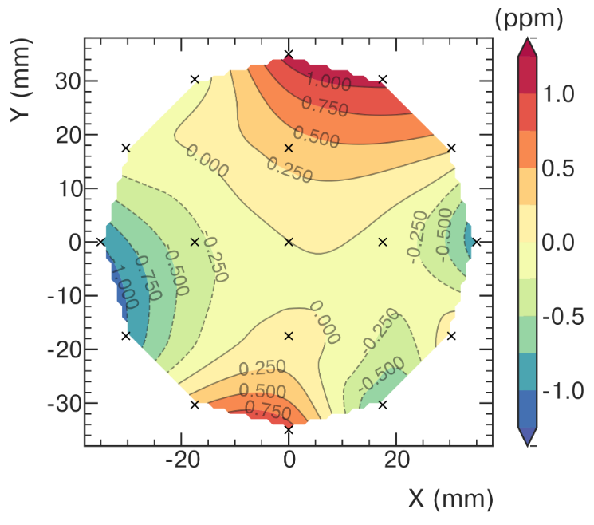
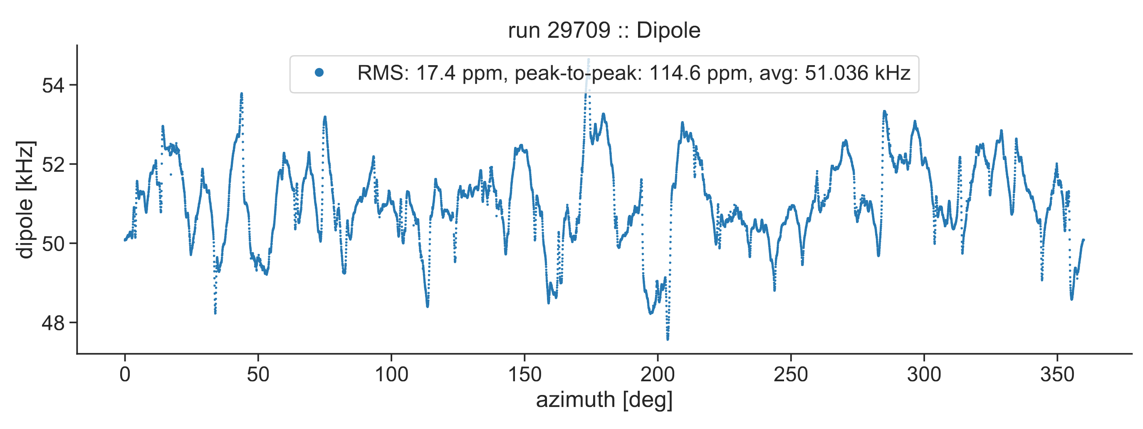
Injecting and storing the beam
Beam injected through inflector magnet → cancel main magnetic field
Kicker magnet applies fast radial magnetic field on first turn
Magnetic field map measured every 3 days, changes monitored continuously
Quads pulse throughout muon fill → vertical focusing

Slide 25
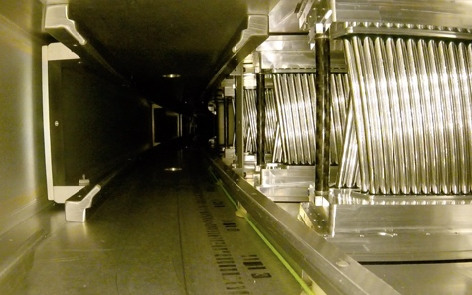
Injecting and storing the beam
Beam injected through inflector magnet → cancel main magnetic field
Straw trackers measure beam profile at 180º and 270º
Kicker magnet applies fast radial magnetic field on first turn
Magnetic field map measured every 3 days, changes monitored continuously
Quads pulse throughout muon fill → vertical focusing

Slide 26
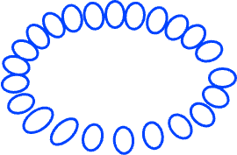



Calorimeter detectors
Positive muons, 3.09 GeV/c, injected into Storage Ring in 125 ns bunches
Muons orbit inside storage ring, spin precesses about vertical B field
Decay to positrons → lower momentum → spiral into centre of storage ring
$$μ^{+}$$
$$μ^{+}$$
$$e^{+}$$
Each calo is a 6x9 array of PbF₂ crystals
  2.5 cm x 2.5 cm x 14 cm (15X₀)
Readout by SiPMs to 800 MHz WFDs (1296 channels in total)
Calorimeters

Slide 27


Spin Precession in the Storage Ring
Muons orbit the ring with cyclotron frequency ω_{c}
Spin precesses with frequency ω_{s}
Both spin and cyclotron frequencies are proportional to B
Spin rotates ahead of momentum as the muon orbits the ring
Difference frequency ω_{a} is proportional to a_{μ} and B
Measure
138 ns
149 ns
Extract
If g were exactly 2, ω_{s} = ω_{c} and ω_{a} = 0

Slide 28

Spin Precession in the Storage Ring
Muons orbit the ring with cyclotron frequency ω_{c}
Spin precesses with frequency ω_{s}
Both spin and cyclotron frequencies are proportional to B
Spin rotates ahead of momentum as the muon orbits the ring
Difference frequency ω_{a} is proportional to a_{μ} and B
Measure
138 ns
149 ns
Extract
If g were exactly 2, ω_{s} = ω_{c} and ω_{a} = 0

Slide 29



Measuring ω_{a}
Highest energy e⁺ preferentially emitted in direction of muon spin
Oscillation in number of emitted decay e⁺ vs time directly proportional to decay asymmetry
Count N(t) = number of e⁺ above an energy threshold over time.
Higher fraction detected above threshold when e⁺ emitted parallel to muon spin
N(t) depends on anomalous precession frequency ω_{a}
Frequency of oscillation = ω_{a}

Slide 30

Measuring muon spin precession
Number of high energy positrons oscillates as a function of time as muon spin points towards/away from detector
Count positrons above an energy threshold
Counts oscillate at frequency ω_{a} → extract from time spectrum
Real Data (Run-3a)
Energy Spectrum
Time Spectrum
Threshold Energy

Slide 31

Extracting ω_{a}: 5-parameter fit function
Five-parameter fit function
$$N\left(t\right)=N_{0}e^{−t/τ}[1 −A\cos{(ω_{a}t+φ)} ]$$
Time-dilated muon lifetime
Precession frequency
Number of e⁺ vs time
Average spin phase at injection
Asymmetry

Slide 32




Fitting the wiggle
32
Calorimeter Performance
$χ^{2}$/ndf = 51530/4150
Simplest 5-parameter fit function captures exponential decay and the g-2 oscillation only
Not sufficient → large spikes in residuals FFT
Need to measure and account for additional terms in the fit

Slide 33


Tracking detectors: measuring the muon beam
Calorimeter Performance
Straw trackers: two stations located at 180⁰ and 270⁰
One station = 8 modules
One module = 128 Argon-Ethane gas-filled straws
Fit tracks and extrapolate to muon decay point
Tracker Module
10 cm

Slide 34

Tracker measurement of the muon beam
34
Calorimeter Performance
The mean and width of the muon beam distribution varies as a function of time
Average radial and vertical position vary around the ring → measure at two locations
Frequency of beam oscillations must be measured → affects ω_{a} measurement

Slide 35



Fitting the wiggle
35
Calorimeter Performance
$χ^{2}$/ndf = 4086/4138
Run 3a
Accounting fully for all the beam oscillations shifts ω_{a} by 1.6 ppm
Final fit function has 27 fit parameters
8 different analysis teams, 19 separate analyses
Simple Fit Function
Full Fit Function

Slide 36
Extracting a_{μ}

Slide 37



Relativistic expression for ω_{a}
Non-relativistic limit
Motion non-perpendicular to B-field
Cyclotron motion assumes motion perpendicular to B-field
Relativistic motional magnetic field
Proportional to electric field
Disappears for “magic” γ = 29.3
→ magic momentum 3.09 GeV / c
E-field correction
Not all muons are at the ‘magic’ momentum of 3.1 GeV
Vertical momentum component aligned with B field
Pitch correction

Slide 38

“Never measure anything but frequency…”
We measure the ratio of two frequencies: ω_{a} and ω_{p}
  ω_{a} : anomalous spin precession frequency
  ω_{p} : muon-weighted magnetic field expressed in terms of Larmor frequency of free proton
Phys. Rev. A 83, 052122 (2011)
Metrologia 13, 179 (1977)
Rev. Mod. Phys. 88 035009 (2016)
Phys. Rev. Lett. 82, 711 (1999)

Slide 39

“… and corrections”
Anomalous precession frequency
Beam dynamics corrections
Clock blinding frequency
Absolute calibration frequency
Magnetic field map
Muon beam distribution
Transient magnetic field corrections

Slide 40
“… and corrections”
Absolute calibration frequency
Magnetic field map
Muon beam distribution
Transient magnetic field corrections

Slide 41
Measuring the magnetic field

Slide 42


The g–2 Storage Ring magnet
Weight measured field by the muon beam distribution
Field in muon storage region
B
Dipole field has ppm-level uniformity (<20 ppm RMS across the full azimuth)
Shimming devices (active and passive) minimise gradients and keep field uniform

Slide 43








Measuring the magnetic field
Trolley containing 17 NMR probes maps full azimuth every few days (muons not present)
378 fixed probes monitor between trolley runs (during muon data collection)
Field map is interpolated between trolley runs using fixed probe information
Fold with muon beam distribution
Sequence 2D field slices as trolley moves
NMR probe

Slide 44





Absolute Calibration
Trolley and fixed NMR probes use petroleum jelly as the proton sample – low volatility
Need to measure protons in H₂0 (measurement standard) → calibration
Trolley and cylindrical H₂0 calibration probe switch places to repeatedly measure the same field in the same place. Calibration performed ~once per year.
Cylindrical H₂0 probe
Calibration region
Uncertainty
17 ppb
Spherical H₂0
Spherical ³He
Cross-check with spherical probes
Uncertainty: 9 ppb
Trolley probes

Slide 45



Transient fields from pulsed systems: Quads
Electrostatic quadrupoles pulse during muon storage
No pulsing during trolley runs
Quad plates vibrate → induces a field
Muons experience a field change which the fixed probes do not see (shielded by Al)
Must be measured using dedicated apparatus
Grey regions = muon storage times
Q1
Q2
Q3
Q4
Locations mapped in Run-1

Slide 46

Transient fields from pulsed systems: Quads
Electrostatic quadrupoles pulse during muon storage
No pulsing during trolley runs
Quad plates vibrate → induces a field
Muons experience a field change which the fixed probes do not see (shielded by Al)
Must be measured using dedicated apparatus
Grey regions = muon storage times
Q1
Q2
Q3
Q4
Locations mapped in Run-1
Run-1: -17 (90) ppb
Run-2/3: -21 (20) ppb
Locations mapped in Run-2

Slide 47


Transient fields from pulsed systems: Kicker
Kicker pulse of 22 mT for 150 ns just after muon injection
Field change caused by residual field (eddy currents) after kicker pulse
Muons present from 30μs to 700μs after the kick (fit region)
Measure eddy current using Faraday magnetometer
Run-2/3: improved hardware setup reduced vibrations
Correction
Run-1: -27 (37) ppb
Run-2/3: -21 (13) ppb

Slide 48

Magnetic field systematics in Run-2/3
Main reduction in uncertainty comes from better understanding of transient field effects
Interpolation uncertainty has also reduced with number of trolley runs
Uncertainty already at TDR goal

Slide 49
Improvements between Run-1 and Run-2/3

Slide 50




Damaged resistors
In Run-1, 2 out of 32 resistors damaged in quad plates
→ unstable beam storage
Redesigned and replaced before Run-2
Reduces phase acceptance (C_{pa}) uncertainties 75ppb → 13 ppb
Beam oscillation frequencies also become more stable
Vertical beam width change
ω_{a} phase change

Slide 51




Kicker strength upgrade
Run 1 beam
Upgraded kicker cables while Run-3 so kicker can run at nominal strength
Muon distribution more centered
  All systematics related to asymmetric beam shape reduced
Muon momentum distribution better centered on magic momentum
  E field correction reduced
Phase space matching improved
  Smaller beam oscillations
Fractional Momentum Shift: dp/p0 [%]
Late Run 3 beam

Slide 52

Statistical improvement: Run-2/3 vs Run-1
Dataset | Statistical Error [ppb]
Run-1 | 434
Run-2/3 | 201
Run-1 + Run-2/3 | 185

Slide 53


Total uncertainty
Total uncertainty: 462 ppb
Run-1
Uncertainty reduced
by factor >2
Statistic and systematic uncertainty reduced by similar amount
Systematic uncertainty below TDR goal
Still statistics dominated
434 ppb
157 ppb
Total uncertainty: 215 ppb
Run-2/3
201 ppb
70 ppb
Radius: uncertainty
Area: variance

Slide 54


Unblinded result & cross-checks
a_{μ}(Run-1) = 0.00 116 592 040(54) [463 ppb]
a_{μ}(Run-2/3) = 0.00 116 592 057(25) [215 ppb]
a_{μ}(FNAL) = 0.00 116 592 055(24) [203 ppb]
a_{μ}(Exp) = 0.00 116 592 059(22) [190 ppb]
Different runs performed at different magnet set-points – a useful consistency check
Also divide datasets by other variables to check consistency (e.g. day/night, temperature, etc)

Slide 55

Beyond Run-2/3 : Total statistics
Surpassed proposal goal!
x3 Run-1/2/3
statistics
MAY 2018
JULY 2023

Slide 56

Conclusions
High precision measurements of Muon g-2 stringent test on SM theory
Run-2/3 data consistent with Run-1 and BNL
Factor >2 in statistical and systematic uncertainty
Surpassed TDR goals in statistics and systematics
First time a three-way comparison of a_{µ} is possible (dispersive-approach, lattice approach, experiment)
Another reduction by factor of 2 in statistical uncertainty from Run-4/5/6
Expect final result in 2025

Slide 57

Thank you!

Slide 58

Acknowledgements
Department of Energy (USA)
National Science Foundation (USA)
Istituto Nazionale di Fisica Nucleare (Italy)
Science and Technology Facilities Council (UK)
Royal Society (UK)
Leverhulme Trust (UK)
European Union’s Horizon 2020
Strong 2020 (EU)
German Research Foundation (DFG)
National Natural Science Foundation of China
MSIP, NRF, and IBS-R017-D1 (Republic of Korea)

