Slide 1


Characterisation of a 3D aluminium cavity for the QSHS experiments
Joshoua Condicion Esmenda¹, Sam Furness¹, Edward Laird¹,
Paul Smith², Ed Daw² and Yuri A. Pashkin¹
¹ Lancaster University
² The University of Sheffield

Slide 2
Al cylindrical cavity drawing
Material: Al grade 6061 Chemical composition (%): Mg 0.8 – 1.2; Si 0.4 – 0.8; Cu 0.15 – 0.4

Slide 3
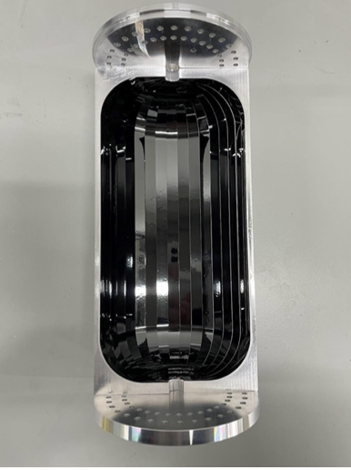
Al cylindrical cavity with HTS coating
2.3 GHz, 1.6 L, EuBCO+APC Tapes (Fujikura)
TM010
Q ~ 3.5e6 @ 8 T
TM011
Courtesy of Dahno Ahn, CAPP IBS, Korea

Slide 4
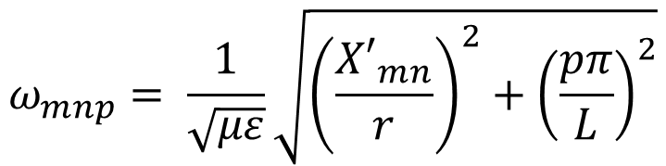
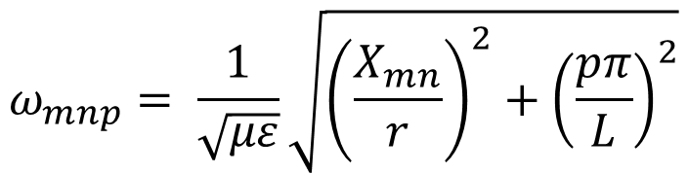
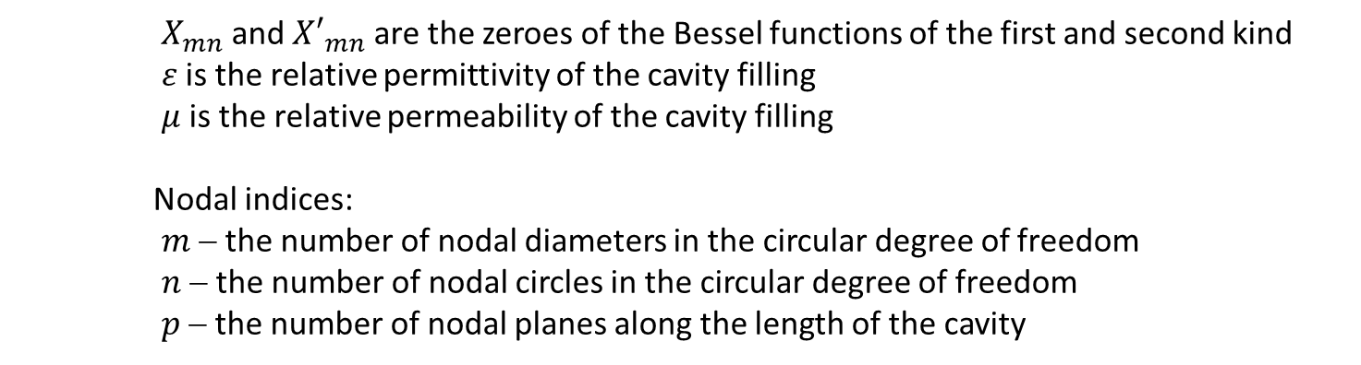
Cylindrical cavity resonant modes
r
$$ω_{mnp}= \frac{1}{\sqrt{με}}\sqrt{{\left(\frac{X_{mn}}{r}\right)}^{2}+{\left(\frac{pπ}{L}\right)}^{2}}$$
Transverse Magnetic (TM)
L
$$ω_{mnp}= \frac{1}{\sqrt{με}}\sqrt{{\left(\frac{{X′}_{mn}}{r}\right)}^{2}+{\left(\frac{pπ}{L}\right)}^{2}}$$
Transverse Electric (TE)
$X_{mn}$ and ${X′}_{mn}$ are the zeroes of the Bessel functions of the first and second kind
$ε$ is the relative permittivity of the cavity filling
$μ$ is the relative permeability of the cavity filling
Nodal indices:
$m$ − the number of nodal diameters in the circular degree of freedom
$n$ − the number of nodal circles in the circular degree of freedom
$p$ − the number of nodal planes along the length of the cavity

Slide 5
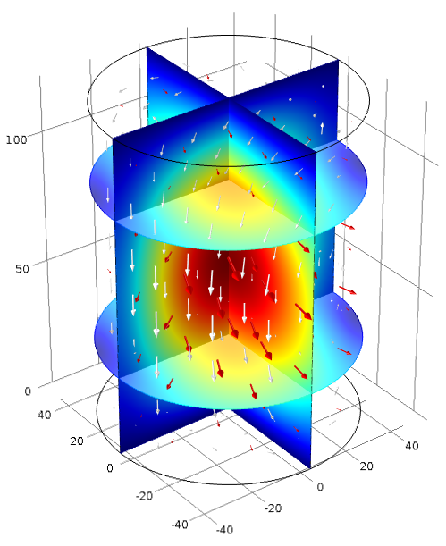
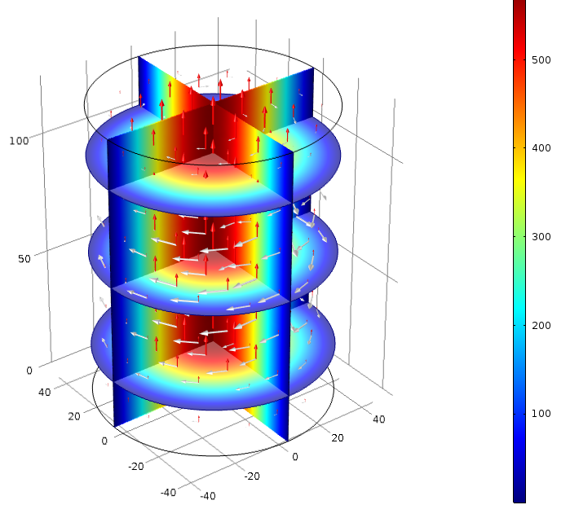
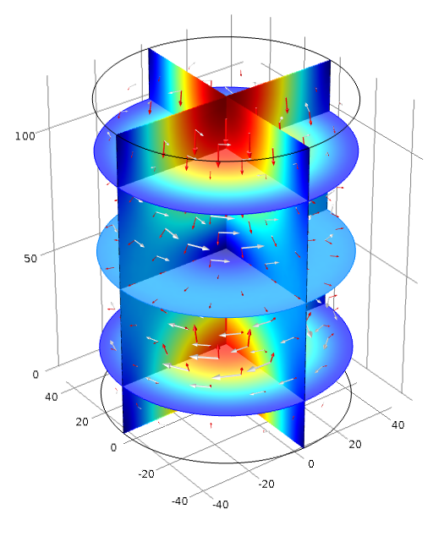
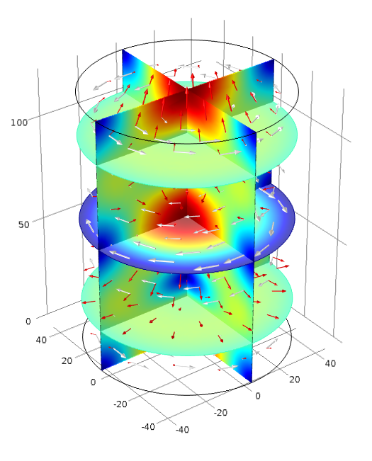
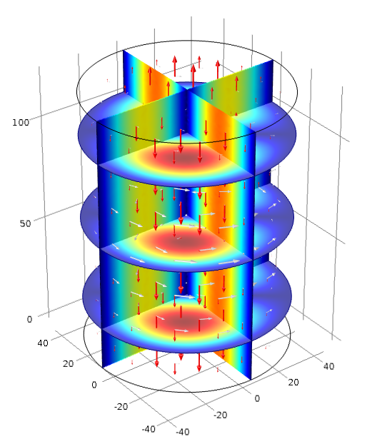
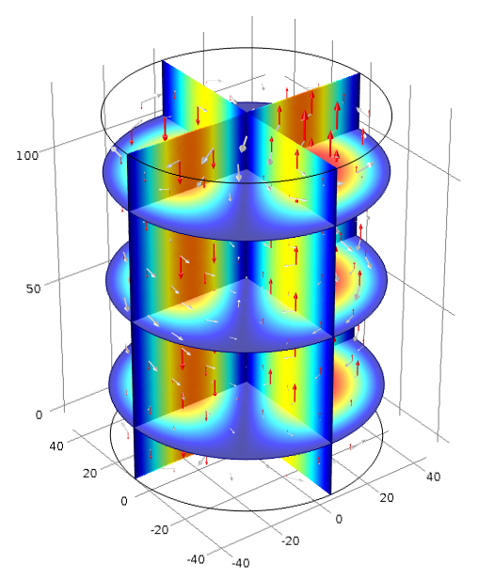
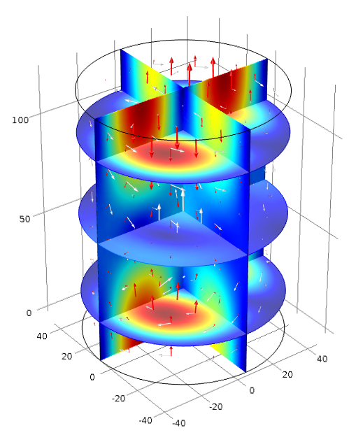
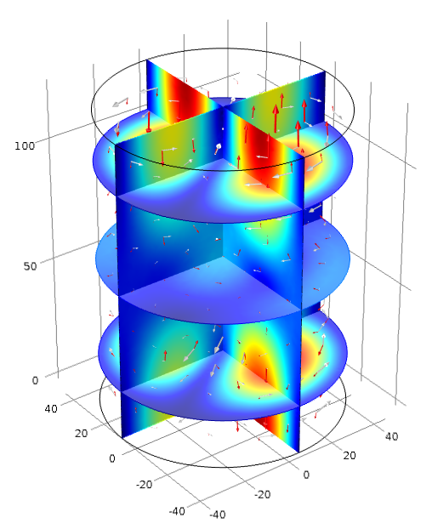
Resonant modes
Mode TE111
Fundamental Mode TM010
Second Mode TM011
Third Mode TM012
4th and 5th Modes TM110
6th and 7th Modes TM111

Slide 6
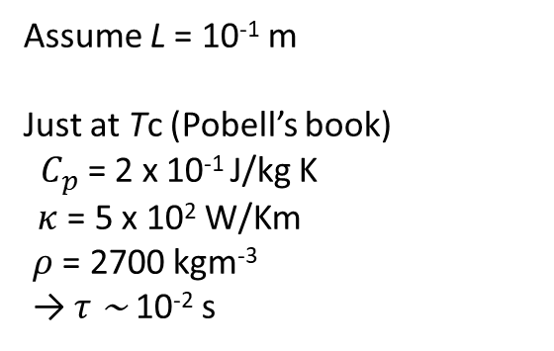
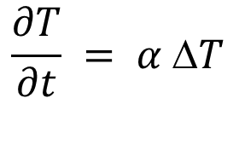
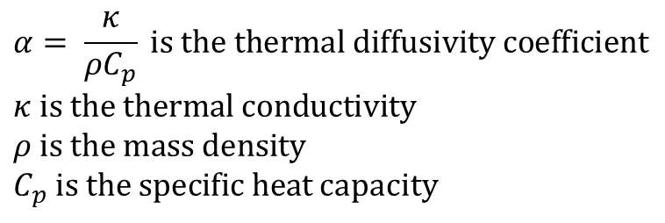
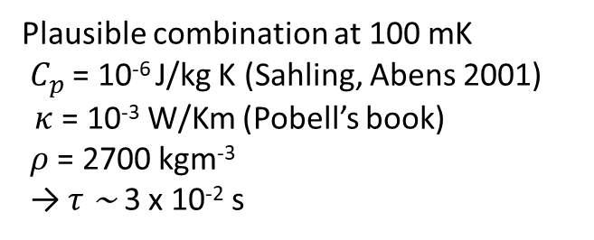
Equilibration time of superconducting aluminium
$$\frac{∂T}{∂t} = α ΔT$$
$$α= \frac{κ}{ρC_{p}} is the thermal diffusivity coefficient$$
$$κ is the thermal conductivity$$
$$ρ is the mass density$$
$C_{p} is the specific heat$ capacity
The heat equation:
$The solution to the above differential equation has a term e^{−\frac{τ}{t}}, where τ$ ~ $\frac{L^{2}}{α}$
Assume L = 10⁻¹ m
Just at Tc (Pobell’s book)
$C_{p}$ = 2 x 10⁻¹ J/kg K
$κ$ = 5 x 10² W/Km
$ρ$ = 2700 kgm⁻³
→ $τ$ ~ 10⁻² s
Plausible combination at 100 mK
$C_{p}$ = 10⁻⁶ J/kg K (Sahling, Abens 2001)
$κ$ = 10⁻³ W/Km (Pobell’s book)
$ρ$ = 2700 kgm⁻³
→ $τ$ ~ 3 x 10⁻² s

Slide 7
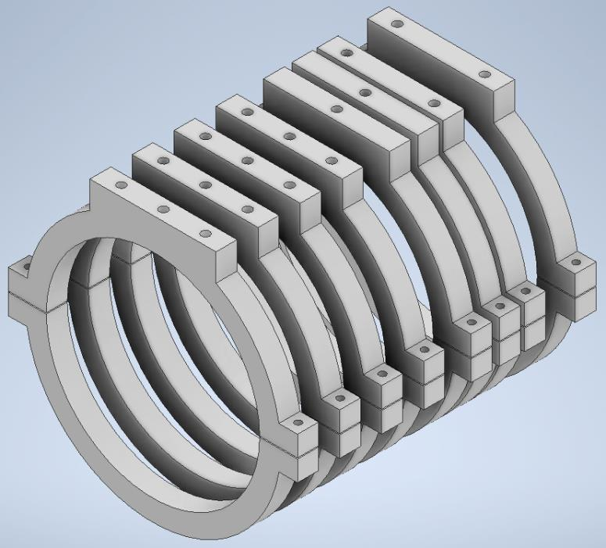
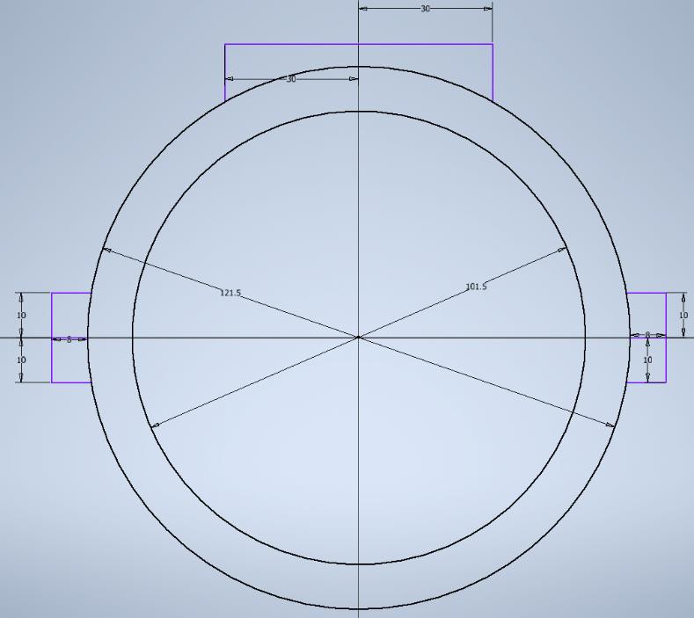
Cavity holders
30 mm
121.5 mm
101.5 mm
10 mm
Eight 1 cm thick clamps consisting of two brackets each
1 mm gap in between the top and bottom brackets

Slide 8
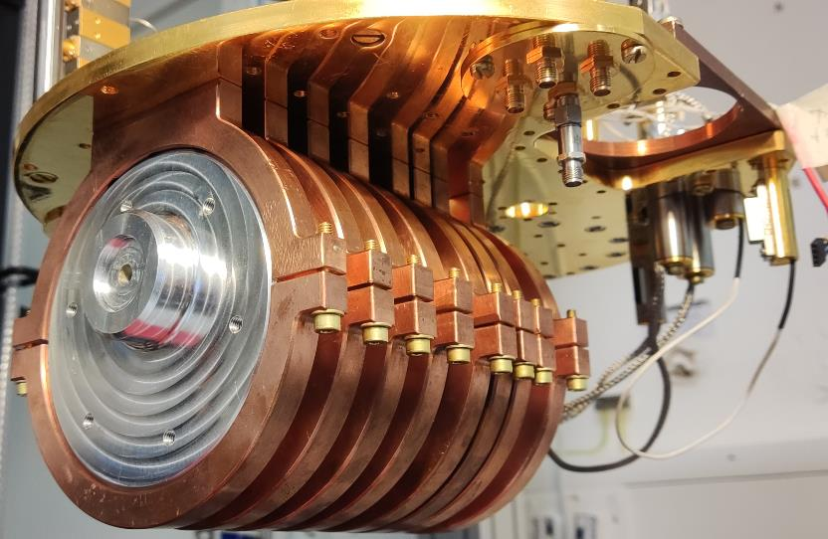
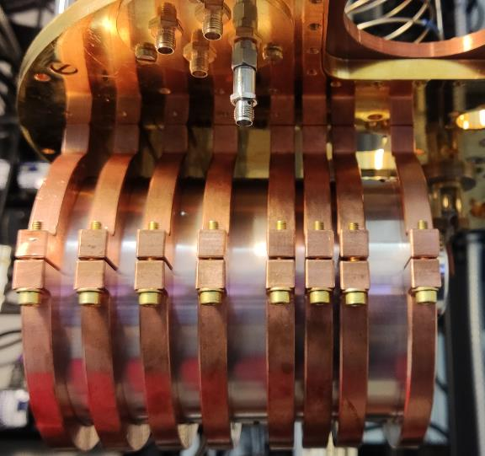
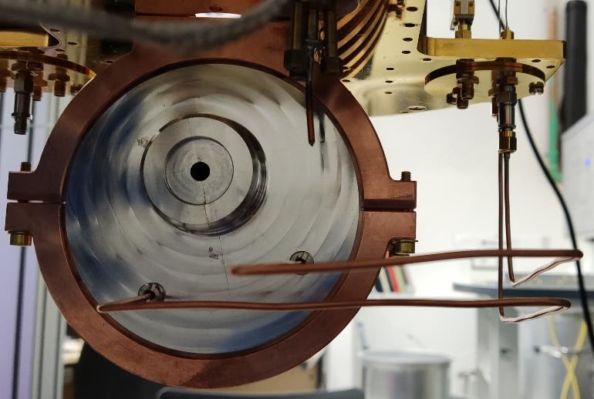
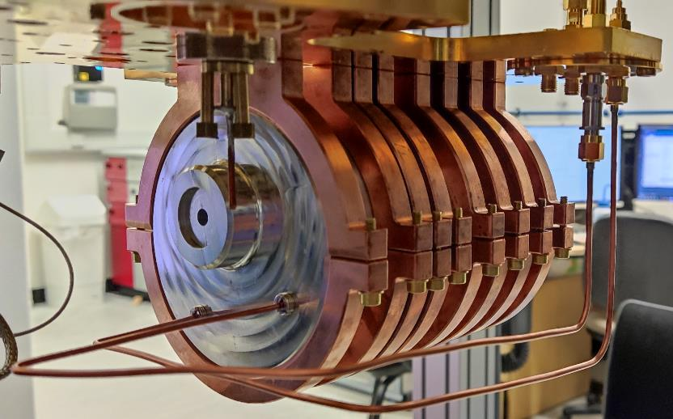
Al cavity attached to the MXC plate
MXC Plate
RF Cavity
Brass screws
All measurements performed with minimal antenna insertion
Copper clamps
Power In
Power Out
Copper cables

Slide 9
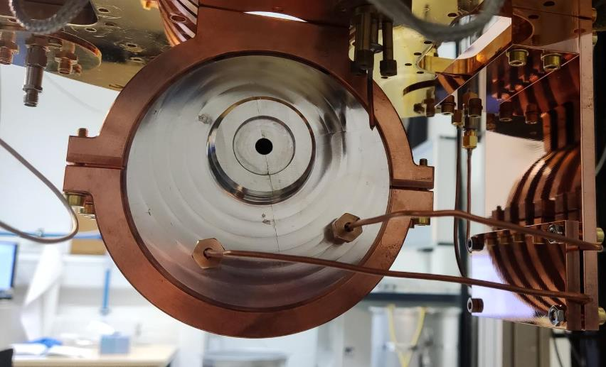
Al cavity attached to the MXC plate
Copper plate to fix the coax lines
Сollet mechanisms
to hold the ends of coax lines
All measurements performed with the minimal antenna insertion
Power In
Power Out

Slide 10
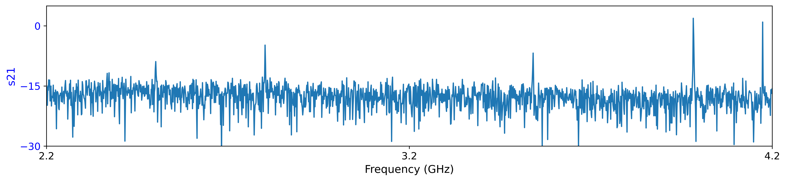
Wideband scan at room T
TM011
2.8025 GHz
TM012
3.5412 GHz
TM110
3.9830 GHz
TM111
4.1738 GHz
TM010
2.5012 GHz
2.5018 GHz 2.7917 GHz 3.5210 GHz 3.9862 GHz 4.1743 GHz
Resonance frequencies obtained from COMSOL modelling
Notes:
Change to dB scale

Slide 11
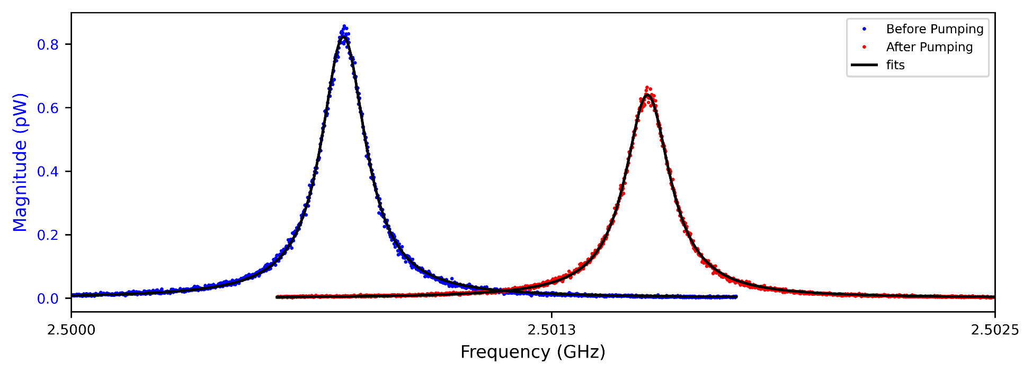

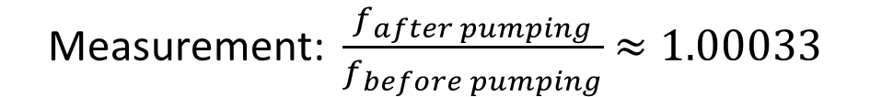
Before and after pumping at room T
$$f∝ \frac{1}{\sqrt{ε_{r}}}$$
f= 2.5007
Q = 16,958
f = 2.5016
Q = 16,719
pumping
Input power = 10 dBm
Prediction: $\frac{f_{vac}}{f_{air}}= \sqrt{ε_{air}}=\sqrt{1.00059 }≈$ 1.00030
$\text{Measurement}\text{:} \frac{f_{after pumping}}{f_{before pumping}}$ $≈1.00033$

Slide 12
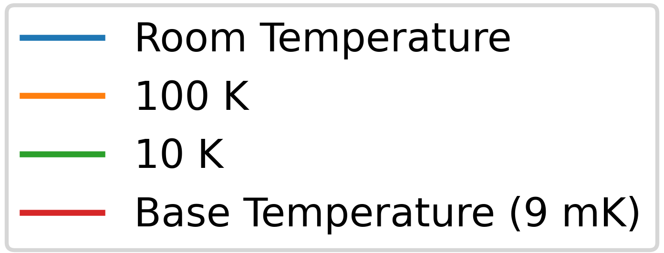
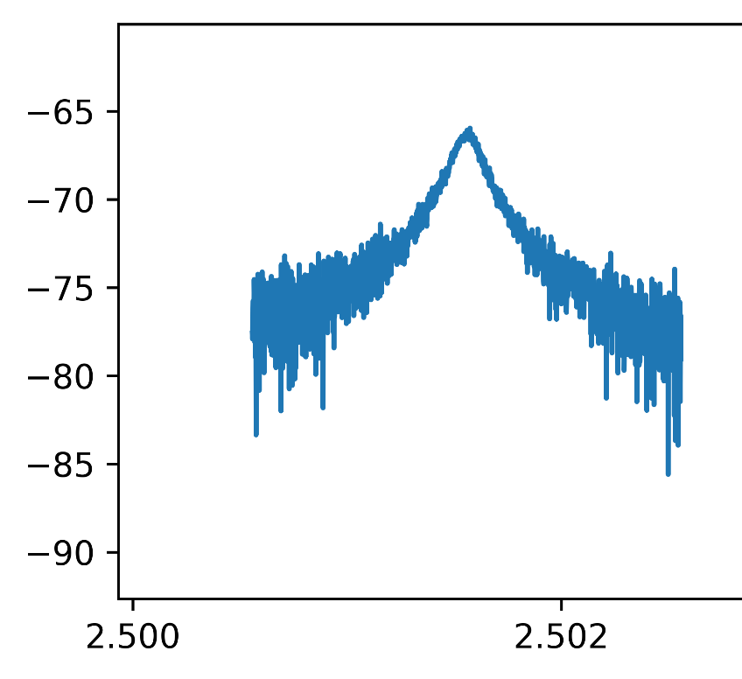
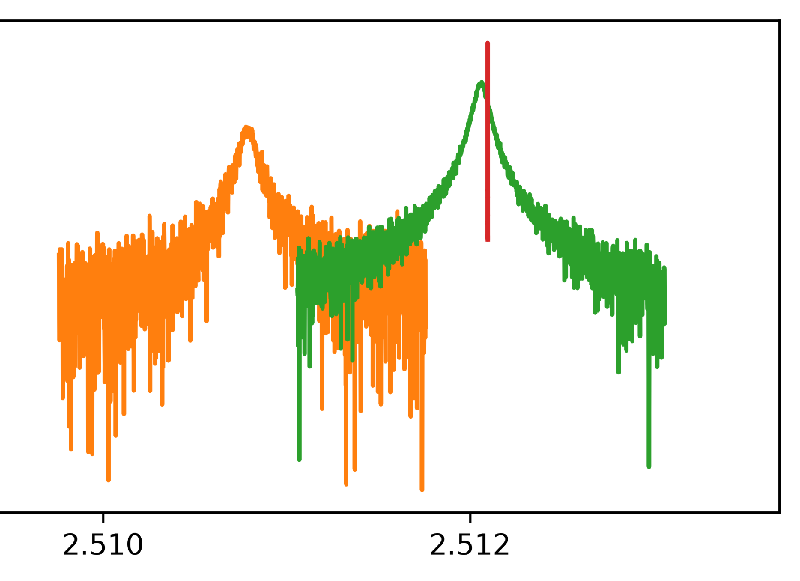
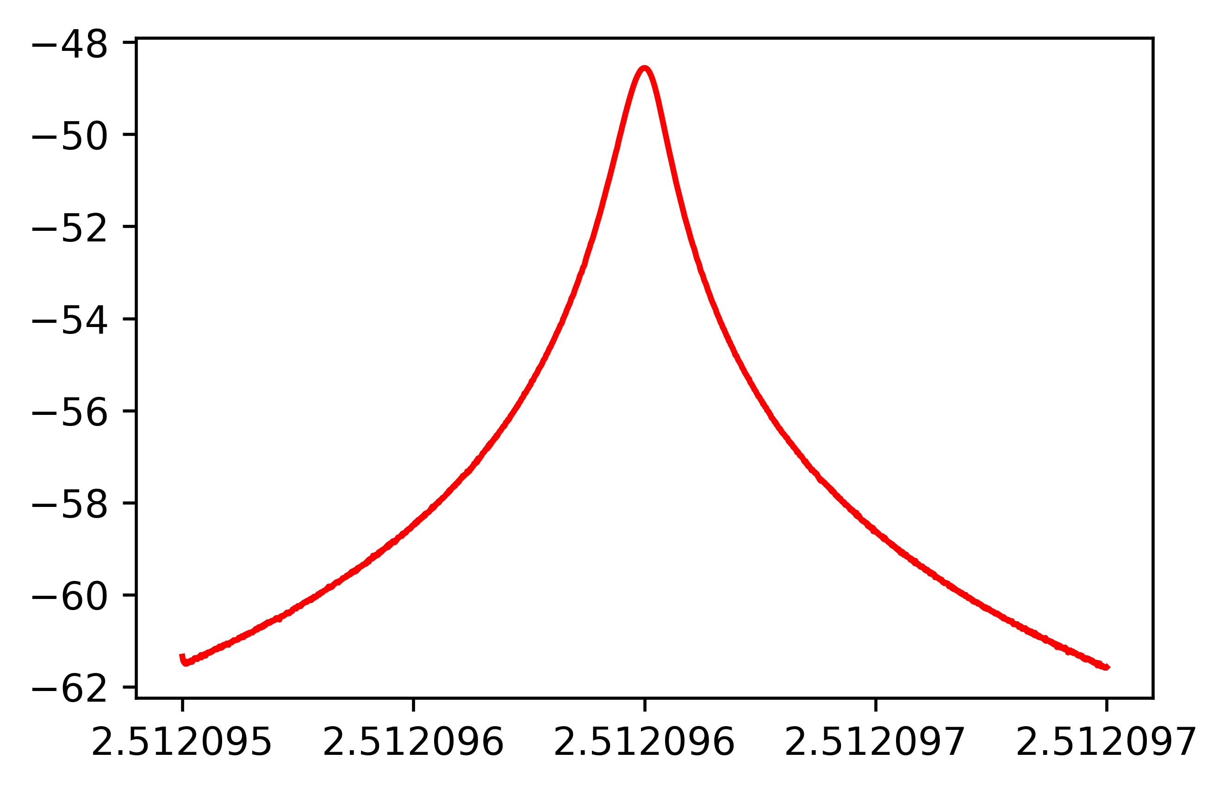



Fundamental mode at different T
f = 2. 512096 GHz
Q = 25,044,537
//
f = 2. 5108 GHz
Q = 52,737
f = 2.5016 GHz
Q = 33,915
f = 2. 5120 GHz
Q = 61,172
$∆f−9.2$ MHz
$$\frac{∆f}{f}=−0.37\%$$
For T = 300 K → 100 K
$$\frac{∆ℓ}{ℓ}≈−0.38\% (F.Pobell)$$
Input power = 0 dBm
//
Note: Baselines for each curve were adjusted to be equal for presentation

Slide 13
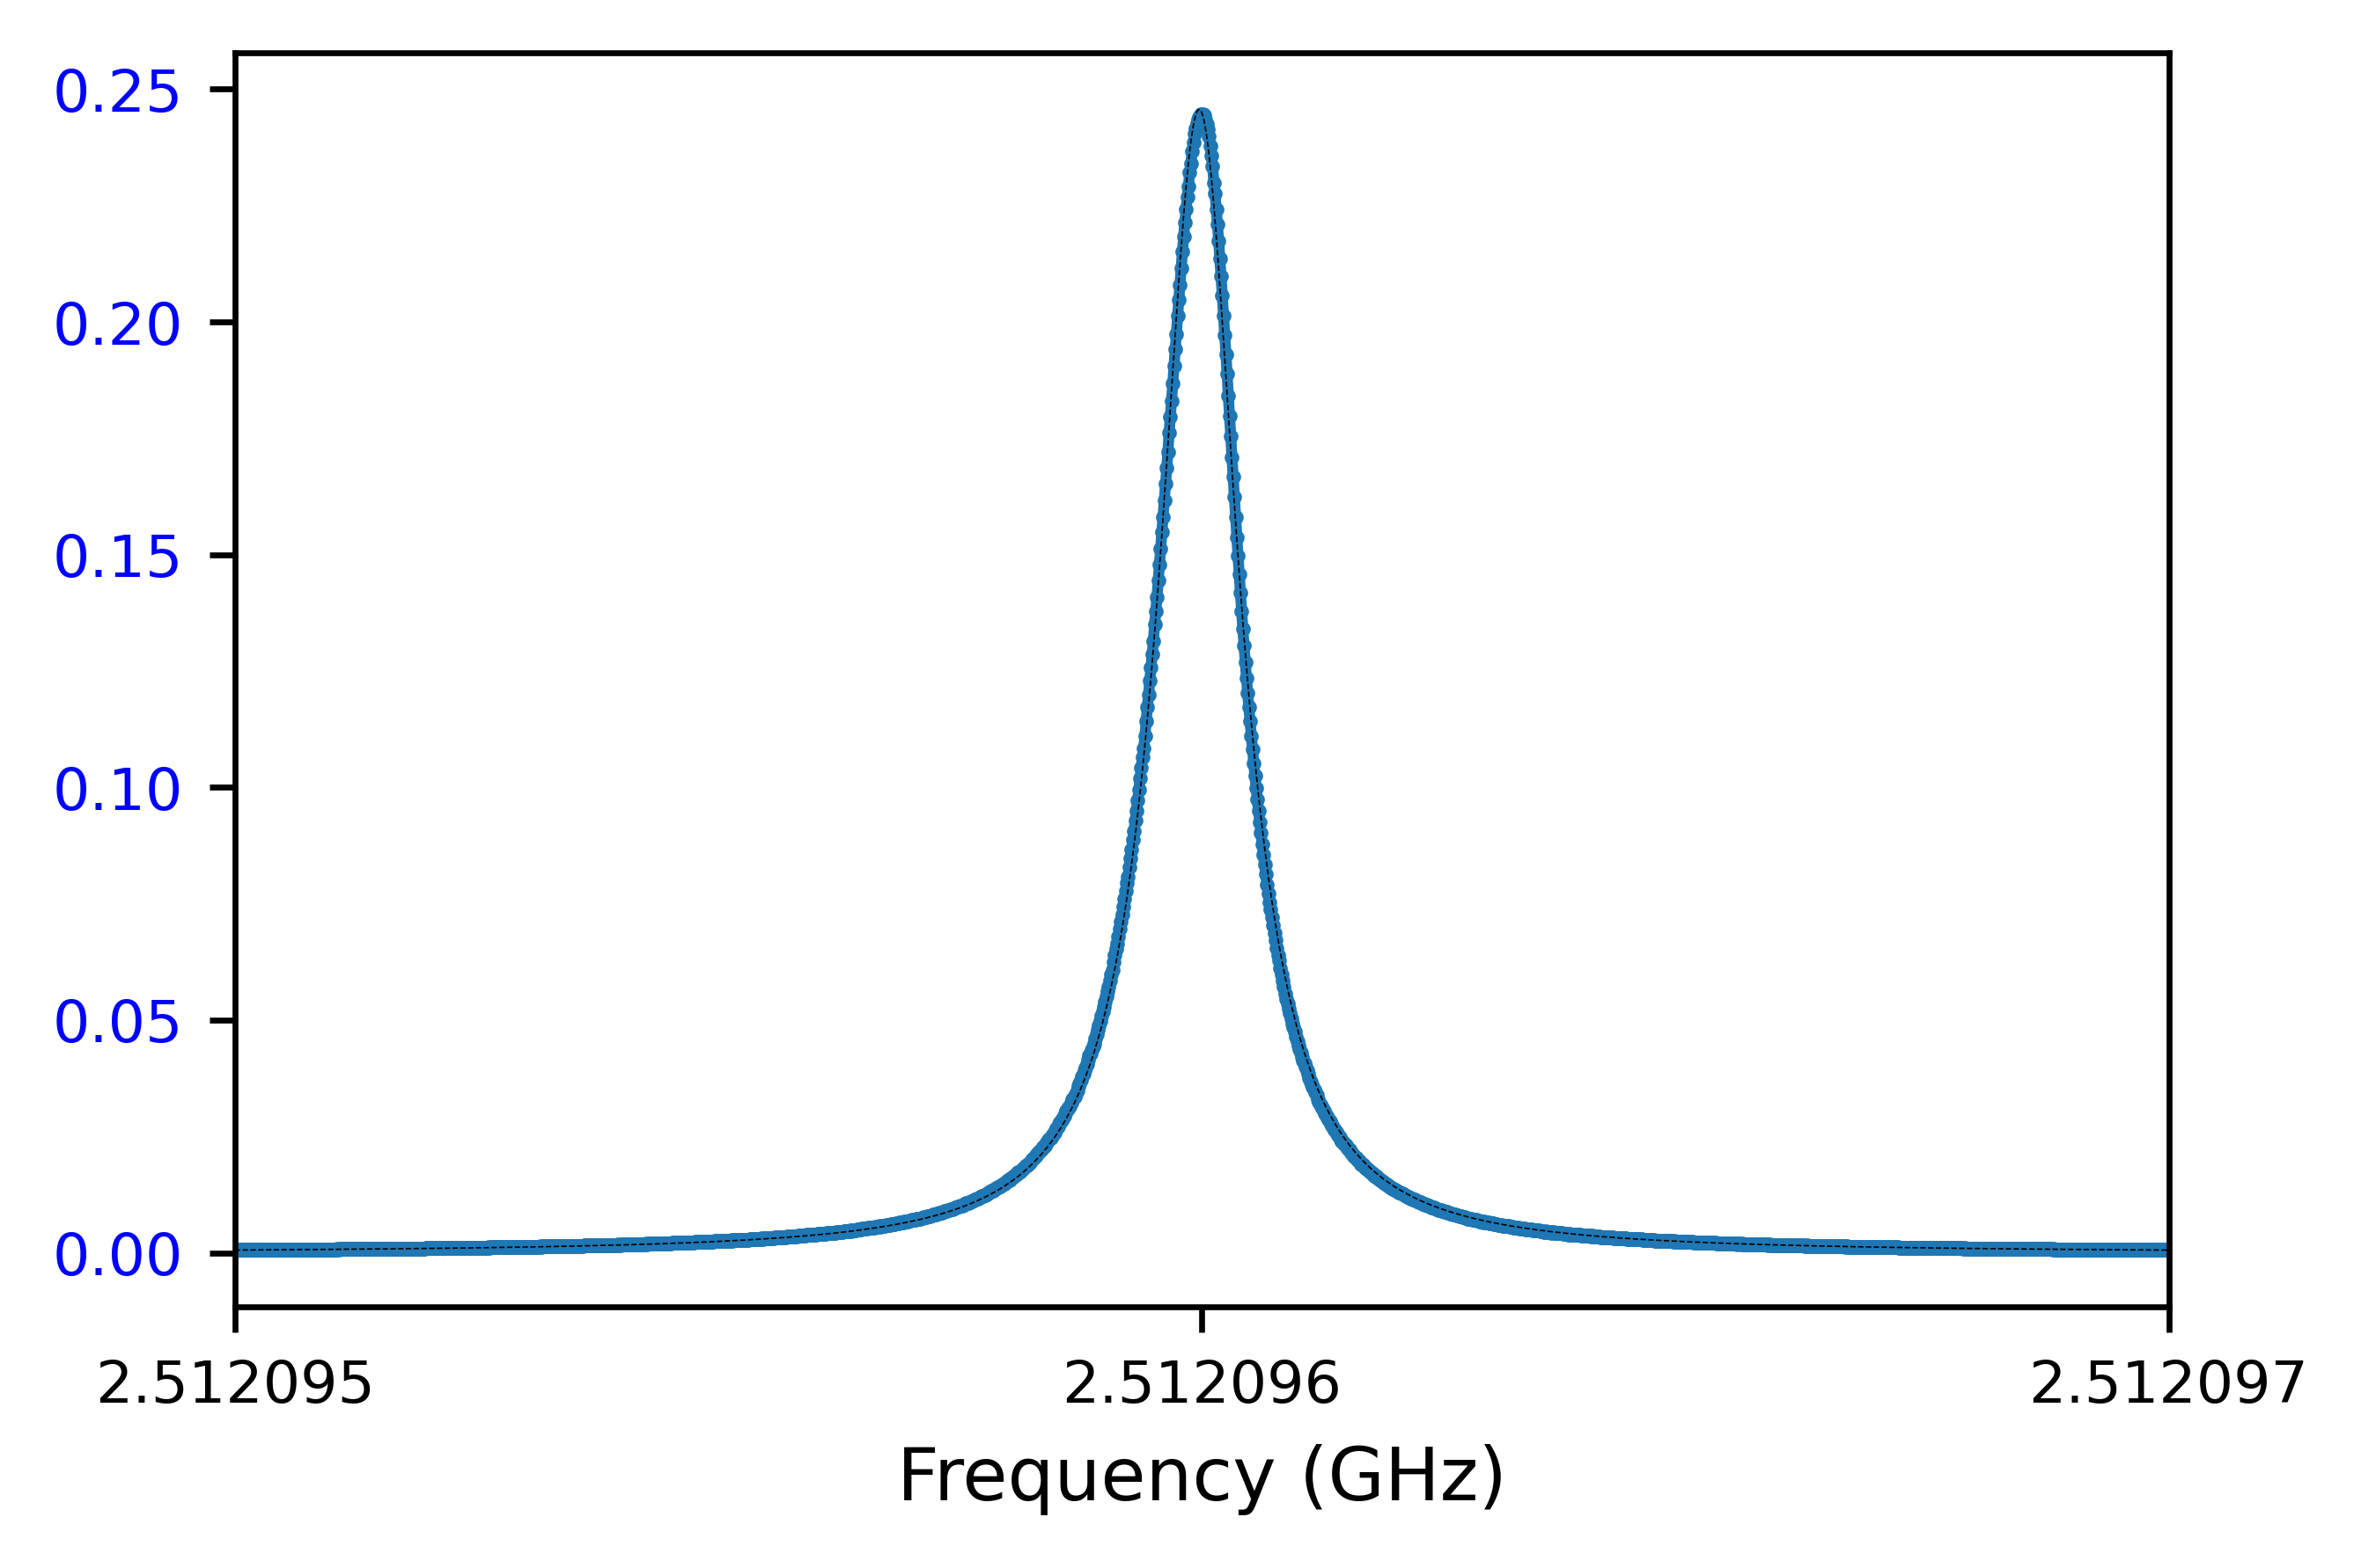
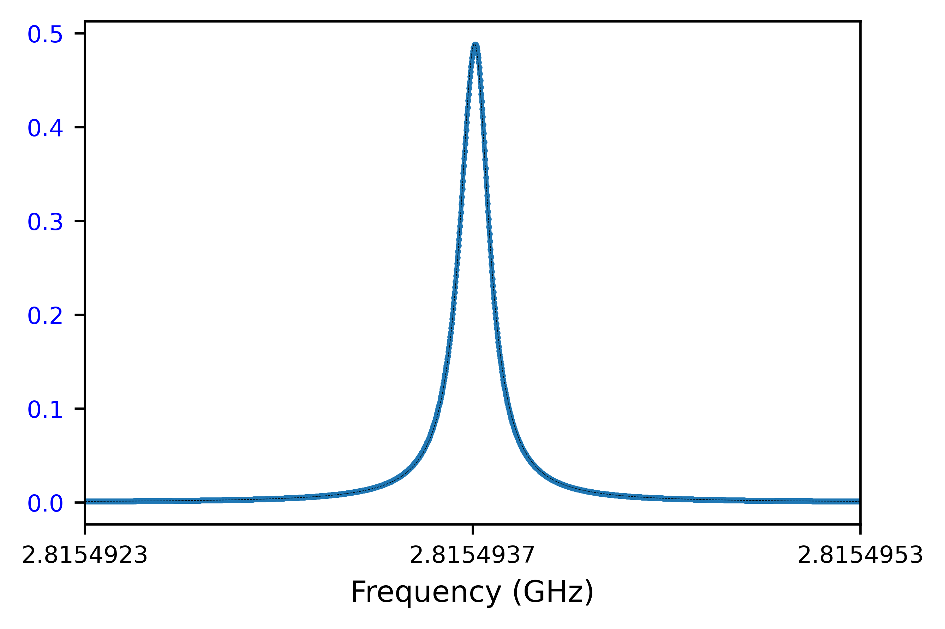
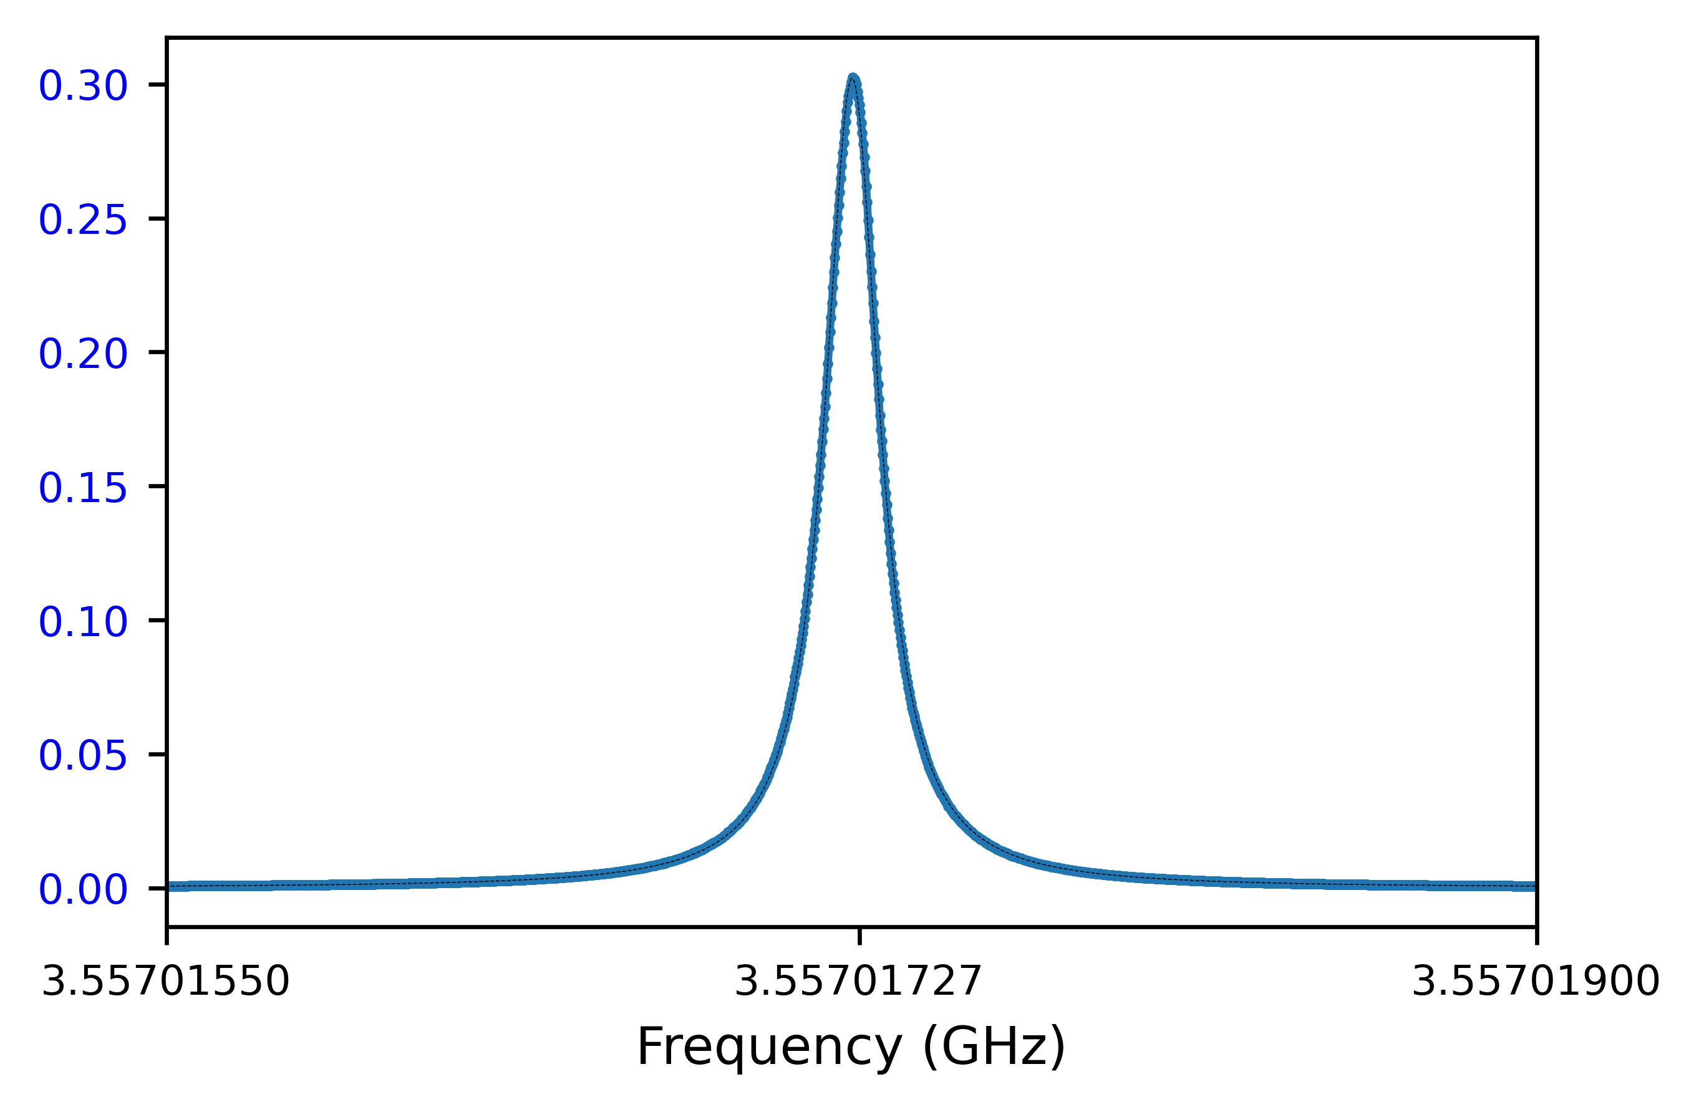
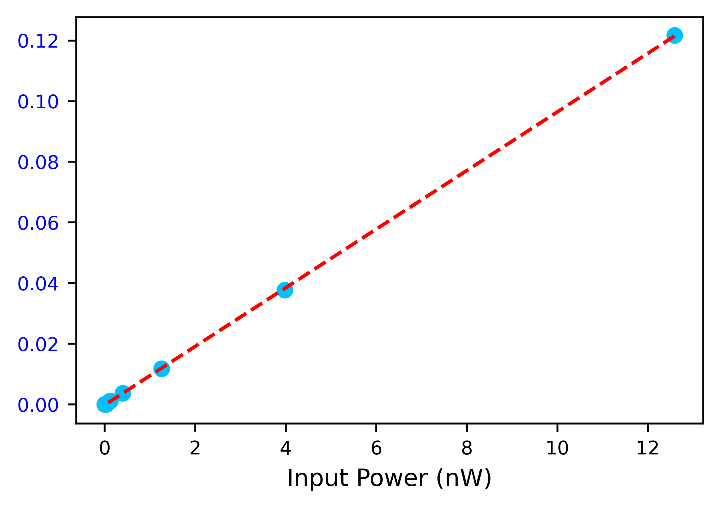
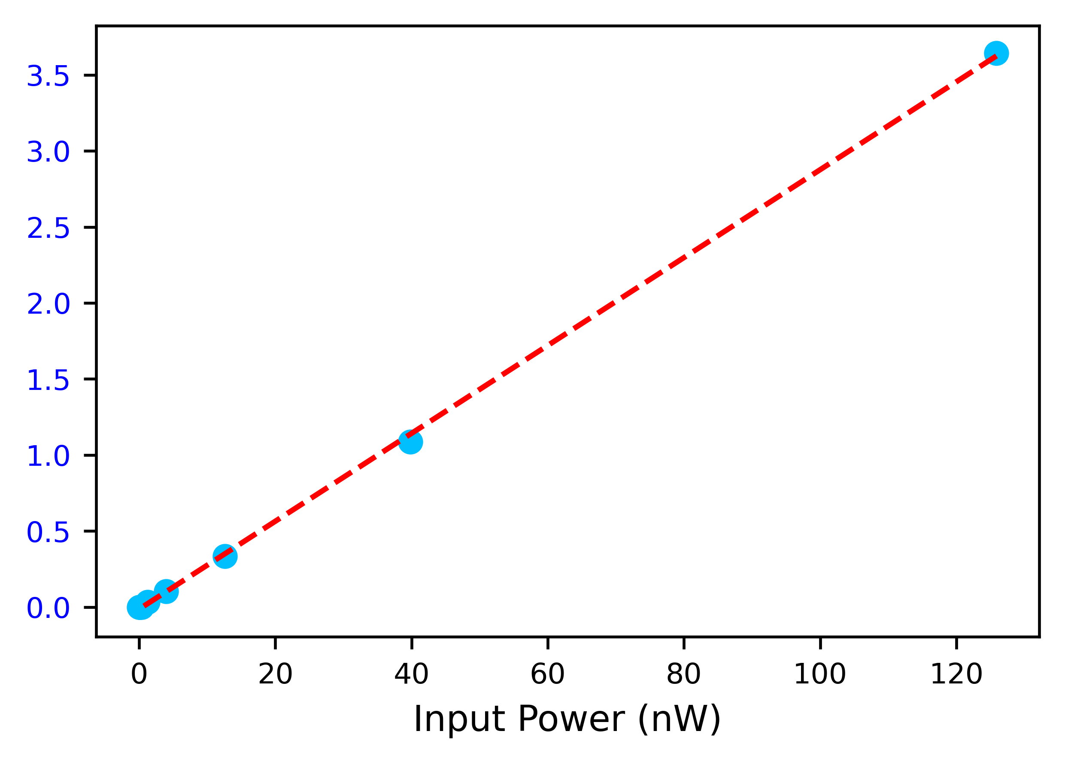
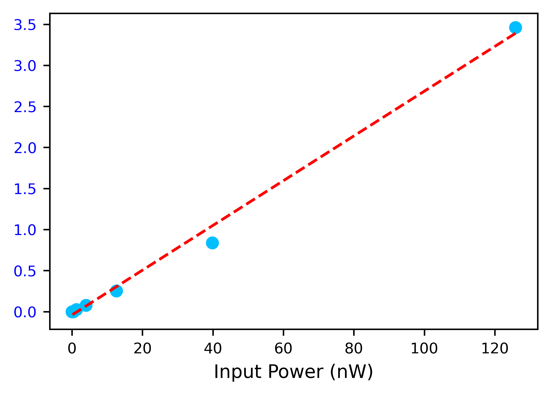
Lowest three modes at base T
f = 2.512 GHz
f = 2.815 GHz
f = 3.557 GHz
FM: Q = 25,044,537 2nd mode: Q = 20,353,042 3rd mode: Q = 21,063,194

Slide 14
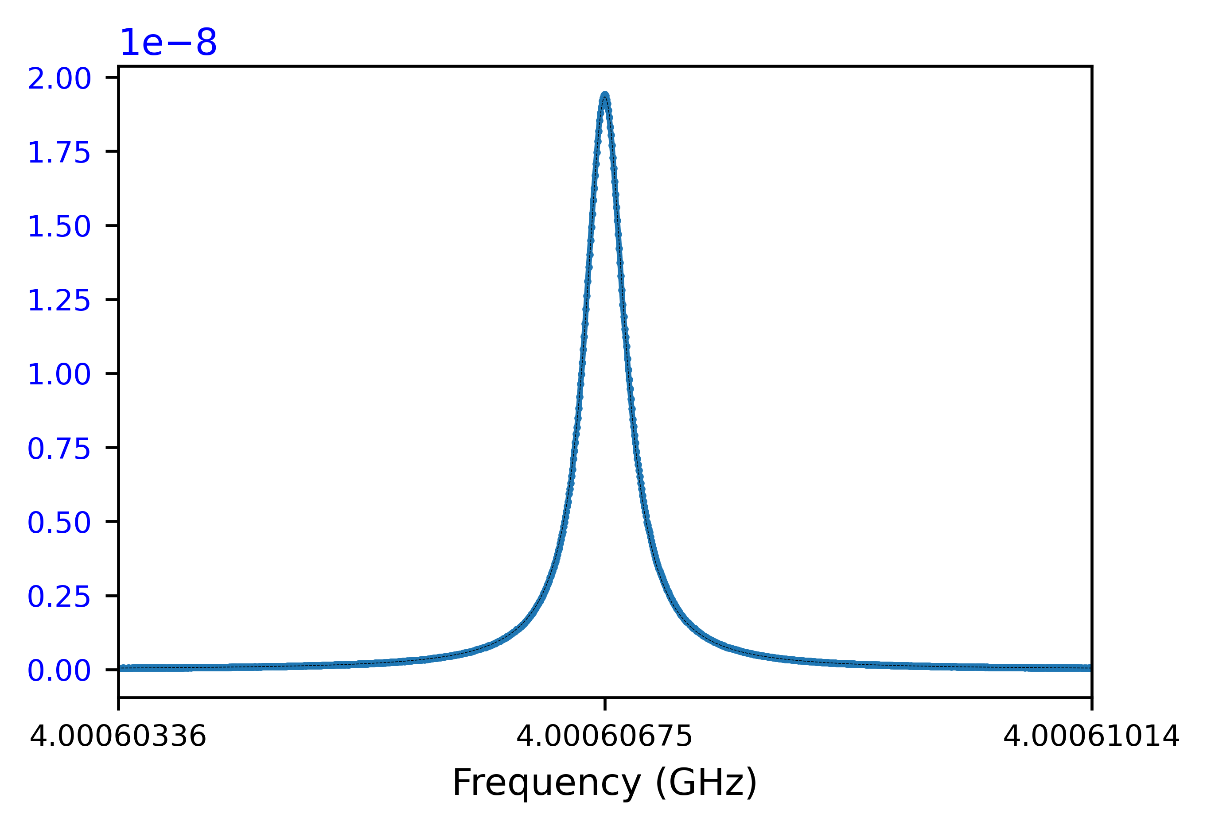
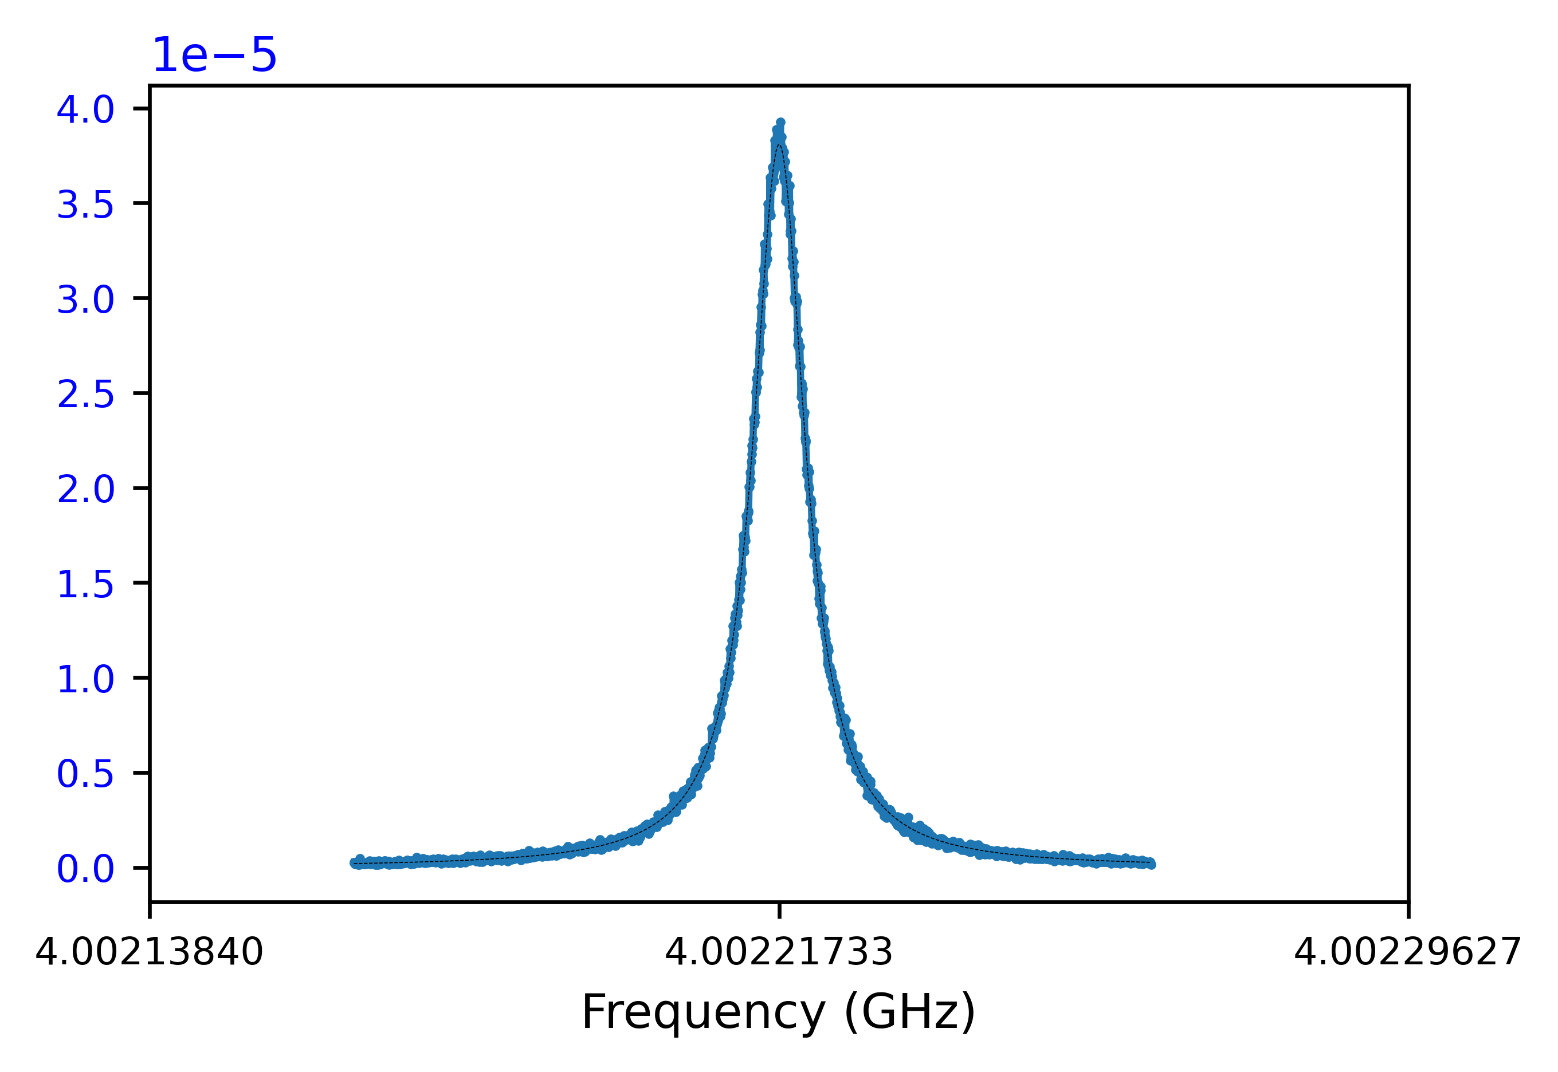
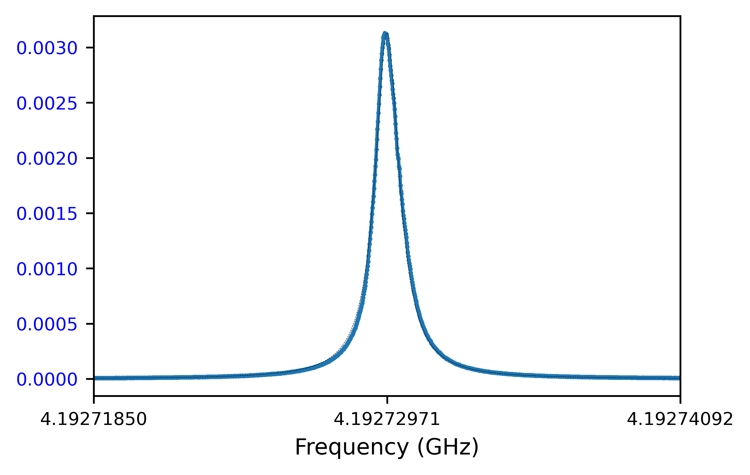
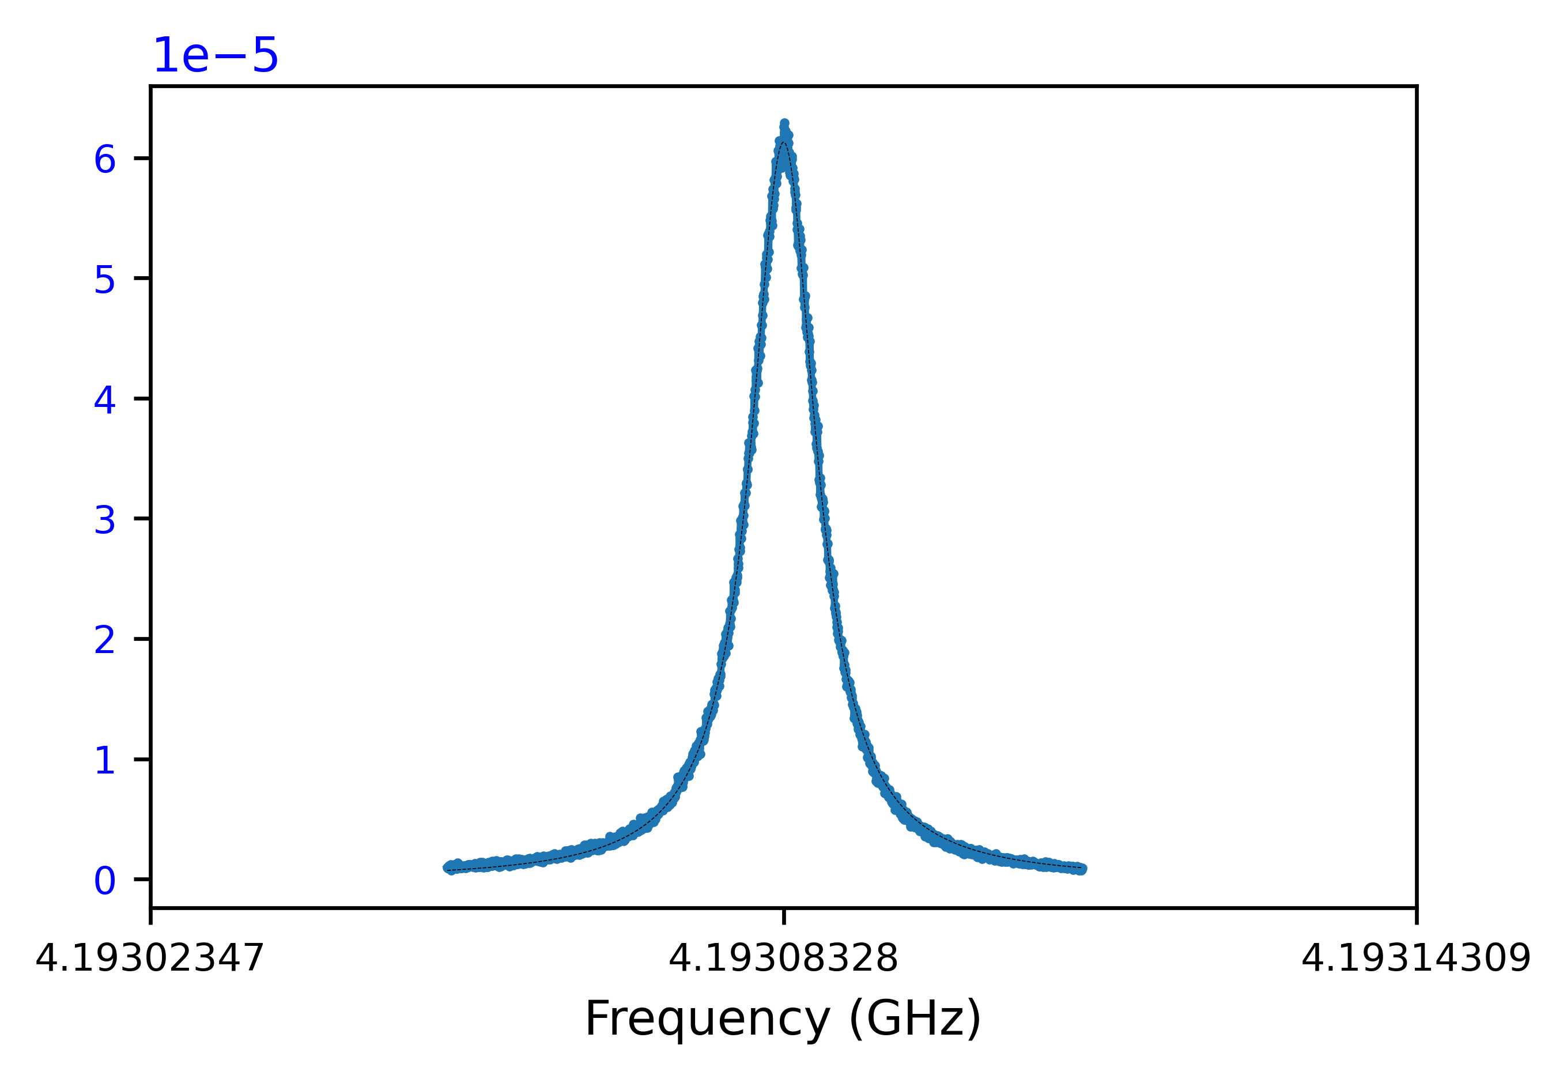
Splitting of higher deg. modes
f = 4.000606 GHz
f = 4.002217 GHz
4th mode: Q = 11,803,640 at -15 dBm
5th mode: Q = 507,029 at -15 dBm
f = 4.192729 GHz
f = 4.193083 GHz
6th mode: Q = 3,739,055 at -15 dBm
7th mode: Q = 560,843 at -15 dBm

Slide 15
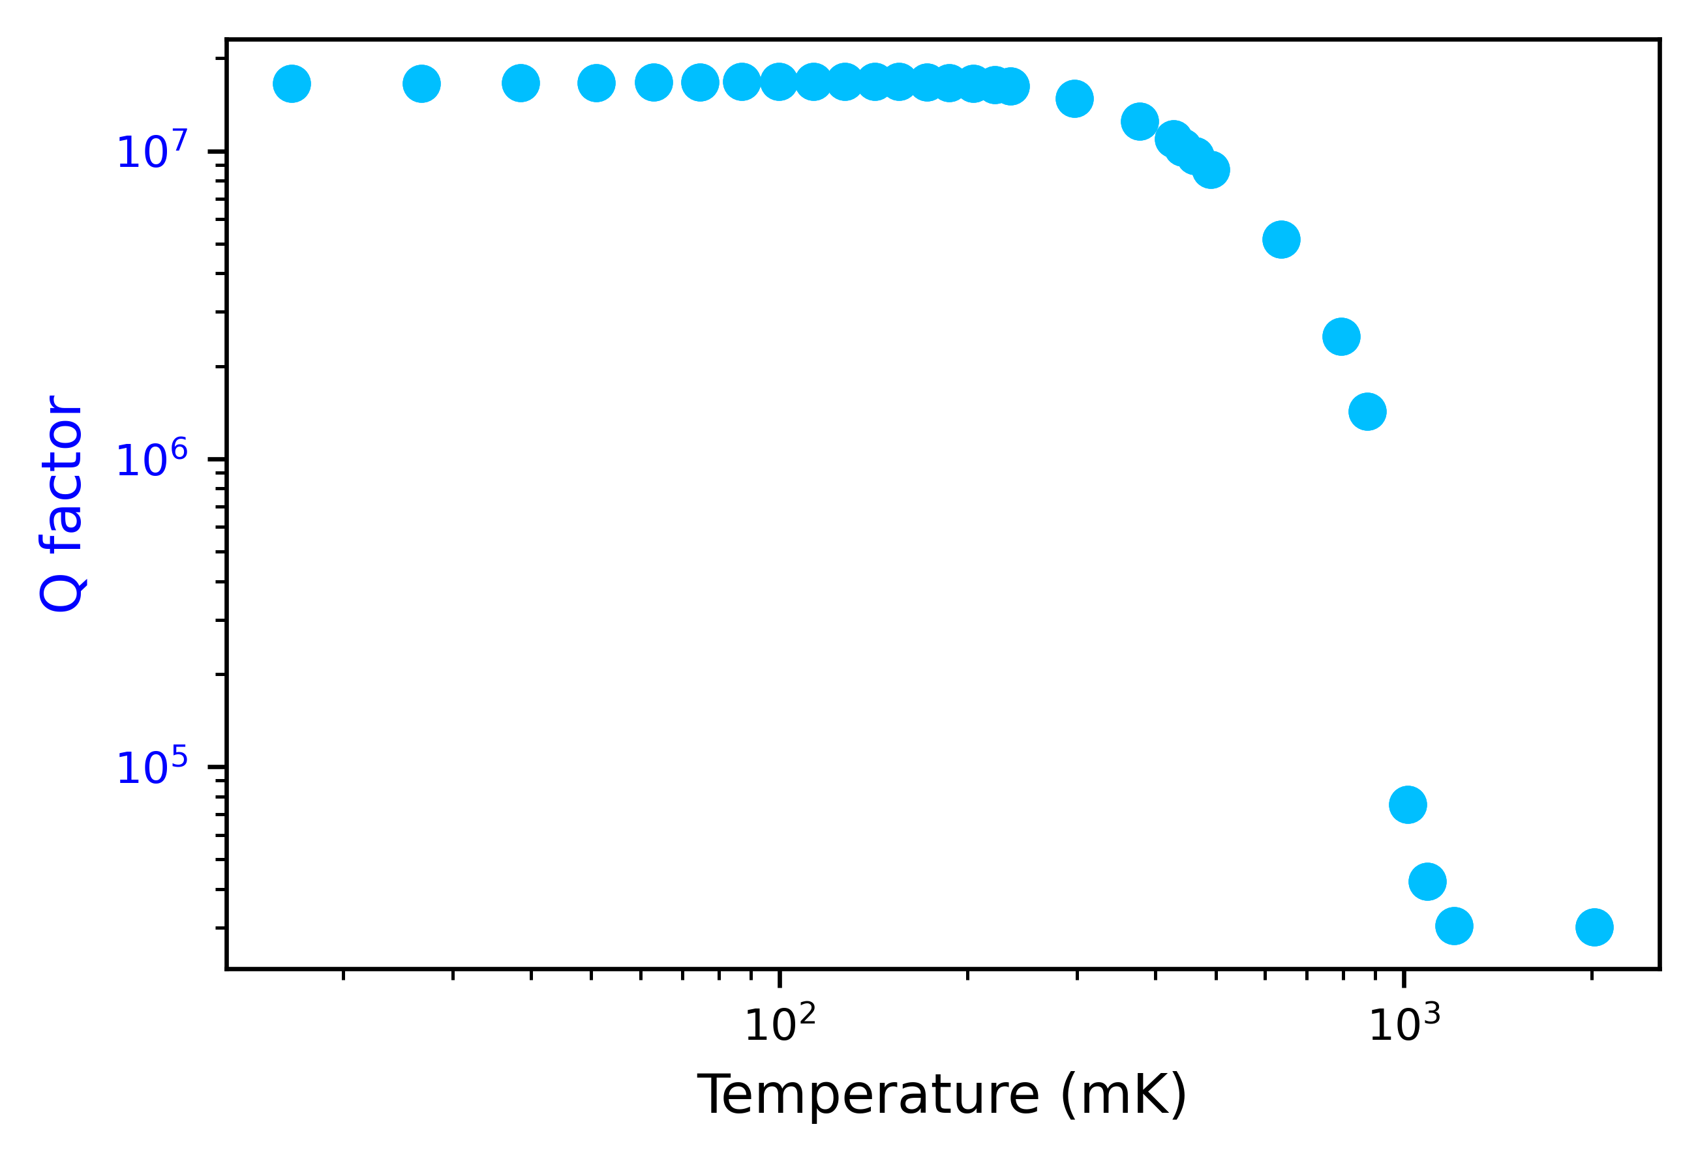
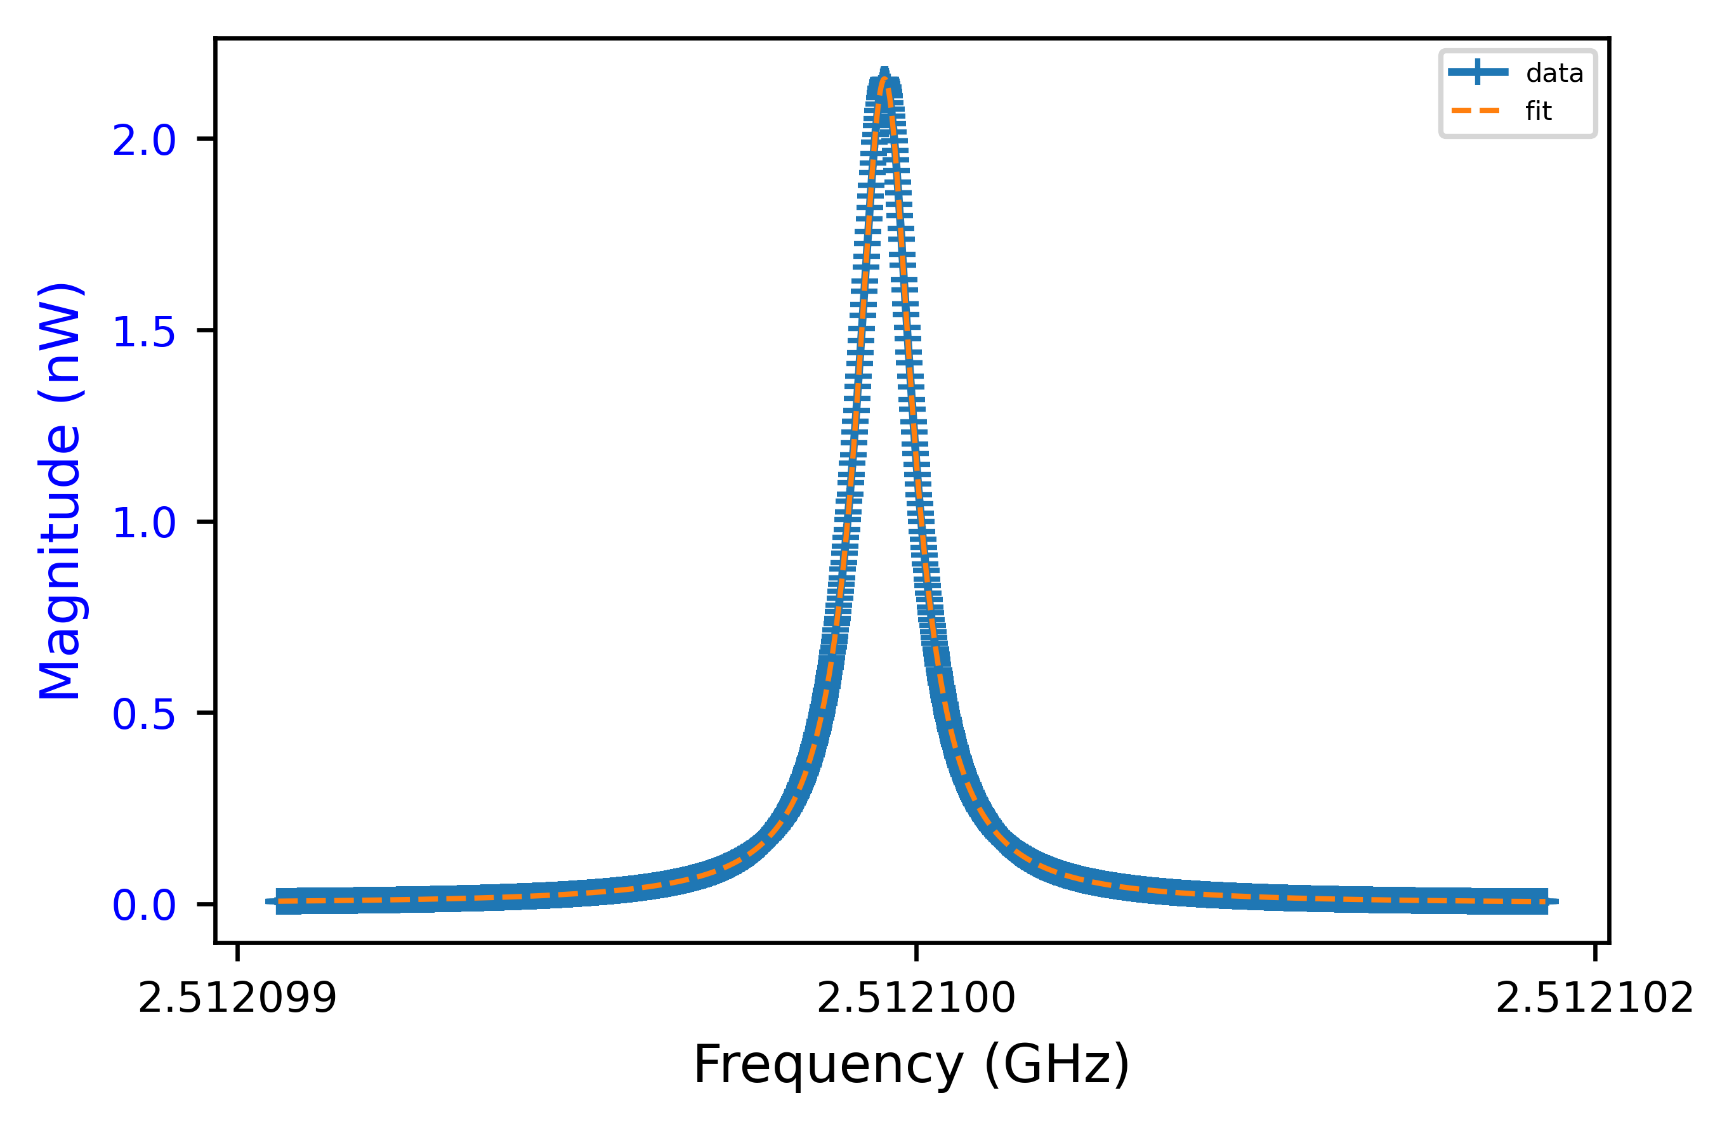
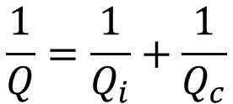
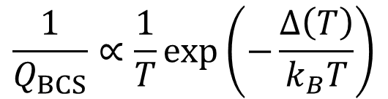
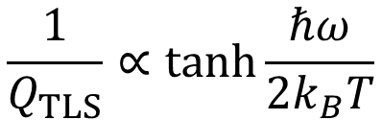
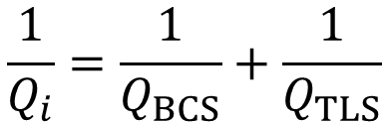
Q vs T
$$\frac{1}{Q}=\frac{1}{Q_{i}}+\frac{1}{Q_{c}}$$
Q is 16.575 x 10⁶ at 16.5 mK
f₀ = 2.512100429 GHz
$$\frac{1}{Q_{i}}=\frac{1}{Q_{BCS}}+\frac{1}{Q_{TLS}}$$
(arb. units)
$$\frac{1}{Q_{TLS}}∝\tanh{\frac{ℏω}{2k_{B}T}}$$
WA Phillips (1987)
$$\frac{1}{Q_{BCS}}∝\frac{1}{T}exp\left(−\frac{Δ\left(T\right)}{k_{B}T}\right)$$

Slide 16
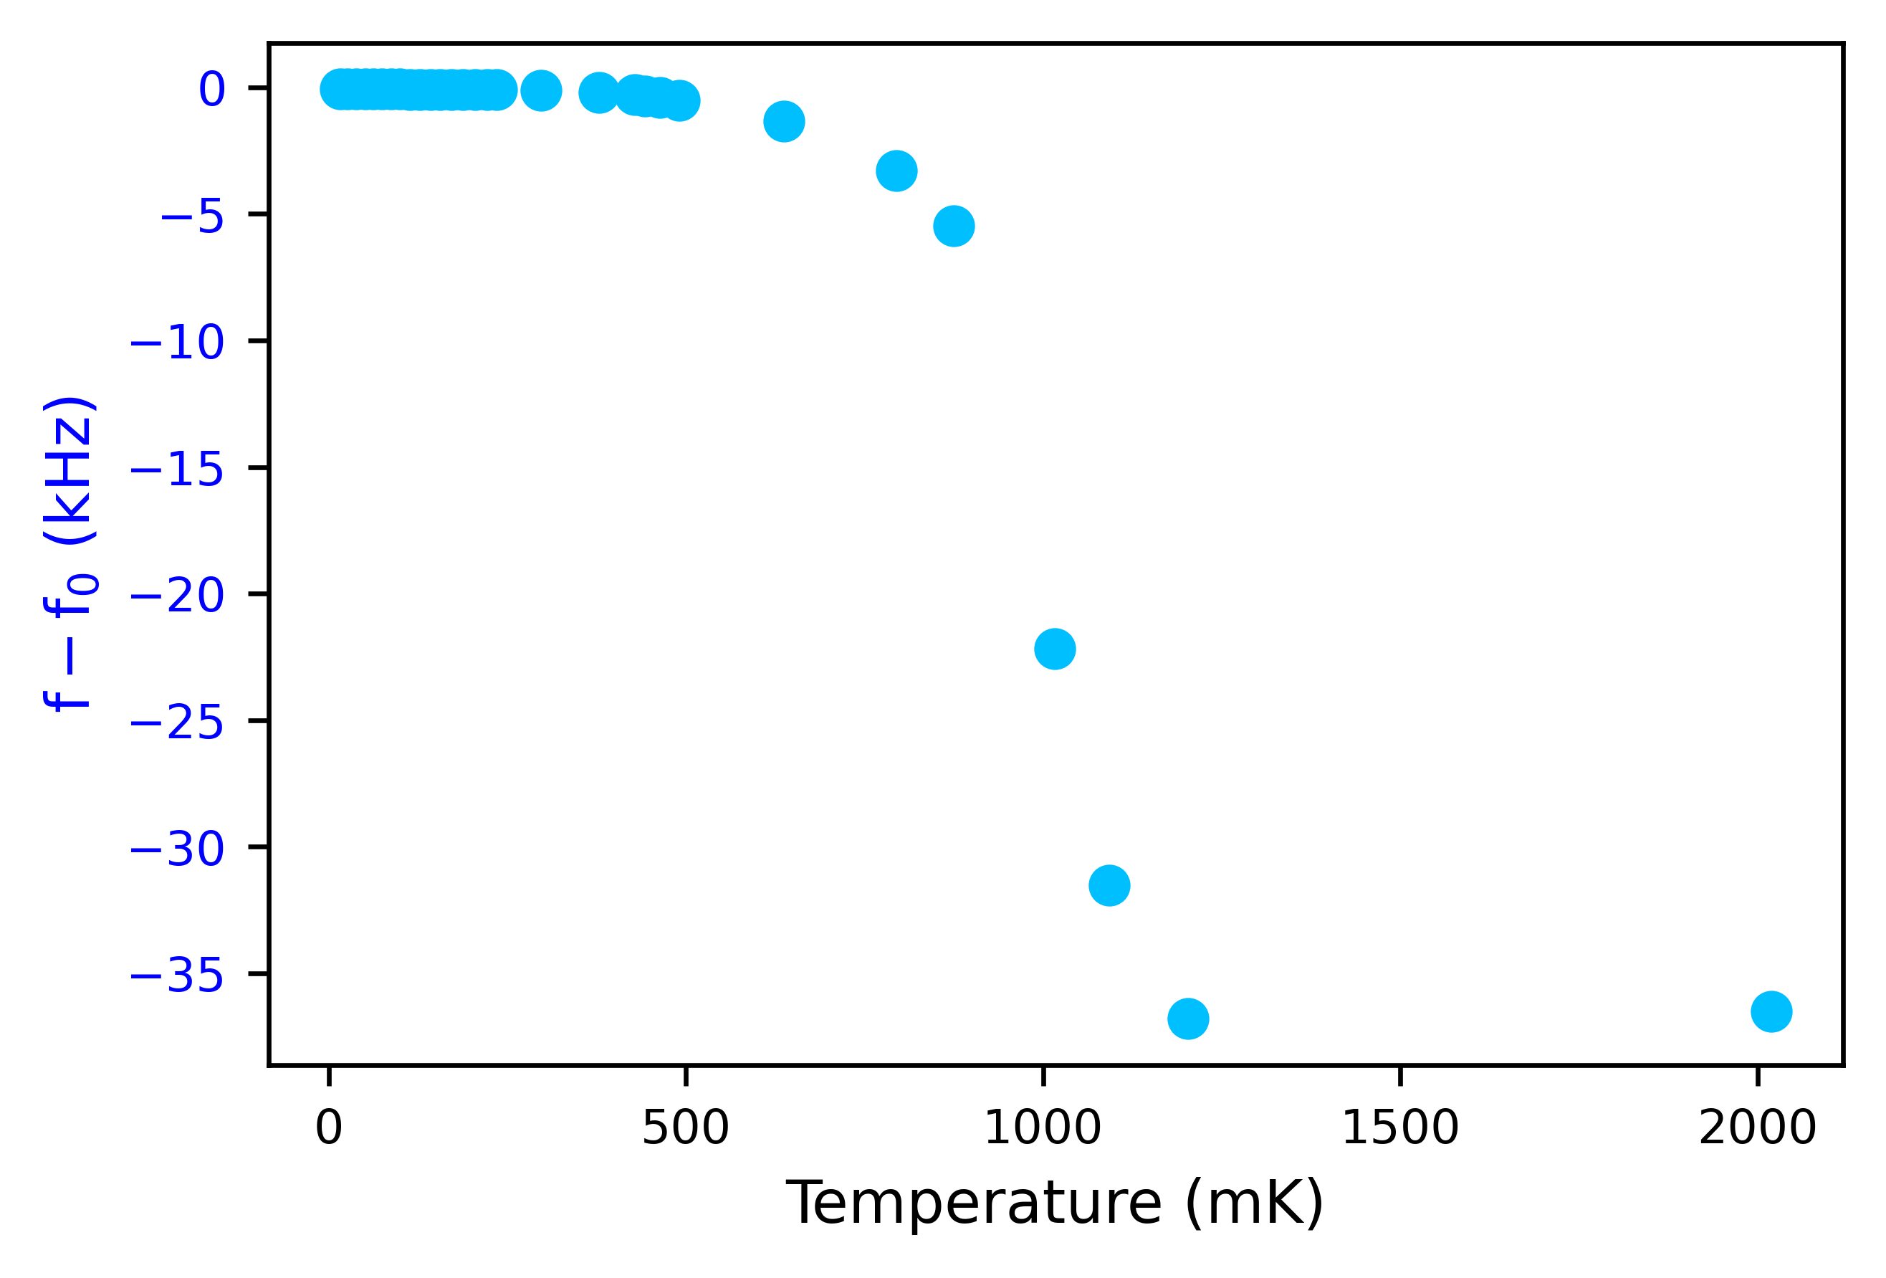
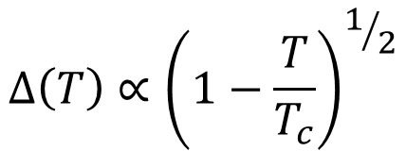





Δf vs T
$$∆ω≈−ω_{0}\frac{L_{k}}{L}$$
$$L_{k}=\frac{ℏR_{n}}{πΔ\left(T\right)}\tanh\left(−\frac{Δ\left(T\right)}{2k_{B}T}\right)$$
37 kHz shift
which is 0.0015%
$$T≪T_{c}$$
$$L_{k}=\frac{ℏR_{n}}{πΔ\left(0\right)}$$
$$T \sim T_{c}$$
$$Δ\left(T\right)∝{\left(1−\frac{T}{T_{c}}\right)}^{1/2}$$

Slide 17

Summary
Al cavity characterised in a wide temperature range, $Q\sim 20$ million
Sharp changes of in Q and ω₀ observed at about T_{c}
Q vs T dependence dominated by BSC and TLS losses
Frequency shift caused by changes of the total inductance of the cavity

