Slide 1
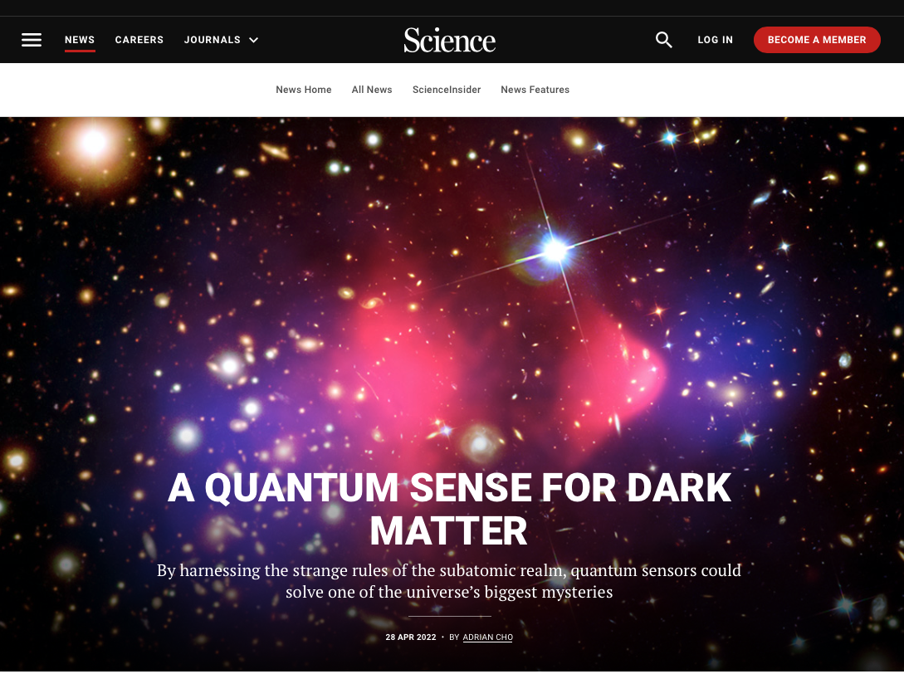
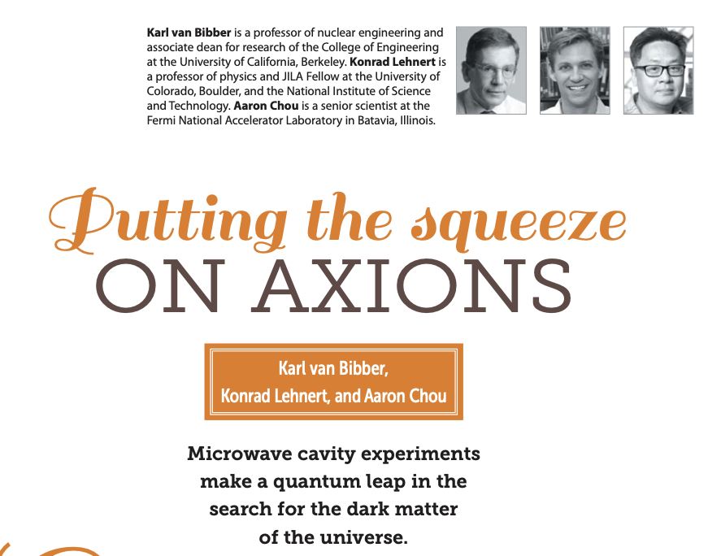
Quantum Sensor Needs for Dark Matter Axion Searches
Science, April 28, 2022
Aaron S. Chou
Fermilab
March 22, 2024
Physics Today, June 2019

Slide 2
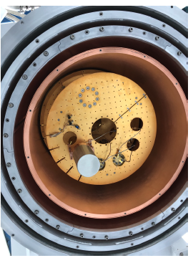
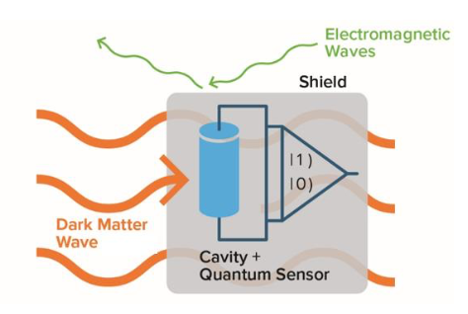
Hmmm… quantum computing platforms look just like dark matter searches:
DOE-OHEP Basic Research Needs white paper, 2018
(R. Harnik cartoon)
Sensitive single-quantum devices are operated in a cryostat and/or vacuum system and well-shielded from external disturbances (heat, light, sound) in order to maximize their coherence time.
Impossible to shield from the dark matter – the DM interacts so weakly that it flies right through the walls.
If your quantum computer crashes, it could be due to dark matter!
… but as consolation, you’ll get a Nobel prize anyway for the discovery.

Slide 3
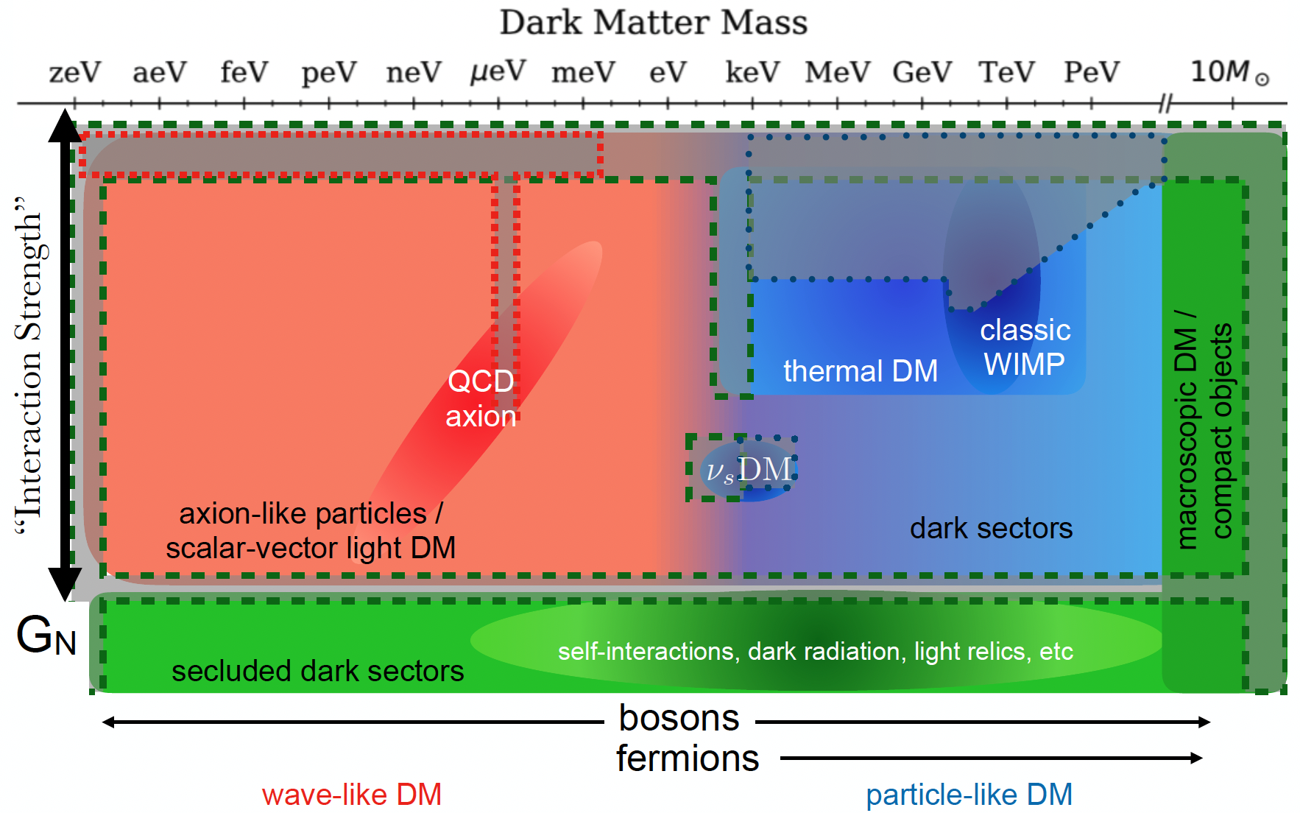
Quantum sensors: E < 1 eV
Current HEP tech:
E > 1 eV
E&M
Cartoon from Snowmass

Slide 4
Quantum sensors: E < 1 eV
Current HEP tech:
E > 1 eV
E&M
Atomic IFOs, clocks
Transmon qubits,
quantum amps, transducers, SRF cavities, SNSPDs, NMR
Single phonon sensors, quantum materials
Xe, Ar,
Si, Ge, colliders, fixed target
Cartoon from Snowmass

Slide 5
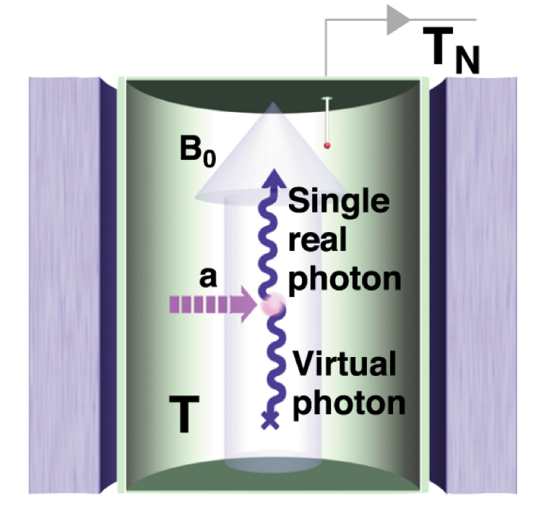
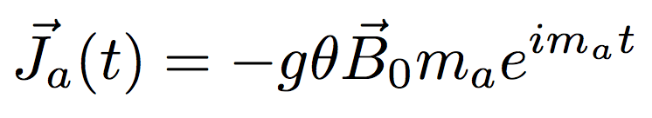
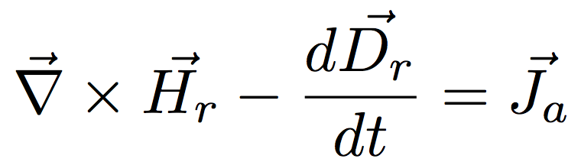
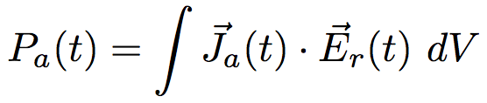
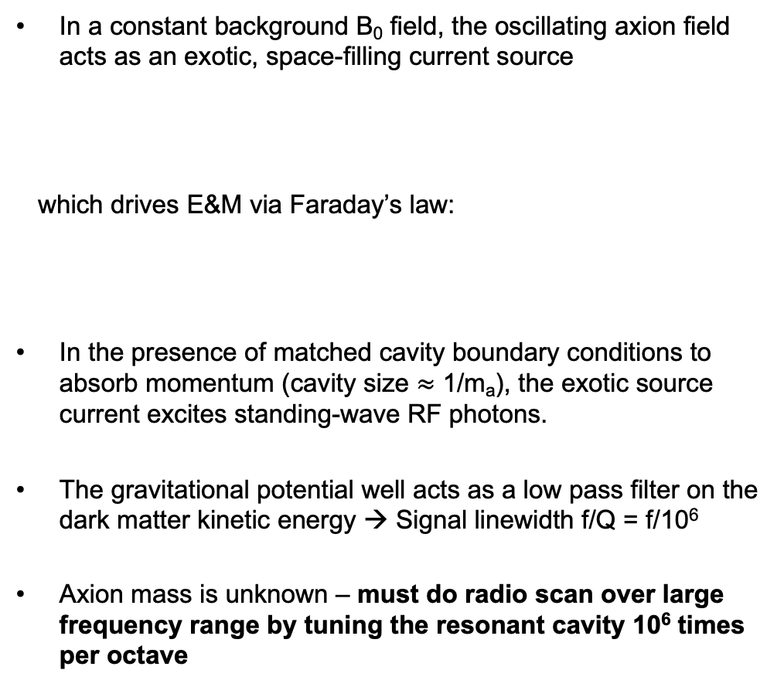
The Sikivie Haloscope technique (1983)
Classical axion wave drives RF cavity mode
In a constant background B₀ field, the oscillating axion field acts as an exotic, space-filling current source
which drives E&M via Faraday’s law:
In the presence of matched cavity boundary conditions to absorb momentum (cavity size $≈$ 1/m_{a}), the exotic source current excites standing-wave RF photons.
The gravitational potential well acts as a low pass filter on the dark matter kinetic energy → Signal linewidth f/Q = f/10⁶
Axion mass is unknown – must do radio scan over large frequency range by tuning the resonant cavity 10⁶ times per octave
A spatially-uniform cavity mode can optimally extract power from the potential energy of interaction:

Slide 6
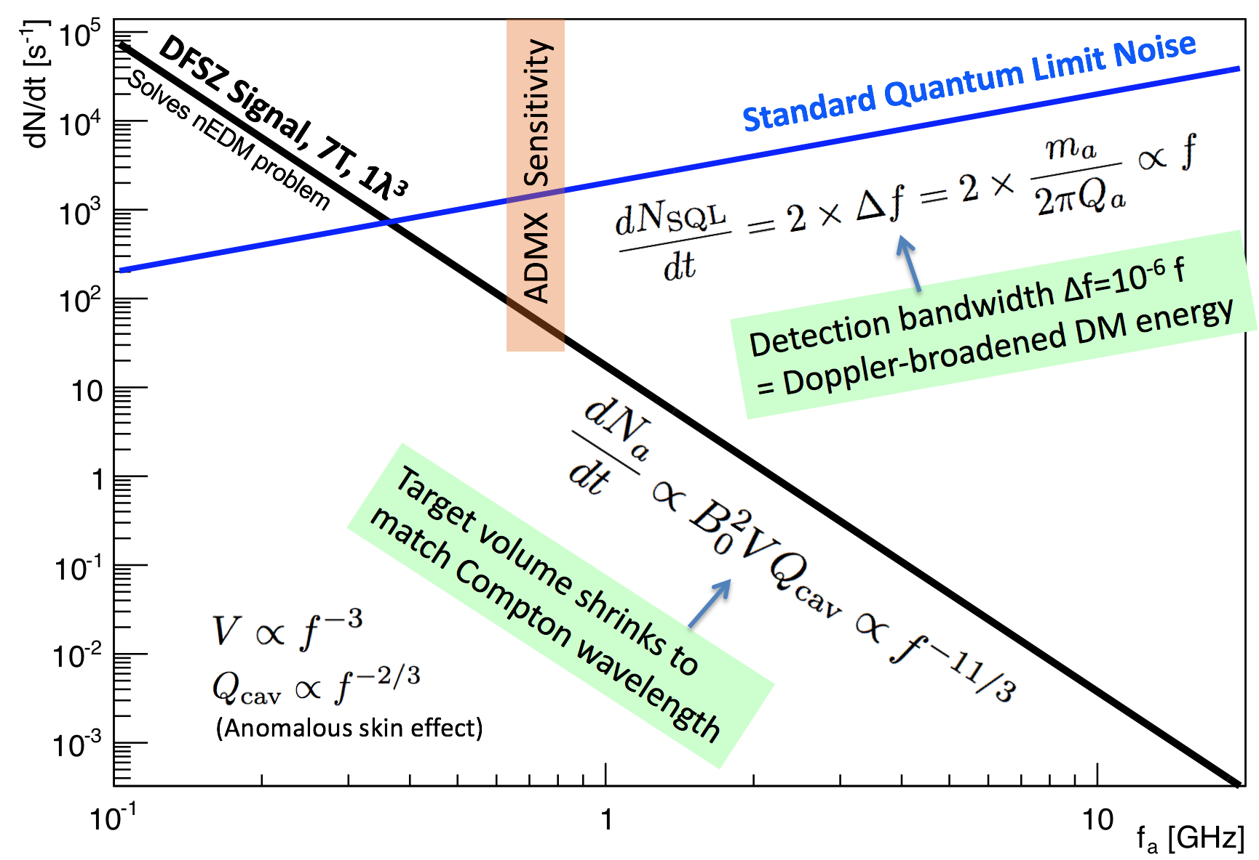
The predicted axion DM signal/noise ratio plummets as the axion mass increases → SQL readout is not scalable.
Effective
DCR = 10⁴/s
Photon rate
Need
DCR < 10⁻²/s
Photon frequency

Slide 7
Need much larger signal/noise ratio in many searches for new physics.
Increase signal?
We do need more magnets, but these are expensive and have long lead time.
Reduce noise?
Many quantum tricks are possible, but must be tailored to the application.

Slide 8
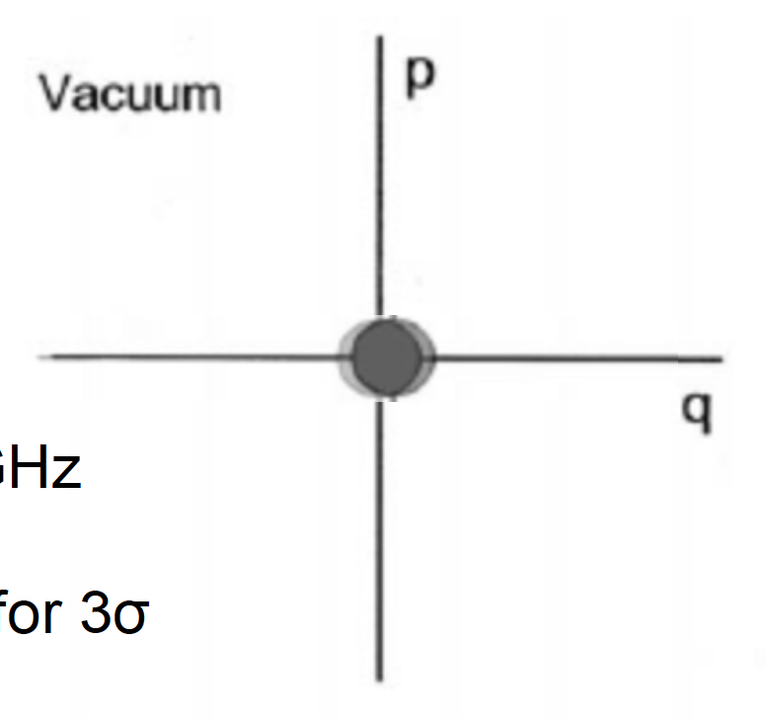

To reduce readout noise below SQL, use photon counting to measure displacement using the Fock basis, i.e. number eigenstates
Previously we measured both amplitude and phase, but this is dumb since the dark matter phase is randomized every coherence time. Useless information obtained at high cost!
Instead, measure only displacement amplitude
no zero-point noise since we are not simultaneously measuring non-commuting observables
Measurement noise, e.g. from dark counts can be arbitrarily low
Blue rings give the probe resolution
1
2
3
Displaced vacuum state exponentially leaks into non-zero Fock number.
Detect displacement by counting the occasional single photon.

Slide 9
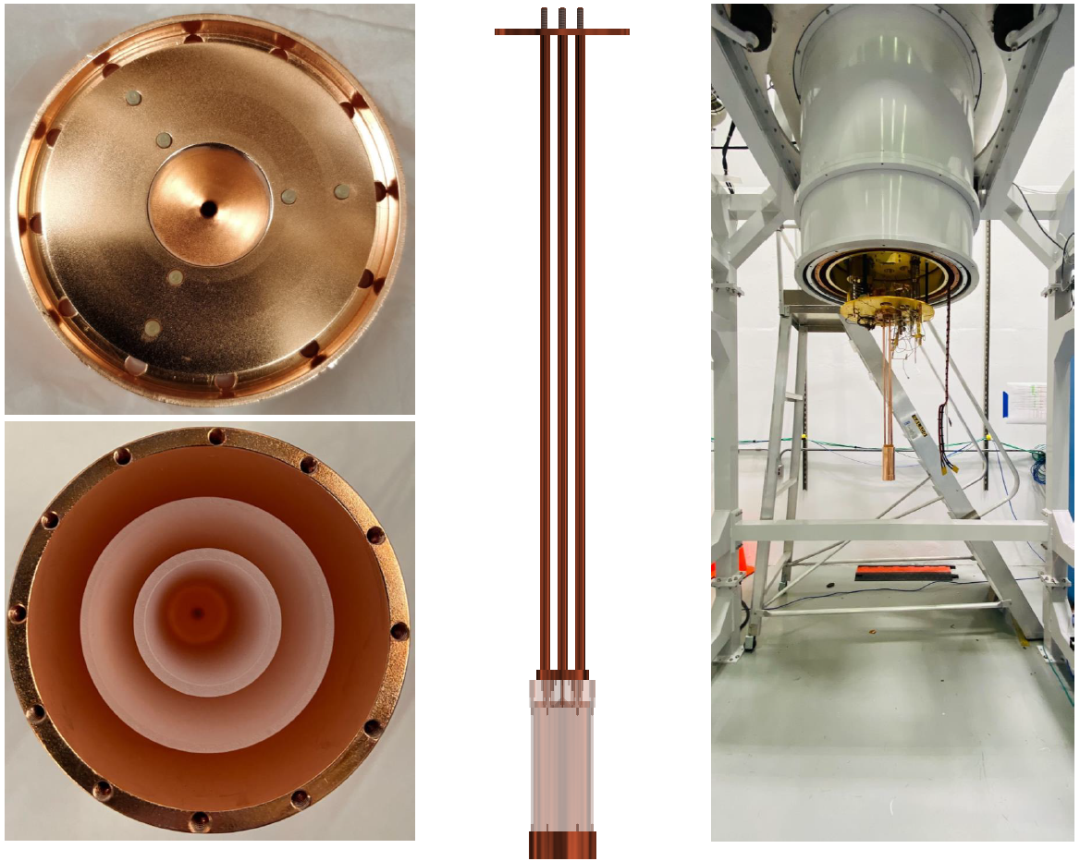
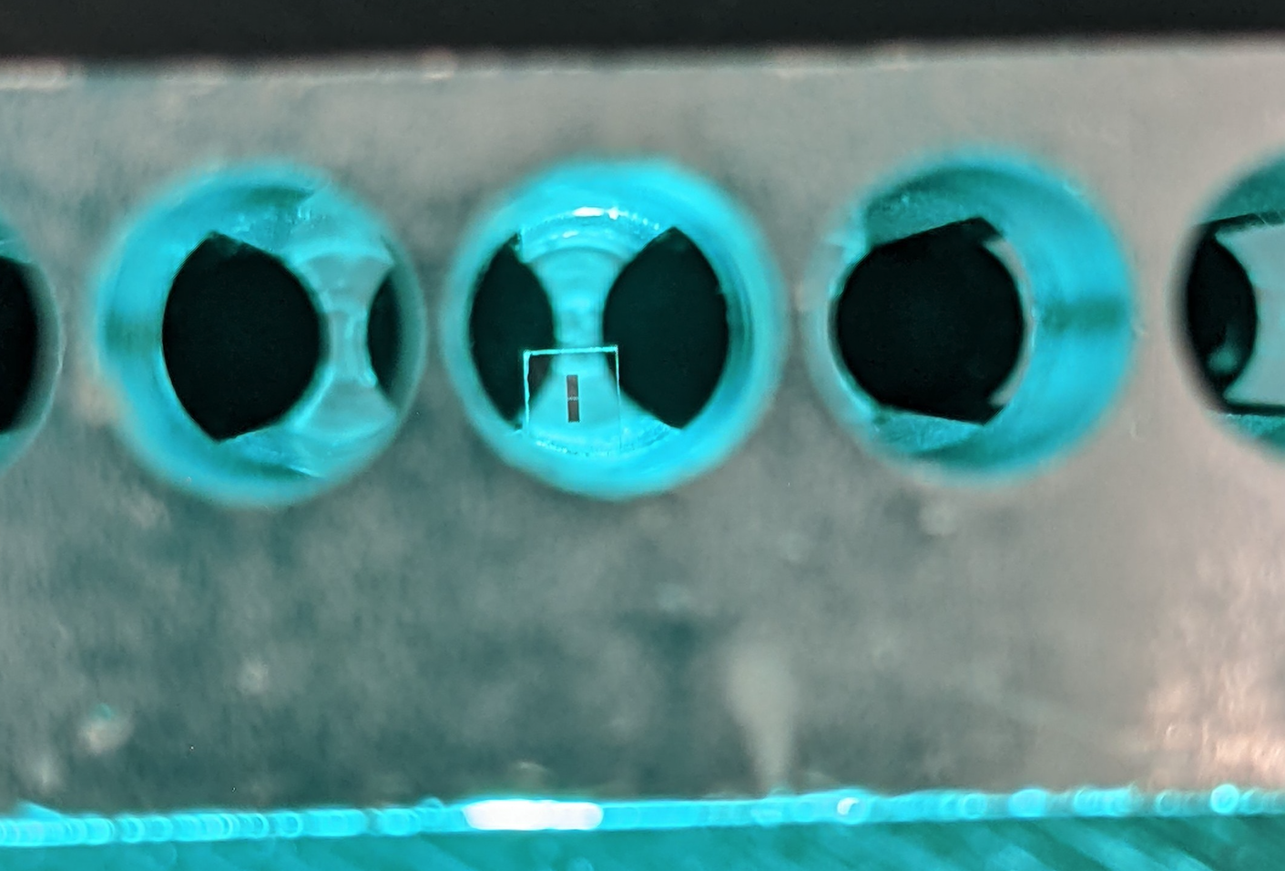
SC qubits as single photon detectors. No quantum noise!
Quantum readout electronics in remote, magnetically-shielded region
Fermilab/Chicago/Stanford
Nested sapphire cavity compatible with high B field needed for axion search: Q>10⁶,
¼-wave layers reflect photon waves back to center
SQuAD (Superconducting Qubits for Axion Darkmatter)
Transmon qubit performs quantum non-demolition single photon counting with noise 36x lower than zero-point noise, 1300x speed-up.
Achieved 1 Hz DCR.
Installed in 10 mK dilution refrigerator and 14T solenoid magnet at Fermilab
(based on design from INFN/QUAX)
A.V. Dixit et al., Phys.Rev.Lett. 126 (2021)
Notes:
This example is from a single-investigator award. Please use the NQISRC template.

Slide 10
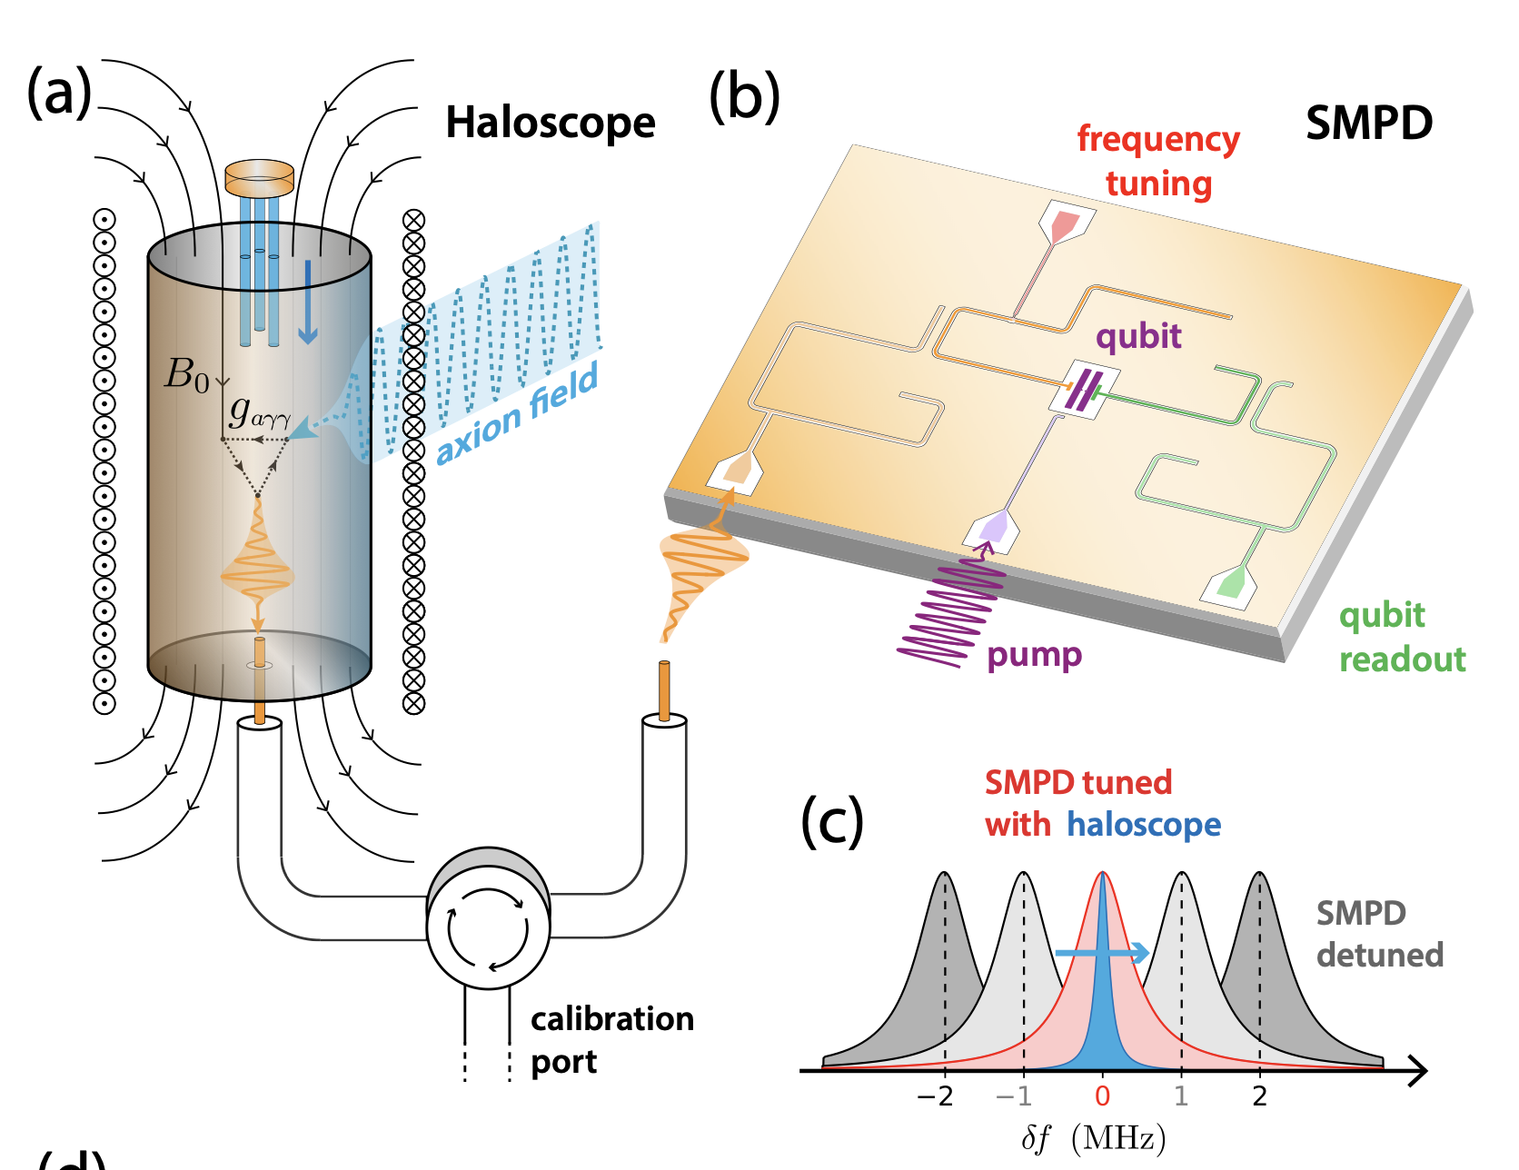
Patrice Bertet’s remote single microwave photon receiver deployed in axion search
Photon is detected via a controlled-X gate, exciting the qubit g→e only when a signal photon is present.
Technical complications:
Remote buffer resonator must be co-tuned with SQUID to match the frequency of the axion cavity.
Large dark count rate ~100/s from poor thermalization of rf lines, spontaneous heating of the qubit state, but better than SQL!
C. Braggio et al., arXiv:2403.02321
(SQMS)

Slide 11
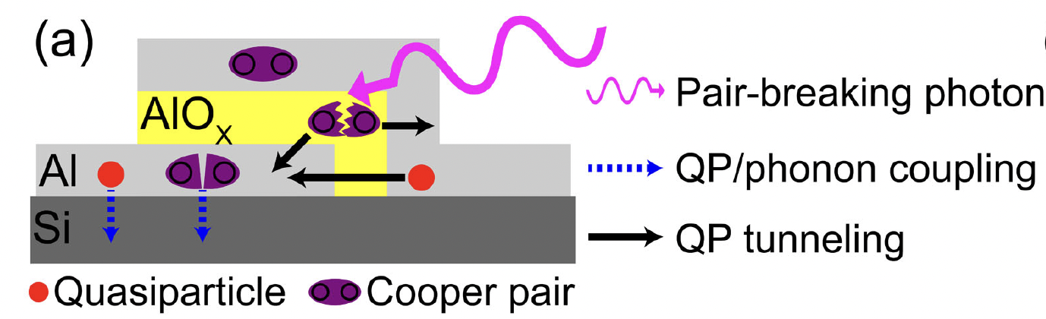
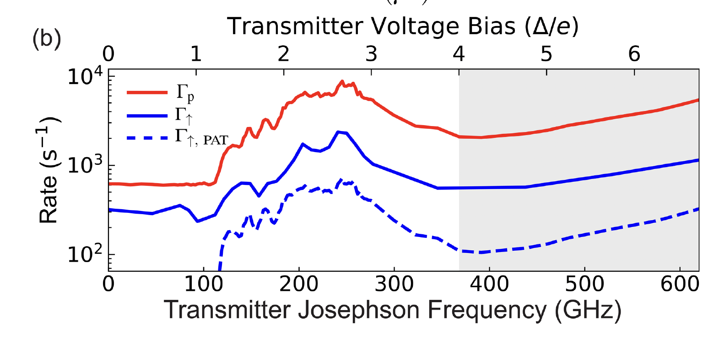
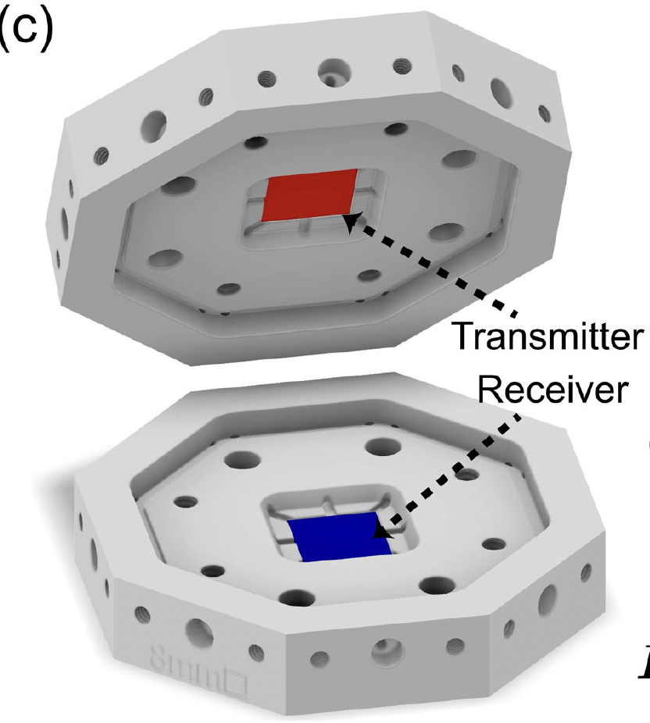
False positives g→e from direct absorption of above-gap photons
.
Robert McDermott’s experiment
PRL 132, 017001 (2024)
Qubit excitation rate is nearly 100% correlated with charge parity switching rate caused by photon absorption!
Apply dipole radiation from AC
Josephson effect

Slide 12
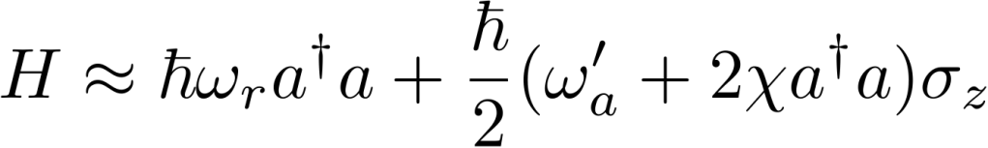
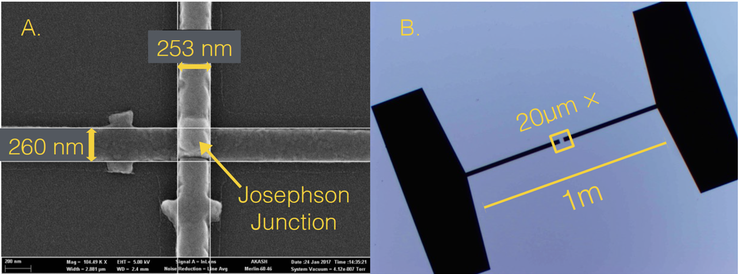
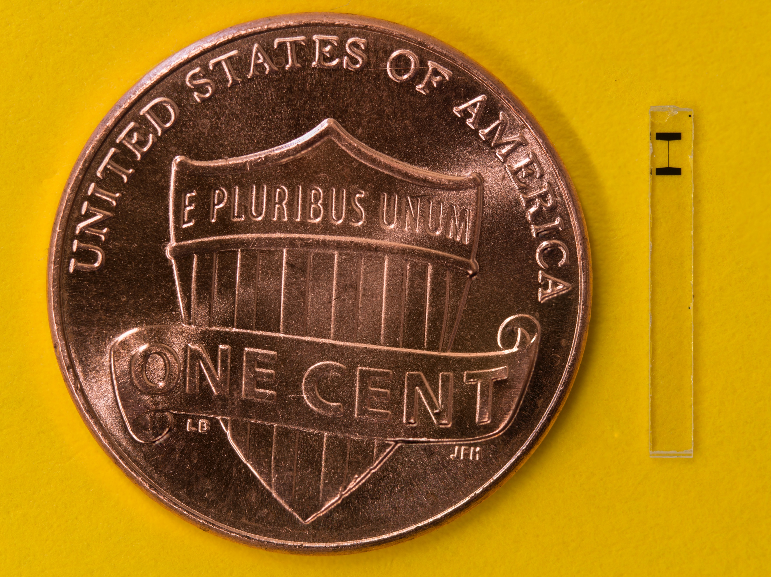

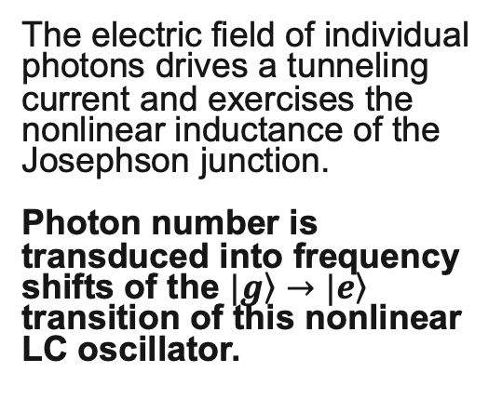
To avoid spontaneous qubit heating background, instead do quantum non-demolition measurements of the cavity photon
Large antennae
1mm
The electric field of individual photons drives a tunneling current and exercises the nonlinear inductance of the Josephson junction.
Photon number is transduced into frequency shifts of the $|\left.g\right\rangle →|\left.e\right\rangle$ transition of this nonlinear LC oscillator.
Transmon qubit in pan flute cavity (photo credit: Akash Dixit)

Slide 13
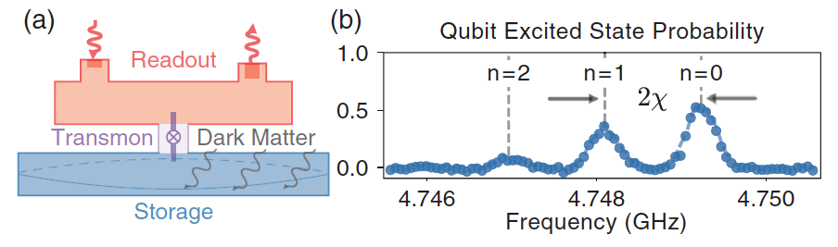
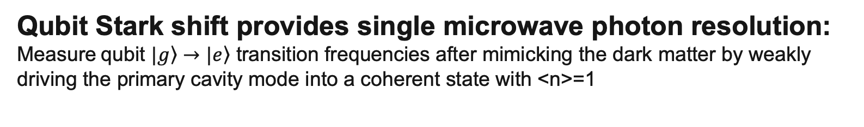
Qubit Stark shift provides single microwave photon resolution:
Measure qubit $|\left.g\right\rangle →|\left.e\right\rangle$ transition frequencies after mimicking the dark matter by weakly driving the primary cavity mode into a coherent state with <n>=1
Non-destructively count photons by measuring the qubit’s quantized frequency shift.
e.g. Measure spectral response by applying pi-pulse to the qubit at the postulated shifted frequency to see if it absorbs the photon.
A.V. Dixit et al., Phys.Rev.Lett. 126 (2021)

Slide 14
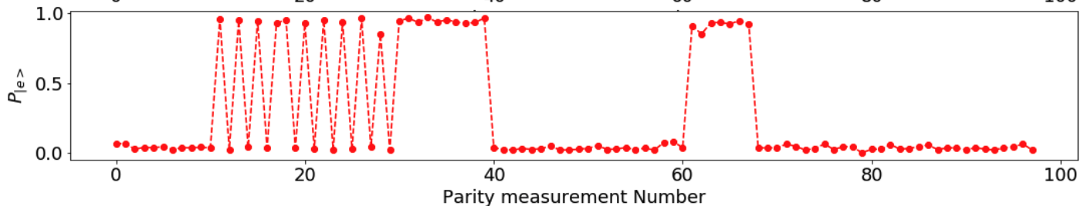
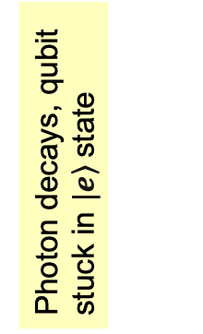
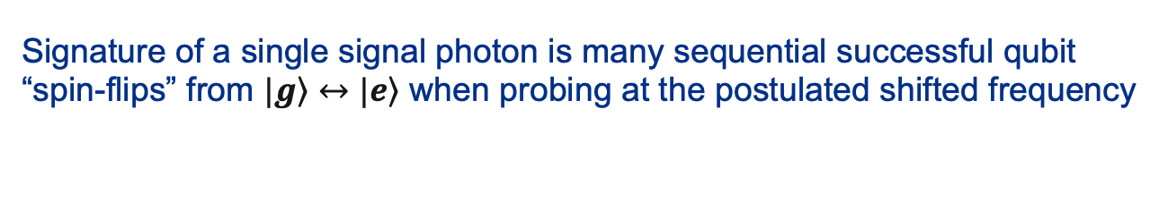
Repeated quantum non-demolition measurements ensure high fidelity tagging of single photon events, rejects qubit heating backgrounds
Signature of a single signal photon is many sequential successful qubit “spin-flips” from $|\left.g\right\rangle ↔|\left.e\right\rangle$ when probing at the postulated shifted frequency
“Axion event”
qubit heating event
Data courtesy of Akash Dixit
Data from Akash Dixit (U.Chicago)
Qubit spontaneously excited and then decays. Does not mimic photon event since subsequent spin-flip attempts fail.
Achieved dark count rate
= 1 photon/s. Need to further reduce this to achieve background-free axion experiments.
Single photon injected, repeated successful qubit spin flips
More successful readouts
Photon decays, qubit stuck in $|\left.e\right\rangle$state
Many failed spin-flips indicate that no photon is present.
Failed spin-flip = readout error
Qubit decays

Slide 15
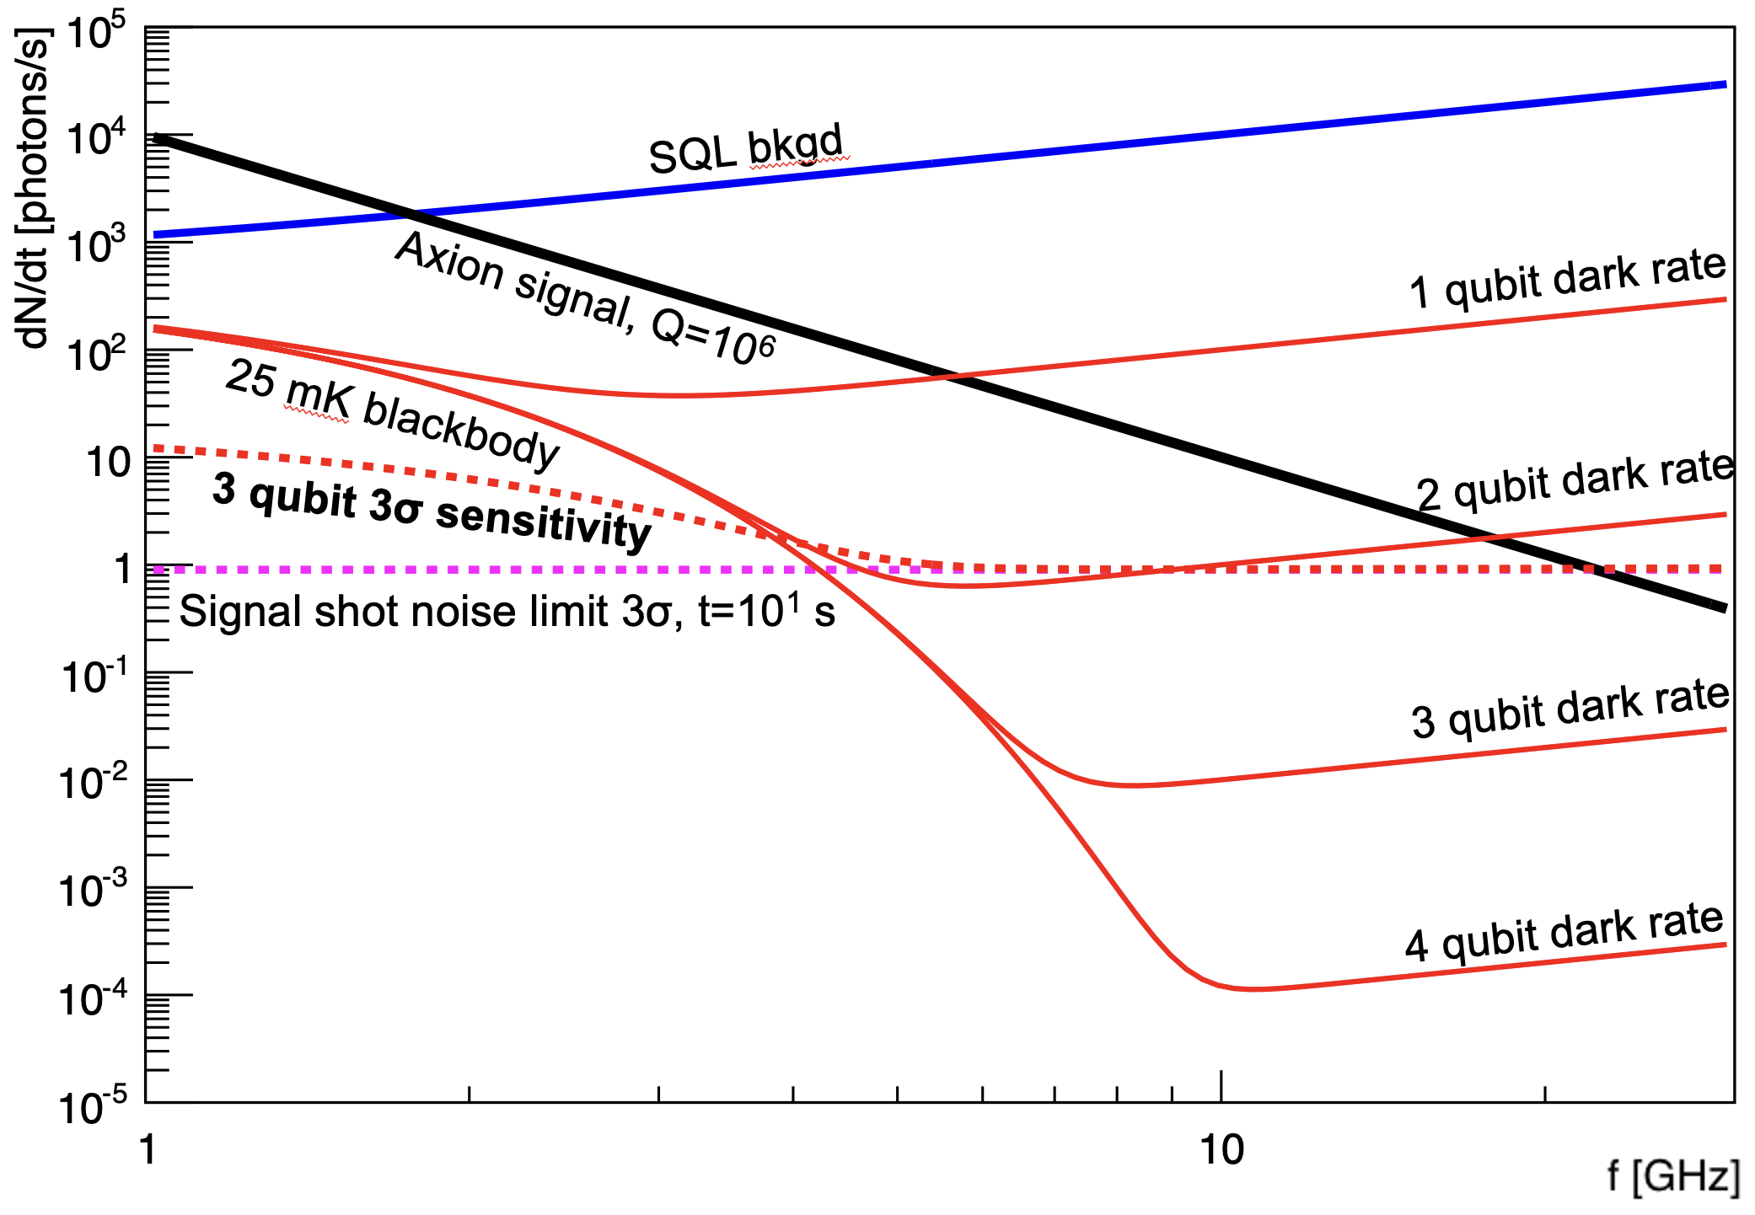
Signal rate sensitivity is determined by the integration time budget: if Q=10⁶ then have maximum t=10 s at each tuning to get 1 octave in mass, i.e. using 10⁶ tunings in 1 year
Assume that quantum sensors will continue to improve until experiments with higher Q cavities are no longer background-limited.
Demonstrated qubit DCR=1 Hz is already nearly good enough for background-free operation in 10 s integration budget.
SQL bkgd
Axion signal, Q=10⁶
1 qubit dark rate
For t = 10 s, the minimum observable signal rate is R_{s}=1 Hz
(Signal shot noise limit, need to count 9 ± 3 photons for 3𝜎 sensitivity)
25 mK blackbody
3 qubit 3σ sensitivity
2 qubit dark rate
Signal shot noise limit 3σ, t=10¹ s
3 qubit dark rate
4 qubit dark rate
Once DCR is sufficiently low, cavity experiments are still signal limited at higher frequencies:
Need larger B²V or stimulated emission to go above 20 GHz.

Slide 16

More stupid qubit tricks:
Increase signal rate by stimulated emission of photons from DM waves
Start the photon wave swinging so it can more easily accept energy from the DM.
Power = $\vec{Force}∙\vec{velocity}$
Good!
Waiting…
Oops, wrong phase
Phase offset determines the direction of energy flow.
Wait ... but we don’t know the instantaneous phase of the DM wave!

Slide 17
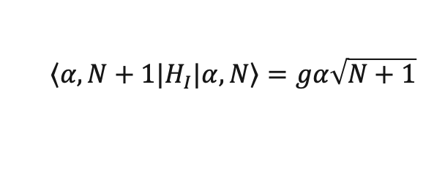

What happens if we initialize the probe to a Fock state instead of a Gaussian blob?
A Fock state is a superposition of an oscillator in all possible phases of its sinusoidal motion: ∆N×∆𝜑 ≥ ½
responds equally well to pushes at any time.
It also has definite occupation number N
→ no Poisson noise!
… and force × velocity still works:
$H_{I}$ = $g(a^{†}b$+${ab}^{†}$) →
$${\left\langle α,N+1|\right.H}_{I}|α,\left.N\right\rangle =gα\sqrt{N+1}$$
N=1 Fock state

Slide 18
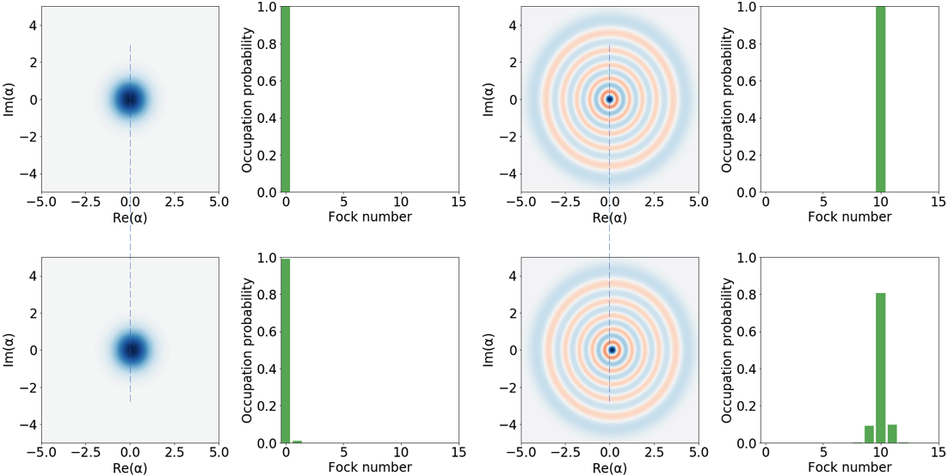

For small amplitudes 𝜶, the transfer of quanta from DM to photons is enhanced by a factor (n+1)
N=0
N=10
Displacement
Displacement
Stimulated emission / absorption signals
Spontaneous emission signal
QuTiP simulation
$${\left|\left\langle n+1 | \hat{D}\left(α\right) | n\right\rangle \right|}^{2}\sim { α}^{2}(n+1)$$

Slide 19
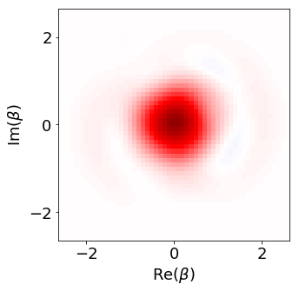
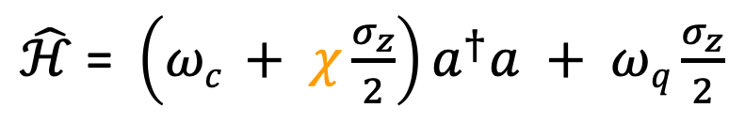
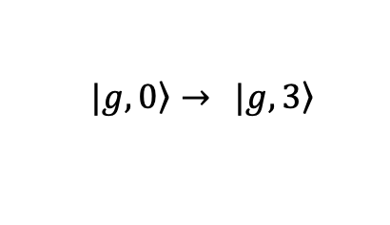
Creating Fock states in a (non)linear system
“Optimal control” sequence of drives at both the qubit and cavity frequencies,
determined by “gradient ascent pulse engineering”
$\hat{ℋ}$ = ${\left({ωc}^{ }+ χ\frac{σ_{z}}{2}\right)a}^{†}a + ωq\frac{σ_{z}}{2}$
$\left. |g, 0\right\rangle →$ $\left. |g, 3\right\rangle$
Slide/data from Ankur Agrawal
Notes:
Fock states are quantum state of light which cannot be created in a linear system such as a cavity. However, if we rewrite the Hamiltonian again, we see that the cavity frequency is dependent on the state of the qubit. This non-linearity allows us to prepare the cavity in any quantum state.
I used an optimal control package which was developed in our lab to solve an inversion problem. Given a Hamiltonian, it uses machine learning algorithm to generate a set of qubit and cavity control drives to perform a non-trivial state transfer. I used a 3D multimode cavity coupled to a transmon as shown in the image here for the experiment.
Here is an example of such a state transfer from the ground state to n=1 Fock state. We can see the cavity’s wave function evolve from n=0 to n=1 in this movie.
Wigner function is a quasi-distribution function which represents the wavefunction of the oscillator. Parity operator is an effective experimental tool to compute the density matrix.

Slide 20
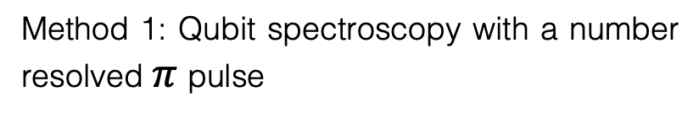
Verifying the state preparation
Sweep pi pulse frequency
Method 1: Qubit spectroscopy with a number resolved $π$pulse
Method 2: Wigner tomography to reconstruct the density matrix
Slide/data from Ankur Agrawal
Notes:
We can use this method to verify the preparation of cavity in a Fock state.
Method 1 is a qubit spectroscopy with a number resolved pi pulse which I had described earlier. On the left, we see the qubit spectrum and a single peak in each spectrum confirms the cavity state in a definite photon number.
The other method is Wigner tomography which is slightly more involved and requires multiple measurements to reconstruct the state of the cavity.
Hence, for the rest of this talk, I am going to use a number resolved qubit pi pulse to probe the cavity state.
I would like to point out that the information that we obtain from a resolved pi pulse and the Wigner tomography is the same, as there is no phase information associated with the cavity state. Henceforth, we will just use resolved pi pulse to probe the cavity state.

Slide 21
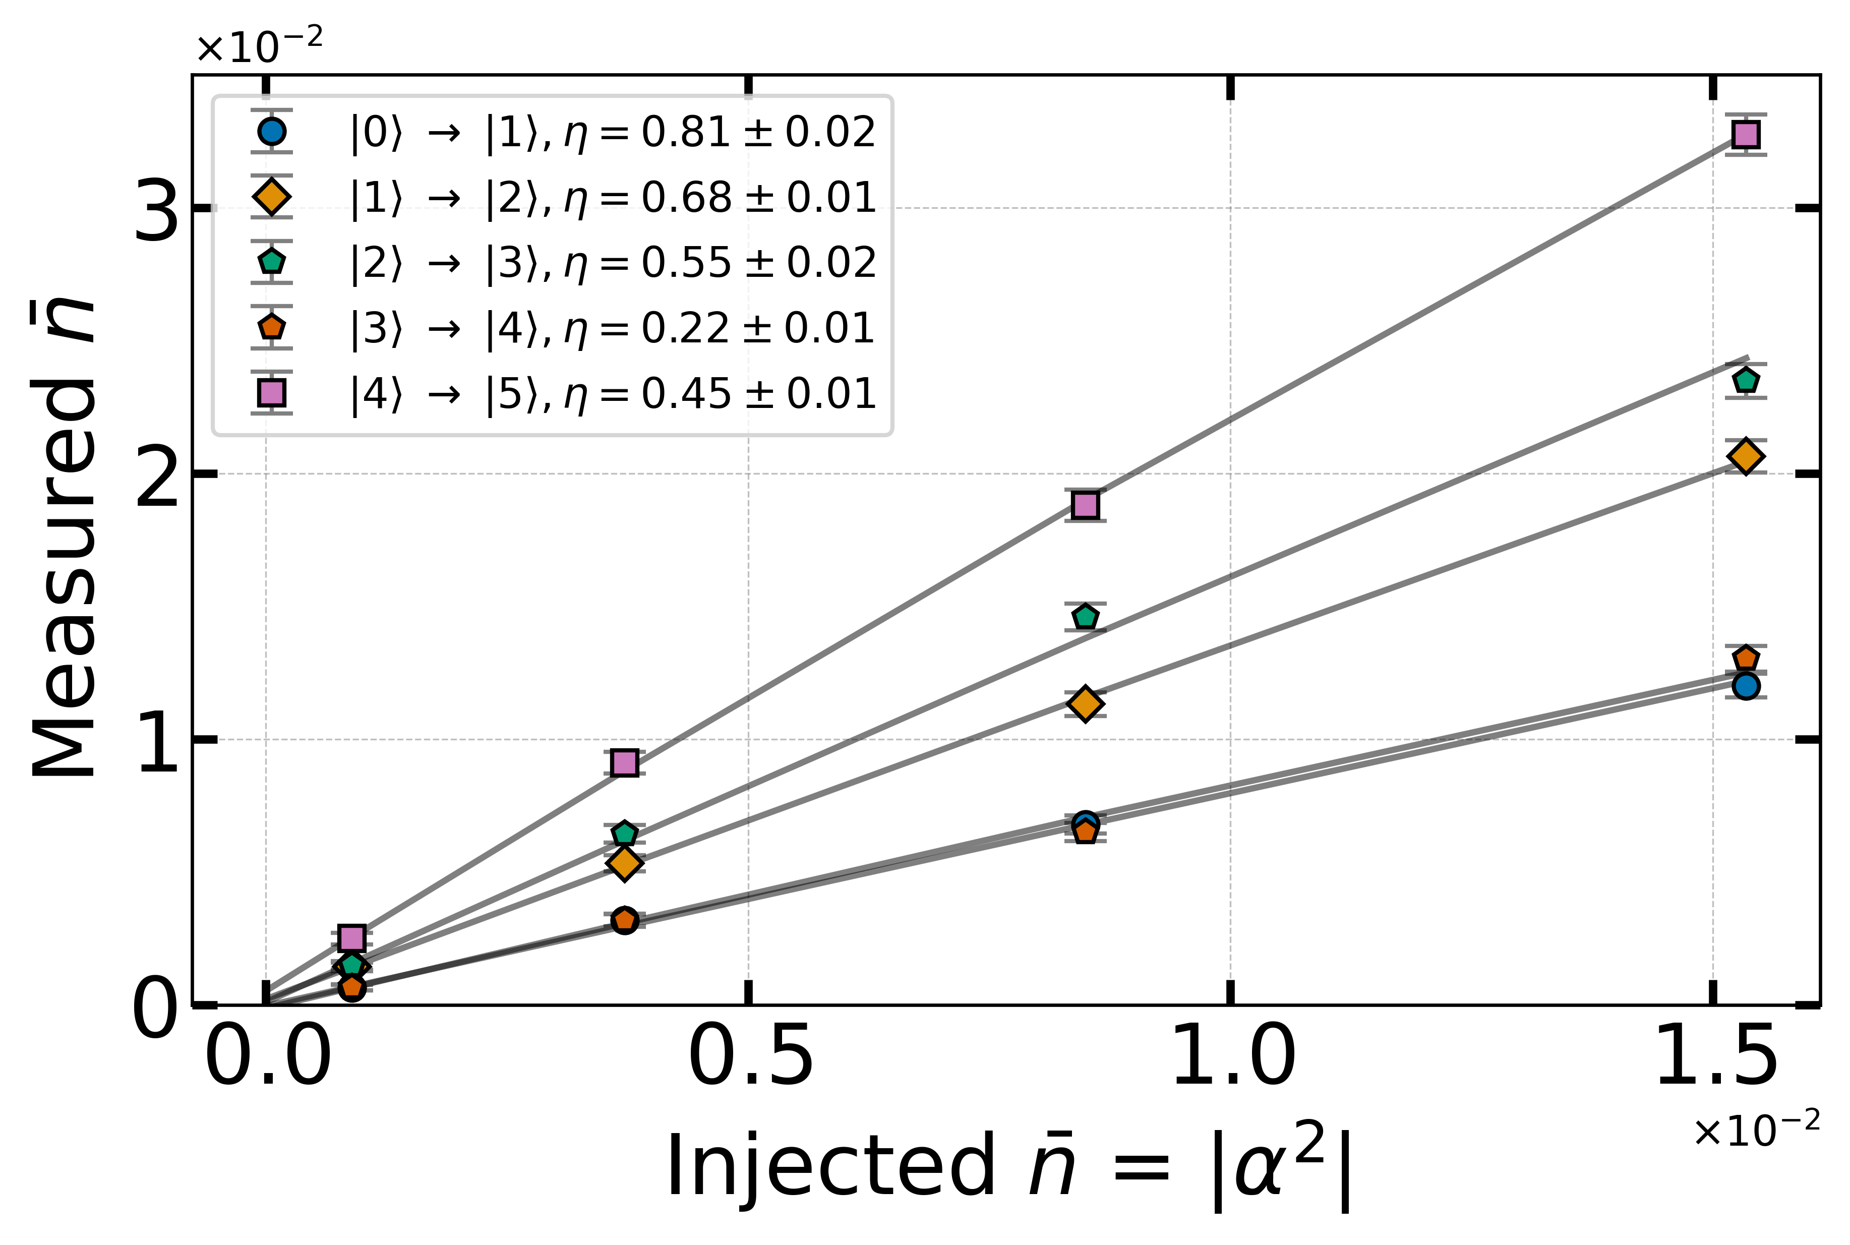
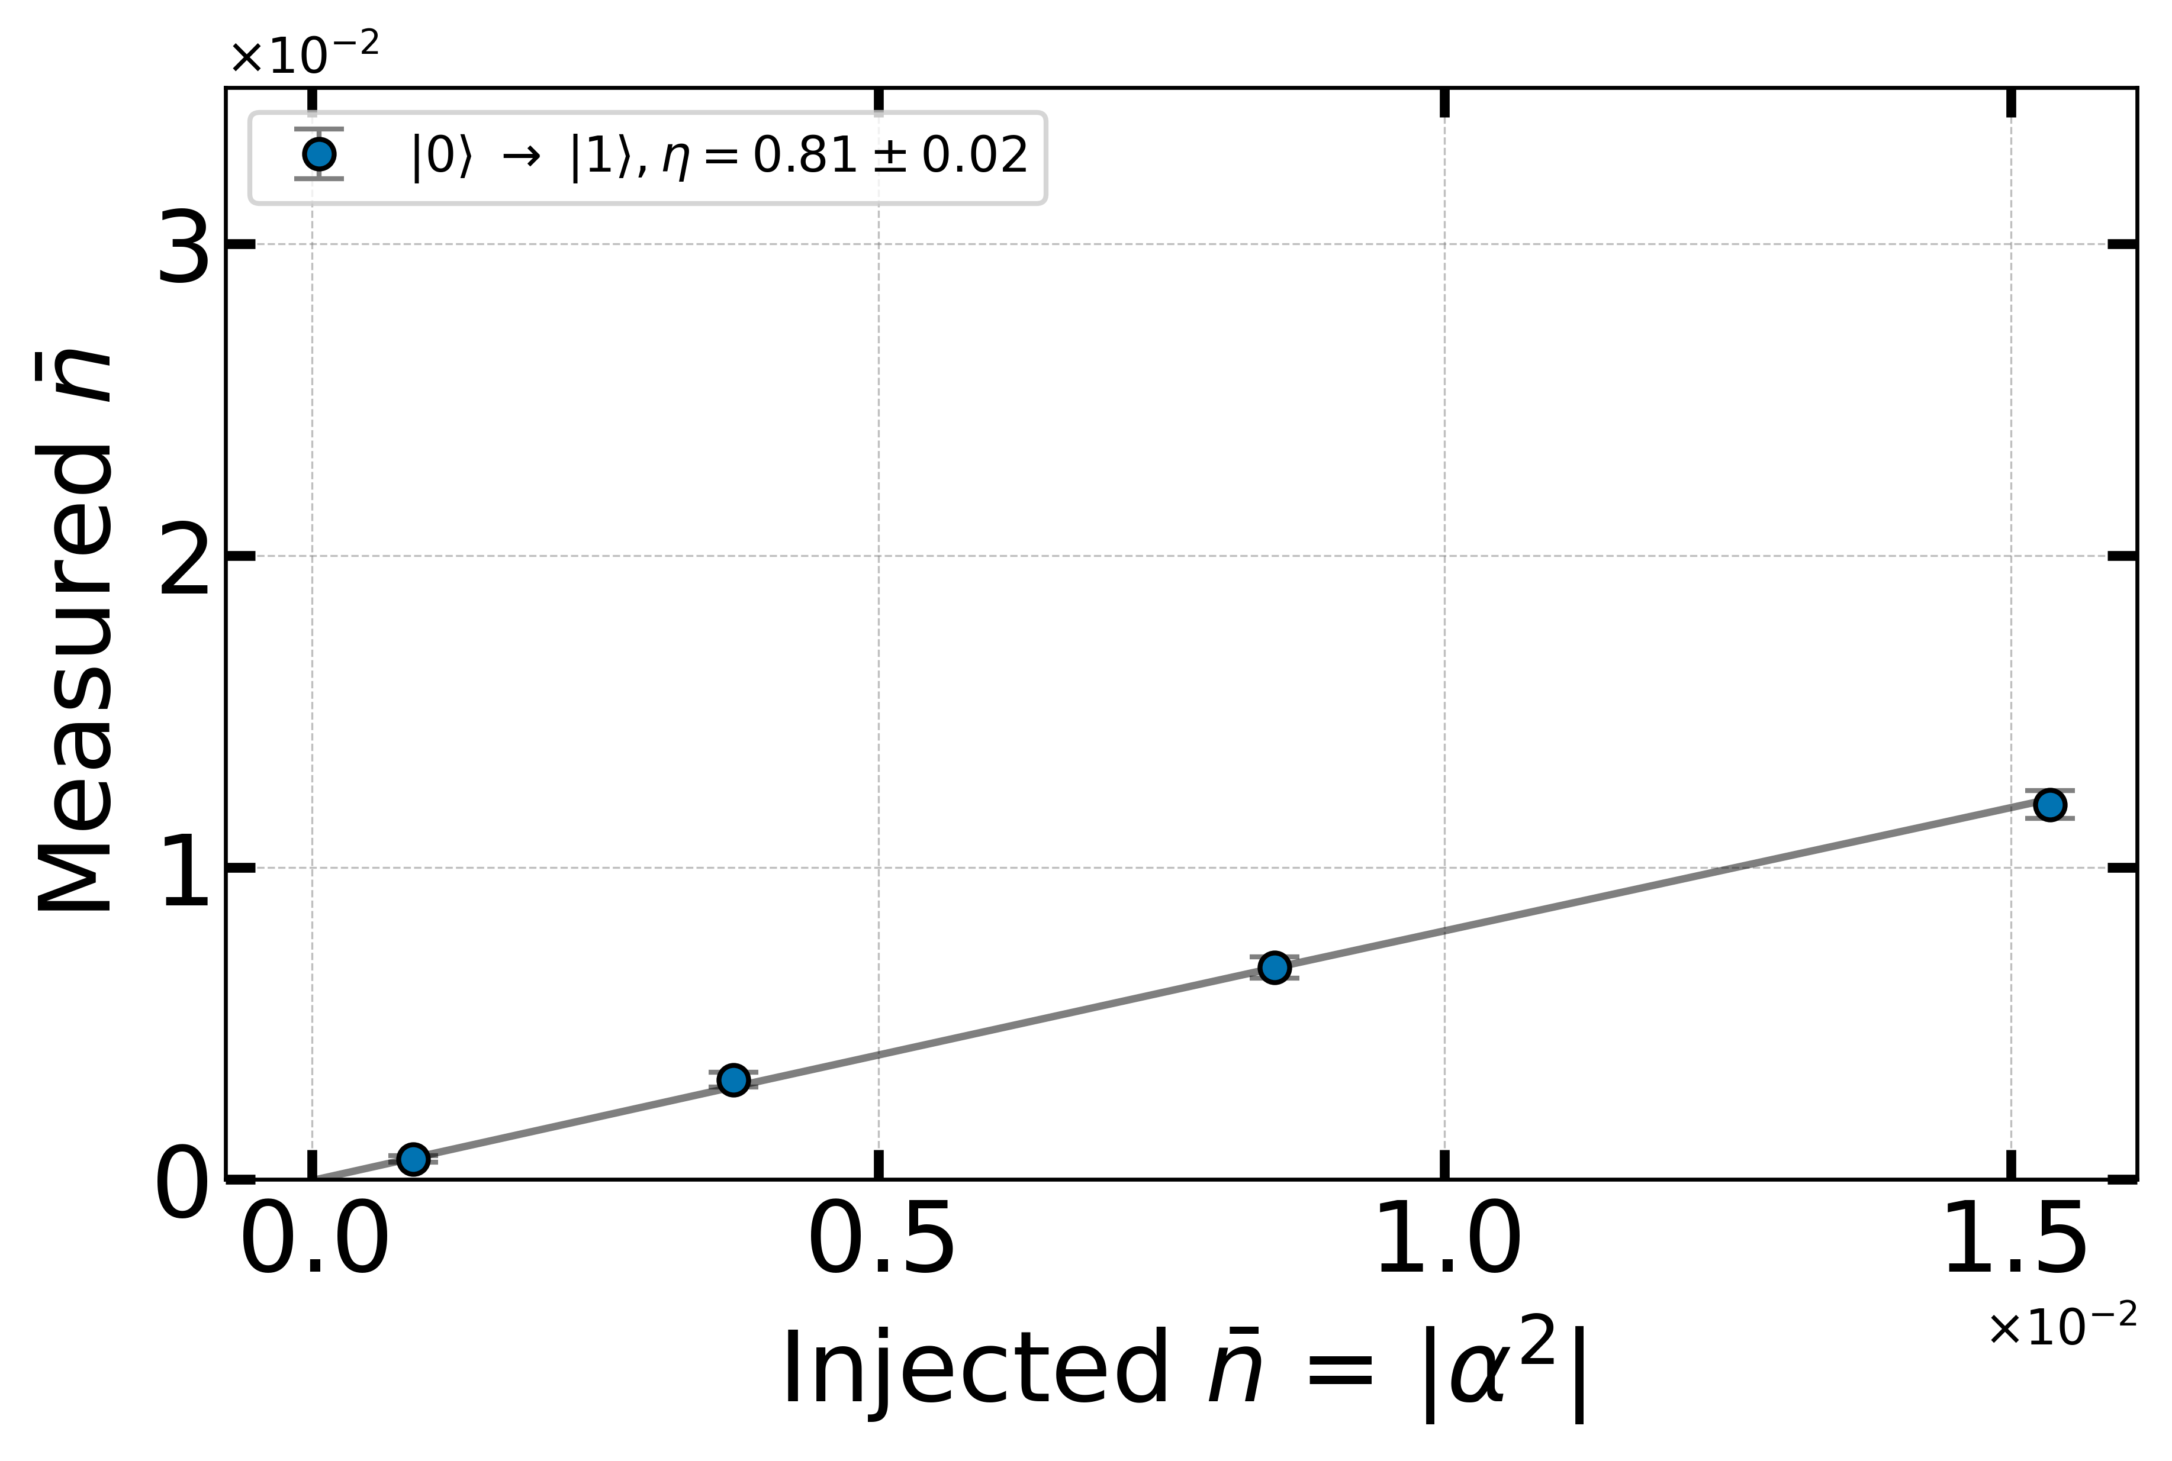
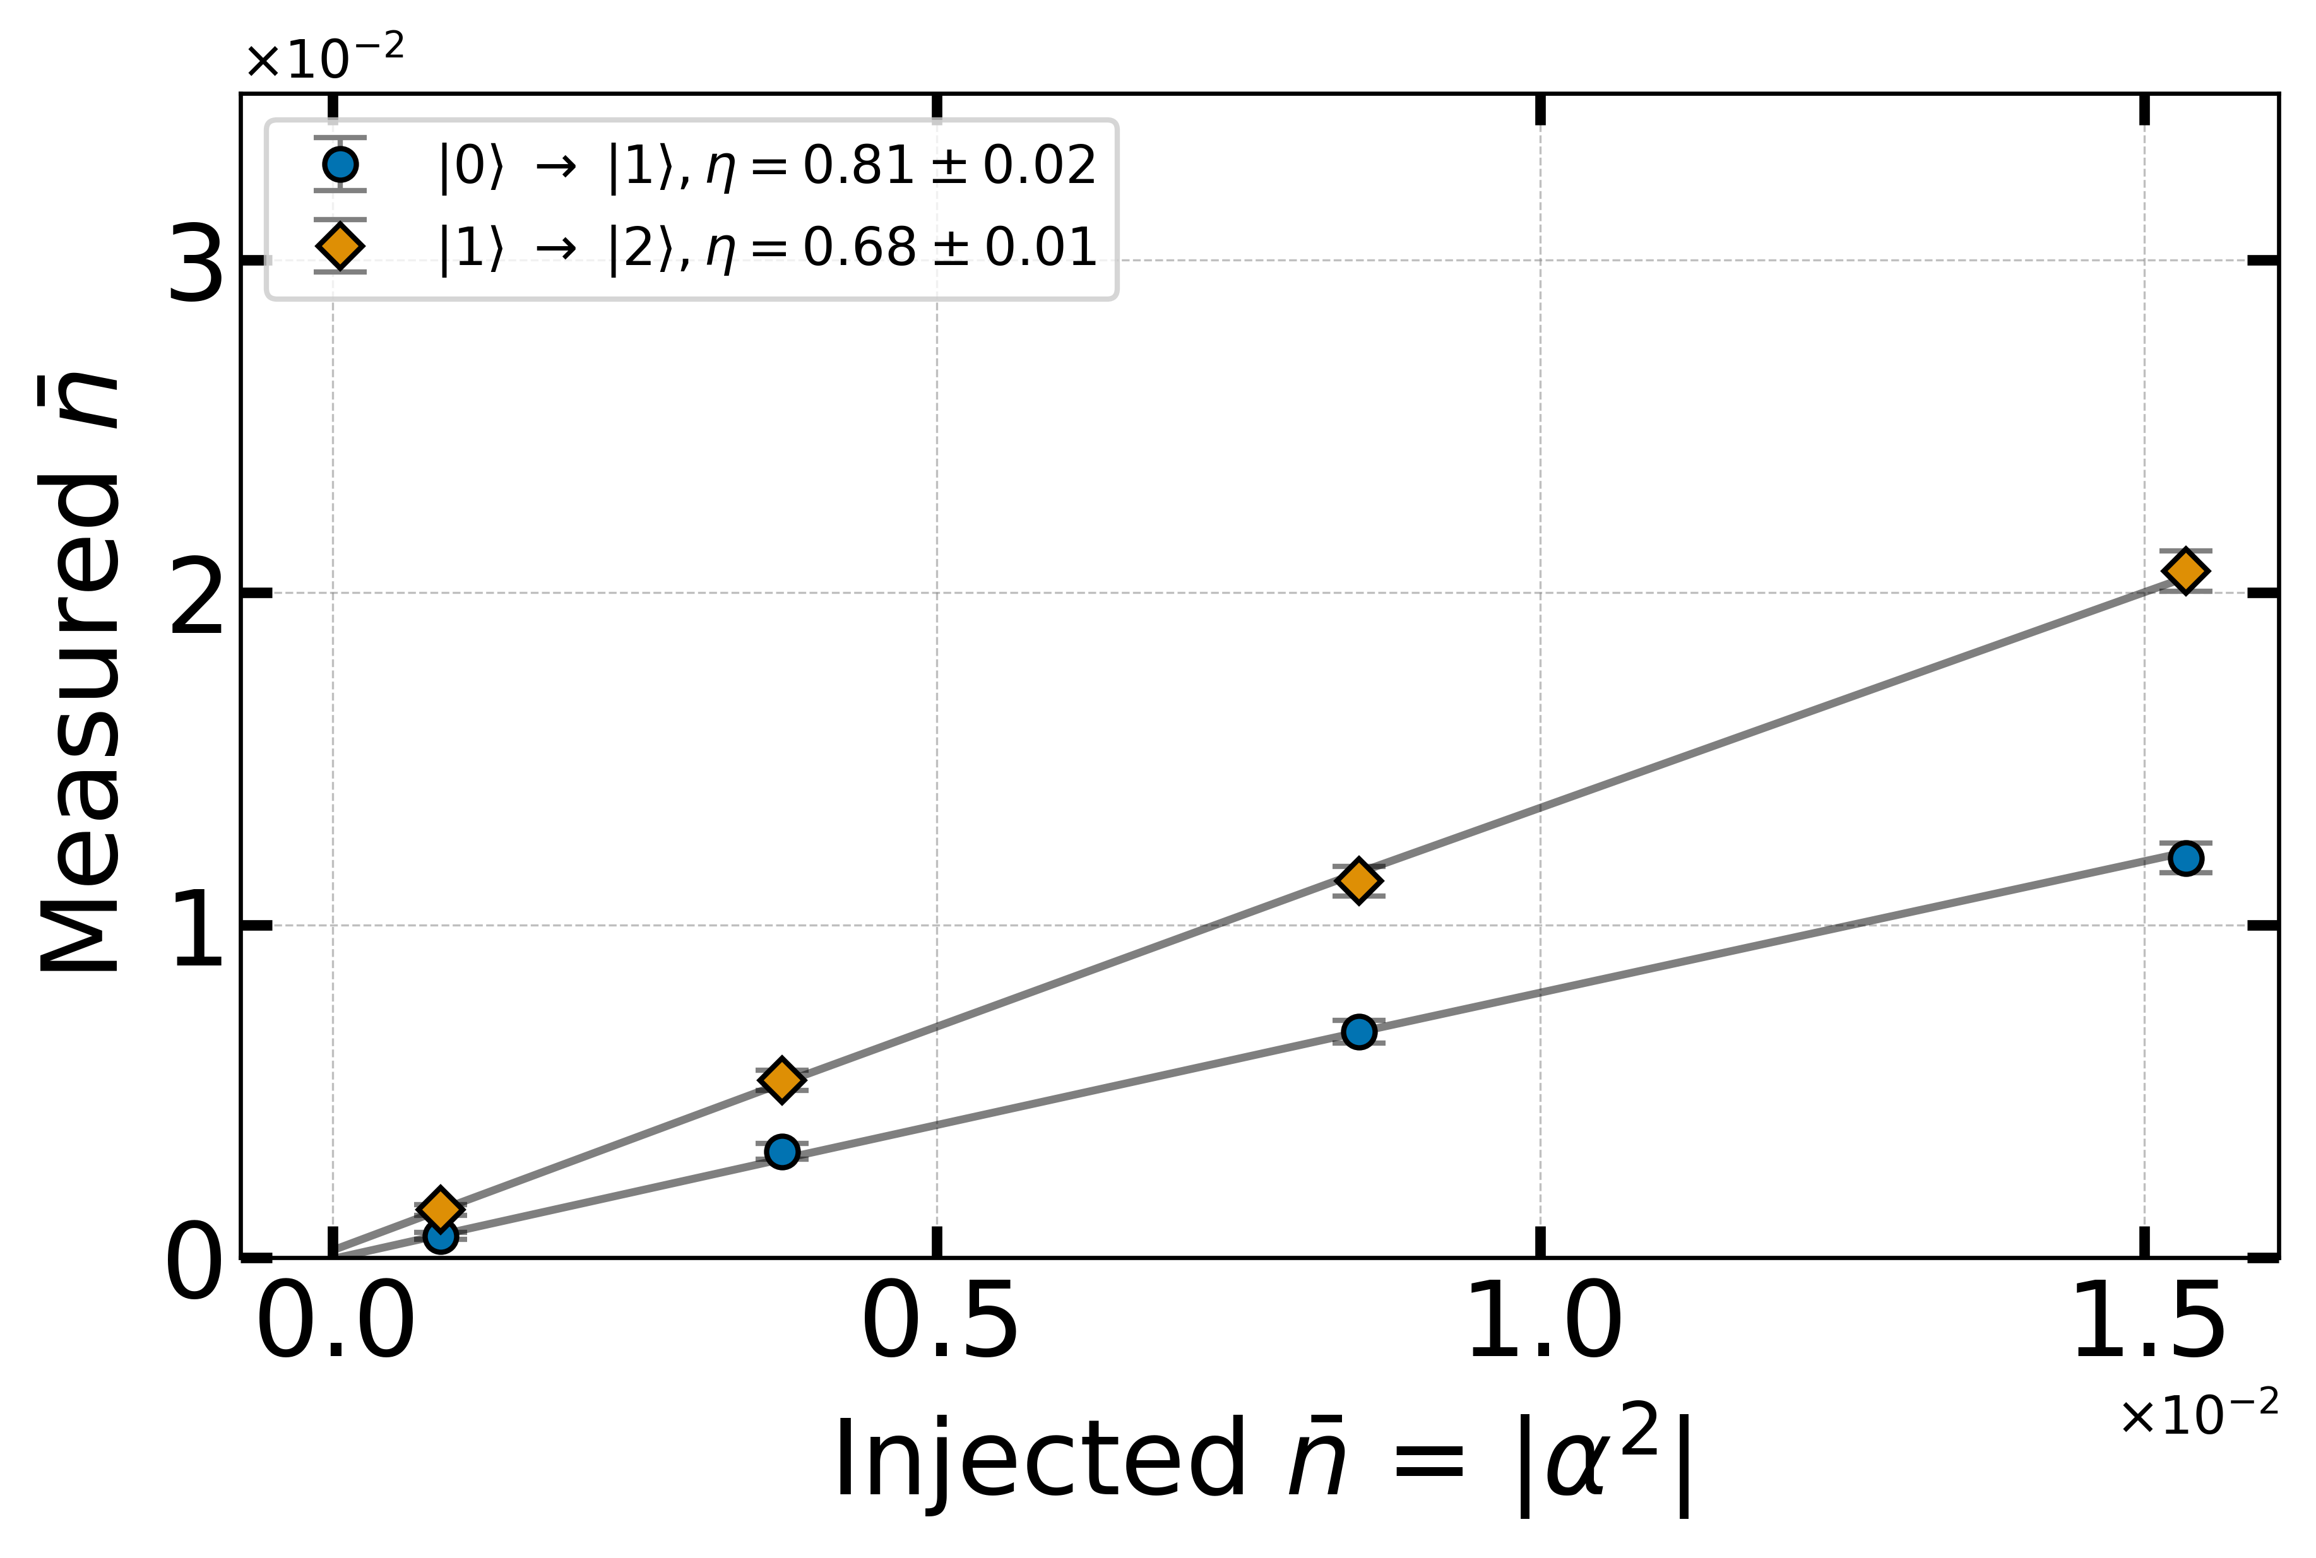
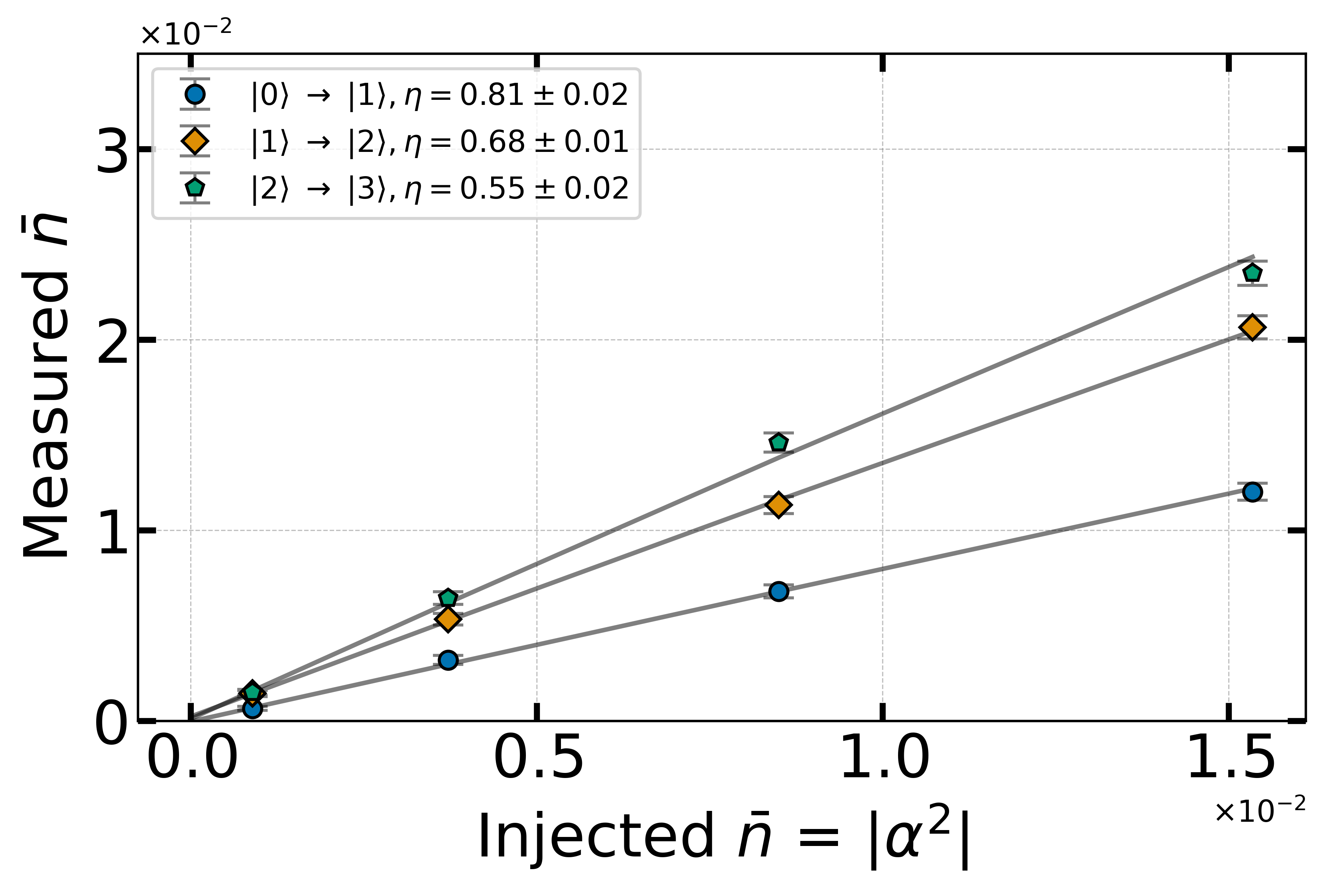
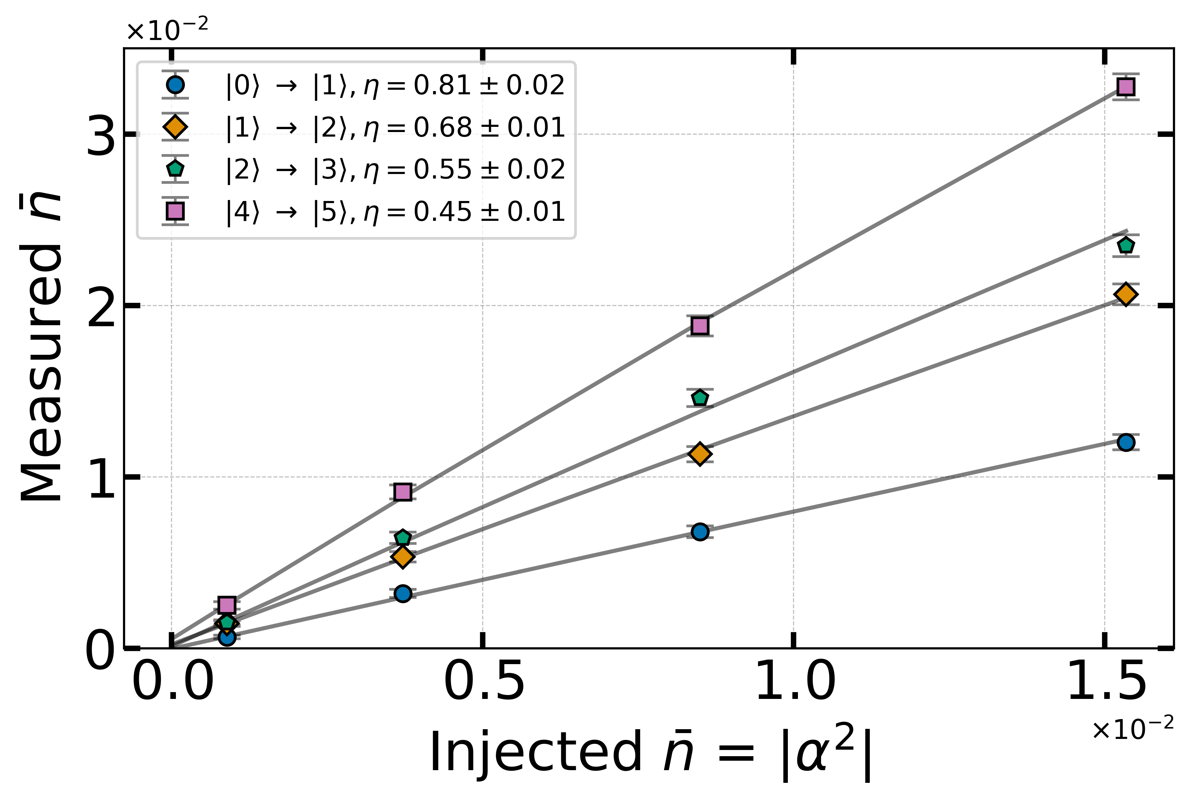
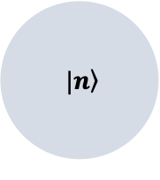
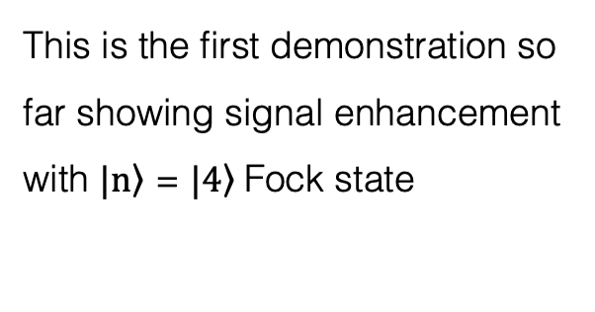

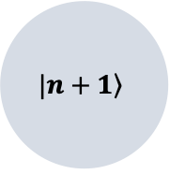
At fixed drive strength, stimulated emission creates a larger response
$$\left. |n\right\rangle$$
$$n_{inj}$$
$$\left.|n+1\right\rangle$$
This is the first demonstration so far showing signal enhancement with $\left.|n\right\rangle$ = $\left.|4\right\rangle$Fock state
Less than a factor of (n+1) due to measurement inefficiencies.
Dark matter scan rate df/dt ∝ (n+1)
→ Factor of 3 improvement
Ankur Agrawal et al., 2305.03700
Notes:
Given this experimental protocol, let me describe how we characterize the detector.
After initializing the cavity in a particular Fock state, we inject a mean photon number shown on the x-axis. Y-axis is the probability of finding the cavity in (n+1) given that the cavity started in the correct Fock state.
So, let’s start with the cavity in its ground state. As we inject more photons, we measure more as expected. Now, if we initialize the cavity in n=1 Fock state then we should see higher occupation probability.
And, we do! Let’s go even higher.
As we can see, the stimulated emission does enhance the signal.
In a previous work such enhancement with n=1 was reported in an ion-trap system.
However, this is the first demonstration of enhancing weak signals using n=4 Fock state.
You may be asking why n=3 is missing. Unfortunately, we see some anomalous behaviour with n=3 and we suspect it is due to leakage to other modes in the cavity. We have identified a couple of potential transition with other modes which could explain this.

Slide 22
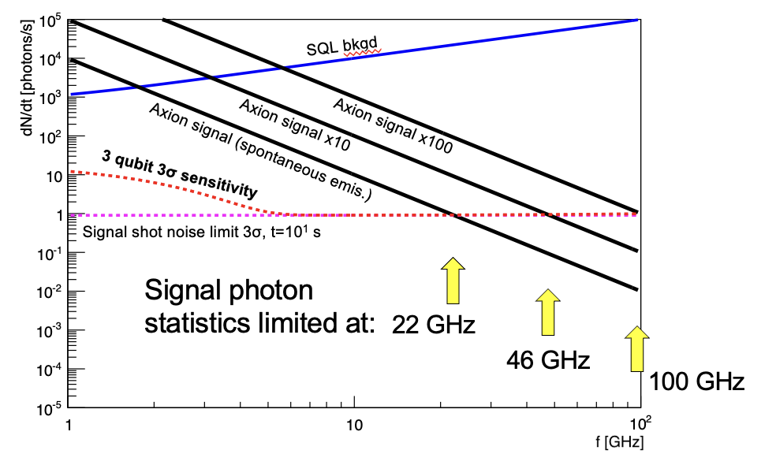
Using Q=10⁸ cavities (SC or sapphire), stimulated emission could boost axion signal by factors up to n=100. Trades Q=10⁸ → Q/n=10⁶ for large n
Not only increases SNR at lower masses, but also extends range to higher masses!
SQL bkgd
Axion signal x10
Axion signal x100
Axion signal (spontaneous emis.)
3 qubit 3σ sensitivity
Signal shot noise limit 3σ, t=10¹ s
Signal photon statistics limited at:
22 GHz
46 GHz
100 GHz
Al qubits limited f<30 GHz → Need higher frequency qubits made of higher Tc superconductor like NbN.
Bonus: maybe can operate these in situ in 9 T magnetic field due to higher Hc.

Slide 23
Quantum tricks like squeezing, stimulated emission will give a little boost to SNR, but eventually, we still need to buy/obtain big magnets to avoid being signal-limited!

Slide 24
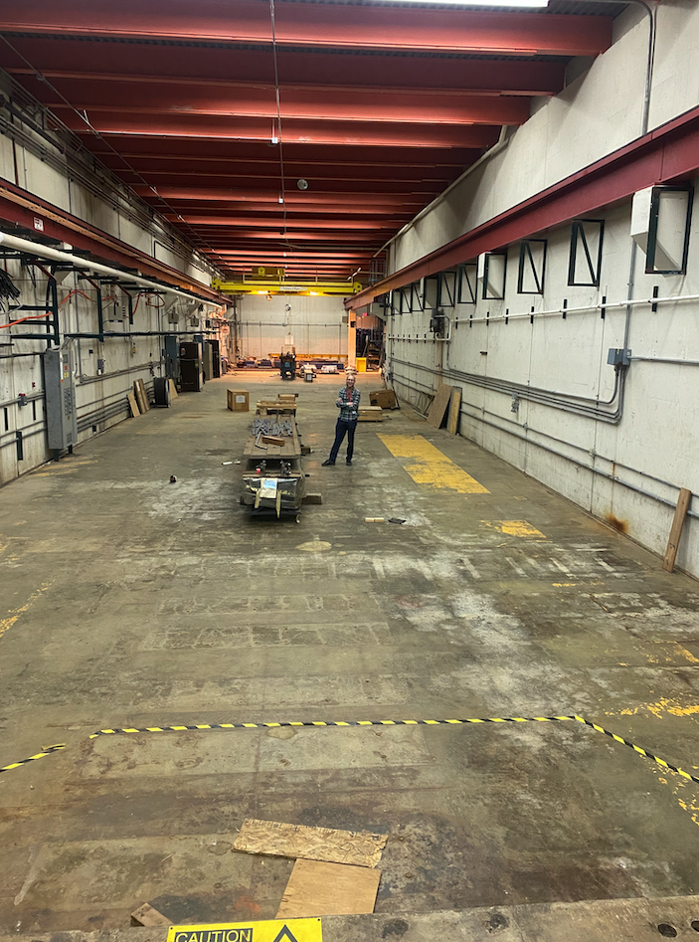
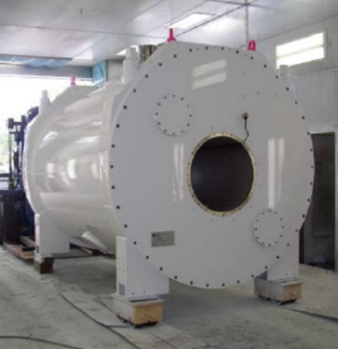
First step: Dark Wave Lab @FNAL
First 9.4 T, warm bore MRI magnet ~$7M to be moved to Fermilab this year for ADMX-EFR.
Can host other experiments.
PW8 building can house 2 magnets

Slide 25
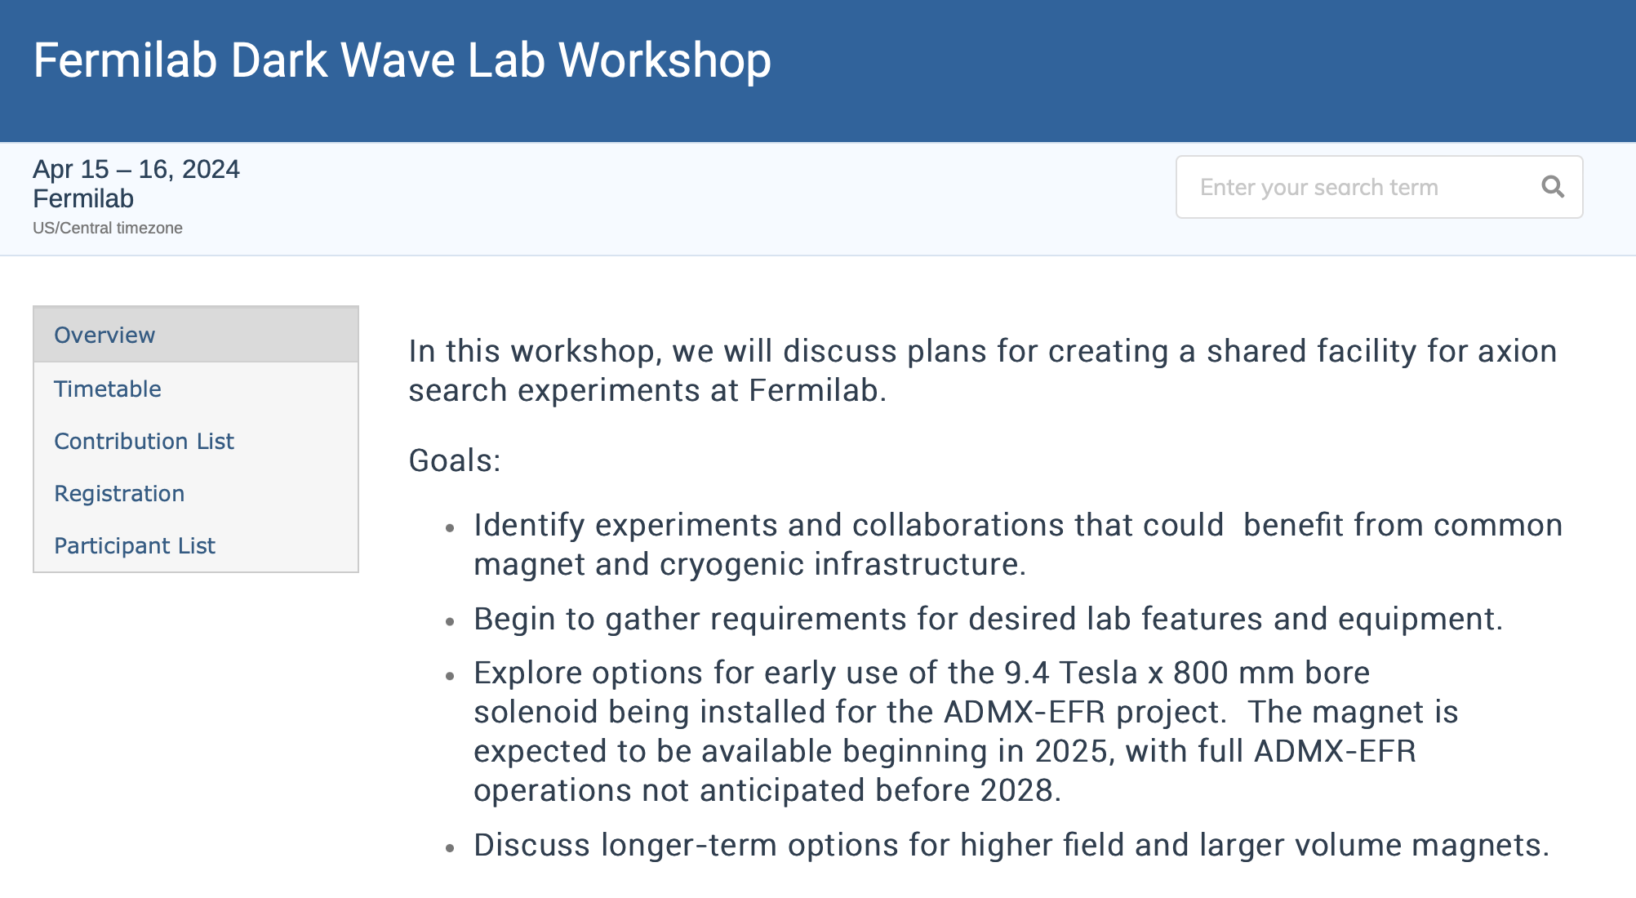

Slide 26
Backup slides

Slide 27
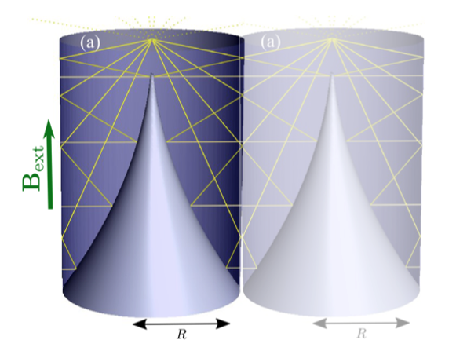
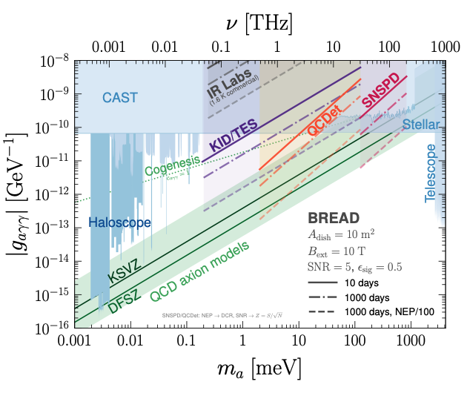
Cannot reject QP backgrounds in detectors that rely on Cooper pair-breaking!
BREAD experiment: Need to reduce best qubit SPD dark count rates by factor 10⁴ !!!
Dark Count Rates:
DCR=1 Hz
10⁸ counts in t=10⁸ s
DCR=10⁻⁴ Hz (!)
10⁴ counts in t=10⁸ s
photon-axion coupling
Signal rate
R_{s} ~ 10⁻⁶ Hz
100 counts in t=10⁸ s
R_{s} limit ~ sqrt(R_{b} / t)

Slide 28
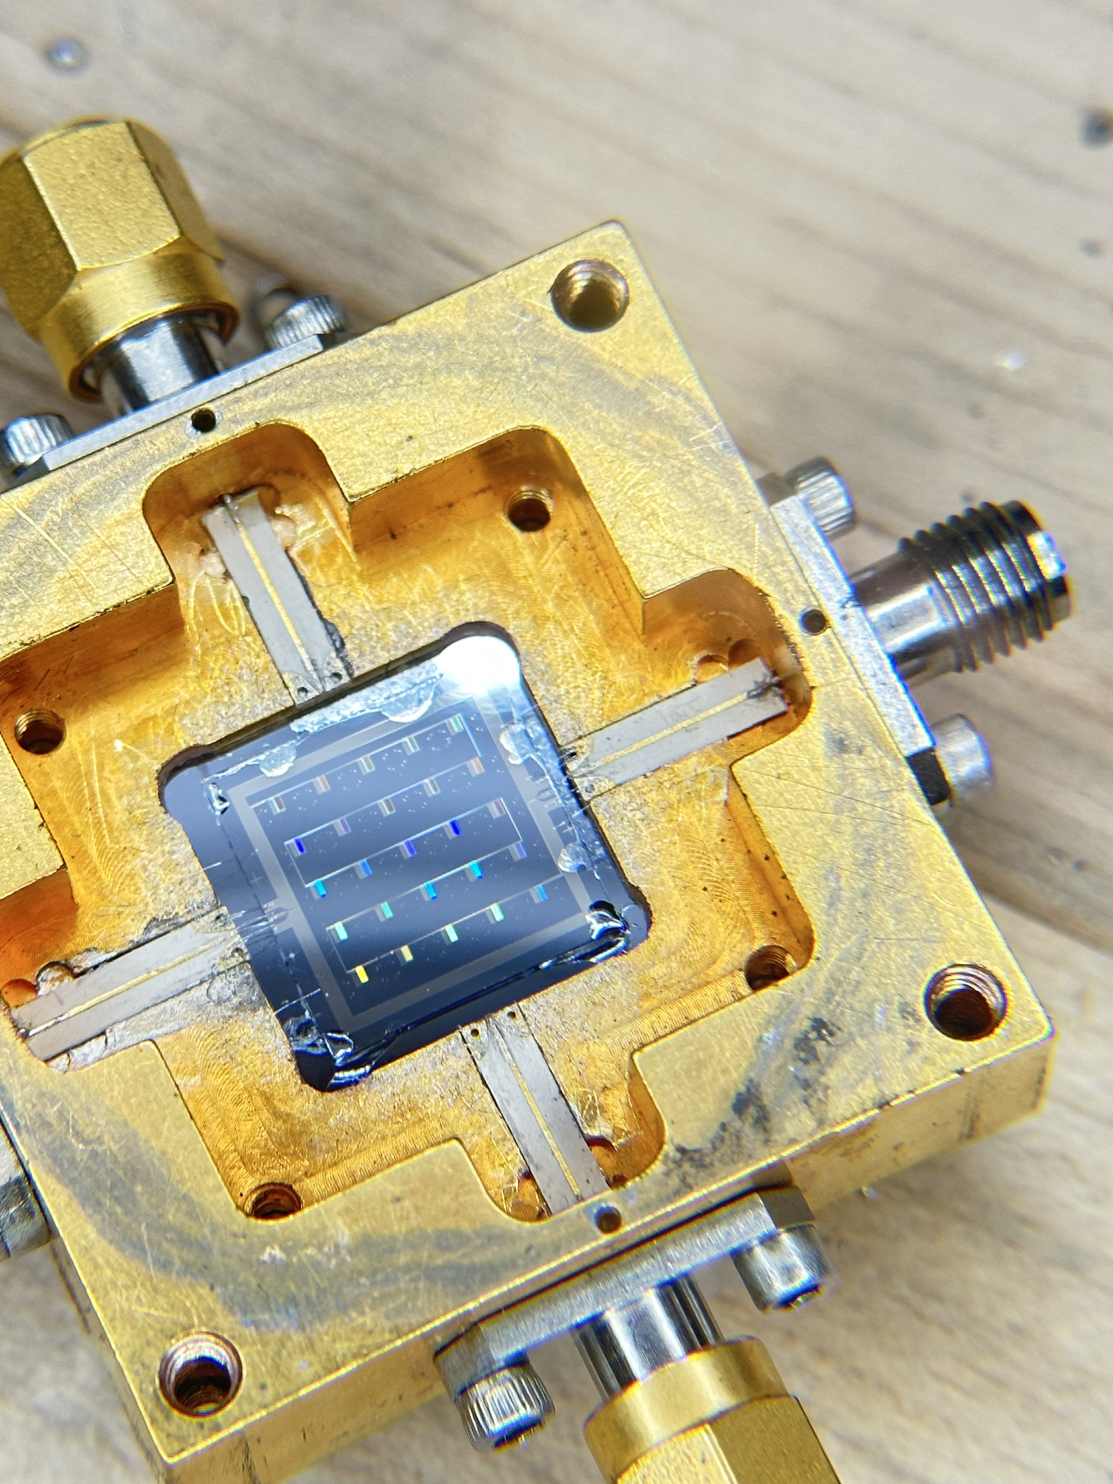
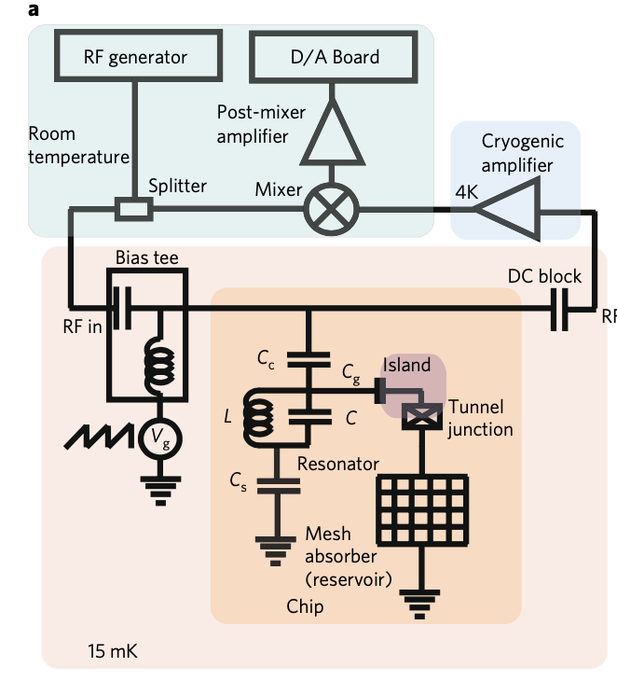
Quantum Capacitance Detector based on charge-parity switching in charge qubit.
Detect QPs from broken Cooper pairs after absorption of single THz photon.
A QCD pixel
Lowest noise-equivalent power of any THz sensor,
DCR = 1 Hz
P. Echternach, A. Beyer, and C. Bradford (2021)
https://doi.org/10.1117/1.JATIS.7.1.011003
Echternach, P. M., et al. Nature Astronomy 2.1 (2018): 90-97.

Slide 29


Backgrounds for single photon / phonon detectors
Unwanted electron-like quasiparticles from broken Cooper pairs are a direct background for qubit-based photon/phonon detectors. They scramble the information stored these single quantum Cooper pair oscillators.
Potential energy
diagram for qubit
No fair playing Dodgeball when kid is stuck in the swing!
Qubit
J. Wenner, et al., PRL 110, 150502 (2013)
A quasiparticle tunneling through the Josephson junction transfers energy/momentum from/to the qubit oscillator. This changes the qubit’s state and creates a false positive detection.

Slide 30


Qubits are also great phonon sensors: Acoustic noise from substrate microfracture events are currently far worse than ionizing radiation!
R. Anthony-Petersen… M. Pyle, et al.,
arxiv:2208.02790
Measure spectrum using tiny, cold, low heat capacity TES sensors developed for the SuperCDMS dark matter search.
Next-generation microcalorimeters will reduce thresholds to milli-eV, provide first look at sub-eV spectrum.
Mitigating these low energy disturbances will be critical to achieving low dark count rates in low threshold single photon/phonon detectors.
Mechanical noise
Ionizing radiation

Slide 31


Workshop to define strategy for the US HEP quantum sensors program

Slide 32


QCD axion motivated by the Strong-CP Problem:
Why is the neutron electric dipole moment so small?
Norman Ramsey
Nobel Prize 1989
Naive estimate gives
nEDM ≈ 10⁻¹⁶ e-cm
Violates both:
P (spatial inversion)
CP (time reversal)
nEDM not yet detected after 70+ years of spin precession experiments
10⁻¹⁵ m
Need CP-violating phase angle θ to create charge asymmetry. But QCD theory contains this!

Slide 33

Natural cosmological potential energy function would cause a putative dynamical axion field A to zero out the CP-violating angle θ_{total}
Axion
Λ_{QCD}⁴
θ_{total}=0
at potential minimum
VEV f_{a} > 10⁹ GeV

Slide 34






Axion dark matter = waves of oscillating $θ$_{CP}
QCD phase transition creates residual oscillations of the QCD θ angle about its CP-conserving minimum:
Cosmological feedback loop zeroes out <$θ$_{CP}> to explain the vanishing of the neutron EDM
ρ_{a}
Local axion density
where
DM oscillations partially undo the Peccei-Quinn mechanism by enabling the coherent field to climb out of the potential minimum. Signal strength suppressed by 𝚲_{QCD}, not by f_{a}.
Phenomenology based on a classically oscillating
CP-violating angle which:
Rotates B-fields into E-fields
Creates ac nucleon EDMs
Creates ac torques on fermion spins
(E)
$$θ$$
(B)

