Slide 1
New Ideas for Low-Frequency Gravitational Wave Detection with Quantum Sensors (MAGIS/AION)
SQMS Quantum for Science Workshop, March 2024
Tim Kovachy
Department of Physics and Astronomy and Center for Fundamental Physics (CFP), Northwestern University

Slide 2
Overview
Brief introduction to atom interferometry
Long-baseline atom interferometers for gravitational wave (GW) detection
  Global landscape of long-baseline atom interferometers
  MAGIS-100 atom interferometer at Fermilab
Recent experiments on enhancing atom interferometers using quantum optimal control (work supported by SQMS)
See also talk by Oliver Buchmueller

Slide 3
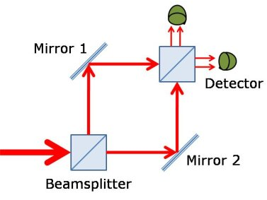
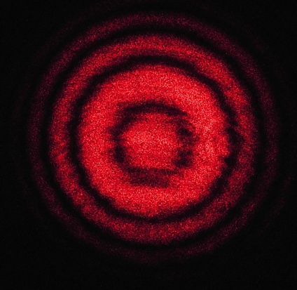
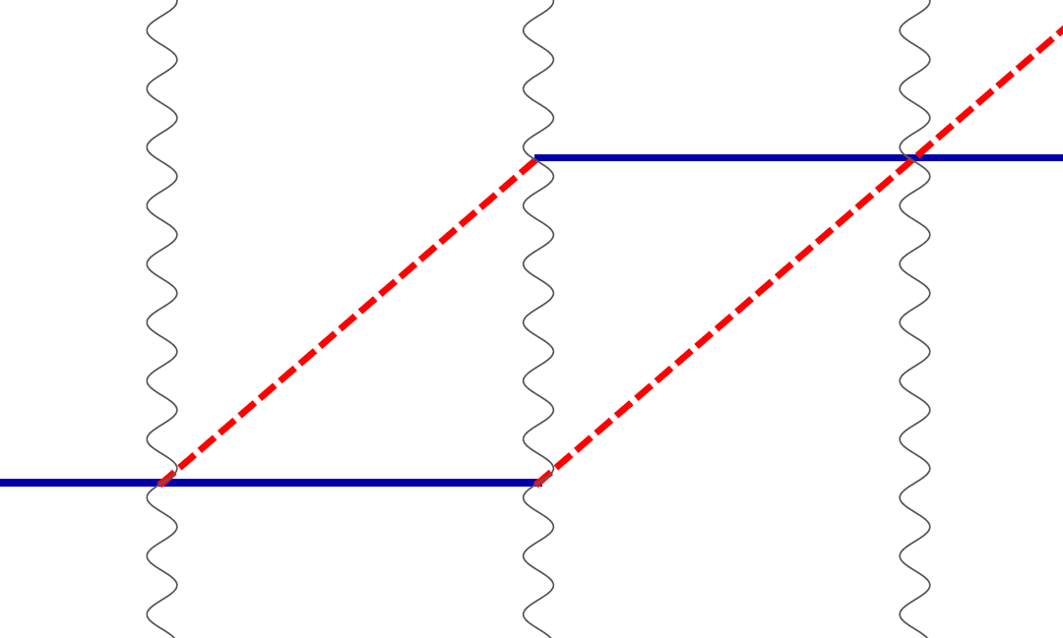
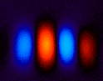
Atom interference
Light interferometer
Light
Light fringes
Atom interferometer
Beamsplitter
Atom fringes
Atom
Beamsplitter
Mirror

Slide 4

Atom optics using light
(1) Light absorption (transition from ground to excited state):
ħk
v = ħk/m
(2) Stimulated emission (transition from excited to ground state):
v = ħk/m
ħk

Slide 5
Atom optics using light
(1) Light absorption:
Rabi oscillations
ħk
v = ħk/m
(2) Stimulated emission:
v = ħk/m
ħk
Time

Slide 6
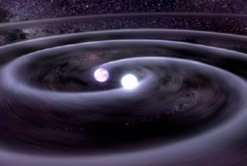
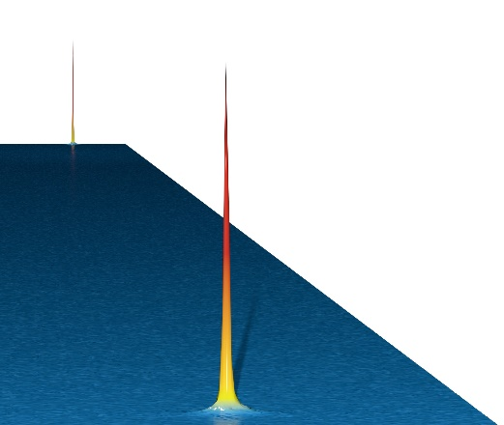
Long-Baseline Atom Interferometeters: Science Motivation
Search for wavelike dark matter
  Oscillating atomic transition frequencies
  Oscillating species-dependent accelerations
  Spin precession
Gravitational wave detection in new, mid-band frequency range (0.03 – 3 Hz)
  Complementary to program of laser interferometer detectors such as LIGO and LISA
  Promising to detect GWs generated during the early Universe, probe of high energy physics
  Provide forewarning to electromagnetic telescopes in advance of merger
Fundamental tests of quantum mechanics at macroscopic scales
  Delocalizations >1 m for multiple seconds
  Test fundamental decoherence mechanisms, non-linear quantum mechanics
Graham et al., PRD 93, 075029 (2016); Arvanitaki et al., PRD 97, 075020 (2018); Graham et al., PRD 97, 055006 (2018)

Slide 7
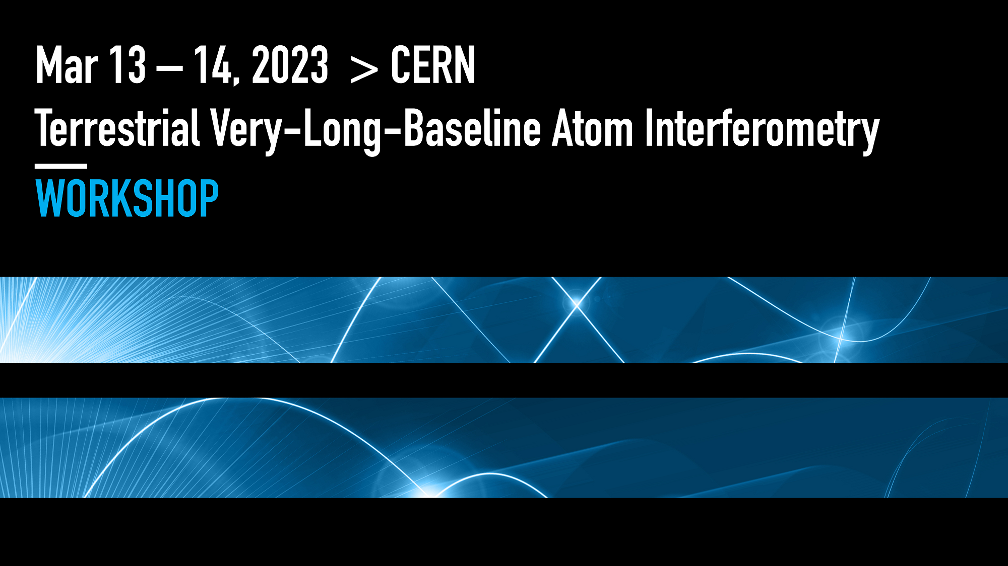
Global Efforts in Long-Baseline Atom Interferometry
- Growing global community in this area
- Example: CERN Very-Long-Baseline Terrestrial Atom Interferometry Workshop, March 13-14 (2023): ~200 registered participants. https://indico.cern.ch/event/1208783/
MAGIS-100 in US (Abe et al., QST 6, 044003 (2021))
AION in UK (Badurina et al., J. of Cosmology and Astrophysics 05 (2020) 011)
MIGA in France (Canuel et al., Scientific Reports 8, 14064 (2018))
ZAIGA in China (Zhan et al., International Journal of Modern Physics D 29, 1940005 (2020))
VLBAI in Germany (Hartwig et al., New Journal of Physics 17, 035011 (2015))
- Community is also studying prospects for future space-based detectors (Abou El-Neaj et al., EPJ Quantum Technology 7, 6 (2020)); synergies with related proposals using optical lattice clocks in space (Kolkowitz et al., PRD 94, 124043 (2016))
Workshop summary: Abend et al., arXiv:2310.08183 (2023), in press AVS Quantum Science

Slide 8
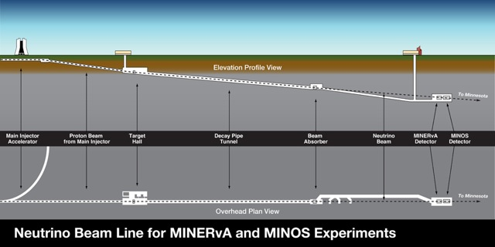
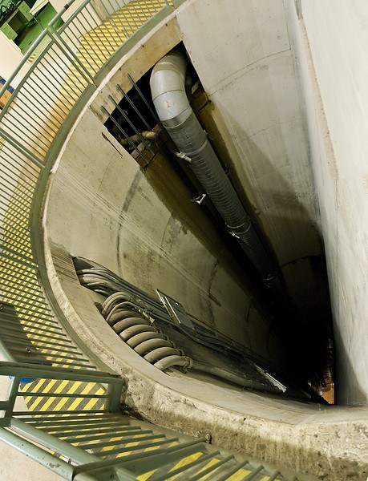











MAGIS-100 detector at Fermilab
Matter wave Atomic Gradiometer Interferometric Sensor
Source 1
50 meters
100 meters
Source 2
50 meters
Source 3
- 100-meter-tall atom interferometry apparatus
- Quantum mechanics at very large scales
- Search for dark matter
- Prototype for a new type of gravitational wave detector
Abe et al., Quantum Science and Technology 6, 044003 (2021)

Slide 9
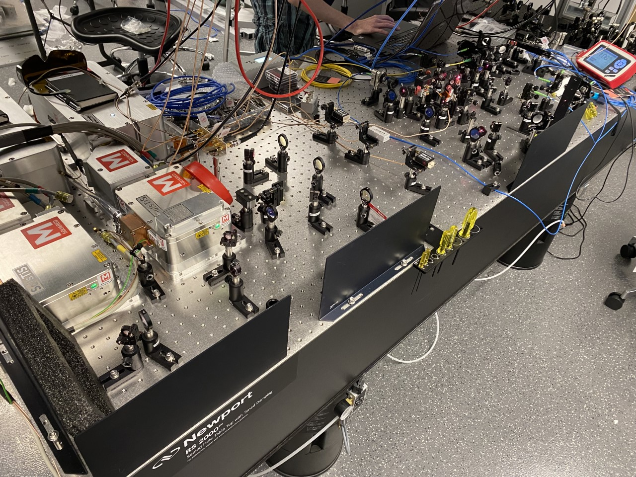
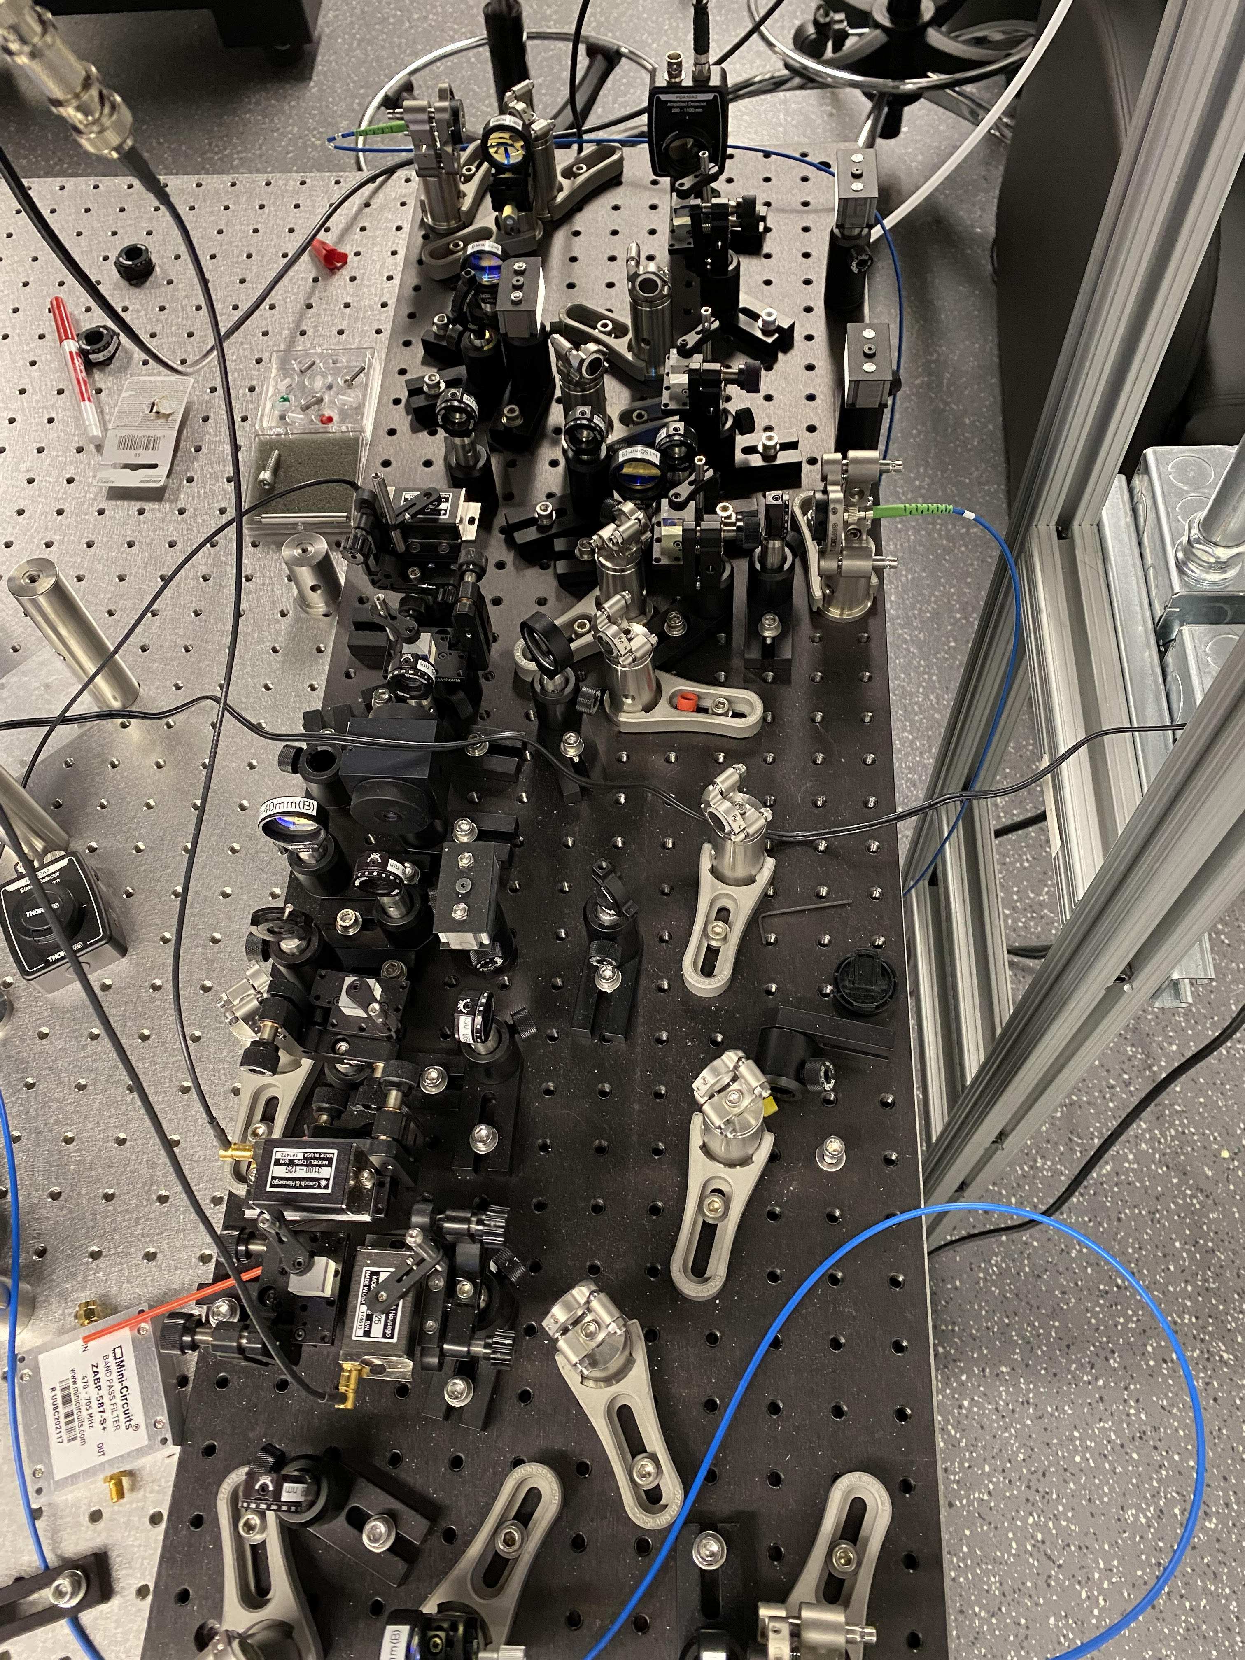
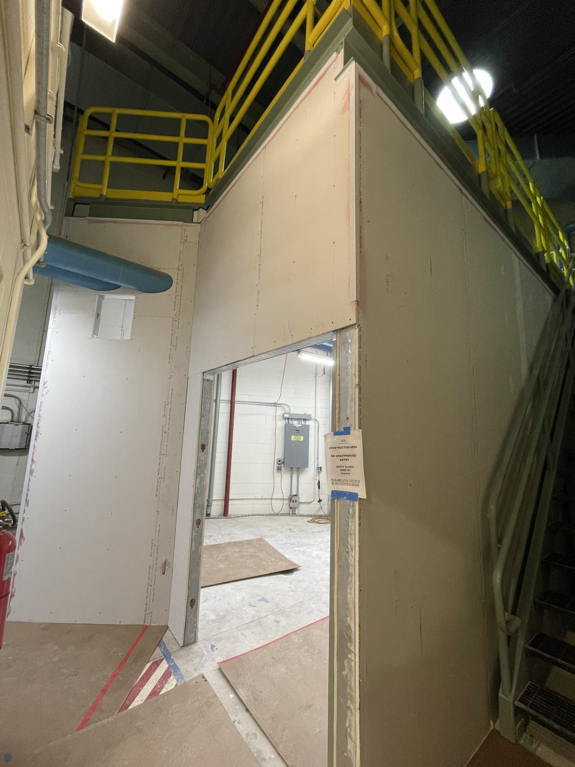
MAGIS-100 Experiment
Modular vacuum section
Cold atom source
Magnetic shield
Interferometry laser system
17 modules, each with magnetic shielding, vacuum pipe, current-carrying wires for generating bias magnetic field
Laser lab at top of shaft (currently undergoing construction)
Three Sr atom sources over 100 m baseline, local optical lattices can launch atoms from each source
High-power laser system with agile frequency control, spatially filtered beam mode, and precisely controlled pointing via tip-tilt mirrors
Construction and testing of subsystems underway
In-vacuum tip-tilt mirror
Laser lab

Slide 10





Measurement Concept
Freely-falling atoms on each end serve as inertial references
Atomic
clock
Atoms act as clocks to measure light travel time across baseline:
“active proof mass”
Multiple pulses across baseline coherently enhance signal
Atomic
clock
Two ways for phase to vary:
Differential phase evolution:
Dark matter
Gravitational wave
Yu and Tinto, GRG 43, 1943 (2011); Graham et al., PRL 110, 171102 (2013); Arvanitaki et al., PRD 97, 075020 (2018); Norcia et al., PRA 96, 042118 (2017)

Slide 11
Strontium clock atom interferometry
Sr has a narrow “optical clock” transition at 698 nm with a long-lived excited state (natural lifetime >100 s)
Atom optics based on absorption/stimulated emission of photons on this 698 nm line
Can also use 689 nm line, higher Rabi frequency but shorter excited state lifetime
Hybrid clock/atom interferometer
Long-lived superposition of internal states with large energy difference: clocklike features
Atom wavefunction spatially splits due to photon momentum recoils: atom interferometer features
Hu et al., PRL 119, 263601 (2017); Rudolph et al, PRL 124, 083604 (2020)

Slide 12
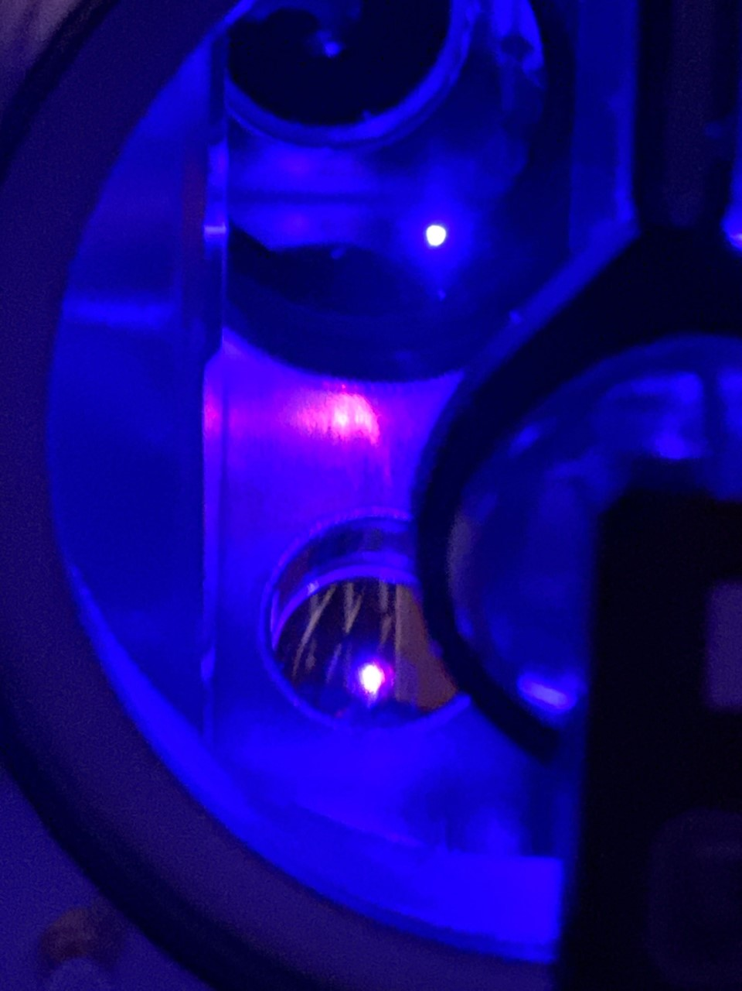
Resonant Atom Interferometry
Proposed for multiple types of dark matter, gravitational wave, and dark energy searches in terrestrial and space experiments
Multiple interferometer loops (N loops) can amplify signal by a factor of 2N at the resonance frequency
Analogy to lock-in detection and dynamical decoupling
Implement using MAGIS laser system with Sr-88 atom interferometer at Northwestern, using single-photon transitions on 689 nm line
Graham, et al., PRD 94, 104022 (2016); Coslovsky et al., Slow Light, Fast Light and OptoAtomic Prevision Metrology X (2017); Jaffe et al. PRL 121, 040402 (2018); Kim et al., arXiv:2201.11888 (2022); Chiow and Yu, PRD 97, 044403 (2018)

Slide 13
Challenges
Hard to make a good atom mirror! Mirror pulse fidelity never perfect due to experimental tradeoffs and imperfections
- Finite atom cloud temperature and size, laser intensity inhomogeneity across atom cloud, etc…
Perform experiments with constraints on atom mirrors representative of expectations for MAGIS-100
How many loops can we do?

Slide 14
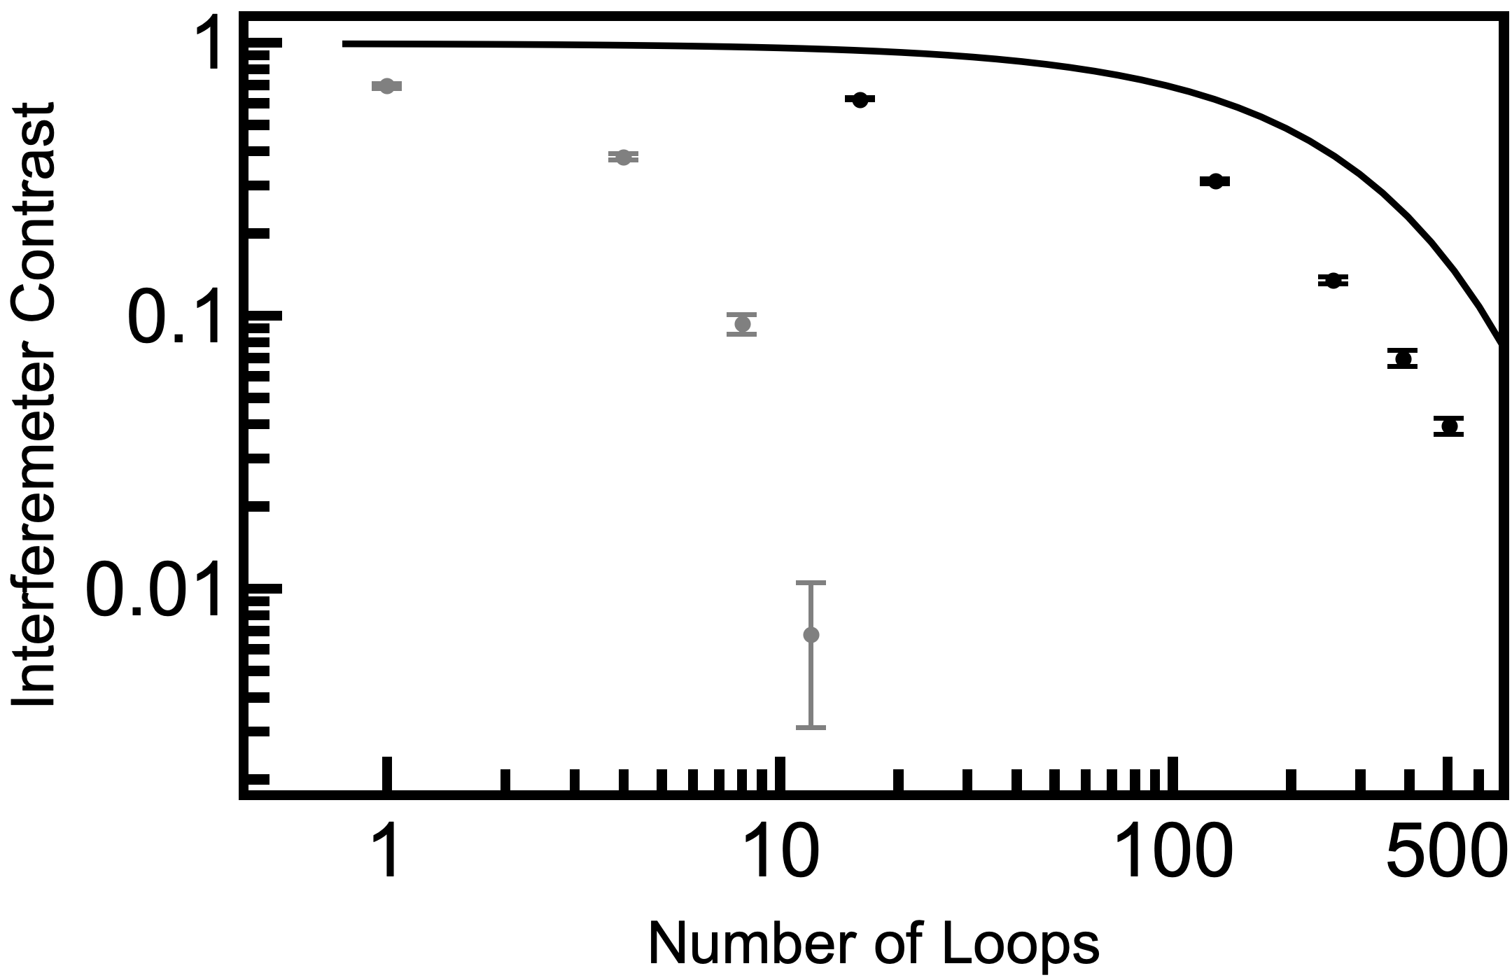

Challenges
Hard to make a good atom mirror! Mirror pulse fidelity never perfect due to experimental tradeoffs and imperfections
- Finite atom cloud temperature and size, laser intensity inhomogeneity across atom cloud, etc…
Perform experiments with constraints on atom mirrors representative of expectations for MAGIS-100
How many loops can we do?

Slide 15

The Ideal (Unrealistic) Case
Perfect atom mirrors
Position
Time

Slide 16

The Realistic Case
Imperfect atom mirrors
Atoms branch off into stray trajectories, which can interfere with each other (multipath interference)
Position
Time

Slide 17
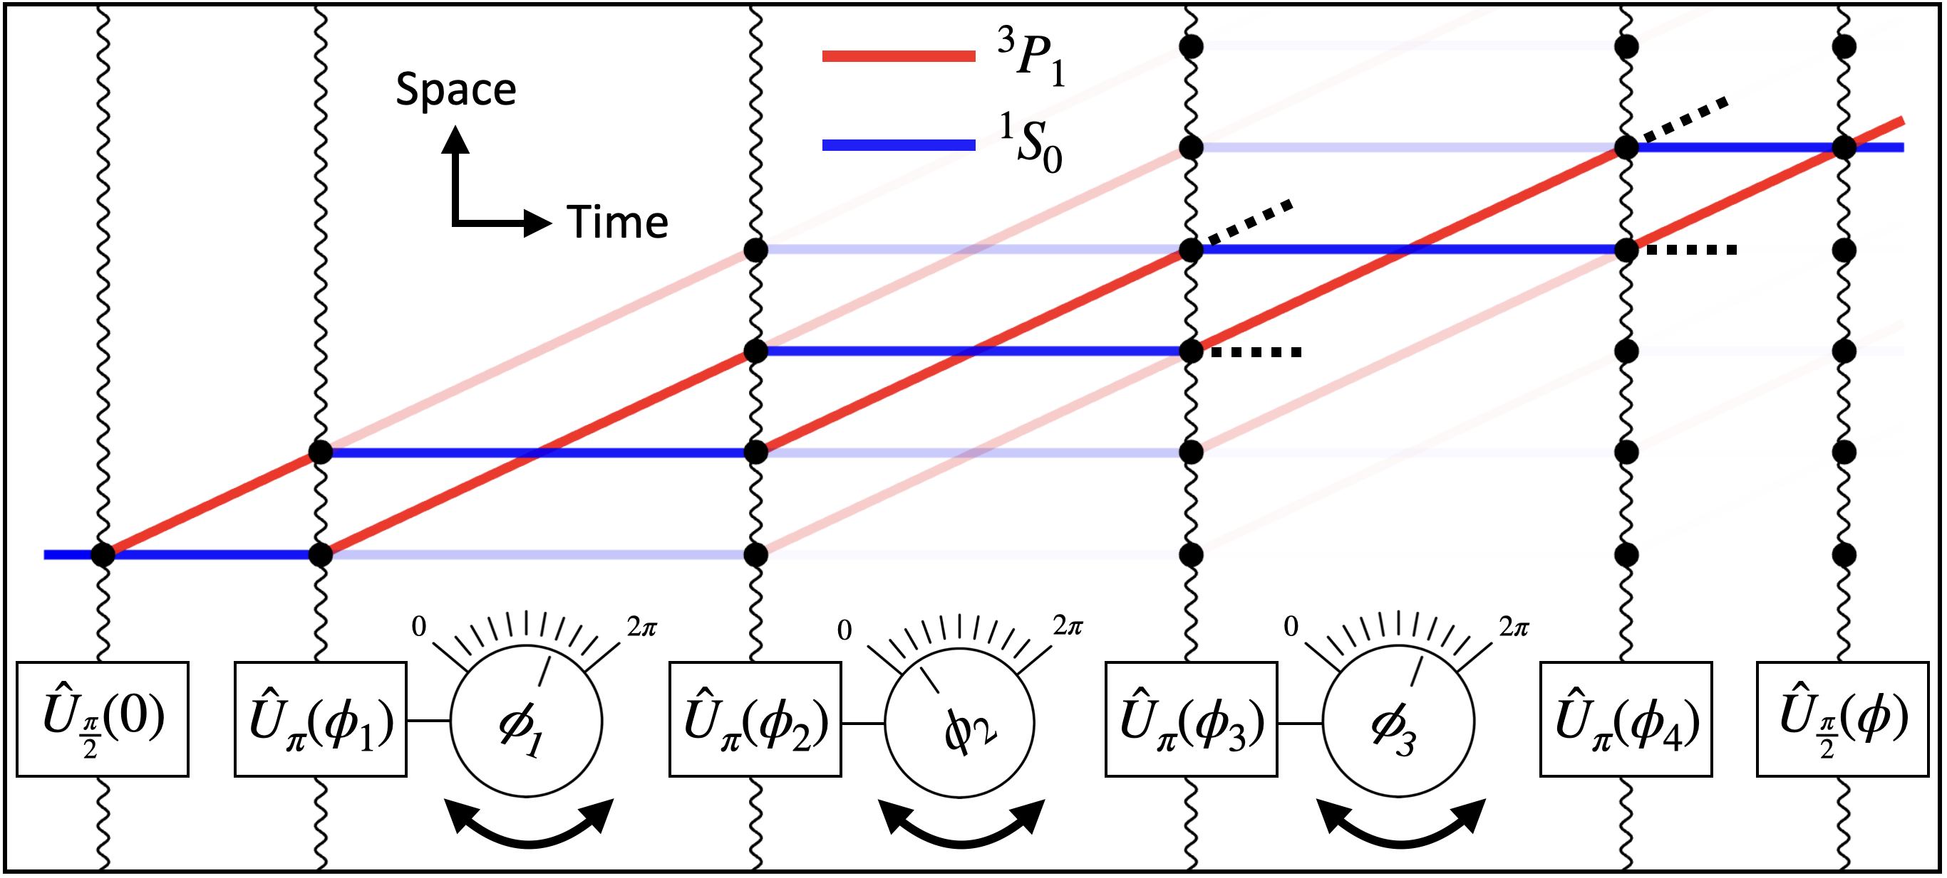
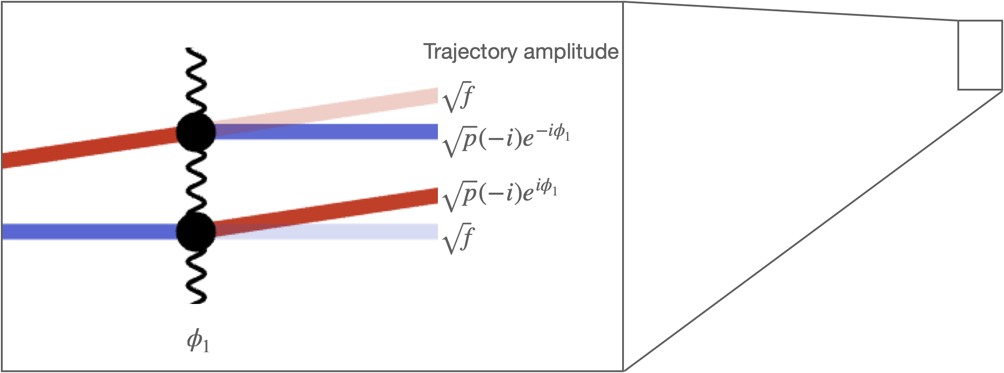
Overcoming the Challenge: Applying Quantum Optimal Control to Multipath Interference
Control variables: phases of various mirror pulses
  Open-loop approach: numerical algorithm to minimize a specified cost function based on simulations of experiment
  Closed-loop approach: use input from experimental data

Slide 18
Our Solution
Choose cost function to:
-maximize probability that stray paths constructively recombine into “central family” of trajectories that overlap with ideal paths
-suppress spreading of atom trajectories through destructive interference
Position
Time

Slide 19
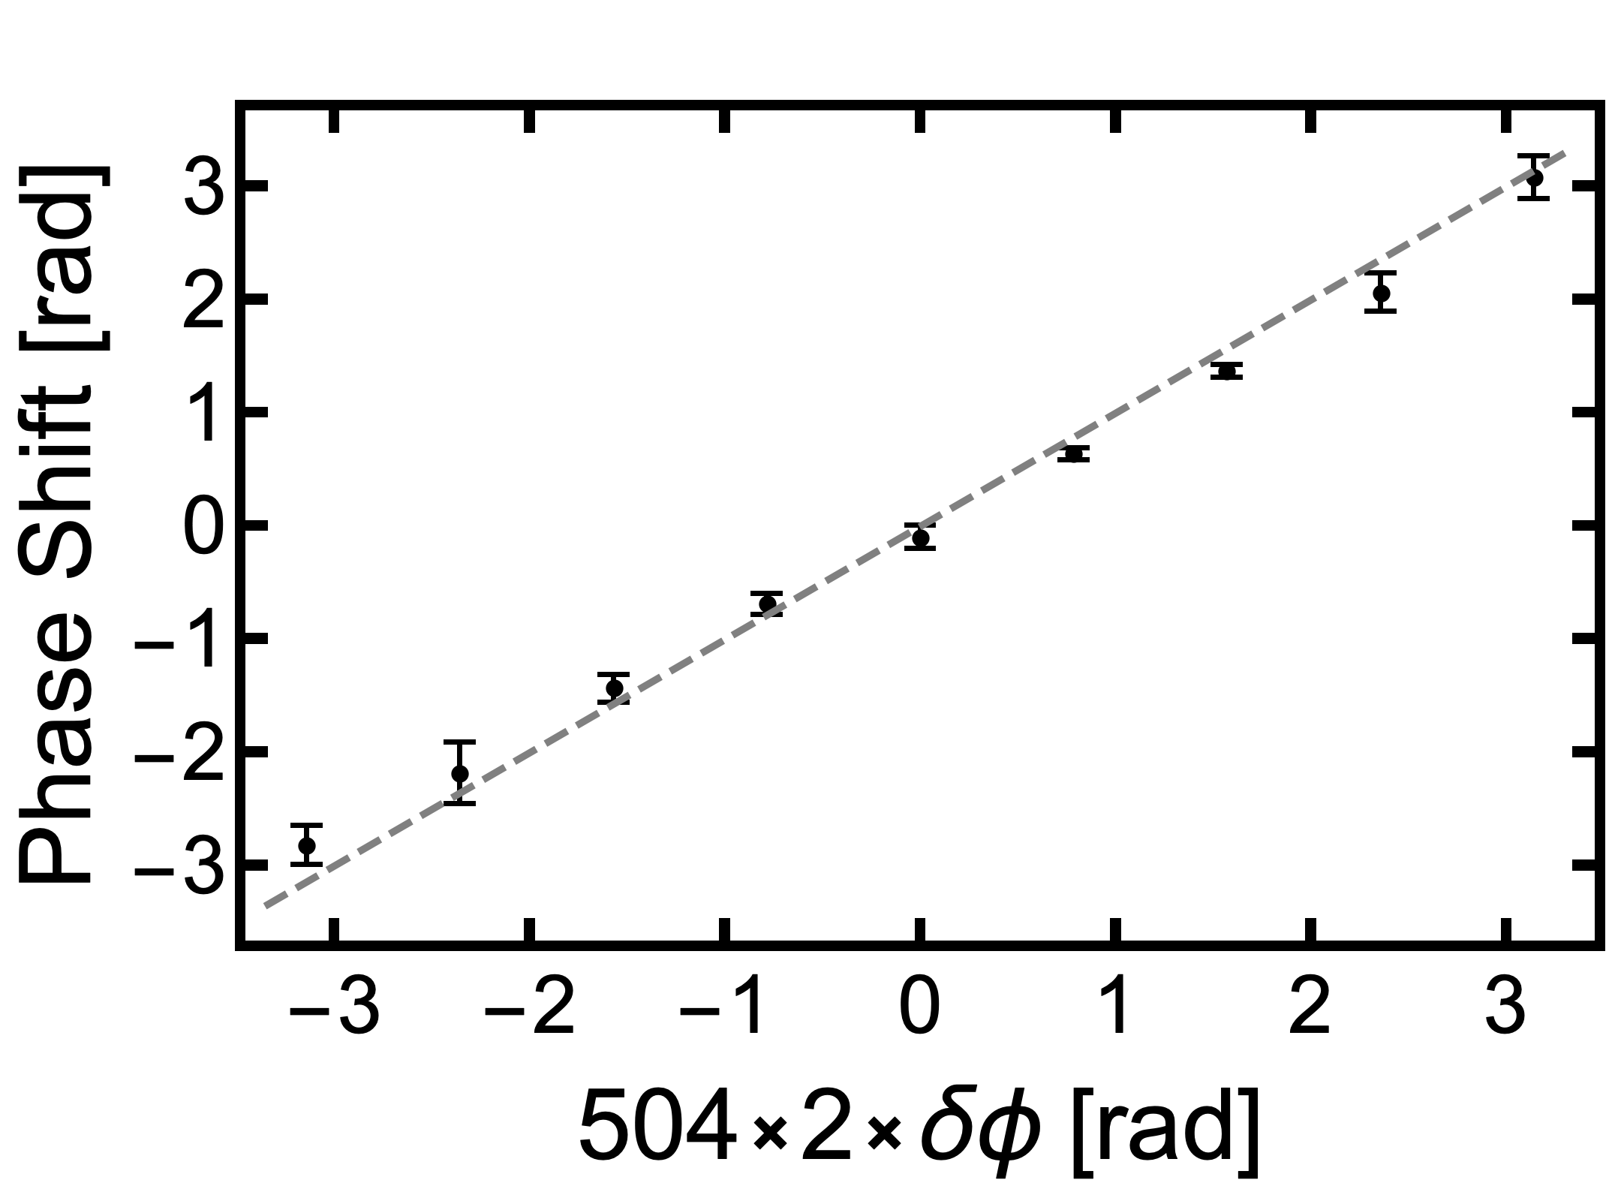
Improvement from Optimization
Thousandfold
phase amplification
50x increase in loop number
  Contrast remains within order 1 factor of fundamental spontaneous emission contrast limit up to ~500 loops

Slide 20
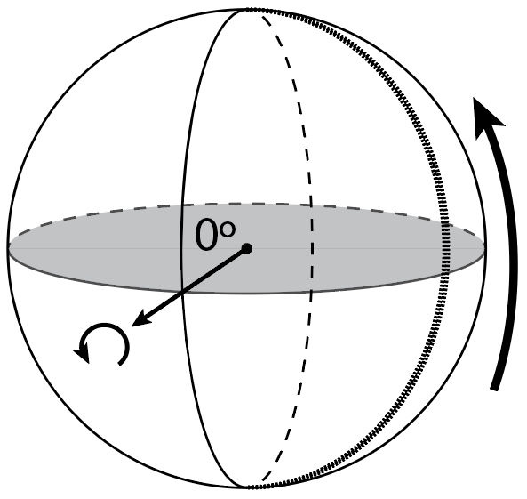
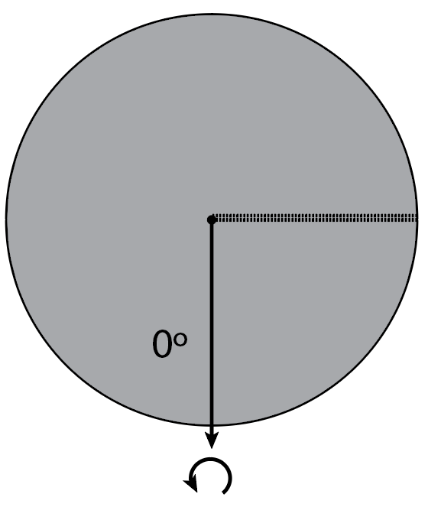
Aggregate Spontaneous Emission Phase
  Atoms can spontaneously decay to ground state midway through a mirror pulse
  Remainder of mirror pulse can once again put the atom in superposition
  Can there be a nonzero average interference pattern generated by atoms that underwent spontaneous emission at different points in time?

Slide 21
Aggregate Spontaneous Emission Phase
  Can there be a nonzero average interference pattern generated by atoms that underwent spontaneous emission at different points in time?
  Yes, for some pulse sequences these atoms build up with a certain average “aggregate phase”, generating interference fringe with high contrast but insensitive to desired signal
  If pulse sequence not chosen careful, this unwanted interference fringe can dominate over the signal we want to measure
  Constrain optimization to avoid pulse sequences where this happens

Slide 22
Conclusion
Long-baseline atom interferometry promising for gravitational wave detection, dark matter searches, gravitational wave detection, and foundational quantum science
Rapidly growing global community in this area
Quantum optimal control has the potential to be an essential tool for allowing these interferometers to reach their full potential in the face of challenging experimental constraints
We have also implemented closed-loop control, converges to similar result as open-loop

Slide 23






Acknowledgements
MAGIS Collaborators
Jason Hogan (Spokesperson) (Stanford)
Mark Kasevich (Stanford)
Peter Graham (Stanford)
Rob Plunkett (FNAL)
Sergei Nagaitsev (Old Dominion and JLab)
Steve Geer (FNAL)
Roni Harnik (FNAL)
Swapan Chattopadhyay (FNAL & NIU)
Surjeet Rajendran (Johns Hopkins)
Jonathon Coleman (Liverpool)
Daniela Bortoletto (Oxford)
Chris Foot (Oxford)
John March-Russell (Oxford)
Ian Shipsey (Oxford)
Jeremiah Mitchell (Cambridge)
Val Gibson (Cambridge)
Ariel Schwartzman (SLAC)
Michael Kagan (SLAC)
Chris Overstreet (Johns Hopkins)
Northwestern Team
Tejas Deshpande (postdoc)
Natasha Sachdeva (postdoc)
Zilin Chen (postdoc)
Ken DeRose (PhD student)
Jonah Glick (PhD student)
Yiping Wang (PhD student)
Kefeng Jiang (PhD student)
Sharika Saraf (PhD student)
Nicholas Miller (PhD student)
Anya Abraham (PhD student)
Hardeep Singh (PhD student)
Jay Jachinowski (undergrad)
Garrett Louie (undergrad)

Slide 24
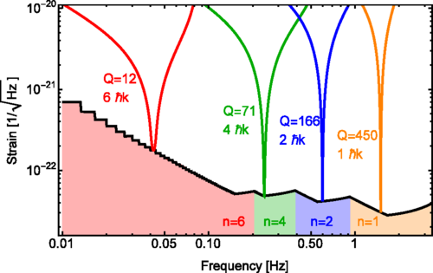
Resonant DM and GW
Graham et al., PRD 93, 075029 (2016); Arvanitaki et al., PRD 97, 075020 (2018); Graham et al., PRD 97, 055006 (2018)

Slide 25
MAGIS-100 Dark Matter Searches
Example: coupling to electron mass or fine structure constant
Bound assumptions: 50 m launch, 1000 ħk atom optics, 10⁸ atoms/s flux, shot noise limited, 1 year of data
Example: vector DM coupling to B-L
Bound assumptions: 50 m launch, 100 ħk atom optics, 10⁶ atoms/s flux, shot noise limited, 1 year of data (solid curve); 100 m launch, 1000 ħk atom optics, 10⁸ atoms/s flux, shot noise limited, 1 year of data (dashed curve);

Slide 26
Mid-band Gravitational Wave Detection
-Path to continued improvement through R&D efforts, which we are pursuing (MAGIS-100 serving as testbed)
-Potential for future km-scale terrestrial detector and satellite-based detector
-GGN (gravity gradient noise) important at lower frequencies for terrestrial detectors: seismic waves disturb local mass distribution, cause oscillating gravity gradient that is a noise background

