Slide 1
FlexRICAN: Flexibility in Research Infrastructures for Global Carbon Neutrality
Sustainable HEP 2025
Collaborators: Diego Herrera and Peyman Olad

Slide 2








About FlexRICAN
The FlexRICAN (Flexibility in RIs for global CArbon Neutrality) project aims to revolutionize energy usage within European research infrastructure (RIs), uniting three prominent institutions: European Spallation Source ERIC (ESS), Extreme Light Infrastructure ERIC (ELI), and European Magnetic Field Laboratory (EMFL).
Through collaborative efforts, FlexRICAN endeavors to optimize energy projects, enhance resource efficiency, and reduce environmental impacts across RIs through the collective efforts of beneficiaries.
Funding for FlexRICAN is provided by the European Commission’s Horizon Europe program, underscoring its commitment to advancing sustainable energy solutions.

Slide 3
About FlexRICAN
WP1 & WP2 Project management
WP3 Renewable energy production at RIs
WP4 Efficient use of battery arrays
WP5 Waste heat recovery
WP6 RI Energy Flexibility
WP7 Implementation of flexibility & carbon reducing solutions in RIs
WP8 & WP9 Communication, Dissemination, Exploitation, Stakeholder engagement and training activities

Slide 4
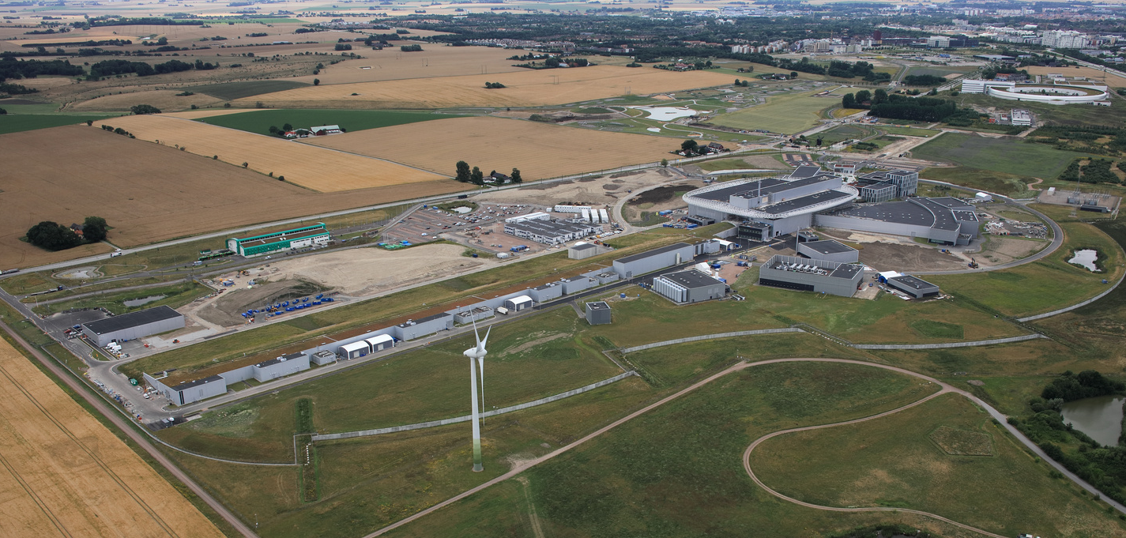
The ESS Project
Target station:
Rotating W target
36 sectors
23 rpm
Cooled by He gas
42 beam ports
Linear proton accelerator:
Energy: 2 GeV
Current: 62.5 mA
Pulse length: 2.86 ms
Rep. rate: 14 Hz
Average beam power: 5 MW
Currently funded: 2 MW
Instruments:
5-6 at BOT (beam on target)
15 in construction budget
22 in total scope
Plans for programme in fundamental physics
Figure from H. Danared

Slide 5
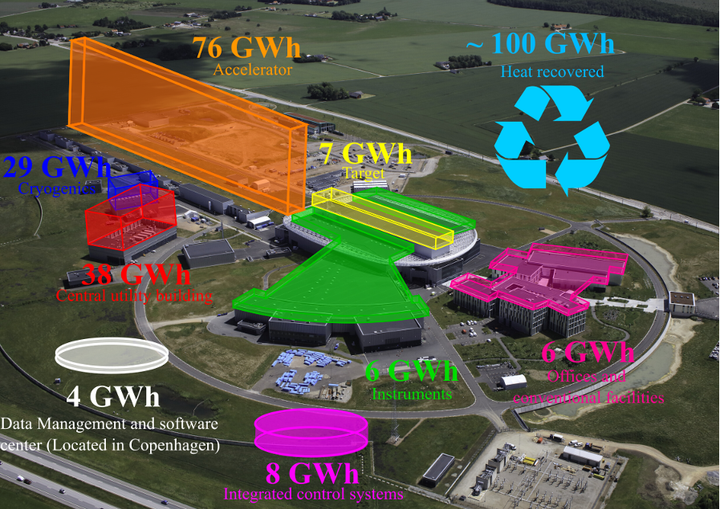
Energy Consumption at ESS
Figure from M. Eshraqi

Slide 6
How to do this?
Doing this on site
It is beneficial to use the energy output directly.
Make the RI more autonomous and robust.
Easier to keep track of performance, monitor the benefits, and fix.
Reduce stress from the grid.
The goal is to reduce while maintaining performance.

Slide 7
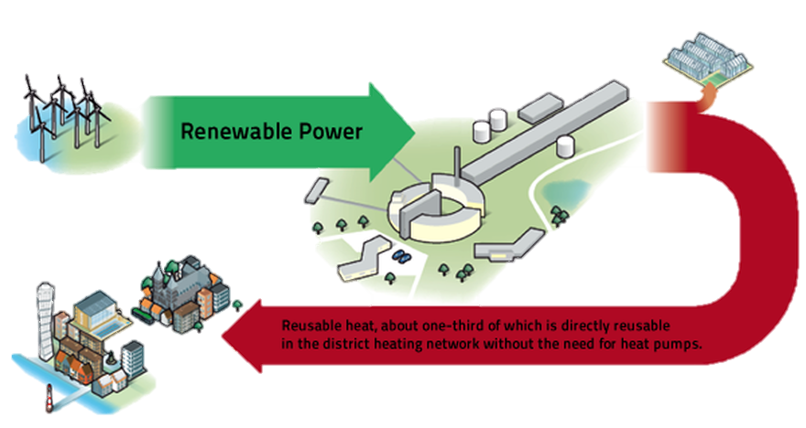
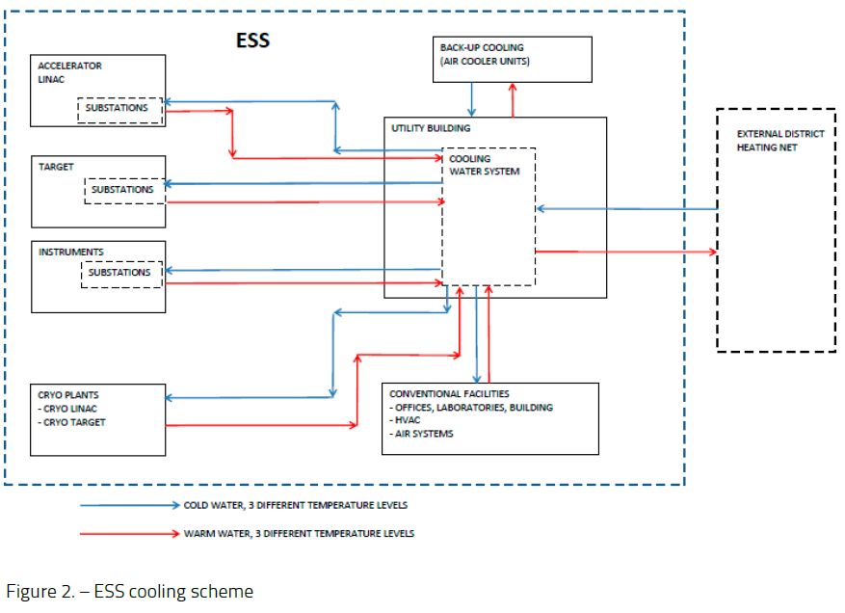
Waste heat recovery
ESS recovered heat covers ≈ 12% - 15% of Lund’s heat demand

Slide 9
Back Up Slides

Slide 10

Benefits
Internal
External
  Identify systems of high relevance
  Design back up systems to support elements that should not stop if there is a power interruption.
  Competitive, stable, and predictable cost of electricity for running the facility.
    Compensate for increase in power consumption.
    Electricity consumption in Lund will increase
    10% ~ 20% when ESS is fully commissioned.
    For local providers:
    Plan effectively around RI operations
    Ensure a reliable network for the city.
  Increase relevance of RE systems and ensures the stability of core systems.
https://ess.eu/contact

Slide 11
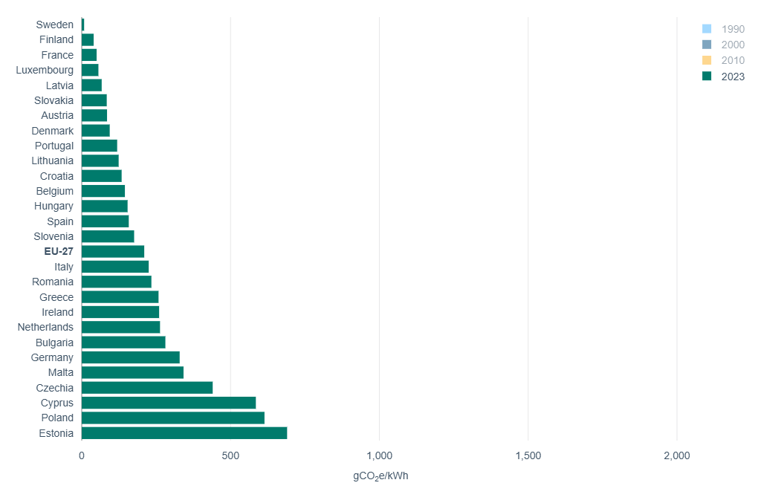
Greenhouse gas emission intensity of electricity generation
Countries in FlexRICAN
Sweden 8
France 50
Hungary 154
Netherlands 263
Germany 329
Czechia 440
Source: European Environment Agency https://www.eea.europa.eu/en/analysis/indicators/greenhouse-gas-emission-intensity-of-1/greenhouse-gas-emission-intensity-of-electricity-generation-country-level?activeTab=570bee2d-1316-48cf-adde-4b640f92119b

Slide 12
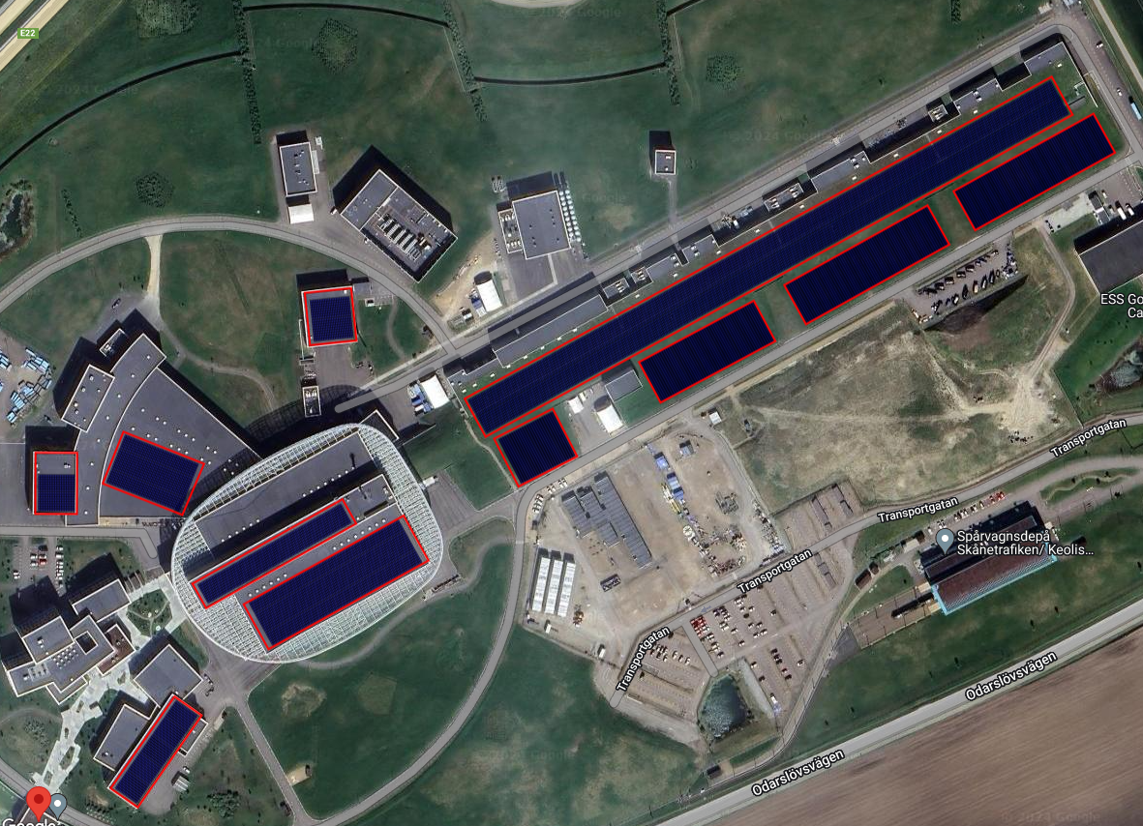
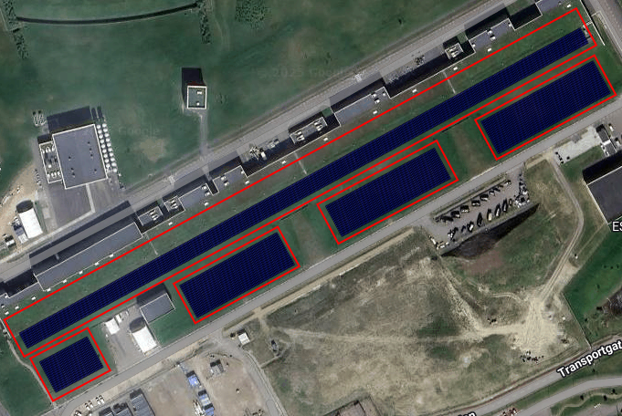
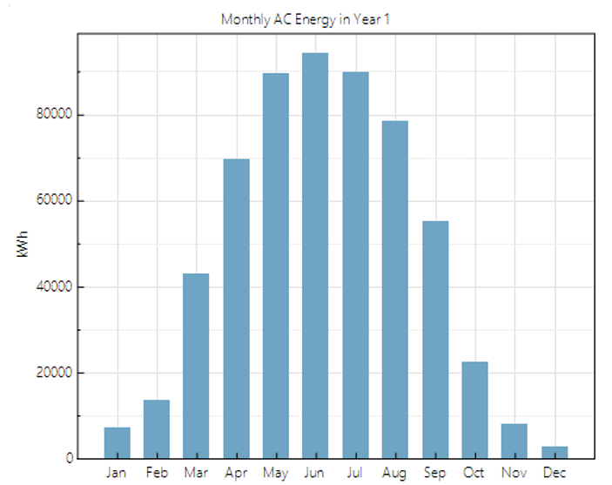
Photovoltaic production
Rough numbers
Section | Modules | kWp | Wp/panel | GWh/year*
Buildings | 4 600 | 2 070 | 450 | 2.10
Tunnel | 12 300 | 5 535 | 450 | 5.50
Total | 16 900 | 7 605 | 450 | 7.60
This is equivalent to ≈ 10% of the estimated energy consumption at ESS in 2025.
Translates into ≈270 t CO2 (35 gCO2e/kWh).
  *For an average of 1000 sun peak hours in the south of Sweden

Slide 13
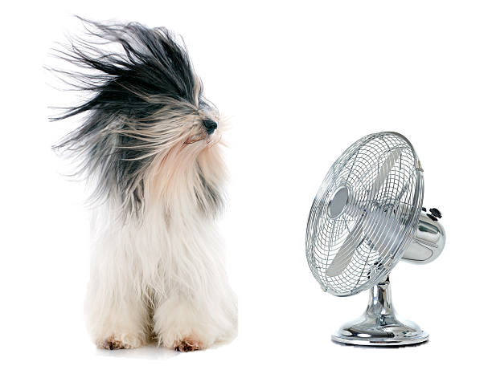
Wind powering of facilities

Slide 14
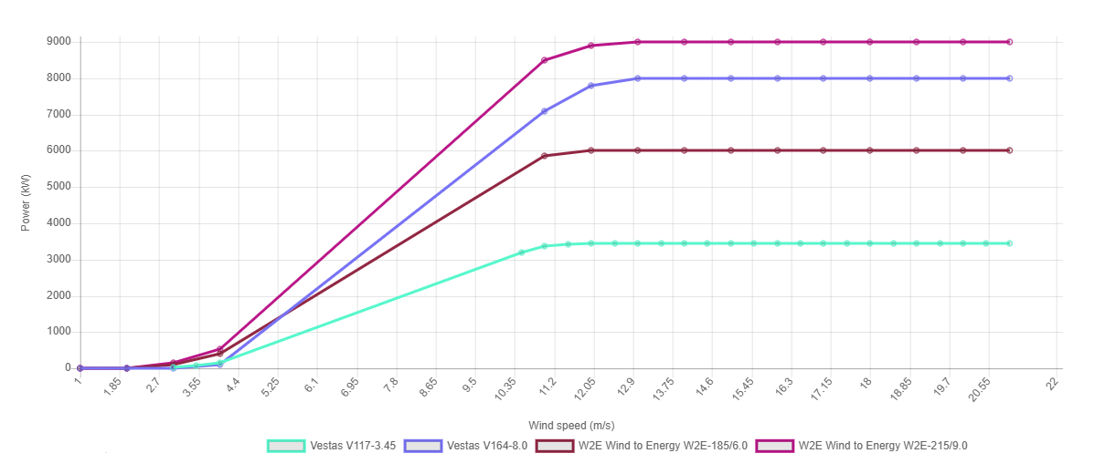
Wind powering of facilities
Performance of different wind turbines available for Lund’s weather conditions.
Average windspeed in 2024 was ≈ 4.2 m/s @ 10 m
Average windspeed in 2024 was ≈ 7 m/s @ 150 m
20 GWh translates into ≈700 t CO2 (35 gCO2e/kWh).

Slide 15
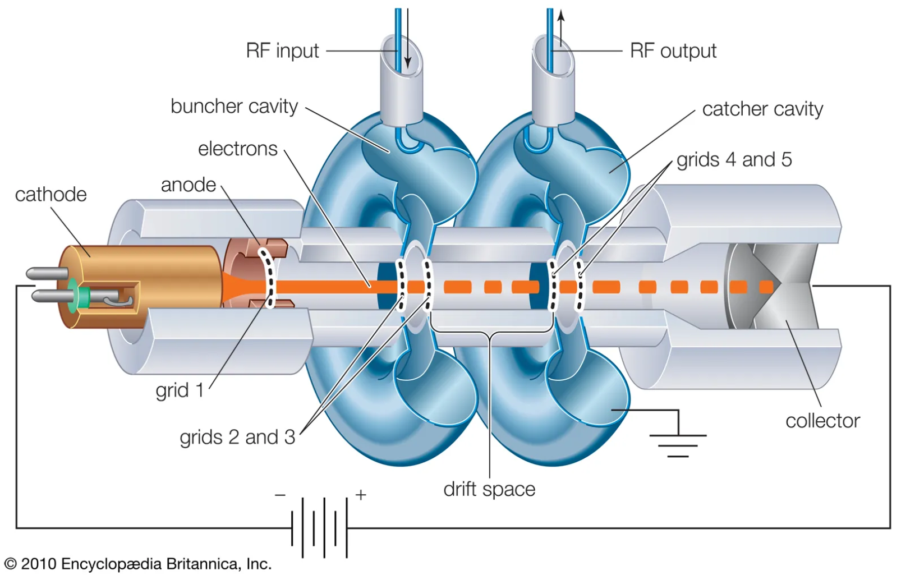
Waste heat recovery
High temperature klystron concept
The collector is cooled down through circulation of water.
The idea is to increase the temperature of the water exiting the collector (produce higher-grade waste heat).
Two approaches are taken:
P&ID modifications
Computational Fluid Dynamics (CFD) simulation

Slide 16
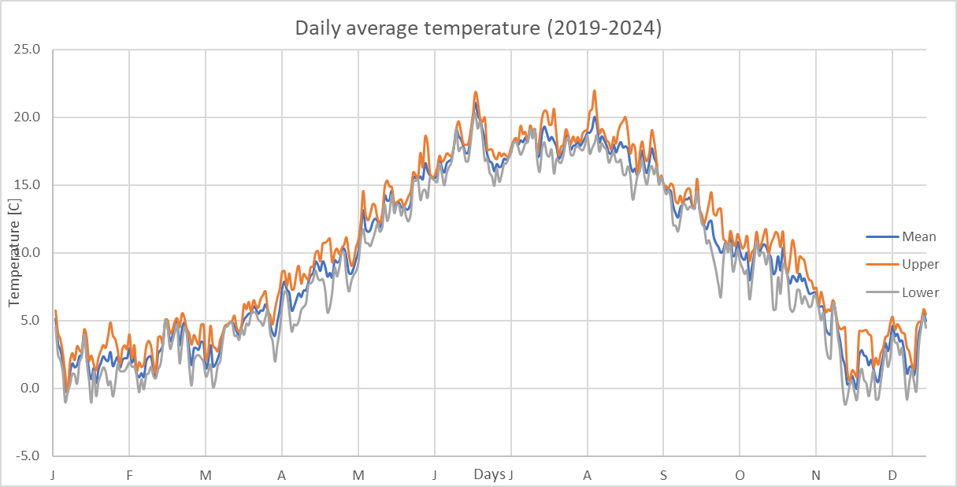
Waste heat recovery
Intermittency issue
Intermittency issue mainly in the summer i.e., what to do with our excess waste heat when district heating does not need it?!
  Based on 5-year data, we have 109 days/year with average temperature > 15 ºC
  On these days, the district heating cannot take all our waste heat
  With the assumption that the district heating can take only 10% of our waste heat on these days, we have an excess waste heat of about 50 GWh/year (5 MW beam power operation)
  Potential solutions?

