Slide 1


Recuperation systems for fluorinated gas at the CERN LHC Experiments
Maria Cristina Arena, A. Bouzaiene, D. Galassi, R. Guida, B. Mandelli, G. Rigoletti
Sustainable HEP 2025 - 4th edition

Slide 2
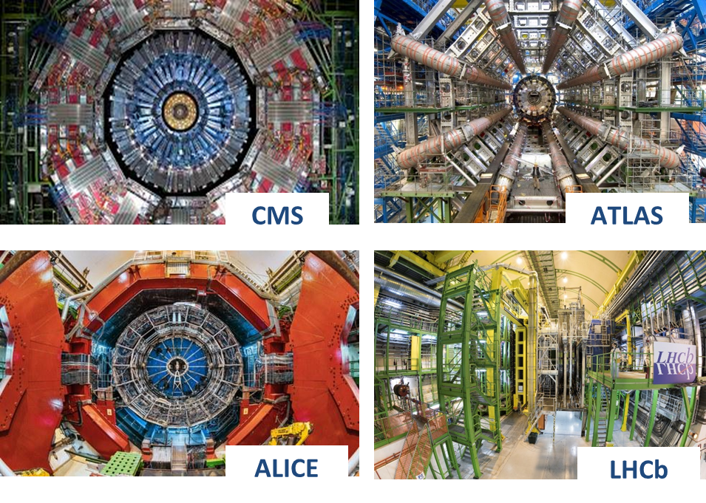
Introduction
•Gaseous detectors are installed in the four main LHC Experiments and in many not-LHC facilities
•Depending on the purpose and the geometry of the detectors, different gas mixtures are required → Some of them are GREENHOUSE GASES (GHG).
•Detectors were designed more than 20 years ago, when the effect of these gases was unknown → gas replacement is now challenging
Sustainable HEP 2025 - 4th edition

Slide 3
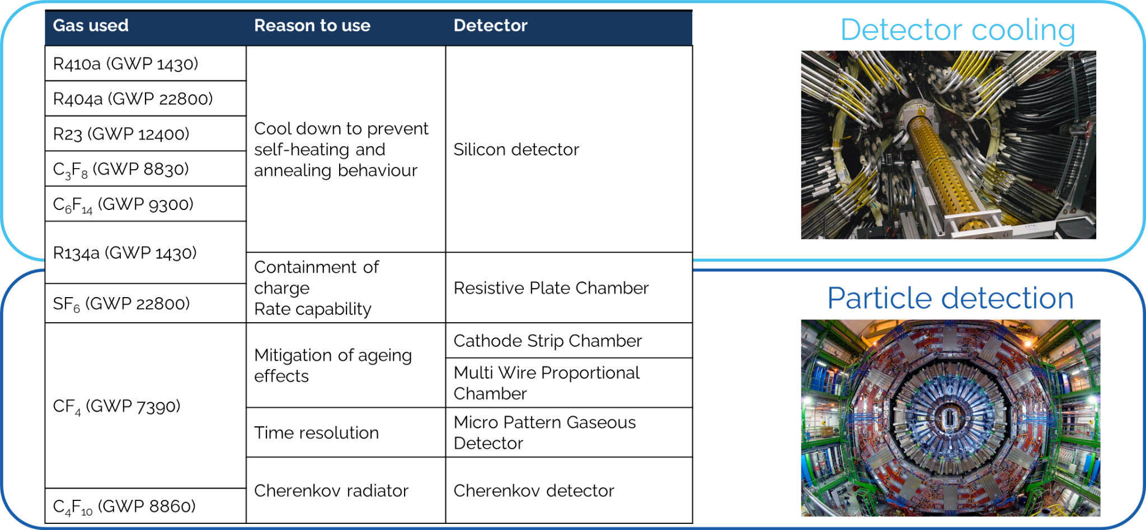
Use of fluorinated gases at the CERN LHC
Sustainable HEP 2025 - 4th edition

Slide 4
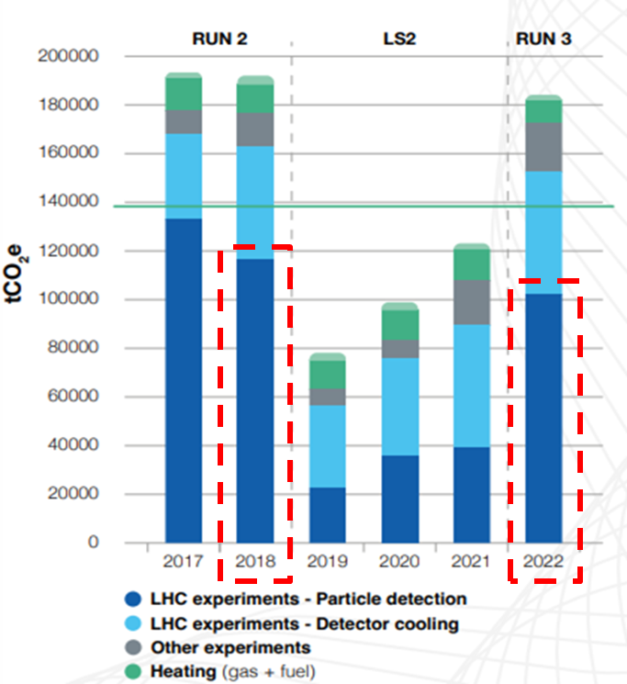
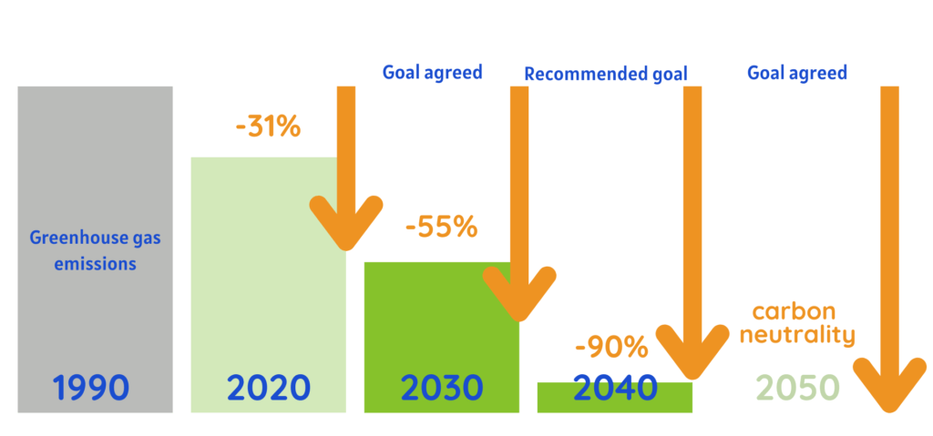
GHGs emissions at CERN
https://doi.org/10.25325/CERN-Environment-2023-003
Fluorinated compounds represent the 78% of total Organization’s emissions which will be reduced by 28% by the end of RUN 3
EU legislation of 2014 is strongly limiting the use of these gases through different approaches:
- Promoting the use of more eco friendly alternatives
- Controlling and preventing emissions
These strategies are causing gas shortages and increase of prices
Sustainable HEP 2025 - 4th edition

Slide 5
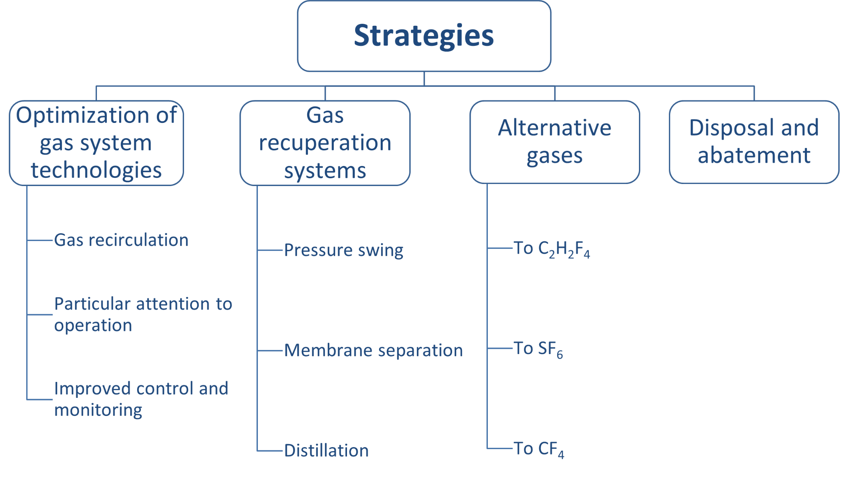
Strategies to reduce GHGs emissions at CERN
Sustainable HEP 2025 - 4th edition

Slide 6
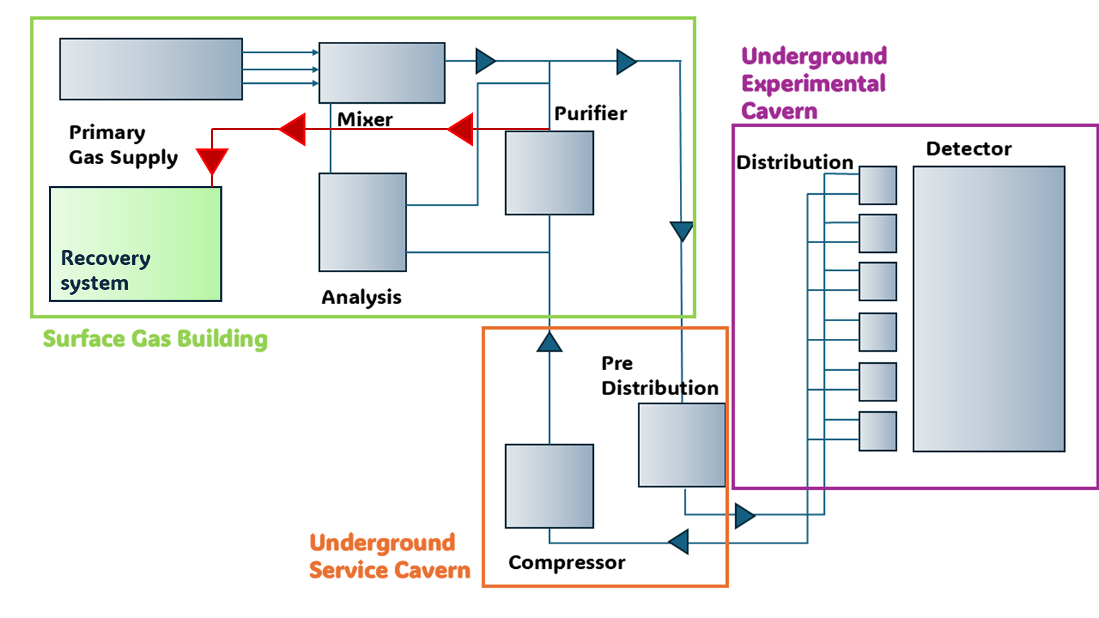
Gas recovery systems for fluorinated gases
Due to air accumulation in the gas mixture, some detectors cannot work with a 100% recirculated flow
Usual recirculation fraction of 90% (detector requirements) → 10% sent to the atmosphere
In some cases, this gas is sent to recovery plants where the GHG is separated from
the other components, stored and then re-injected in the mixer through a dedicated line
Sustainable HEP 2025 - 4th edition

Slide 7
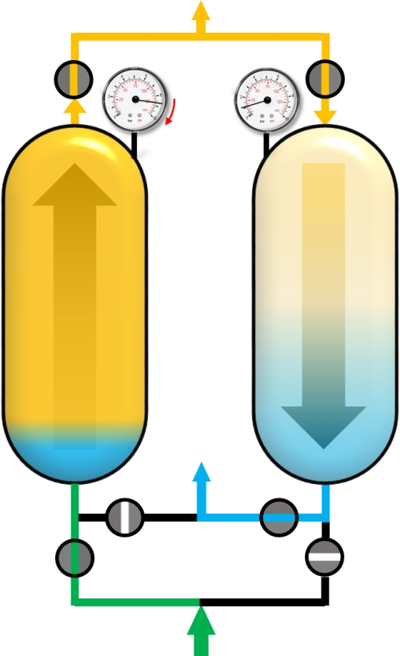
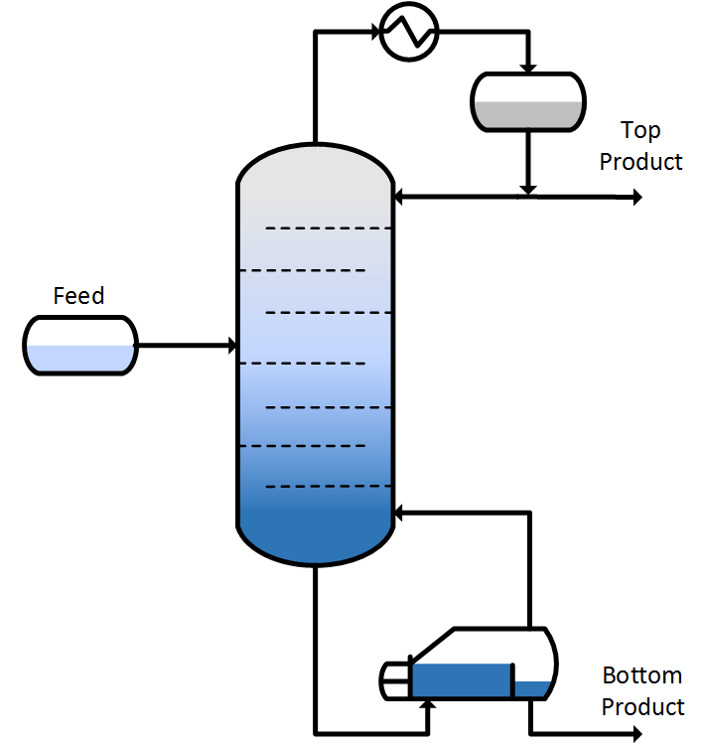
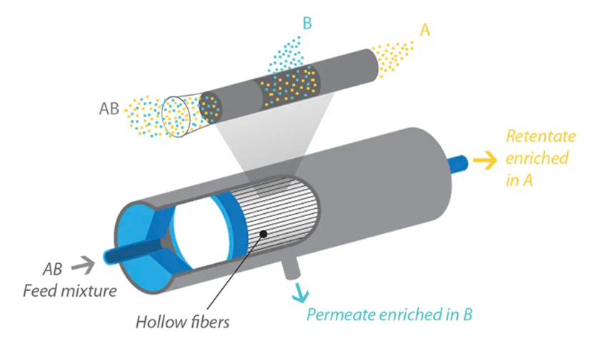
Separation techniques - overview
MEMBRANE SEPARATION PROCESS is driven by →
Permeability → capability of a membrane to permeate gas molecules
Solubility →thermodynamic parameter given the amount of penetrant absorbed by membrane
Diffusivity → dependent on geometry of penetrant: increasing the molecular size, the coefficient decreases
THERMAL/PRESSURE SWING ADSORPTION (TSA/PSA) → Contaminated feed stream is fed to the sieve beds and then the sieve bed pressure is reduced to regenerate the MS. Vacuum regeneration has the advantage of not overheating the material, avoiding break down processes.
DISTILLATION → Purification method to separate 2 or more compounds based on differences in boiling points or volatility: lighter (lower-boiling) component tend to concentrate in vapor phase, heavier (higher-boiling) component tend toward the liquid phase. The two distillation techniques used in our recovery plants are simple and fractional distillation.
Sustainable HEP 2025 - 4th edition

Slide 8
Separation techniques
MEMBRANE SEPARATION
Pressure & Thermal swing adsorption (PSA & TSA)
CMS CSC
CF₄
LHCb RICH2
DISTILLATION
ADSORPTION
DESORPTION
C₂H₂F₄
CMS RPC
SF₆
CMS RPC
C₄F₁₀
LHCb RICH1
Sustainable HEP 2025 - 4th edition

Slide 9
CMS CSC CF₄ recovery system

Slide 10
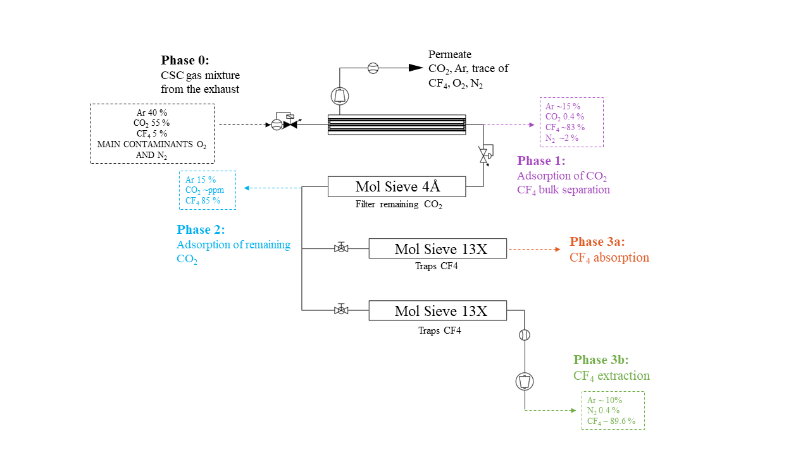
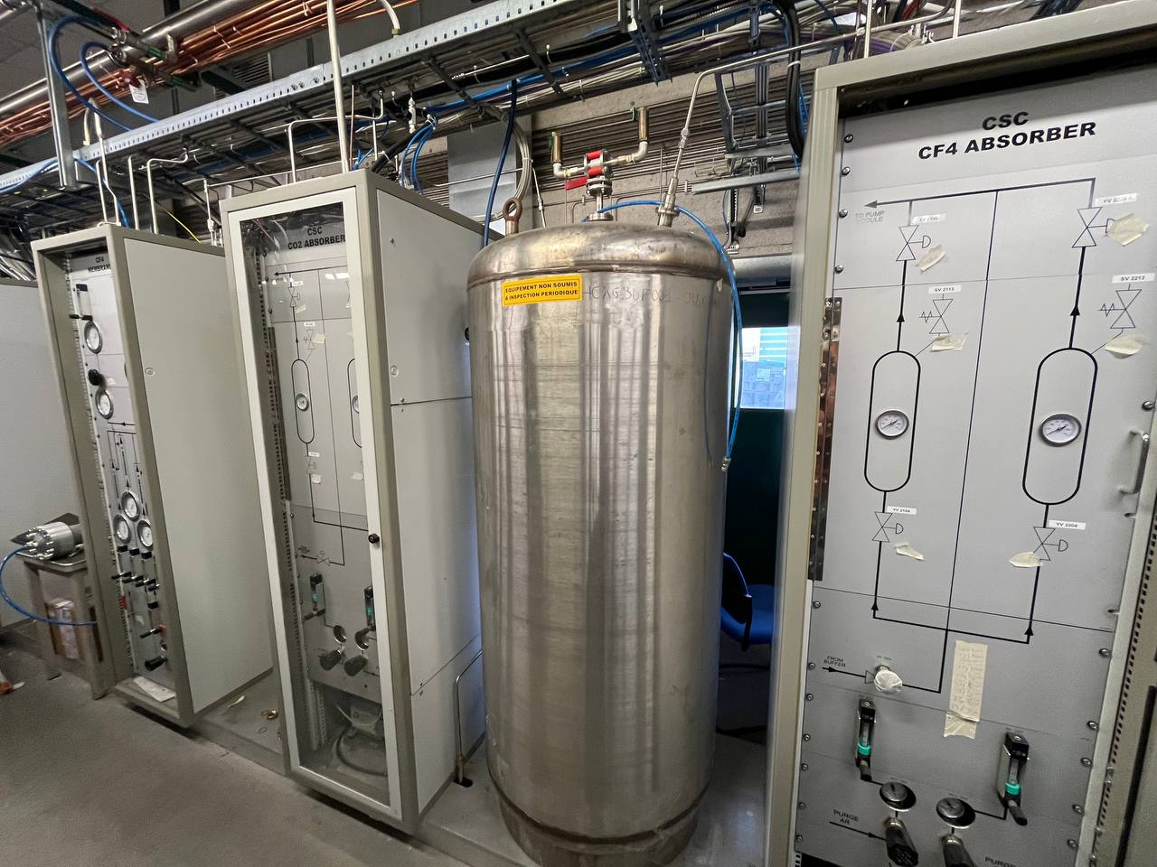
CMS CSC recovery system for CF4
or 10 %
First plant for CF₄ warm adsorption, non-standard gas system
CSC gas mixture → Ar/CO₂/CF₄ in a ratio 40/50/10 or 40/55/5
System is fully controlled by software
Sustainable HEP 2025 - 4th edition

Slide 11
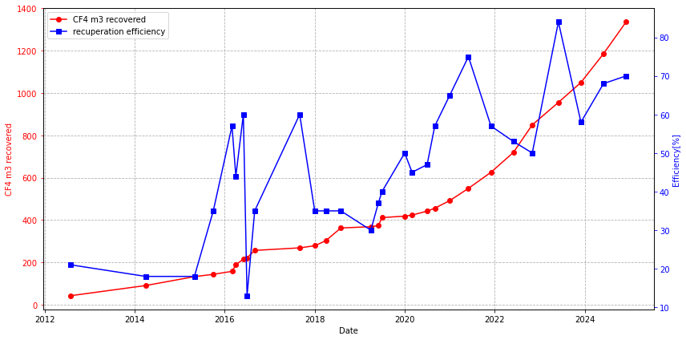
CMS CSC recovery system for CF4
Efficiency mean value: 70% in the period January-November 2024
In 2024, out of 495 m³ of CF₄ injected into the mixer, 290 m³ were recovered CF₄ (60%)
2024 → 8600 tCO2e and 47 kCHF saved
Sustainable HEP 2025 - 4th edition

Slide 12
CMS RPC C2H2F4 recovery system

Slide 13
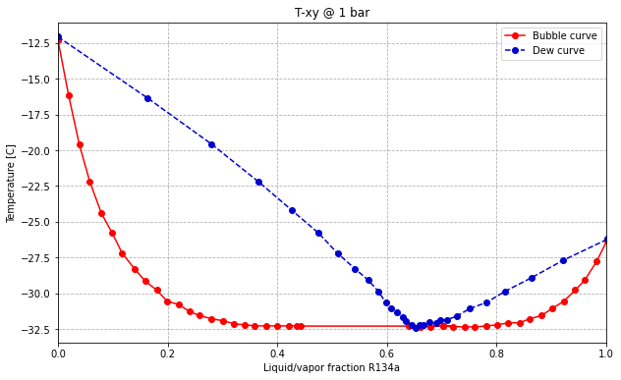
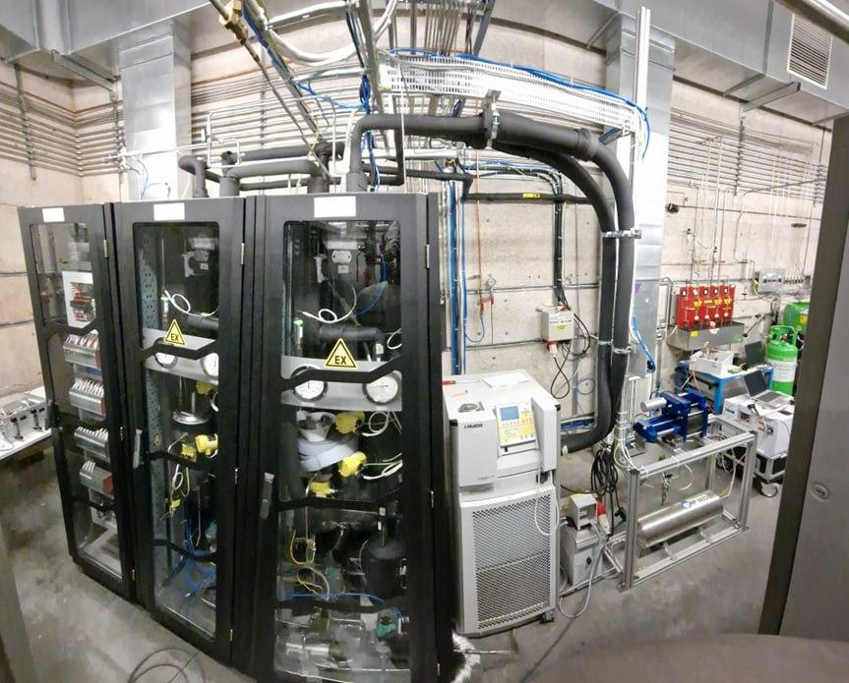
CMS RPC recovery system for C2H2F4 (R134a)
Recovery plant based on distillation process
CMS RPC gas mixture → R134a/SF6/iC4H10 95.2/0.3/4.5
Problem: R134a forms a minimum boiling point azeotrope with iC4H10
SEPARATION MODULES
COMPRESSOR
Slow heating of liquified azeotrope (red curve) allows to enrich the liquid of R134a and the vapor phase of azeotrope
ELECTRICAL RACK
CHILLER
Sustainable HEP 2025 - 4th edition

Slide 14
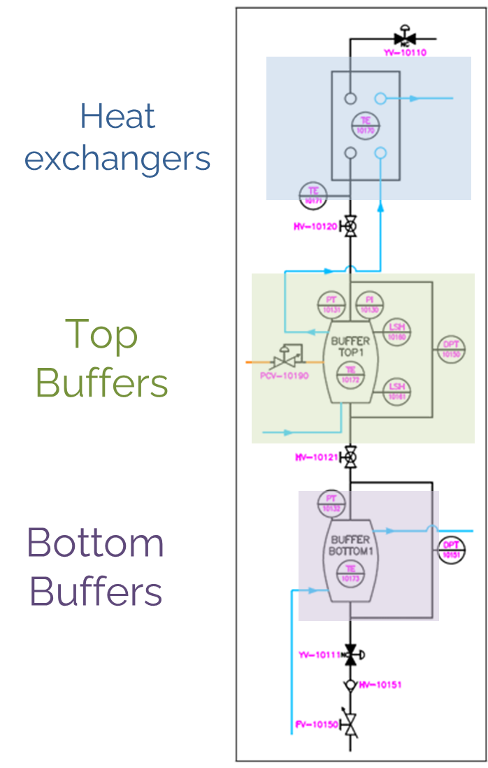
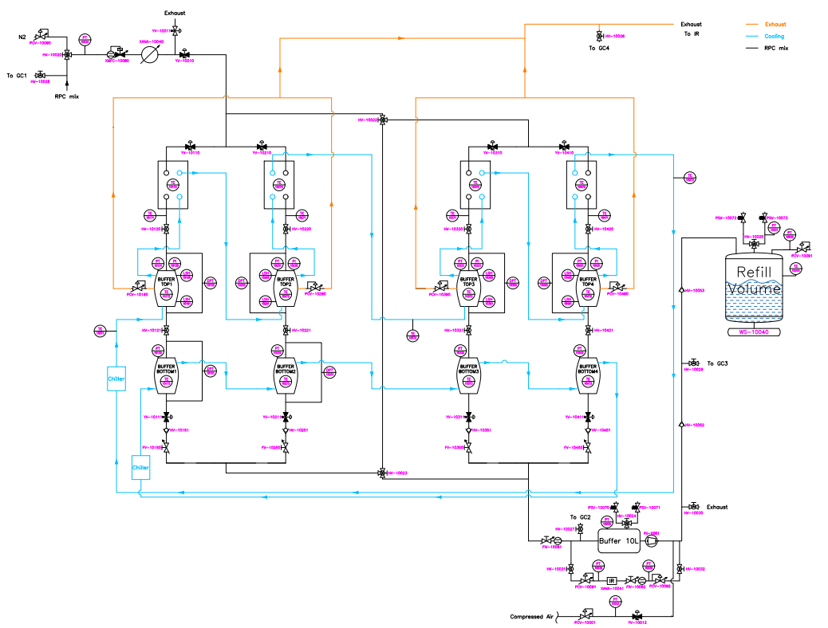
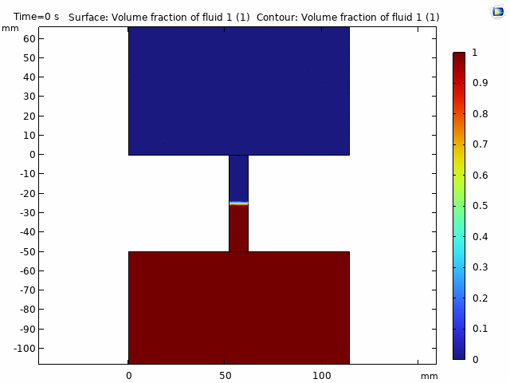
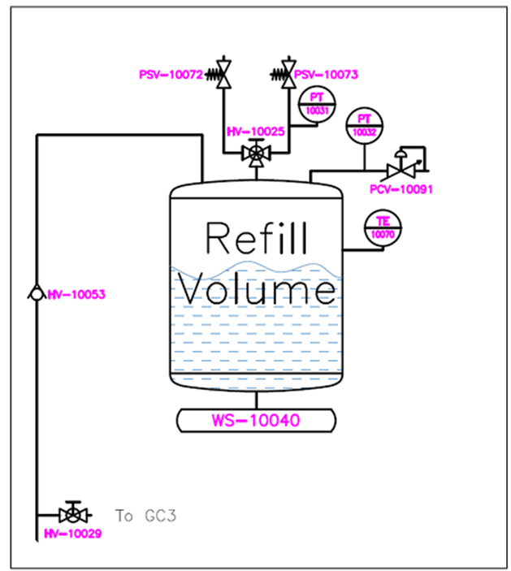
CMS RPC recovery system for C2H2F4 (R134a)
Distillation units
Storage Tank
Thermodynamic simulation done by M. Bruno (PoliTO)
>80% of Recuperation Efficiency, almost the theorical limit for this separation tecnique and 99.5% of gas purity
Compressor module
Sustainable HEP 2025 - 4th edition

Slide 15
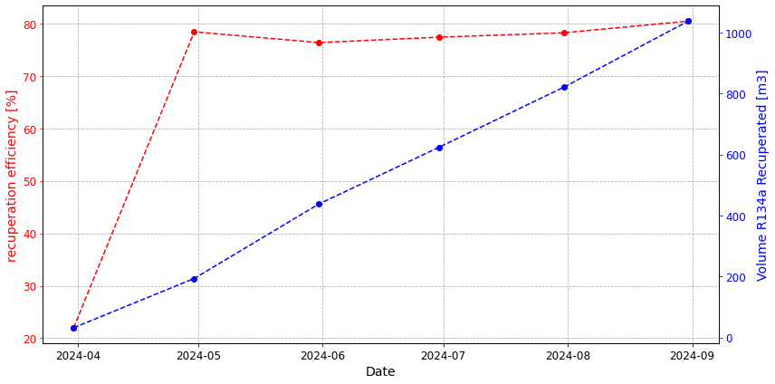
CMS RPC recovery system for C2H2F4 (R134a)
Recovery efficiency > 80% with 5000 ppm iC4H10 in the recuperated R134a
In 2024, the 40% of the total R134a used in the RPC gas system was recuperated R134a
More than 17000 tCO2e and 100 kCHF saved per year
Sustainable HEP 2025 - 4th edition

Slide 16
LHCb RICH1 C₄F₁₀ recovery system

Slide 17
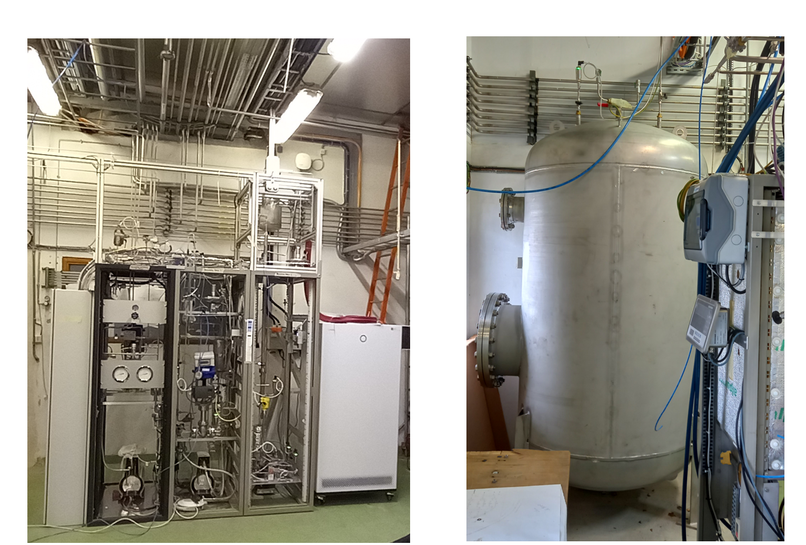
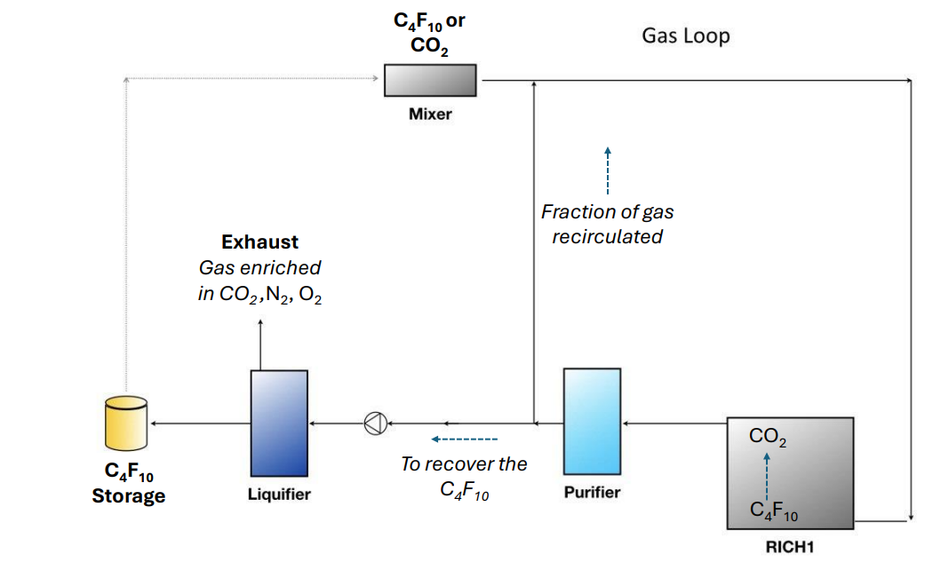
LHCb RI1 C₄F₁₀ recovery system
Depending on the LHC schedule, the RI1 can be filled with pure C4F10 (RUN) or CO2 (LS or YETS) → C4F10 recuperation
New recovery plant installed at the beginning of 2025 and currently used in the recuperation process
Sustainable HEP 2025 - 4th edition

Slide 18
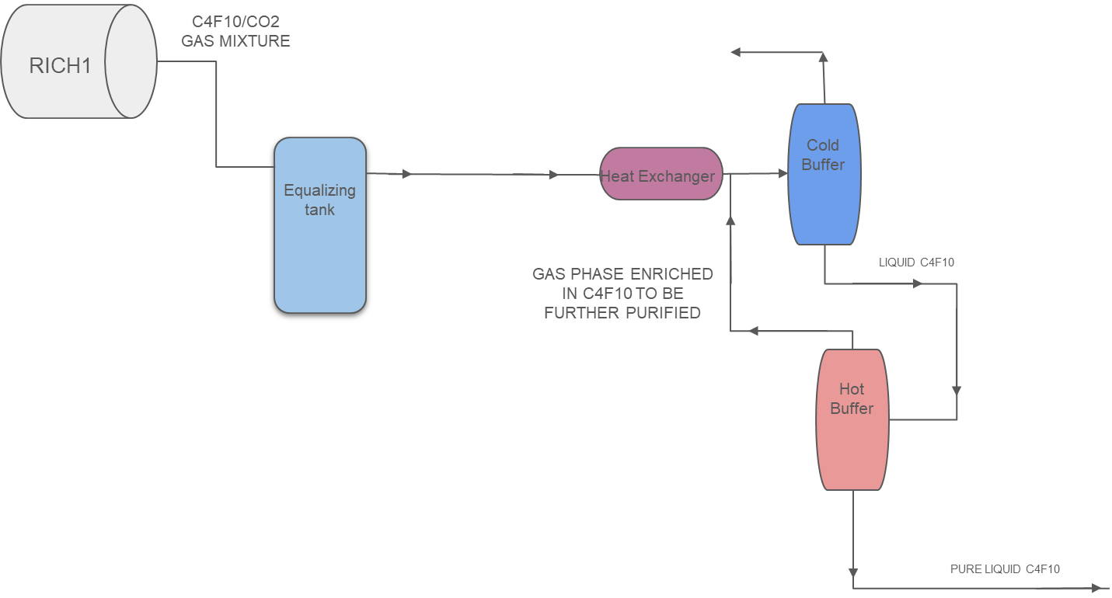
LHCb RI1 C₄F₁₀ recovery system
300 kg of C4F10 saved in the last 3 years!
Separation path
The separation process is based on distillation → thanks to the equalizing tank we can keep constant the concentration CO₂/C₄F₁₀ to improve the separation
Sustainable HEP 2025 - 4th edition

Slide 19
Conclusions
Fluorinated gases are responsible for more than 80% of CERN GHG emissions
Thanks to our recovery systems, these emissions are already reduced by 20%!
4 operational recovery systems (2 CMS and 2 LHCb) and studies for a new recovery system ongoing
Use of recuperation system implies more control on gas quality → daily gas chromatograph analyses and online monitoring systems (e.g., SWPC and IR)
Recovery systems allow to overcome critical situations when the new/fresh gas is not available
Sustainable HEP 2025 - 4th edition

Slide 20
Thanks for your kind attention!

Slide 21
Backup

Slide 22
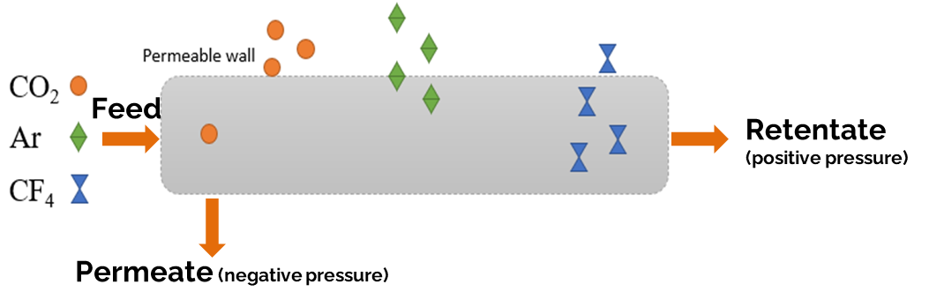

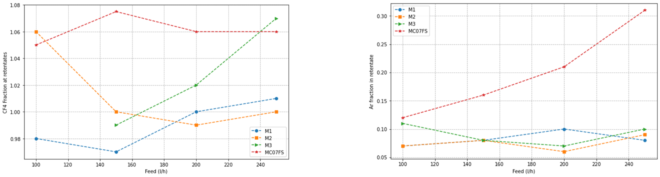


CMS CSC recovery system for CF4 - Membranes
Sustainable HEP 2025 - 4th edition

Slide 23

CMS CSC recovery system for CF4 - 13X zeolite
Based on Vacuum Swing Adsorption (VSA)
Temperature and ambient pressure → no degradation of zeolite
Last module of the recovery plant used to reduce Ar and N2 concentration in the final product, thanks to the affinity of CF4 for 13X zeolite
Thanks to the studies performed, the system is now working at 70% of recovery efficiency and 90% of CF4 purity
Sustainable HEP 2025 - 4th edition

Slide 24
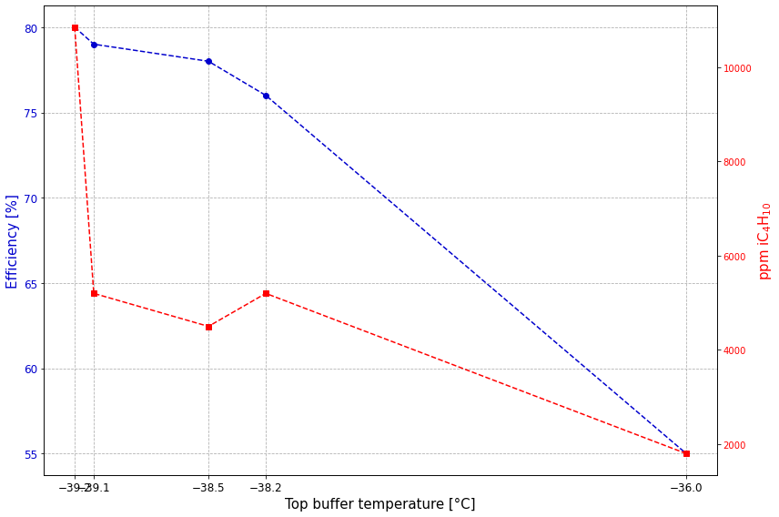
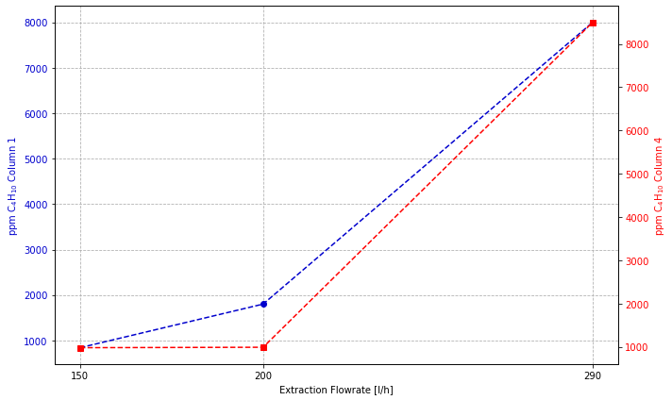
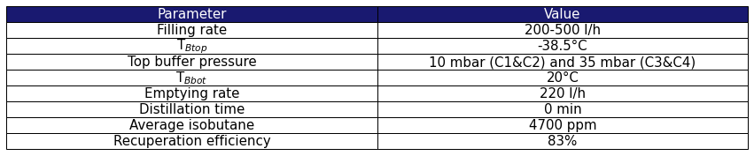
CMS RPC recovery system for C2H2F4 (R134a)
Effect of extraction flowrate on the quality of recuperated R134a for columns 1 and 4
Effect of top buffer temperature on the quality of recuperated R134a and recuperation efficiency
Sustainable HEP 2025 - 4th edition

