Slide 1
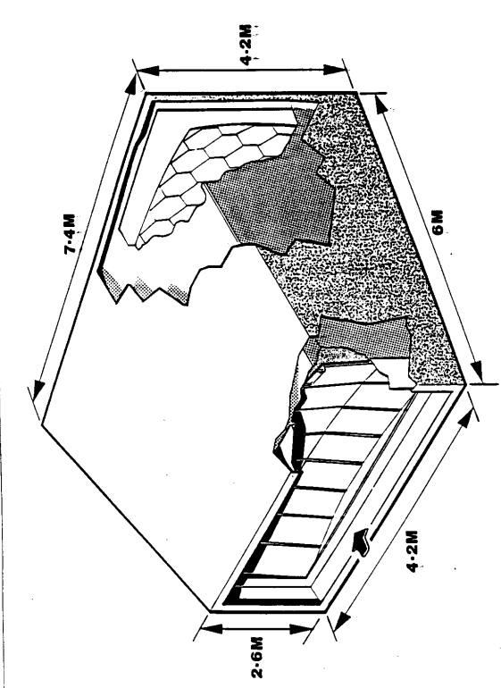

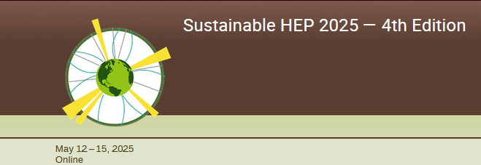
Gas optical properties are vital
for particle identification:
fluorocarbons have been ideal
Green (gas) Cherenkov Radiators
(Partly based on previous presentations:
see reference slides)
(See also yesterday’s ALICE talk by Nicola Nicassio)
G. Hallewell
Aix Marseille Université,
CNRS/IN2P3, CPPM, Marseille, France
.
May 12-15 2025 Online
1
Notes:
1

Slide 2
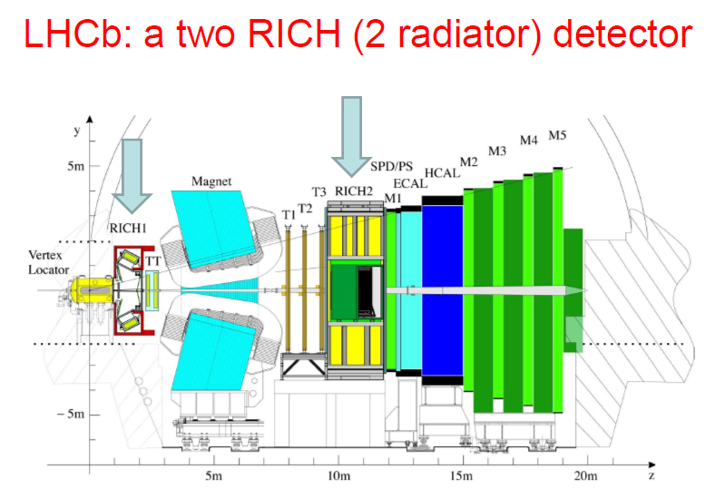
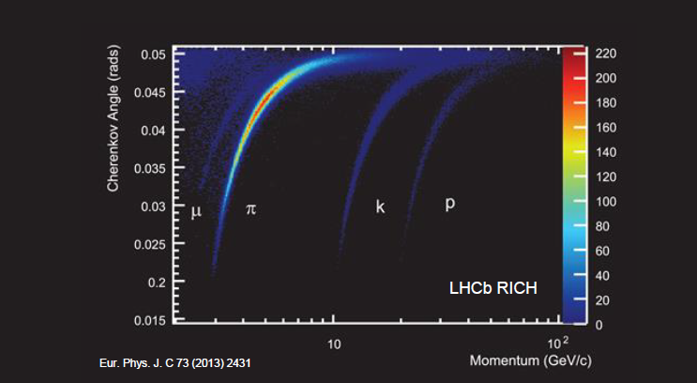
RICH 1: C₄F₁₀ radiator
n = 1.00145 (4 m³):
lower momentum PID
RICH 2: CF₄ (+CO₂) radiator:
n = 1.00049 (100 m³):
higher momentum PID
COMBINED RICH PEFORMANCE & PARTICLE SPECIES IDENTIFCATION RANGE
Θ_{c} = cos⁻¹ (1/βn)
2
G. Hallewell: Green Cherenkov radiators Sustainable HEP 4th Edition, CERN 12-15 May 2025

Slide 3
“Green” fluorocarbons for Cherenkov radiators?
Saturated fluorocarbons (PFCs, SFCs: C_{n}F_{(2n+2)}) chosen for optical properties as Cherenkov radiators: C₄F₁₀ & CF₄ in COMPASS & LHCb RICH1&2.
Non-conductivity, non-flammability, non-toxicity & radiation resistance
➔ ideal coolants
- C₆F₁₄ (liquid) used in all LHC experiments,
- C₃F₈ evaporatively cools ATLAS silicon tracker, TOTEM;
These fluids however have high GWPs (GWP₂₀ > 5000*CO₂);
Fluoro-ketones (C_{n}F_{2n}O), while not industrialised over a wide C_{n}F_{2n}O range,
can offer similar performance at very low, or 0 GWP;
Radiation tolerance & thermal performance of 3M NOVEC 649® (lin-C₆F₁₂O) sufficiently promising to be considered by CERN to replace C₆F₁₄ for cooling,
but acid production (in humidity) and materials compatibility issues to resolve.
G. Hallewell: Green Cherenkov radiators Sustainable HEP 4th Edition, CERN 12-15 May 2025

Slide 4
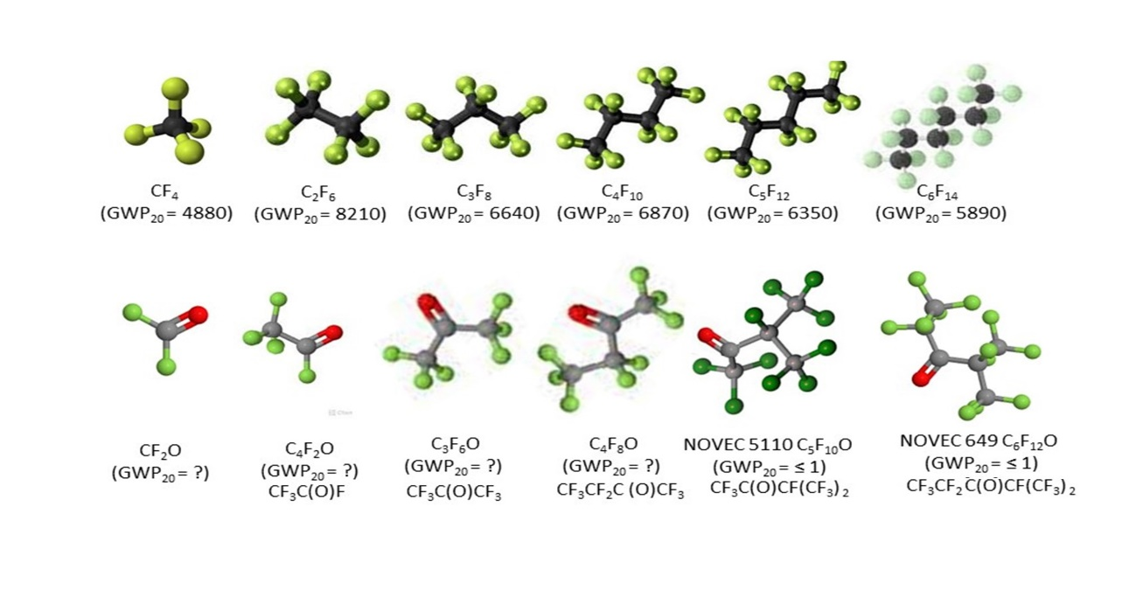
Molecular shapes, GWP & toxicity
Cherenkov
Radiator
Cherenkov
Radiator
(hist.)
Si cooling
(Evap.)
Cherenkov
Radiator
Cherenkov
Radiator
(hist.)
Cherenkov
Radiator
(hist.) + Cooling (Liq.)
Ih.T. H335
Ih.T. H335
Ih.T. H335
Ih.T. H335
Ih.T. H335
Ih.T. H335
C₂F₄O
Ih.T H330, reactive
Ih.T H331,
reactive
Ih.T H331,
reactive
CAS# 337-20-2
Ih.T. H335
CAS# 756-12-7
Ih.T. H335
CAS# 756-13-8
Ih.T. H335
Upper: molecular shapes of SFCs, including common gaseous Cherenkov radiators.
Lower: shapes of some non-cyclic C_{n}F_{2n}O analogues (20-year GWPs & GHS inhalation toxicities (source www.synquest.com
G. Hallewell: Green Cherenkov radiators Sustainable HEP 4th Edition, CERN 12-15 May 2025

Slide 5
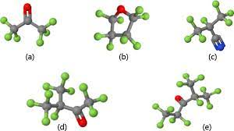
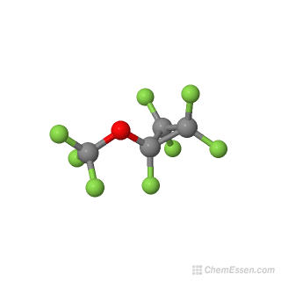
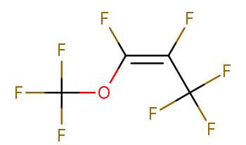
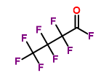
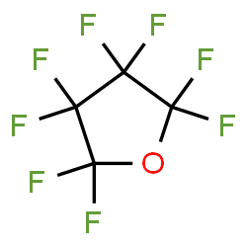
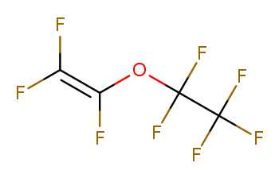
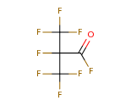
Molecular shape is important for GWP and toxicity!!
Cyclic, non-cyclic & non-cyclic double c-bonded C₄F₈O isomers
☺
CAS# 337-20-2
Octafluoro-2-butanone
(GWP₂₀ = ?) [H335]
GWP ?
Optical performance similar
to C₄F₁₀: (BTeV & ALICE VHMPID)
High GWP!!
GWP ?
CAS# 67641-44-5
Octafloro-1-methoxyprop-1-ene
(GWP₂₀ = ?) [H332, 335, 336]
CAS# 335-42-2
Heptafluorobutyryl fluoride
(GWP₂₀ = ?) [H331]
GWP ?
C₄F₈O
CAS# 773-14-8
Cyclic
Perfluorotetrahydrofuran,
Octofluorotetrahydrofuran
(GWP₂₀ = 8975) [ref EPJP]
[H335]
CAS# 10493-43-3
Pentafyoroethyltrifluorovinyl ether
(GWP₂₀ = ?) [H332, 335]
CAS# 677-84-9
Heptafluoroisobutyryl fluoride
(GWP₂₀ = ?) [H335]
C₄F₈O Linear with Oxygen atom as
internal link and double carbon
bonded link
C₄F₈O Linear & iso, with
Oxygen atom on external spur
G. Hallewell: Green Cherenkov radiators Sustainable HEP 4th Edition, CERN 12-15 May 2025

Slide 6
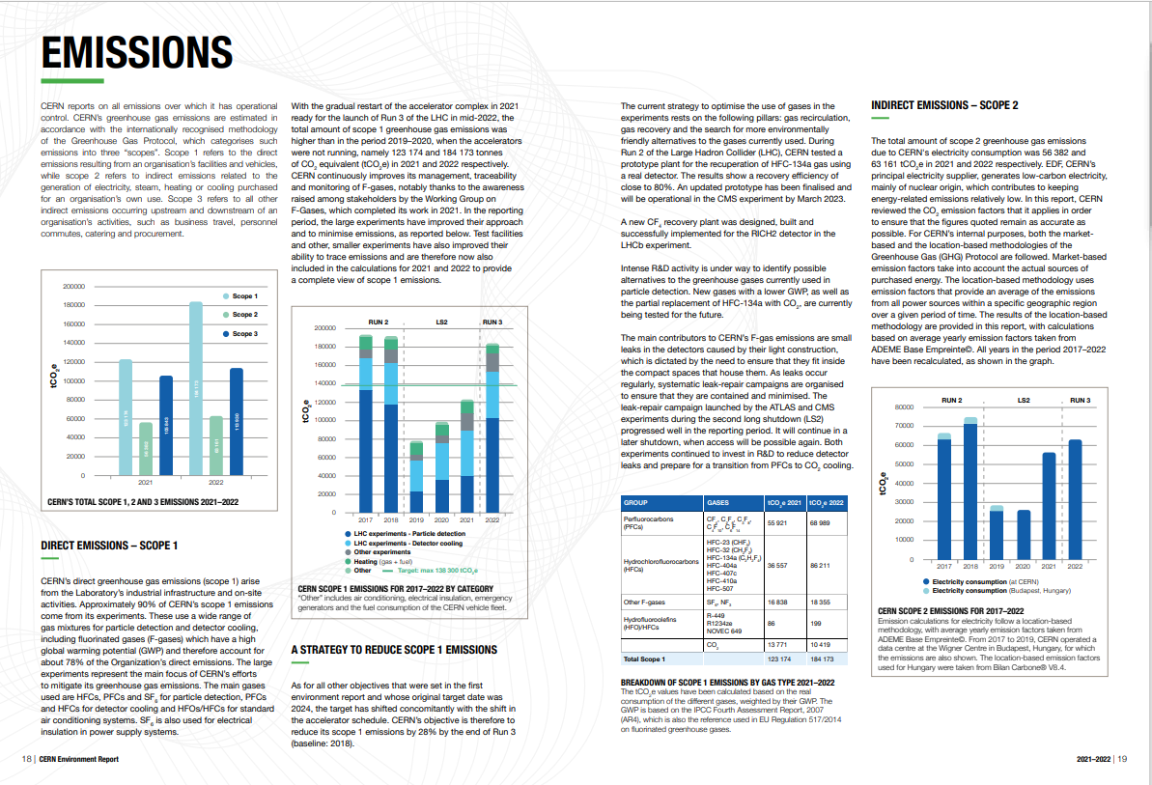
https://doi.org/10.25325/CERN-Environment-2023-003
But no mention at all of the ATLAS ultrasonic fluorocarbon leak monitor system !
G. Hallewell: Green Cherenkov radiators Sustainable HEP 4th Edition, CERN 12-15 May 2025

Slide 7
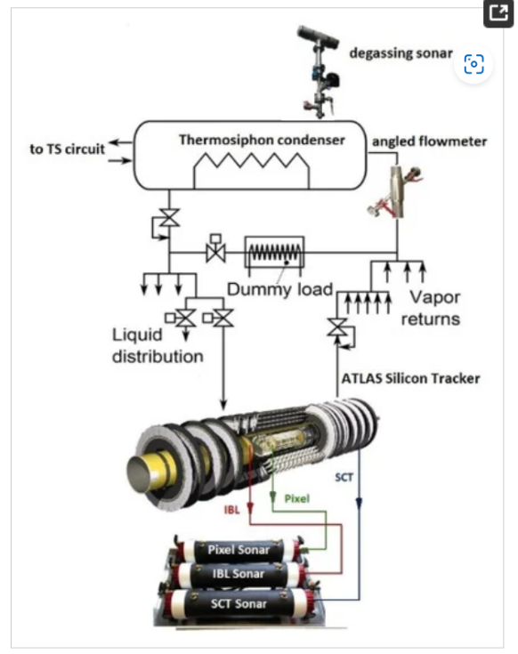
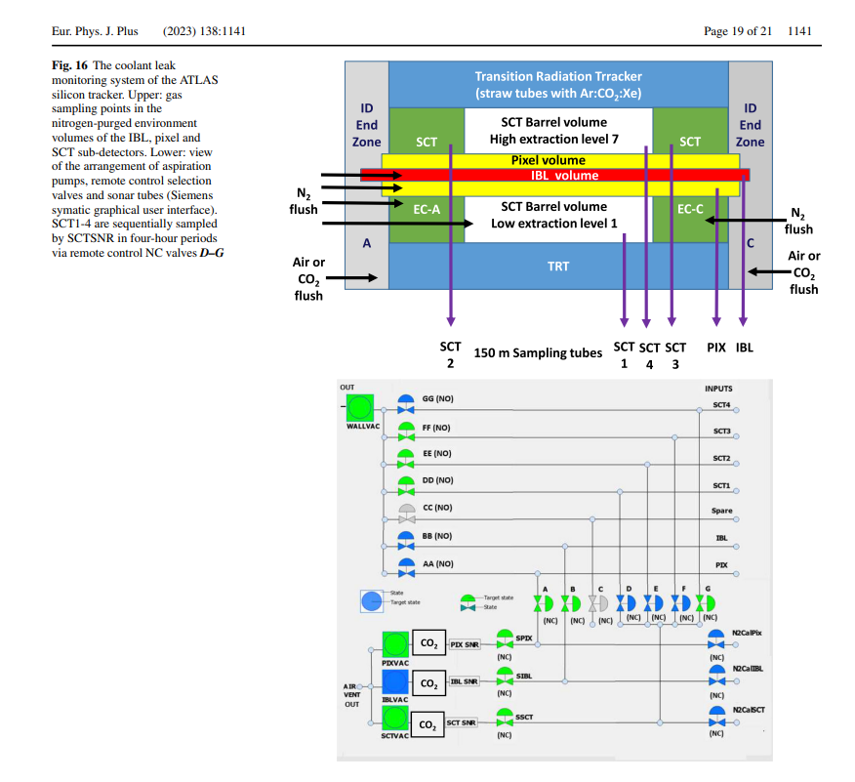
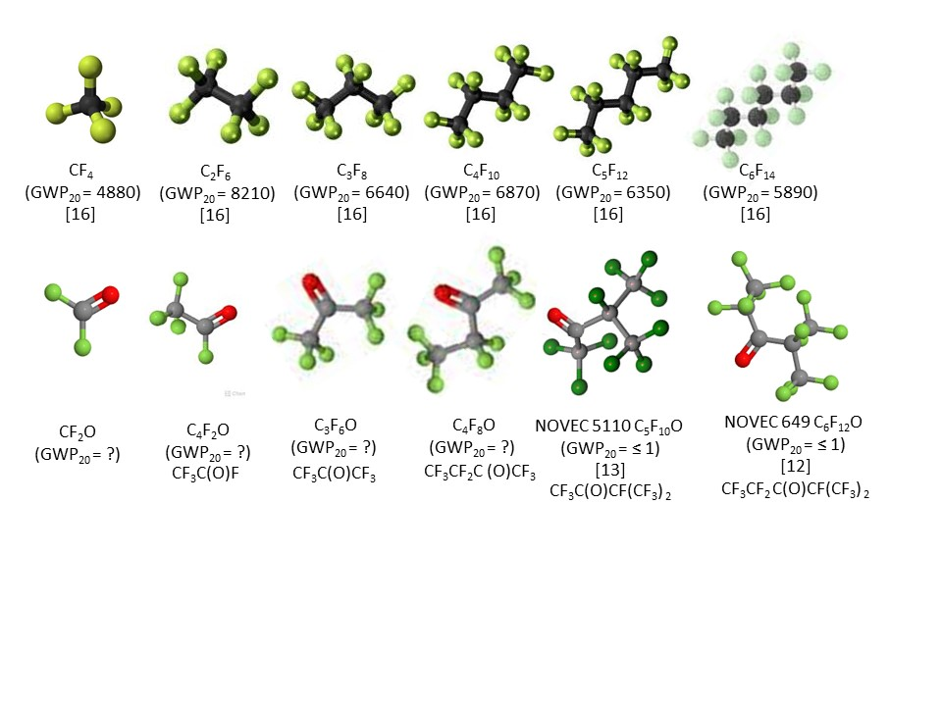
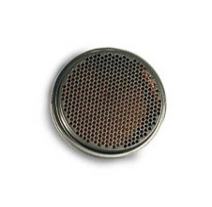
Ultrasonic detection of fluorocabon gas leaks:
ATLAS silicon tracker: SFC leak monitoring
https://www.mdpi.com/2410-390X/5/1/6
92 m
Gas aspirated through
150m tubes from
silicon tracker
N₂ environmental
volumes to
‘sonar’ devices
for C₃F₈
leak monitoring
(~ 10⁻⁵ C₃F₈ in N₂ )
G. Hallewell: Green Cherenkov radiators Sustainable HEP 4th Edition, CERN 12-15 May 2025

Slide 8

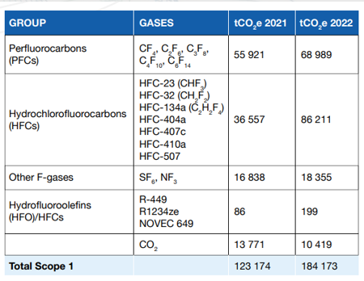
This latest CERN environmental report https://doi.org/10.25325/CERN-Environment-2023-003
Collective loss of SFCs only around 10 tonnes (whole of LHC + expts)
(compare that to yearly mass-loss at a ‘grande surface’ supermarket!)
SF₆ GWP = 23000
NF₃ GWP = 17000
R449: (CFH blend) GWP=1397
R1234 (HFO): GWP = 7
NOVEC 649 (C₆F₁₂O): GWP=0
G. Hallewell: Green Cherenkov radiators Sustainable HEP 4th Edition, CERN 12-15 May 2025

Slide 9
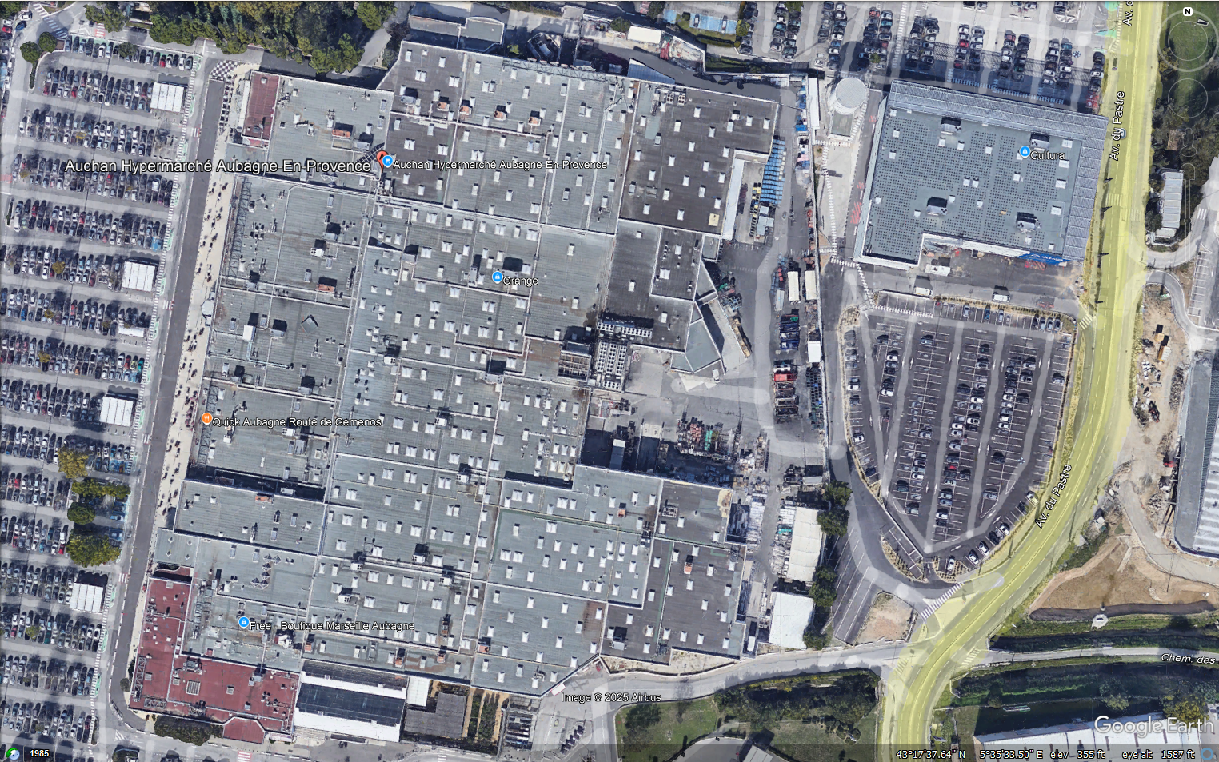
Some perspective (2): Auchan Aubagne (13) “Grande Surface” near Marseille
(Hectaires of A/C, tonnes of loss per year: R134a? (GWP=1430) ➔ R32? (GWP=675?)
G. Hallewell: Green Cherenkov radiators Sustainable HEP 4th Edition, CERN 12-15 May 2025

Slide 10
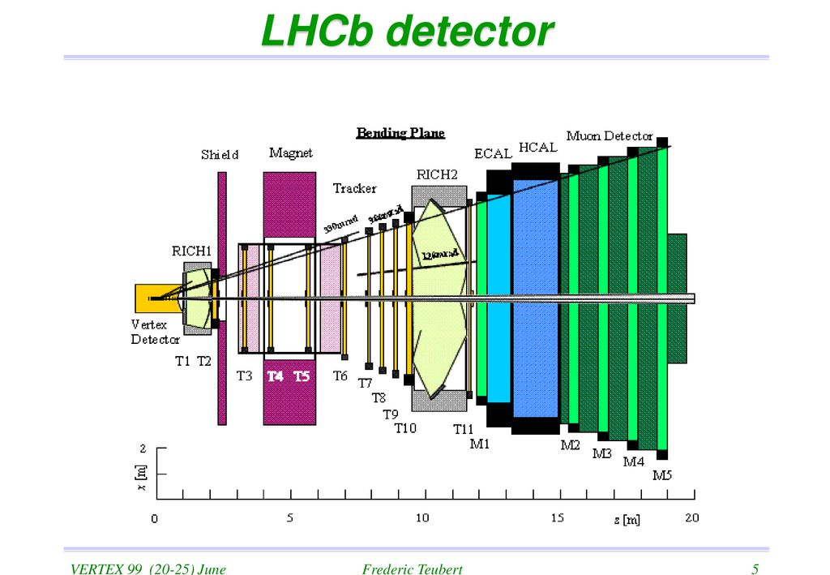
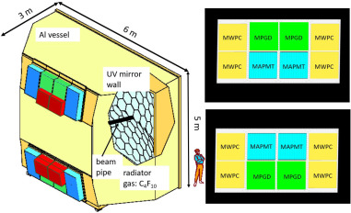
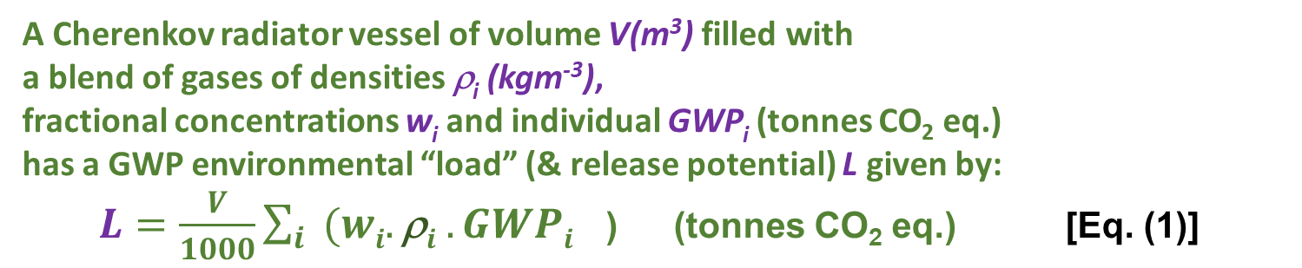
Refractive index & GWP ’load’ in a Cherenkov Gas Radiator
A Cherenkov radiator vessel of volume V(m³) filled with
a blend of gases of densities ρ_{i} (kgm⁻³),
fractional concentrations w_{i} and individual GWP_{i} (tonnes CO₂ eq.)
has a GWP environmental “load” (& release potential) L given by:
$L=\frac{V}{1000}\sum_{i}{{(wi.\text{r}i .GWPi}^{}}$) (tonnes CO₂ eq.) [Eq. (1)]
LHCb RICH 1
(4m³ C₄F₁₀: GWP₂₀ = 4880
GWP eqv. CO₂: 274 tonnes
LHCb RICH 2
(100 m³: CF₄ GWP₂₀ = 6870
+ ≤ 5% CO₂)
GWP eqv. CO₂: 1737 tonnes
COMPASS RICH
(100 m³ C₄F_{10:} GWP₂₀ = 4880)
GWP eqv. CO₂: 6849 tonnes
G. Hallewell: Green Cherenkov radiators Sustainable HEP 4th Edition, CERN 12-15 May 2025

Slide 11
The big SFC-using Ring Imaging CHerenkov Detectors at CERN
Ideally… replace SFCs with
same-order GWP₀ FKs
with good UV transparency, refractivity…
LHCb RICH 1
(4m³ C₄F₁₀)
GWP eqv CO₂: 274 tonnes
LHCb RICH 1
(4m³ lin-C₄F₈O)
GWP eqv. CO₂: 0 tonnes
LHCb RICH 2
(100 m³: CF₂O + ?)
GWP eqv. CO₂: 0 t
COMPASS RICH
(100 m³ lin- C₄F₈O)
GWP eqv. CO₂: 0 tonnes
LHCb RICH 2
(100 m³: CF₄ + ~5% CO₂)
GWP eqv. CO₂: 1737 t
COMPASS RICH
(100 m³ C₄F₁₀)
GWP eqv CO₂: 6849 tonnes
CF₂O Toxicity ☹
G. Hallewell: Green Cherenkov radiators Sustainable HEP 4th Edition, CERN 12-15 May 2025

Slide 12
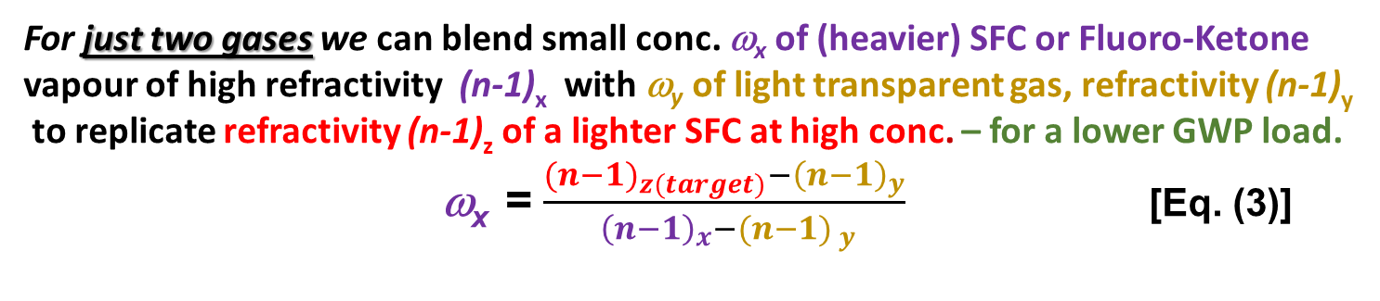
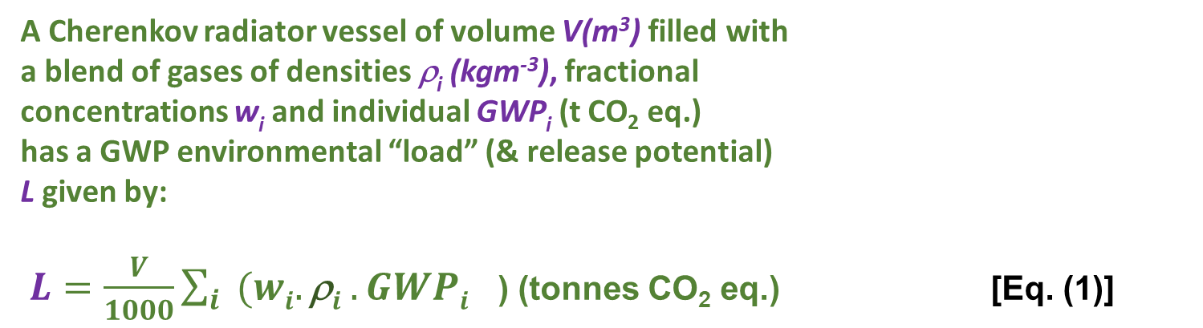
But if direct 1 for 1 substitution is not possible…
A Cherenkov radiator vessel of volume V(m³) filled with
a blend of gases of densities ρ_{i} (kgm⁻³), fractional
concentrations w_{i} and individual GWP_{i} (t CO₂ eq.)
has a GWP environmental “load” (& release potential)
L given by:
$L=\frac{V}{1000}\sum_{i}{{(wi.\text{r}i .GWPi}^{}}$) (tonnes CO₂ eq.) [Eq. (1)]
V,ρ
The corresponding radiator gas mixture refractivity for a gas blend is given by :
$\text{(}\text{n}\text{−1)}rad =\sum_{i}{{(wi.\text{(}\text{n}\text{−1)}i}^{}}$ [Eq. (2)]
For just two gases we can blend small conc. ω_{x} of (heavier) SFC or Fluoro-Ketone
vapour of high refractivity (n-1)_{x} with ω_{y} of light transparent gas, refractivity (n-1)_{y}
to replicate refractivity (n-1)_{z} of a lighter SFC at high conc. – for a lower GWP load.
ω_{x} = $\frac{{{(n−1)}_{z(target)}−\left(n−1\right)}_{y}}{{ {\left(n−1\right)}_{x}−(n−1)}_{ y}}$ [Eq. (3)]
G. Hallewell: Green Cherenkov radiators Sustainable HEP 4th Edition, CERN 12-15 May 2025

Slide 13
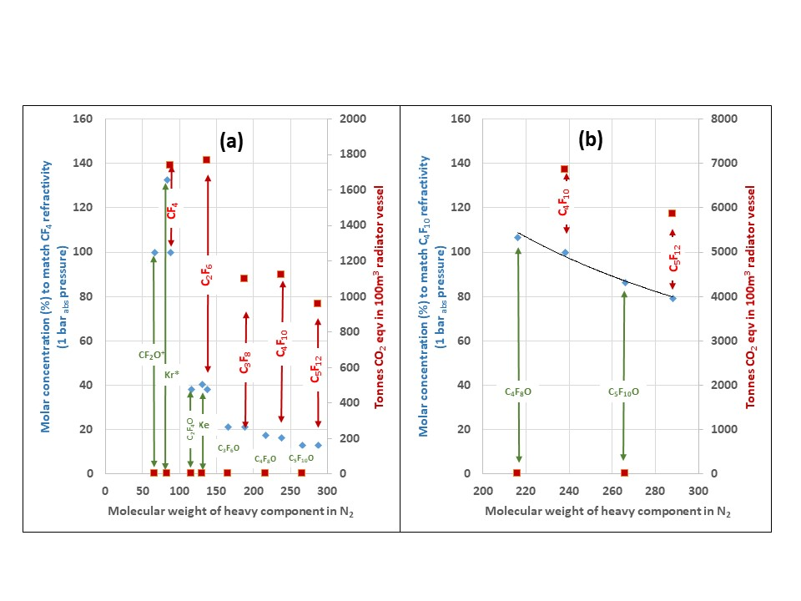
Targeting the refractivity of CF₄ & C₄F₁₀ (100 m³: examples) at 1 bar_{abs} with gases of differing molecular weight in varying fractional concentrations with N₂
(conc. > 100% indicate need for overpressure): includes hypothetical light fluoro-ketones
CF₄
C₄F₁₀
G. Hallewell: Green Cherenkov radiators Sustainable HEP 4th Edition, CERN 12-15 May 2025

Slide 14
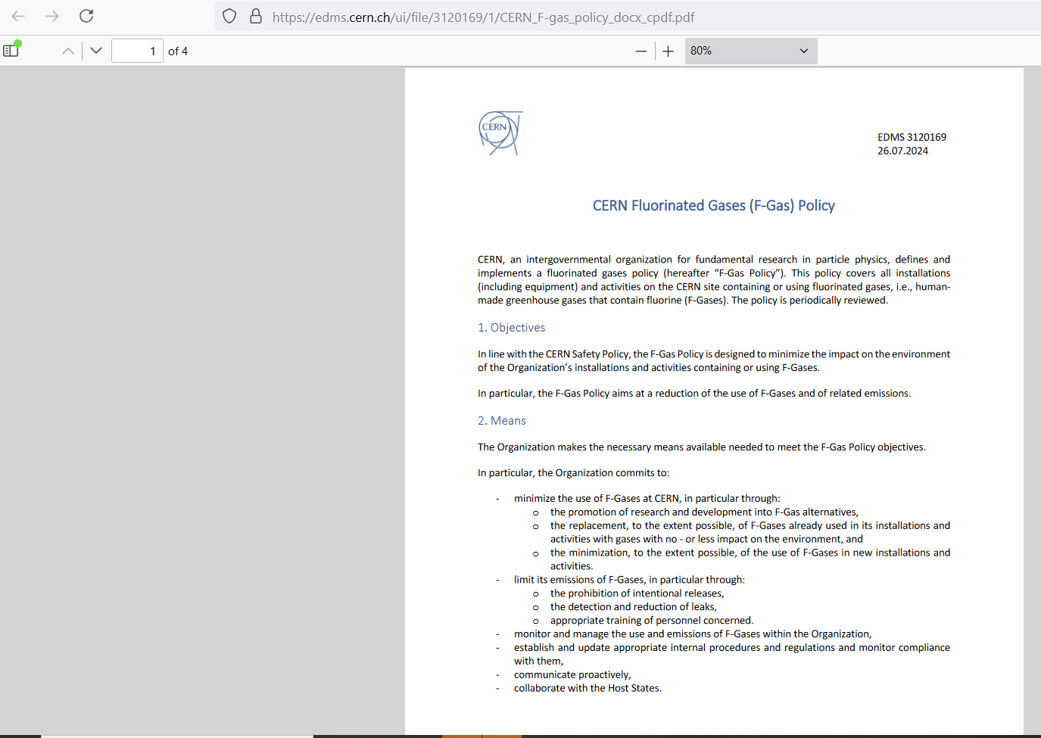
CERN F-gas policy document on EDMS (July 2024)
https://edms.cern.ch/ui/file/3120169/1/
CERN_F-gas_policy_docx_cpdf.pdf
Page 1 of 4
In the possible absence of suitable F-K alternatives (compatibility issues),
some options for better husbandry of heritage SFCs/PFCs follow:
G. Hallewell: Green Cherenkov radiators Sustainable HEP 4th Edition, CERN 12-15 May 2025

Slide 15
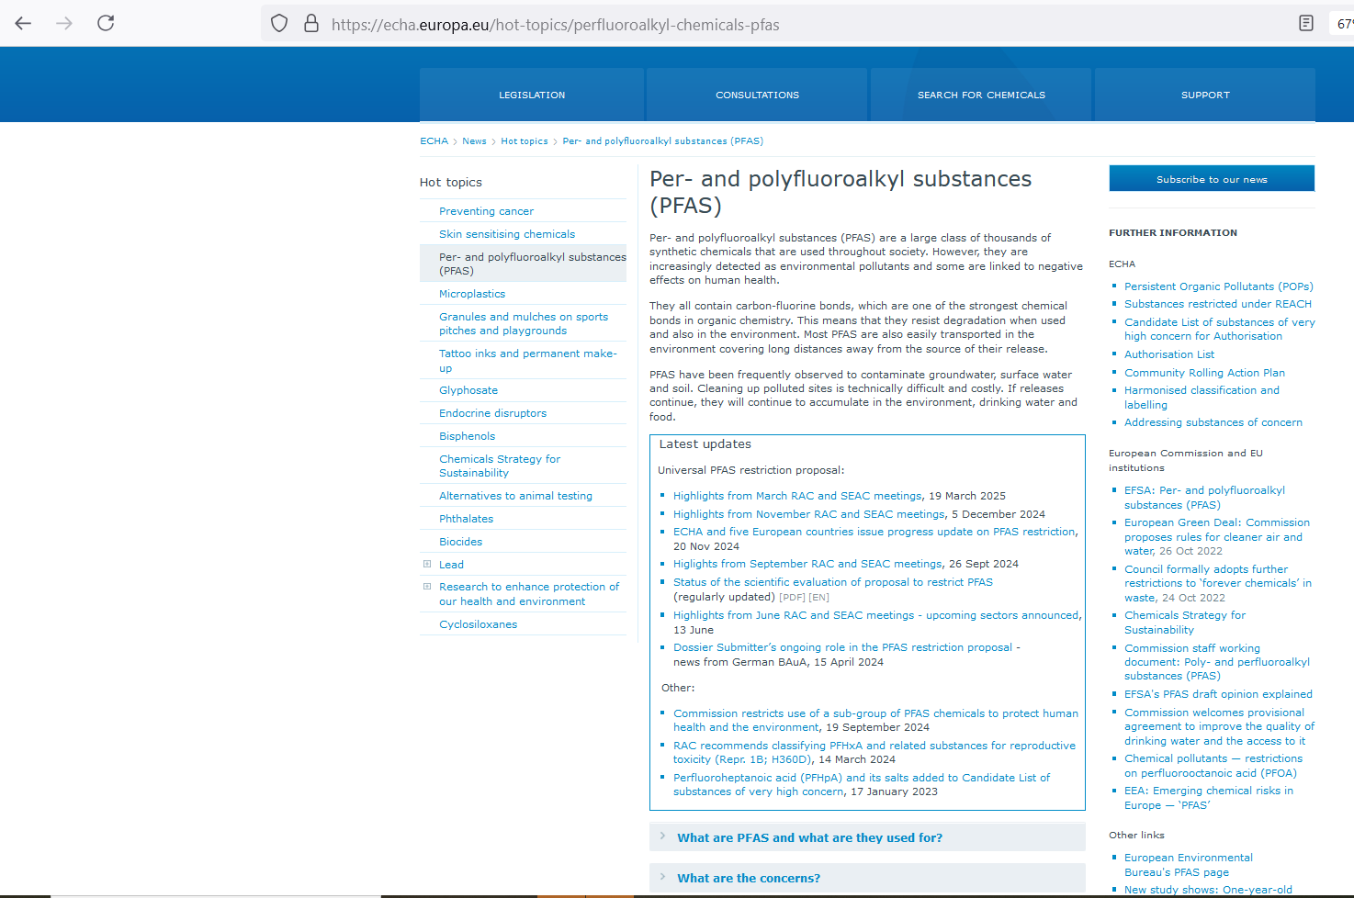
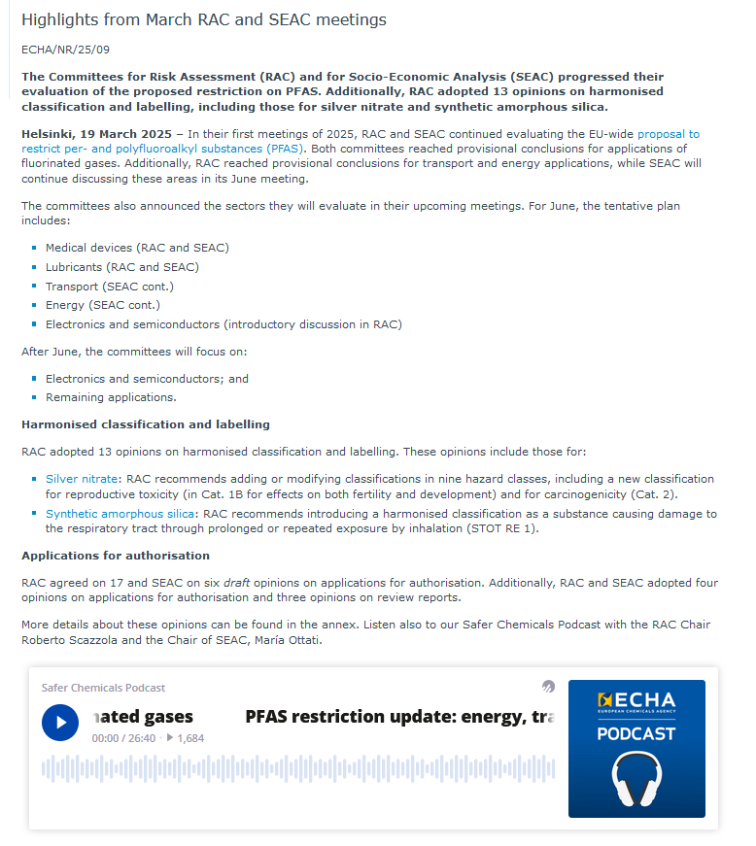
G. Hallewell: Green Cherenkov radiators Sustainable HEP 4th Edition, CERN 12-15 May 2025

Slide 16
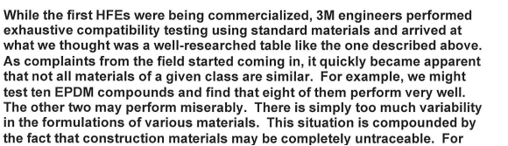
(1 of 2): Perspective from a recent e-mail exchange [Apr. 2025] with a chemical company producing Saturated Fluoro-Carbons (SFCs),
a.k.a Per-Fluoro-Carbons (PFCs)
“C₅F₁₂O et seq.: “NOVEC” Fluoro-ketones are undeniably good fluids: for the majority of applications:
they work well as a substitute for fully fluorinated alkanes but have compatibility issues to overcome.
“About 10 years ago I discovered a 3M report posted on the internet that detailed across 27 pages
the performance differences between NOVECs and fully fluorinated alkanes:
NOVEC’s unpredictable lack of compatibility with the many and varied materials of constructions
being a major reported issue along with poorer thermal stability and dielectric strength.
“We tell our customers that if fluid performance is absolutely critical to an application (e.g. aerospace)
prioritizing reducing leaks and / or capture and recycling is worth the effort ahead of a fluid swap.
Unfortunately it’s not a very glamorous or exciting solution.”
G. Hallewell: Green Cherenkov radiators Sustainable HEP 4th Edition, CERN 12-15 May 2025

Slide 17
(2 of 2): Perspective from a recent e-mail exchange [Apr 2025] with
a chemical company producing Saturated Fluoro-Carbons (SFCs),
a.k.a Per-Fluoro-Carbons (PFCs)
“[…] So far we have not seen any serious diminishing of business due to
PFAS or F-gas restrictions.
“[…] F-gas and PFAS are a constant topic of conversation with customers,
but the same conclusions seem to be happening over and over again.
“Simply there is no alternative that works as well, and compromising safety
or efficacy is not in anyone’s interest, in particular space and military are not
inclined to change for inferior performance.
In fact we are working with customers on new projects that use our PFC’s.
“Basically there was a initial wobble, but it doesn’t seem to have spooked
everyone - there are still brave souls out there.”
G. Hallewell: Green Cherenkov radiators Sustainable HEP 4th Edition, CERN 12-15 May 2025

Slide 18
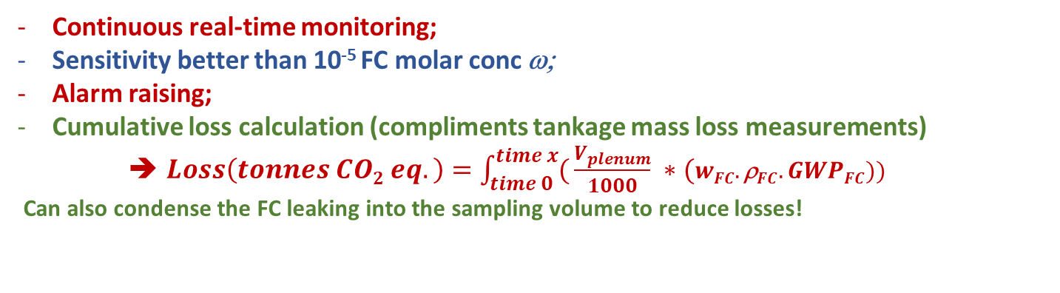
Improved leak capture: Surrounding a FC RICH radiator with a thin (for example: N₂) - purged leak sniffing plenum equipped with ultrasonic monitoring of FC molar mass
Internal placement of ultrasonic transducers?
Aspiration to analyser: membrane pumps & tubes?
Aspiration from the bottom best: hydrostatics of heavier FC
Care with volume calculation if jacket walls are flexible:
(Hydrostatic bowing with heavy FCs)
SensComp
(ex-Polaroid) 50 kHz
Ultrasonic transducer
https://senscomp.com
Cold trap to
liquify & recapture
fluorocarbon
Aspiration
pump
Sonar
Continuous real-time monitoring;
Sensitivity better than 10⁻⁵ FC molar conc ω;
Alarm raising;
Cumulative loss calculation (compliments tankage mass loss measurements)
➔ $Loss\left(tonnes CO2 eq.\right)=\int_{time 0}^{time x}{(}\frac{V_{plenum}}{1000} ∗(wFC.\text{r}FC.GWPFC))$
Can also condense the FC leaking into the sampling volume to reduce losses!
https://www.mdpi.com/2410-390X/5/1/6
G. Hallewell: Green Cherenkov radiators Sustainable HEP 4th Edition, CERN 12-15 May 2025

Slide 19
Improved ‘Optigeneric’ FC blend RICH radiator gas recirculator suppression of moving parts like gas blowers & compressors
(often major points of failure & leaks)
Cooling fluid
to coils
(probably boil-off
from LN₂, LAr
Light carrier
Gas escape
(eg N₂)
Atmospheric
reference pressure
safety bubbler
Liquid FC
ρgh > P_{evap} evap sufficient to drive circulation
Fluorocarbon
Condenser
-80 °C
Condenser
Coil
OUT
Liq FC
Keep cold coil
Radiator
vessel
h
FC liquid phase purifier
(O2, H2O removal etc.)
Fluorocarbon
Evaporator
Gas mixture
Monitor & control
P_{evap}
Low mass flow
FC liquid
pump
IN
N₂ in
Mass Flow Controller
G. Hallewell: Green Cherenkov radiators Sustainable HEP 4th Edition, CERN 12-15 May 2025

Slide 20
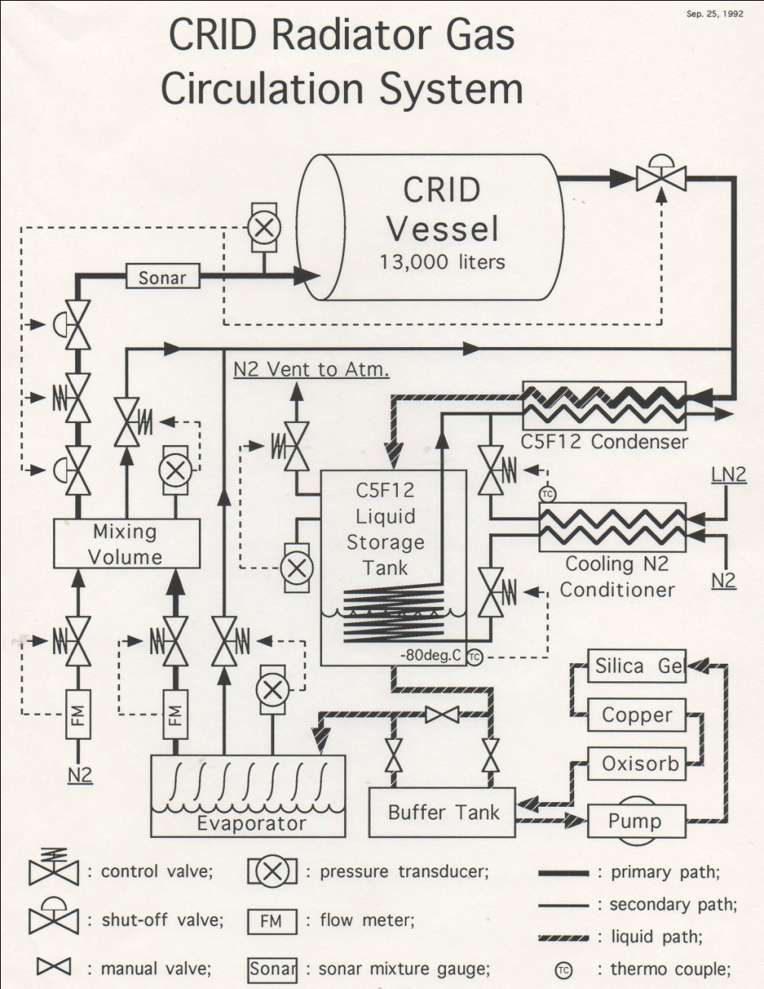
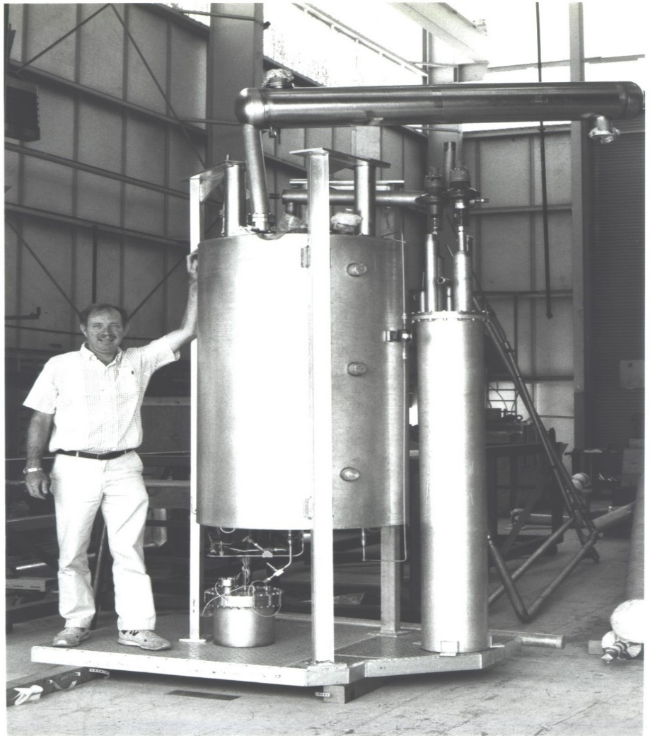
Example of such a thermosiphon recirculator: SLD CRID C₅F₁₂/N₂ gas radiator:
Low temperature (-80°C)
N₂ gas-induced condensation (B):
of C₅F₁₂ fromC₅F₁₂/N₂ radiator gas (flow~1m³/hr, negligible C₅F₁₂ loss)
followed by (C) electric re-evaporation
(1-1.5m below condenser liq. level)
Cold N₂ gas (‘conditioned’ by
counter-flow with boil-off LN₂
from liquid argon calorimeter: (A))
Ultrasonic (speed of sound) – aided
“on-the fly” mixing of typical
17%N₂ /83%C₅F₁₂ (molar) radiator gas mixture (D)
A
B
D
C
G. Hallewell: Green Cherenkov radiators Sustainable HEP 4th Edition, CERN 12-15 May 2025

Slide 21
So where are we (May 2025)..?
(Interim conclusion: as you have seen, PFAS are a moving target)
Despite high GWP SFCs/PFCs (form C_{n}F_{(2n+2)}) currently indispensable as benign Cherenkov radiators (refractivity, good UV & near-UV transparency) ;
C₄F₁₀ & CF₄ in COMPASS & LHCb RICH 1 & 2, possibly soon C₂F₆ (again).
3M Corp leaving PFAS market place by end of 2025: affects 3M SFC/PFC & NOVEC® Fluoro-Ketone PFAS fluids, but other manufacturers collectively filling gaps.
Examples: France: Dehon Co. (subsidiary Climalife): https://climalife.com
UK: F2 Chemicals: https://f2chemicals.com
USA: Synquest (FL): https://synquestlabs.com
China: Sanming Hexafluo Chemicals Co. : http://www.hexafluo.com
So how threatened will future PFAS availability really be?
(needs of electronics, semiconductor industry)..?
While not industrialised over a wide C_{n}F_{2n}O range fluoro-ketones might offer similar optical performance at very low, or 0 GWP Studies starting in DRD4;
Material compatibility issues, low order C_{n}F_{2n}O reactivity & toxicity an issue?
Lin (or iso?) -C₄F₈O could replace C₄F₁₀ while C₄F₈O or C₅F₁₀O blended with N₂
& controlled in real time by sound velocity gas analysis - could replace CF₄
Better usage of existing stocks of SFCs the best way to go?: ‘compressor-less’ (thermosiphon) circulation & leak capture plenums round large SFC volumes..?
G. Hallewell: Green Cherenkov radiators Sustainable HEP 4th Edition, CERN 12-15 May 2025

Slide 22
Previous related presentations
& references
G. Hallewell: Green Cherenkov radiators Sustainable HEP 4th Edition, CERN 12-15 May 2025

Slide 23
This is a follow-on from previous presentations in this vein:
(too much for here): for more information see:
“Green radiators”: Controlling refractive index & reducing Cherenkov gas radiator GWP: a challenge in an era of diminishing fluorocarbon availability
Related paper: https://link.springer.com/article/10.1140/epjp/s13360-023-04703-w
Also DRD4 meeting, May 2023 https://indico.cern.ch/event/1263731/contributions/5398511
ATLAS sustainability forum CERN, Jan 26 2024
https://indico.cern.ch/event/1371158/contributions/5773321/attachments/2788215/4861759/G_Hallewell_ATLAS_sustainability_forum_Jan_26_2024_v2.pptx
Sustainable HEP 2024 https://indico.global/event/4744/contributions/39611/
ICHEP2024 (July 2024): https://indico.cern.ch/event/1291157/contributions/5900402
DRD4 meeting Oct. 2024: https://indico.cern.ch/event/1456663/sessions/566400/#20241024
DRD4 meeting April 2025: https://indico.cern.ch/event/1473071/contributions/6430251/
.
23
G. Hallewell: Green Cherenkov radiators Sustainable HEP 4th Edition, CERN 12-15 May 2025
Notes:
23

Slide 24
G. Hallewell: Green Cherenkov radiators Sustainable HEP 4th Edition, CERN 12-15 May 2025

Slide 25
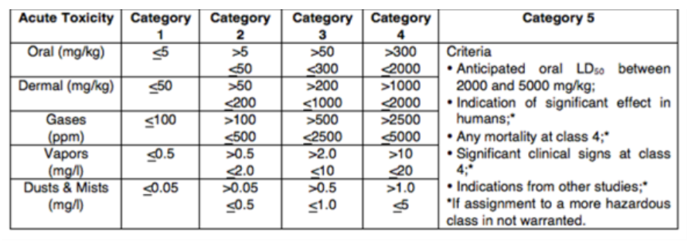
GHS Classification Criteria for Inhalation & skin Toxicity
Global Harmonized System of Classification and Labelling of Chemicals (GHS). 10th revision, United Nations (2023}
About the GHS | UNECE https://unece.org/about-ghs
H330 | Fatal if inhaled
H331 | Toxic if inhaled
H332 | Harmful if inhaled
H333 | May be harmful if inhaled
H334 | May cause allergy or asthma symptoms or breathing difficulties if inhaled
H335 | May cause respiratory irritation
H336 | May cause drowsiness or dizziness
H310 | Fatal in contact with skin
H311 | Toxic in contact with skin
H312 | Harmful in contact with skin
H313 | May be harmful in contact with skin
H314 | Causes severe skin burns and eye damage
H315 | Causes skin irritation
G. Hallewell: Green Cherenkov radiators Sustainable HEP 4th Edition, CERN 12-15 May 2025

Slide 26

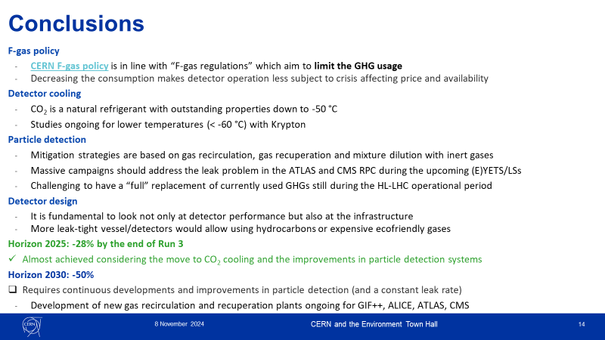
CERN and the Environment (what?)Town Hall meeting 8 November 2024
Watch this (CEPS) space
- and GET SB MEMBERSHIP
- to represent the
Cherenkov detector
community and its needs!
(from Guida talk)
G. Hallewell: Green Cherenkov radiators Sustainable HEP 4th Edition, CERN 12-15 May 2025

Slide 27
Cherenkov radiator and related general references (1 of 2) from
https://link.springer.com/article/10.1140/epjp/s13360-023-04703-w
[1] CERN Environment Report 2017–2018 https://doi.org/10.25325/CERN-Environment-2020-001
[2] B. Mandelli; Eco-gas mixtures and mitigation procedures for Green-house Gases (GHGs);
ECFA Detector R&D Road-map Symposium: T.F. 1 Gaseous Detectors, 29/4/2021
https://indico.cern.ch/event/999799/contributions/4204191/attachments/2236047/3789965/BMandelli_ECFA.pdf,
[3] B. Mandelli; R&D for the optimization of the use of greenhouse gases in particle detector systems;
Mini workshop on gas transport parameters for present and future generation of experiments: CERN April 22, 2021
https://indico.cern.ch/event/1022051/contributions/4325947/
[4] G. Rigoletti; Studies to reduce greenhouse gas emissions from detectors at the LHC; EP-DT Seminar May 4, 2022.pdf (cern.ch)
[5] S. Dalla Torre et al; Long term experience with C₄F₁₀ in COMPASS RICH-1; Presentation 11th Intl. Workshop on Ring Imaging Cherenkov detectors, Edinburgh, Scotland, Sept 12-16 2022. https://indico.cern.ch/event/1094055/contributions/4932286/attachments/2508724/4311387/RICH2022_C4F10_dallatorre.pdf
[6] 3M PFG-3480: c-octofluorotetrahydrofuran (C₄F₈O). Note: fluid out of production : product reference now used for a non-fluidic product. For historic product data sheet mentioning its high GWP see (for example): http://static6.arrow.com/aropdfconversion/a7116f41dfdd5b79d2eb7b40afd687f8af23d8ef/mediawebserver(563).pdf
[7] M. Artuso et al; Nucl. Instr & Meth. A Volume 558, (2006), 373-387
[8] Product #2H07-2-08 Synonyms: 2,2,3,3,4,4,5,5-octafluorotetrahydrofuran, Perfluorotetrahydrofuran; CAS No: 773-14-8, MDL No. MFCD00465561: SynQuest Labs Inc., 13201 Rachael Boulevard, Alachua, FL 32615, USA https://www.synquestlabs.com/Home/ProductDetail?SearchText=Octafluorotetrahydrofuran
[9] T. Acconcia et al ; Nucl. Instr & Meth A 767 (2014) 50–60
[10] M. Vollmer et al; Abundances, emissions, and loss processes of the long-lived and potent greenhouse gas octafluorooxolane (octafluorotetrahydrofuran, c-C4F8O) in the atmosphere; Atmos. Chem. Phys., 19, 3481–3492, 2019
[11] 3M Novec® range of fluorinated fluids; https://www.3m.com/3M/en_US/p/c/b/novec/?Ntt=novec
[12] 3M Novec 649/1230 fluid (C₆F₁₂O); https://multimedia.3m.com/mws/media/569865O/3m-novec-engineered-fluid-649.pdf,
https://multimedia.3m.com/mws/media/124688O/3m-novec-1230-fire-protection-fluid.pdf]
[13] 3M Novec 5110 fluid (C₅F₁₀O); https://multimedia.3m.com/mws/media/1132123O/3m-novec-5110-insulating-gas.pdf
[14] CERN report EN-CV 22/12/2017, EDMS 1751219 2017-334 rev 1.0: Technical Note NOVEC Fluids Qualification Report: Report on the study executed for the qualification of the NOVEC Fluid for Detector Cooling applications.
[15] J. Owens, Understanding the stability and environmental characteristics of a sustainable Halon alternative.
3M Performance Materials 3M Center, St. Paul, MN 55144
G. Hallewell: Green Cherenkov radiators Sustainable HEP 4th Edition, CERN 12-15 May 2025

Slide 28
Cherenkov radiator and related general references (2 of 2) from
https://link.springer.com/article/10.1140/epjp/s13360-023-04703-w
[16] CERN Mini-workshop on gas transport parameters for present and future generation of experiments 20/04/2021;
S. Easo; LHCb-RICH detectors and their gas radiators
https://indico.cern.ch/event/1022051/contributions/4333562/attachments/2231064/3780374/LHCb-RICH-Current-GasRadiators-April-2021.pdf,
Options for alternate radiators in LHCb-RICH system (including calculations by O. Ullaland); S. Easo,
https://indico.cern.ch/event/1022051/contributions/4319538/attachments/2231436/3781060/LHCb-RICH-Future-Radiators.pdf
[17] S.Easo; Nucl.Inst.& Meth. A 876 (2017) 168-173
[18] E. Lemmon, M. Huber, & M. McLinden; REFPROP Standard reference database 23, version 9.0 (2010)
U.S. National Institute of Standards & Technology.
[19] E. Nappi and J. Seguinot Rivista del Nuovo Cimento Vol. 28, N. 8-9 2005 DOI 10.1393/ncr/i2006-10004-6
[20] K. Abe et al. ; IEEE Trans. Nucl. Sci. 45 (1998) 648 SLAC-PUB-7705 DOI: 10.1109/23.6826
[21] G. Hallewell et al; Nucl. Instr. & Meth A264 (1988) 219-234
[22] G. Hallewell; Nucl. Instr & Meth A 876, (2017) 50-53
[23] G. Hallewell et al; MDPI Instruments (2021) 5(1), 6;
[24] P. Stassi et al; Ultrasonic Gas mixture analysis system in the Forward RICH of DELPHI,
DELPHI Internal Note 95-124 RICH73, 25 July 1995
[25] M.Sannino; Nucl. Instr. and Methods in Physics Research A 595 (2008) 208–211
[26] C. D'Ambrosio et al; Monitoring, Alignment and Control of the RICH Detectors;
LHCb-Memo-2000-80 RICH 6 September 2000.
[27] P. Fauland, PhD thesis; (COMPASS experiment) University of Bielefeld March 2004.
[28] Now marketed as SensComp model 600 transducer, http://www.senscomp.com/ultrasonic-sensors/
[29] T. Blake et al; Nucl. Instr. Meth A791 (2015) 27-31
[30] A. Papanestis; Nucl. Instr. Meth. A766 (2014) 14–18
[31] R. Calabrese et al; 2022 JINST 17 P07013
[32] J. Vavra (SLAC National Laboratory); private communication.
G. Hallewell: Green Cherenkov radiators Sustainable HEP 4th Edition, CERN 12-15 May 2025

Slide 29
Silicon tracker cooling and related general references FROM
https://link.springer.com/article/10.1140/epjp/s13360-023-04703-w
[33] P. Tropea; The CMS tracker fluorocarbon cooling system,
Engineering Forum: experiences from cooling systems for LHC detectors Oct 30 2008
[34] G. Aglieri Rinella et al, 2019 JINST 14 P07010
[35] G. Anelli et al ; 2008 JINST 3 S08007
[36] D. Attree et al, 2008 JINST 3 P07003
[37] W. Adam et al ; 2021JINST16P02027 CMS Technical Design Report; Pixel Detector Upgrade CMS-TDR-011, CERN-LHCC-2012-016 07/09/2012
[38] ATLAS Insertable B-Layer Technical Design Report; CERN-LHCC-2010-013 ATLAS TDR 19 15/09/2010
[39] O. de Aguiar Francisco et al; Nucl. Instr. Meth A. 1039 (2022) 166874
https://www.sciencedirect.com/science/article/pii/S0168900222003394
[40] Fluoroketone C₂F₅C(O)CF(CF₃)₂ as a Heat Transfer Fluid for Passive and Pumped 2-Phase Applications;
P. Tuma, 3M Co., 3M Center, 236-2B-01St. Paul, MN 55144, USA, Proc. 2008 IEEE 24th IEEE Semiconductor Thermal
Measurement and Management Symposium, San Jose CA, March 16-20 DOI: 10.1109/STHERM.2008.4509386
also accessible via: https://twiki.cern.ch/twiki/pub/LHCb/SciFiDemoCooling/F.Tuma_c6K_as.....pdf
[41] L. Gruber et al; Nucl. Instr. & Meth. 958 (2020) 162025 https://www.sciencedirect.com/science/article/abs/pii/S016890021930422X?via%3Dihub
[42] ”Building the future of LHCb”; C. Frei, S. Gambetta, B. Leverington; CERN Courier, September 2021 (2 September 2021)
https://cerncourier.com/a/building-the-future-of-lhcb
[43] M. Battistin et al; Int. J. Chemical Reactor Engineering 2015; 13(4): 511–521
[44] R. Bates et al; 2015 JINST 10 P03027
[45] https://lhc-commissioning.web.cern.ch/schedule/LHC-long-term.htm
[46] L. Contiero et al; Cold Krypton system for the Phase III Upgrade of the LHC,
Forum on Tracking Detector Mechanics 2023, Tuebingen Germany May 31-June 2 2023
[47] L. Contiero et al; Krypton, applied as refrigerant for cooling of silicon detector trackers;
GL 2022: 15th IIR-Gustav Lorentzen Conference on Natural Refrigerants, Trondheim, Norway, June 13-15 2023
[48] D. Alvarez et al: Thermo-Mechanical Performance of the Local Supports for the ATLAS ITk Pixel Outer Barrel:
Experimental and FEA Studies; Forum on Tracking Detector Mechanics 2023, Tuebingen Germany May 31-June 2 2023
[49] B. Verlaat; CO₂ cooling experiences in the LHCb Velo Thermal Control System
Engineering Forum: experiences from cooling systems for LHC detectors Oct 30 2008
[50] R. Bates et al; 2013 JINST 8 P02006
[51] ECHA/NR/23/04; https://echa.europa.eu/-/echa-publishes-pfas-restriction-proposal]
[52] ECHA Candidate List of substances of very high concern for Authorisation; https://echa.europa.eu/candidate-list-table
[53] Annex to the Annex XV restriction report proposal for restriction: Per- & polyfluoroalkyl substances (PFASs);
ECHA; 22/03/2023 https://echa.europa.eu/documents/10162/d2f7fce1-b089-c4fd-1101-2601f53a07d1
[54] Per- and polyfluoroalkyl substances (PFAS); ECHA https://echa.europa.eu/hot-topics/perfluoroalkyl-chemicals-pfas
G. Hallewell: Green Cherenkov radiators Sustainable HEP 4th Edition, CERN 12-15 May 2025

Slide 30
Back up matl.
G. Hallewell: Green Cherenkov radiators Sustainable HEP 4th Edition, CERN 12-15 May 2025

Slide 31
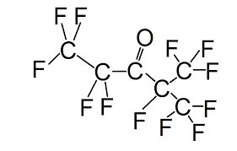
What gives NOVEC 649/1230 (lin C₆F₁₂O: FK-5-1-12) its low GWP?
A: Structure!: a double-bonded oxygen atom on a peripheral spur of the molecule
This fluoro-ketone configuration is:
CF₃CF₂C(O)CF(CF₃)₂
G. Hallewell: Green FCs for Cherenkov detectors & Si tracker cooling Sustainability session: ICHEP2024 Prague 18-24 July 2024
31

Slide 32
What gives NOVEC 649/1230 (lin C₆F₁₂O: FK-5-1-12) its low GWP?
https://www.nist.gov/system/files/documents/el/fire_research/R0301570.pdf
[15]
Scission by UV photons of λ ~300 nm in upper atmosphere (low P, high UV): fragments do not re-associate* into C_{n}F_{(2n+2)} SFCs
*The Environmental Impact of CFC Replacements HFCs and HCFCs
T. WALLINGTON et al Environ.Sci.Technol.1994(28)7 320A https://doi.org/10.1021/es00056a714
G. Hallewell: Green FCs for Cherenkov detectors & Si tracker cooling Sustainability session: ICHEP2024 Prague 18-24 July 2024
32

Slide 33
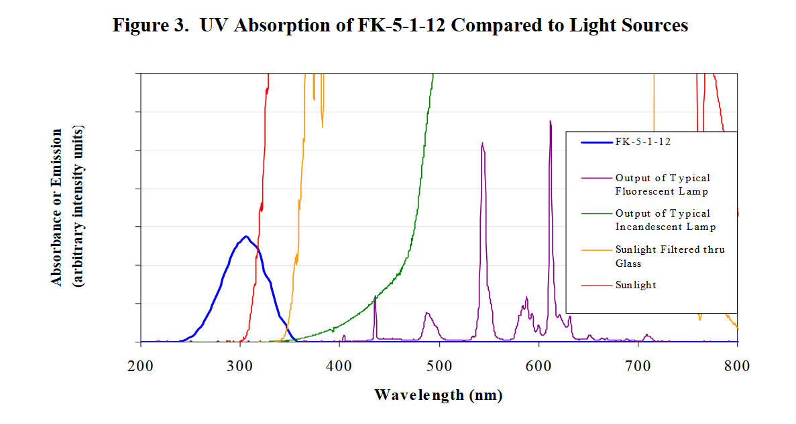
Q: What gives NOVEC 649/1230 its low GWP?
https://www.nist.gov/system/files/documents/el/fire_research/R0301570.pdf
[15]
Problematic UV absorbance
band for Cherenkov
light detection?
Scission by UV photons of λ around 300 nm
In the atmosphere (low pressure, high UV): the fragments do not reassociate* into saturated fluorocarbons of the type C_{n}F_{(2n+2)} (which would have high GWP)
*The Environmental Impact of CFC Replacements HFCs and HCFCs
T. WALLINGTON et al Environ.Sci.Technol.1994(28)7 320A https://doi.org/10.1021/es00056a714
33
G. Hallewell: Green Cherenkov gas radiators DRD4 WG-2 session: 11/04/2025

Slide 34
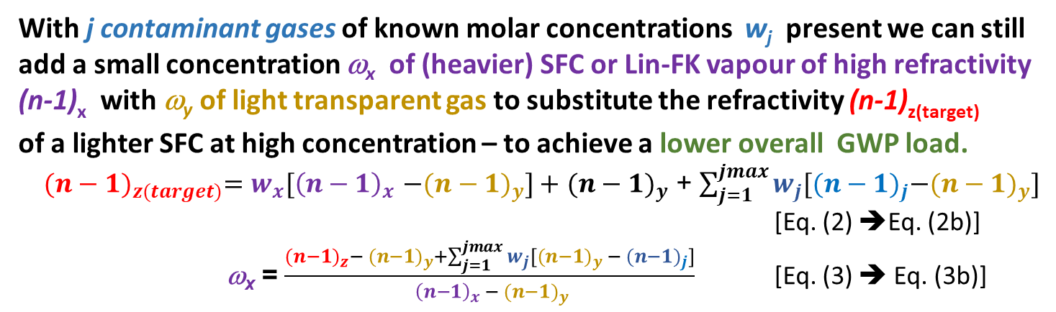
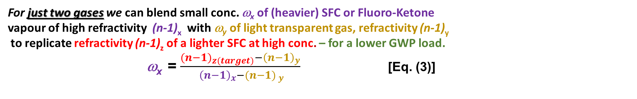
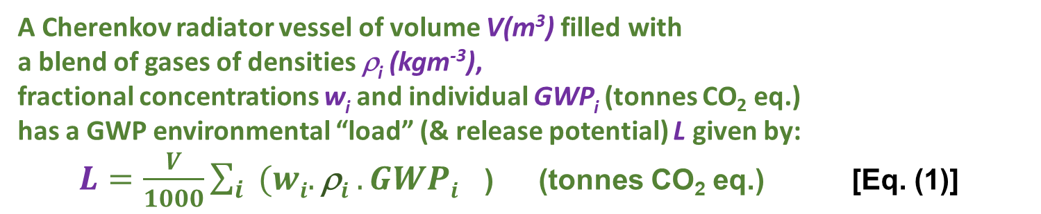
Refractive index & GWP ’load’ in a Cherenkov Gas Radiator
3 large RICH detectors currently in operation at CERN:
using saturated fluorocarbon gas volumes:
C₄F₁₀ (COMPASS: 100m³, LHCb RICH 1: 4m³): GWP₂₀ = 4880,
CF₄ (LHCb RICH 2: 100m³): GWP₂₀ = 6870
V,ρ
A Cherenkov radiator vessel of volume V(m³) filled with
a blend of gases of densities ρ_{i} (kgm⁻³),
fractional concentrations w_{i} and individual GWP_{i} (tonnes CO₂ eq.)
has a GWP environmental “load” (& release potential) L given by:
$L=\frac{V}{1000}\sum_{i}{{(wi.\text{r}i .GWPi}^{}}$) (tonnes CO₂ eq.) [Eq. (1)]
With j contaminant gases of known molar concentrations w_{j} present we can still
add a small concentration ω_{x} of (heavier) SFC or Lin-FK vapour of high refractivity
(n-1)_{x} with ω_{y} of light transparent gas to substitute the refractivity (n-1)_{z(target)}
of a lighter SFC at high concentration – to achieve a lower overall GWP load.
${{(n−1)}_{z(target)}=w_{x}[\left(n−1\right)}_{x}$ ${−(n−1)}_{y}]+$ ${(n−1)}_{y}$ + $\sum_{j=1}^{jmax}{w_{j}[{{(n−1)}_{j}−(n−1)}_{y}]}$
[Eq. (2) ➔Eq. (2b)]
ω_{x} = $\frac{{{(n−1)}_{z}− (n−1)}_{y}+\sum_{j=1}^{jmax}{w_{j}[{{(n−1)}_{y} − (n−1)}_{j}]}}{{ {\left(n−1\right)}_{x} − (n−1)}_{y}}$ [Eq. (3) ➔ Eq. (3b)]
The corresponding radiator gas mixture refractivity is given by :
$\text{(}\text{n}\text{−1)}rad =\sum_{i}{{(wi.\text{(}\text{n}\text{−1)}i}^{}}$) [Eq. (2)]
For just two gases we can blend small conc. ω_{x} of (heavier) SFC or Fluoro-Ketone
vapour of high refractivity (n-1)_{x} with ω_{y} of light transparent gas, refractivity (n-1)_{y}
to replicate refractivity (n-1)_{z} of a lighter SFC at high conc. – for a lower GWP load.
ω_{x} = $\frac{{{(n−1)}_{z(target)}−\left(n−1\right)}_{y}}{{ {\left(n−1\right)}_{x}−(n−1)}_{ y}}$ [Eq. (3)]
G. Hallewell: Green Cherenkov radiators Sustainable HEP 4th Edition, CERN 12-15 May 2025

Slide 35
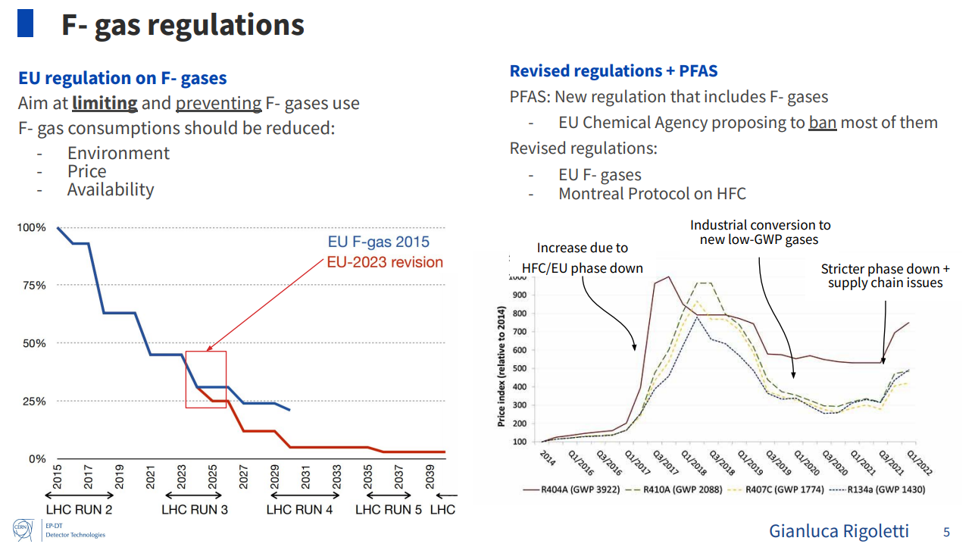
EU strategy to reduce Fluronated (PFAS) compound production and use
(includes also fluorinated plastics not shown here: see back-up material)
Dynamic price hiking :
like Trimposing demand-dependent tariffs…?
Projected Usage
From: ICHEP2024
G. Hallewell: Green Cherenkov gas radiators DRD4 WG-2 session: 11/04/2025

Slide 36
Cherenkov threshold: lin-C₅F₁₀O (eg: 3M NOVEC 5110)/N₂
& (heritage) C₅F₁₂/N₂ blend
and GWP load comparison with LHCb RICH2 (CF₄: 100m³)
N₂-NOVEC5110 (C₅F₁₀O) will be very similar (MW 266 vs. 288)
LHCb RICH 2: CF₄ thresholds
GWP load = (0.95 molar*4880*V.ρ)
~ 14% molar Novec 5110 gives a GWP load reduction of 1737 tonnes
(everything in the 100m³ radiator vessel):
Even substituting CF₄ with ~ 13% molar heritage stock C₅F₁₂ SFC (!) reduces GWP load by ~800 tonnes
C₅F₁₂ concentration (%)
LHCb RICH 2 with C₅F₁₀O/N₂
GWP load = (0.13 molar*1*V.ρ)
G. Hallewell: Green FCs for Cherenkov detectors & Si tracker cooling Sustainability session: ICHEP2024 Prague 18-24 July 2024
36

Slide 37
GWP load reduction through CF₄ index matching (LHCb RICH2)
Table 1: GWP loads of various SFCs and NOVEC 5110 blended with N₂ ((n-1) = 310.10⁻⁶) to match refractivity of CF₄ and C₄F₁₀
assumed radiator volume: 100 m³
https://link.springer.com/article/10.1140/epjp/s13360-023-04703-w
Base fluid | Base fluid density (1bar,25˚C) kgm⁻³ | Base fluid GWP (20-yr) | Component (n-1) (*10⁶) (@ nm) | % Blend with N₂ to match (n-1) CF₄ | GWP load (t.CO₂) | % Blend with N₂ to match (n-1) C₄F₁₀ | GWP load (t.CO₂)
CF₄ LHCb RICH2 (100m³) | 3.56 [18] | 4880 [16] | 488 (180-310 nm) [19] | 100 | 1737 | not applicable | n/a
CF₂O | - |  |  | ~100 | 1 | n/a | n/a
C₂F₆ | 5.63 [18] | 8210 [16] | 793 (180-310 nm) [19] | 38.1 | 1762 | not applicable | n/a
Lin-C₂F₄O | - |  |  | - |  | n/a | n/a
C₃F₈ | 7.75 [18] | 6640 [16] | 1180 (250 nm) [16] | 21.4 | 1099 | not applicable | n/a
Lin-C₃F₆O | - |  |  | - |  | n/a | n/a
C₄F₁₀ LHCb RICH1 (4m³): COMPASS (100m³) | 9.97 [18] | 6870 [16] | 1450 (250 nm) [16] | 16.3 | 1119 | 100 | 6849
Lin-C₄F₈O (Non-cyclic C₄F₈O)* | 9.5 (est.) | Probably < 1 (NOVEC 5110 Analogy) | 1380 @ 400nm (based on 3M PFG-3480 c-C₄F₈O [7]: linear C₄F₈O not yet measured but assumed similar) | 18.4 | 0.18 | 112.7* (>100% would imply necessity of operating C₄F₈O at slight overpressure) | 1.07
C₅F₁₂ | 11.63 [18] (BP 30 ˚C at 1 bar) | 6350 [16] | 1750 (180-310nm)[19] (40 ˚C, undiluted) | 13.0 | 957 | 79.3 | 5857
NOVEC 5110 C₅F₁₀O | 10.7 [13] (BP 27 ˚C at 1 bar) | <1 [13] | Not yet measured: probably around 1650 by analogy with C₄F₁₀ and C₄F₈O ratio | 13.9 | 0.149 | 85.2 | 0.91
Positions of presently unavailable-in-bulk C_{n}F_{2n}O fluids are shown in italics. Refractivities to match (CF₄ and C₄F₁₀) shown in bold.
GWP loads and refractivities calculated using eqs. (1)-(3): assumed radiator volume: 100 m³
*Made in research quantities by Synquest Inc. as isomers Heptafluorobutyryl fluoride PN: 2116-2-07 CAS: 335-42-2
Octafluoro-2-butanone PN: 2117-2-10 CAS: 337-20-2 & Heptafluoroisobutyryl fluoride PN: 2116-2-0A CAS: 677-84-9
G. Hallewell: Green FCs for Cherenkov detectors & Si tracker cooling Sustainability session: ICHEP2024 Prague 18-24 July 2024

Slide 38
Even bigger GWP load reduction through C₄F₁₀ index matching
(eg here: COMPASS RICH)
Table 1: GWP loads of various SFCs and NOVEC 5110 blended with N₂ ((n-1) = 310.10⁻⁶) to match refractivity of CF₄ and C₄F₁₀
assumed radiator volume: 100 m³
Base fluid | Base fluid density (1bar,25˚C) kgm⁻³ | Base fluid GWP (20-yr) | Component (n-1) (*10⁶) (@ nm) | % Blend with N₂ to match (n-1) CF₄ | GWP load (t.CO₂) | % Blend with N₂ to match (n-1) C₄F₁₀ | GWP load (t.CO₂)
CF₄ LHCb RICH2 (100m³) | 3.56 [18] | 4880 [16] | 488 (180-310 nm) [19] | 100 | 1737 | not applicable | n/a
CF₂O | - |  |  | ~100 | 0 | n/a | n/a
C₂F₆ | 5.63 [18] | 8210 [16] | 793 (180-310 nm) [19] | 38.1 | 1762 | not applicable | n/a
Lin-C₂F₄O | - |  |  | - |  | n/a | n/a
C₃F₈ | 7.75 [18] | 6640 [16] | 1180 (250 nm) [16] | 21.4 | 1099 | not applicable | n/a
Lin-C₃F₆O | - |  |  | - |  | n/a | n/a
C₄F₁₀ LHCb RICH1 (4m³): COMPASS (100m³) | 9.97 [18] | 6870 [16] | 1450 (250 nm) [16] | 16.3 | 1119 | 100 | 6849
Lin-C₄F₈O (Non-cyclic C₄F₈O)* | 9.5 (est.) | Probably < 1 (NOVEC 5110 Analogy) | 1380 @ 400nm (based on 3M PFG-3480 c-C₄F₈O [7]: linear C₄F₈O not yet measured but assumed similar) | 18.4 | 0.18 | 112.7* (>100% would imply necessity of operating C₄F₈O at slight overpressure) | 1.07
C₅F₁₂ | 11.63 [18] (BP 30 ˚C at 1 bar) | 6350 [16] | 1750 (180-310nm)[19] (40 ˚C, undiluted) | 13.0 | 957 | 79.3 | 5857
NOVEC 5110 C₅F₁₀O | 10.7 [13] (BP 27 ˚C at 1 bar) | <1 [13] | Not yet measured: probably around 1650 by analogy with C₄F₁₀ and C₄F₈O ratio | 13.9 | 0.149 | 85.2 | 0.91
G. Hallewell: DRD4 WG 2 Low GWP FC radiator gases: June 19 2024

Slide 39
C_{n}F_{2n}O fluid selection search criteria
Bibliographic
Materials tests
Optotests
Start(ed)
Next C_{n}F_{2n}O fluid
(order & isomer)
to evaluate
Y
Non-
Flammable
(MSDS)
?
Y
Non-
Oxone-
depleting
?
Y
Non-toxic
(MSDS)
?
N
N
N
N
Low GWP!
?
Y
N
N
N
Acid
formation
with H₂O
?
Y
Y
Rad.
Tolerant
(more for
cooling)
?
Y
N
Y
Materials/
purifier
Compatible
?
Dielectric
?
Y
N
Recirc.
Thermo-
dynamics
OK
?
Y
UV-Vis
transparency
OK
?
Y
(n-1) &
Chrom. Disp.
OK
?
Y
Accept
fluid
N
N
N
G. Hallewell: Green FCs for Cherenkov detectors & Si tracker cooling Sustainability session: ICHEP2024 Prague 18-24 July 2024

Slide 40
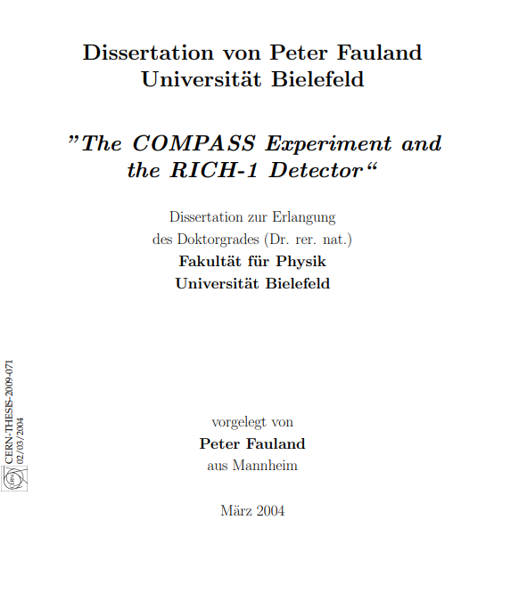
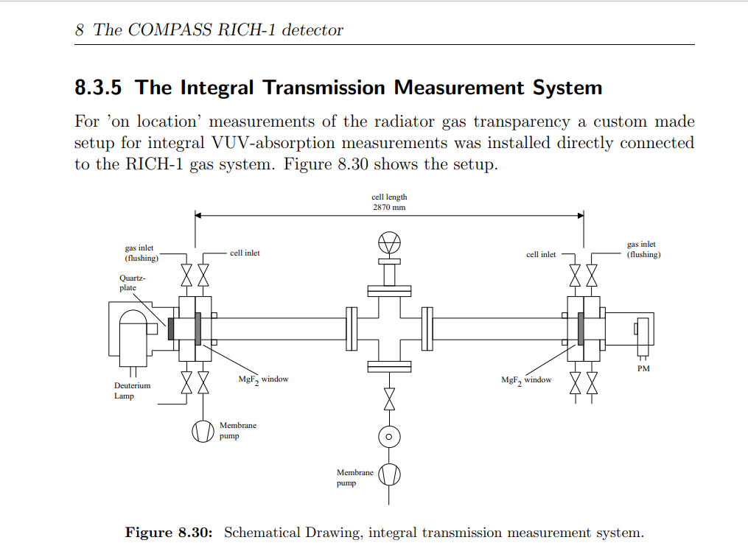
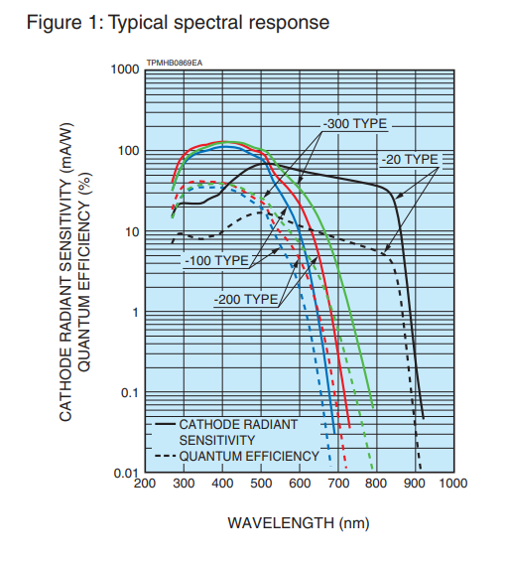
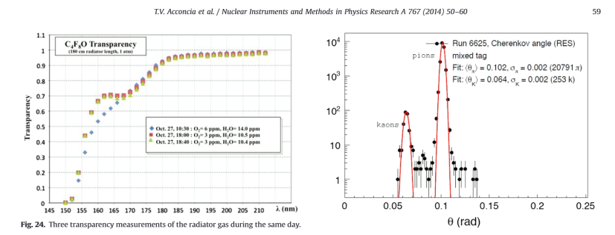
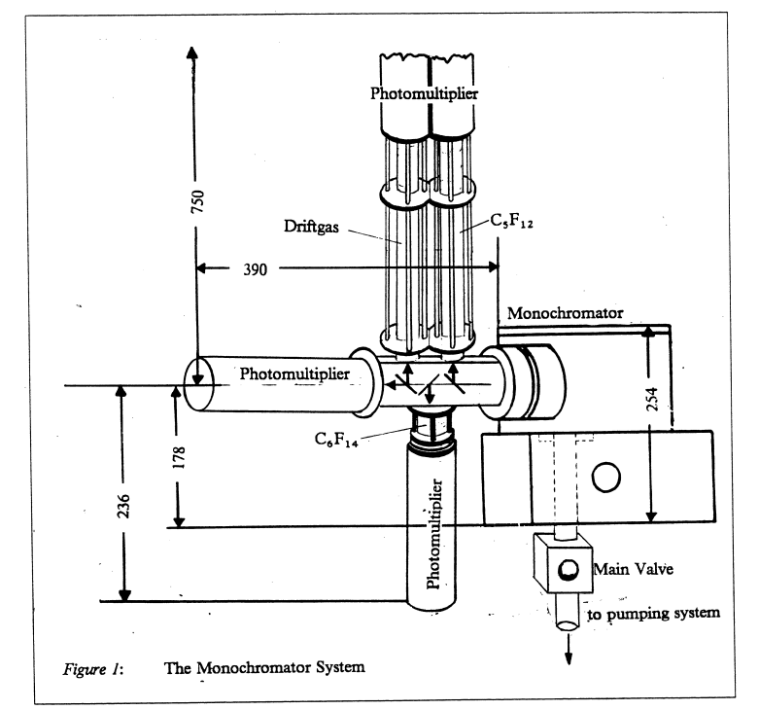
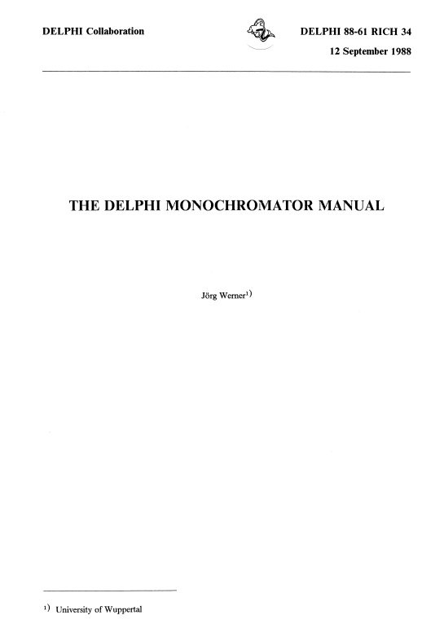
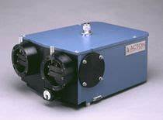
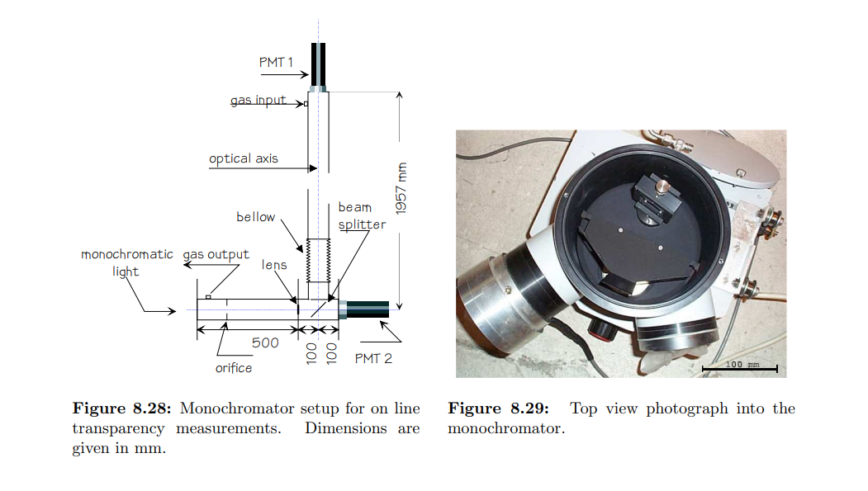
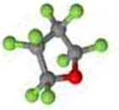
UV transparency, refractivity, cmhemical stability & compatibility studies needed
for different C_{n}F_{2n}O molecular shapes.
RICH detector community very competent & equipped for detailed UVT & (n-1)
- much ex-DELPHI RICH diagnostic equipment at CERN for example
A
Minuteman Model 302 VM.
ALICE VHMPID: transparancy
measurements in c-C₄F₈O
Octafluorotetrahydrofuran
CAS: 773-14-8
Synquest Inc. FL, USA
Most probable PC spectral range
in new build gas RICH detectors
G. Hallewell: Green FCs for Cherenkov detectors & Si tracker cooling Sustainability session: ICHEP2024 Prague 18-24 July 2024

Slide 41
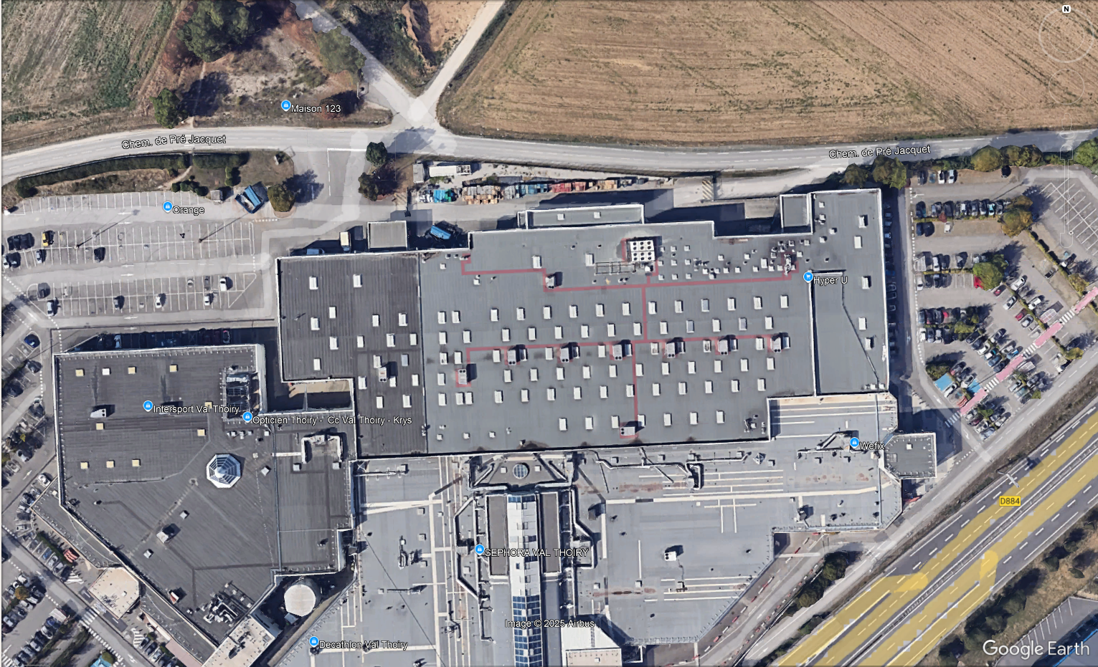
Some perspective (1): Val Thoiry (01) “Grande Surface” shopping centre near CERN:
G. Hallewell: Green Cherenkov radiators Sustainable HEP 4th Edition, CERN 12-15 May 2025

