Slide 1



Sustainable Practice and Research Knowledge (SPARK) Hub
Notes:
The abstract pattern can be removed or repositioned if required. Be careful to ‘Send to Back’ so that it does not obscure any important information.

Slide 2
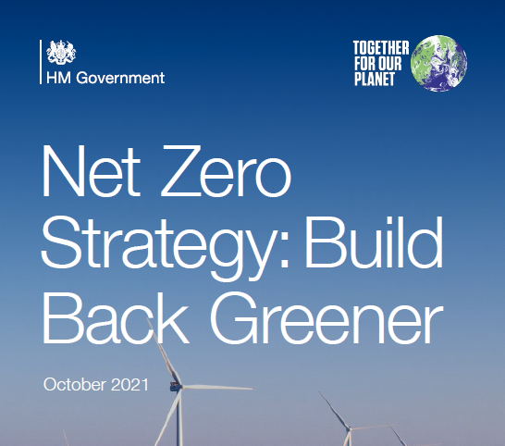
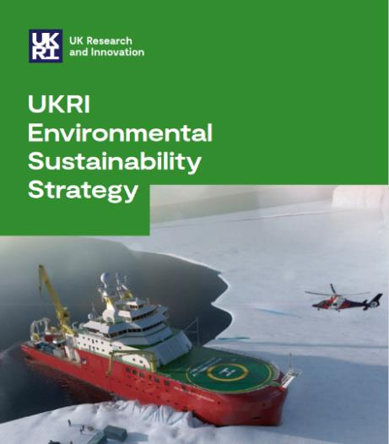
2050 – UK net zero
2040 – UKRI net zero

Slide 3
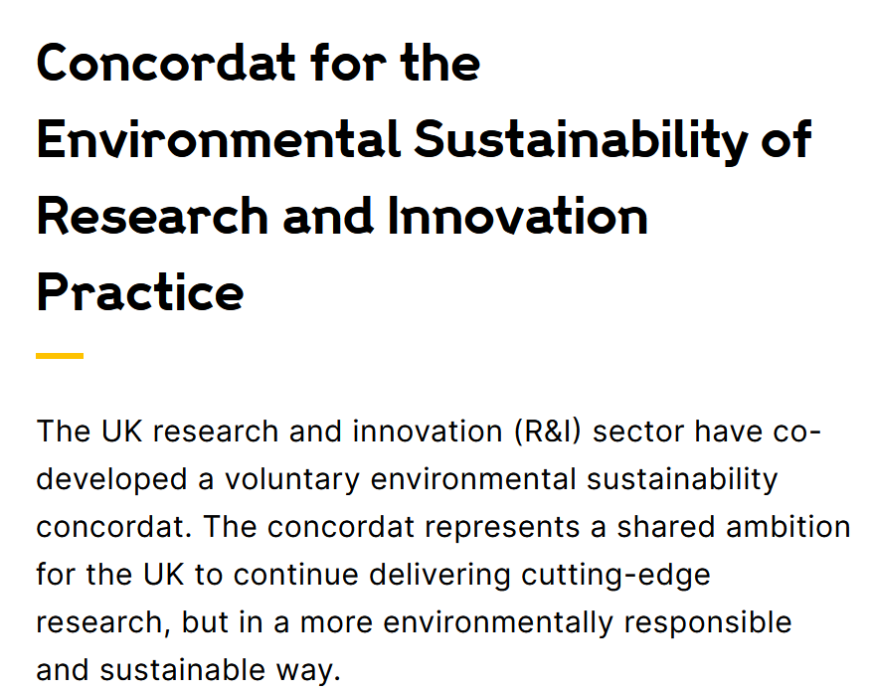
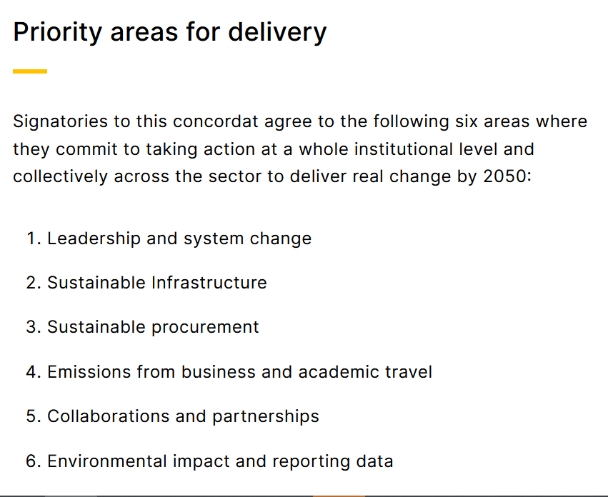

Slide 4
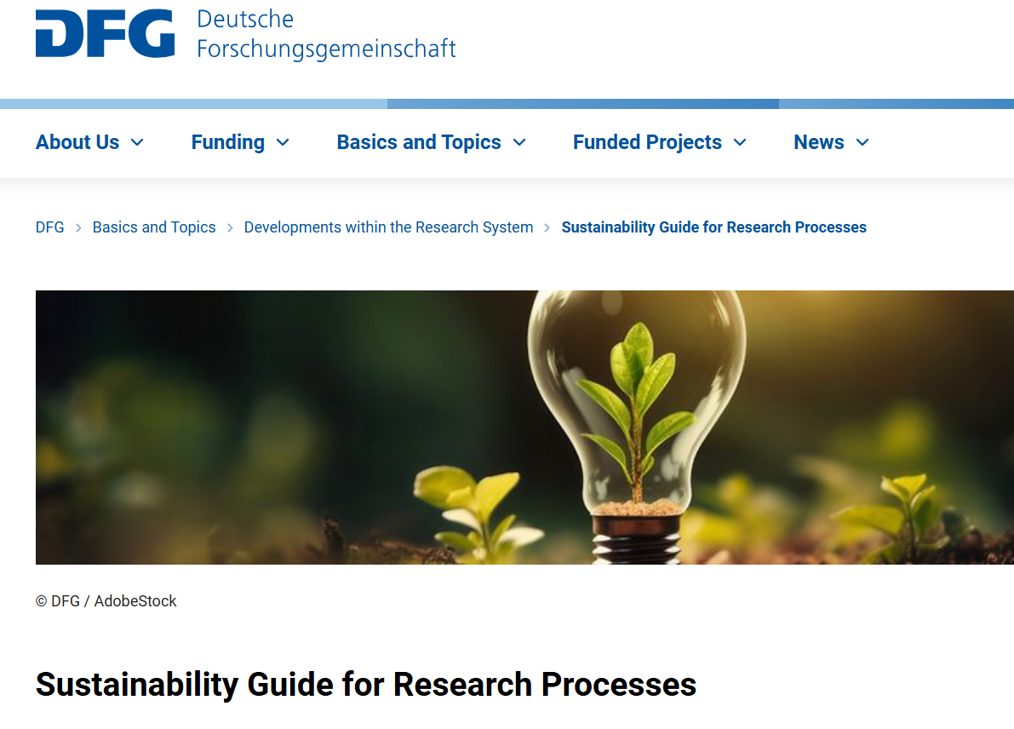
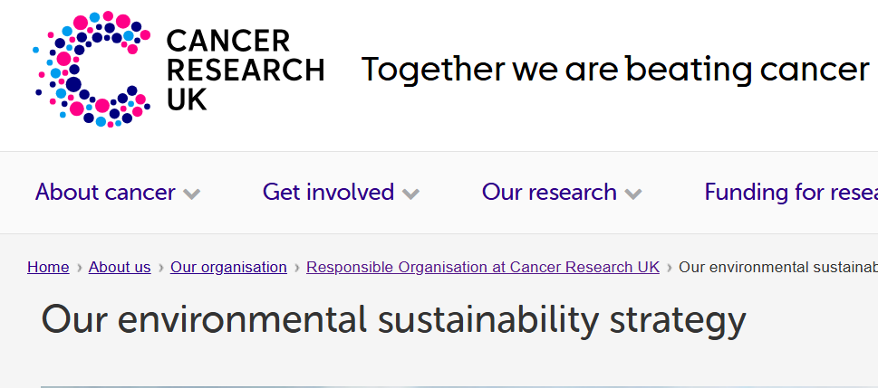
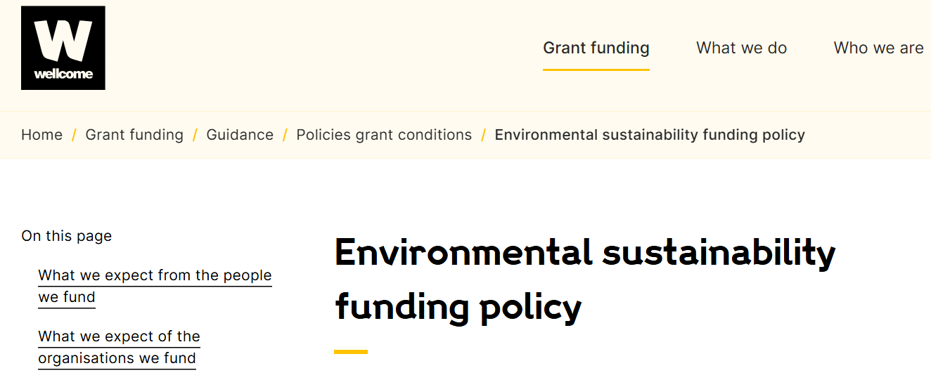

Slide 5
Landscape : sustainable research initiatives
Type of resource
Note this table is not exhaustive
Type of research | Networks | Emissions calculators and measuring tools | Guidance | Certification | Training
General | Max Planck Sustainability Network Various learned Societies interested EAUC (UK) | Exeter Research Carbon Calculator | Wellcome Environmentally Sustainable Research Policy Various institution-specific policies | Green Impact | Carbon Literacy Project
Wet labs | Sustainable European Laboratories (SELs), Laboratory Efficiency Action Network (LEAN), GreenLabNL, Labos1.5 GreenYourLab | Labos 1.5 | LEAF My Green Labs | LEAF My Green Labs Green Impact
Animal research labs |  |  | NC3Rs plans to start work on this in future.
Computational research | Upcoming Community of Practice on ESCR | Green Algorithms Green Algorithms 4 HPC Code Carbon Carbon Tracker Organization for Human Brain Mapping | '10 Simple Rules' 'GREENER principles’ DiSC | Green DiSC
Clinical trials |  | Methodology in place, a private and public tool both in development.
Social sciences
Clinical settings | Sustainable Healthcare Coalition Networks |  | MRC/GreenerNHS Clinical Lab Fellowship. NIHR Carbon Reduction Guidelines | EFLM Green & Sustainable Laboratory Home (rcem.ac.uk)
Institutional | EAUC (UK) | GHG Protocols, but no calculators

Slide 6
Challenges to ES in Funding
There is lacking ES guidance for many research areas we fund, including institutional action to align with ISO/EMAS
Methods of quantifying impact vary
There are barriers to access some of the existing guidance (either financial or open-access), as well as resource required.
Require quality control, as well as appropriate governance and stewardship as we see in comparable areas
Open-ended questions in grants run the risk of adding to bureaucracy (UKRI funding service has a principle regarding not including questions we cannot assess)
Result: We cannot effectively integrate ES in within our funding

Slide 7
What is it?
Certification to cover all research areas, and which is flexible depending on research activity
Covers activity for groups and institutions
Open-access resource which can host or sign-post training
Platform to either host or sign-post emission calculators
How will it work?
Peer-to-peer auditing/certification with a % that are randomly validated
Supported by Research Funders
Content is curated by elected lead of academics

Slide 8

A collaborative project: Open-access platform SPARKHUB
Free and easy to use
Calculators
Co-owned & funded by funders
Training
Content created by researchers/
experts/you
Standard actions & certification
Open access
Quality control

Slide 9
Benefits to funders and researchers
To funders
Transparency and open access
  Visibility of emissions and actions
  Enables independent verification, as well reduced bureaucracy for funding panels
  Comparability
Scalability
A means to integrate sustainability into grants long-term, not mandatory
Efficiency of costs and resources by preventing duplication
Align with a broader initiative for a European network on greening research practices, as proposed by Science Europe / NWO
To the research sector
Transparency and open access
Empowered to make decisions to reduce environmental impacts
Able to quantify carbon emissions
Access to high quality training, and good-practice via certifications and networks
Scalability
Sharing of good practice would ensure a quick proliferation of novel solutions to often challenging settings.

Slide 10
What have we done?
Initiated a working group of funders who met to review specification of a website and governance
Conducted a public procurement for website developers
Conducted at 15 workshops with RPOs and experts. Sought engagement beyond Europe, with colleagues in Australia & the US
Projected costing completed
Started website development, and done a visual identity
Developed calculators for common office / laboratory equipment
Co-developing training

Slide 11

Next Steps
Does this sound like a helpful idea for Physics?
Please get in touch!
We are running small workshops to engage on this topic
Martin.Farley@ukri.org
We want to support a more sustainable research sector
Notes:
Replace this guidance text with your own bullet pointed content.
For further guidance please see https://www.bdadyslexia.org.uk/advice/employers/creating-a-dyslexia-friendly-workplace/dyslexia-friendly-style-guide

Slide 12
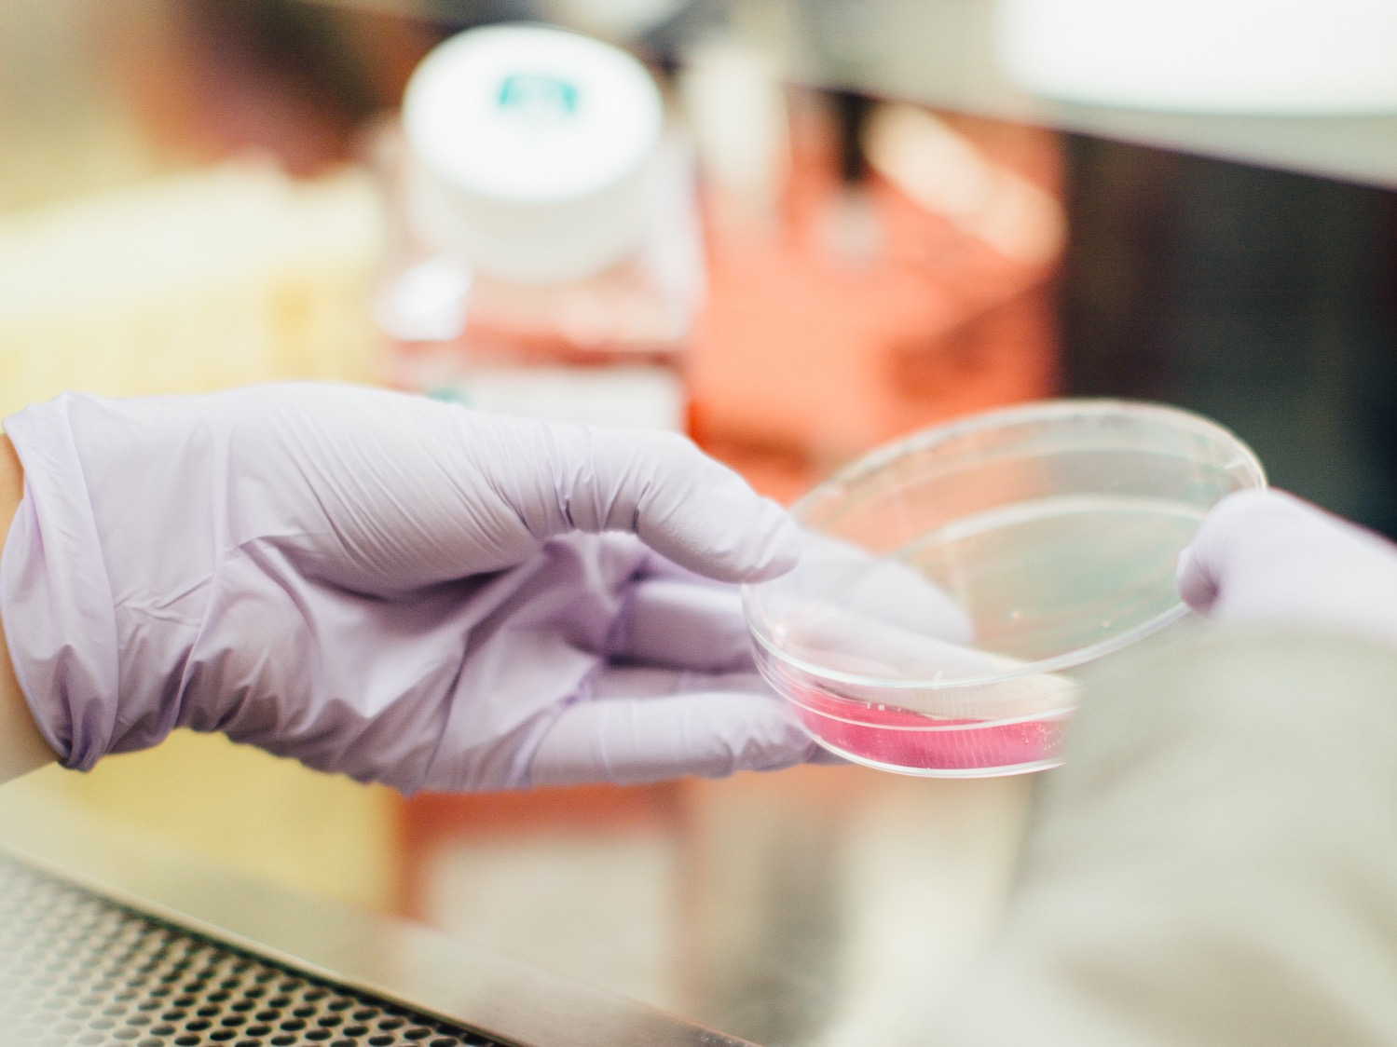




Notes:
To edit the background image, select ‘Format’ from the PowerPoint menu and ‘Slide Background’ from the drop-down menu. Within the new list of options that appears on the right of the screen, select the ‘File’ button under ‘Insert picture from’ and select your image from your file browser.
The abstract pattern can be removed or repositioned if required. Be careful to ‘Send to Back’ so that it does not obscure any important information.

