Slide 1



The Interaction Region BPMs for the HiLumi LHC Upgrade
Douglas BETT, University of Oxford
JAI Fest 2024, Royal Holloway, 19 December 2024

Slide 2
Contents
Introduction
Experimental setup
Results
Conclusion

Slide 3
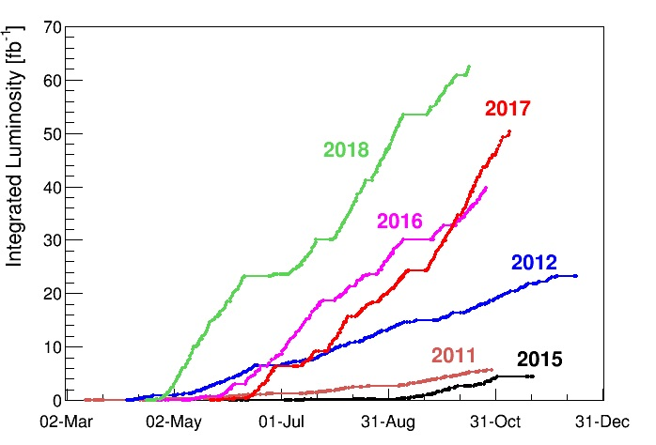
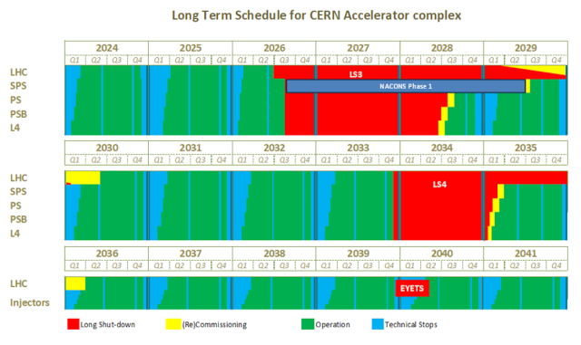
Introduction
The High-Luminosity LHC (HL-LHC) project aims to increase the integrated luminosity of the LHC by a factor of 10 beyond the original, producing >15 million Higgs boson / year from 2030
Requires upgrading quadrupoles, adding new crab cavities, replacing collimators etc.
Vidal and Manzano

Slide 4
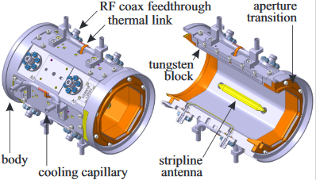
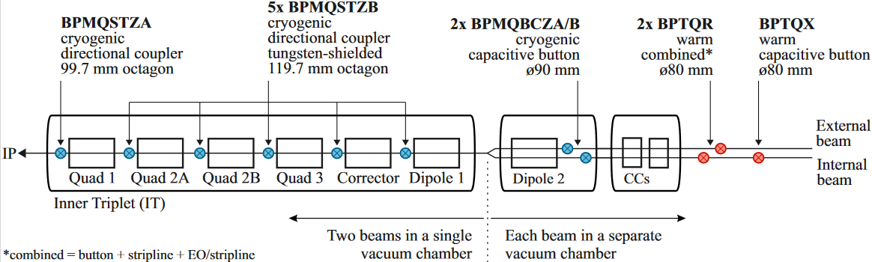
BPM upgrade
New stripline BPMs in the immediate vicinity of interaction regions 1 (ATLAS) and 5 (CMS), where the two beams coexist within a single pipe
6 either side of each IP (24 in total)
Two different types with type-B BPMs rotated by 45° to accommodate shielding elements
CAD model of the Type-B BPM
BPM | Type | s [m] | bxt [ns]
Q1 | A | 21.853 | 3.92
Q2A | B | 33.073 | 3.92
Q2B | B | 43.858 | 6.82
Q3 | B | 54.643 | 9.72
CP | B | 65.743 | 10.52
D1 | B | 73.697 | 7.36

Slide 5
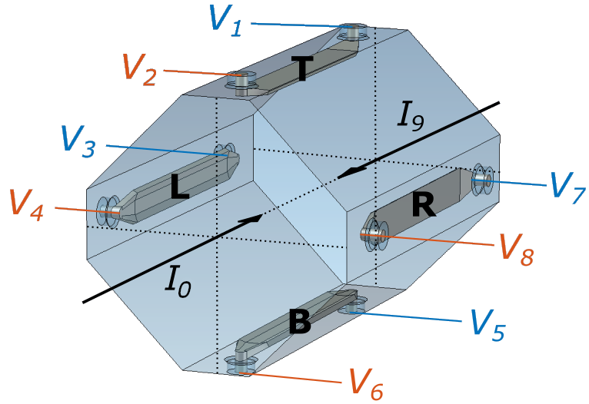
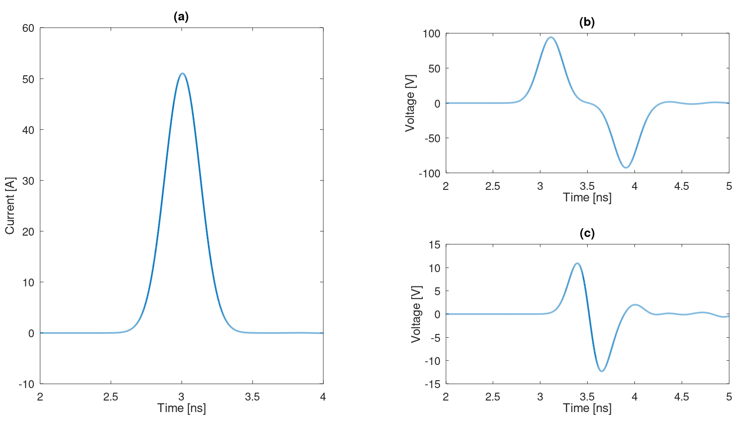
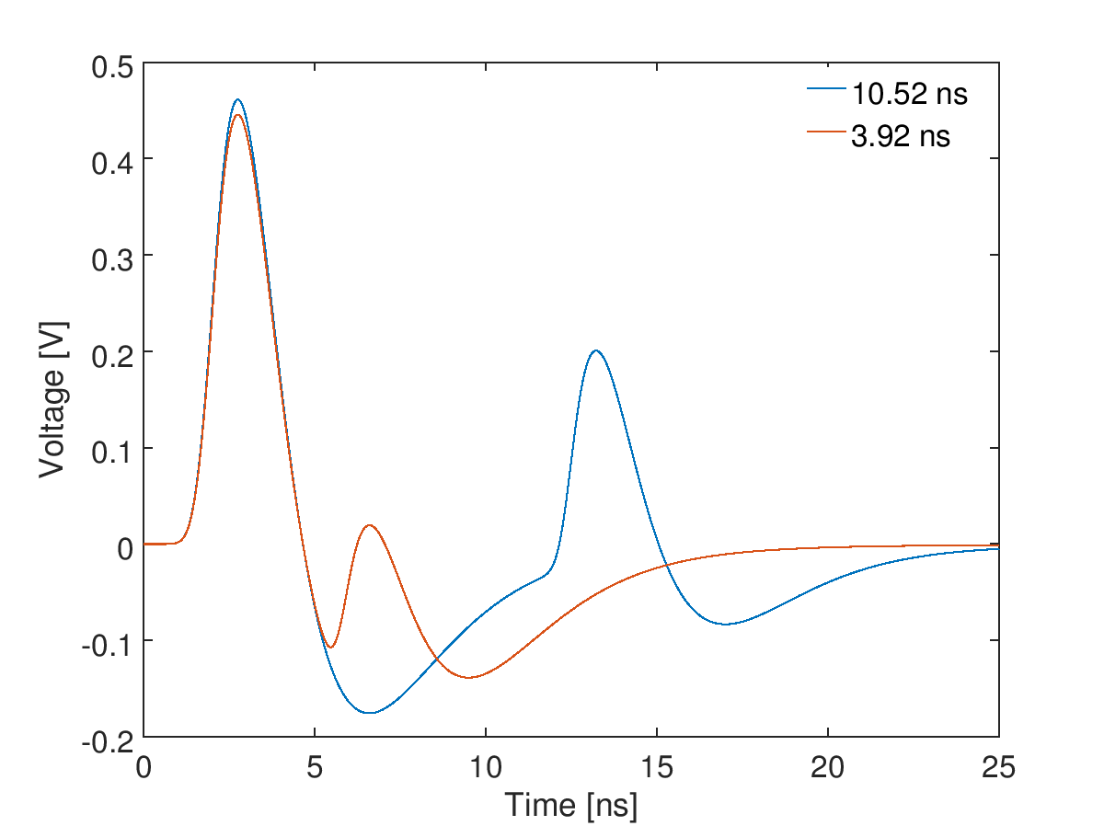
Signal processing with two beams
Signals from all eight ports required to calculate the horizontal and vertical position of both beams
Distortion of main beam signals due to presence of counter beam must be compensated for
Simulation framework developed to inform design of a processing algorithm (“counter beam compensation”)
Signal induced at upstream ports
“coupled”
Beam profile
Signal induced at downstream ports
“isolated”

Slide 6
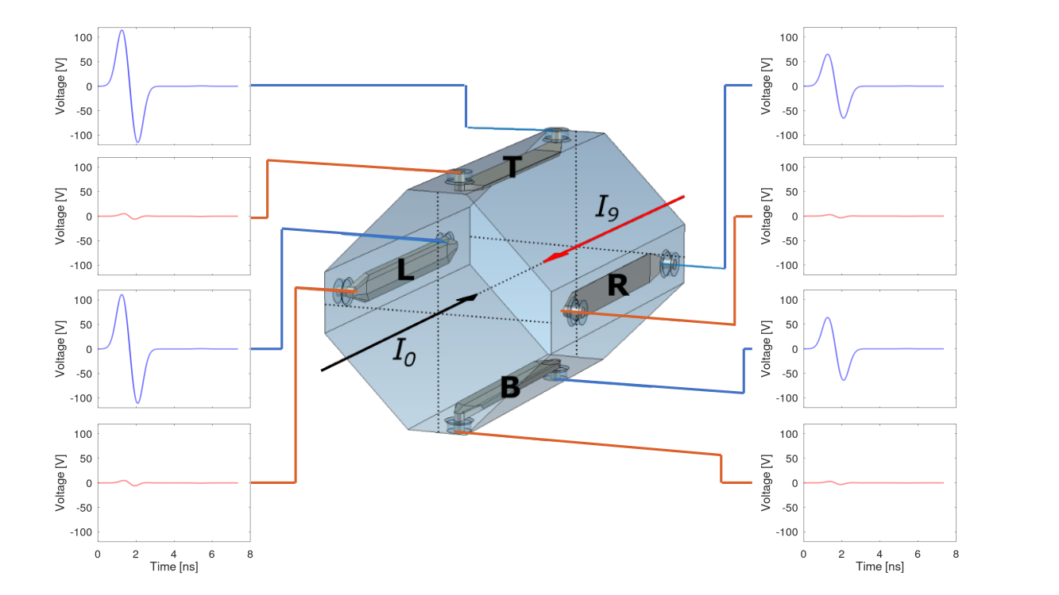

Example signals
Beam “9” only
Beam “0” only (3.92 ns later)
Blue: coupled; red: isolated
Blue: isolated; red: coupled

Slide 7
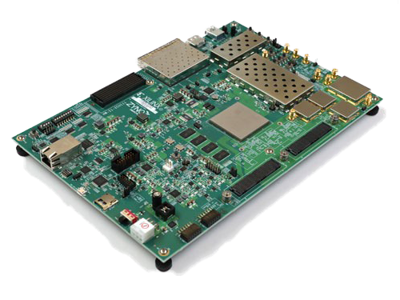
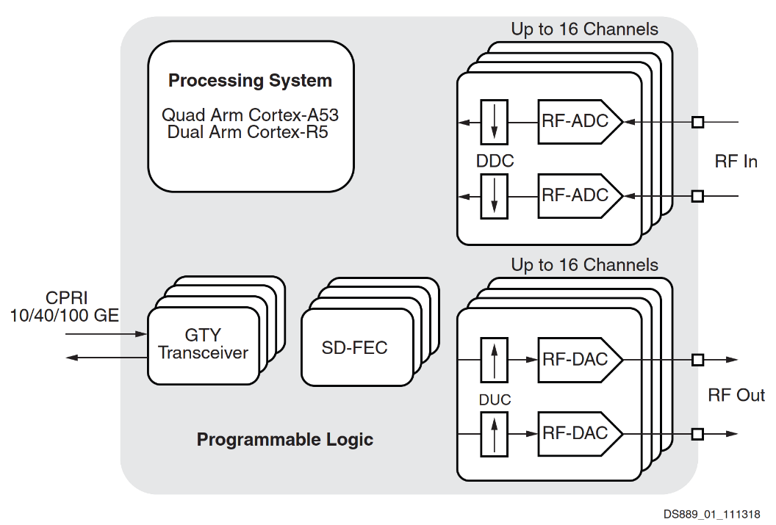
RFSoC
Radio Frequency System-on-Chip: candidate BPM processor
RF-ADCs/DACs, programmable logic, CPU in a single package
Evaluation board “ZCU” acquired for proof-of-concept tests
Xilinx Zynq XCZU28DR (gen. 1)
RF Features
Max. RF input Frequency (GHz) |  | 4
Decimation / Interpolation |  | 1x, 2x, 4x, 8x
12-bit RF-ADC | # of ADCs | 8
 | Max Rate (GSPS) | 4.096
14-bit RF DAC | # of DACs | 8
 | Max Rate (GSPS) | 6.554
Source: Zynq UltraScale+ RFSoC Data Sheet: Overview (DS889)
Notes:
RF Features
Max. RF input Frequency (GHz)
4
Decimation / Interpolation
1x, 2x, 4x, 8x
12-bit RF-ADC
# of ADCs
8
Max Rate (GSPS)
4.096
14-bit RF DAC
# of DACs
8
Max Rate (GSPS)
6.554

Slide 8
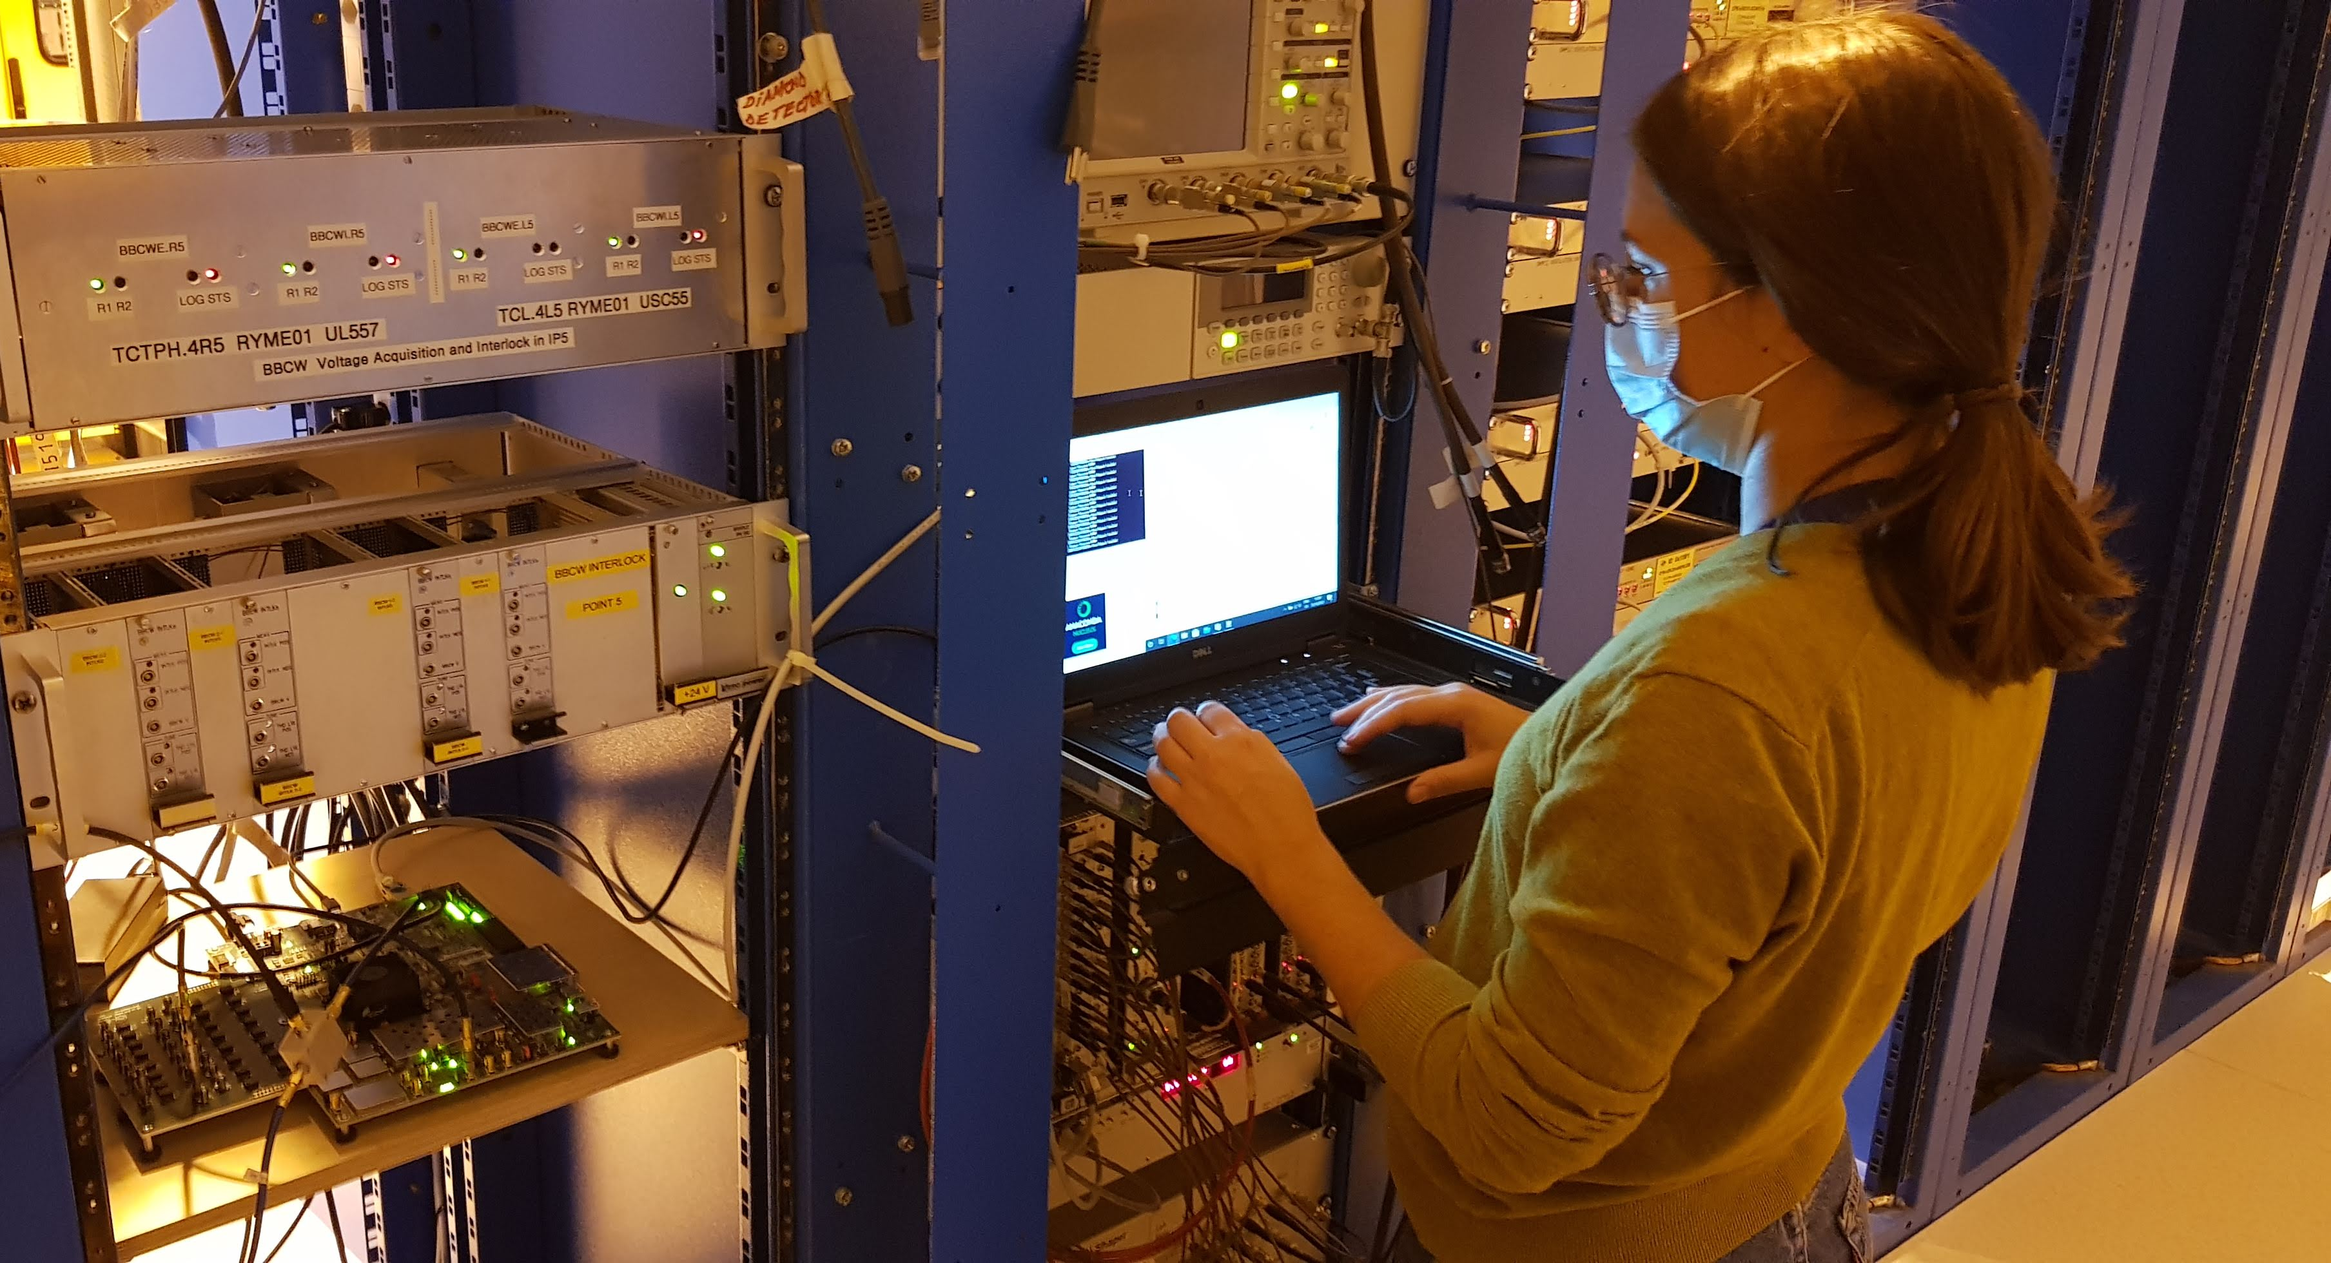
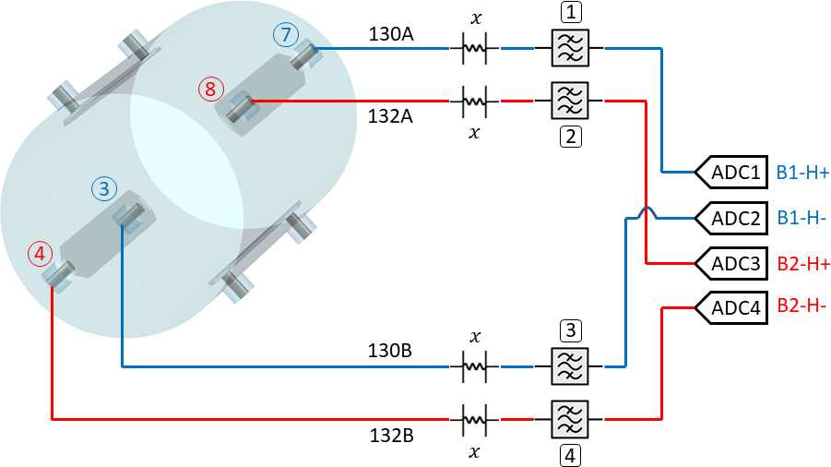
Experimental setup
Custom analogue front-end board by Selim Ozdogan
Software/firmware developed by Irene Degl’Innocenti
Board installed in region accessible during operation
BPMSY.4L5

Slide 9
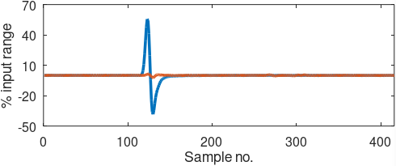
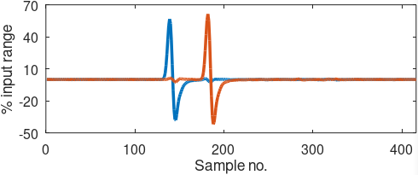
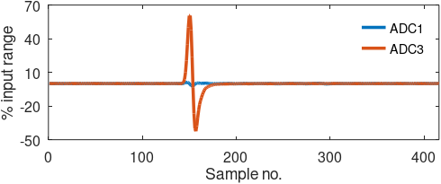
Data taking [MD6948]
Beam 2 test bunch
Beam 2 reference bunch
200 ns
100 ns
Beam 1 reference bunch
Beam 1 test bunch
WINDOW 2
WINDOW 1
WINDOW 3
Bunch crossing timing

Slide 10
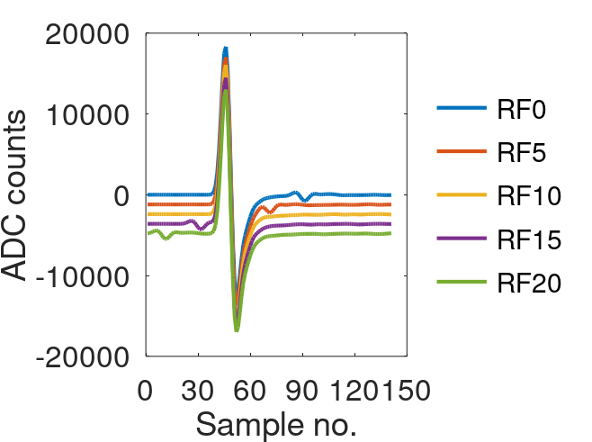
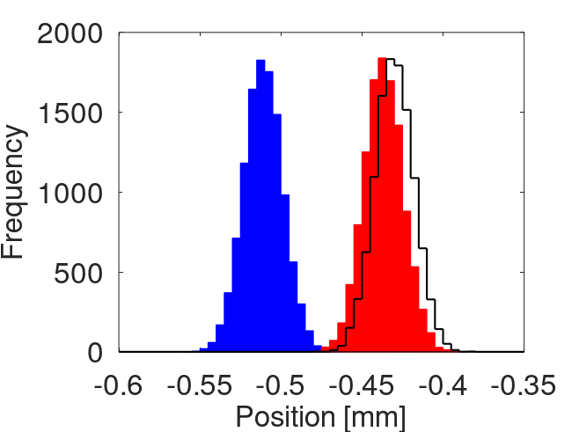
Results
RF cogging
Example correction
Blue: apparent position
Red: corrected position
Black: reference bunch

Slide 11
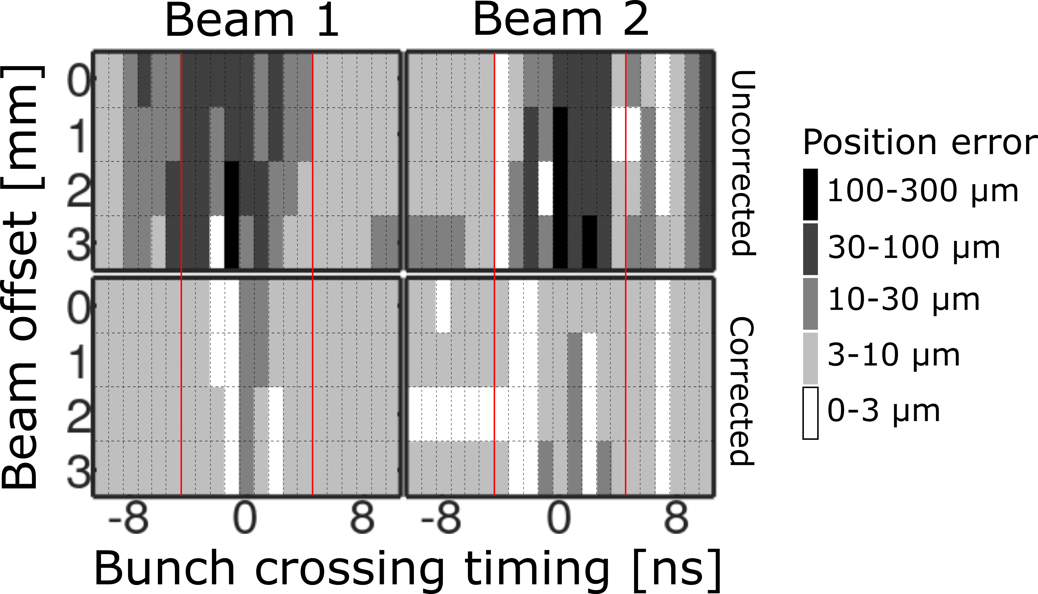
Scan results

Slide 12
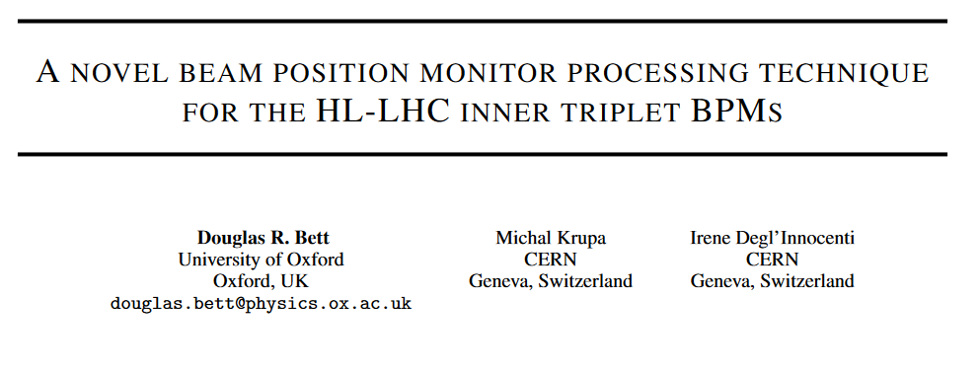
OUTLOOK
Work continues on the RFSoC software and firmware
  Use all eight channels, integration with LHC control system
Paper recently submitted to Phys. Rev. Accel. Beams

Slide 13
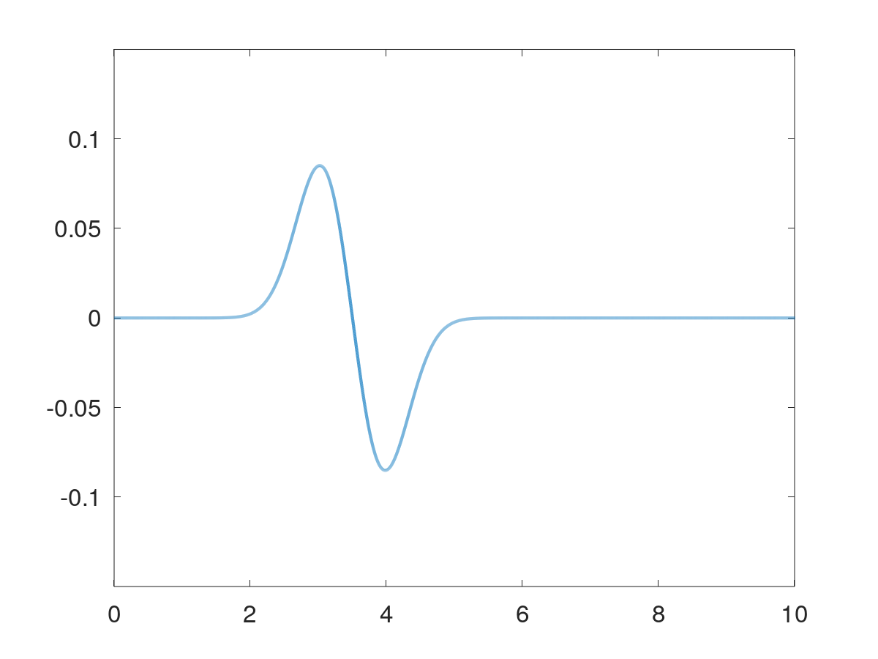
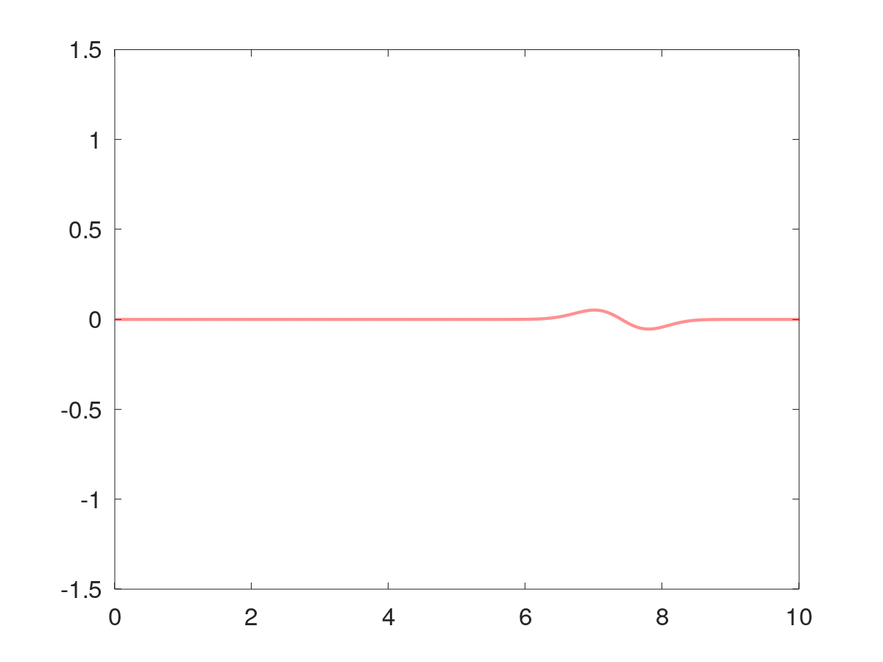
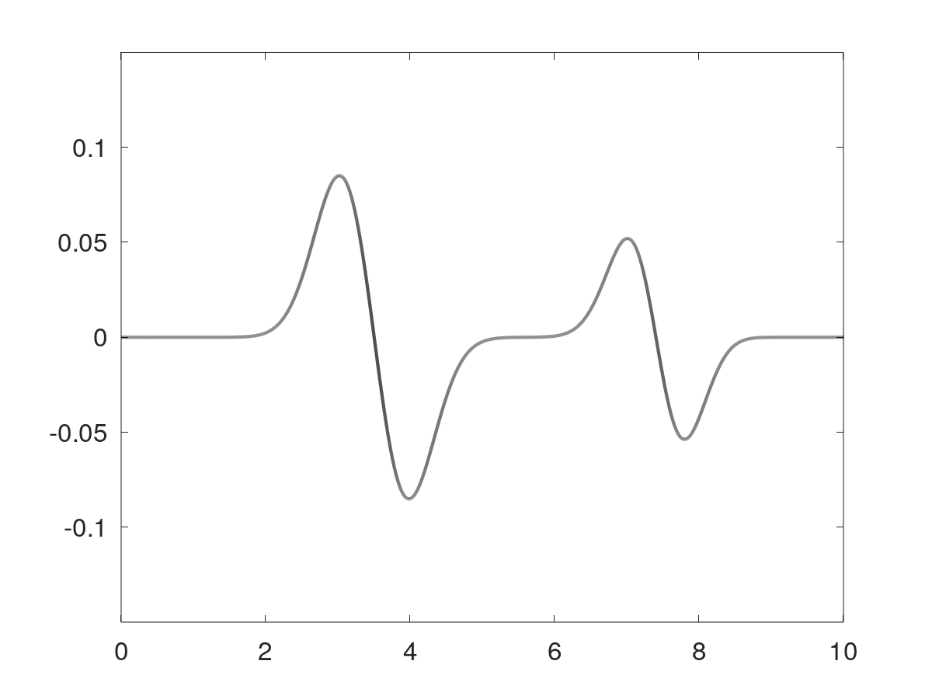




Counter beam compensation concept
Primary challenge of the IR-BPM system is the simultaneous presence of signals from both BPMs
Studies using simulated waveforms suggest the power from a single beam can be estimated from the total power at both ends of a single stripline and some calibration parameters that vary with the bunch crossing timing
Each waveform can be expressed in the form:
$$V_{1}=κ_{0T}V_{0c}+κ_{9T}V_{9i}$$
$$κ_{0T}V_{0c}$$
$$κ_{9T}V_{9i}$$
$$V_{1}$$
+
=
$κ$ scale factor sets amplitude of each term according to intensity, position of beam

Slide 14

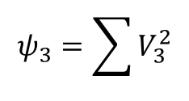

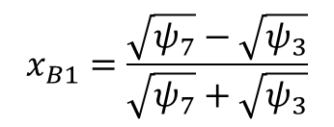

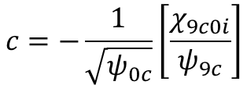
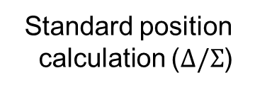
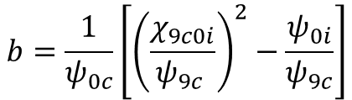
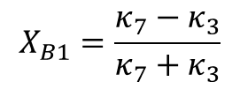

Counter beam compensation algorithm
$$ψ_{3}=\sum{V_{3}^{2}}$$
$$x_{B1}=\frac{\sqrt{ψ_{7}}−\sqrt{ψ_{3}}}{\sqrt{ψ_{7}}+\sqrt{ψ_{3}}}$$
“Power” of the $V_{3}$ waveform
Standard position calculation ($Δ/Σ$)
Power compensation
$$X_{B1}=\frac{κ_{7}−κ_{3}}{κ_{7}+κ_{3}}$$
$$κ_{7}=\sqrt{aψ_{7}+bψ_{8}}+c\sqrt{ψ_{8}}$$
$ψ_{7}$, $ψ_{8}$ calculated in real time
$a$, $b$ and $c$ calculated in advance from reference waveforms
$$a=\frac{1}{ψ_{9c}}$$
$$b=\frac{1}{ψ_{0c}}\left[{\left(\frac{χ_{9c0i}}{ψ_{9c} }\right)}^{2}−\frac{ψ_{0i}}{ψ_{9c}}\right]$$
$$c=−\frac{1}{\sqrt{ψ_{0c}}}\left[\frac{χ_{9c0i}}{ψ_{9c}}\right]$$

Slide 15
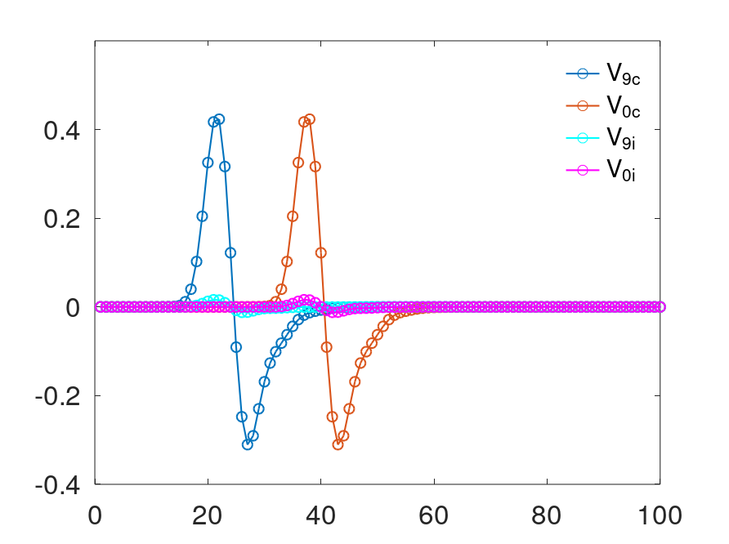
Reference waveforms
Reference waveforms sourced from model or (single-beam) observations
Voltage
Sample index

Slide 16
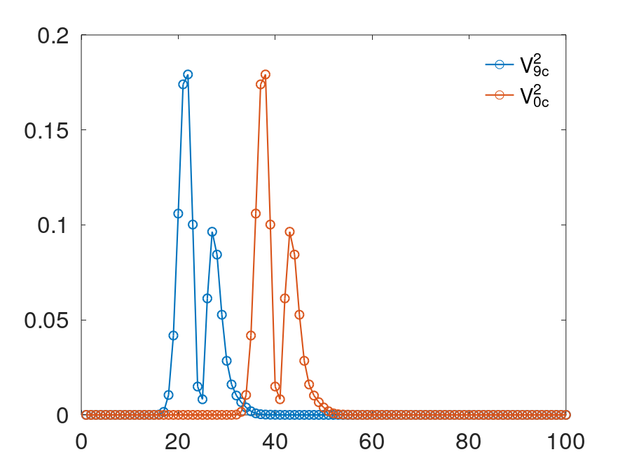
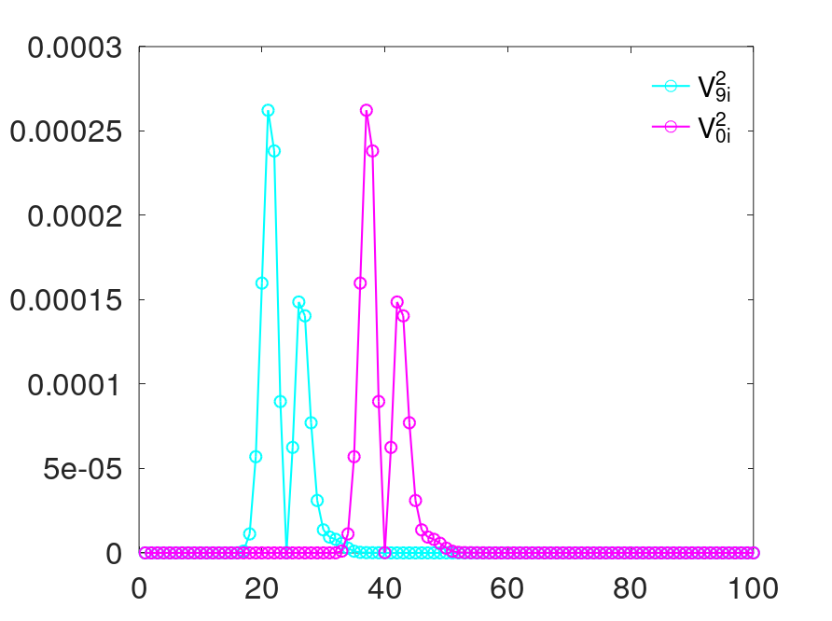
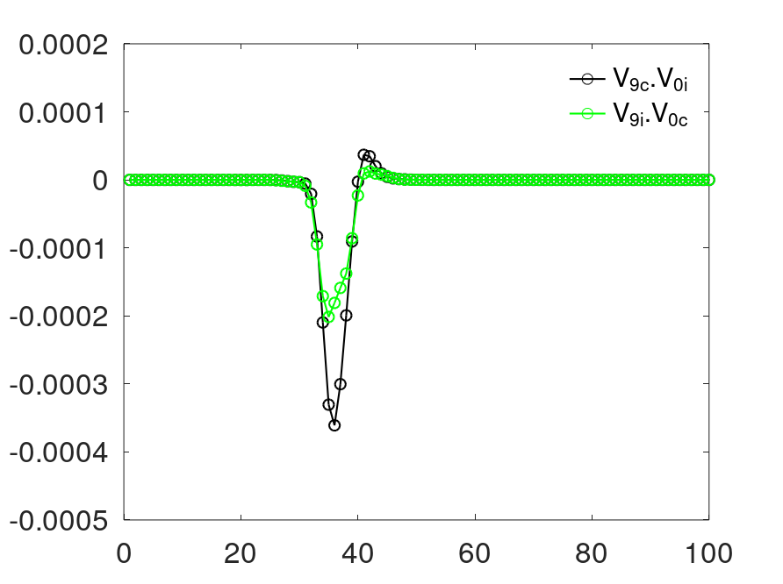






Power compensation parameters
The parameters are functions of the elementwise sums of the below waveforms
$$ψ_{9c}$$
$$ψ_{0c}$$
$$ψ_{9i}$$
$$ψ_{0i}$$
$$χ_{9c0i}$$
$$χ_{9i0c}$$
coupled × coupled
isolated × isolated
coupled × isolated

