Slide 1


Collimation studies for the High Luminosity LHC
B. Lindström, A. Abramov, G. Broggi, R. Bruce, X. Buffat, R. de Maria, A. Donadon,
L. Giacomel, S. Gibson, P. Hermes, D. Mirarchi, M. Monikowska, C.E. Montanari,
N. Mounet, M. Rakic, S. Redaelli, N. Traintafyllou, A. Vella, D. Veres,
F. Van der Veken
Thanks to: S. Fartoukh, M. Solfaroli, R. Tomás,
J. Wenninger, MD coordinators, LHC OP, OMC team
JAI Fest 2024, Royal Holloway – 19th December 2024

Slide 2
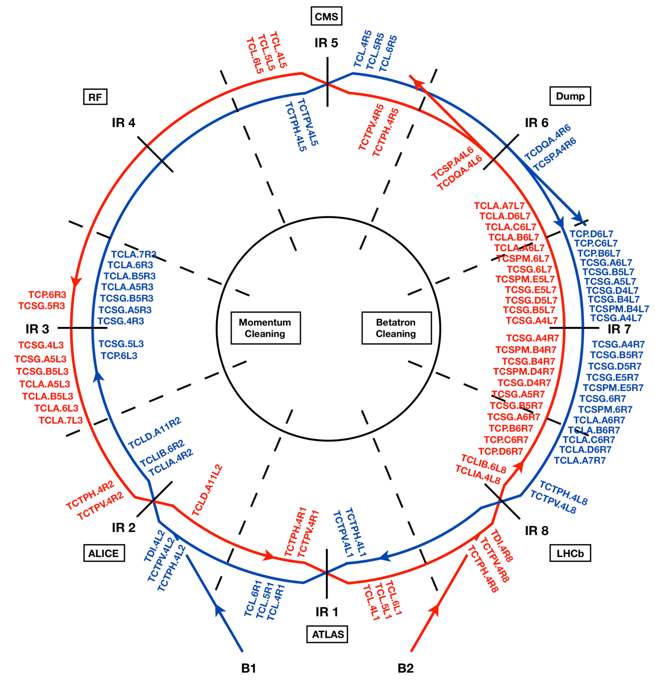
Collimation insertions in LHC

Slide 3
Collimation insertions in LHC
Momentum cleaning (IR3)
  Particles with large momentum offsets
Betatron cleaning (IR7)
  Particles with large
  betatron amplitudes
IR3
IR7
 | 2023 | LHC design | HL-LHC design
Bunch intensity [p+] | 1.4-1.6 | 1.15 | 2.3
Energy [GeV] | 6800 | 7000 | 7000
Stored beam energy [MJ] | 410 | 362 | 678

Slide 4
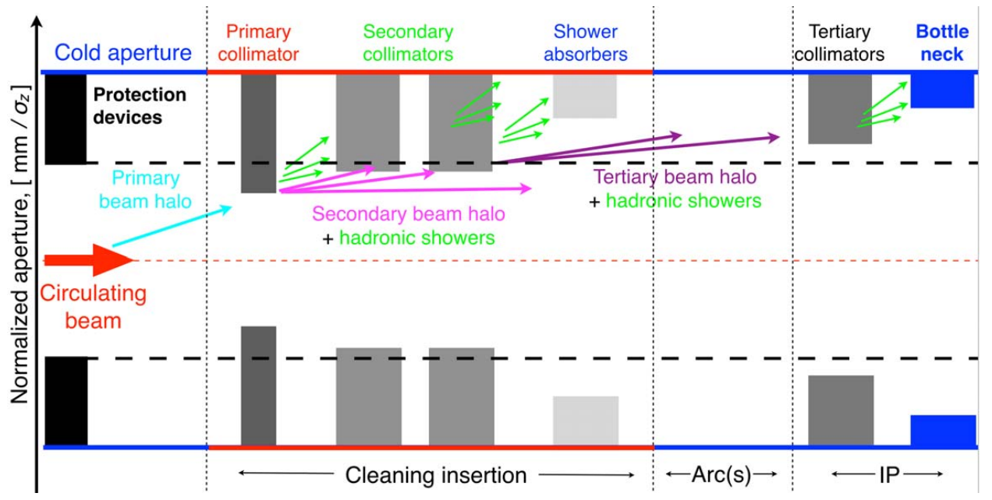
Multi-stage Collimation
Momentum cleaning (IR3)
Betatron cleaning (IR7)

Slide 5
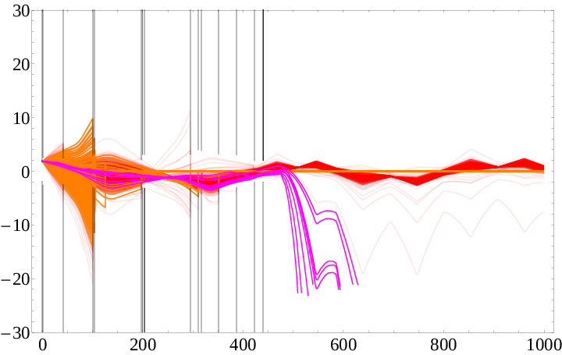
Cleaning inefficiency
Inefficiency: energy in aperture normalized by length and total collimation losses
Critical region: superconducting magnets in dispersion suppressor downstream of IR7
secondary collimators
B2
on momentum
primary collimator
off momentum

Slide 6
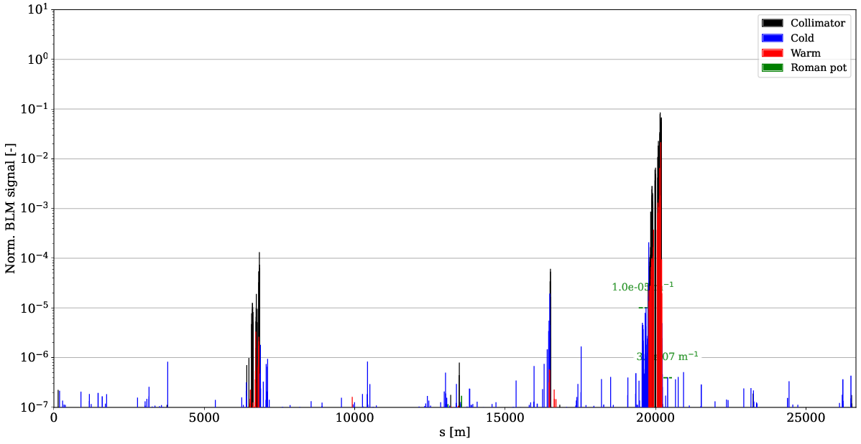
Loss maps
Betatron:
Bunch is excited by transverse kicker to provoke beam losses
Evaluate cleaning performance

Slide 7
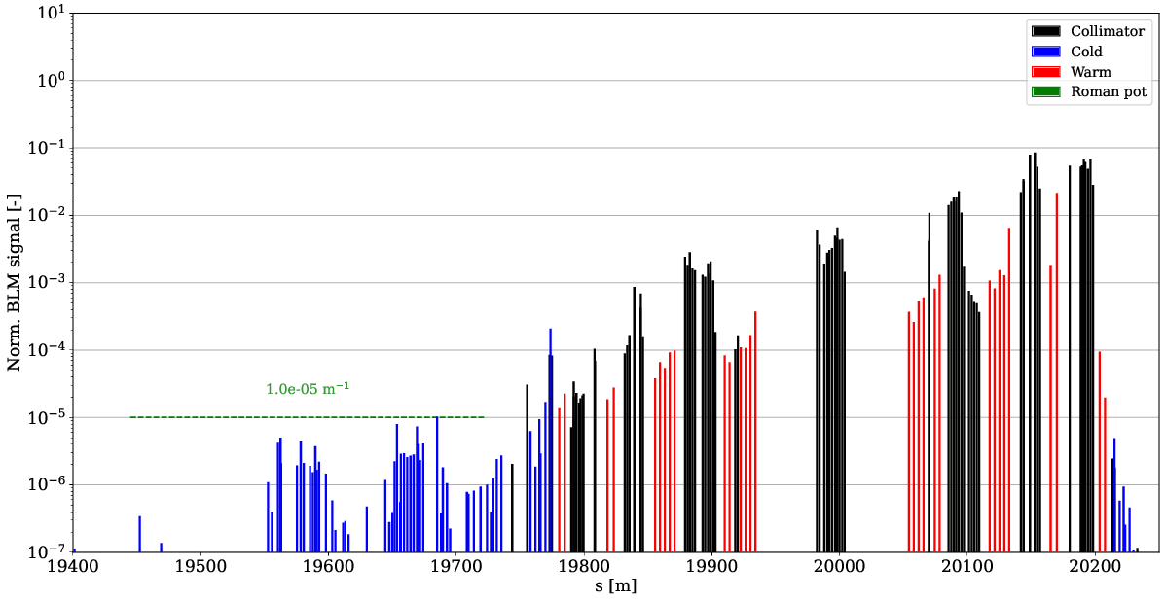
Loss maps
Betatron:
Bunch is excited by transverse kicker to provoke beam losses
Evaluate cleaning performance
IR7 zoom
DS losses

Slide 8
Loss maps
Betatron:
Bunch is excited by transverse kicker to provoke beam losses
Evaluate cleaning performance
Observables:
Collimator hierarchy
DS leakage
Tertiary collimator losses
(around collision points)
No unexplained spikes
(indicates aperture issues)
IR7 zoom
DS losses

Slide 9
HL-LHC challenges
Protons per bunch increase:
  1.15e11 (design) → 1.4e11 (now) → 2.3e11 (HL)
Impedance scales with bunch charge
  → beam lifetime decreases, instabilities
  Collimators main source of impedance
  (low conductivity and tight gaps)
Collimator leakage scales with beam intensity
(assuming same lifetime)
  → increased quench risk
Limitations mainly from Betatron Collimation (IR7)
Mitigate both by changing optics
(n.b. LHC collimation optics have not changed since 2008)

Slide 10
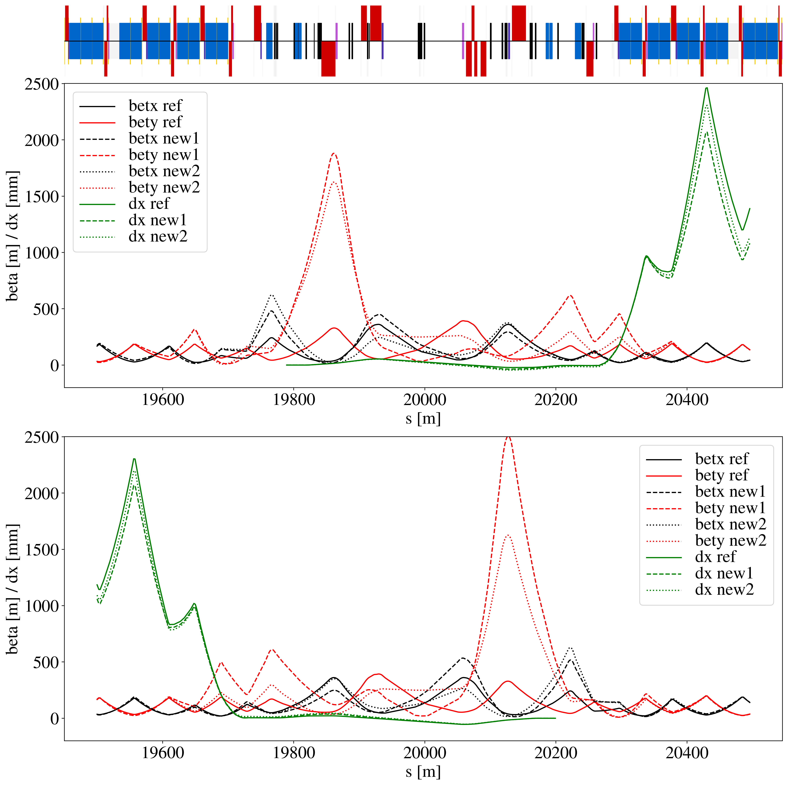
Optics rematch and constraints
Used Xsuite for matching
Quadrupoles (individual and common for b1/b2) up to cells 13
Constraints:
  Optics are matched to the arcs
  Peak beta function kept reasonably small (aperture, field errors)
Goals:
  (1) Large betx/bety at primary collimators – cleaning impedance
  (2) Small betx at secondary collimators and absorbers – cleaning impedance
  (3) Increase single-pass dispersion – cleaning impedance
  (4) Small beta function in orthogonal plane of collimators – cleaning impedance

Slide 11
Optics rematch and constraints
Used Xsuite for matching
Quadrupoles (individual and common for b1/b2) up to cells 13
Constraints:
  Optics are matched to the arcs
  Peak beta function kept reasonably small (aperture, field errors)
Goals:
  (1) Large betx/bety at primary collimators – cleaning impedance
  (2) Small betx at secondary collimators and absorbers – cleaning impedance
  (3) Increase single-pass dispersion – cleaning impedance
  (4) Small beta function in orthogonal plane of collimators – cleaning impedance
(1)

Slide 12
Optics rematch and constraints
Used Xsuite for matching
Quadrupoles (individual and common for b1/b2) up to cells 13
Constraints:
  Optics are matched to the arcs
  Peak beta function kept reasonably small (aperture, field errors)
Goals:
  (1) Large betx/bety at primary collimators – cleaning impedance
  (2) Small betx at secondary collimators and absorbers – cleaning impedance
  (3) Increase single-pass dispersion – cleaning impedance
  (4) Small beta function in orthogonal plane of collimators – cleaning impedance
(1)
(2)

Slide 13
Optics rematch and constraints
Used Xsuite for matching
Quadrupoles (individual and common for b1/b2) up to cells 13
Constraints:
  Optics are matched to the arcs
  Peak beta function kept reasonably small (aperture, field errors)
Goals:
  (1) Large betx/bety at primary collimators – cleaning impedance
  (2) Small betx at secondary collimators and absorbers – cleaning impedance
  (3) Increase single-pass dispersion – cleaning impedance
  (4) Small beta function in orthogonal plane of collimators – cleaning impedance
(1)
(2)
(3)

Slide 14
Optics rematch and constraints
Used Xsuite for matching
Quadrupoles (individual and common for b1/b2) up to cells 13
Constraints:
  Optics are matched to the arcs
  Peak beta function kept reasonably small (aperture, field errors)
Goals:
  (1) Large betx/bety at primary collimators – cleaning impedance
  (2) Small betx at secondary collimators and absorbers – cleaning impedance
  (3) Increase single-pass dispersion – cleaning impedance
  (4) Small beta function in orthogonal plane of collimators – cleaning impedance
(1)
(4)
(2)
(3)

Slide 15
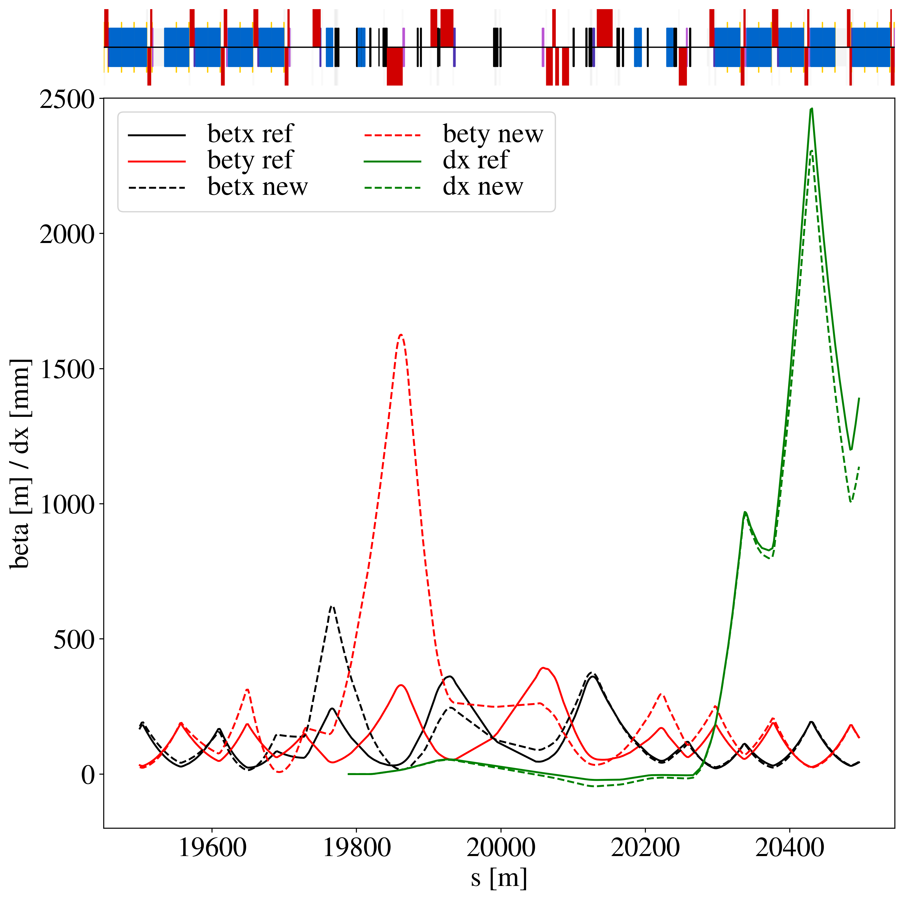
Experimental validation in LHC
Series of tests with new optics in 2023/2024
Operational complication:
peak beta function not compatible
with injection energy aperture
→ combined ramp and desqueeze
  Normally only done around collision
  points
Validate collimation performance
Check that no issue changing optics
at primary collimators during ramp

Slide 16
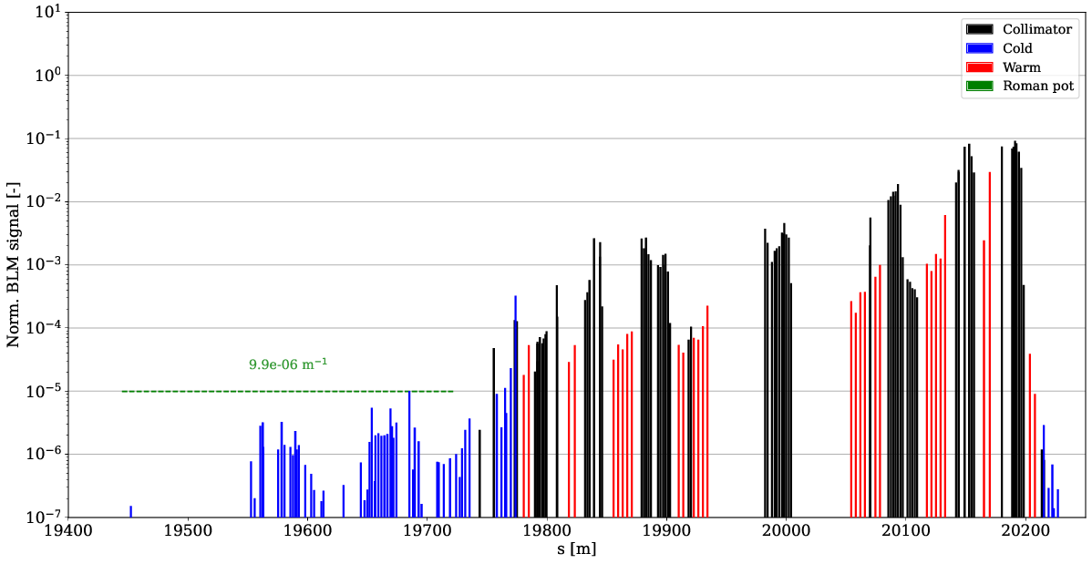
B2H losses (FT – HL MD)
nominal meas.

Slide 17
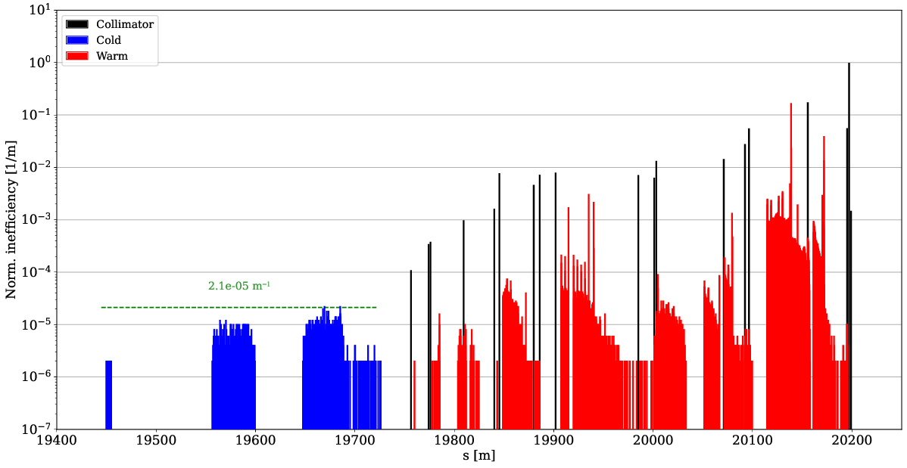
B2H losses (FT – HL MD)
nominal sim.
nominal meas.

Slide 18
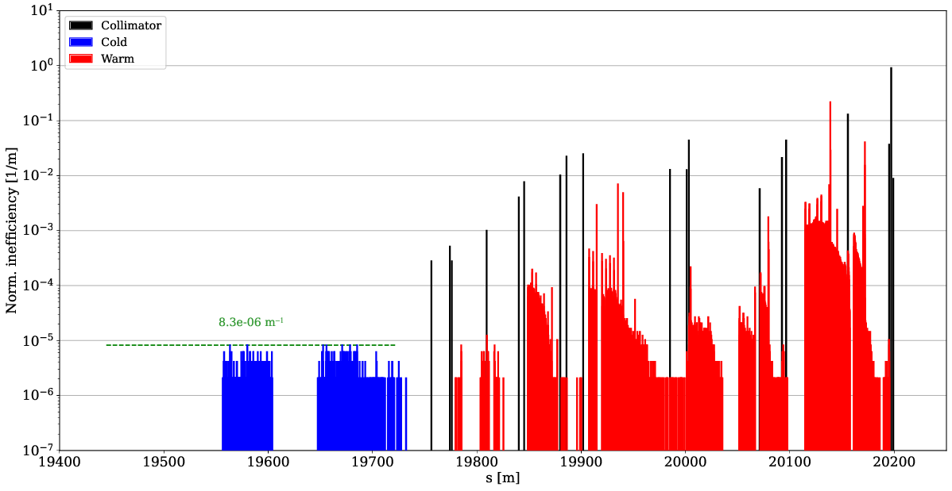
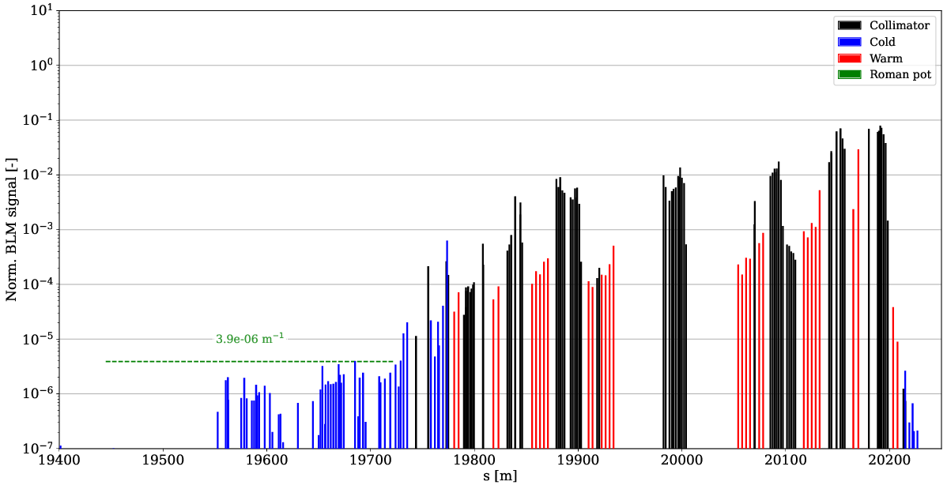
B2H losses (FT – HL MD)
Simulated 61 % improvement – measured 61 % (σ=7.4 %)
nominal sim.
HL MD sim.
nominal meas.
HL MD meas.

Slide 19
B2H losses (FT – HL MD)
Simulated 61 % improvement – measured 61 % (σ=7.4 %)
Secondary stages catch more losses – less leakage to DS
nominal sim.
HL MD sim.
nominal meas.
HL MD meas.

Slide 20
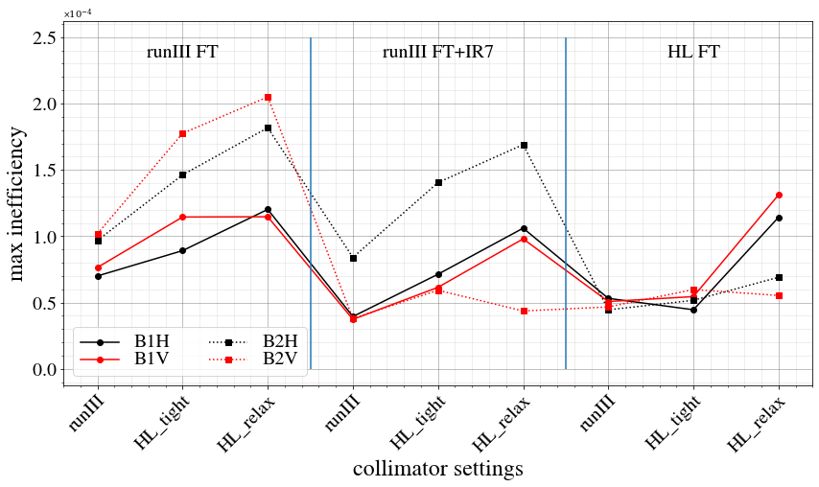
Summary of DS betatron cleaning
Significant worsening with relaxed settings (estimate only ~7 % worse than tight)
In general, significant improvement due to new optics!

Slide 21
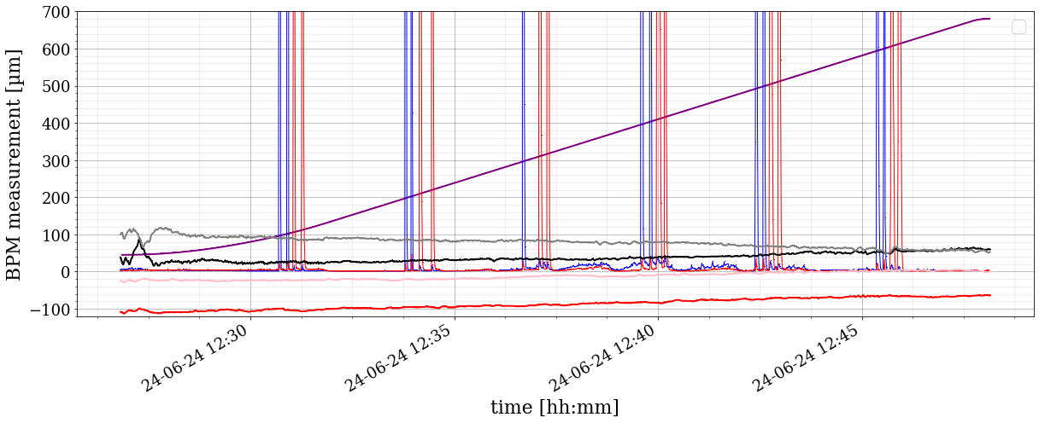
Losses during ramp
Changing optics in IR7 during ramp not done before
  Spurious loss spikes at collimators?
Ramp with tight settings and low intensity beam:
  Orbit well controlled and optics corrected
  Similar lifetime to normal ramps
  No significant loss spikes noted
Follow-up with high intensity beam required for further validation
loss maps

Slide 22
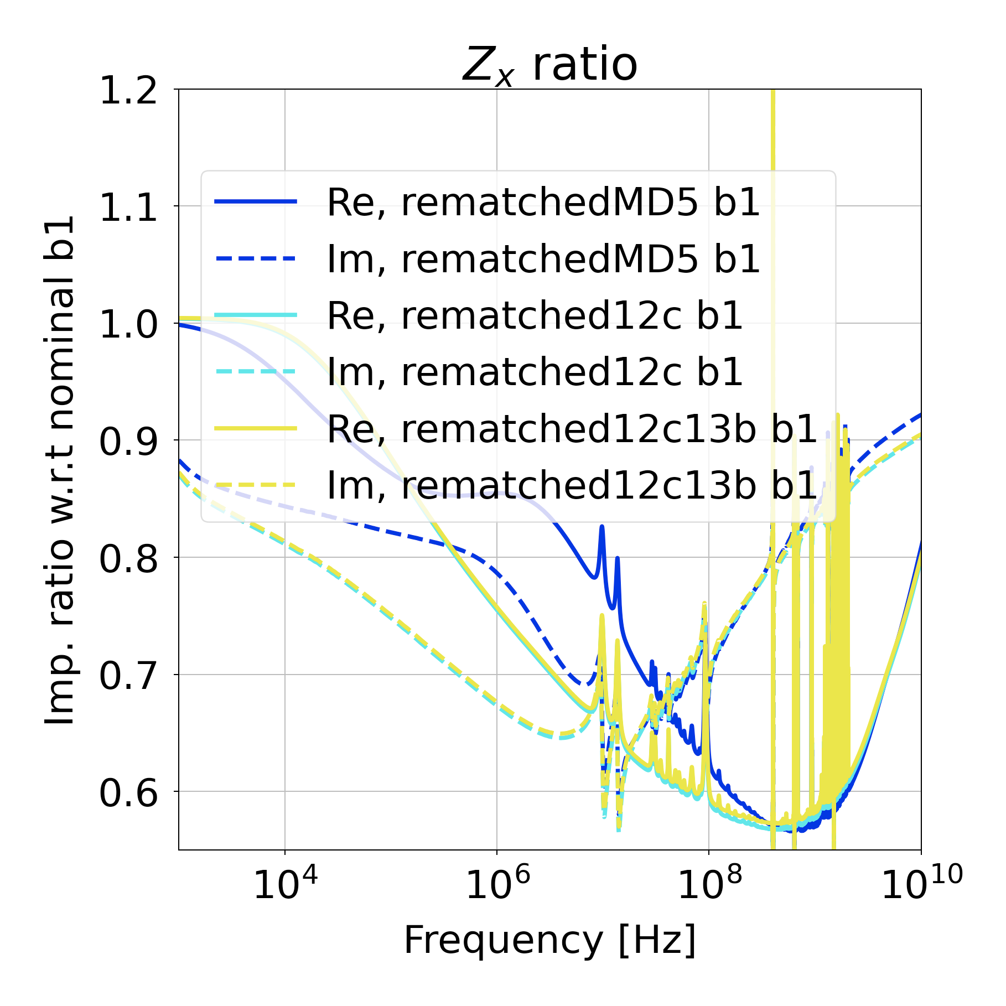
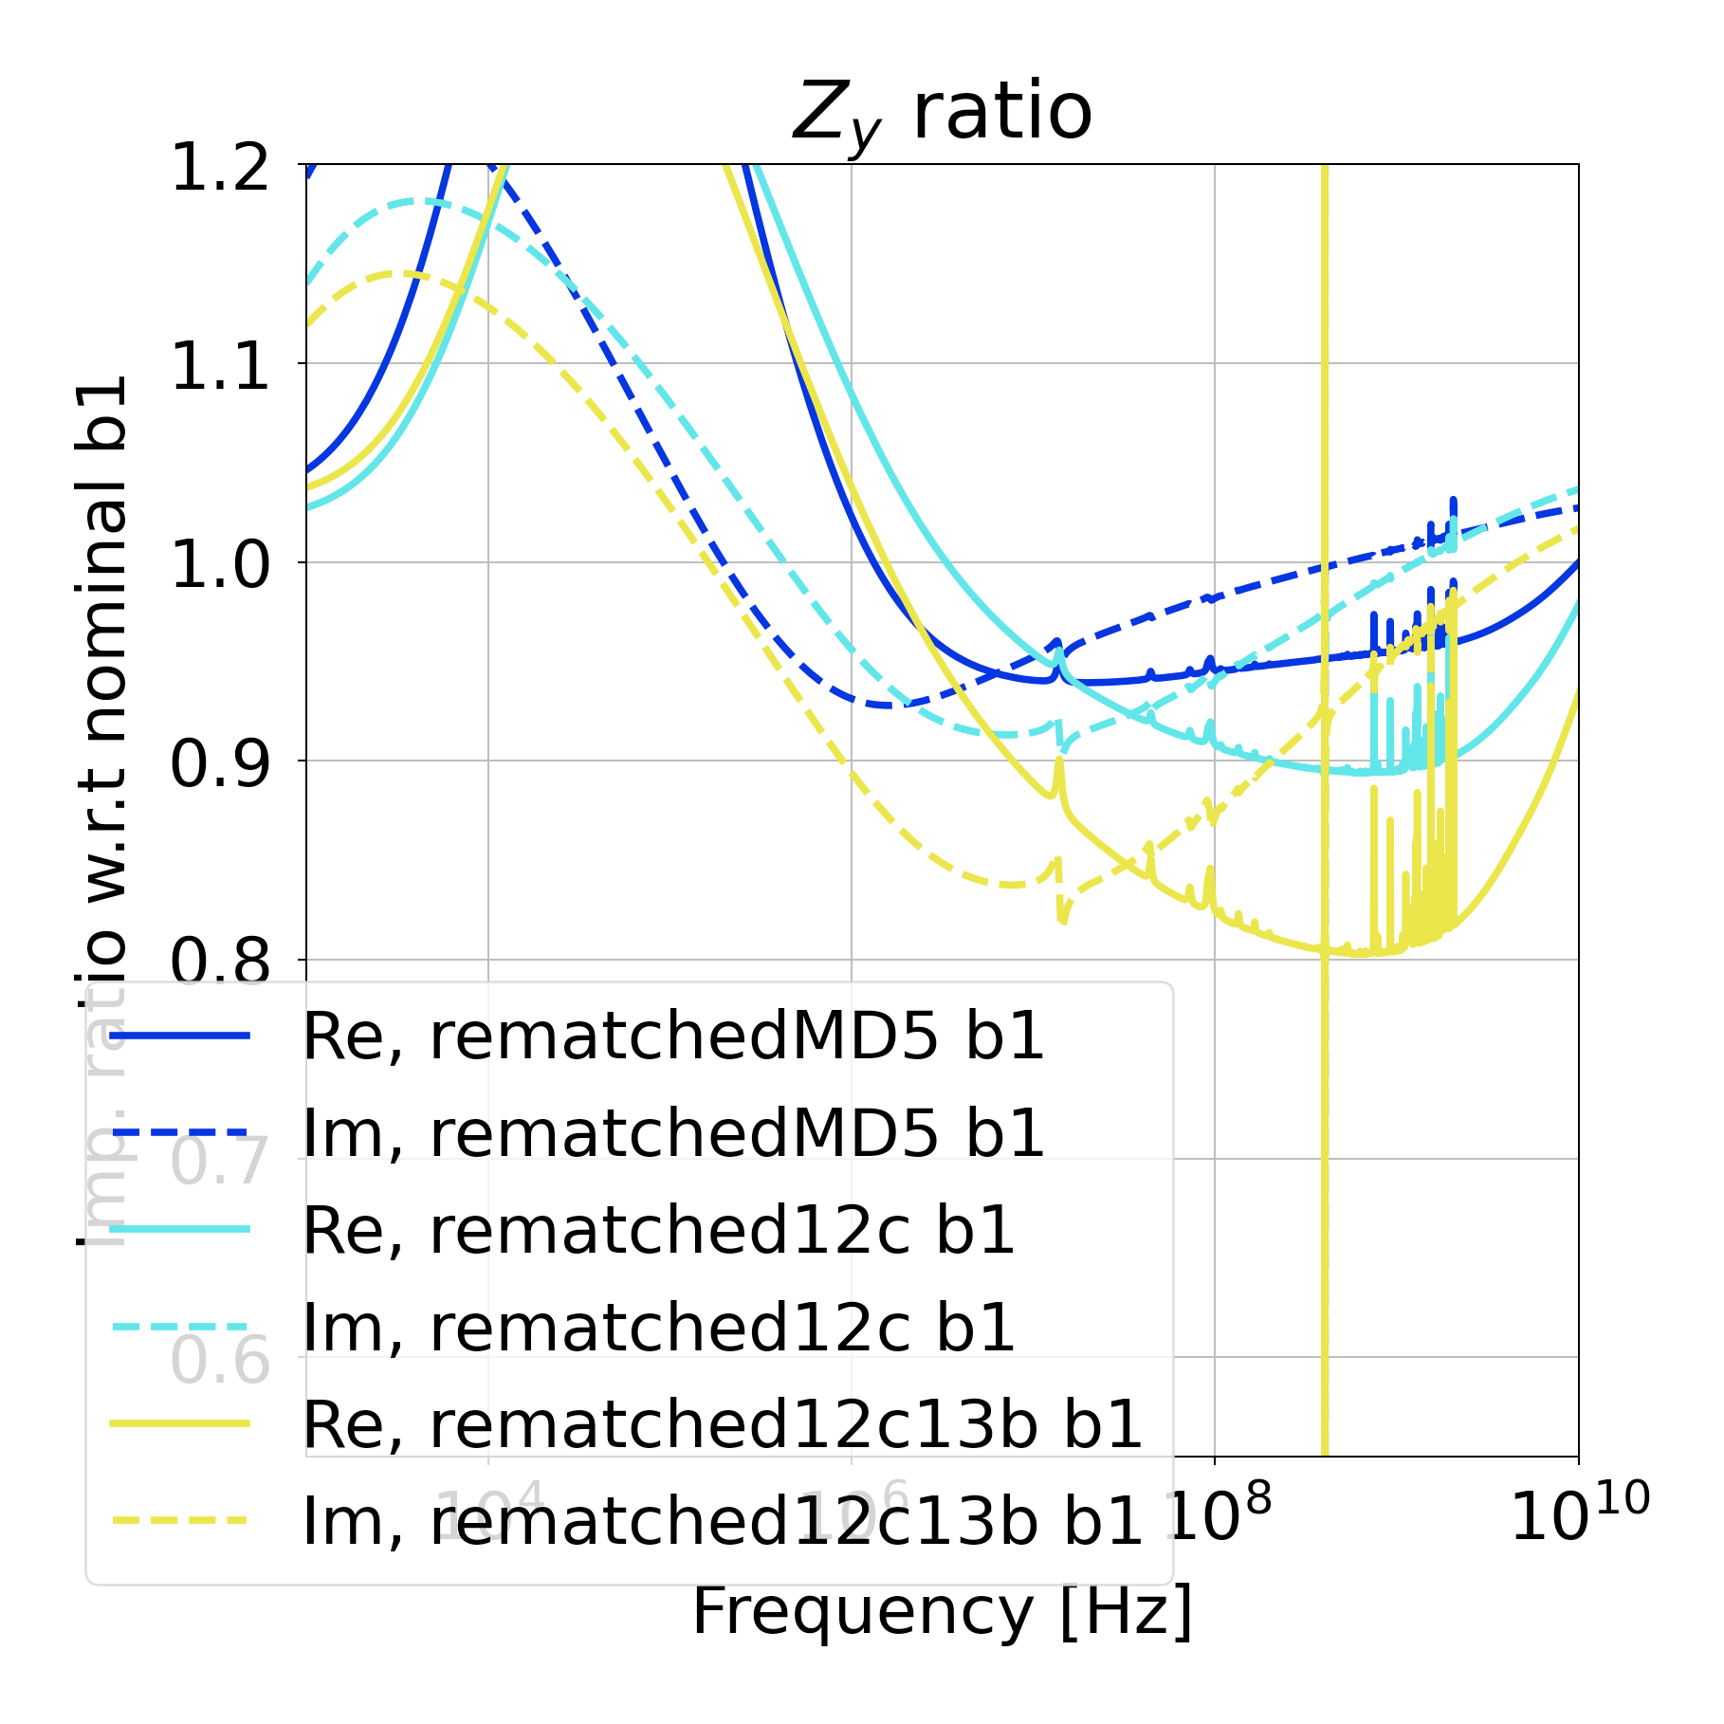
Impedance
Expecting > 40 % gain in H and 10-20 % in V in HL-LHC*
Measurement results:
B1H signal too noisy to measure due to unrelated HW issue
 | B1H | B1V | B2H | B2V
IR7 MD | 4 % | 26 % | 33 % | 19 %
* L. Giacomel
https://indico.cern.ch/event/1421594/contributions/5979671/

Slide 23
Simulation software

Slide 24
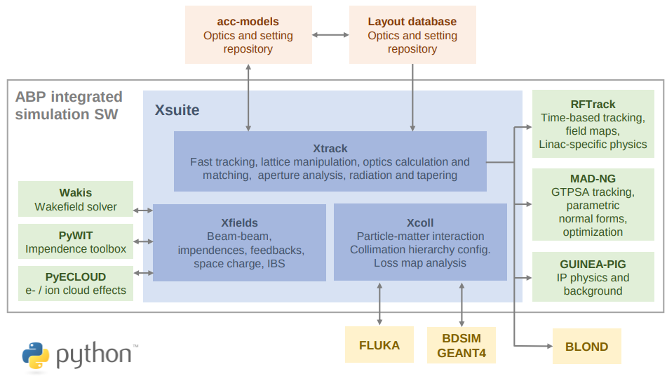
Xsuite
Suite of python libraries for comprehensive accelerator simulations
Interface in python – user-friendly and modular, flexible design
Tracking and other low-level functions in C – faster than SixTrack
Main developers: G. Iadarola, R. de Maria, S. Lopaciuk

Slide 25
Xcoll
Module dedicated to collimation studies
Handles collimators, aperture models, particle losses
Particle-matter interaction codes:
  Everest – successor to K2, the internal scattering model in SixTrack
  FLUKA – via a TCP/IP coupling
  GEANT4 – via pybind11 and BDSIM (coupling created by A. Abramov)
Tracked particle encounters collimator → scattering module
→ energy loss and collimator impact locations
→ secondary particles are generated
→ surviving particles back to Xtrack for further tracking
Main developer: F. Van der Veken

Slide 26
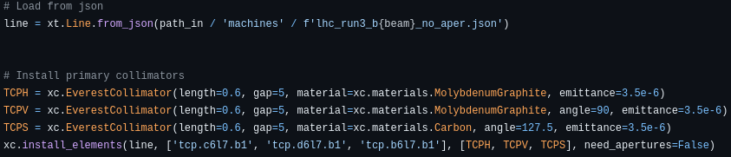
Xcoll
Module dedicated to collimation studies
Handles collimators, aperture models, particle losses
Particle-matter interaction codes:
  Everest – successor to K2, the internal scattering model in SixTrack
  FLUKA – via a TCP/IP coupling
  GEANT4 – via pybind11 and BDSIM (coupling created by A. Abramov)
Tracked particle encounters collimator → scattering module
→ energy loss and collimator impact locations
→ secondary particles are generated
→ surviving particles back to Xtrack for further tracking
replace by xc.Geant4Collimator for BDSIM instead
Main developer: F. Van der Veken

Slide 27
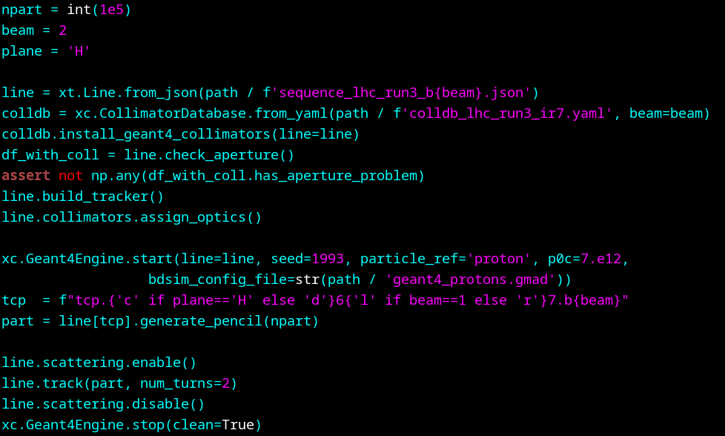
Example loss map with BDSIM
Run a lossmap in the LHC

Slide 28
Example loss map with BDSIM
Run a lossmap in the LHC
LHC lattice with all the optics

Slide 29
Example loss map with BDSIM
Run a lossmap in the LHC
Database of collimators and their settings

Slide 30
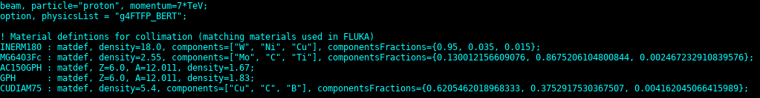
Example loss map with BDSIM
Run a lossmap in the LHC
gmad input file with beam, physics list and material definitions

Slide 31
Example loss map with BDSIM
Run a lossmap in the LHC

Slide 32
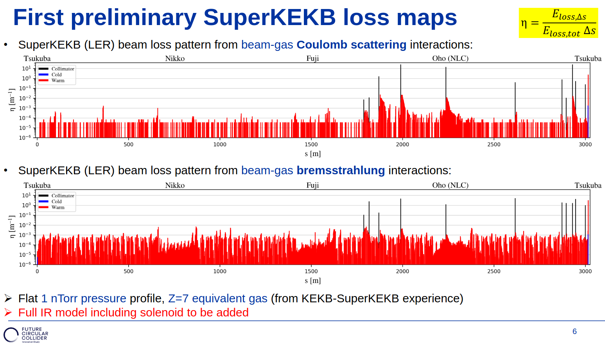
Current status
Release expected in January
Used in full production for FCC-ee collimation studies (G. Broggi / G. Nigrelli)
Ongoing effort to benchmark Xcoll-BDSIM with measured data
  Super KEKB: Xsuite optics model being developed (J. Salvesen, G. Iadarola, G. Broggi)
G. Broggi

Slide 33
Conclusions
Collimation optics changed for first time in LHC
Very promising results on cleaning performance
  DS leakage cut by factor of ~2
Significant reduction of impedance by 19 – 33 %
  B1H could not be measured
Need combined ramp & desqueeze
  Initial tests no issue
  Further validation with high intensity beams in 2025
Xcoll: collimator simulation module within Xsuite
  Support for Geant4 using BDSIM: release expected in January
    Currently only for collimation studies
  More general BDSIM integration with Xsuite under development
  (S. Boogert, W. Shields)

Slide 34
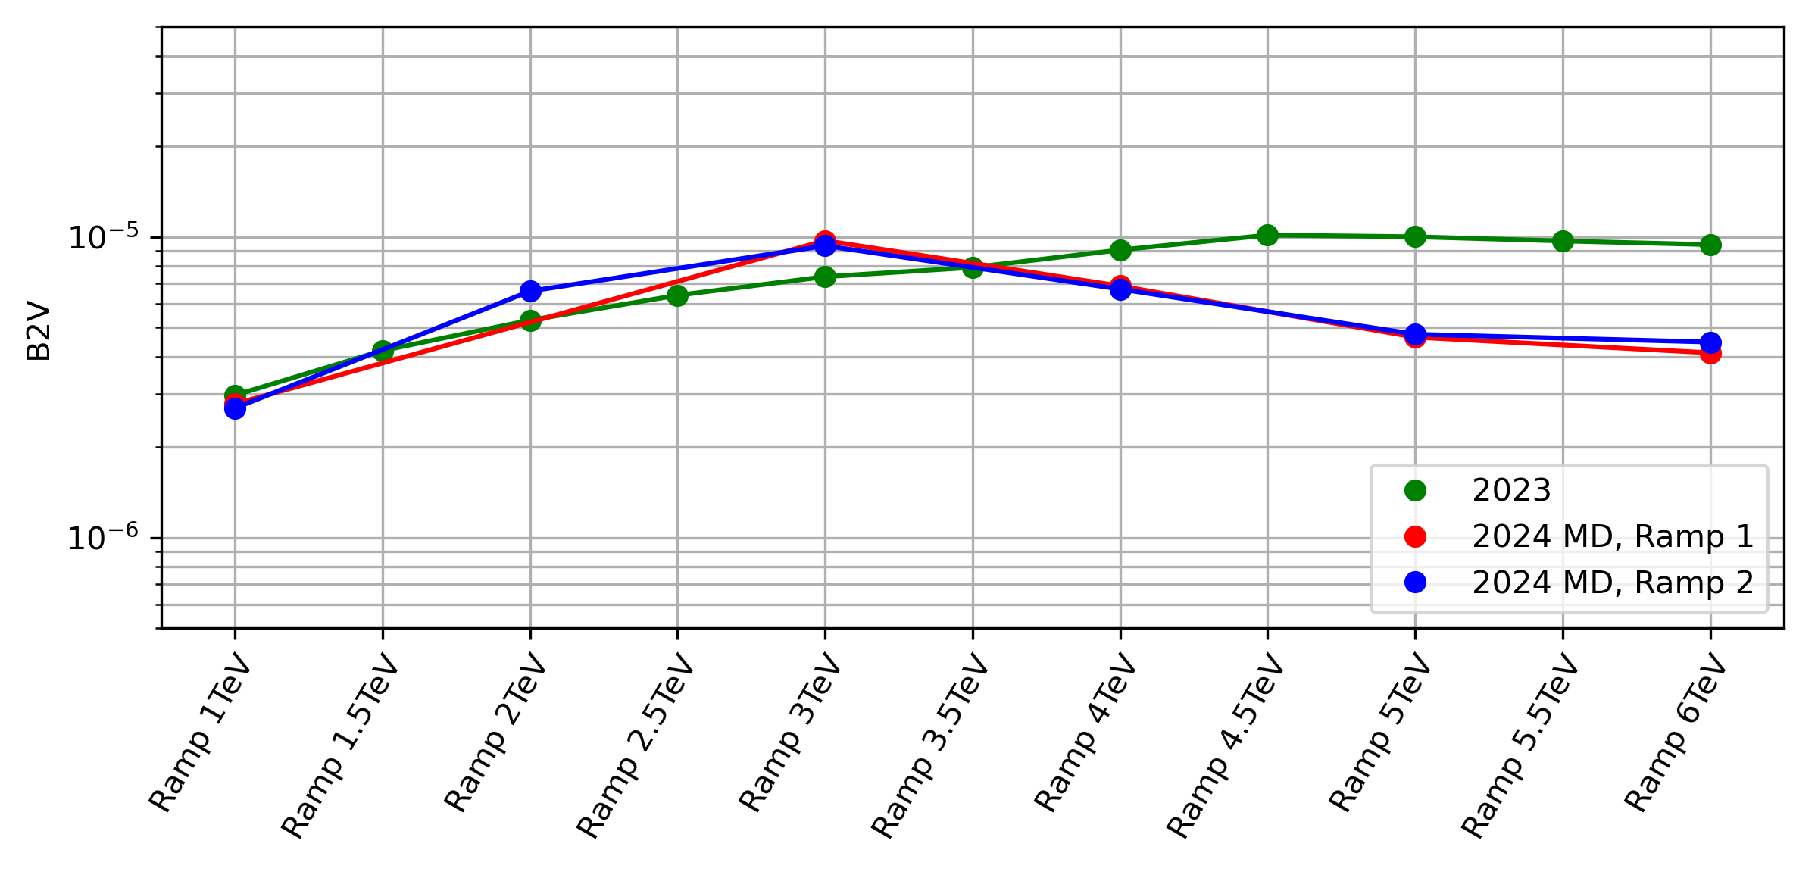
Cleaning during ramp
No issues observed in betatron loss maps
DS cleaning starts improving around 3 TeV as IR7 desqueeze kicks in
N. Triantafyllou

Slide 35
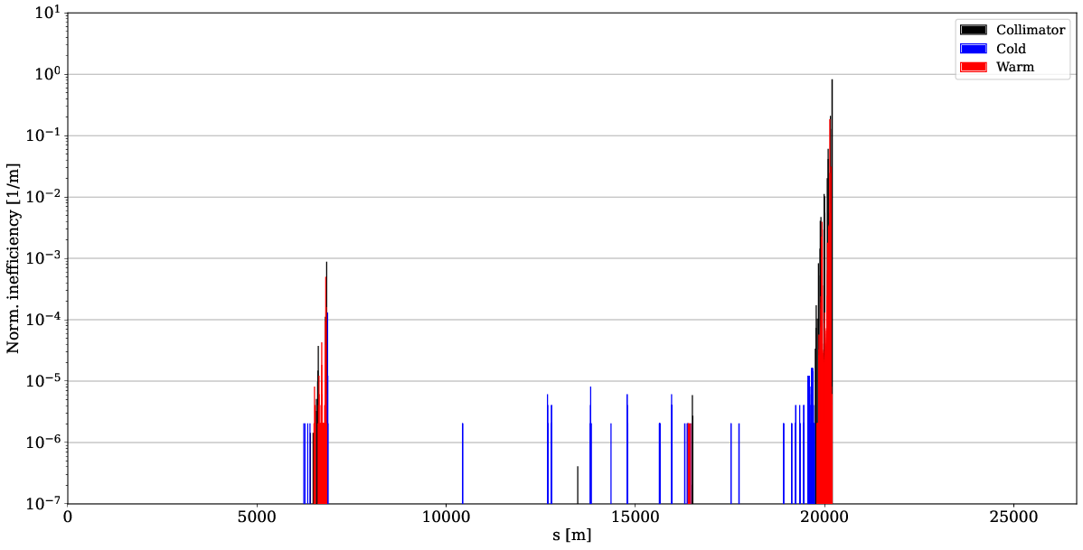
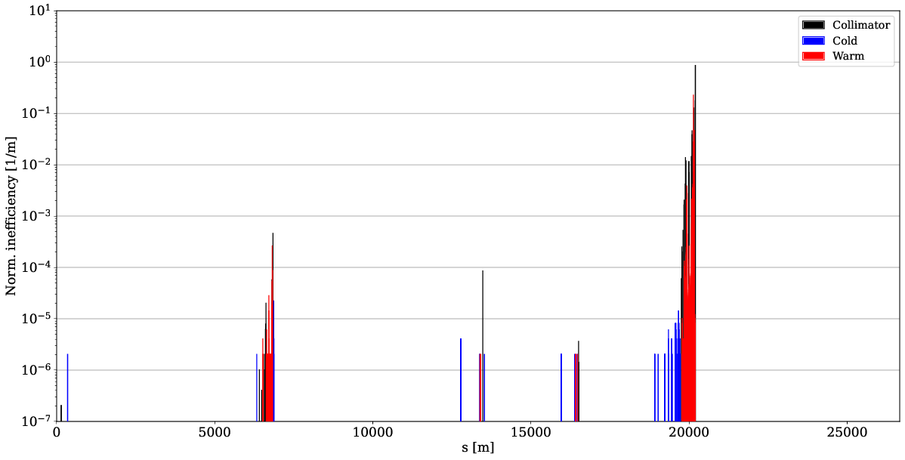
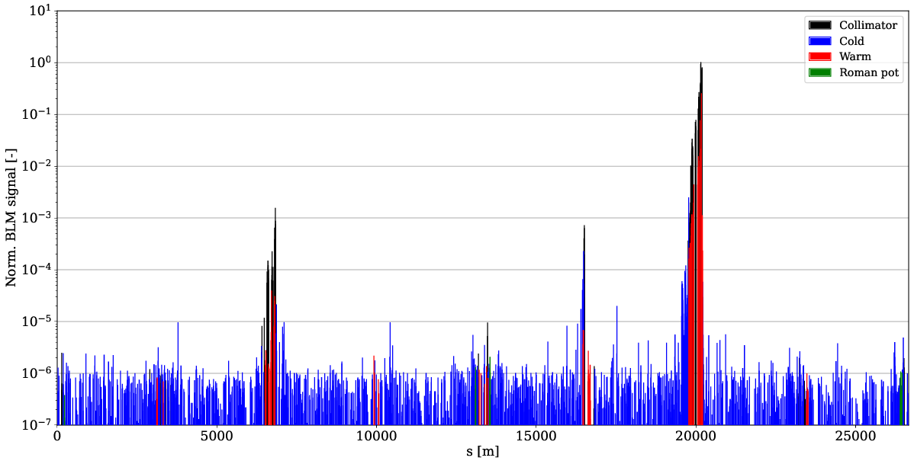
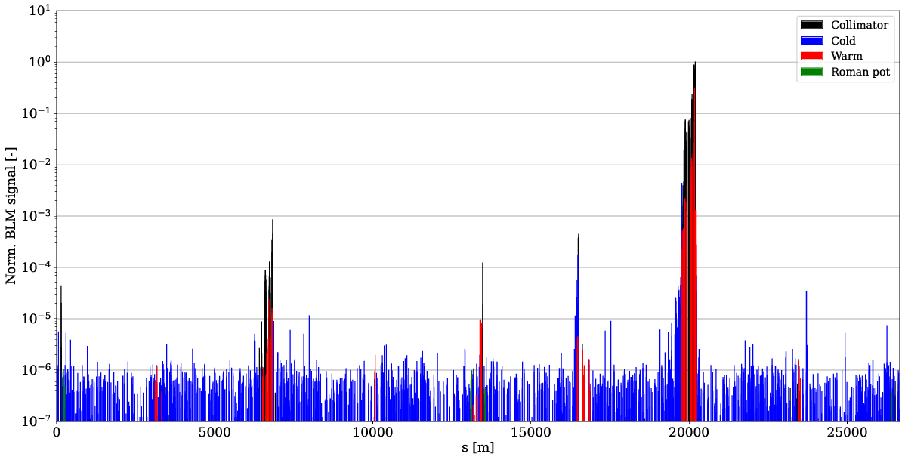
TCT losses – B2V
Increase of TCT losses
TCT power load and detector background should be evaluated
Can be mitigated with phase advance from TCP to TCT
n.b. TCTs at 18 sigma, go to 8.5 sigma during levelling
nominal sim.
IR7 MD sim.
nominal meas.
IR7 MD meas.

Slide 36
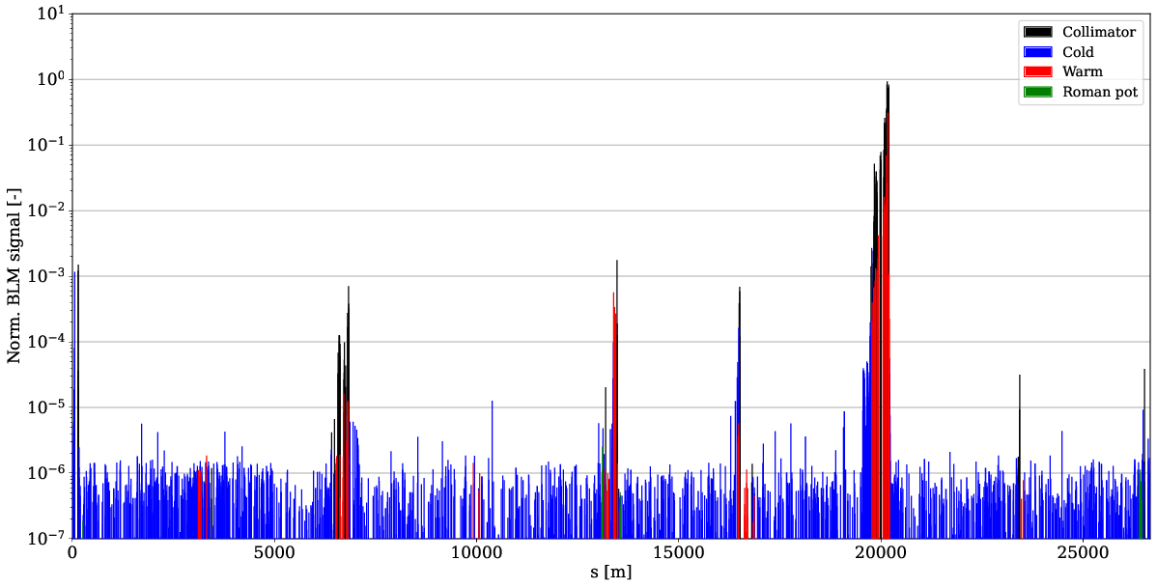
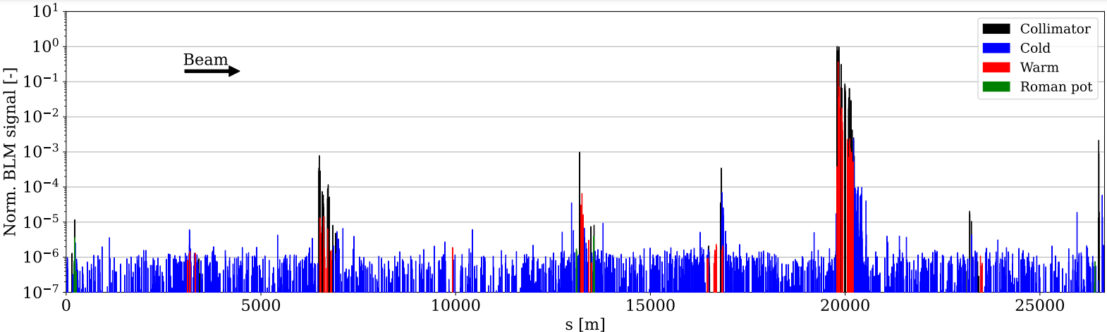
Tight TCT settings
Worst TCT losses in 2024 operation IR1 for B1H
Similar to HL MD optics
  Only B2 measurements with tight TCT
Phase advance not yet optimized in the MD optics
In HL, TCTs in cell 6 as well
B2V: HL MD meas.
B1H: 2024 ref. meas.

Slide 37
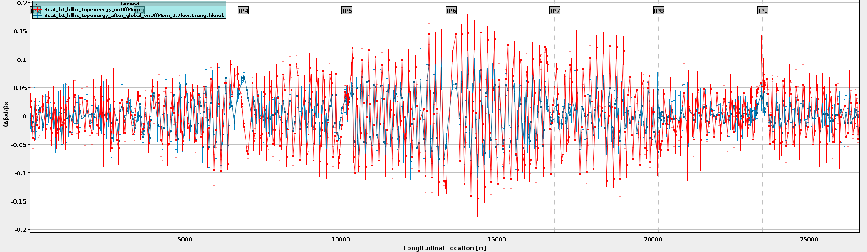
Optics measurements
Optics successfully deployed, with global corrections at INJ, RAMP and FT
  beta beat:
    FT: < 10 %
    RAMP: < 30 % @ 1 TeV
    INJ: < 15 %
  dispersion: < 0.02
  orbit: excellent (< 35 µm off at collimators)
B1 FT beta beat before / after correction
HL MD

Slide 38
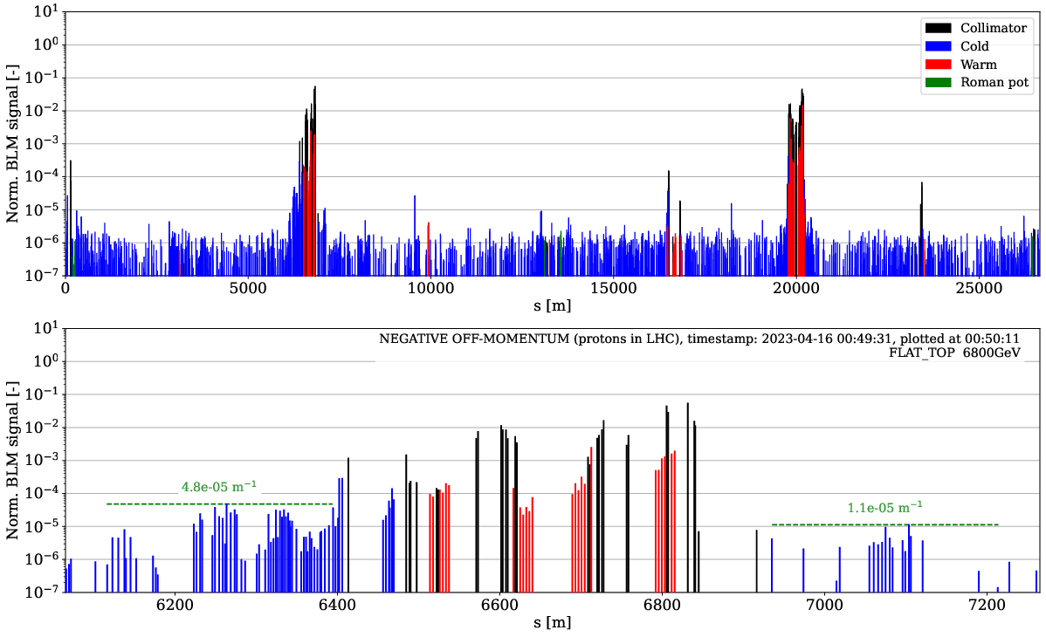
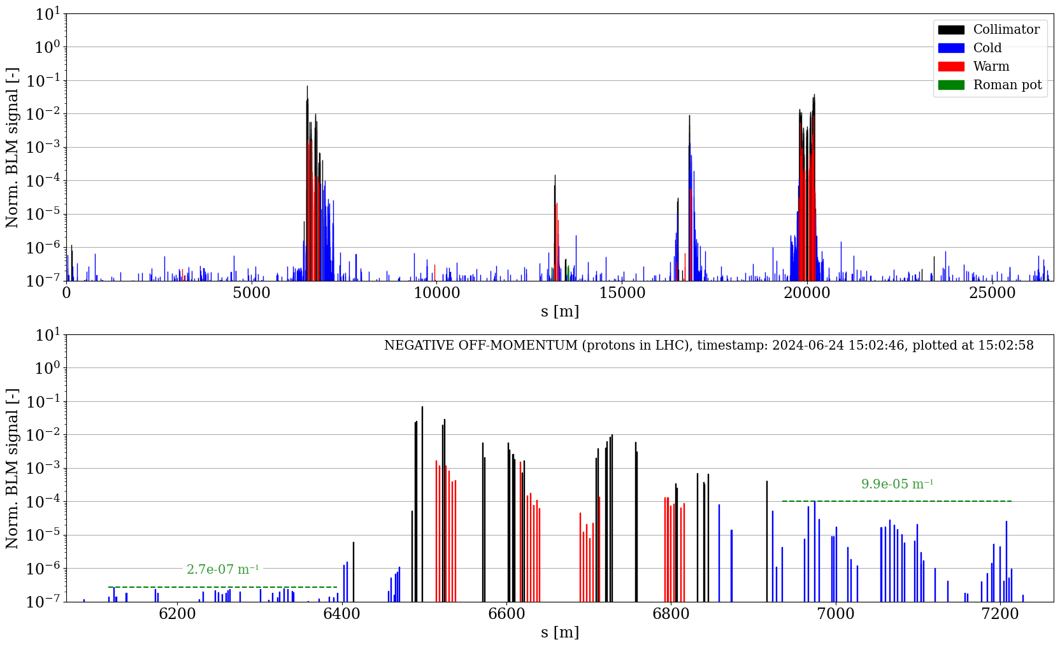
Off-momentum loss maps
Could only do negative
Similar balance IR3 / IR7 and TCT losses
Large increase in IR6, possibly due to new optics and different TCDQ setting
2023 commissioning
HL optics FT

Slide 39
Off-momentum loss maps
Worse IR3 DS losses, but still lower than positive off-momentum reference
Hierarchy looks good
Need to repeat loss maps and also do positive
2023 commissioning
HL optics FT

Slide 40
IR3 / IR7 balance of losses – B2V
Balance of losses between IRs has implications for radiation dose
Can go up or down, here down by 44 % in IR3
nominal sim.
IR7 MD sim.
nominal meas.
IR7 MD meas.

Slide 41
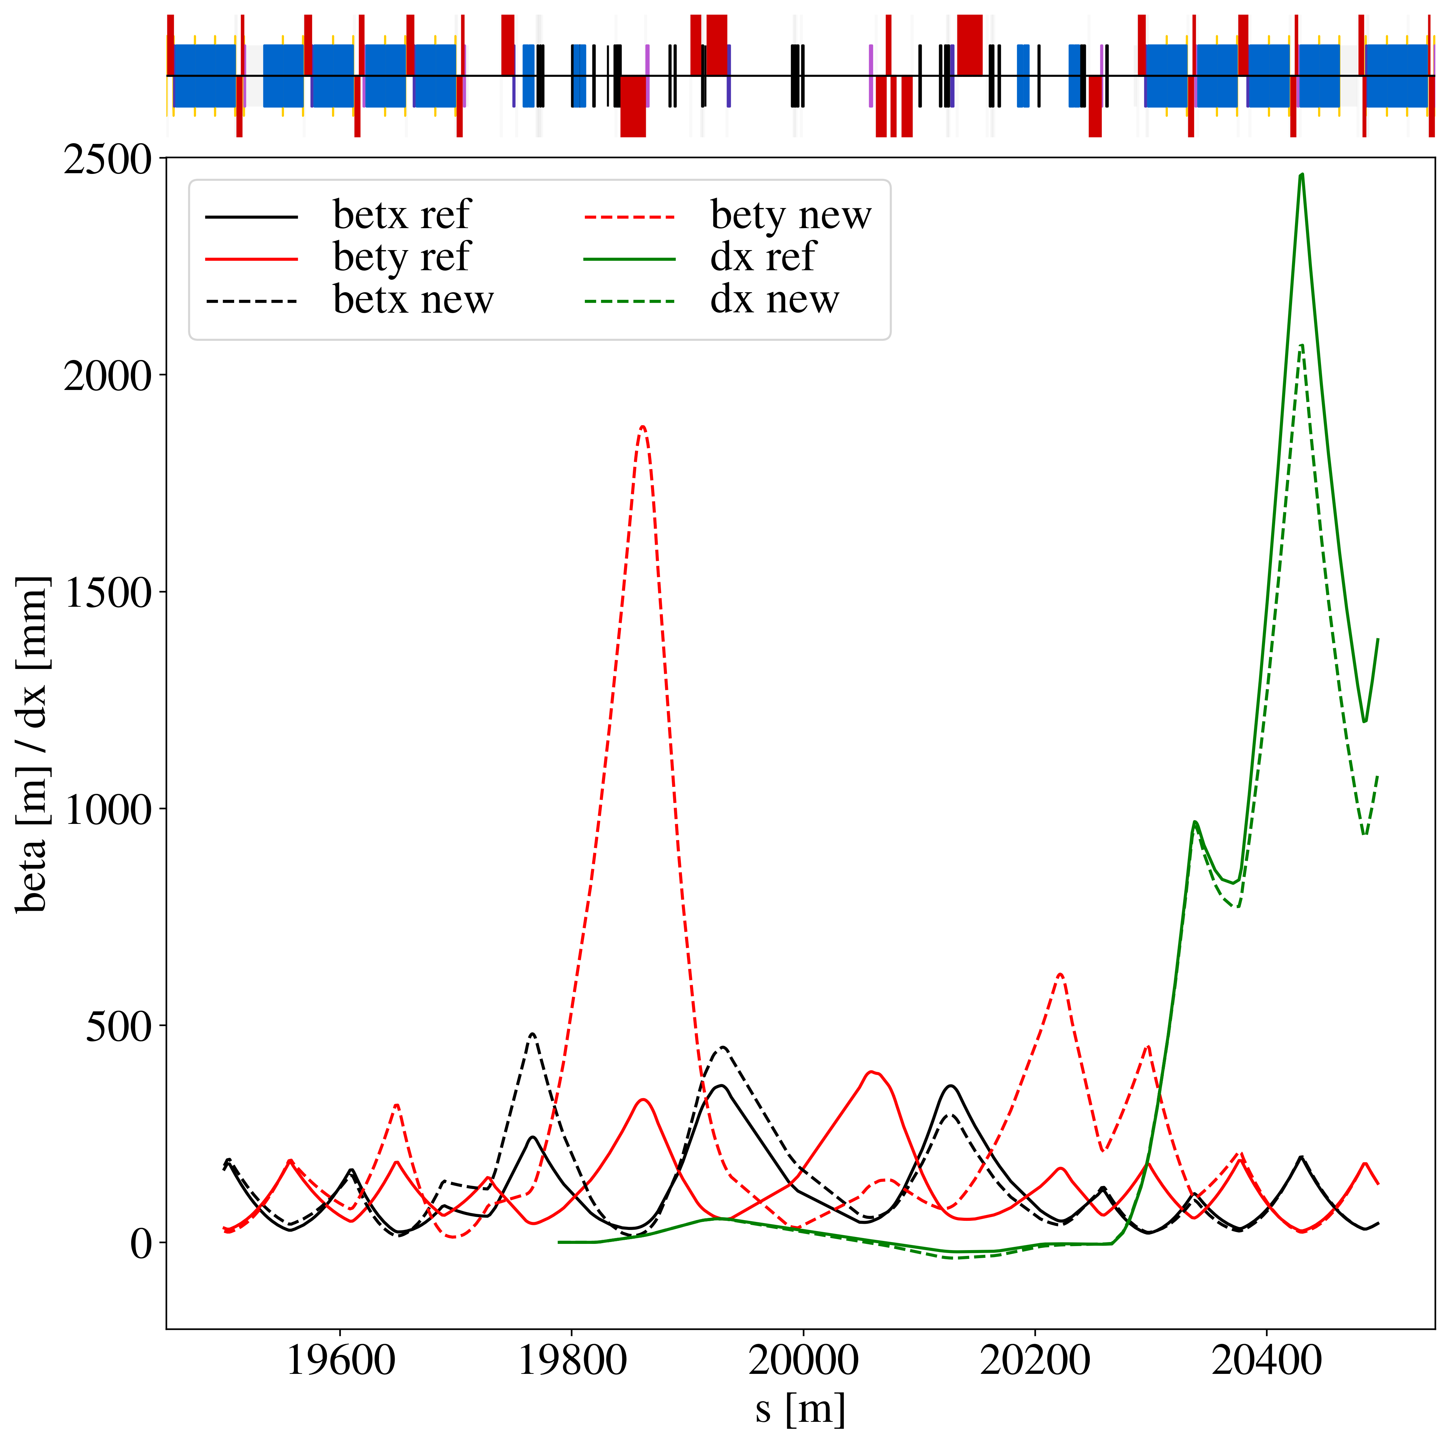
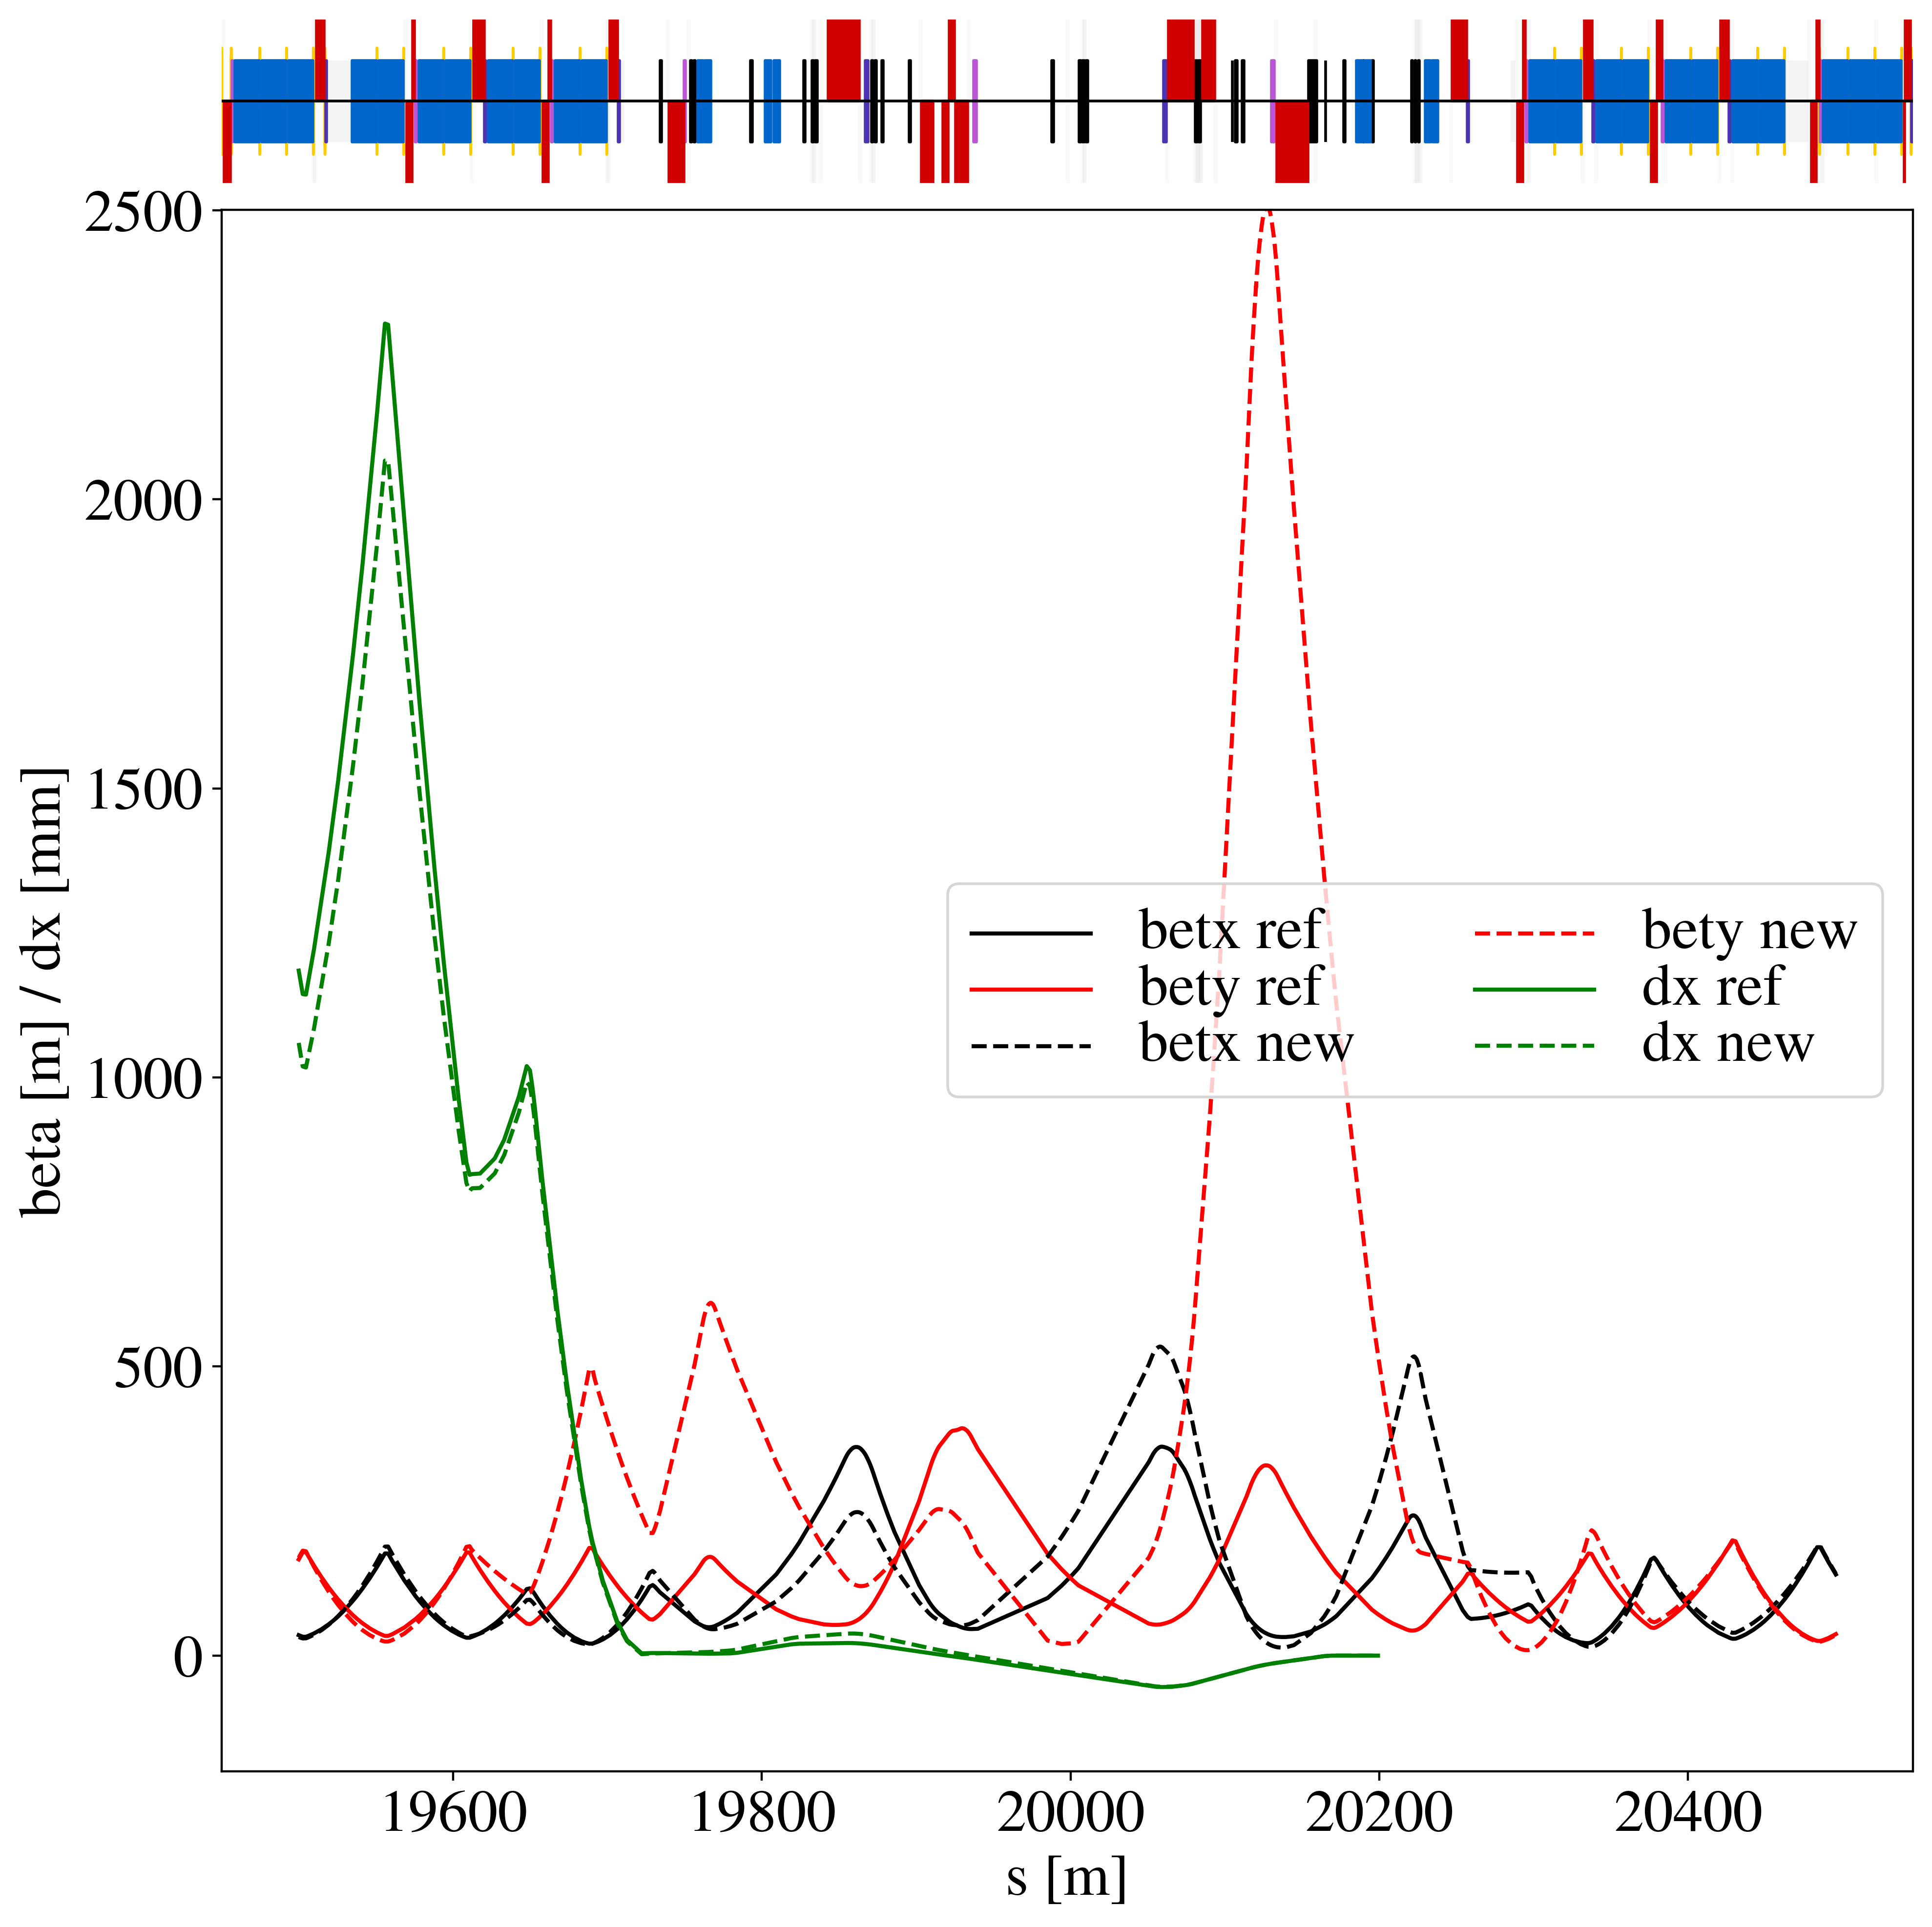
IR7 MD optics (reMD5)
B1
B2

Slide 42
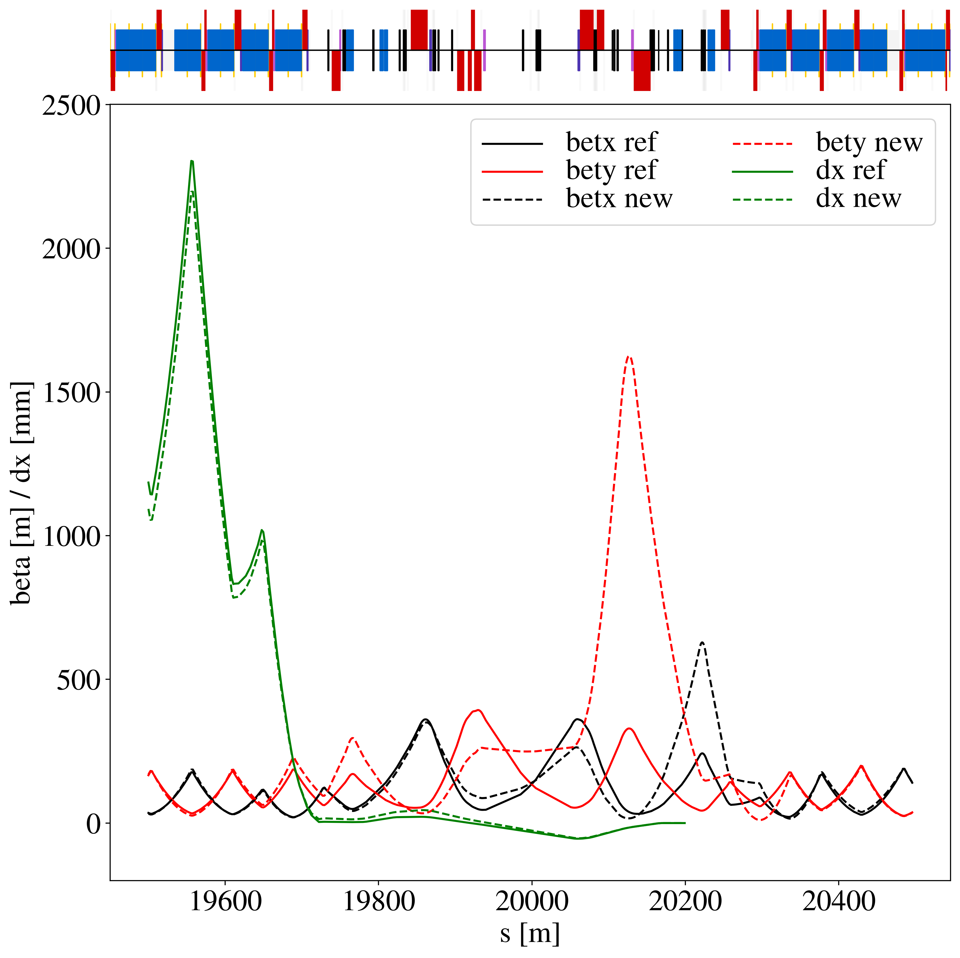
HL MD optics (re12c)
B1
B2

Slide 43
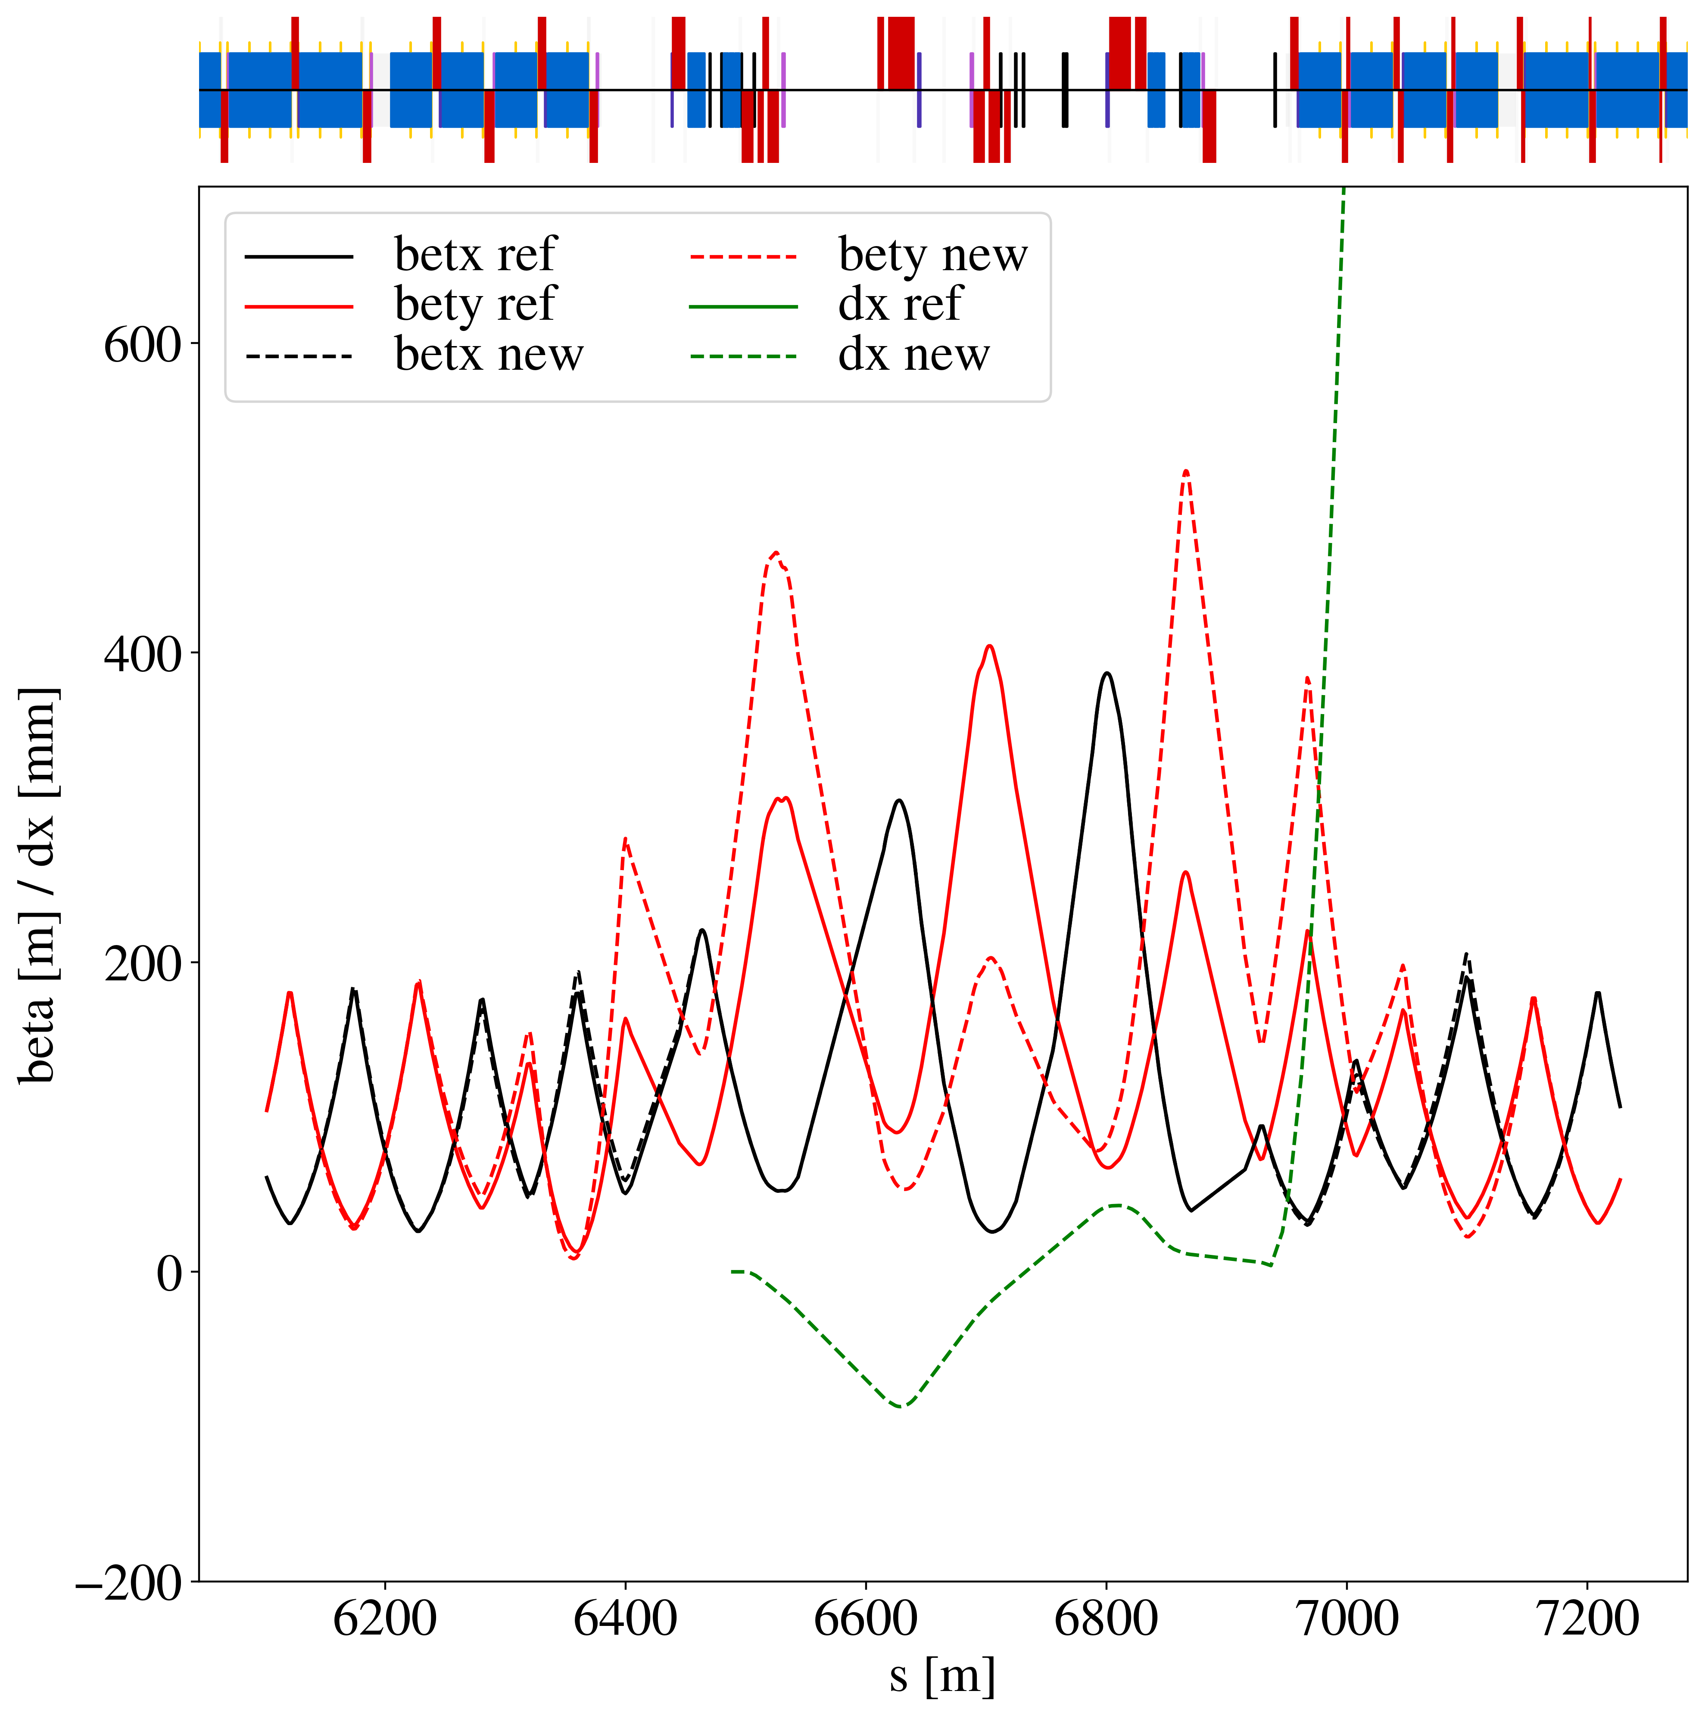
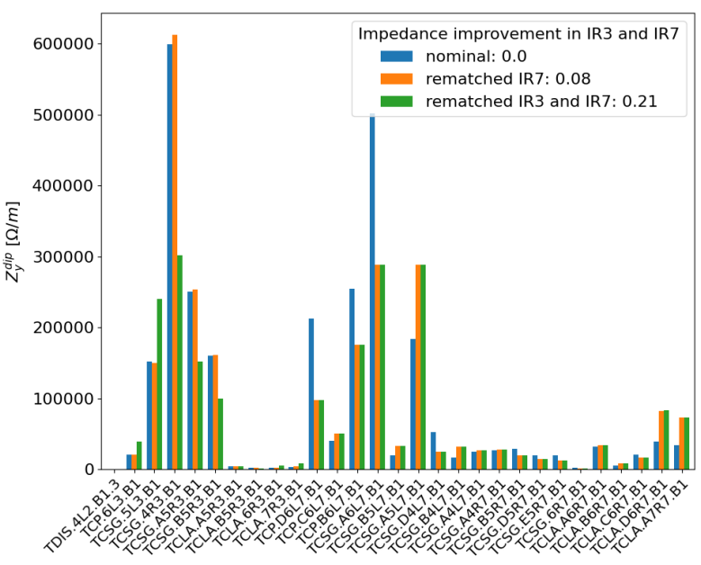
New IR3 optics
One single collimator creates majority of dispersion due to small horizontal gap and large vertical beta function
B1
IR3 collimation is mostly horizontal
Idea: reduce problematic vertical beta peak, while keeping horizontal plane unchanged
L. Giacomel

Slide 44
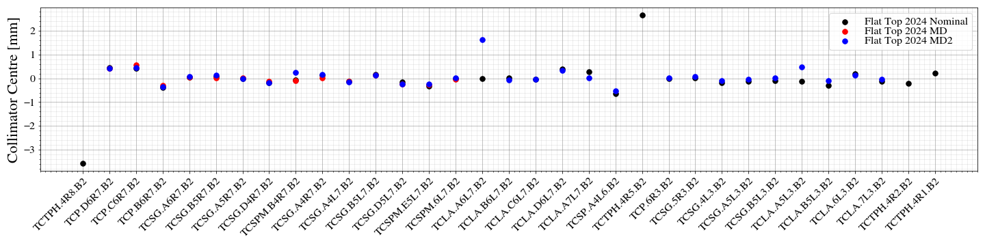
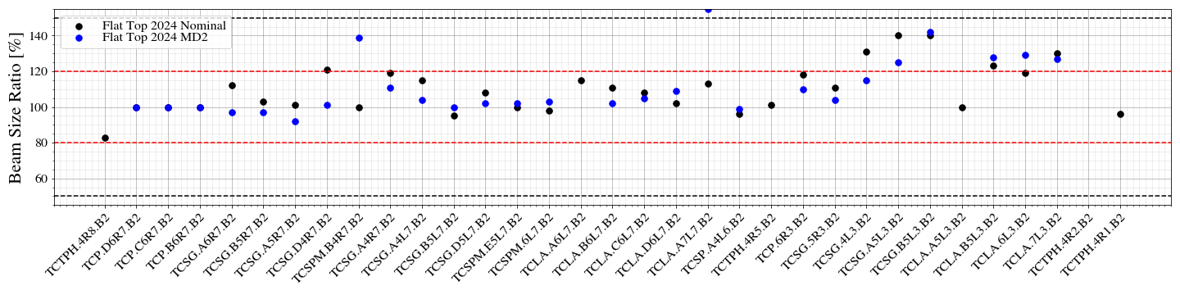
Collimator centers
Excellent agreement of collimator centers between MD optics and nominal
  No change expected, but critical to check that OFB updated properly to new cycle
A few outliers, likely caused by erroneous loss spike detection during alignment

Slide 45
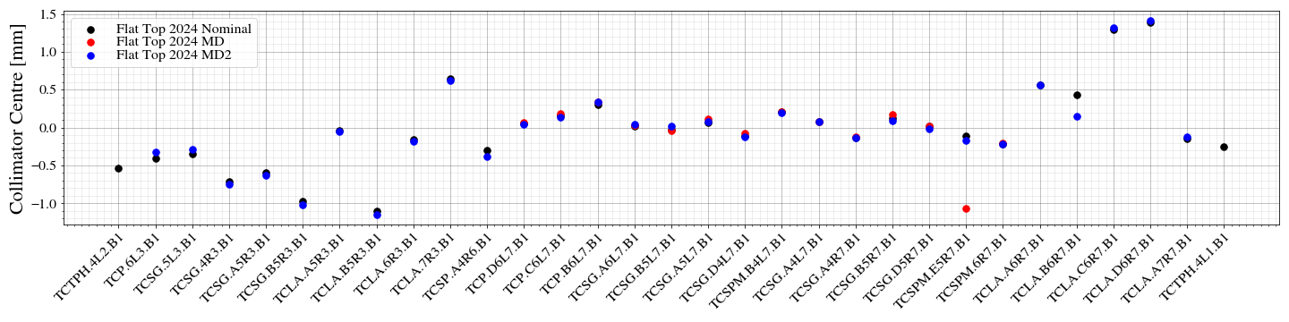
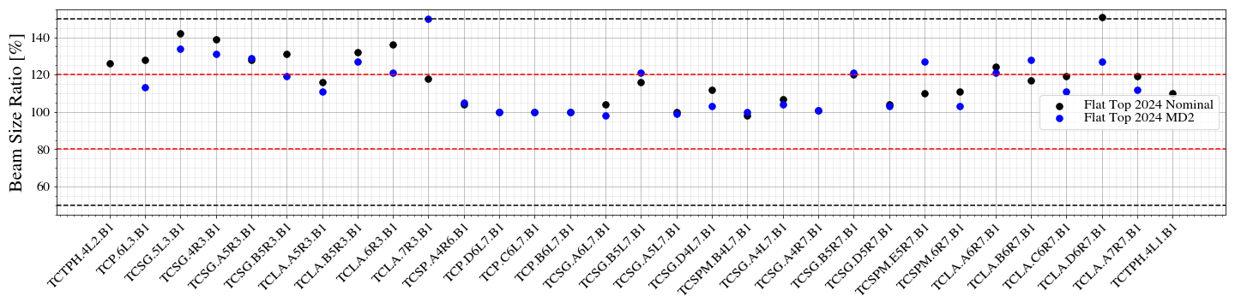
Collimator centers
Excellent agreement of collimator centers between MD optics and nominal
A few outliers, likely caused by erroneous loss spike detection during alignment

Slide 46
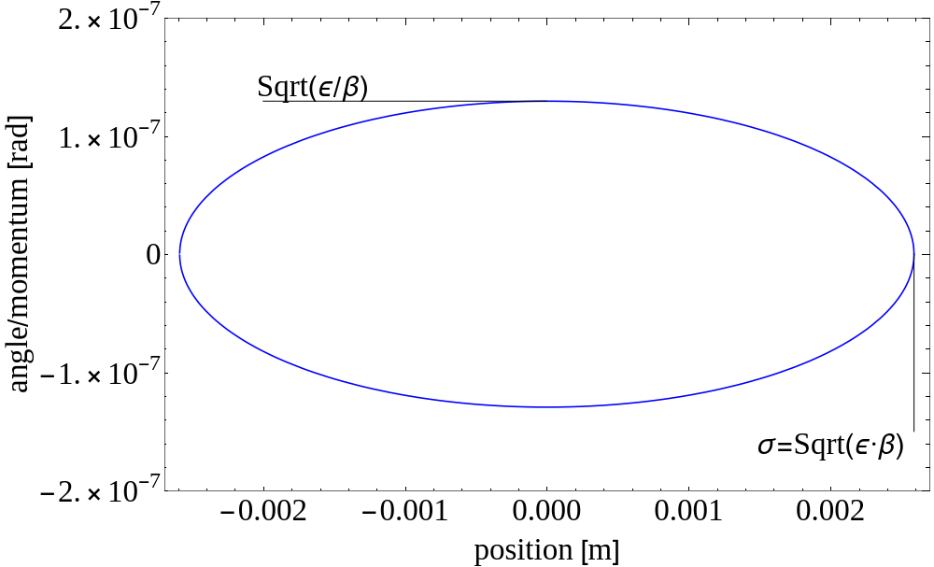


Beam sensitivity to perturbations
Constant area: $π⋅ε$

Slide 47
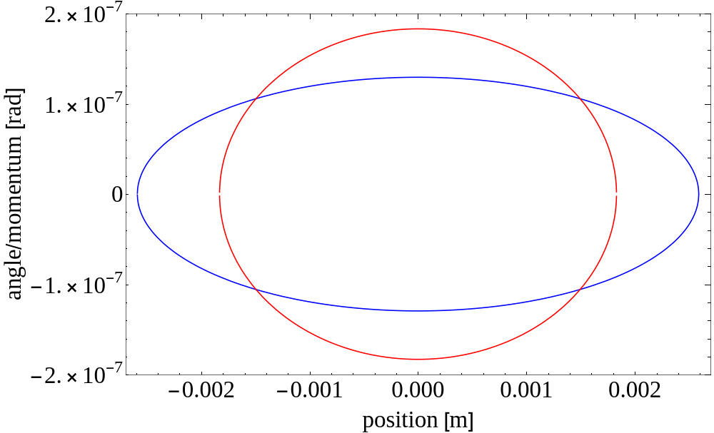
Beam sensitivity to perturbations
Ellipse at location with smaller beta function, area is the same

Slide 48
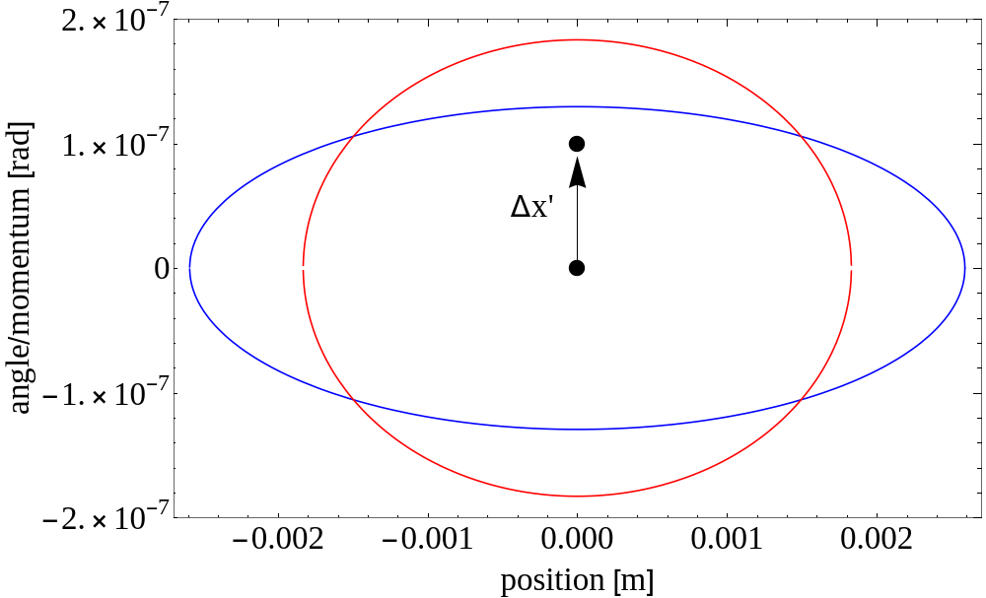
Beam sensitivity to perturbations
A particle receives a kick

Slide 49
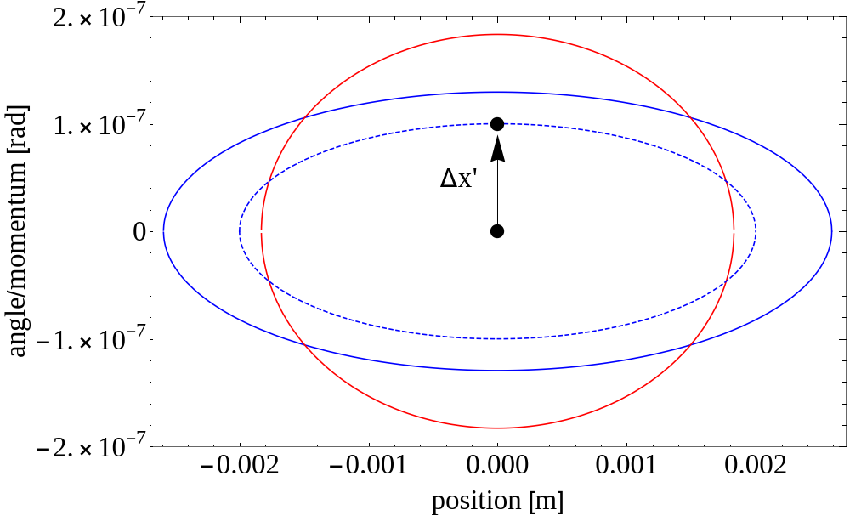
Beam sensitivity to perturbations
Particle traces out ellipse in phase space

Slide 50
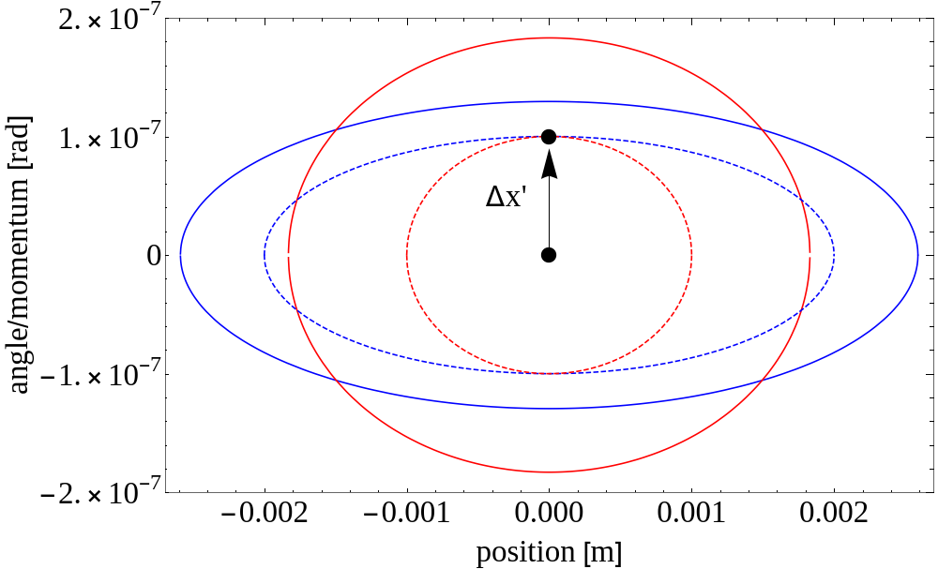
Beam sensitivity to perturbations
Particle at other location traces out different ellipse

Slide 51
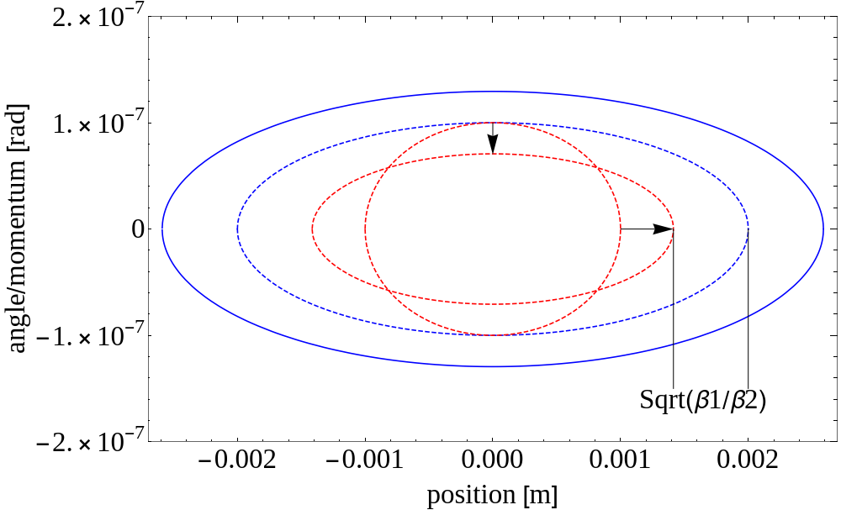
Beam sensitivity to perturbations
Observe Red particle at Blue location, transforms the ellipse
Amplitude of particle kicked at Red location smaller than particle kicked at Blue location. This is because of the beta function

Slide 52
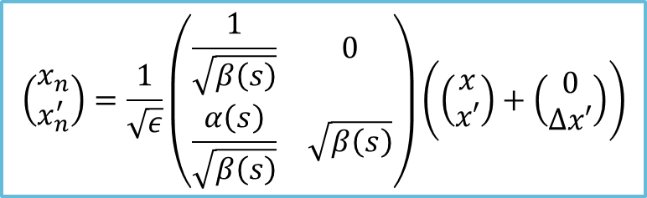
Beam sensitivity to perturbations
Observe Red particle at Blue location, transforms the ellipse
Amplitude of particle kicked at Red location smaller than particle kicked at Blue location. This is because of the beta function
$$\left(\begin{matrix}x_{n} \\ x_{n}^{′}\end{matrix}\right)=\frac{1}{\sqrt{ε}}\left(\begin{matrix}\frac{1}{\sqrt{β\left(s\right)}} & 0 \\ \frac{α\left(s\right)}{\sqrt{β\left(s\right)}} & \sqrt{β\left(s\right)}\end{matrix}\right)\left(\left(\begin{matrix}x \\ x′\end{matrix}\right)+\left(\begin{matrix}0 \\ Δx′\end{matrix}\right)\right)$$

