Slide 1
Intense Hadron Beams at ISIS
Contributions from D. Posthuma de Boer, R Williamson, C. Jolly, H. Wakeling, J. Flowerdew, M Topp-Mugglestone
Presented by Billy Kyle
Imperial College
15/04/2024

Slide 2
Contents
Introduction to ISIS
R&D at ISIS – Hadron Beams at the Intensity Limit
ISIS II Design Program
IBEX

Slide 3
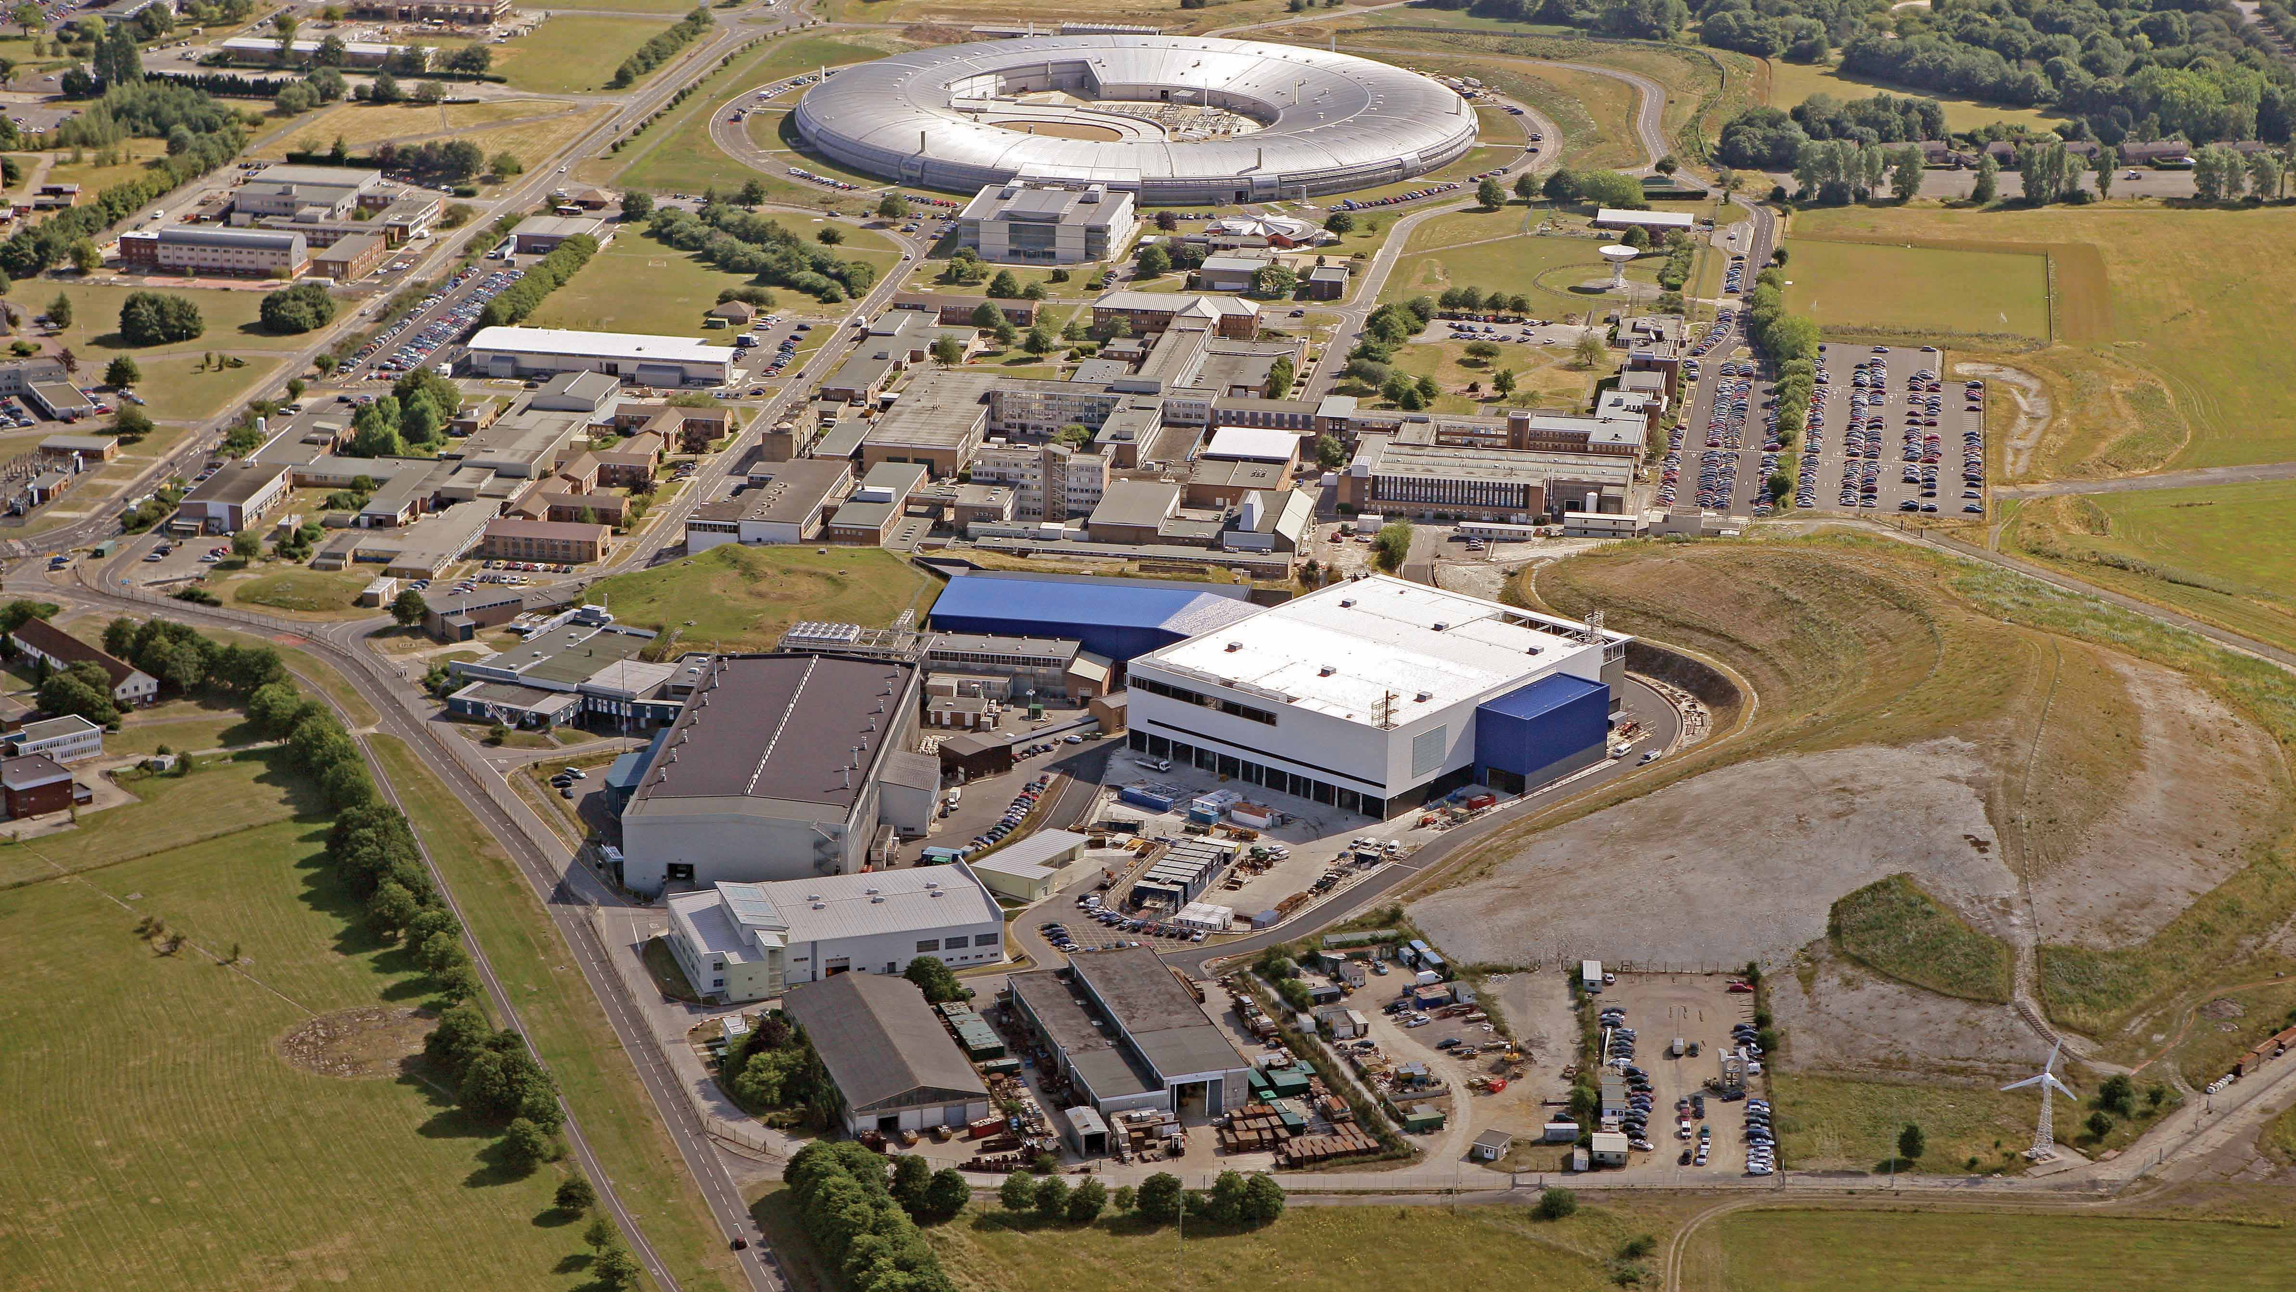

Slide 4
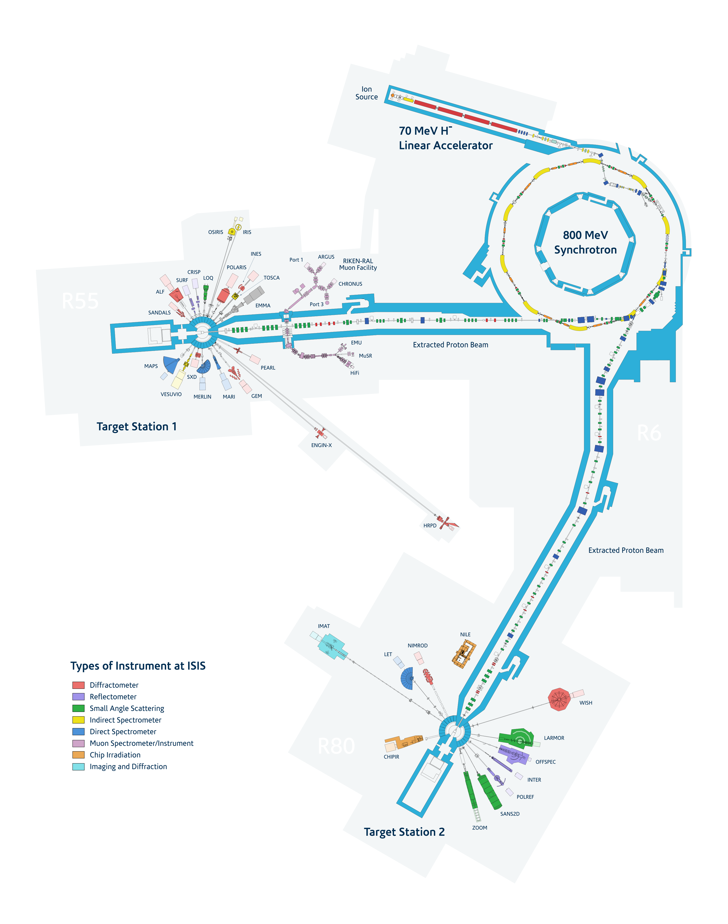
The ISIS Facility
H⁻ source (RFQ + DTL)
800 MeV RCS
Target Station 1
Target Station 2

Slide 5
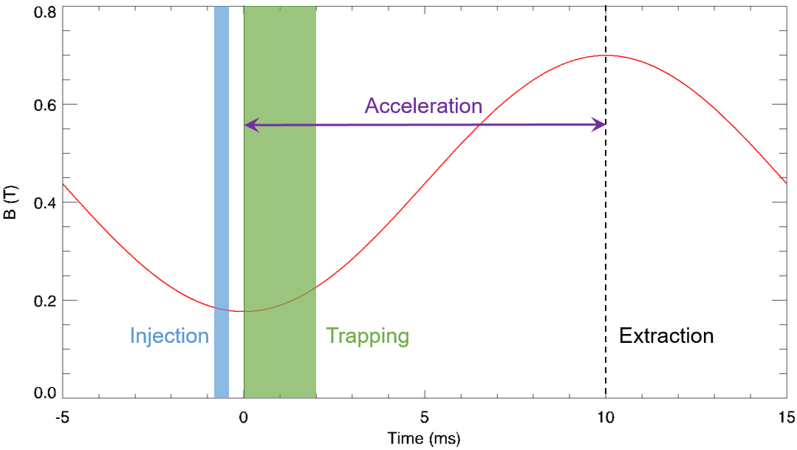
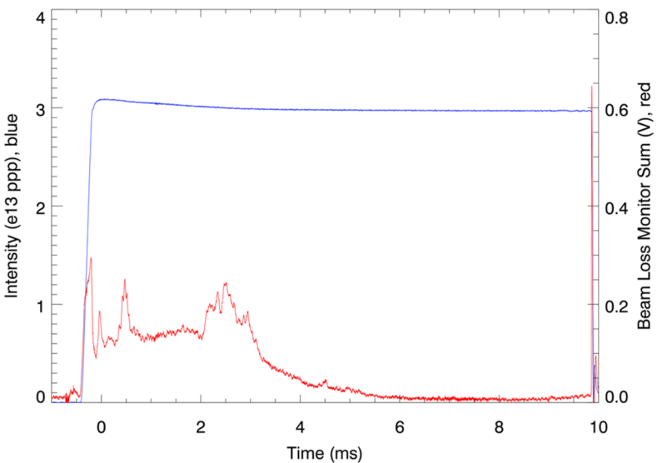
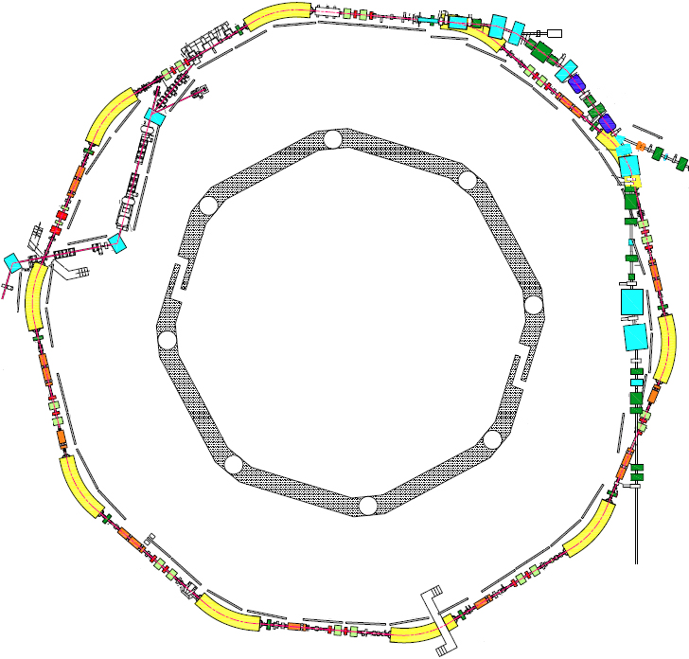
The ISIS RCS
Mean Radius | 26 m
Beam Energy | 70 – 800 MeV
Intensity | ~3e13 ppp
Repitition Rate | 50 Hz
Lattice Periodicity | 10 SP
Injection | 220 μs, 130 turns (charge exchange)
Painting | Dispersive horizontal, injected beam position scanned vertically
Extraction | Single turn, vertical
Betatron Tune | (Q_{x}, Q_{y}) = (4.31, 3.83), programmable
Beam Losses | Injection: 2%, Trapping: <3%, Acceleration/Extraction: <0.5%
RF System | 6 × fundamental (h=2) @ 160 kV/turn, 4 × 2nd-harmonic (h=4) @ 80 kV/turn
Extraction
TS2
Injection
TS1

Slide 6
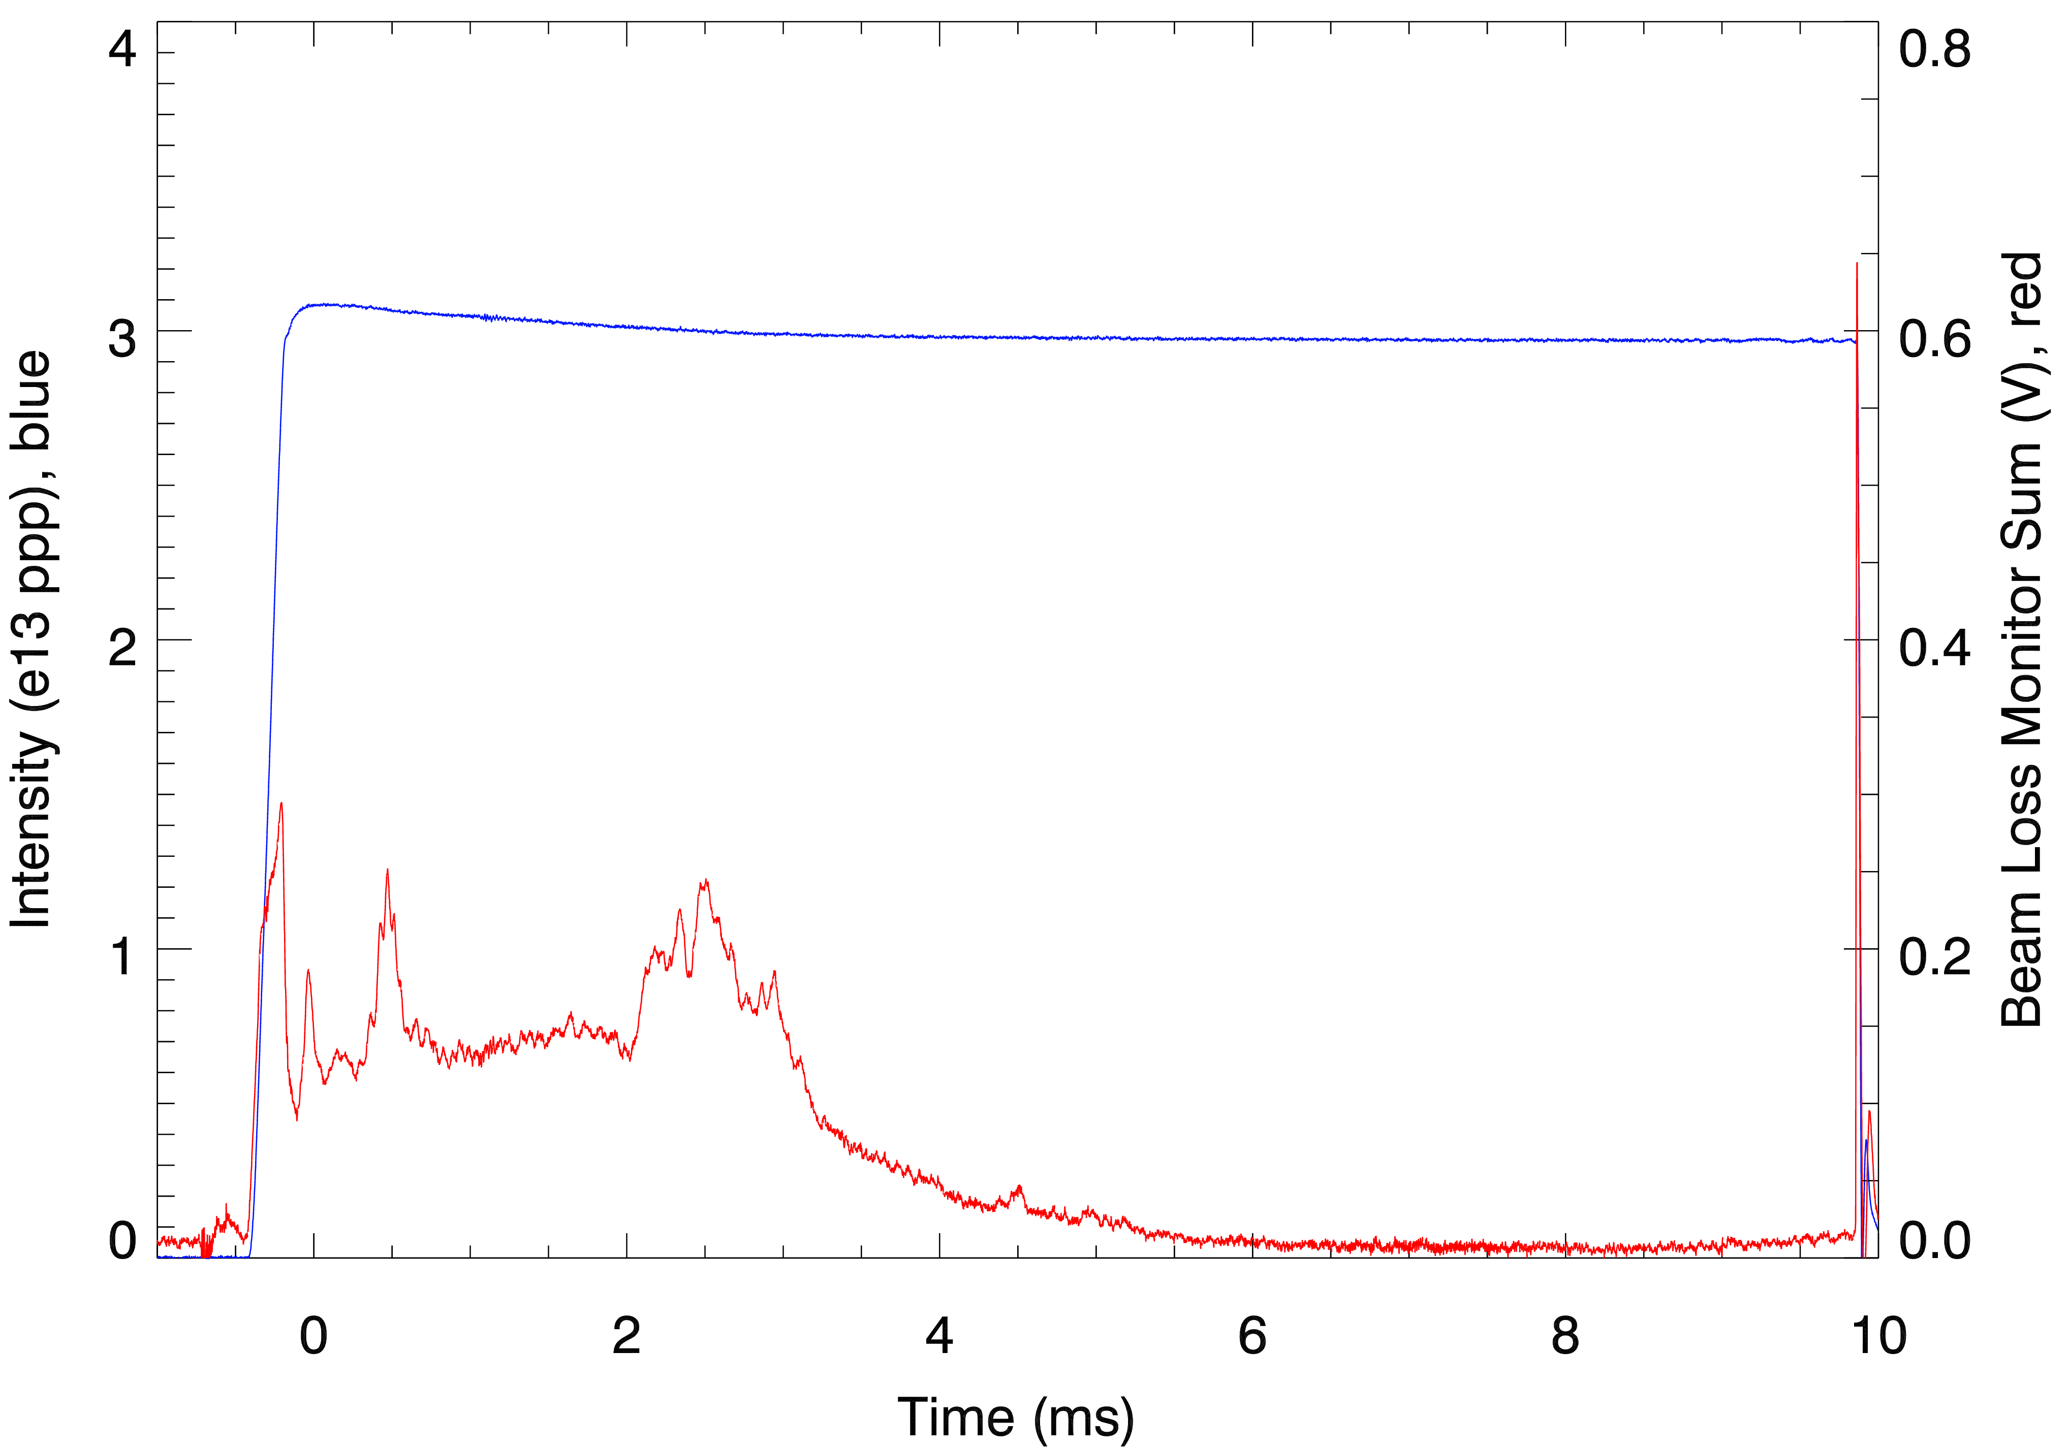
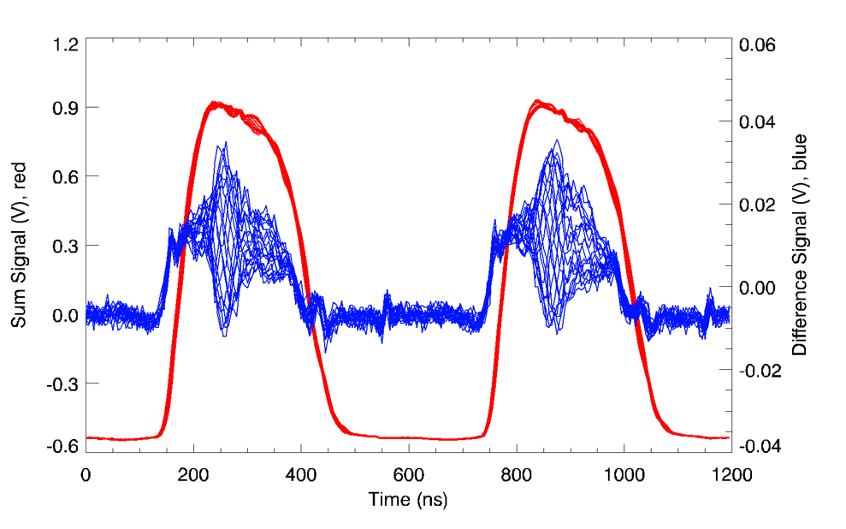
ISIS R&D – Beam Instability Studies
(Rob Williamson, JAI Lecturer & Former Student, David Posthuma de Boer, JAI Student)
Background:
Coherent vertical intrabunch head-tail instability observed from 1 – 2.5 ms through acceleration
Calculations suggest mode-2 or 3 with growth times 𝜏≈4ms, but typically observe mode-1 with growth times on order of 100 µs.
Key intensity limit due to beam-loss
Mitigated through various techniques
Overall scope of research:
Identify driving source of instability
Measure, simulate and understand head-tail instability mechanism
  Dual-harmonic RF, space charge, etc.
  Investigate unexpected features
Identify and develop further mitigation methods
BPM Sum and Difference Signals at 2 ms
Notes:
First report of HT in 1988

Slide 7
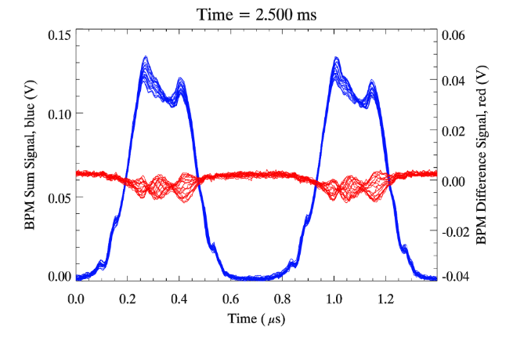
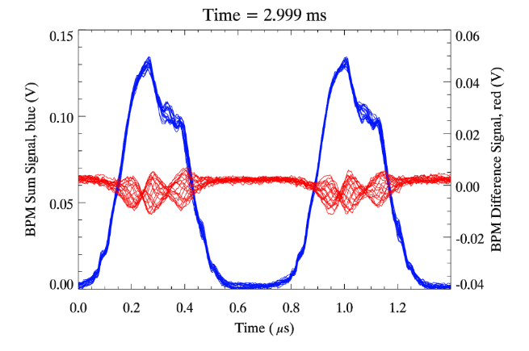
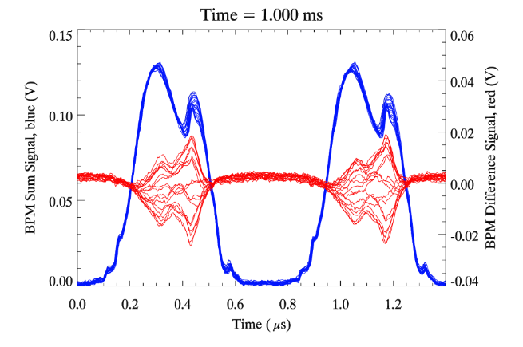
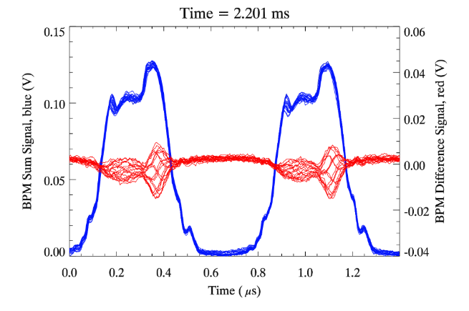
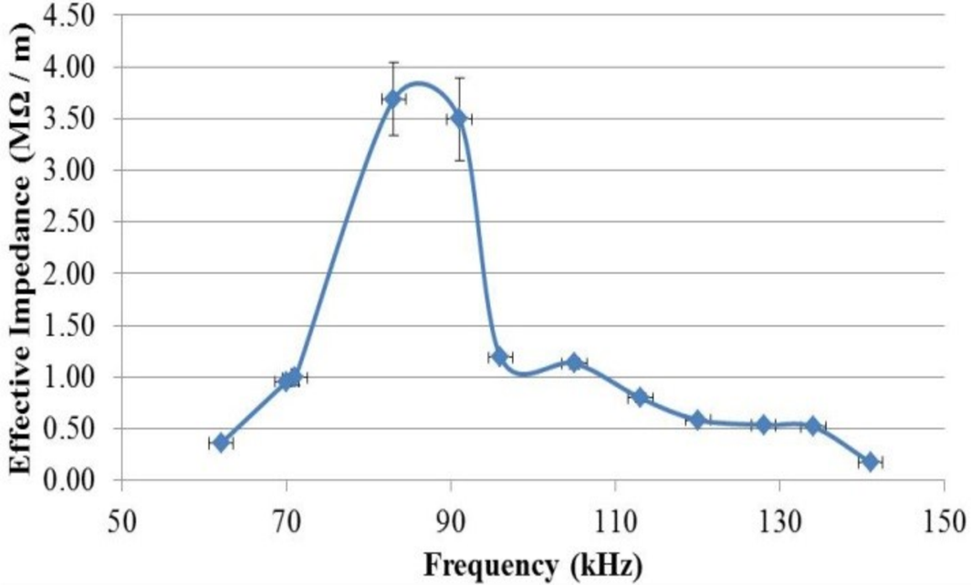
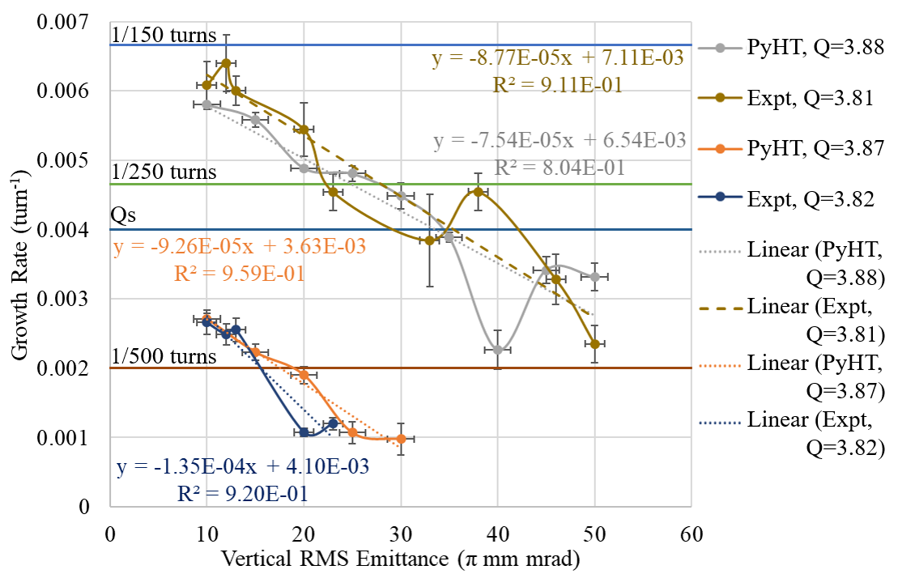
ISIS R&D – Beam Instability Studies
(Rob Williamson, JAI Lecturer & Former Student)
10 π mm mrad
50 π mm mrad
Q_{y}=3.800
Characterise the Instability:
Behaviour with machine and beam parameters
  Vertical tune
  Vertical emittance
Comparison with theoretical models
  Only low intensity, single harmonic RF
  Limited models for behaviour with space charge
PyHEADTAIL simulations with and without space charge
  Smaller vertical emittance beams have larger growth rates, as observed experimentally
Novel features
  Mode dependence on tune
  Instability over an “effective” bunch length
  Mode structure different to theoretical predictions
Next steps
  Further measurements vs intensity and distribution
  Changes to machine tuning techniques
  Prototype damper system developments
  Link to impedance studies
Q_{y}=3.810
Low-frequency, narrowband impedance

Slide 8
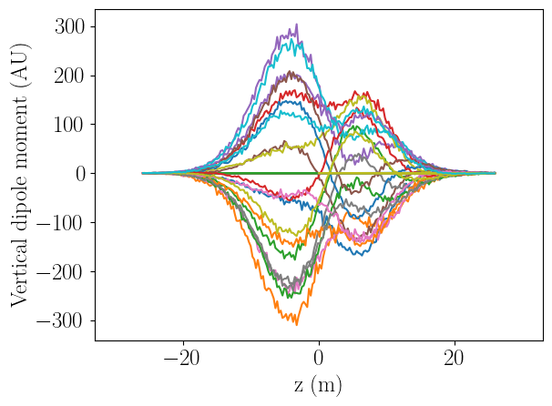
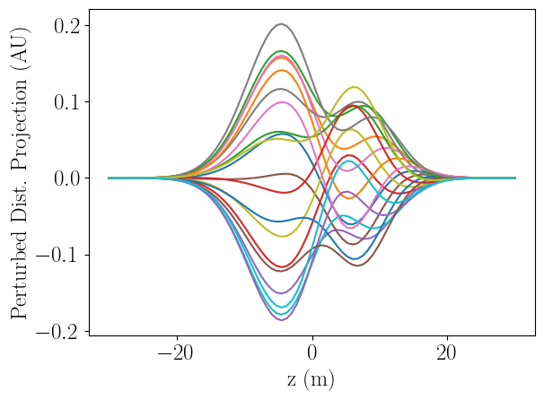
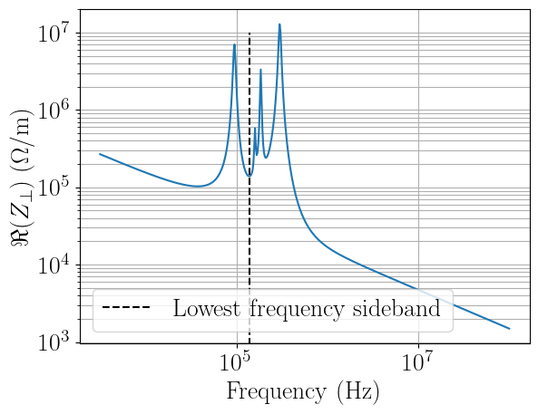
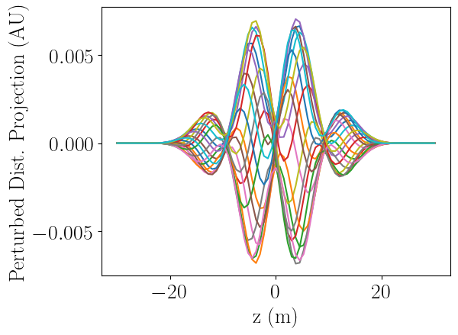
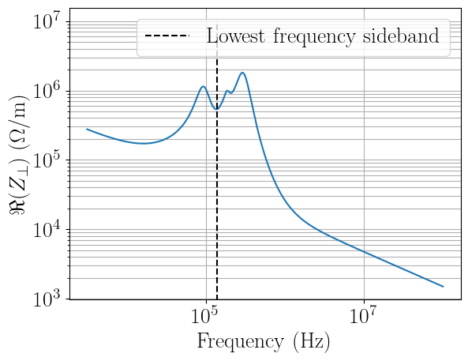
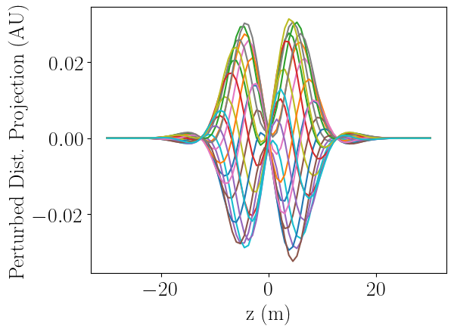
ISIS R&D - Head-Tail Predictions
(Dave Posthuma de Boer, JAI Student)
PyHEADTAIL
PyTMCI
𝜏 = 72 µs
𝜏 = 76 µs
Benchmarking of Vlasov solver, PyTMCI has been performed.
Two impedance models developed, based on RF screen resonators and resistive wall.
In both cases, predicted growth time match observed order-of-magnitude.
CST models have a simplified geometry. Resonator parameters must still be confirmed, but currently believe these screens are primarily responsible for head-tail instability at ISIS.
Refinement of impedance model required and further experimental verification.
Mitigation methods under investigation.
  Mode-3, 𝜏≈440 µs.
  Mode-1, 𝜏≈175 µs.

Slide 9
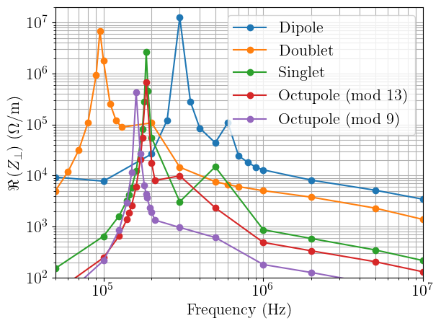
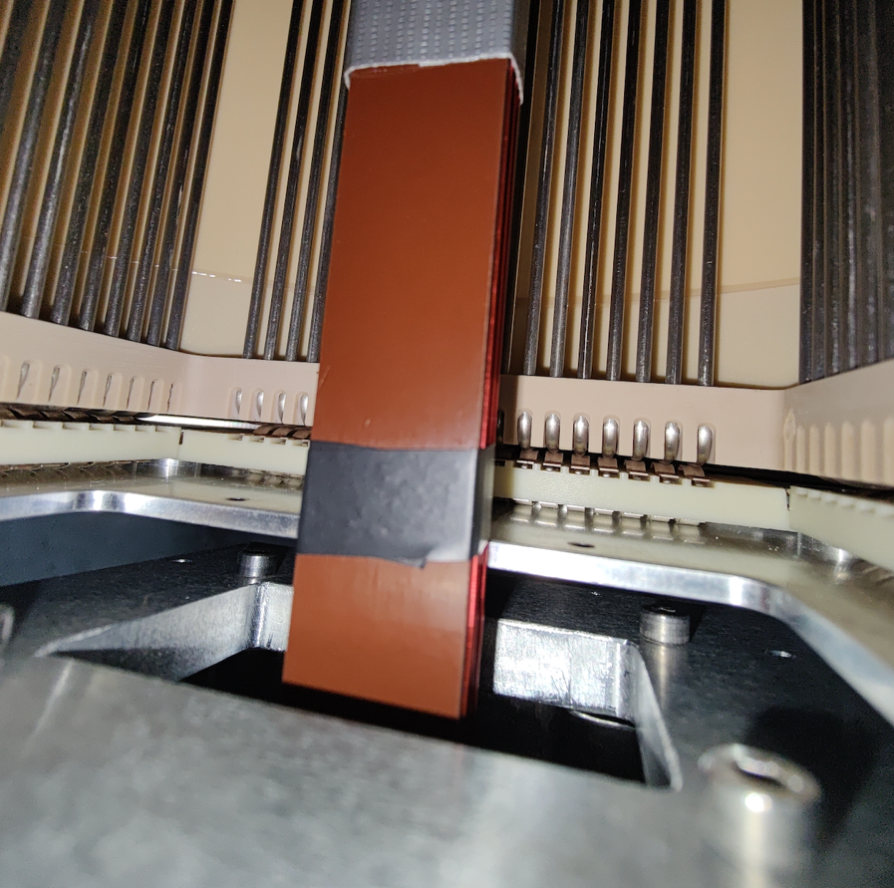
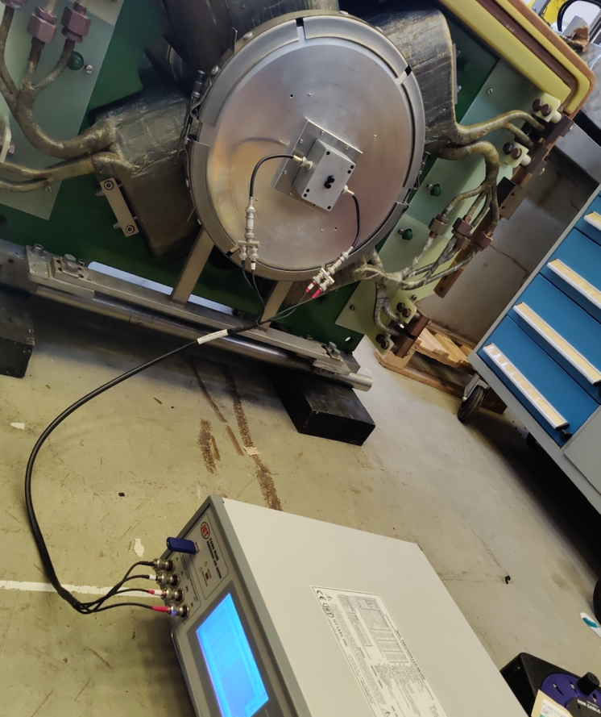
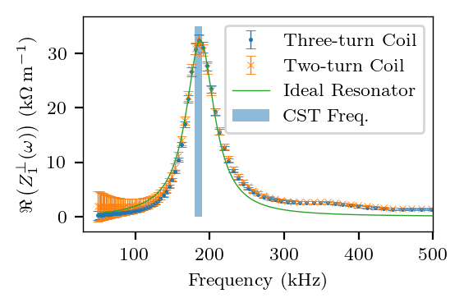
ISIS R&D - RF Screen Impedance
(Dave Posthuma de Boer, JAI Student)
Simulations of RF screens have been extended to include coupling capacitors.
Predicted very large, low-frequency resonant impedances.
Peak in real part of transverse impedance measured at almost exactly predicted frequency, but with lower magnitude and wider.
Similar structures present in other RCS’s. Discussions are ongoing.
Notes:
Honorable mention of Ajit Kurup

Slide 10
ISIS-II Megawatt Upgrade
ESFRI Neutron Scattering Facilities in Europe Report (2016)
“…by far the most cost effective solution would therefore be to build a MW-class short pulse facility at ISIS, reusing existing infrastructure and facilities as well as drawing upon on-site competences. The current facility could operate until the new facility is operational with its initial suite of instruments.”
Sentiment echoed in UKRI Infrastructure Opportunity Report (2023)
Europe (incl. UK) is a world leader in neutron-based science
Decommissioning of reactor sources of neutrons
Potential European “neutron drought”
ISIS-II vital to maintain European competitiveness with Japanese (J-PARC) and American (SNS) short-pulse neutron sources
ISIS-II Working Specifications
1.25 MW proton accelerator
1.2 GeV beam on target
0.1% beam-loss
Exact specification to be determined
Conventional Ring (RCS, AR) and FFA options being explored
Special focus on
  Sustainability of the future machine
  Ensuring health of the neutron user community during construction phase
Phase 1
Phase 2
Phase 3
2019
2021
2027
2031
2040
Feasibility, design studies and R&D
Integrated facility technical design
ISIS-II construction
Phase 1.1
Physics design
Small-scale prototypes
Phase 1.2
Physics design
Large-scale prototypes

Slide 11
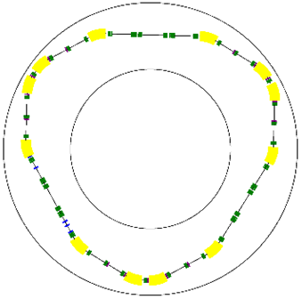
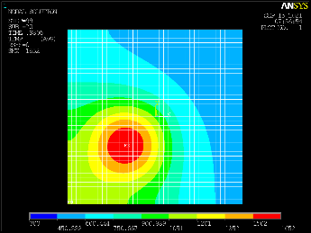
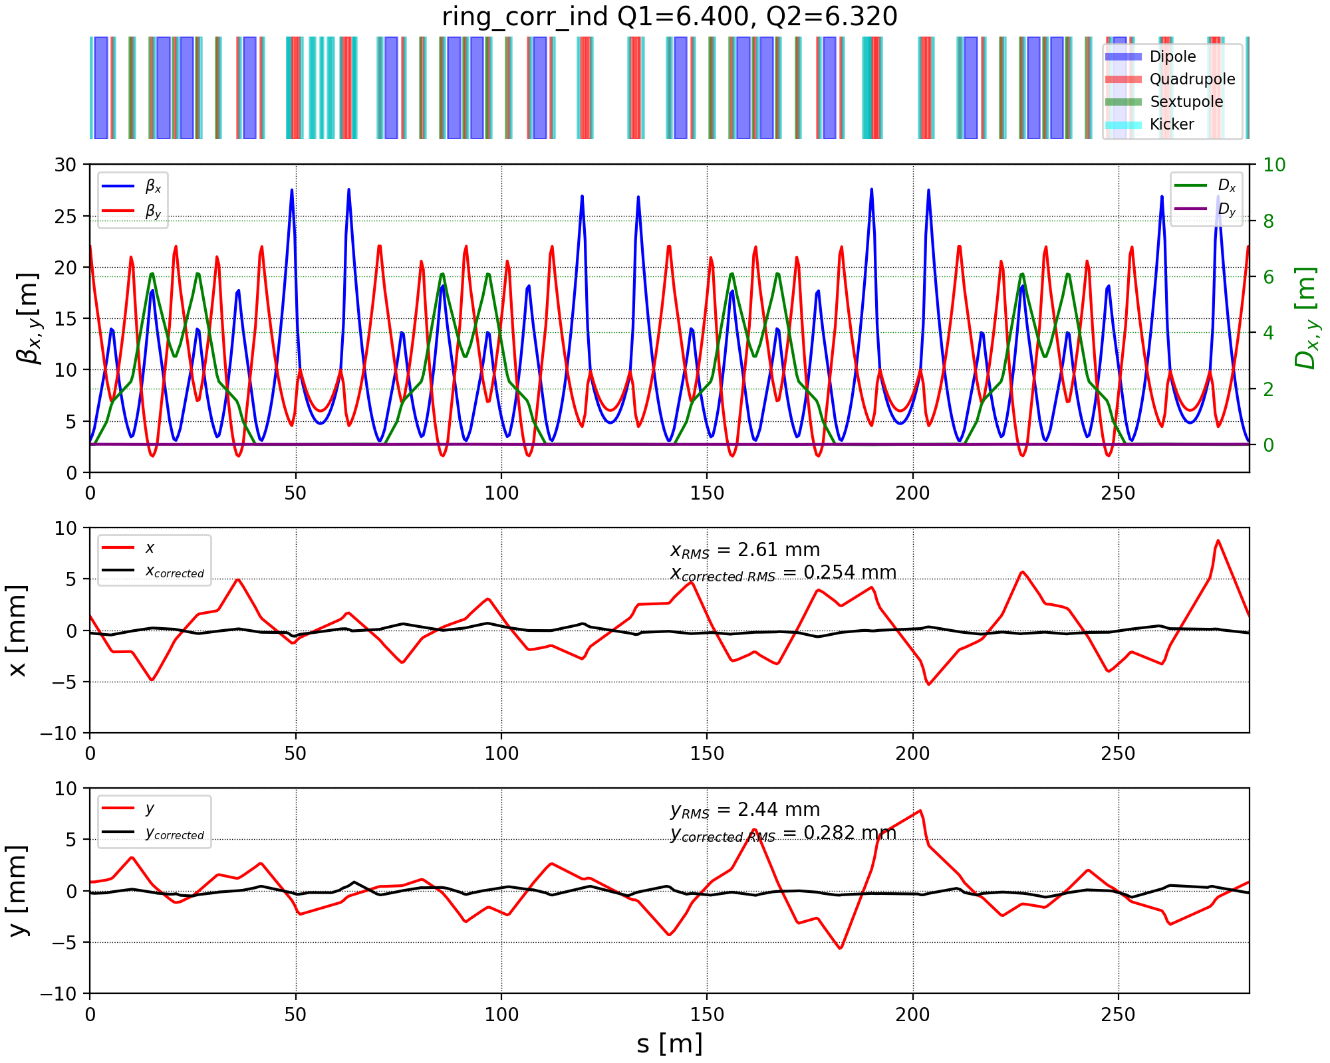
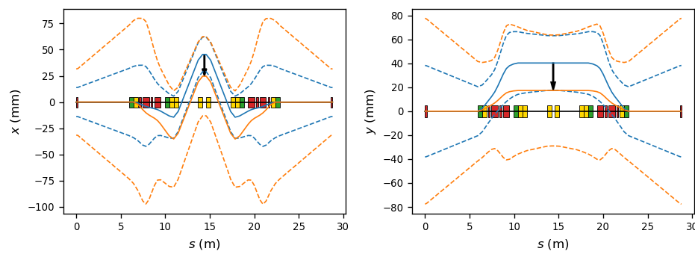
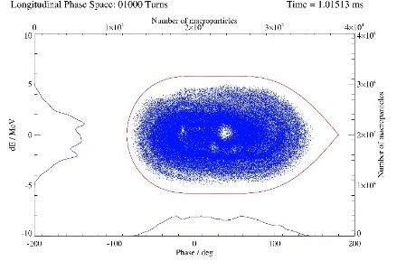
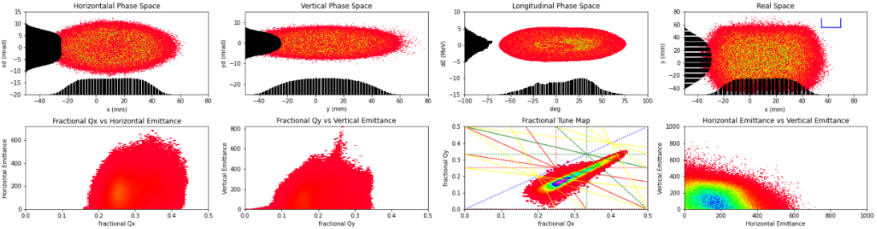
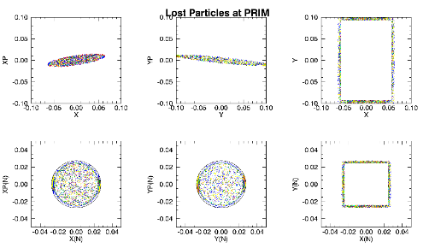
ISIS-II Megawatt Upgrade – “Conventional” Rings
1. Lattice Design (Dean Adams)
2. Longitudinal Dynamics (Rob Williamson – JAI student)
3. Transverse Dynamics (Chris Warsop – JAI supervisor, et al.)
4. 3D Beam Dynamics Design (Dean Adams, et al.)
5. Injection Straight Design and Foils (Hayley Cavanagh, Bill Kyle, et al.)
6. Correction Systems (Haroon Rafique)
7. Collimation, Extraction (Hayley Cavanagh, Haroon Rafique, et al.)
8. Instabilities (Rob Williamson, David Posthuma de Boer – JAI students)
Completed exploratory designs
  2 x Rapid Cycling Synchrotron
  2 x Accumulator Rings
New sustainability-focussed designs under investigation
Working Point
Injection Straight & Foil Temperature
Closed Orbit Correction
Lattice Design
Longitudinal Simulations
Collimation Simulations
3D Simulations

Slide 12
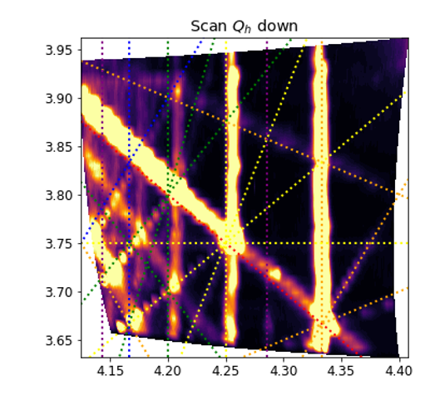
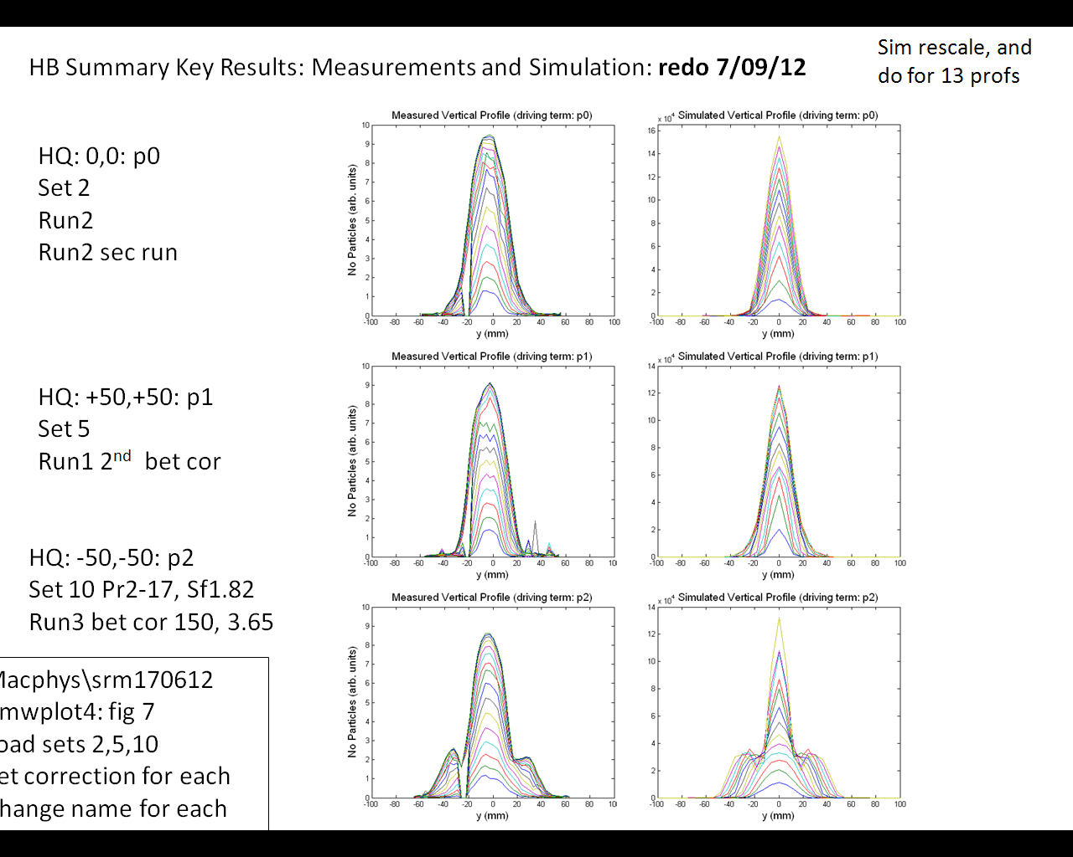
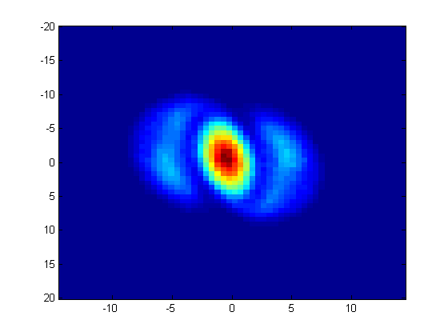
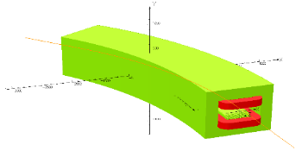
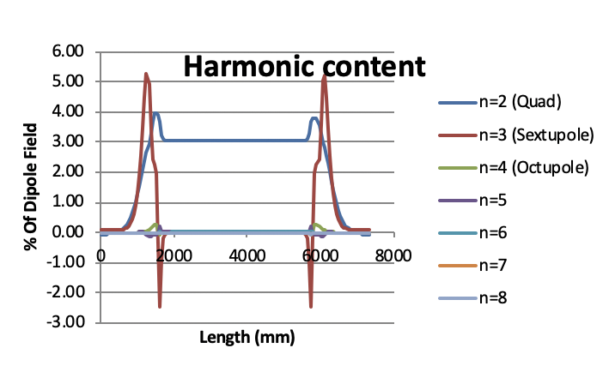
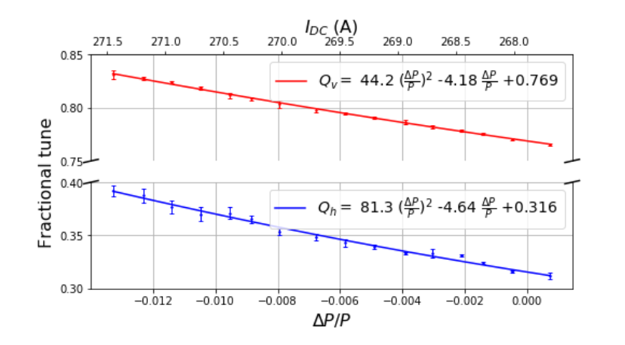
ISIS-II Megawatt Upgrade – “Conventional” Rings R&D
  Frozen space charge halo
Tune Plane Measurements
Design studies highlighted
  Need to reliably predict loss on the 0.01 – 0.1% level
  Track halo evolution
  Reason for beam-loss in codes often not clear
Need models benchmarked to measurements ISIS
  Test particular loss mechanisms
  Effects of resonances, instabilities
  2D and 3D injection painting, trapping, etc.
Compare with other accelerators and other codes systematic exploration of the high intensity limit
Predict 2→3 SFP: observe?
Transverse Profiles, grad. error (2Q_{v}=7)
Measured
ORBIT
  Non-linear components
Chromaticity

Slide 13
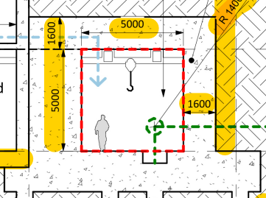
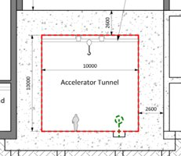








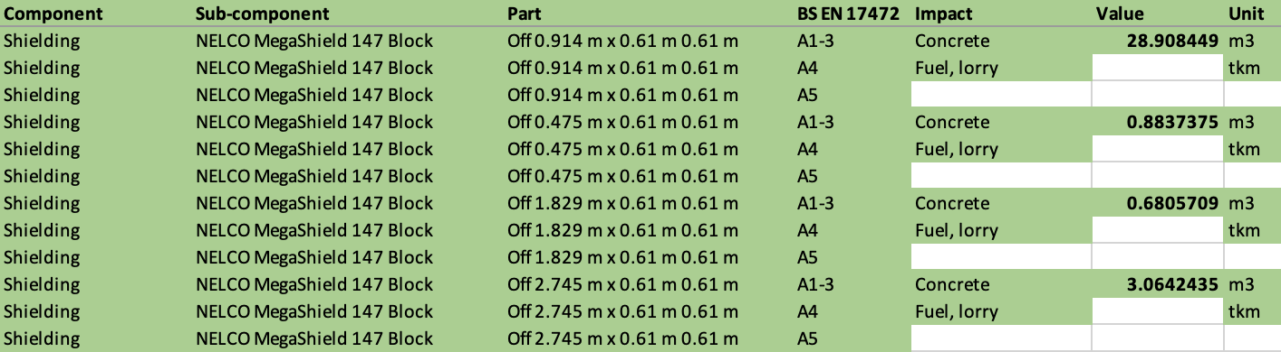
ISIS-II Environmental Impact Evaluation (Hannah Wakeling, JAI Post-doc)
Inventory analysis: Construction, operation and decommissioning
The first order of magnitude estimations are available for shielding, tunnelling, and some ISIS-II components.
LINAC
Ring
Targets
EPB
10s ktCO₂
10s ktCO₂
100s ktCO₂
10s ktCO₂
Development of LCA inventory analysis underway.
Using BS EN 17472 standard as guidance.
Modelling performed using existing facilities such as SNS and J-PARC, where ISIS-II designs not yet available.

Slide 14
ISIS-II Environmental Impact Evaluation (Hannah Wakeling, JAI Post-doc)
First estimations of the embodied CO₂e emissions due to building construction for various designs of ISIS-II range between 23 and 68.5 kt CO₂e.
Similarly, tunnel shielding estimates total ~130 kt CO₂e.
Components are expected to be the same to an order of magnitude.
With the net-zero goals of UK grid power generation*, construction of ISIS-II is the largest carbon impact of the facility.
These efforts have influenced the feasibility and design studies of ISIS-II, e.g. efforts are underway to evaluate concrete options (“green” concrete, less concrete, other materials).
Studies underway:
180 MeV LINAC impact (to be presented at IPAC 2024 (May))
Whole ISIS-II Facility impact (to be presented at ICHEP 2024 (July))
Ring design comparison; AR vs RCS (vs FFA) (to be completed Summer 2024)
(Simplified) Life Cycle Analysis
  At the inventory analysis stage
  Evaluation of radioactive materials methodology under development
* UK not currently meeting goals to make the net-zero 2050 deadline, in which case lifetime estimates of CO₂e = ~500 kt CO₂e

Slide 15
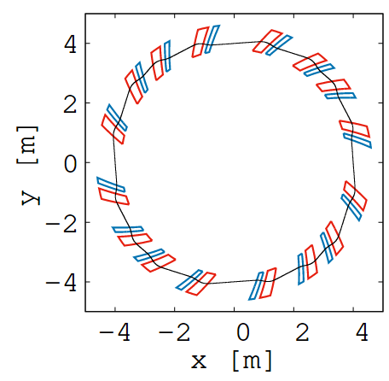
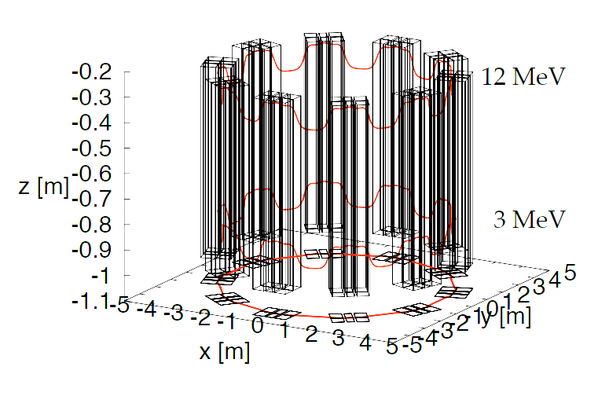
ISIS-II Megawatt Upgrade – Fixed Field Accelerator Option
FFA proof-of-concept – FETS FFA
  Demonstrator for FFA for ISIS-II
  Experimental study of injection painting, orbit correction, resonances, collimation, etc.
FFA for ISIS-II
Aiming for
  Sustainability
  Reliable operation
  Capacity
  Capability
1. Optics and Dynamics (Shinji Machida – JAI supervisor, David Kelliher – JAI lecturer, et al.)
2. Analytical Approach (Max Topp-Mugglestone – JAI student)
3. Injection & Extraction (Chris Rogers, Jaroslaw Pasternak – JAI staff)
4. Longitudinal Dynamics (David Kelliher – JAI lecturer, Carl Jolly – JAI student)
5. Collective Effects (David Kelliher – JAI lecturer)
6. Magnet Physics Design (Jean Baptiste-Lagrange, Alan Letchford, Ta-Jen Kuo – JAI Student)
7. Magnet Engineering (Iker Rodriguez, et al.)
8. Collimation & Diagnostics (Emi Yamakawa)
9. RF Hardware (Bradley Kirk, Ian Gardner)
Notes:
Mention convergence of direction with LhARA; exploring synergies in the coincident development

Slide 16
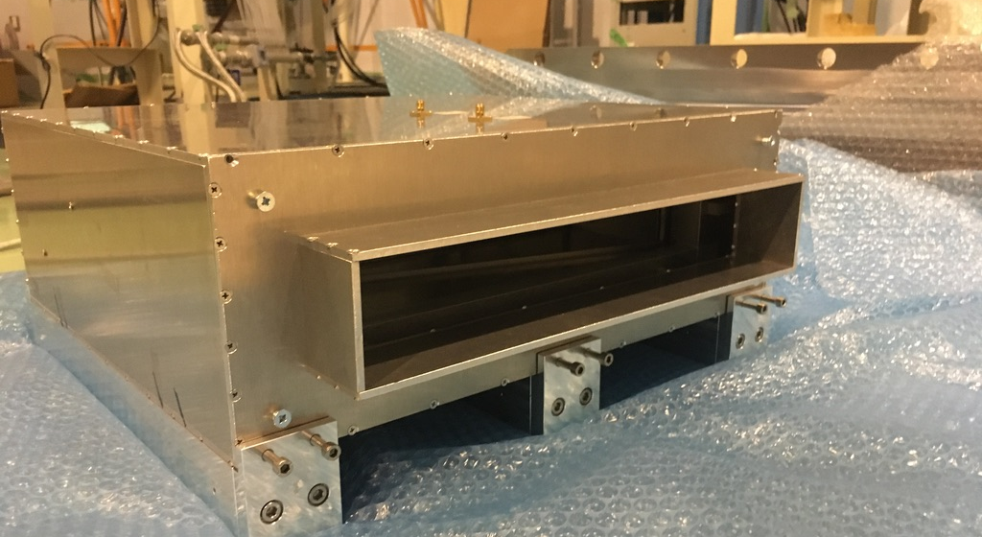
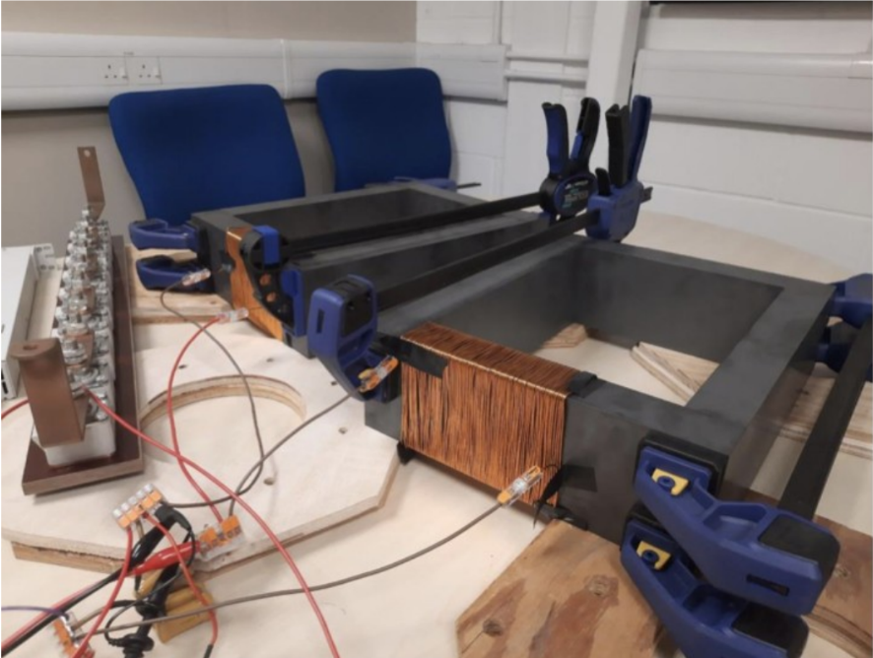
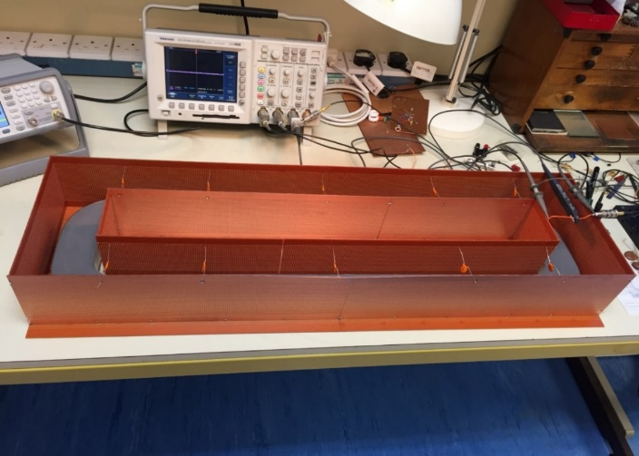
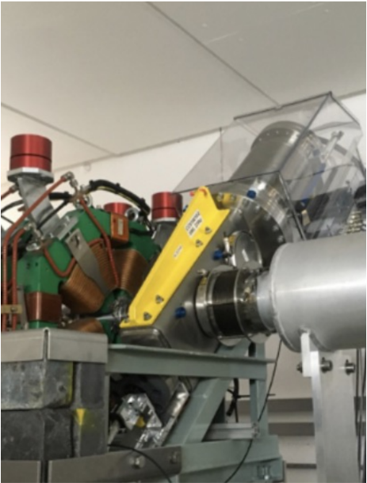
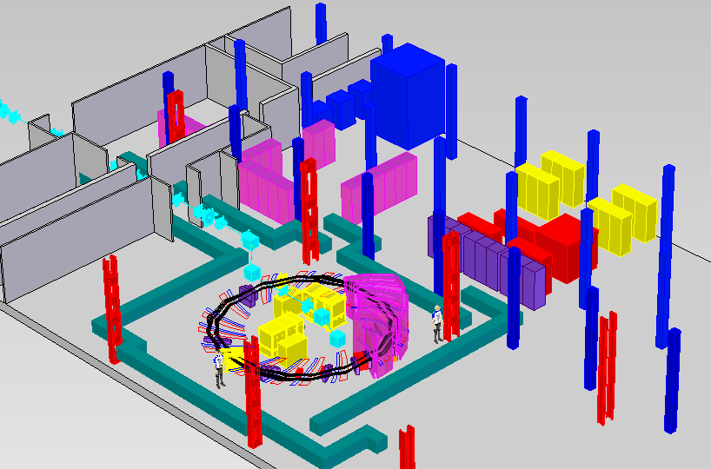
ISIS-II Megawatt Upgrade – FETS FFA
HV-testing underway for RF cavity magnetic alloy and ferrite cores
3 – 12 MeV
4 – 4.4 m radius
50 Hz beam repetition
3x10¹¹ protons per bunch
30 W power
Space charge tune shift ~-0.35
Still a work in progress
Completion of CDR by March 2025
Prototype BPM and wire scanner tests at KURNS
Notes:
Work also underway for: scintillating screens, scintillating and ion-chamber BLMs, student to be working on Faraday cup for injected beam current measurement

Slide 17
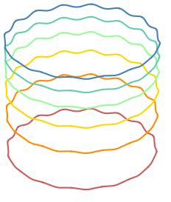
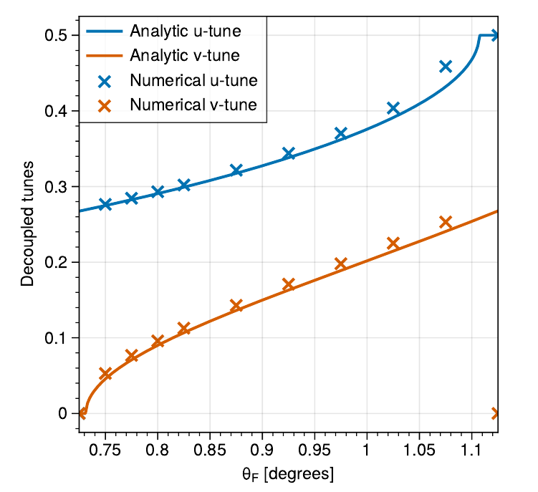
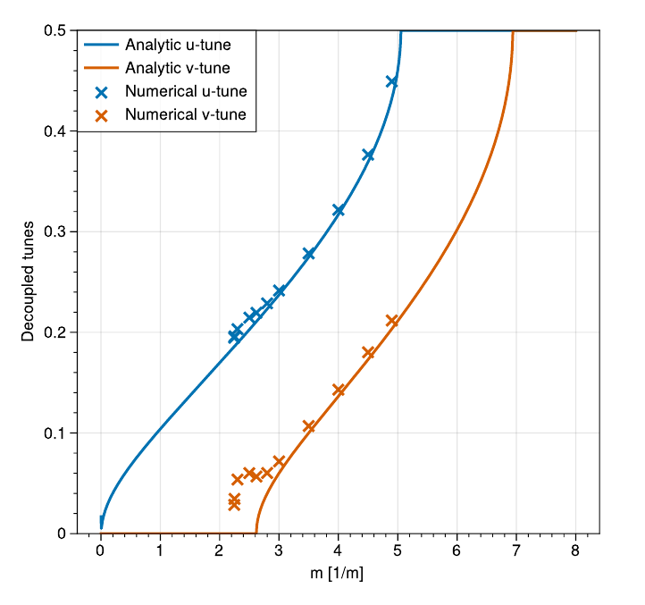
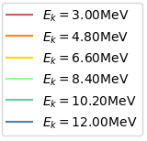

ISIS-II FFA Option: vFFA Studies (Max Topp-Mugglestone)
Closed orbit model based on geometric constraints
Hamiltonian optics model
Accurate tune predictions for vFFA lattices
Numerically benchmarked against simulations
Applicable to large-ring lattices (fringe fields not considered)
Vertical-excursion FFA (vFFA):
  Higher energy orbits are vertically translated copies of lower energy orbits
  Zero chromaticity if fields increase with vertical coordinate (Z) following scaling law $B={B_{0}e}^{mZ}$
Energy
Notes:
Zero path length difference means…
$→$ Zero momentum compaction factor $α_{c}$
$→$ Transitionless
$→$ Quasi-isochronous for relativistic particles

Slide 18



ISIS-II FFA Option: Beam Stacking Studies (Carl Jolly, JAI Student)
Experimental verification of beam stacking @ KURNS FFA
Technique for increasing the extracted beam current from an FFA
One of the key advantages over conventional accelerators.
Inject, accelerate and store a coasting beam at the “top” energy.
Inject a second beam, accelerate the second beam.
Stack the two beams by bringing them together in the longitudinal phase space.
The challenge:
How do you show you have “stacked” the two coasting beams?
→ Measure Schottky signals from the coasting beam

Slide 19

ISIS-II FFA Option: Beam Stacking Studies (Carl Jolly, JAI Student)
Beam 2 – Schottky signal
Results from KURNS:
Plot on the right shows a Schottky signal from the two beams.
The two Schottky peaks correspond to two beams stacked in the longitudinal phase space.
Beam 1 – Schottky signal

Slide 20


IBEX 2.0 (Jake Flowerdew, Former JAI Student)
Ionisation Region
Experimental Region
End Caps
Gate
End Caps
Non-linear upgrade for accelerator physics studies
Much quicker modelling beam dynamics than particle tracking codes
Incorporates space charge dynamics, resonance effects, non-linear optics into one
Low energy ions do not produce radionuclides when lost!
Octupole field

Slide 21






IBEX 2.0 (Jake Flowerdew, Former JAI Student)
Focus on the study of quasi-integrable optics (QIO): correctly scaling octupole fields to make Hamiltonian time-independent.
T-insert
$$φ=nπ$$
$$\frac{1}{β^{3}\left(s\right)}$$
Beta (m)
Octupole Strength
T-insert lattice used to excite coherent resonance
$$β_{x}=β_{y}$$

Slide 22














IBEX 2.0 (Jake Flowerdew, Former JAI Student)
Signal from MCP
$−5.0 ±0.1 \%$ loss
VSim simulations of QI octupole lattice demonstrate dampening of 2nd-order coherent resonance
T-insert QI octupole lattice reproduced in IBEX 2.0
- Background from electrodes
$−36.9±0.3 \%$loss
= Ion signal
Integrated Ion signal
$﻿−70.4±0.3 \%$loss
1000 super-periods
$${Q_{0}=1.278, ∆Q}_{rms}=0.036$$
No Oct, No space charge: ﻿$−2.3(1)\%$
No Oct: $﻿−36.9(3) \%$
﻿Non-QI Oct: $−70.4(3) \%$
QI-Oct: $−5.0(1) \%$
Development passed onto new JAI student, J. Appleby

Slide 23
Summary
High intensity hadron beams at ISIS facilitate unique research opportunities for accelerator physics in the UK
JAI Students and Post-doctoral Researchers make a significant contribution to current ISIS operations
Many exciting R&D avenues being pursued for ISIS-II
Advanced tools (practical and computational) being developed by JAI members in the modelling of high intensity beam dynamics

