Slide 1

Light Sources Update
I. Martin
JAI Advisory Board Meeting
15th April 2024

Slide 2
Talk Outline
Updates on Diamond-II:
Project status
Tendering and prototyping
Updated storage ring injection scheme
Timeline
Updates from JAI members:
Joint-Appointment PDRA between Oxford / Diamond (R. Husain, UO/DLS)
Feasibility Studies of Cherenkov Diffraction Radiation BPMs (A. Clapp, RHUL/DLS)
Application of machine learning for improving operational performance of storage ring light sources (S. Preston, UO/DLS/ALC)
Fast Beam Loss Monitor System for Diamond-II and Machine Learning Applications (C. Lehmann, UO/DLS)
Conclusions
Ian Martin, Light Sources, JAI AB, 15/04/2024

Slide 3
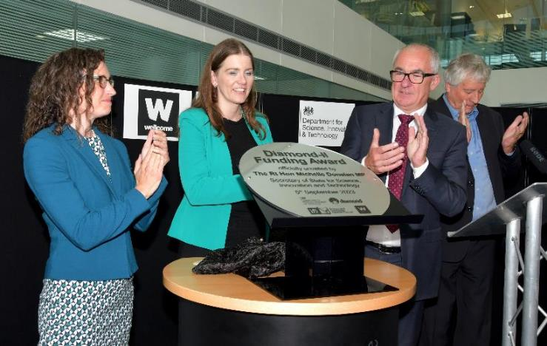
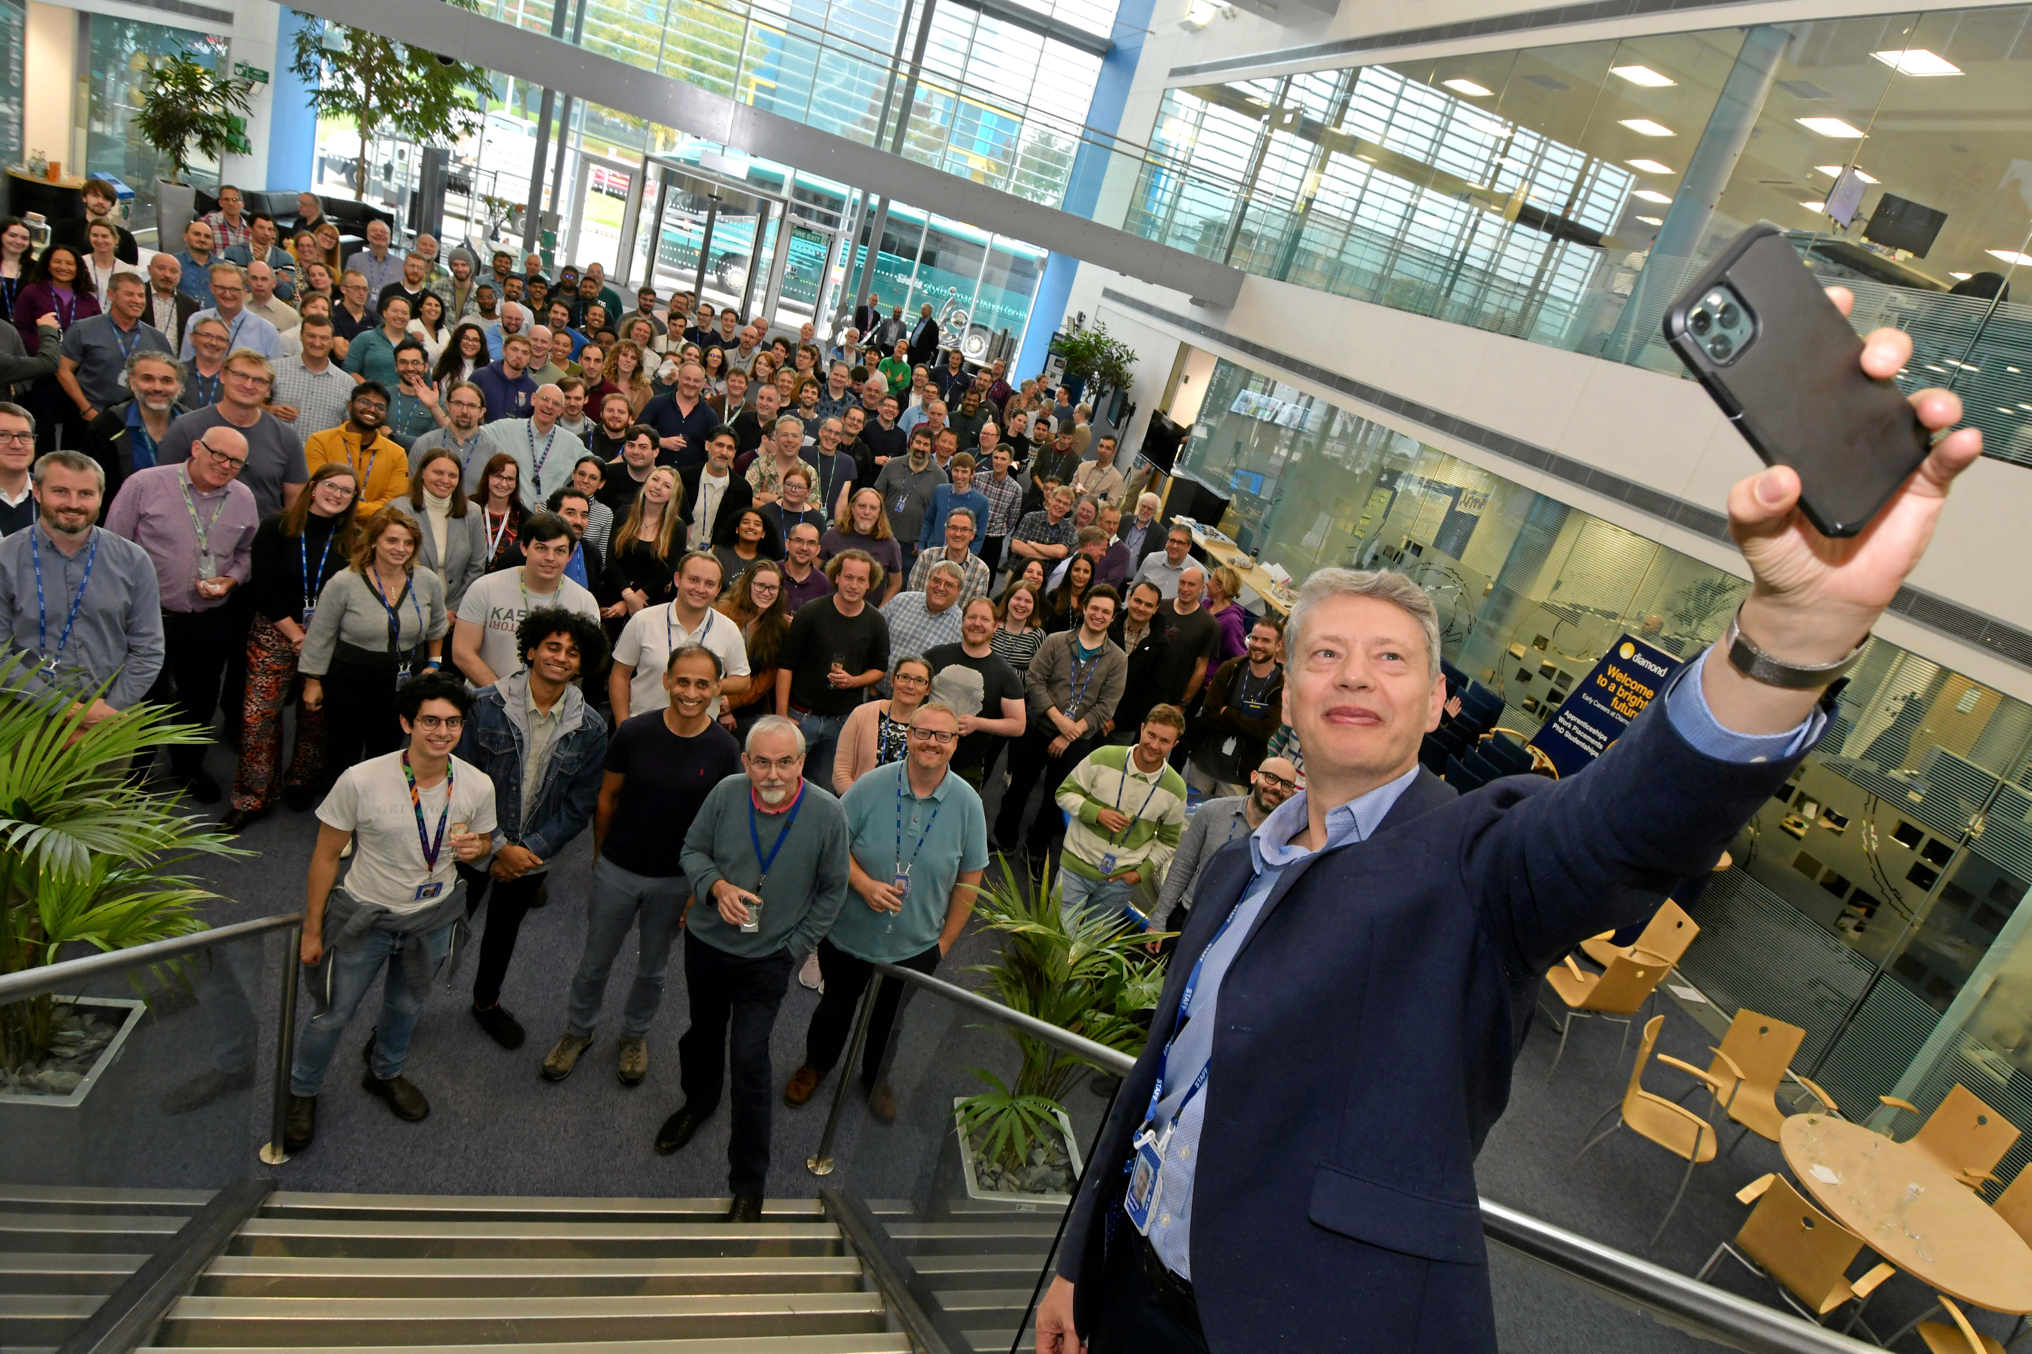
Diamond-II Project Approval
Status at last JAI AB meeting:
April 2021: Wellcome approved its share of funding (14%) for Diamond-II, subject UK Government approval
June 2022: UKRI confirmed first phase of funding (Apr 22-Mar 25), contingent on Final Business Case approval
Since then:
Final Business Case was reviewed by
  UKRI Infrastructure Advisory Working Group (April 2023)
  UKRI Executive Committee (May 2023)
  DSIT Project and Investment Committee (June 2023)
Confirmation of funding approval from HMT (July 2023)
Official announcement at Diamond by the Secretary of State for Science, Innovation and Technology (September 2023)
Staff celebration with Diamond Board and new CEO (October 2023)
Ian Martin, Light Sources, JAI AB, 15/04/2024

Slide 4
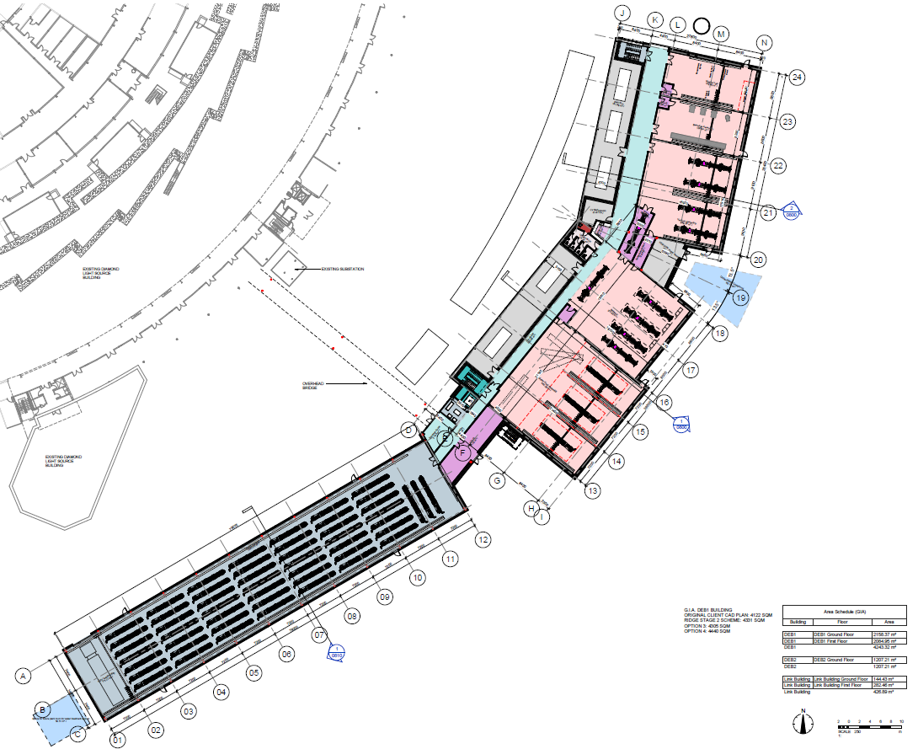
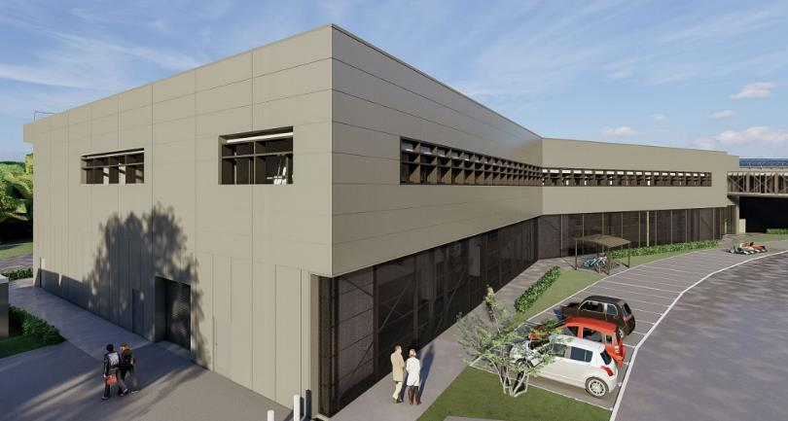
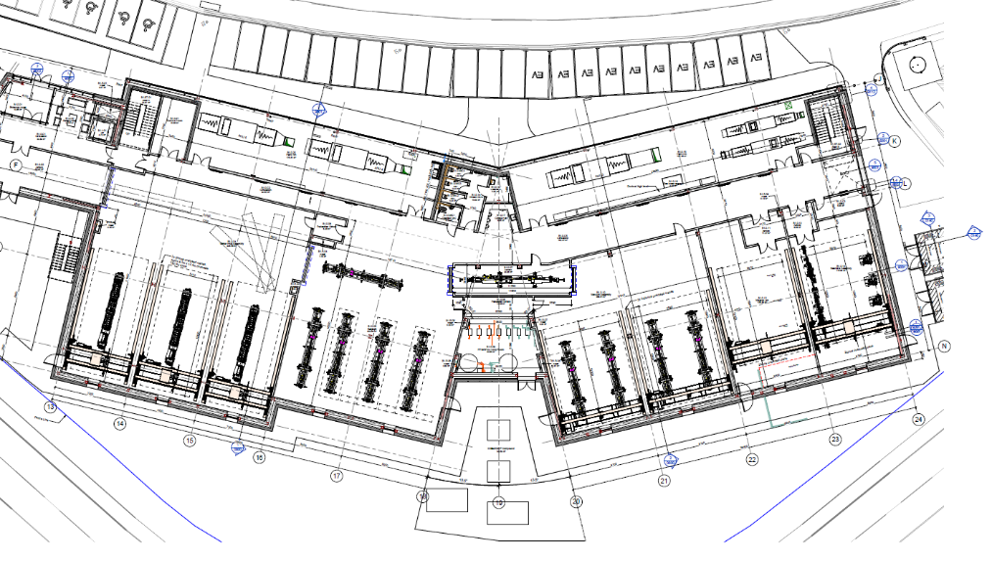
Diamond-II Extension Building (DEB)
Girder assembly
Magnet Lab.
Girder assembly
Vessel assembly
Bakeout
Beamline assembly
Girder storage
Courtesy P. Coll
Ian Martin, Light Sources, JAI AB, 15/04/2024

Slide 5
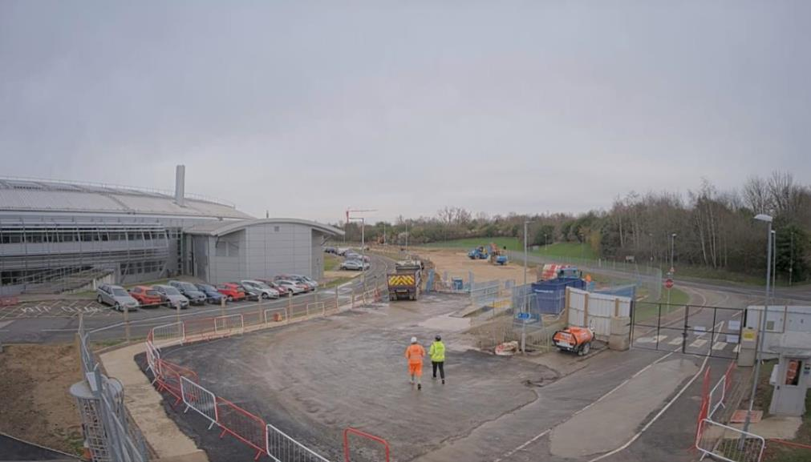
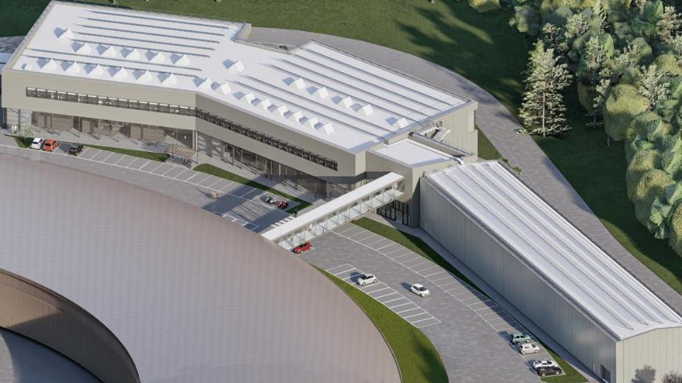
Diamond-II Extension Building (DEB)
DEB2:
girder storage and girder mock-up
will be re-purposed after Diamond-II
Contract award 12th December 2023
Completion February 2025
DEB1:
ground floor: magnet measurement, vacuum assembly and bakeout, girder assembly etc.
1st floor: offices and labs etc.
28/2/24
Courtesy P. Coll
Ian Martin, Light Sources, JAI AB, 15/04/2024

Slide 6
Diamond-II Project Status
Tendering for major components underway:
Solid-state amplifiers for normal conducting RF cavities (ITT Aug ’23, contract placed Nov ‘23)
Storage ring quadrupole magnets (ITT Jan ‘24, contract placed Mar ‘24)
Superconducting 3rd harmonic RF cavity (ITT Feb ‘24)
Storage ring sextupole magnets (ITT Mar ‘24)
Booster magnet power supplies (ITT Mar ‘24)
Booster girder assemblies (ITT Apr ‘24)
Major items in next few months:
Permanent magnet blocks and shunts for storage ring longitudinal gradient (DL) dipoles
Transverse gradient (DQ) electromagnet dipoles
Main RF cavities
Hybrid permanent magnet undulators
Copper and stainless-steel girder vacuum vessels (NEG coated)
Ian Martin, Light Sources, JAI AB, 15/04/2024

Slide 7
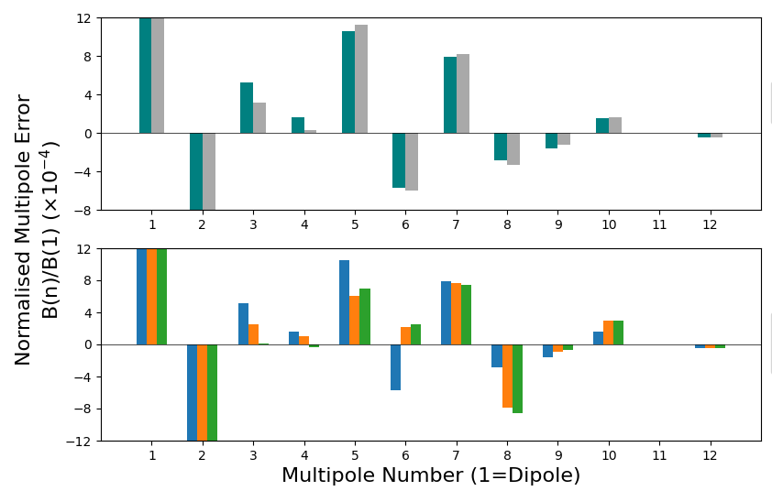
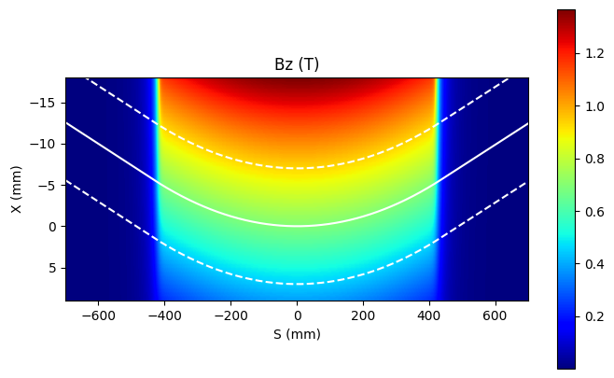
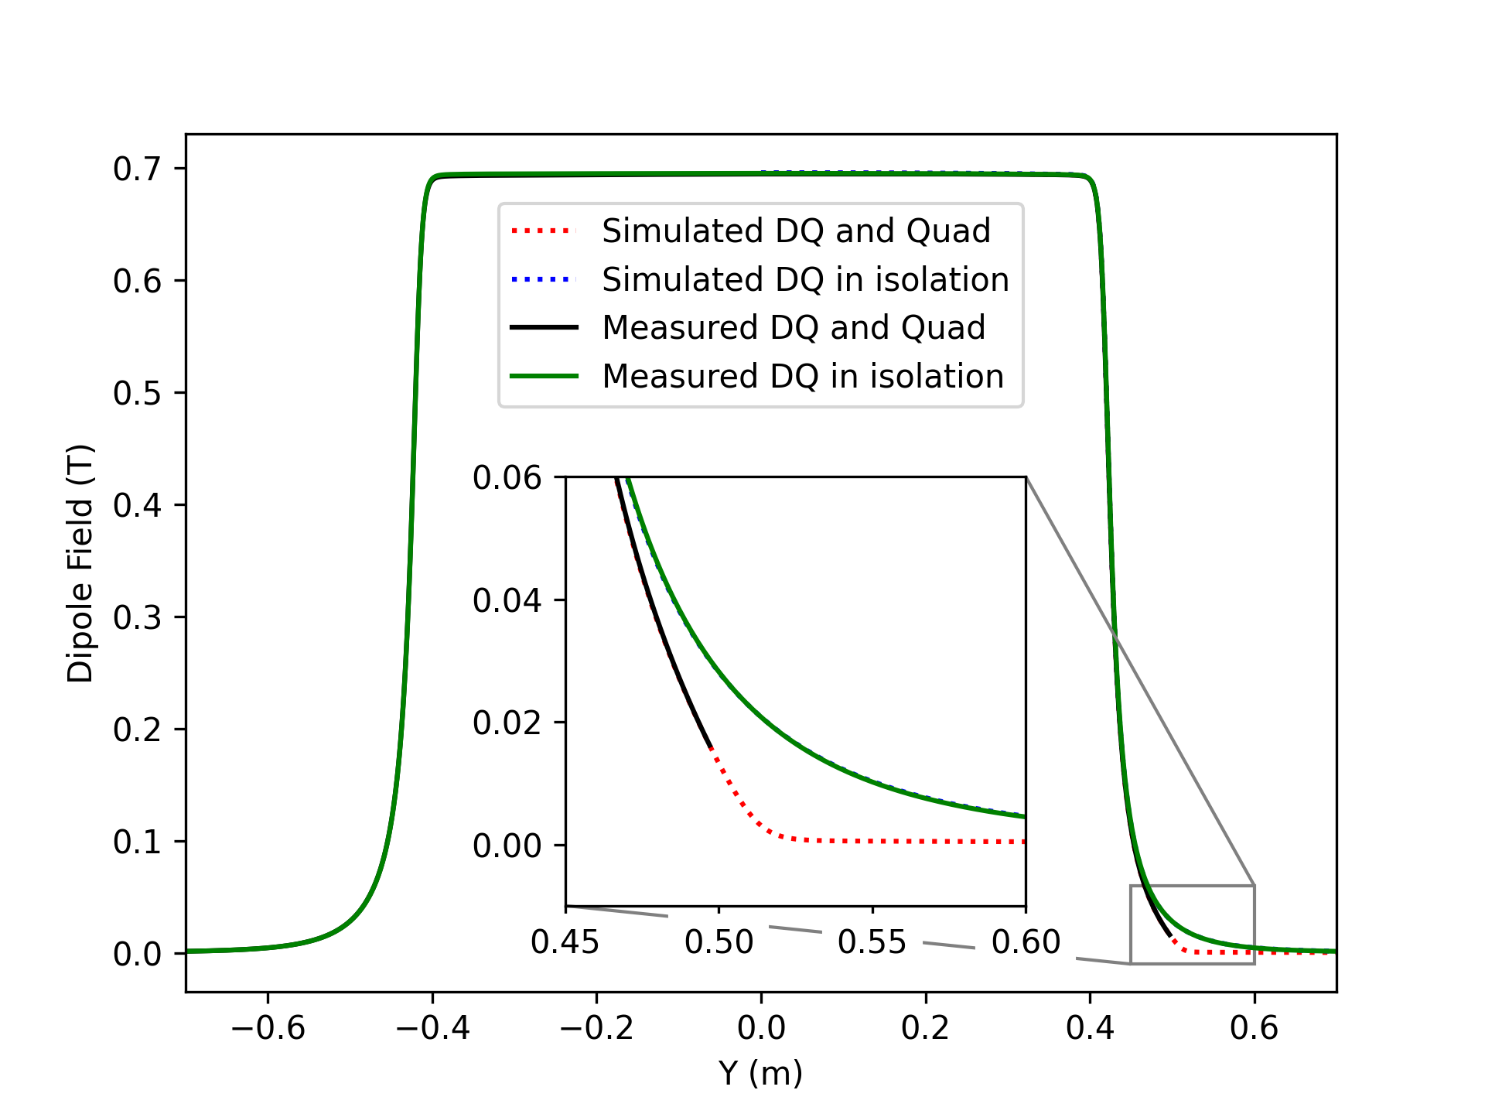
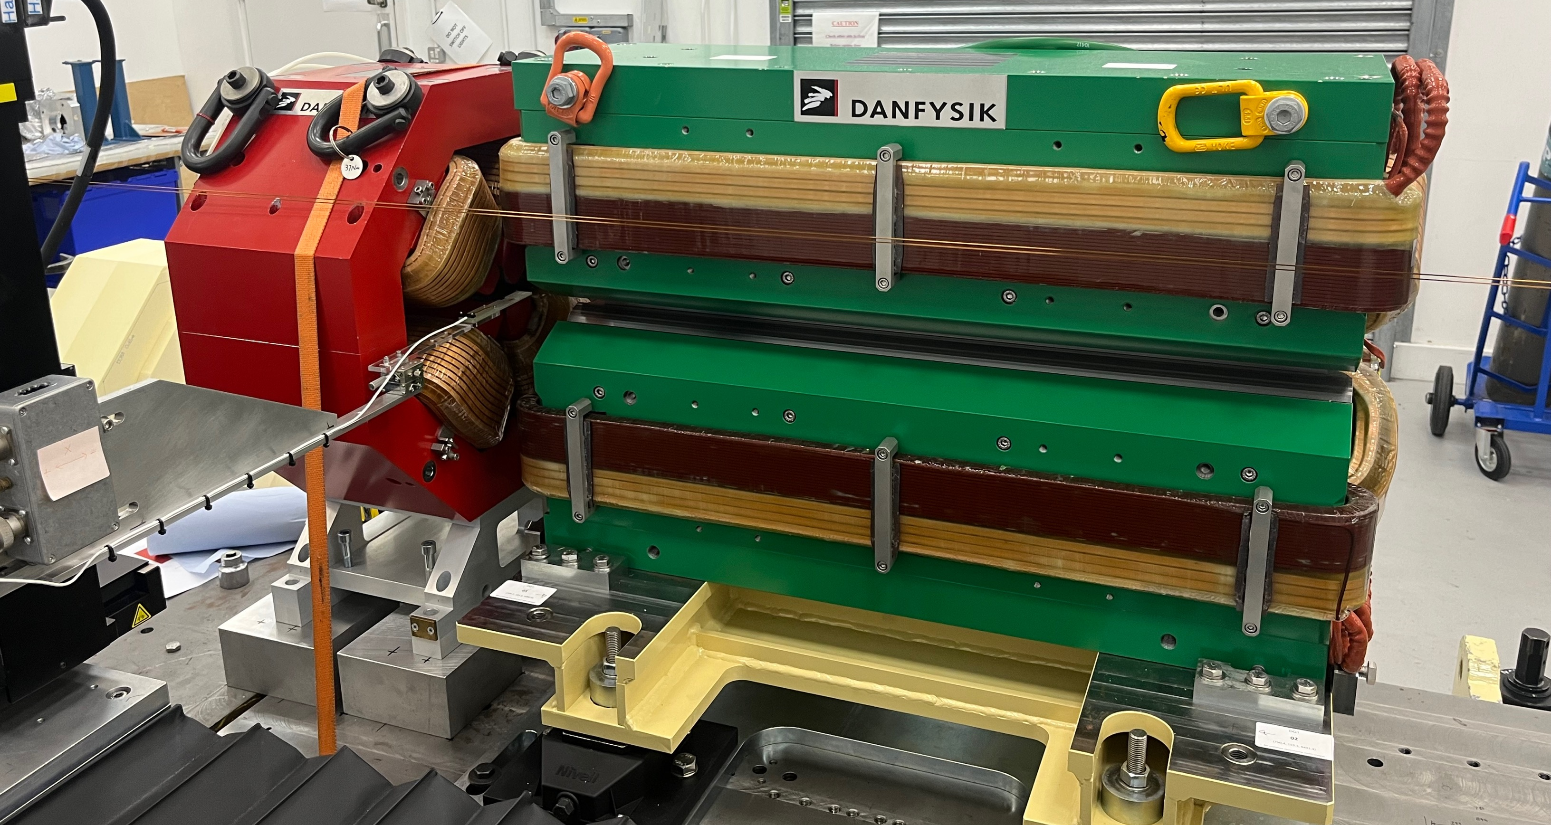
DQ Dipole Prototype
DQ prototype built by Danfysik (0.7 T, 33 T/m):
Site Acceptance measurements done by DF using the Stretch Wire Bench (SWB)
Later confirmed by remeasuring at Diamond, both with SWB and Hall probe
Good agreement between model and measurements observed using Hall probe
  Magnet in isolation
  Cross-talk with adjacent DDBA Quad
Courtesy A. Shahveh
Ian Martin, Light Sources, JAI AB, 15/04/2024

Slide 8
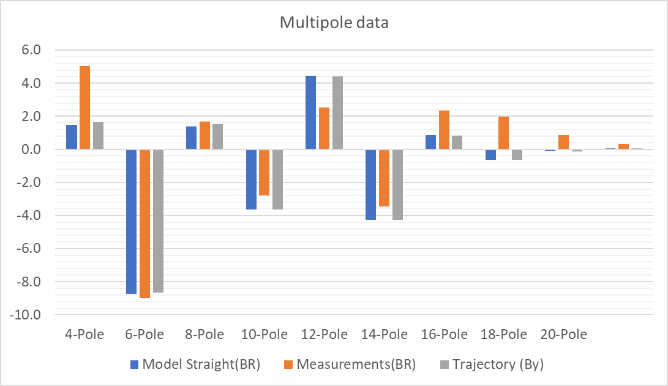
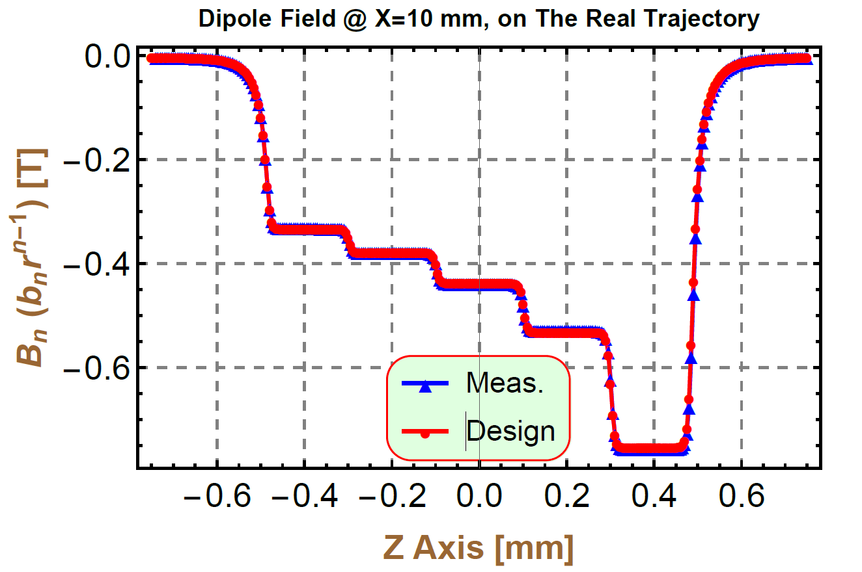
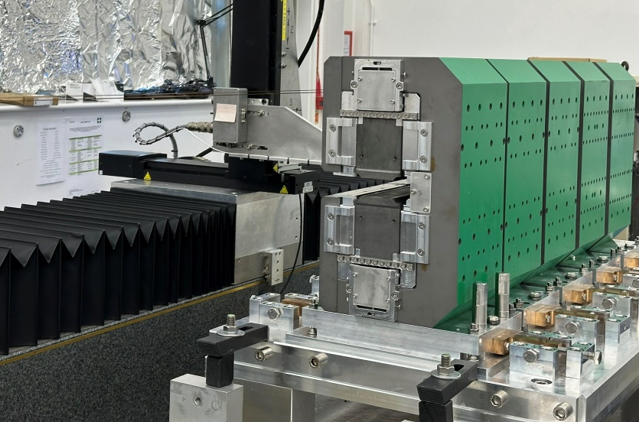
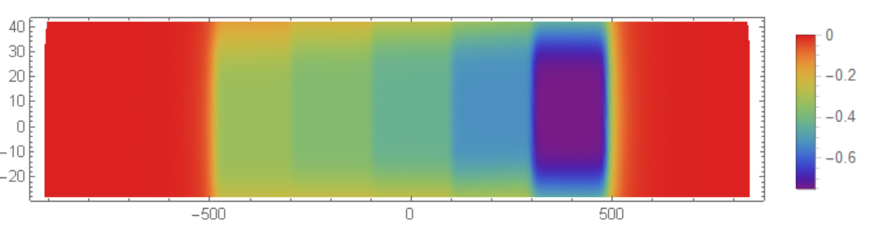
DL Dipole Prototype
A DL prototype has been built to examine the in-house capacity for building the main DLs
  Modules manufactured by UK based company
  PM blocks inserted and assembled at Diamond
Good agreement observed between results from the measurements and simulation
Courtesy A. Shahveh
Ian Martin, Light Sources, JAI AB, 15/04/2024

Slide 9
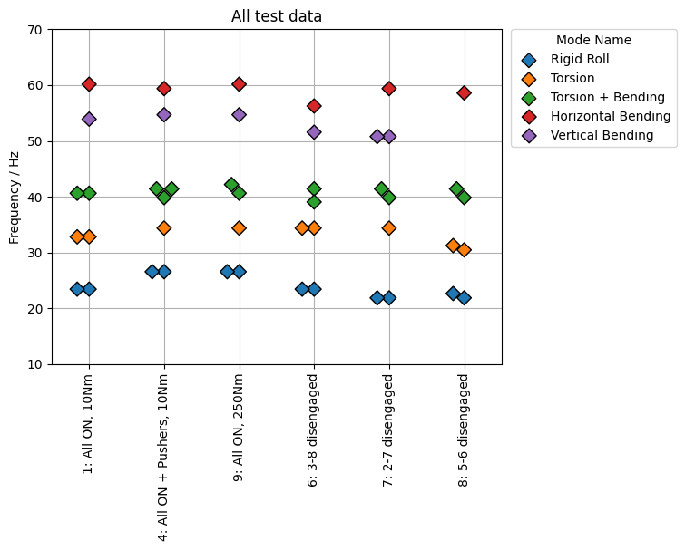
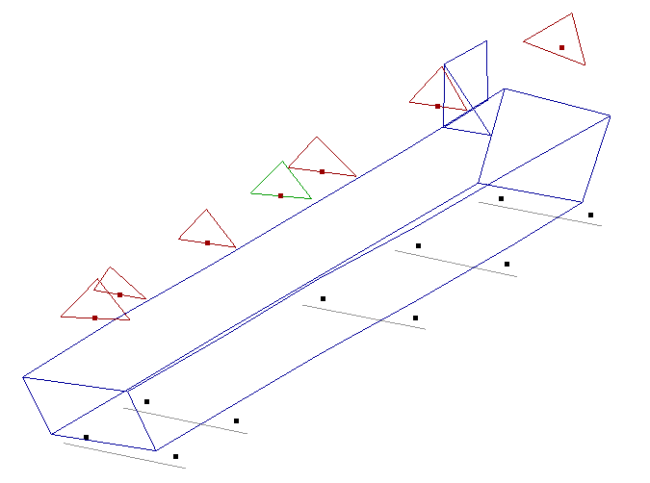
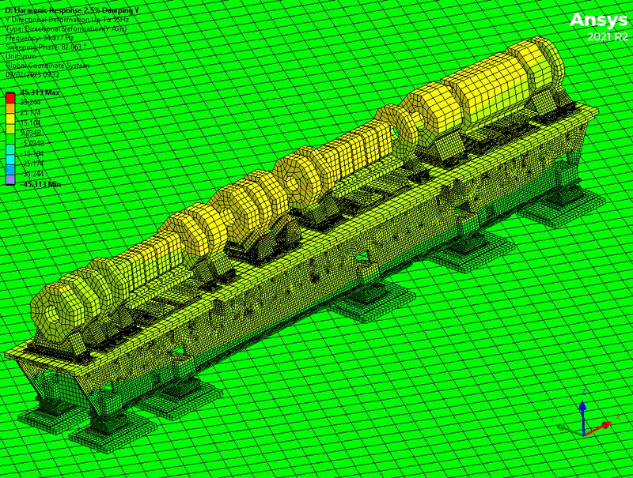
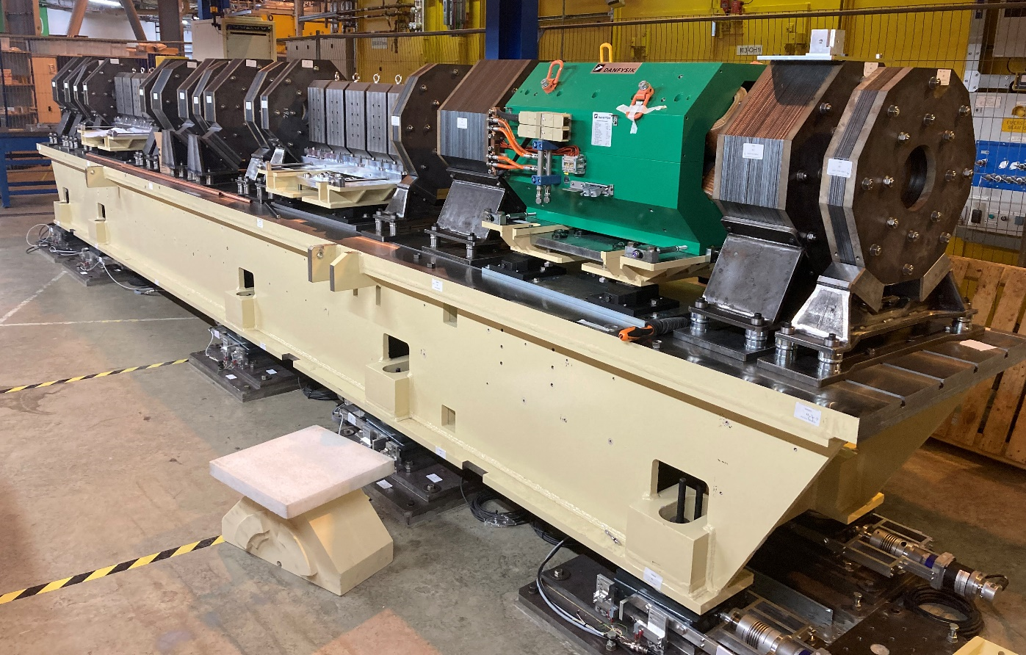
Diamond-II Prototype Girder Vibration Tests
Magnets for Diamond-II will be supported on single 8m girders per half-cell
Design goals:
Allow accurate alignment of magnetic centres during girder assembly
Rapid installation and in-situ alignment (manual)
Low vibration transmissibility, avoiding resonant frequencies that overlap with dominant ground vibrations
FEA modelling and experimental validation carried out:
Good correlation between model and experimental results
Numerous configurations tested => revised girder design
FEA - Rigid roll 34.5 Hz
Experimental - Rigid roll 27 Hz
Ian Martin, Light Sources, JAI AB, 15/04/2024
Courtesy P. Vivian

Slide 10
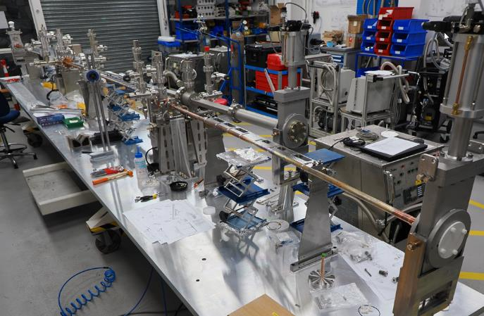
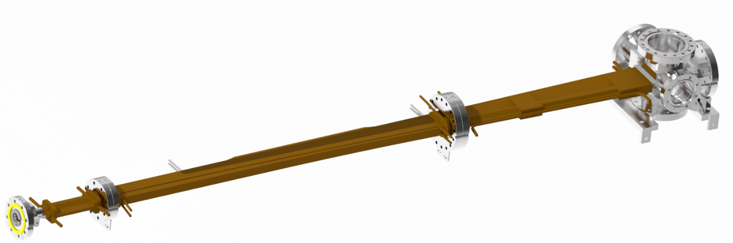
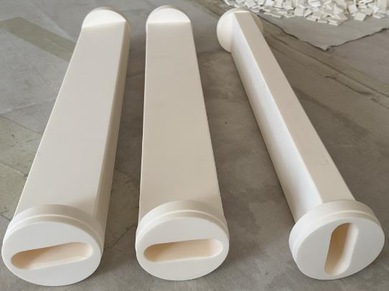
Vacuum Vessel Prototypes
Prototyping and NEG coating trials are underway.
Complete 8m vacuum string assembled and successfully baked-out (with previous Aluminium dipole vessel).
  New copper dipole vessel due Apr ‘24
Prototype kicker ceramic vessels produced and flange welding trials underway prior to Ti coating.
Copper dipole vessel
~ 2m long, machined copper and stainless steel
integrated water-cooling channels
made in 3 parts, joined then NEG coated
Courtesy M. Cox
Ian Martin, Light Sources, JAI AB, 15/04/2024

Slide 11
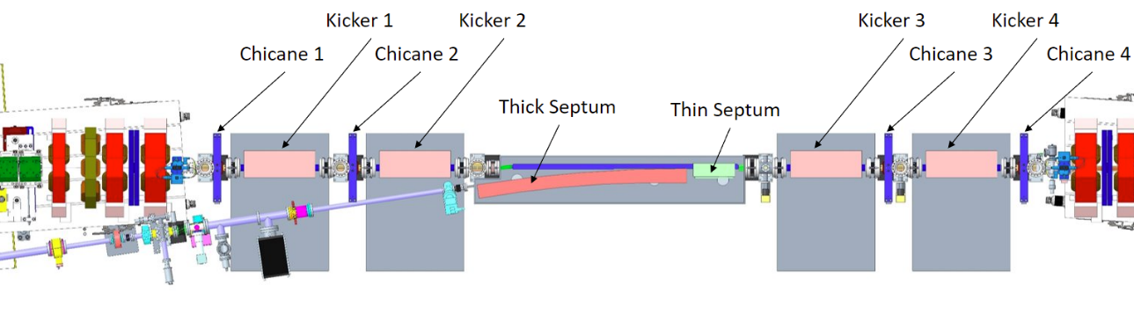
Diamond-II Injection Scheme
Diamond-II will operate two different injection schemes:
Standard four kicker bump (single or multi-bunch)
Stripline kicker injection (single bunch only)
Standard four kicker bump
Robust, proven technology
Can be adjusted for different stages during commissioning:
  single shot, on-axis injection
  off-axis accumulation with closed orbit bump
Baseline injection scheme for re-filling during operations
Downside: difficult to make injection invisible to users
I01 Injection Straight
Ian Martin, Light Sources, JAI AB, 15/04/2024

Slide 12
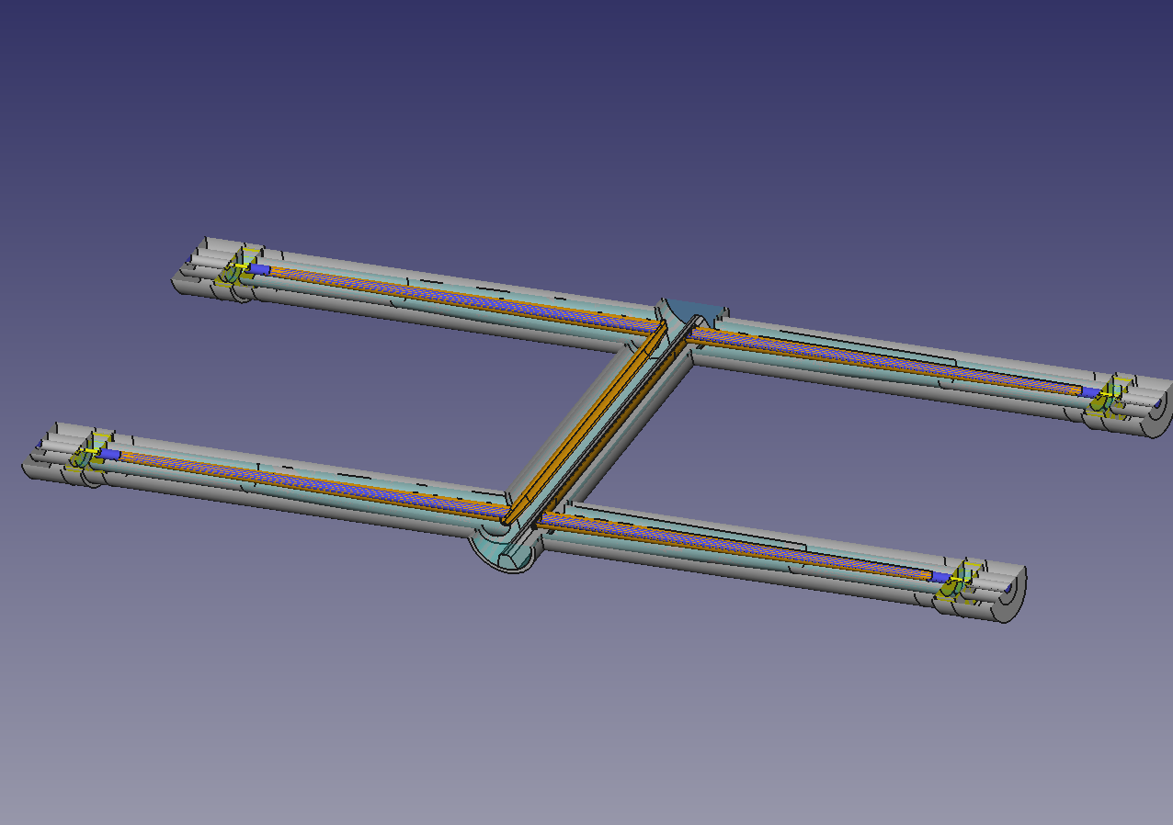
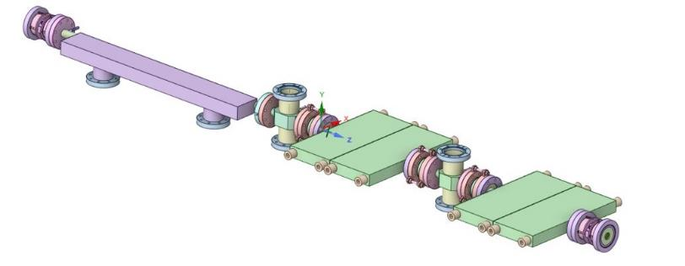
Diamond-II Injection Scheme
Stripline kicker injection
Used for top-up injection with shutters open
(improved transparency: 1-3 bunches in 899 kicked)
‘Aperture-sharing’ scheme developed for TDR
Issues
Stored bunch oscillations reduce photon flux for users
Transverse wakefields limit amount of charge that can be stored
Interaction of multi-bunch feedback with off-axis bunches
Aperture-sharing injection
Oscillation amplitude
(Injected beam only)
Stripline kickers
Oscillation amplitude
(Stored and injected beams)
Injection septum
2 ns
K01 Injection Straight
<1 ns
>1 ns
<1 ns
Courtesy A. Morgan, W. Tizzano
Ian Martin, Light Sources, JAI AB, 15/04/2024

Slide 13
Diamond-II Injection Scheme
‘Kick-and-cancel’ injection
Same as aperture-sharing injection scheme as far as the injected bunch is concerned
Stored bunch gets a pre-kick before injection to start it oscillating
Injection is timed such that stored bunch oscillation phase has advanced 180 degrees and second injection kick cancels the first, placing stored bunch back on-axis
Benefits
Improved overall transparency as only injected bunch continues to oscillate
Reduced transverse wakefields / interaction with TMBF as stored bunch is back on-axis
Potential to do further aperture sharing by over-kicking the stored bunch
Septum plate
Straight I01
Straight K01
Turn = -3
Kick from striplines
Stored bunch
Injected bunch
Turn = 0
I01
K01
magnets
striplines
septum
Δμ_{x} ~ 90 deg
Ian Martin, Light Sources, JAI AB, 15/04/2024

Slide 14
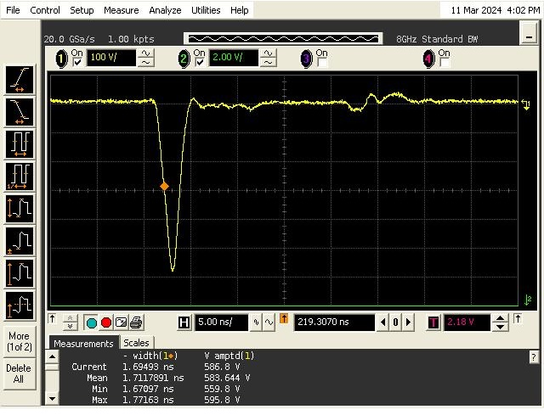
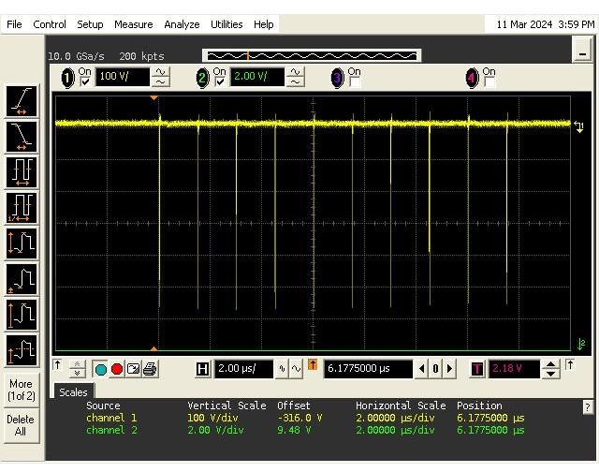
Diamond-II Injection Scheme
A multi-pulse, high voltage pulser is under development by Kentech Instruments Ltd.
The second stage prototype is currently being built:
  ± 4 kV
  bursts of up to 10 pulses with programmable amplitude and spacing
  5%-5% width ≤ 4 ns (best effort for 3 ns)
Synergies with ILC pulsers
  Parallel developments underway with Kentech Instruments Ltd.
  Potential to test ILC prototype pulser using Diamond-II prototype striplines
Second stage prototype status
4 ns
 | ILC |  | Diamond-II
Operating mode | Baseline | Hi Luminosity | Aperture-sharing | Kick-and-cancel
Pulse structure | 1312 burst | 2625 burst | Single kick | Double kick
Rep rate | 5 Hz | 5 Hz | 5 Hz | 5 Hz
Pulse duration | <6 ns FW | <3 ns FW | <3 ns FW | <4 ns FW
Pulse separation | 554 ns | 332 ns | - | ~2-20 µs
Voltage | ±10 kV | ±10 kV | ±15-20 kV | ±15-20 kV
1.5 µs
Ian Martin, Light Sources, JAI AB, 15/04/2024

Slide 15
Diamond-II Timeline
Milestone | Planned date
Approval for the Diamond-II Project and start of funding | July 2023
Completion of the Diamond Extension Building | February 2025
Girder assembly complete | September 2027
Start of the dark period | December 2027
Start of storage ring beam commissioning | December 2028
Start of regular beamline X-ray commissioning | June 2029
First phase of beamlines become operational | September 2029
End of the Diamond-II project | March 2030
Ian Martin, Light Sources, JAI AB, 15/04/2024

Slide 16
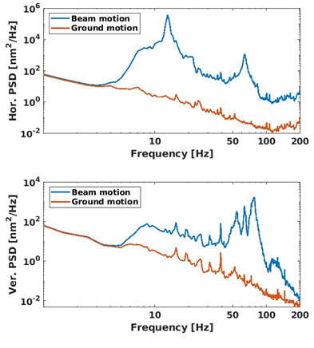
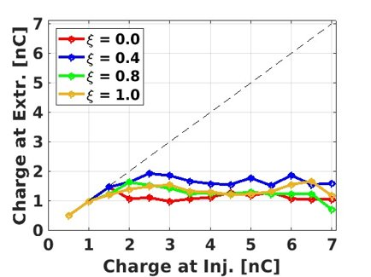
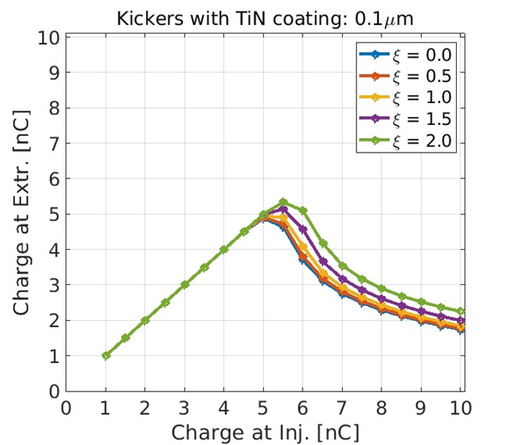
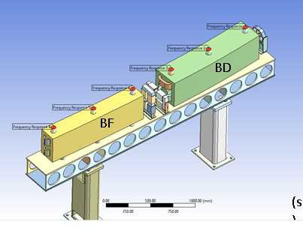
Oxford / DLS PDRA: Riyasat Husain (Feb-Dec 2023)
Joint appointment PDRA created between Oxford University and Diamond Light Source (Feb 2023 to Dec 2023)
Main topic of study was the Diamond-II injector performance, concentrating on studying the impact of collective effects during the booster ramp
  Impact of chromaticity and injection energy on extracted charge thresholds
  Impact of TiN coating thickness for booster kicker ferrites on kicker pulse properties and extracted charge thresholds
  Variation of booster ramp profile for faster acceleration
  Shot-to-shot position and angle of extracted beam due to ground vibration
Impact of booster girder resonances on electron beam
Single bunch
Multi-bunch
Booster Arc Girder
Supervisors: P. Burrows and I. Martin
Ian Martin, Light Sources, JAI AB, 15/04/2024

Slide 17
PhD Student: Alec Clapp (started 2021)
“Feasibility study on the use of incoherent Cherenkov Diffraction Radiation to develop a non-invasive BPM”
Cherenkov Diffraction Radiation (ChDR) is a type of polarisation radiation. It occurs when a charged particle moves in the vicinity of a medium, with the photon yield dependent upon the distance between the charged particle and the dielectric medium. Enables beam position measurement using purely light signals (quartz target + glass fibres; no metal)
Single pick-up using one target, collimator and fibre optic is commissioned and evaluated with beam.
Dual pick-up ChDR BPM using two targets installed and first beam tests completed on 3-4th April 2024
→ First step towards demonstration of a 1D ChDR BPM using pick-ups at visible wavelengths
Electron beam
Single ChDR pick-up response
Upstream Inductive BPM reference signals
Electron beam passes between targets
ChDR is emitted by target and collected by collimators
Light is propagated out of vacuum by fibre optic feedthroughs and PMT
Quartz prism target
A. Clapp et al., Proc. of IBIC’2023, Saskatoon, Canada, MOP032
Supervisors: P. Karataev and L. Bobb
Ian Martin, Light Sources, JAI AB, 15/04/2024

Slide 18
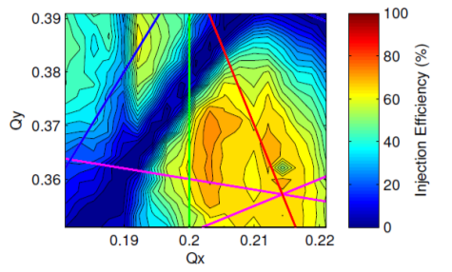
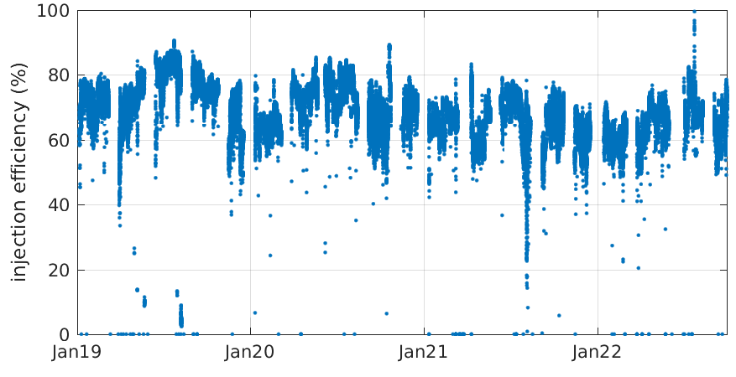
DPhil Student: Shaun Preston (started 2023)
“Application of Machine Learning for Improving Operational Performance of Storage Ring Light Sources”
Joint appointment between Oxford JAI and Ada Lovelace Centre, hosted by Diamond
Ada Lovelace Centre newly formed cross-disciplinary data intensive science centre at RAL for better exploitation of research carried out at large-scale national facilities (including Diamond, ISIS, CLF, Culham, …)
Can provide support and expertise on range of topics (imaging and reconstruction, modelling for data interpretation, machine learning, data management and analysis, automation)
Primary goals:
Build tools, techniques, knowledge, experience and collaboration networks in field of ML
Acquire the tools and experience to assist in the commissioning and early operation of Diamond-II
Demonstrate improved performance and / or stability of Diamond
Injection efficiency changes with ID gap
Project outline:
Research, test and apply ML techniques to improve understanding / optimise the performance of the Diamond Accelerators
Seasonal drift in injection efficiency
Supervisors: P. Burrows and I. Martin
Ian Martin, Light Sources, JAI AB, 15/04/2024

Slide 19
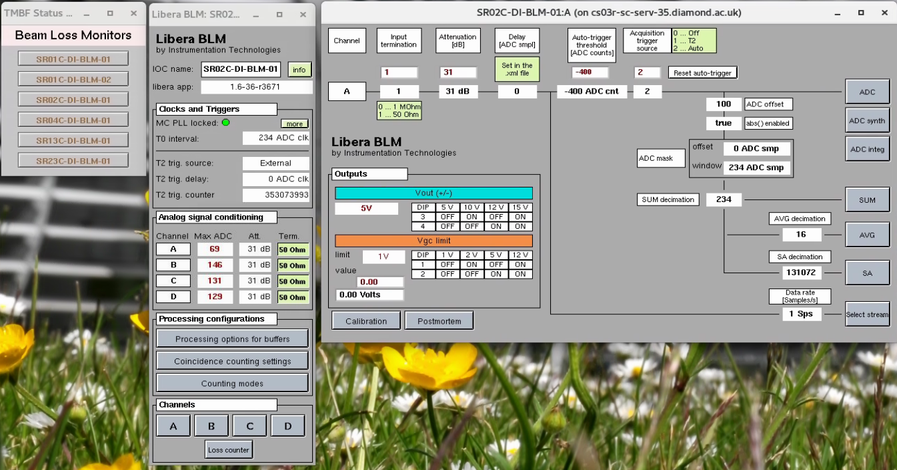
DPhil Student: Corey Lehmann (started 2023)
“Fast Beam Loss Monitor System for Diamond-II and Machine Learning Applications”
Joint appointment between Oxford JAI and Diamond Light Source
Project outline:
  Commission a fast BLM system enabling slow and fast loss monitoring at Diamond in preparation for Diamond-II
  Explore ML applications using the new data available from the fast BLMs for fault detection.
Primary goals:
  Commission fast BLMs on the storage ring at Diamond
  Evaluation of new EPICS tools for fast BLMs in preparation for Diamond-II
  Conduct review of machine learning techniques applicable for beam loss data and fault detection
  Demonstrate the proof-of-principle application of a suitable ML algorithm to fast BLMs
  Document and/or publish findings as appropriate
Existing Fast BLMs on Diamond
Supervisors: P. Burrows and L. Bobb
Ian Martin, Light Sources, JAI AB, 15/04/2024

Slide 20
Conclusions
JAI continues to be active in a number of areas of light source design and operation:
Facility design
Enhanced performance / special operating modes
Photon / electron beam diagnostics
Direct support and well-integrated with Diamond-II Project
Providing training and expertise in light sources for next generation of accelerator physicists:
Four PhD/DPhil Studentships (RHUL and Oxford)
Joint Diamond / JAI PDRA working on Diamond-II – to be readvertised pending confirmation of JAI grant renewal and availability of Diamond funding
Ian Martin, Light Sources, JAI AB, 15/04/2024

